Slide 1



FCC-hh cryogenics
This project has received funding from the European Union's Horizon 2020 research and innovation programme under grant agreement No 951754.
Layout update for 1.9 K and 4.5 K options
L. Delprat, A. Petrovic, B. Bradu, P. Borges de Sousa, X. Gallud
On behalf of the CERN Cryogenics Group
FCC Week 2025 – Vienna – May 19th to 23rd, 2025

Slide 2

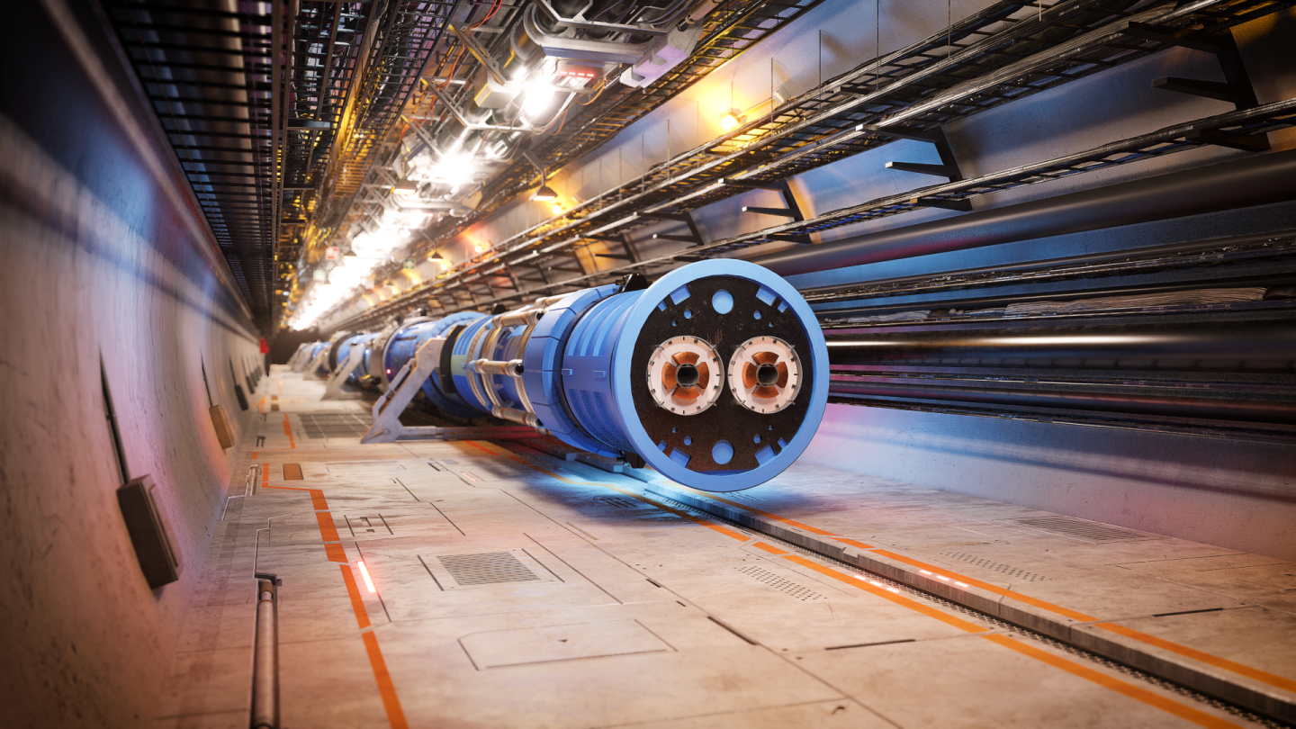
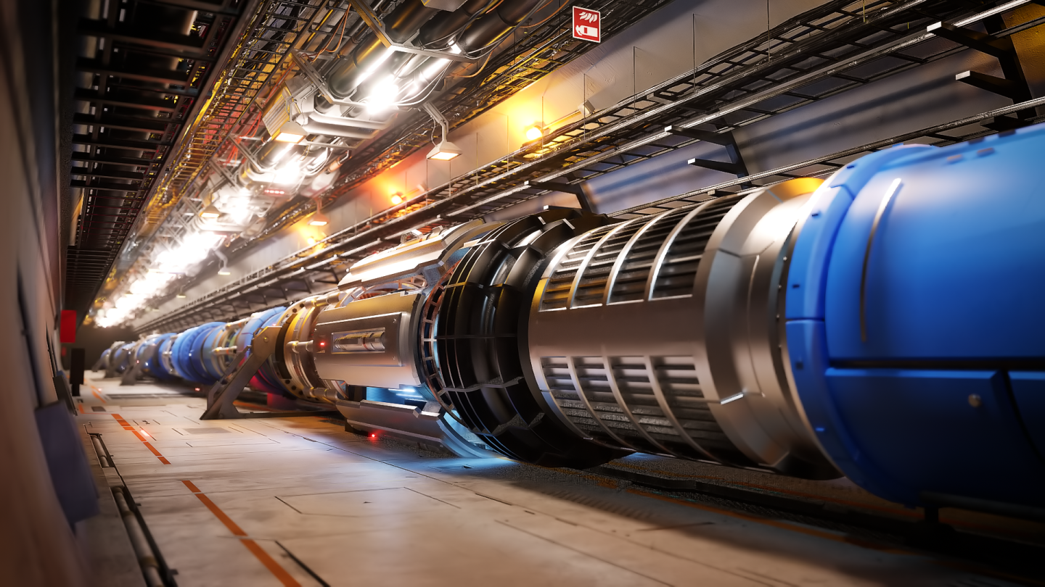
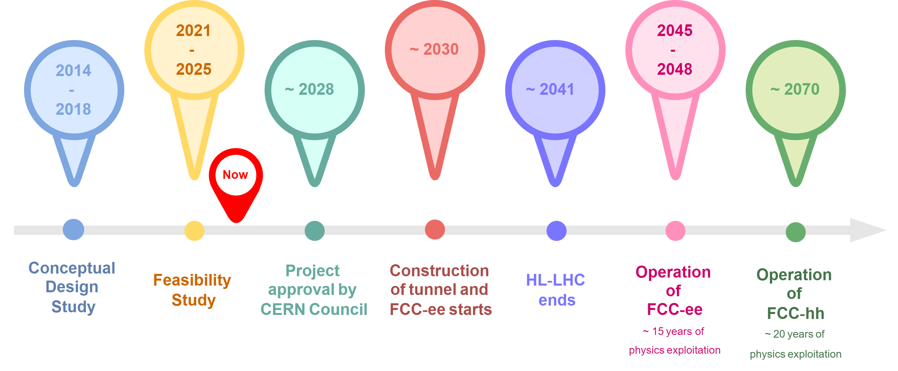
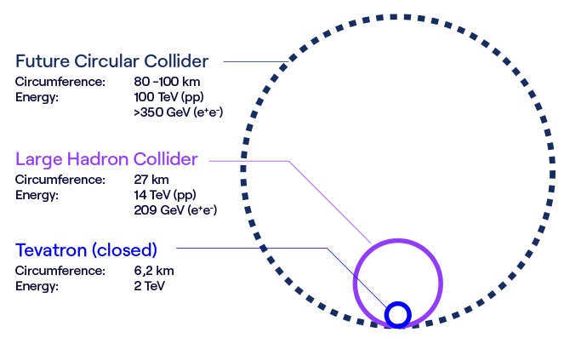
L. Delprat | FCC-hh Cryogenics
1. Introduction & status
2. FCC-hh at 1.9 K
- Layout
- Heat loads distribution
- Summary
5. Conclusions
- And perspectives for the pre-TDR phase
3. FCC-hh at 4.5 K
- Why?
- Layout
- Heat loads distribution
- Summary
4. Helium inventory and electrical power consumption
- About an economic mode

Slide 3
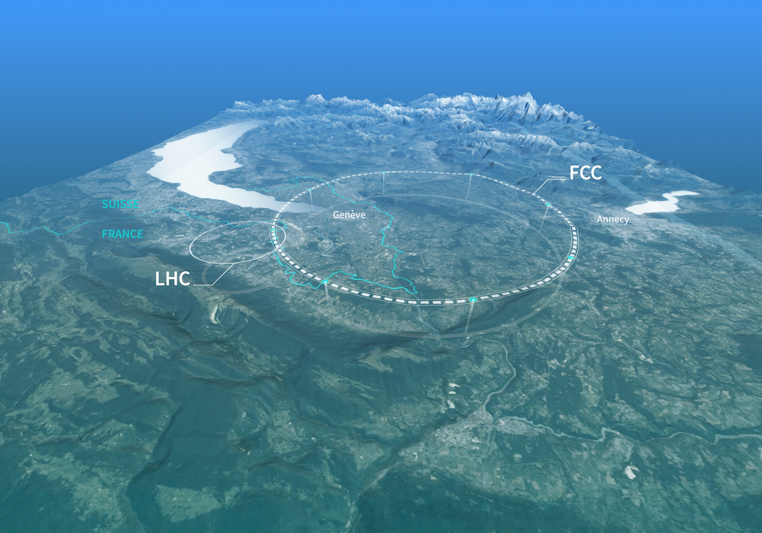
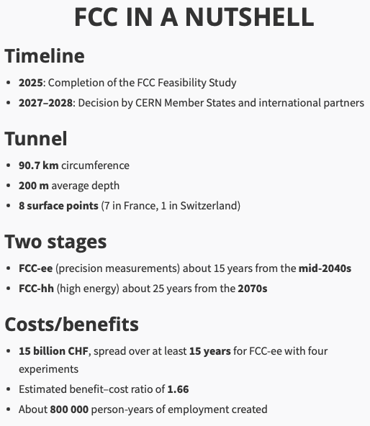
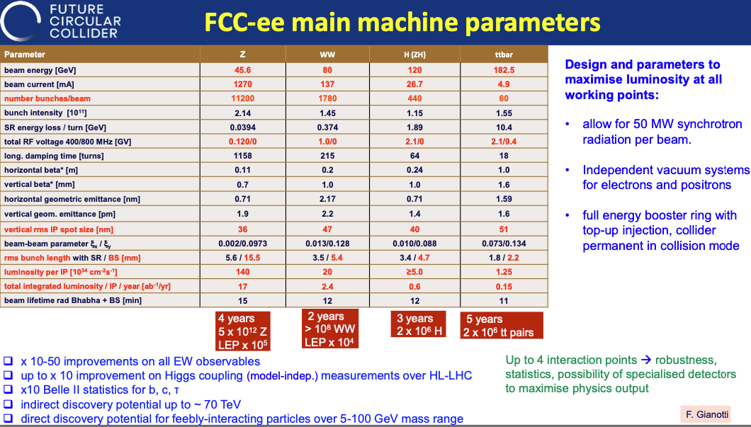
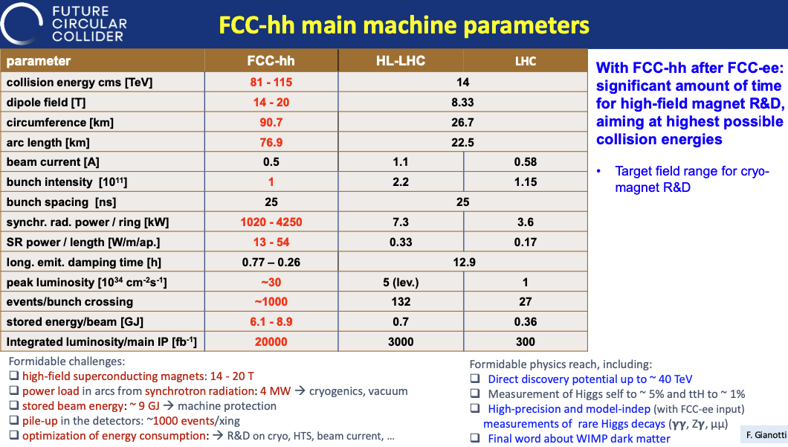
The Future Circular Collider
L. Delprat | FCC-hh Cryogenics
https://home.cern/science/accelerators/future-circular-collider
From FCC Week 2024

Slide 4
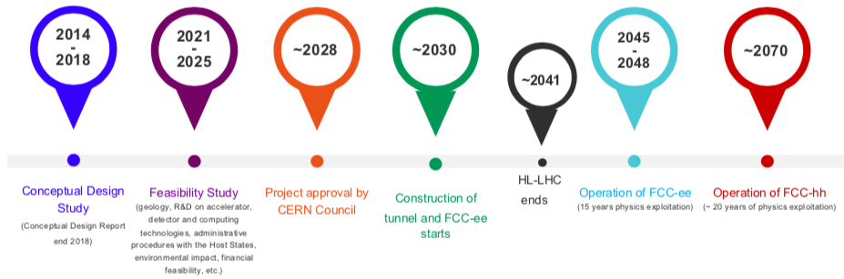

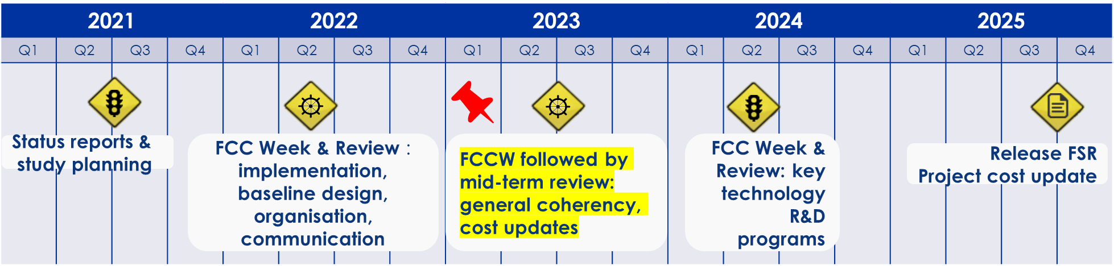


Where we are today
L. Delprat | FCC-hh Cryogenics
  Main objectives:
  Launch the civil engineering procurement right after the approval in 2028
  Complete all the studies deemed necessary to do so
  For cryogenics: refine the design foreseen in the Feasibility Study with industrial partners (2nd round)
Mandate: WP4.6 Cryo pre-TDR description, EDMS 3254016
Timeline:
2025: FCC Feasibility Study completion and beginning of Pre-TDR phase
2027: ESPP update
2028: approbation by the CERN council
F. Gianotti
M. Benedikt

Slide 5
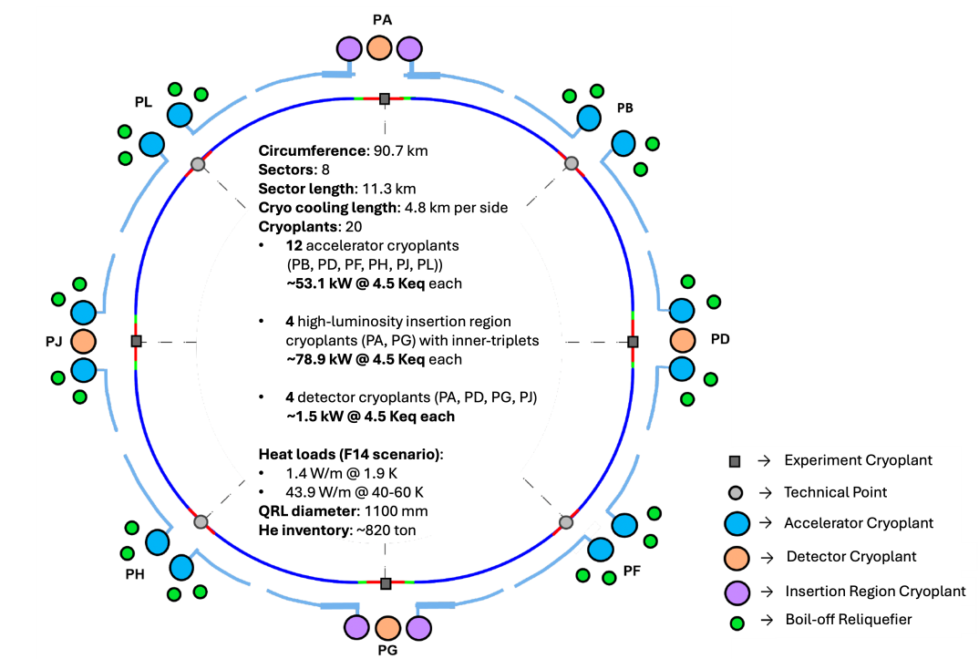
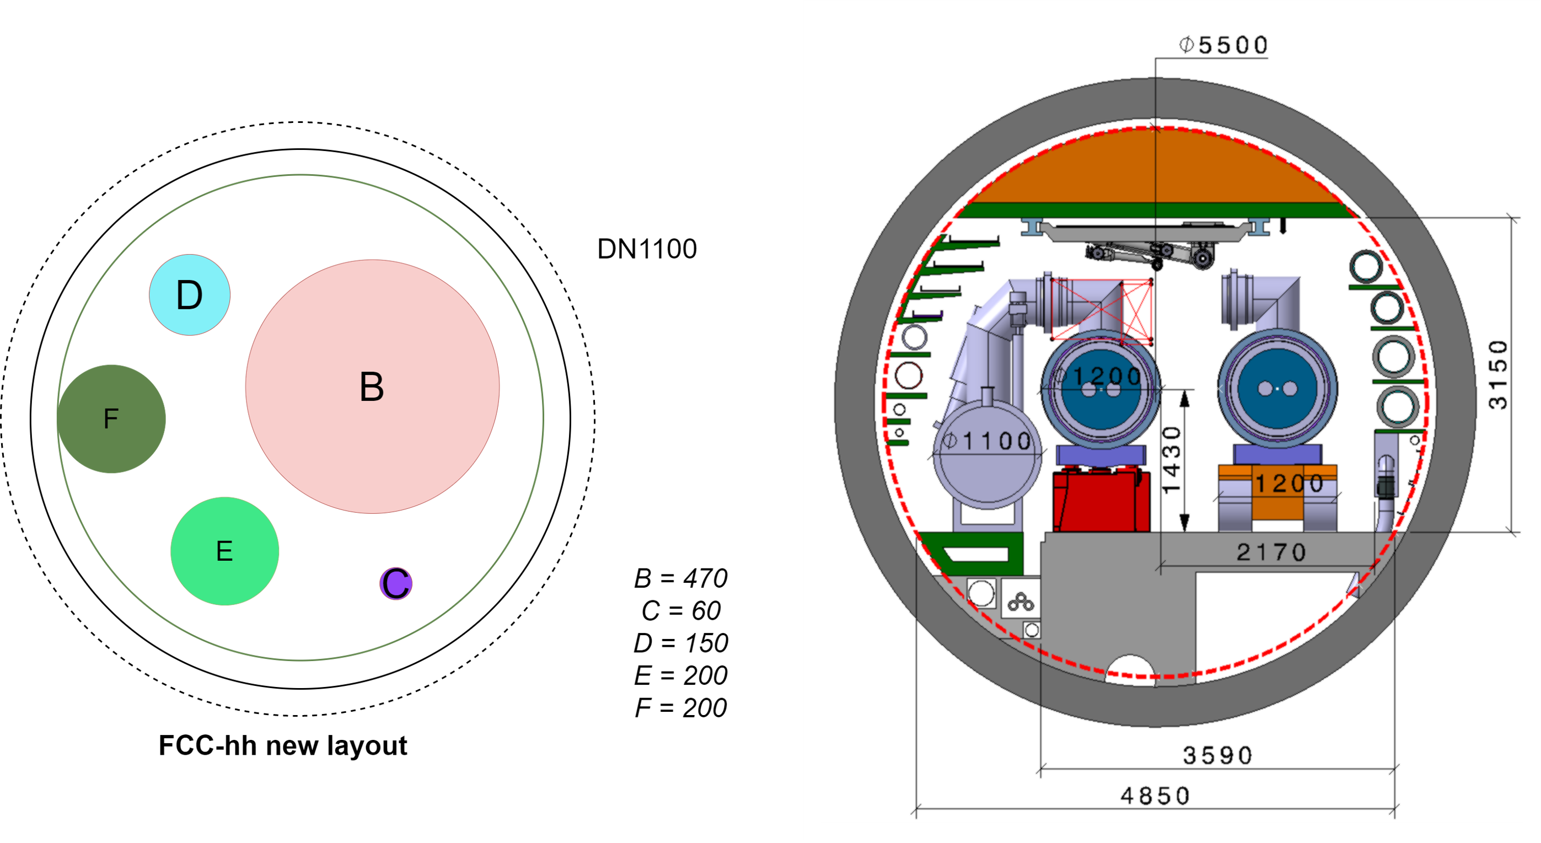
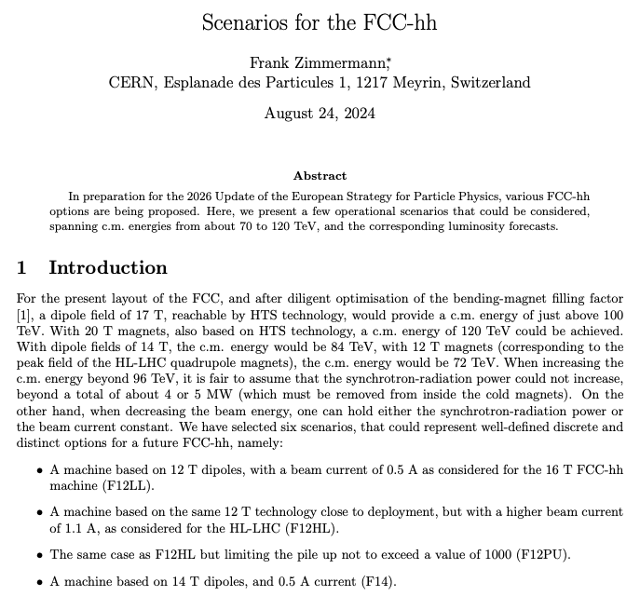
L. Delprat | FCC-hh Cryogenics
FCC-hh @ 1.9 K – Nb₃Sn @ 14T (“F14 scenario”)
“F14 scenario”
Cryogenic distribution line
Circumference: 90.7 km
Sectors: 8
Sector length: 11.3 km
Cryo cooling length: 4.9 km per side
Cryoplants: 16 + 4
12 accelerator cryoplants
(PB, PD, PF, PH, PJ, PL))
4 high-luminosity insertion region cryoplants (PA, PG) with inner-triplets
4 detector cryoplants (PA, PD, PG, PJ)
Heat loads (F14 scenario):
1.4 W/m @ 1.9 K
43.9 W/m @ 40-60 K
3.1 W/m @ 1.9 K for transient AC losses
QRL diameter: 1100 mm
He inventory: ~820 ton

Slide 6
L. Delprat | FCC-hh Cryogenics
Typical technical point cryoplants layout (preliminary)
LHe storage boil-off reliquefier
Cryogenic plant for 1 half-sector
Turbo-Brayton
Helium refrigerator
Technology
1 half-sector
of 4917 m
Thermal shields
Beam screens
Current leads cooling
Magnets
RF cavities
1 half-sector
of 4917 m
Heat loads
[40 – 60] K
g/s @ [40 – 290] K
1.9 K
4 K VLP
4.5 K isothermal
Temperatures

Slide 7
L. Delprat | FCC-hh Cryogenics
Summary of 1.9 K option – whole FCC
Item | Machine | High luminosity Insertions | Unit | Comments
Turbo-brayton cooling capacity | 3454 | 182.8 | kW @ [40-60] K | incl. current leads cooling
Turbo-brayton electrical power consumption | 46 | 2.8 | MW_elec | /
Main helium refrigerator cooling capacity | 609 (⬄ 16 * 38.1 kW @ 4.5 Keq) | 95.8 (⬄ 4 * 24 kW @ 4.5 Keq) | kW @ 4.5 Keq | /
Main helium refrigerator electrical power consumption | 136 | 21.2 | MW_elec | /
Total electrical power consumption | 182 | 24 | MW_elec | /
Grand total | 206 |  | MW_elec
**without considering the detectors, generally representing approx. 10% of the accelerator figures

Slide 8
Looking into a 4.5 K option for FCC-hh
L. Delprat | FCC-hh Cryogenics

Slide 9
Main drivers for studying the 4.5 K option
L. Delprat | FCC-hh Cryogenics
Reduce the capital cost
  With less cryogenic cooling power installed
Reduce the operation cost
  With a reduced electrical power consumption
Reduce the required cryogens inventory
######
Challenging magnets loads transients’ management (AC losses)
  installed capacity of 2.8 W/m (⬄ extra 7 kW per half-sector)
  … was 2.0 W/m (⬄ extra 3 kW per half-sector) in the feasibility for 1.9 K option
Notes:
During the ramping-up we will have 1.4 (static + dynamic without ML)+3.1 (magnetization losses) = 4.5 W/m to extract at ~4 K but we will install "only" 2.8 W/m. And this will of course imply a recovery time afterwards to release this excess of energy accumulated somewhere... and somehow... this is the question !

Slide 10
L. Delprat | FCC-hh Cryogenics
FCC-hh @ 4.5 K – Nb₃Sn @ 14T (“F14 scenario”)
PA
DISCLAIMER
!!! Preliminary conceptual design only !!!
Magnet transients’ management challenging: very large AC losses without large He II inventory available to buffer the energy as in the 1.9 K option
Need of work ahead to produce a technical feasibility report
PL
PB
Circumference: 90.7 km
Sectors: 8
Sector length: 11.3 km
Cryo cooling length: 4.9 km per side
Cryoplants: 16 + 4
12 accelerator cryoplants
(PB, PD, PF, PH, PJ, PL))
4 high-luminosity insertion region cryoplants (PA, PG) with inner-triplets
4 detector cryoplants (PA, PD, PG, PJ)
Heat loads (F14 scenario):
1.4 W/m @ 1.9 K
43.9 W/m @ 40-60 K
7 W/m @ 4 K for transient AC losses
QRL diameter: < 850 mm (preliminary)
He inventory: ~390 ton
PJ
PD
QRL
⌀_{QRL 4.5 K} < 1.9 K option (1100mm)
⌀_{QRL 4.5 K expected} < 850 mm
Highly dependent on
  Magnets cooling scheme
  Sector length
→ Experiment Cryoplant
→ Technical Point
→ Normal sector cryoplant
PH
PF
→ Detector Cryoplant
→ Insertion sector cryoplant
→ Boil-off Reliquefier
PG
Notes:
QRL will be smaller than the 1.9 K version, probably between 650 mm and 850 mm.
the 850 mm already investigated were for the 10km sector version.
for 5km version, with the 4.5 W/m peak, we obtain ~1.3 kg/s i.e. a line B of DN200 to have ΔP of 80mbar (or DN250 for 25mbar).
So, this will be better assessed once we agree on what we do on the cooling scheme and the sector length.

Slide 11
L. Delprat | FCC-hh Cryogenics
Summary of 4.5 K option – whole FCC
Item | Machine | High luminosity Insertions | Unit | Comments
Turbo-brayton cooling capacity | 3454 | 182.8 | kW @ [40-60] K | incl. current leads cooling
Turbo-brayton electrical power consumption | 46 | 3 | MW_elec | /
Main helium refrigerator cooling capacity | 299 (⬄ 16 * 18.7 kW @ 4.5 Keq) | 30.6 (⬄ 2 * 15.3 kW @ 4.5 Keq) | kW @ 4.5 Keq | /
Main helium refrigerator electrical power consumption | 82 | 8 | MW_elec | /
Total electrical power consumption | 128 | 11 | MW_elec | /
Grand total | 139 |  | MW_elec
**without considering the detectors, generally representing approx. 10% of the accelerator figures

Slide 12
L. Delprat | FCC-hh Cryogenics
FCC-hh 1.9 K and 4.5 K comparison
FCC-hh Parameters | F14 scenario at 1.9 K [2024] | F14 scenario at 4.5 K [2024]
Circumference [km] | 90.7 | 90.7
Dipole field [T] | 14 | 14
Centre of mass energy [TeV] | 85 | 85
Sync. Rad. for 2 beams [MW] | 2.4 | 2.4
Magnet temperature [K] Beam screen temperatures[K] | 1.9 [40 – 60] | 4.5 [40 – 60]
Helium Cryogenic Capacity @ 4.5 K equivalent [kW] | 1040 | 698
Number of cryo islands [-] | 8 | 8
Number of cryoplants in total [-] | 16 | 16
ARC cooling length [km] | 16 x 4.9 = 78.4 km | 16 x 4.9 = 78.4 km
Electrical consumption [MW] | 206 | 139
Helium inventory [tons] | 820 | 390
**without considering the detectors, generally representing approx. 10% of the accelerator figures

Slide 13
L. Delprat | FCC-hh Cryogenics
Helium inventory
FCC-hh at 1.9 K: 820 tonnes of helium
  Scaled from the estimate of the Conceptual Design Report (CDR) published in 2019
  Electrical power consumption in nominal: 206 MW_elec
FCC-hh at 4.5 K: 390 tonnes of helium
  Distribution: 214 t
  Magnets : 130 t
  Cryoplants: 16 t
  Gas storage: 30 t
  Electrical power consumption in nominal: 139 MW_elec

Slide 14
L. Delprat | FCC-hh Cryogenics
Electrical power consumption and economic mode
A provisional economic mode was studied (operation scenario not defined yet)
Assumptions:
  No dynamic heat load (only static)
  The ability to handle magnet transients
Results:
  FCC-hh at 1.9 K:
    Nominal: 206 MW_elec
    Eco mode: 103 MW_elec
  FCC-hh at 4.5 K:
    Nominal: 139 MW_elec
    Eco mode: 66 MW_elec
DISCLAIMER
Like LHC, 3 modes could be considered
  Physics (cryo consumption ⬄ beam energy and intensity)
  Eco: see on the left
  Cold standby: neither beam nor magnets powering allowed, machine kept at 20 K in standby (shutdowns)
-50%
-53%
Notes:
Mis en perspective avec le LHC, voici les modes cryo qu’on peut imaginer pour le FCC-hh, quelle que soit sa température nominale:
« Physics » : on fait de la physique, et l électricité de la cryo dépend de l’énergie et de l intensité des faisceaux. Dans le LHC, ça représente entre 30 et 37 MW d électricité pour la cryo selon les faisceaux mais on peut imaginer un bcp plus grand intervalle avec le FCC-hh à cause des plus grandes charges dynamiques du faisceau proportionnellement aux charges statiques.
« Eco » : on fait du magnet powering, du commissioning avec quelques bunches dans la machine ou alors avec des ions qui n'induisent quasi pas de charge thermique. Dans le LHC, c’est ~26 MW de conso cryo.
« Cold standby » : on ne peut pas mettre de puissance dans les aimants ni de faisceau, mais on garde la machine à température cryo ~20 K. C est pour les shutdowns. Dans le LHC, ca représente 15 MW pour la cryo.

Slide 15
Conclusion
L. Delprat | FCC-hh Cryogenics
All required documentation was delivered on time for the Feasibility Study
  For -hh at 1.9 K and at 4.5 K configurations
  With FCC-hh at 1.9 K still being the baseline
Pre-TDR study is launched
Potential R&D lines are identified that are of interest for the cryogenic design of FCC-hh
  With the industry for centrifugal compression and turbo-brayton cycles towards energy savings up to 20%
  With a new cooling scheme adapted to the FCC-hh at 4.5 K configuration (conduction cooled)
Full steam ahead towards pre-TDR report completion in 2027!
See P. Borges de Sousa’s talk on Thursday 11h30 on FCC-hh accelerator: Optics baseline session

Slide 16
Thank you for your attention
This project has received funding from the European Union's Horizon 2020 research and innovation programme under grant agreement No 951754.
laurent.delprat@cern.ch
FCC Week 2025 – Vienna – May 19th to 23rd, 2025

