Slide 1
Integration update tunnel, arcs, Experiment caverns, service caverns and Alcoves
22.05.2025 / FCC Week
F. Valchkova-Georgieva
EN-ACE-INT

Slide 2
22.05.2025 / FCC Week
F. Valchkova-Georgieva EN-ACE-INT
  FCC Underground Structure Overview
  Integration of FCC-ee/hh Arc Cell
  FCC-ee/hh Underground Structure point A
  Integration of FCC-ee Beamstrahlung dump point A
  FCC-ee Booster Injection at point A
  FCC-ee Underground Structure point B
  FCC-ee/hh Underground Structure point D and point J
  FCC-ee Underground Structure point F
  FCC-ee Underground Structure point G
  Integration of FCC-ee Alcoves and transport areas

Slide 3
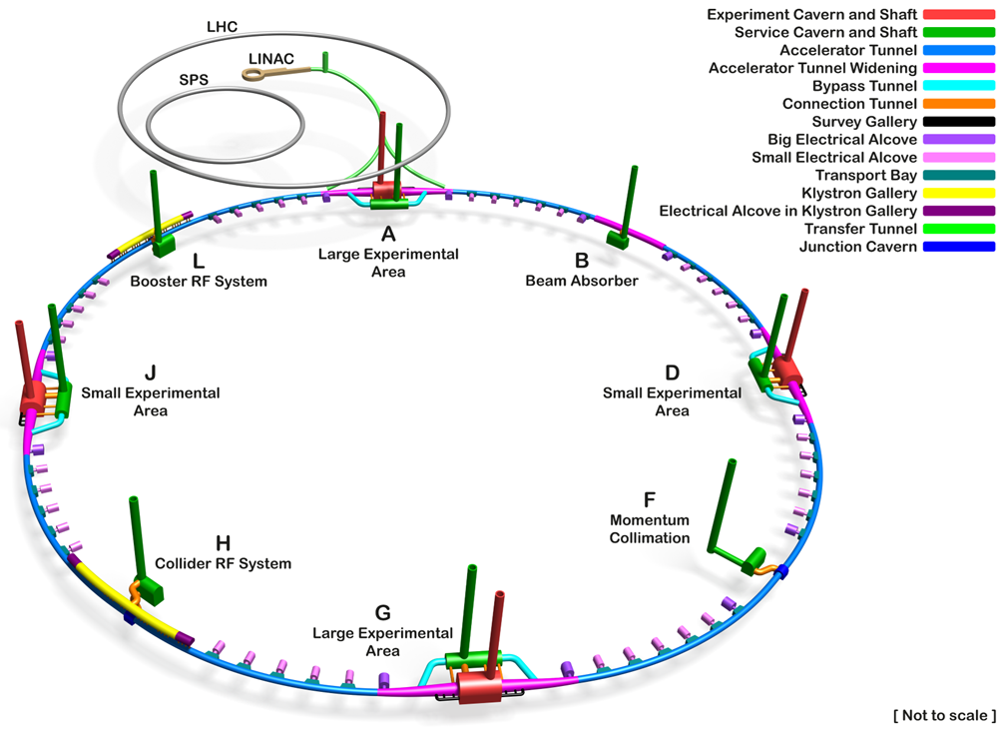
22.05.2025 / FCC Week
F. Valchkova-Georgieva EN-ACE-INT
  FCC-ee Underground Structure Overview
Only schematic, and not to scale.
Courtesy A. Navascues Cornago

Slide 4
22.05.2025 / FCC Week
F. Valchkova-Georgieva EN-ACE-INT
  Integration study of FCC Arc Cell
PLM References:
FCC-ee Arc Cell: https://plm.cern.ch/p/CAD/number:ST1901108_01
FCC-hh Arc Cell: https://plm.cern.ch/p/CAD/number:ST1883395_01
EDMS References: https://edms.cern.ch/document/3136748/1.1

Slide 5
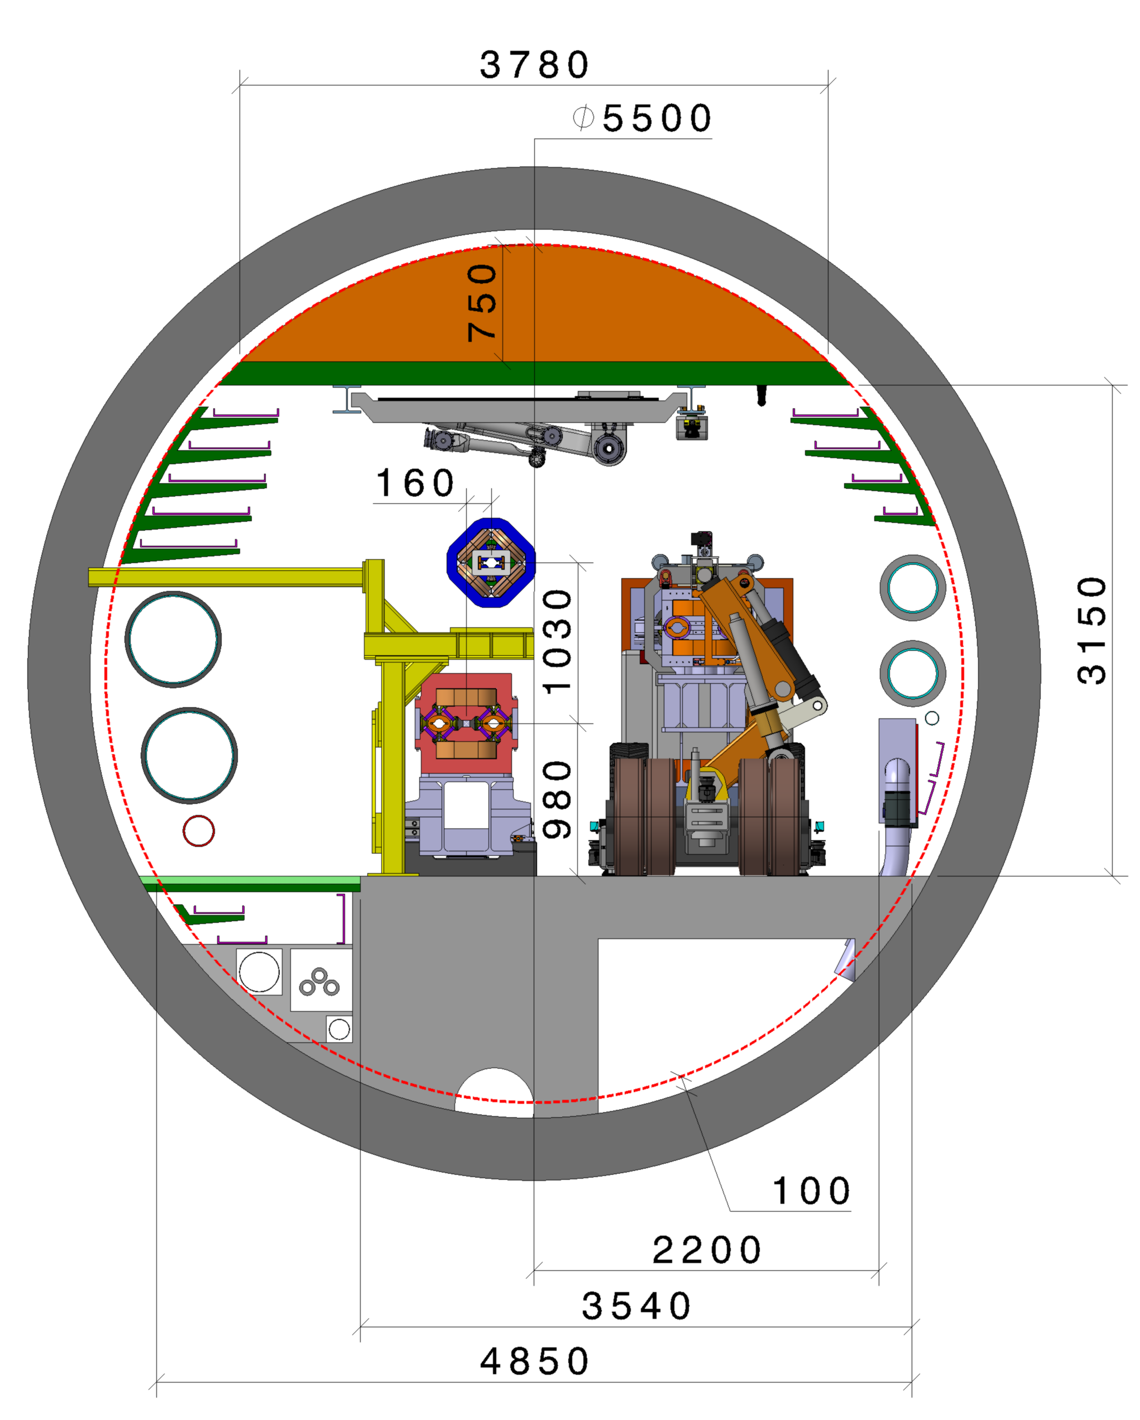
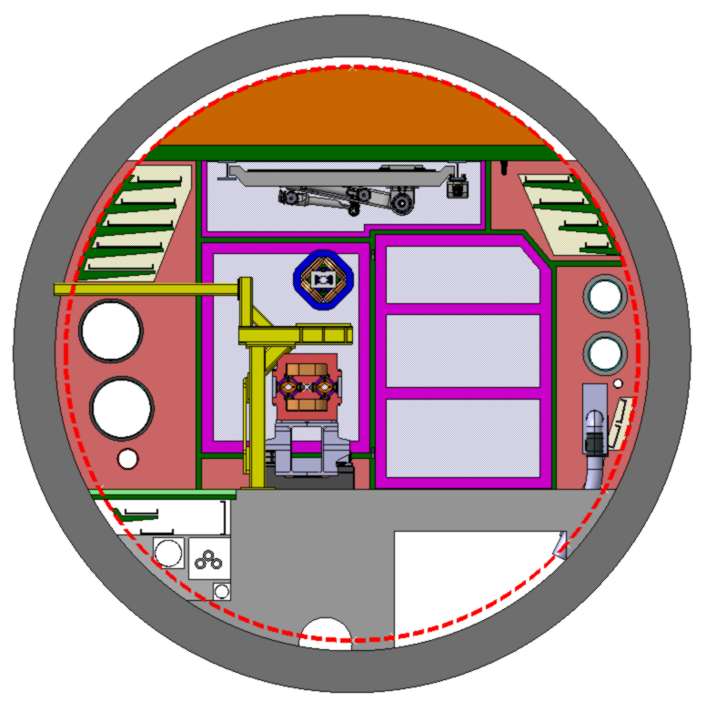
22.05.2025 / FCC Week
F. Valchkova-Georgieva EN-ACE-INT
  Integration of FCC-ee machine elements (regular arc)
Machine tunnel 5.5m in diameter
Robot space reservation
2.9m x 0.55m (LxH)
He/Smoke extraction
Booster ring
Leaky feed
4 Cable trays
5 Cable trays
Collider ring
Chilled water
DN300
Magnet vehicle
Transport space reservation
2.2m x 2.25m (LxH)
Demineralized water
DN550
Compressed air
DN80
He recovery line
3 Cable trays
2 Cable trays
Raw water
DN250
Fresh air duct
HV Cable
Main cross section as for FCC-hh
Main ring below of booster ring
Main ring and booster ring 1.03 m distant
Reject water
DN125
Collider Center
Drain

Slide 6
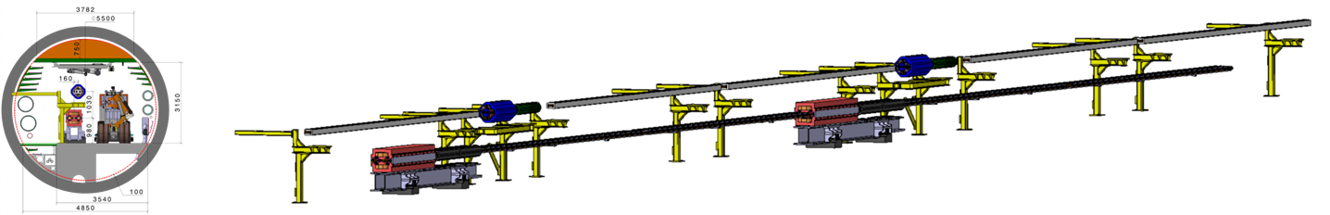
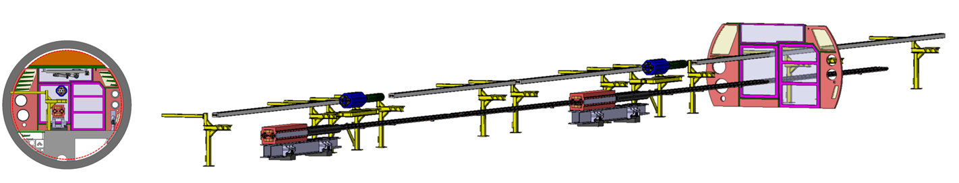
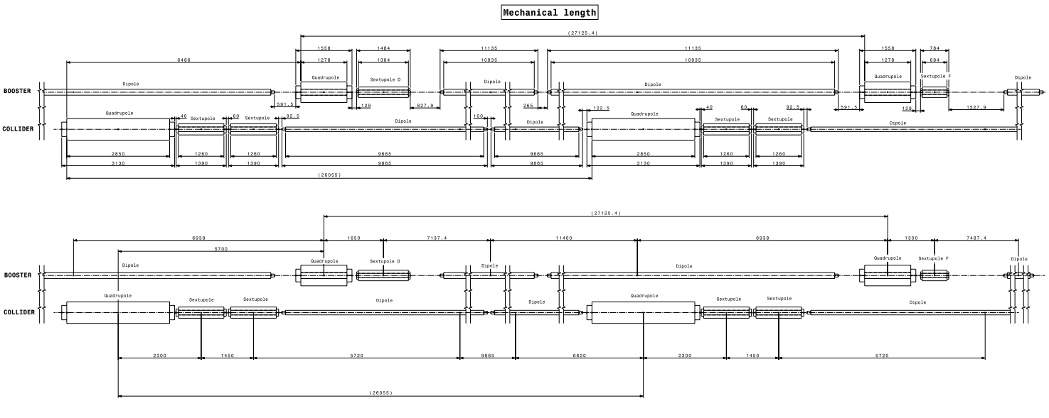
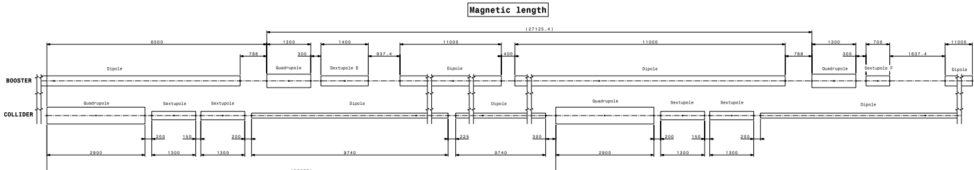
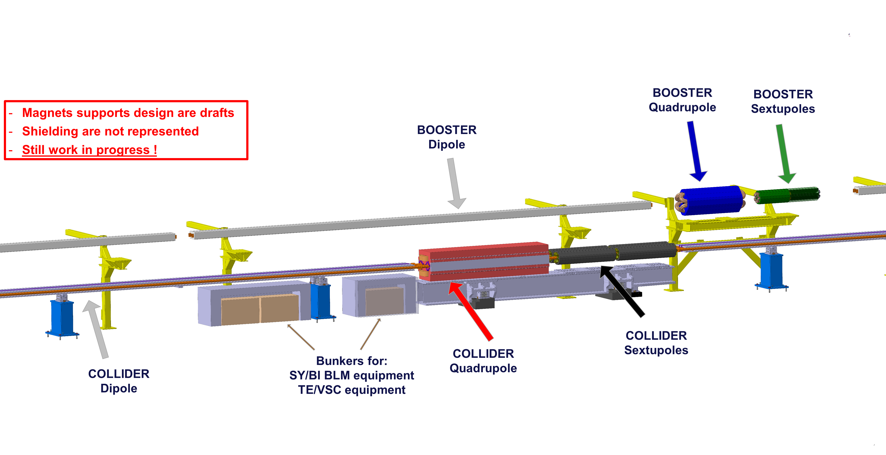
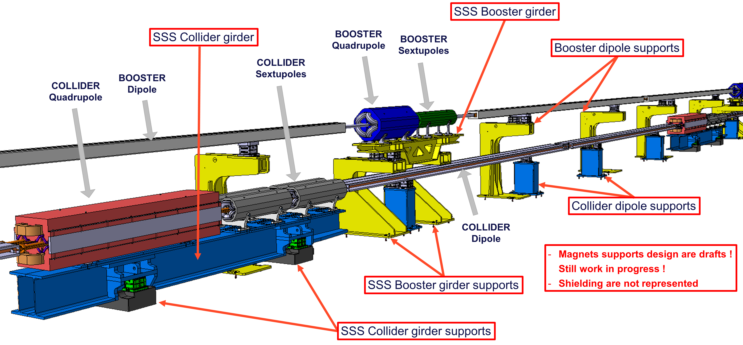
22.05.2025 / FCC Week
F. Valchkova-Georgieva EN-ACE-INT
  Integration of FCC-ee machine elements (regular arc)
Booster ring
Quadrupole
Sextupole
Dipole
Collider ring
Quadrupole
Sextupole
Dipole
Integration study pre-TDR phase
Please follow Anton Lechner’s presentation "Strategy for mitigating radiation to equipment in FCC-ee"
Please follow Federico Carra’s & Audrey Piccini’s presentation "Arc half-cell mock-up status"
Please follow Barbara Humann’s presentation "Radiation environment"

Slide 7
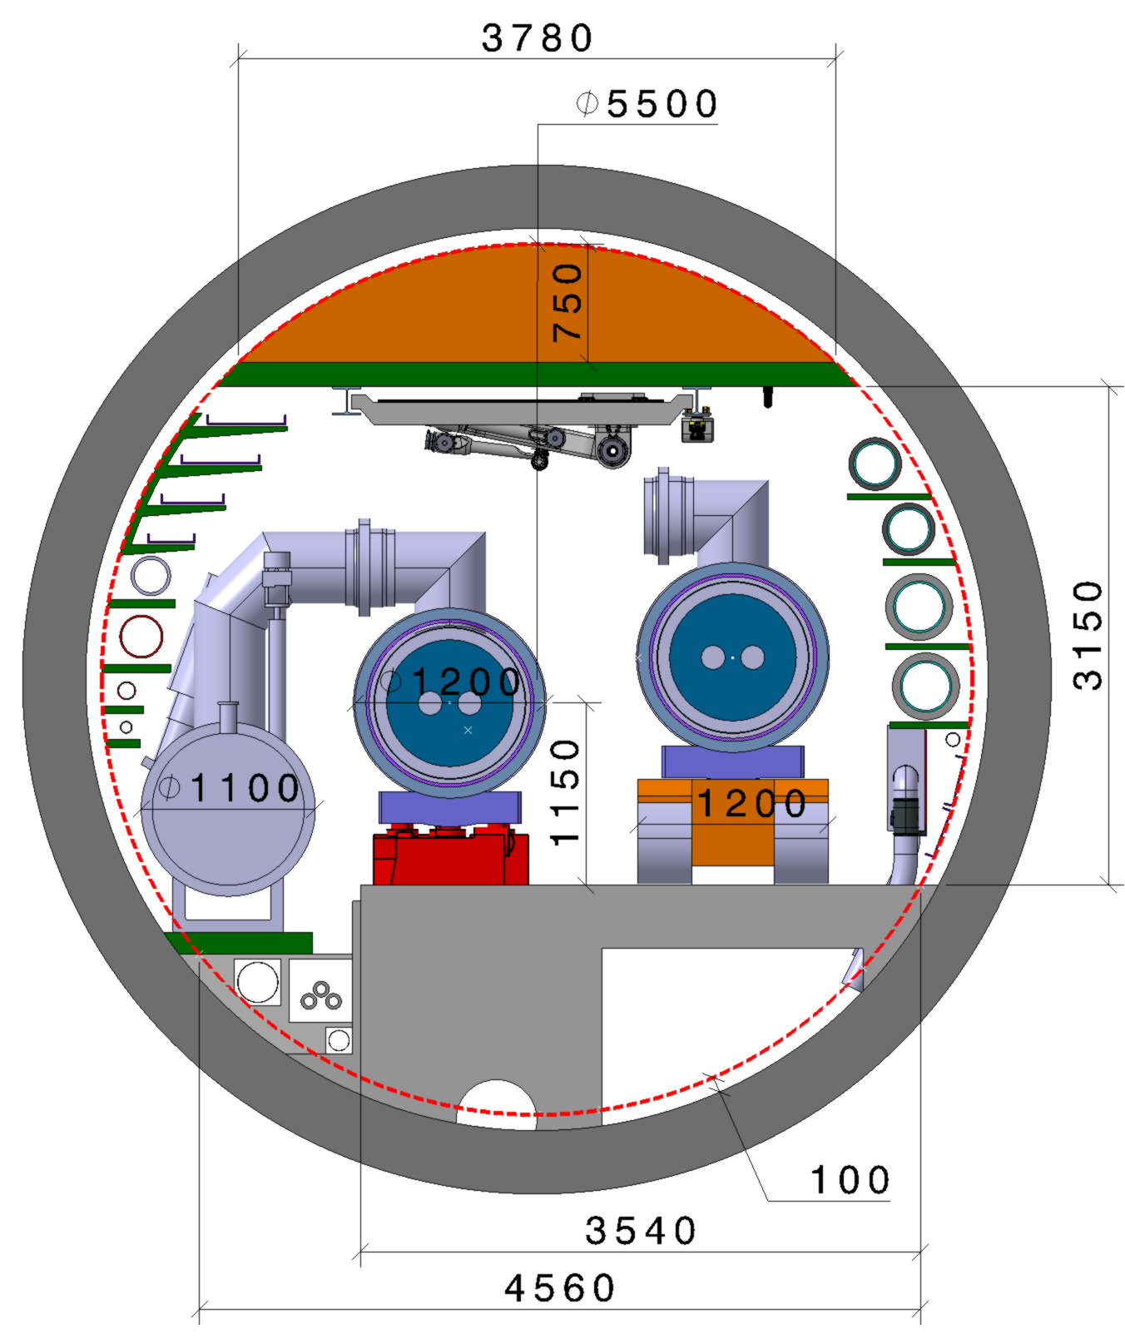
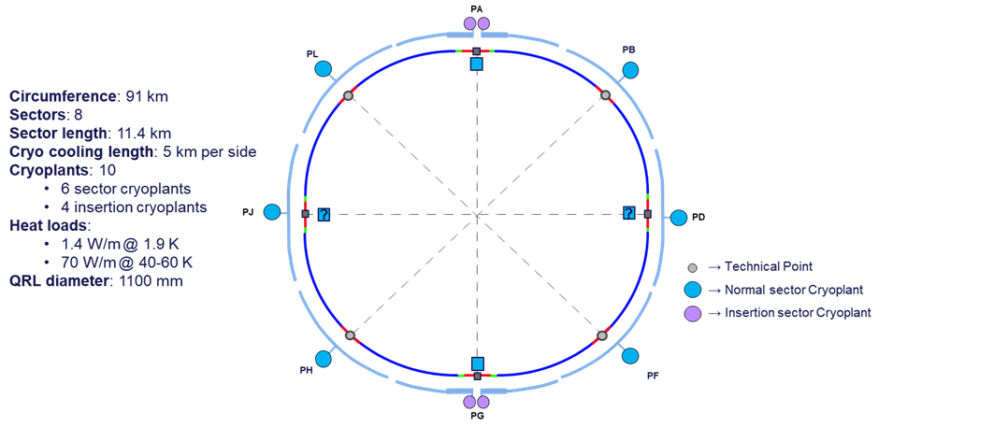

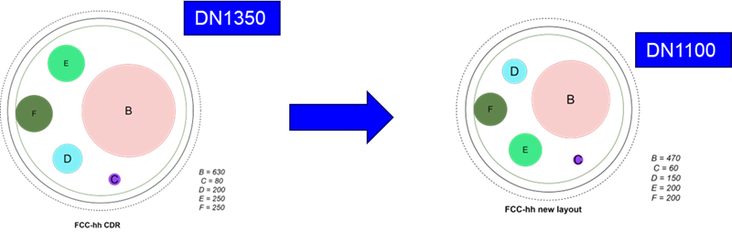
22.05.2025 / FCC Week
F. Valchkova-Georgieva EN-ACE-INT
  Integration of FCC-hh machine elements (regular arc)
Machine tunnel 5.5m in diameter
FCC-hh cryogenic system updated layout
Main cross section as for FCC-ee
Robot space reservation
2.9m x 0.55m (LxH)
He/Smoke extraction
Leaky feed
4 Cable trays
Demineralized water
DN250
Superconducting link DN250
Warm He recovery DN250
Chilled water
DN300
Helium Recovery line DN100
Magnet vehicle
Transport space reservation
2m x 2.25m (LxH)
Demineralized water felling DN65
QRL ø 1100
Compressed air
DN80
Machine cryostat ø 1200
Raw water
DN250
2 Cable trays
HV Cable
Fresh air duct
Reject water
DN125
Collider Center
Drain

Slide 8
22.05.2025 / FCC Week
F. Valchkova-Georgieva EN-ACE-INT
  FCC-ee Underground Structure point A
PLM References: https://plm.cern.ch/p/CAD/number:ST1874371_01
EDMS References: https://edms.cern.ch/document/3126003/1.0

Slide 9
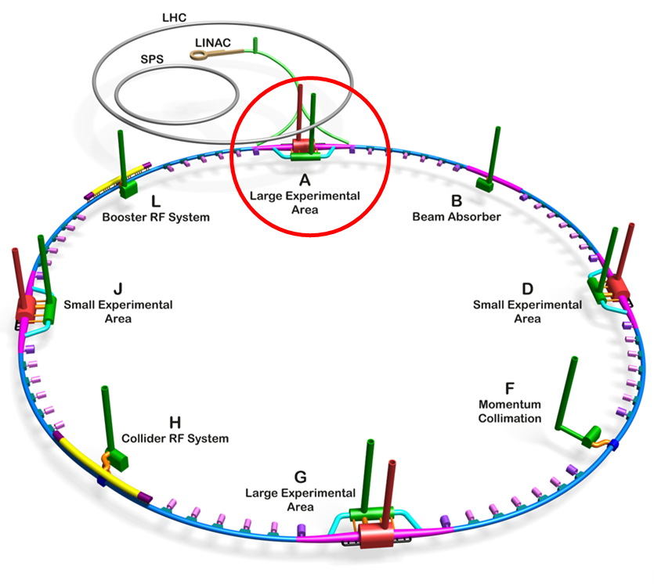
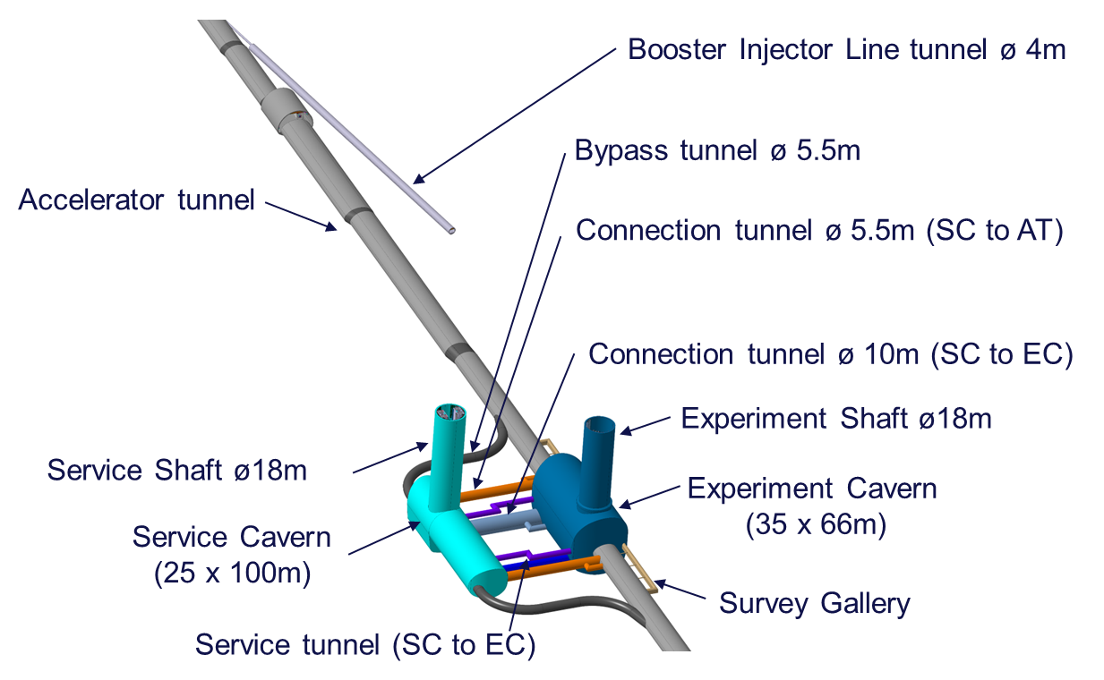
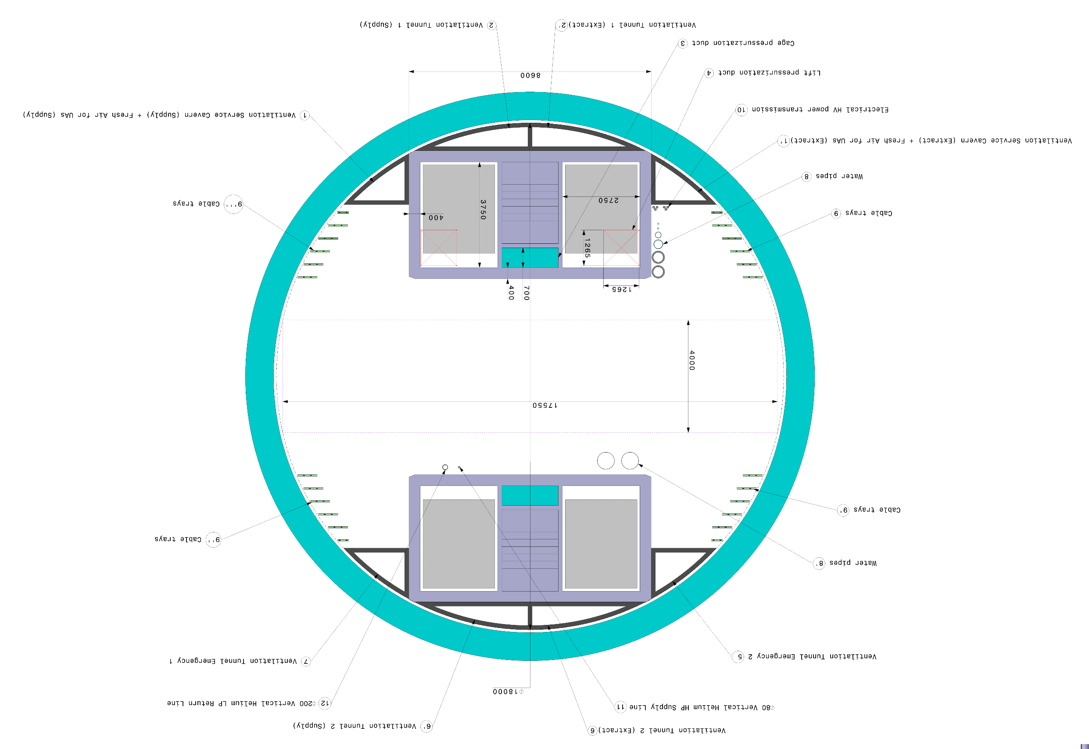
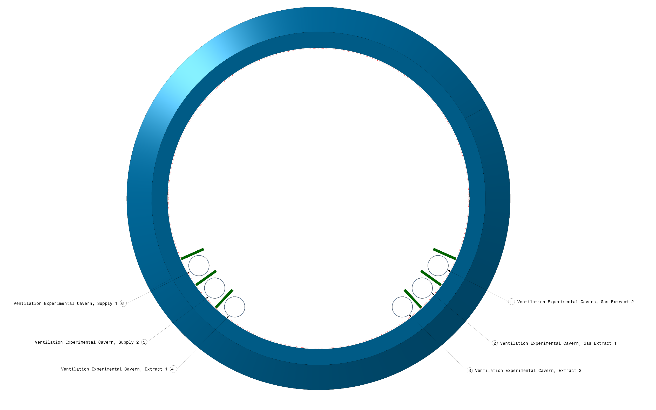
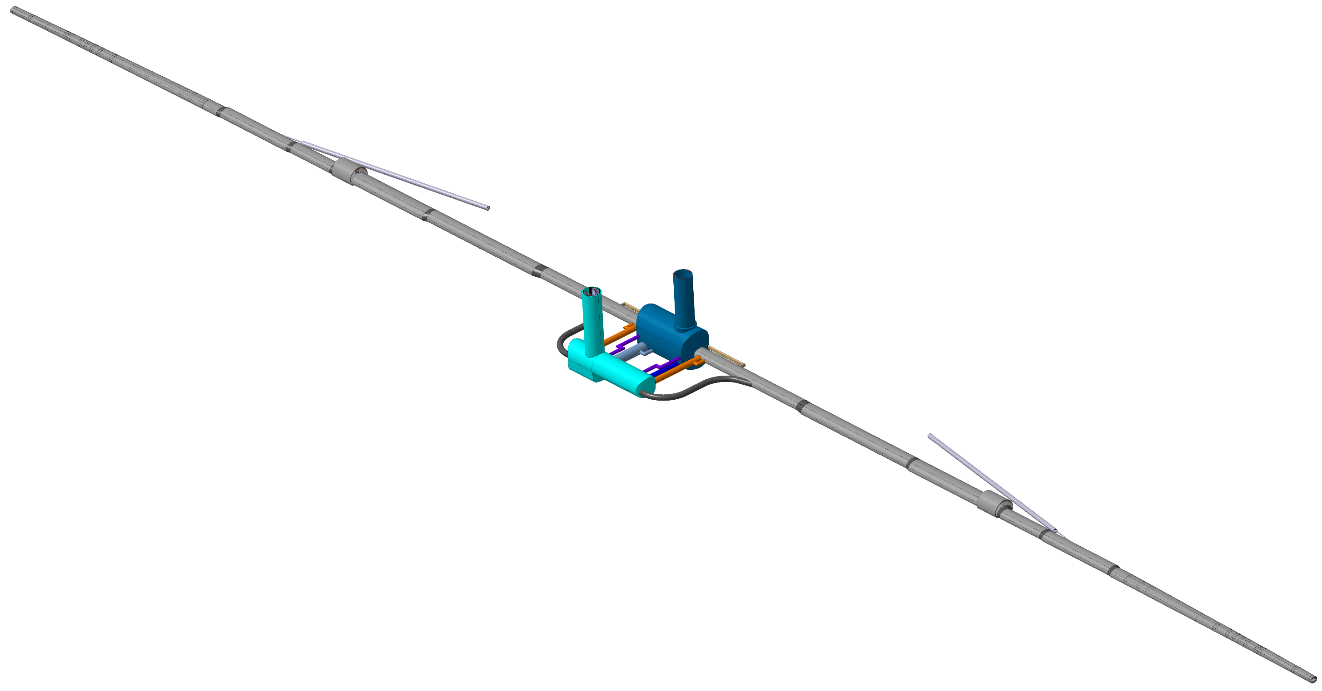
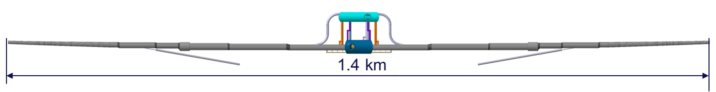
22.05.2025 / FCC Week
F. Valchkova-Georgieva EN-ACE-INT
  FCC-ee Underground Structure at point A
Service Shaft ø18m
Experiment Shaft ø18m

Slide 10
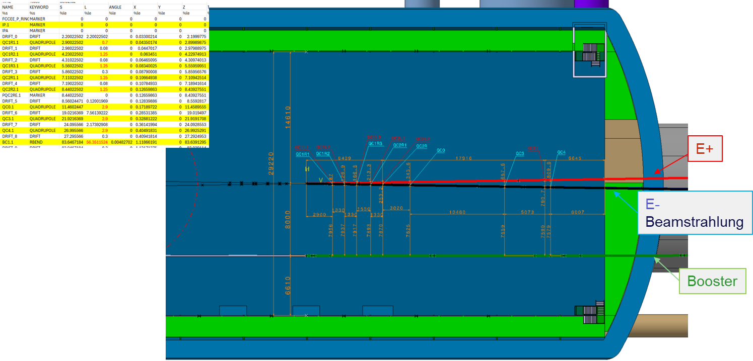
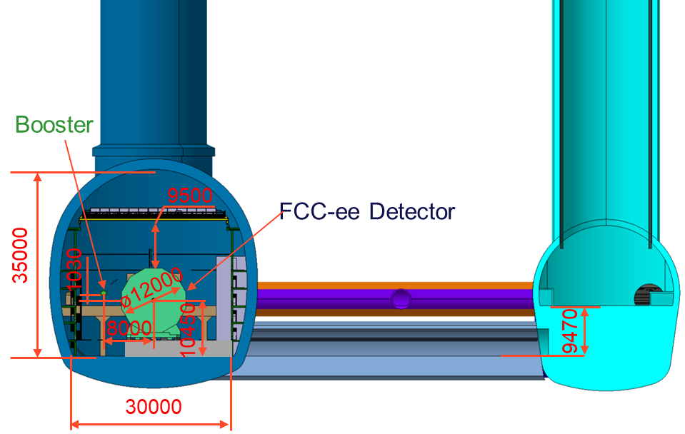
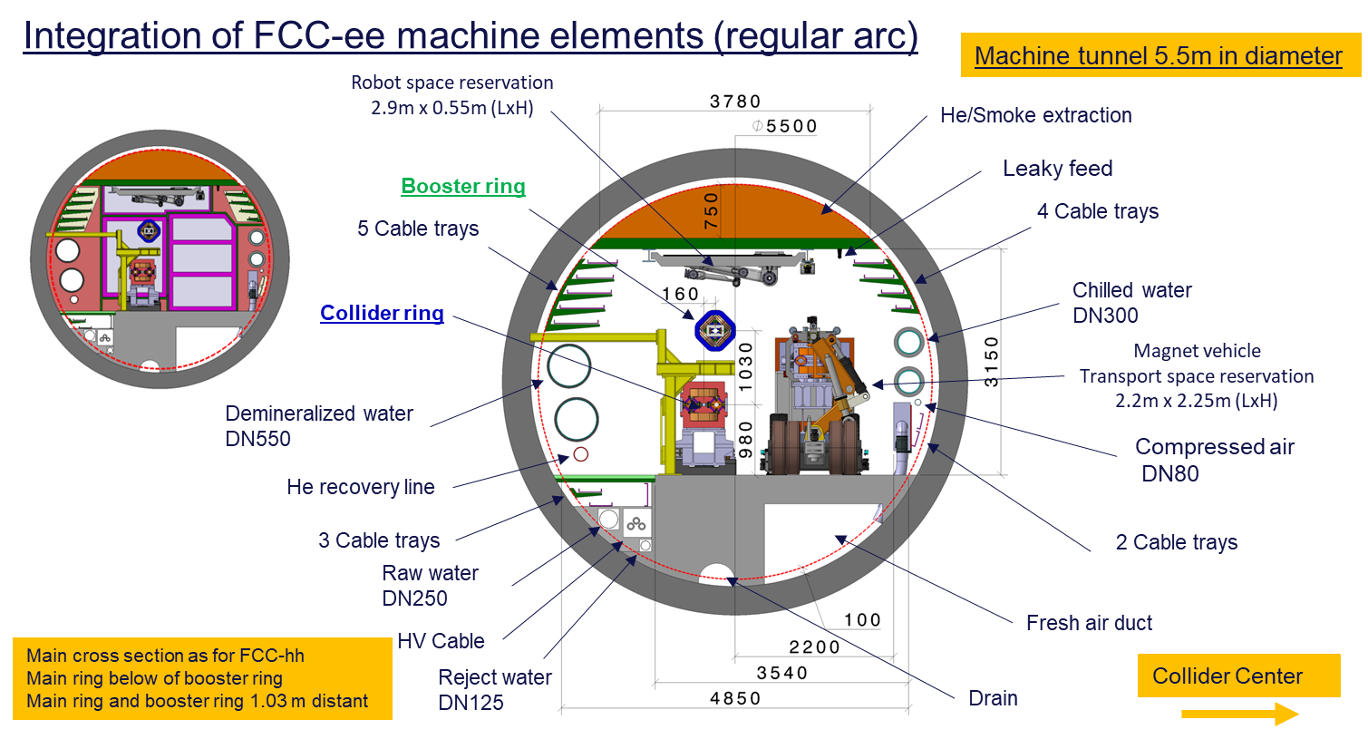
22.05.2025 / FCC Week
F. Valchkova-Georgieva EN-ACE-INT
  FCC-ee Underground Structure at point A

Slide 11
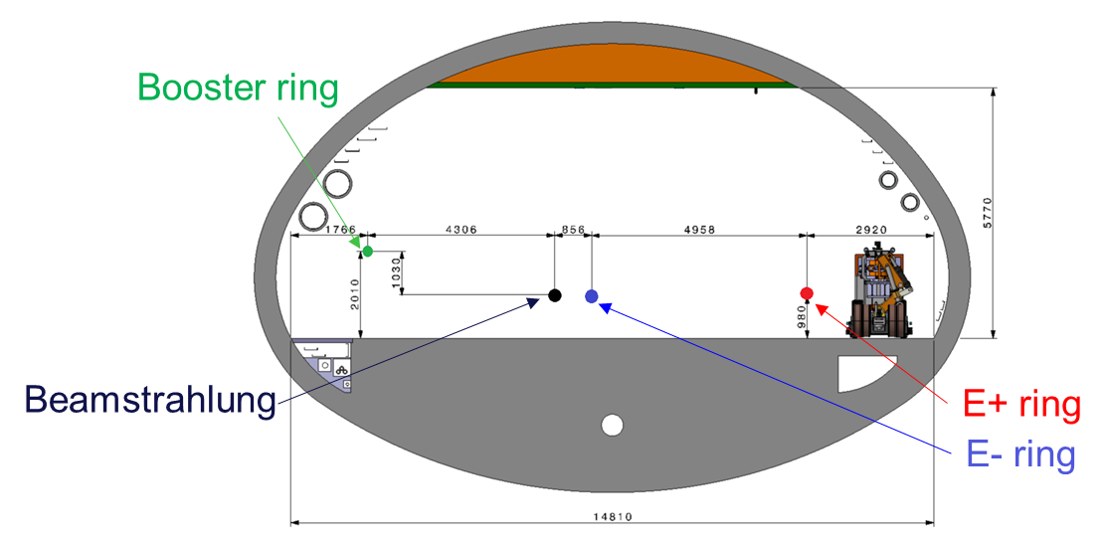
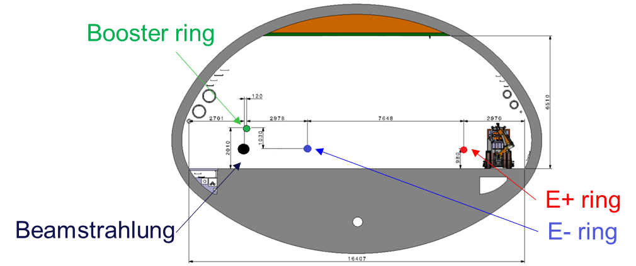
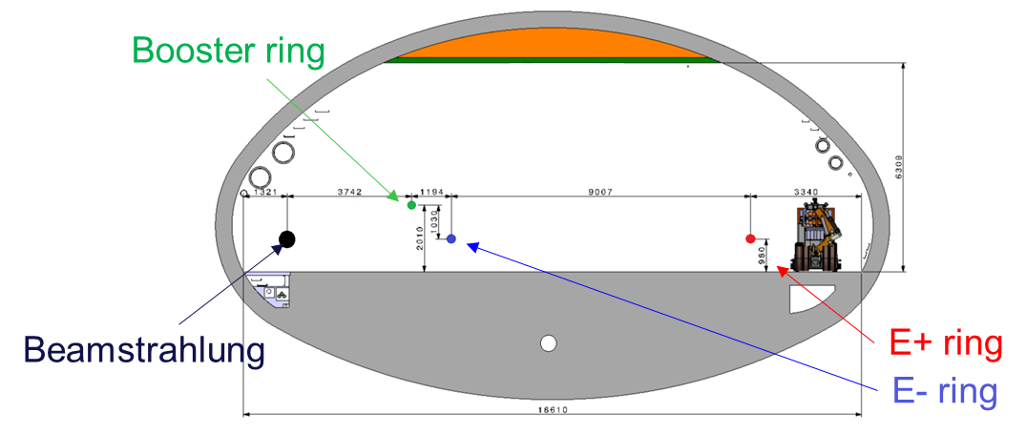
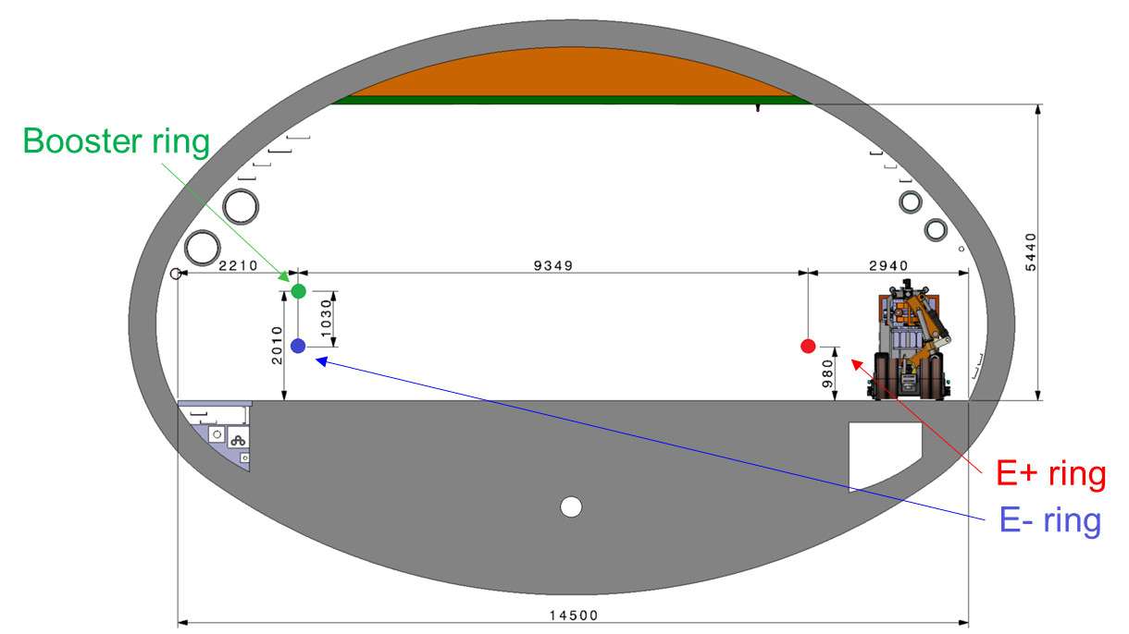
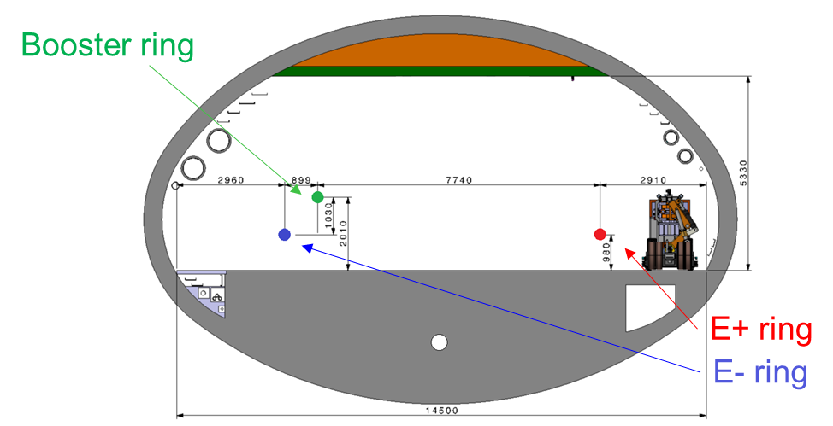
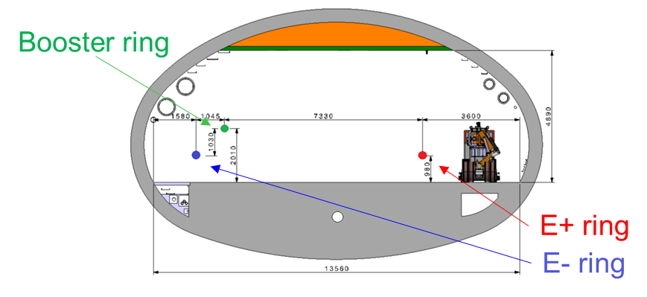
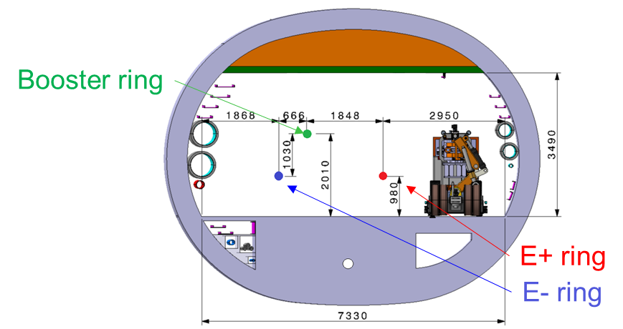
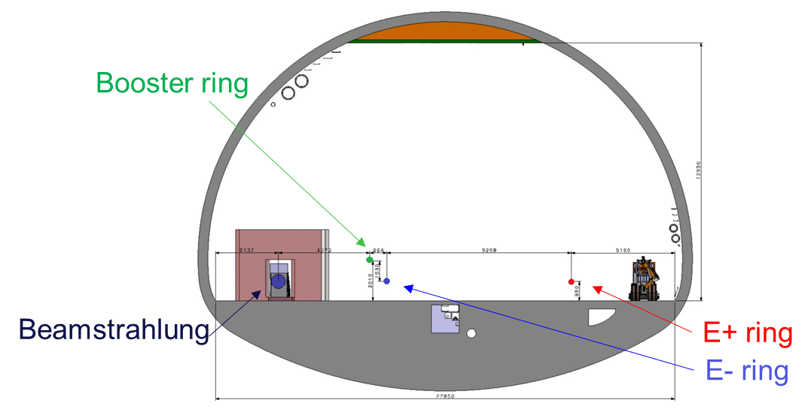
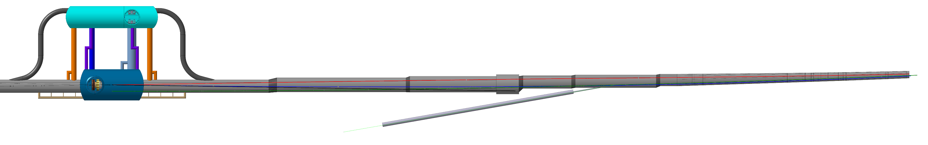
22.05.2025 / FCC Week
F. Valchkova-Georgieva EN-ACE-INT
  FCC-ee Underground Structure at point A
  Section 1
  Section 2
  Section 3
  Section 4
  Section Dump
  Section 5
  Section 6
  Section 7
1
2
3
D
4
5
6
7
10m
5m
5m
5m
5m
20m
97m
150m
160m
60m
100m
288m
132m
948m

Slide 12
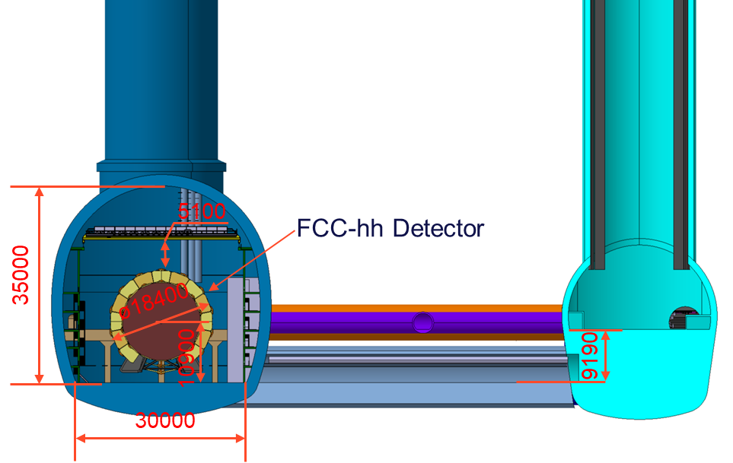
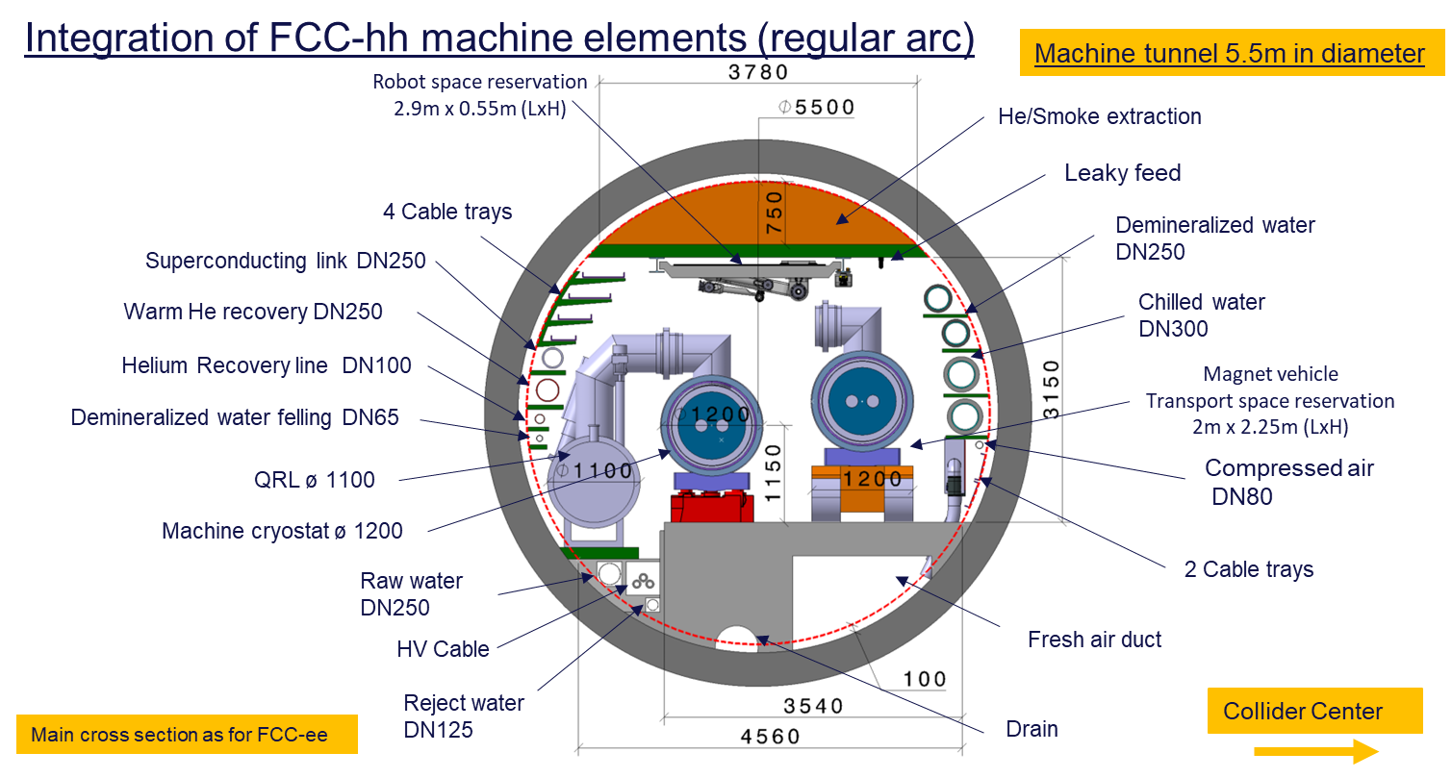
22.05.2025 / FCC Week
F. Valchkova-Georgieva EN-ACE-INT
  FCC-hh Underground Structure at point A

Slide 13
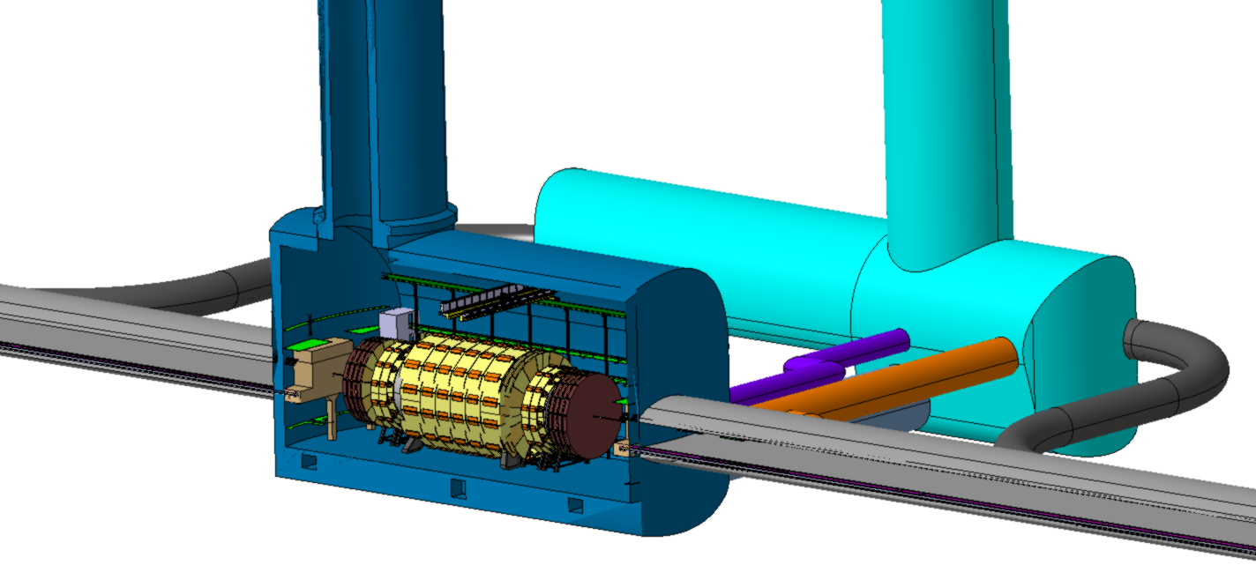
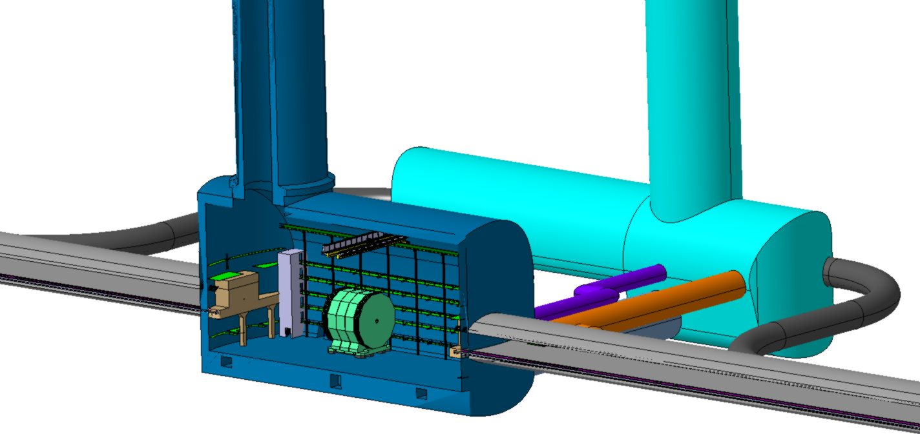
22.05.2025 / FCC Week
F. Valchkova-Georgieva EN-ACE-INT
  FCC Underground Structure at point A
  FCC-hh
  FCC-ee

Slide 14
22.05.2025 / FCC Week
F. Valchkova-Georgieva EN-ACE-INT
  Integration study of FCC-ee Beamstrahlung dump point A

Slide 15
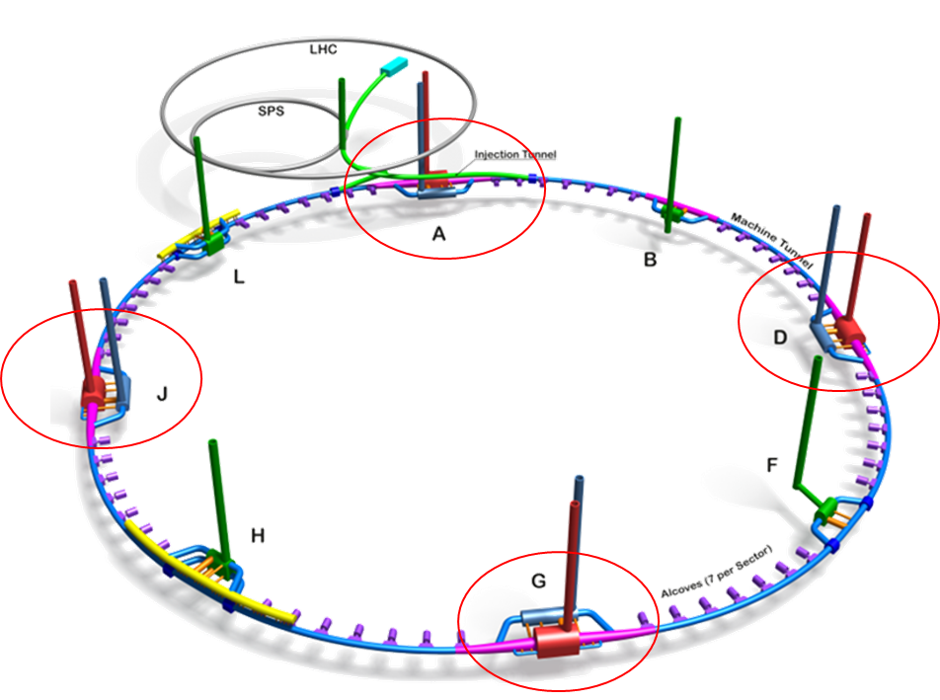
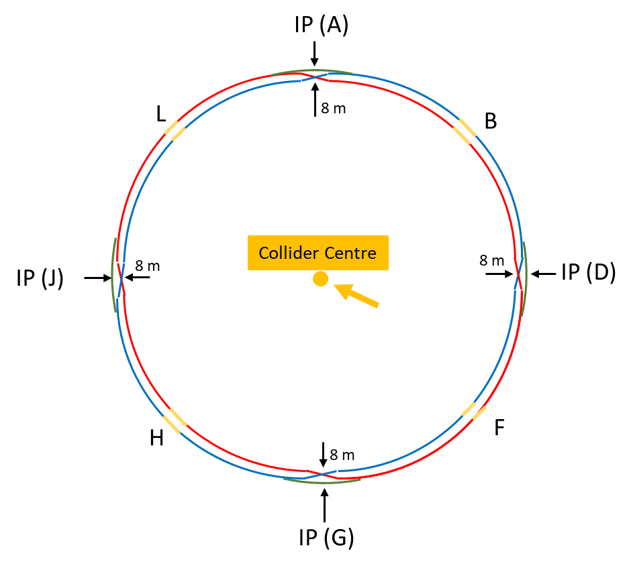
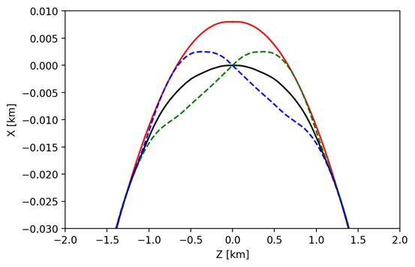
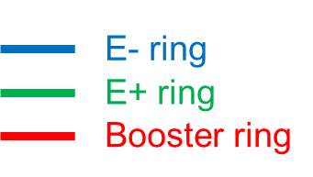
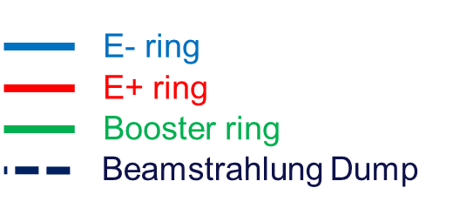
22.05.2025 / FCC Week
F. Valchkova-Georgieva EN-ACE-INT
  FCC-ee main and booster rings Layout
Courtesy K. Oide/ A. Chance
The separation of 3 rings is about 12.7m
Wide tunnel in necessary around the IP for 0.8 km

Slide 16
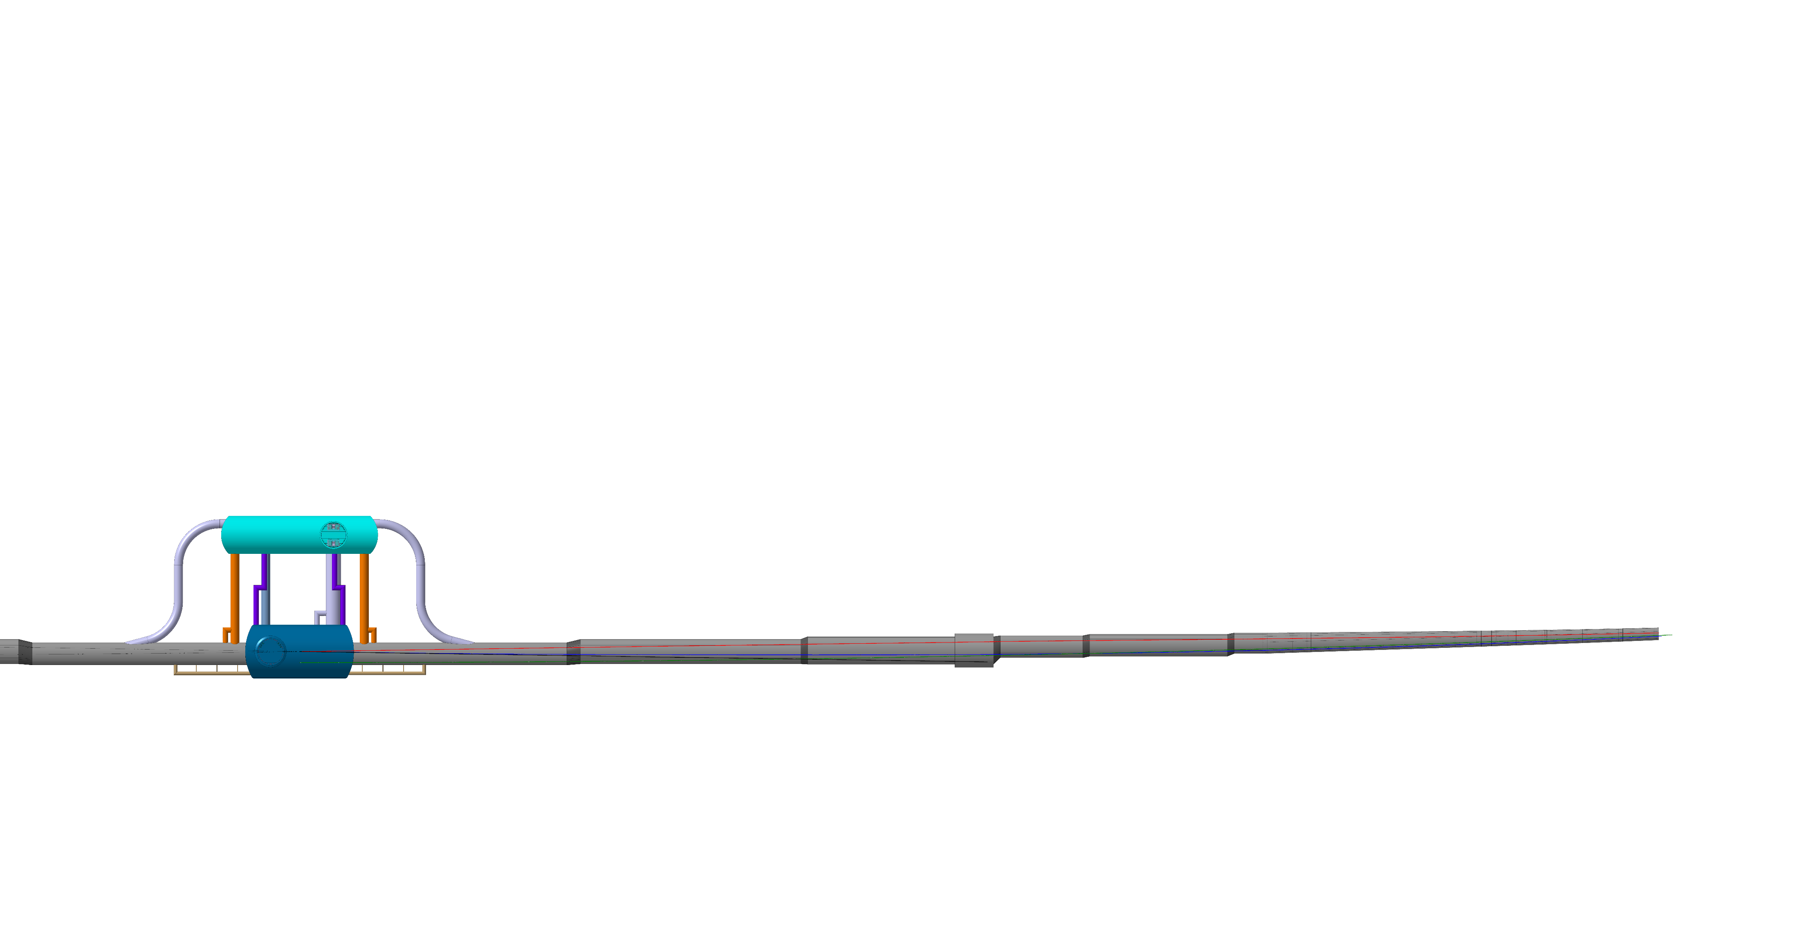
22.05.2025 / FCC Week
F. Valchkova-Georgieva EN-ACE-INT
  FCC-ee beamstrahlung dump integration at point A
IP
194m

Slide 17
22.05.2025 / FCC Week
F. Valchkova-Georgieva EN-ACE-INT
  FCC-ee beamstrahlung dump integration at point A
IP
364m

Slide 18
22.05.2025 / FCC Week
F. Valchkova-Georgieva EN-ACE-INT
  FCC-ee beamstrahlung dump integration at point A
IP
476m

Slide 19
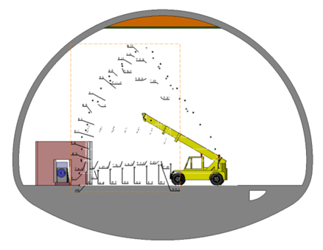
22.05.2025 / FCC Week
F. Valchkova-Georgieva EN-ACE-INT
  FCC-ee beamstrahlung dump integration at point A
IP
500m

Slide 20
22.05.2025 / FCC Week
F. Valchkova-Georgieva EN-ACE-INT
  FCC-ee Booster Injection at point A

Slide 21
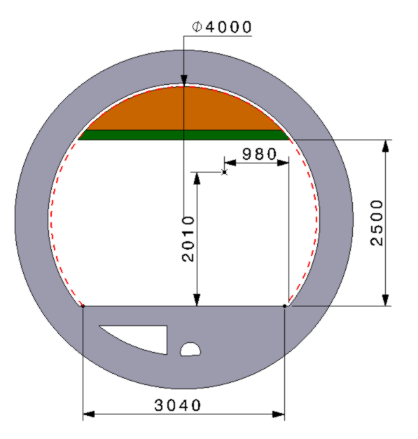
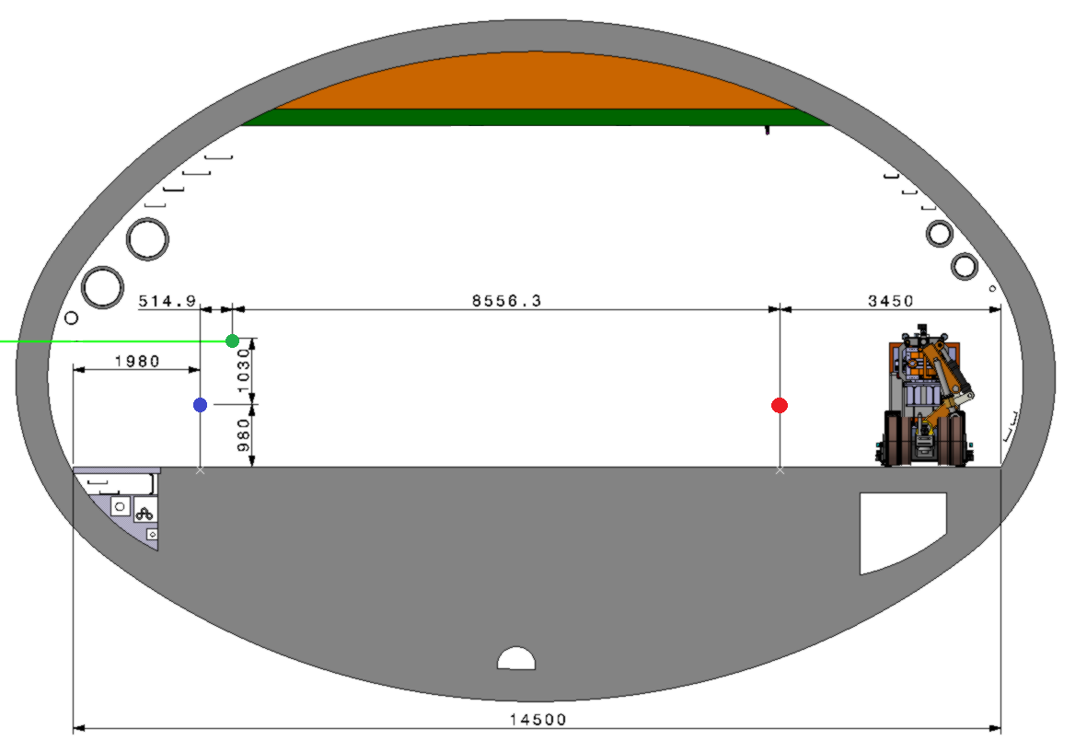
22.05.2025 / FCC Week
F. Valchkova-Georgieva EN-ACE-INT
  FCC-ee Booster injection integration at point A
Booster ring
Booster injection line
Booster injection line
E- ring
E+ ring
Booster Injection Line Tunnel
  Machine tunnel Section 5
693.3m
Evacuation Tunnel

Slide 22
22.05.2025 / FCC Week
F. Valchkova-Georgieva EN-ACE-INT
  FCC-ee Underground Structure point B
PLM References: https://plm.cern.ch/p/CAD/number:ST1875595_01
EDMS References: https://edms.cern.ch/document/3126005/1.0

Slide 23
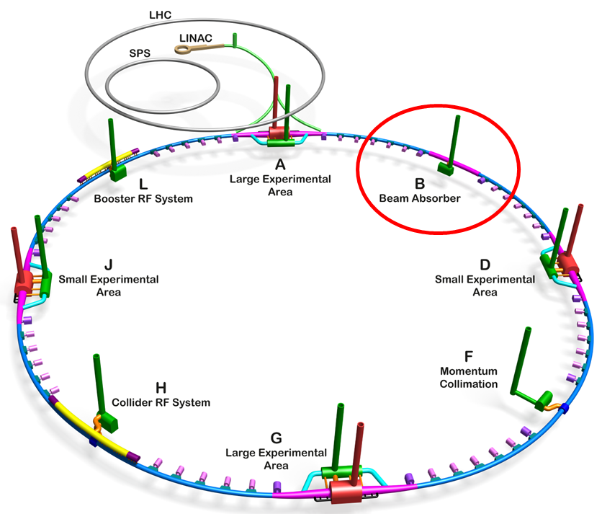
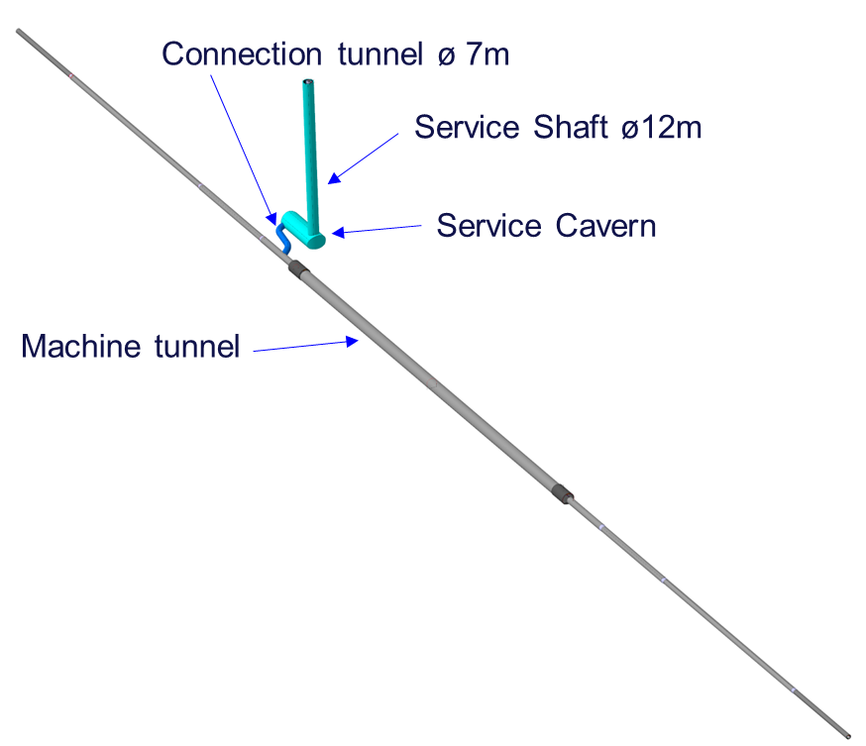
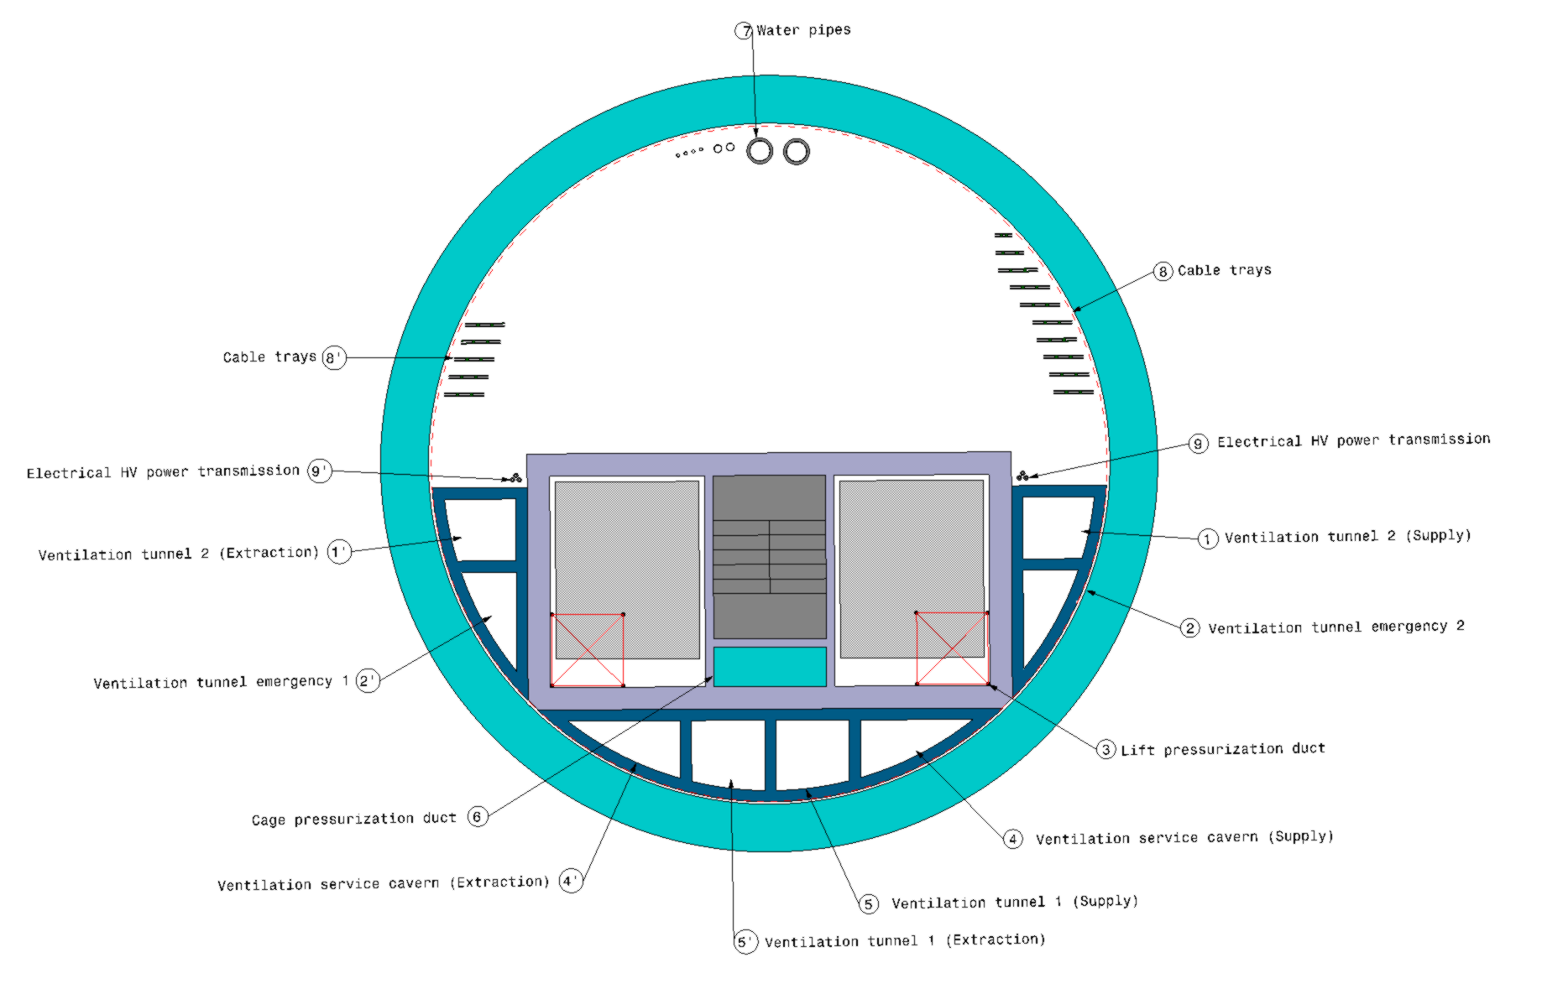
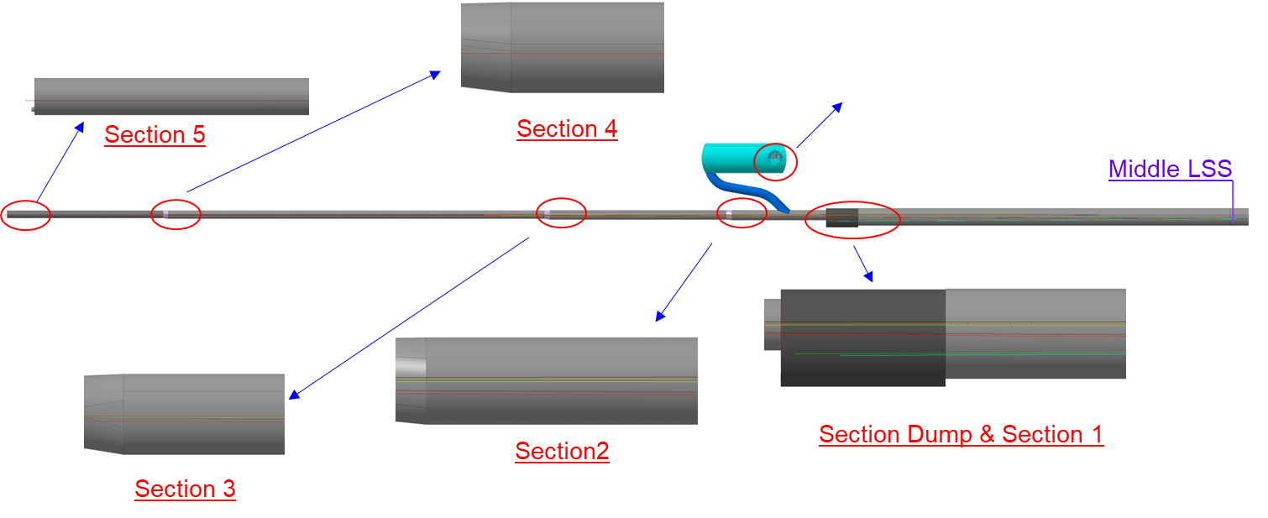
22.05.2025 / FCC Week
F. Valchkova-Georgieva EN-ACE-INT
  FCC-ee Underground Structure at point B
Collider dump electron
Booster dump electron
Collider dump positron
Booster dump positron
Collider injection & Dump positron
Booster extraction & Dump
Collider injection & Dump electron
  Service Shaft

Slide 24
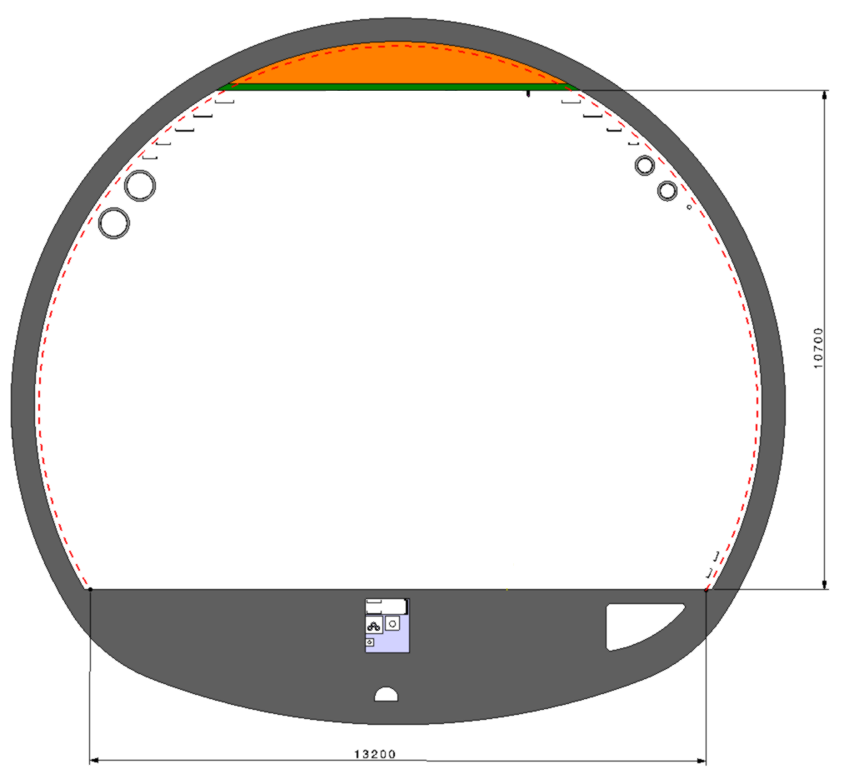
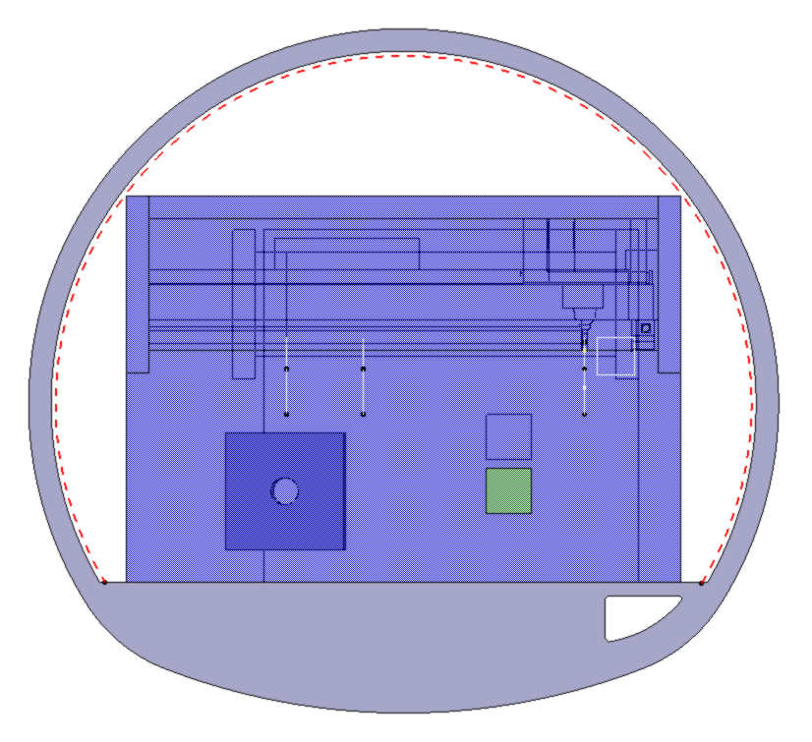
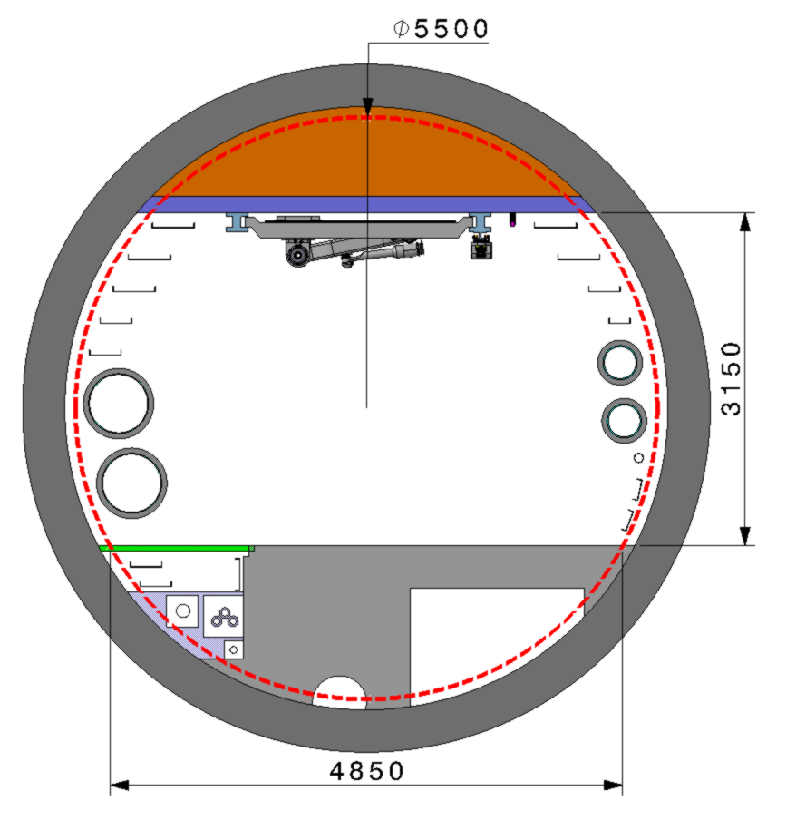






22.05.2025 / FCC Week
F. Valchkova-Georgieva EN-ACE-INT
  FCC-ee Underground Structure at point B
  Transport space occupation
  Section 5
  Section Dump
  Section 3
  Section 2
  Section 1
  Section 4
5
4
3
2
D
1
  Middle LSS
5m
5m
5m
138.5m
330m
155m
83m
28m
327m

Slide 25
22.05.2025 / FCC Week
F. Valchkova-Georgieva EN-ACE-INT
  FCC-ee Underground Structure
  point D and point J
PLM References: https://plm.cern.ch/p/CAD/number:ST1914309_01
EDMS References: https://edms.cern.ch/document/3126007/1.0

Slide 26




22.05.2025 / FCC Week
F. Valchkova-Georgieva EN-ACE-INT
  FCC Underground Structure at point D and point J
Service Shaft ø18m
Experiment Shaft ø15m

Slide 27


22.05.2025 / FCC Week
F. Valchkova-Georgieva EN-ACE-INT
  FCC-ee Underground Structure at point D and point J

Slide 28


22.05.2025 / FCC Week
F. Valchkova-Georgieva EN-ACE-INT
  FCC-hh Underground Structure at D and point J

Slide 29


22.05.2025 / FCC Week
F. Valchkova-Georgieva EN-ACE-INT
  FCC Underground Structure at D and point J
  FCC-hh
  FCC-ee

Slide 30
22.05.2025 / FCC Week
F. Valchkova-Georgieva EN-ACE-INT
  FCC-ee Underground Structure point F
PLM References: https://plm.cern.ch/p/CAD/number:ST1943583_01
EDMS References: https://edms.cern.ch/document/3126008/1.0

Slide 31


22.05.2025 / FCC Week
F. Valchkova-Georgieva EN-ACE-INT
  FCC-ee Underground Structure at point F
Accelerator tunnel
Service Shaft ø12m
Junction Cavern/Machine tunnel
Junction Cavern/Shaft
Connection tunnel ø 7m
Access Tunnel ø9m
Service Cavern

Slide 32


22.05.2025 / FCC Week
F. Valchkova-Georgieva EN-ACE-INT
204m
  FCC-ee Underground Structure at point F
  Service Shaft
540m
  Transport Tunnel
  Section Machine Tunnel

Slide 33
22.05.2025 / FCC Week
F. Valchkova-Georgieva EN-ACE-INT
  FCC-ee Underground Structure point G
PLM References: https://plm.cern.ch/p/CAD/number:ST1939652_01
EDMS References: https://edms.cern.ch/document/3136745/1.0

Slide 34



22.05.2025 / FCC Week
F. Valchkova-Georgieva EN-ACE-INT
  FCC-ee Underground Structure at point G
Service Shaft ø18m
Experiment Shaft ø18m

Slide 35

22.05.2025 / FCC Week
F. Valchkova-Georgieva EN-ACE-INT
  FCC Underground Structure at point G

Slide 36
22.05.2025 / FCC Week
F. Valchkova-Georgieva EN-ACE-INT
  Integration study of FCC alcove and transport Layby
PLM References:
FCC-ee Standard Big Alcove: https://plm.cern.ch/p/CAD/number:ST1947597_01
FCC-ee Big Alcove point A/point G: https://plm.cern.ch/p/CAD/number:ST1828012_01
FCC-ee Big Alcove point B: https://plm.cern.ch/p/CAD/number:ST1948847_01
FCC-ee Alcove ARC: https://plm.cern.ch/p/CAD/number:ST1950313_01
FCC-ee Arc Junction Small Parking Area: https://plm.cern.ch/p/CAD/number:ST1921399_01
FCC-ee Arc Junction Big Parking Area: https://plm.cern.ch/p/CAD/number:ST1921600_01
EDMS References: https://edms.cern.ch/document/3136752/1.0

Slide 37


22.05.2025 / FCC Week
F. Valchkova-Georgieva EN-ACE-INT
  FCC Alcove and transport Layby integration
Courtesy Jean-Paul Burnet
Schematic of the principle of cabling from the alcoves

Slide 38


22.05.2025 / FCC Week
F. Valchkova-Georgieva EN-ACE-INT
  FCC Alcove and transport Layby integration
  Electrical requirements for Small Alcoves:
  Electrical requirements for Big Alcoves:

Slide 39






22.05.2025 / FCC Week
F. Valchkova-Georgieva EN-ACE-INT
  FCC-ee Underground Structure Big Alcove point A and point G
Big Alcove 1st Level
Big Alcove 2nd Level
Booster Dipole. Magnet Circuit
Laser Hutch
Collider Dipole Magnet Circuit
Booster Quadrupole Magnet Circuit
Collider Quad. Magnet Circuit
Collider Quad. Magnet Circuit
Booster Quadrupole Magnet Circuit
HV Cubicles

Slide 40




22.05.2025 / FCC Week
F. Valchkova-Georgieva EN-ACE-INT
  FCC-ee Underground Structure Big Alcove point A
Section View
830m
Isometric View

Slide 41






22.05.2025 / FCC Week
F. Valchkova-Georgieva EN-ACE-INT
  FCC-ee Underground Structure Big Alcove point B
Big Alcove 1st Level
Big Alcove 2nd Level
Booster Dipole. Magnet Circuit
Collider Dipole Magnet Circuit
Booster Quadrupole Magnet Circuit
Collider Quad. Magnet Circuit
Collider Quad. Magnet Circuit
Booster Quadrupole Magnet Circuit
HV Cubicles

Slide 42




22.05.2025 / FCC Week
F. Valchkova-Georgieva EN-ACE-INT
  FCC-ee Underground Structure Big Alcove point B
Section View
Isometric View

Slide 43





22.05.2025 / FCC Week
F. Valchkova-Georgieva EN-ACE-INT
  FCC-ee Underground Structure Big Alcove at point F
Big Alcove 1st Level
Big Alcove 2nd Level
Booster Dipole. Magnet Circuit
HV Cubicles
Collider Dipole Magnet Circuit
Collider Quad. Magnet Circuit
Booster Quadrupole Magnet Circuit
Collider Quad. Magnet Circuit
Booster Quadrupole Magnet Circuit

Slide 44




22.05.2025 / FCC Week
F. Valchkova-Georgieva EN-ACE-INT
  FCC-ee Underground Structure Big Alcove at point F
Section View
Isometric View

Slide 45



22.05.2025 / FCC Week
F. Valchkova-Georgieva EN-ACE-INT
  FCC-ee Underground Structure Big Alcove at point D and point J
Section View
Isometric View

Slide 46




22.05.2025 / FCC Week
F. Valchkova-Georgieva EN-ACE-INT
  FCC-ee Underground Structure Small Alcove in the Arc

Slide 47




22.05.2025 / FCC Week
F. Valchkova-Georgieva EN-ACE-INT
  FCC-ee Underground Structure Small Alcove in the Arc
Small Alcove with Small Parking Area
Small Alcove with Big Parking Area
Small Parking Area
Big Parking Area

Slide 48
22.05.2025 / FCC Week
F. Valchkova-Georgieva EN-ACE-INT
  Conclusion
Integration of all underground infrastructures for FCC-ee and FCC-hh are under study (pre-TDR phase)
Two optics families should be compared: GHC (Oide-san), LCC (P. Raimondi). Today the integration study is based on GHC optic
The integration studies will continue to evolve addressing the stakeholder requirements in order to provide preliminary 3D models to the civil engineering design office for the overall FCC underground areas, including detectors, accelerators, services, transfer lines, and access tunnels by December 2025.

Slide 49

I would like to acknowledge the FCC Technical Infrastructure Coordination team and the FCC Accelerator Technology team for their input and support in the integration studies.
22.05.2025 / FCC Week
F. Valchkova-Georgieva EN-ACE-INT
49

Slide 50
Thank you for your attention.
22.05.2025 / FCC Week
F. Valchkova-Georgieva EN-ACE-INT
50

