Slide 1
Review of the safety concept: pre-TDR roadmap
22/05/2025 FCC Week
A. Henriques
FCC Week 2025
22/05/2025

Slide 2
Review of the safety concept: pre-TDR roadmap
22/05/2025 FCC Week
gratefully acknowledging the contributions of the FCC Safety WP members:
Ghislain Roy
Giacomo Lavezzari
Guven Nergiz
Markus Widorski
Oriol Rios
Pavol Vojtyla
Thomas Otto
Tomasz Ladzinski
… and the TIWG WG

Slide 3

Outline
Safety concept – recap
Review of the Safety Concept
  Internal
  External
Review – UK Health & Safety Executive
Safety WP – pre-TDR
  Tasks
  Master plan
Conclusion

Slide 4
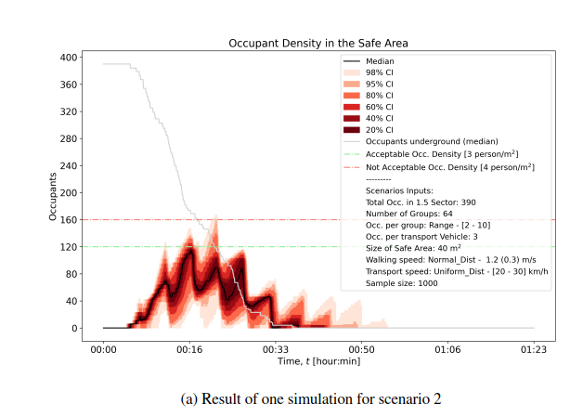
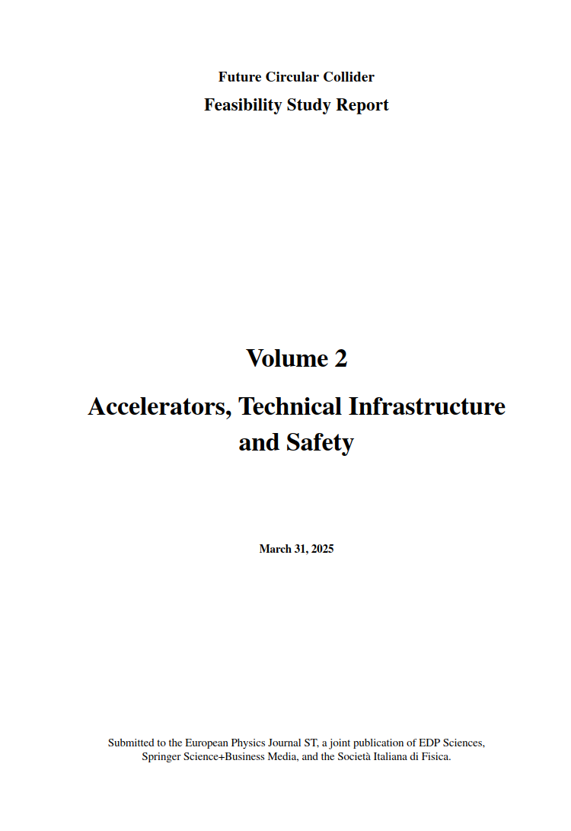
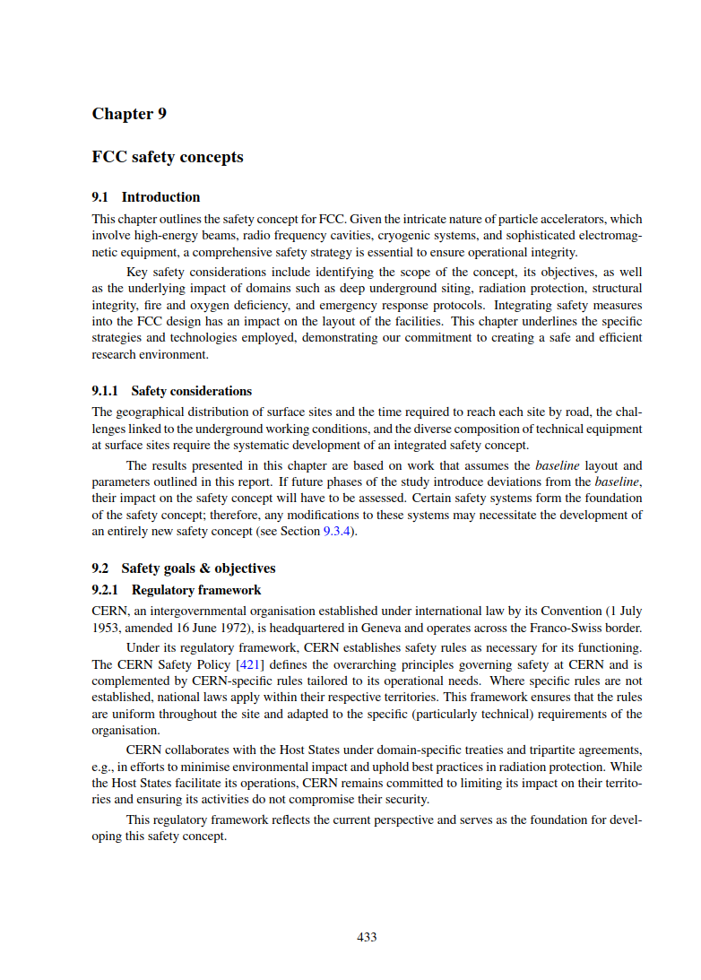
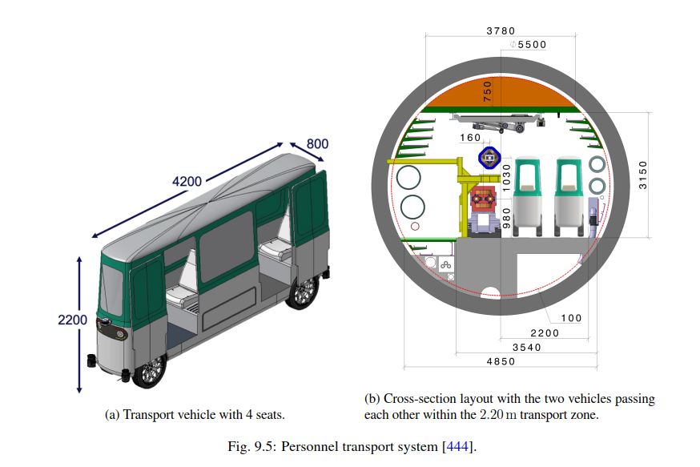
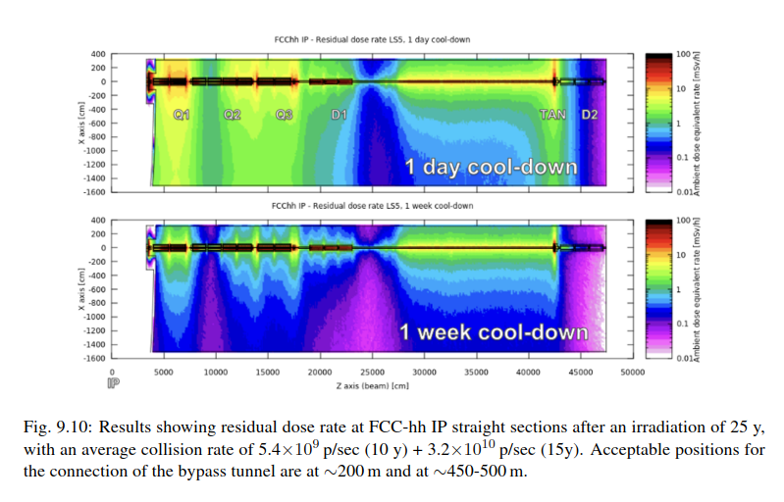
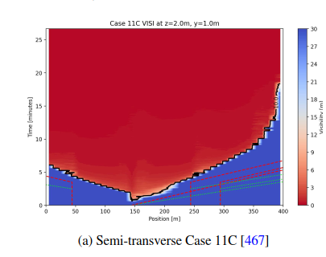
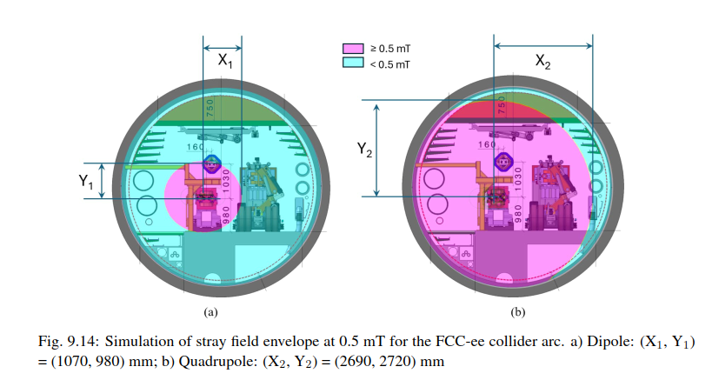
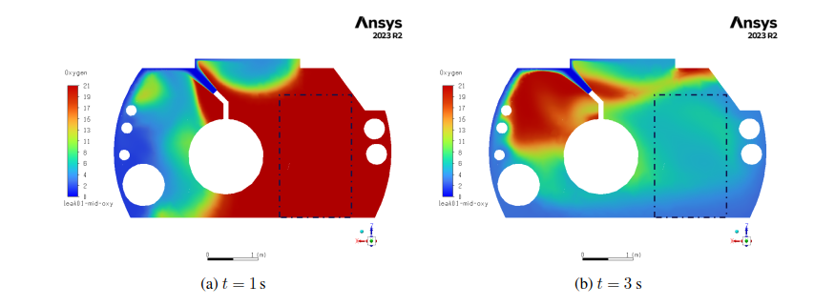
FCC Feasibility Study – Safety concept
~40% of Technical Infrastructure sections
See Safety talks

Slide 5
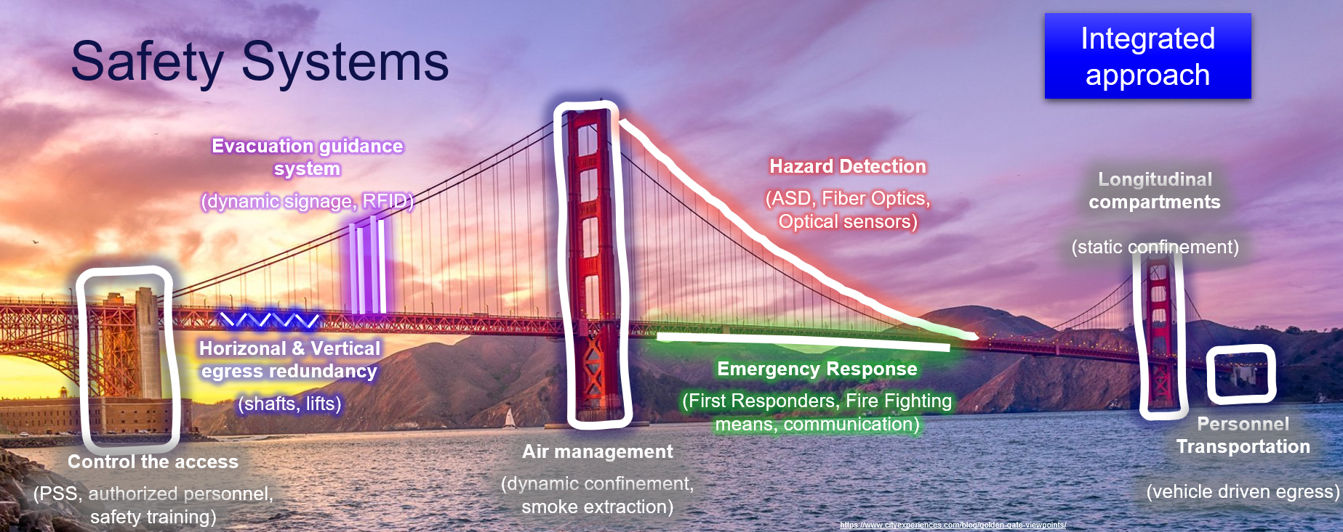
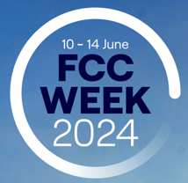
Safety Concept - recap

Slide 6
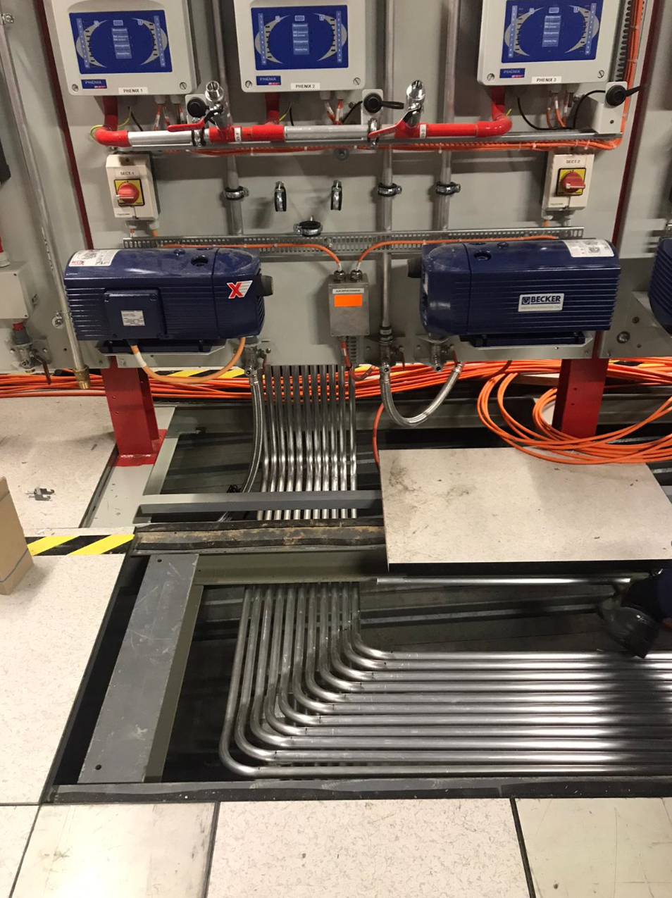
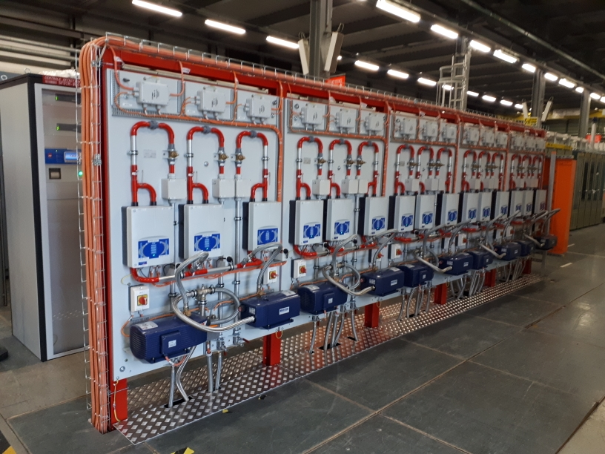

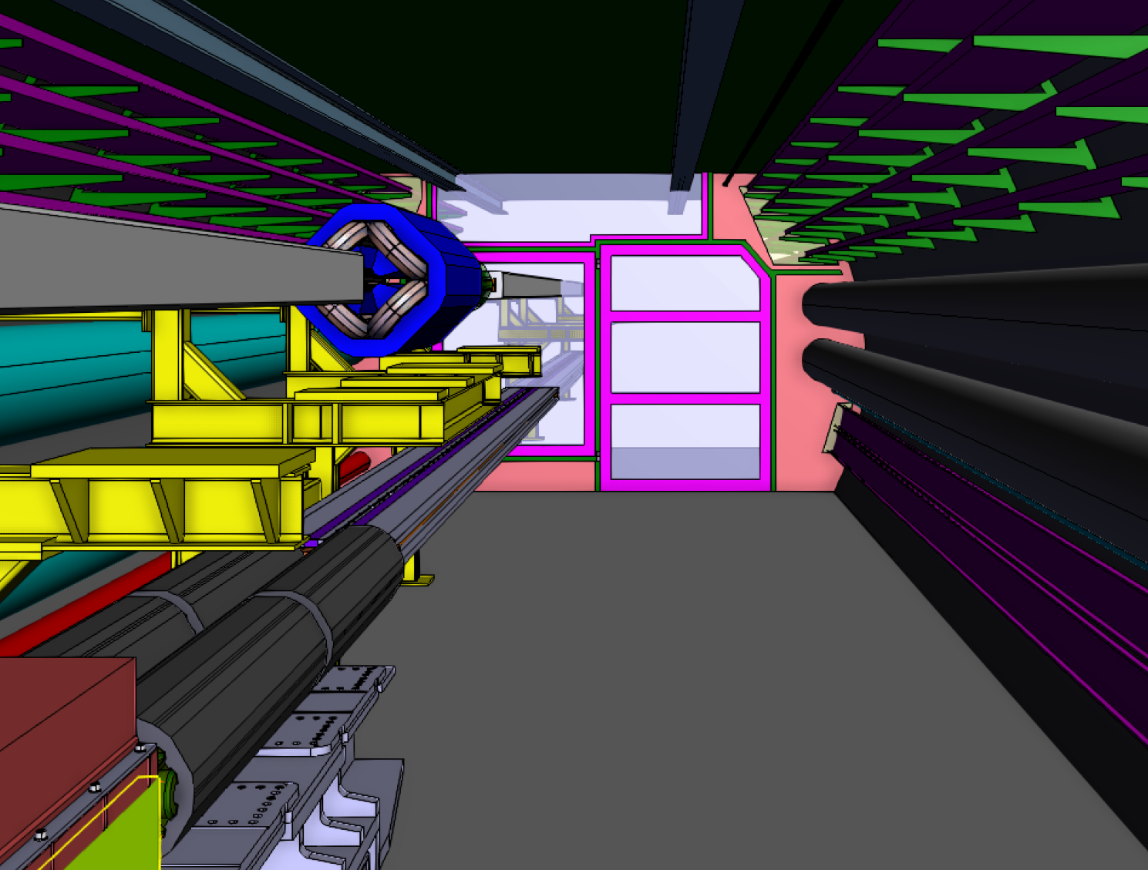
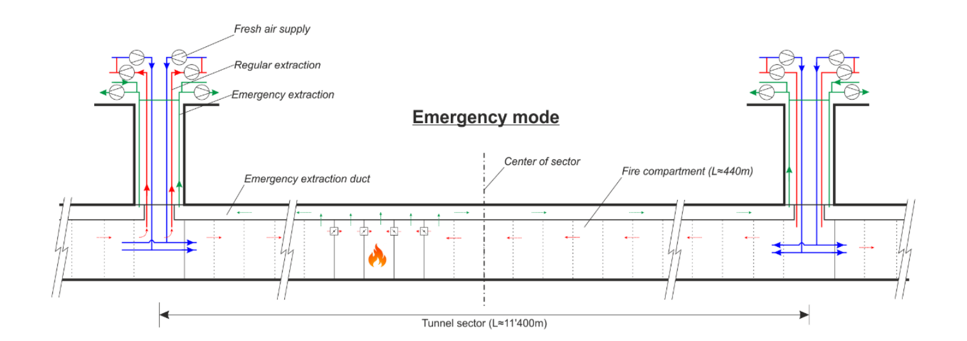
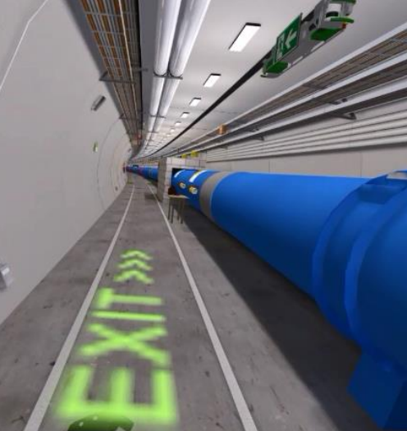
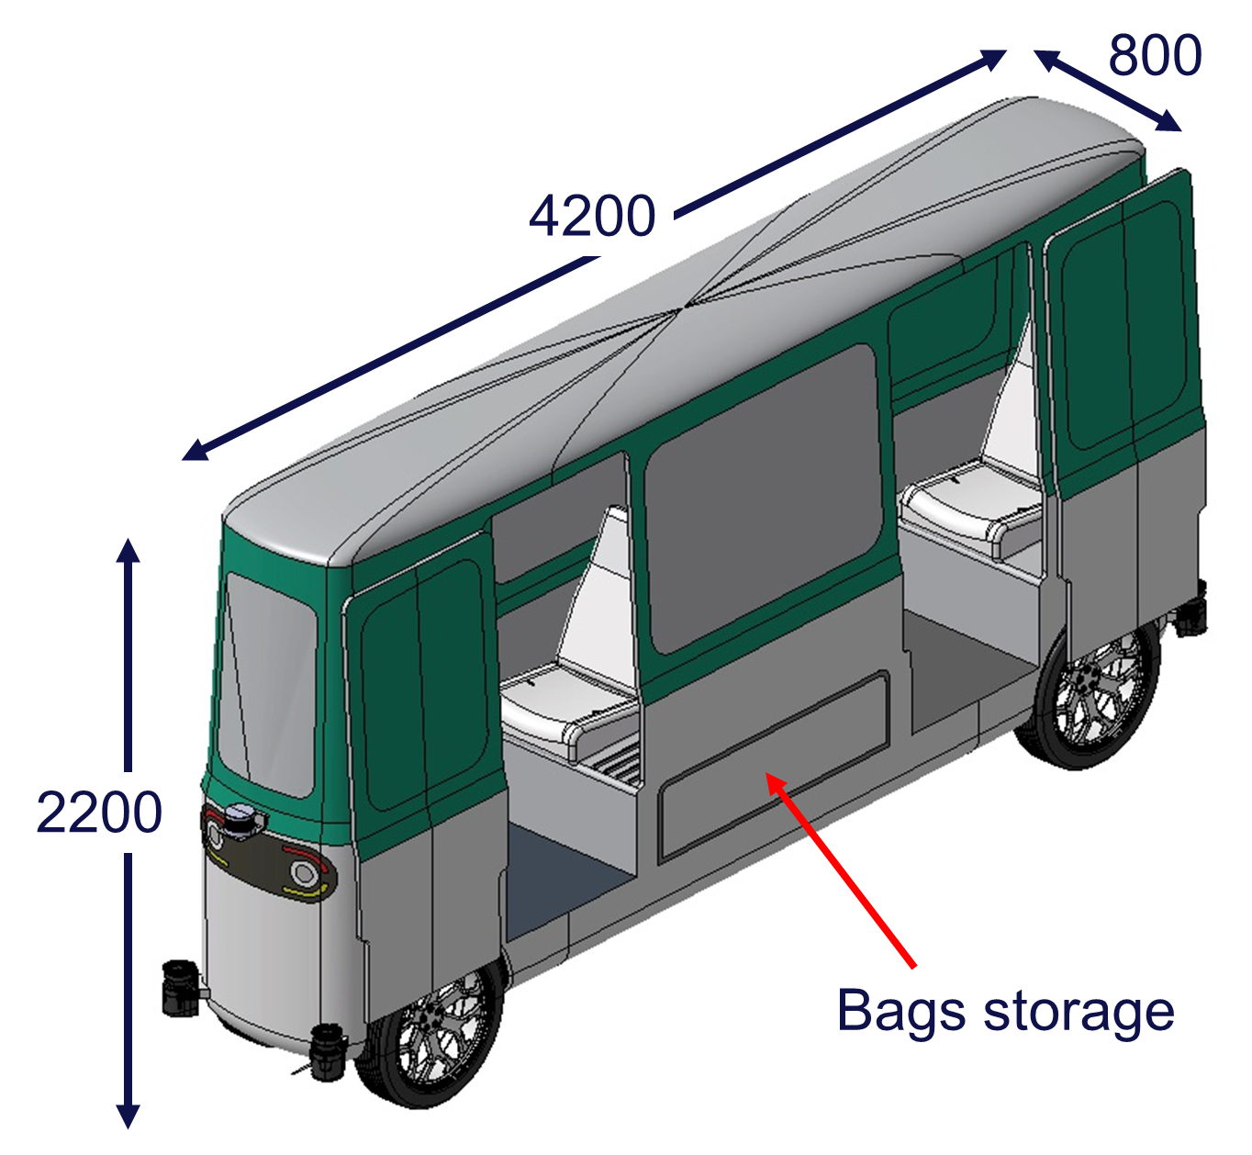
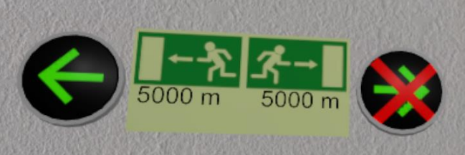
Safety Concept - recap
Hazard detection
Longitudinal compartments
Horizonal & Vertical egress redundancy
Evacuation guidance system
Emergency Response
Access control
Air management
Egress / Personnel Transportation
Integrated approach

Slide 7

Review of the Safety Concept – Internal
MTR
Source: https://indico.cern.ch/event/1369398/#8-communications

Slide 8
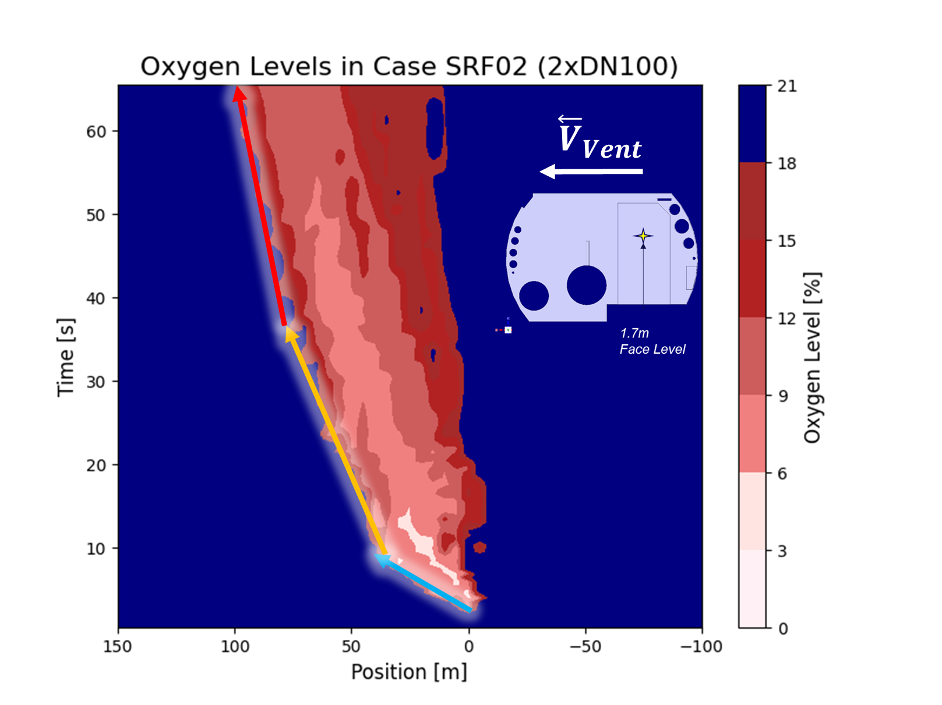


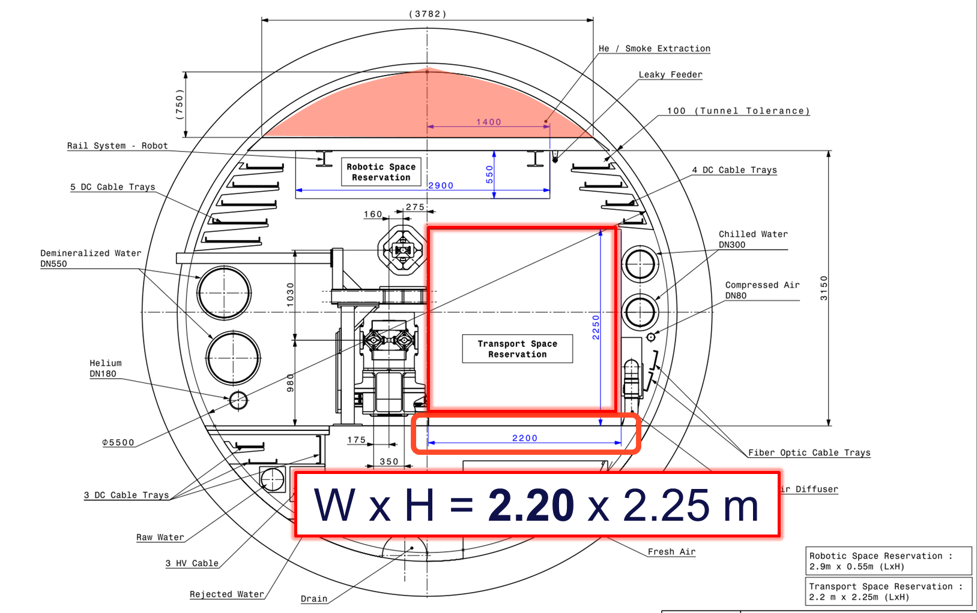
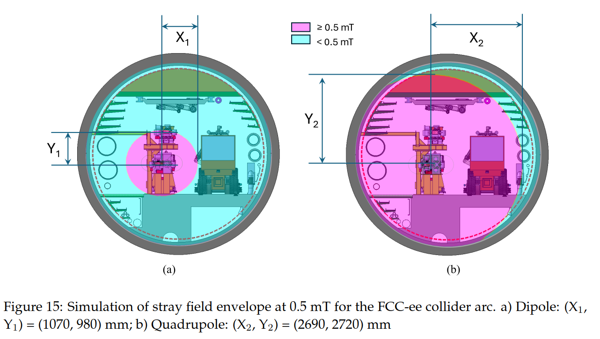
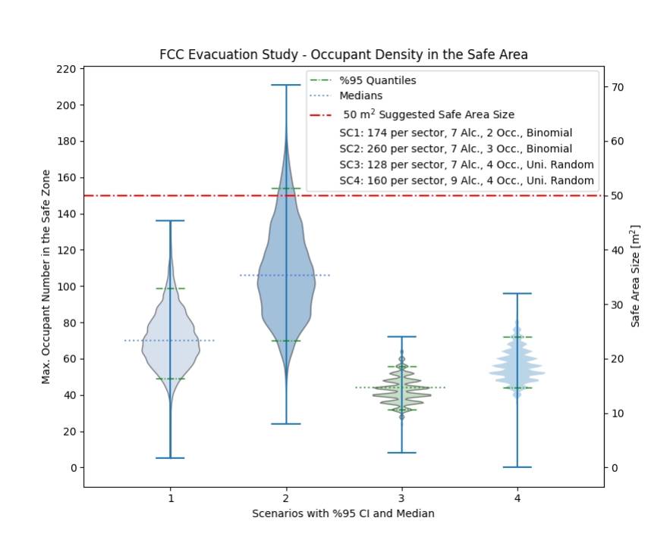
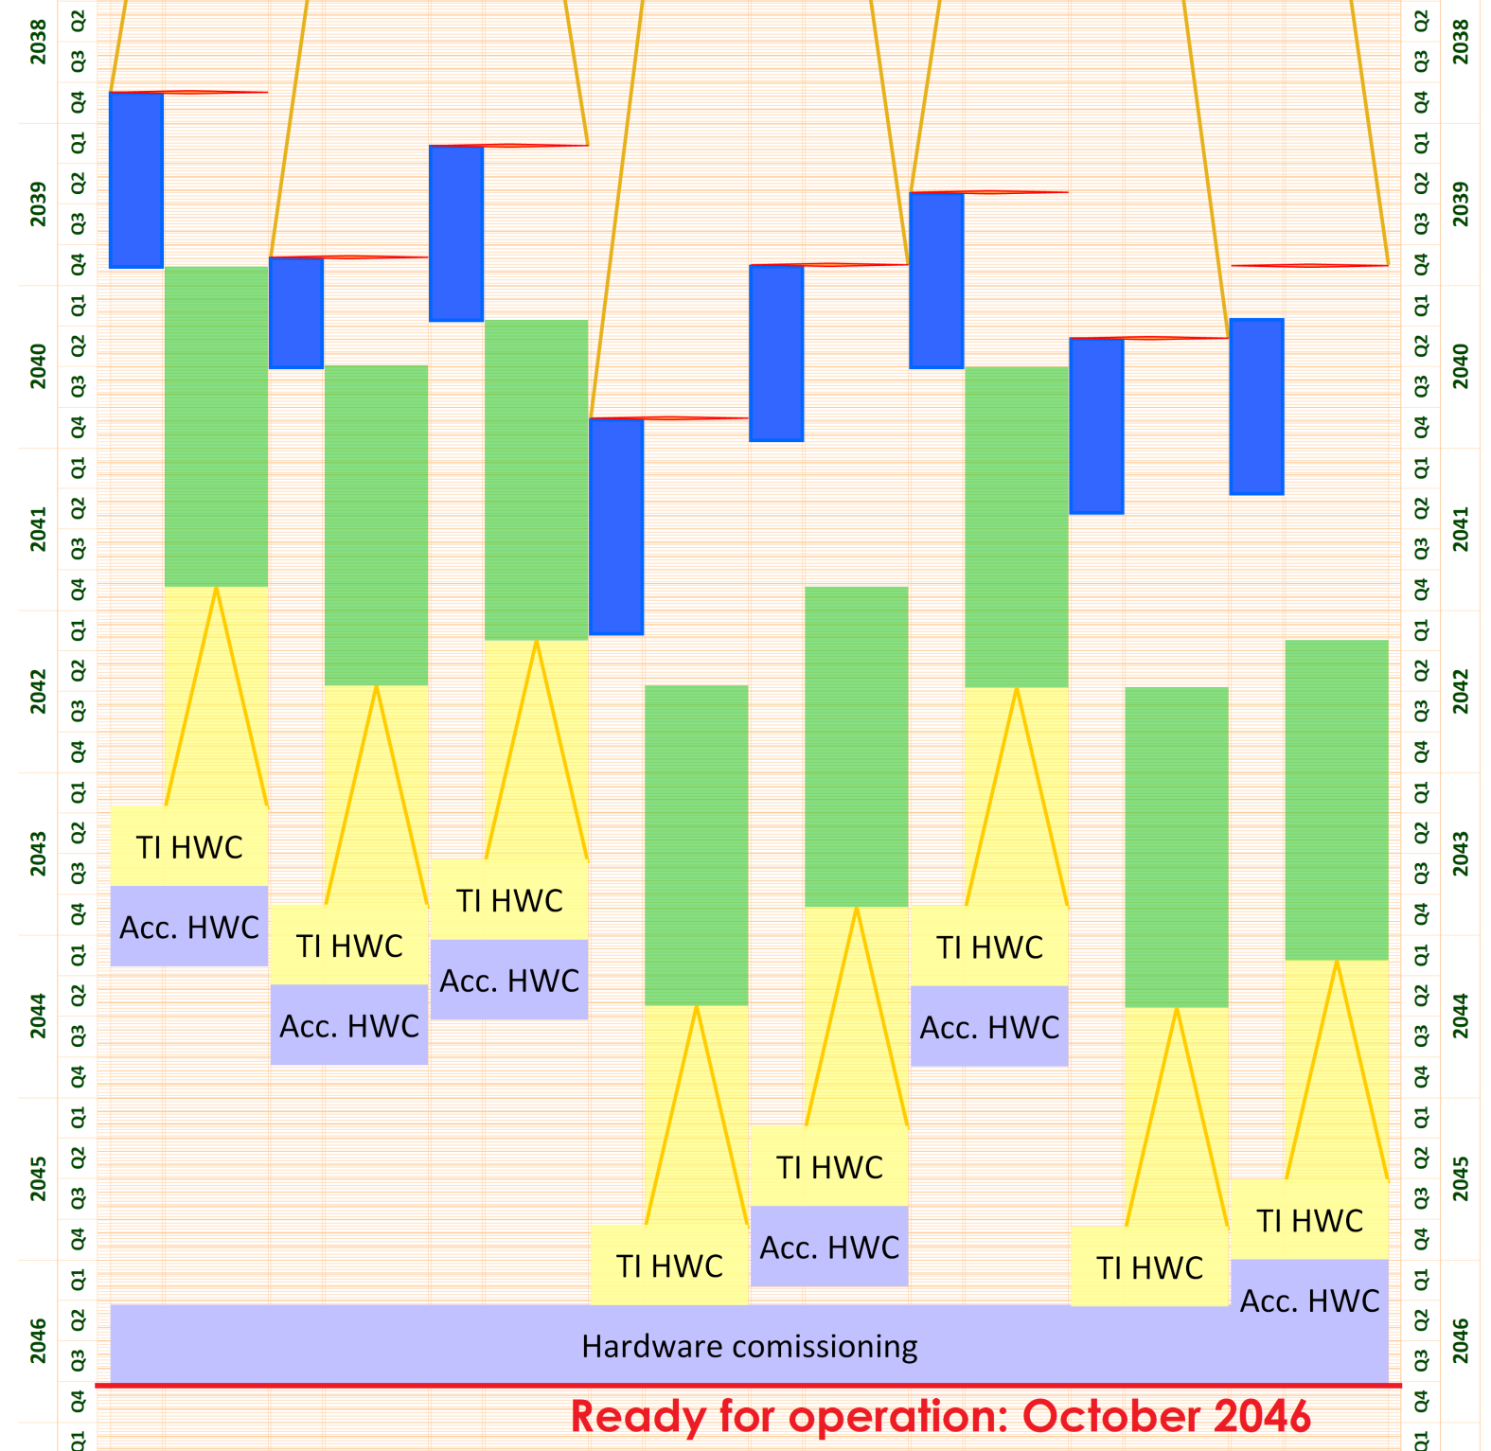
Review of the Safety Concept – Internal

Slide 9

Review of the Safety Concept – Internal
SAC
External review

Slide 10
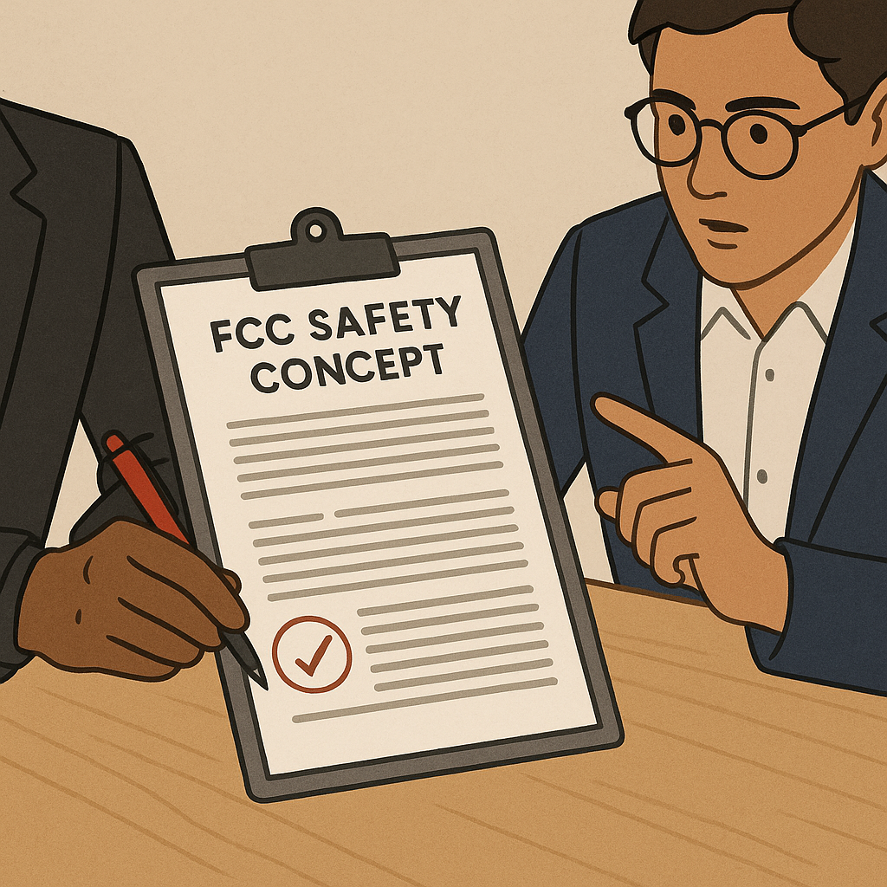

Review of the Safety Concept – External
Notified body in the member states
Multi-disciplinary team
Experience in large infrastructure projects
Obj #1: Identifying any showstoppers
SPC action: Carry out (…) a risk analysis by external consultant to verify that no important changes (…) are required.

Slide 11

Review of the Safety Concept – External
Notified body in the member states
Multi-disciplinary team
Experience in large infrastructure projects
Obj #1: Identifying any showstoppers
SPC: Carry out (…) a risk analysis by external consultant to verify that no important changes (…) are required.
Page 1 / 99
Obj #2: Identify improvements

Slide 12
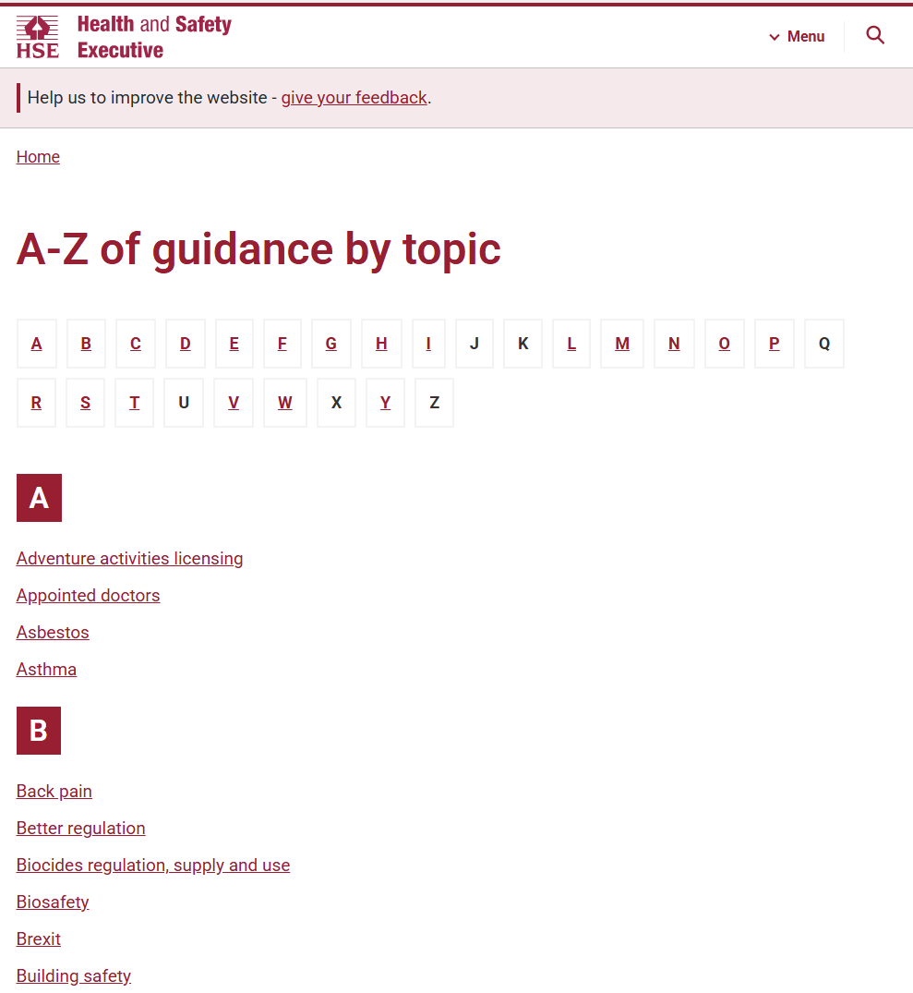

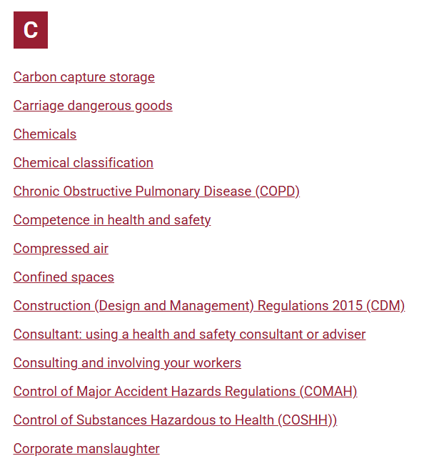
Review of the Safety Concept – HSE UK
Britain’s statutory regulator of occupational health and safety
https://www.hse.gov.uk/guidance/topics.htm

Slide 13
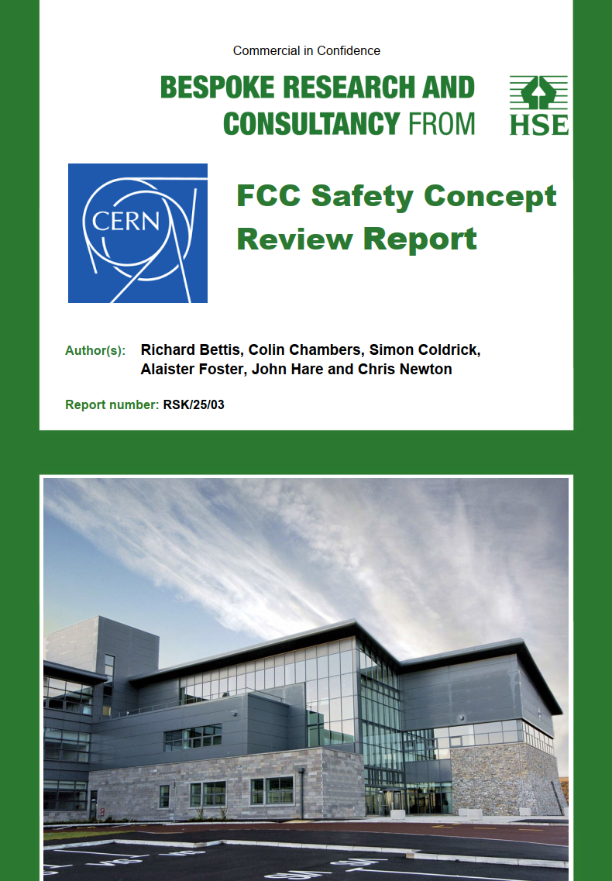
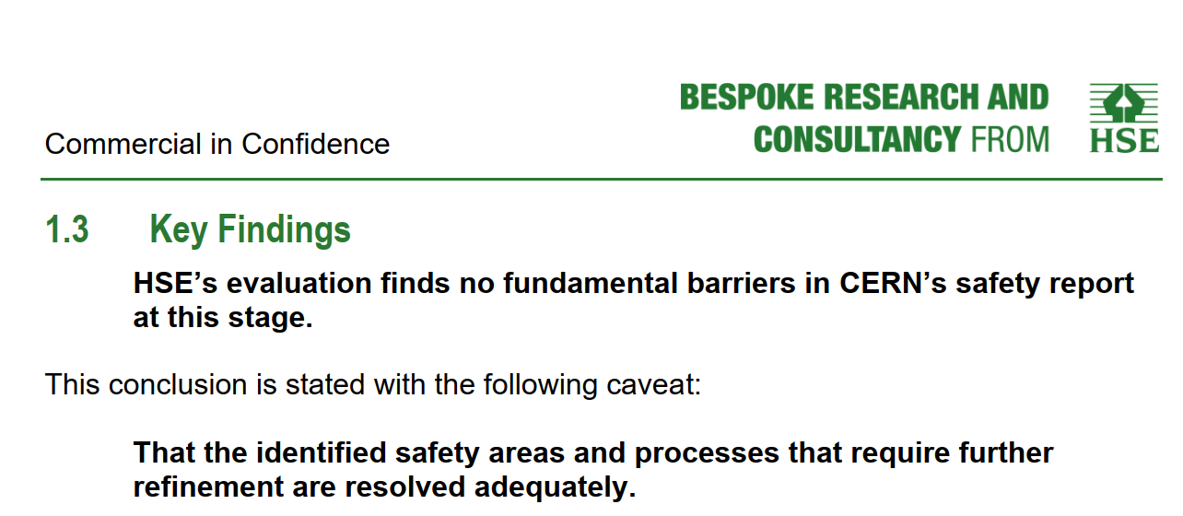
Review – UK HSE
Review of all safety domains, except Radiation Protection
Objective #1
Objective #2
Conclusions:
Following HSE’s (UK) assessment of the CERN Future Circular Collider (FCC) concept safety case, HSE (UK) have identified several areas that require further refinement to address potential concerns. CERN’s responses [2] reflect a commitment to resolving these issues. CERN have indicated that certain matters have been or will be addressed and as such HSE’s evaluation finds no fundamental barriers in the concept safety report at this stage. However, this determination is subject to the consideration of HSE’s comments and recommendations.
https://edms.cern.ch/document/3296700/1

Slide 14
Review – UK HSE
Objective #2 - TODOs
Enhanced risk assessments and scenario modelling:
- “What if” scenarios
Fire / ODH and ventilation interaction studies
Expand evacuation plan / studies
Single point failure mitigation in electrical secure power network
Impact on design changes and technology updates
https://edms.cern.ch/document/3296700/1
pre-TDR tasks

Slide 15
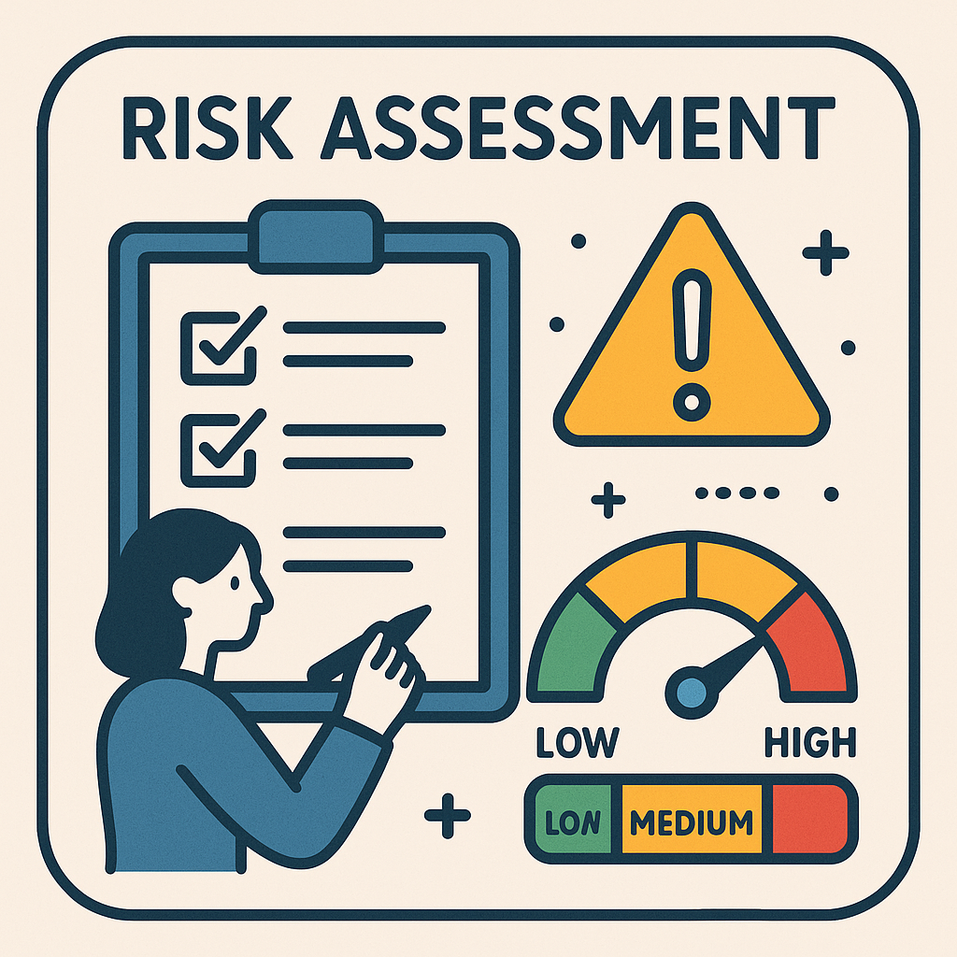
Safety WP – pre-TDR
See Safety talks
“What if” scenarios
Failure of Compartment Doors
Door closed during evacuation
Lift Failure
Smoke Extraction Failure
Delayed Fire Detection
Failure in MV Network
Evacuation Alarm Failure
Definition of MCI for SRF
Power Loss
Autonomous Vehicle Malfunction
Vehicle Fire in Alcoves
Blocked Escape Routes During Installation phase
Panic / victims
Seismic hazard
First task: HAZOP / HAZIDs for all safety domain

Slide 16
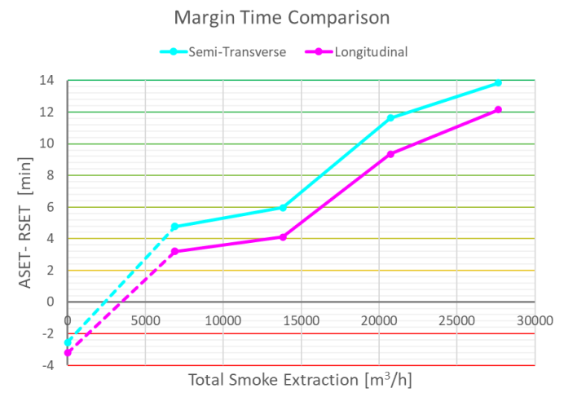


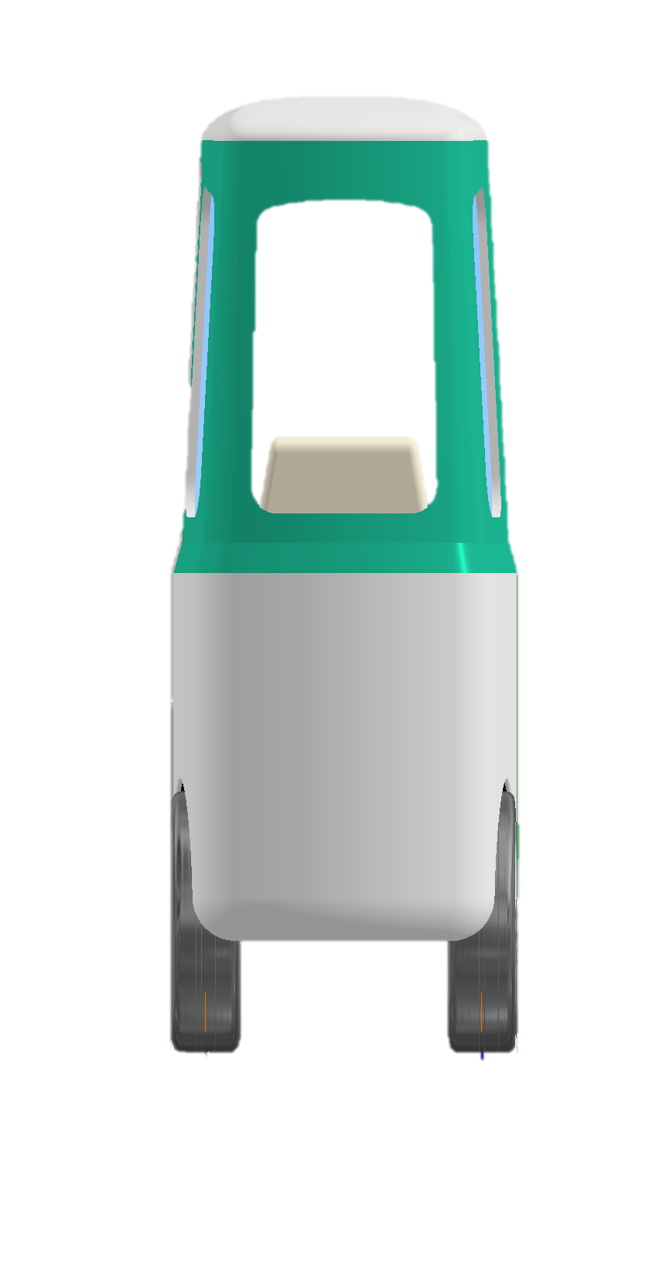
Safety WP – pre-TDR
“What if” scenarios - examples
Door closed during evacuation
Smoke Extraction Failure
O. Rios et al, FCC Week 2024
See “Reviewed fire safety concept and future studies”,
O. Rios

Slide 17
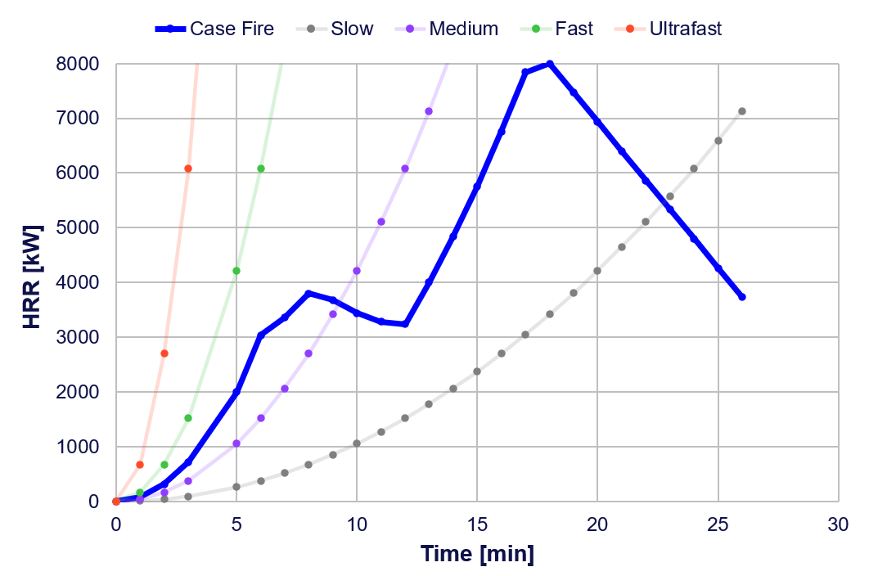
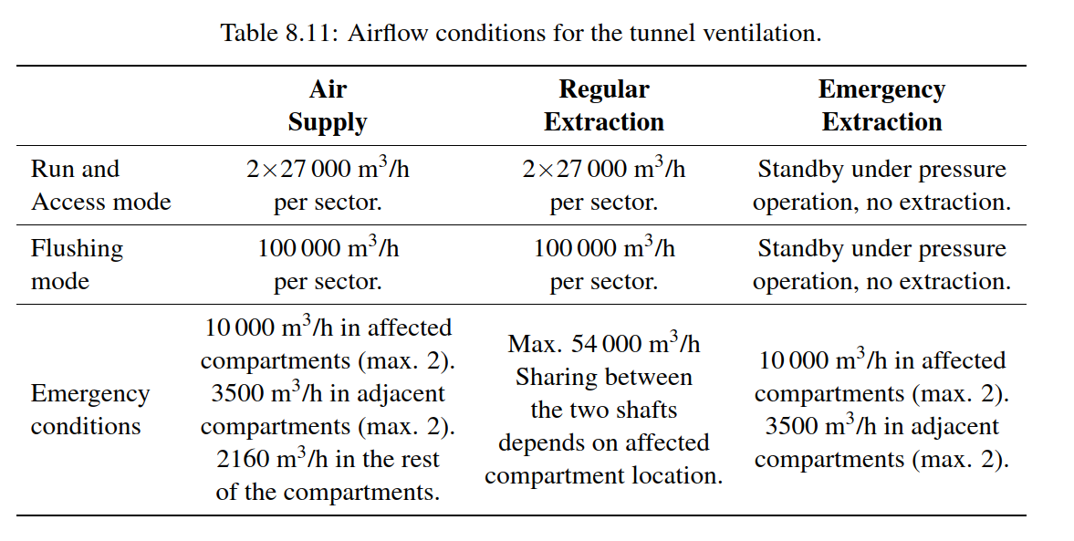
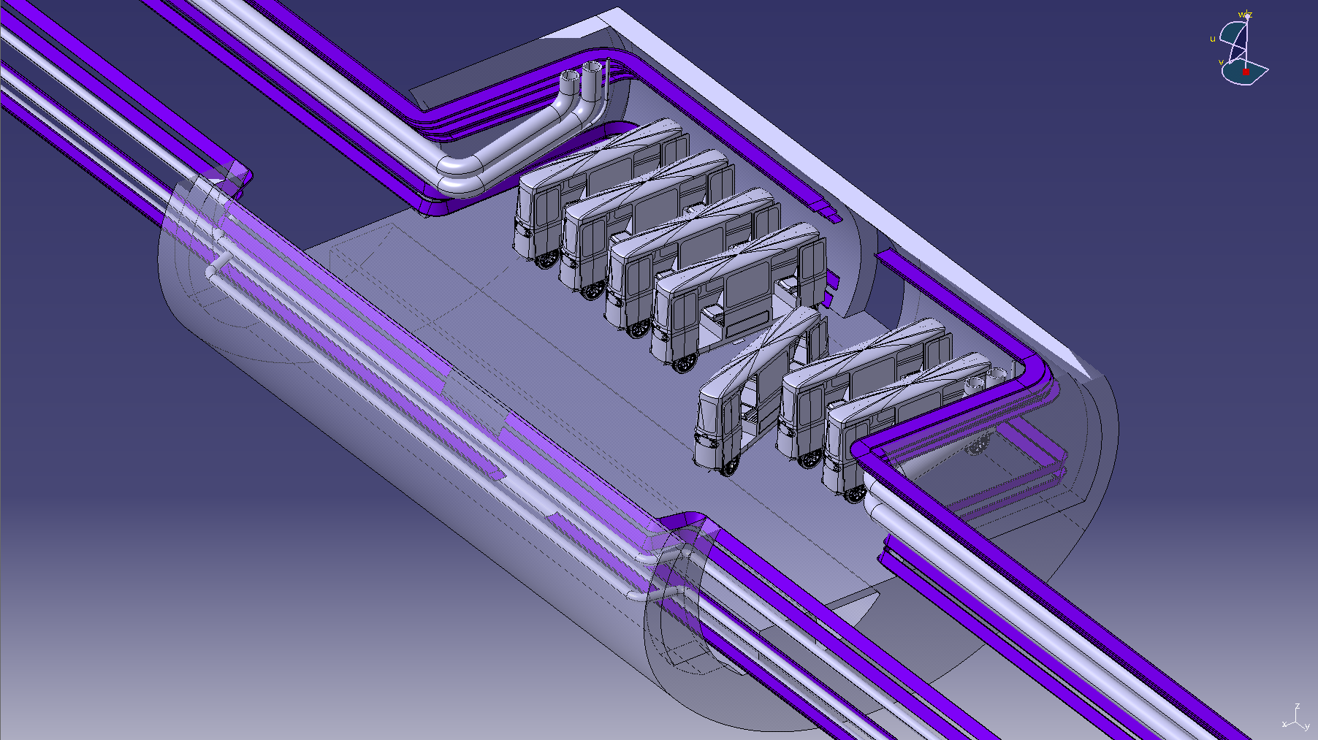
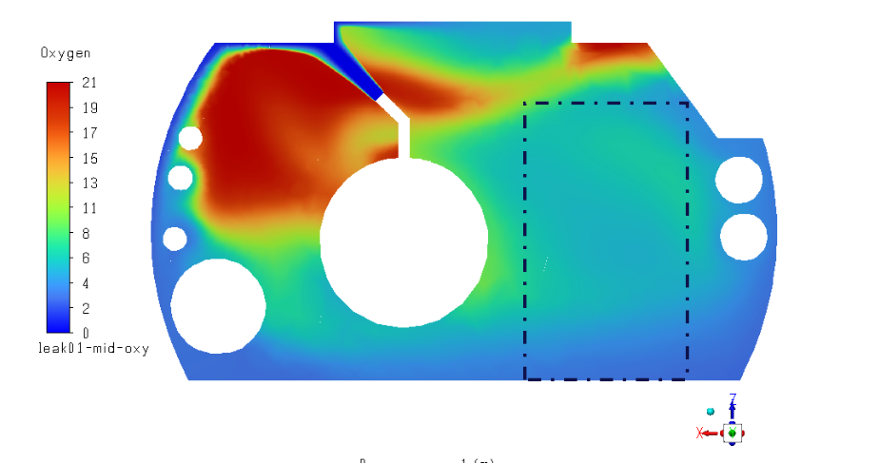

Safety WP – pre-TDR
Fire / ODH and ventilation interaction studies
FCC Feasibility Study report, Vol II
O. Rios et al, FCC Week 2024
See “ODH simulations”,
G. Nergiz
D. Lafarge et al.

Slide 18
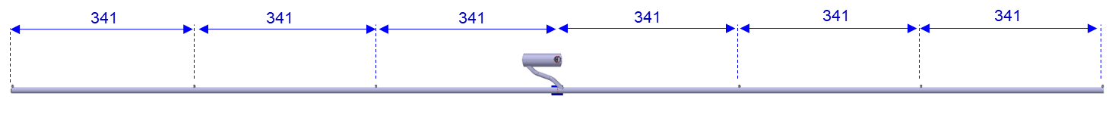
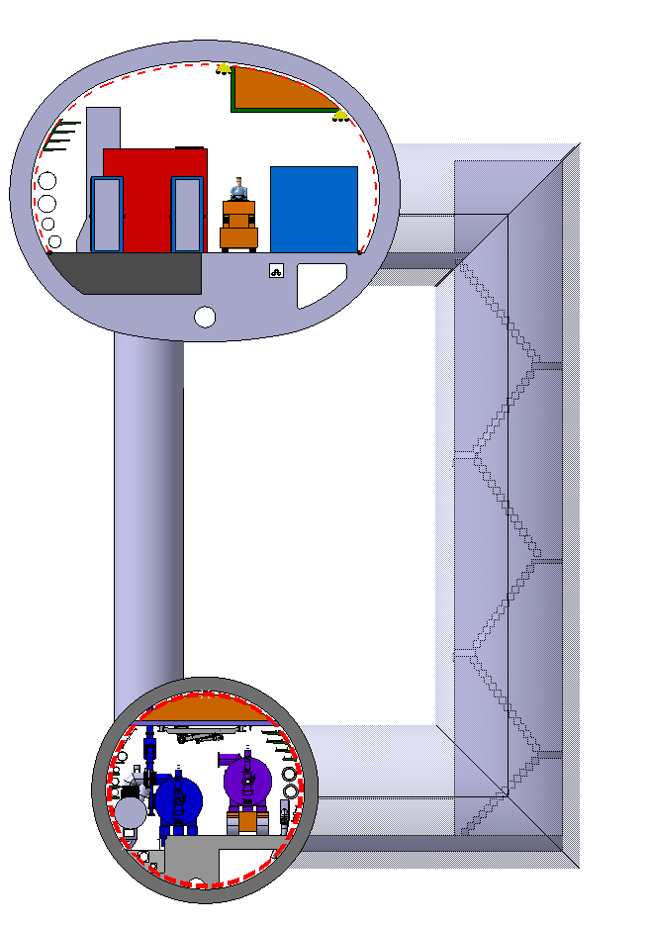
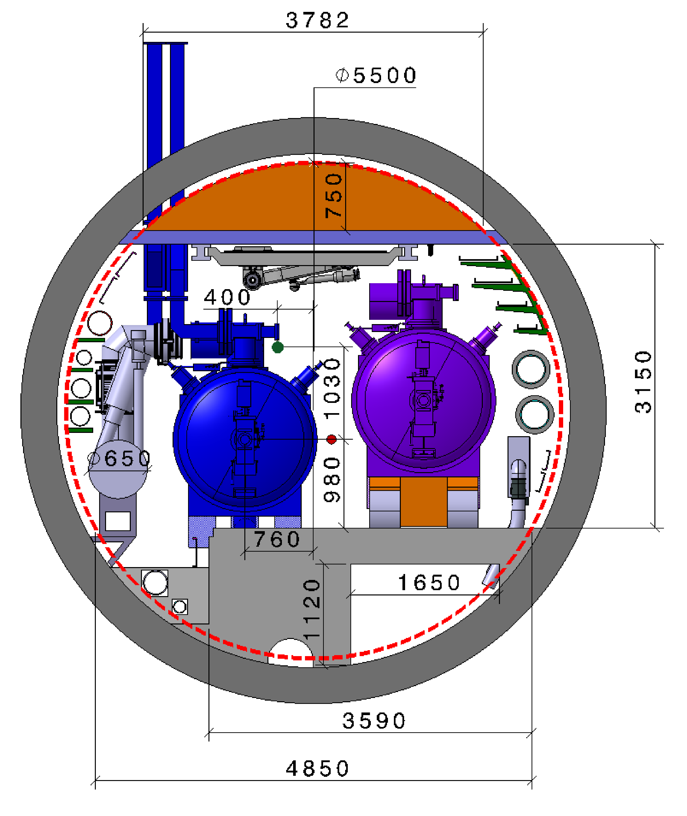
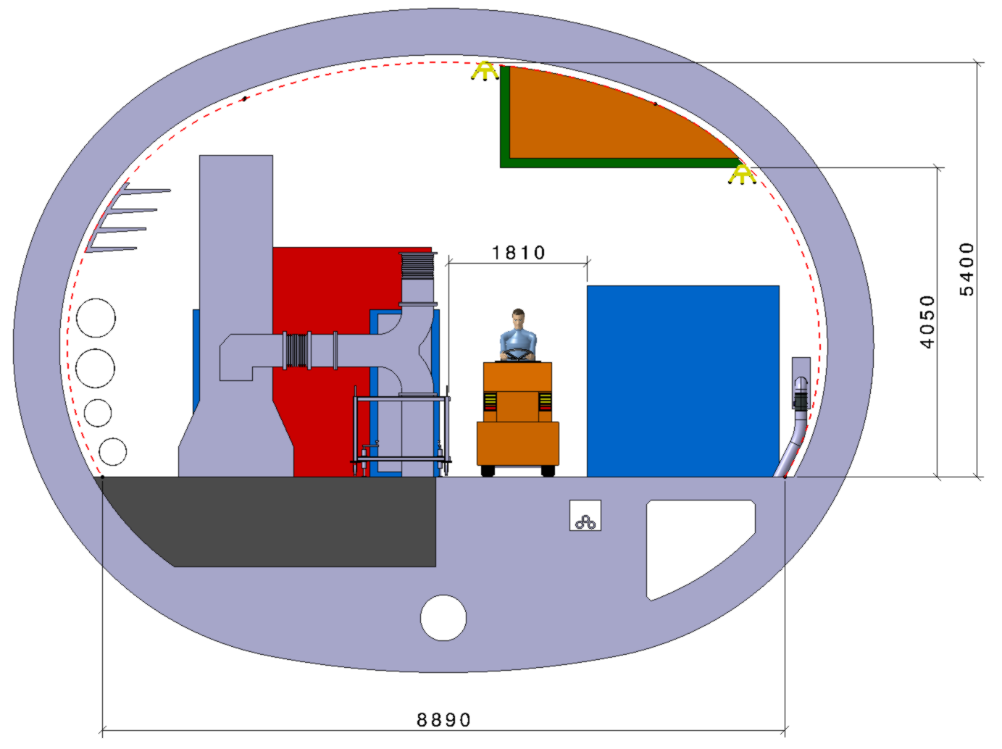

Safety WP – pre-TDR
Expand evacuation plan / studies
RF sectors
W x H = 2.20 x 2 m
F. Valchkova-Georgieva
R. Rinaldesi, FCC Week 2024

Slide 19
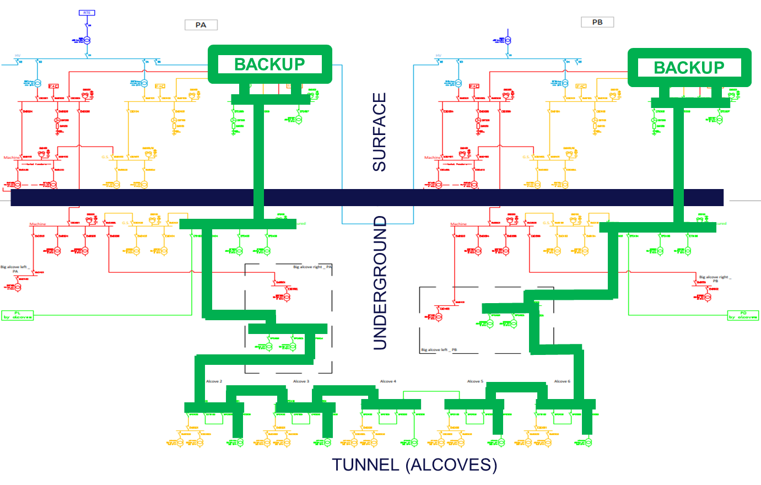
Safety WP – pre-TDR
Single point failure mitigation in electrical secure power network
Secured and uninterruptible network distribution in the tunnel in MV
Use the same link (20 kV) for general services AND safety systems
Load shedding logic in case of power outage - risk assessment required
Power unavailability: 10-30 s
MV line, cables and equipment (switches, etc) in tunnel = safety standards
C. Marcel,
FCC Week 2025
FCC Feasibility Study report, Vol II

Slide 20
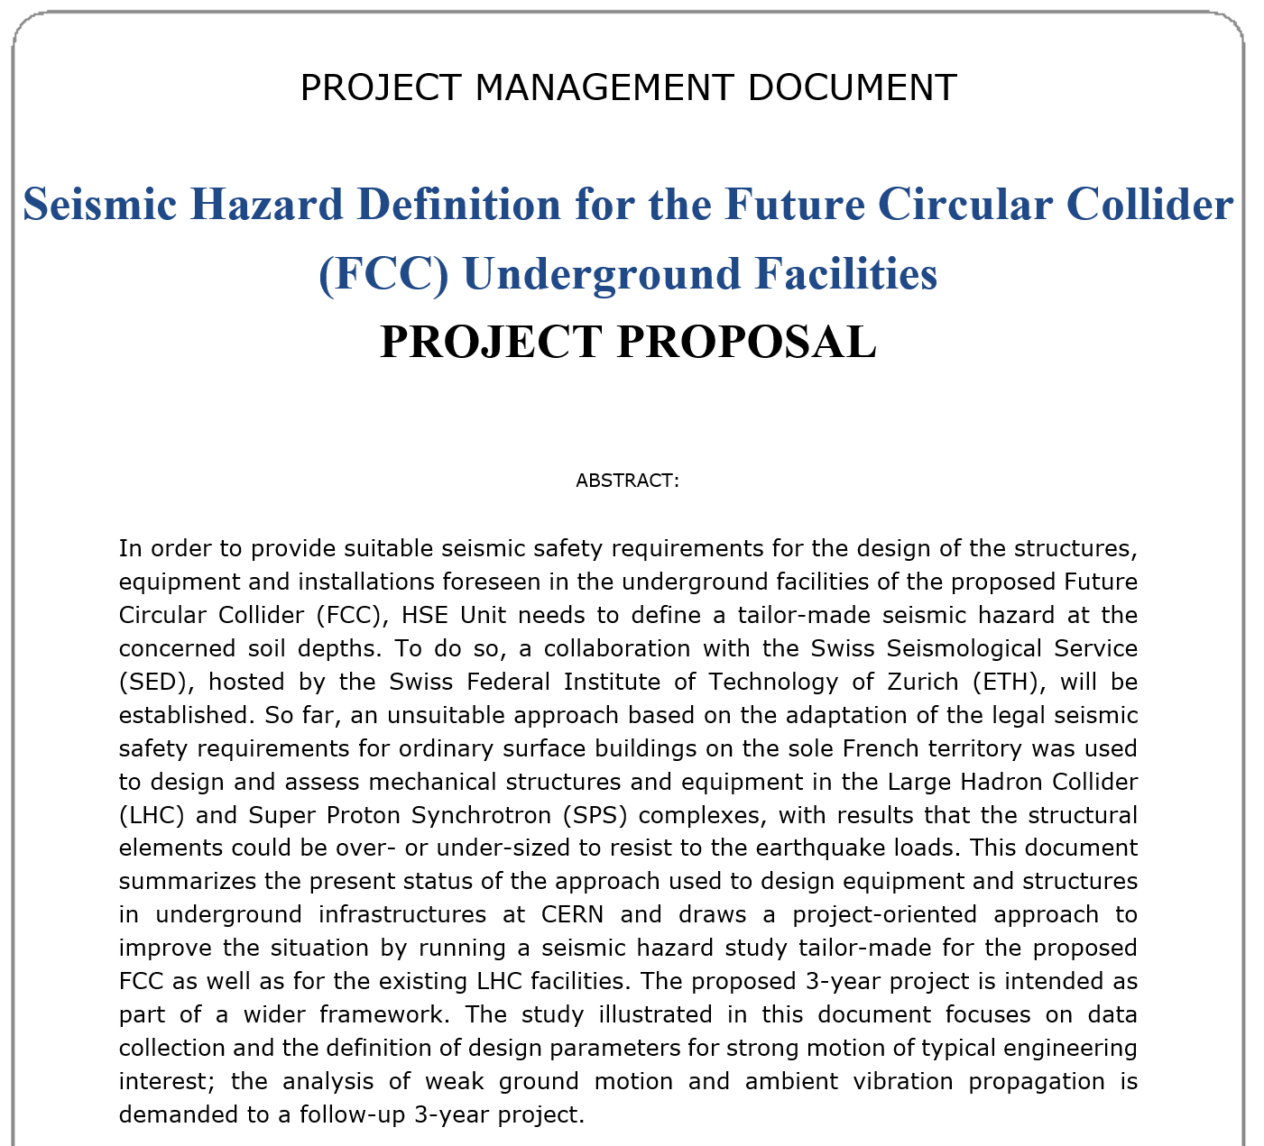
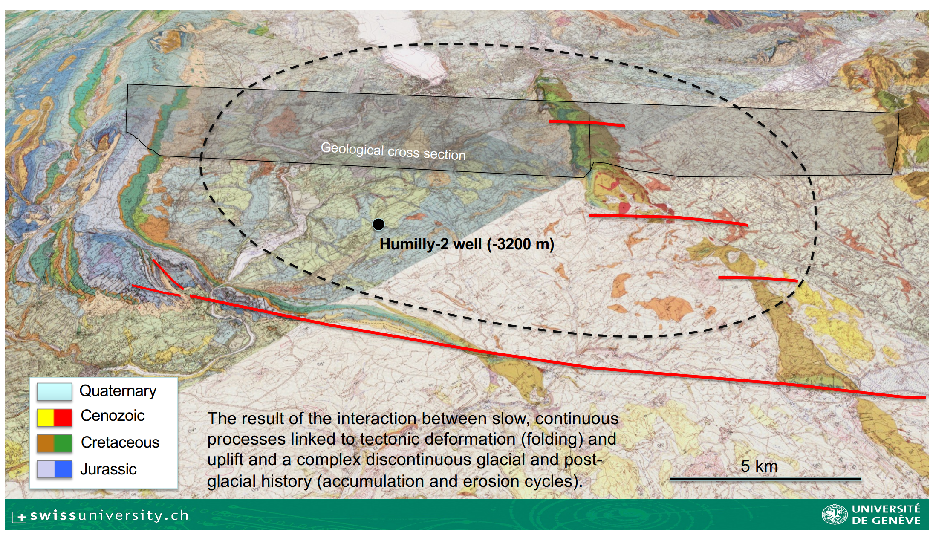



Safety WP – pre-TDR
Seismic hazard assessment
See “Advances in Derisking the FCC Tunnel Design”,
A. Moscariello
M. Andreini
FCC Feasibility Study report, Vol II

Slide 21
Safety WP – pre-TDR
CFD studies
Evacuation scenarios during construction / installation
Mesh sensitivity analysis
Benchmarking
Smoke Extraction in Caverns
Cyber-physical security
PPE
Ergonomics
…
Safety Documentation

Slide 22



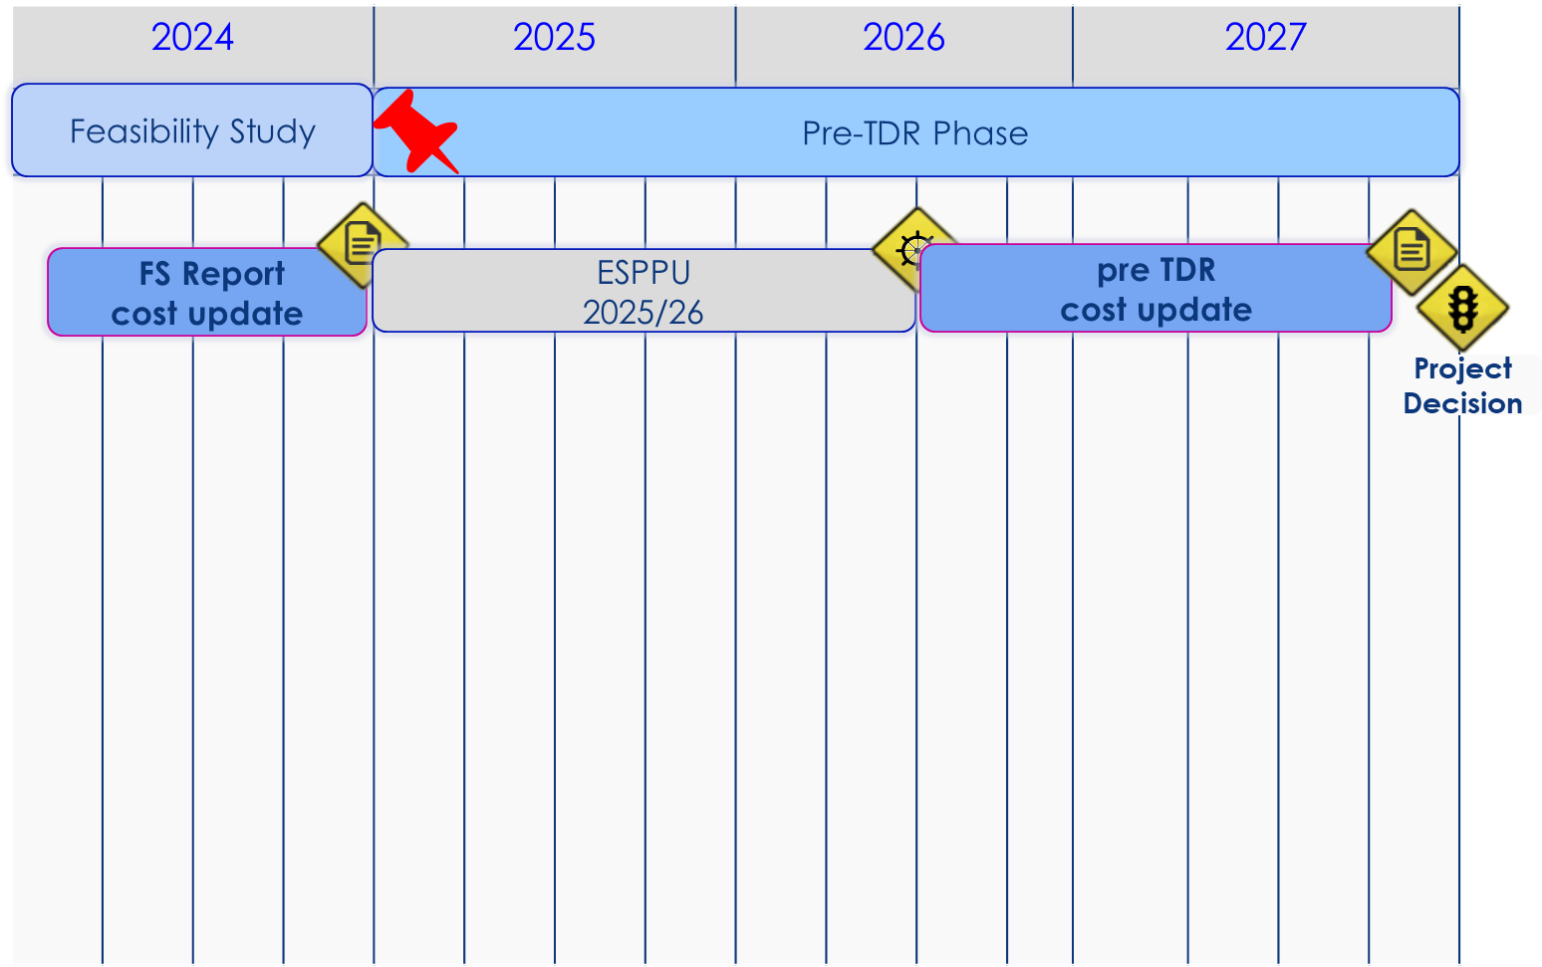
pre-TDR Master Plan
2024 |  |  |  | 2025 |  |  |  | 2026 |  |  |  | 2027
Q1 | Q2 | Q3 | Q4 | Q1 | Q2 | Q3 | Q4 | Q1 | Q2 | Q3 | Q4 | Q1 | Q2 | Q3 | Q4
Feasibility Study
Pre-TDR Phase
FS Report
cost update
ESPPU
2025/26
pre TDR
cost update
Project Decision
FCC
Review SC
What if scenarios
Risk assessment
Pre-TDR
Report
New
commers
Safety studies
Safety WP
Evac modelling
ASET / RSET
CFD simulations
Seismic hazard assessment
M. Benedikt

Slide 23


Conclusion
Let's get to work, shall we !!
Page 99 / 99
Confirmation +
pre-TDR work plan
pre-TDR master plan
Feasibility confirmed w.r.t Safety

Slide 24
Thank you
Gratefully acknowledging the contributions of the FCC Safety WP members and the TIWG WG

