Slide 1

Future Circular Collider
Technical Infrastructure
Ventilation update for FCC
I. Martin Melero (EN/CV)
FCC Week 2025

Slide 2

Inigo Martin Melero (CERN/EN/CV)
2
Outline
0. Definitions
1. Update on thermal toads
  1.1. Primary circuit heat loads
  1.2. Chillers
  1.3. Chilled water loads
2. Update on integration
  2.1. Technical Points: B, F
  2.2. RF Points: H, L
  2.3. Exp. Points: A, D, G, J
3. Update on tunnel concept
  3.1. General parameters
  3.2. Semi-transverse
  3.3. Longitudinal
  3.4. Adaptation Run / Access → Emergency
  3.5. Fire heat effects
  3.6. Pressure differences
  3.7. Degraded modes
4. Next steps

Slide 3
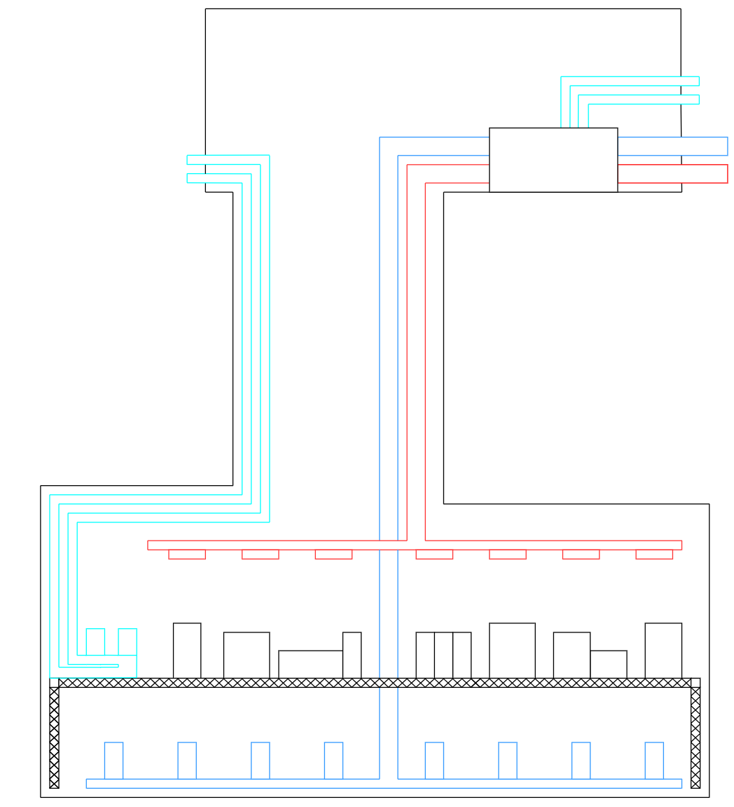
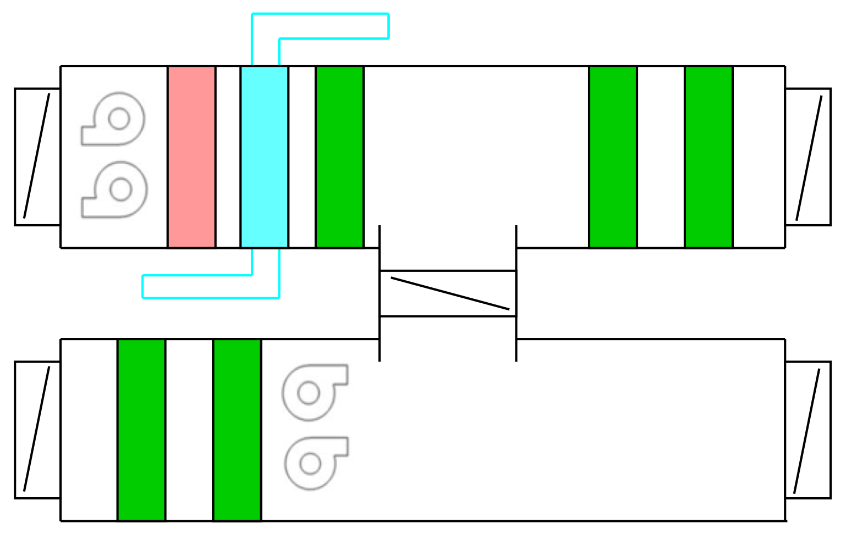

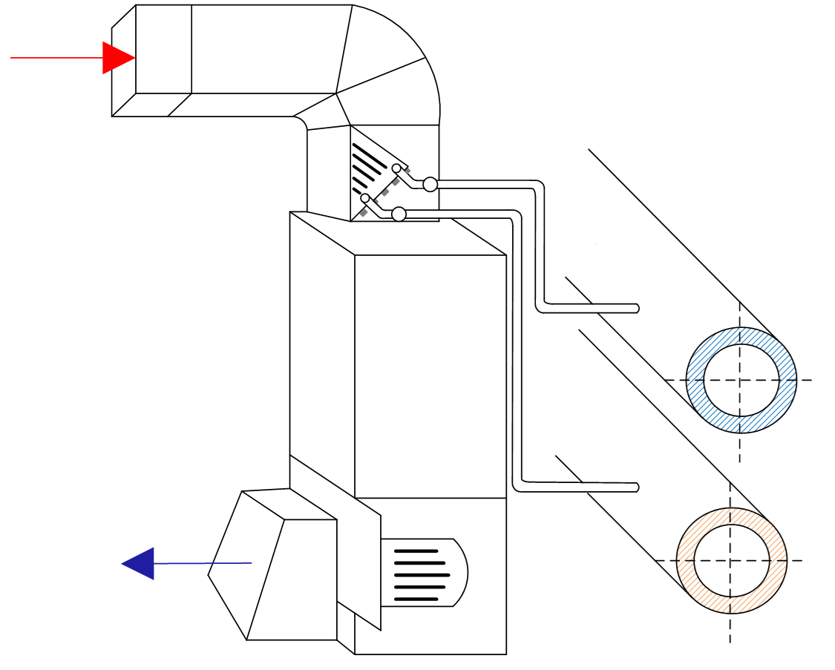
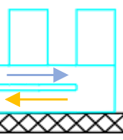
Inigo Martin Melero (CERN/EN/CV)
3
0. Definitions
Surface
AHUs
Treatment of the air to temperature and humidity conditions
Chilled water
Supply
Return
Chilled water
Chilled water
Supply
Supply AHU
Supply air
Supply
AHUs
Supply air
Return
Exhaust air
Supply air
Cold battery
Heating battery
Air filter
Air filter
Air filter
Underground
Shaft
Return
Recycled air
Air filter
Air filter
Exhaust air
Cavern
Hot air
Return AHU
Exhaust air
Heat Exchanger
Fancoils
Recirculation of air through coils to locally adjust temperature conditions
Fancoils
Cold air
Chilled water supply and return
Blower

Slide 4
Inigo Martin Melero (CERN/EN/CV)
4
1. Update on thermal loads
Surface
Chilled water
Supply
Return
TO CHILLERS
Supply
Chilled water
Supply air
TO CHILLERS
AHUs
Exhaust air
Return
Underground
Shaft
Cavern
Fancoils

Slide 5
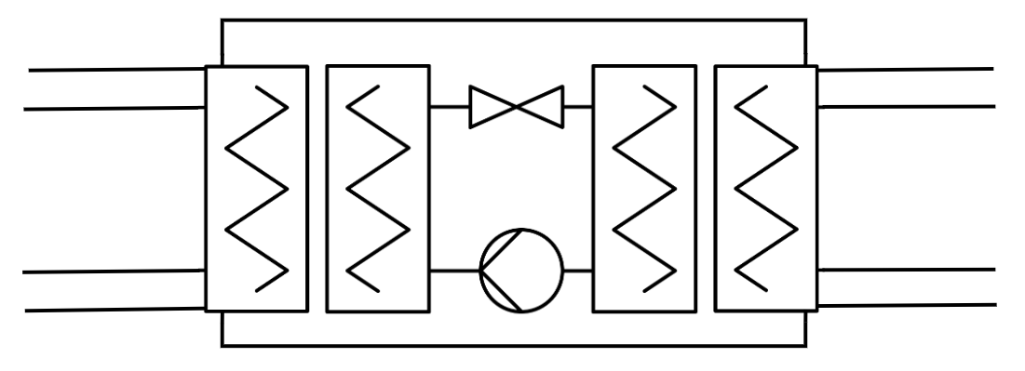

Inigo Martin Melero (CERN/EN/CV)
5
1. Update on thermal loads
Primary circuit heat loads
Heat loads (MW) at Cooling Towers, FCC-ee ttbar
Point | Cryogenics | Experiment | General Services | Power converters RF | Chilled Water | Underground | TOTAL
A | 0.35 | 0.50 | 2.00 |  | 5.87 | 42.56 | 51
B |  |  | 2.00 |  | 5.18 | 1.05 | 8
D | 0.35 | 0.50 | 2.00 |  | 5.84 | 42.56 | 51
F |  |  | 2.00 |  | 5.18 | 1.05 | 8
G | 0.35 | 0.50 | 2.00 |  | 5.87 | 42.56 | 51
H | 34.00 |  | 2.00 | 4.50 | 11.24 | 48.95 | 100
J | 0.35 | 0.50 | 2.00 |  | 5.84 | 42.56 | 51
L | 10.00 |  | 2.00 | 0.07 | 5.71 | 2.74 | 20
Chiller
Refrigerant
Ventilation cooling requirements in Primary Water Circuit
12°C
25°C
6°C
More info:
I. Martin Melero @ Session TIWG 5
Primary water
$$\dot{Q}$$
Chilled water

Slide 6
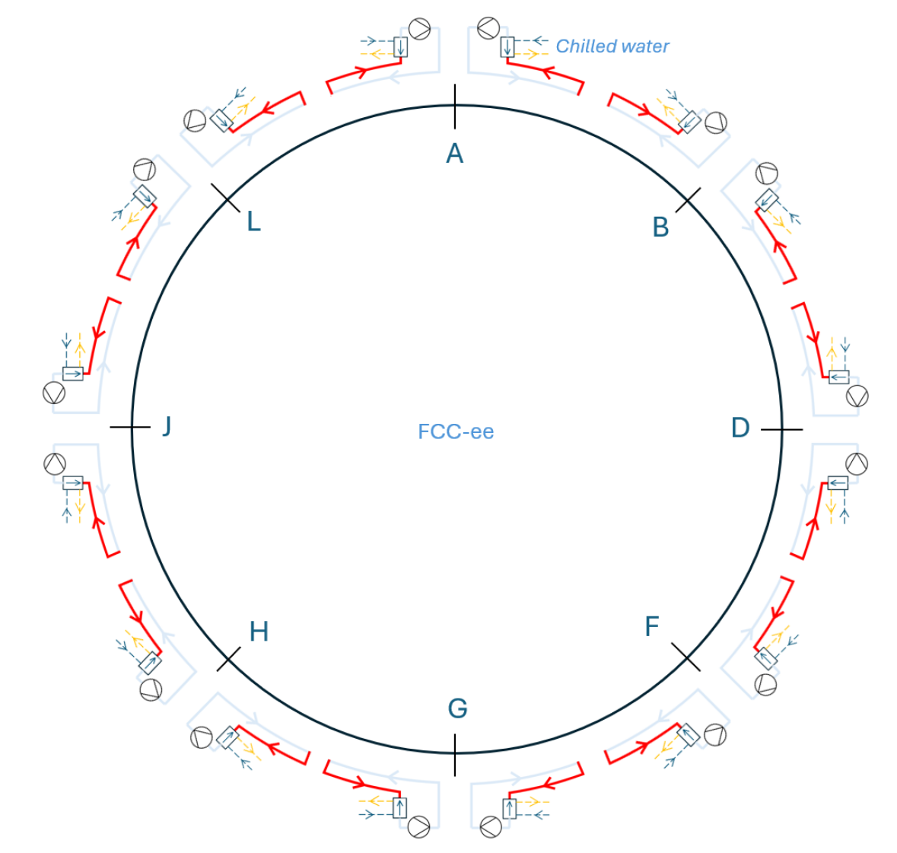
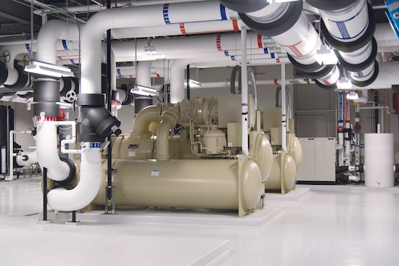
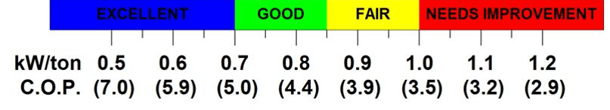

Inigo Martin Melero (CERN/EN/CV)
6
1. Update on thermal loads
Chillers
Chillers, FCC-ee ttbar
Point | Cooling power (kW) | Flow rate (m³/h) | Number of chillers | Cooling power / chiller (kW) | TOTAL (kW)
A | 4,895 | 703 | 6 | 1,000 | 6,000
B | 4,322 | 620 | 6 | 900 | 5,400
D | 4,875 | 700 | 6 | 1,000 | 6,000
F | 4,322 | 620 | 6 | 900 | 5,400
G | 4,895 | 703 | 6 | 1,000 | 6,000
H | 9,367 | 1345 | 7 | 1,800 | 12,600
J | 4,875 | 700 | 6 | 1,000 | 6,000
L | 4,757 | 683 | 6 | 1,000 | 6,000
Chilled water requirements
Increase in chillers due to cable load Tunnel
Chiller
Refrigerant
Primary water requirements
in Table p. 5
12°C
COP ≈ 5
25°C
6°C
Primary water
$$\dot{Q}$$
Chilled water

Slide 7
Inigo Martin Melero (CERN/EN/CV)
7
1. Update on thermal loads
Chilled water loads
1. Surface heat loads to chilled water (kW)
POINT | Cryogenics | Power Converters | General Services | Experimental Areas | Shaft Pressurisation | Fresh Air for Underground Areas | TOTAL TO CHILLED WATER
A | 13 |  | 500 | 50 | 300 | 150 | 1013
B |  |  | 500 |  | 150 | 50 | 700
D | 13 |  | 500 | 40 | 300 | 150 | 1003
F |  |  | 500 |  | 150 | 50 | 700
G | 13 |  | 500 | 50 | 300 | 150 | 1013
H | 1,400* | 2,250* | 500 |  | 150 | 150 | 800
J | 13 |  | 500 | 40 | 300 | 150 | 1003
L | 402* | 35* | 500 |  | 150 | 150 | 800
Chilled water load
=
1. Surface + 2. Underground
+ 3. Sector
*Extracted without chilled water → Option: free cooling
2. Underground heat loads to chilled water (kW)
POINT | Cryogenics | RF | Experimental Areas | Power Converters | Ventilation UW | TOTAL
A | 10 |  | 50 | 220 | 200 | 480
B |  |  |  | 220 |  | 220
D | 10 |  | 40 | 220 | 200 | 470
F |  |  |  | 220 |  | 220
G | 10 |  | 50 | 220 | 200 | 480
H | 145 | 4,600 |  | 220 | 200 | 5,165
J | 10 |  | 40 | 220 | 200 | 470
L | 60 | 75 |  | 220 | 200 | 555
3. Sector heat loads to chilled water (kW)
Magnets | Cables | Synchrotron radiation absorbers | Alcoves | TOTAL PER SECTOR
352 | 2,500 | 250 | 300 | 3,402
Scenario for 7 alcoves

Slide 8
Inigo Martin Melero (CERN/EN/CV)
8
2. Update on integration
Surface
Chilled water
Supply
Return
TO CHILLERS
Supply
Chilled water
Supply air
TO CHILLERS
AHUs
Exhaust air
Return
Underground
Shaft
Cavern
Fancoils

Slide 9
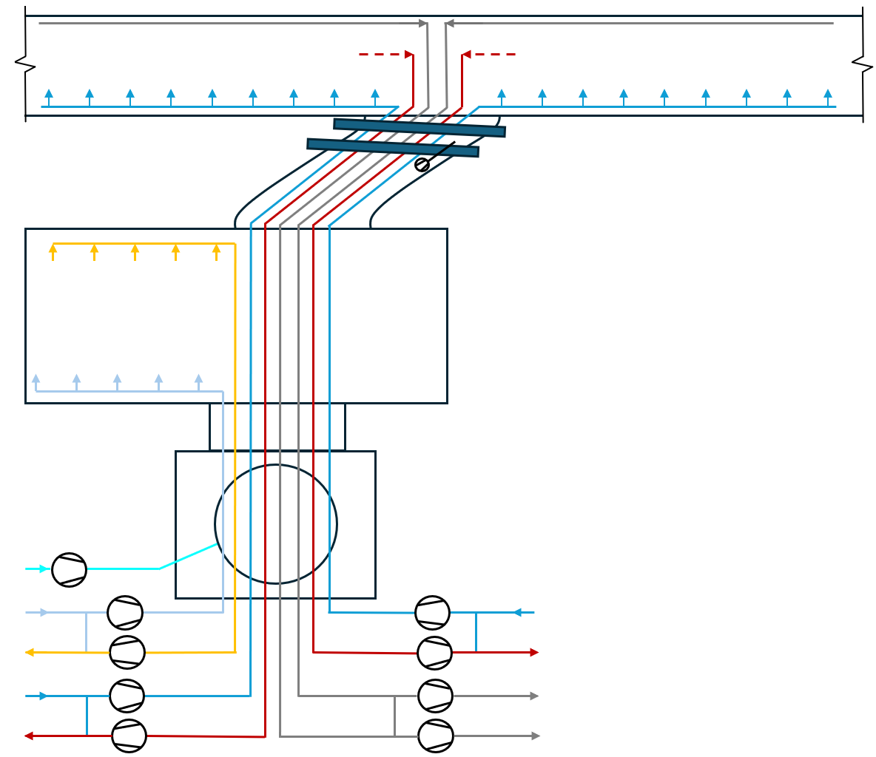
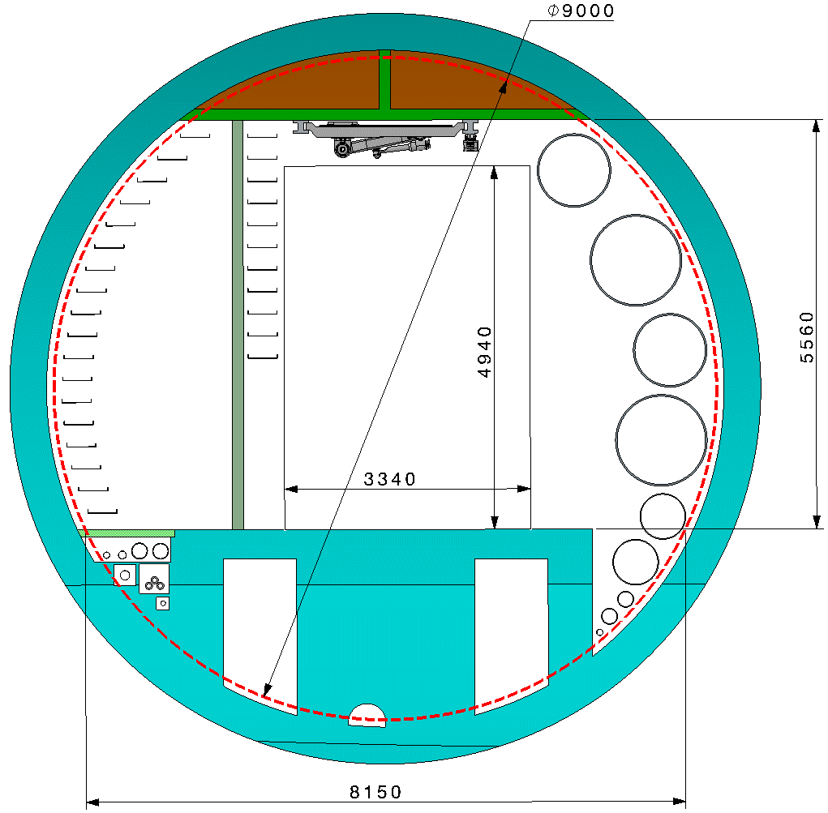
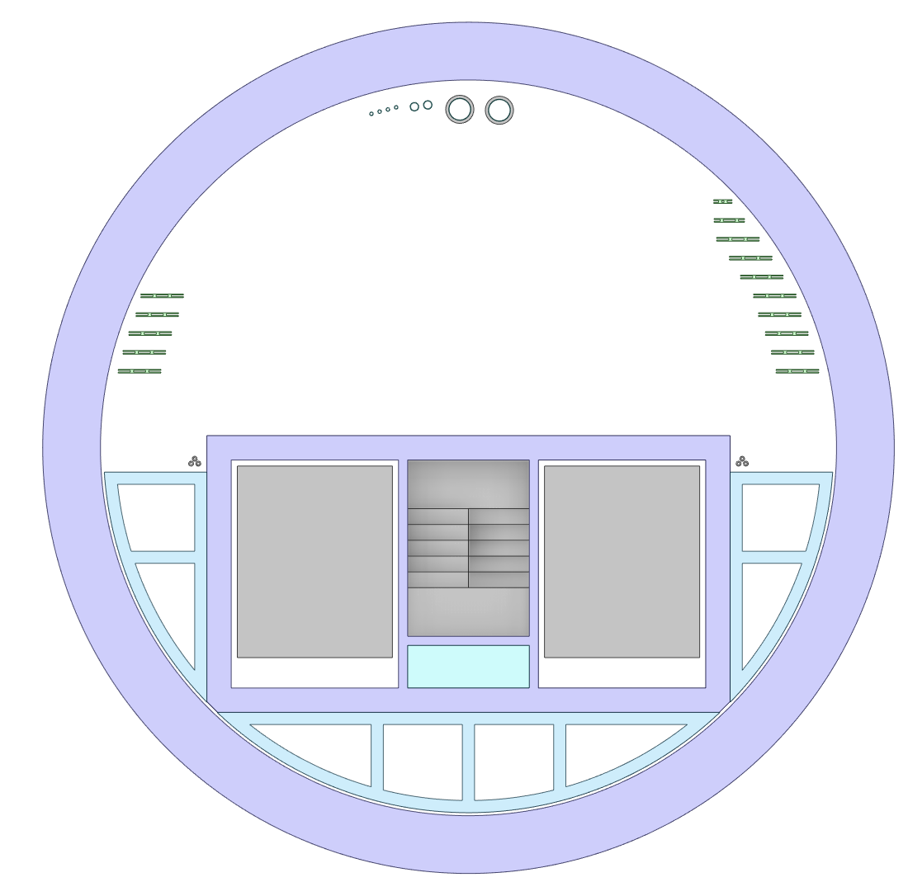
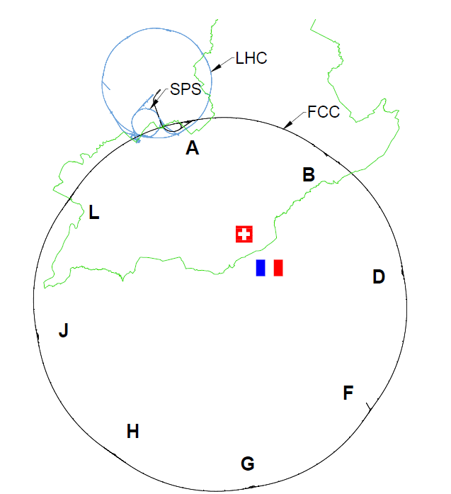
Inigo Martin Melero (CERN/EN/CV)
9
2. Update on integration
Technical Points: B, F
Reference | Duct Function | Size
PF.1 | Ventilation Tunnel Supply 1 | 1.2 m
PF.2 | Ventilation Tunnel Extract 1 | 1.2 m
PF.3 | Ventilation Emergency Extract 1 | 1.2 m
PF.4 | Ventilation Tunnel Supply 2 | 1.2 m
PF.5 | Ventilation Tunnel Extract 2 | 1.2 m
PF.6 | Ventilation Emergency Extract 2 | 1.2 m
PF.7 | Ventilation Service Cavern Supply | 1.1 m
PF.8 | Ventilation Service Cavern Extract | 1.1 m
PF.9 | Shaft Pressurisation | 1.2 m
PF.3
PF.6
PF.8
Tunnel Section
PF.2
PF.7
PF.5
PF.1
PF.4
Integration
under study
Shaft View
PF.9
PF.7
PF.4
PF.8
PF.5
PF.5
PF.4
PF.1
PF.6
PF.3
PF.6
PF.2
PF.3
PF.9
Technical Areas in B, F | Air Supply | Extraction | Emergency extraction
Access Mode | Ventilation Service Cavern: 40,000 m³/h | 40,000 m³/h | 40,000 m³/h
PF.8
PF.2
PF.1
PF.7

Slide 10
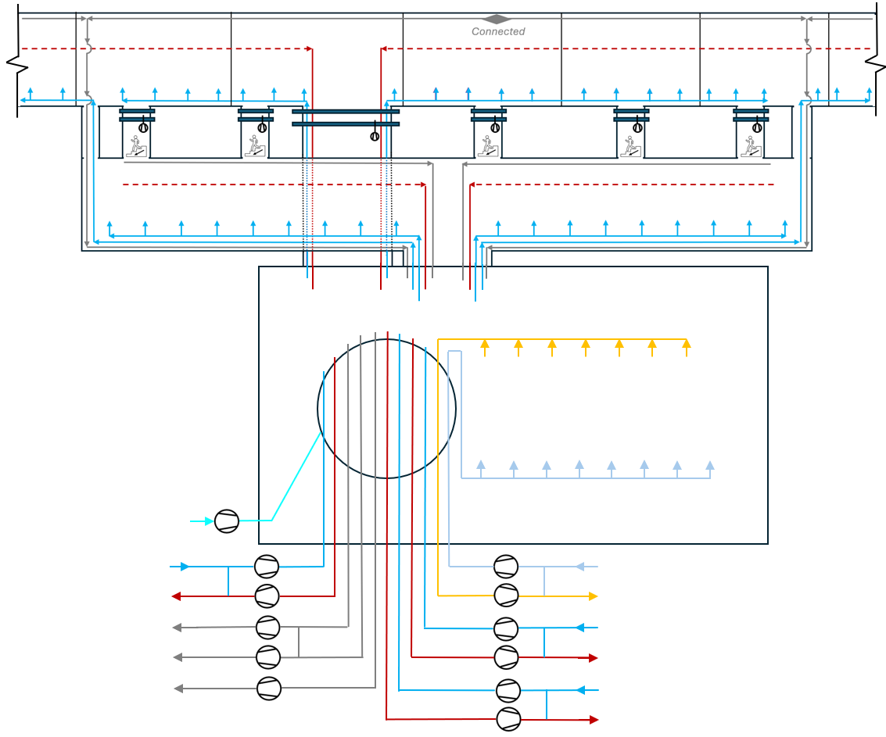
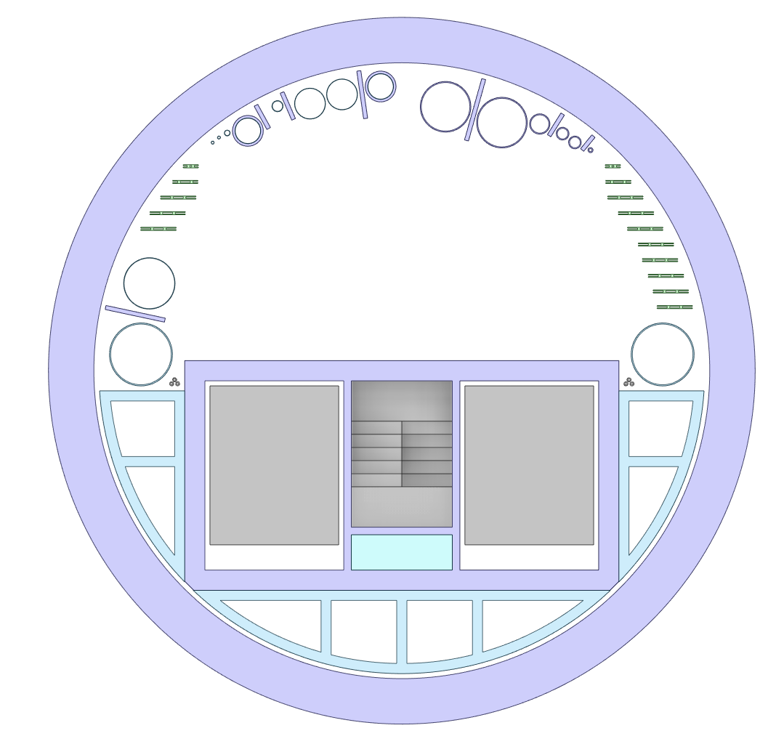
Inigo Martin Melero (CERN/EN/CV)
10
2. Update on integration
RF Points: H, L
Reference | Duct Function | Size
PH.1 | Ventilation Service Cavern Supply | 1.1 m
PH.2 | Ventilation Service Cavern Extract | 1.1 m
PH.3 | Ventilation Klystron Gallery Supply | 1 m
PH.4 | Ventilation Klystron Gallery Extract | 1 m
PH.5 | Ventilation Klystron Gallery Emergency | 1 m
PH.6 | Ventilation Tunnel Supply 1 | 1.2 m
PH.7 | Ventilation Tunnel Extract 1 | 1.2 m
PH.8 | Ventilation Emergency Extract 1 | 1.2 m
PH.9 | Ventilation Tunnel Supply 2 | 1.2 m
PH.10 | Ventilation Tunnel Extract 2 | 1.2 m
PH.11 | Ventilation Emergency Extract 2 | 1.2 m
PH.12 | Shaft Pressurisation | 1.2 m
Tunnel
Klystron Gallery
Integration
under study
PH.5
PH.10
PH.11
PH.5
PH.8
PH.9
PH.6
PH.7
PH.4
PH.4
PH.9
PH.6
PH.3
PH.3
Shaft View
PH.5
PH.7
PH.6
PH.12
PH.4
PH.3
PH.9
PH.1
PH.10
PH.2
PH.2
PH.1
PH.11
PH.6
PH.12
PH.8
PH.7
PH.5
PH.3
PH.10
PH.11
PH.8
PH.9
PH.4
Technical Areas in H,L | Air Supply | Extraction | Emergency extraction
Access Mode | Ventilation Service Cavern: 40,000 m³/h | 40,000 m³/h | 40,000 m³/h

Slide 11
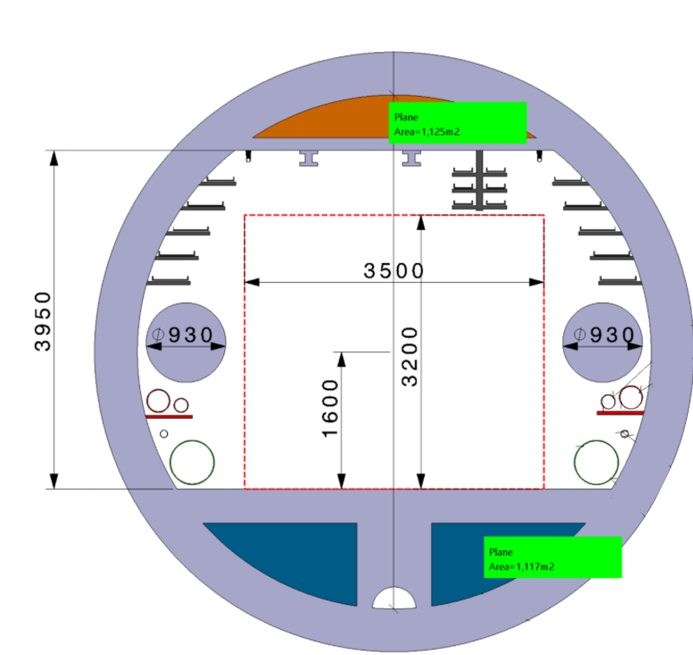
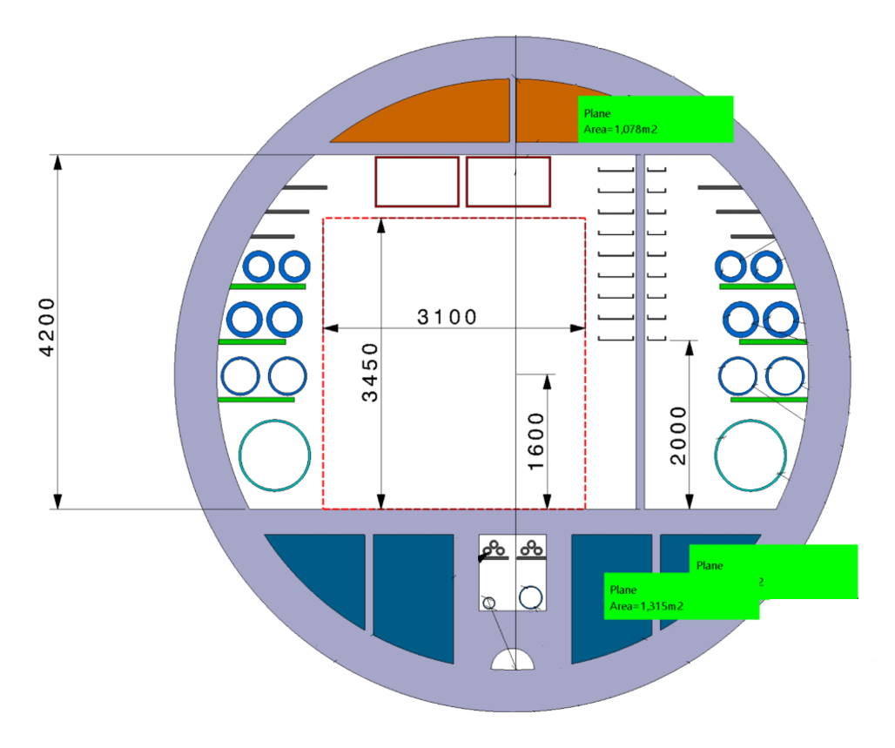
Inigo Martin Melero (CERN/EN/CV)
11
2. Update on integration
RF Points: H, L
Reference | Duct Function | Size
PH.1 | Ventilation Service Cavern Supply | 1.1 m
PH.2 | Ventilation Service Cavern Extract | 1.1 m
PH.3 | Ventilation Klystron Gallery Supply | 1 m
PH.4 | Ventilation Klystron Gallery Extract | 1 m
PH.5 | Ventilation Klystron Gallery Emergency | 1 m
PH.6 | Ventilation Tunnel Supply 1 | 1.2 m
PH.7 | Ventilation Tunnel Extract 1 | 1.2 m
PH.8 | Ventilation Emergency Extract 1 | 1.2 m
PH.9 | Ventilation Tunnel Supply 2 | 1.2 m
PH.10 | Ventilation Tunnel Extract 2 | 1.2 m
PH.11 | Ventilation Emergency Extract 2 | 1.2 m
PH.12 | Shaft Pressurisation | 1.2 m
Tunnel
Tunnel Section
Klystron Gallery
PH.9
PH.6
PH.5
PH.10
PH.11
PH.5
PH.8
PH.9
PH.6
PH.7
PH.4
PH.4
PH.9
PH.6
PH.3
PH.3
PH.10
PH.7
Integration
under study
PH.11
PH.8
PH.5
PH.5
PH.12
PH.9
PH.1
Tunnel Section
PH.10
PH.2
PH.11
PH.6
PH.4
PH.4
PH.8
PH.7
PH.5
PH.3
PH.4
PH.3
PH.3
PH.9
PH.6
Technical Areas in H,L | Air Supply | Extraction | Emergency extraction
Access Mode | Ventilation Service Cavern: 40,000 m³/h | 40,000 m³/h | 40,000 m³/h

Slide 12
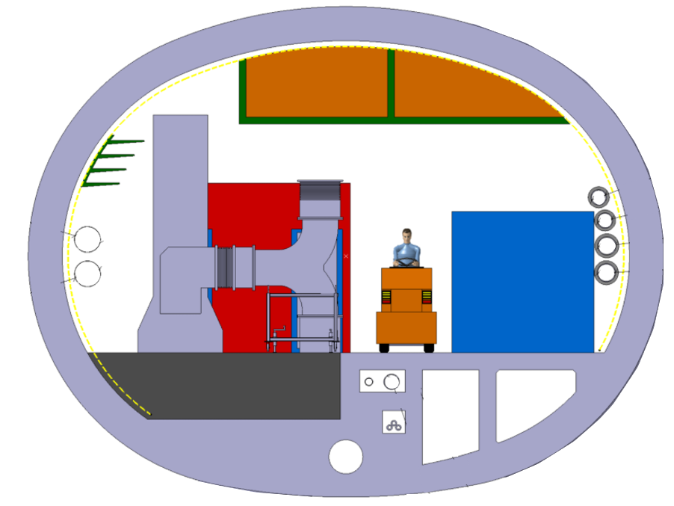
Inigo Martin Melero (CERN/EN/CV)
12
2. Update on integration
RF Points: H, L
Reference | Duct Function | Size
PH.1 | Ventilation Service Cavern Supply | 1.1 m
PH.2 | Ventilation Service Cavern Extract | 1.1 m
PH.3 | Ventilation Klystron Gallery Supply | 1 m
PH.4 | Ventilation Klystron Gallery Extract | 1 m
PH.5 | Ventilation Klystron Gallery Emergency | 1 m
PH.6 | Ventilation Tunnel Supply 1 | 1.2 m
PH.7 | Ventilation Tunnel Extract 1 | 1.2 m
PH.8 | Ventilation Emergency Extract 1 | 1.2 m
PH.9 | Ventilation Tunnel Supply 2 | 1.2 m
PH.10 | Ventilation Tunnel Extract 2 | 1.2 m
PH.11 | Ventilation Emergency Extract 2 | 1.2 m
PH.12 | Shaft Pressurisation | 1.2 m
Tunnel
Klystron Gallery
PH.8
PH.5
Klystron Gallery Section
PH.5
PH.10
PH.11
PH.5
PH.8
PH.9
PH.6
PH.7
PH.4
PH.4
PH.9
PH.6
PH.3
PH.3
PH.6
PH.3
PH.12
PH.9
PH.1
Integration
under study
PH.10
PH.2
PH.11
PH.5
PH.11
PH.6
Klystron Gallery Section
PH.8
PH.7
PH.5
PH.3
PH.4
RF Areas in H, L | Air Supply | Extraction | Emergency extraction
Run & Access Mode | 30.000 m³/h | 30.000 m³/h | OFF
Emergency conditions | < 30.000 m³/h | < 30.000 m³/h | < 30.000 m³/h
PH.9
PH.3

Slide 13
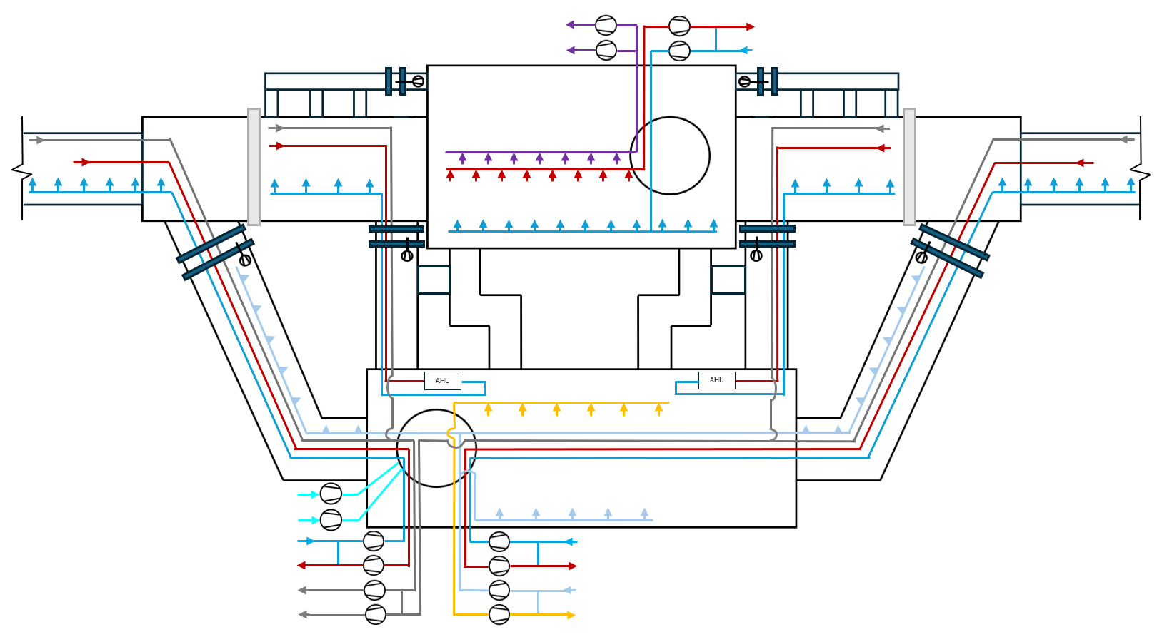
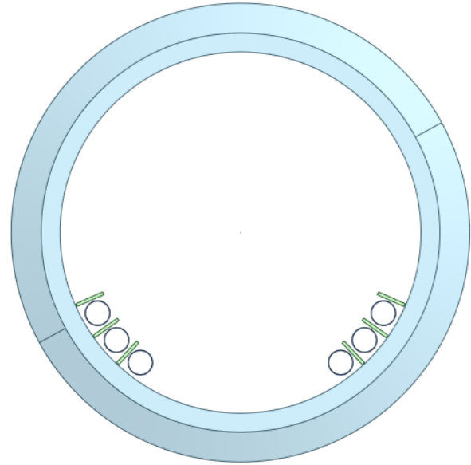
Inigo Martin Melero (CERN/EN/CV)
13
2. Update on integration
Exp. Points: A, D, G, J
PA.3
PA.2
Reference | Duct Function | Size
PA.1 | Ventilation Experimental Cavern, Supply | 1.2 m
PA.2 | Ventilation Experimental Cavern, Extract | 1.2 m
PA.3 | Ventilation Experimental Cavern, Gas Extract | 1.2 m
PA.1
Integration
under study
Shaft View
PA.1
PA.3
PA.1
PA.3
PA.2
PA.2
Exp. Areas in A,D,G,J | Air Supply | Regular Extraction | Gas Extraction
Run & Access Mode | 50.000 – 70.000 m³/h | 50.000 – 70.000 m³/h | OFF
Flushing Mode | 50.000 – 70.000 m³/h | 50.000 – 70.000 m³/h | OFF
Fire Emergency | Up to 70.000 m³/h | Up to 70.000 m³/h | OFF
Gas Emergency | 20.000 m³/h | OFF | 20.000 m³/h

Slide 14
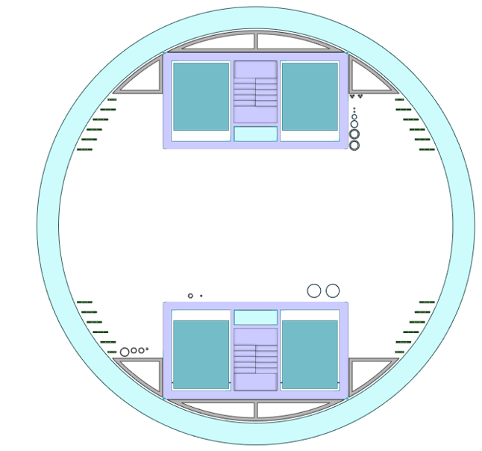
Inigo Martin Melero (CERN/EN/CV)
14
2. Update on integration
Exp. Points: A, D, G, J
PA.3
PA.2
Reference | Duct Function | Size
PA.4 | Ventilation Service Cavern Supply + Fresh Air for UAs Supply | 1.3 m
PA.5 | Ventilation Service Cavern Extract + Fresh Air for UAs Extract | 1.3 m
PA.6 | Ventilation Tunnel Supply 1 | 1.2 m
PA.7 | Ventilation Tunnel Extract 1 | 1.2 m
PA.8 | Ventilation Emergency Extract 1 | 1.2 m
PA.9 | Ventilation Tunnel Supply 2 | 1.2 m
PA.10 | Ventilation Tunnel Extract 2 | 1.2 m
PA.11 | Ventilation Emergency Extract 2 | 1.2 m
PA.12 | Shaft Pressurisation 1 | 1.2 m
PA.13 | Shaft Pressurisation 2 | 1.2 m
PA.1
PA.6
PA.7
PA.4
PA.5
PA.13
PA.12
Shaft View
PA.13
PA.9
PA.6
PA.12
PA.10
PA.7
PA.11
PA.4
Integration
under study
PA.8
PA.5
PA.8
PA.11
PA.9
PA.10
Technical Areas in A,D,G,J | Air Supply | Extraction | Emergency extraction
Run & Access Mode | Fresh air UAs: 20,000 m³/h Ventilation Service Cavern: 40,000 m³/h | 60,000 m³/h | 60,000 m³/h

Slide 15
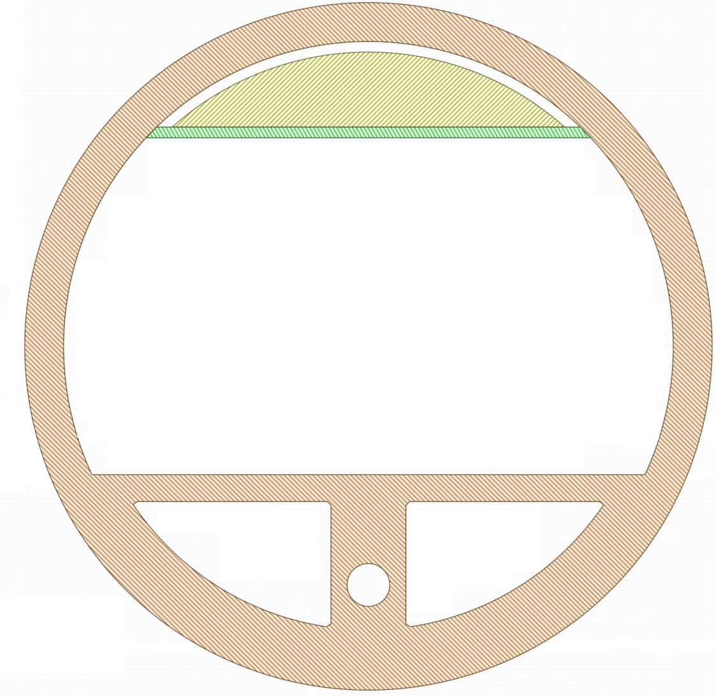
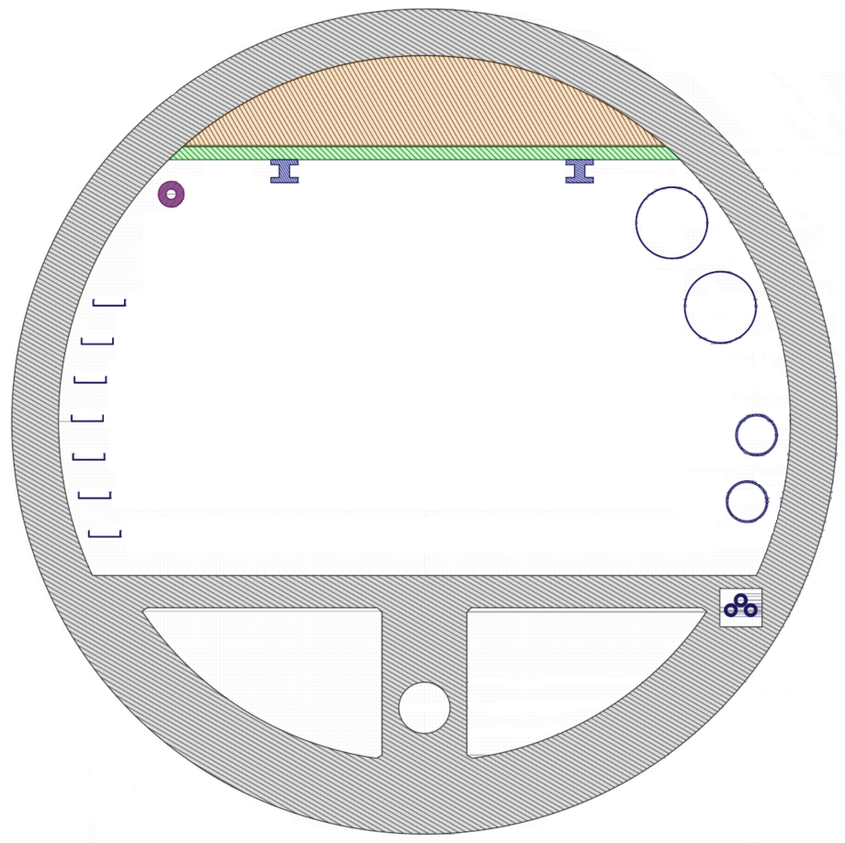
Inigo Martin Melero (CERN/EN/CV)
15
2. Update on integration
Exp. Points: A, D, G, J
PA.3
PA.2
Reference | Duct Function | Size
PA.1 | Ventilation Experimental Cavern, Supply | 1.2 m
PA.2 | Ventilation Experimental Cavern, Extract | 1.2 m
PA.3 | Ventilation Experimental Cavern, Gas Extract | 1.2 m
PA.1
Reference | Duct Function | Size
PA.4 | Ventilation Service Cavern Supply + Fresh Air for UAs Supply | 1.3 m
PA.5 | Ventilation Service Cavern Extract + Fresh Air for UAs Extract | 1.3 m
PA.6 | Ventilation Tunnel Supply 1 | 1.2 m
PA.7 | Ventilation Tunnel Extract 1 | 1.2 m
PA.8 | Ventilation Emergency Extract 1 | 1.2 m
PA.9 | Ventilation Tunnel Supply 2 | 1.2 m
PA.10 | Ventilation Tunnel Extract 2 | 1.2 m
PA.11 | Ventilation Emergency Extract 2 | 1.2 m
PA.12 | Shaft Pressurisation 1 | 1.2 m
PA.13 | Shaft Pressurisation 2 | 1.2 m
++
+
PA.8⁺⁺
Tunnel Section
PA.12
PA.13
PA.9
PA.6
PA.10
PA.7
PA.8⁺
PA.11
PA.4
PA.6⁺⁺
PA.7⁺⁺
PA.8
PA.5
Tunnel Section
Integration
under study
PA.6⁺
PA.7⁺

Slide 16
Inigo Martin Melero (CERN/EN/CV)
16
3. Update on tunnel concept
Surface
Chilled water
Supply
Return
TO CHILLERS
Supply
Chilled water
Supply air
TO CHILLERS
AHUs
Exhaust air
Return
Underground
Shaft
Cavern
Fancoils

Slide 17
Inigo Martin Melero (CERN/EN/CV)
17
3. Update on tunnel concept
General parameters
General Input data
Cross section area | 15.2 m²
Sector length | 11,396 m
Max. Temperature (running conditions) | 32ºC (to be confirmed)
Max. dew point Temperature | 12ºC (to be confirmed
Ventilation parameters
Normal operation air flow per sector | 2 x 27,000 m³/h
Flushing air flow (longitudinal) per sector | 100,000 m³/h
Air supply points per compartment | 4
Air flow per supply point (normal operation) | 474 m³/h
Time to complete air renewal (flushing) | 1.7 h
Maximum air speed (normal operation – flushing) | 0.5 m/s – 1.8 m/s
Cooling capacity in normal operation for ΔT = 15 K per sector | 271 kW
Compartment Input data
Number of Compartments | 29
Compartment length | 400 m
Volume Compartment | 6,080 m³

Slide 18
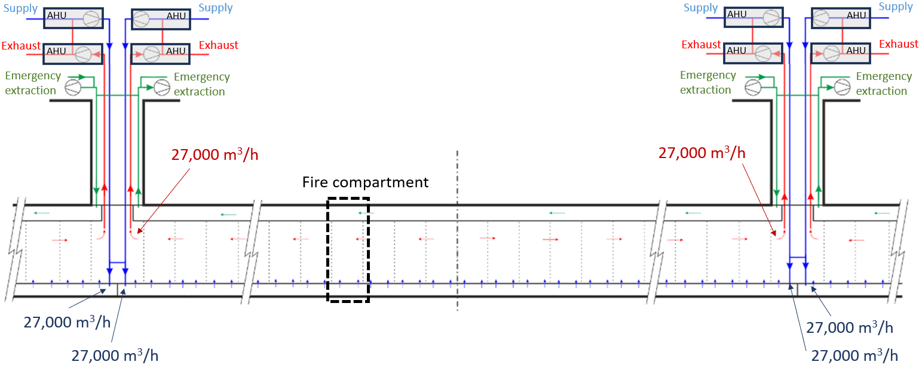
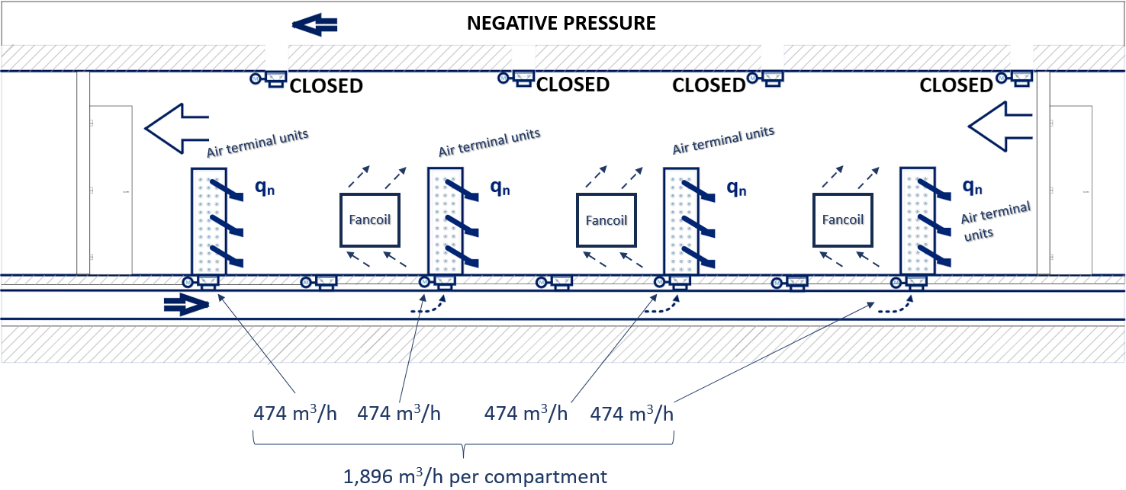
Inigo Martin Melero (CERN/EN/CV)
18
3. Update on tunnel concept
Semi-transverse
Run Mode → Machine is in operation
Access Modes → Maintenance / works are done in the tunnel

Slide 19
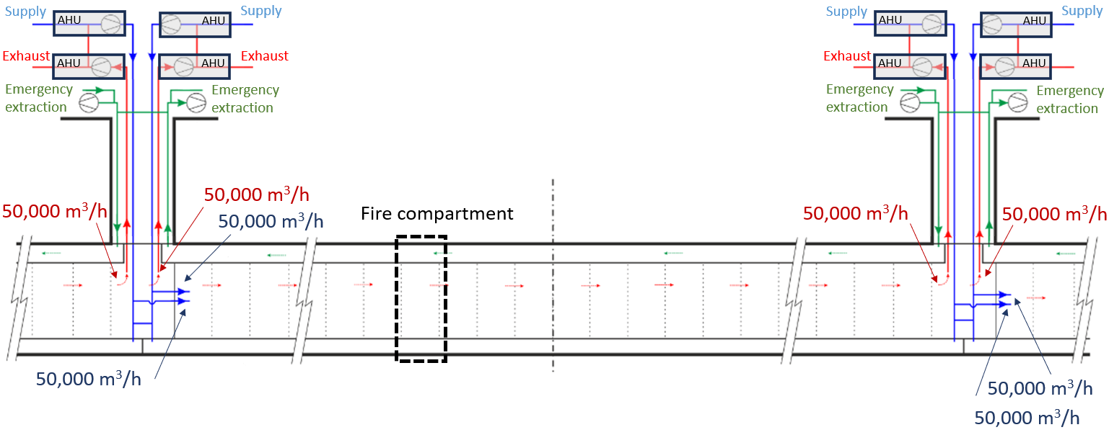
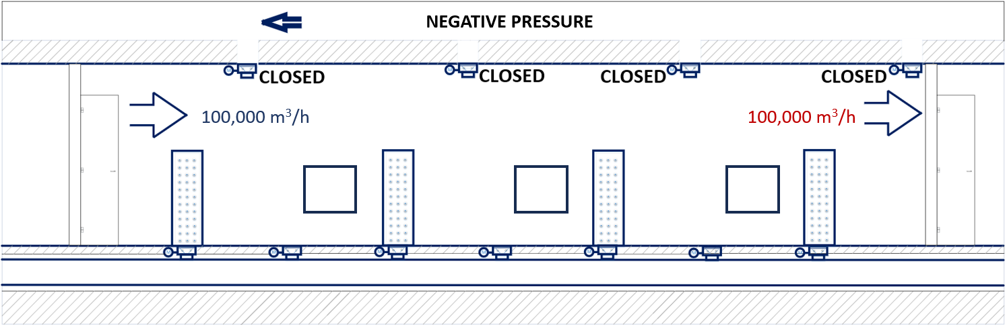
Inigo Martin Melero (CERN/EN/CV)
19
3. Update on tunnel concept
Semi-transverse
Flushing Mode → Full air renewal between
Access and Run Modes

Slide 20
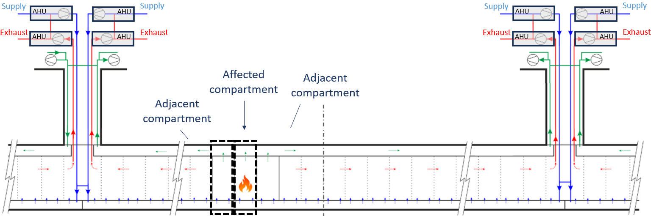
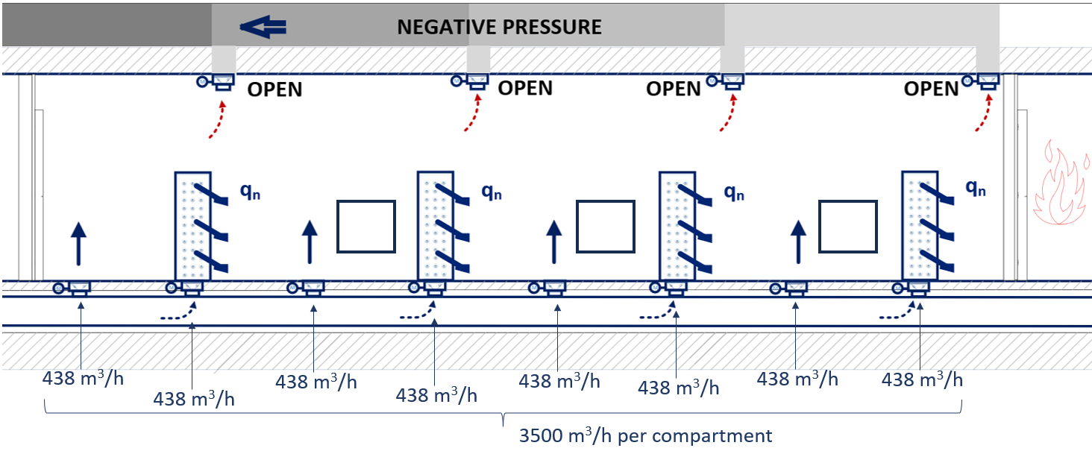
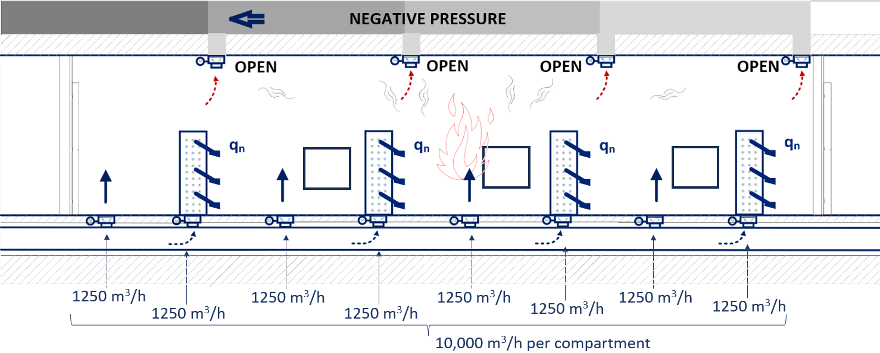
Inigo Martin Melero (CERN/EN/CV)
20
3. Update on tunnel concept
Semi-transverse
Emergency Mode → Smoke & fire or helium leak scenario

Slide 21
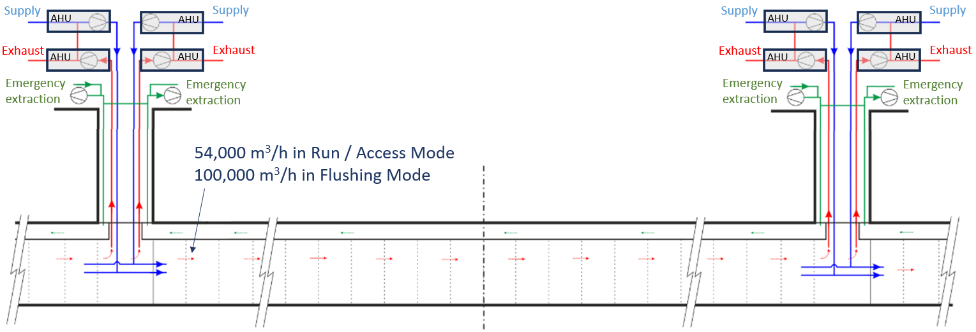
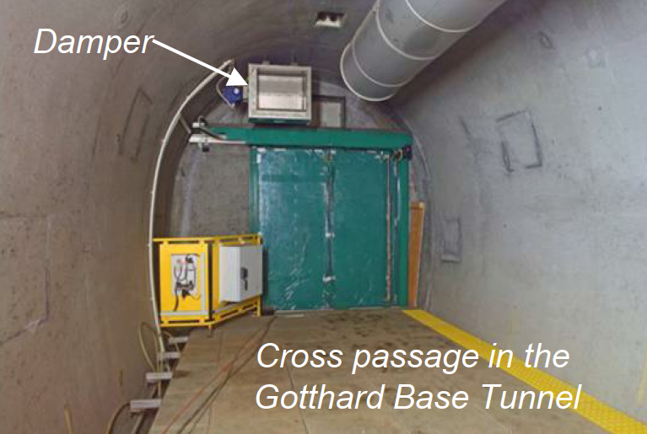
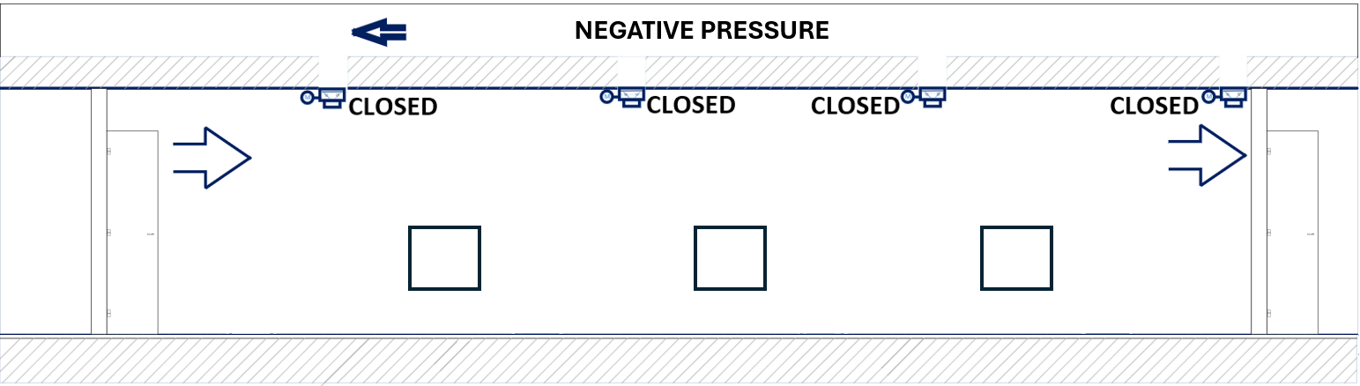
Inigo Martin Melero (CERN/EN/CV)
21
3. Update on tunnel concept
Longitudinal
Run Mode → Machine is in operation
Access Modes → Maintenance / works are done in the tunnel
Flushing Mode → Full air renewal between
Access and Run Modes
Advantages
- No slab duct needed
- Less and simpler controls (dampers,etc)
- More efficient overall, less pressure loss
Challenges
Degraded modes
Force needed to open compartment doors
Larger dampers at compartment walls

Slide 22
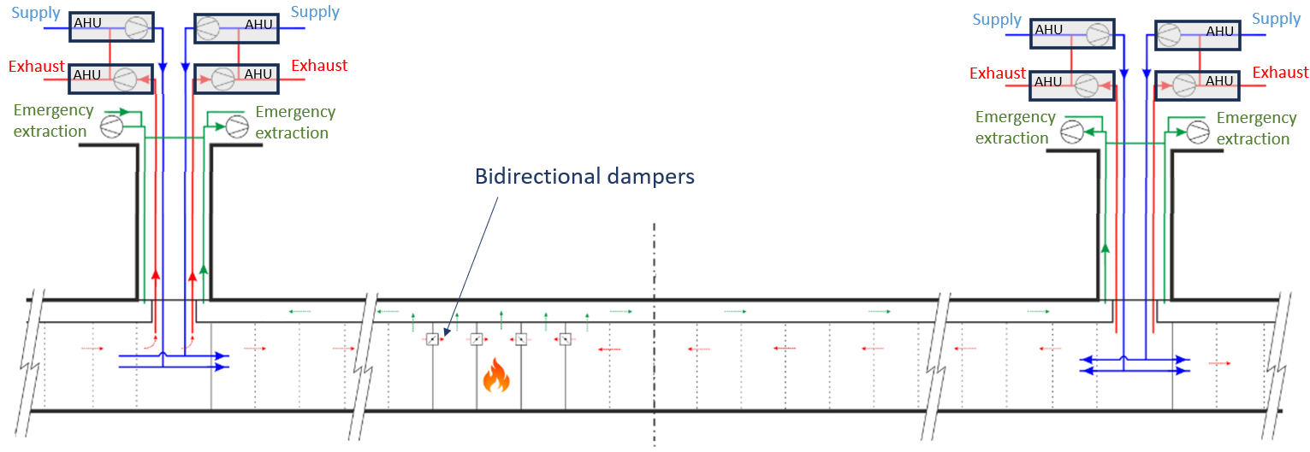
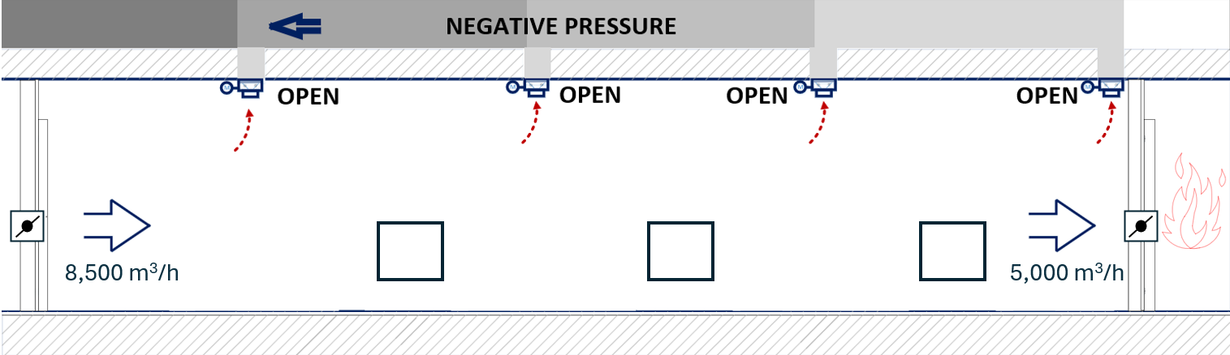
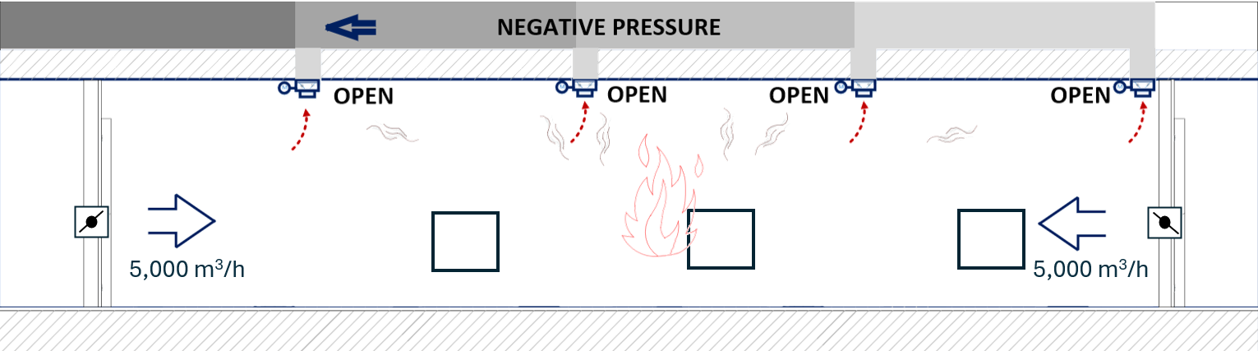
Inigo Martin Melero (CERN/EN/CV)
22
3. Update on tunnel concept
Longitudinal
Emergency Mode → Smoke & fire or helium leak scenario

Slide 23
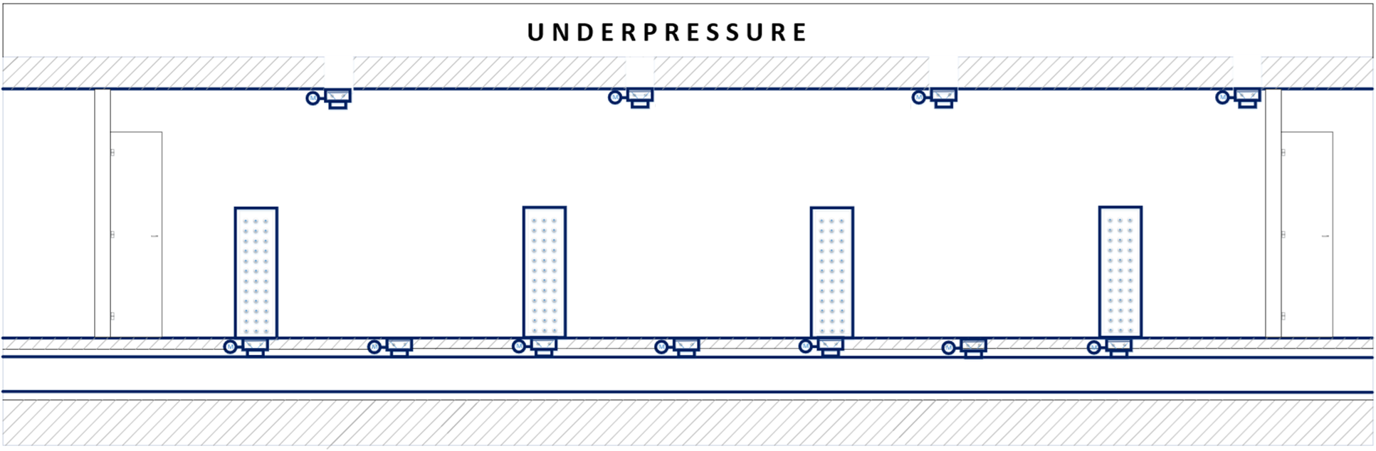
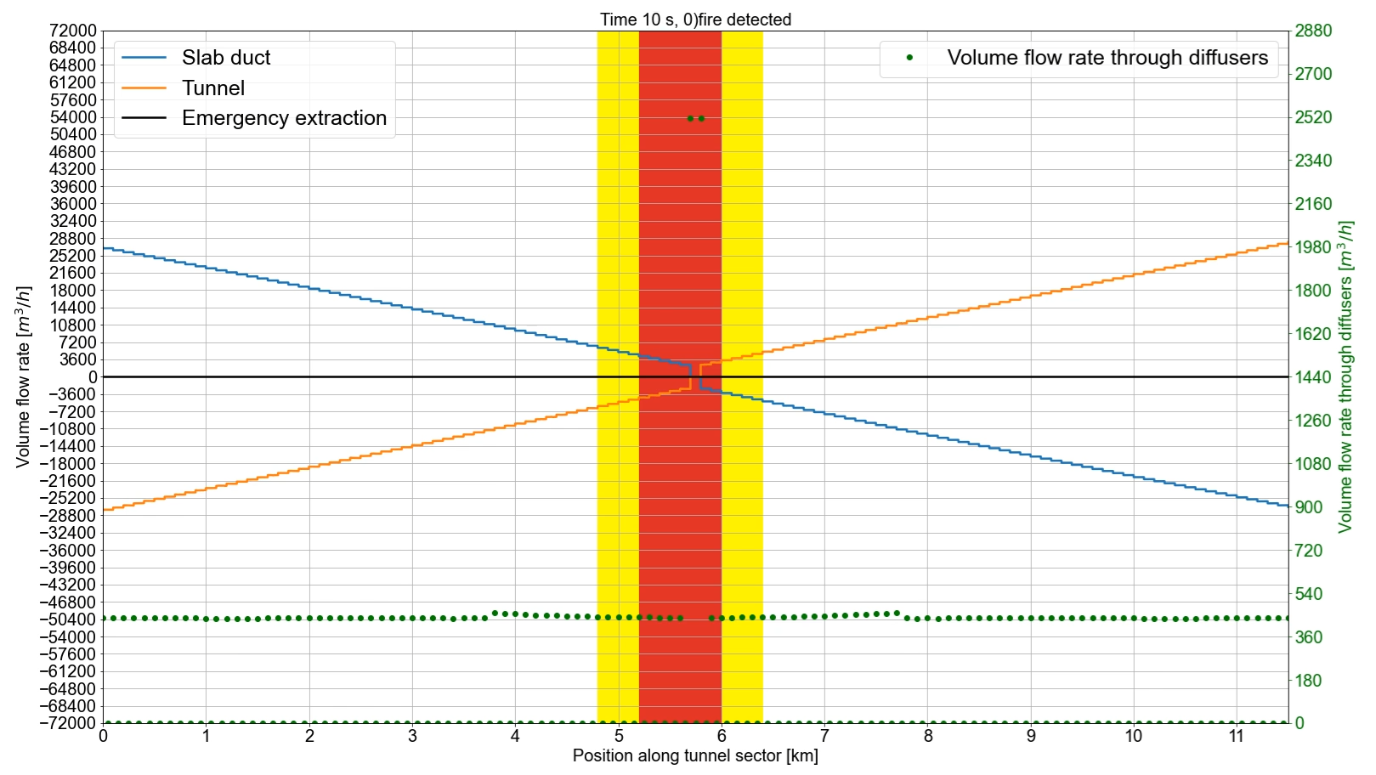
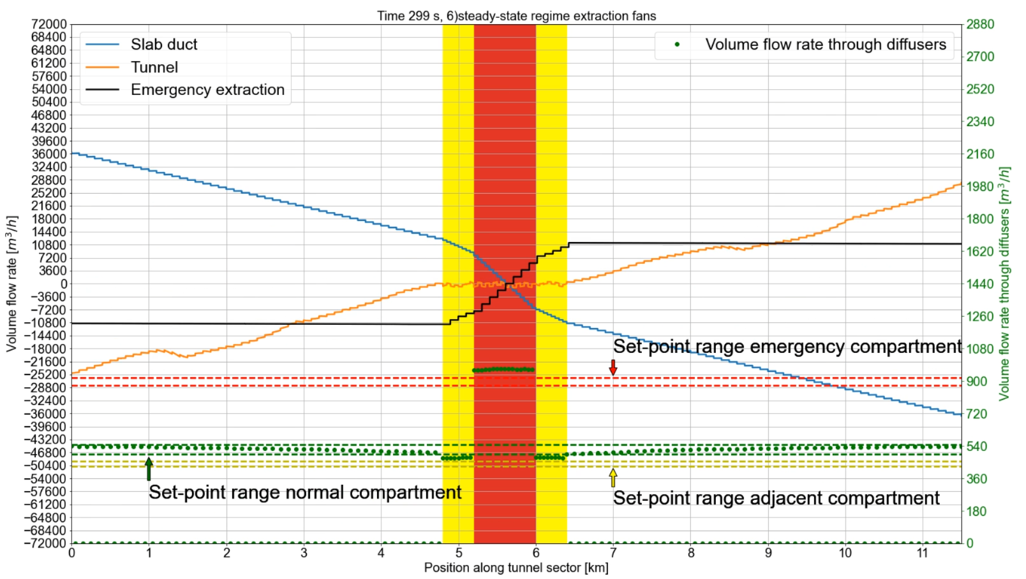
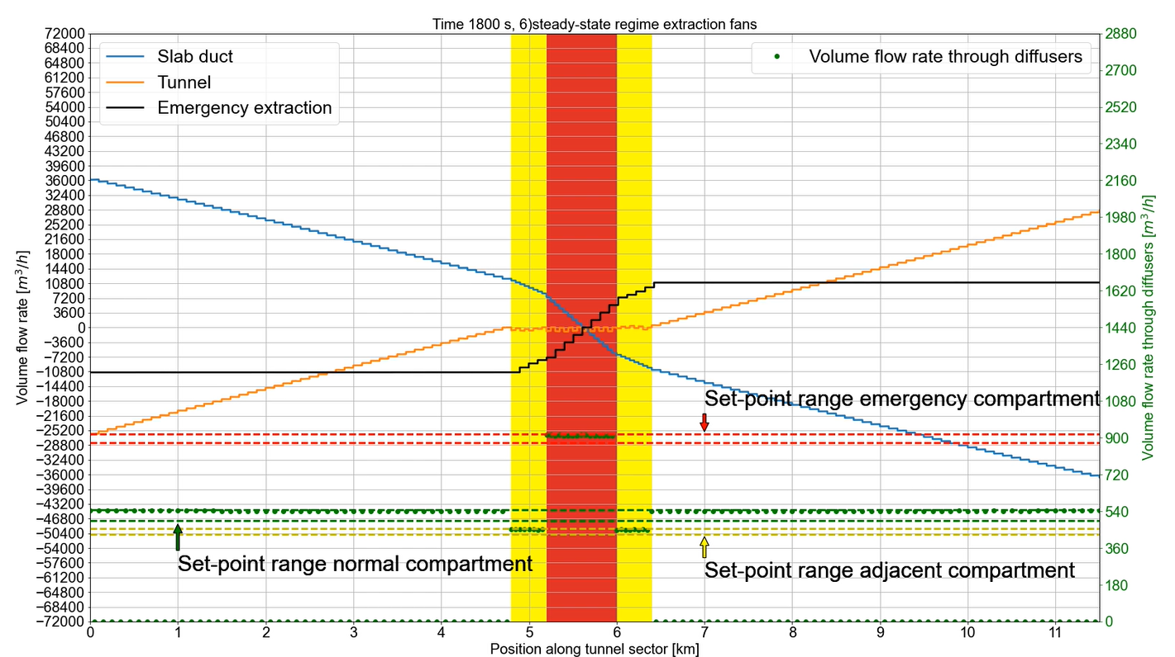
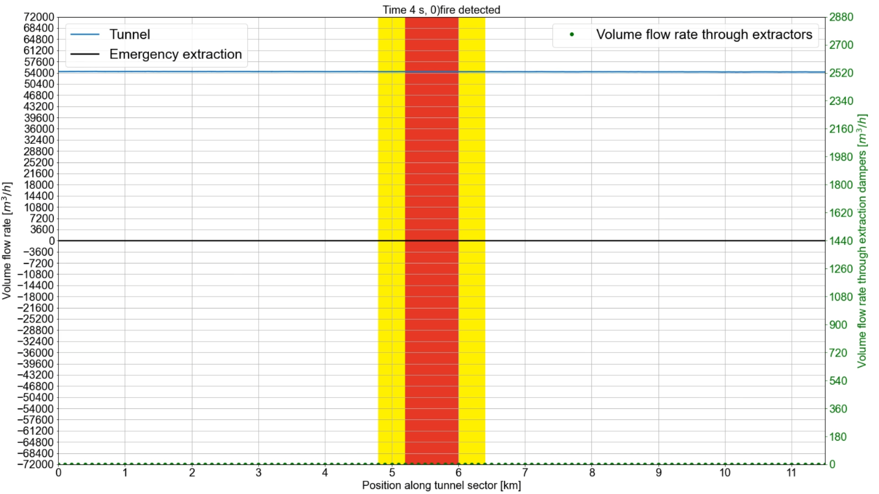
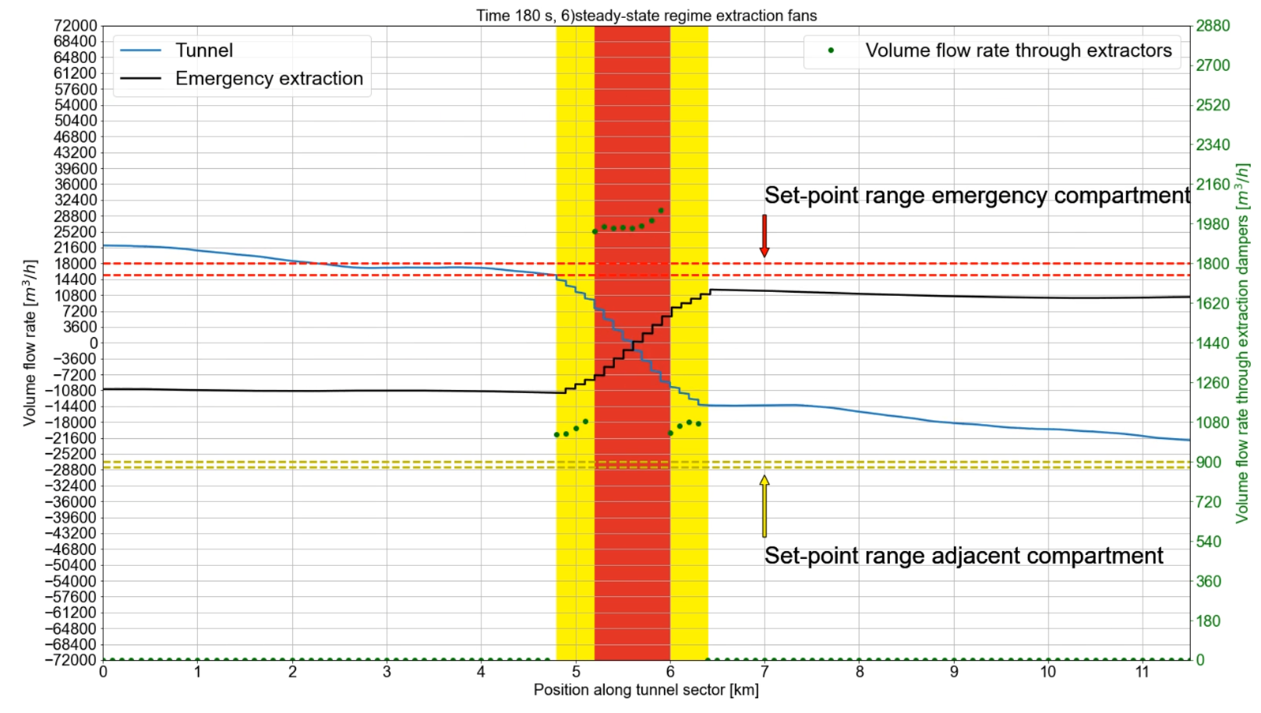
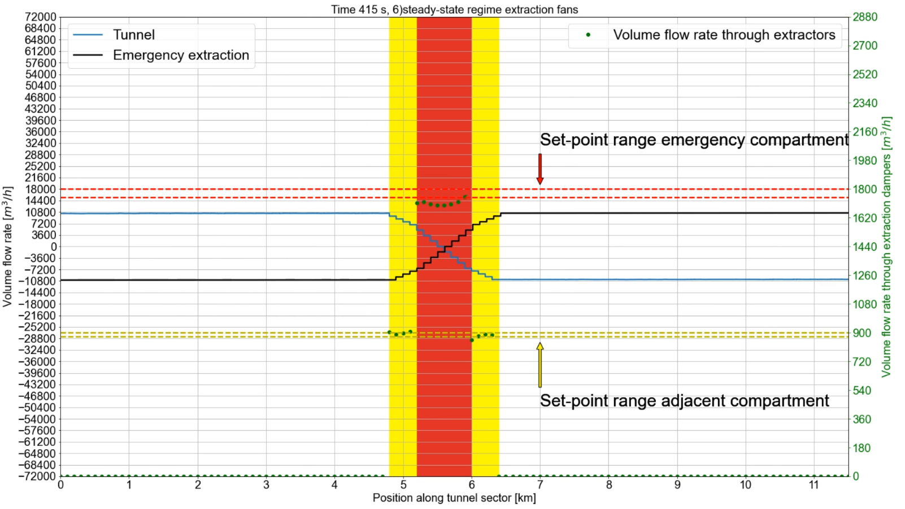
Inigo Martin Melero (CERN/EN/CV)
23
3. Update on tunnel concept
(-)
Adaptation Run / Access → Emergency
(+)
Signs criteria
Emergency in central compartment*
*With 7000 m³/h per affected compartment
Semi-transverse
0 min
3 min
15 min
SMOKE EXTRACTION CONDITIONS MET
STABLE
VENTILATION
Longitudinal
0 min
3 min
8 min
STABLE
VENTILATION
SMOKE EXTRACTION CONDITIONS MET

Slide 24
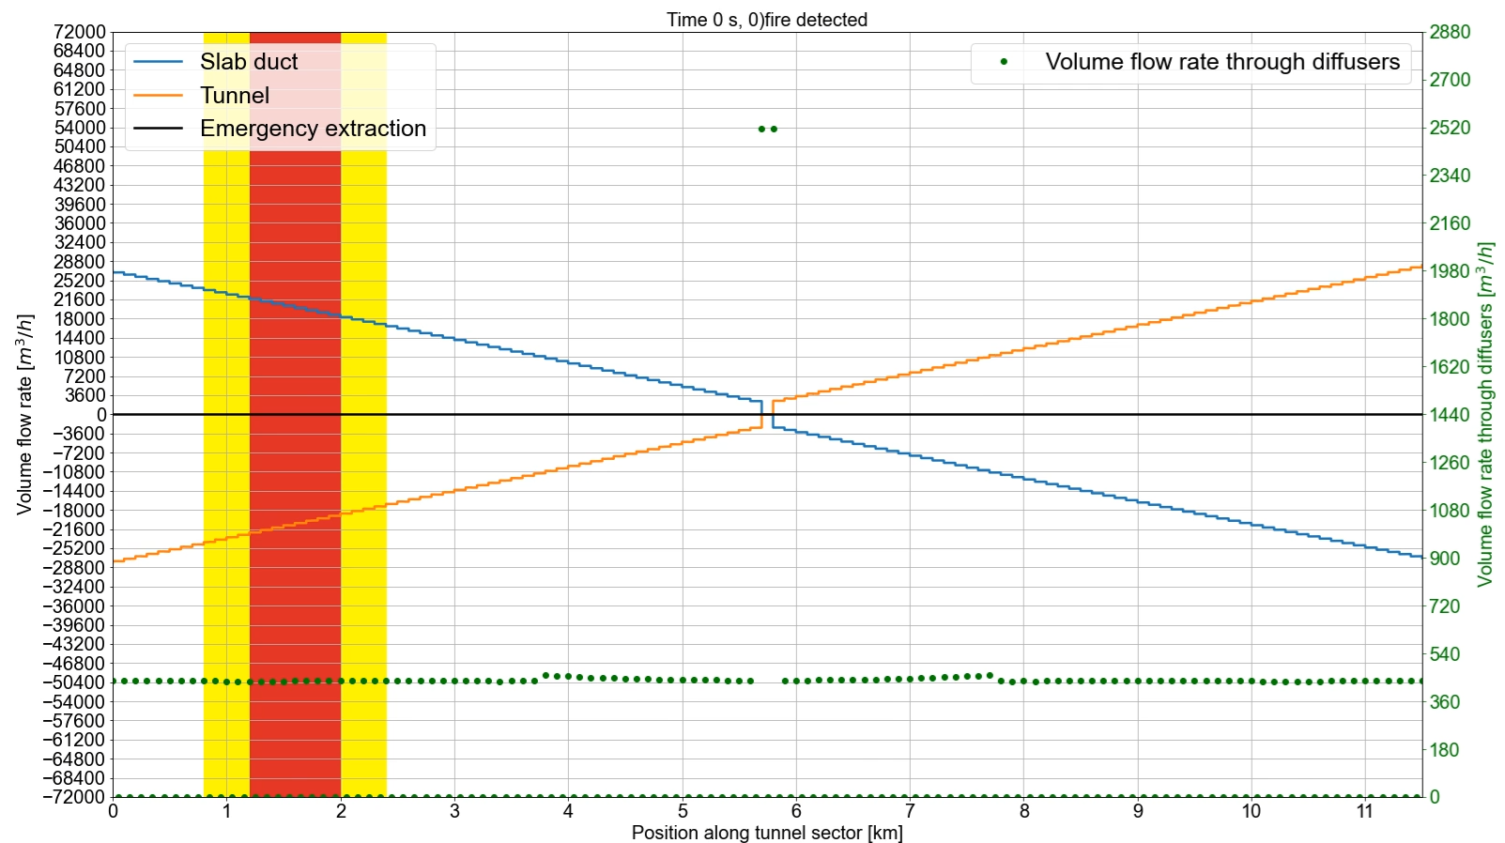
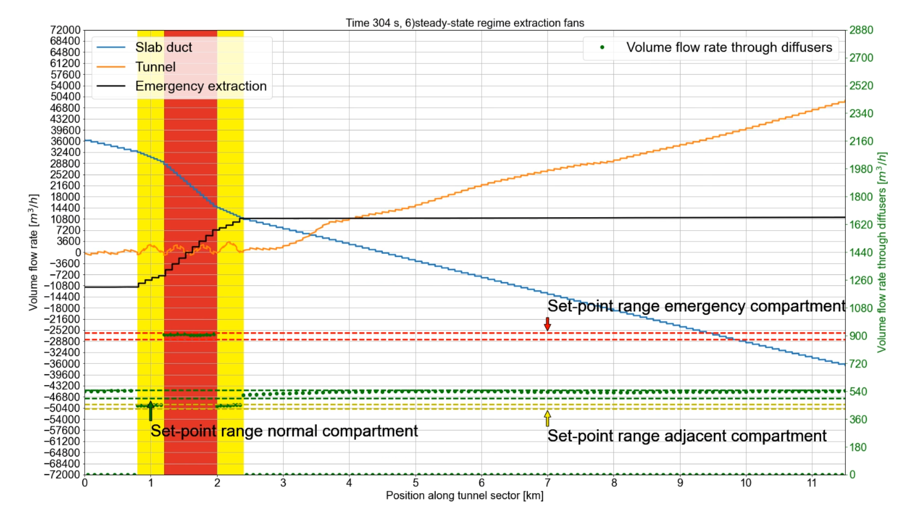
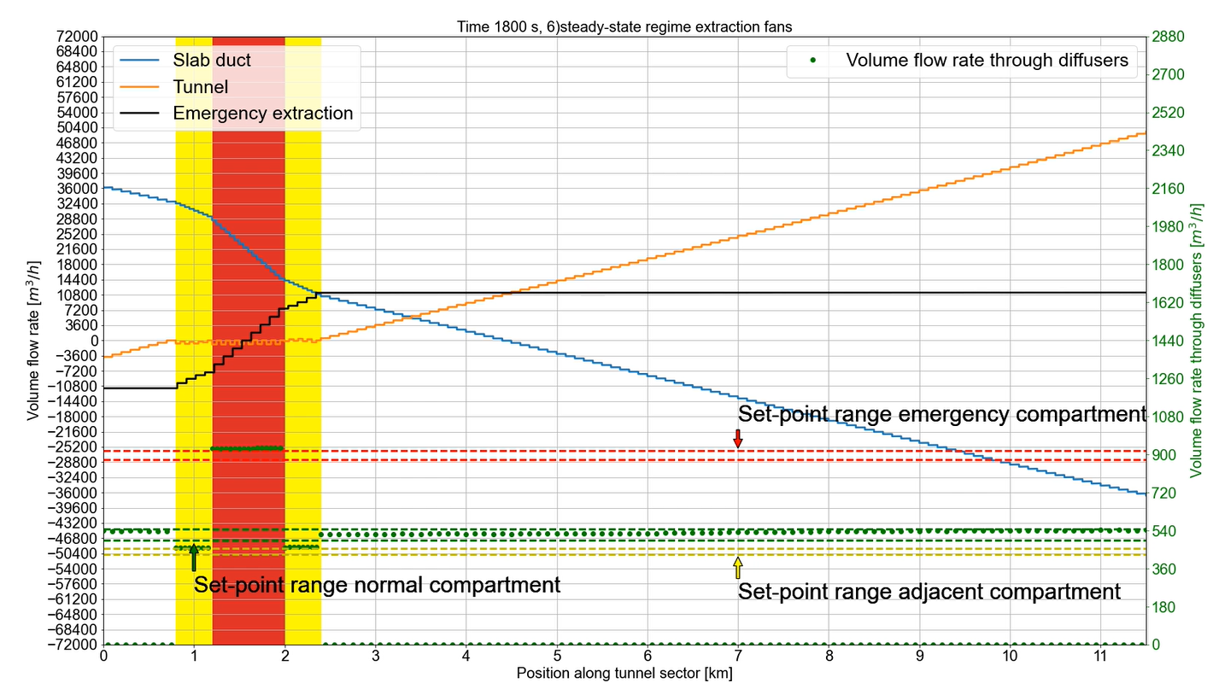
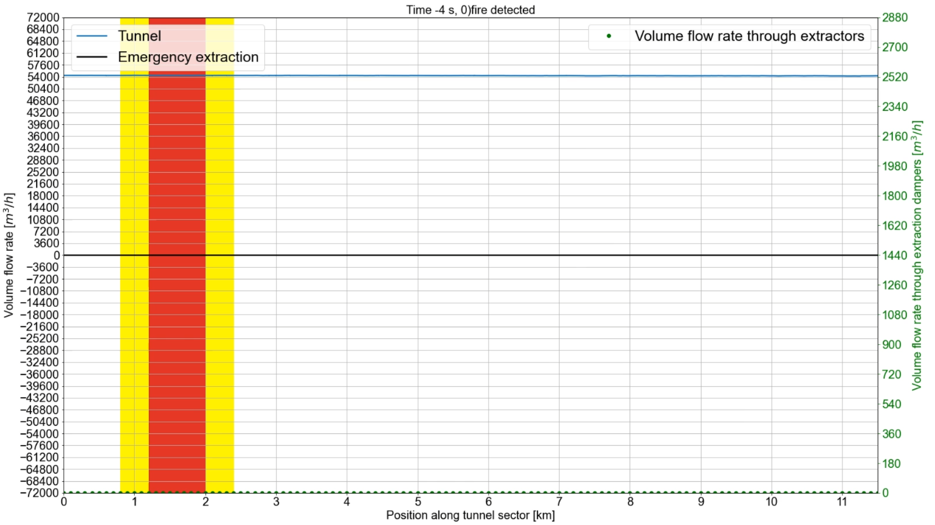
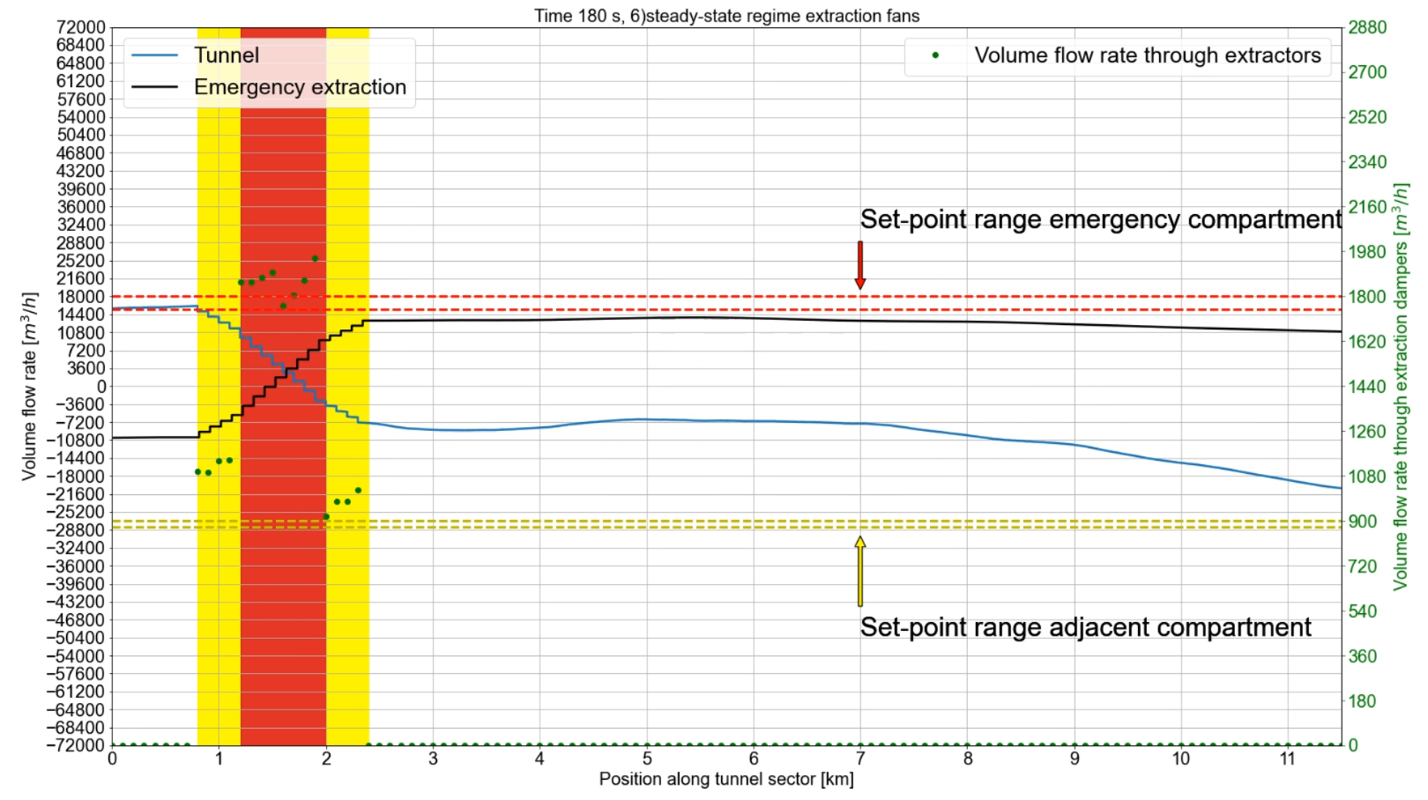
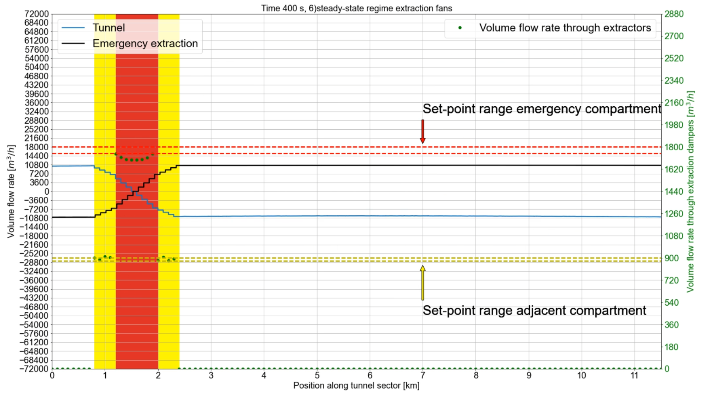
Inigo Martin Melero (CERN/EN/CV)
24
3. Update on tunnel concept
(-)
Adaptation Run / Access → Emergency
(+)
Signs criteria
Emergency in lateral compartment*
*With 7000 m³/h per affected compartment
Semi-transverse
0 min
3 min
15 min
SMOKE EXTRACTION CONDITIONS MET
STABLE
VENTILATION
Longitudinal
0 min
3 min
8 min
STABLE
VENTILATION
SMOKE EXTRACTION CONDITIONS MET

Slide 25
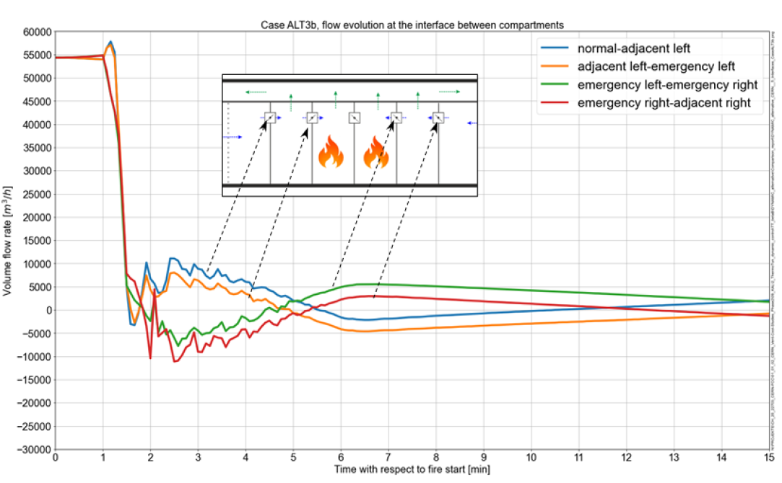
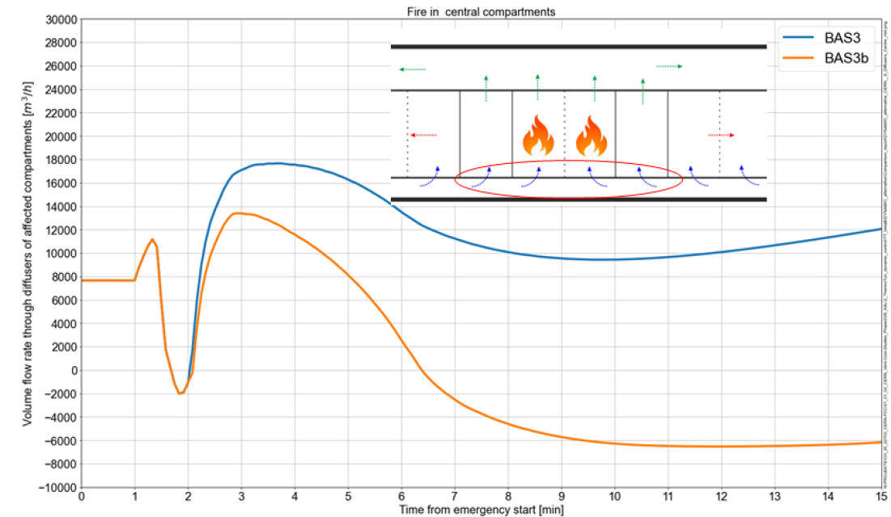


Inigo Martin Melero (CERN/EN/CV)
25
3. Update on tunnel concept
(-)
Fire heat effects
(+)
Signs criteria
Longitudinal
7000 m³/h per affected compartment
Considering heat release rate of fire
Local expansion of air due to fire heat
supply
7,000 m³/h
Prevention by increase in airflow
Inversion of the supply,
Smoke leaves fire-affected compartment
Inversion of supply
Semi-transverse
supply
14,000 m³/h
supply
14,000 m³/h
Inversion of supply
supply
7,000 m³/h

Slide 26








Inigo Martin Melero (CERN/EN/CV)
26
3. Update on tunnel concept
(-)
Pressure differences
(+)
Signs criteria
*With 10,000 m³/h per affected compartment, and a damper of 0.6 m²
Access / Run
Emergency, 1 compartment*
Maximum admissible opening force < 70 N
Required opening force = 87 N
Pressure drop across compartment walls with closed doors and opened emergency dampers: 36 Pa
Flushing
Emergency, 2 compartments*
Required opening force = 224 N
Pressure drop across compartment walls with closed doors and opened emergency dampers: 93 Pa
However, if damper increased to 1 m², we are below < 70 N in both cases.

Slide 27
Inigo Martin Melero (CERN/EN/CV)
27
3. Update on tunnel concept
Degraded modes
Cases
Longitudinal
Extraction Dampers
Wall Dampers
Semitransverse
Extraction Dampers
Emergency supply dampers
Normal Ventilation Dampers
Door
Door
Extraction dampers of adjacent and affected compartments do not open
The wall damper, open by default, closes.
Worst case: all dampers of affected and adjacent compartments close
The door does not close, it stays open
Extraction dampers of adjacent and affected compartments do not open
They don’t change position
They don’t open
Door does not close, it stays open
Supply from both extremes and no extraction will result in the tunnel being pressurized. There won’t be any flow, the smoke should behave as a case without any ventilation.
Asymmetric and incomplete smoke extraction.
Fire enclosed in the affected compartments by the walls. Depression created in the compartments, while pressure at door levels is much higher. Sliding door as pressure relief mechanism.
Compartmentalization is lost, but the smoke extraction would continue to work.
Affected and adjacent compartments are overpressured
Affected and adjacent compartments have higher flow than nominal values
The air supply will be smaller than in the nominal values. Smaller smoke extraction, slightly depressurized compartment.
Higher risk of smoke leaving the affected/adjacent compartments than in longitudinal.

Slide 28
Inigo Martin Melero (CERN/EN/CV)
28
4. Next steps
Analyze and decide between the semi-transverse ventilation or changing to the longitudinal concept
Interact with the rest of departments and exchange information: heat loads, ducts integration, sustainability considerations…
Further refine the design of special areas like Klystron Galleries, connecting tunnels, etc.
Proceed with the preTDR tasks defined for the ventilation part

Slide 29
Thank you
for your attention.
Thank you
for your attention.

Slide 30
Thank you
for your attention.
SPARES

Slide 31





Inigo Martin Melero (CERN/EN/CV)
ThermoTun software
Transient simulations
1D modelling software, developed by Dundee Tunnel Research and University of Dundee (Scotland).
Transitory analysis of air pressures and velocities.
Metro Melbourne
Citytunnel Frankfurt

Slide 32


Inigo Martin Melero (CERN/EN/CV)
Simulations
Configuration
Both the baseline, semi-transverse concept and the alternative, longitudinal concept are included in the simulations.
Simulation of the Run Modes.
Supply fans ramp up time: 60 s
Setpoint in damper of baseline concept ramp up time: 100 s
Simulation of Emergency Modes.
Timeline of events for transition
from Run to Emergency Modes

Slide 33

Inigo Martin Melero (CERN/EN/CV)
Longitudinal ventilation
Pressure on compartment
door
Rectangular fire dampers with dimensions 1.5 m x 0.4 m (free area 0.6 m²) are considered, to be moved from robot space.
Pressure difference across compartment walls must not hinder the opening of integrated doors in case of emergency
Maximal door opening force of 70 N shall not be exceeded. Accounting for the type and dimensions of the doors in the compartment walls (swing door with dimensions 1.5m x 3.0m), the maximal allowable pressure difference is 30 Pa.

