Slide 1


Slide 2
Installation schedule
22.05.2025 / FCC Week 2025
Sarah Fleury
S. Fleury | J.P Burnet | M. Bernardini
Together with valuable contributions of FCC teams

Slide 3
Outline
22.05.2025 / FCC Week 2025
Sarah Fleury
Civil engineering and installation schedules optimisation
Technical infrastructure sequence new inputs
Installation sequence in shafts, arcs and radio frequency points
Overall FCC-ee and FCC-hh installation schedule
Next steps

Slide 4
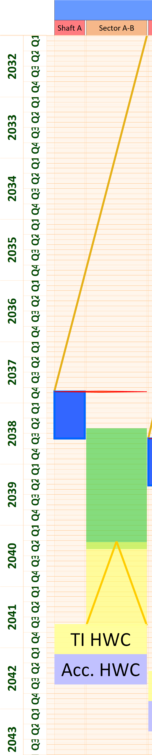
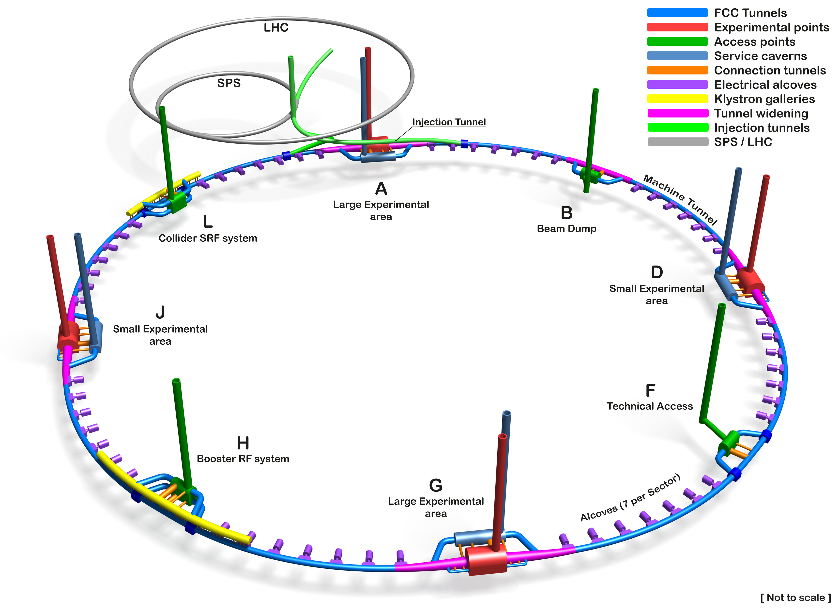
May 2024: Civil engineering strategy
22.05.2025 / FCC Week 2025
Sarah Fleury
Courtesy: Angel Navascues Cornago
During the FCC week 2024, civil engineering schedule included a single handover (shafts and one adjacent sector simultaneously).
In total, 8 such handovers are planned to initiate the installation sequence.
Handover
Shaft works
Technical infrastructure installation
Machine installation planning
Civil engineering release strategy explained with overall machine layout
Example of installation schedule from point A to point B with the single handover strategy

Slide 5
May 2024: Two schedules to be aligned
22.05.2025 / FCC Week 2025
Sarah Fleury
The single handover would imply:
  Shafts (for experimental points - 2 shafts): no possibility to start the installation in one shaft while civil engineering is still ongoing in the other.
FCC Machine layout

Slide 6
May 2024: Two schedules to be aligned
22.05.2025 / FCC Week 2025
Sarah Fleury
The single handover would imply:
  Shafts (for experimental points - 2 shafts): no possibility to start the installation in one shaft while civil engineering is still ongoing in the other.
  Arcs: no activity could take place there, before the completion of necessary shaft works (delay of several months).
FCC Machine layout

Slide 7
May 2024: Two schedules to be aligned
22.05.2025 / FCC Week 2025
Sarah Fleury
The single handover would imply:
  Shafts (for experimental points - 2 shafts): no possibility to start the installation in one shaft while civil engineering is still ongoing in the other.
  Arcs: no activity could take place there, before the completion of necessary shaft works (delay of several months).
Opportunity for schedule optimisation
FCC Machine layout
Notes:
Mention 4 out of 8 exp points

Slide 8
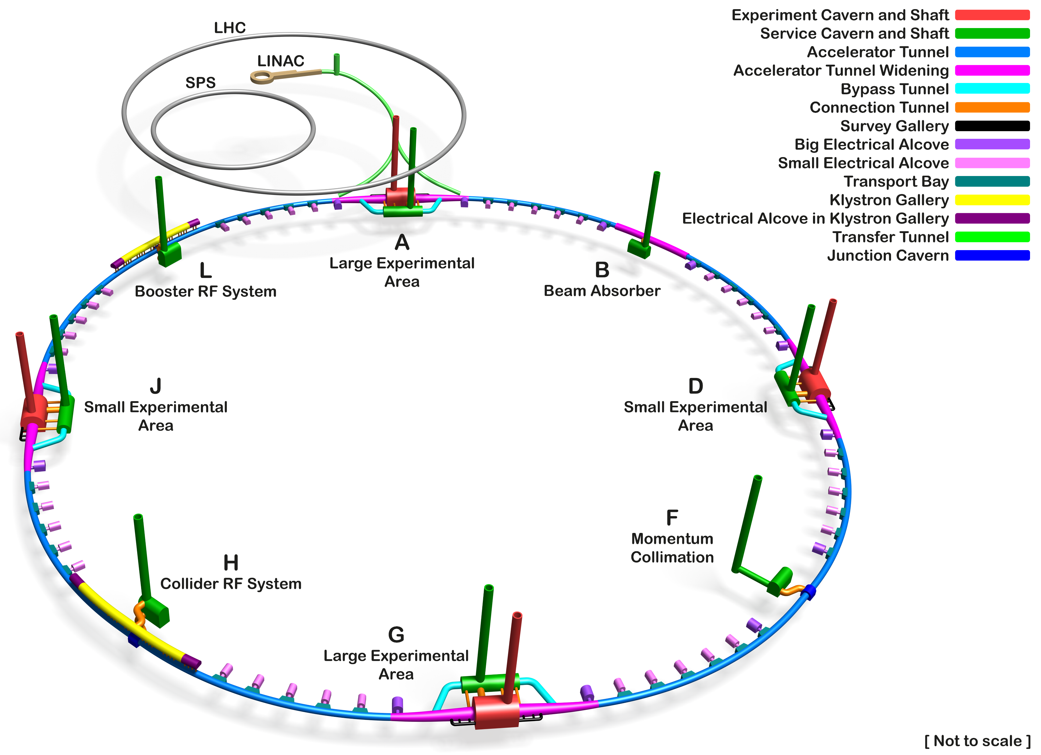
Post FCC Week 2024: optimization
22.05.2025 / FCC Week 2025
Sarah Fleury
Until the end of the feasibility study, several iterations with civil engineering were conducted to define an optimal and feasible handover strategy:
The Tunnel Boring Machines (TBM) will be extracted from
the experimental points.
  This enables for an earlier release of technical shaft.
  The installation in the arc can start only after the TBM drive.
1. Technical shaft release
FCC Machine layout

Slide 9
Post FCC Week 2024: optimization
22.05.2025 / FCC Week 2025
Sarah Fleury
2. Arc gradual release corresponding distance between two alcoves
Until the end of the feasibility study, several iterations were conducted to define an optimal and feasible handover strategy:
The Tunnel Boring Machines (TBM) will be extracted from
the experimental points.
  This enables for an earlier release of technical shaft.
  The installation in the arc can start only after the TBM drive.
Multiple arc releases phases are foreseen, each covering at least one alcove and ~1600 metres of tunnel.
  This strategy implies two independent worksites along the arc: final civil engineering works and installation activities.
  This allows an anticipated start of installation across the arc.
FCC Machine layout

Slide 10
Post FCC Week 2024: optimization
22.05.2025 / FCC Week 2025
Sarah Fleury
Until the end of the feasibility study, several iterations were conducted to define an optimal and feasible handover strategy:
The Tunnel Boring Machines (TBM) will be extracted from
the experimental points.
  This enables for an earlier release of technical shaft.
  The installation in the arc can start only after the TBM drive.
Multiple arc releases phases are foreseen, each covering at least one alcove and ~1600 metres of tunnel.
  This strategy implies two independent worksites along the arc: final civil engineering works and installation activities.
  This allows an anticipated start of installation across the arc.
3. Experimental shaft
FCC Machine layout

Slide 11
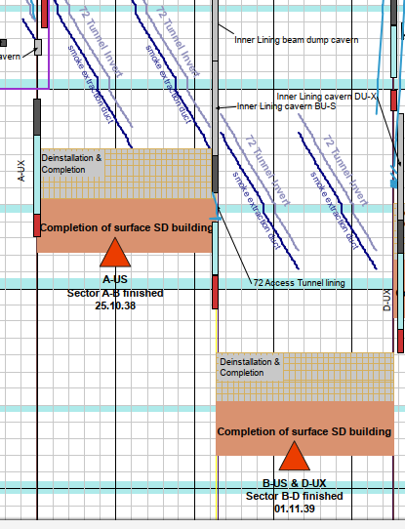
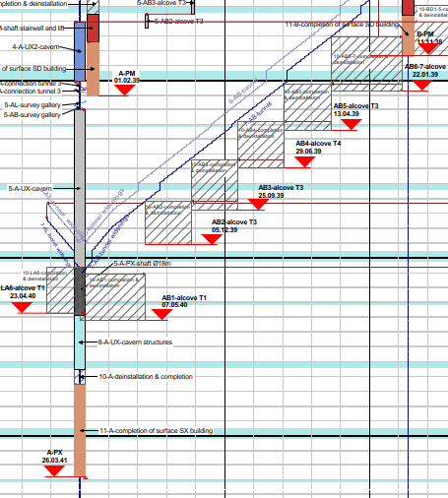
Impact on installation schedule
22.05.2025 / FCC Week 2025
Sarah Fleury
Courtesy: Civil engineering team
Courtesy: Civil engineering team
Shaft works
Shaft works
Underground technical infrastructure
Shaft works
Underground technical infrastructure
Machine installation
Machine installation
Shaft works
Underground technical infrastructure
May 2024 civil engineering schedule with main installation blocks
May 2025 civil schedule with main installation blocks
Machine installation
A significant part of technical infrastructure work is in the shadow of civil engineering schedule
Simulation planning

Slide 12
Outline
22.05.2025 / FCC Week 2025
Sarah Fleury
Civil engineering and installation schedules optimisation
Technical infrastructure sequence new inputs
Installation sequence in shafts, arcs and radio frequency points
Overall FCC-ee and FCC-hh installation schedule
Next steps

Slide 13
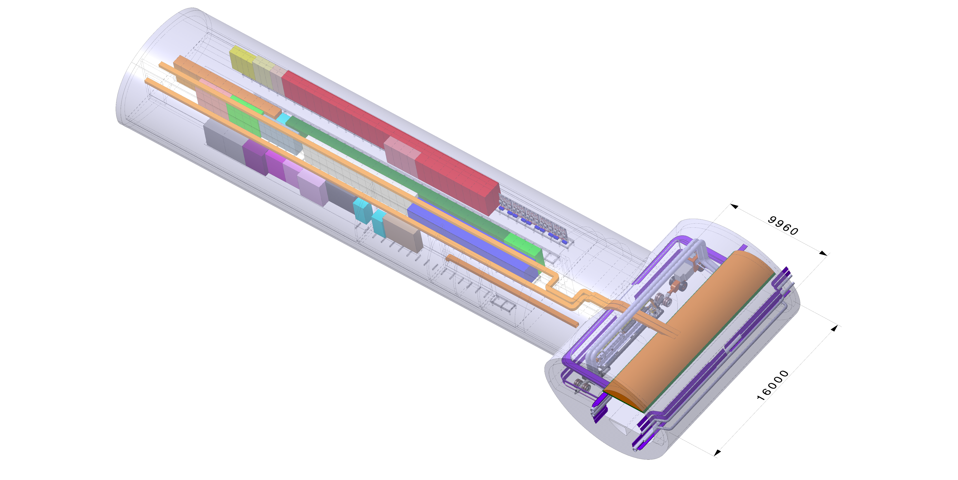
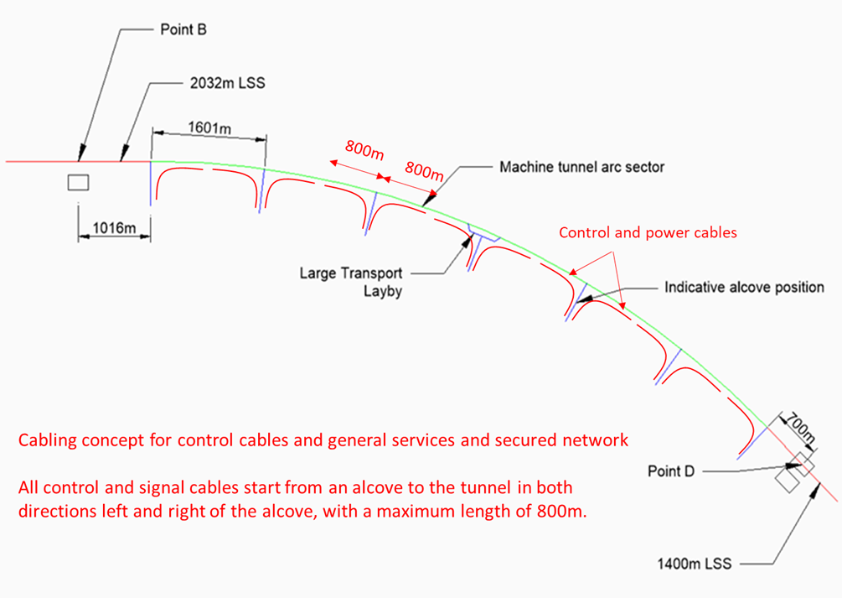
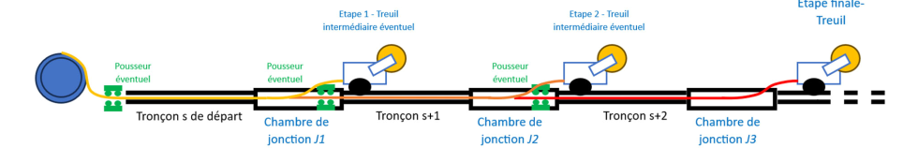
EN-EL technical infrastructure installation
22.05.2025 / FCC Week 2025
Sarah Fleury
Courtesy: Fani Valchkova-Georgieva
Small alcoves integration
Alcove installation duration:
Installing a small alcove, including all required equipment up to commissioning, takes approximately 18 weeks (based on 1 team working in 1 shift).
This should be completed prior to the start of high-voltage cabling activities.
Courtesy: Jean-Paul Burnet
Courtesy: EN-EL team
Installation methodology of High Voltage cable needs
Alcoves layout along the arc

Slide 14
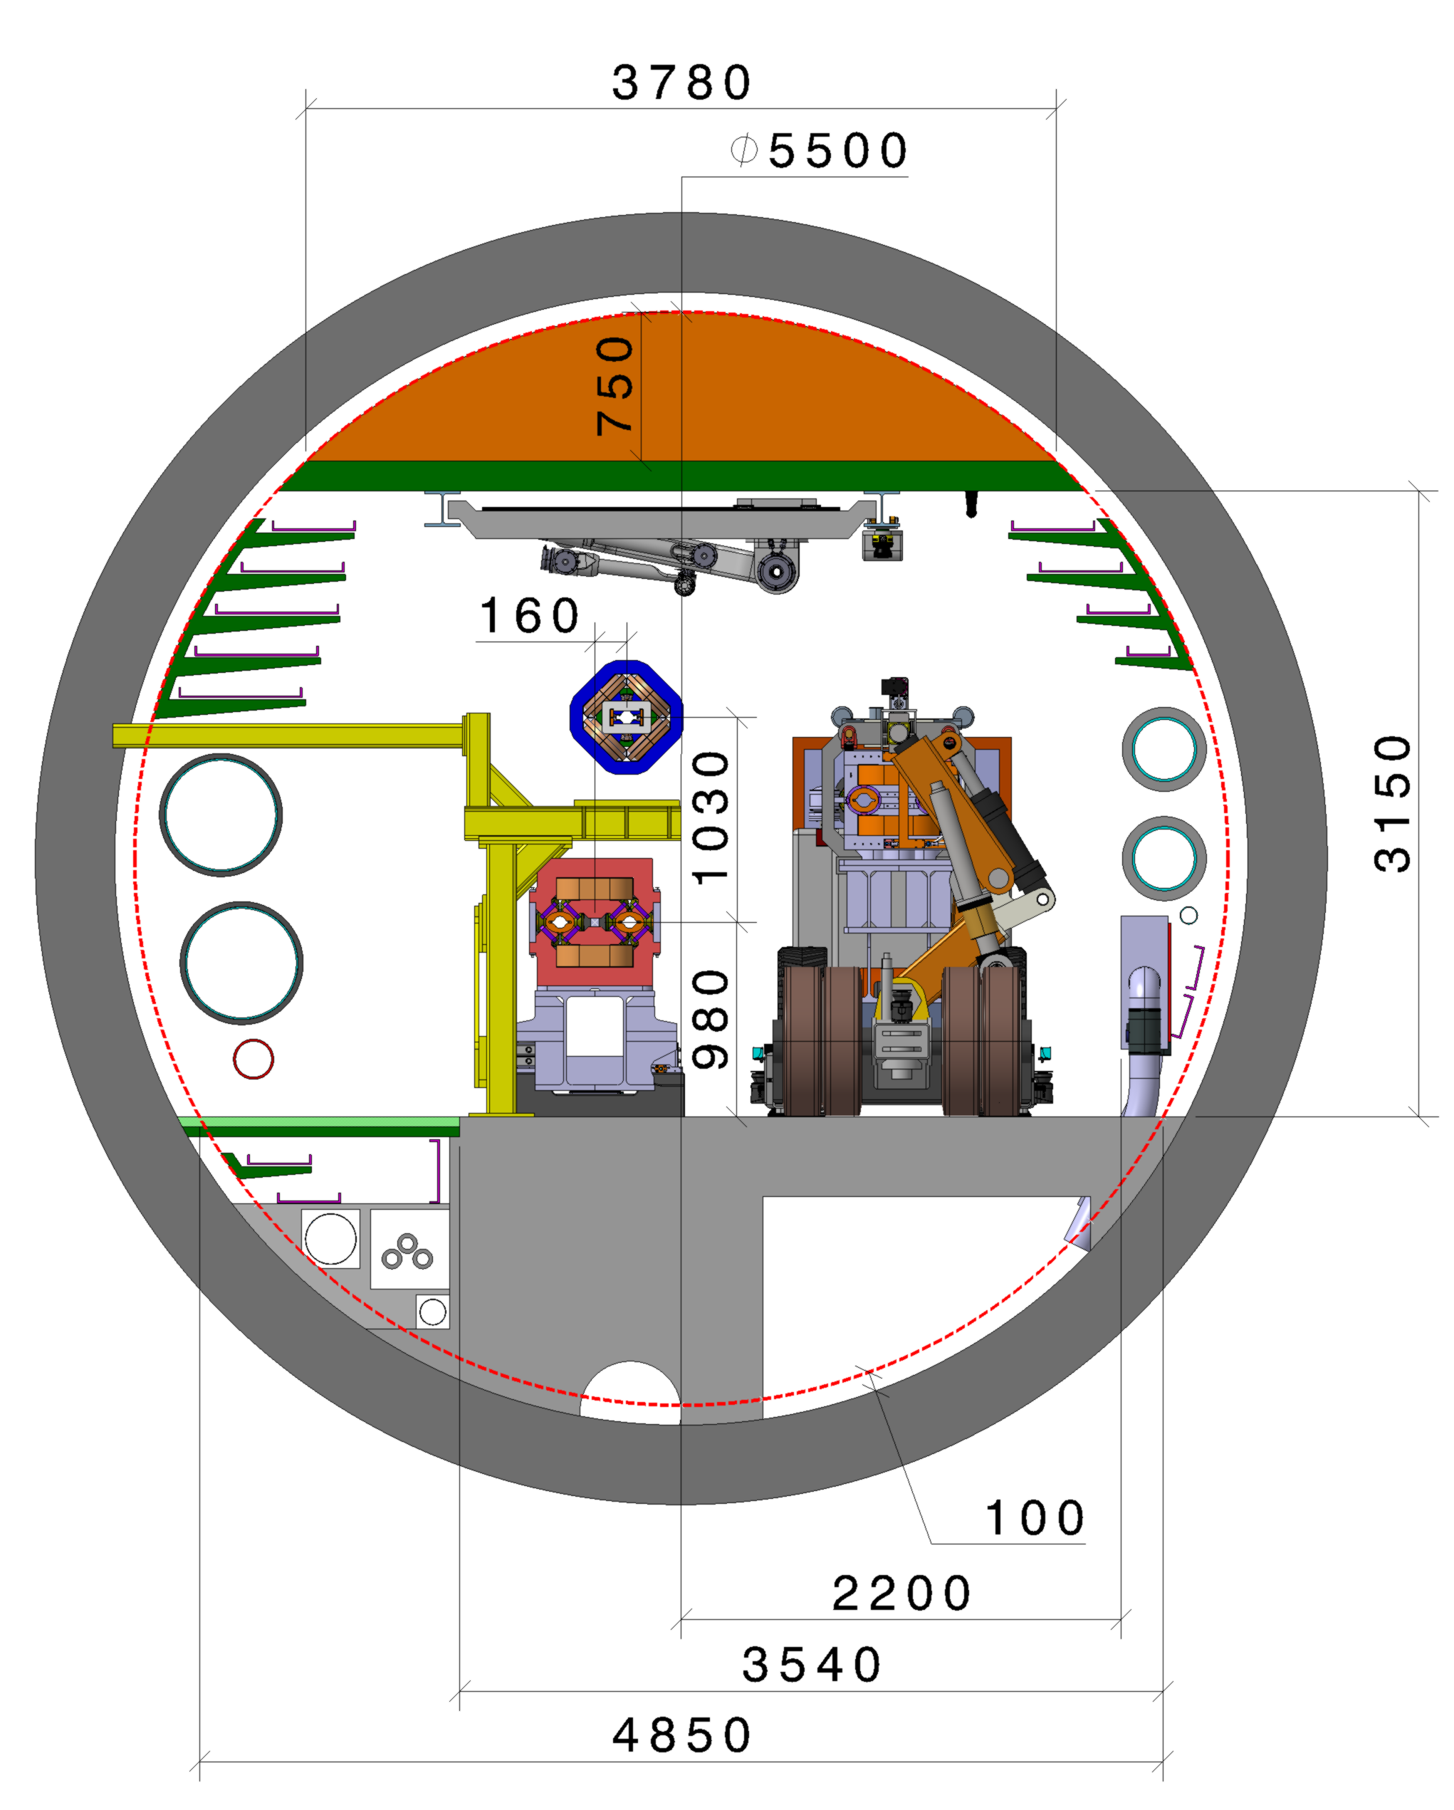
EN-EL input for technical infrastructure installation
22.05.2025 / FCC Week 2025
Sarah Fleury
Courtesy: Fani Valchkova-Georgieva
High-voltage cable installation considerations:
The currently planned cable drum (which covers one alcove distance of cable) is too large to fit in the tunnel.
Only one cable tube is available to transport the cable along the arc.
  The closest accessible cable tube must be used to install cables in the furthest sections. The installation requires the overall arc released by civil engineering.
Work is carried out in front of the alcoves. Installation in the arc is possible only if the winch can be positioned within the transport corridor.
FCC cross section
in the arcs
Courtesy: Jean-Paul Burnet
Courtesy: EN-EL team
Installation methodology of High Voltage cable needs
Alcoves layout along the arc

Slide 15
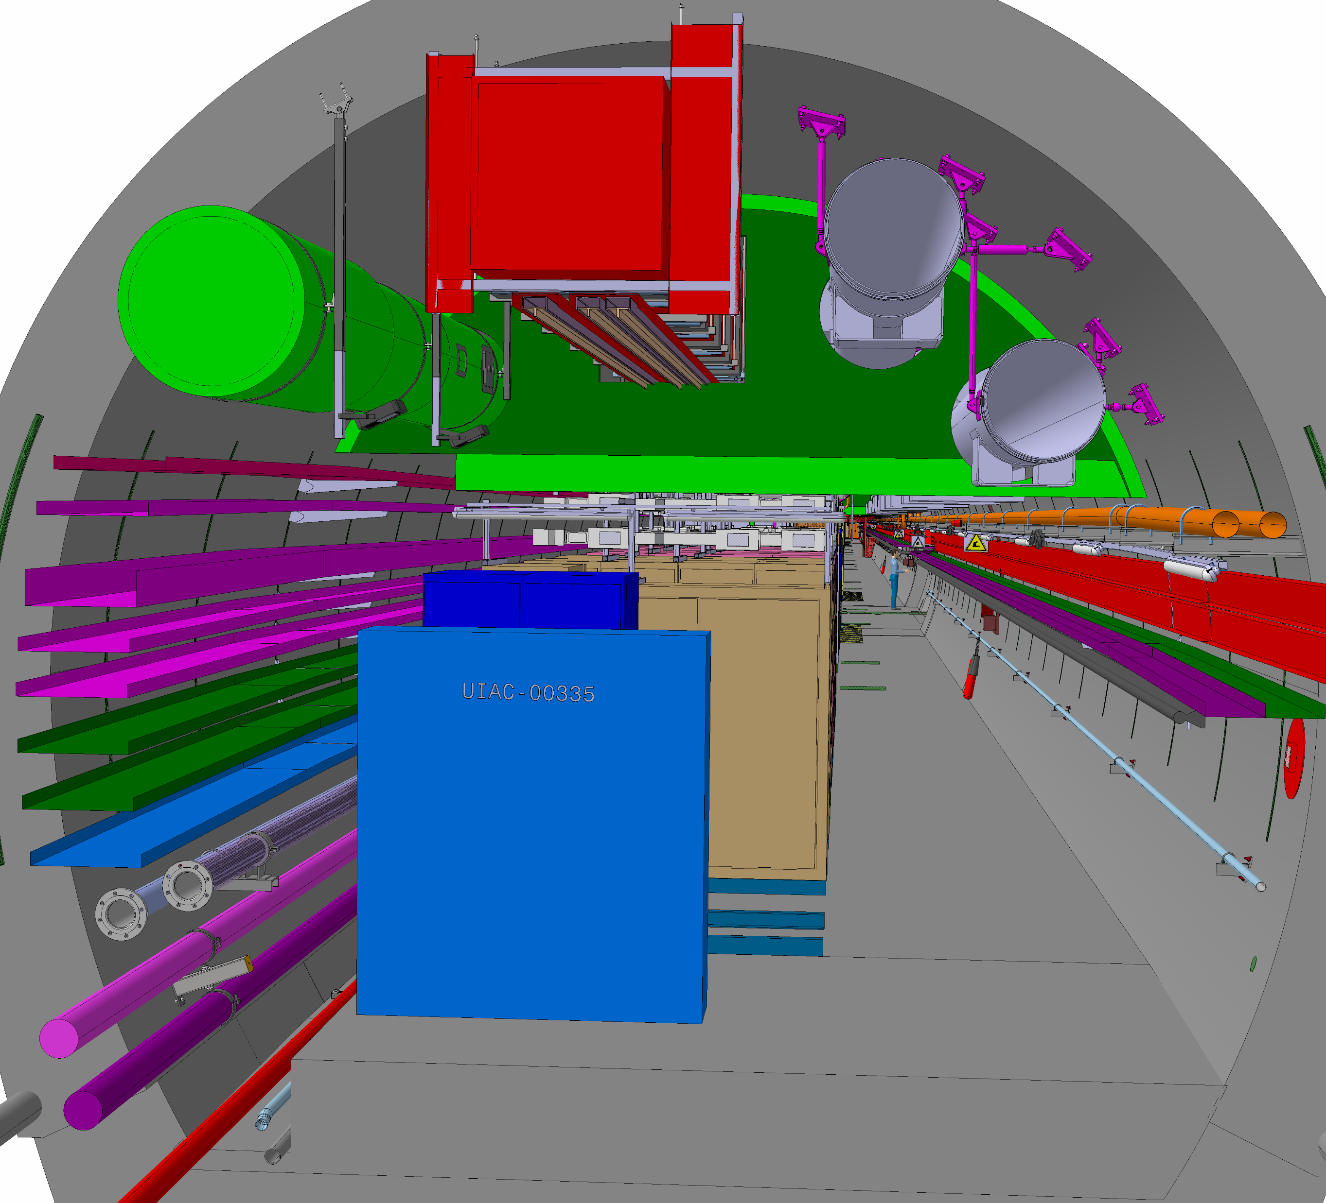
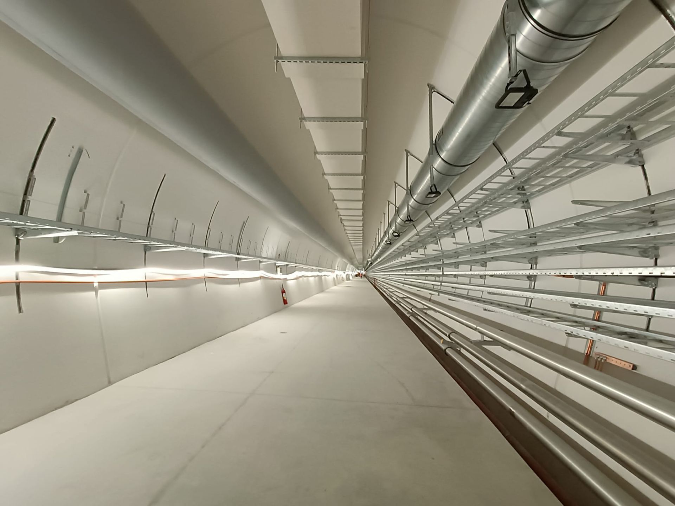
HL-LHC feedback & sequence
22.05.2025 / FCC Week 2025
Sarah Fleury
Courtesy: Fani Valchkova-Georgieva
FCC cross section
in the arcs
Many thanks to Henry de Maynard and Thomas Bauler managing installation of HL-LHC galleries for their valuable input !
Courtesy: Stéphane Maridor
Courtesy: Henry de Maynard
HL-LHC cross-section of underground galleries in point 1 and point 5 extracted from 3D reference ST1120748_01 12/05/2025
Picture of Point 5 underground gallery
The most recent tunnel construction and underground installation of service galleries (80 m deep and 300 m long) was carried out at Points 1 and 5 of the LHC.
The FCC technical infrastructure design draws on the experience gained from the HL-LHC project.
Notes:
The number of cable trays is comparable, although the HL-LHC uses smaller ducts. Smoke extraction and ventilation ducts are not integrated into the concrete structure, and no alcoves are provided along the tunnel.

Slide 16
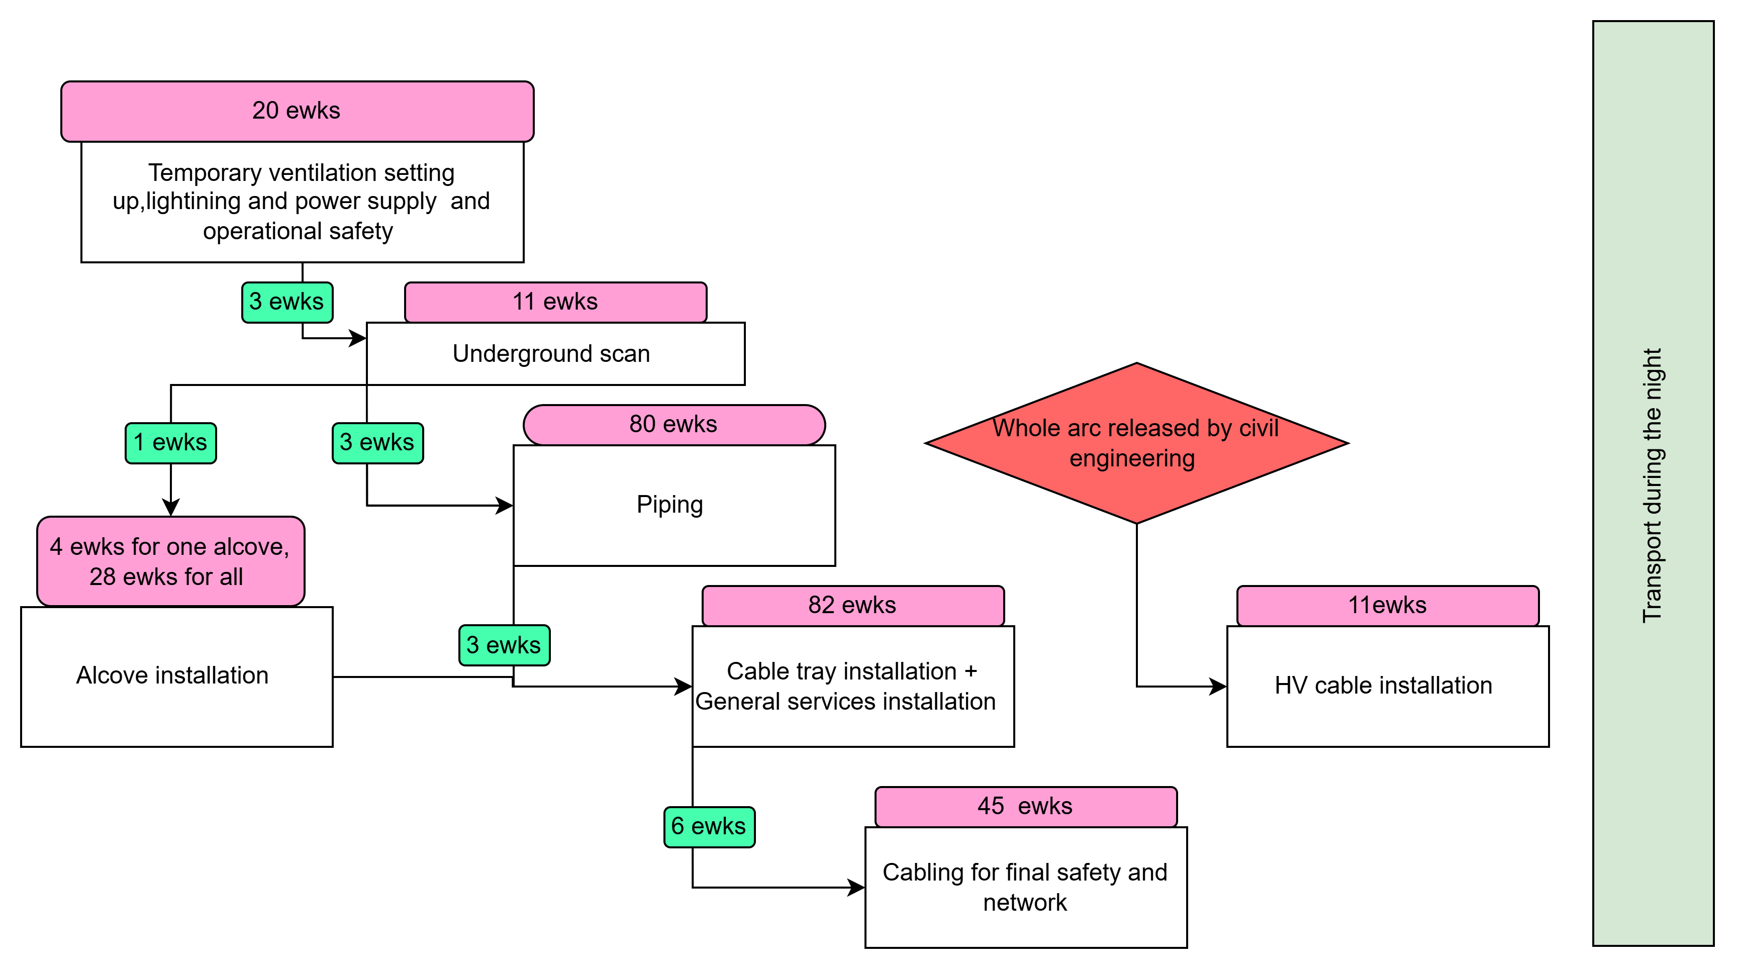
Technical infrastructure sequence in arcs
22.05.2025 / FCC Week 2025
Sarah Fleury
Fits within the 2-year slot
Detailed sequence for technical infrastructure installation and related duration for the entire arc

Slide 17
Hypothesis and parameters for technical infrastructure installation
22.05.2025 / FCC Week 2025
Sarah Fleury
Technical infrastructure installation in the arc is foreseen as follows:
The durations are expressed in calendar days.
Installation activities are planned in two shifts dedicated to installation and one shift for transport.
Disclaimer: For reference, this corresponds to a pace approximately four times faster than HL-LHC installation rates. However, due to the larger scale of the FCC project and the associated need for automation, the effort required for technical infrastructure installation differs significantly from that of HL-LHC.

Slide 18
Outline
22.05.2025 / FCC Week 2025
Sarah Fleury
Civil engineering and installation schedules optimisation
Technical infrastructure sequence new inputs
Installation sequence in shafts, arcs and radio frequency points
Overall FCC-ee and FCC-hh installation schedule
Next steps

Slide 19
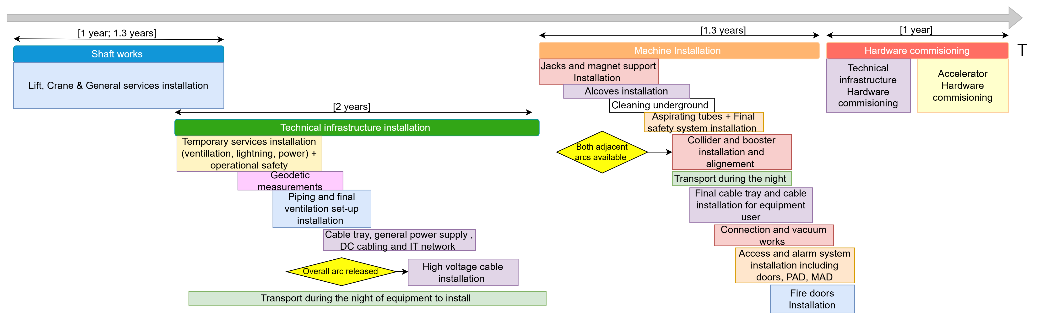
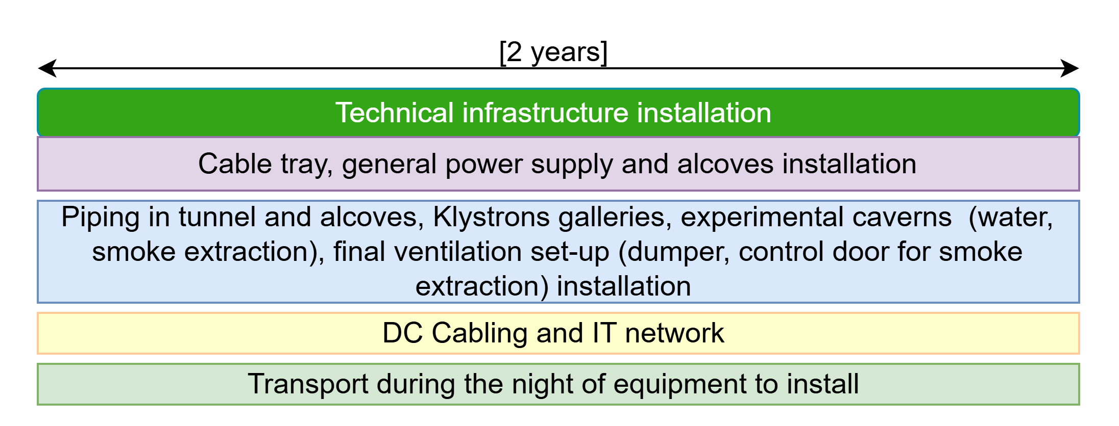
General arc sequence
22.05.2025 / FCC Week 2025
Sarah Fleury
Sequence for technical shaft and arc installation
May 2024 sequence of technical infrastructure installation
The installation sequence follows the same block structure as presented last year. The sequence for the technical infrastructure has since been refined into a train-like progression.
According to the resource-loaded schedule, a maximum of four arcs can be in the same installation phase simultaneously (i.e., within the same main block).

Slide 20
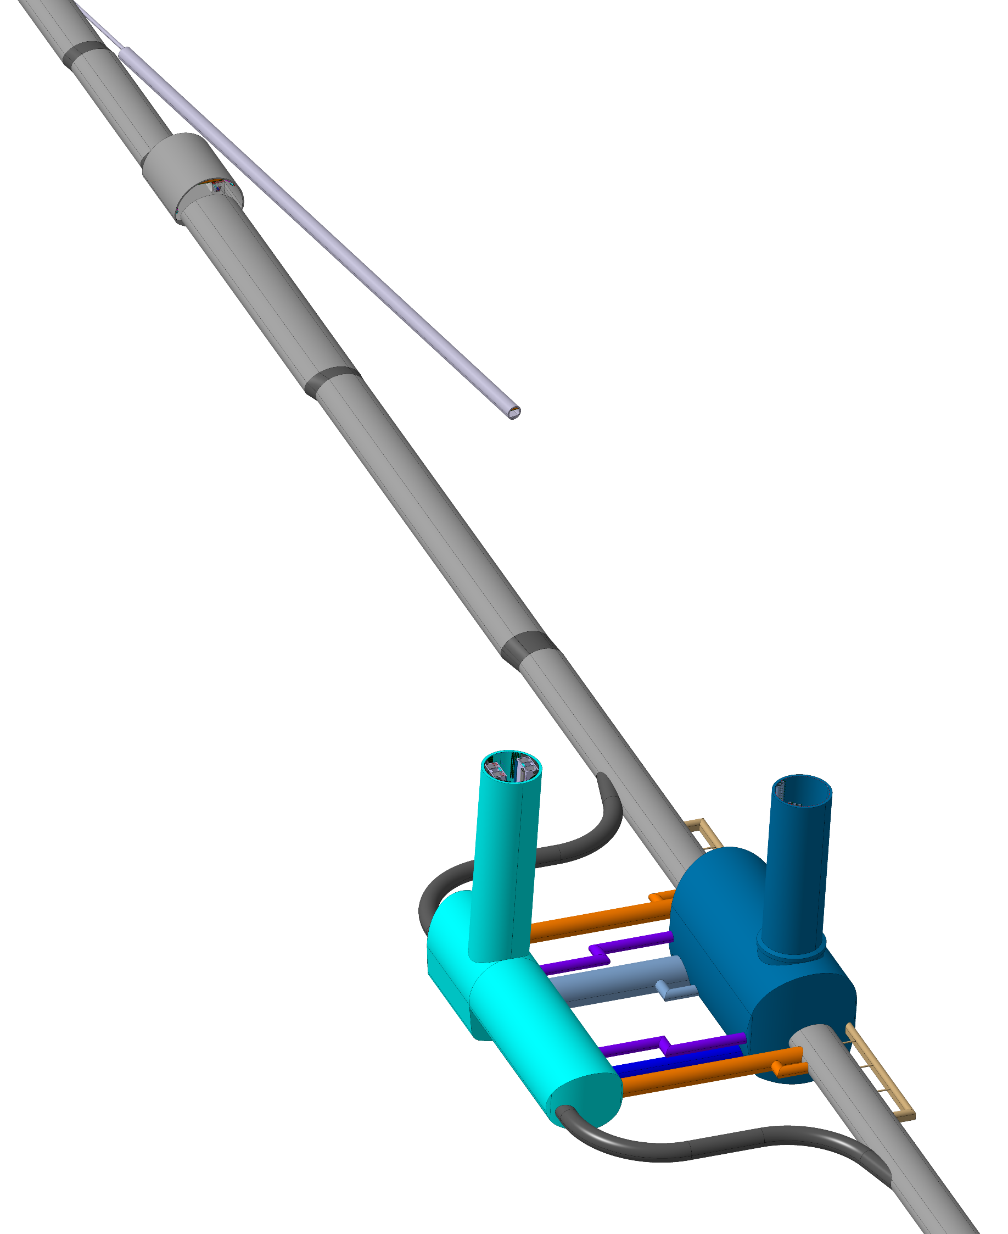
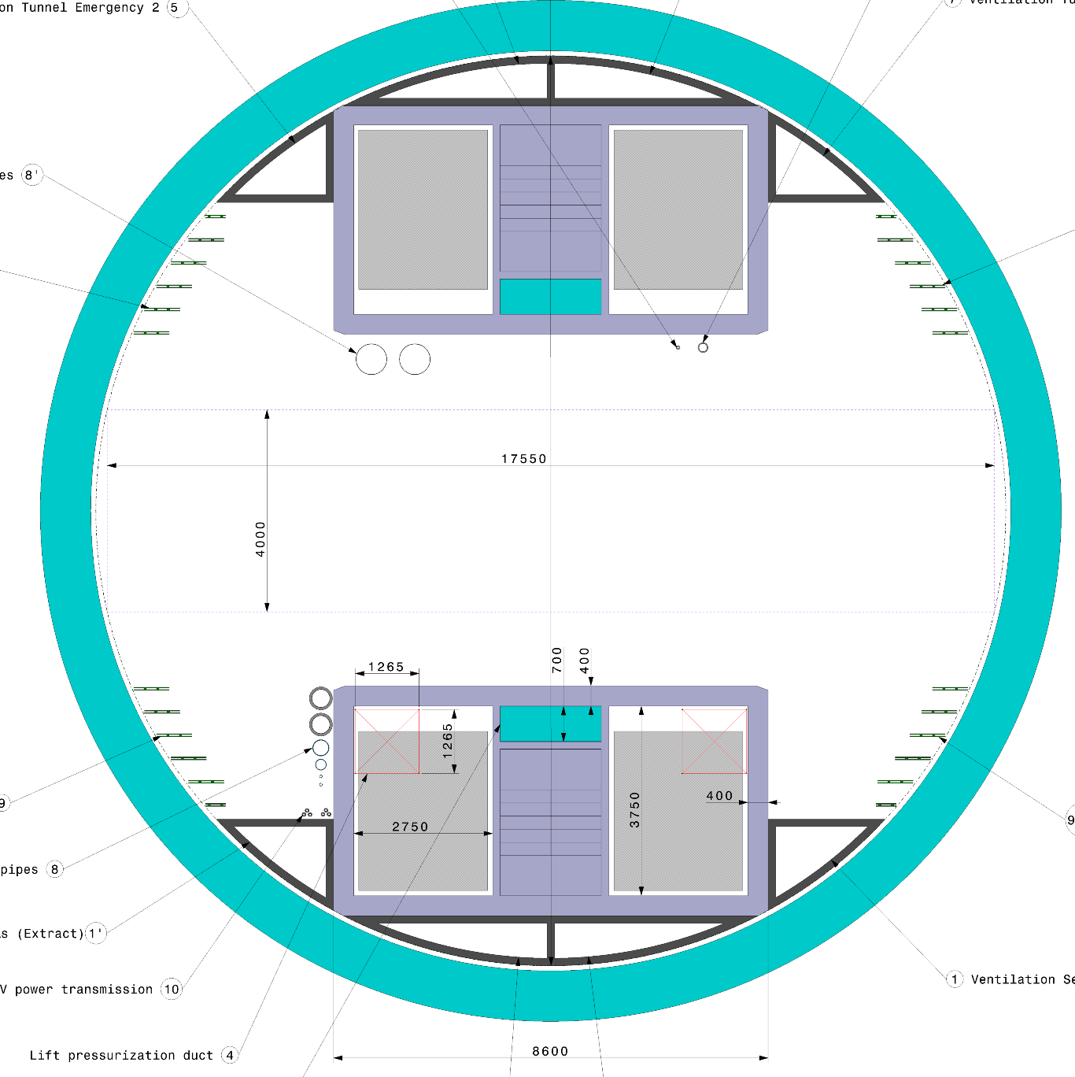
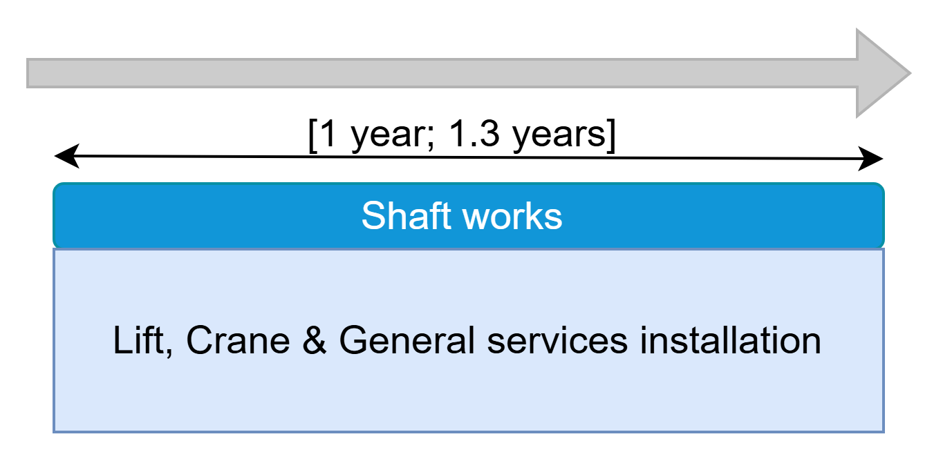
Technical shaft installation
22.05.2025 / FCC Week 2025
Sarah Fleury
Crane
Temporary services
Accelerator tunnel
3. Lifts
4. Final general services (duct, pipes, cable tray and cable)
Service Shaft ø18.2m
Courtesy: Fani Valchkova-Georgieva
Service shaft at Point A with respect to the tunnel and the experiment cavern
Point A service shaft integration

Slide 21
Arc layout after the handover from civil engineering
22.05.2025 / FCC Week 2025
Sarah Fleury
He/Smoke extraction
Courtesy: Fani Valchkova-Georgieva
Cross-section of the arcs
Drain
Fresh air duct

Slide 22
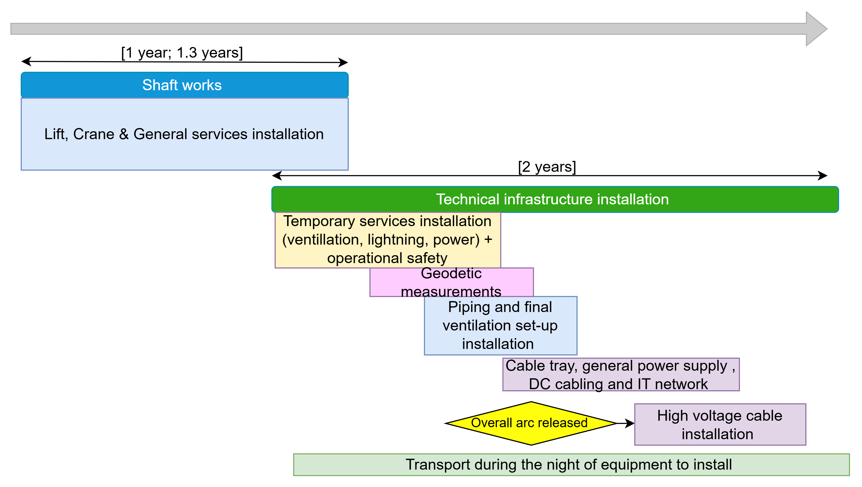
Technical infrastructure installation in arcs
22.05.2025 / FCC Week 2025
Sarah Fleury
He/Smoke extraction
5 Cable trays
4 Cable trays
Chilled water
DN300
Demineralized water
DN550
Transport space reservation
2.2m x 2.25m (LxH)
He recovery line
Compressed air DN80
3 Cable trays
Raw water DN250
2 Cable trays
Courtesy: Fani Valchkova-Georgieva
Reject water
DN125
Fresh air duct
Cross-section of the arcs
HV Cable
Drain

Slide 23
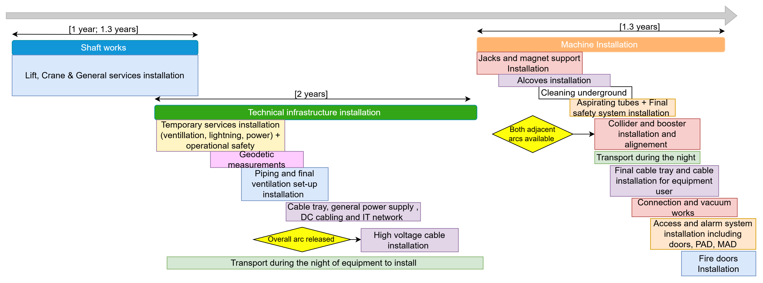
Machine installation in arcs
22.05.2025 / FCC Week 2025
Sarah Fleury
Robot space reservation
He/Smoke extraction
5 Cable trays
4 Cable trays
Collider ring
Chilled water
DN300
Magnet vehicle
Transport space reservation
2.2m x 2.25m (LxH)
Demineralized water
DN550
He recovery line
Compressed air DN80
3 Cable trays
Raw water DN250
2 Cable trays
Courtesy: Fani Valchkova-Georgieva
Reject water
DN125
Cross-section of the arcs
HV Cable
Drain
Fresh air duct

Slide 24

Hardware commissioning
22.05.2025 / FCC Week 2025
Sarah Fleury
Robot space reservation
He/Smoke extraction
5 Cable trays
4 Cable trays
Collider ring
Chilled water
DN300
Magnet vehicle
Transport space reservation
2.2m x 2.25m (LxH)
Demineralized water
DN550
He recovery line
Compressed air DN80
3 Cable trays
Raw water DN250
2 Cable trays
Courtesy: Fani Valchkova-Georgieva
Reject water
DN125
Cross-section of the arcs
HV Cable
Drain
Fresh air duct

Slide 25
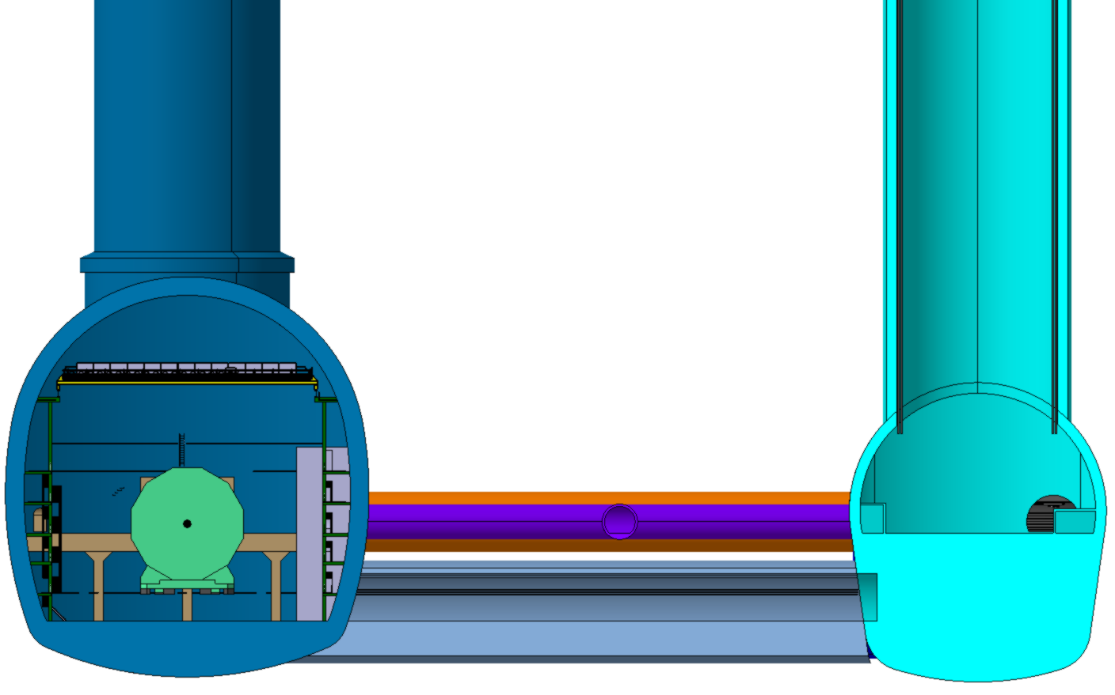
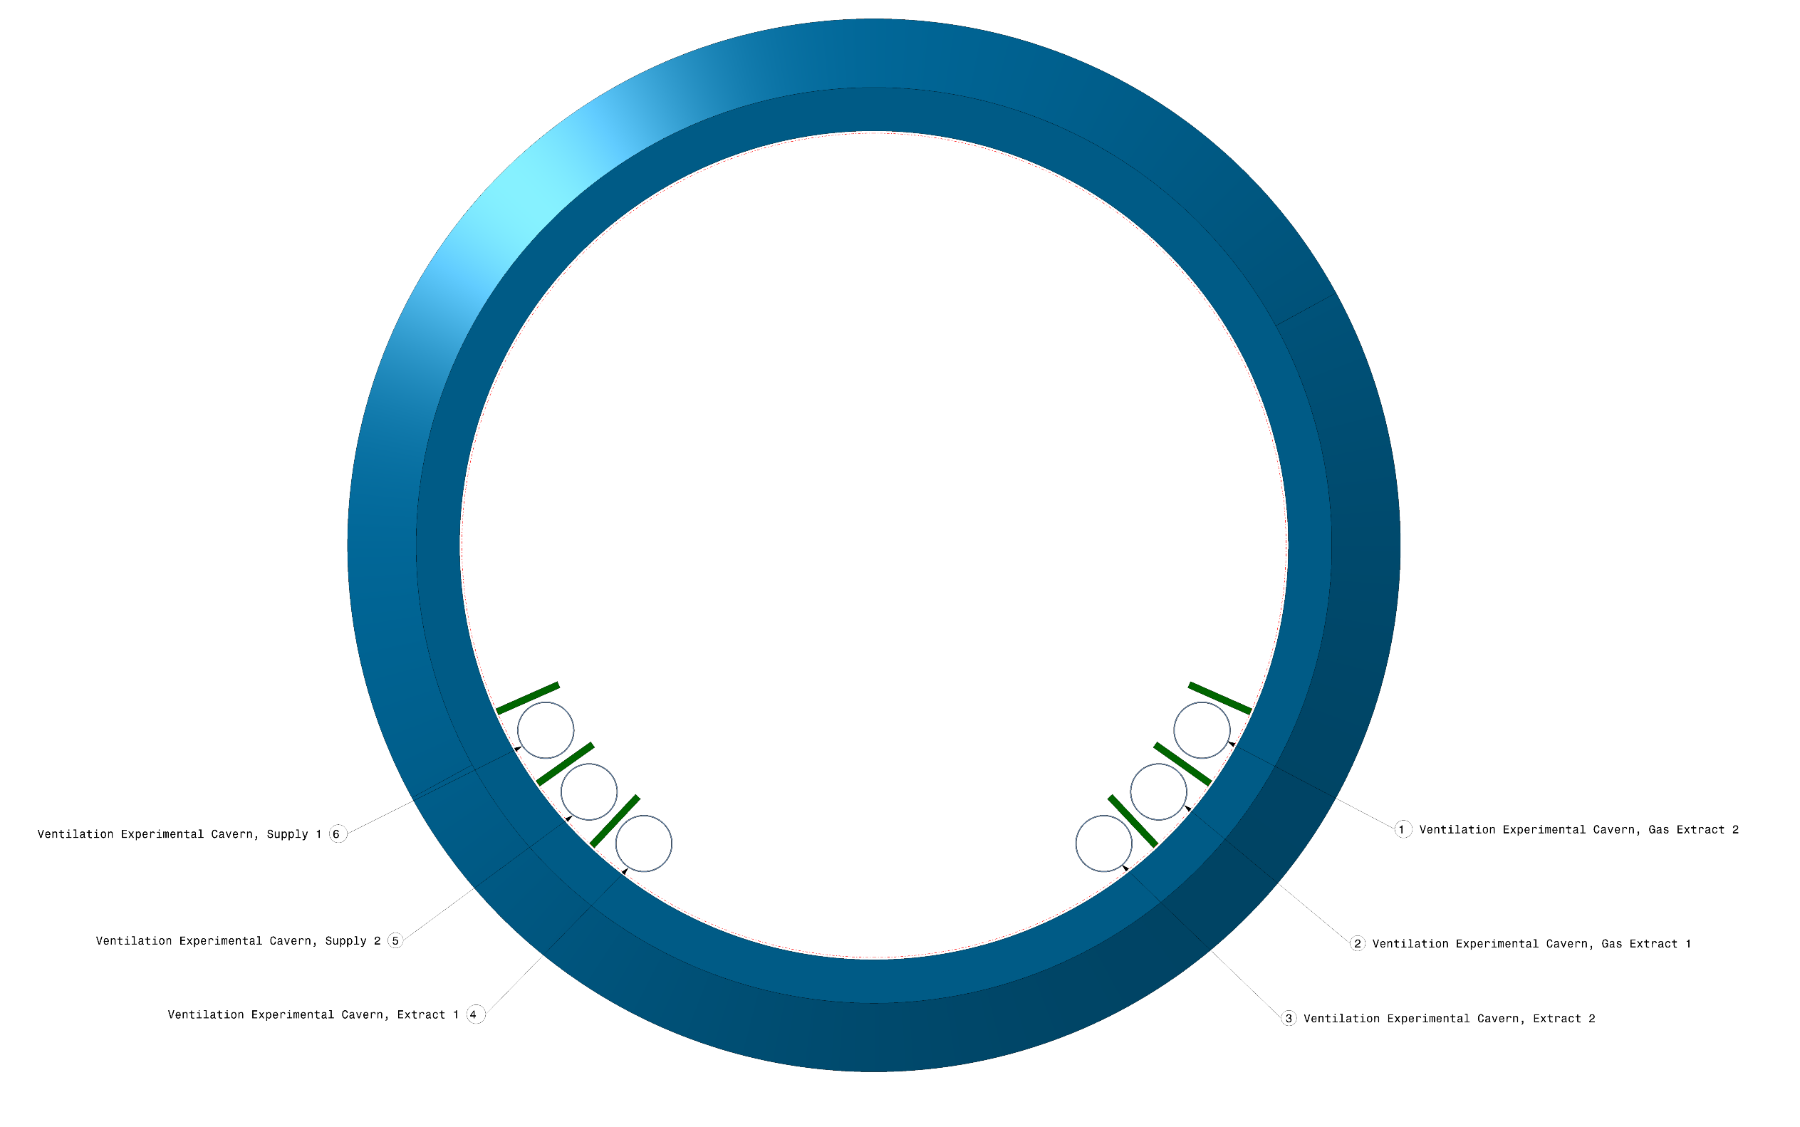
Experimental shaft and cavern installation
22.05.2025 / FCC Week 2025
Sarah Fleury
Ventilation ducts
Experimental cavern
Service cavern
FCC-ee
Detector
Courtesy: Fani Valchkova-Georgieva
Experimental shaft ø18m at Point A
Cavern layout in point A
Sequence for experiment shaft and cavern
The shaft works on the experimental shaft are expected to take approximately 6 months to complete.
For each of the four experimental points, the installation of the experiment in the cavern is planned to last 2 years, followed by 6 months of synchronized hardware commissioning in coordination with the machine.

Slide 26
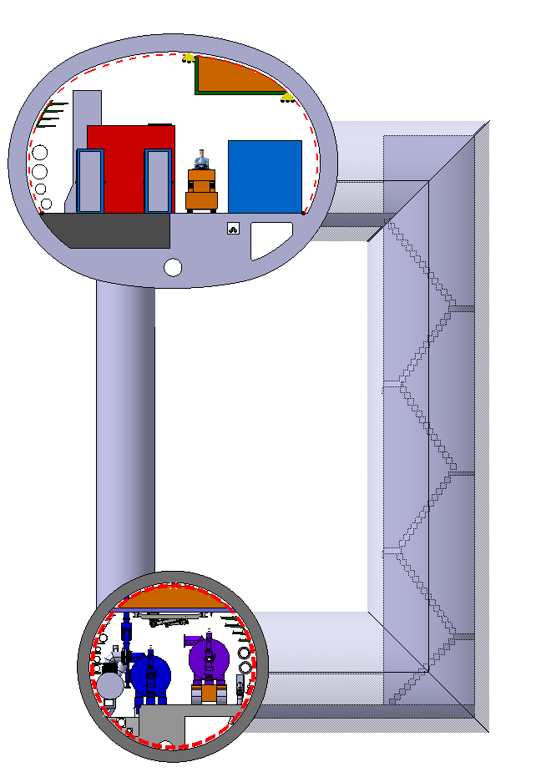
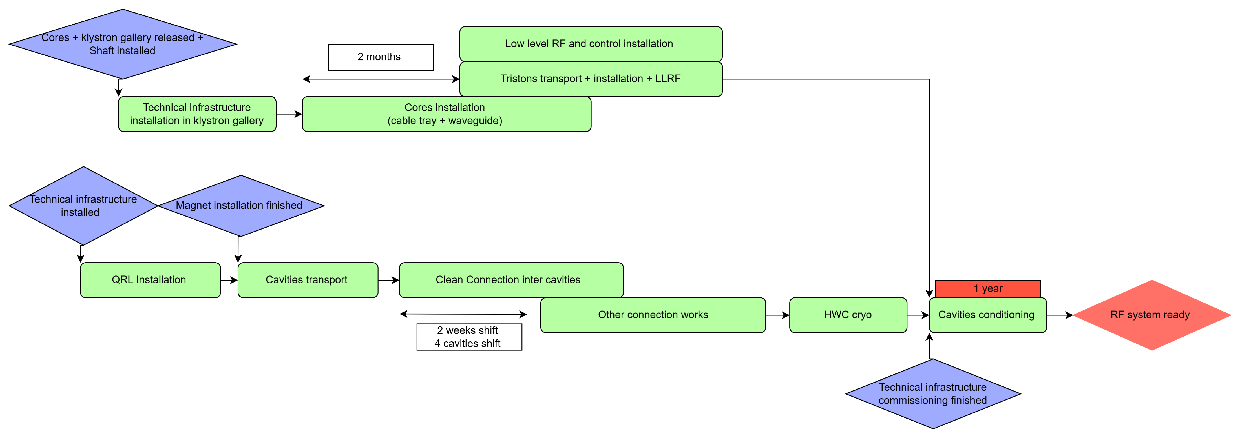
Radio Frequency systems installation
22.05.2025 / FCC Week 2025
Sarah Fleury
Radiofrequency systems will be installed in Point H and Point L Long Straight Section and klystron galleries. The installation of the QRL was also studied and placed in the sequence.
Two stages of installation are foreseen for cryomodules and RF power stations to first operate for Z, W, ZH FCC-ee modes and then tt-bar.
Klystron Gallery
Waveguide duct
Machine tunnel
With RF cavities
Courtesy: Fani Valchkova-Georgieva
Klystron gallery and machine tunnel (LSS) at point H
Sequence of installation for Radiofrequency systems at point H and point L

Slide 27
Outline
22.05.2025 / FCC Week 2025
Sarah Fleury
Civil engineering and installation schedules optimisation
Technical infrastructure sequence new inputs
Installation sequence in shafts, arcs and radio frequency points
Overall FCC-ee and FCC-hh installation schedule
Next steps

Slide 28
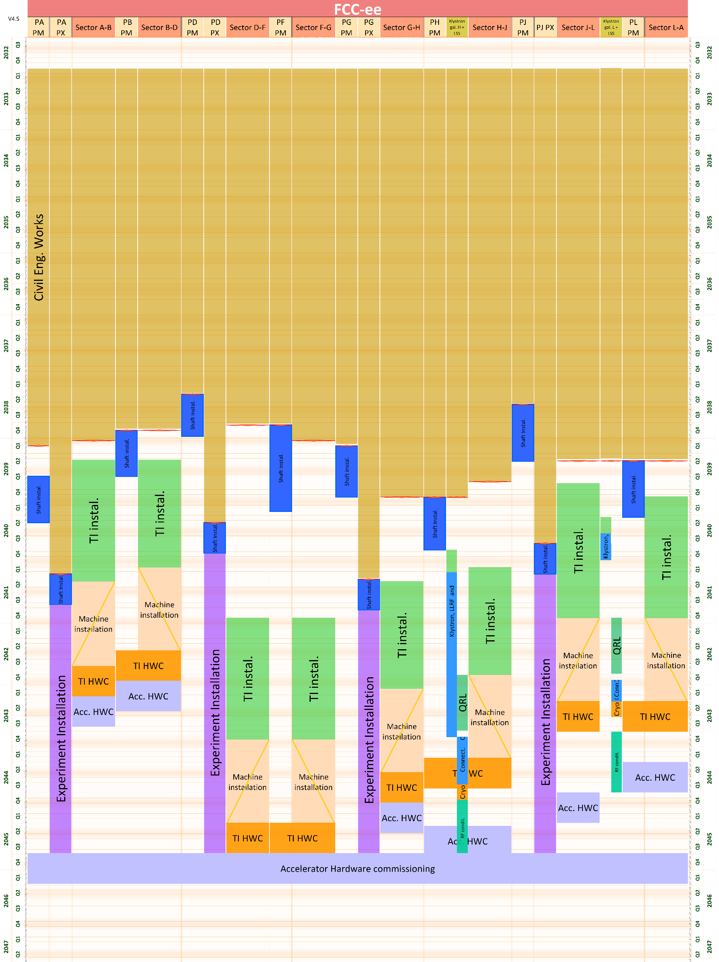
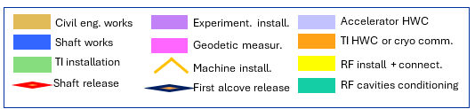
Overall installation schedule FCC-ee
22.05.2025 / FCC Week 2025
Sarah Fleury
Civil engineering excavation is scheduled to begin in January 2033. The first technical shaft will be released in 2038, with the last area expected in 2041.
These initial technical shaft releases will be the starting point for technical infrastructure installation.
The installation of radio frequency systems at Point H and Point L is not on the project’s critical path and will therefore not impact the overall schedule.
Total duration for installation including hardware commissioning: 2038-2046, 8 years.
Readiness for operation in April 2046.
Civil engineering works
FCC-ee overall installation schedule

Slide 29
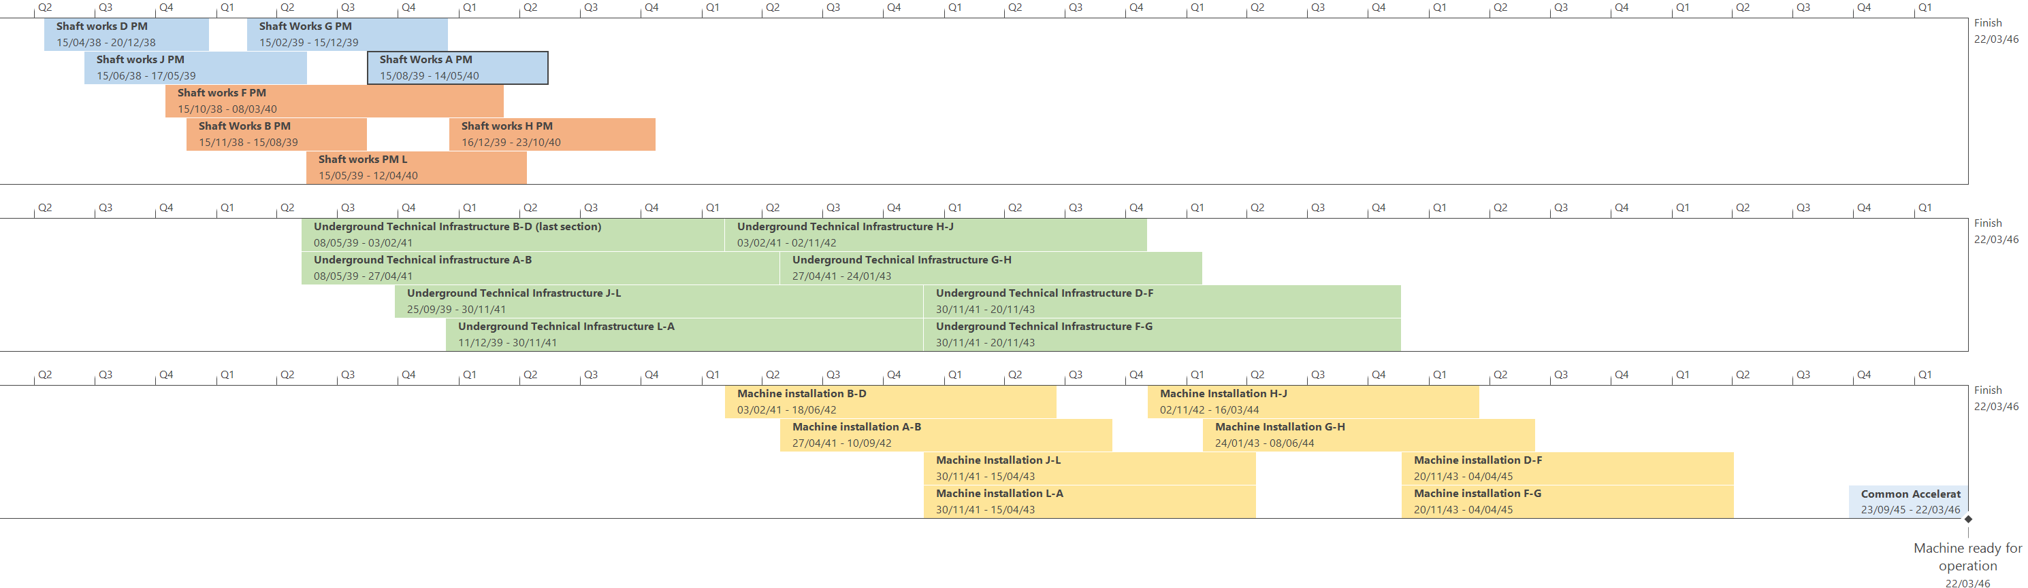
Resource installation schedule FCC-ee
22.05.2025 / FCC Week 2025
Sarah Fleury
FCC-ee overall installation schedule – resource view
The resource limitation introduced to balance the workload indicates that a maximum of four arcs can be engaged simultaneously in the same type of installation activities (technical shaft installation, technical infrastructure installation, or machine component installation).
The resource view enables verification that this constraint is respected.

Slide 30
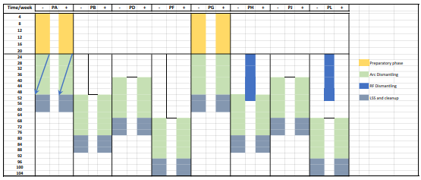
FCC-hh installation schedule
22.05.2025 / FCC Week 2025
Sarah Fleury
After 15 years of operation, FCC-ee is planned to stop at the end of 2061 (December 2061), with dismantling activities scheduled to begin by the end of 2062, i.e. 12 months after shutdown.
The target timeline for the transition to FCC-hh includes a total of 10 years:
2 years for dismantling,
8 years for installation activities.
The dismantling strategy has been analysed and documented in a dedicated report by M. Benedikt, P. Collier, and J. Poole.
Courtesy: M.Benedikt, P. Collier, J. Poole

Slide 31
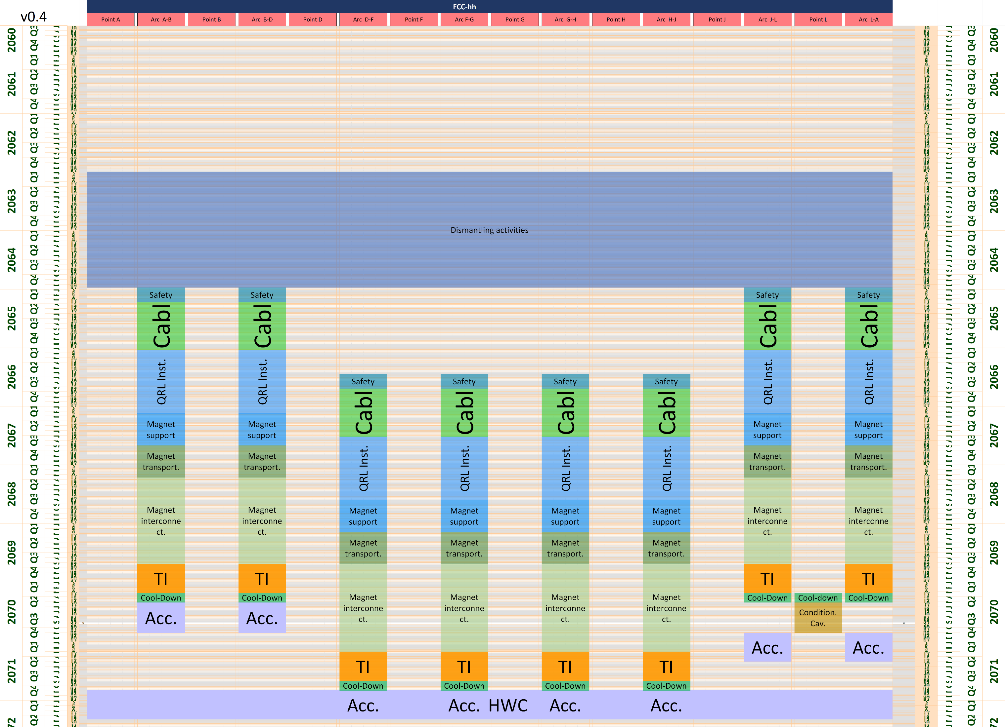
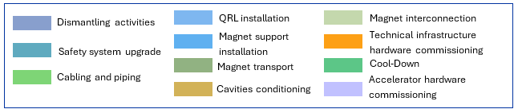
FCC-hh installation schedule
22.05.2025 / FCC Week 2025
Sarah Fleury
4 arcs maximum for one type of activities
Dismantling + machine installation + HWC: 9.5 years
Machine ready for beam on 04/2072

Slide 32
Summary
22.05.2025 / FCC Week 2025
Sarah Fleury
The FCC-ee installation schedule has been refined in coordination with the civil engineering timeline, to optimise the handover strategy and allow installation work to begin while civil works are still ongoing in the arc.
Drawing on experience from the HL-LHC underground gallery installations, a refined sequence for technical infrastructure installation was developed, including the integration of high-voltage cable installation.
The radiofrequency equipment installation sequence has been incorporated into the overall schedule and does not impact the critical installation path.
The transition from FCC-ee to FCC-hh is designed to fit within a 10-year window, including 2 years of dismantling and 8 years of FCC-hh infrastructure and machine installation.

Slide 33
Next steps
22.05.2025 / FCC Week 2025
Sarah Fleury
Define the ventilation strategy during installation, in collaboration with EN-CV.
Discuss the installation of safety systems and the management of degraded operational modes during installation, together with the Safety Team.
Integrate the cryogenic systems into the installation sequence within the shaft and caverns, in coordination with the Cryogenics Team.
Plan the installation of all remaining tunnels and underground caverns, in collaboration with the relevant groups.
Continue to closely monitor the civil engineering schedule.

Slide 34
Thank you for your attention.
22.05.2025 / FCC Week 2025
Sarah Fleury
34

