Slide 1
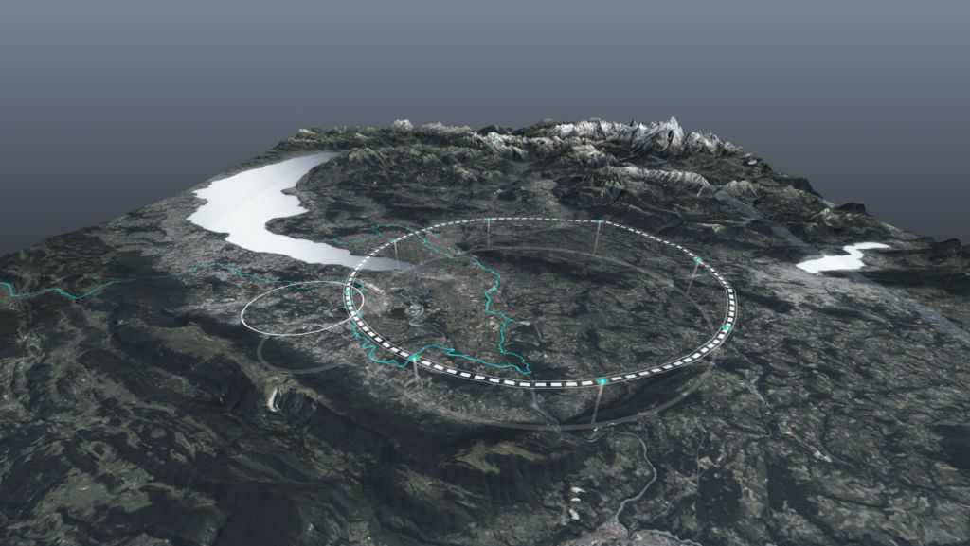










FCC Collaboration Status
G. Bernardi (CNRS/IN2P3), P. Chomaz (CEA) & E. Tsesmelis (CERN)
FCC Week 2025 Vienna
19 May 2025
http://cern.ch/fcc
Work supported by the European Commission under the HORIZON 2020 projects EuroCirCol, grant agreement 654305; EASITrain, grant agreement no. 764879; iFAST, grant agreement 101004730, FCCIS, grant agreement 951754; E-JADE, contract no. 645479; EAJADE, contract number 101086276; and by the Swiss CHART program
photo: J. Wenninger

Slide 2

Science for Peace
CERN was founded in 1954 with 12 European Member States
CERN’s annual budget
is 1200 MCHF (equivalent
to a medium-sized European university)
24 Member States
Austria – Belgium – Bulgaria – Czech Republic
Denmark – Estonia – Finland – France – Germany
Greece – Hungary – Israel – Italy – Netherlands
Norway – Poland – Portugal – Romania – Serbia
Slovakia – Spain – Sweden – Switzerland – United Kingdom
Employees:
2704 staff,
1181 graduates and fellows
Associates:
12 406 users, 1401 others
10 Associate Member States
Brazil – Croatia – Cyprus* – India – Latvia – Lithuania – Pakistan – Slovenia* – Türkiye – Ukraine
4 Observers
Japan – USA – European Union – UNESCO
* Associate Member State in the pre-stage to Membership
~ 50 Cooperation Agreements
Albania – Algeria – Argentina – Armenia – Australia – Azerbaijan – Bahrain – Bangladesh – Bolivia – Bosnia and Herzegovina
Canada – Chile – Colombia – Costa Rica – Ecuador – Egypt – Georgia – Honduras – Iceland – Iran – JINR – Jordan
Kazakhstan – Lebanon – Malta – Mexico – Mongolia – Montenegro – Morocco – Nepal – New Zealand
North Macedonia – Palestine – Paraguay – People's Republic of China – Peru – Philippines – Qatar – Republic of Korea
Saudi Arabia – South Africa – Sri Lanka – Thailand – Tunisia – United Arab Emirates – Uruguay – Vietnam
Data as of 31 December 2024
Chile and Ireland are to become CERN Associate Member States.
Notes:
The speaker can highlight CERN’s second mission as stated when it was established: to foster peaceful collaborations between nations that had recently been at war.
Additional information (OPTIONAL)
More than 40% of CERN’s budget is returned to industry through materials, utilities and services

Slide 3
A laboratory for people around the world
Distribution of all CERN Users by the location of their home institute
Geographical & cultural diversity
Users of 110 nationalities
23.7 % women
Member States (7675)
Austria 88 – Belgium 142 – Bulgaria 49 – Czech Republic 250 Denmark 50 – Estonia 27 – Finland 88 – France 856 – Germany 1260
Greece 101 – Hungary 84 – Israel 75 – Italy 1657 – Netherlands 174 Norway 88 – Poland 363 – Portugal 110 – Romania 110 – Serbia 42
Slovakia 72 – Spain 448 – Sweden 103 – Switzerland 409
United Kingdom 1029
Associate Member States (631)
Brazil 141 – Croatia 35 – Cyprus* 12 – India 158 – Latvia 22
Lithuania 21 – Pakistan 35 – Slovenia* 29 – Türkiye 151 – Ukraine 27
Observers (2330)
Japan 229 – United States of America 2101
* Associate Member State in the pre-stage to Membership
Cooperation Agreements (1770)
Albania 7 – Algeria 1 – Argentina 17 – Armenia 28 – Australia 31 – Azerbaijan 2 – Bahrain 10 – Canada 203 – Chile 58 Colombia 25 – Costa Rica 8 – Cuba 3 – Ecuador 4 – Egypt 22 – Georgia 36 – Hong Kong 17 – Iceland 3 Indonesia 8 – Iran 18 – Ireland 11 – JINR 305 – Jordan 2 – Kazakhstan 8 – Kuwait 2 – Lebanon 12 – Madagascar 1 Malaysia 1 Malta 3 Mexico 66 – Montenegro 4 – Morocco 22 – New Zealand 1 – Nigeria 1 – Oman 1 – Palestine 1
People’s Republic of China 472 – Peru 3 - Philippines 1 – Republic of Korea 184 - Saudi Arabia 4 – South Africa 73
Sri Lanka 7 - Taiwan 49 – Thailand 17 - Tunisia 3 – United Arab Emirates 14 – Vietnam 1
Data as of 31 December 2024
Notes:
THIS SLIDE WILL INCLUDE THE NUMBER OF MEMBERS OF PERSONNEL OF THE VISITORS’ COUNTRY OF ORIGIN

Slide 4
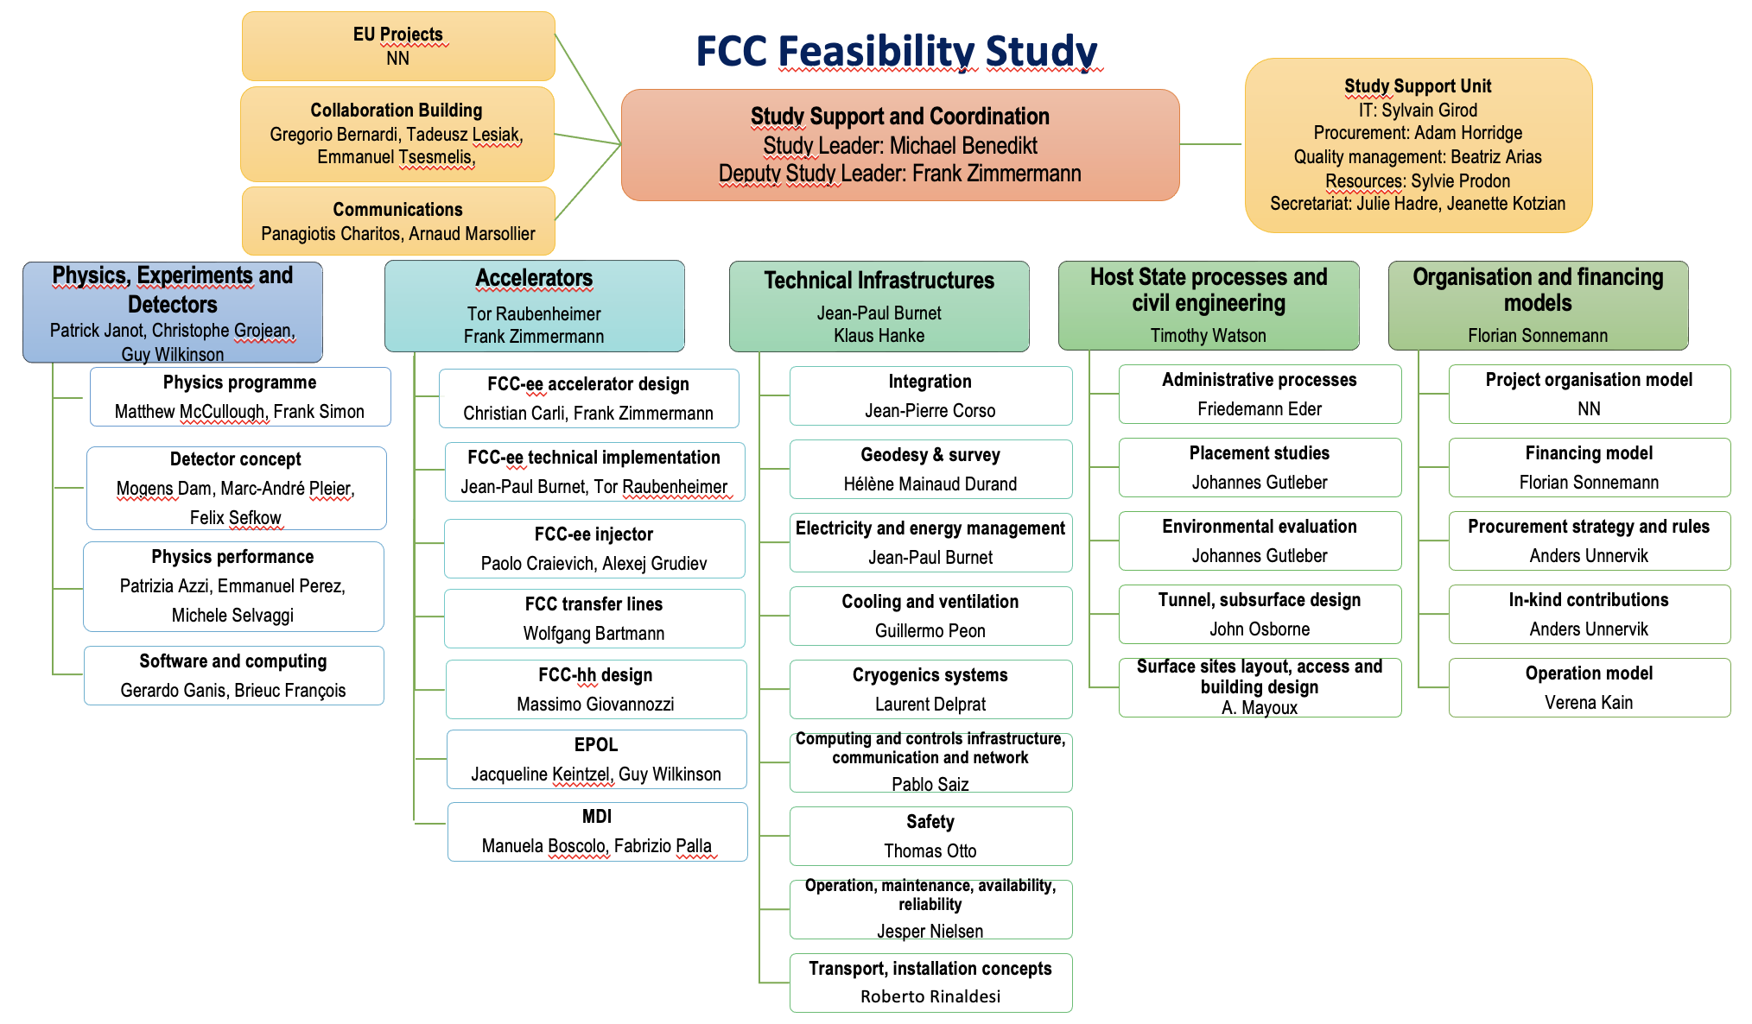
Bottom-up approach
in the community

Slide 5
The FCC Approach to Global Collaboration
FCC Collaboration being formed through a global, two-way and integrative process, while being geographically balanced and topically complementary.
Open to areas beyond conventional accelerator R&D (environment & sustainability; education & training; knowledge transfer to society; & public engagement) and in areas that are non-core activities for CERN (e.g. geology, geodesy, logistics & materials science).
Prepare foundations for contributions via national laboratories, institutes and universities and for industrial R&D.
CERN engaged in discussions with potential major partners as part of the FCC Feasibility Study for such a global project being hosted at CERN.

Slide 6
FCC Global Collaboration Working Group (FGC)
Engage with the participants - national laboratories, institutes and universities as well as industry in the MS, AMS and NMS - to carry out the following mandate:
  Encourage an expanded membership.
  Explore opportunities for future prospective participants.
  Support new participants in application process.
  Assist the new participants in defining areas of collaboration.
  Conclude relevant agreements.
  Facilitate the integration process.
  Facilitate interest in CERN non-core areas - geology, geodesy, logistics, materials science.
  Prepare the foundations for R&D and contributions by industry.
  Liaise with national contact persons and forums.
Convened by Emmanuel Tsesmelis (CERN International Relations)

Slide 7

FCC Engagement Meetings
Overview
  Extended forums with interested countries to discuss collaboration with FCC.
  Topics:
    Introduction to FCC.
    Presentation of FCC physics, experiment, detector, accelerator and global collaboration.
    Presentations from the country scientific community.
Meetings
  Mexico (mini meeting on accelerator)
    June 2021
  Republic of Korea
    September 2021
  Pakistan
    September 2021
  Portugal
    November 2021
  Estonia
    March 2022
  Greece
    January 2023, June 2023
  India
    September 2024
  Engagement Meetings with Canada, Lithuania and Thailand to take place
Much interest continues to be expressed by participating countries
and the FCC looks forward to stronger / deeper involvement in the follow-up.

Slide 8
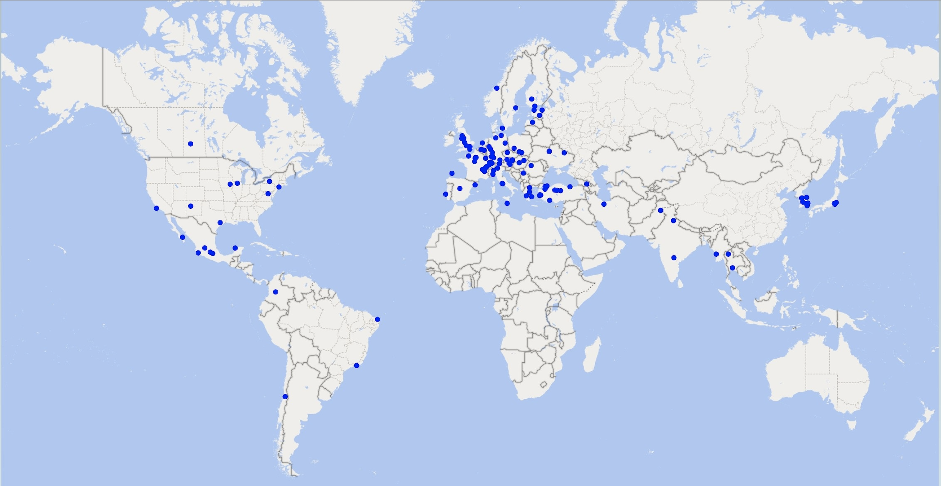


Status of the FCC Global Collaboration
Increasing international collaboration is a prerequisite for success:
→links with science, research & development and high-tech industry will be essential to further advance and prepare the implementation of the FCC
38 Participating Countries
Austria – Belgium – Brazil – Canada – Chile – Colombia – Czech Republic – Denmark – Estonia – Finland – France – Georgia – Germany – Greece – Hungary – India – Iran – Italy – Japan – Latvia – Malta – Mexico – Netherlands – Norway – Pakistan – Poland – Portugal – Republic of Korea – Romania – Serbia – Spain – Sweden – Switzerland – Thailand – Türkiye – Ukraine – United Kingdom – United States of America
162 Institutes
38 Countries
+
CERN

Slide 9
INSTITUTION | COUNTRY
University of Liège | Belgium
PUC - Pontificia Universidad Católica de Chile | Chile
SAPHIR Millenium Institute | Chile
Universidad Nacional de Colombia (UNAL) | Colombia
Université Gustave Eiffel (Eiffel) | France
BRGM - Bureau de recherches géologiques et minières | France
Georgian Technical University (GTU) | Georgia
University of Miskolc | Hungary
UPES | India
INFN Sezione di Roma Tre | Italy
University of Malta (UM) | Malta
UAS, Universidad Autonoma de Sinaloa | Mexico
CINVESTAV | Mexico
Cracow University of Technology (PK) | Poland
Horia Hulubei National Institute for R&D in Physics and Nuclear Engineering (IFIN-HH) | Romania
INCDTIM - National Institute for Research and Development of Isotopic and Molecular Technologies | Romania
Thailand Center of Excellence in Physics | Thailand
Topkapı Üniversitesi | Türkiye
Yozgat Bozok University | Türkiye
Akdeniz University | Türkiye
Institute for Scintillating Materials (ISMA) | Ukraine
Bogolyubov Institute for Theoretical Physics (BITP) | Ukraine
Kharkiv Institute of Physics and Technology (NSC KIPT) | Ukraine
V. N. Karazin Kharkiv National University | Ukraine
Taras Shevchenko National University of Kyiv (TSNUK) | Ukraine
Imperial College London (ICL) | United Kingdom
UoM, The University of Manchester | United Kingdom
Stony Brook University | United States
28 Memoranda of
Understanding (MoUs)
signed since previous
Collaboration Board
(June 2024)

Slide 10
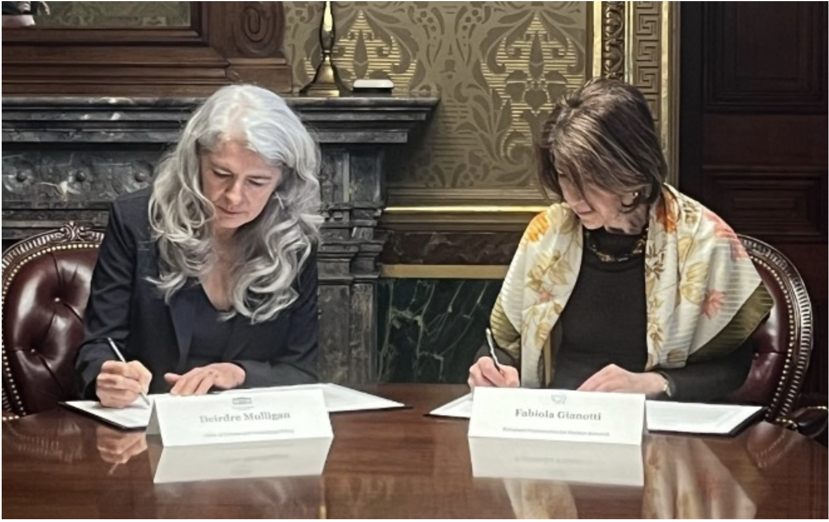
Statement of Intent – CERN & USA
CERN and the US government have released a joint statement concerning future planning for large research infrastructures, advanced scientific computing and open science.
CERN and the US intend to enhance collaboration in planning activities for large-scale, resource-intensive facilities with the goal of providing a sustainable and responsible pathway for the peaceful use of future accelerator technologies.
“Should the CERN Member States determine the FCC-ee is likely to be CERN’s next world-leading research facility following the high-luminosity Large Hadron Collider, the United States intends to collaborate on its construction and physics exploitation, subject to appropriate domestic approvals.”
CERN Director-General, Fabiola Gianotti (right), and Principal Deputy US Chief Technology Officer,
Deirdre Mulligan, of the White House Office of Science and Technology (left) at the signing ceremony.
(Image:US Department of State, Bureau of Oceans & International Environmental & Scientific Affairs)
Washington, D.C., 26 April 2024

Slide 11
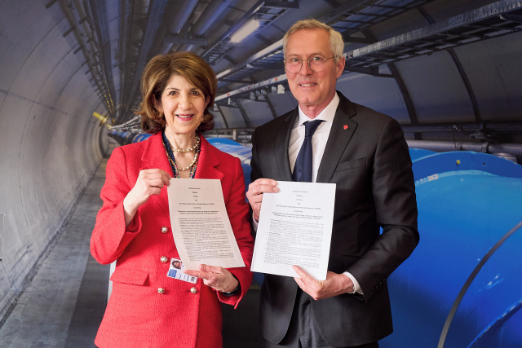
Statement of Intent – CERN & Canada
CERN and the Canadian government have released a joint
statement concerning collaboration on future planning for large research infrastructure facilities, and on novel and advanced techniques and tools.
CERN and Canada intend to enhance collaboration in planning of future projects, continue & expand cooperation on innovative detector, accelerator and computing technologies, strengthen collaboration on FCC studies, and promote joint efforts in developing advanced techniques and tools, such as artificial intelligence and quantum technologies.
“Should the CERN Member States determine that the FCC is
likely to be CERN’s next world-leading research facility following the High-Luminosity Large Hadron Collider, Canada intends to collaborate on its construction and physics exploitation, subject to appropriate domestic approvals.”
Signature of the Statement of Intent. CERN Director-General, Fabiola Gianotti, and His Excellency Mr Patrick Wittmann, Ambassador of Canada to Switzerland and Liechtenstein
March 2025

Slide 12

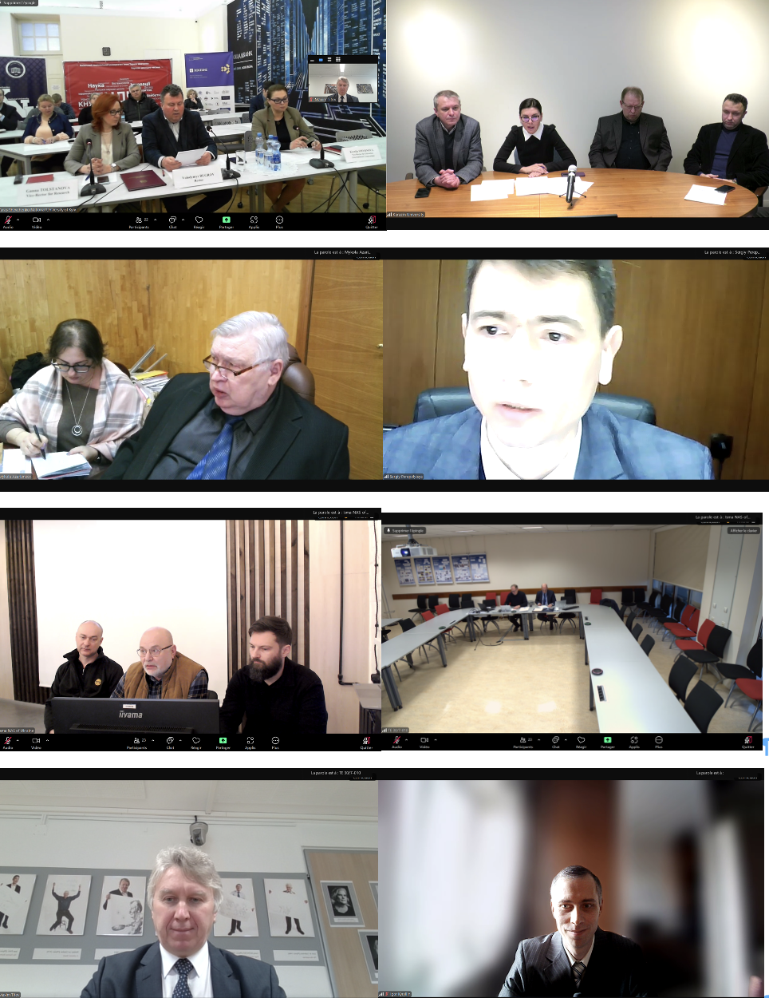
Latin America
Ukraine
Special FCC Session
Institute | Country
CBPF, Brazilian Center for Physics Research | Brazil
UFRN, Federal University of Rio Grande do Norte | Brazil
PUC, Pontificia Universidad Católica de Chile | Chile
Millenium Institute SAPHIR | Chile
UNAL - Universidad Nacional de Colombia | Colombia
CINVESTAV, Centro de Investigación y de Estudios Avanzados del IPN | Mexico
UADY, Autonomous University of Yucatan | Mexico
UGTO, Universidad de Guanajuato | Mexico
BUAP, Benemérita Universidad Autónoma de Puebla | Mexico
UCOL, University of Colima | Mexico
UAS, Universidad Autonoma de Sinaloa | Mexico
Online Signing Ceremony with 5 Institutes from Ukraine (10 January 2025)

Slide 13
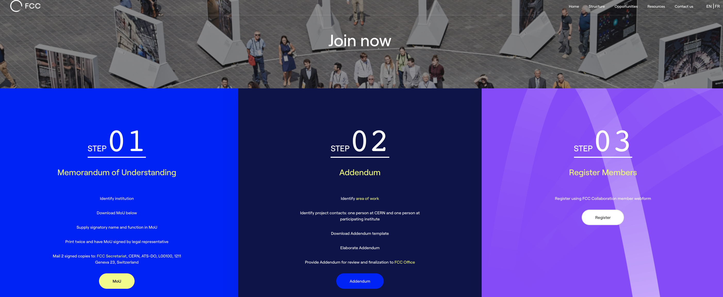
Participation in FCC through MoU and Addenda
https://fccis.web.cern.ch/join-now
Current procedure at least until post FCC Feasibility Study structures are put in place.

Slide 14
International Forum of National Contacts (IFNC)
With an emphasis on Physics, Experiments and Detectors (PED), the IFNC engages with countries with mature communities, a long-standing participation in CERN’s programmes and the potential to contribute substantially to the Organization’s long-term scientific objectives to facilitate opportunities for national participation in the Feasibility Study and enlarge the HEP community of FCC.
Contact physics groups in a country, typically from LHC or Future Colliders groups, requesting to join as new institution.
  Discuss the physics case and the opportunities:
    To study R&D / Detector concepts for FCC.
    To expand the FCC Physics scope via the study of physics case studies.
    To improve the theoretical calculations to exploit the FCC physics potential.
  Help form a national FCC group in each country, with strong PED component, which can hold its national FCC meetings, including with the accelerator community (when possible).
  Identify one or two National Contacts to exchange information between country and the FCC Management, across countries via IFNC meetings, and to strengthen/structure the national community.
  Orient the new efforts towards the different FCC working groups.
  Enlarge the list of participating institutes and institute contacts (IFIC) inside each country to create a sufficiently large community to ensure support and resources for four experiments.
Convened by Gregorio Bernardi and Tadeusz Lesziak (also National Contacts of France and Poland)

Slide 15
IFNC FCC PED Kick-off Meetings
(c.f. FGC FCC Engagement Meetings)
Overview
  Forums with interested countries to discuss collaboration with FCC on PED topics:
    Introduction to FCC Feasibility Study.
    Detailed presentations of FCC physics, experiments & detectors.
    General information on accelerator and global collaboration.
Recent Kick-off Meetings
  Nordic Countries (DK, NO, SE, FI) March 2021
  India (Bangalore) November 2022
  Brazil (Rio de Janeiro) March 2023
  Mexico (Mexico City) November 2024
  Chile (Santiago) January 2025
  Taiwan (Taipei) May 2025
  + informal meetings
On-going discussions
  With not yet deeply involved European countries.
  Argentina and Canada (Japan and China have a special status).
Several other initiatives. Examples:
  2nd Joint FCC France-Italy Workshop in Venice in November 2024 Joint FCC-France & Italy Workshop in Venice
  3rd annual US-FCC Workshop at FNAL/Argonne April 2025 link (48 institutes participated)
  German meeting on Future Colliders@CERN In May 2024 (150 participants, >10 institutes participating in FCC)

Slide 16
FCC Experiment Collaborations
Expressions of Interest (EoIs) for subdetectors and detector concepts submitted to ESPPU (March 2025)
Set up process after ESPPU in 2028-2029 for proto-collaboration formation
The FCC Feasibility Study review committee recommends to work with the scientific community, institutes, laboratories and funding agencies to ensure support and resources for four experiments, facilitating the exploitation of the full scientific potential offered by the large investment in the FCC-ee facility:
Complete list of tasks of the institutes in the IFNC.
Iterate with National Contacts to gather latest information of possible funding of the HEP teams.
Explore how the countries/institutes position themselves on the current and future potential detector concepts.
A possible strategy for building FCC experiment collaborations for the next five years (for discussion):
Start from EoI for sub-detector and detector concepts in 2025.
Assuming positive recommendation to push forward by around 2028 by the CERN Council:
  Start setting up FCC Committee (FCCC) and proto-collaborations, probably around proposed proto-detector concepts following call for Conceptual Design Reports (CDRs).
  Benefit from the formation of the Detector R&D (DRD) collaborations.
  Find a scheme to reduce the number of proto-collaborations (e.g. merging) if more than 4 proposals.
  Process could converge by 2030-2031.

Slide 17
Concluding Remarks
Strengthening the FCC Collaboration
Starting from the support of the CERN Host States, build the support of the Member States, Associate Member States and non-Member States (including the Observer States).
  The successful realisation of the LHC (and HL-LHC) is testament to the strong and consistent support CERN received from its Member States and Associate Member States.
  CERN Council required significant support from Non-Member States, including the Observer States, before giving final approval to the LHC.
  High-level events similar to that with the US and Canada should be organized with strong statements of intent.
Set up governance structure that will encourage participation / contribution / commitment to the FCC.
  FCC requires long-term engagement and support of participants from CERN’s Member, Associate Member & Non-Member States. As the project evolves further, it is crucial to refine and adapt the collaboration model to ensure the efficient allocation of resources and sustained momentum.
Continue building interest in the FCC by engaging with communities world-wide through the FCC Global Collaboration (FGC) Working Group and the International Forum of National Contacts (IFNC).
Implement measures as proposed in the FCC-IS deliverable “FCC Communication Plan”. https://zenodo.org/records/10567956

Slide 18
Thank you

