Slide 1
update on Civil engineering for the fcc
Timothy WATSON
Civil Engineering Coordinator

Slide 2
Progress on Civil engineering for the fcc
Site and Civil Engineering Department (SCE) team directly supporting the FCC Project
Liam Bromiley
Angel Navascues Cornago
Roddy Cunningham
Guihlem Gabriel
Philippe Magnano
Antoine Mayoux
SCE GIS Team
Acknowledging the contributions made by our external collaborators during 2024. SGS3, Geotech IOI, Amberg, ILF, Quantum, Rendel/Ingerop, Stone Consulting and the University of Geneva, Earth Sciences department.

Slide 3
Contents
5 June 2023 / FCC Week
Timothy WATSON
Civil Engineering technical, cost and schedule baseline
Feedback from European industry
Baseline strategy for schedule sequence
Results from site investigations
Work scope for Pre-TDR phase

Slide 4
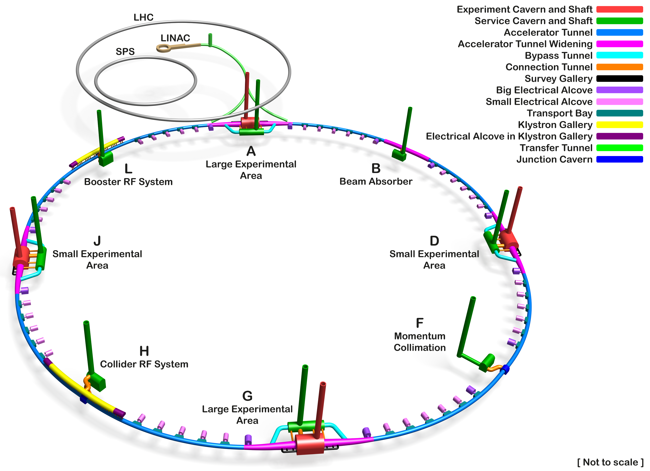
Key features of the Underground Civil Engineering Baseline
5 June 2023 / FCC Week
Timothy WATSON
Tunnel Circumference: 90.7 km
Excavated vol: 6.25M m³ (in-situ volume)
Access shafts: 12
Construction shafts: 1
Large experiment sites: 2
Small experiment sites: 2
Technical sites: 4
Deepest shaft: 400m
Average shaft depth: 243m
Total concrete volume: 1.9 M m³

Slide 5
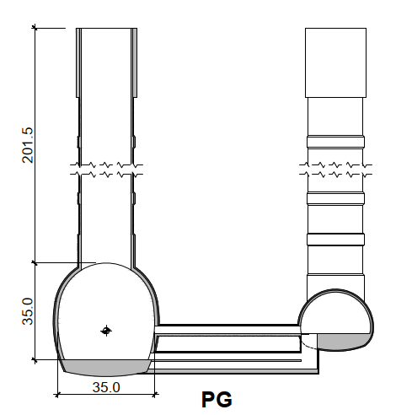
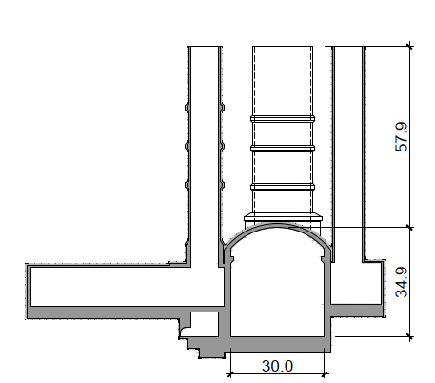
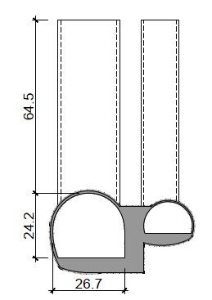
Comparison between FCC and the ATLAS/CMS Caverns Complexes
FCC
ATLAS
CMS
Note that although cavern dimensions are similar to FCC, in-situ ground stress is expected to be about 3 x greater
For the deepest experimental site (PJ) the depth is 250m so in-situ vertical stress will be about 6.4MPa

Slide 6
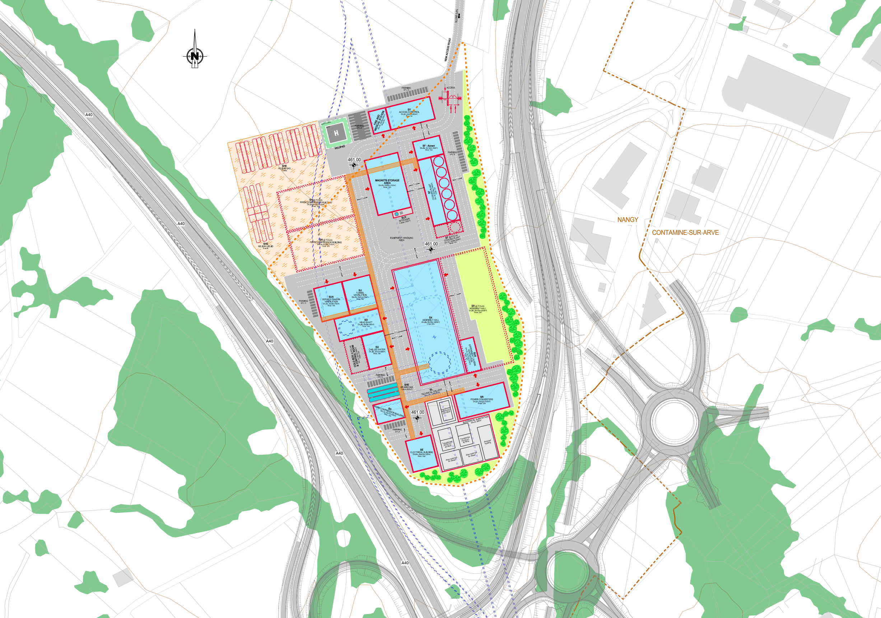
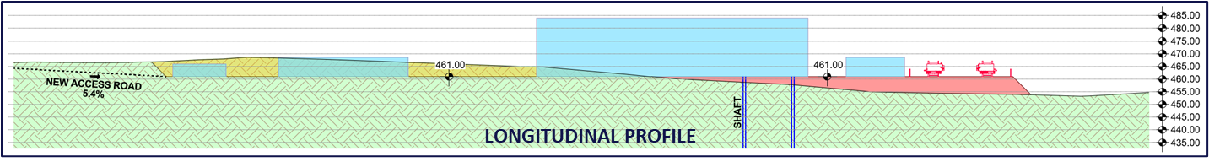
Surface Civil Engineering Baseline
5 June 2023 / FCC Week
Timothy WATSON
Preliminary plan views and sections of all eight surface sites have been prepared at CERN based on the requirements study led by the integration team and target land plots identified by the territorial implementation team.
The dimensions and function of the buildings are to a large extent based on CERNs previous experience as detailed engineering studies for most interfacing systems have not yet been carried out.
The plans, drawings and specifications have been prepared primarily for the purpose of cost estimation, this being done by an external contractor.
PLAN VIEW

Slide 7
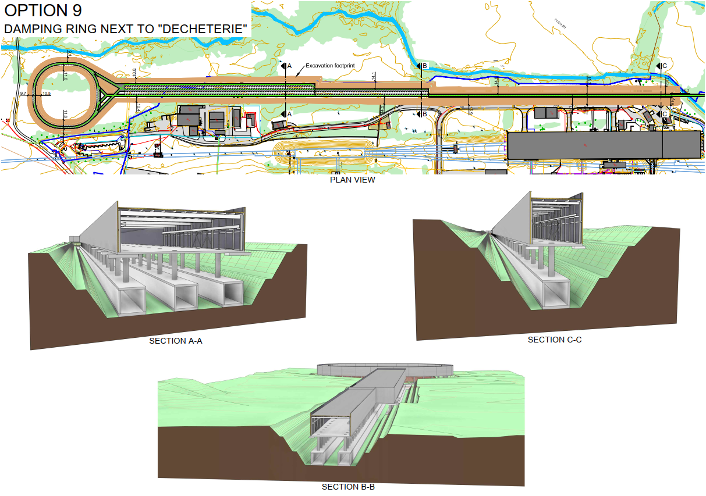
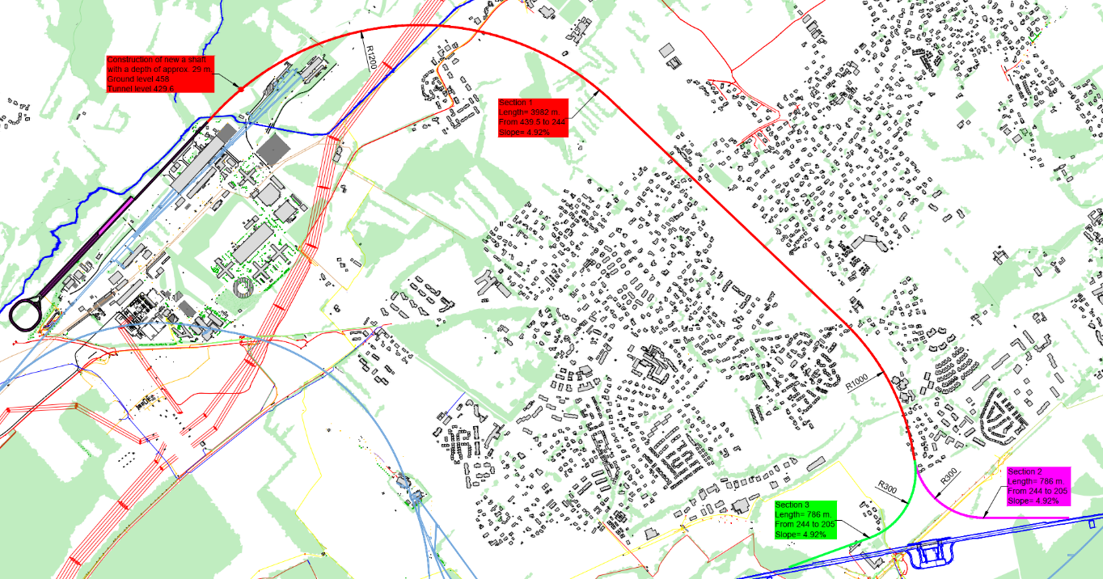
Injection Complex Baseline
Preliminary layout that fits within current Prevessin fence line.
Contracts for hydrological and geological assessments are about to be launched
Initial state analysis to be undertaken (ATS with HSE).
Studies ongoing to confirm overall footprint and main CE requirements (SY-ABT/PSI/CHART)

Slide 8
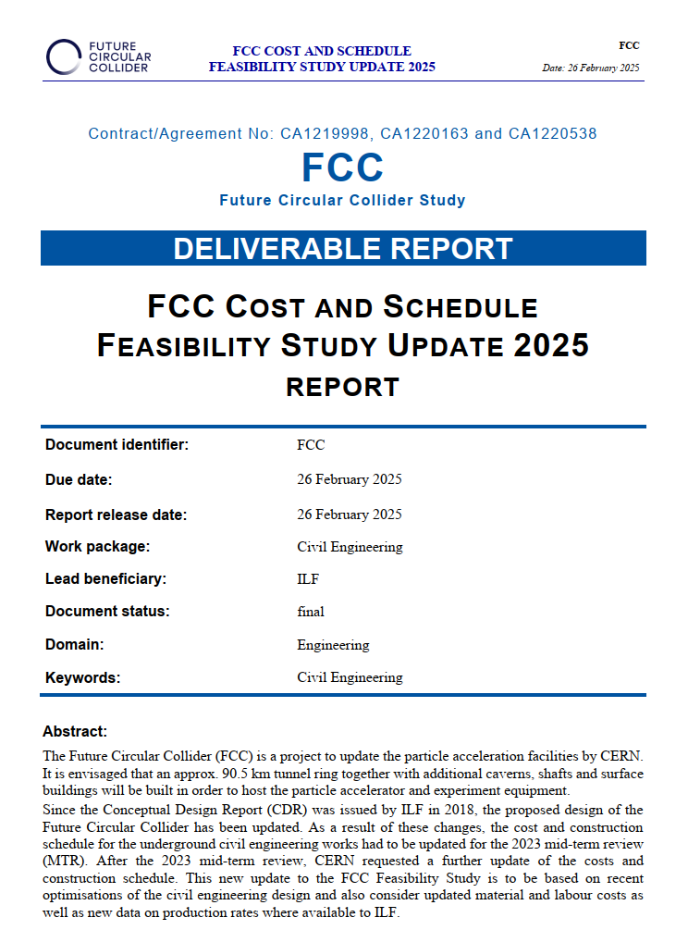
Construction Schedule/Cost
5 June 2023 / FCC Week
Timothy WATSON
External consultant ILF (AT/CH) were contracted to update the schedule and cost estimate for the underground works for the baseline civil engineering as of October 2024.
A detailed schedule was built up using assumed construction methodology and sequencing as well as ILF data on construction performance (advance rates etc.) from numerous underground projects.
The update includes the the CERN decision to drive 2 TBMs from four of the eight sites and also included the removal of the constraint that tunnel sectors must be handed over to CERN only when fully complete over their full 11km length.
Unit costs were updated and advance rates of tunnel excavation reduced to account from industry feedback given to CERN.
Phased handover of tunnel sectors now gives a wider spread on sector delivery dates but gives earlier access to the finished tunnel from the technical sites.

Slide 9
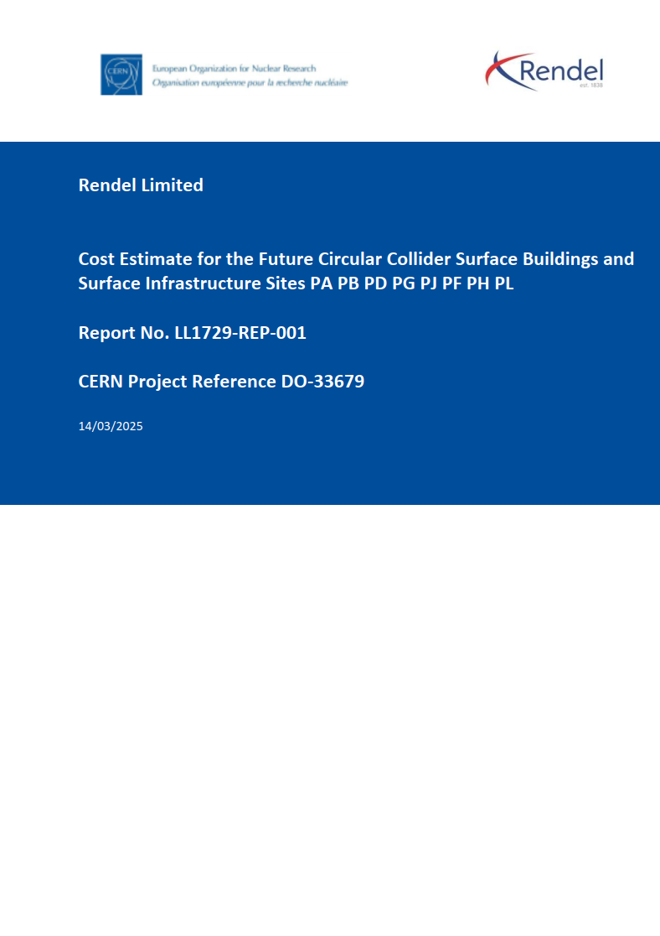
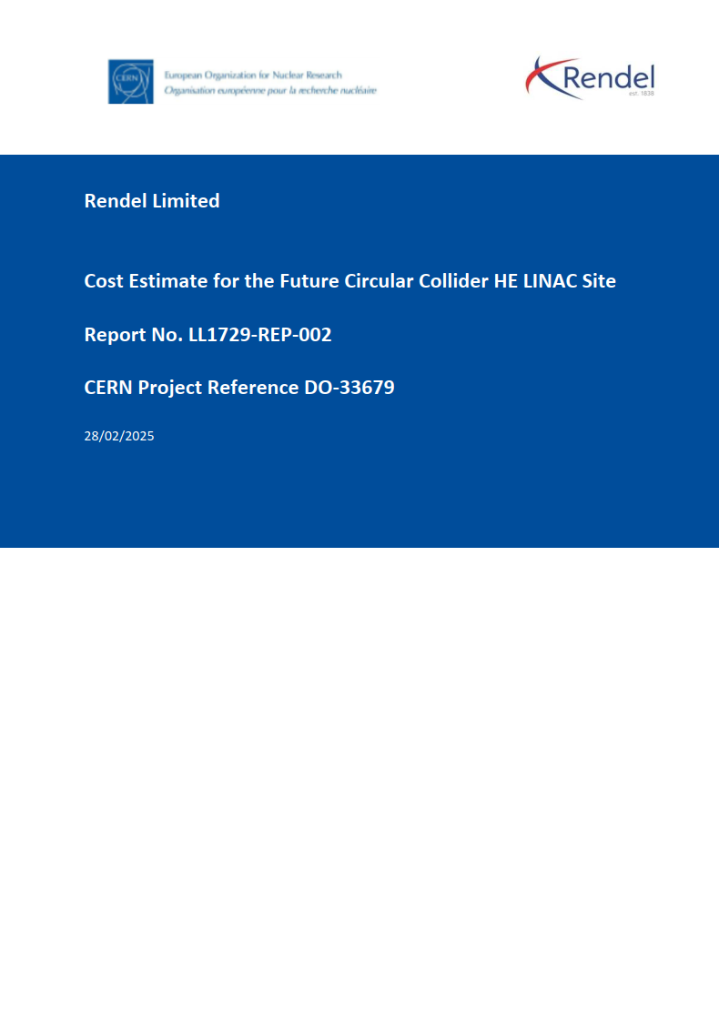
Construction Schedule/Cost
5 June 2023 / FCC Week
Timothy WATSON
For the surface works, CERN contracted with a UK/FR/CH consortium from the Ingerop engineering group.
CERN prepared preliminary layouts and cross-sections for each surface site as well as bills of quantities for two of the sites.
The consultant built up cost estimates based on quantities for all buildings/infrastructure for each of the eight sites.
The same consultant performed a similar exercise for the FCC Injector complex on the Prevessin site.
The surface buildings make up about 12% of the civil works (by cost).
No detailed schedule has been prepared for the surface buildings, but it is expected that most of the work will be done off the project critical path.

Slide 10
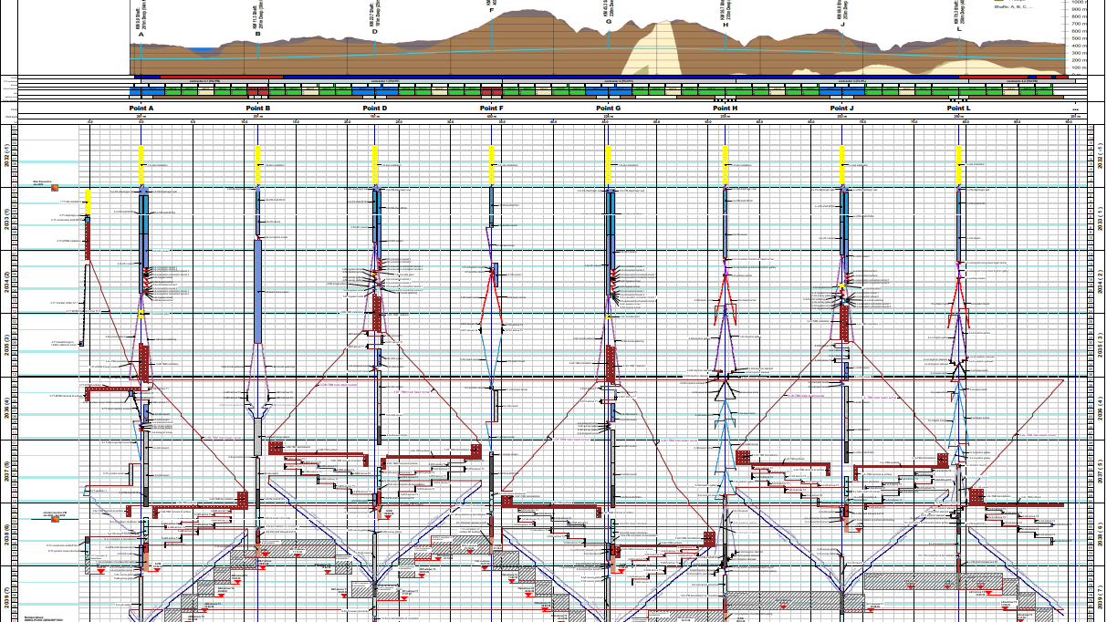

Slide 11
Industry Feedback
5 June 2023 / FCC Week
Timothy WATSON
CERN has continued to meet with key players from member state civil engineering companies.
Companies from AT, CH, DE, ES, FR, GB, IT, SE, have been engaged in informal discussions on technical and strategic topics.
Most contractors considered that the complete civil engineering scope would be too great for one company to undertake alone.
All contractors recognized the difficulty of working in new markets that already have mature and capable industry.
Most contractors flagged the benefits of so called “ early contractor involvement”
All contractors agreed that there is only one European TBM manufacturer capable to build machines suitable for FCC.
Long lead times for TBM procurement should be expected (> 1 year)

Slide 12
Technical Feedback
5 June 2023 / FCC Week
Timothy WATSON
All of the companies considered that the underground works were feasible and well within the technological capabilities of the civil engineering industry today.
The long single access tunnels of about 10km was not considered to be an issue but logistics may become the critical activity. CERN commissioned specific studies on this topic.
Having a single shaft to access the underground works was considered a potential bottleneck given that everything coming into and out of the underground would need to pass through this shaft. CERN commissioned specific studies on this topic.
All contractors considered that dealing with excavated material was a major challenge and that this was a risk that the Client should directly manage in advance of the civil works. This is CERN’s strategy.
One specific ongoing project in GB is of particular interest due to its technical similarities to FCC – Woodsmith mine tunnel.

Slide 13
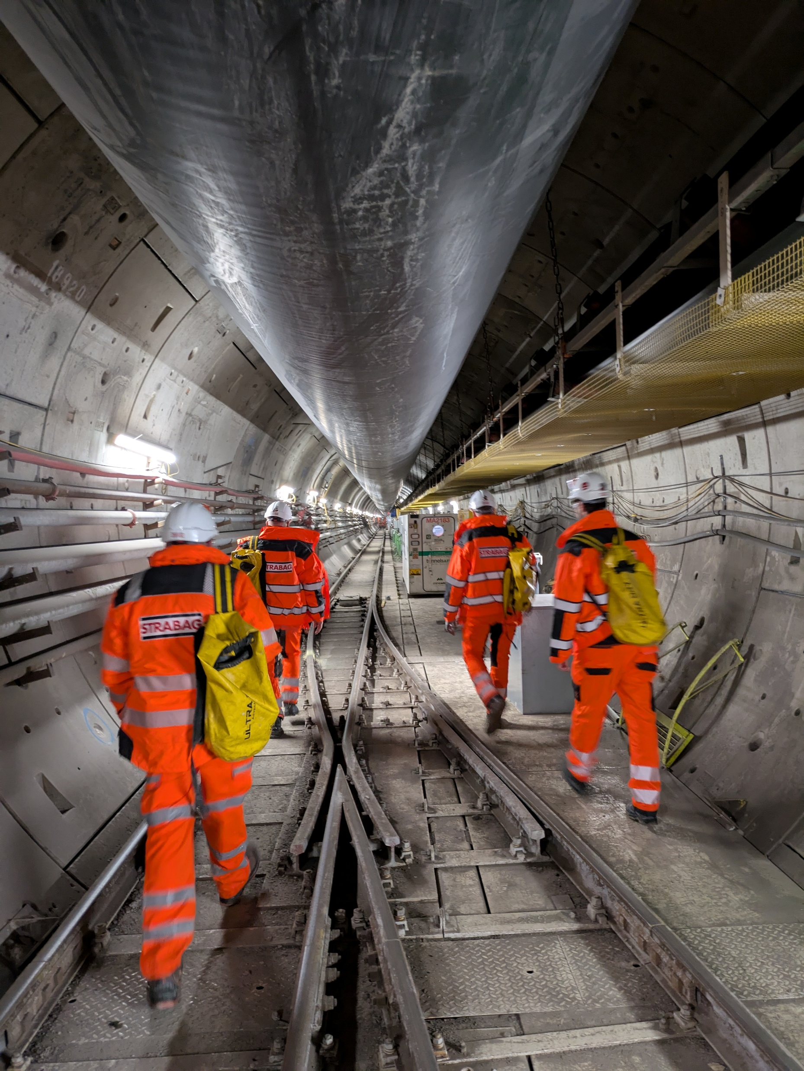
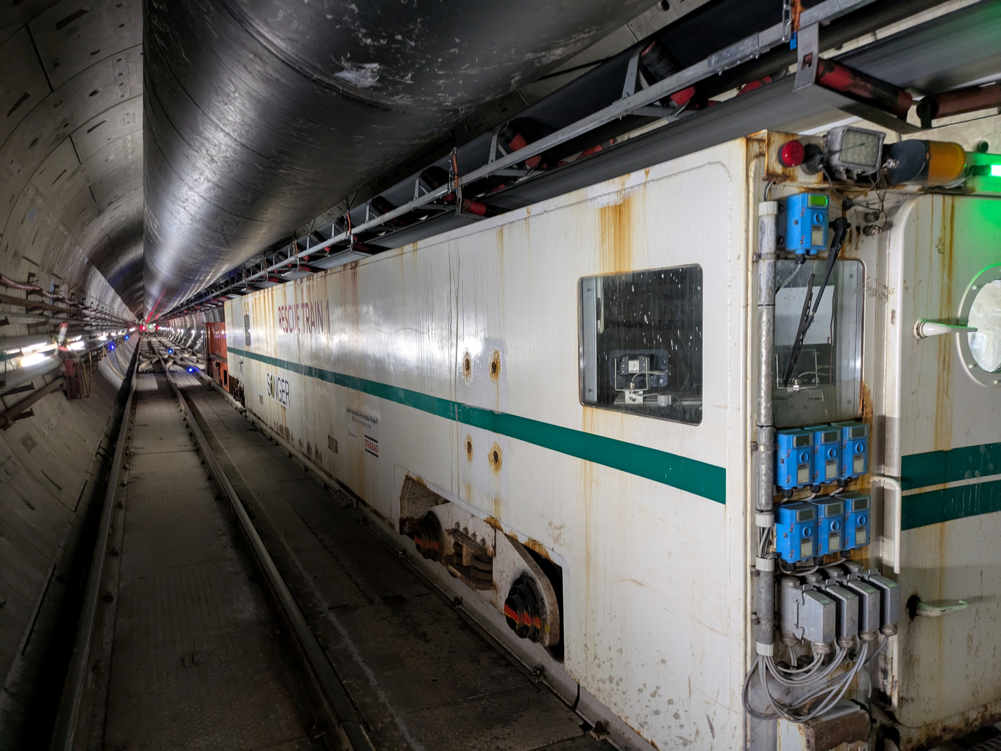
Woodsmith Mine Tunnel
Sedimentary rock similar in strength and variability to molasse
36 km using a single TBM
Internal diameter 4.9m (FCC is 5.5m)
One-pass segmental lining
Average depth around 250m
Advance rates of 20m/day
Contractor Strabag (AT)

Slide 14
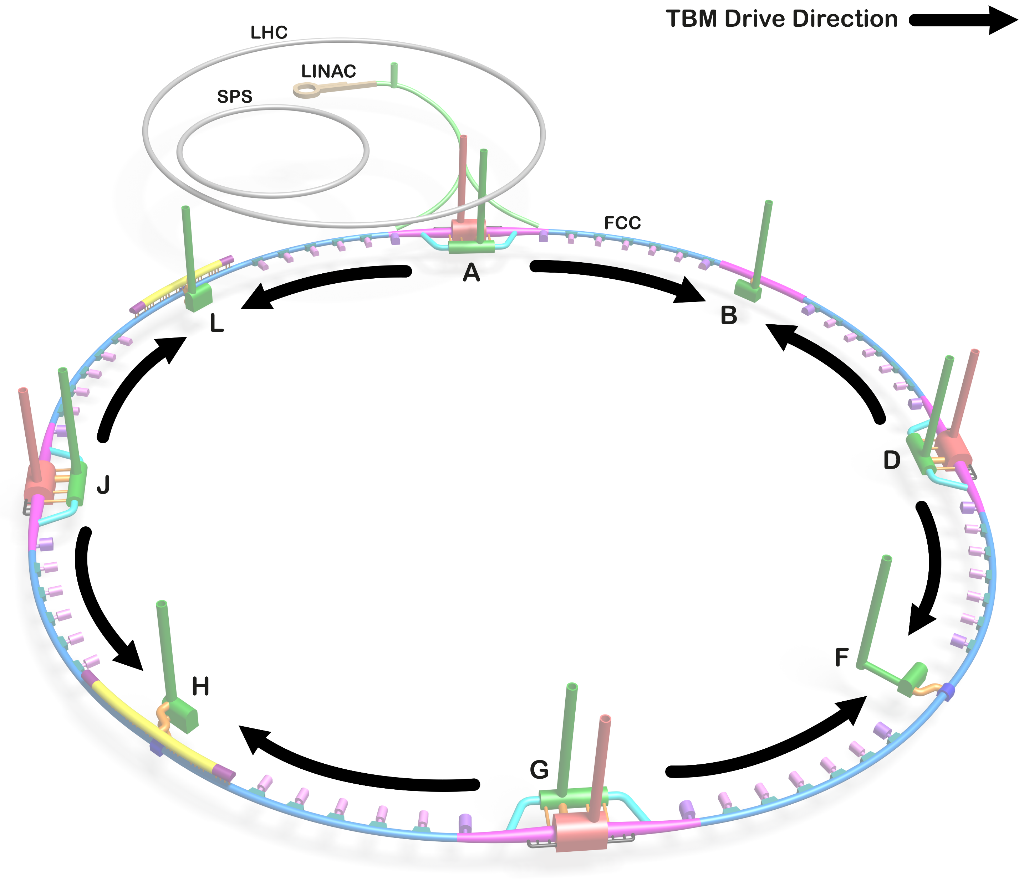
Contract Strategy for Construction
Contract strategy for underground works is strongly influenced by TBM drivage and removal sequence.
From a technical perspective it is considered better to drive two TBMs from each of the four experimental sites rather than a single TBM from each of the eight sites because:
Two shafts allow for better provision of ventilation and ability to separate material and personnel access to underground
The experiment shaft is directly on the axis of the beam tunnel making TBM installation easier
The necessary tunnel widenings can be used to assemble the TBMs underground
More efficient surface construction sites as the same configuration is used for two TBMs
Focuses construction infrastructure and spoil removal infrastructure at only four sites.
Allows earlier release of the technical sites for subsequent infrastructure installation activities.
A downside of this is that the single shaft in CH (PB) has no TBM drives and therefore only a small volume of spoil being removed (about 4% of the total).

Slide 15
Contract Strategy for Construction
The strategy for division of the work scope is based on the following factors:
The total quantity of work is several billion CHF
The need to maintain as far as possible a fair return to member states
The need to minimise and simplify the interfaces between contractors
The need to make the value of work packages large enough to attract major industry players
The need to make the work packages of a size (value) that will attract not only the very largest of contractors from member states
The need to maintain an option to start the construction of the Injector complex earlier than the rest of the civil works.
On this basis, the current strategy is to have five construction contracts, four for the main works and a stand-alone contract for the injection complex and transfer tunnels.

Slide 16
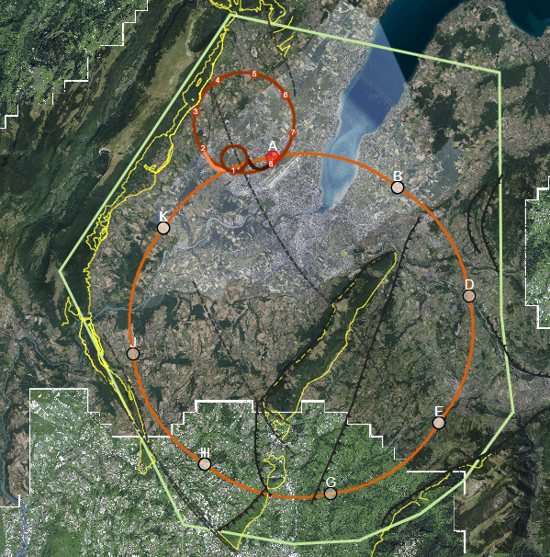
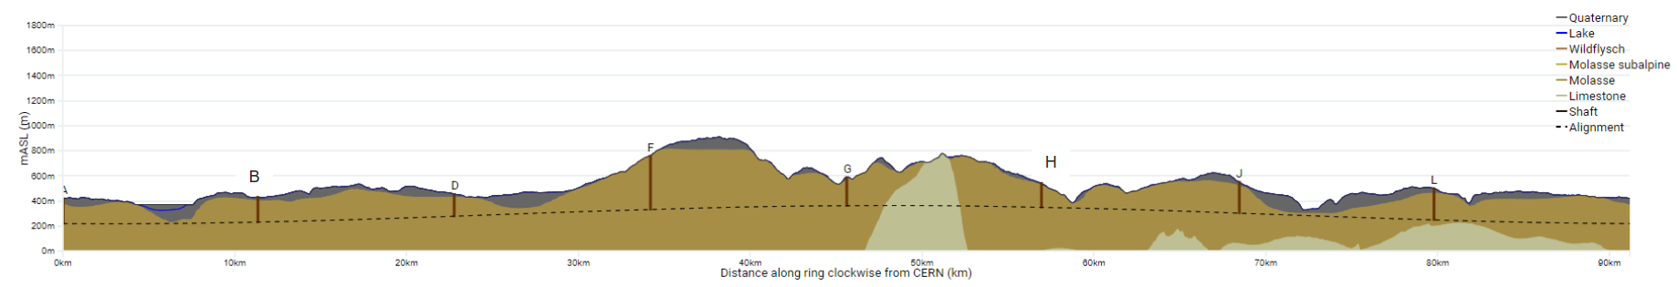
Areas of Geological Uncertainty
Good knowledge of the ground (e.g. information near to CERN from LEP/LHC projects)
Lac Léman
Moraine/molasse interface uncertain
Soils and rock properties uncertain
High uncertainty in the hydrogeological conditions
Jura
Limestone/molasse interface uncertain.
Risk of karts and high-water pressures
A
B
Vallée de l‘Arve
Moraine/molasse interface uncertain.
Lack of reliable borehole information
L
Le Rhône
Moraine/molasse interface uncertain.
D
Bornes
Insufficient deep borehole information
Complex faulted region
Quality of molasse is uncertain.
J
Vuache
Limestone/molasse interface not certain.
Proximity to active fault
J
F
H
Mandallaz
Fractured limestone formations, characteristics and locations of karsts unknown.
Potentially high-water pressures
Les Usses
Moraine/molasse interface uncertain.
Low tunnel rock cover
G
Bornes
Mandallaz
Usses
Lake
Arve
Rhône
Jura

Slide 17
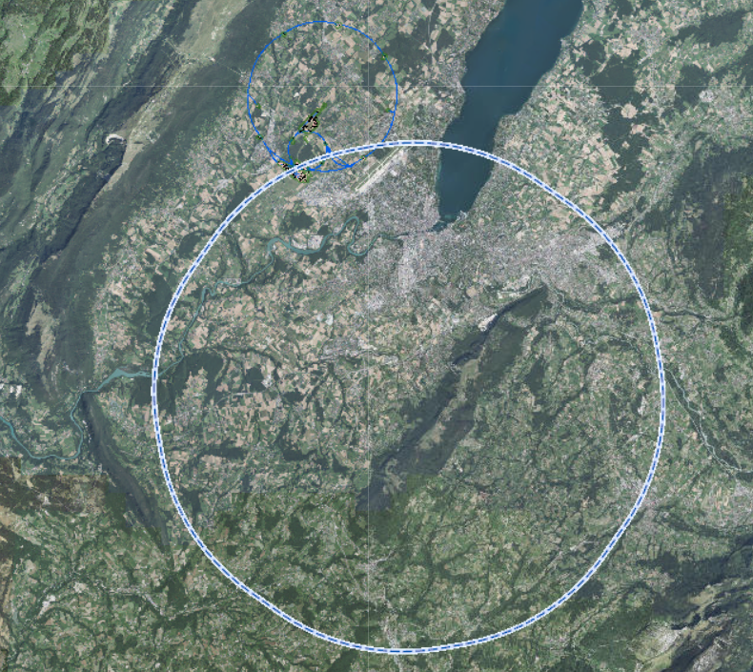
Site Investigation Phase 1
Original plan was to award a single contract for full scope.
This was amended as CERN received only two offers, both close in value
Contracts to 4 major member states (FR/CH/UK/IT) and gives CERN more flexibility to allocate works
Engages more industrial partners ahead of larger future SI campaigns
4 shaft boreholes not located in target areas were postponed to the future campaign
Geophysics scope remained unchanged
JURA 2
LAKE
JURA 1
RHONE
ARVE
VUACHE
BORNES
Nominal
USSES
Optional
MANDALLAZ
Division of SSI scope

Slide 18
Overview of Works
South-western work package SGS3
Works began in October 2024
Geophysics acquisition complete and interpretation ongoing
Drilling activities complete for all 10 boreholes
Testing and report preparation ongoing
North-eastern work package GEOTEC-IOI
Works began in France in April 2025
Drilling activities ongoing on 3 boreholes
Geophysics planned for September 2025 due to environmental constraints
Still awaiting permits for drilling and geophysics in Switzerland
Complete
JURA 2
Ongoing
Pending
JURA 1
LAKE
RHONE
ARVE
VUACHE
BORNES
USSES
MANDALLAZ

Slide 19
Preliminary Results
Usses Valley
Tunnel is shallow (about 60m depth)
Molasse encountered after 14m drilling
Geophysics are being processed but seems the interface is fairly consistent in this region
Positive result as assures that tunnel will be in molasse rock
Vuache
Looking for roof of limestone
4 boreholes undertaken and 5 seismic lines
Results indicate that current horizon is well within good quality, impermeable molasse
Arve (provisional)
2 drill sites both recently completed
Initial results indicate shaft at PD will be predominantly in the molasse and the tunnel fully within molasse.
Mandallaz
Looking for extent of limestone outcrop
1 vertical and 1 inclined drilling
Limestone extent seems to be less than previously thought
Known fault was not intersected
Karst encountered but without water
Rhone (provisional)
First drilling has started and shows thick layer of moraine
Results from both drill sites will be required to determine more accurate location of molasse under the Rhone river.
Second borehole can only be done in September as it is in an environmentally sensitive area.

Slide 20
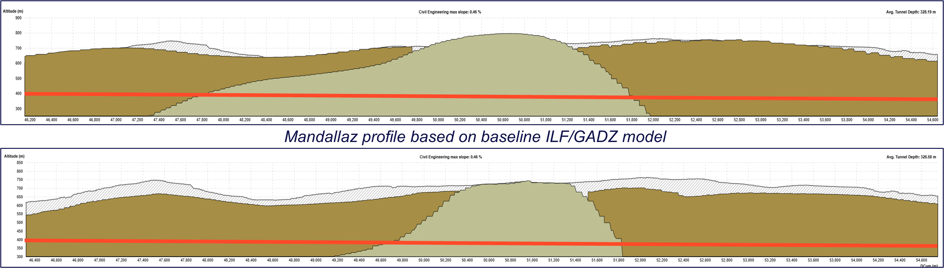
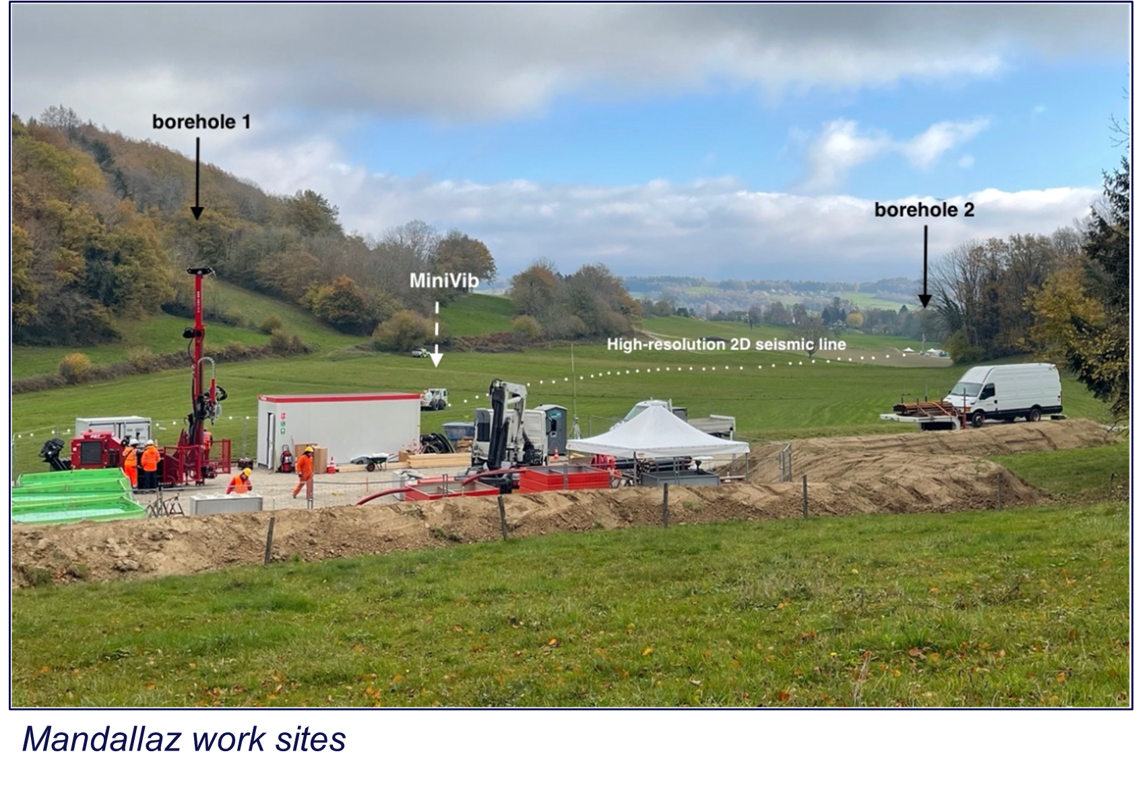
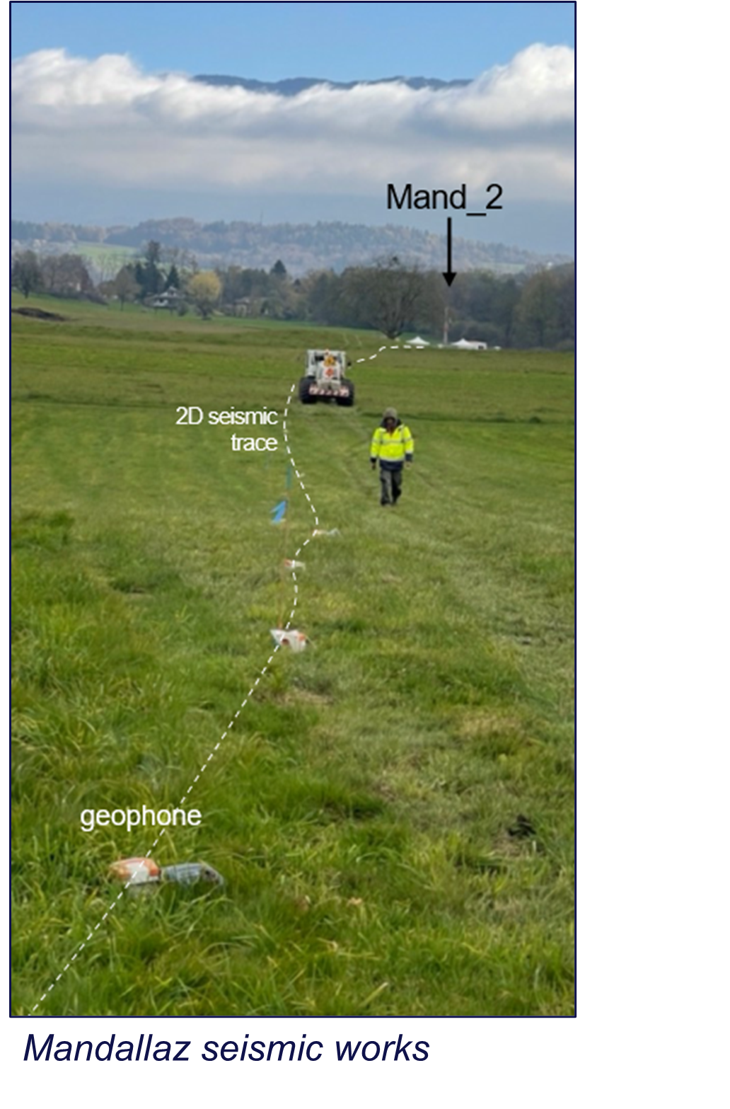
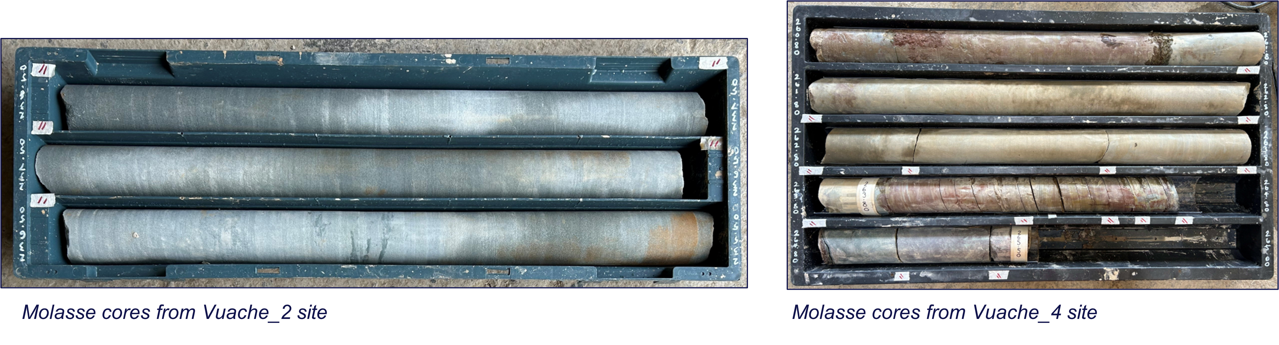
Preliminary Results

Slide 21
Pre-TDR Work Scope
For underground civil engineering works to start in early 2033 there are a number of critical tasks that CERN must complete during the Pre-TDR phase ie between now and early 2028.
These tasks cover five main areas:
Complete the current site investigation campaign
Prepare for the second site investigation campaign
Develop the surface sites in conjunction with professional architects and engage with stakeholders to develop acceptable solutions
Continue to improve the maturity of the underground designs and study some specific technical topics with the aim to reduce overall cost, schedule and technical risks.
Advance on the design maturity for the injection complex including impact assessments for the existing structures and infrastructure.

Slide 22
Thank you for your attention.
22

