Slide 1
Update on civil engineering strategy and schedule
Timothy WATSON
Civil Engineering Coordinator

Slide 2
Contents
5 June 2023 / FCC Week
Timothy WATSON
Summary of overall work scope
Current strategy for the main construction contracts
Possible strategy scenarios for main consultancy contracts
Civil engineering scope during the next phase of FCC
Schedule of work leading to shaft construction in 2033
CE resources and organization
Key elements for success

Slide 3
Work Scope
5 June 2023 / FCC Week
Timothy WATSON
Underground Works
Represent close to 90% of the total cost of the FCC civil engineering
91km long main beam tunnel
12 shafts
12 large caverns (>20m span)
52 alcove caverns
Numerous other connection tunnels, galleries, small caverns vertical shafts
As a comparative metric, the total volume of un-bulked rock to be excavated from the underground is 6 million m³. This can compare to Hi-Lumi (100,000 m³ ) and for LEP (1.5 million m³)

Slide 4
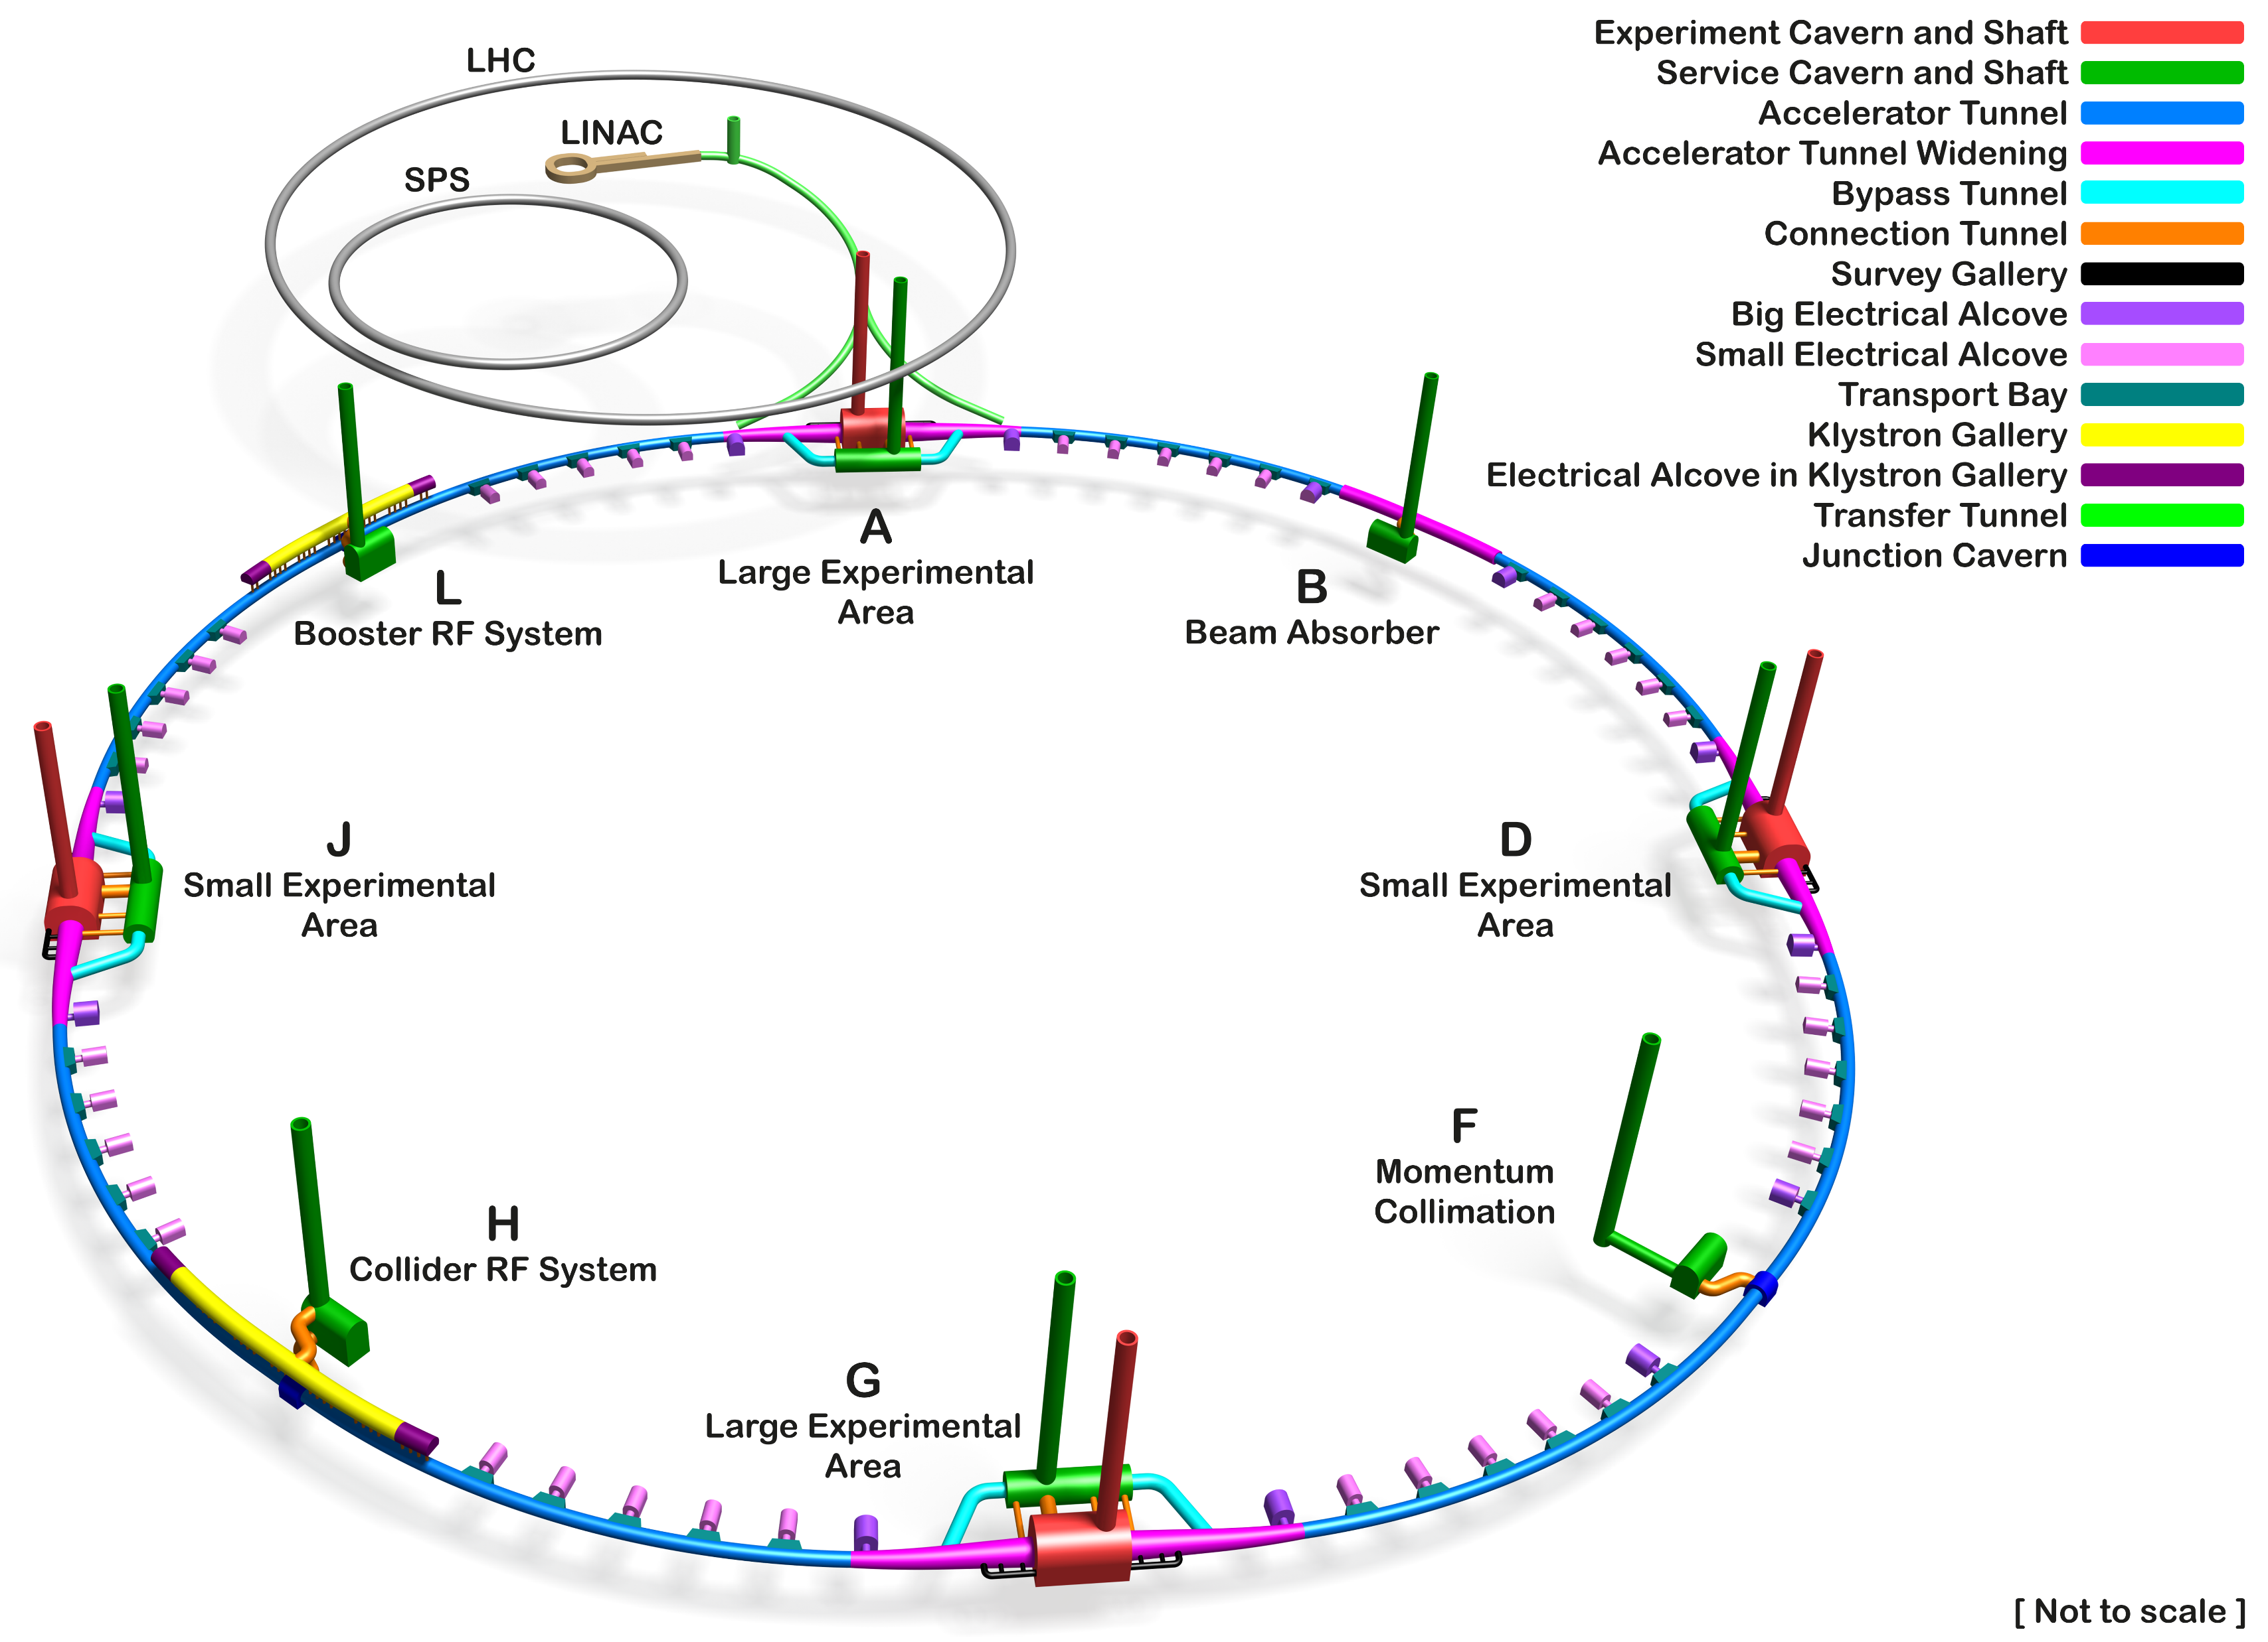
FS Baseline for Underground Civil Engineering
5 June 2023 / FCC Week
Timothy WATSON
Simplified arrangement for PH and PL (removal of by-pass tunnels)
Simplified arrangement at PB (removal of by-pass tunnels and technical cavern moved), shorter connection tunnel.
Simplified arrangement at PF (removal of by-pass tunnels)
Change of elliptical shafts to circular
Improved definition of HE LINAC Complex

Slide 5
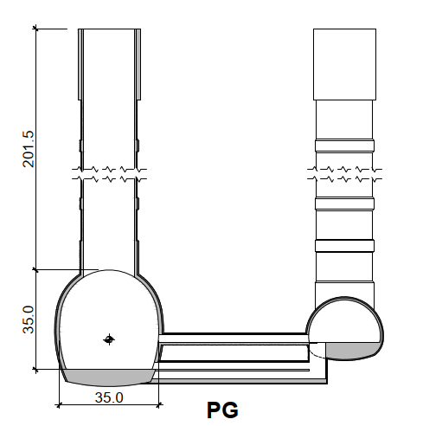
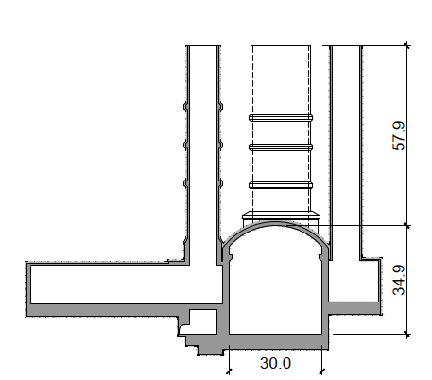
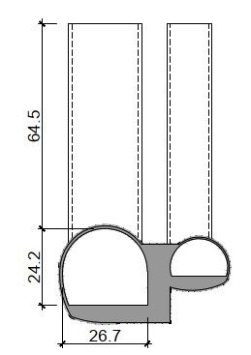
Comparison FCC to ATLAS and CMS Cavern Complexes
FCC
ATLAS
CMS
Depth of FCC large caverns is over 3 times the LHC cavern depths. Meaning 3 times the in-situ stress in the rock mass

Slide 6
Surface Civil Engineering
5 June 2023 / FCC Week
Timothy WATSON
Preliminary plan views and sections have been prepared at CERN based on the requirements study led by the integration team.
The requirements were largely based on CERNs past experience as detailed engineering studies for most systems and processes have not yet been carried out.
The plans, drawings and specifications have been used solely for the purpose of cost estimation, this being done by an external contractor (Ingerop/Rendel).
In the pre-TDR phase, the civil engineering will need to be further developed on the basis of a more robust set of user requirements.
In addition, architectural input and input from external stakeholders will need to be taken into account in particular from the perspective of the integration into the local environment.

Slide 7
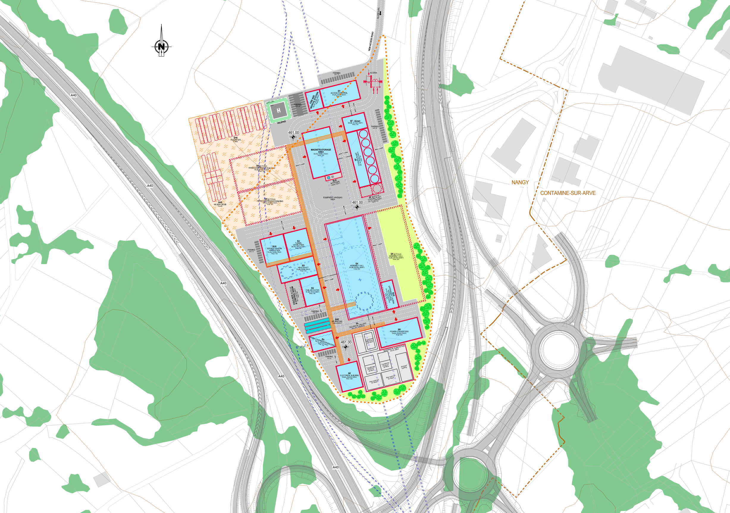
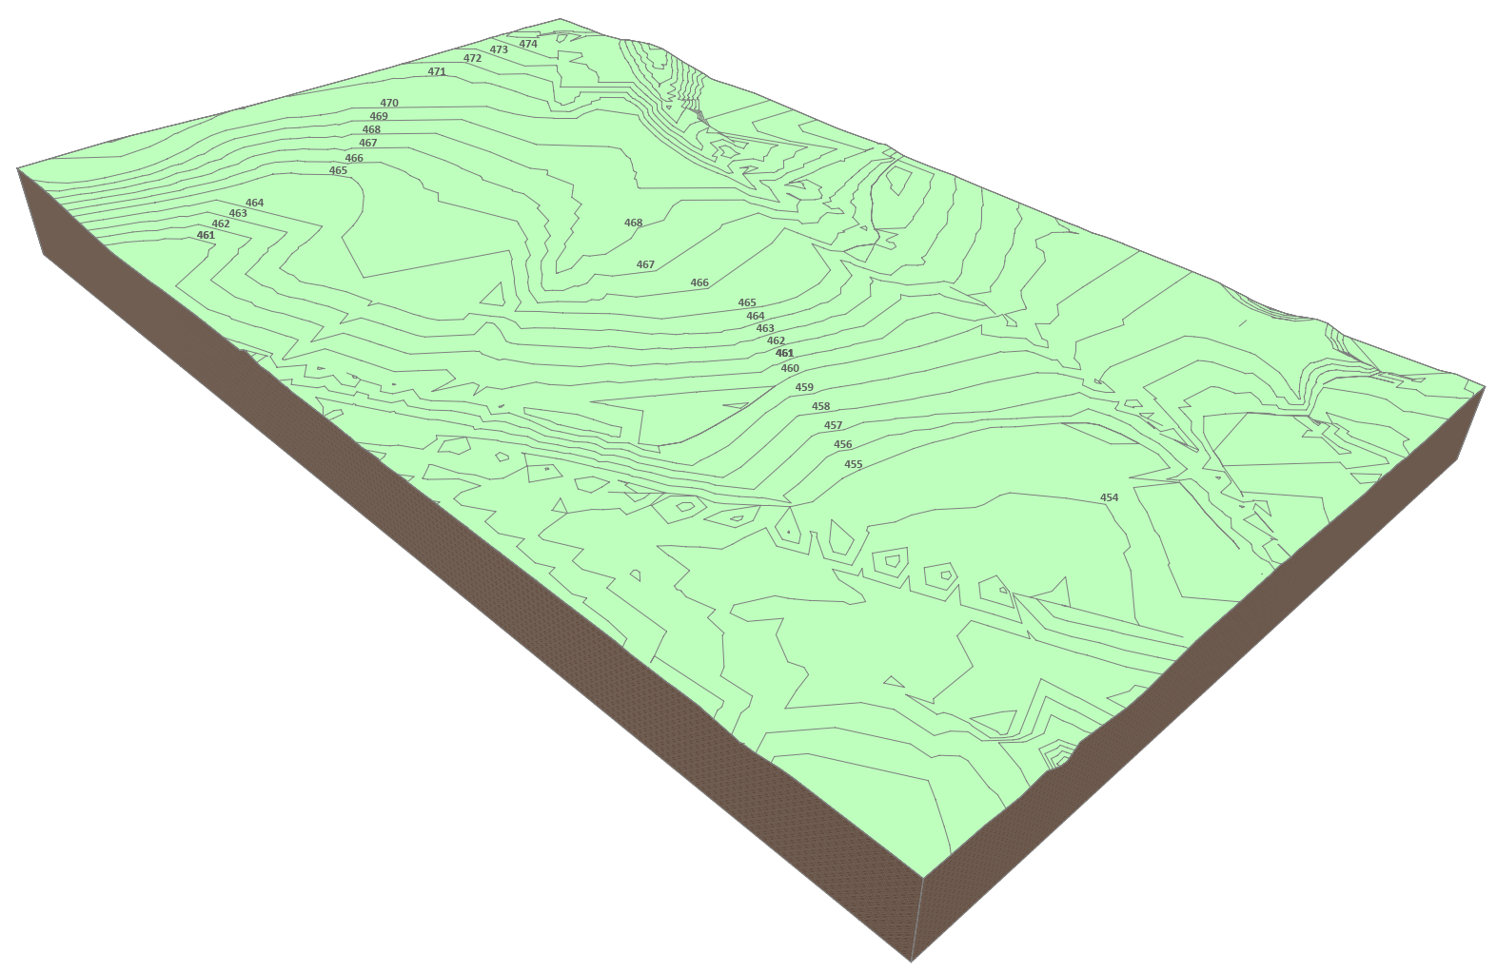
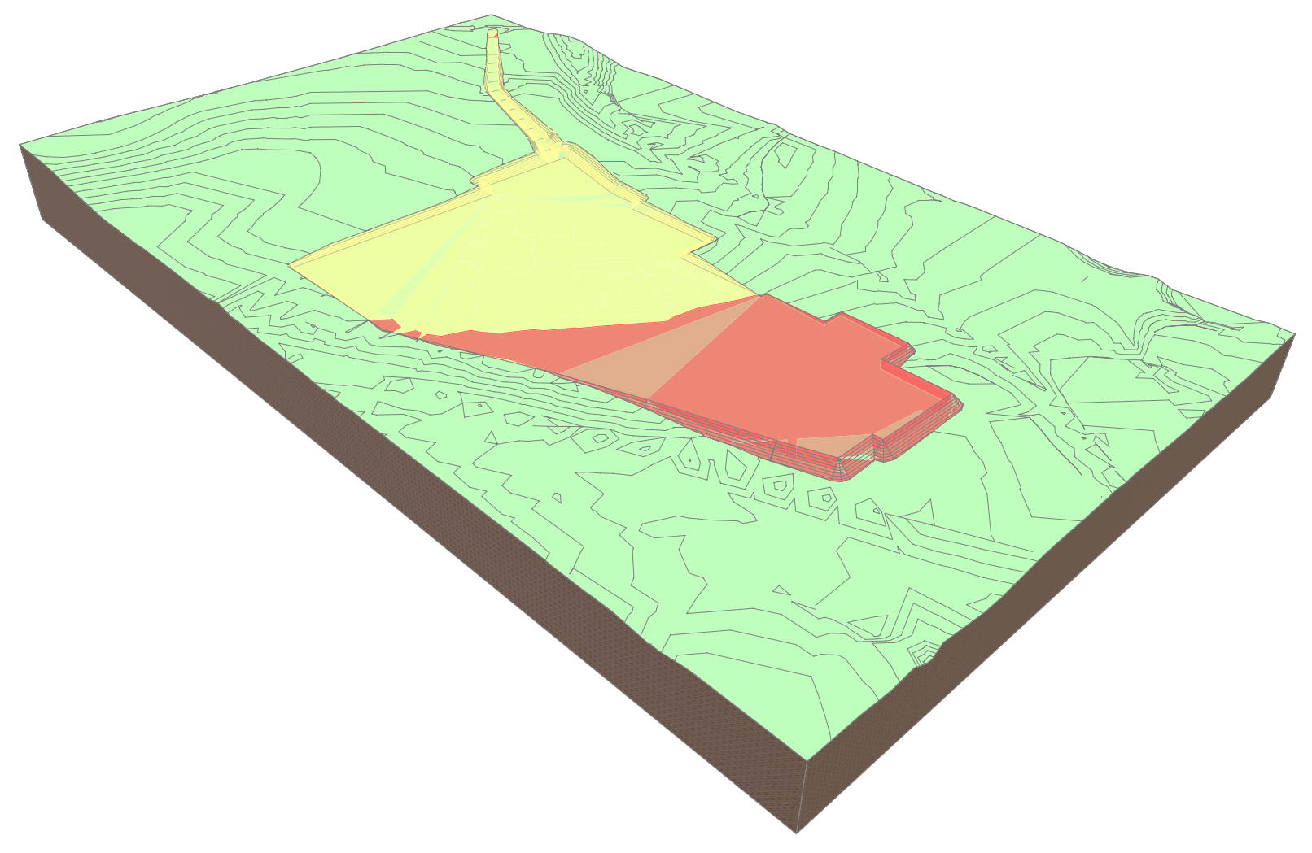
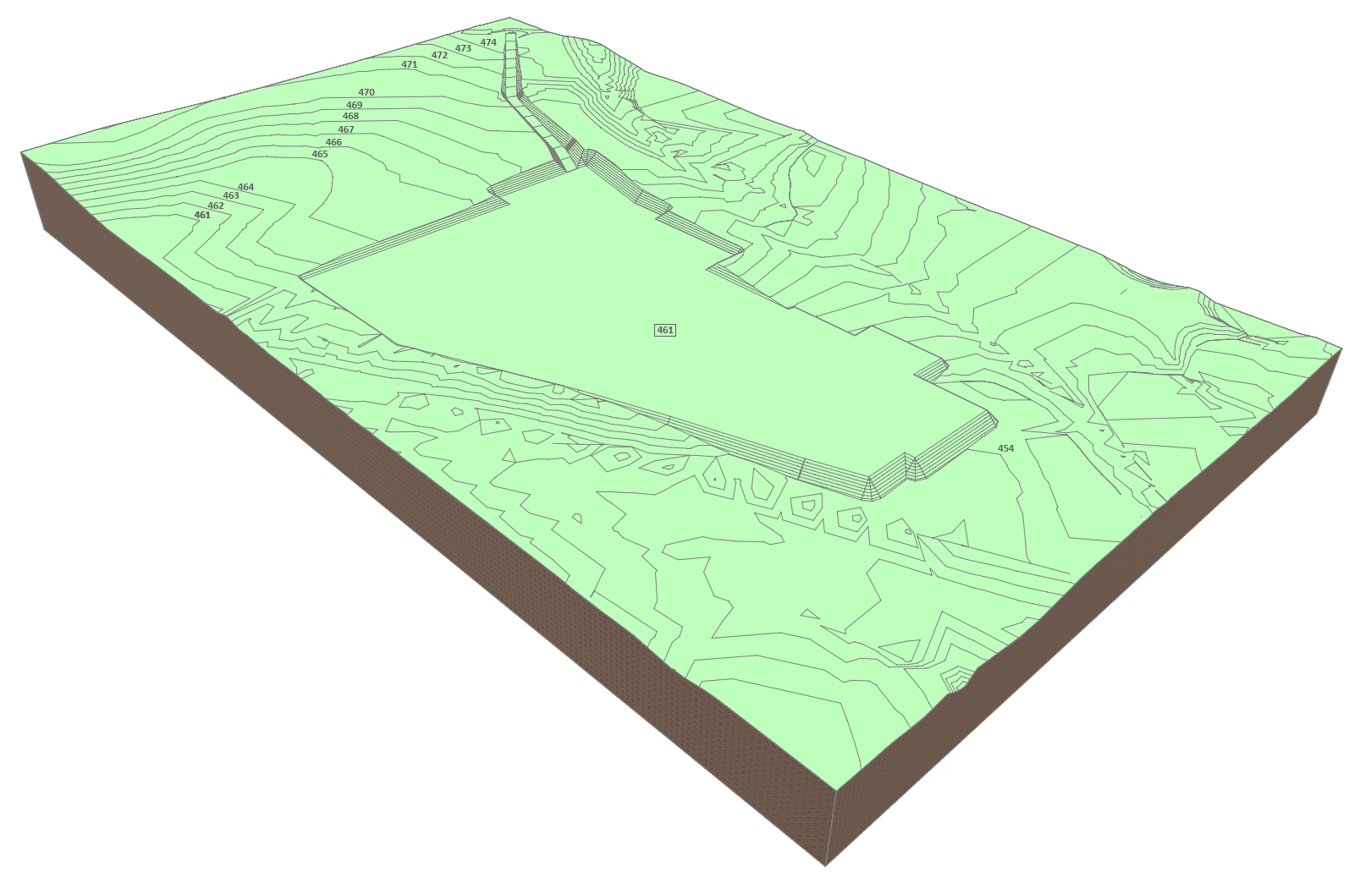
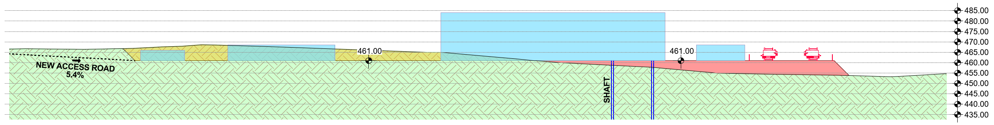
Example Details of Experiment Surface Site – For Costing Purposes
EXISTING
CUT & FILL
PLAN VIEW
FUTURE
LONGITUDINAL PROFILE

Slide 8
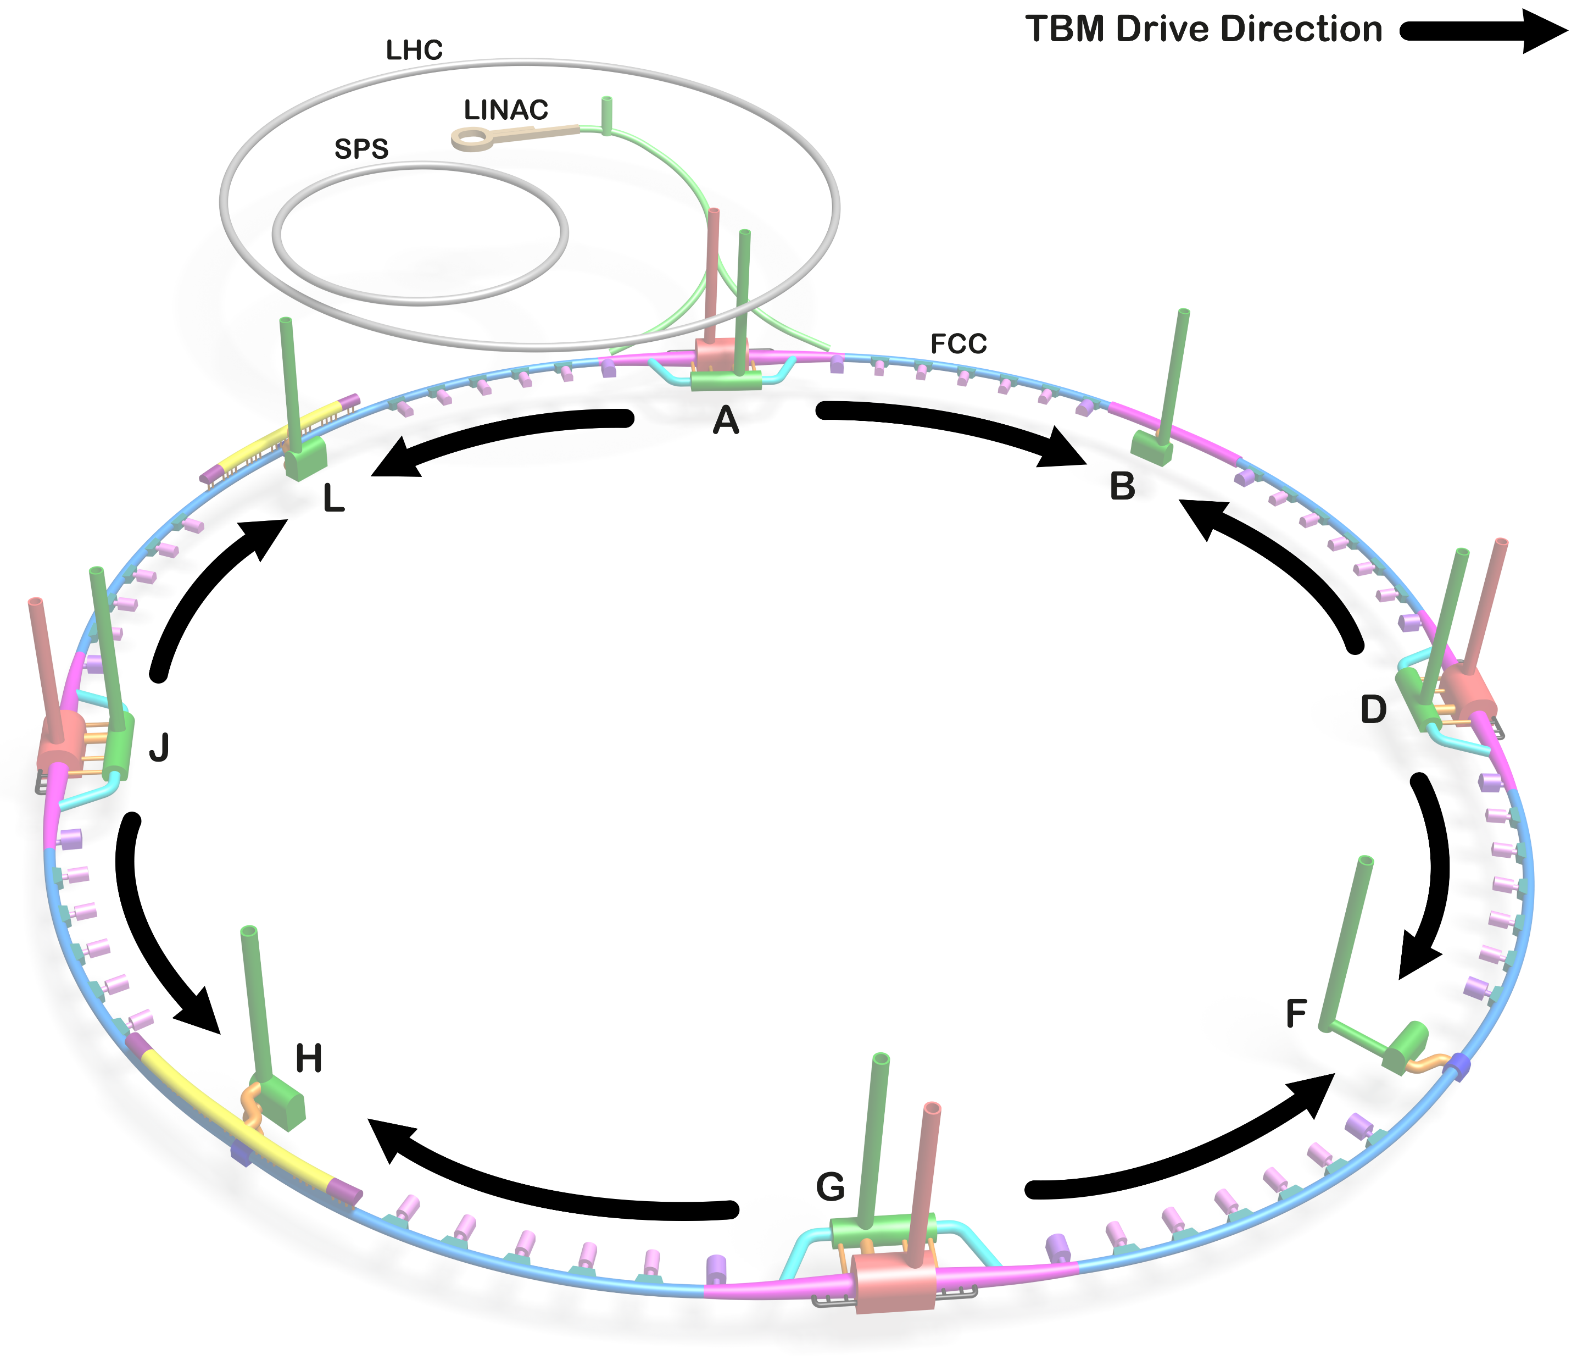
Contract Strategy for Construction
Contract strategy for underground works is strongly influenced by TBM drivage and removal sequence.
From a technical perspective it is considered better to drive two TBMs from each of the four experimental sites rather than a single TBM from each of the eight sites because:
Two shafts allow for better provision of ventilation and ability to separate material and personnel access to underground
The Experiment shaft is directly on the axis of the beam tunnel making TBM installation easier
The necessary tunnel widenings can be used to assemble the TBMs underground
More efficient surface construction sites as the same configuration is used for two TBMs
Focuses construction infrastructure and spoil removal infrastructure at only four sites.
Allows earlier release of the technical sites for subsequent infrastructure installation activities.
A downside of this is that the single shaft in CH (PB) has no TBM drives and therefore only a small volume of spoil being removed (about 4% of the total).

Slide 9
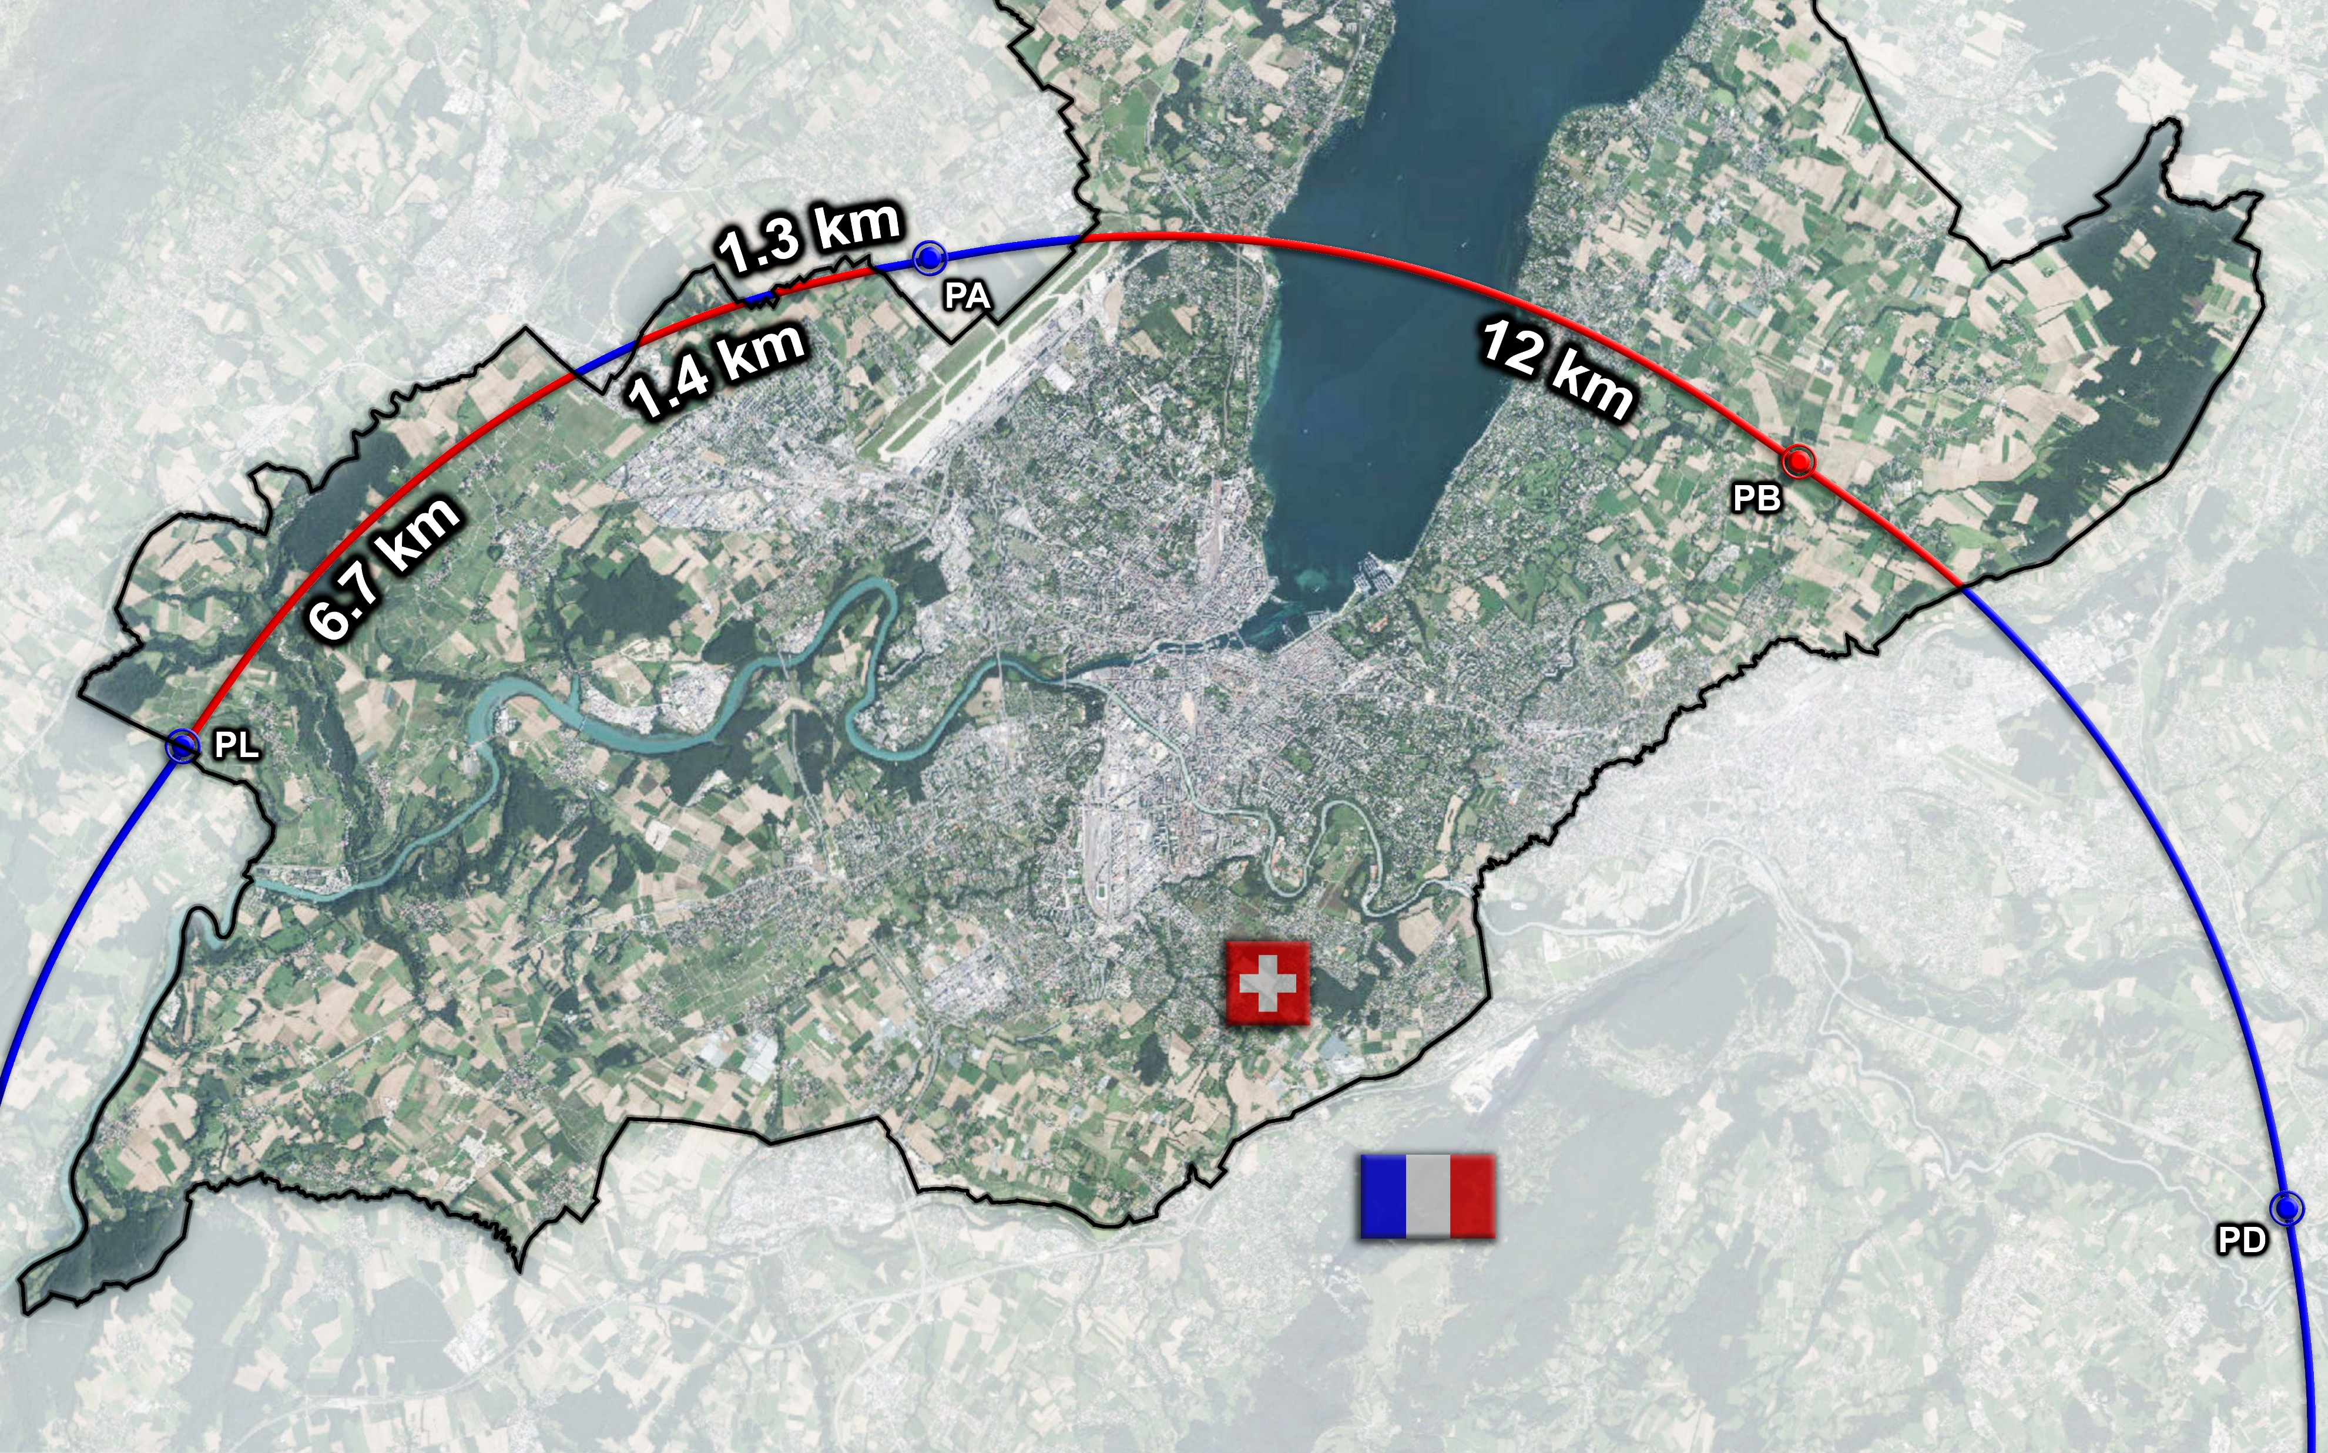
Contract Strategy for Construction
There are four sections of the tunnel located in Swiss territory
Three sections are located between PA and PL and one longer section between PA and PB, extending towards PD
The total length of tunnel in Swiss territory is 21.4 km (23%)
Only one of these parts has a shaft (PB)
But PB is not an experiment site and therefore not currently planned to be used for TBM launch
PL, close to a section under Switzerland is also not planned to be used for tunnel excavation.

Slide 10
Contract Strategy for Construction
The strategy for division of the work scope is based on the following factors:
The total quantity of work is several billion CHF
The need to maintain as far as possible a fair return to member states
The need to minimise and simplify the interfaces between contractors
The need to make the value of work packages large enough to attract major industry players
The need to make the work packages of a size (value) that will attract not only the very largest of contractors from member states
The need to maintain an option to start the construction of the Injector complex earlier than the rest of the civil works.
On this basis, the current strategy is to have five construction contracts as follows:

Slide 11
Contract Strategy for Construction
One stand-alone contract for the construction of the Injection complex on the Prevessin site and the transfer tunnels down to the FCC
Four similar contracts that would each contain:
A complete experiment site including all surface civil engineering
The TBM drive up in a clockwise direction up to the adjacent technical site
The construction of the adjacent technical site on the clockwise side including all surface civil engineering
The construction of the main tunnel sector in an anti-clockwise direction up to a point close to the adjacent technical site on the anticlockwise side

Slide 12
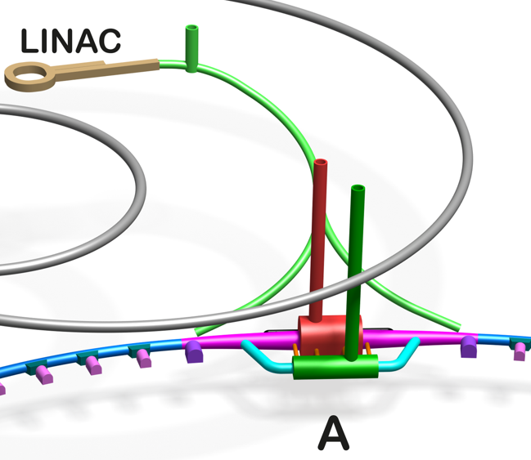
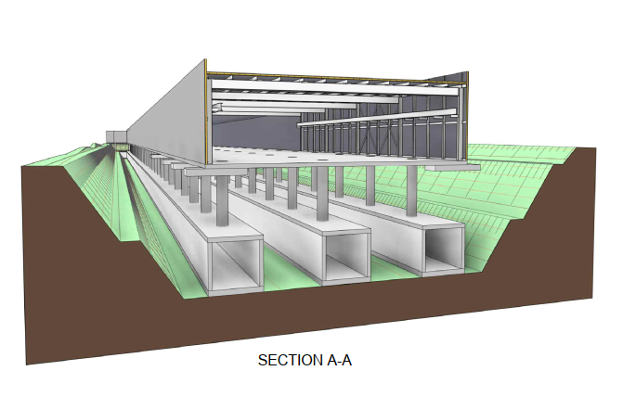
Contract Strategy for Design and Construction Oversight
Contract 1 – Injection complex and transfer tunnels
PA

Slide 13
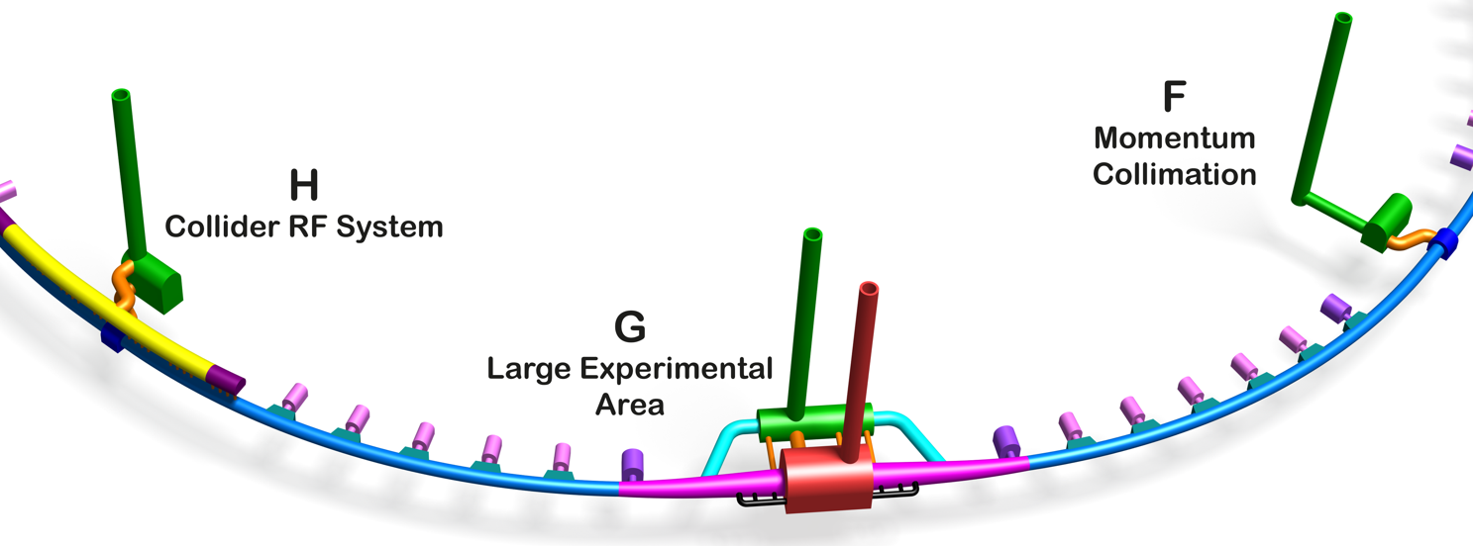
Example of Construction Contracts 2, 3, 4,5
Only five interfaces between the contractors
Assuming 2,3 or 4 entities in each consortia then potentially 10 to 20 separate companies could participate
Physical Limit of contract

Slide 14
Contract Strategy for Design and Construction Oversight
No decision made on the number of contracts for design and oversight.
The options are 1, 2,3,4 or 5 contracts. Probably 3 or 5 will be the selected option.
All consultancy contracts need to be signed in early 2028 if we are to have any chance to meet the start of underground construction in 2033.
The market survey would need to be issued in 2026 noting that the estimate total value of all the design/supervision contracts is estimated at around CHF 600 M.
Other contracts that would need to be put in place for CE works include Architects, landscaping, safety oversight, legal support, Adjudicator services and other specialist services.

Slide 15
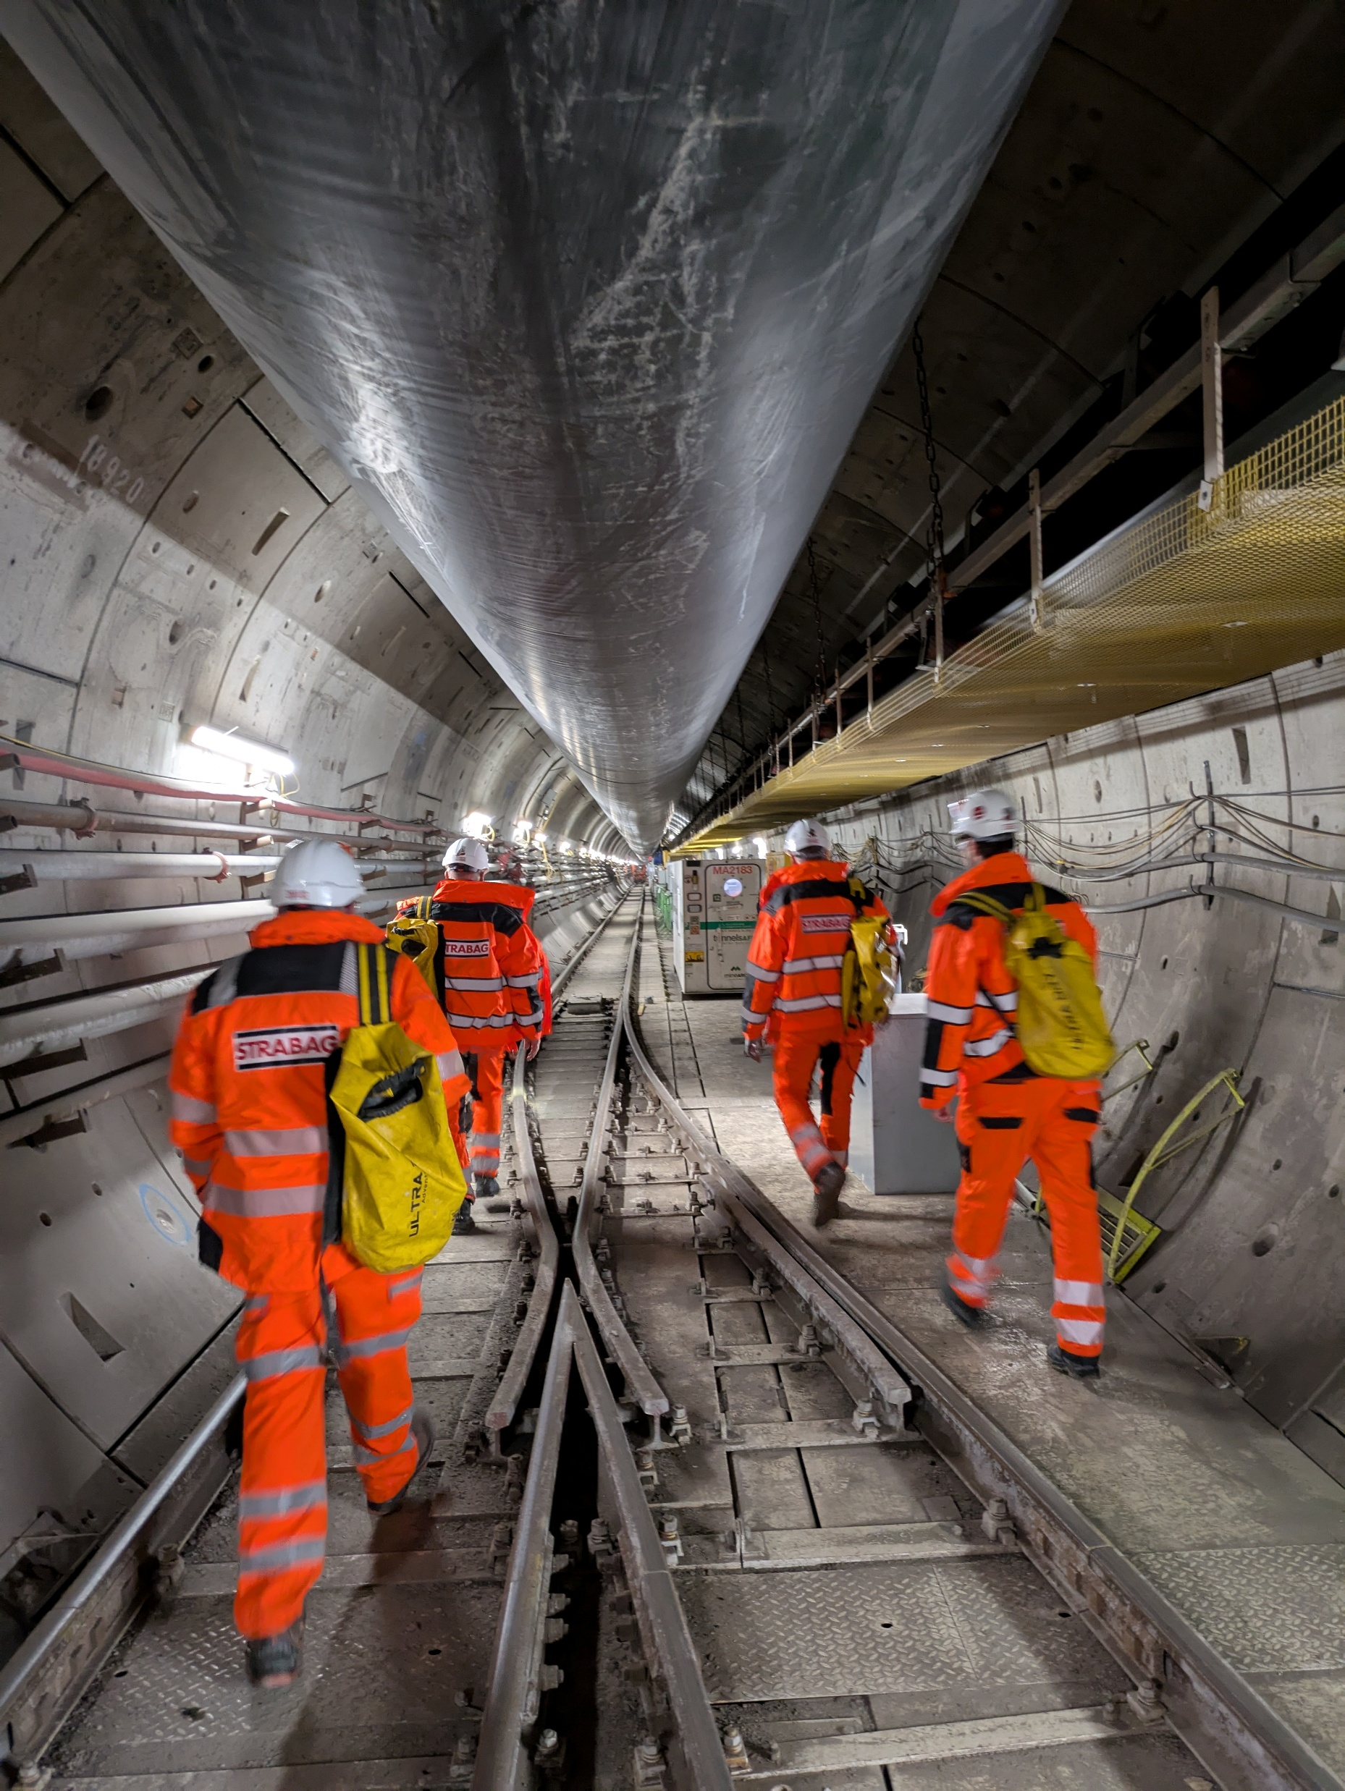
Engagement with Industry
CERN has met informally with a number of major civil engineering contractors from several member states.
Topics covered included technical aspects of the underground works as well as contractual aspects.
This engagement will continue through the next phase of the project
One project in particular was brought to CERNs attention and staff from SCE Department visited in January 2025. The Woodsmith mine project.
Similar depth range to FCC (up to 500m)
Sedimentary medium strength rock (similar to most of FCC)
Crosses fault zones
4.9m internal diameter
Single TBM used for the full 36 km length of the tunnel

Slide 16
CE Tasks for Pre-TDR
5 June 2023 / FCC Week
Timothy WATSON
For underground civil engineering works to start in early 2033 there are a number of critical tasks that CERN must complete during the Pre-TDR phase ie between now and the formal approval of the FCC Project (currently assumed to be by end 2027).
These tasks cover three main areas:
Complete the current site investigation campaign
Prepare for the second site investigation campaign
Develop the surface sites in conjunction with professional architects and engage with stakeholders to develop acceptable solutions
Undertake additional technical studies for the underground civil engineering

Slide 17
5 June 2023 / FCC Week
Timothy WATSON
CE Tasks for Pre-TDR
Site Investigations:
Complete the remaining drilling works in France
Start and complete the drilling and seismic works in Switzerland
Procure consultants for the next phase of site investigation (at least 80 new drillings expected)
Assess the results from the current site investigation and prepare the specifications for the next site investigation campaign. Specific focus to be given to the identification of sub-surface water sources and fault characterisation.
Undertake the procurement of drilling contractors for the next campaign (noting no financial commitment can be made until after approval of the FCC as a project).

Slide 18
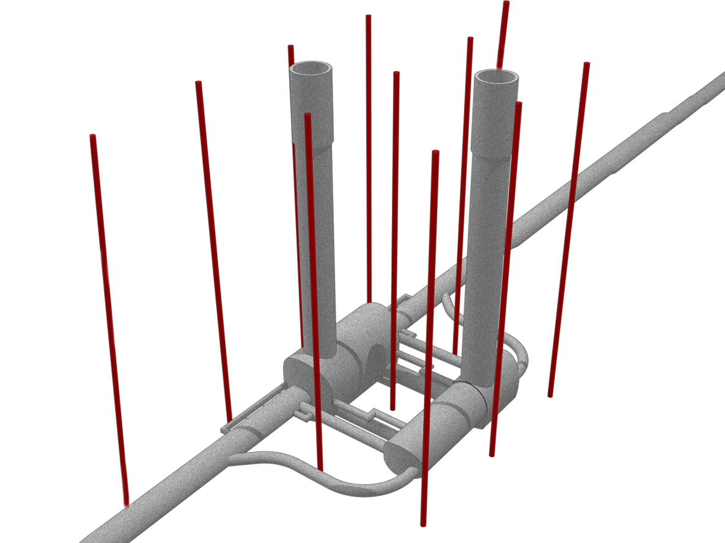
Phase 2 Site Investigation
5 June 2023 / FCC Week
Timothy WATSON
The Phase 1 investigations was only intended to cover the areas where no accurate information of the location of the molasse was available. This was/is important as the basis of the cost and schedule is that the tunnel remains largely within this rock type.
A larger campaign is needed to obtain the detailed information necessary to start detailed design of the underground structures. The market survey for services to define this next campaign has been launched and the procurement for the actual campaign itself will be carried out in 2027.
The main focus will be on the eight sites where large caverns will be built as in these areas, detailed 3-dimensional models will be necessary along with full geotechnical and hydrological data.
It is estimated that between 80 and 100 new boreholes could be required.
The detailed needs will be developed once all the results from the current Phase 1 campaign have been assessed.

Slide 19
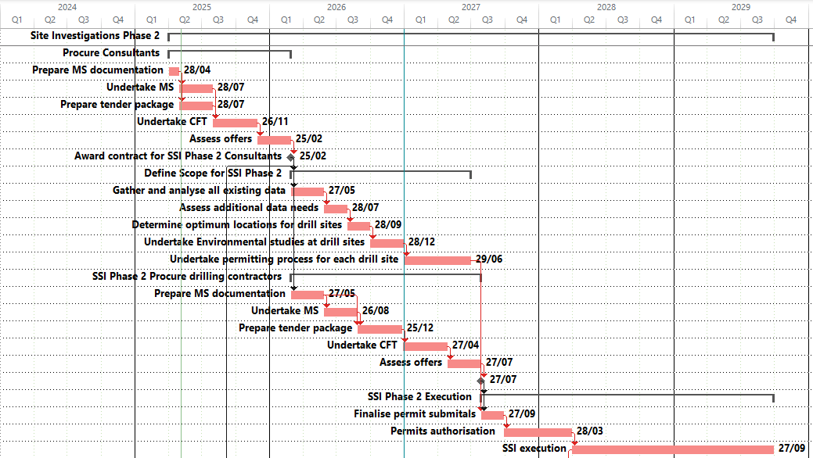
Phase 2 Site Investigation
Market Survey has been issued for the consultancy services
CfT will be issued in Q3 2025 with the aim of adjudication at the first FC of 2026
A single contract will be awarded with scope covering:
Assessment of data from previous investigations
Assessment of data needs and corresponding gap analysis including for Matex and seismic studies
Preparation of tech. specification for Phase 2 Site Investigation campaign
Undertake all works necessary to obtain permits including additional environmental assessments
Assist CERN in obtaining permits.

Slide 20
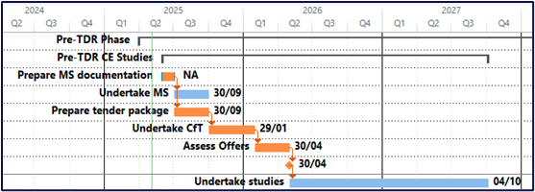
5 June 2023 / FCC Week
Timothy WATSON
CE Tasks for Pre-TDR
Underground works:
Procure the services of a consultancy firm specialized in underground civil engineering.
Undertake numerical analysis of some key underground structures using the geotechnical data obtained from the current site investigation.
Study the possibility of TBM entrapment in potentially water bearing molasse as could be encountered in faulted areas
Study the impact of the results from the current site investigation on the tunnel alignment and tilt. Some re-adjustment of the tunnel depth may be required.
Study the possibility to use shotcrete as a permanent lining
Study the technical issues of tunnelling through the limestone using a single-pass TBM (i.e. segmental lining for permanent support)
Update cost and schedule baseline at least once to reflect any changes to requirements and outcomes from the site investigations

Slide 21
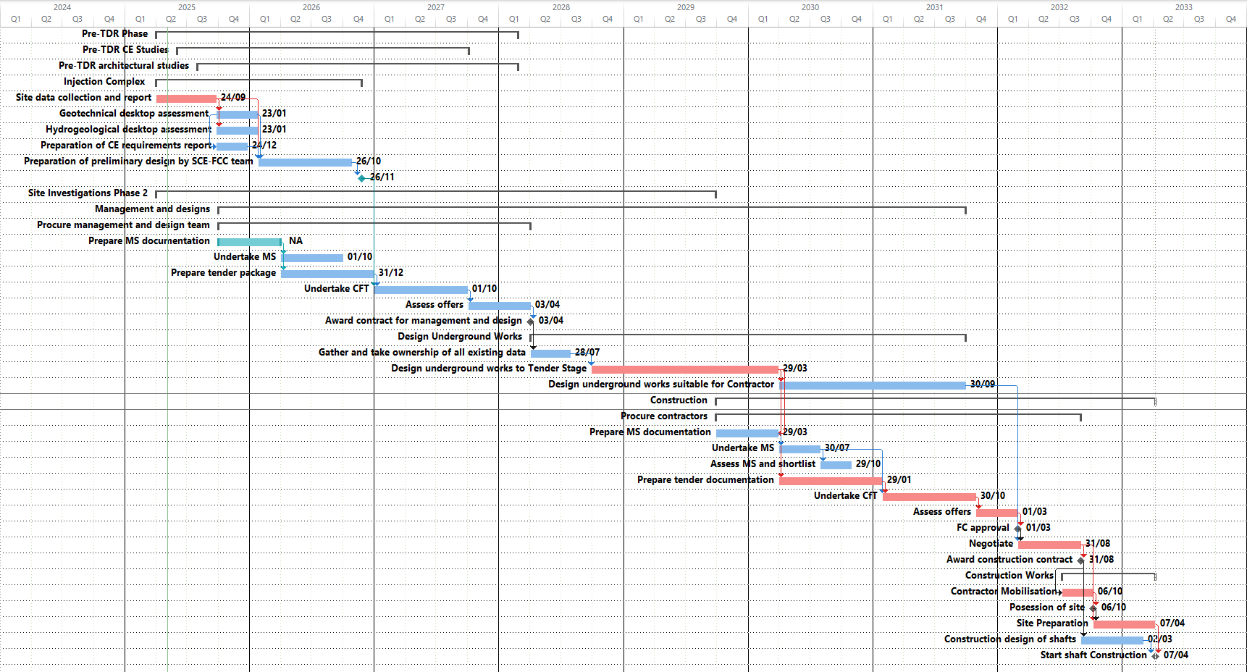
Critical Civil Engineering Tasks to Construction

Slide 22
5 June 2023 / FCC Week
Timothy WATSON
CE Tasks for Pre-TDR
Key Contracts
Several major contracts need to be put in place in 2026, 2027 and 2028
Phase 2 SSI consultants
Pre-TDR architects
Pre-TDR civil engineering consultants
Phase 2 SSI contractors (probably at least three contracts)
Design and supervision consultants (3 or 5 large contracts)
Main works contracts (possibly 5 very large contracts)
During pre-TDR phase the team will need to be reinforced with at least two or three senior staff (2 contract managers and 1 Senior structural/architectural engineer)

Slide 23
First Estimate of CE Resources
Current staff
T. Watson – CE team leader
R. Cunningham – Geotech contract manager
P. Magnano – civil engineer injection complex
Mayoux – permitting and surface
L. Bromiley – civil engineer underground
G. Guihlem (Geotech grad)
Designer support (1 FTE)
GIS support (0.1 FTE)
7.1 FTE
Staff needed during construction
CE Project Manager
Deputy Project Manager
Support Team
2 Designers
Scheduler
Admin/doc control
Snr Geotech Engineer
Snr Underground Engineer
Snr structural engineer/architect
Claims/Disputes manager
Team 1
Contract Manager
Engineer
Site supervisor
Team 2
Contract Manager
Engineer
Site supervisor
Team 3
Contract Manager
Engineer
Site supervisor
Team 4
Contract Manager
Engineer
Site supervisor
Team 5
Contract Manager
Engineer
Site supervisor
~25 FTE

Slide 24
Key Elements for Success
5 June 2023 / FCC Week
Timothy WATSON
Clear definition of roles and work scope for all aspects of FCC project
Clear organization for all FCC including appropriate and clear lines of responsibility.
A documented baseline and a robust and workable change management process
An integrated schedule across all disciplines managed by a core project management team
Validated strategy for procuring the main design services and the construction contracts
Adequate and appropriately qualified resources to implement the multi-billion CHF civil engineering contracts. This does not mean a team of 50 graduates!!

Slide 25
Thank you for your attention.
25

