Slide 1

Open sky view
A field monitoring and data acquisition system

Slide 2
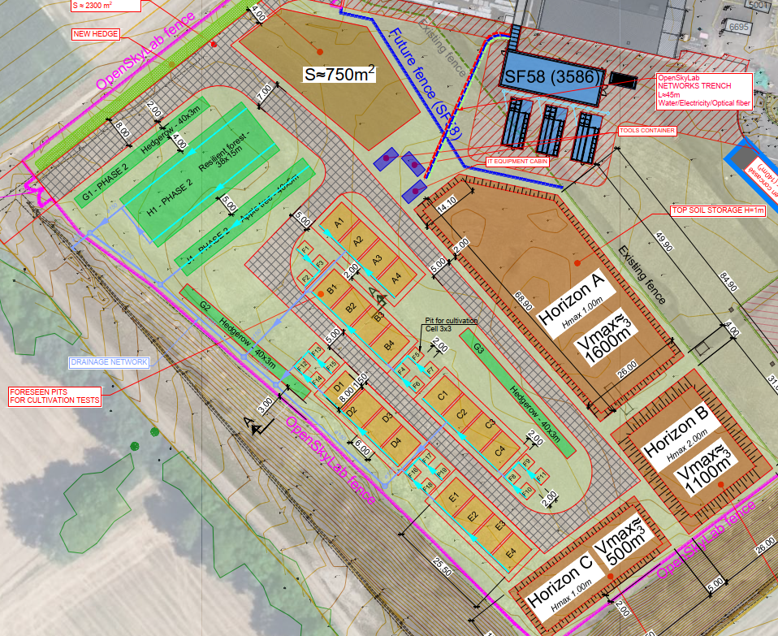
Objectives of OpenSkyView
  Acquisition of online measurements (via active sensors)
  Acquisition of offline measurements (manual measurements, lab reports, etc.)
    Tracking of plot treatment (e.g.: plowing, seeding, adding amendments, etc.)
    Tracking of used seeds and amendments
    Tracking of used machinery
      Storing of timeseries images
        Automatic via connected IP-Cameras
        Manual (e.g. taken via the drone)
        Controlling of irrigation system
        Tasklist
        Logbook
        Visualization and export of stored data

Slide 3
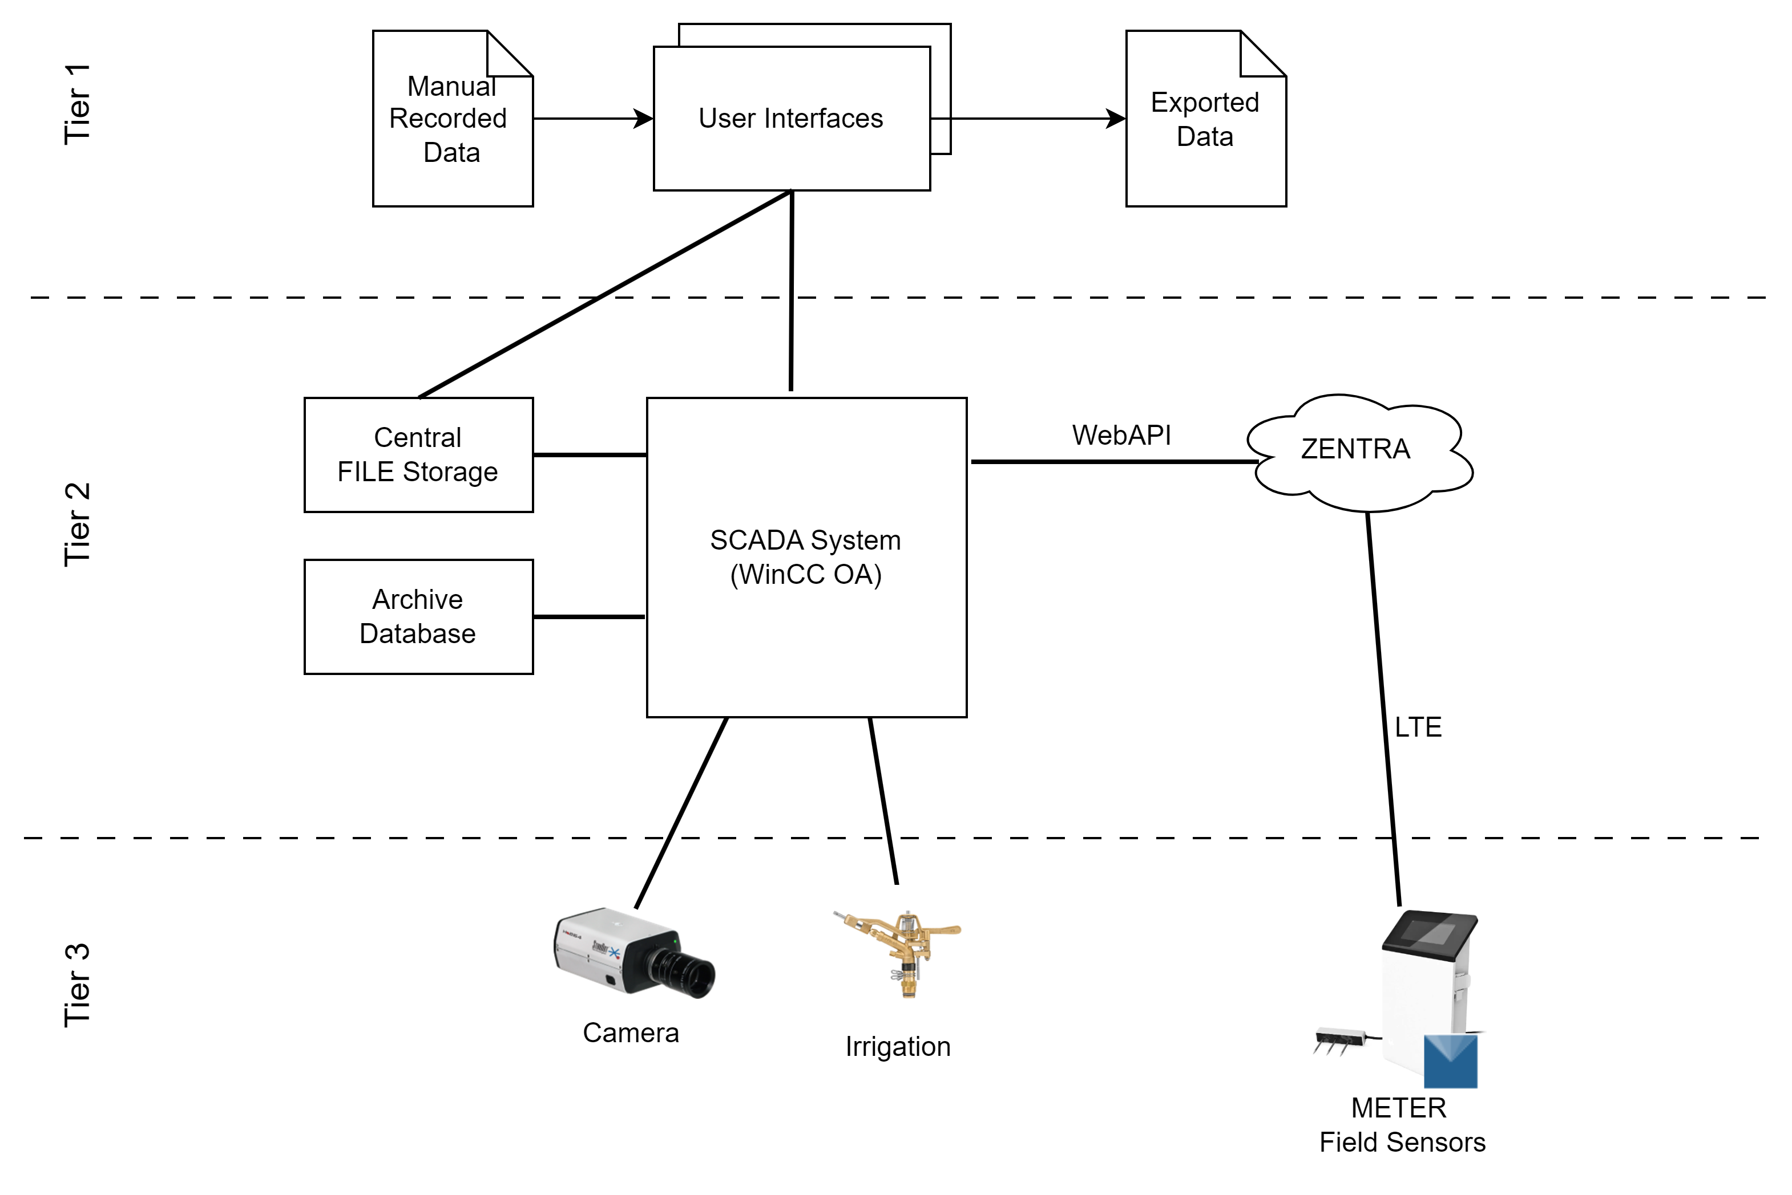
Base architecture
Follows a standard industrial 3-Tier architecture

Slide 4
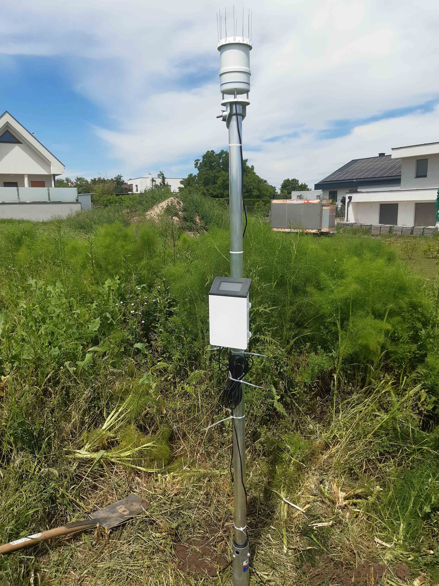
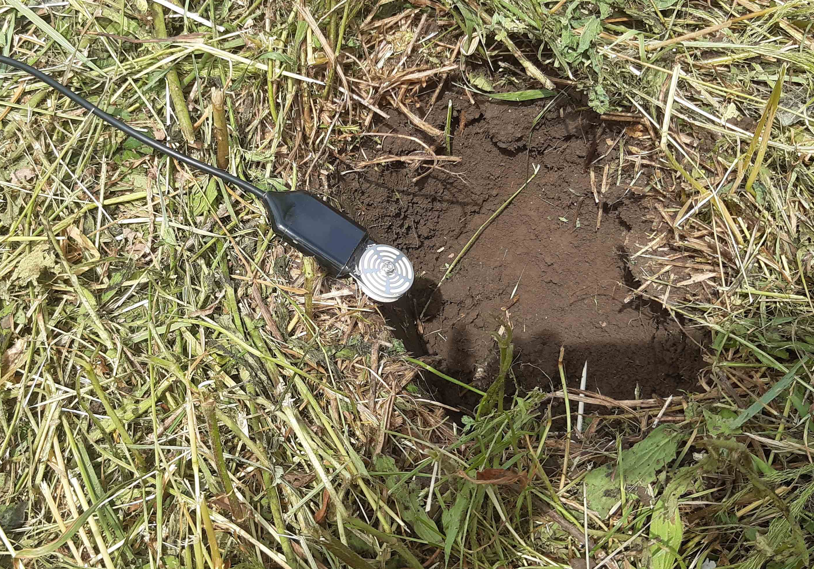
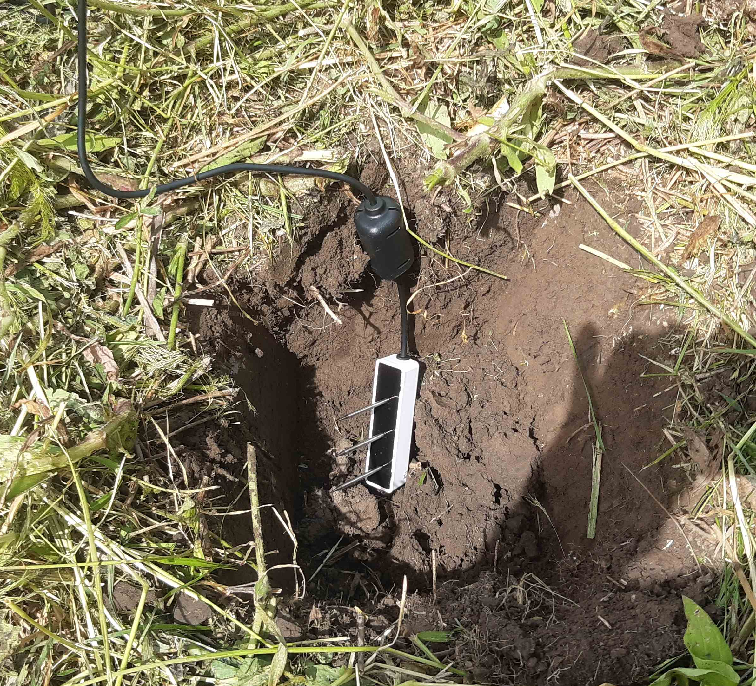
Integrated active Sensors
  ATMOS 41 (weather station)
    TEROS 12 (soil temp. / water content)
      TEROS 21 (soil temp. / matric potential)
    TEROS 21
    ATMOS 41 with Data-Logger
    TEROS 12

Slide 5
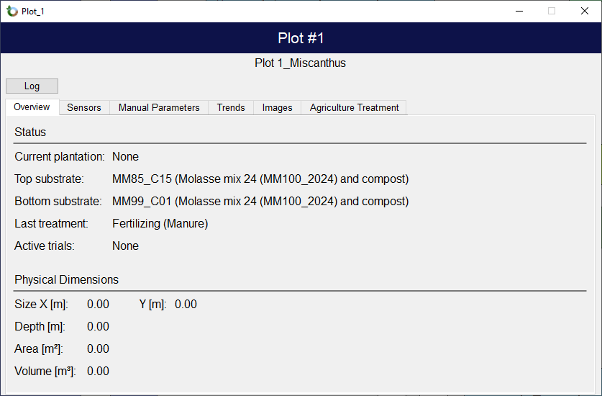
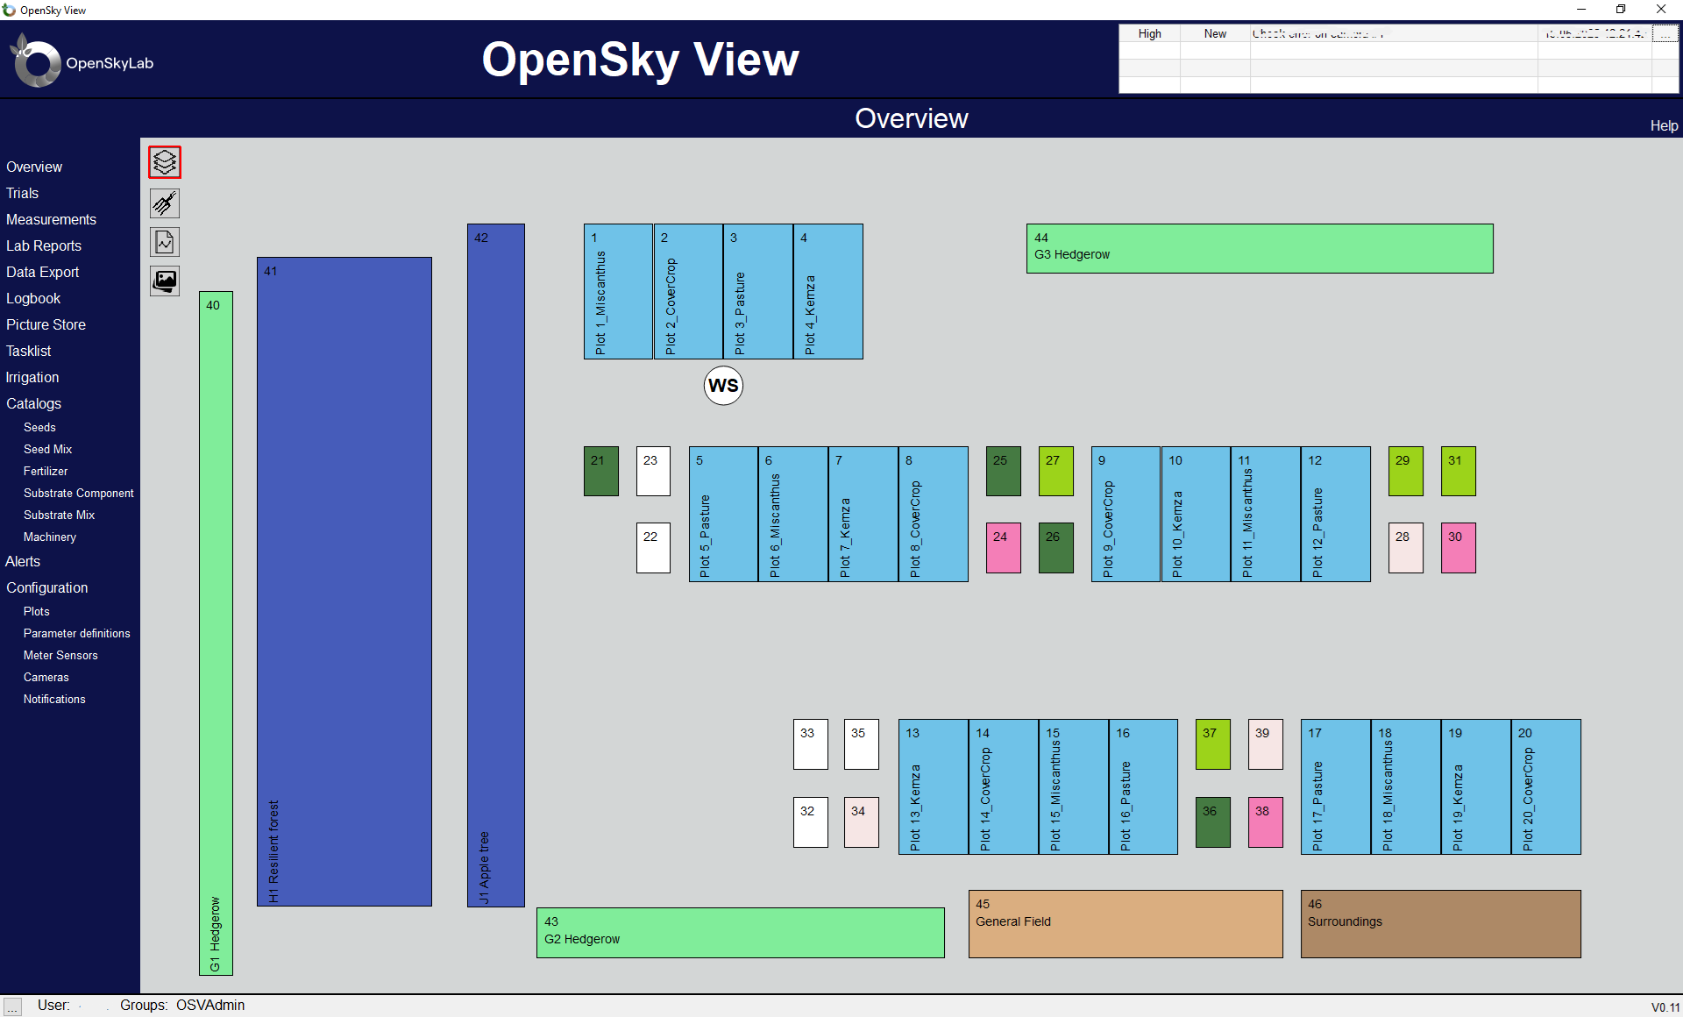
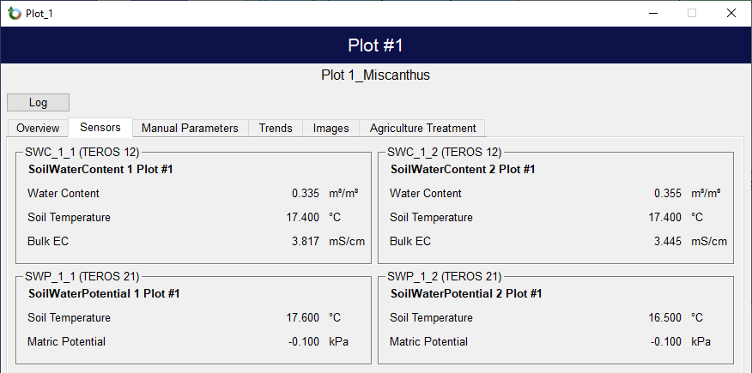
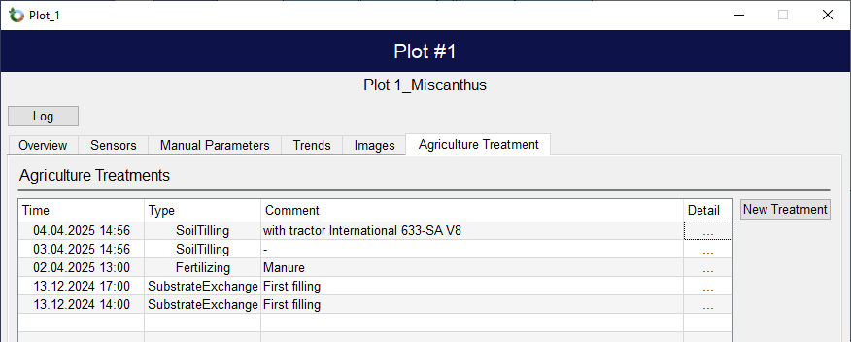
Overview

Slide 6
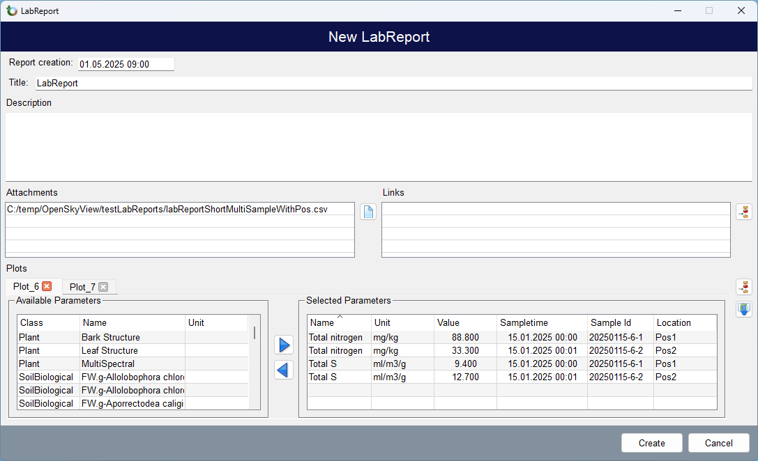
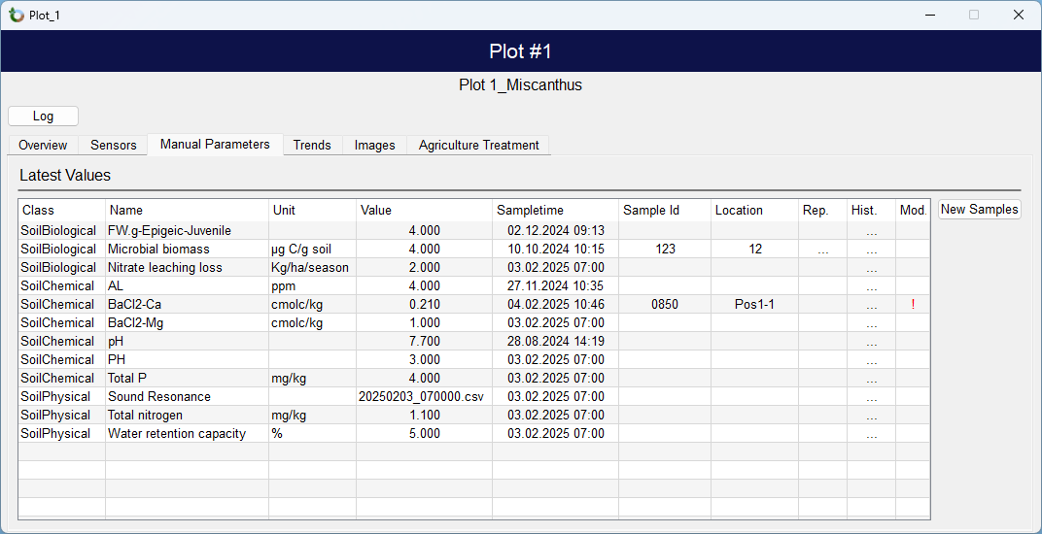
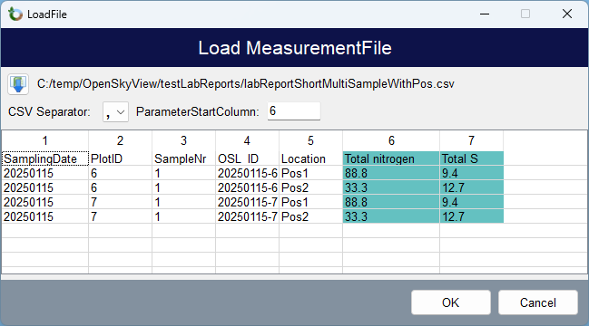
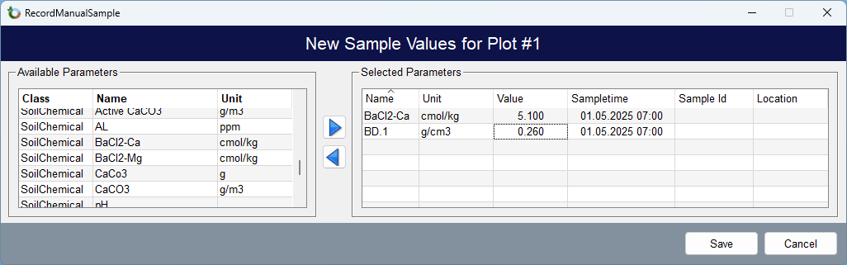
Manual Data recording
  Manual entering of values
    Import via csv from a LabReport
Note: Variables and values shown here are placeholders!

Slide 7
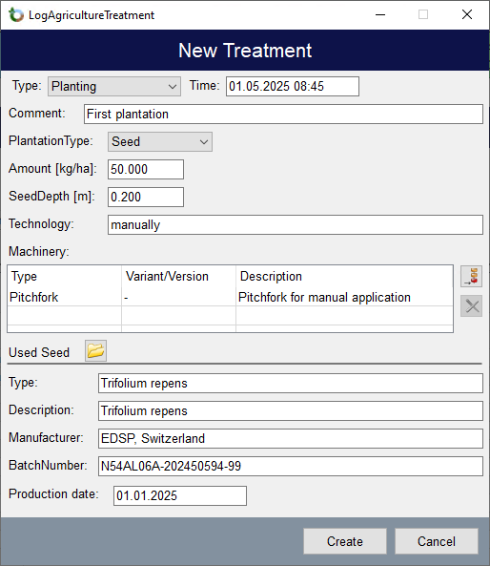
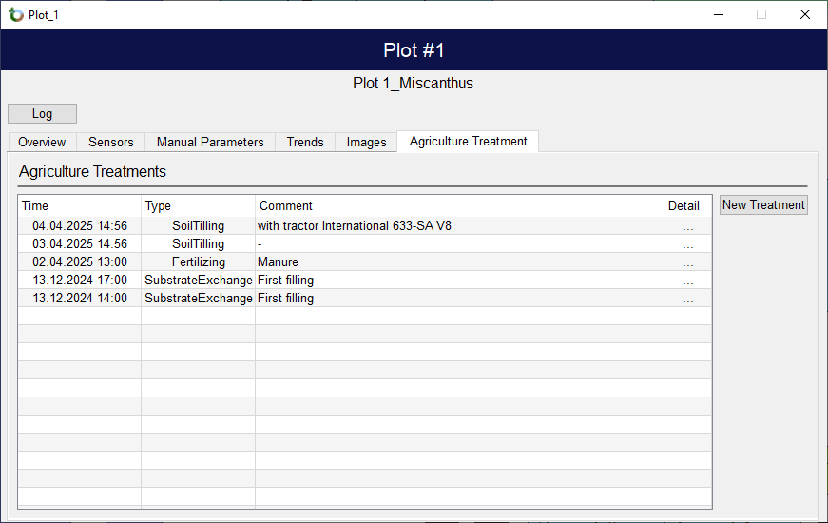
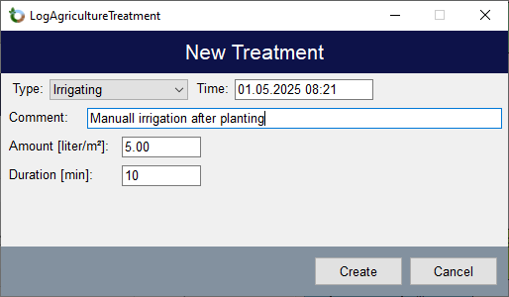
Agriculture Treatment recording
  Planting
    Harvesting
      SoilTilling
      Fertilizing
      Weeding
      Pruning
      Termination
      Cutting
      Substrate Exchange

Slide 8
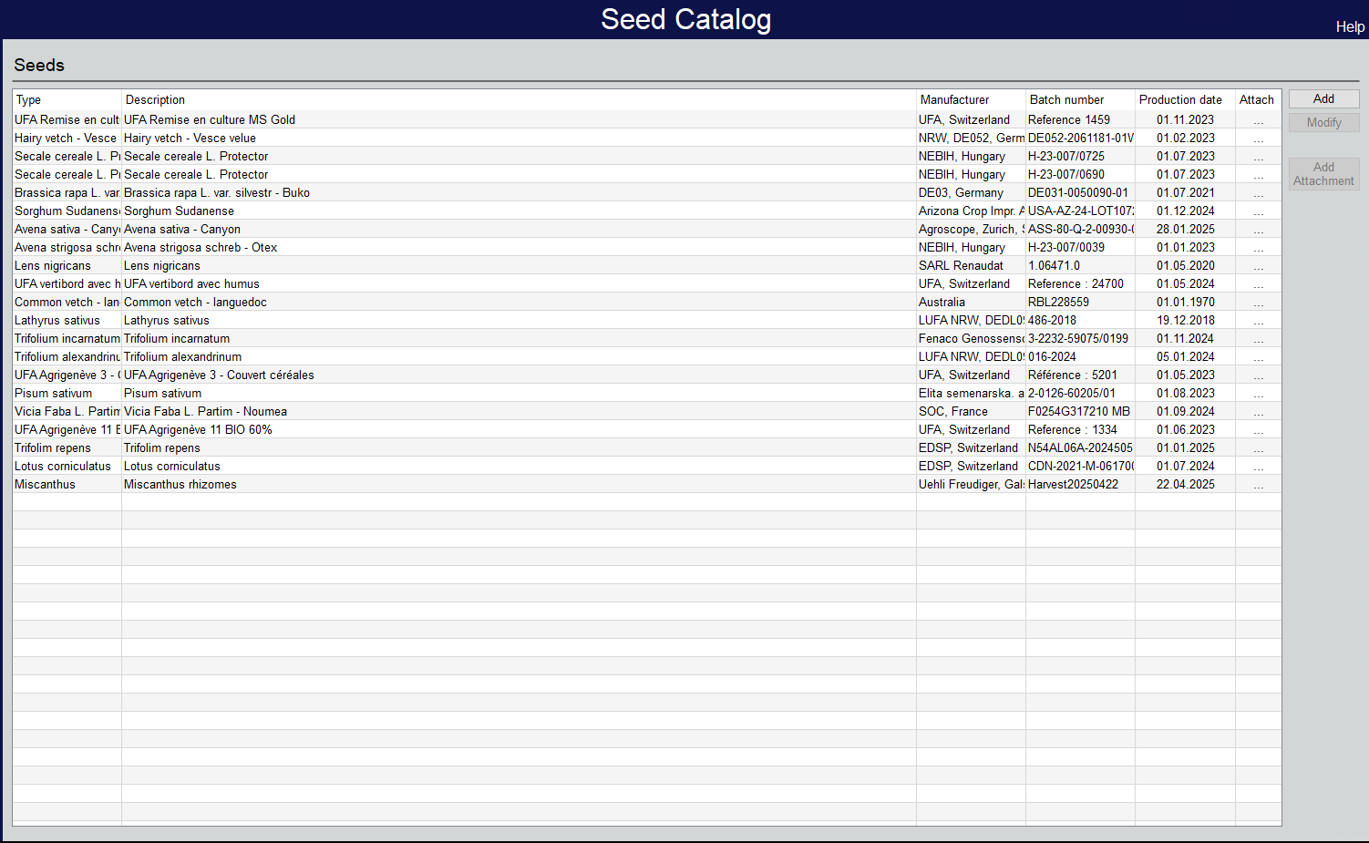
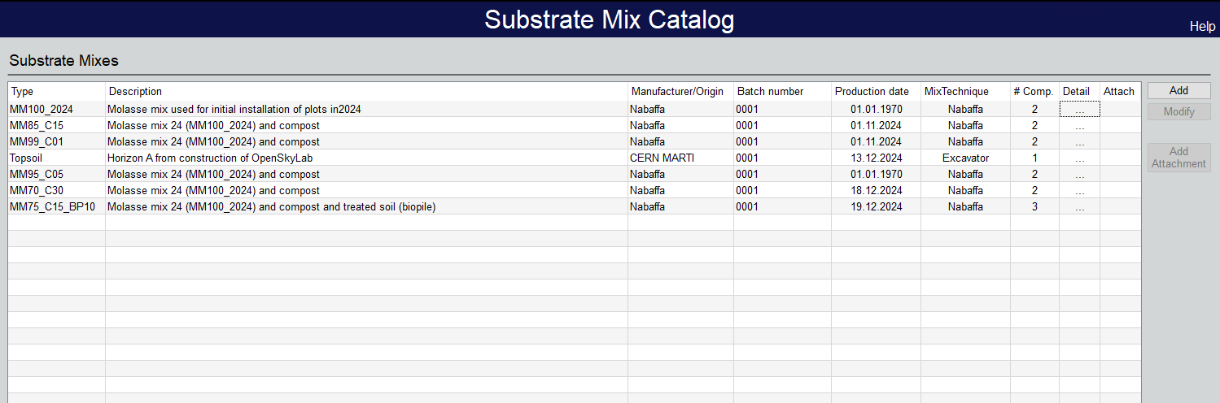
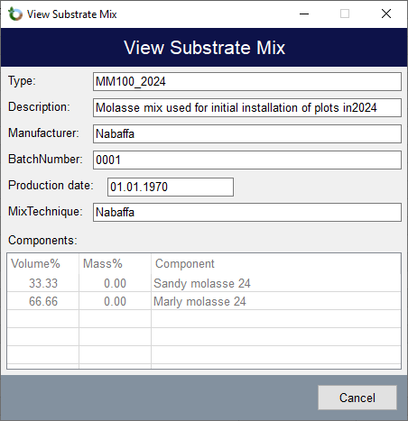
Catalogues
  Seeds
    Seed Mix
      Fertilizer
      Substrate Components
      Substrate Mix
      Machinery

Slide 9
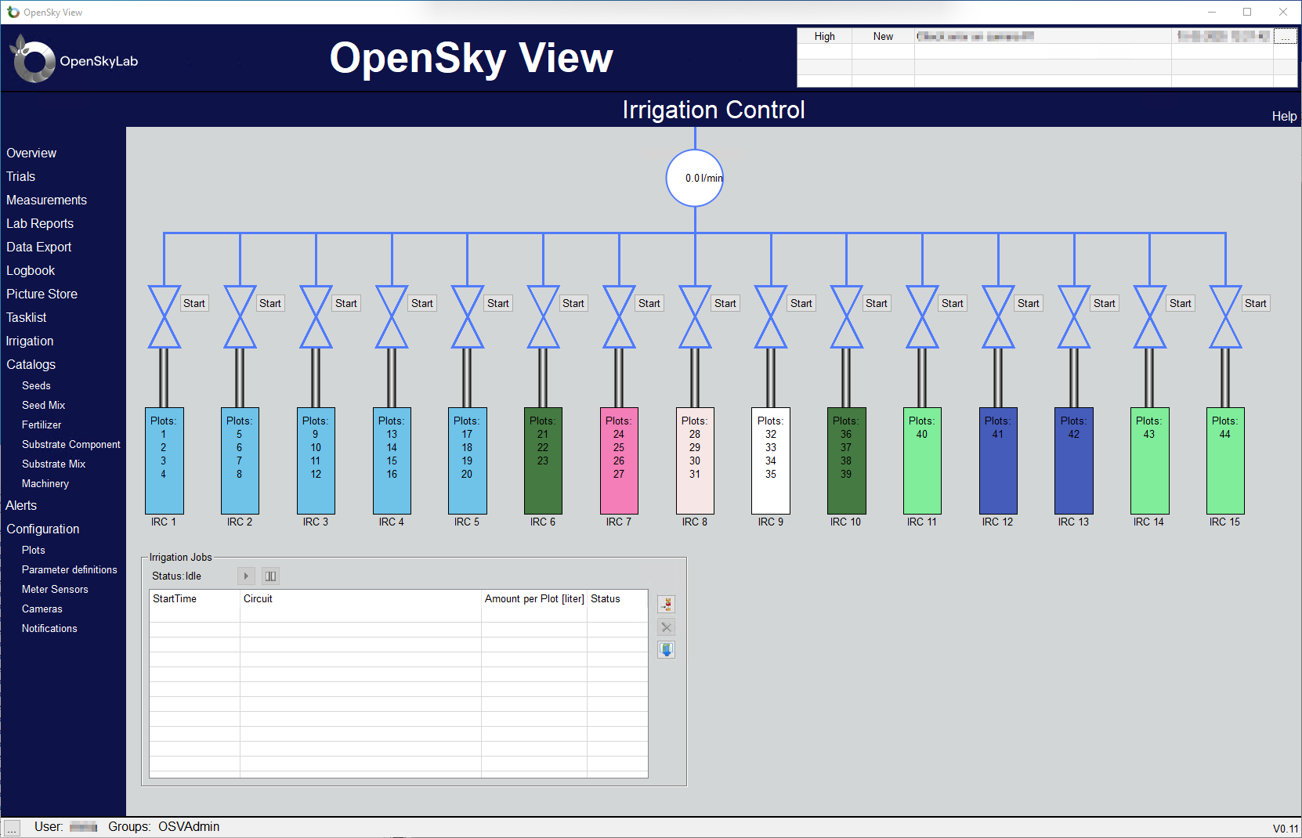
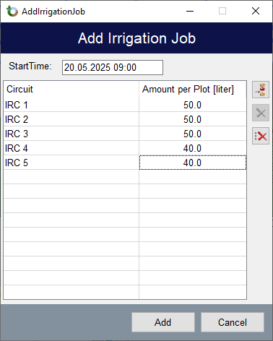
Irrigation Control
  Control of individual irrigation circuits
    Manual or via a predefined schedule
      Plots grouped to a circuit
      Automatic recording of irrigation treatment

Slide 10
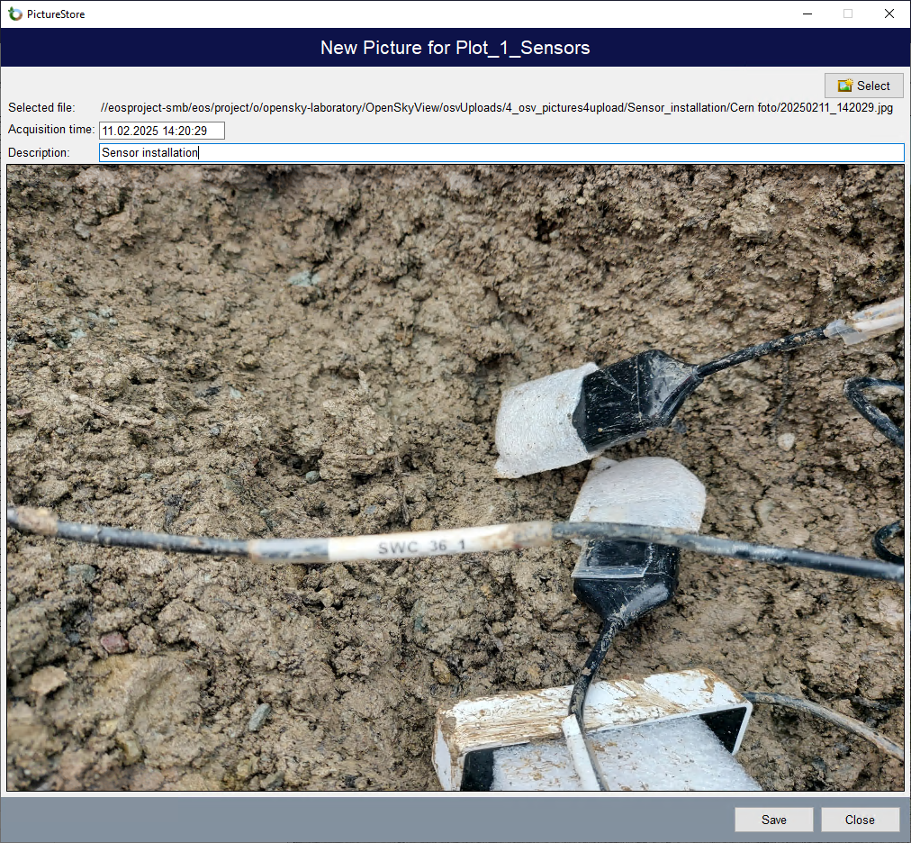
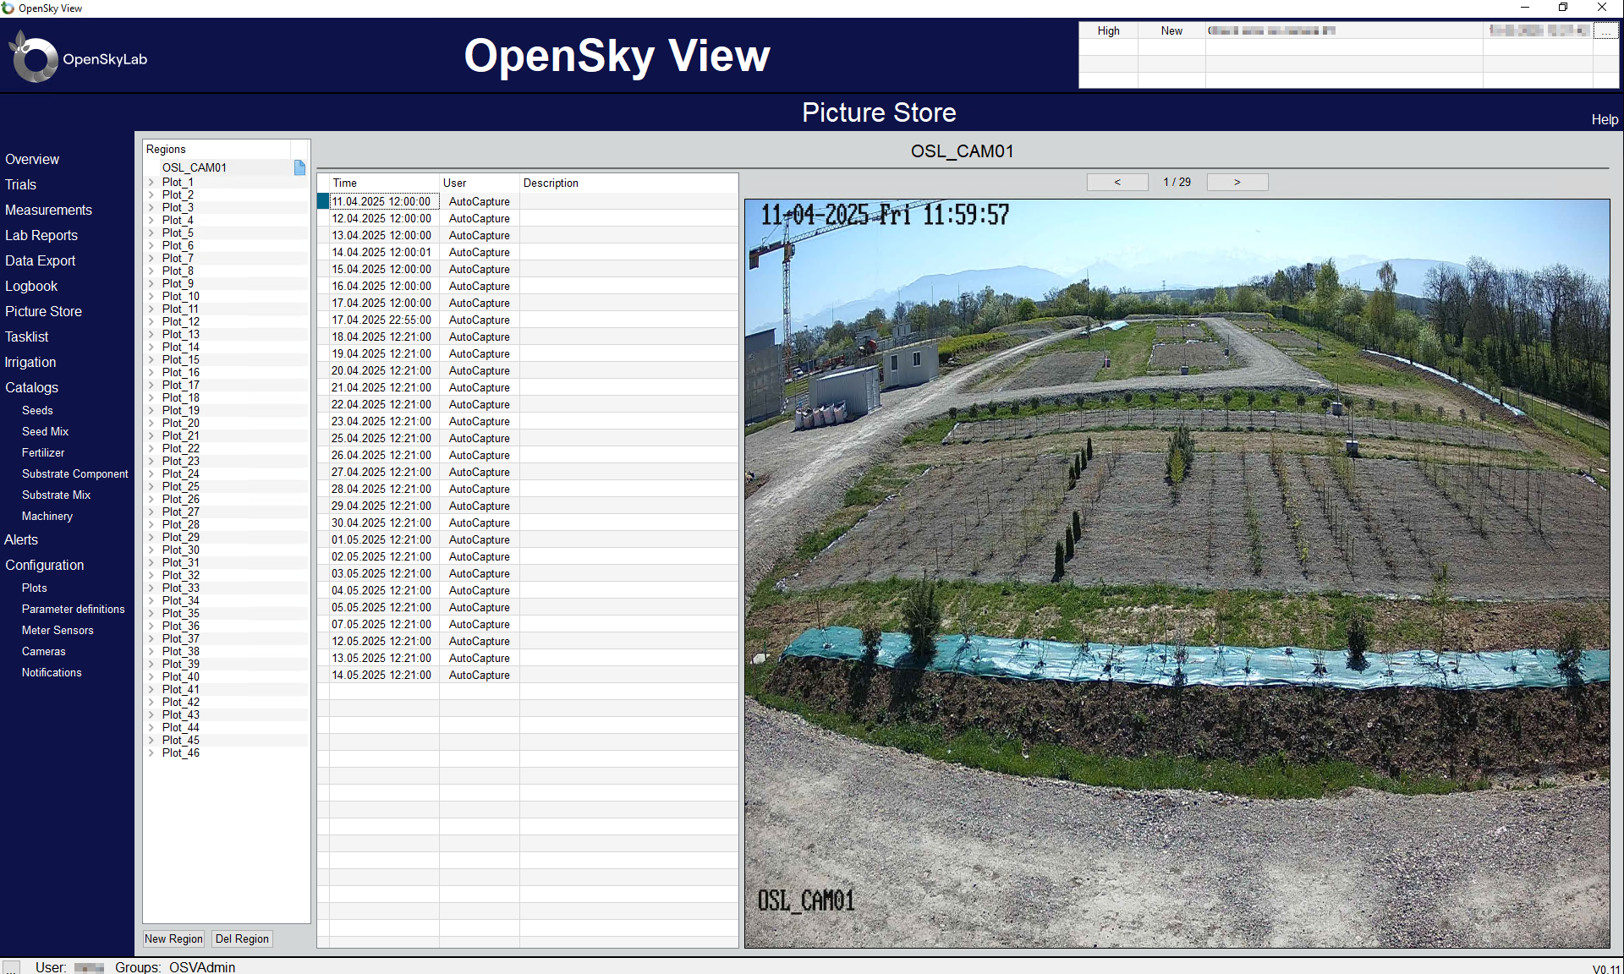
Time series images

Slide 11
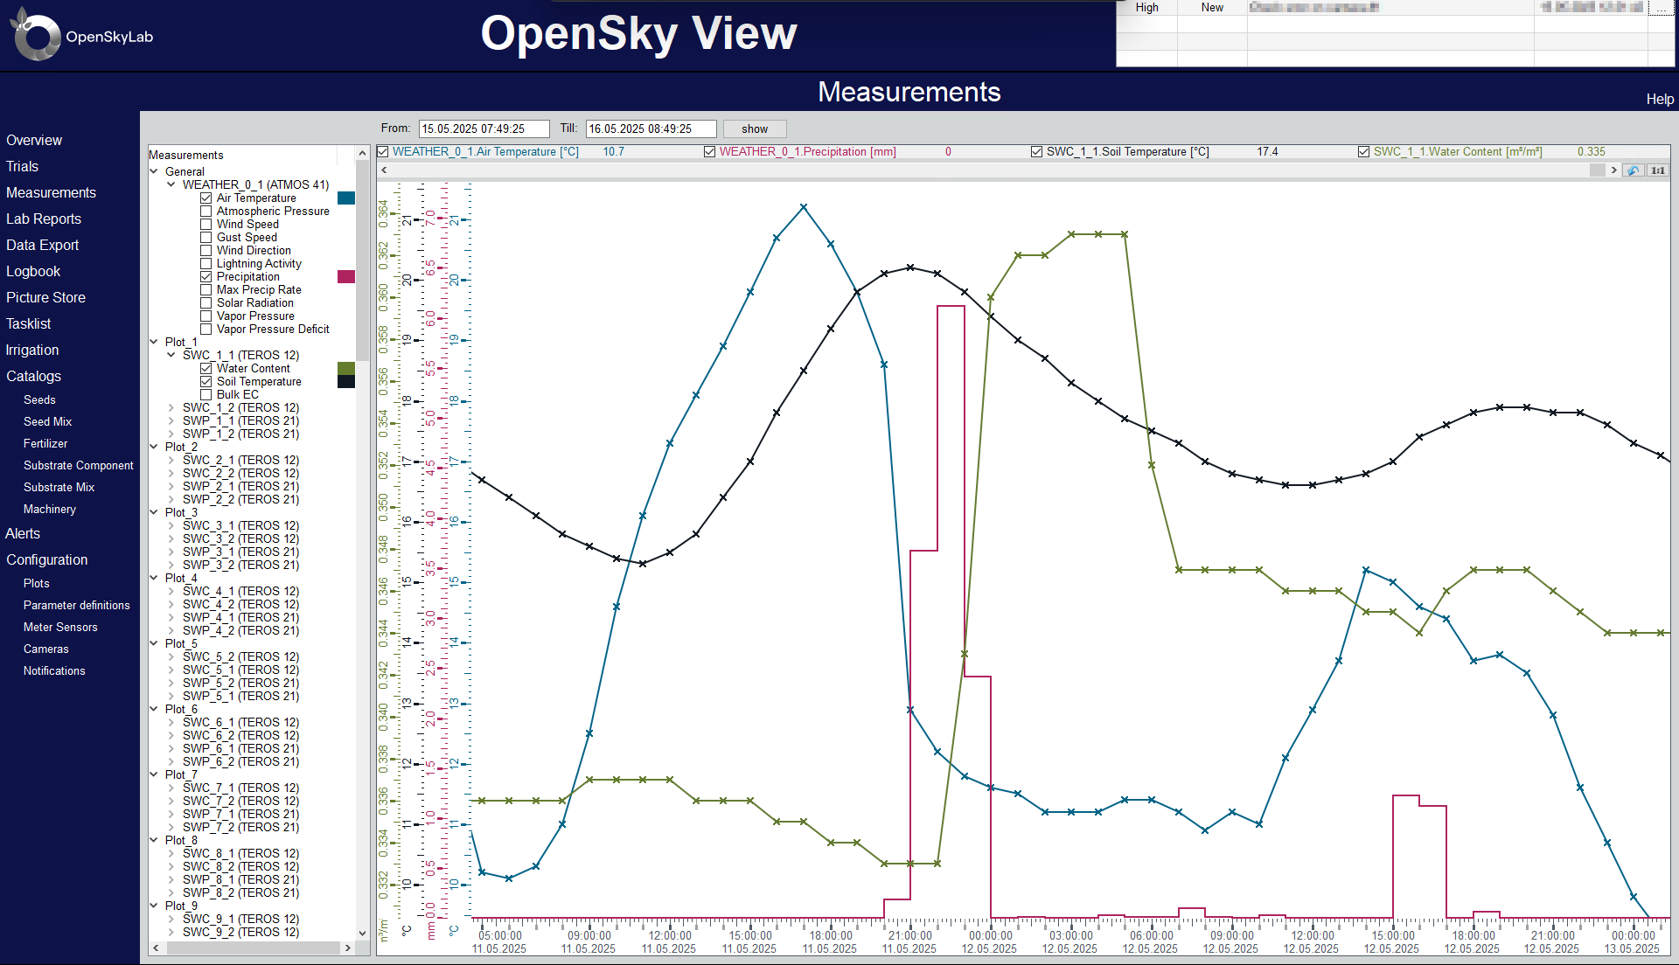
Data visualization

Slide 12
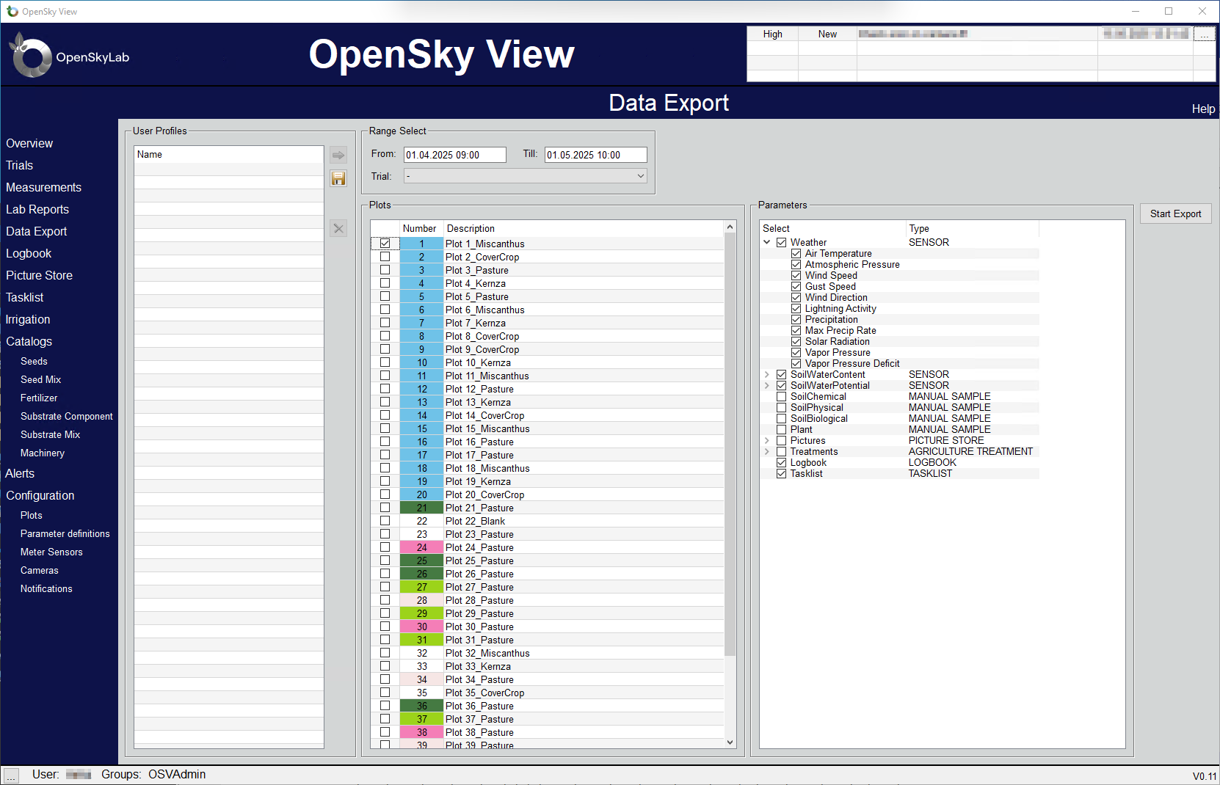
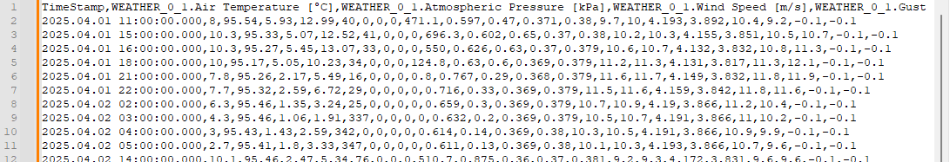
Data export
  Selection of time range
    Selection of Plots
      Selection of Parameters
      Export in csv files

Slide 13
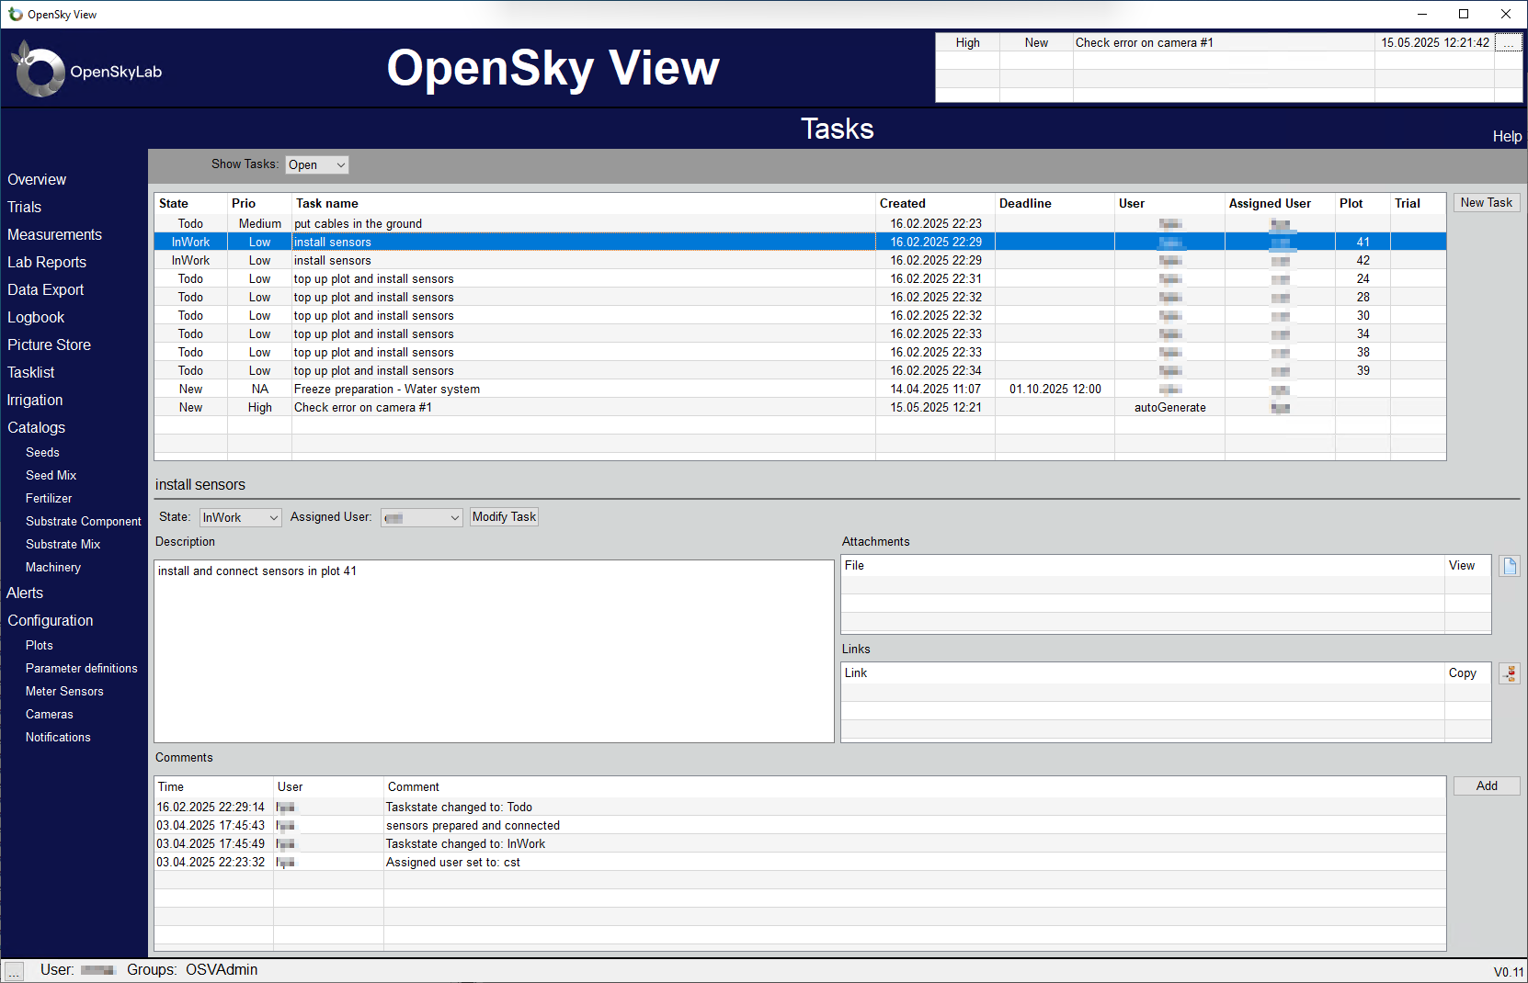
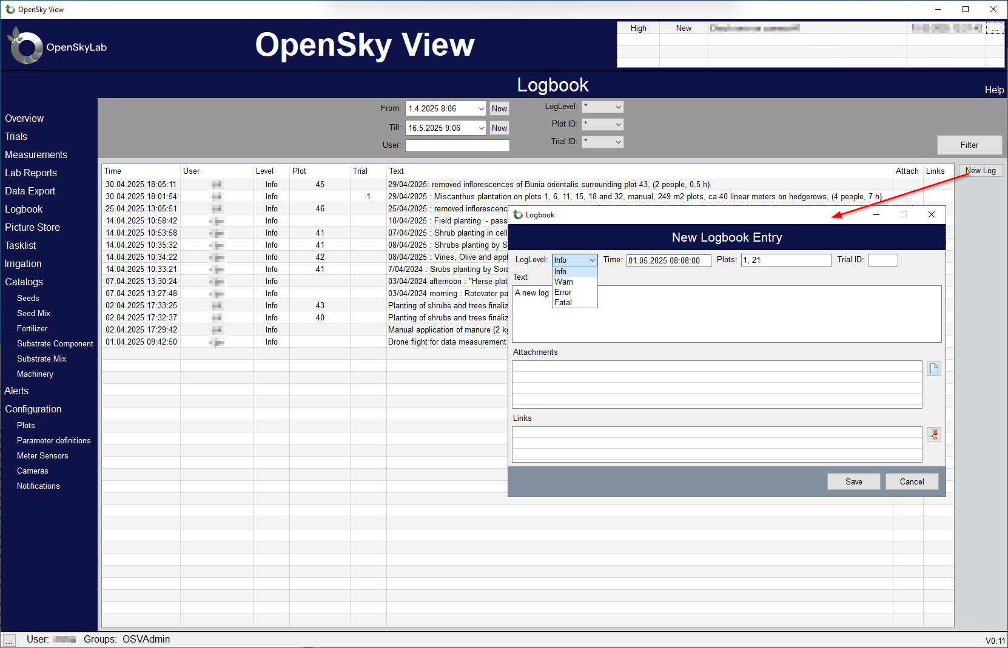
Tasklist / Logbook

Slide 14
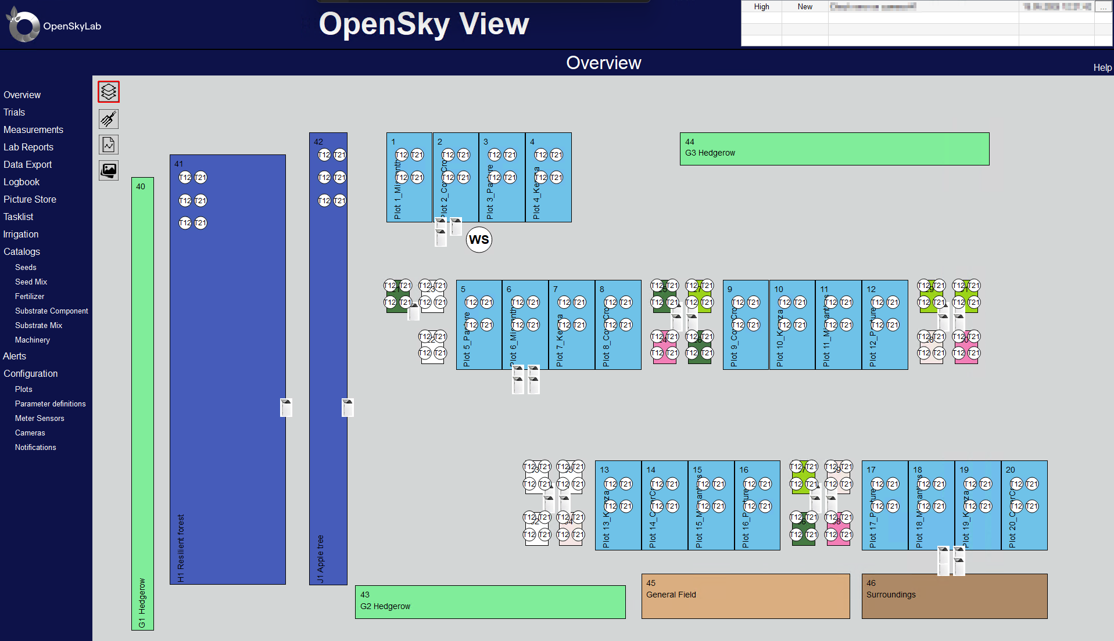
Current status
  System in production since beginning of 2025
  46 individual plots defined
  169 active sensors installed
  30 Data-Logger installed
    One IP-Camera integrated
    Integration of irrigation system ongoing
    Integration of multispectral images ongoing

Slide 15

15
Thank you
for your attention!
This project has received funding from the European Union's Horizon 2020 research and innovation programme agreement No 951754.

