Slide 1
waste heat supply concept
20/05/2025
Leslie ALIX (CERN/CNRS)

Slide 2
1. Waste heat study results
2. Socio-Economic Benefits of reusing waste heat
3. Case study – PD site

Slide 3

Waste heat supply study
Waste heat :
Heat generation from equipment during operation
Cooling water removes the excess heat
Usually released via cooling towers (lost energy)
Opportunity: Recover and reuse this thermal energy, e.g., in district heating networks
Host states are requesting to include waste heat use in the design of future CERN projects from the beginning on.
This encompasses diverse aspects such as technical, economic, and societal dimensions.
Identification of the opportunities and viability
Feasibility of the technical concept
Interactions with local authorities (FR) and SIG (CH)
Study carried out with Ginger Burgeap (August 2023 to May 2024) :
Phase 1 : Study on the consumption potentials
Phase 2 : Study of the energy recovering process and optimisation pathways
Phase 3 : Technical-economic assessment and complementary technologies

Slide 4
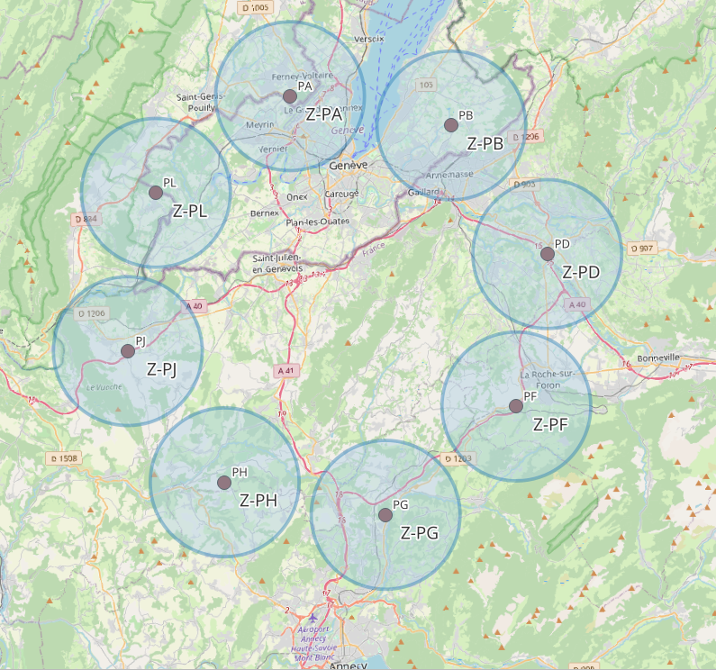
Reminder: FCC waste heat quantities
5 kms
Emitted heat - Annual production [GWh]
Temperature range : 40°C / 45°C
Site/Mode | Z | W | H | L. S | tt
PA | 138 | 152 | 172 | 16 | 225
PB | 15 | 18 | 23 | 0 | 34
PD | 138 | 152 | 172 | 16 | 225
PF | 15 | 18 | 23 | 0 | 34
PG | 138 | 152 | 172 | 16 | 225
PH | 230 | 314 | 336 | 4 | 524
PJ | 138 | 152 | 172 | 16 | 225
PL | 25 | 48 | 56 | 2 | 109
Total per year | 836 | 1,005 | 1,128 | 68 | 1,603

Slide 5
Potential reuse of waste heat…
…Without seasonal adaptation
Z mode: 222 GWh/y
Ttbar mode : 295 GWh/y

Slide 6
Potential reuse of waste heat…
…With seasonal adaptation
Z mode: 306 GWh/y
Ttbar mode : 439 GWh/y
Notes:
With 26 week change

Slide 7
1. Waste heat study results
2. Socio-Economic Benefits of reusing waste heat
3. Case study – PD site

Slide 8
Socio-economic benefits of reusing waste heat quantification
Benefits of reusing waste heat:
Avoided energy costs: Lower heating costs thanks to FCC's waste heat, which is cheaper than conventional sources (oil, wood, gas, electricity)
CO2eq emissions savings: Carbon savings by replacing fossil fuels and conventional electricity with cleaner energy from FCC
Water savings: Reduced water consumption by reusing waste heat instead of evaporating it
Steps:
Estimation of the amount of waste heat recovered
Estimation of demand for waste heat
Estimation of the avoided costs
Estimation of the socio-economic value of CO2eq savings
Estimation of the water savings
Estimation of the benefits discounted and undiscounted (specific discount rate of 2.8% for FCC-ee socio-economic assessment)
Baseline: average of 330 GWh/year (5,100 GWh over the entire FCC-ee programme)

Slide 9
Socio-economic benefits of reusing waste heat avoided costs
Avoided cost = when the final cost per MWh from the heat network is lower than the current energy cost.
Heating source | Cost of the service (S) | Cost of energy (E) | Price paid by the final consumer (P) | Avoided cost by reusing waste heat
 | EUR/MWh | EUR/MWh | EUR/MWh | EUR/MWh
Gas | 25.7 | 103.4 | 129.1 | 19
Electricity | 129.3 | 219.5 | 219.5 | 109
FCC waste heat | 108.0 | 2.0 | 110.0 | 64
 |  | Total discounted | Total undiscounted
 |  | EUR | EUR
 | FCC-ee programme | 138,509,888 | 328,132,263
 | EAV* | 9,233,992
~137 GRAD origin annual salaries
*Equivalent Annual Value
Notes:
(This is typically true for households, but less so for industrial users, who often benefit from negotiated or preferential rates. Need to be adapted case-by-case. Had to use an assumption, not considered (mainly not industrial)

Slide 10
Socio-economic benefits of reusing waste heat reduction and shadow cost of carbon
CO2eq emissions savings potential:
Current average carbon intensity of heating in the CERN region:
  186.7 gCO2eq/kWh (with a 4% of reduction rate per year)
Estimated carbon intensity to obtain FCC’s waste heat:
  18 gCO2eq/kWh (baseline)
Projected CO2eq savings:
  Over the FCC-ee operational phase: 173,563 tCO2eq (baseline)
  Annual average: 11,570 tCO2eq (~1,244 French people annual emissions or 1,329 trips by car around the world)
Social cost of carbon:
CO₂eq value in 2024: 192 EUR/ton*
Increasing to 1,037 EUR/ton by 2050 and after
 |  | Total discounted | Total undiscounted
 |  | EUR | EUR
 | FCC-ee programme | 77,741,373 | 178,415,699
 | EAV | 5,182,758
~ 77 GRAD origin annual salaries
*European Commission, Vademecum for the economic appraisal, 2021
Notes:
The shadow cost (or social cost) of carbon is the monetary value of the damage caused by emitting one tonne of CO₂ into the atmosphere.
It reflects the real cost to society, including impacts on health, the environment, agriculture, and climate-related disasters.
4% rate reduction efforts made to achieve carbon neutrality.

Slide 11
Socio-economic benefits of reusing waste heat water savings
By considering a saving of 1.6 m3 per MWh:
FCC-ee operational phase: 8.2 million of m3 saved
Annual average: 543,680 m3 (~9,928 people annual water consumption or 218 Olympic swimming pools)
Cost savings due to water savings:
 |  | Total discounted | Total undiscounted
 |  | EUR | EUR
 | FCC-ee programme | 3,014,201 | 7,139,878
 | EAV | 200,947
~3 GRAD origin annual salaries
Notes:
With an assumption of a cost of 0.88 EUR per m3

Slide 12
1. Waste heat study results
2. Socio-Economic Benefits of reusing waste heat
3. Case study – PD site

Slide 13
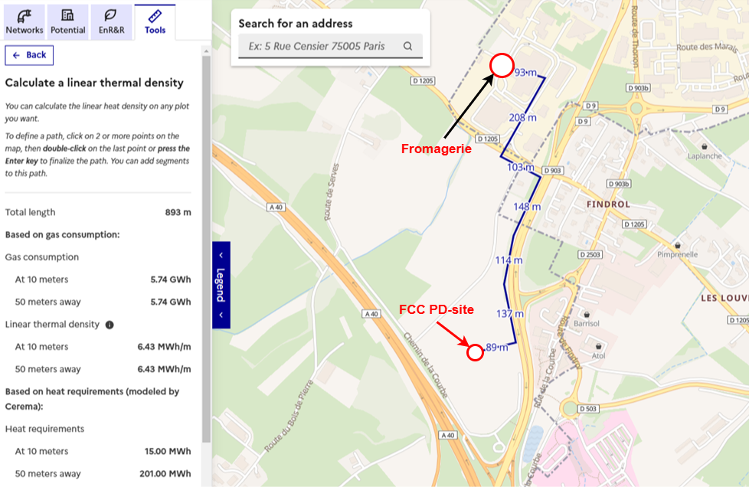
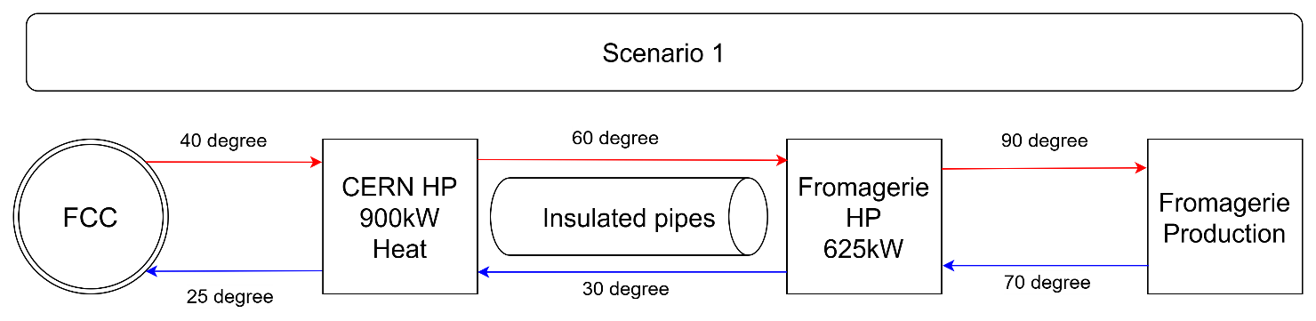
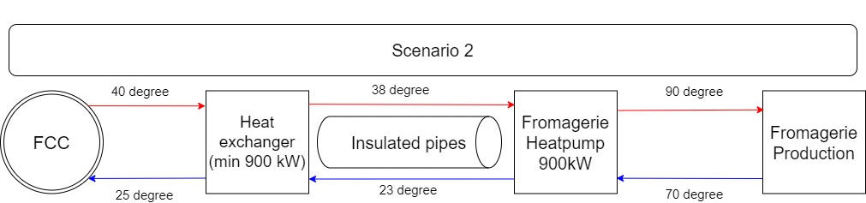
Case study: PD site technical concept
Courtesy: J. Holmstad Larsen
Cheese producer:
5 GWh of gas consumption annually
Linear heat density:
= 6.43 MWh/m (well above ADEME's viability (1.5) and profitability (5) thresholds, making the project both feasible and eligible for Fonds Chaleur funding).
Preliminary technical concept:
Notes:
The linear heat density is a very important parameter to consider, it is around 6.43 MWh, which means that for every meter along the length of the structure (such as a pipeline, cable, or heat exchanger), there is an associated energy value of 6.43 megawatt-hours.
Improve the quality for the final user (higher temperature) + facilitate extension to other consumers
Opportunity to split costs
Technical concept only based on assumptions: based on the cheese producer

Slide 14
Case study: PD site cost estimates
Courtesy: J. Holmstad Larsen
CAPEX:
OPEX:

Slide 15
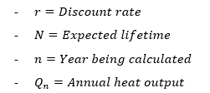

Case study: PD site cost for the final consumer
Courtesy: J. Holmstad Larsen
LCOH = Levelized Cost of Heat:
Scenario 1 (DR = 2,8%)
Input | Unit | Undiscounted | Discounted
Heat | MWh | 100,000 | 75,782
CAPEX | € | 1,724,040 | 1,724,040
OPEX | € | 5,578,396 | 4,227,404
Result
LCOH | €/MWh | 78.53
Total (minus 15%) |  | 66.75
Total (plus 15%) |  | 90.31
$$LCOH=\frac{CAPEX+\sum_{n=1}^{N}{\frac{OPEX}{{\left(1+r\right)}^{n}}}}{\sum_{n=1}^{N}{\frac{Q_{n}}{{\left(1+r\right)}^{n}}}}$$
According to France's Multiannual Energy Program (Programmation Pluri-Annuelle de l’Énergie):
  Average cost of waste heat recovery projects funded by the Fonds Chaleur: 97 €/MWh (excluding subsidies)
AMORCE's annual survey on heat and cooling prices:
  Average price of heat in a district heating network: 80 €/MWh
Scenario 2 (DR = 2,8%)
Input | Unit | Undiscounted | Discounted
Heat | MWh | 100,000 | 75,782
CAPEX | € | 1,411,560 | 1,411,560
OPEX | € | 3,400,276 | 2,576,787
Result
LCOH | €/MWh | 52.63
Total (minus 15%) |  | 44.74
Total (plus 15%) |  | 60.52
Notes:
Project relevant

Slide 16
Case study: PD site reduction and shadow cost of carbon
CO2eq emissions savings from using heat pump instead of gas:
Projected CO2eq savings:
  Over the FCC-ee operational phase: 17,800 tCO2eq (baseline)
  Annual average: 890 tCO2eq (~96 French people annual emissions or 102 trips by car around the world)
Social cost of carbon:
CO₂eq value in 2024: 192 EUR/ton*
Increasing to 1,037 EUR/ton by 2050 and after
 |  | Total discounted | Total undiscounted
 |  | EUR | EUR
 | FCC-ee programme | 13,900,037 | 18,368,573
 | EAV | 695,002
~10 GRAD origin annual salaries
No calculation on avoided cost

Slide 17
Case study: PD site
water savings
By considering a saving of 1.6 m3 per MWh:
FCC-ee operational phase: 160,000 of m3 saved
Annual average: 8,000 m3 (~146 people annual water consumption or 3,2 Olympic swimming pools)
Cost savings due to water savings:
 |  | Total discounted | Total undiscounted
 |  | EUR | EUR
 | FCC-ee programme | 106,701 | 140,800
 | EAV | 5,335
~0,08 GRAD origin annual salaries

Slide 18
Conclusions and challenges
There is a potential of waste heat recovery
There are benefits (carbon footprint, avoided costs, water savings)
Due to site-dependent variability, waste heat recovery and supply should be planned on a location-specific basis
Integration of heat recovery and supply in the design of machines, experiments, technical infrastructures, and their sub-systems
5. Adapting operations and annual schedules to meet heat consumption needs
6. Commitment from territorial stakeholders to implement heat distribution and supply to end-users must be embedded within a broader urban development framework and aligned with urban network planning
7. Importance of SIG’s engagement as Geneva offers the highest potential for heat recovery

Slide 19
Thank you for your attention.
19

