Slide 1
Integration of RF points for FCC-ee
20.05.2025 / FCC Week
F. Valchkova-Georgieva and Marc Timmins
With contribution from : V. Parma, S. Gorgi Zadeh, F. Peauger, I. Karpov, F. Cottenot, C. Sharp, S. Calvo, L. Delprat
And inputs from: D. Passarelli (FNAL), V. Roger (FNAL) and CERN technical infrastructure working group
FCC week 2025, Vienna

Slide 2
20.05.2025 / FCC Week
Outline
CM design and assumptions for feasibility study
CM Integrations in Pts H and L
Optimizations as part of the pre -TDR phase
Underground structure integration for Pt H and L
Next steps
Virtual visit

Slide 3
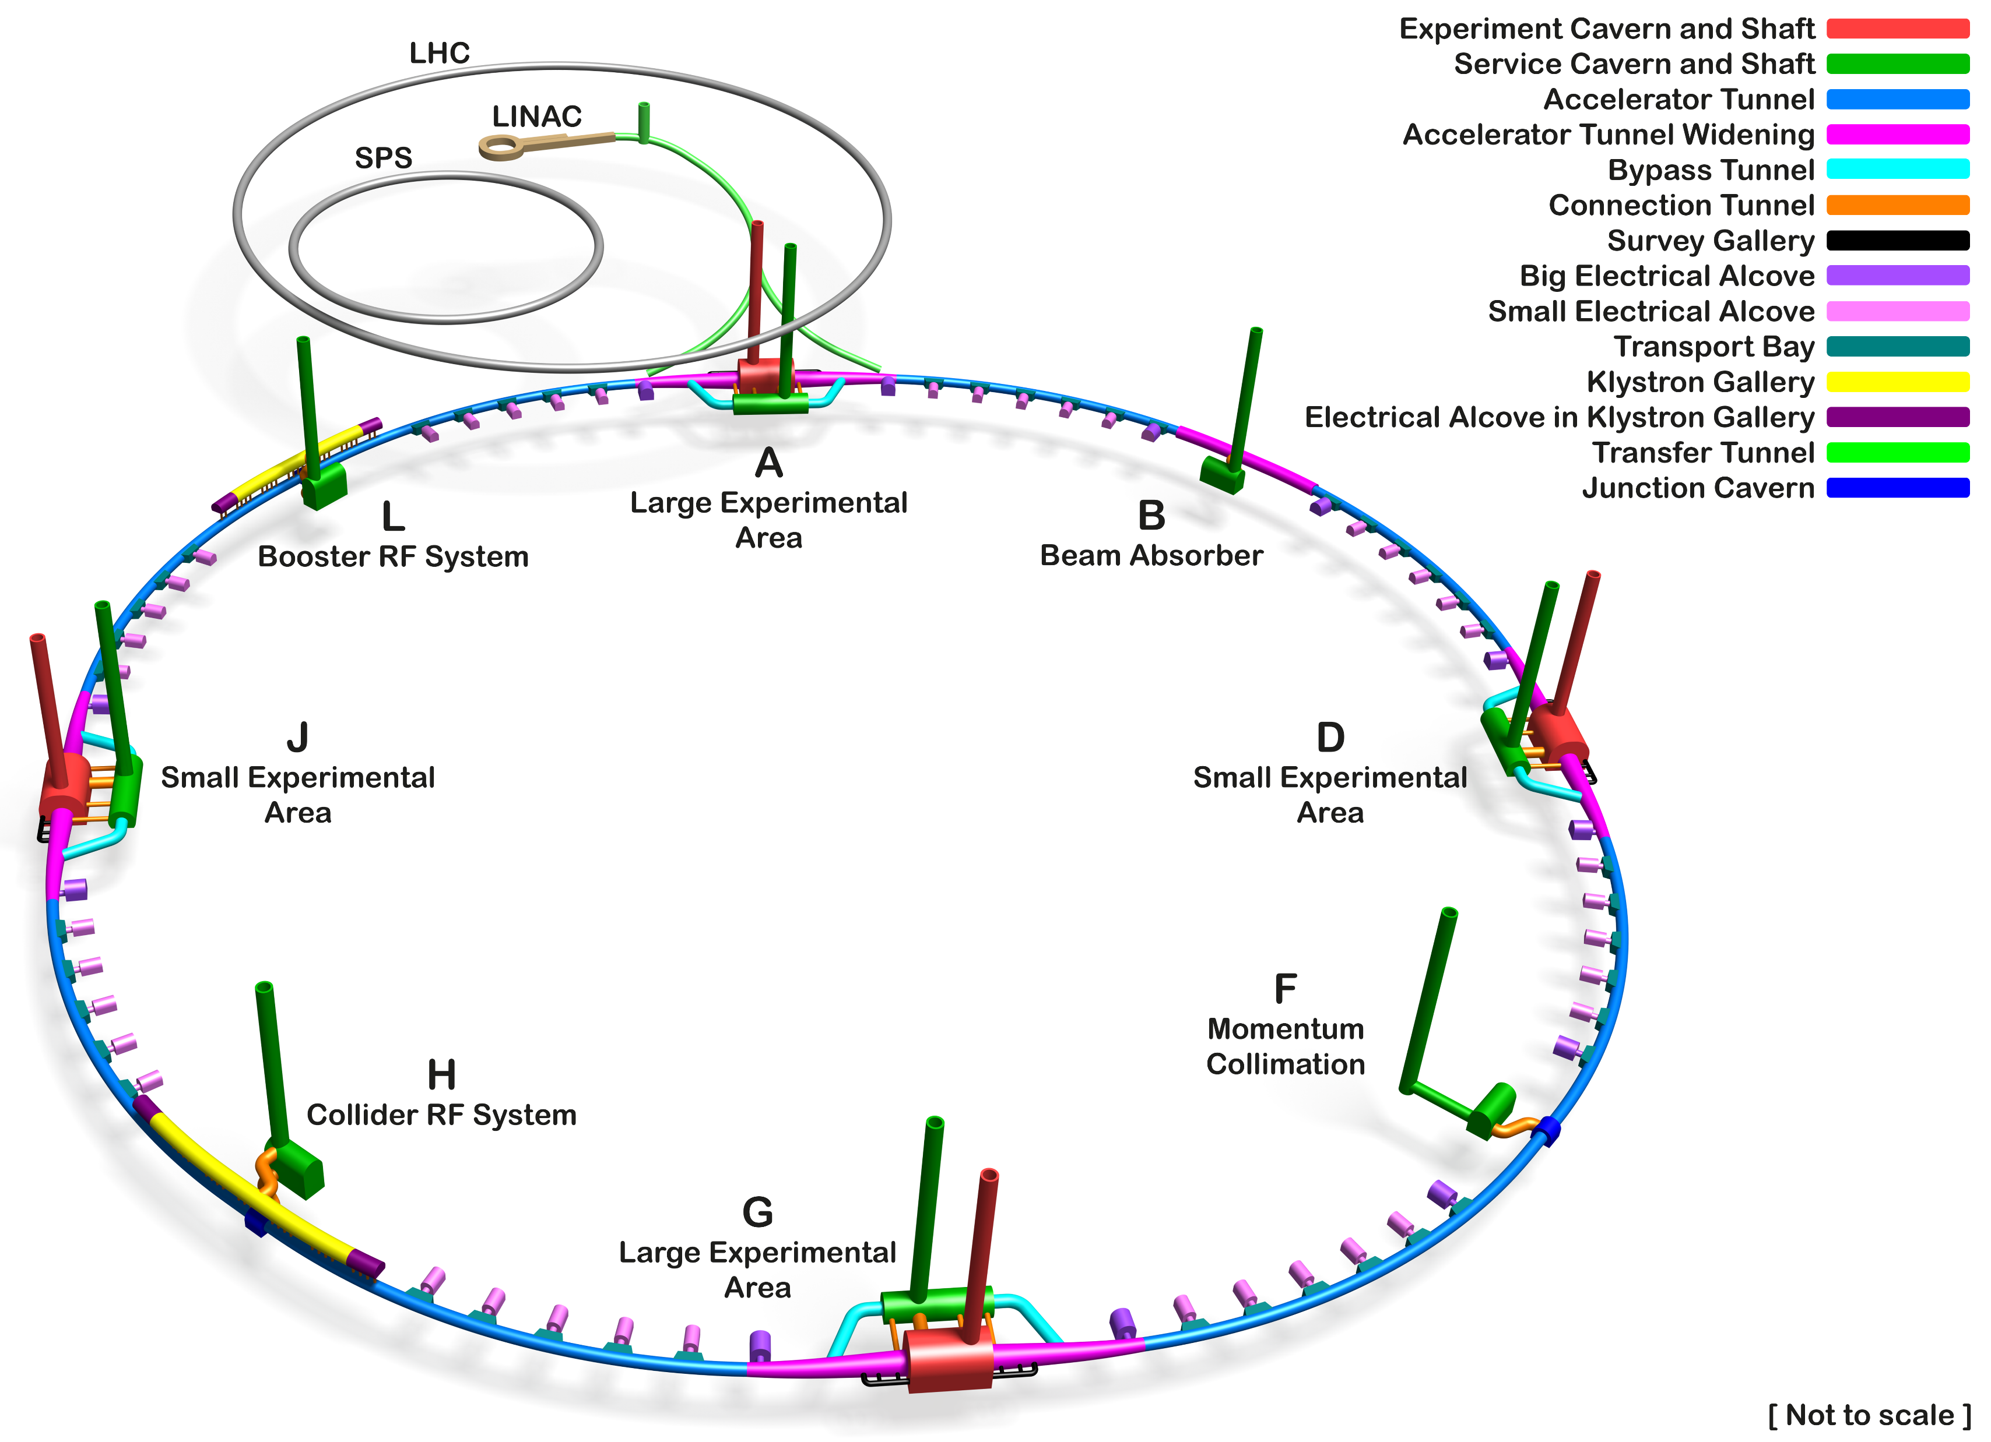
20.05.2025 / FCC Week
FCC-ee Underground Structure Overview
Booster
800 MHz cavities
Collider
400 & 800 MHz cavities
Only schematic, and not to scale.
Courtesy A. Navascues Cornago

Slide 4
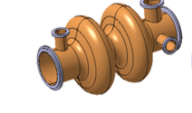
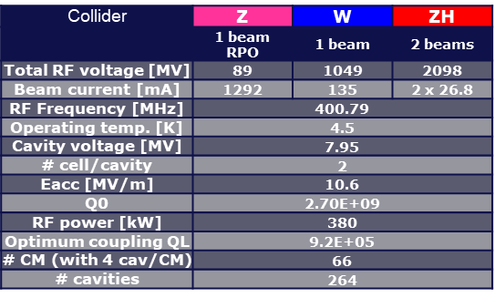
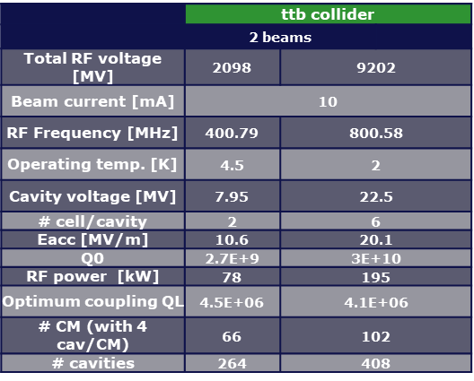
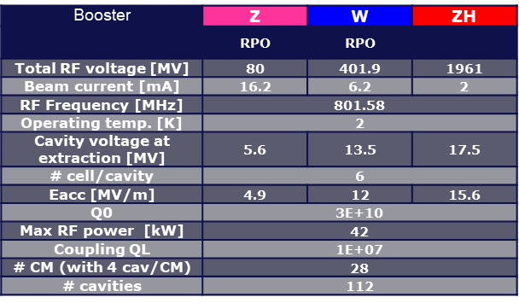
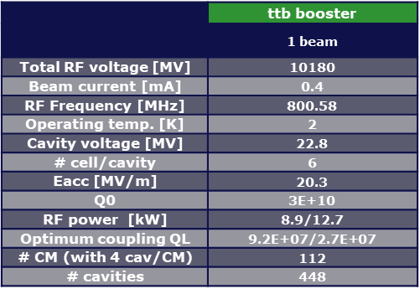
20.05.2025 / FCC Week
Base line parameters for feasibility study
Collider
RPO (same cavities and CM for Z, W, ZH)
400 MHz 2 cell cavity for all working points. (Pt H. 66)
800 MHz 6 cell cavity (Pt L. 102)
Booster
Same physical
Cryomodule
800 MHz 6 cell cavity (Pt L. 112)
Further details in K. Canderan’s presentation ''SRF 400 & 800 MHz cryomodules: Design evolution and future work”

Slide 5
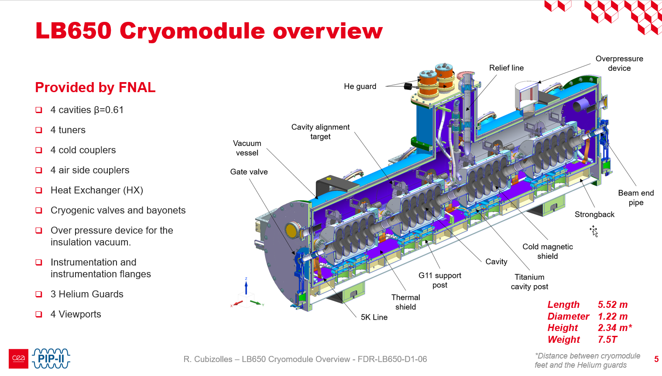
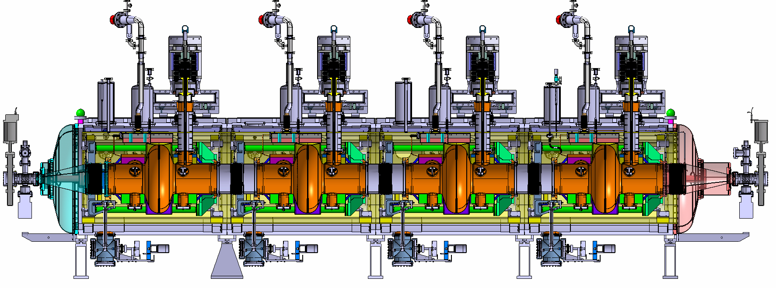
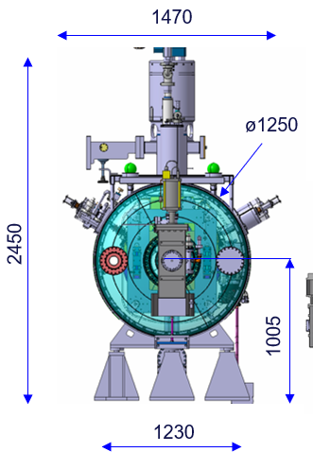
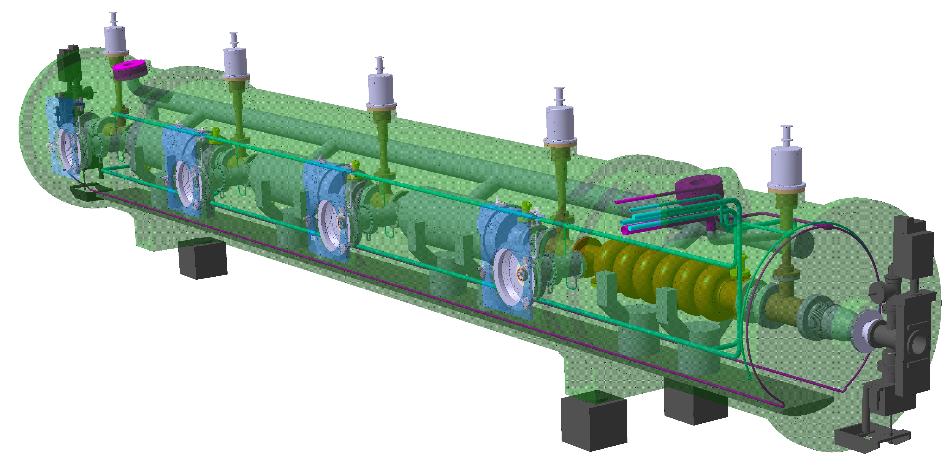
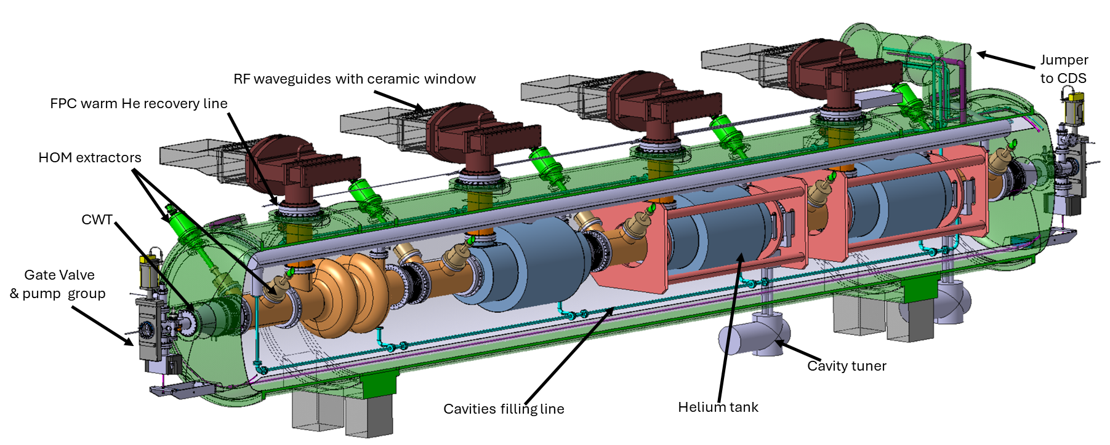
20.05.2025 / FCC Week
1 - CM design and assumptions for feasibility study
800 MHz cavities strongly inspired from PIPII
400 MHz cavities strongly inspired from LHC
Vertical FPC from the top
Horizontal FPC from the side
Courtesy Fermilab. (D. Passarelli)

Slide 6
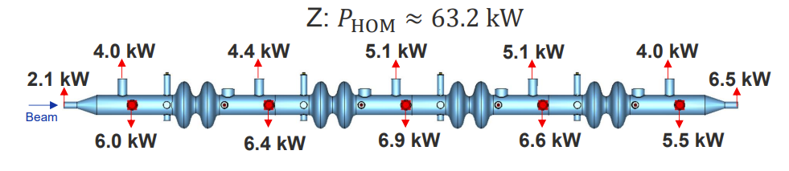
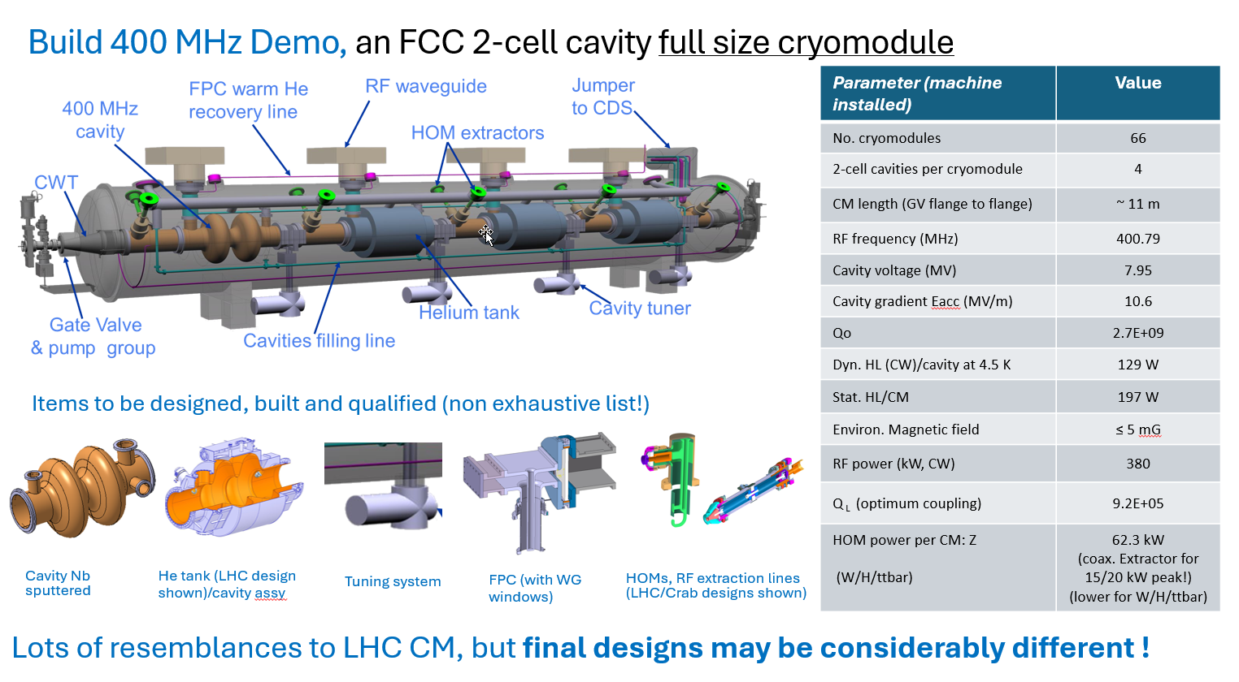

20.05.2025 / FCC Week
1 - CM design and assumptions for feasibility study
New powers (RPO) for FPC, HOM and tappers not taken into account in the design.
Vertical FPC from the top
11.24 m
Ø1.6 m
Superconducting elliptical cavity
400 MHz, 2-cell
1.5 m. long
Electropolished and seamless RF surface
Niobium thin film with HiPIMS
RF design by S. Gorgi Zadeh
Further details in K. Canderan’s presentation ''SRF 400 & 800 MHz cryomodules: Design evolution and future work”
LHC supporting structure and insertion scheme
LHC design
LHC design
LHC/CRAB design (no longer representative)
New design
New design

Slide 7
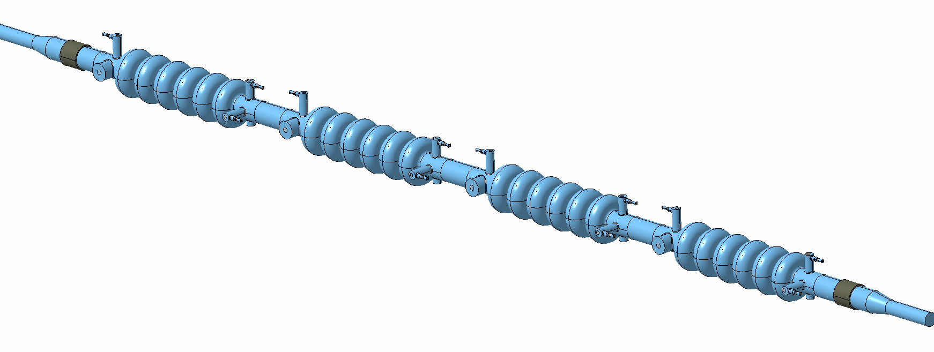
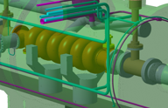
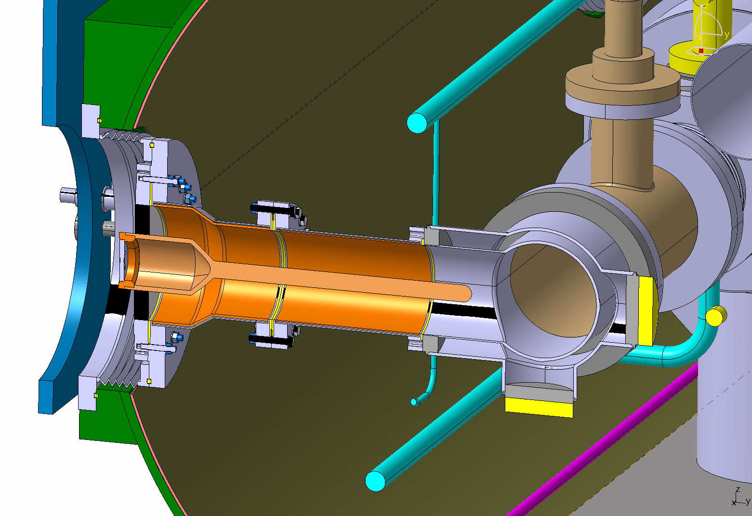
20.05.2025 / FCC Week
1 - CM design and assumptions for feasibility study
collider
FCC 800 MHz cavity
Superconducting elliptical cavity
800 MHz, 6-cell
1.5 m. long
Bulk Niobium with electropolished and doped RF surface (mid T baked)
2 phase pipe
He tank
HOMs
Jumper
6 cell cavities
booster
10.25 m
RF design by S. Gorgi Zadeh
Filling line
Horizontal FPC from side
Sector valves
& pumping
FPC
Further details in K. Canderan’s presentation ''SRF 400 & 800 MHz cryomodules: Design evolution and future work”
FPC
booster
He tank
PIPII design
Tuner
PIPII design
New CERN design
Same supporting structure and insertion scheme
New CERN design
LHC/CRAB design

Slide 8
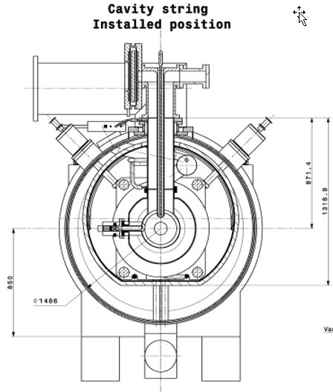
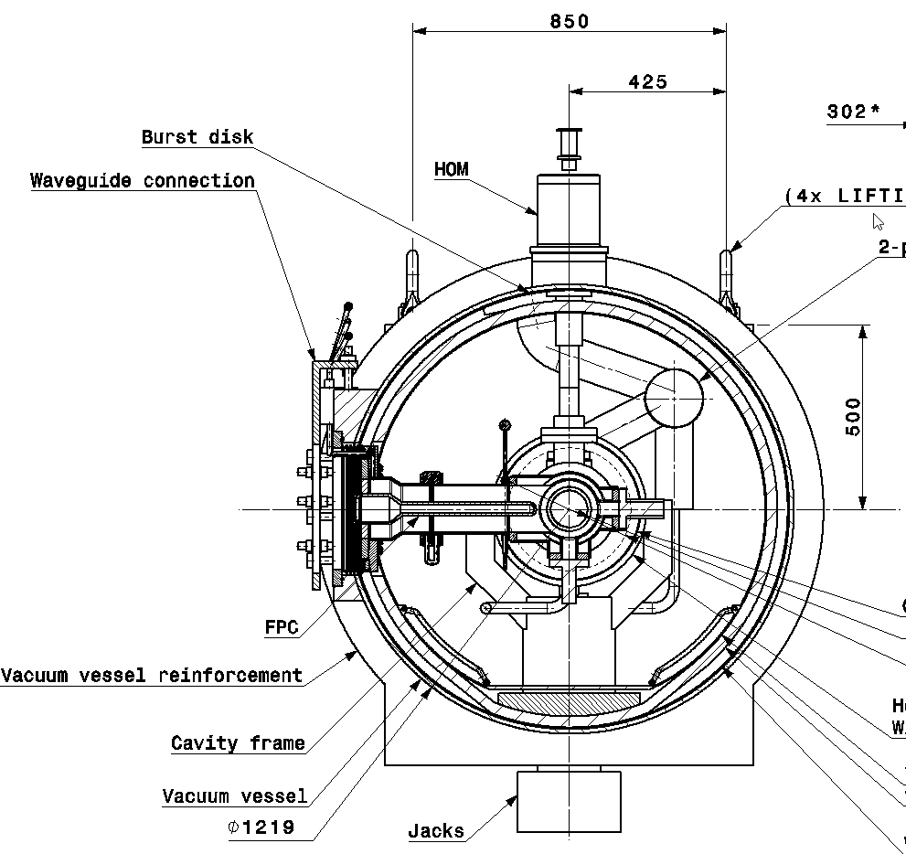
1 - CM design and assumptions for feasibility study
20.05.2025 / FCC Week
Driving dimensions
FPC ceramic window for high power (800 kW) now reduced !
800 MHz CM
400 MHz CM
1.6 m
FPC
~200
Double wall tube
~370
~650
~170
HOM
Rigid coax lines based on LHC design
ø1400
~650
200
Wave guide
2.7 m
ø1600
~700
Cavity
LHC
Vacuum tank
1.2 m
Thermal shield
Frame
~740
Tuning system
FPC (250 kW)
Double wall tube
Cavity
1.9 m

Slide 9
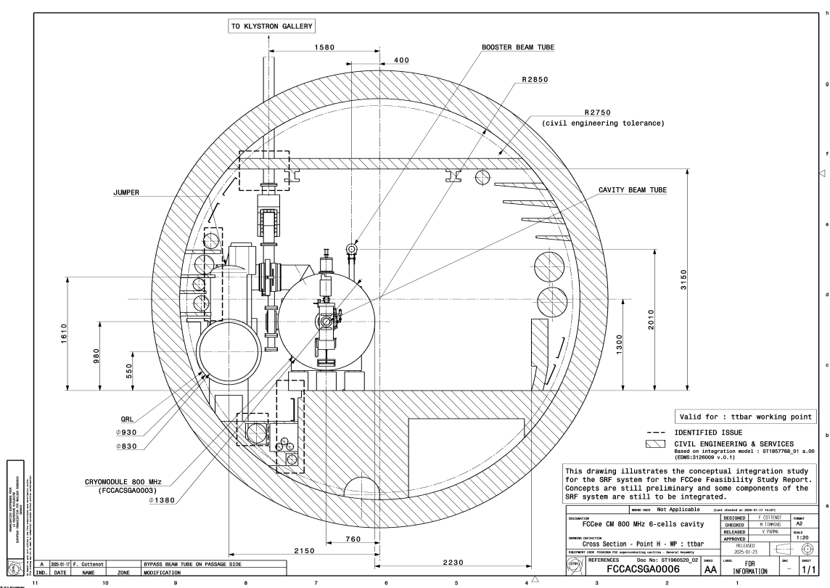
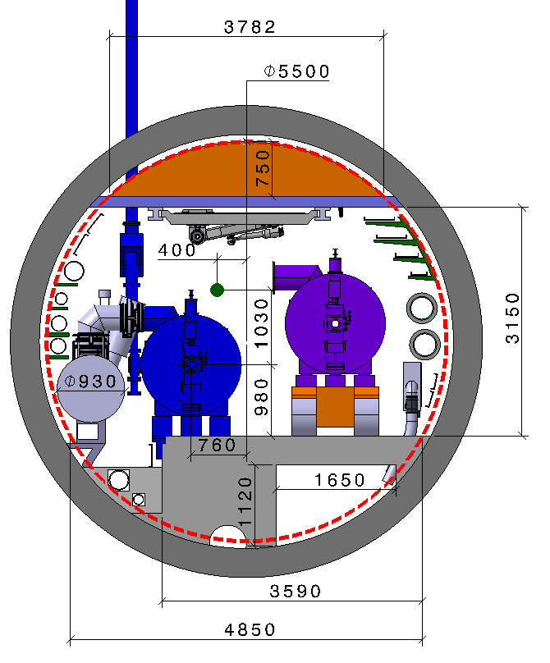
800 MHz CM in Pt H (Collider)
2 - Integrations in Pts H and L
Some integration issues:
Interference QRL-service ducts → minor, reposition lines (already integrated in feasibility study)
Interference service ducts →minor, reposition lines (already integrated in feasibility study)
CM jack in trench →minor, relocate cables, extend floor (coming soon)
1
2
3

Slide 10
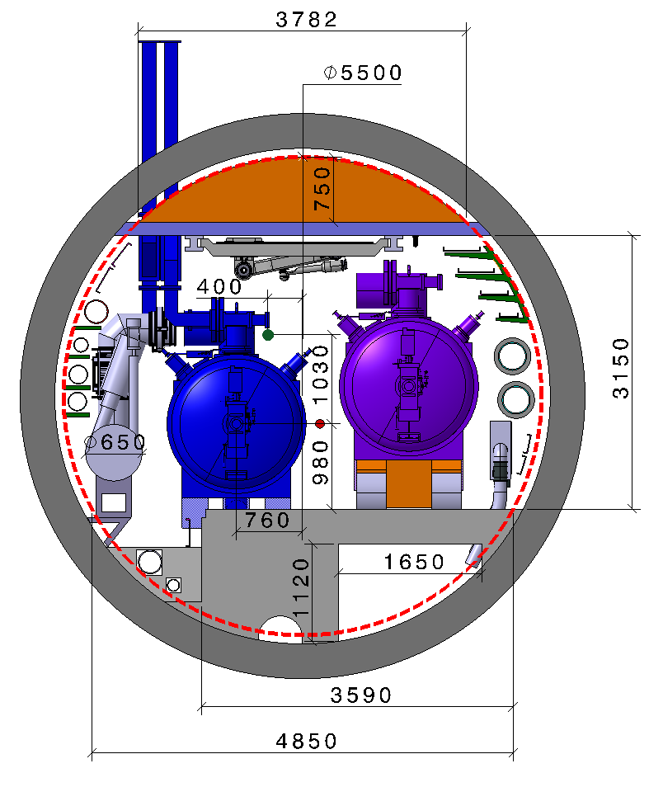
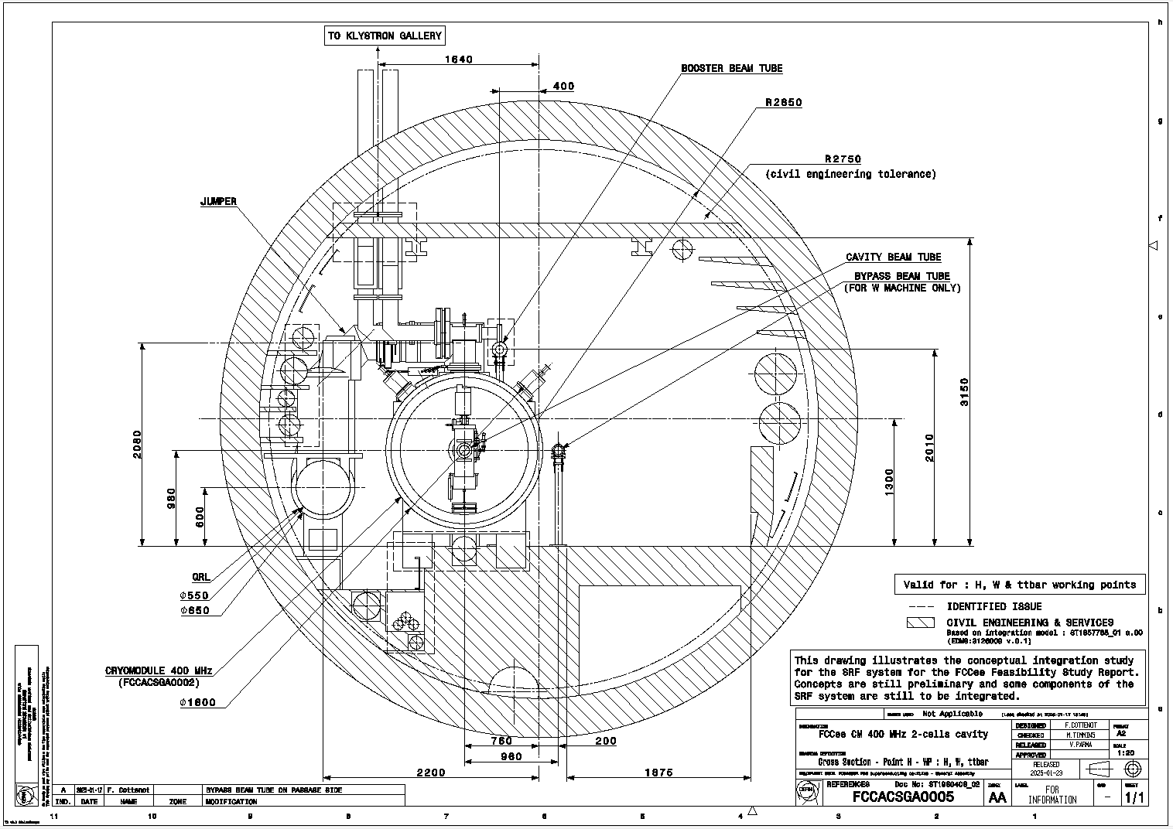
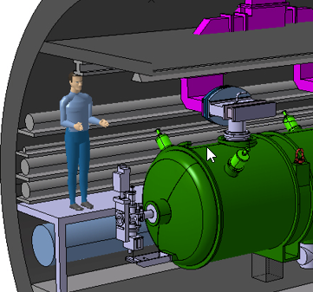
400 MHz CM in Pt H (Collider)
2 - Integrations in Pts H and L
Please follow Jeremie Bauche’s presentation “Collider magnets for FCC-ee“
Same CE as arcs
Some integration issues:
Interference QRL-service lines → (already integrated in feasibility study)
Interference with booster → minor, can be coped with design
CM jack in trench → relocate cables, extend floor. (already integrated in feasibility study)
Beam height as arcs, CM jacks underground → sloped tunnel between arcs and Pt. H, or more compact CM size (not an option today)
Interface Quad/beam pipe transport space reservation.
1
2
5
4
Quad
3
Platform for maintenance of critical components (FPC, HOMs, tuners

Slide 11
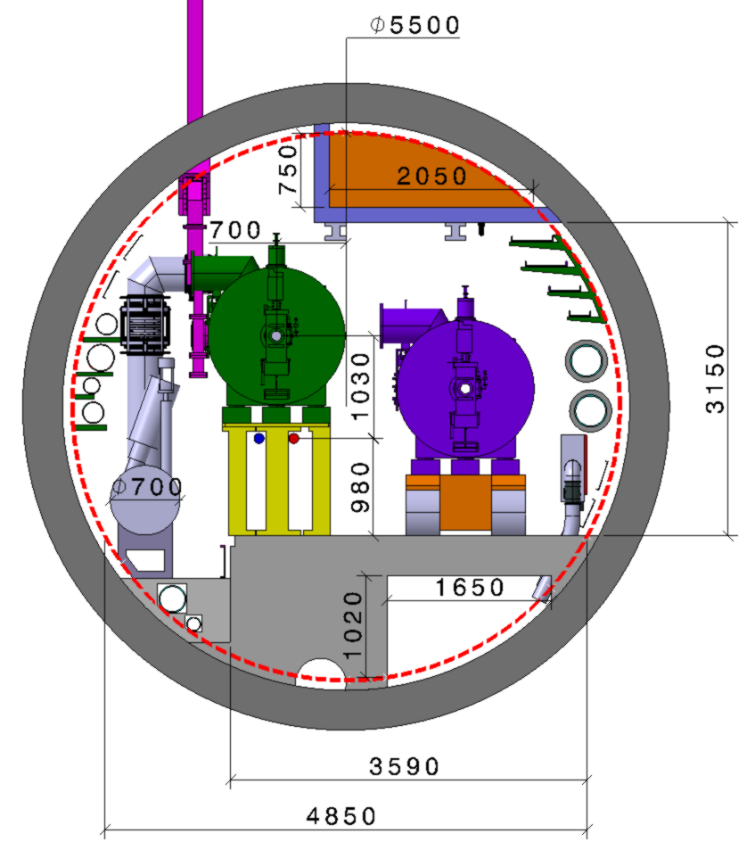
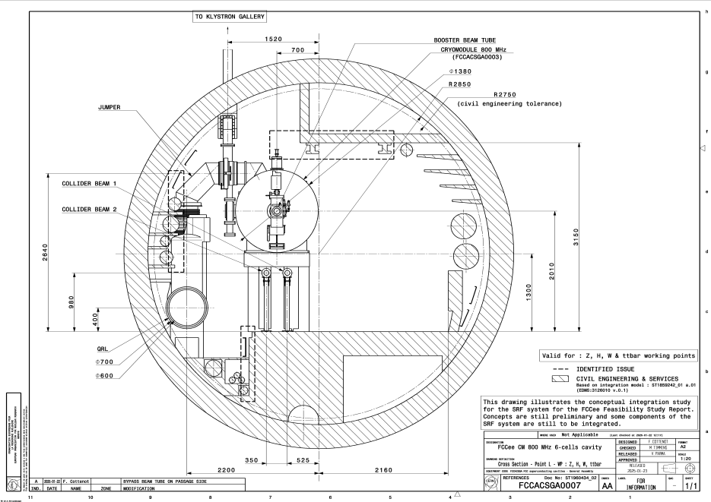
800 MHz CM in Pt L (Booster)
2 - Integrations in Pts H and L
Some integration issues:
Interference QRL-service ducts → minor, reposition lines (already integrated in feasibility study)
Installation potential interference with ceiling→ installation to be studied
CM jack in trench → relocate cables, extend floor (already integrated in feasibility study)
1
2
Horizontal Circulating Beam position to be studied
3

Slide 12
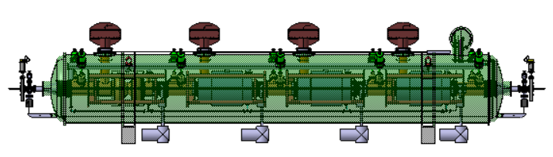
Integration
Longitudinal spacing Pt.H (1/2)
( from RF team – details of the spacing between two quadrupoles 400MHz CMs)
2 - Integrations in Pts H and L
IP
989,37 m
Q
Q
Q
Q
Q
Q
Q
Q
Q
Q
Q
Q
5x 400
7x 400
7x 400
7x 400
7x 400
8x 800
8x 800
8x 800
8x 800
3x 800
8x 800
8x 800
3x 800
8x 800
0.5m
0.5m
0.5m
L_{m}=3.1m
11.24m
11.24m
L_{m}=3.1m
85.78 m
K. Canderan

Slide 13
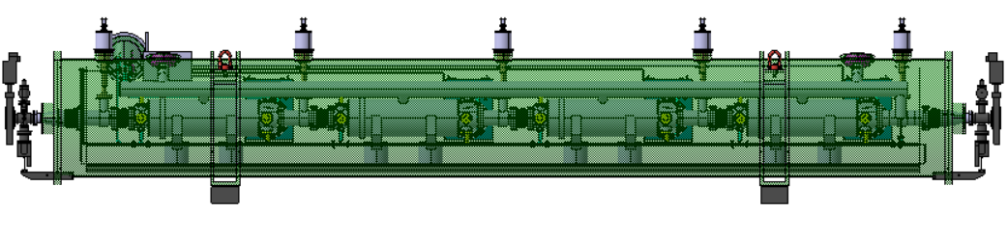
Integration
Longitudinal spacing Pt.H (2/2)
( from RF team – details of the spacing between two quadrupoles 00MHz CMs)
2 - Integrations in Pts H and L
IP
989,37 m
Q
Q
Q
Q
Q
Q
Q
Q
Q
Q
Q
Q
5x 400
7x 400
7x 400
7x 400
7x 400
8x 800
8x 800
8x 800
8x 800
3x 800
8x 800
8x 800
3x 800
8x 800
0.5m
0.5m
0.5m
L_{m}=3.1m
10.25m
10.25m
L_{m}=3.1m
89.6m
K. Canderan

Slide 14
Integration
Longitudinal spacing Pt.L
( from RF team – details of the spacing between two quadrupoles 00MHz CMs)
2 - Integrations in Pts H and L
IP
673.55 m
Q
Q
Q
Q
Q
Q
Q
Q
Q
Q
8x 800
8x 800
8x 800
8x 800
8x 800
8x 800
8x 800
8x 800
8x 800
0.5m
0.5m
0.5m
L_{m}=3.1m
10.25m
10.25m
L_{m}=3.1m
89.6m
K. Canderan

Slide 15
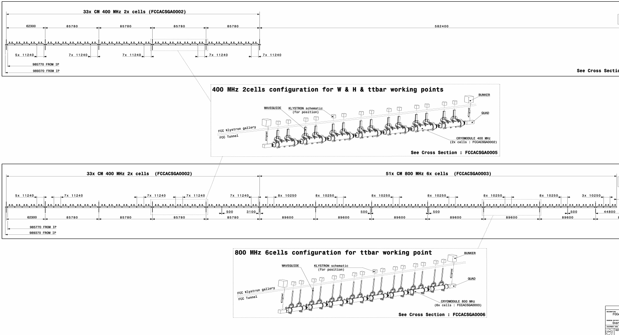
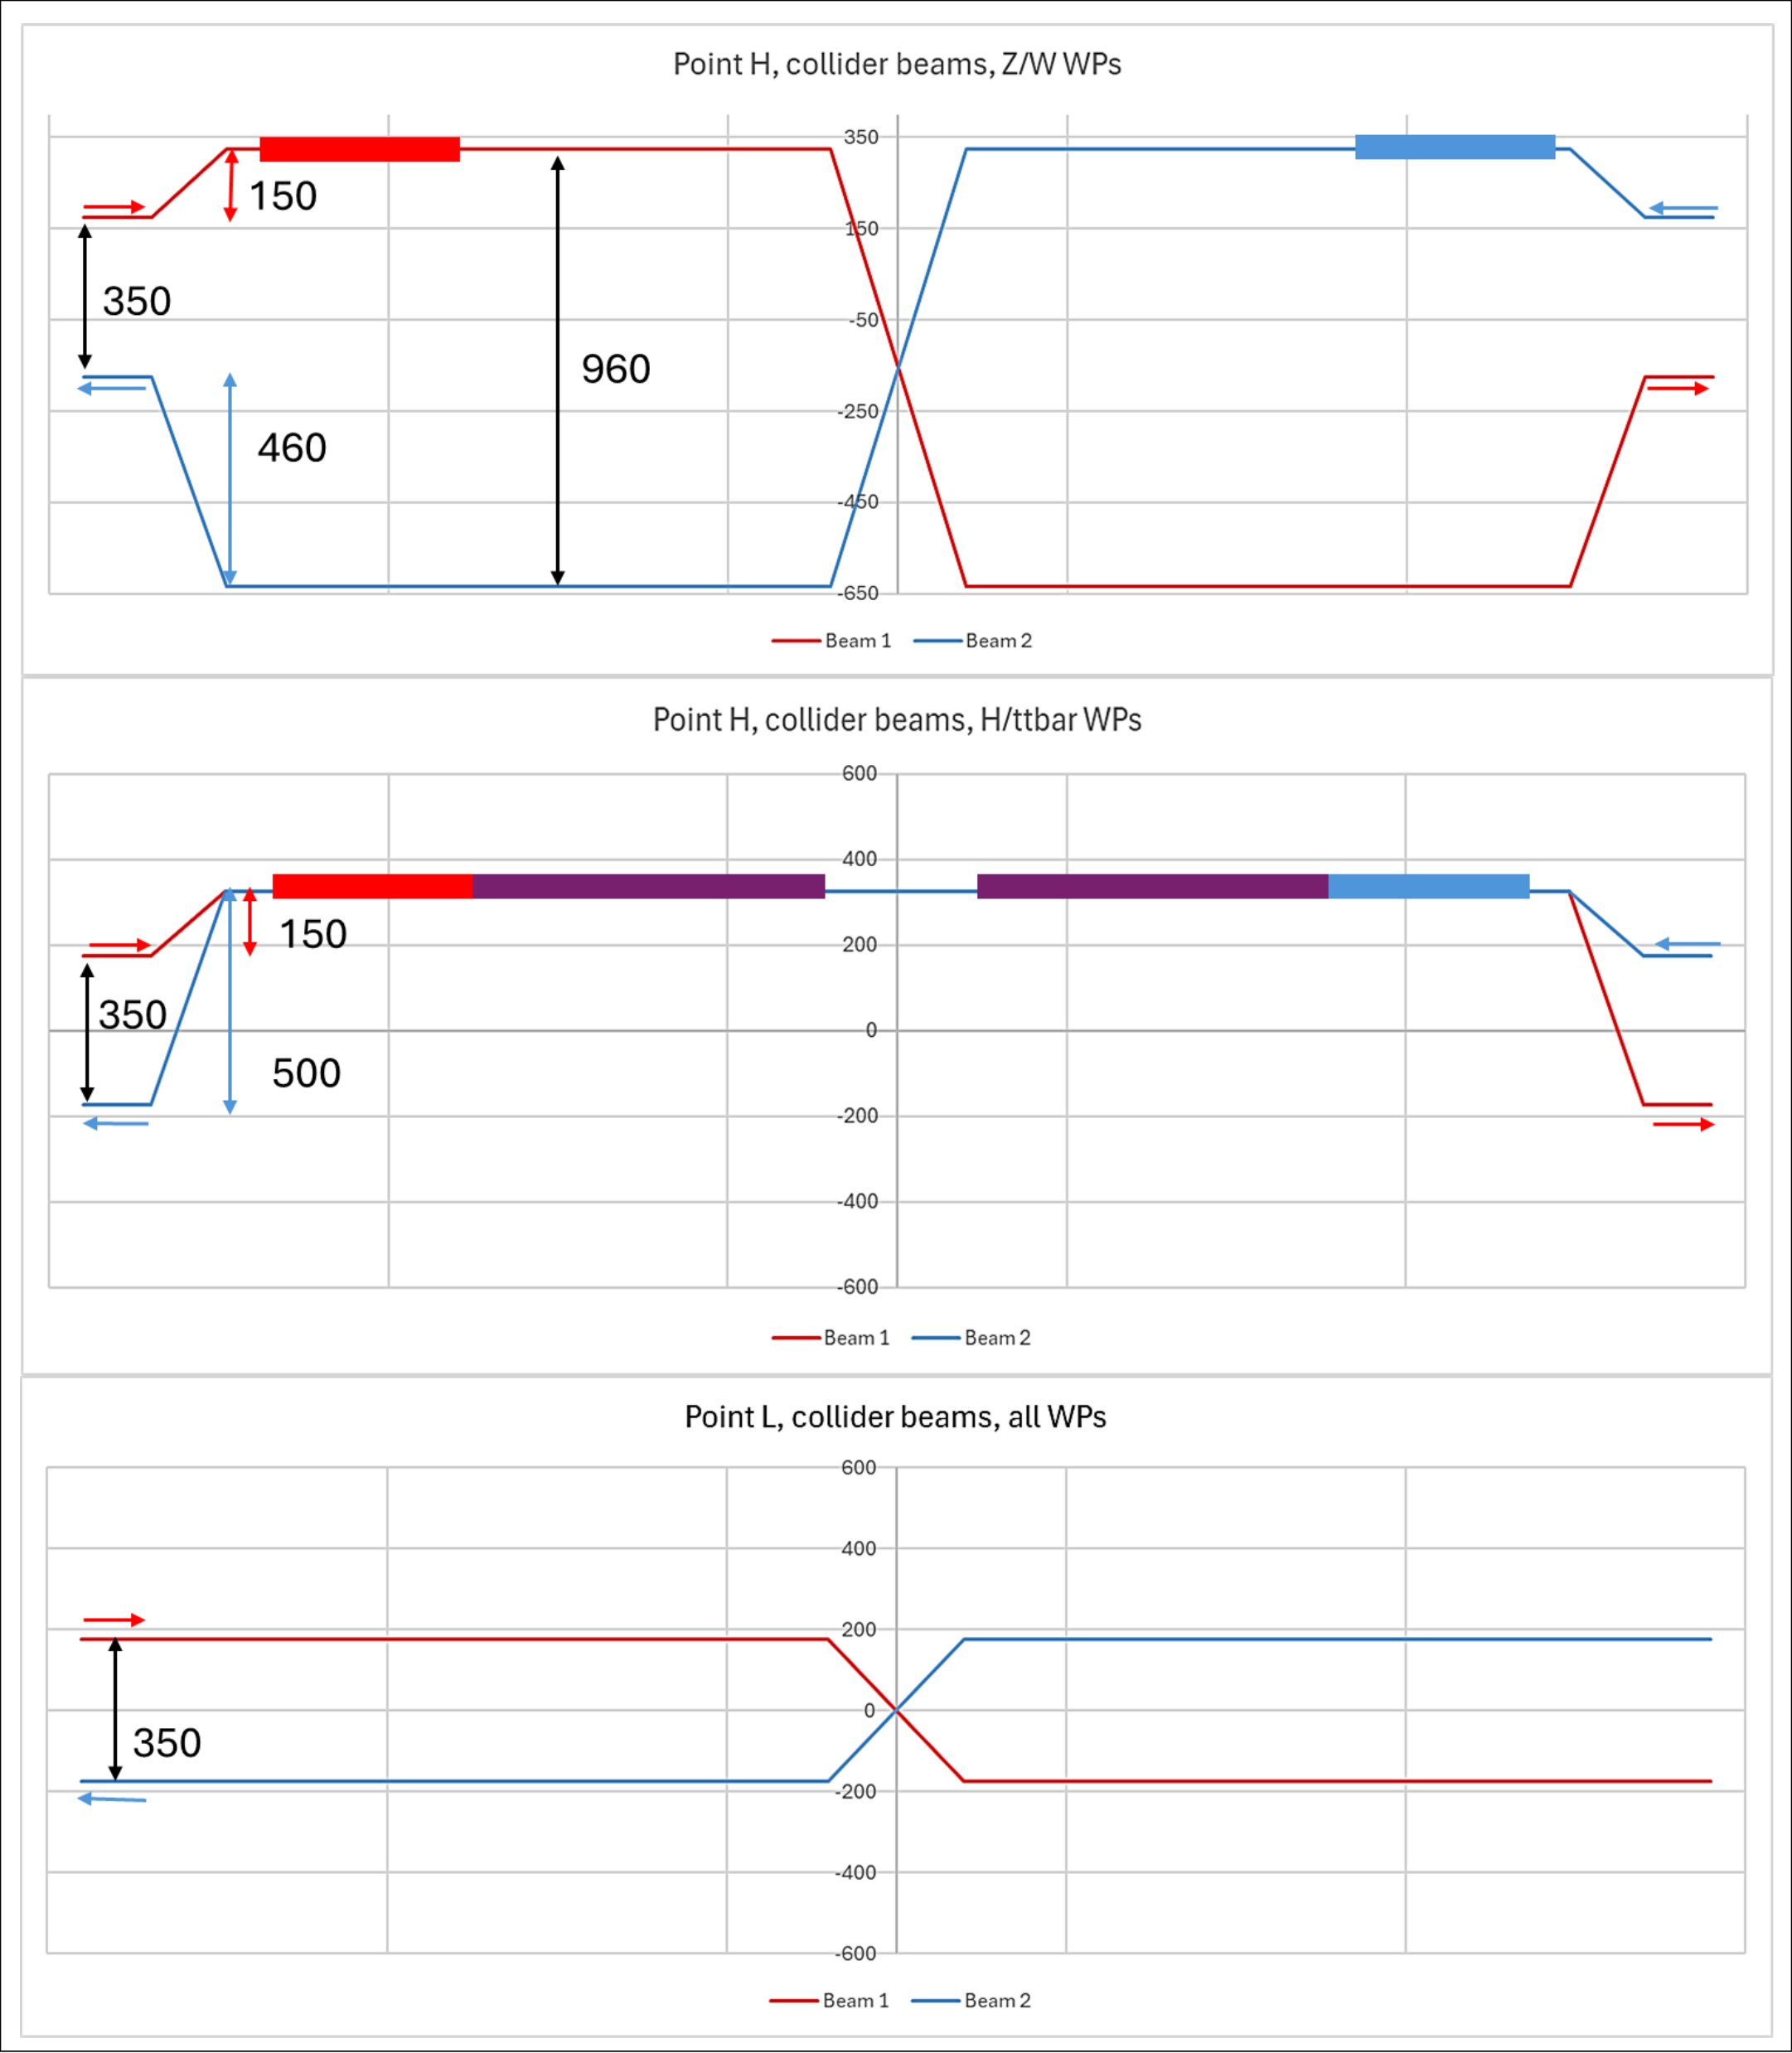
20.05.2025 / FCC Week
Pt H
CM installed for Z/W don’t move
2 - Integrations in Pts H and L
Ref drawing: FCCACSGA0008
IP
Z / W
Collider
Collider
960
400 MHz (33)
ARCS
Collider
Collider
Collider
Collider
H / ttbar
400 MHz (33)
800 MHz (51)
989,370 m (to last quad)
Beam Steering transition
Possible issue in longitudinal space occupation (not enough room for transition…)

Slide 16
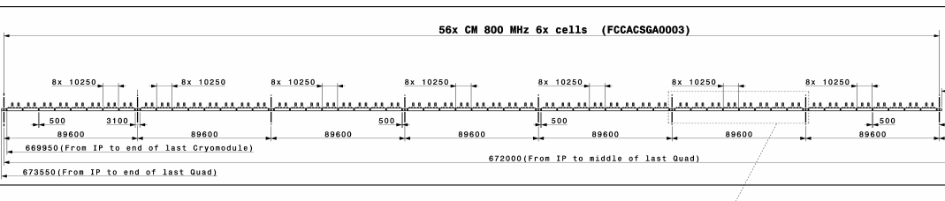
20.05.2025 / FCC Week
2 - Integrations in Pts H and L
Pt L
(Z / W / H) / ttbar
IP
Ref drawing: FCCACSGA0010
Collider
Collider
Booster
Booster
ARCS
800 MHz (56)
Collider
Collider
673.550 m (to last quad)

Slide 17
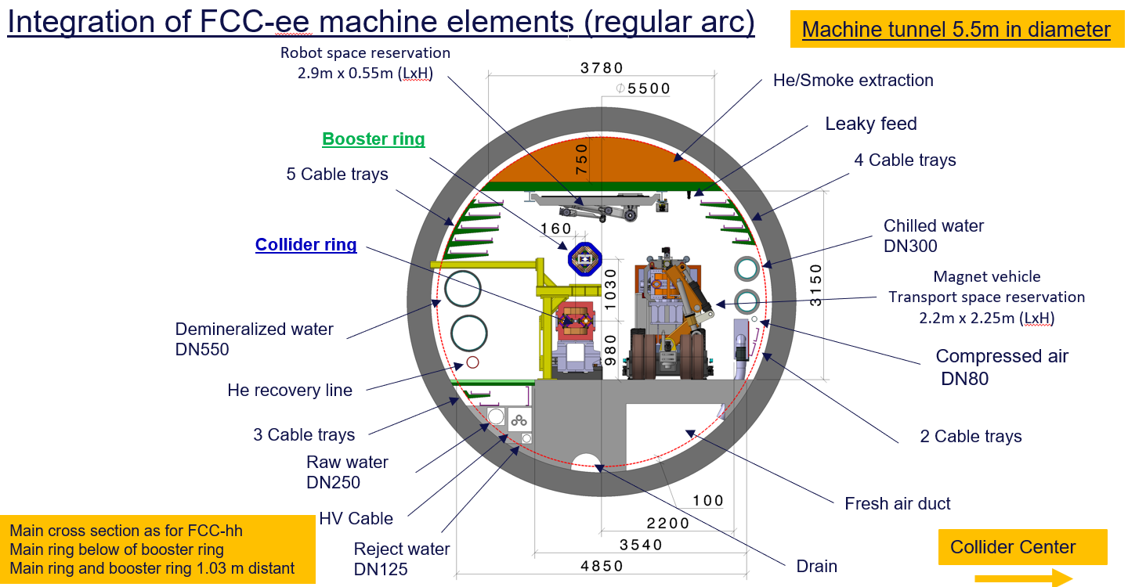
1 - CM design and assumptions for feasibility study
Machine tunnel 5.5m in diameter
20.05.2025 / FCC Week
B1-B2 collider Arc position
B1 CM: collider inlet CM
B2 CB: collider circulating beam
B3: Booster
Transversal Beam positions in Pt H (Z, W)
400
260
1030
980
Collider Center
150
350
960

Slide 18
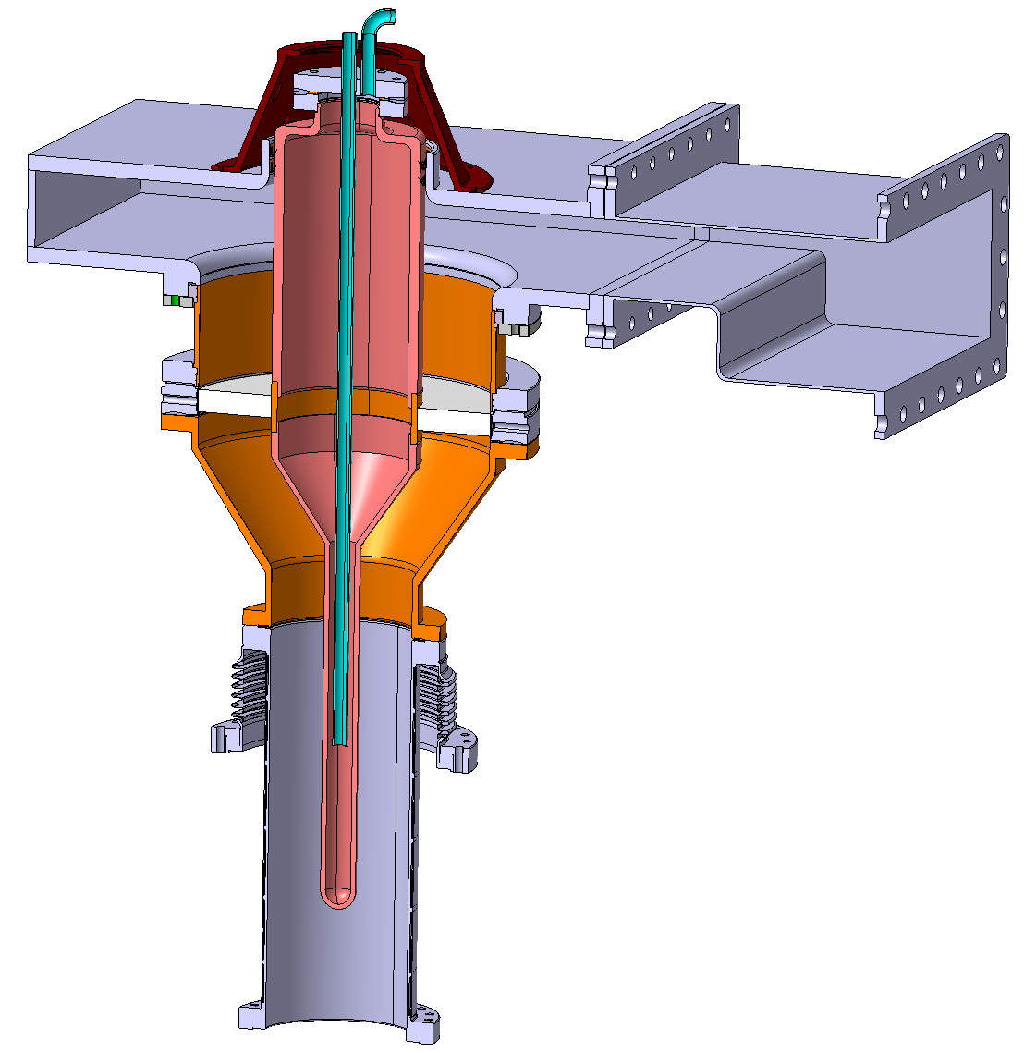
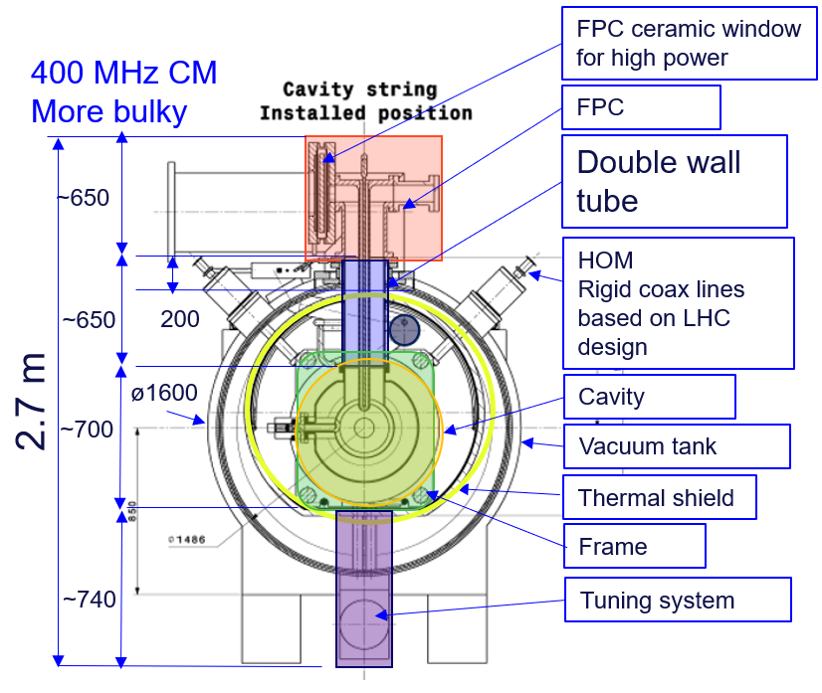
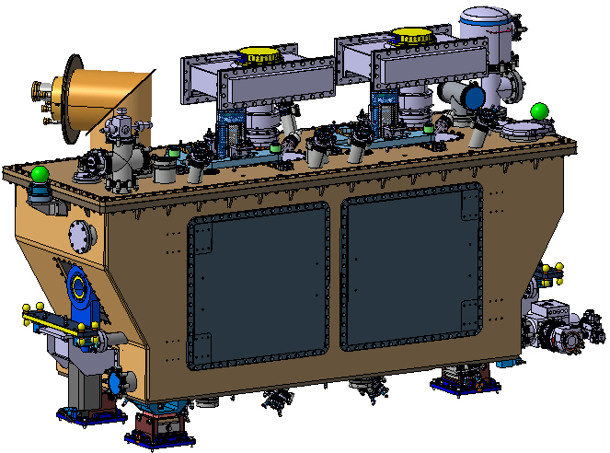
20.05.2025 / FCC Week
3 – Optimization in pre-TDR phase
Work in progress pre-TDR (SRF R&D-D project V. Parma)
Possible new compact design (ceramic window in coupler (Lower power 500 kW peak )
Possible optimization of length (reduced dynamic loads)
FPC new design
S. Calvo
HOM optimization length (challenging seen the higher power in RPO.
Vacuum tank shape and insertion scheme are currently being studied)
Exploring the feasibility of designing a tuning system that does not require a frame
Crab cavity CM
T. Capelli
Investigation alternative locations and more compact tuning system

Slide 19
22.05.2025 / FCC Week
FCC-ee Underground Structure point H
PLM References: https://plm.cern.ch/p/CAD/number:ST1857768_01:AA.04
EDMS References: https://edms.cern.ch/document/3126009/1.0
Feasibility Report

Slide 20
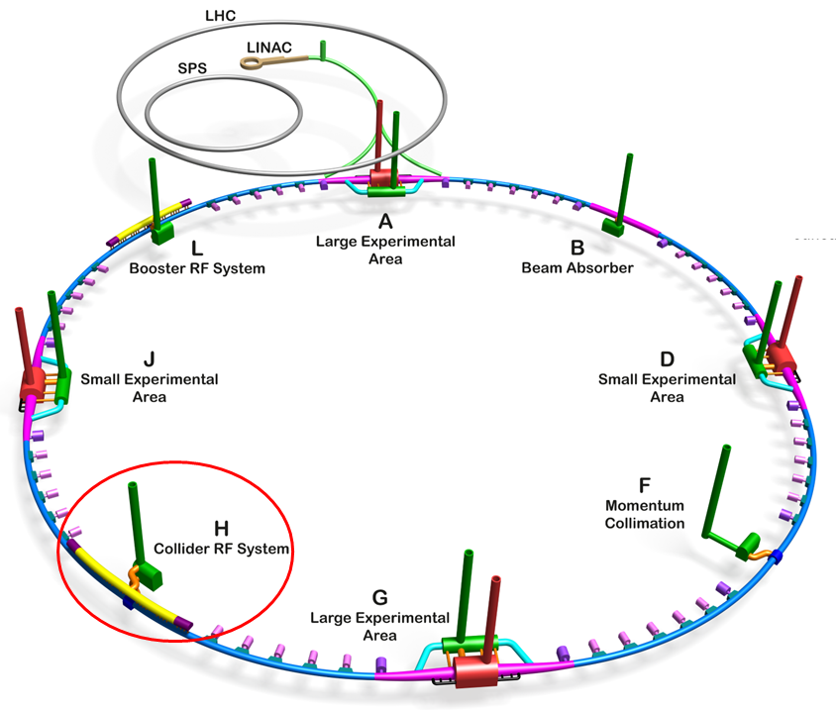
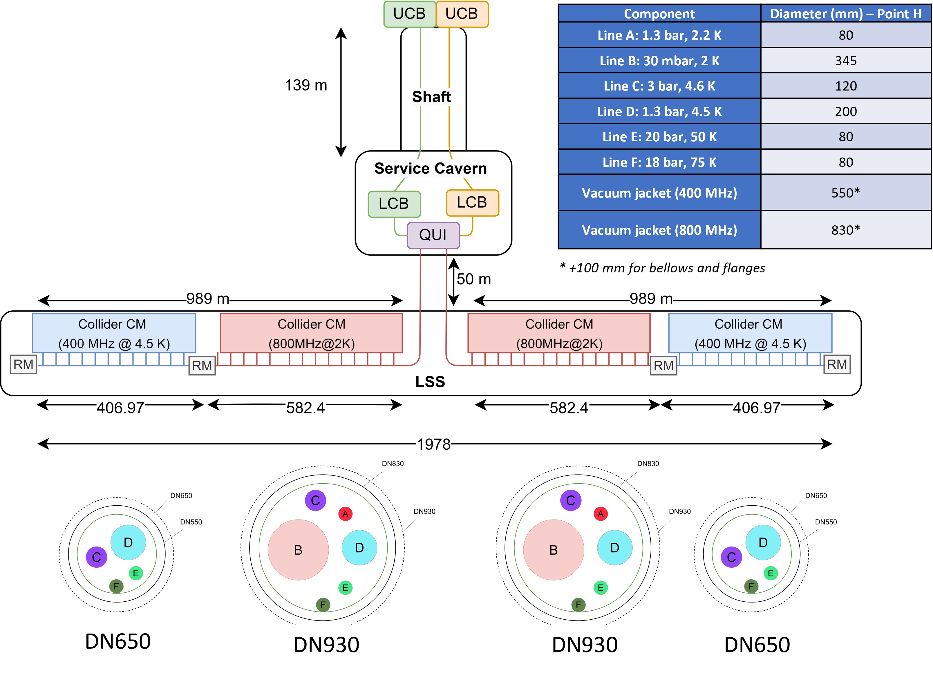
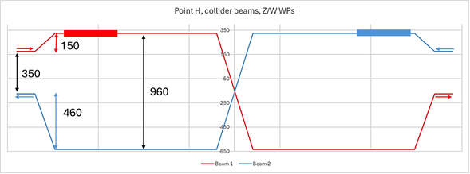
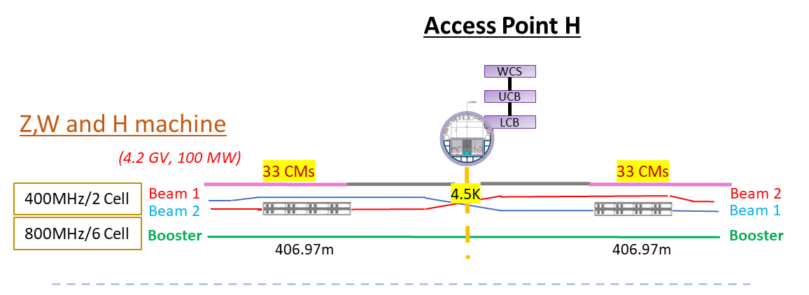
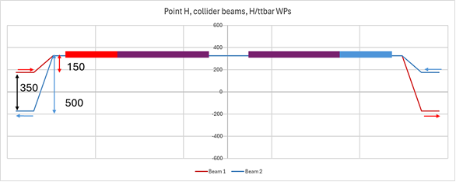
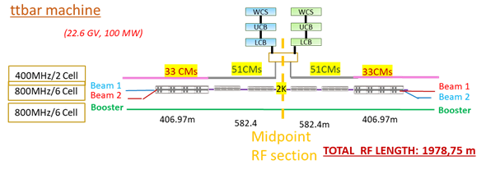
20.05.2025 / FCC Week
TLSS length: 2032 m
FCC-ee RF/Cryogenic Layout point H
Courtesy Cryo team
The RF configuration does not change anymore allowing the run at Z, W or H operation
2K Booster CMs near to cryoplants then 4.5K Collider CMs

Slide 21
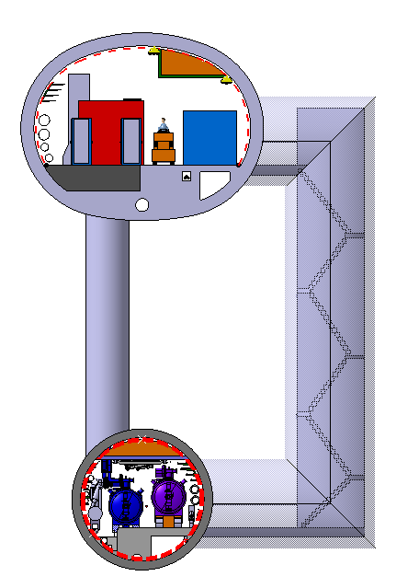
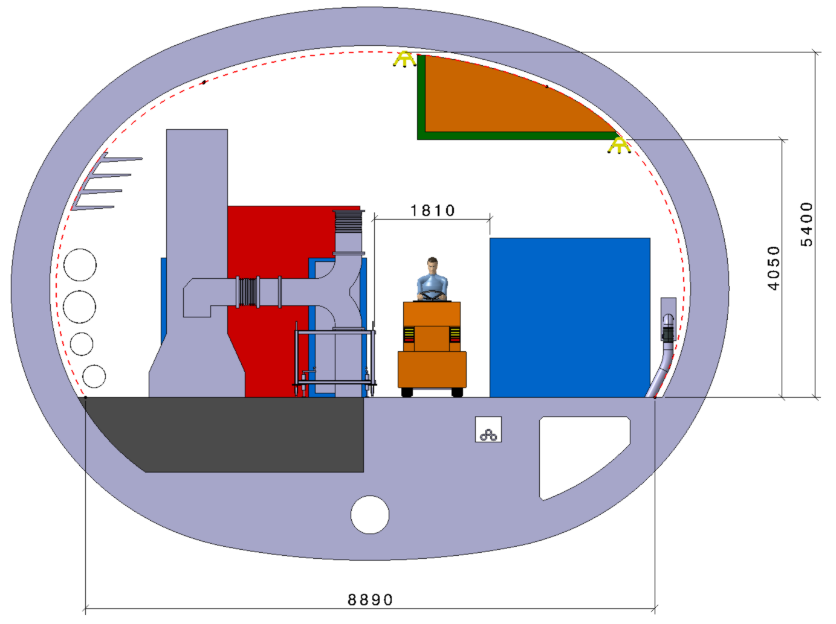
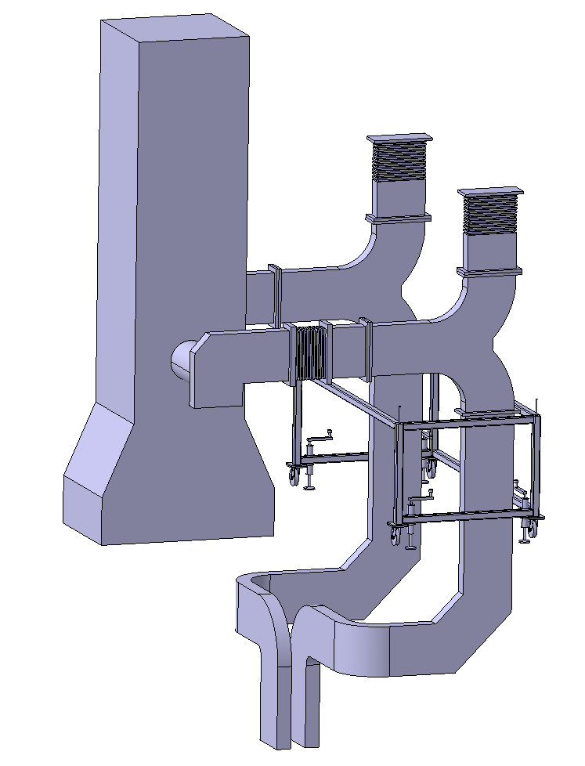
20.05.2025 / FCC Week
FCC-ee RF Machine tunnel & Klystron Gallery cross section (z,w machine)
Feasibility Report
400 MHz cryomodules (ø 1.6 m x 11.24 m), half RF LSS
33 e⁺e⁻ CM (406.97 m)
66 klystrons
Klystron, circulator & rack
HV Bunker
Klystron Gallery
Waveguide duct
10000
Faraday cage
Collider Center
Machine tunnel

Slide 22
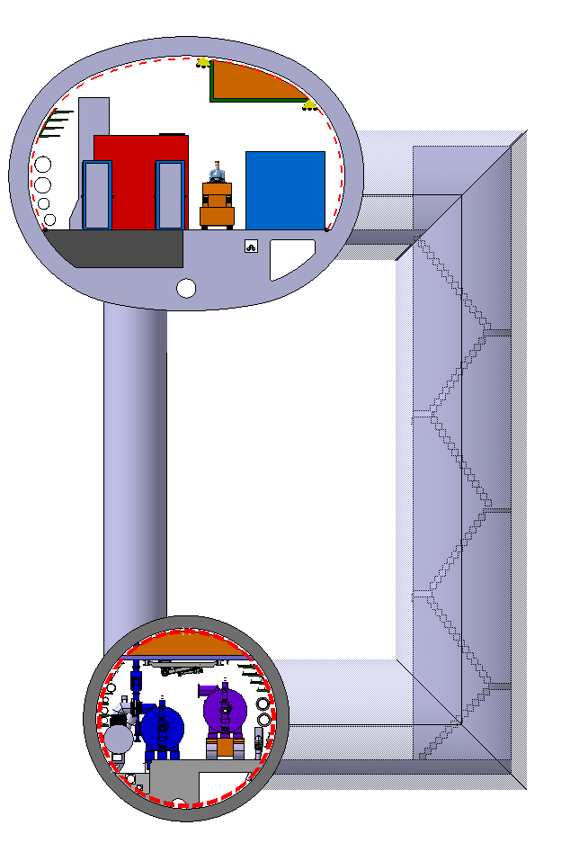
20.05.2025 / FCC Week
FCC-ee RF Machine tunnel & Klystron Gallery cross section (ttbar machine)
800 MHz cryomodules (ø 1.38 m x 10.25 m), half RF LSS
51 e⁺e⁻ CM (582.4 m)
102 klystrons
Feasibility Report
Klystron, circulator & rack
HV Bunker
Klystron Gallery
Waveguide duct
10000
Faraday cage
Collider Center
Machine tunnel

Slide 23
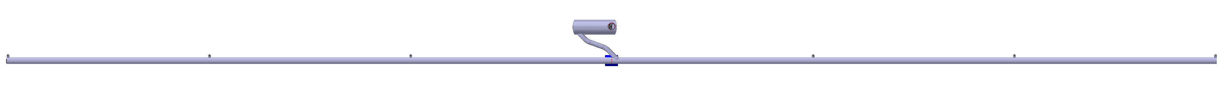
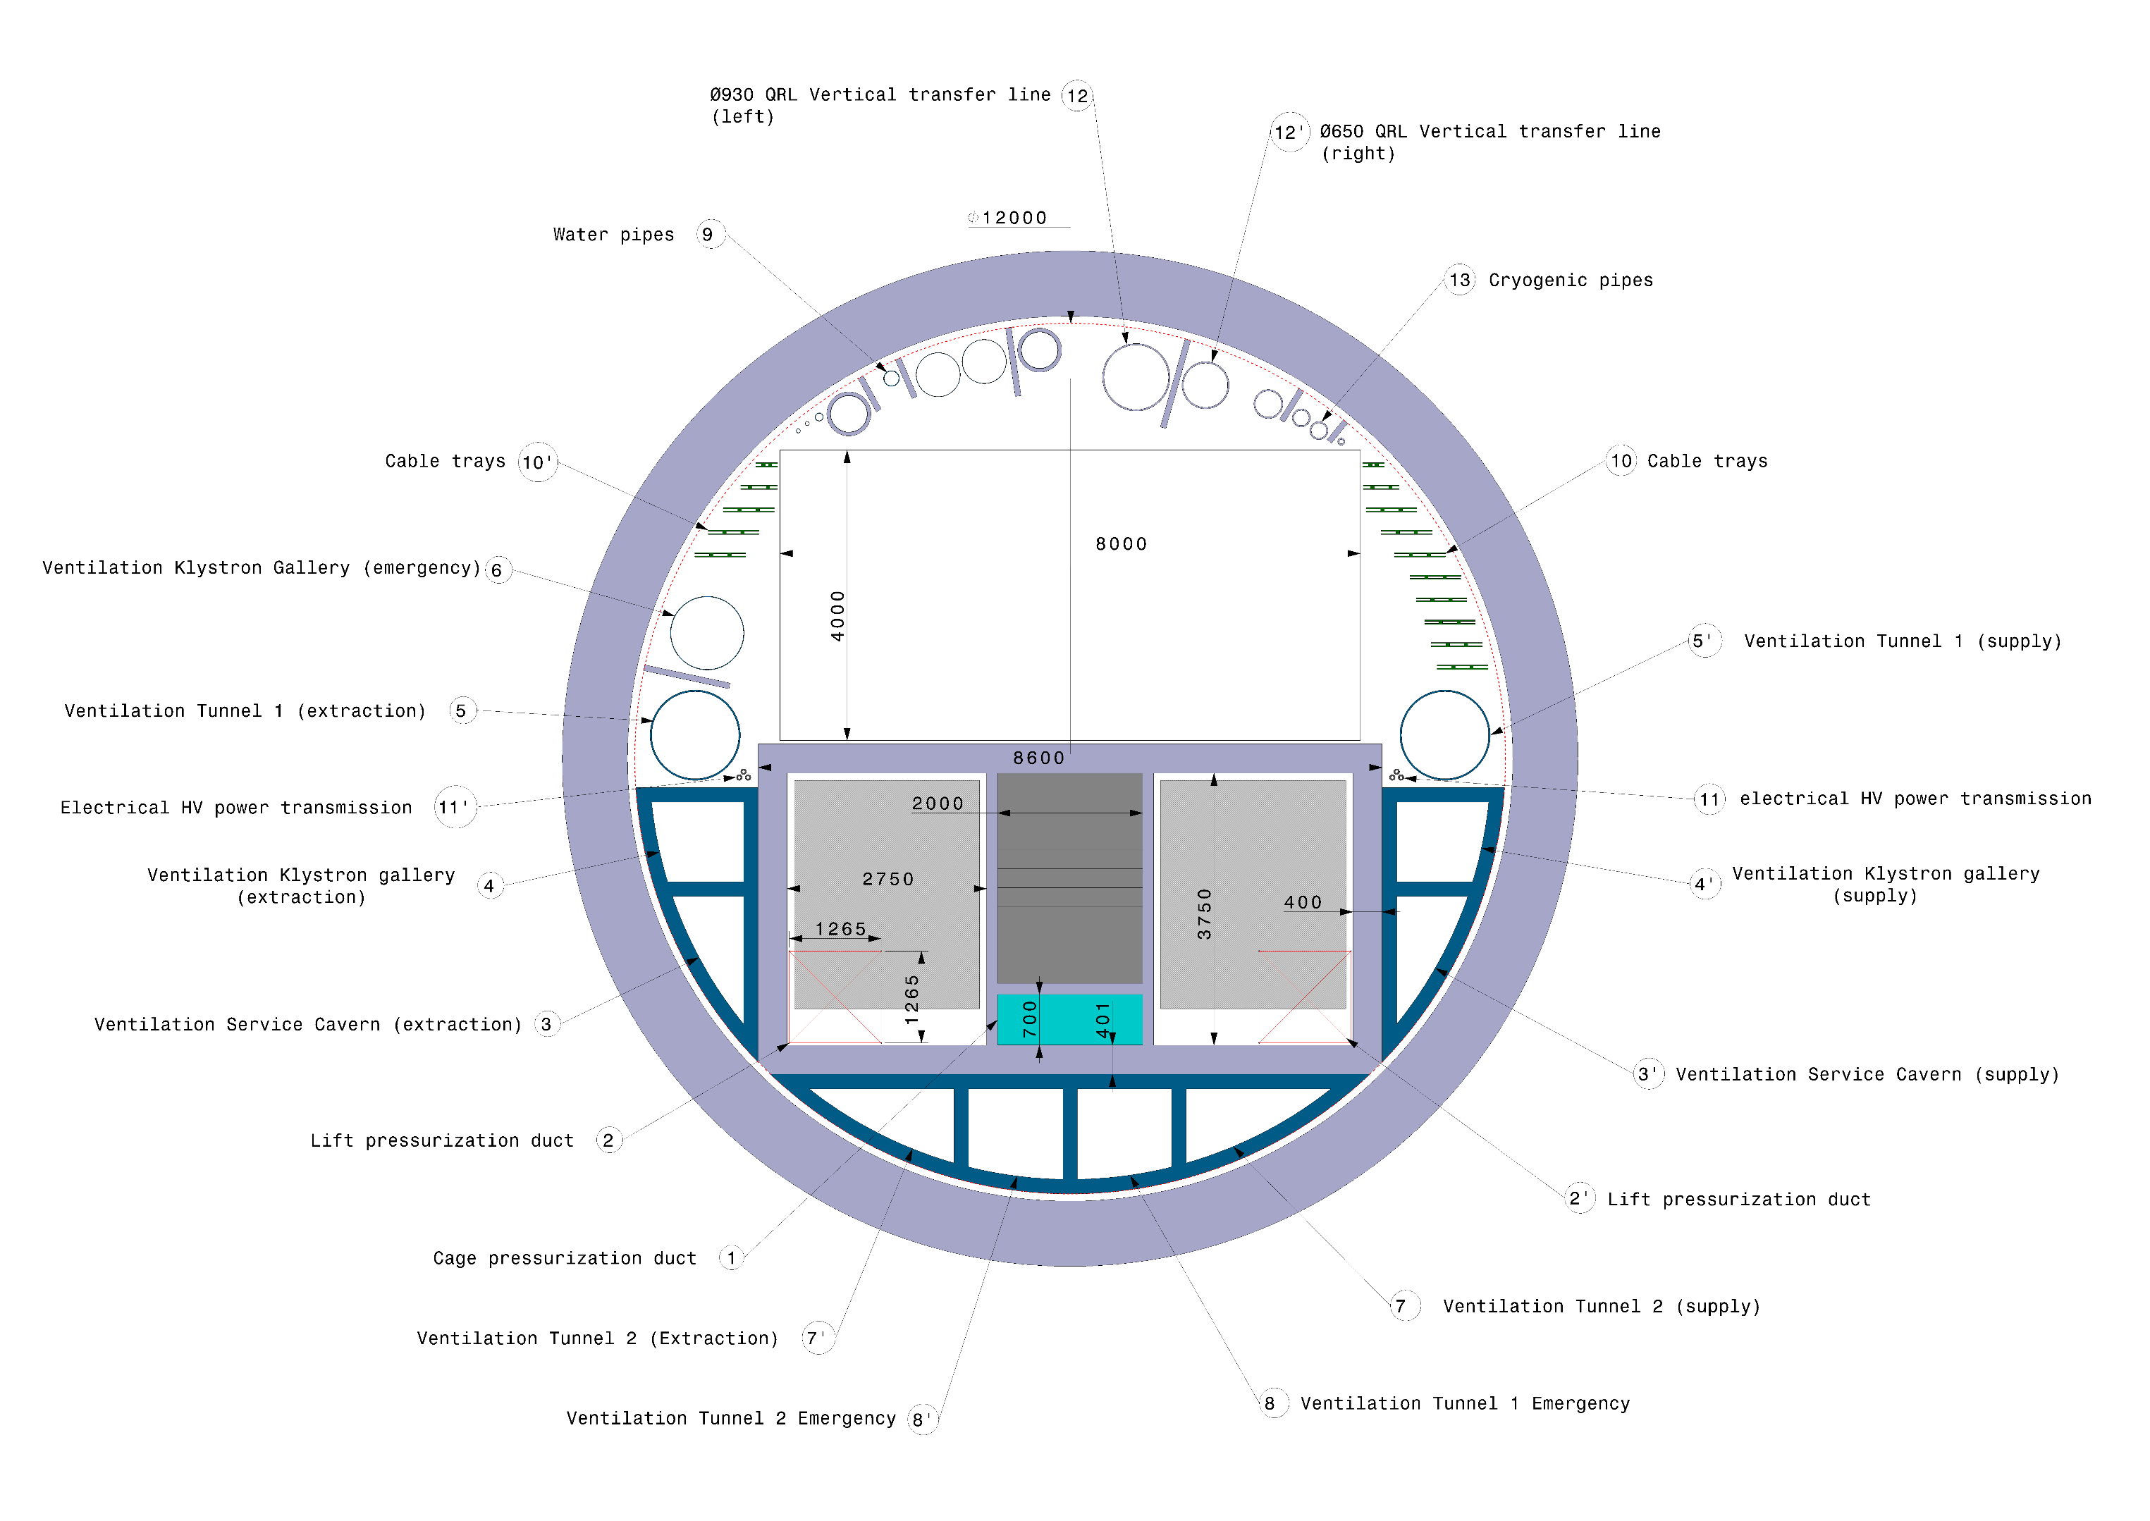
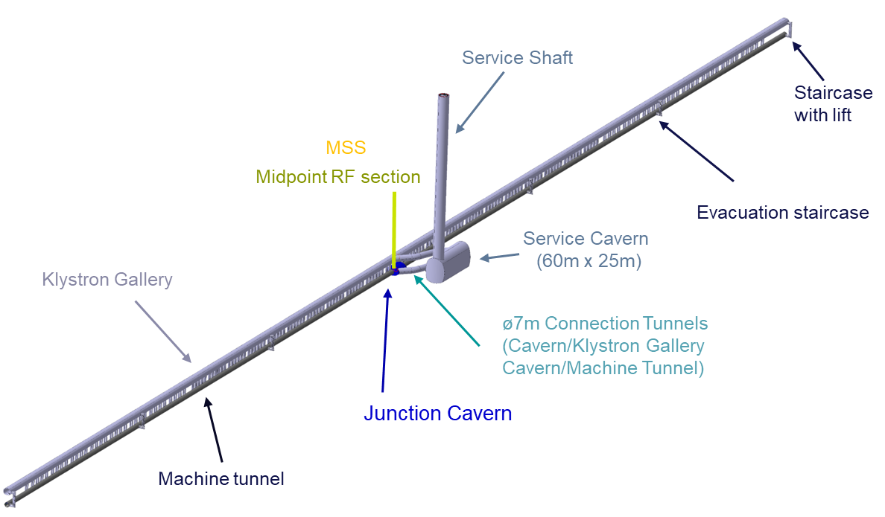
20.05.2025 / FCC Week
FCC-ee Underground Structure study Point H
Collider Center
Feasibility Report
MSS
Midpoint RF section
341
341
341
341
341
341
Service Shaft

Slide 24
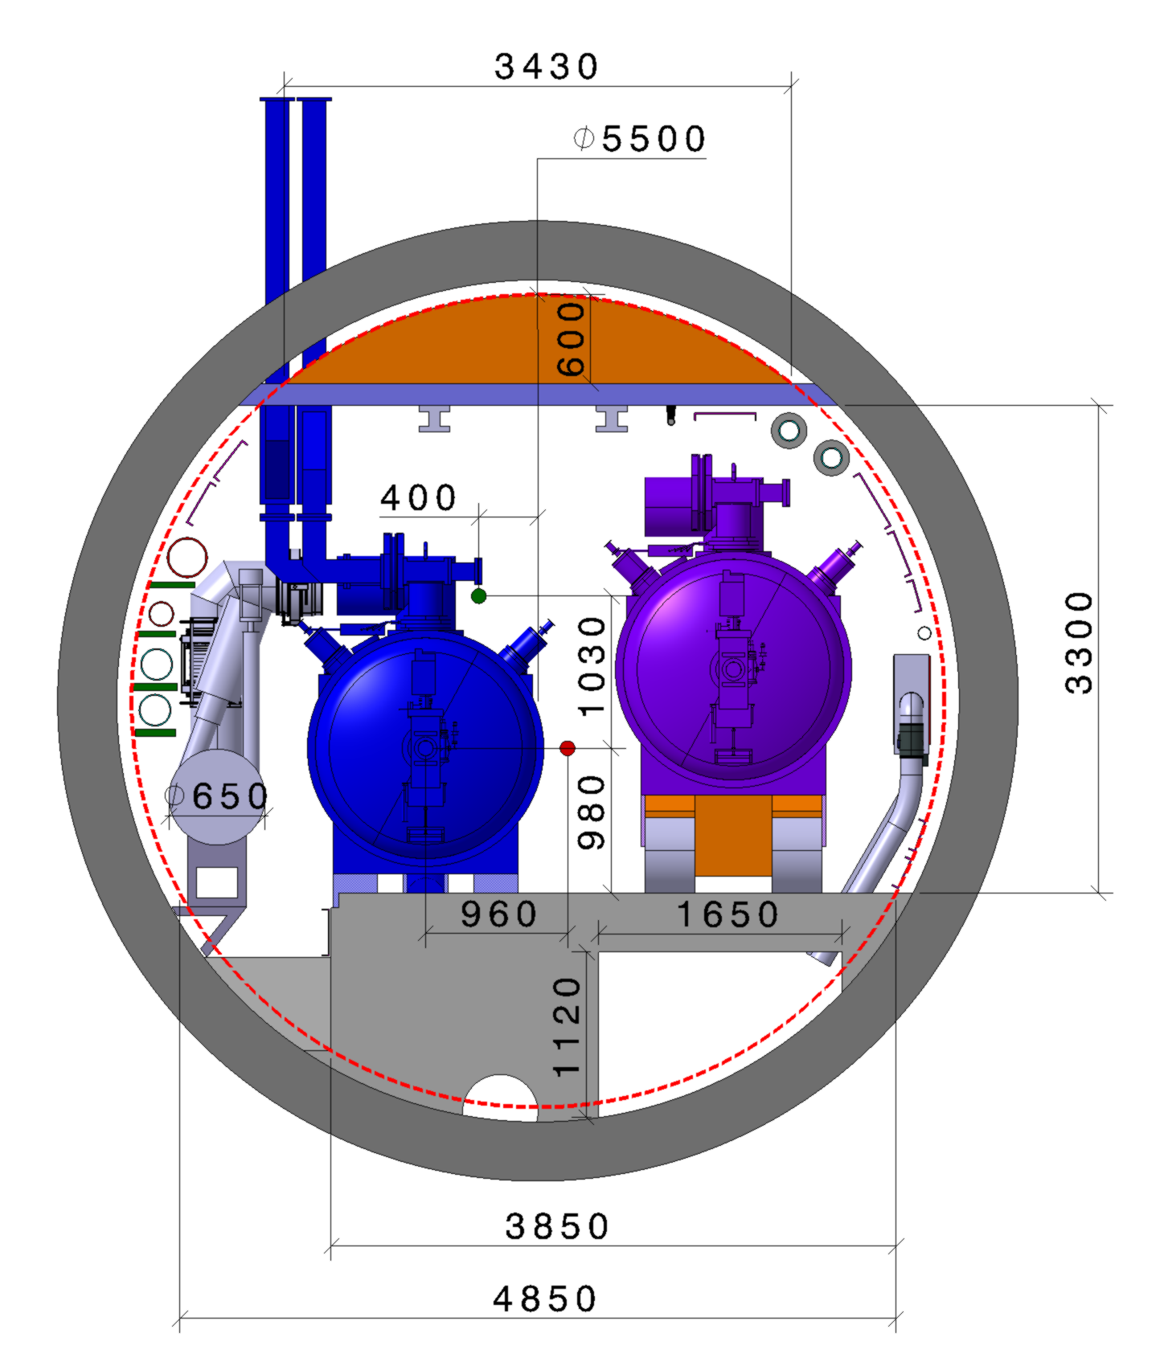
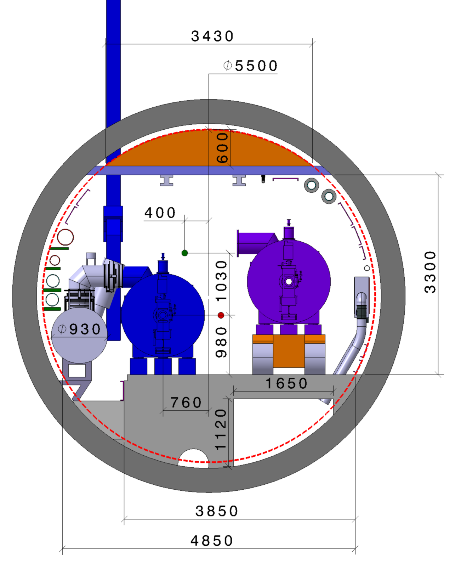
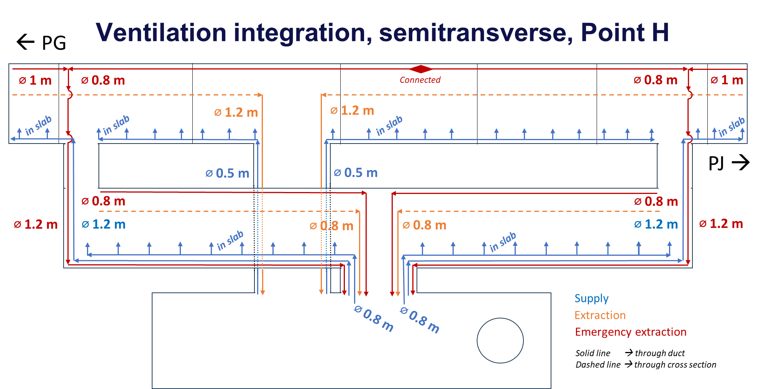

20.05.2025 / FCC Week
FCC-ee RF Machine tunnel cross section
Pre-TDR Study
Machine tunnel cross section with 800Mhz Cryomodule (H, ttbar operation)
Machine tunnel cross section with 400Mhz Cryomodule (Z, W operation)
Magnet vehicle
Transport space reservation
1.9 m x 3.1 m (LxH)
Magnet vehicle
Transport space reservation
1.9 m x 3.1 m (LxH)
Single aperture quadrupole topology
Collider Center
Klystrons
Please follow Jeremie Bauche’s presentation “Collider magnets for FCC-ee“
Klystrons
Collider&Booster quadropules
Collider&Booster quadropules
Collider 400 MHz Cryomodules
Collider 400 MHz Cryomodules

Slide 25



20.05.2025 / FCC Week
FCC-ee RF Machine tunnel & Klystron Gallery cross section (z,w machine)
Klystron Gallery
Pre-TDR Study
HV Bunker
Klystron
Waveguide duct
10 000
Faraday cage
Collider Center
Please follow Inigo Martin Melero’s presentation “Ventilation update“
Accelerator tunnel

Slide 26
22.05.2025 / FCC Week
FCC-ee Underground Structure point L
PLM References: https://plm.cern.ch/p/CAD/number:ST1859242_01:AA.05
EDMS References: https://edms.cern.ch/document/3126010/1.0
Feasibility Report

Slide 27




20.05.2025 / FCC Week
FCC-ee RF/Cryogenic Layout point L
Courtesy Cryo team
TLSS length: 2032 m
Component | Diameter (mm) – Point L
Line A: 1.3 bar, 2.2 K | 60
Line B: 30 mbar, 2 K | 265
Line C: 3 bar, 4.6 K | 20
Line D: 1.3 bar, 4.5 K | 20
Line E: 20 bar, 50 K | 60
Line F: 18 bar, 75 K | 60
Vacuum jacket (400 MHz) | -
Vacuum jacket (800 MHz) | 600*
The RF configuration does not change anymore allowing the run at Z, W or H operation
*+100 mm for bellows and flanges
2K Booster CMs near to cryoplants

Slide 28

20.05.2025 / FCC Week
FCC-ee RF Machine tunnel & Klystron Gallery cross section (ttbar machine)
Klystron Gallery
Feasibility Report
HV Bunker
Klystron, circulator & rack
Waveguide duct
10 000
Klystron longitudinal
Faraday cage
Collider Center
Machine tunnel

Slide 29



20.05.2025 / FCC Week
FCC-ee Underground Structure study Point L
Collider Center
Feasibility Report
MSS
Midpoint RF section
354
354
354
354
Service Shaft ø 12m

Slide 30
13.06.2024 / FCC Week
Conclusion
For Collider Z, W, H and ttbar machine all 400MHz Cryomodules will be housed at point H.
For Collider ttbar machine 800MHz Cryomodules will be housed at point H.
For Booster Z, W, H and ttbar machine all 800MHz Cryomodules will be housed at point L .
The integration study is still at a conceptual level and needs to be regularly updated with the evolution of the design of the CMs, the cryogenic lines, and other machine elements. The layout of the klystron galleries will further evolve with the technical design of all services.
RF feedback based on SRF R&D project during pre-TDR phase (structured process to manage configurations).

Slide 31
I would like to acknowledge the FCC Technical Infrastructure Coordination team and the FCC Accelerator Technology team for their input and support in the integration studies.
13.06.2024 / FCC Week
31

Slide 32
Thank you for your attention.
13.06.2024 / FCC Week
F. Valchkova-Georgieva & Dieudonne Adrien Ngo'O Ella
32

Slide 33
Back-up slides

Slide 34


20.05.2025 / FCC Week
1 - CM design and assumptions for feasibility study
11.24 m
FCCee Feasibility Study Report (par.3.4.10, Fig.3.32)
From RF model to Mechanical design
HOM’s
FPC
Pick-ups
New power hasn’t been taken into account in the design of HOMs tappers

Slide 35


20.05.2025 / FCC Week
1 - CM design and assumptions for feasibility study
FCC 800 MHz cavity
Superconducting elliptical cavity
800 MHz, 6-cell
1.5 m. long
Bulk Niobium with electropolished and doped RF surface (mid T baked)
From RF input to mechanical input
9,646 m
From RF model to Mechanical design
HOMs
FPC on the side
HOMs
6 cell cavity

Slide 36
Integration
Longitudinal spacing Pt.H (1/2)
( from RF team – details of the spacing between two quadrupoles 400MHz CMs)
IP
989,37 m
Approx. 13m longer than actual baseline
Q
Q
Q
Q
Q
Q
Q
Q
Q
Q
Q
Q
5x 400
7x 400
7x 400
7x 400
7x 400
8x 800
8x 800
8x 800
8x 800
3x 800
8x 800
8x 800
3x 800
8x 800
0.5m
0.5m
0.5m
L_{m}=3.1m
11.24m
11.24m
L_{m}=3.1m
85.78 m
K. Canderan

Slide 37
Integration
Longitudinal spacing Pt.H (2/2)
( from RF team – details of the spacing between two quadrupoles 00MHz CMs)
IP
989,37 m
Approx. 13m longer than actual baseline
Q
Q
Q
Q
Q
Q
Q
Q
Q
Q
Q
Q
5x 400
7x 400
7x 400
7x 400
7x 400
8x 800
8x 800
8x 800
8x 800
3x 800
8x 800
8x 800
3x 800
8x 800
0.5m
0.5m
0.5m
L_{m}=3.1m
10.25m
10.25m
L_{m}=3.1m
89.6m
K. Canderan

Slide 38
Integration
Longitudinal spacing Pt.L
( from RF team – details of the spacing between two quadrupoles 00MHz CMs)
IP
673.55 m
Q
Q
Q
Q
Q
Q
Q
Q
Q
Q
8x 800
8x 800
8x 800
8x 800
8x 800
8x 800
8x 800
8x 800
8x 800
0.5m
0.5m
0.5m
L_{m}=3.1m
10.25m
10.25m
L_{m}=3.1m
89.6m
K. Canderan

Slide 39







20.05.2025 / FCC Week
1 - CM design and assumptions for feasibility study
FCC week 2025
FCC week 2022
400 MHz CM based on LHC design
11.240 m
Drawing ref: FCCACSGA0002
800 MHz CM based on SPL design
10.250 m
Drawing ref: FCCACSGA0003

