Slide 1
Feasibility Study Baseline Layout and Prospects for FCC-hh
22nd May 2025 FCC Week
Gustavo Pérez Segurana
A. Abramov, W. Bartmann, M. Benedikt, R. Bruce, M. Giovannozzi,
T. Risselada, E. Todesco, F. Zimmermann

Slide 2
Overview
22nd May 2025 FCC Week
Gustavo Pérez Segurana
Current design of FCC-hh
  Changes from last FCC Week
Alternative configurations
Current and future work

Slide 3
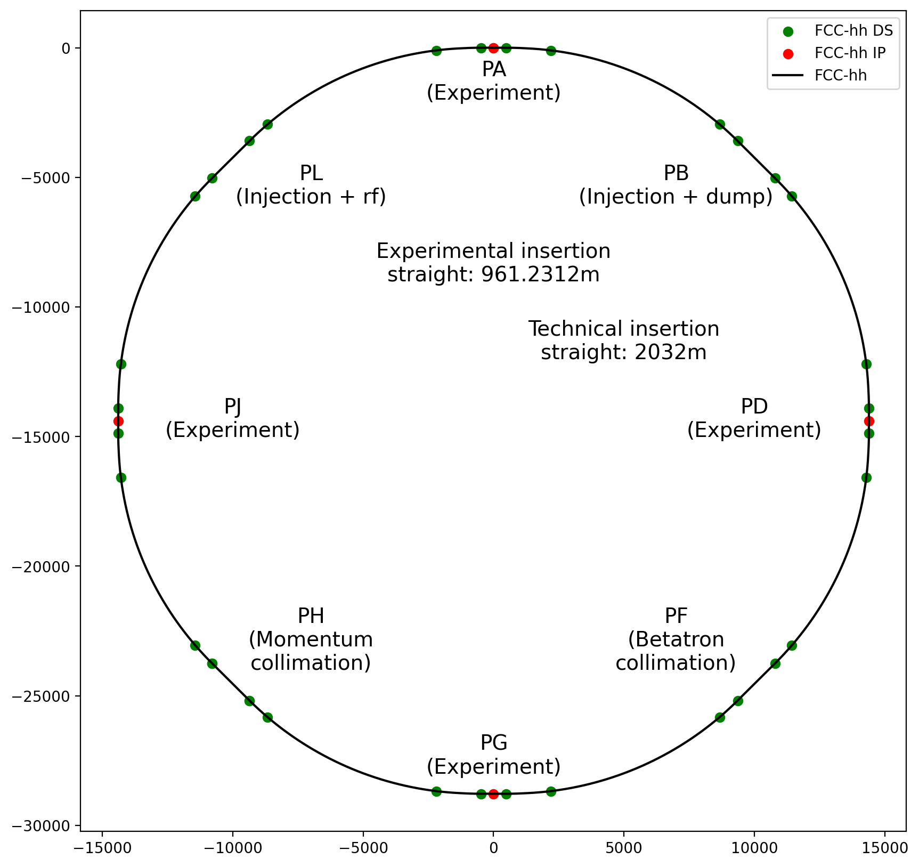
FCC-hh: Layout & main parameters
22nd May 2025 FCC Week
Gustavo Pérez Segurana
3
Status at last year’s FCCWeek
Parameter | Value
Collision energy CoM [TeV] | 84.6 – 120.8
Dipole field [T] | 14(Nb₃Sn) - 20(HTS/Hybrid)
Circumference [km] | 90.657
Adapted layout and lattice following placement studies.
Maximize dipole filling factor to maximize collision energy.
Follow up conclusions from FCCWeek2024 and feasibility study midterm review.

Slide 4
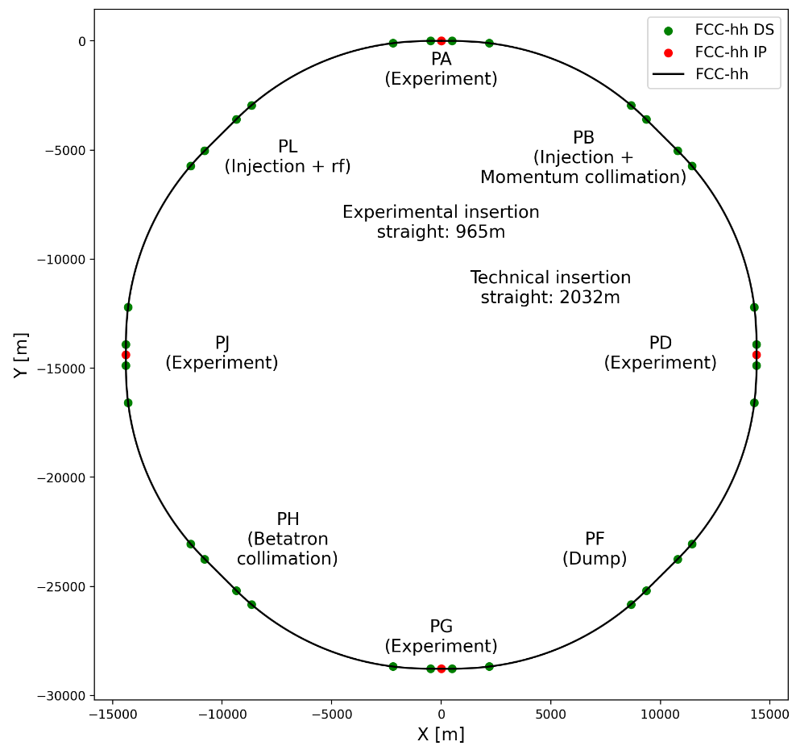
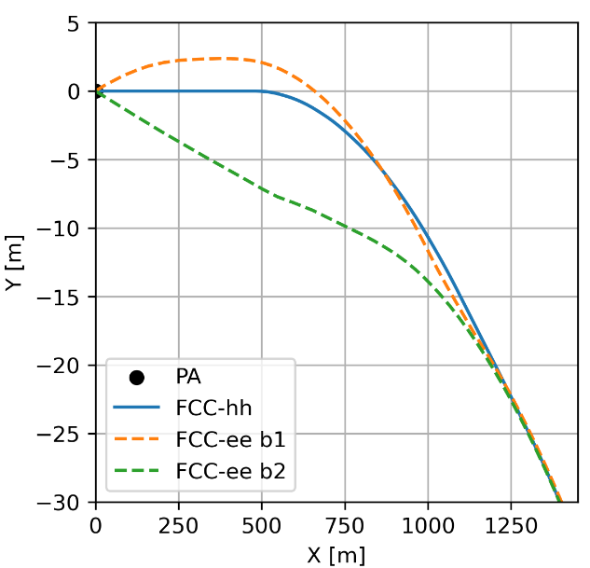
FCC-hh: Layout
22nd May 2025 FCC Week
Gustavo Pérez Segurana
4
Circumference: 90.657 km
4464 MB, 14.187m,14T
→ 42.3 TeV / 84.6 TeV CoM
Limiting factor: aperture at injection.
Here we consider injection at 3.3TeV
Survey comparison: FCC-hh and FCC-ee.
Agreement between IP positions (sub-mm)
Compared to V24.4GHC

Slide 5
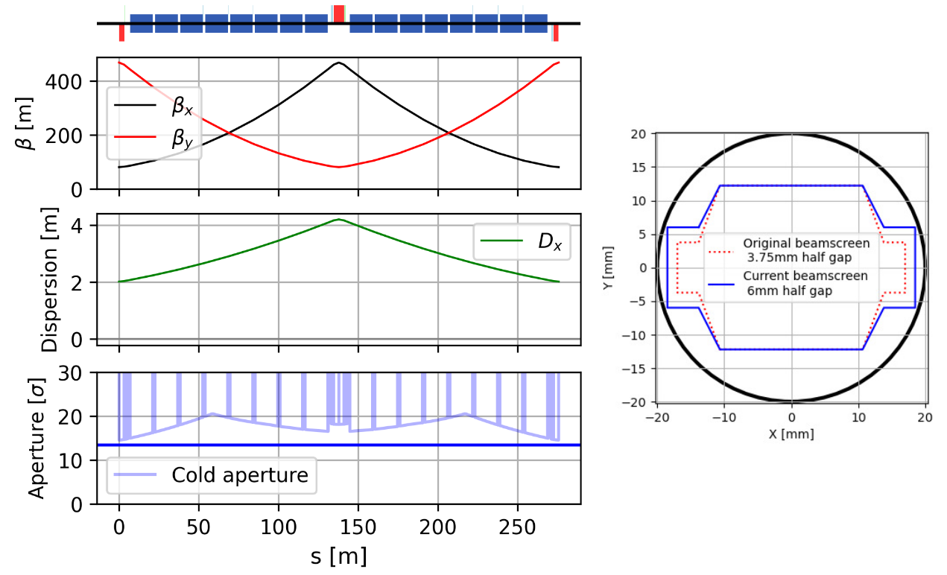
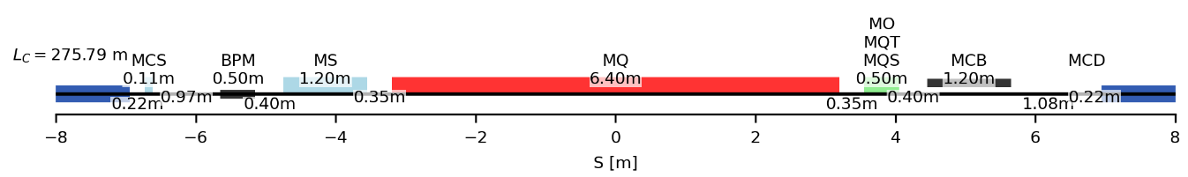
Long arc cells
22nd May 2025 FCC Week
Gustavo Pérez Segurana
5
~275m
 | CDR cell 12-dipole | 12-dipole | 16-dipole
# dipoles | 4668 | 4288 | 4464
Cell length [m] | 213.030 | 213.030 | 275.792
Circumference [km] | 97.75 | 90.657 | 90.657
CoM energy @14T [TeV] | 88.477 | 81.275 | 84.611
Short Straight Section

Slide 6
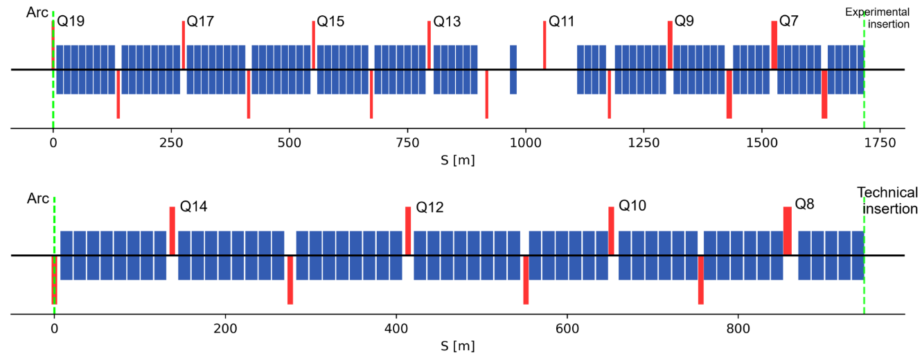
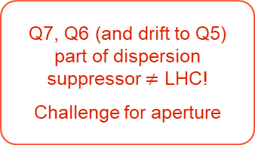
Dispersion suppressors
22nd May 2025 FCC Week
Gustavo Pérez Segurana
6
Break of the continuous dipole sequence shifts radially the IPs
Q7, Q6 (and drift to Q5) part of dispersion suppressor $≠$ LHC!
Challenge for aperture
Shorter half-cells and longer quadrupoles enable optics matching satisfying aperture constraints
Space reserved for collimators around selected quadrupoles. Possible to redistribute these drifts following results from collimation studies.

Slide 7
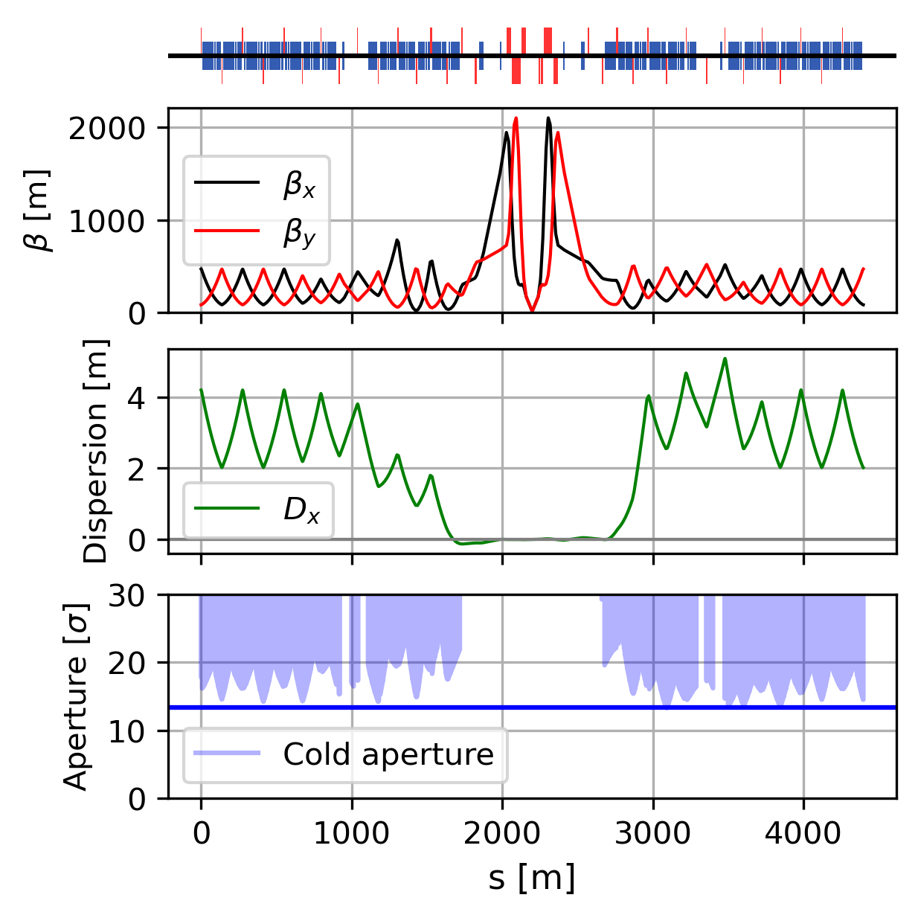
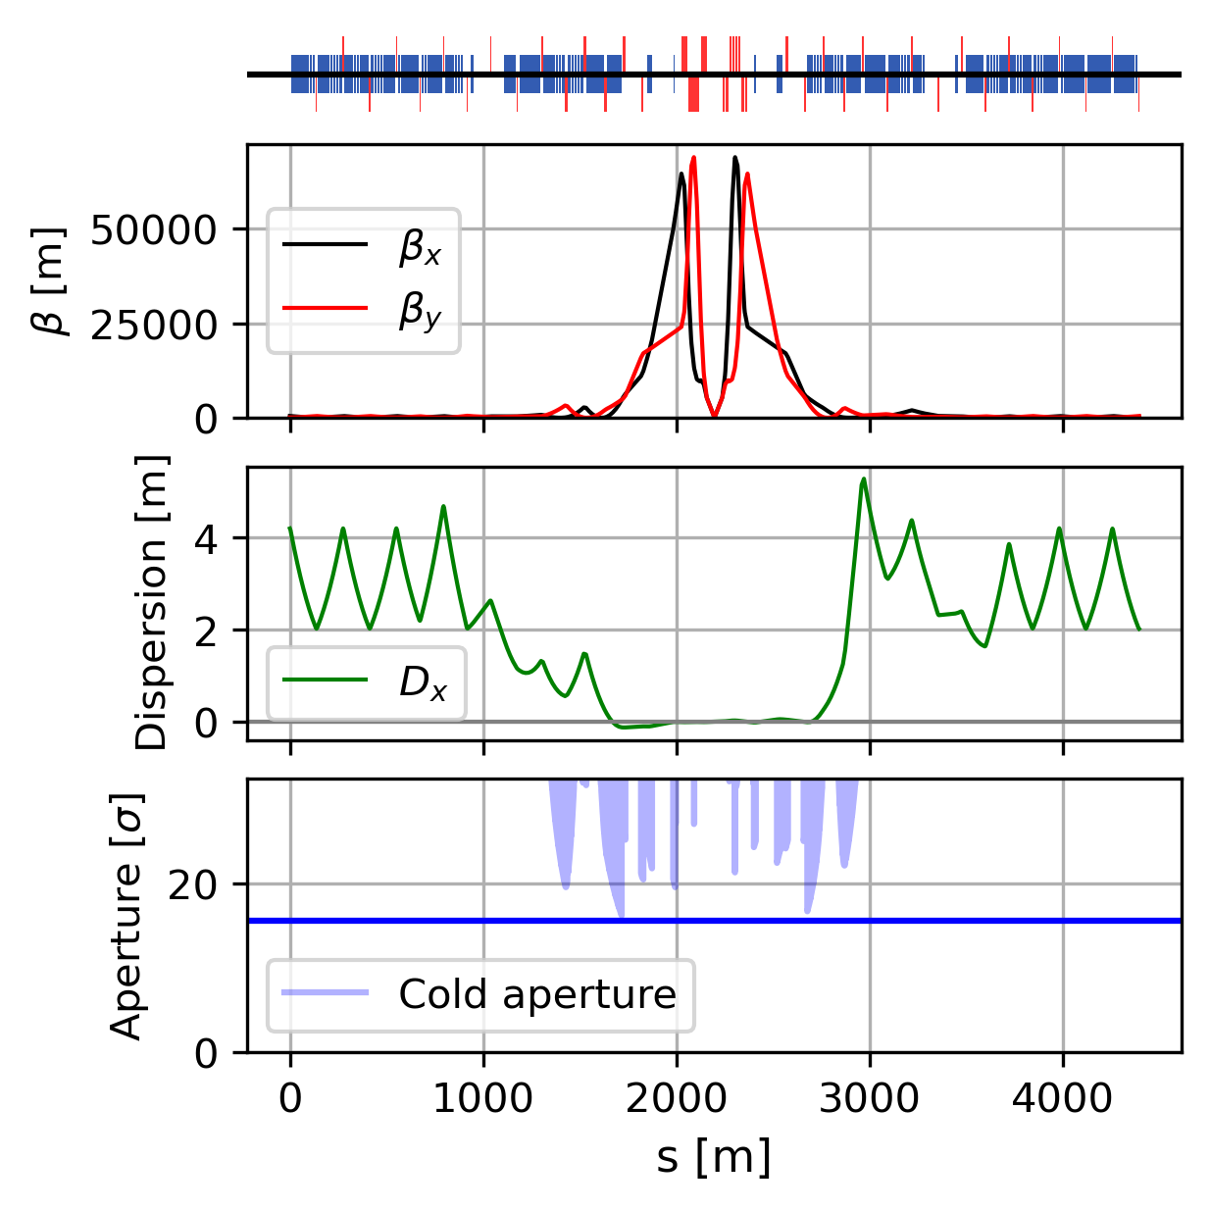


Experimental straight sections
22nd May 2025 FCC Week
Gustavo Pérez Segurana
7
Injection $β^{∗}=10m$
Four identical experimental insertions except for crossing scheme
Collision $β^{∗}=30cm$
Superconducting dipoles in experimental insertions
Reserved space for non-linear correctors
New matching with constant phase advances during squeeze

Slide 8
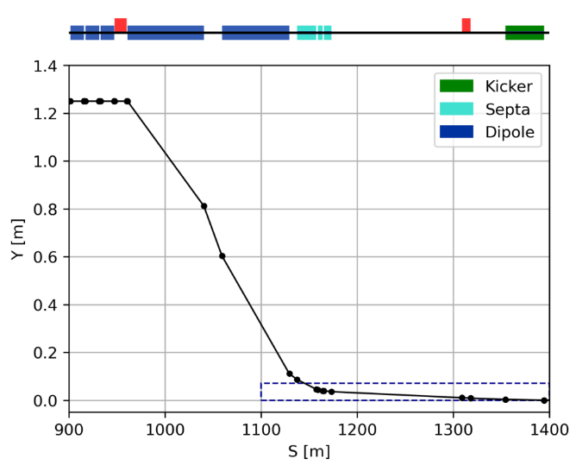
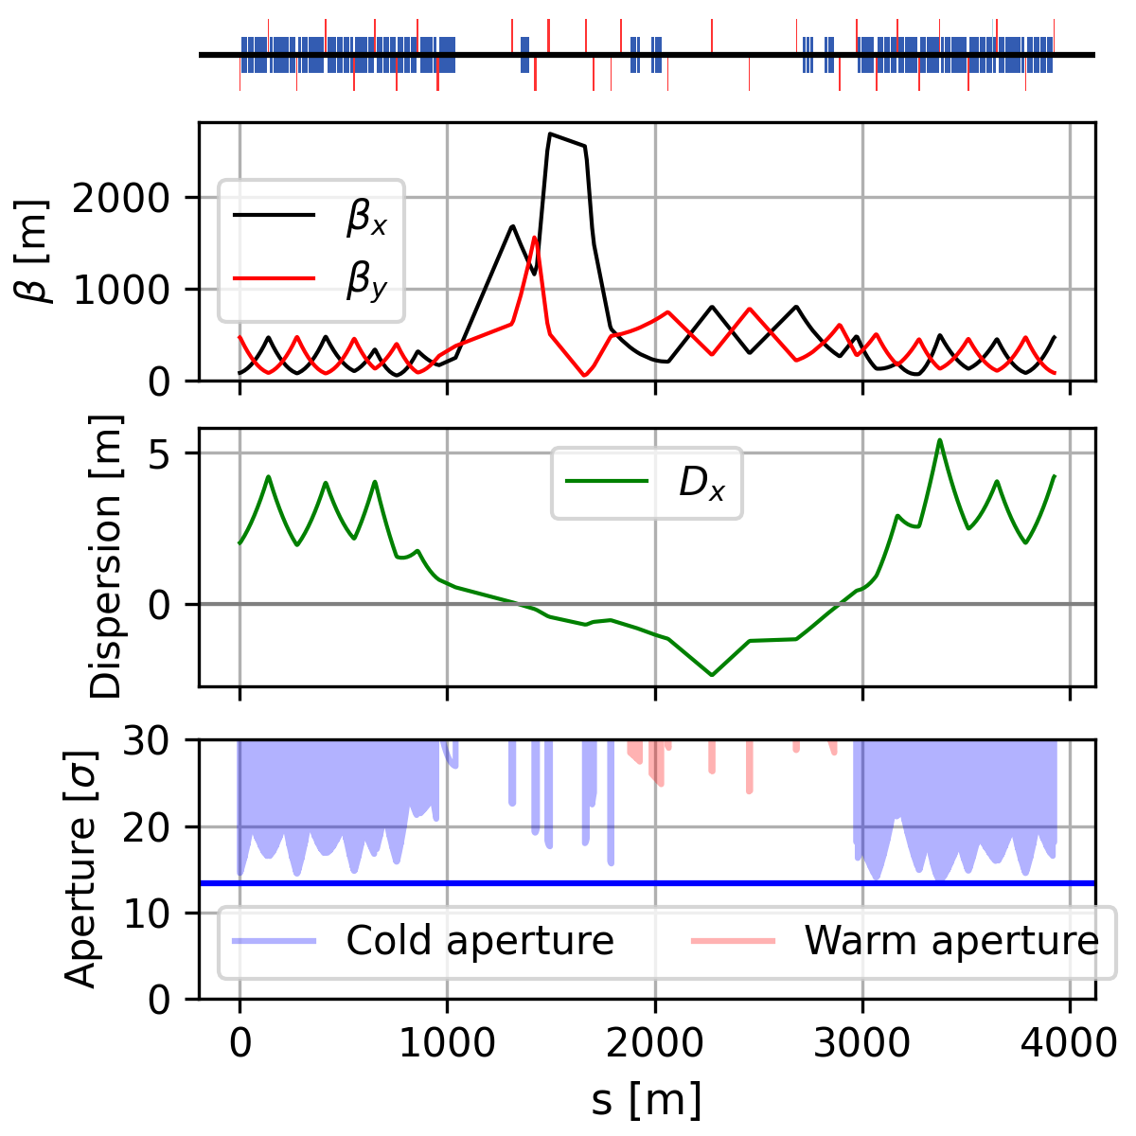
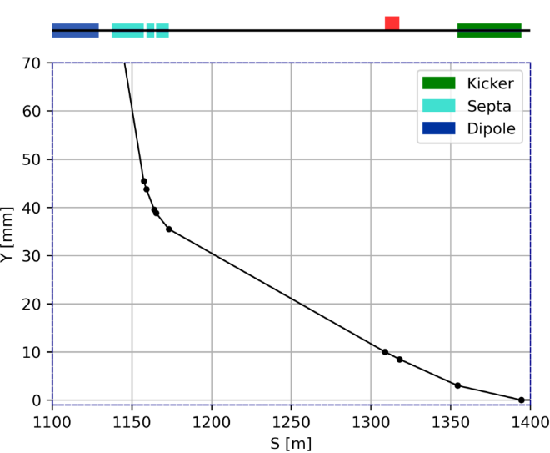
22nd May 2025 FCC Week
Gustavo Pérez Segurana
8
Injection beam 1 & momentum collimation – PB
Additional constraints for injected beam
Injection and collimation systems separated by matching section.
Iterated on the design of PB.
Fewer quadrupoles are required.
Homogenized magnet families.

Slide 9
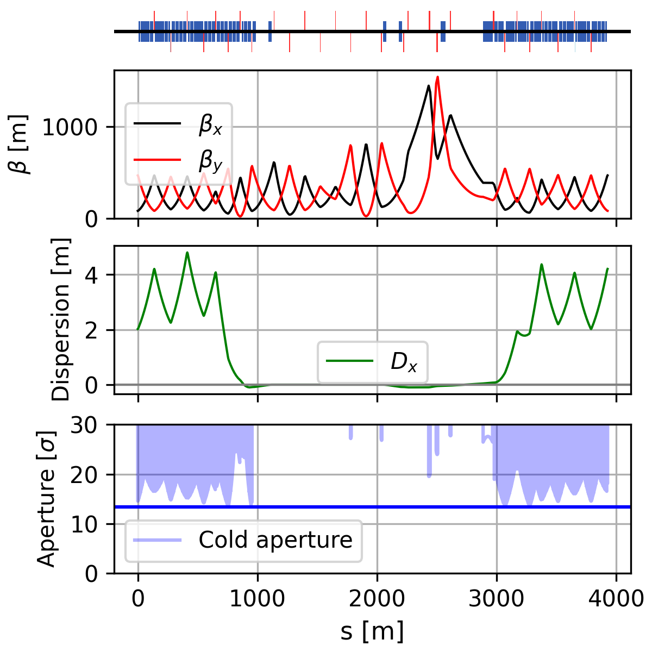
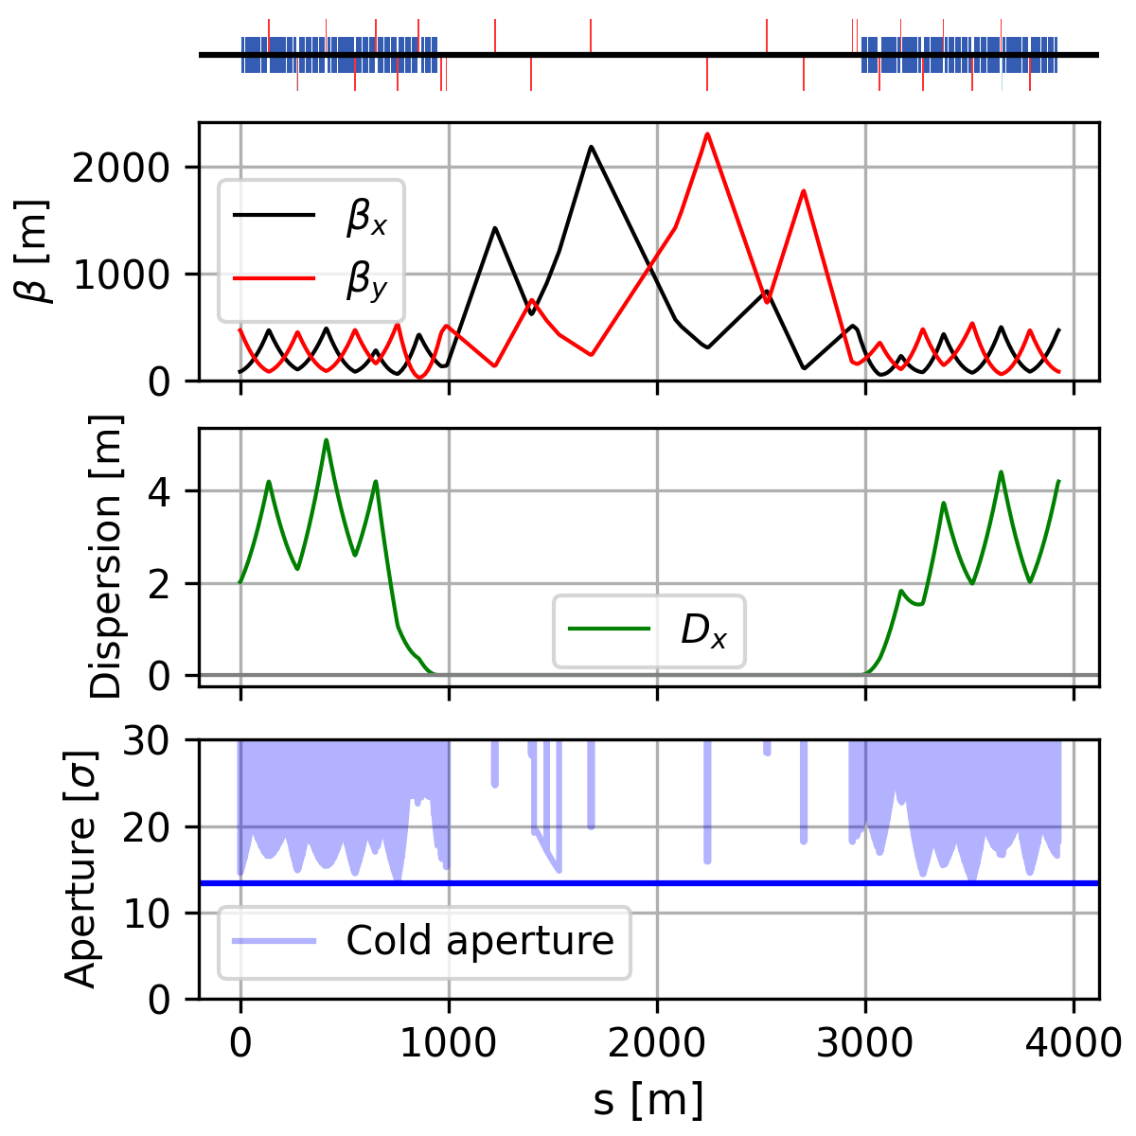
Injection beam 2 and RF – PL
22nd May 2025 FCC Week
Gustavo Pérez Segurana
9
Beam dump – PF
Transition from injection to collision tunes rematching dispersion suppressors
Increased inter-beam distance for RF cavities in dispersion free region
Increased inter-beam distance for RF elements
Large reduction in the number of quadrupoles

Slide 10
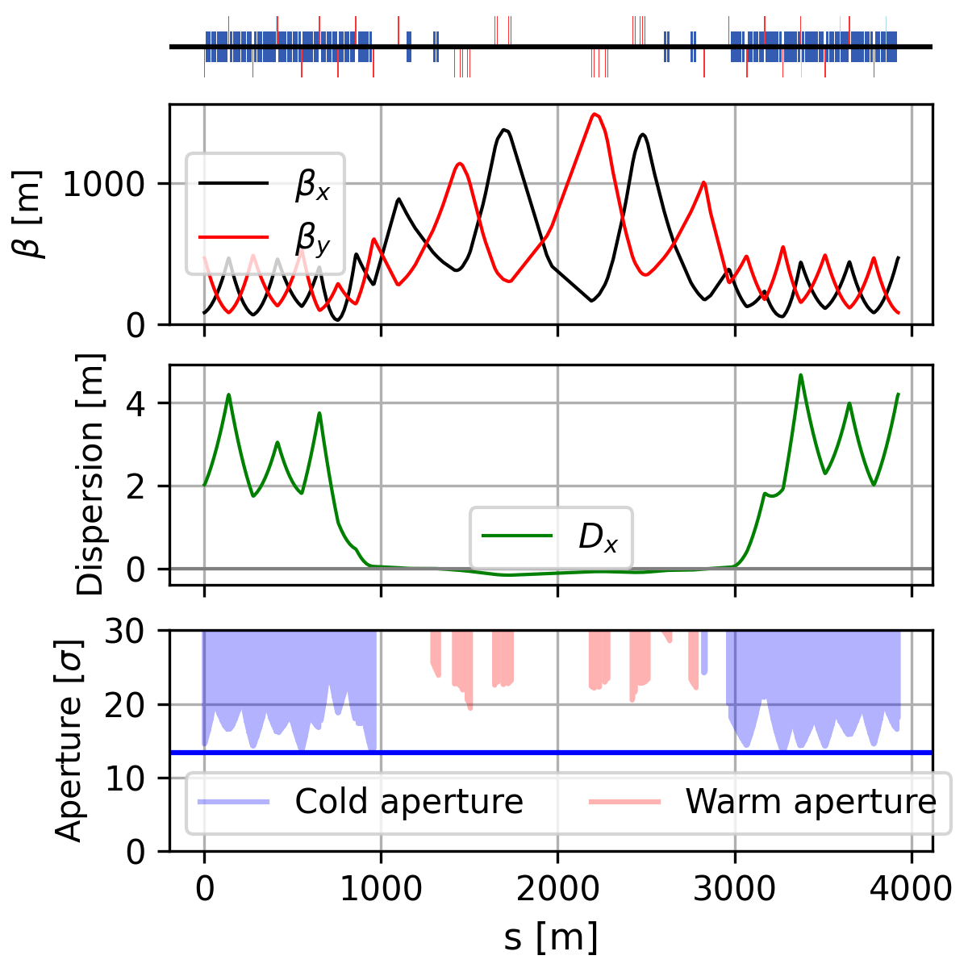
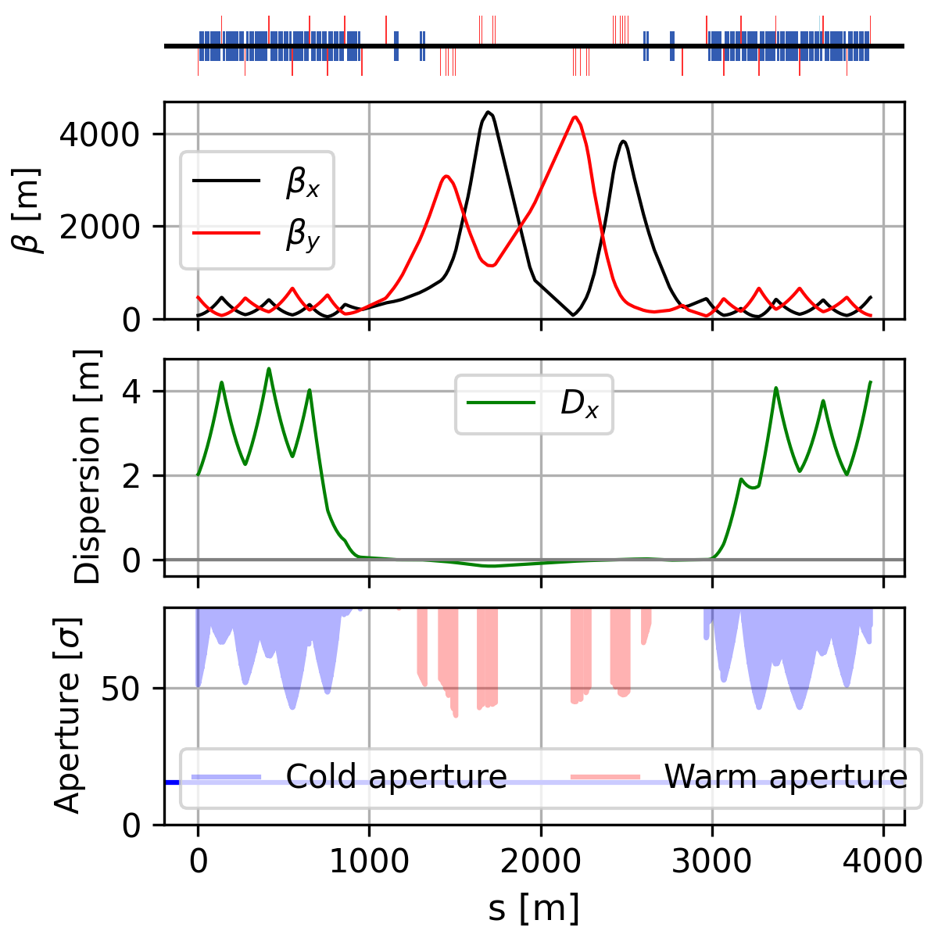
Betatron collimation – PH
22nd May 2025 FCC Week
Gustavo Pérez Segurana
10
High beta collimation optics following HL-LHC studies
Low beta
Primary collimators placed in doglegs to avoid showers of neutrals hitting the coils or downstream cold magnets
High beta
Constant inter-beam distance allows shared optics between both beams

Slide 11
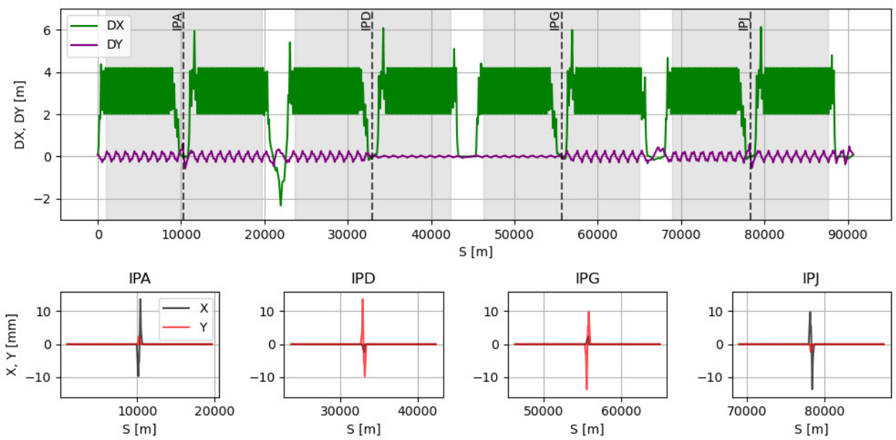
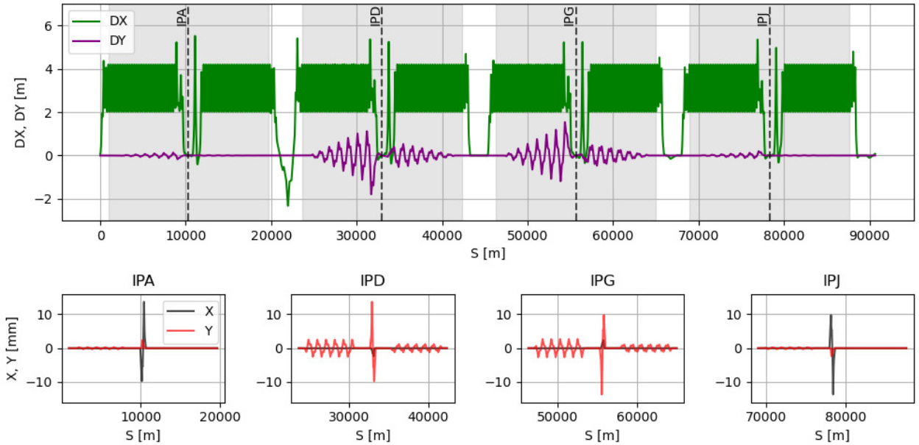
All together
22nd May 2025 FCC Week
Gustavo Pérez Segurana
11
Crossing scheme
Correction of spurious vertical dispersion
Transition from injection tunes to collision tunes
Beam clearance within specifications
Fewer magnet families
85 TeV CoM
Injection
Collision

Slide 12
Going beyond the Feasibility Study
22nd May 2025 FCC Week
Gustavo Pérez Segurana
12
Footprint reduction of short straight sections
Treat dipole length as a free parameter
Combined-function main dipoles
Increase energy at flat top

Slide 13
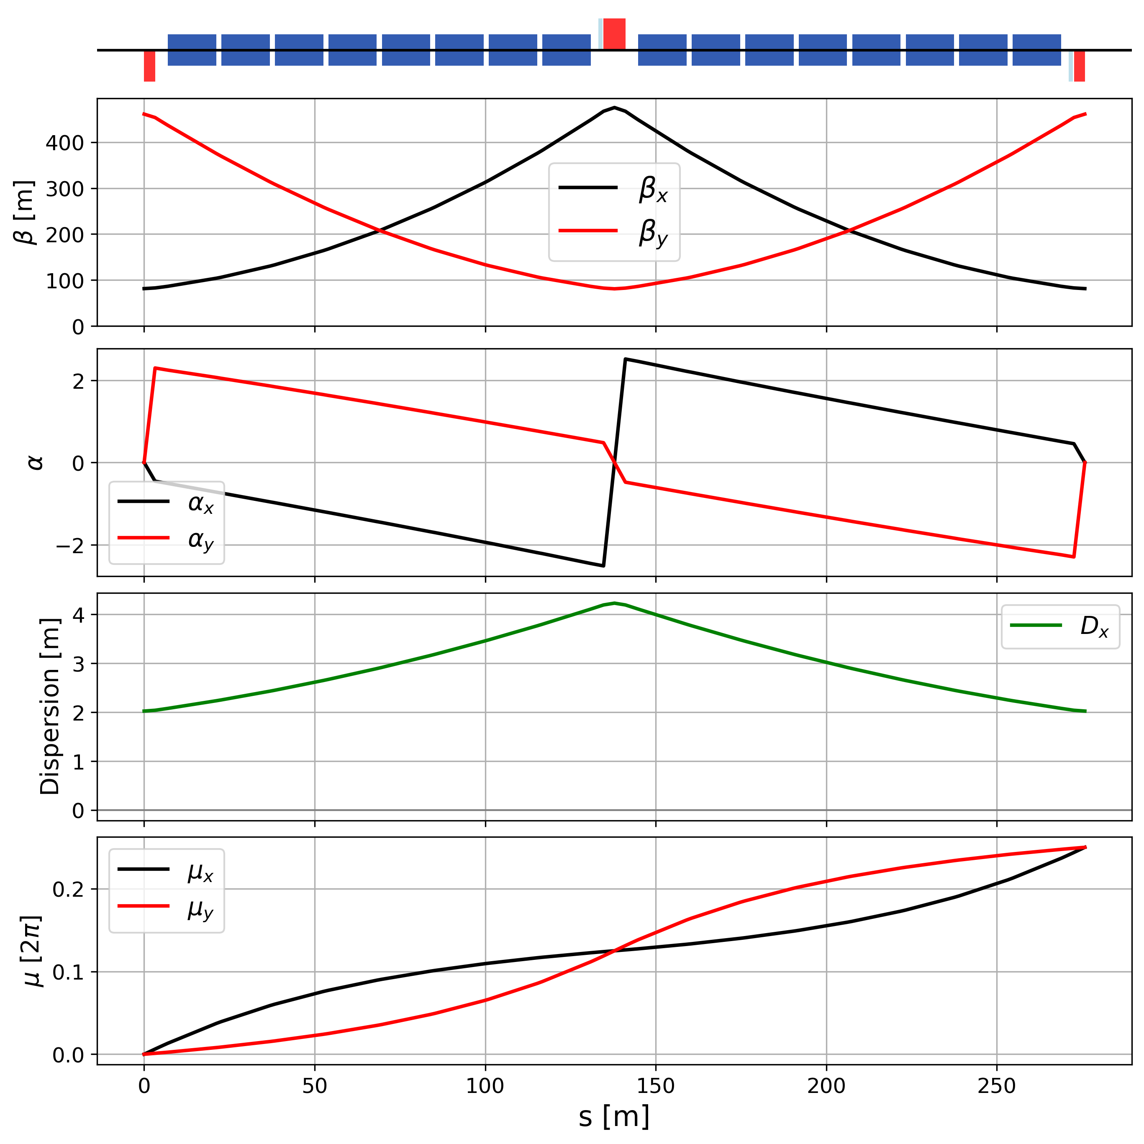
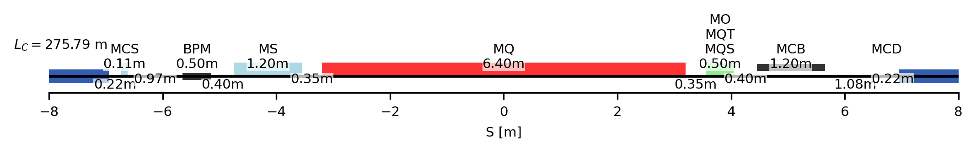
Review of short straight sections
22nd May 2025 FCC Week
Gustavo Pérez Segurana
13
Landau octupole
Trim quadrupole
Skew quadrupole
Main quadrupole
Orbit corrector
Spool sextupole
Main sextupole
Spool decapole
Arcs with fewer longer cells have less short straight sections and fewer corrector slots.
However, higher $β$-functions and dispersion make correctors more efficient!

Slide 14

Review of short straight sections
22nd May 2025 FCC Week
Gustavo Pérez Segurana
14
Main quadrupole
Orbit correctors & main sextupoles
Longer cells require lower gradient.
6.4 m to 4.1 m $^{∗}$
Modest increase of dipole corrector strength allows shortening while keeping the same integrated strength.
Sextupoles still able to correct chromaticity
  1.2 m to 1.1 m
  Nest orbit corrector with main sextupole
Trim quadrupoles, skew quadrupoles and octupoles
Able to correct tune and linear coupling.
Maintain the same amplitude detuning considered in previous studies.
0.5 m to 0.45 m
These changes have been studied in conjunction with the magnet design.
$^{∗}$ depending on the required integrated gradient
G. Perez-Segurana, E. Todesco and M. Giovannozzi, "Study of the corrector systems for the new lattice of the CERN hadron-hadron Future Circular Collider", in Proc. IPAC'24, Nashville, TN, May 2024, pp. 79-82. doi:10.18429/JACoW-IPAC2024-MOPC15

Slide 15
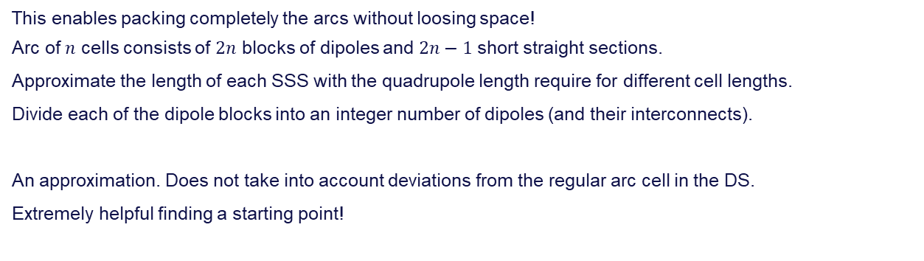
Dipole length as a free parameter
22nd May 2025 FCC Week
Gustavo Pérez Segurana
15
Outcome from last year’s FCC Week:
~14.3m was a soft-limit (transport). Followed up by the HFM forum.
Should consider longer dipoles, up to 20m.
Check impact on integration.
For now, considered up to 16m to fit within the diameter of the shaft to lower the magnets.
FS baseline (and CDR): 14.187m
This enables packing completely the arcs without loosing space!
Arc of $n$ cells consists of $2n$ blocks of dipoles and $2n−1$ short straight sections.
Approximate the length of each SSS with the quadrupole length require for different cell lengths.
Divide each of the dipole blocks into an integer number of dipoles (and their interconnects).
An approximation. Does not take into account deviations from the regular arc cell in the DS.
Extremely helpful finding a starting point!

Slide 16
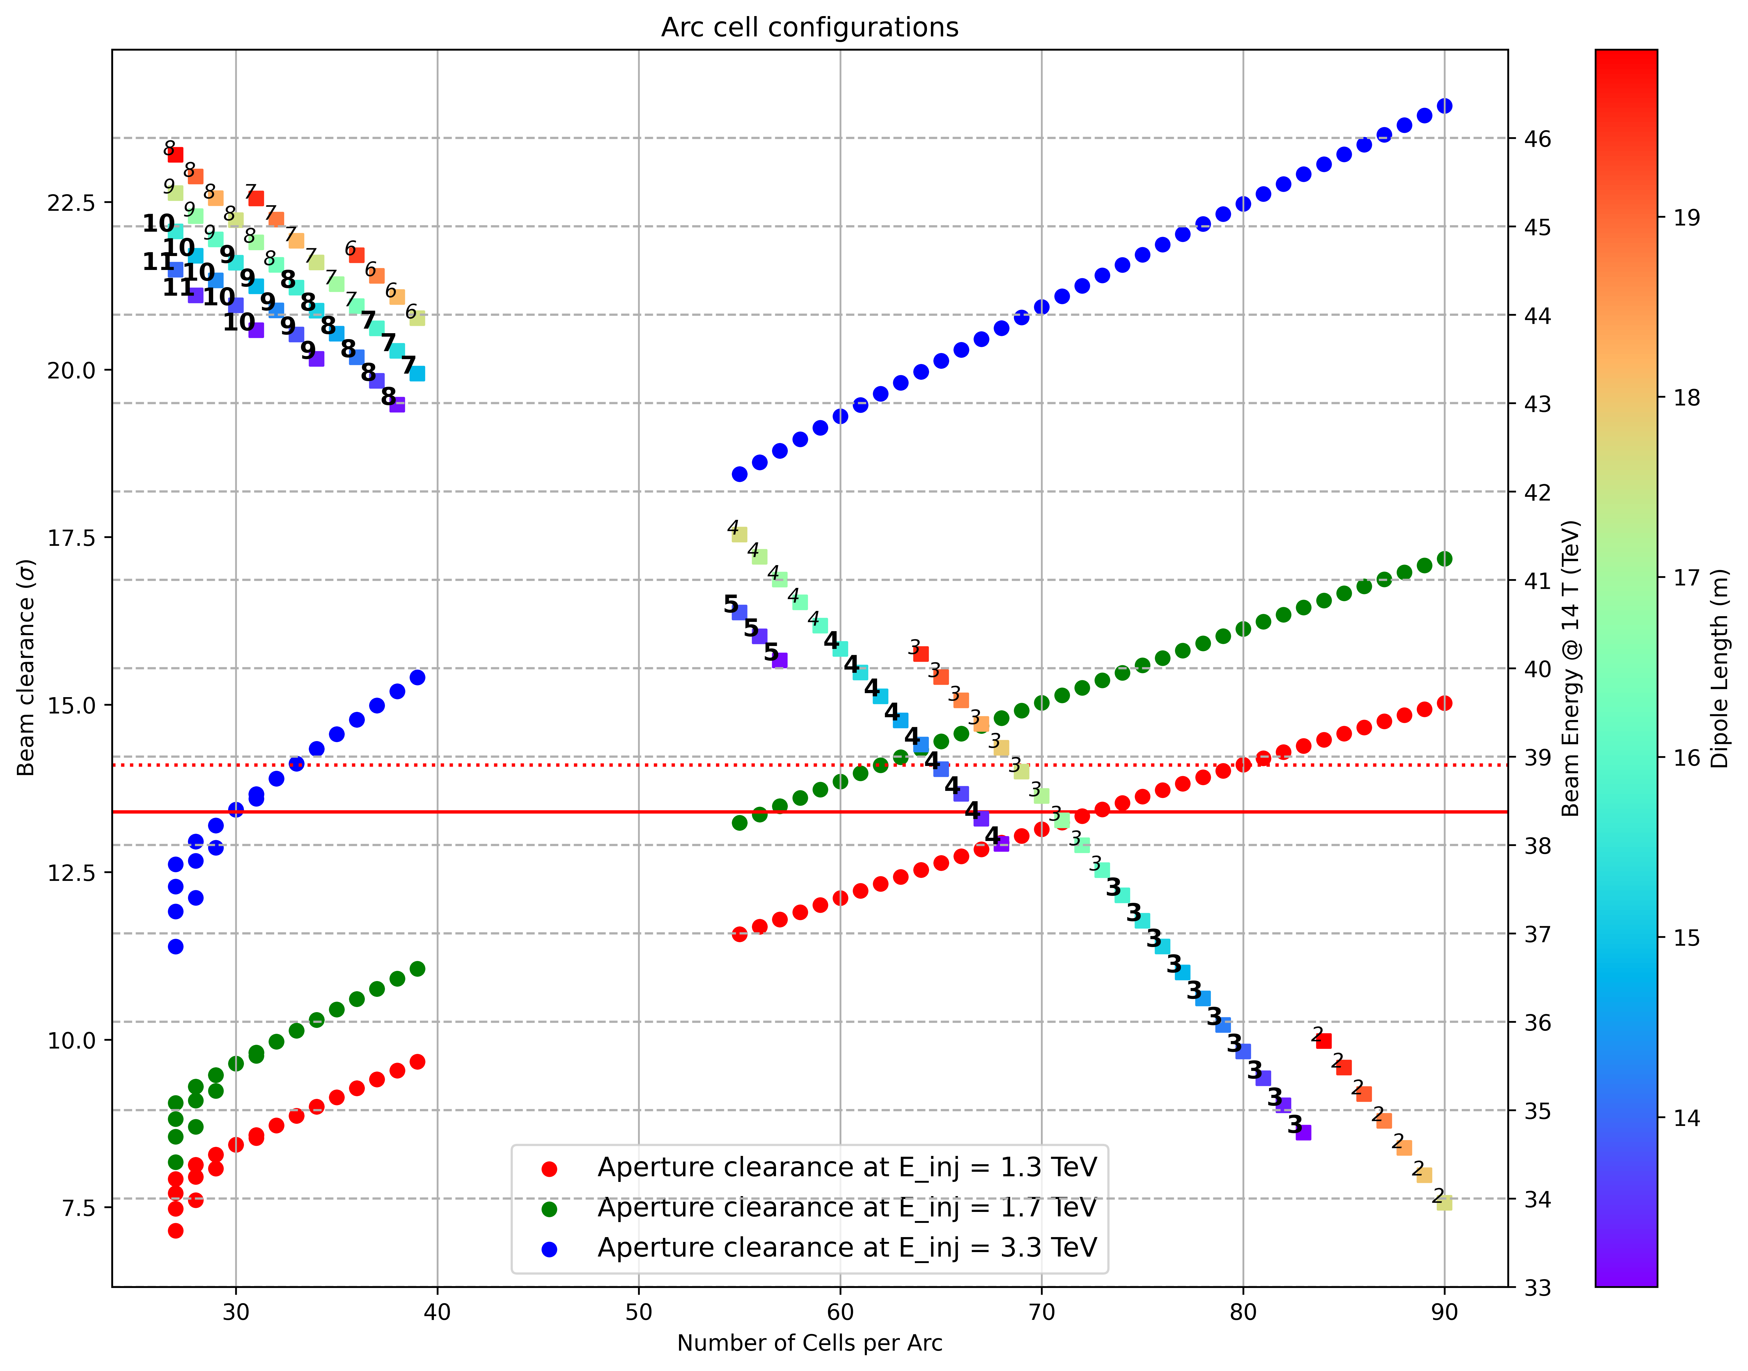
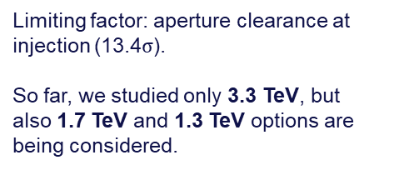



Dipole length as a free parameter
22nd May 2025 FCC Week
Gustavo Pérez Segurana
16
FS baseline: 14.187m
Candidate solutions per injection energy
3.3 TeV
1.7 TeV
Closest to FS report
# MB/half-cell
$$≤16 m$$
$$>16 m$$
1.3 TeV
Flat top energy
Limiting factor: aperture clearance at injection (13.4$σ$).
So far, we studied only 3.3 TeV, but also 1.7 TeV and 1.3 TeV options are being considered.
14.1$σ$
lowest I’ve been able to match DS
13.4$σ$
limit
An approximation. Does not take into account deviations from the regular arc cell in the DS.

Slide 17
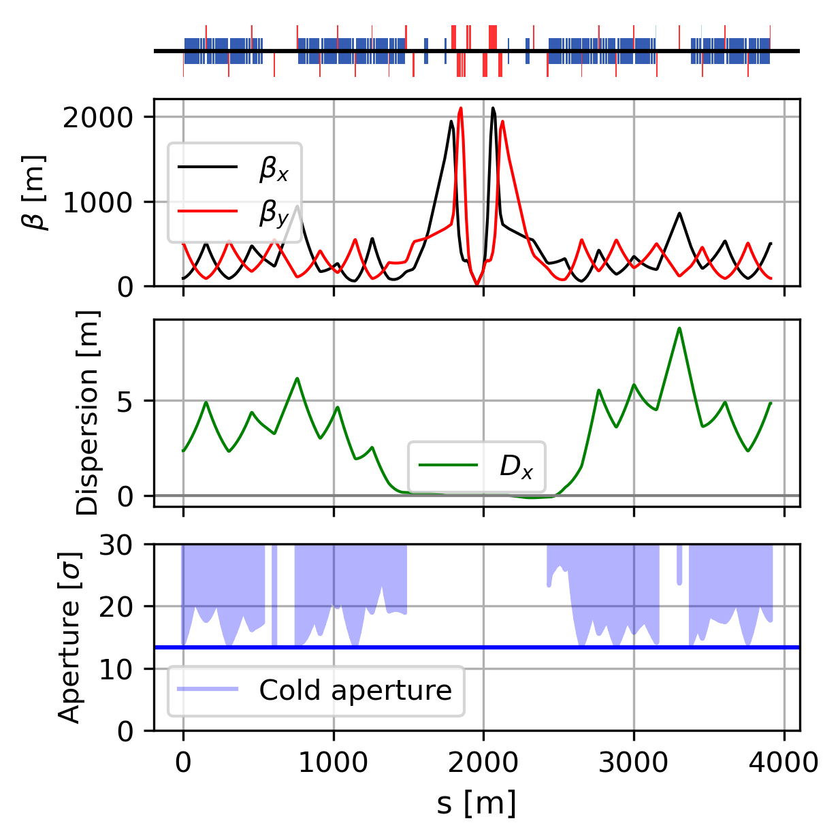
Dipole length as a free parameter + new SSS
22nd May 2025 FCC Week
Gustavo Pérez Segurana
17
Initial optics matching - PA
Start the study of this lattice by matching the experimental insertions. Technical insertions to be done next.
Reduce last 3 half-cells to 6-dipoles and redistribute the dipole length trough the arc.
Allow longer MQs in DS for matching flexibility.
Replicate radial IP shift.
Replace lone MQ12s by a pair of MQYs (aperture)
In previous designs, matching the experimental insertions has been the most challenging due to the absorption of Q6 and Q7 into the DS.
Justifies the margin in aperture when considering the regular arc…
Work in Progress
4128 Dipoles, 15.99 m and shortened SSS
44.1 TeV, 88.2 TeV CoM @14 T
FS report: 84.6 TeV CoM @14 T

Slide 18
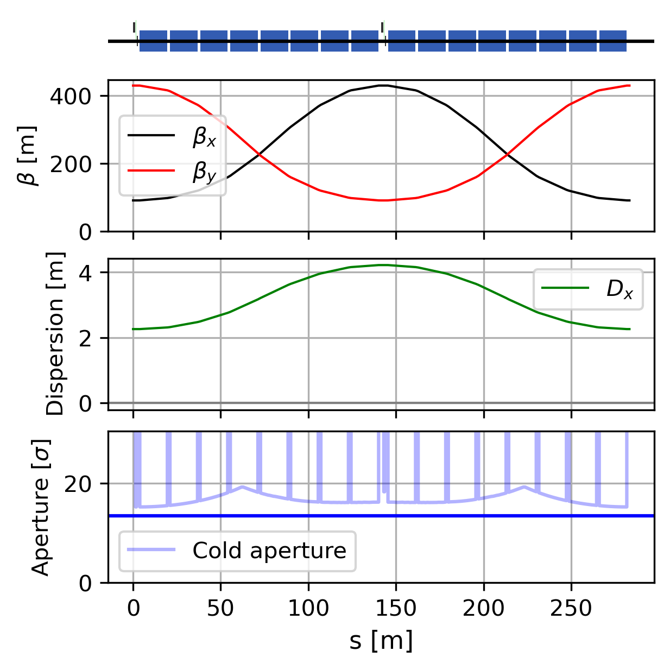
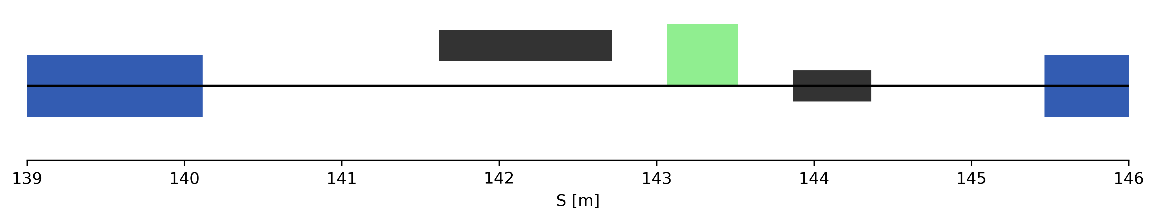
Combined-function arc cells
22nd May 2025 FCC Week
Gustavo Pérez Segurana
18
Same number of focusing and defocusing dipoles: only even number of dipoles per half cell.
Short straight section still has slots for correctors
Orbit corrector
+
Main sextupole
Landau octupole /
Trim quadrupole /
Skew quadrupole
MB
BPM
MB
Short Straight Section
Giovannozzi, M., Todesco, E. Combined-function optics for circular high-energy hadron colliders. Eur. Phys. J. Plus 137, 361 (2022). https://doi.org/10.1140/epjp/s13360-022-02583-0
Giovannozzi, M. Considerations on combined-function optics for high-energy storage rings and colliders. EPJ Techn Instrum 9, 5 (2022). https://doi.org/10.1140/epjti/s40485-022-00081-2

Slide 19
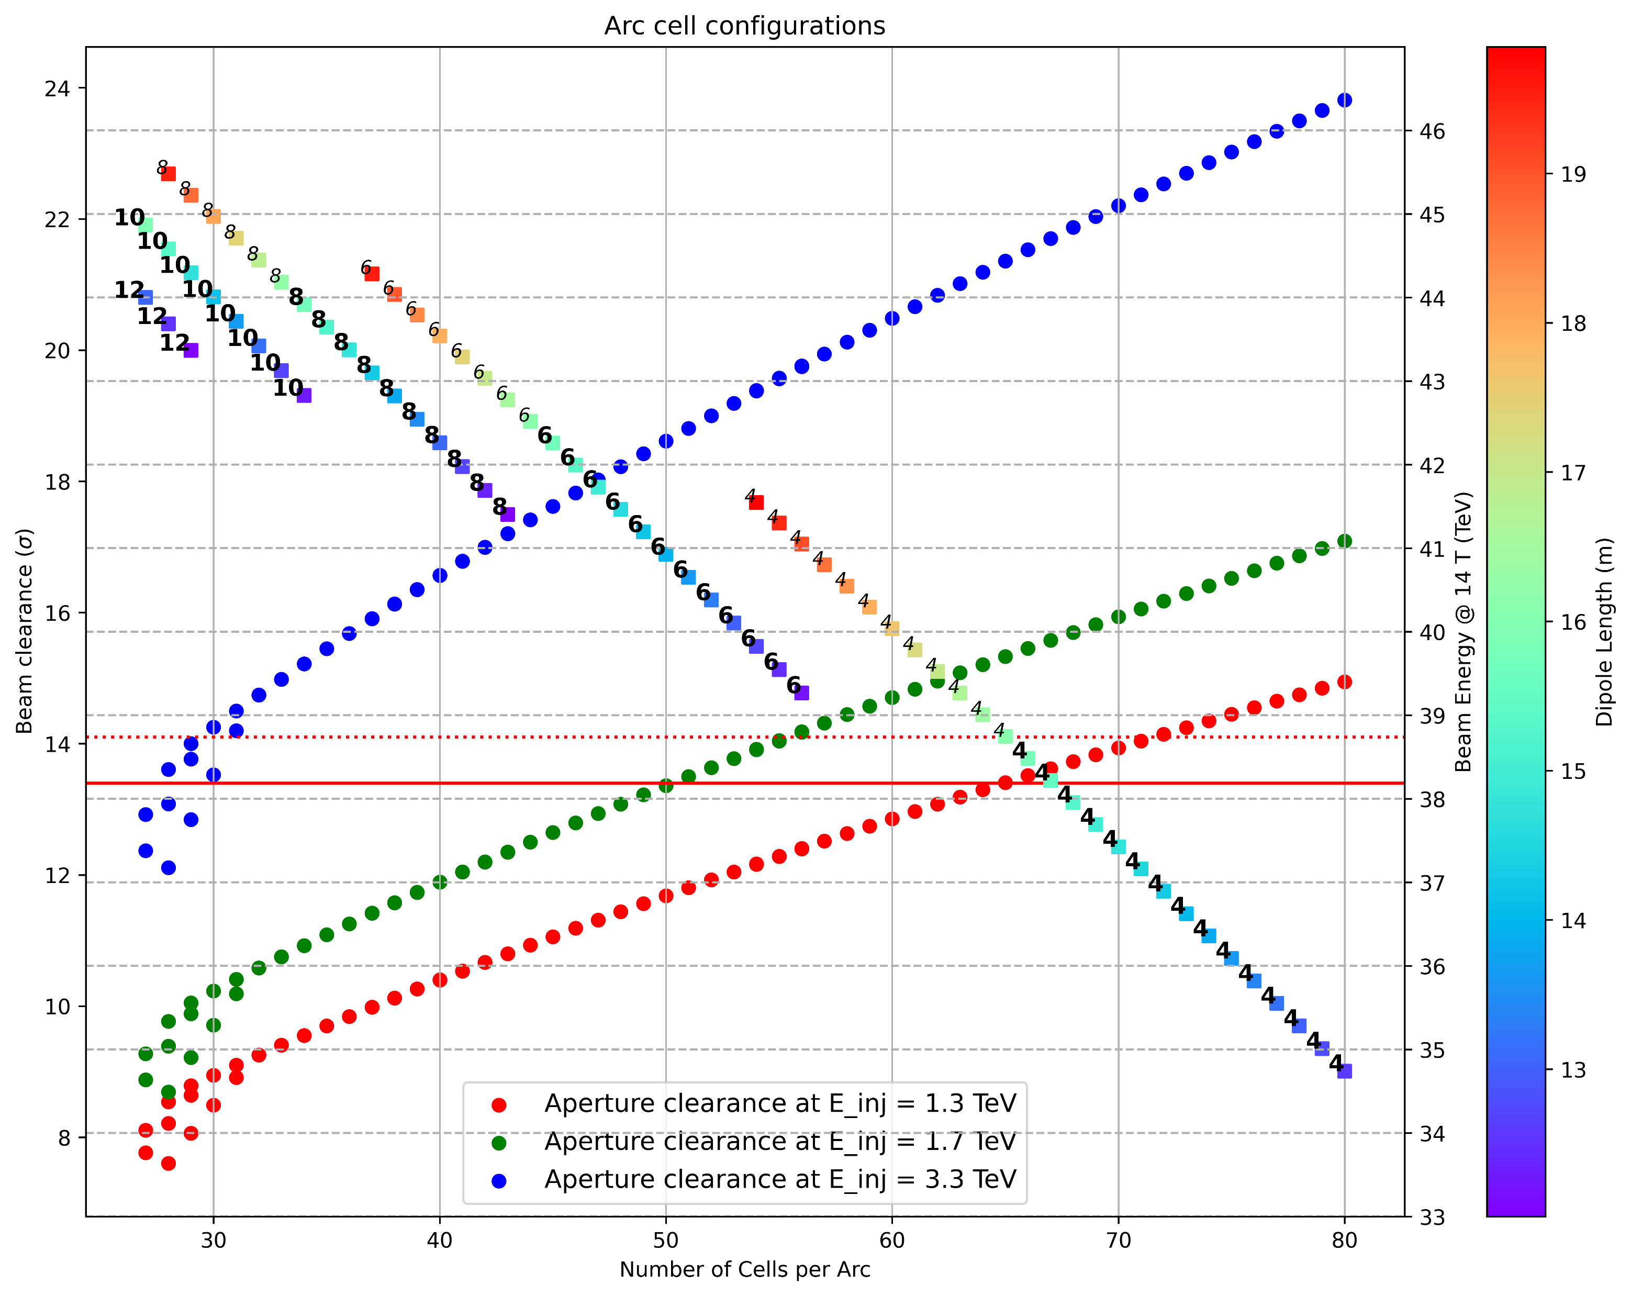
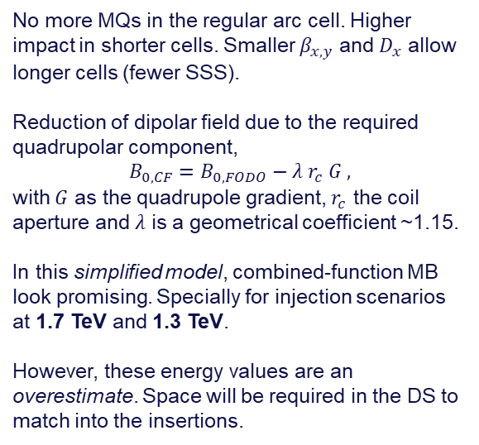

Dipole length as a free parameter
+ combined-function
22nd May 2025 FCC Week
Gustavo Pérez Segurana
19
Candidate solutions per injection energy
3.3 TeV
1.7 TeV
1.3 TeV
No more MQs in the regular arc cell. Higher impact in shorter cells. Smaller $β_{x,y}$ and $D_{x}$ allow longer cells (fewer SSS).
Reduction of dipolar field due to the required quadrupolar component,
$$B_{0,CF}=B_{0,FODO}−λ r_{c} G ,$$
with $G$ as the quadrupole gradient, $r_{c}$ the coil aperture and $λ$ is a geometrical coefficient ~1.15.
In this simplified model, combined-function MB look promising. Specially for injection scenarios at 1.7 TeV and 1.3 TeV.
However, these energy values are an overestimate. Space will be required in the DS to match into the insertions.
# MB/half-cell
$$≤16 m$$
$$>16 m$$
Flat top energy
E. Todesco and M. Giovannozzi, “Combined-function optics for the lattice of the CERN hadron-hadron Future Circular Collider ring”, in Proc. IPAC'23, Venice, Italy, May 2023, pp. 594-597. doi:10.18429/JACoW-IPAC2023-MOPL032

Slide 20

Dipole length as a free parameter
+ combined-function
22nd May 2025 FCC Week
Gustavo Pérez Segurana
20
Combined-function
Separate function
# MB/half-cell
$$≤16 m$$
$$>16 m$$
Flat top energy

Slide 21
Conclusions and next steps
22nd May 2025 FCC Week
Gustavo Pérez Segurana
Baseline design as presented in the feasibility study represents a complete lattice, with a significant recovery in CoM energy thanks to the meticulous optimisation carried out in the last few years.
Most of the conclusions about performance, rely heavily on results from the CDR era (beam-beam, dynamic aperture, …). Some, extrapolations from HL-LHC studies (aperture requirements).
Launched several exploratory studies seeking the greatest impact.
  Maximize utilization of the length of the arcs freeing the length of the main dipole.
  Lattices based on combined-function dipoles. Beam dynamics implications to be studied.
Next milestones
  Full ring optics with new dipole length and short SSS.
  Determine potential of combined-function lattice.
Beam dynamics studies (beyond lattice design) should be undertaken in the future.

Slide 22
Thank you for your attention.
Gustavo Pérez Segurana

