Slide 1






Tl-1223 Superconducting Films for Beam Screen Coatings in FCC: Synthesis and Performance Validation
Emilio Bellingeri

Slide 2



OUTLINE
    Project
    Why Thallium-based?
    Phase diagram study
    Precursor coating deposition and reaction
    Structural characterization
    DC and RF superconducting properties
    High vacuum compatibility
    Conclusions
Notes:
I will start by outlining the project, then proceed to explain the reasons behind the study of Thallium and describe our collaboration. Finally, in the second part, I will discuss the development of this material that we carried out.

Slide 3








FCC beamscreen projects @SPIN
First project: Tl based HTS preparation
              PI Emilio Bellingeri
              Addendum FCC-GOV-CC-0049 (EDMS1580502, KE3112)
New project: New project for assessing Tl (1223) superconducting coating feasibility
              PI Alessandro Leveratto
      Addendum FCC-GOV-CC-0217 (KE5072/TE)
2016-2019
2021- 2024
Sample preparation, structural characterization, DC measurements, theory
Alessandro Leveratto, Aisha Saba, Cristina Bernini, Federico Matteo, Cialone, Ruggero Vaglio
Accelerator environment compatibility, theory
Marcel Himmerlich, Bernard Henrist ,Stephanie Fernandez-Peña Mauro Taborelli, Guillaume Rosaz, Sergio Calatroni, Massimo Giovannozzi
RF measurements
Andrea Alimenti, Alessandro Magalotti, Nicola Pompeo, Kostyantin Torokhtii, Pablo Vidal García, Enrico Silva
Structural and Transport Characterization: TEM, SEM, EBSD, Jc (T, B), SHPM,…
Sigrid Holleis, Florian Semper Michael Eisterer
Andreas Steiger-Thirsfeld , Johannes Bernardi

Slide 4
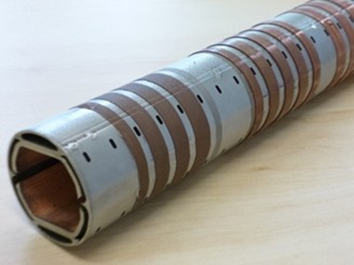
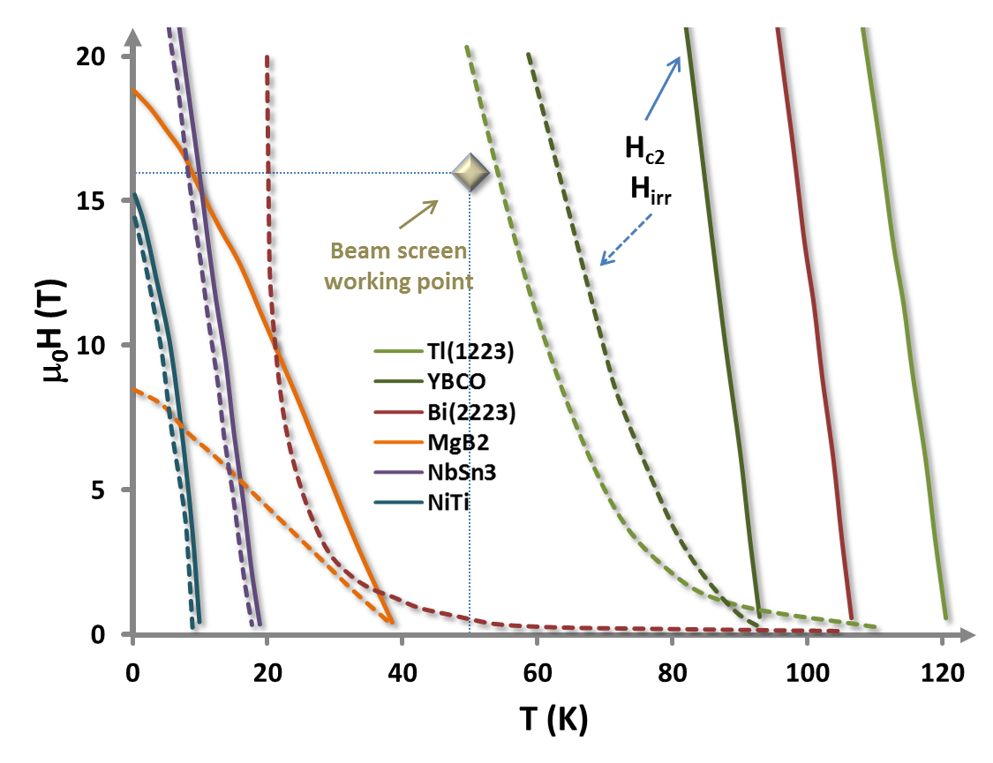
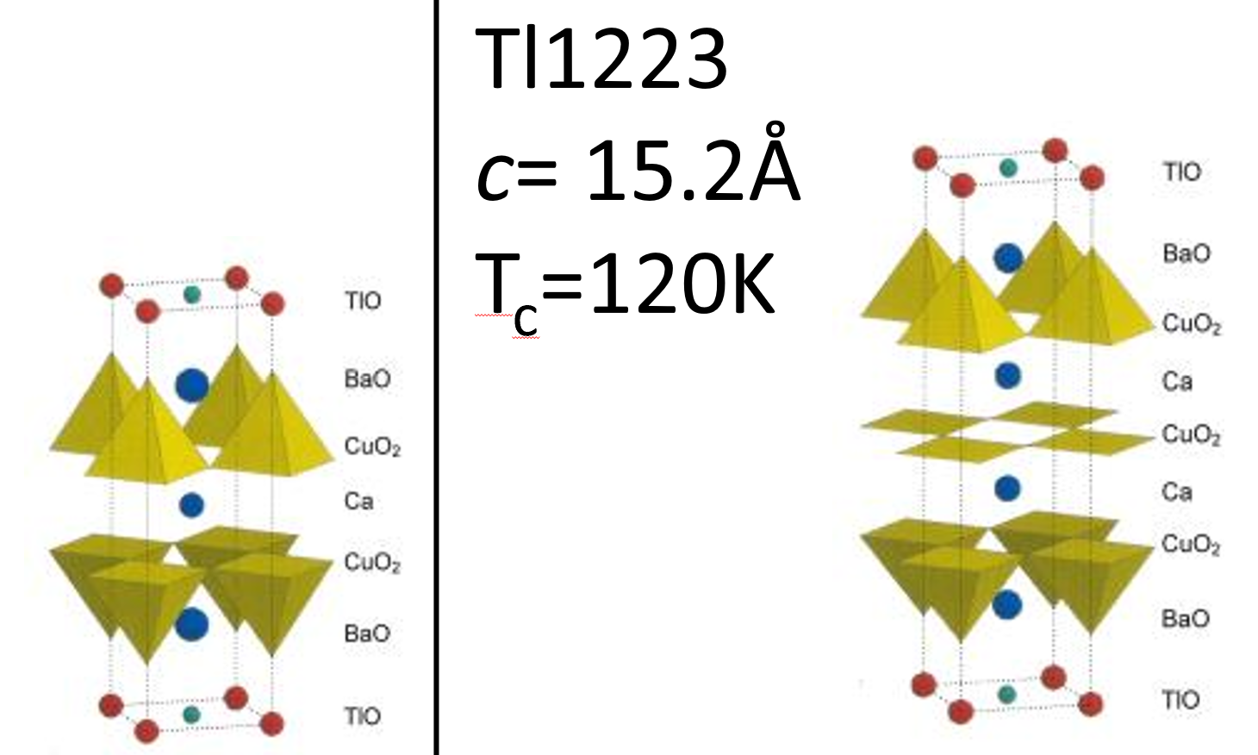

In FCC-hh Beam screen is foreseen to work at T>50K. The surface resistance of copper at 50 k may not be sufficiently low to guarantee a safe operational margin for the fcc-beams (in particular at injection energy).
Idea: superconducting coating!
Work condition:
B=14 T (or 16 T)
T=50K (or 100 K)
Jc > 10⁴ Acm⁻²
$$ν≈1GHz$$
ReBCO (Cu1212)
Tl1212
c=12.7Å
T_{c}=80 108K
T = 50 B = 16 T
ν = 1GHz 100 TeV High syncrotron
radiation intensity

Slide 5
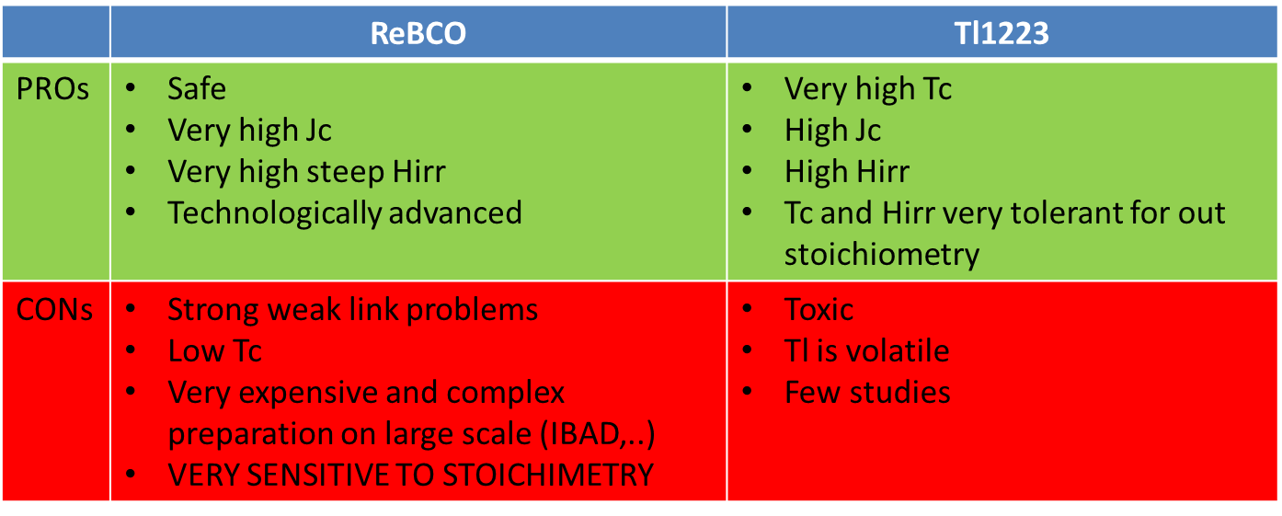
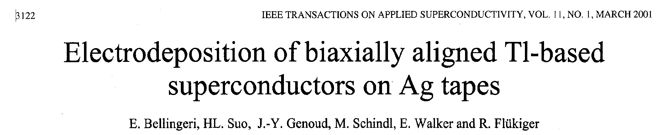
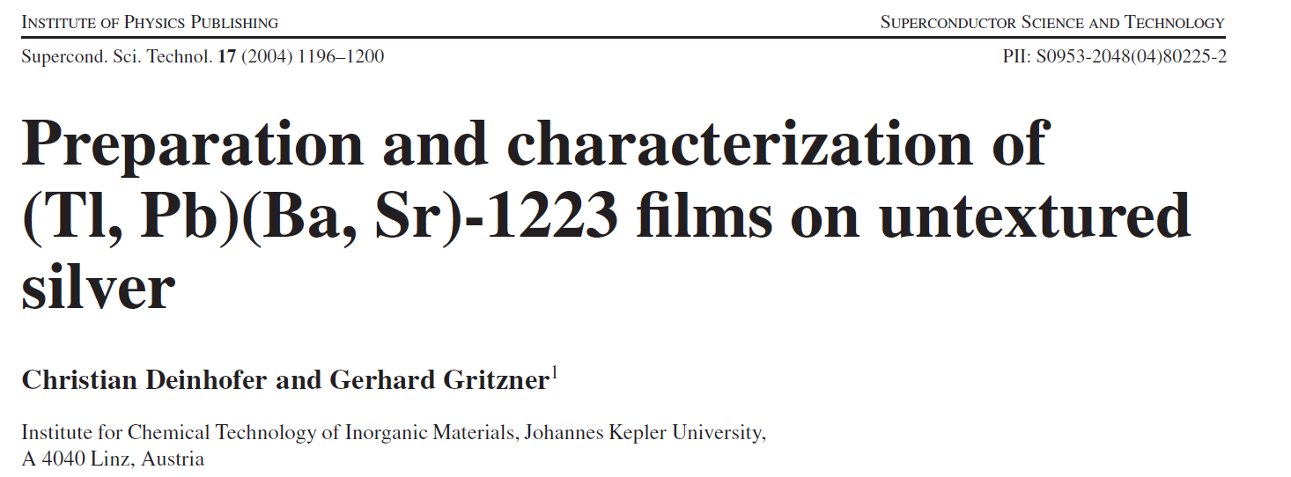

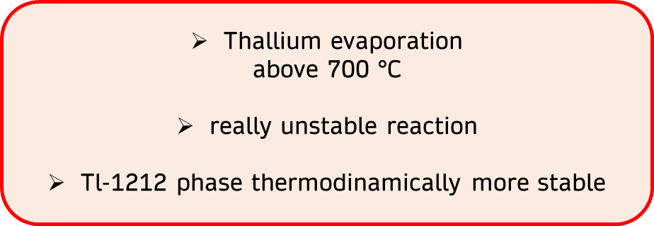
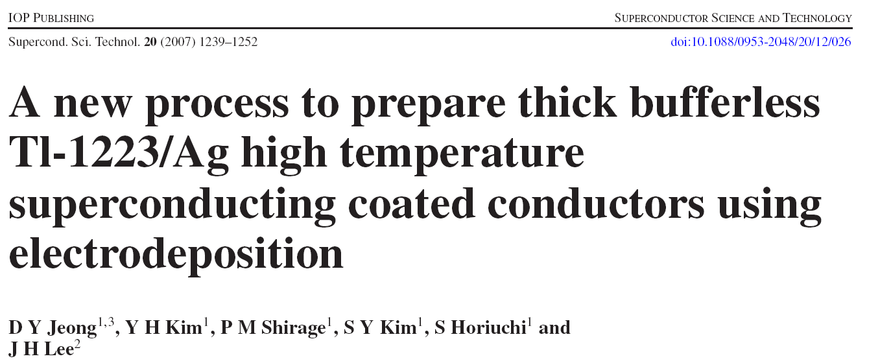
Why Thallium-1223 ?
E. Bellingeri et al. IEEE 2001
G. Gritzner et al. SUST 2004
D.Y. Jeong et al SUST 2007
Already demonstrated the possibility to deposit via electrochemistry thanks to the high out-of-stoichiometry tolerance with respect to RE-123
Cheap and scalable technique, which could be considered for a direct deposition on tubes or arbitrarily shaped templates
Tc ~ 120 K

Slide 6

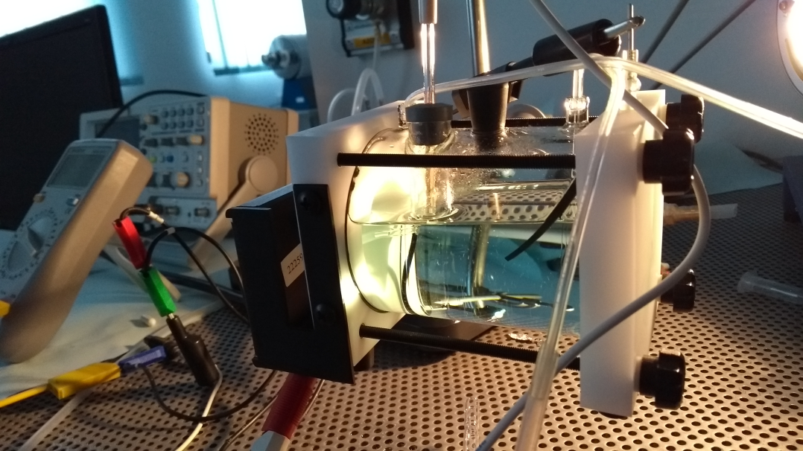
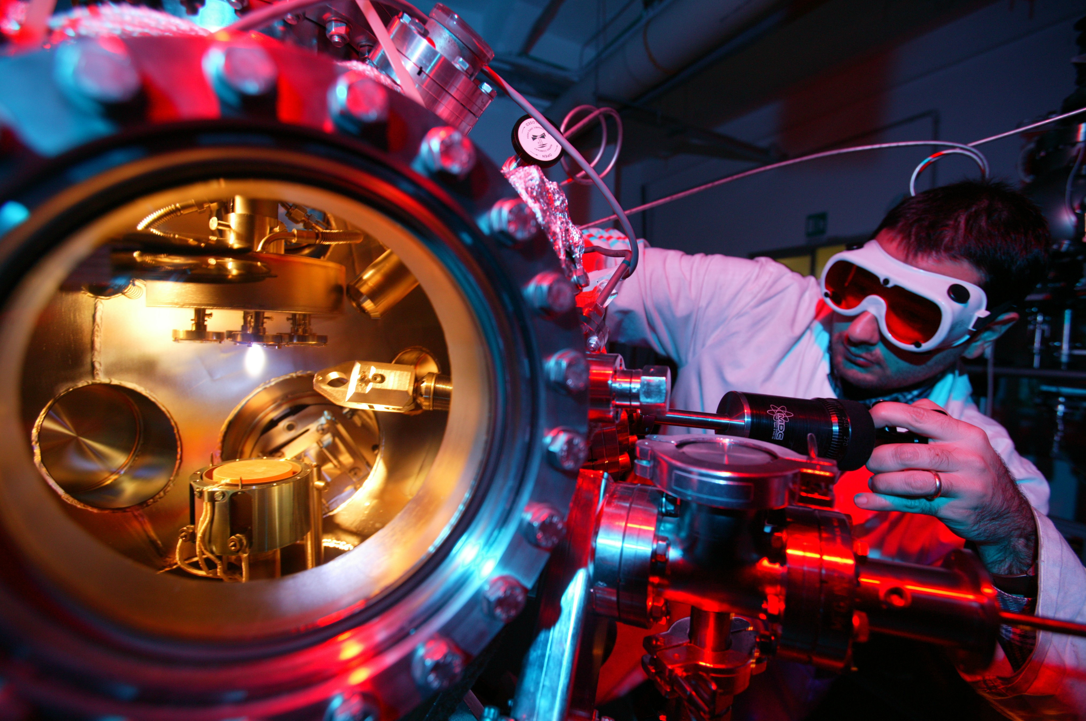
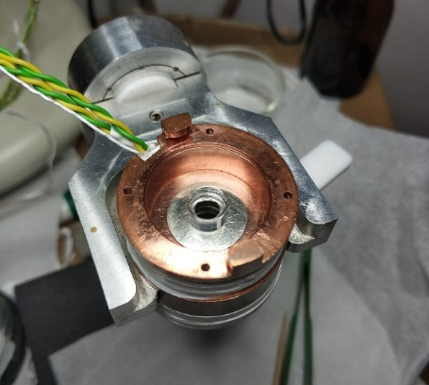
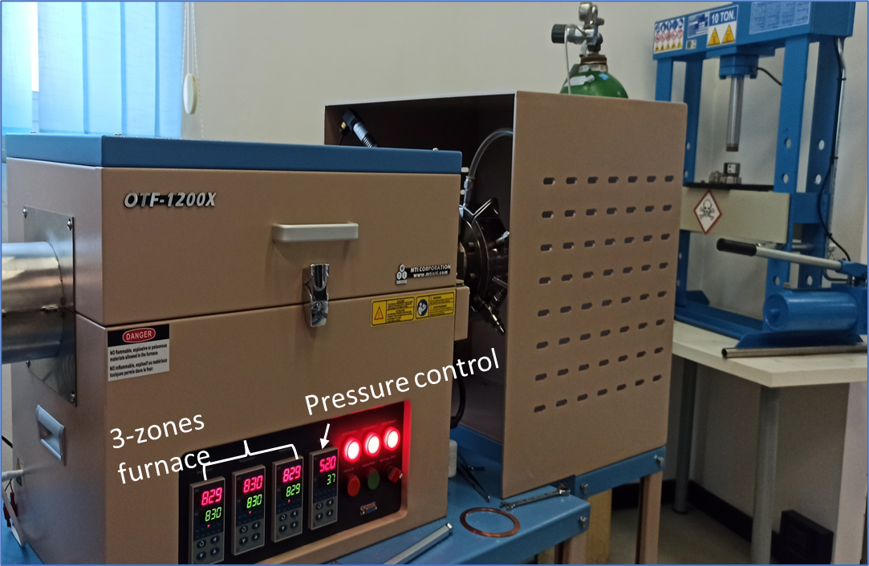
TOXIC LAB CONSTRUCTION
PRECURSOR DEPOSITION
CHARACTERIZATION
POWDER AND BULKS REALIZATION
HIGH PRESSURE REACTION

Slide 7
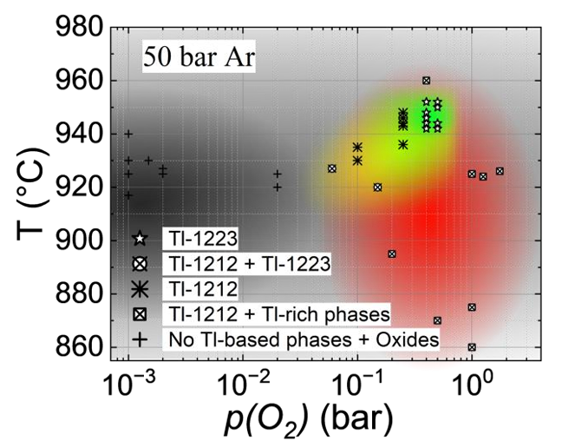
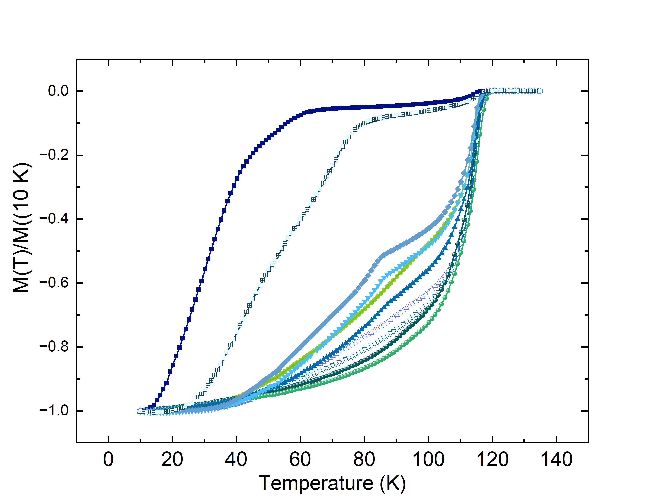
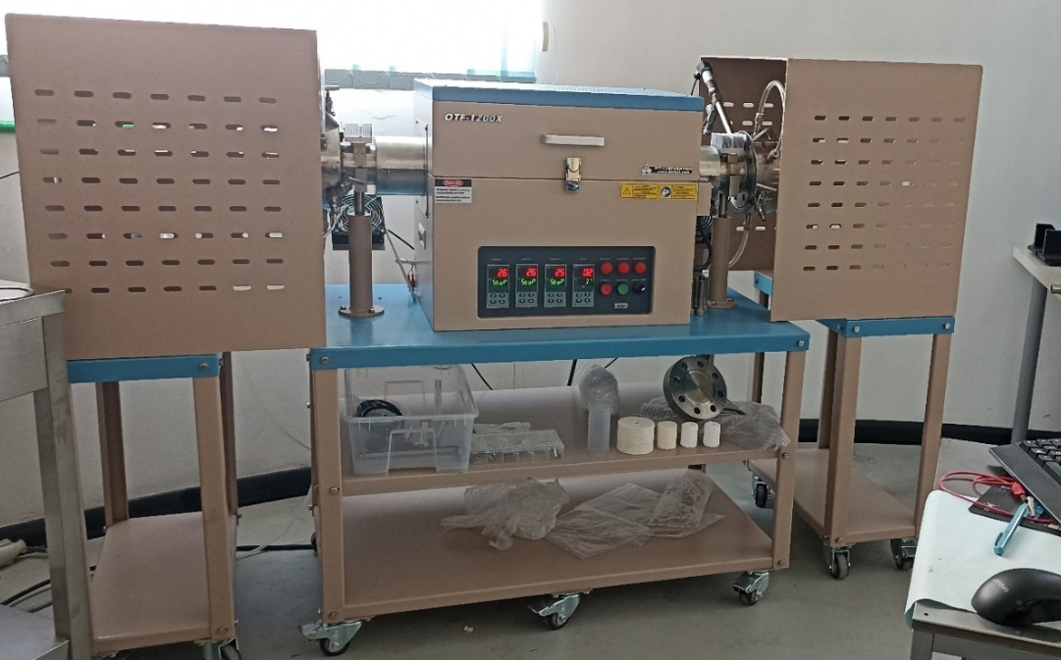
    Phase diagram study
High Ar pressure syntesis in order to prevent Tl evaporation
Tl-based cuprated
PHASE DIAGRAM STUDY
ON VARYING MANY PARAMETERS:
TEMPERATURE
INITIAL PRESSURE
FINAL PRESSURE
O₂ PARTIAL PRESSURE
938 °C
940 °C
955 °C

Slide 8
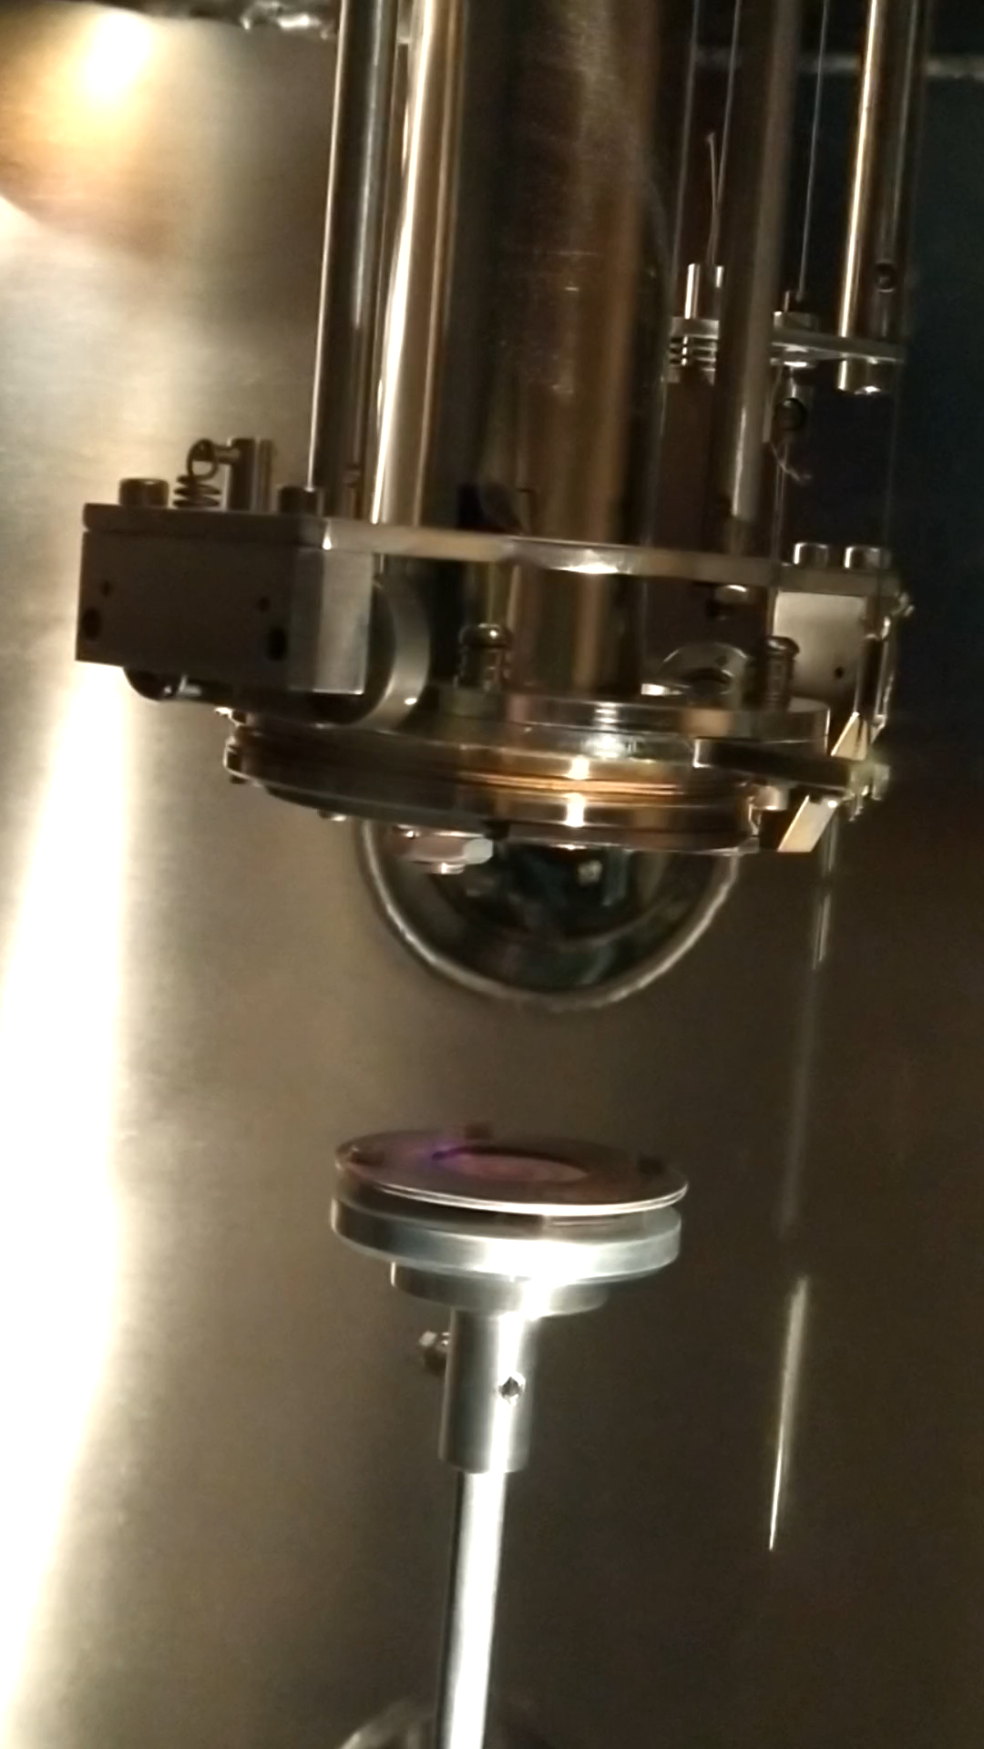
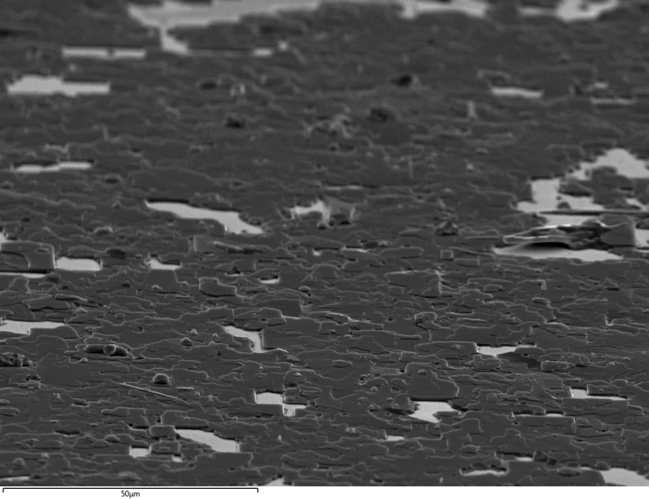
Precursos layer Reacted film
HT-HP REACTION
950 °C
50 bar Ar+ p(O2)
3 h
Nd:YAG 1064 nm
5 Hz 90 min
Substrate LAO 001
T _{substrate} = RT
p(O2) = 8.7-9.3 10⁻² mbar

Slide 9
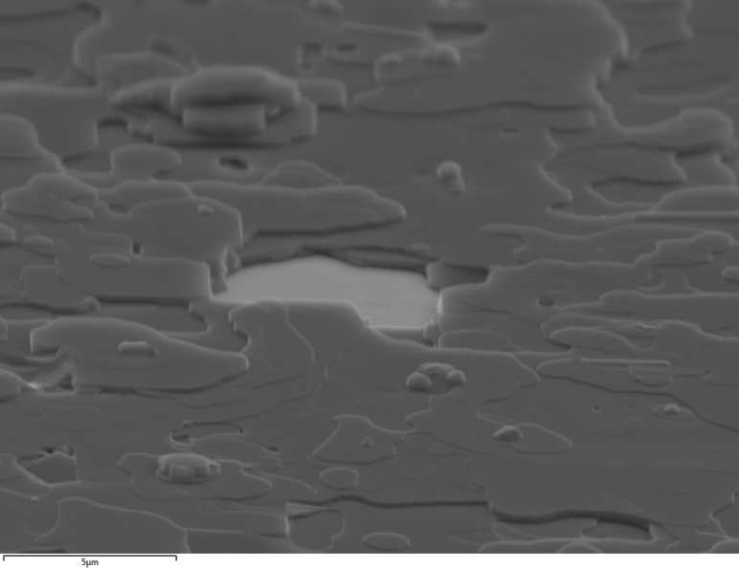
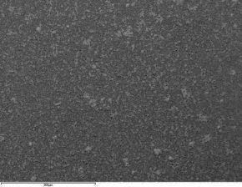
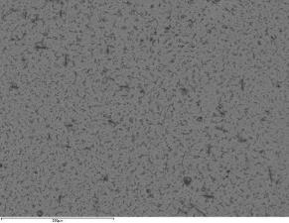
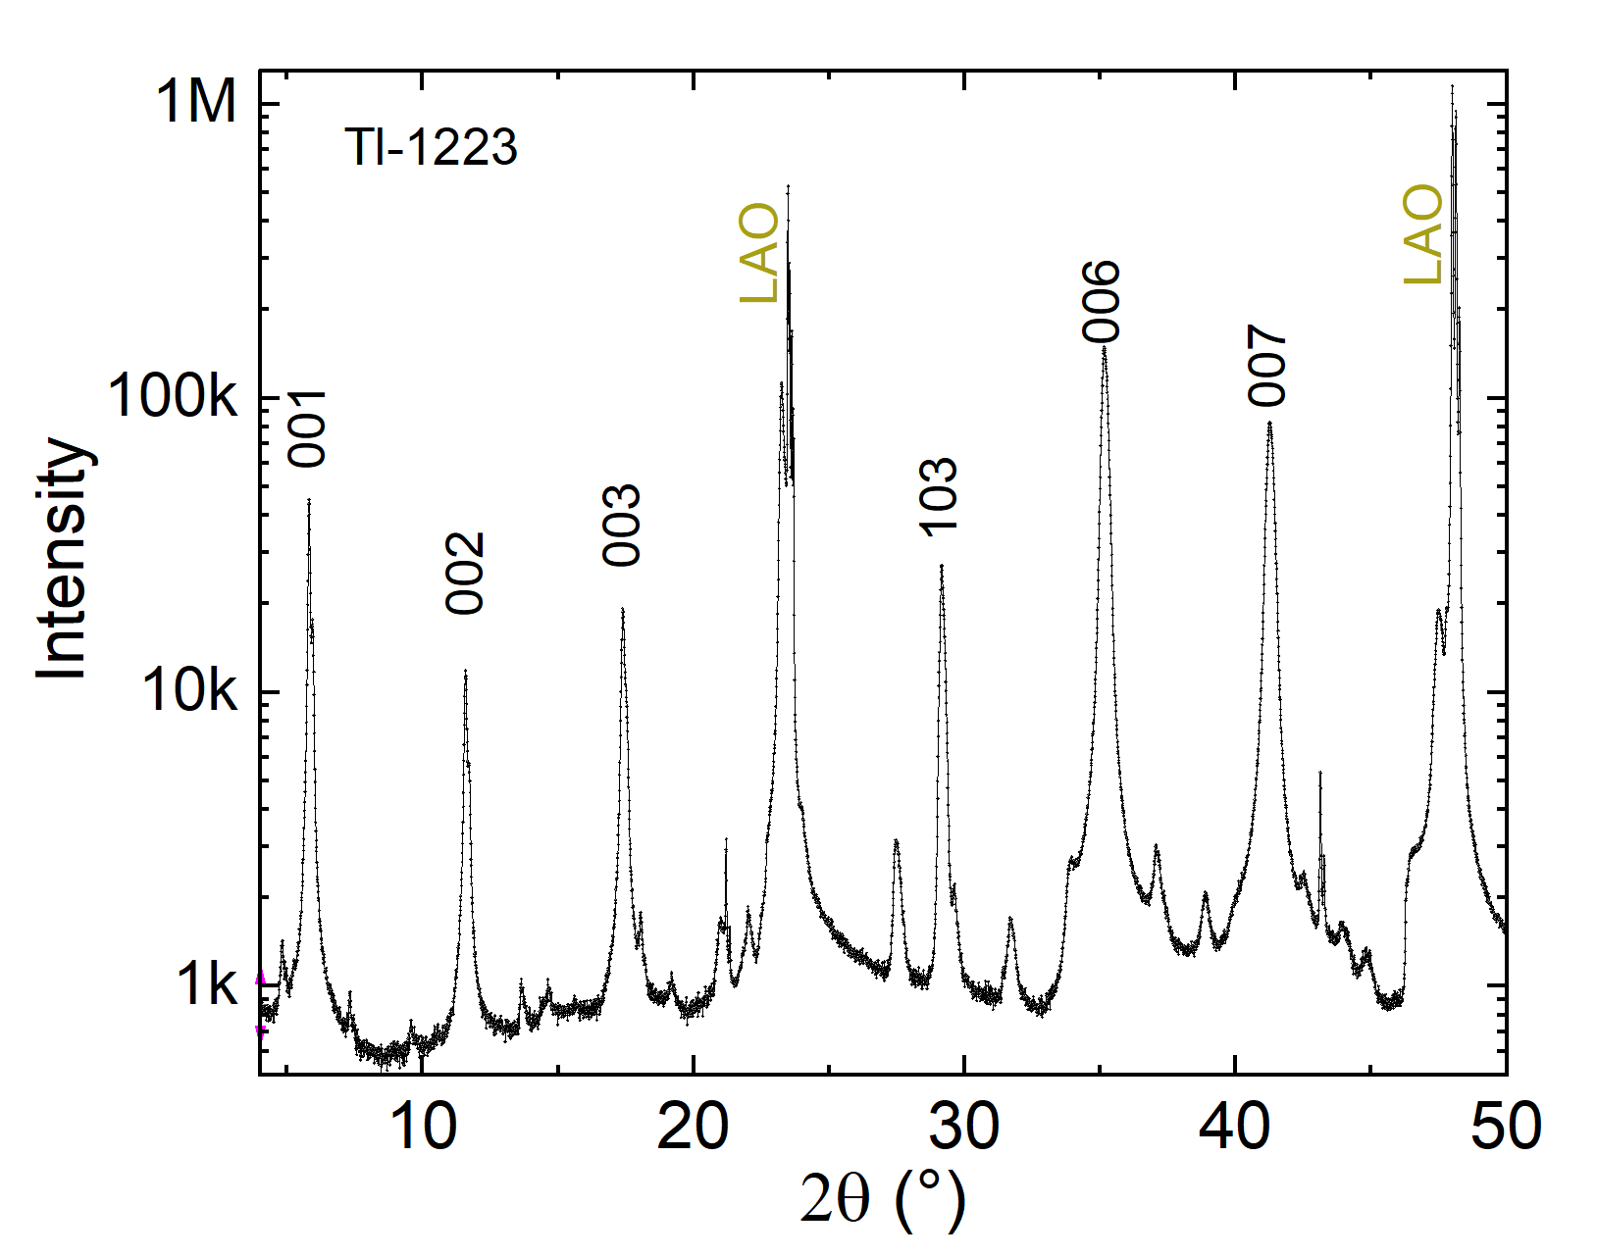
Structural properties
SE
BSE
500 µm
500 µm
FWHM= 0.6 °
Very pure Tl(1223) phase, policristalline but fully (c and ab ) oriented

Slide 10
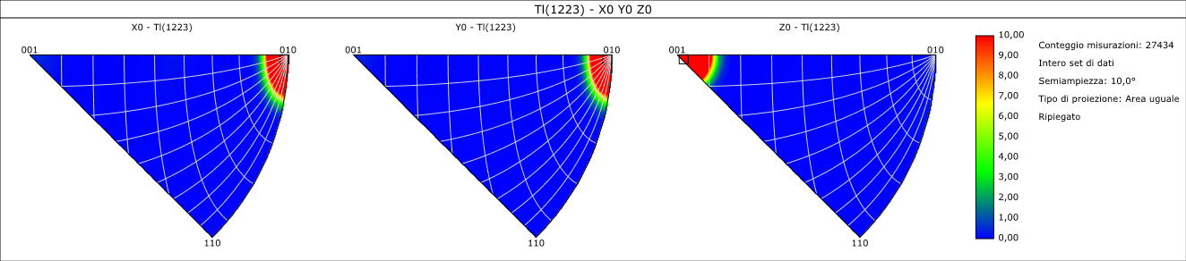
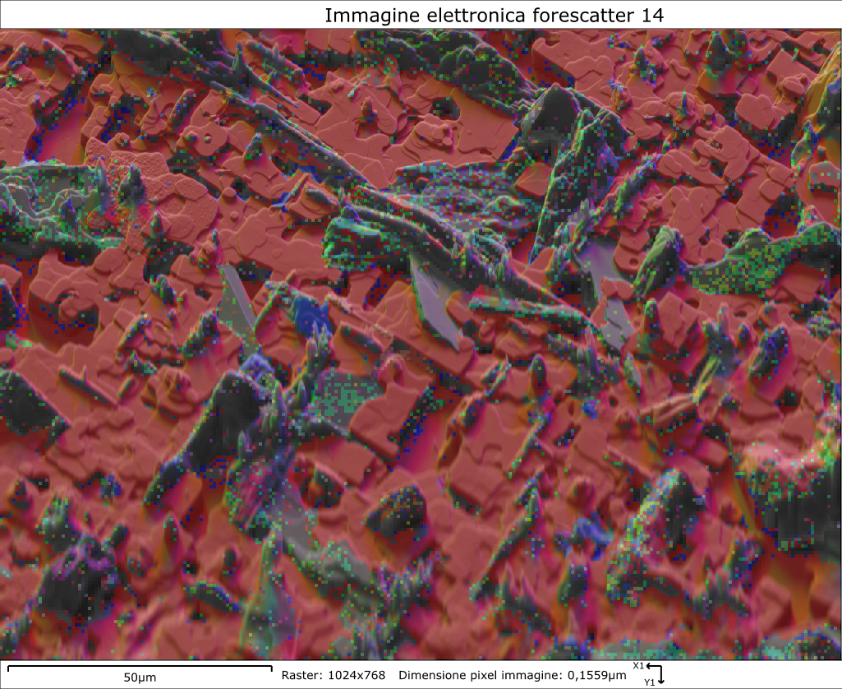
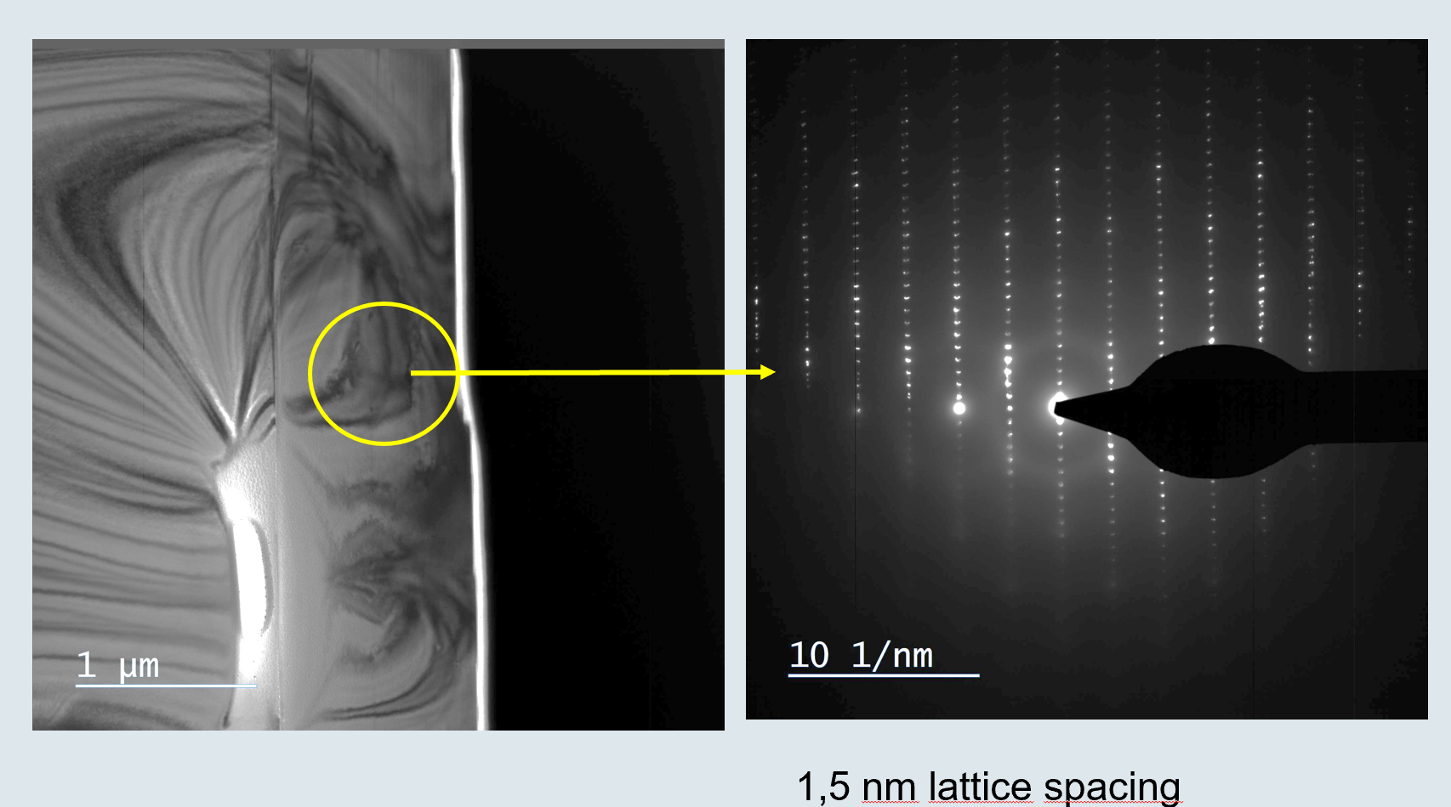
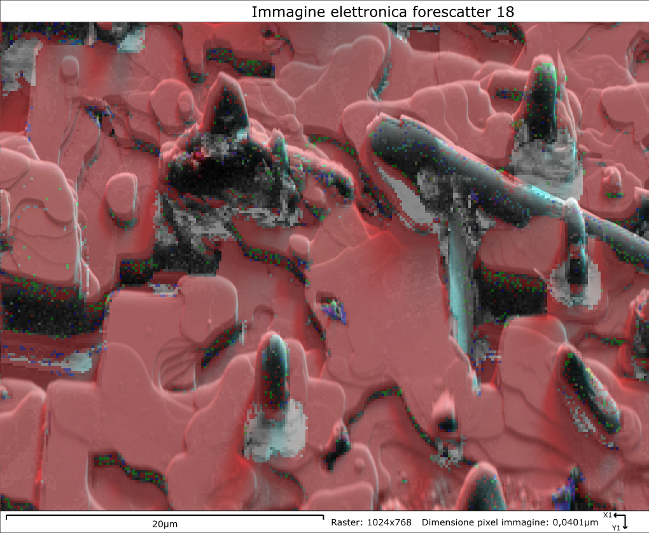
  Microscopy–SEM EBSD TEM

Slide 11
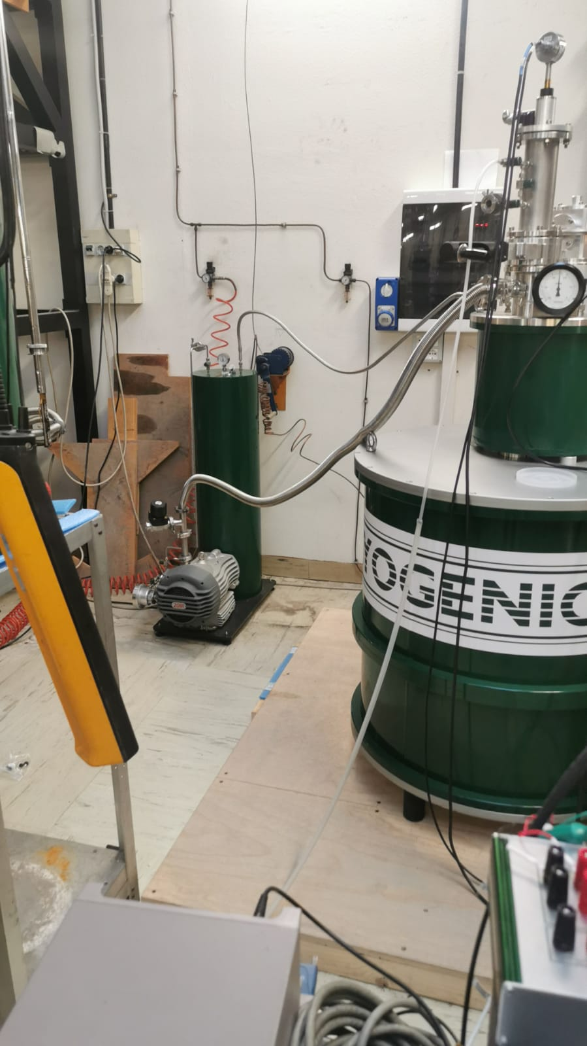
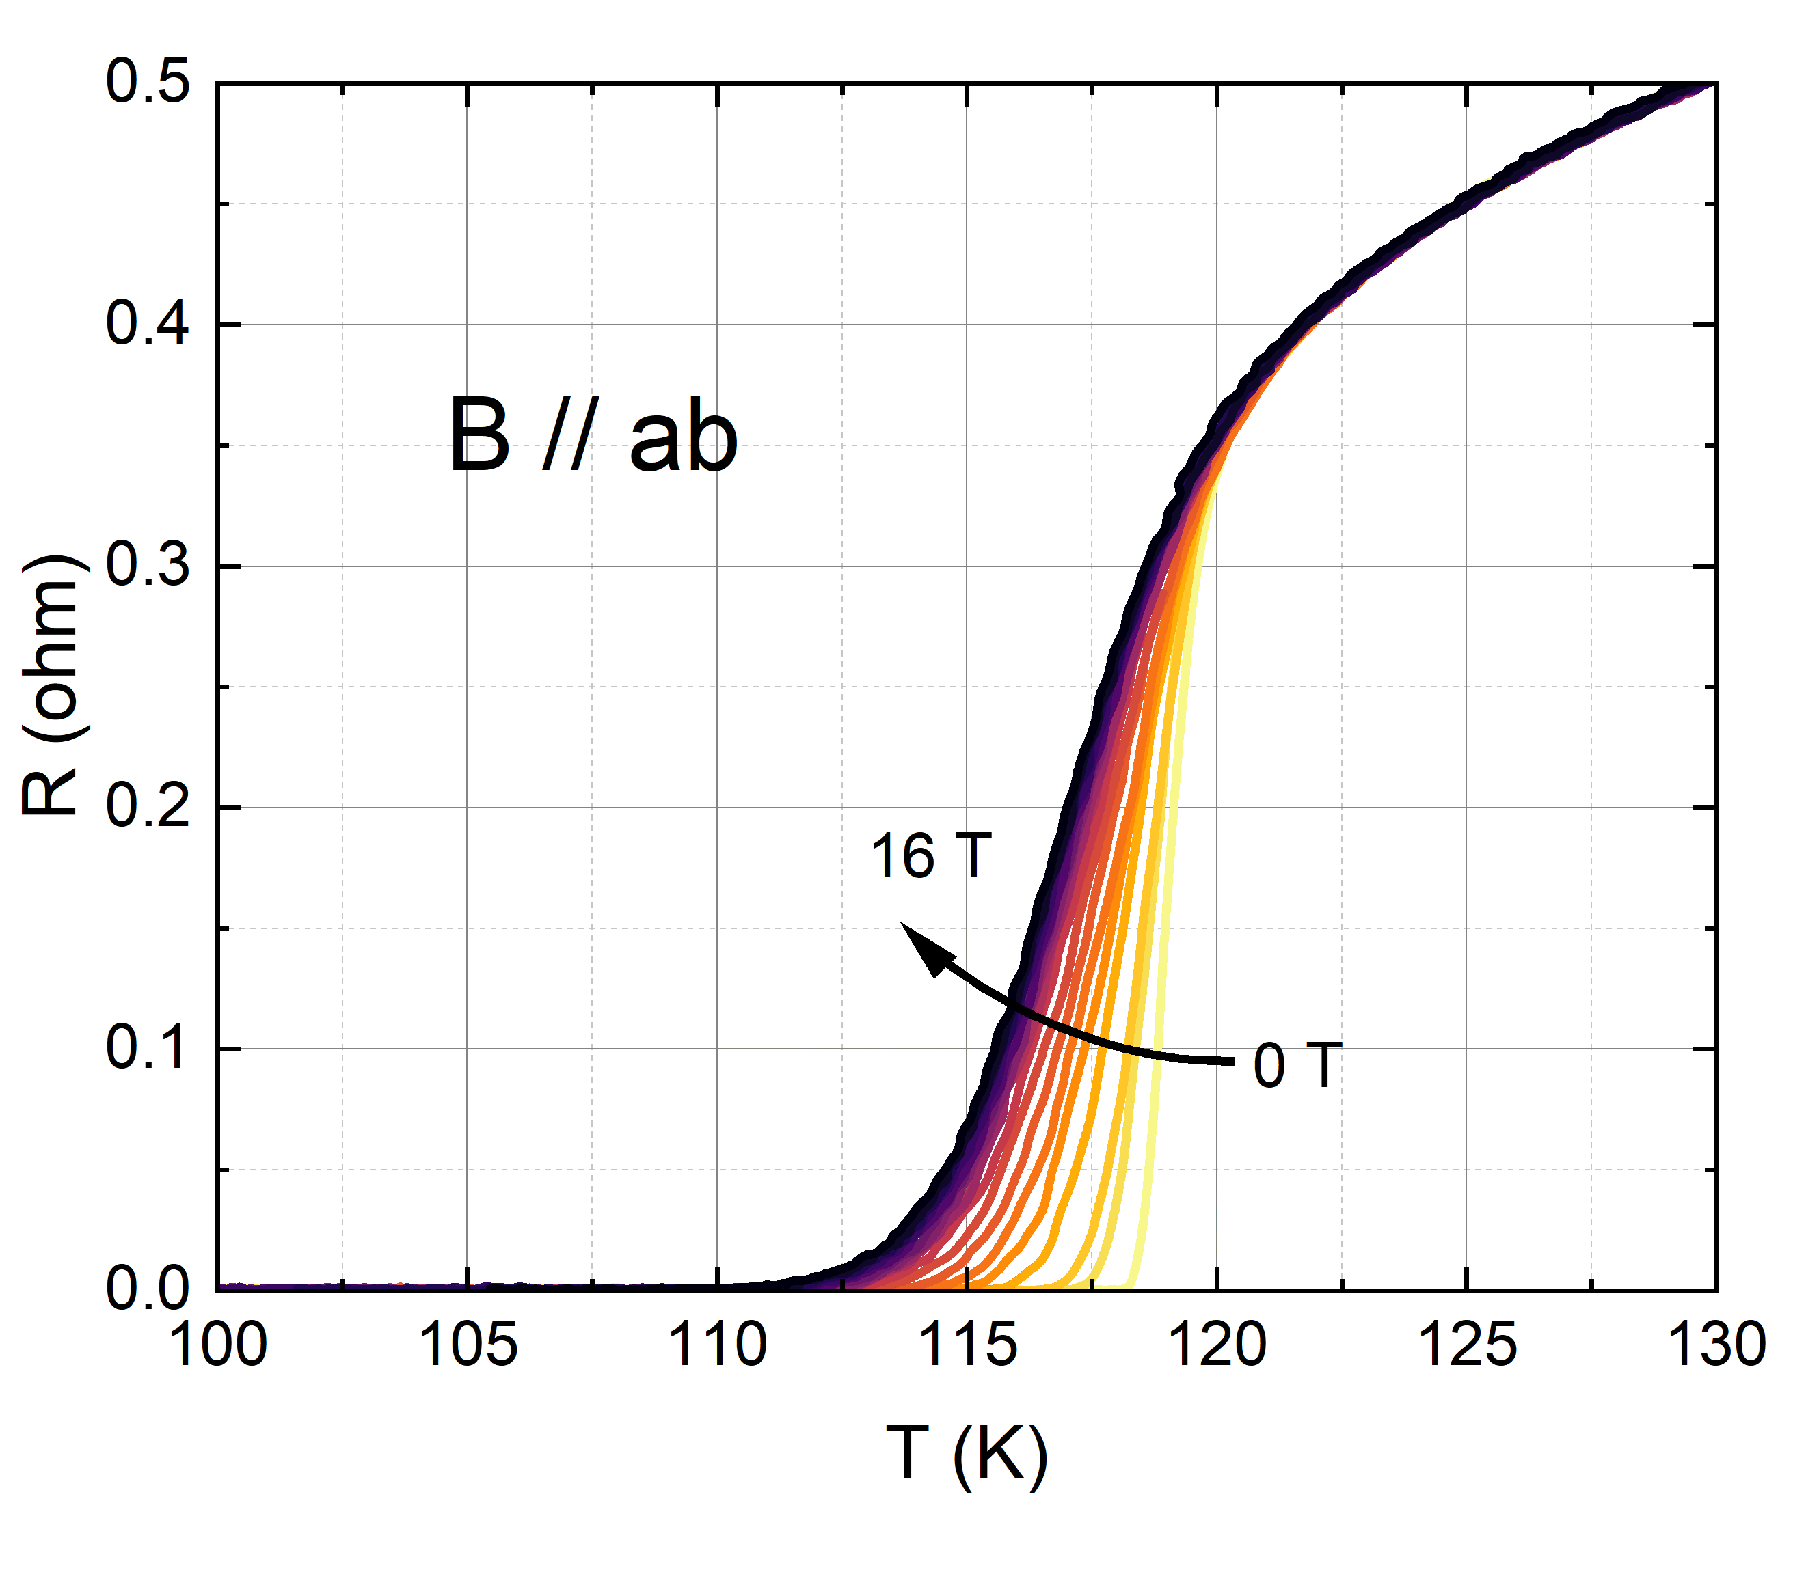
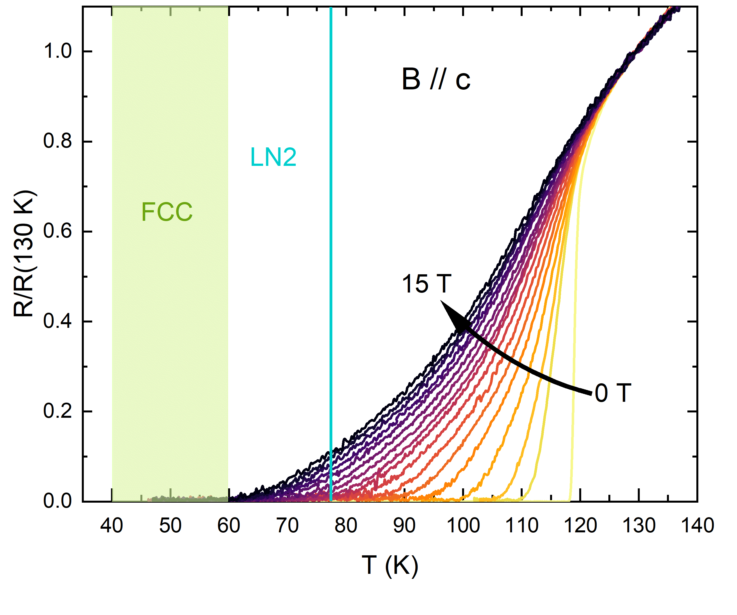
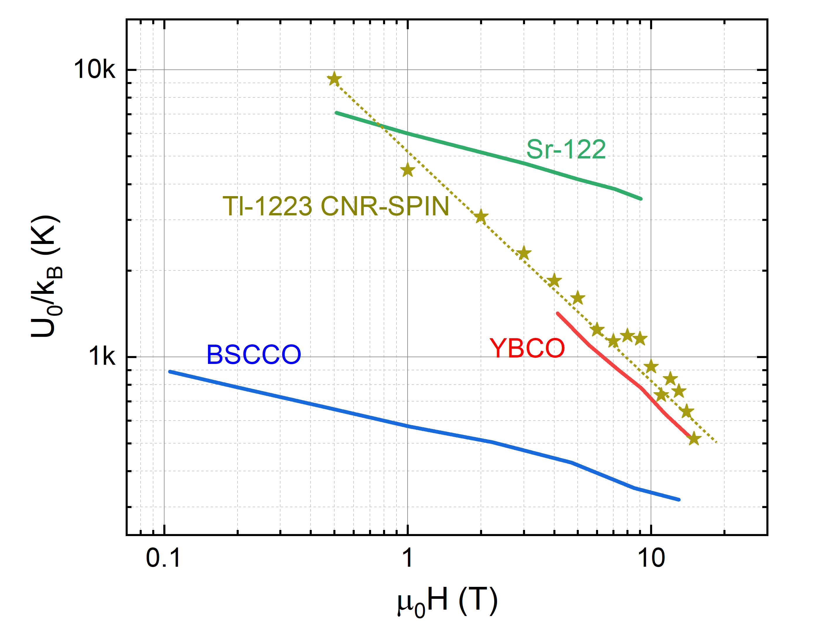
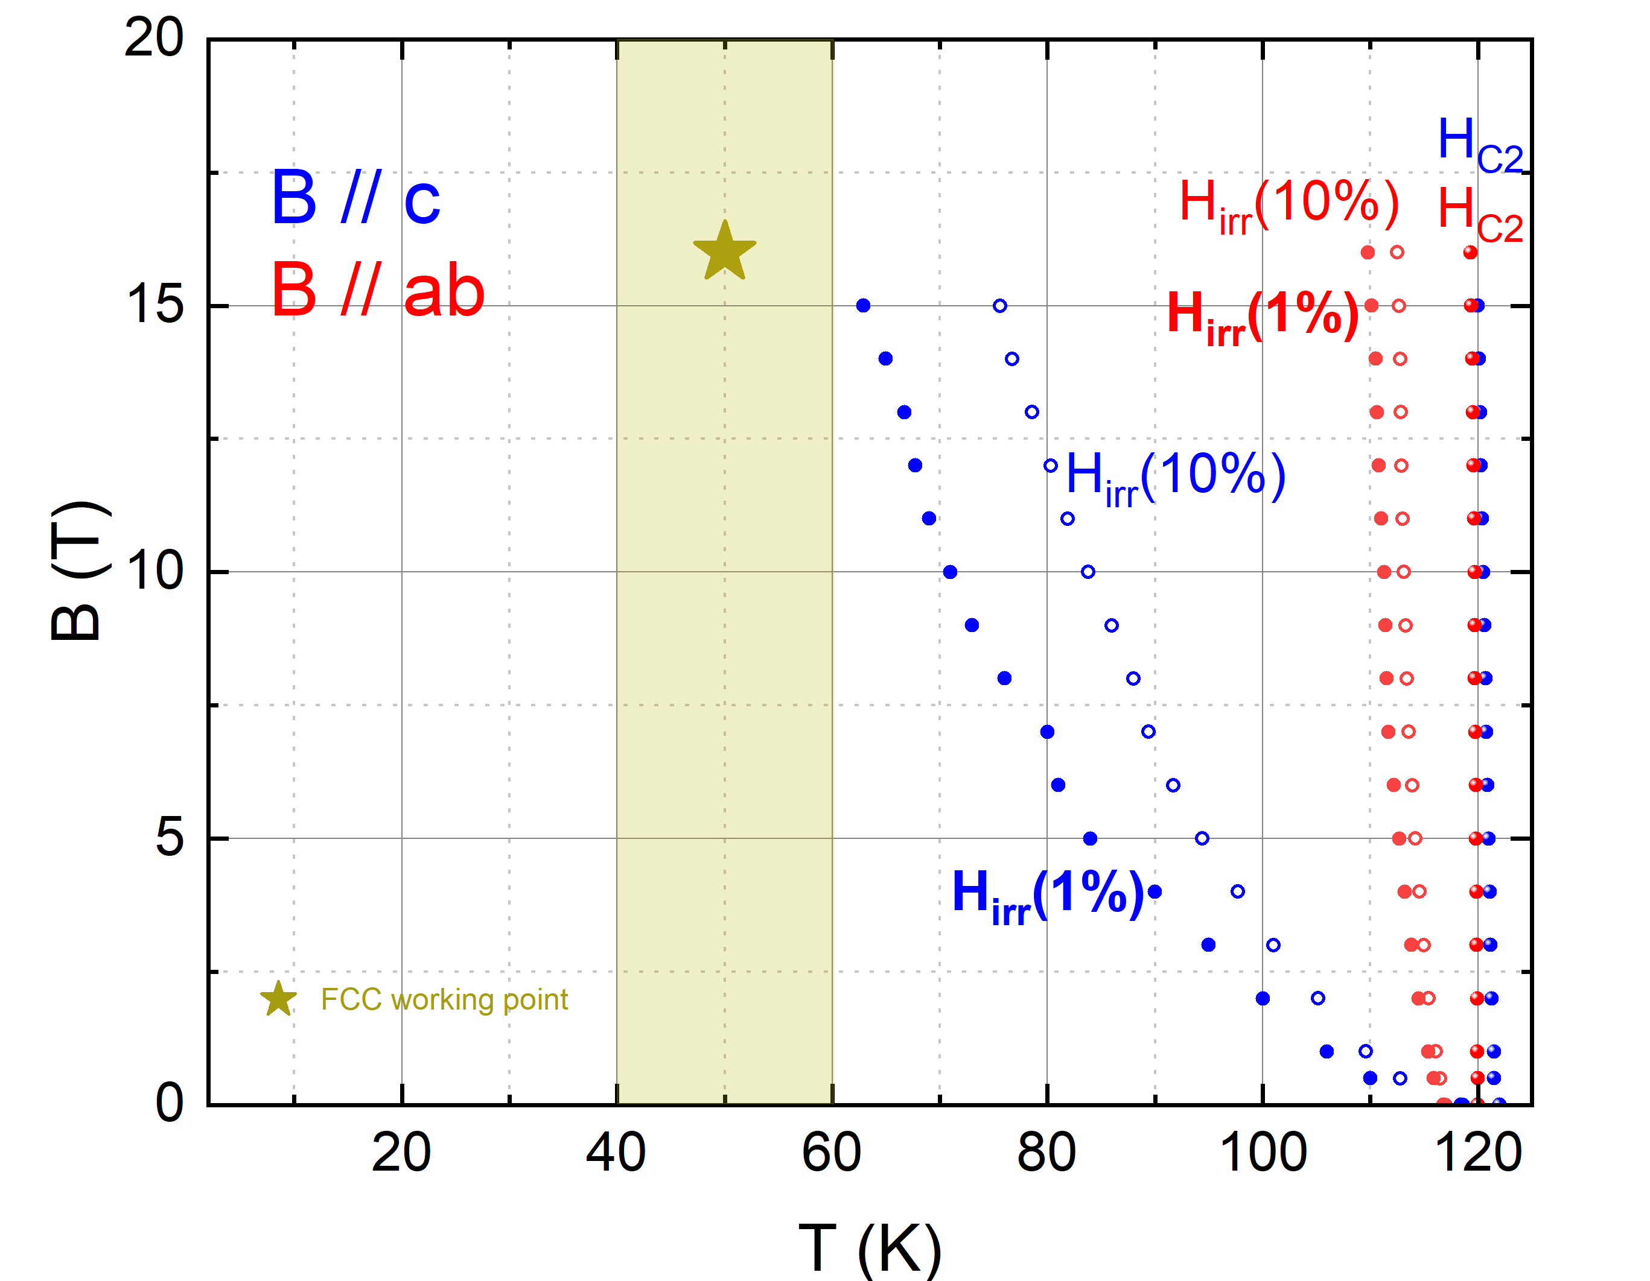
R(T, B) > H_{C2}, H_{irr}
VTI – 16 T

Slide 12
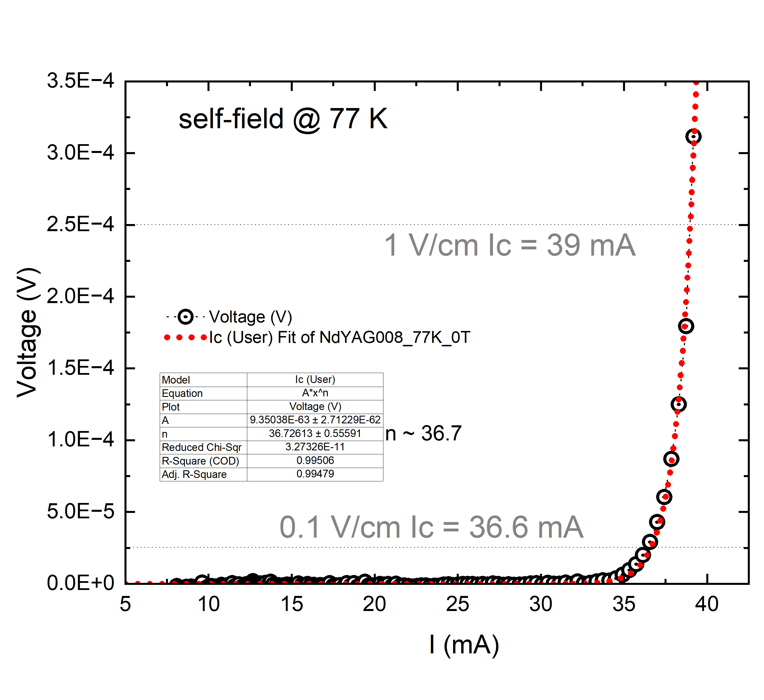
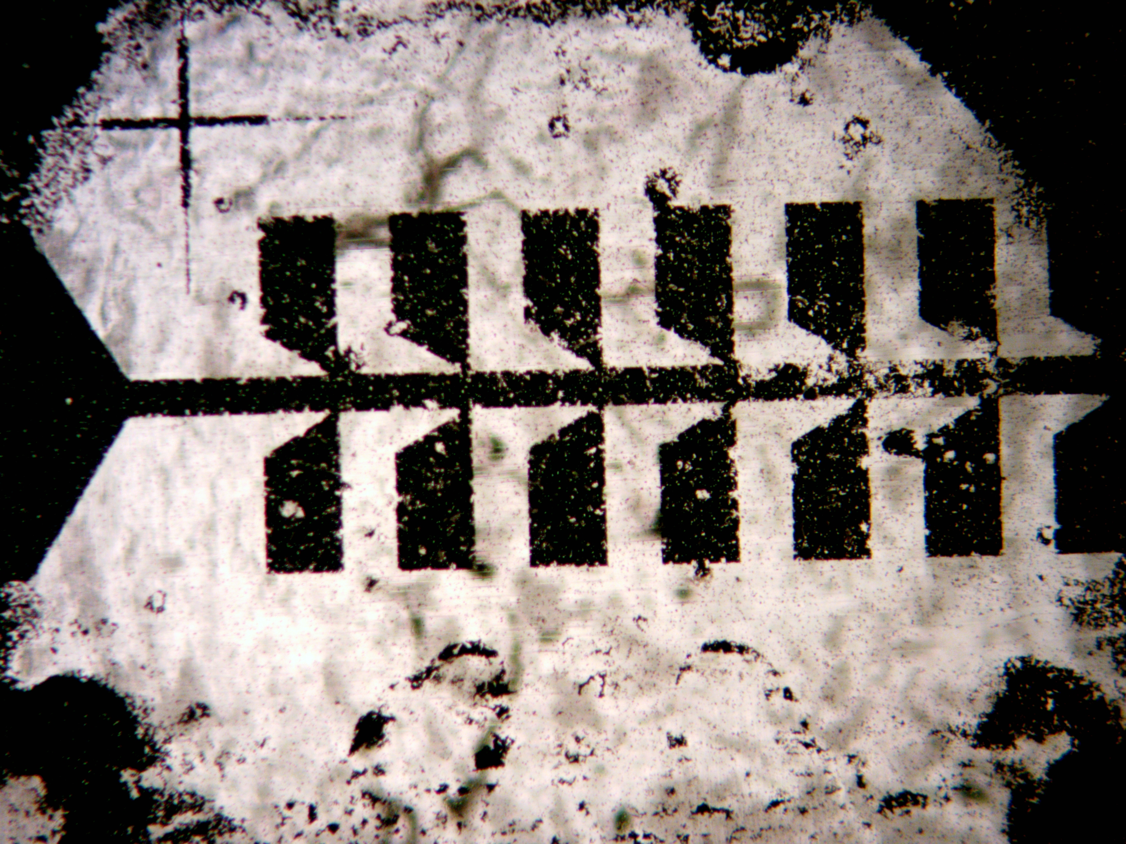
Critical current density J_{c}
Transport current measured 4 wire on patterned samples to reduce Ic
Nominal channel geometry
Length l_{V+V-} = 300 µm
Width d = 100 µm
Thikness z = 0.5 µm
s = 50 10⁻⁸ cm²
J_{c} = 2 10⁵ A/cm²
H₃PO₄ 8.5%
VTI – 16 T

Slide 13
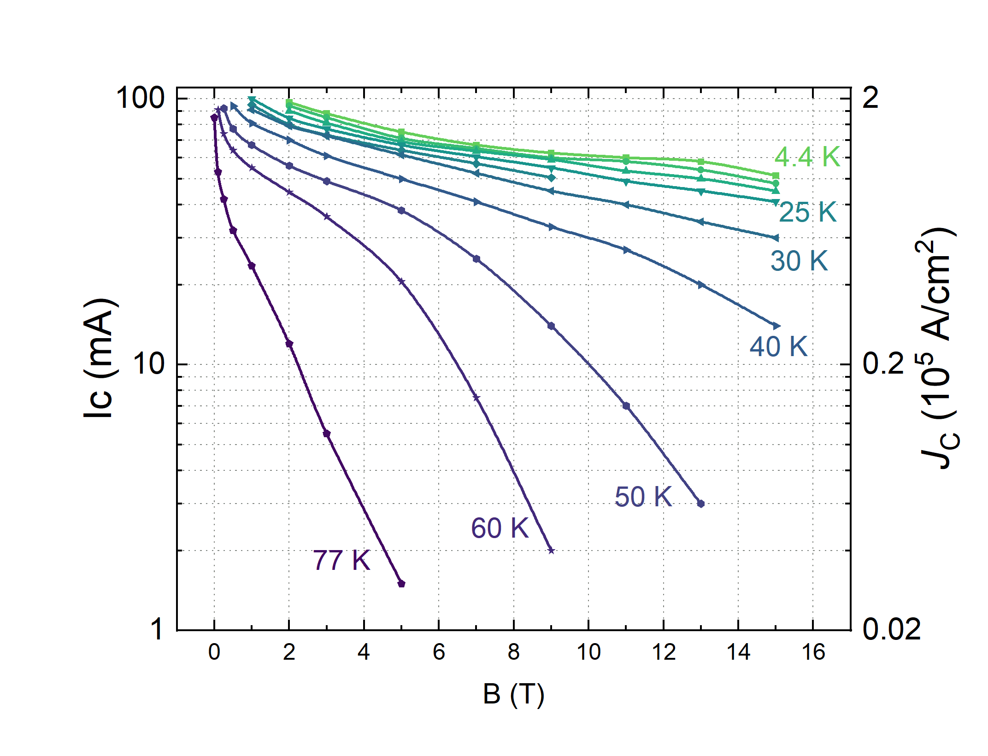
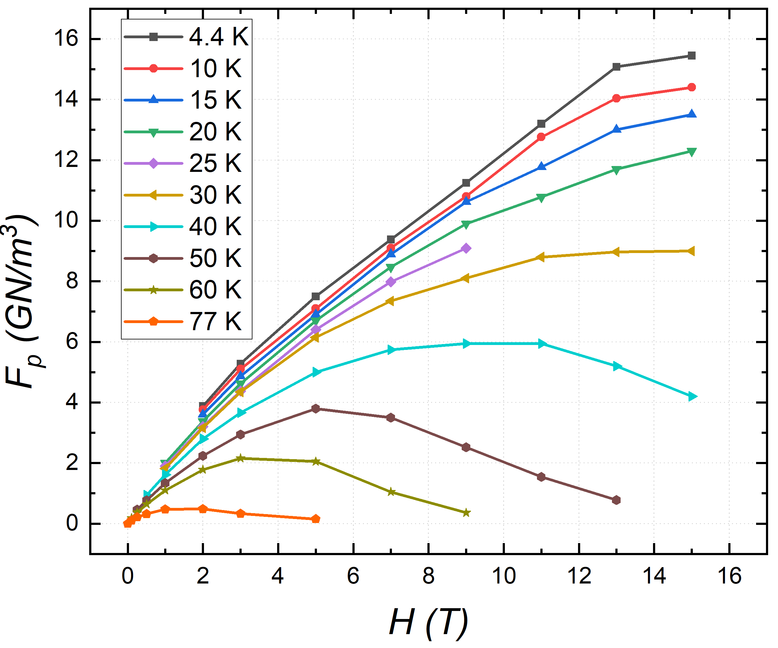
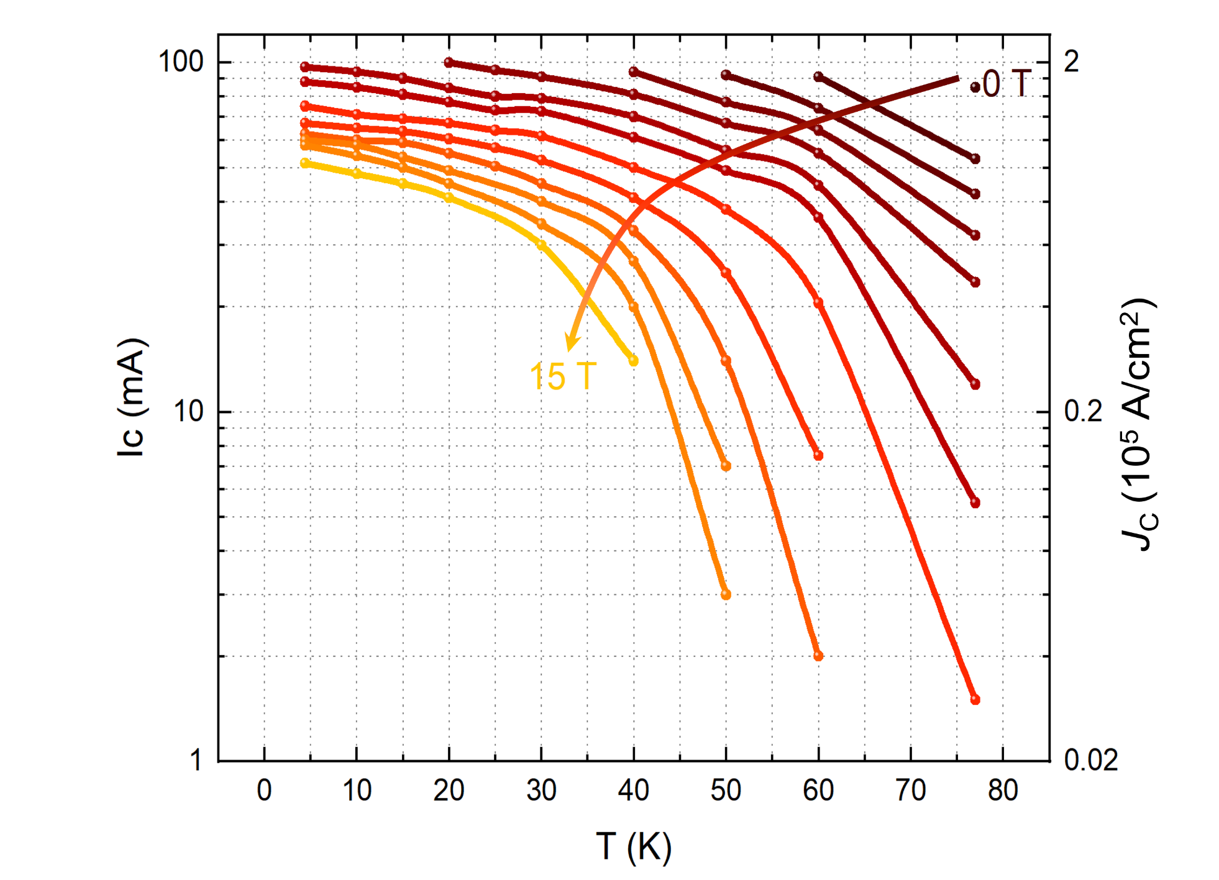
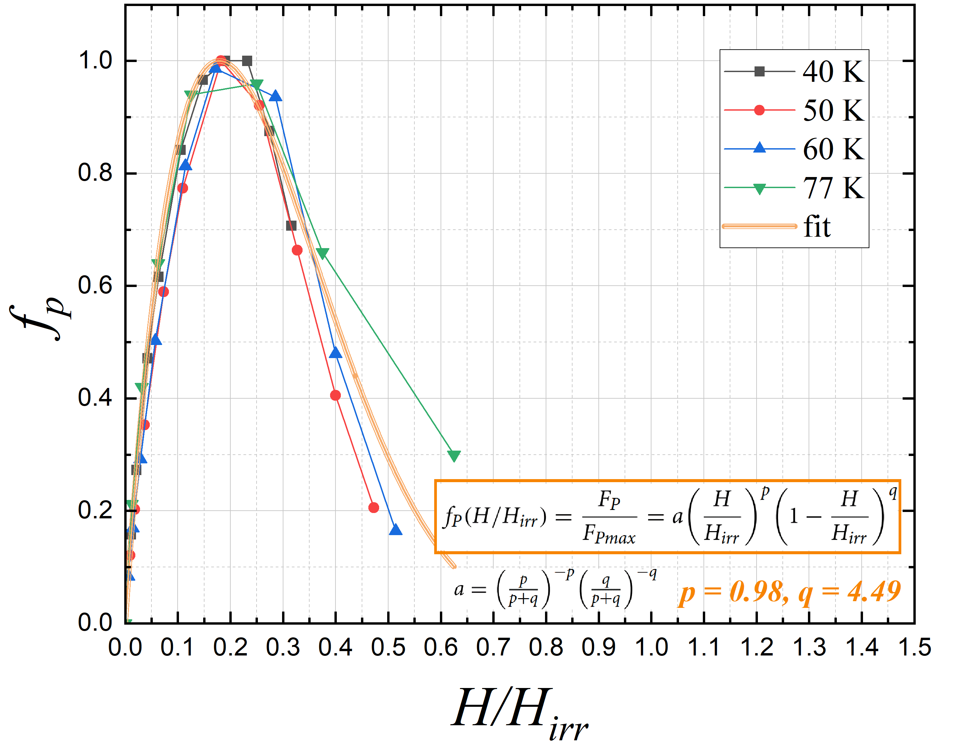
Critical current, critical current density, Pinning Force
Critical current density J_{c}
VTI – 16 T

Slide 14

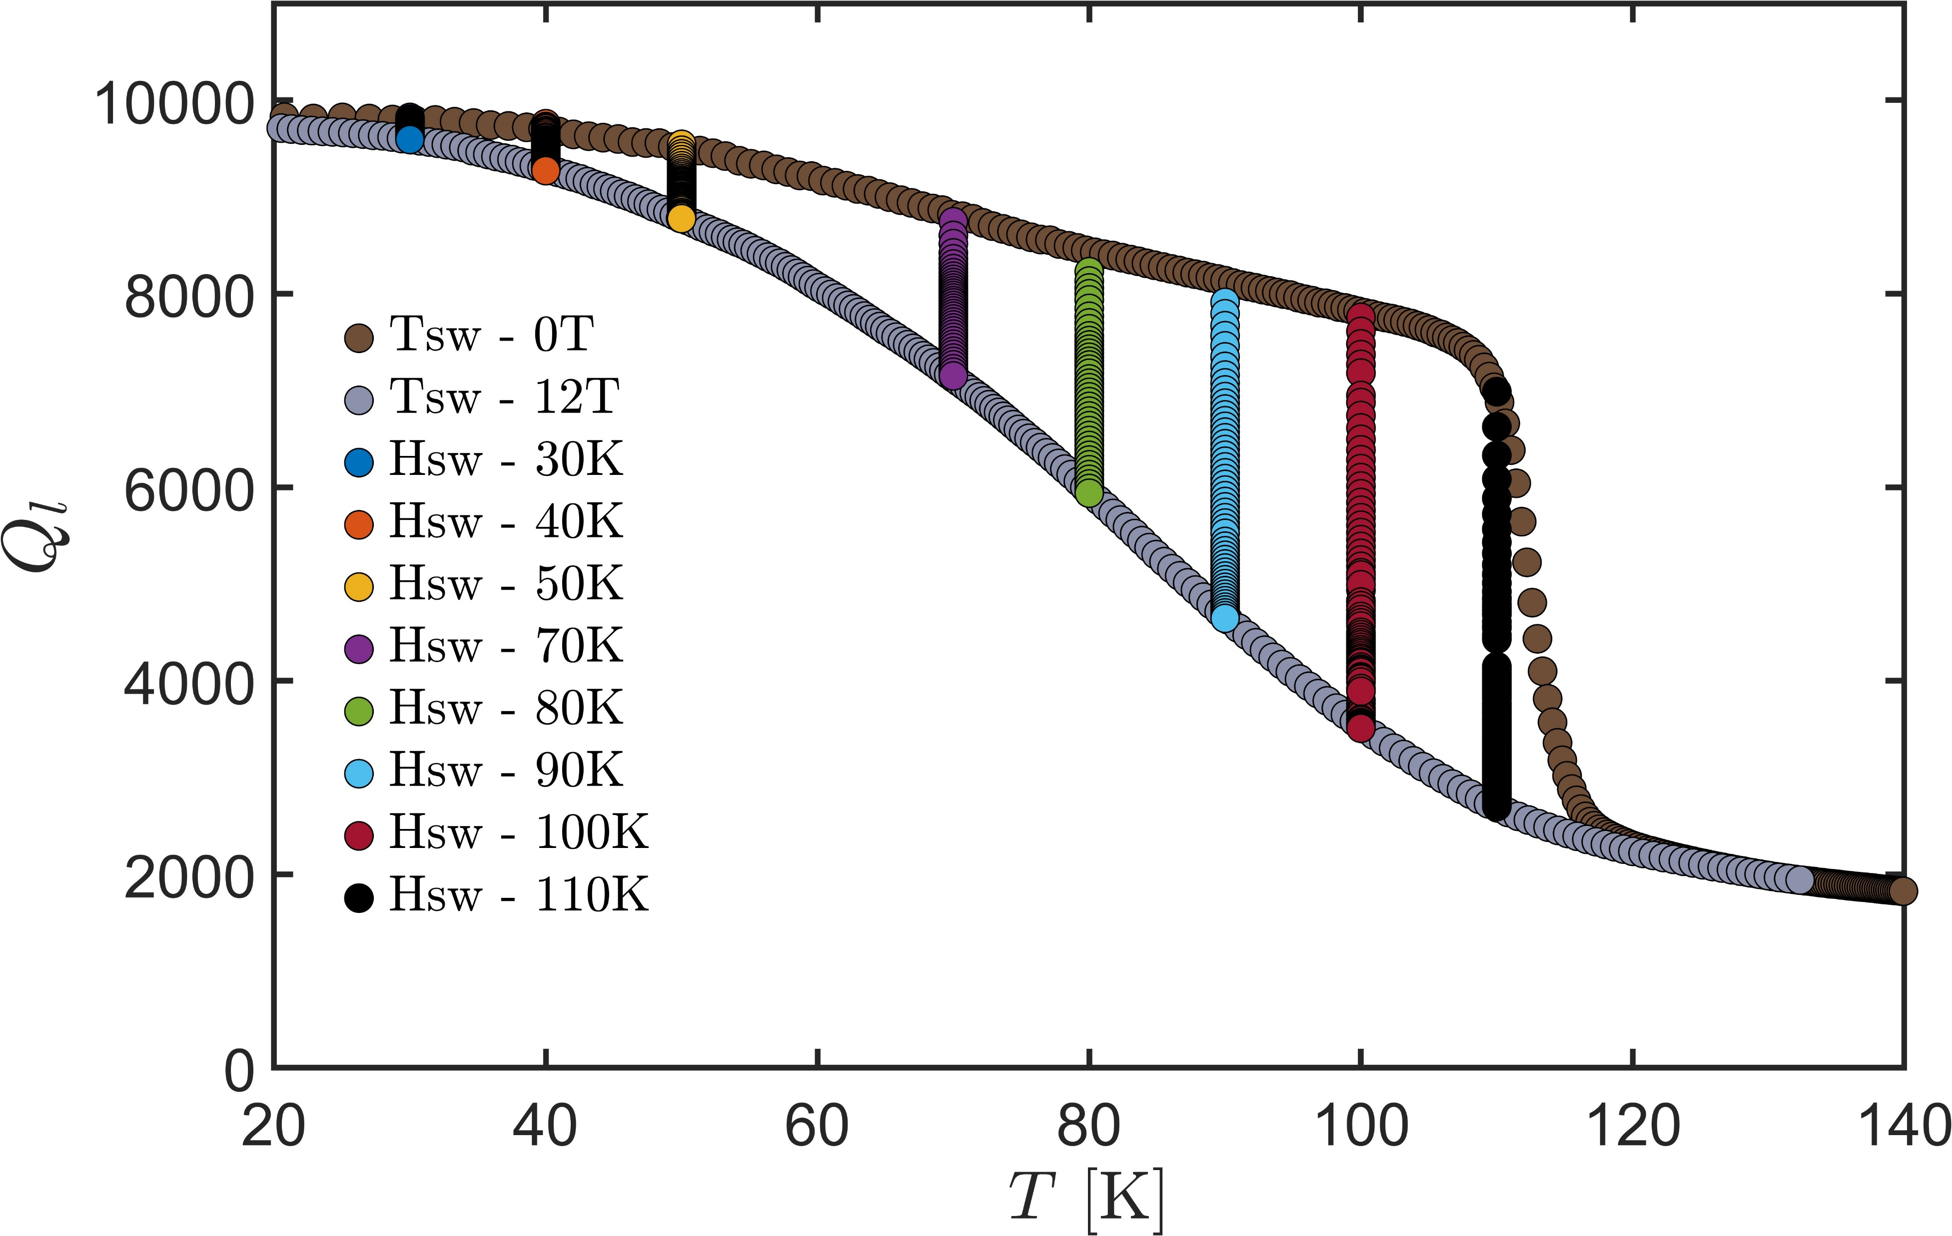
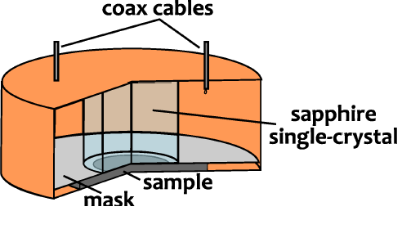

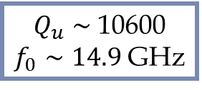
Microwave characterization
Measurement technique
Sample thickness ≈ 1 µm
T_{c} = 116 K (Tl-1223), no signs of a second phase
“Higher” Q-factor compared to the previous sample
Dielectric-loaded resonator
Surface perturbation method
VNA
S₂₁
$Q_{u}∼$ 10600
$f_{0}∼14.9$ GHz
Transm. coeff.
H
sample
$$H$$
VNA
Vortex motion resistivity ρvm

Slide 15
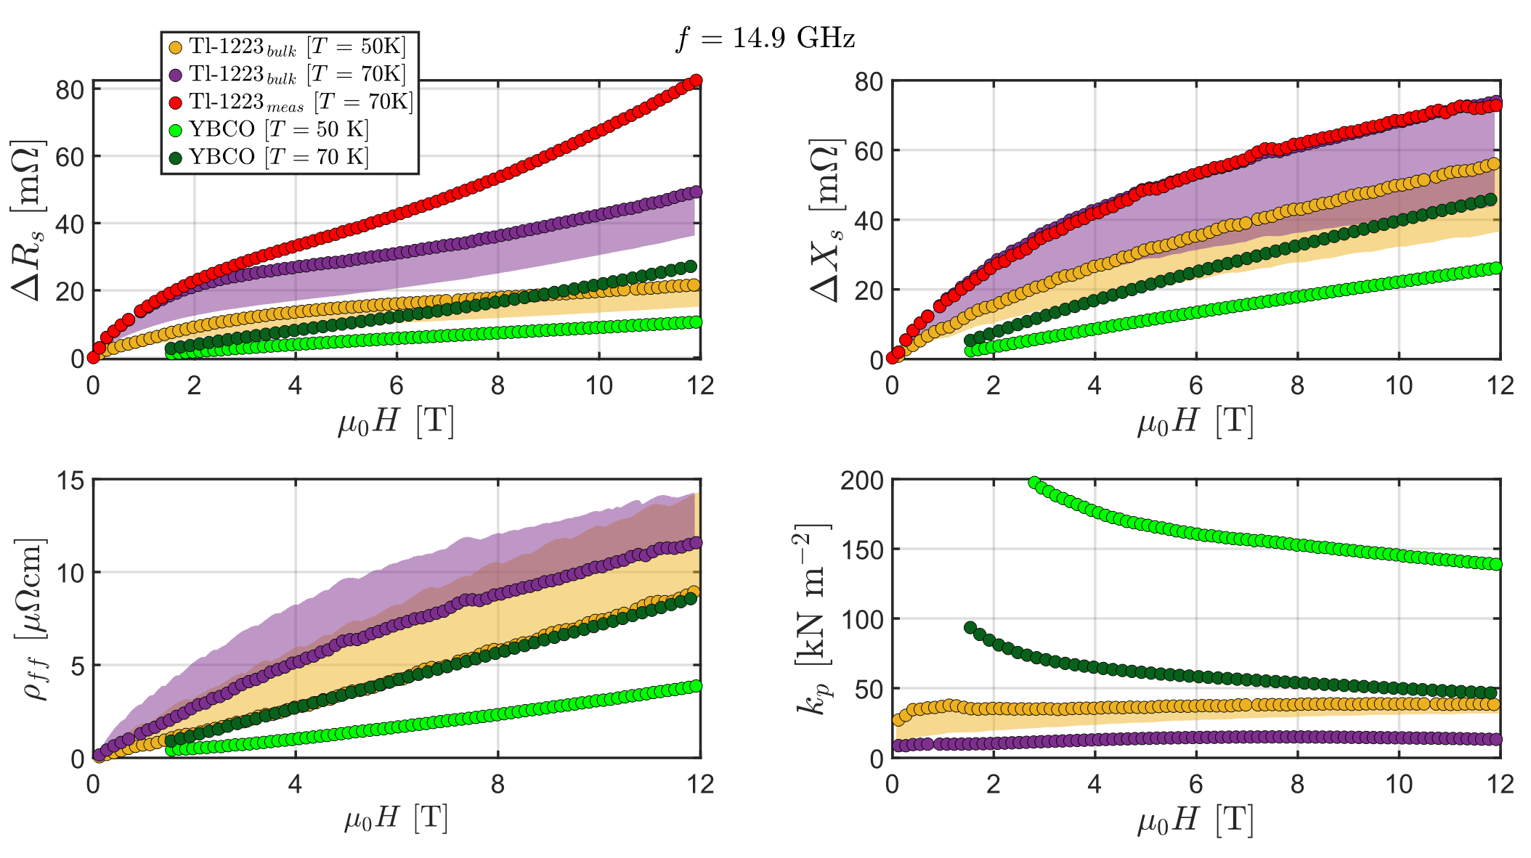
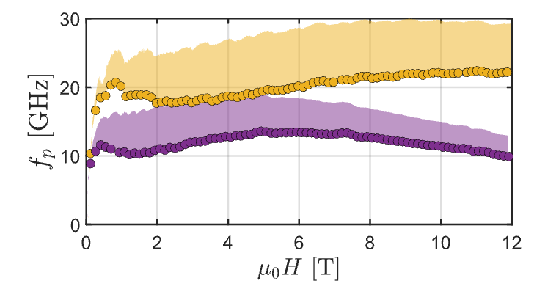
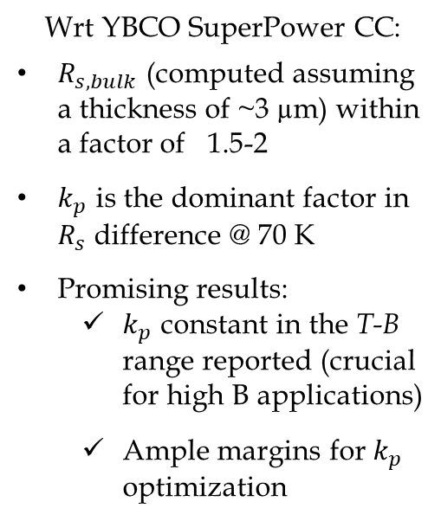
Microwave characterization
Bands refer to different assumed values for
λ_{L}(0) = [150,600] nm
Wrt YBCO SuperPower CC:
$R_{s,bulk}$ (computed assuming a thickness of ~3 µm) within a factor of 1.5-2
$k_{p}$ is the dominant factor in $R_{s}$ difference @ 70 K
Promising results:
  $k_{p}$ constant in the T-B range reported (crucial for high B applications)
  Ample margins for $k_{p}$ optimization
Vortex motion resistivity ρvm

Slide 16
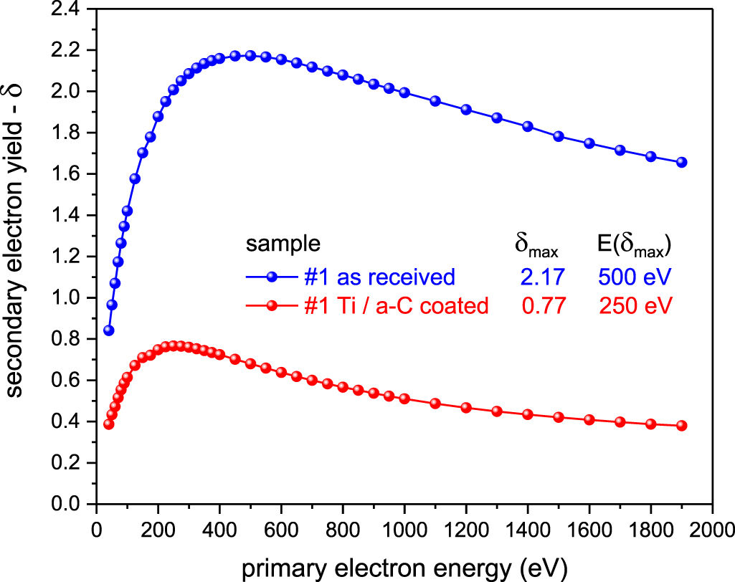
Requirements inherent of the particle accelerator environment.
Vacuum: Pumping test of degassing RGA from surface after 24 h pumping are
The RGA after 24 h of pumping was readily within CERN's acceptance criteria for unbaked components. In addition, XPS analysis revealed that no high atomic mass elements (Tl, Pb, Bi) are released by the pellet.
Secondary Electron Yield (SEY): the bare Tl-1223 surface has a rather high initial δmax at room temperature. The application of a thin amorphous carbon coating
(150 nm thick Ti buffer layer followed by addition of a 100 nm thick a-C top layer). dropped the SEY to 0.77, very promising result for further development of this approach.

Slide 17
Conclusion
A reliable method based on amorphous precursor deposition followed by a high temperature/high pressure thermic treatment to produce almost pure Tl(1223) superconducting coating has been demonstreated
Electrochemical deposition of precursors is possible but give less dense layers:To be optimized
Tl-1223 coatings approach the performances required, in terms of critical current and irreversibility field, by FCC application.
Results are on LaAlO3 single crystal:
a suitable substrate need to be optimized (Reaction temperature is too high for pure silver)
Tl(1223) sample exhibits a vortex flux-flow resistivity (𝜌_ff) that is nearly comparable to ReBCO tapes. The observed lower surface resistance is due to a lower pinning constant (k_p), (that in ReBCO tapes has been artificially increased through the introduction of controlled defects)
Pinning force shoul be increased
Thikness increased up to few micometers
Thank you for your attention
Notes:
let's go back the way we came

Slide 18
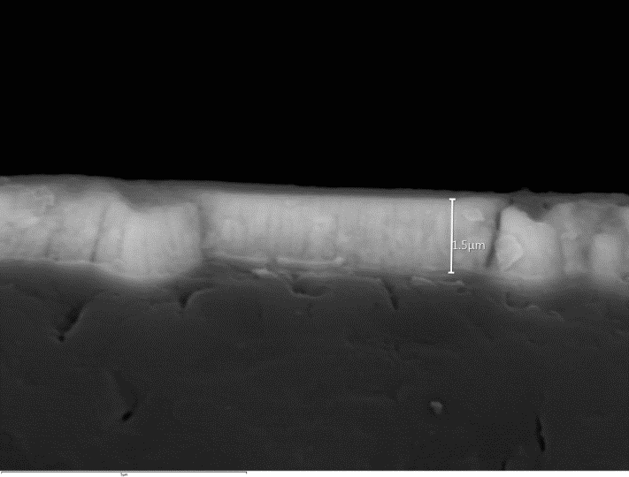
Istituto SPIN
Genova, L’Aquila, Napoli, Roma, Salerno
Film Deposition Of Thallium Based Precursors
Electrochemical deposition
Pulsed Laser Deposition
Frequency | 5 Hz
Laser energy | 1-3 J/cm²
Vacuum | 8 × 10⁻⁸ mbar
O2 pressure | 10⁻² – 10⁻¹mbar
d target - substrate | 3-4 cm
SUBSTRATES
EMPLOYED
LAO (001)
STO (001)
CONSTANT POTENTIAL
PULSED POTENTIAL

Slide 19
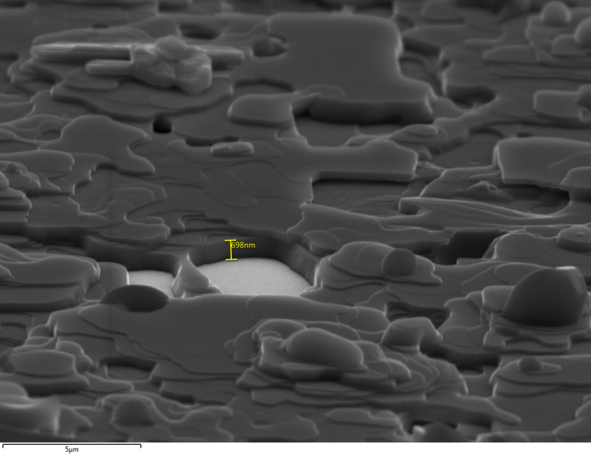
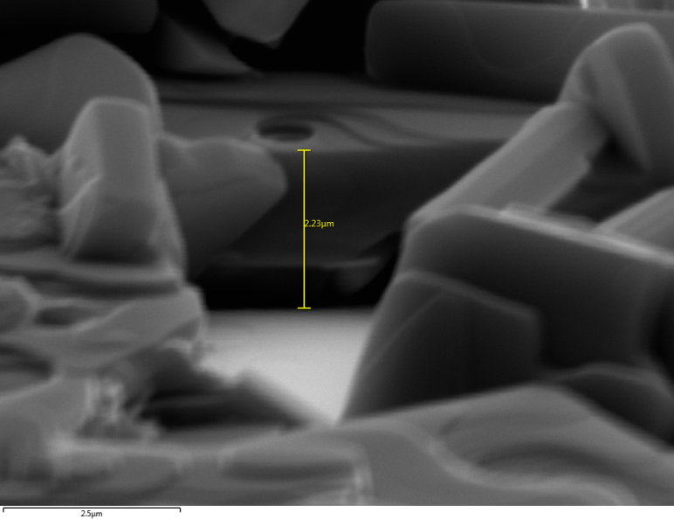
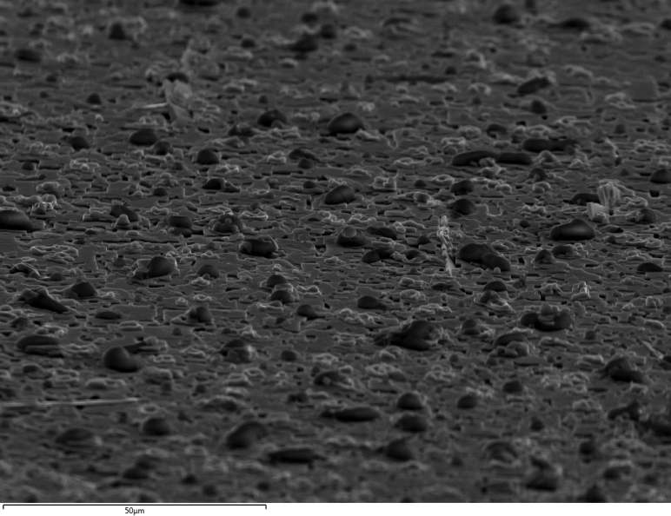
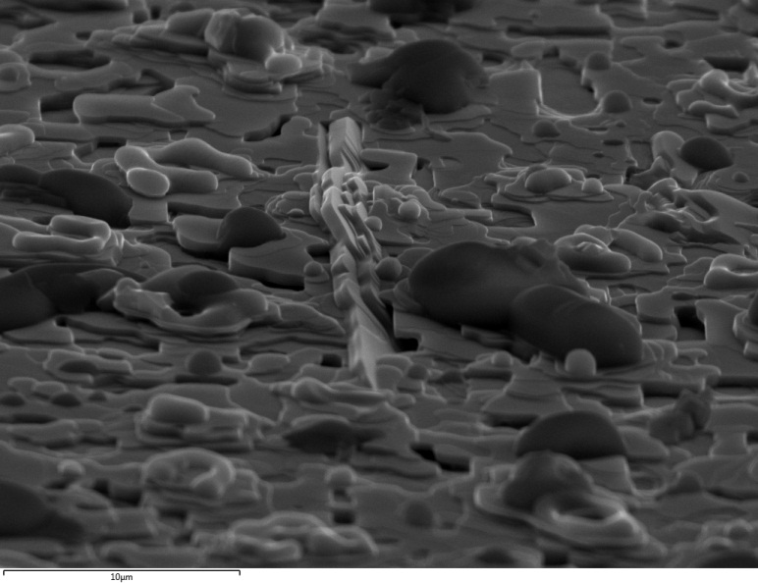
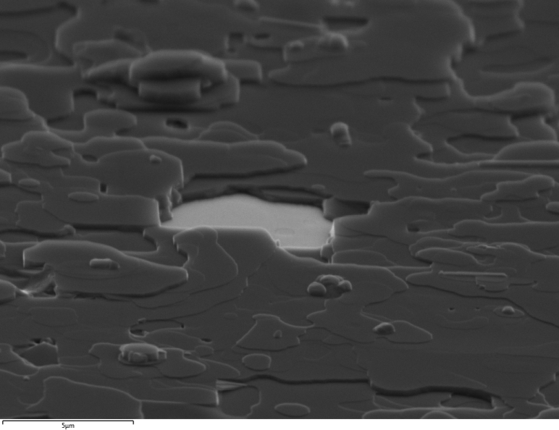


Istituto SPIN
Genova, L’Aquila, Napoli, Roma, Salerno
Thicker
(2 h dep.)
Thinner
(1 h dep.)
2.2 um
700 nm
875 nm
120 nm

Slide 20

Istituto SPIN
Genova, L’Aquila, Napoli, Roma, Salerno
Thicker
Thinner
Alessandro Leveratto, CNR-SPIN Genova SPIN Seminar series – October 24, 2024

Slide 21





Istituto SPIN
Genova, L’Aquila, Napoli, Roma, Salerno
R(T, B) > U₀
$$R=R_{N} e^{{−U\left(H\right)}/{k_{B}}}$$
$$U\left(H\right)\sim H^{−n}$$
VTI – 16 T
$μ_{0}H // ab$ with n ≈ 0.48;
$μ_{0}H // c$ with n ≈ 0.77.

Slide 22


















Istituto SPIN
Genova, L’Aquila, Napoli, Roma, Salerno
955 °C
Increasing T 850 to 950°C
Decreasing p(O2) 1 to 0.1 bar at RT
Alessandro Leveratto, CNR-SPIN Genova Joint Workshop UniGe – IFW– Genoa – June 10, 2024

Slide 23











Measurement technique – dual mode dielectric loaded resonator
Dielectric loaded resonators
f_{1,2} = [8; 14],[16; 27] GHz
TE₀₂₁ - mode
$$H$$
VNA
Q-factor
Res. frequency
Effective surface
impedance
Vortex motion resistivity
Flux flow resistivity
Pinning frequency
$Q_{1},f_{1},Q_{2},f_{2}$ at $T, H$
$$ΔZ\left(T,H,f_{1}\right)$$
$$ΔZ\left(T,H,f_{2}\right)$$
$${\tilde{ρ}}_{vm}\left(T,H,f_{1}\right)$$
$${\tilde{ρ}}_{vm}\left(T,H,f_{2}\right)$$
$$ρ_{ff}\left(T,H\right)$$
$$f_{p}\left(T,H\right)$$
Modified Lorentzian fit
TMQF - fit
e.m. simulation
geometrical factors $G_{i}$ estimation
Classical
electromagnetism + vortex motion
Single vortex physical model
N. Pompeo et al., Measurement, 184, 109937, 2021
A. Alimenti et al., IEEE Instrum. Meas. Mag., 24(9), 2021
K. Torokhtii et al., Measurement: Sensors 18, 2021
A. Alimenti et al., Meas. Sci. Technol, 30(6), 2020
K. Torokhtii et al., Acta IMEKO 9(3), 2020
K. Leong et al., IEEE Trans. Microw. Theory Techniq., 50(9), 2002

Slide 24
Measurement technique
Measurement technique
= Dielectric-loaded cylindrical resonator.
Note: this is essentially a bulk technique, meaning that the surface impedance (a kind of AC electrical resistance) is measured as an average over the entire sample, both in terms of surface area and thickness.
Superconducting sample
= Placed inside the resonator, between one of its end plates and the internal dielectric crystal (see schematic in slide 2).
Resonator
= Acts as a source of electromagnetic radiation → induces RF currents on the sample surface, allowing us to measure its resistivity.
The measurement
= A differential surface impedance measurement (ΔZₛ), calculated from variations (typically induced by the magnetic field) in the quality factor Q and resonant frequency f of the resonator with respect to a reference value*.
Theoretical/physical models
= Allow us to extract vortex parameters (such as the flux-flow resistivity ρ_ff, pinning frequency fₚ, etc.).
Measurements
= Performed at a fixed frequency; either at constant magnetic field and varying temperature ("transitions"), or at fixed temperature and varying magnetic field ("field ramps", used to extract the vortex parameters mentioned above).
* For example, in measurements with varying magnetic field and fixed temperature, the reference values Q(B=0) and f(B=0) are compared to the experimental values Q(B>0) and f(B>0).

Slide 25








Measured Samples
Sample NdYAG012 (03/2024)
Sample NdYAG031 (12/2024)
Sample thickness ≈ 1 µm
RF measurements show two different T_{c} [116 K (Tl-1223); 80 K (Tl-1212)]
“Low” Q-factor → large losses (high ${ΔR}_{s}$)
Sample thickness ≈ 1 µm
T_{c} = 116 K (Tl-1223), no signs of a second phase
“Higher” Q-factor compared to the previous sample
$Q_{u}∼$ 10600
$f_{0}∼14.9$ GHz
$$Q_{u}∼3000$$
$f_{0}∼26.$7 GHz
T_{c2}
$$0 T$$
$$Ql$$
$$1.2 T$$
T_{c1}
$$T [K]$$

Slide 26

Temperature sweeps at constant B
Estimated normal state resistivity ≈ 100 µΩ cm
Normal state resistivity from literature [1,2,3,4] ≈ 300-500 µΩ cm
f = 14.9 GHz
[1] G. Triscone, Physica C 272, 21-25 (1996).
[2] R. Awad, et al., Supercond. Sci. Technol,17 35 (2004).
[3] S. Isber, Supercond. Sci. Technol. 18 311 (2005).
[4] A.I. Abou Aly, J Supercond Nov Magn, 23 (2010).

Slide 27

Magnetic field sweeps at constant T (Surface impedance)
From the magnetic field sweep:
Rs increases with field -> dissipation due to increased number of fluxons in the sample
Rs (surface resistance) and Xs (surface reactance) allow for the determination of the vortex parameters (an estimation of of λ_{L} is needed)

Slide 28


Magnetic field sweeps at constant T (Desired thickness)
To be in the bulk regime (no substrate contribution to R_{s}),
the required coating thickness is computed from the e.m. penetration depth.
This estimation depends on the actual λ_{L}
At lower frequencies, a thicker sample is needed.
In the worst case (pure flux flow), with the present data, at T < 70 K, B = 12 T and f = 2 GHz:
R_{s}( f₂) ≈ R_{s}( f₁) sqrt( f₂/f₁) → thickness ~ 9 µm
At T < 70 K, B = 12 T and f = 14.9 GHz:
If λ_{L} = 150 nm → Thickness ≥ 3.1 µm

Slide 29
Magnetic field sweeps
Dimensional crossover
= Depending on the values of magnetic field and temperature, the sample transitions between different electromagnetic geometries (bulk, thick film, thin film).
This complicates both data analysis and interpretation, making the London penetration depth λL a particularly critical parameter.
λL
= Leaving aside the strictly physical aspects, the analysis was carried out by treating λL as a free parameter.
As a result, the extracted microscopic parameters are accompanied by a "confidence range" (shaded areas) that reflects the possible variations of λL.
Clearly, the range is wide (λL up to 600 nm), yet the confidence intervals remain relatively narrow.
Desired thickness
= In view of a potential FCC application, and in order to avoid dimensional crossovers, the system must operate in the bulk regime.
To achieve this with the current performance of the superconductor, a minimum thickness of 4–5 μm at 70 K and 12 T is required.
If the material performance is improved, a thinner layer will be sufficient to stay in the bulk regime (and thus effectively shield electromagnetic radiation).

Slide 30


Magnetic field sweeps at constant T (Pinning Parameters)
Bands refer to different assumed values for
λ_{L}(0) = [150,600] nm
(full dots correspond to 150 nm)
Gittleman-Rosenblum pinning parameters, with the estimation of the maximum creep factor $χ_{max}$, see:
N. Pompeo, et al., Physical Review B 78.9 (2008): 094503.
Considering pinning, at T < 70 K, B = 12 T and f = 2 GHz:
If λ_{L}(0) = 150 nm → thickness ~ 4 µm
If λ_{L}(0) = 600 nm → thickness ~ 5.5 µm

Slide 31


Bands refer to different assumed values for
λ_{L}(0) = [150,600] nm
Wrt YBCO SuperPower CC:
$R_{s,bulk}$ (computed assuming a thickness of ~3 µm) within a factor of 1.5-2
$k_{p}$ is the dominant factor in $R_{s}$ difference @ 70 K
Promising results:
  $k_{p}$ constant in the T-B range reported (crucial for high B applications)
  Ample margins for $k_{p}$ optimization

Slide 32





Pinning parameters comparison, magnetic field sweeps at constant T
$$26.7 GHz$$
$$24.2 GHz$$
The recent sample (NdYAG031) clearly shows improved performances both in ${ΔR}_{s}$ and $k_{p}$ compared to the old one (NdYAG012)

Slide 33






Vortex motion resistivity ${\tilde{ρ}}_{vm}$
Resistività di vortice (grandezza complessa)
$${\tilde{ρ}}_{vm}=ρ_{vm,1}+iρ_{vm,2}=ρ_{ff} \frac{χ+i\frac{f}{f_{c}}}{1+i\frac{f}{f_{c}}}$$
$ρ_{ff}=ρ_{n}B/B_{C2}$: flux-flow resistivity (dissipation)
$f_{c}$ (or $f_{p}$): pinning frequency (pinning strength)
$χ$ : creep factor (thermal activation)
$\text{For} \text{high}\text{−}\text{frequency} \text{applications}$:
Minimize the flux-flow resistivity $ρ_{ff}$ (dissipation)
Increase the pinning frequency $f_{c}>f$ (pinning strength)
Low losses
High losses
$${\tilde{ρ}}_{vm}$$
$$R_{s}$$

