Slide 1
Status of HFM development
at INFN
Alessandra Pampaloni
On behalf of the INFN Genova and LASA collaboration
May 22, 2025

Slide 2
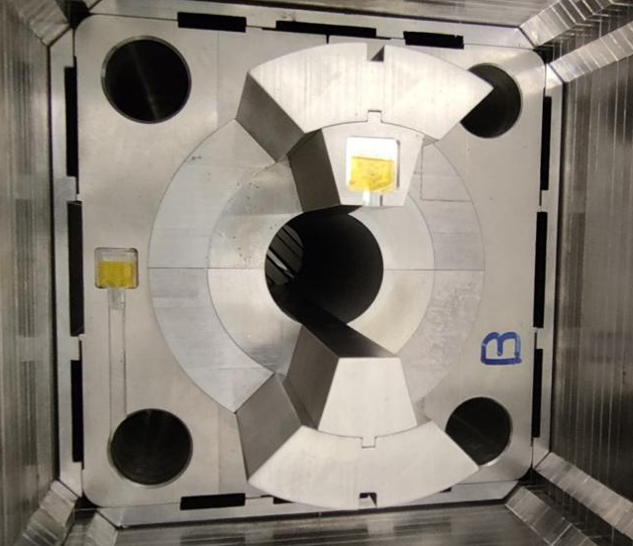
Outline
12 T Nb₃Sn Falcon Dipole
  Electromagnetic Design
  Winding Tests
  Mechanical Design
  Mechanical Mockup
Toward the 14 T Program
  LTS Technology
  HTS Technology
Conclusion

Slide 3
12 T Nb₃Sn Falcon Dipole
The FalconD program, signed in 2018, is being developed in accordance with the CERN/INFN KE 4102 agreement
An amendment was issued in March 2023 to update the project's scope and schedule
The project involves the development and construction of a short model Nb₃Sn dipole with the following specifications:
  Single aperture with an inner bore of 50 mm
  2-layer cos-theta coil providing a bore field of 12 T at 1.9 K
  Mechanical assembly using bladder & key technology
  The total coil length is 1.5 m

Slide 4



12 T Nb₃Sn Falcon Dipole
The FalconD project includes the following activities:
  At ASG Superconductors, manufacturing of:
    1 dummy pole wound with copper cable
    2 practice poles wound with Nb₃Sn cable
    5 poles wound with Nb₃Sn cable for the single aperture
  At INFN LASA, assembly and testing @ 4.2 K of the magnet
CERN supports all activities and supplies the magnet components, including the cable, spacers and other necessary items
ASG is responsible for manufacturing the coils, which include 7 Nb₃Sn coils and 1 dummy copper coil
INFN is responsible of the magnet design, B&K assembly and preliminary test @ 4.2 K at LASA laboratory

Slide 5
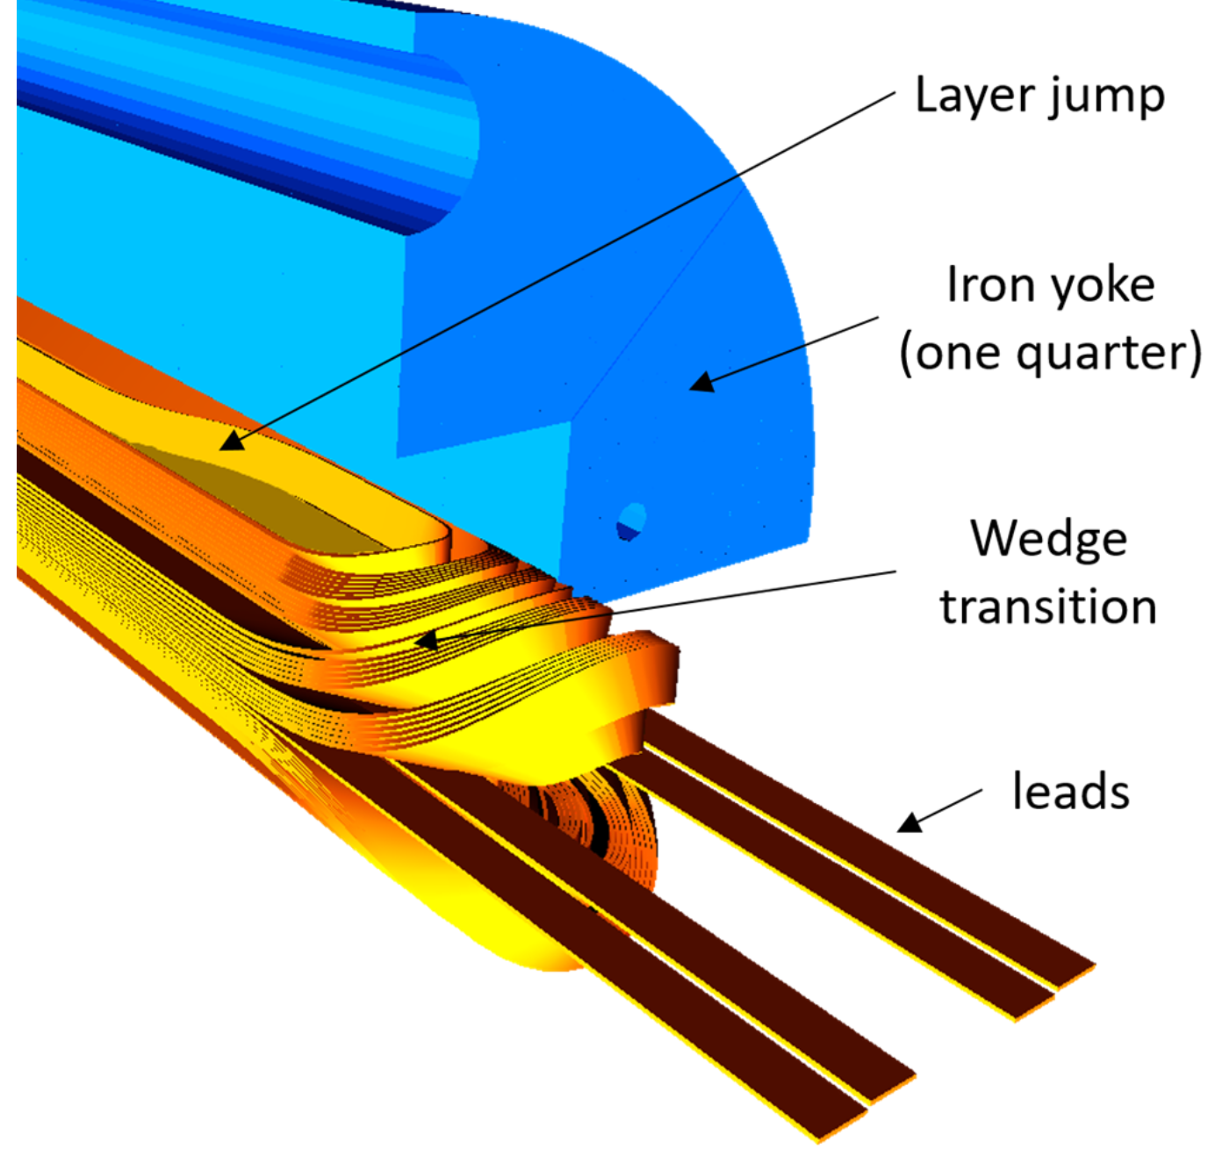
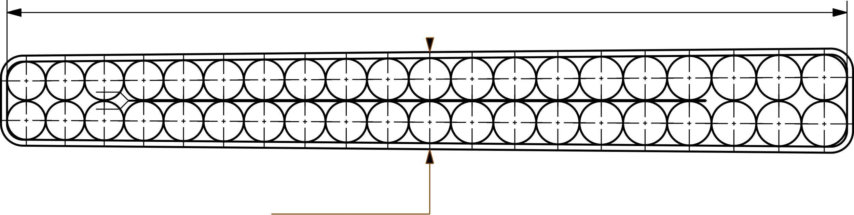
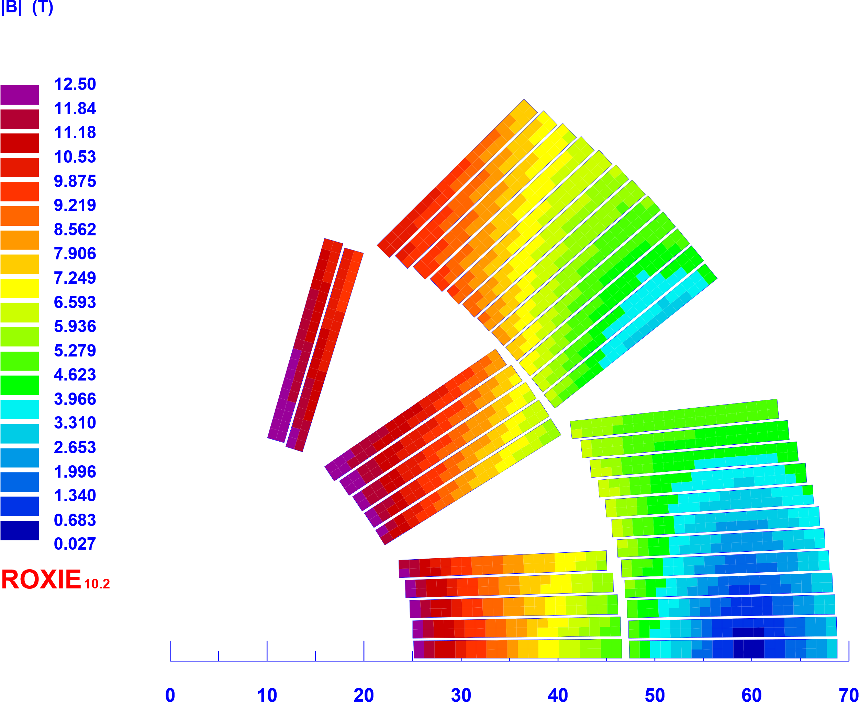
Electromagnetic Design
The 2D and 3D electromagnetic design is completed.
21.42 mm
Reacted cable:
Width +2%
Mid-thick +4.5%
1.89 mm
40 strands Ø 1 mm
Bore Field | Operating Current | Margin on loadline @ 1.9 K **
12 T | 20180 A | 24.4%
13.5 T * | 23000 A | 15%
Parameter | Value
Cu/NCu | 0.9
J_{overall} [A/mm²] | 424
J_{SC} [A/mm²] | 1220
w_{eqv} [mm] | 37
Number of turns | 12+24
Unit length [m] | 150
1.98 mm
1.17 mm
9.85 mm
1.38 mm
  * intended as mechanical limit
  ** margins are calculated with the EuroCirCol J_{C} curve scaled to J_{C}(16 T, 4.2 K) = 1200 A/mm²
Courtesy of R. U. Valente

Slide 6
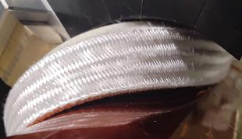
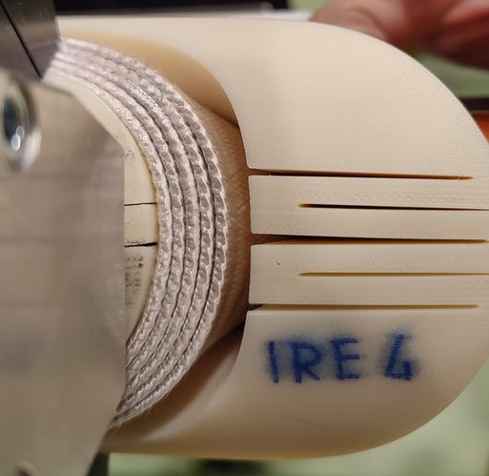
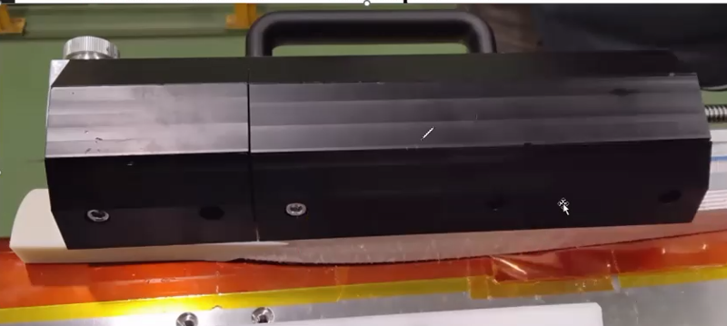
Winding Tests
Winding tests have been performed using bare Cu cable, insulated Cu cable and insulated Nb₃Sn revealing significant differences in the results
Key findings include:
  Turns closer to the pole are less critical, as most of the bending occurs in the easy way
  The most critical turns are those near the midplane, where significant hard way bending is combined with pronounced twisting
  The natural turn angles did not correspond to that designed for the end spacers
  A significant detachment (protrusion) of the accumulated turns from the mandrel has been observed (accumulation is nearly 1 mm/turn)
Courtesy of R. U. Valente

Slide 7
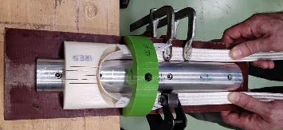
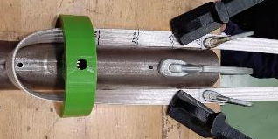
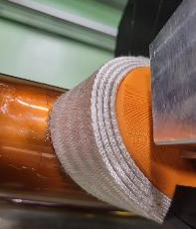
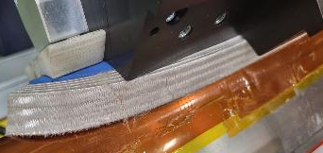
Winding Tests
Free bending tests of the midplane turn have been performed
These tests confirmed the challenges, particularly for short coil ends (~ 100 mm); however, extending the coil end to ~ 200 mm appears to mitigate or solve the issue
To further refine the design, we have been working to extend the end spacers and align them with the natural conductor angles measured during the winding tests
The new design of the end spacers is very promising, but modifications to the winding machine are necessary, so we will repeat the winding tests as soon as the new tooling is finalised
Courtesy of R. U. Valente

Slide 8
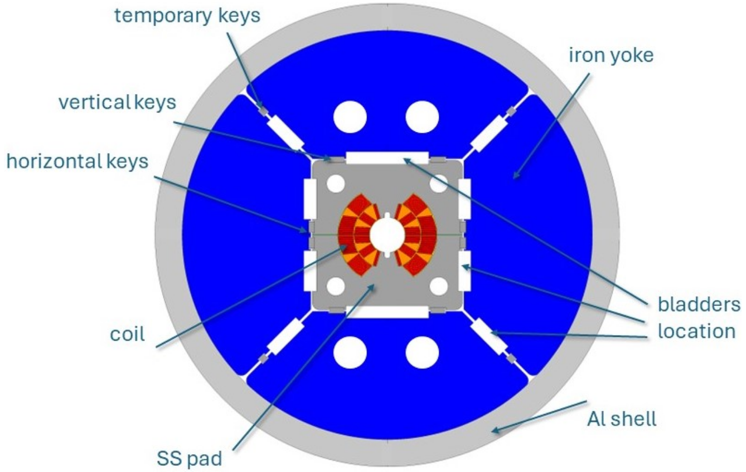
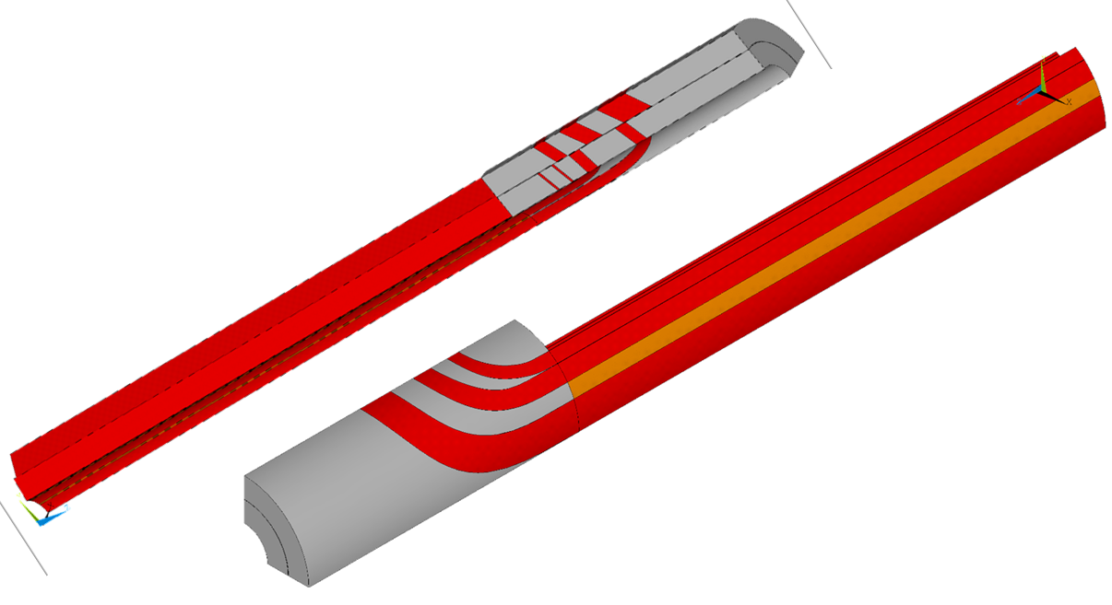
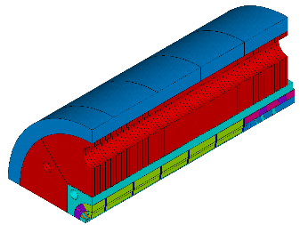
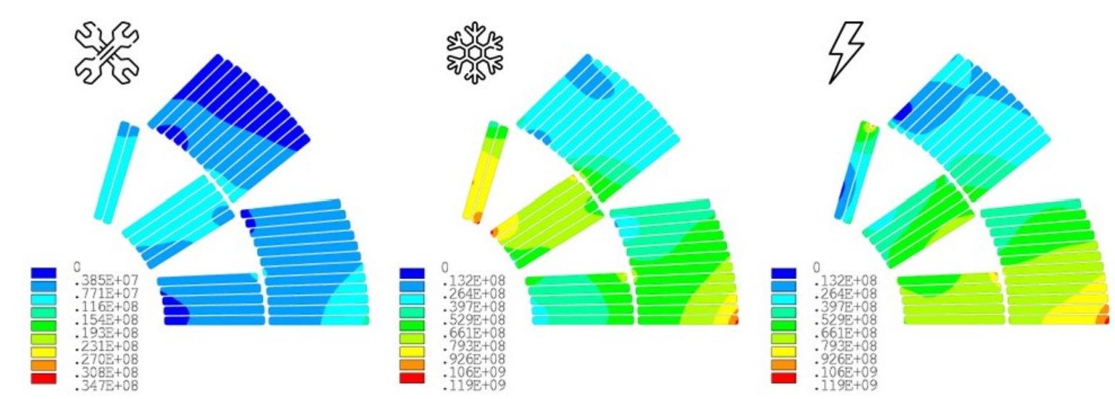
Mechanical Design
The 2D and 3D mechanical design was optimised and finalised
We are working on the definition of the assembly procedure
Courtesy of N. Sala

Slide 9
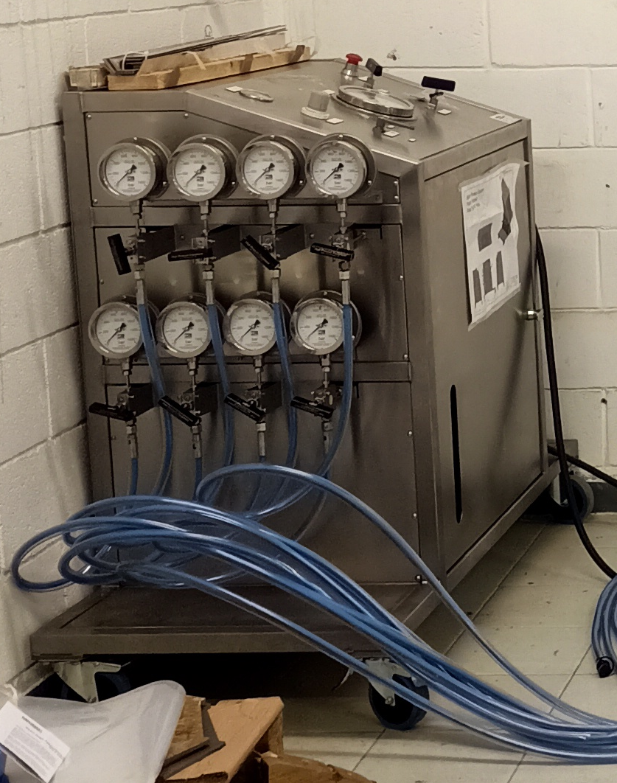
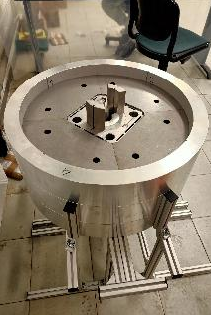
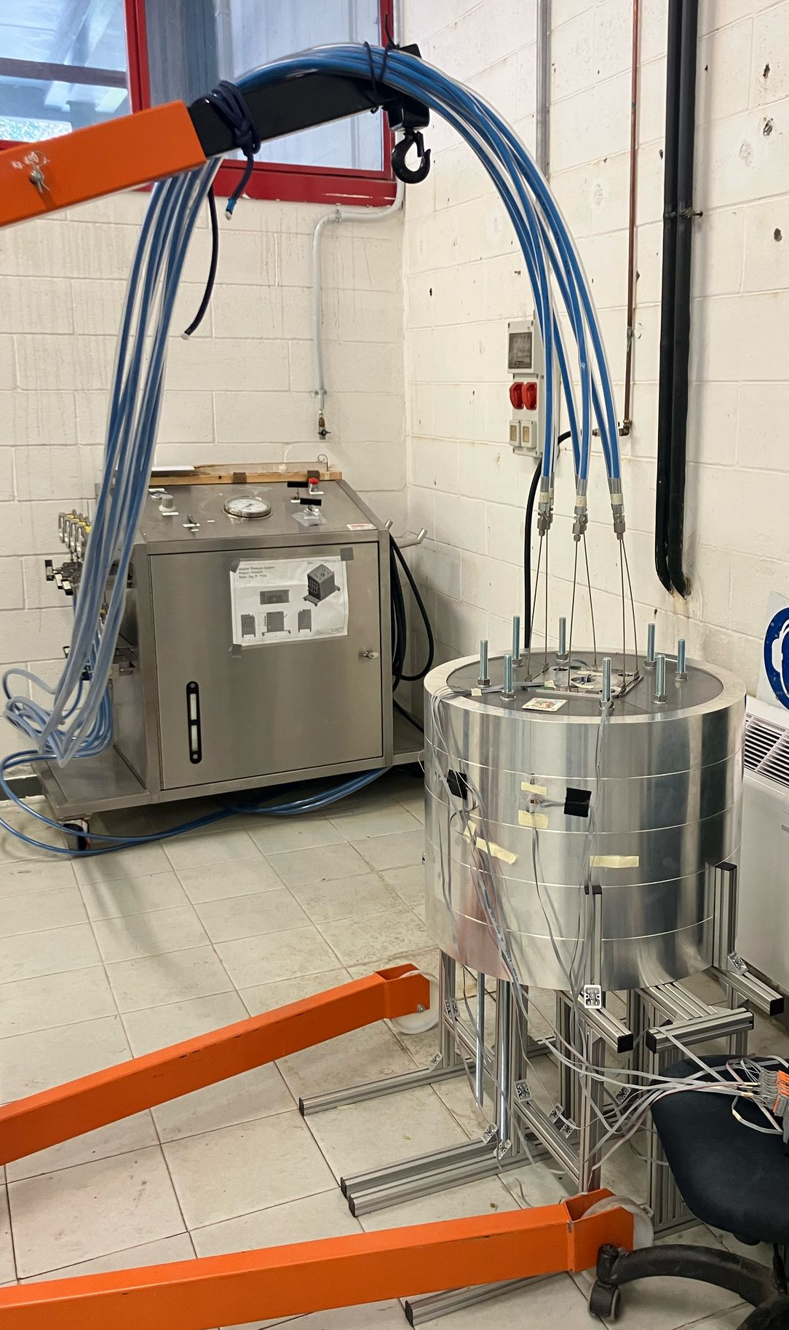
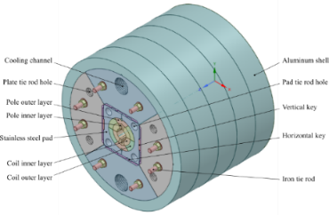
Mechanical Mockup
Consolidation of mechanical FEA to predict stress and strain conditions during B&K assembly
Determining the most efficient assembly sequence
Personnel training to gain specific skills in B&K assembly
The mockup also served as a test of the 8-channel bladder pumping system that we will use for the final assembly of FalconD
500 mm
Courtesy of A. Bersani and A. Gagno

Slide 10
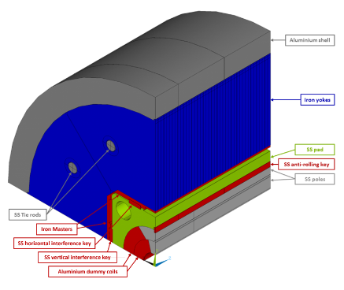
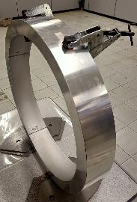
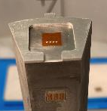
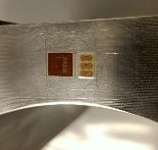
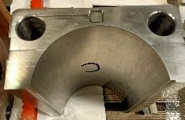
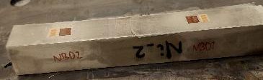
Mechanical Mockup
The mock-up is instrumented with several strain gauges
The measured outer diameter, obtained using a caliper, is in line with FEM model expectations
Analyses on the recorded data by the strain gauge are in progress and will be available in the near future
Courtesy of A. Bersani and A. Gagno

Slide 11
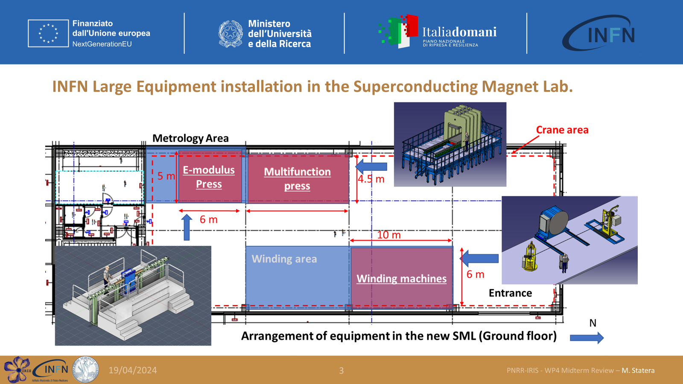
Toward the 14 T Program – LTS Technology
Presently it is in advanced approval phase a new INFN – CERN collaboration to finalizing a 6-year proposal within the HFM R&D Program framework
One of the main goals is to construct a 14 T demonstrator in a cos-theta configuration
The construction will take place at the new IRIS program facility at the LASA laboratory in the consolidated joint work between Milan & Genoa INFN sections
Courtesy of E. De Matteis

Slide 12
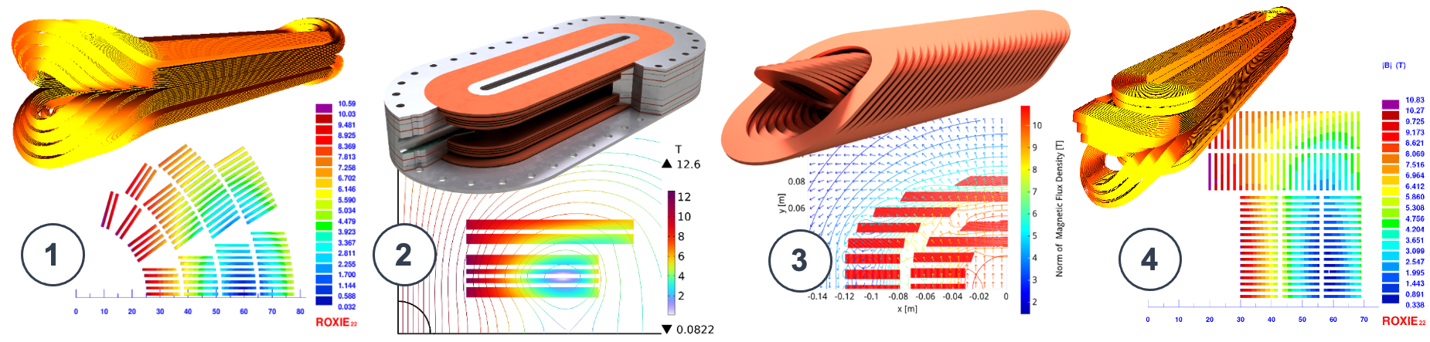
Toward the 14 T Program – HTS Technology
The proposal within the HFM R&D Program framework under discussion with CERN also includes activities focused on HTS
  Study and evaluate multiple configurations of HTS-based (REBCO-type) dipole magnets designed with characteristics suited for accelerator applications
  Design, construct and test a single-aperture, subscale HTS dipole model targeting a central field of 10 T, operating at temperatures between 10 and 20 K
Courtesy of M. Statera

Slide 13
Conclusion
The 2D and 3D electromagnetic and mechanical design of FalconD has been finalized
We are working on the assembly procedure and manufacturing drawings
Through the mockup construction we are getting familiar with the bladder & key assembly procedure, and we are validating our finite element models
As soon as the new winding tooling is available in ASG we will repeat the winding tests with the final optimized design of the end spacers
  If these tests are also successful, we will begin the production of the dummy coil
The program will continue with the new agreement toward a 14 T INFN demonstrator Nb₃Sn dipole and a 10 T demonstrator in REBCO

Slide 14
Thank you for your attention!

