Slide 1

Preliminary technical design for the FCC-ee dipole shielding
A.Romero Francia, A.Perillo Marcone, A.Lechner, B.Humann, R.Seidenberg, M.Calviani [SY-STI]
S.Sgobba, M.Simoes [EN-MME]
22-05-2025

Slide 2
Outlook
Background and motivation.
FCC-ee arc shielding design and development.
  Feasibility Study Report (FSR) design.
  Current conceptual design.
Thermomechanical performance of the shielding.
Challenges, production and logistics.
Conclusions.

Slide 3
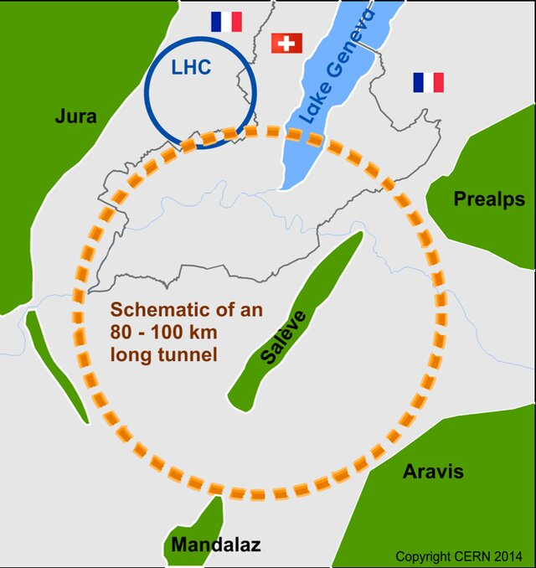
1. Background and motivation
Comprehensive long-term program maximizing physics opportunities.
Stage 1 (from 2040, 15 years): FCC-ee (Z, W, H, ttbar) as Higgs factory, electroweak & top factory at higher luminosities.
Stage 2 (from 2070, 25 years): FCC-hh (~100 TeV) as natural continuation at energy frontier, pp & AA collisions; e-h option.
For stage 1, the synchrotron radiation is too high for standard components. Dedicated shielding is required.

Slide 4
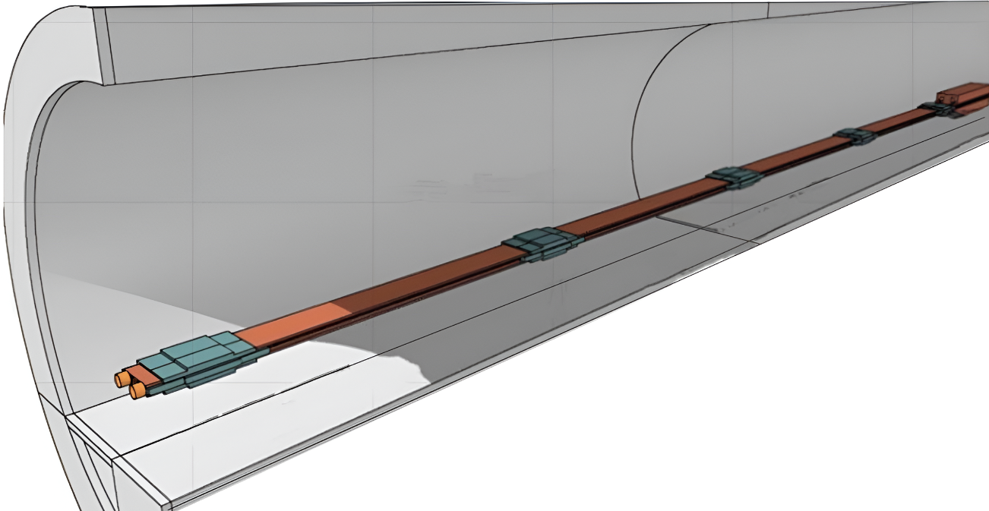
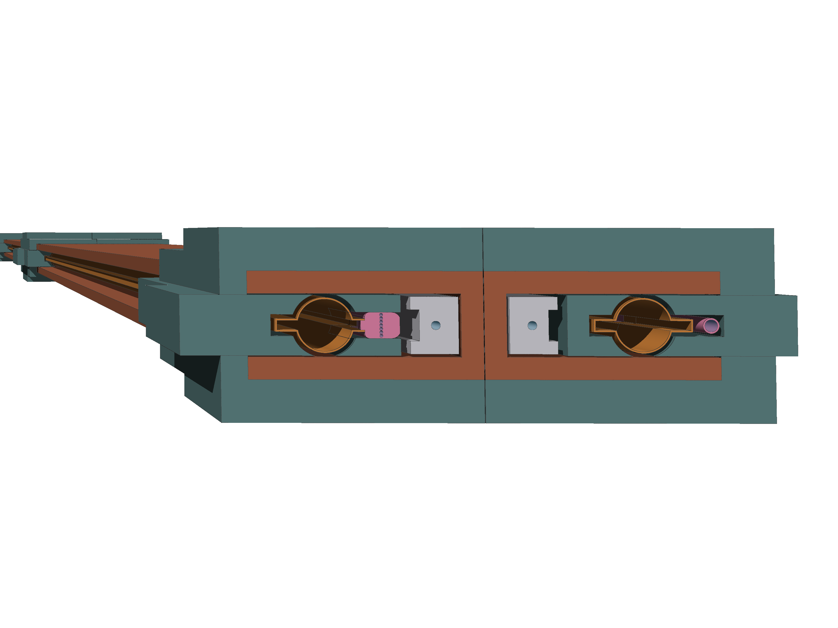
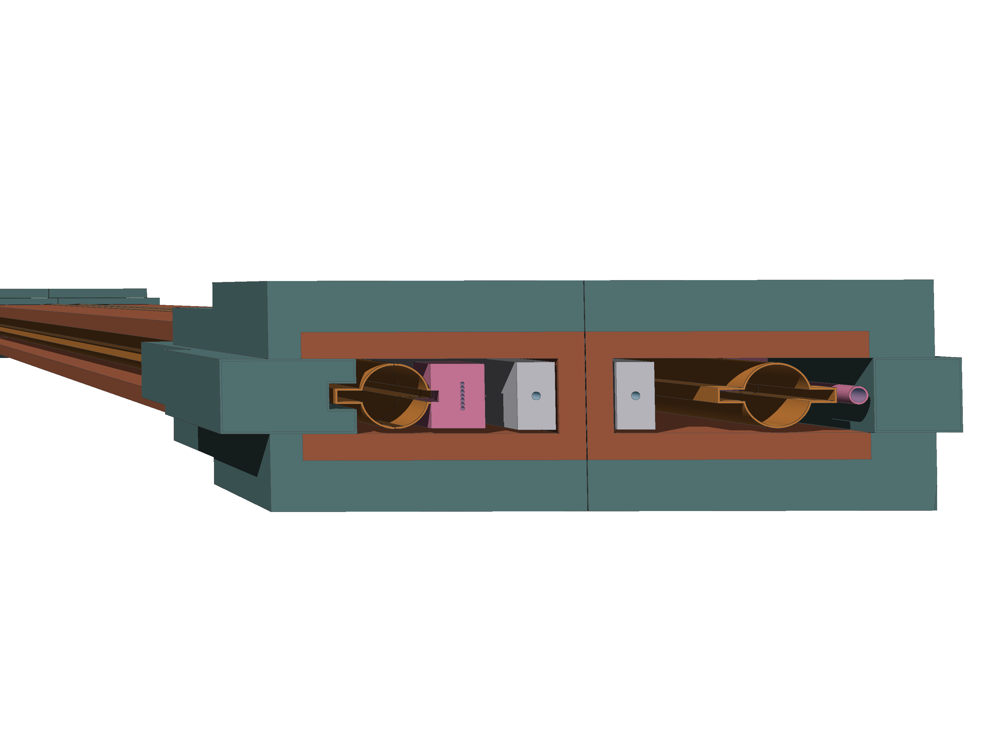
2. FCC-ee arc shielding design and development
Feasibility study report (FSR)
Busbar
Shielding
Shielding material: Pb, Pb(2-4%)Sb
W considered, though high cost.
Vacuum chamber
Current Conceptual design
# Dipoles: 2840
# Photon stoppers per dipole: 10
# Shielding units: 28400
Shielding
Yoke
This presentation provides results for ttbar operation mode.
Photon stopper
Photon stopper design: M.Morrone, R.Ady
Magnet design: J.Bauche, C.J. Eriksson, L.van Freeden

Slide 5
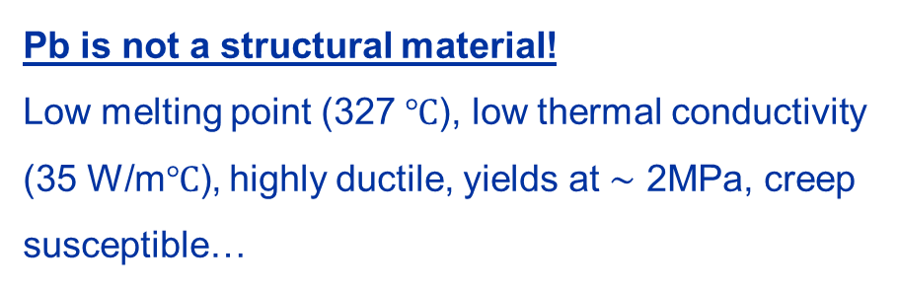
2. FCC-ee arc shielding design and development
Feasibility study report (FSR)
Busbar
Shielding
Shielding material: Pb, Pb(2-4%)Sb
W considered, though high cost.
Vacuum chamber
Current Conceptual design
Pb is not a structural material!
Low melting point (327 $℃$), low thermal conductivity (35 W/m$℃$), highly ductile, yields at $\sim$ 2MPa, creep susceptible…
Shielding
Yoke
Photon stopper
This presentation provides results for ttbar operation mode.
Photon stopper design: M.Morrone, R.Ady
Magnet design: J.Bauche, C.J. Eriksson, L.van Freeden

Slide 6
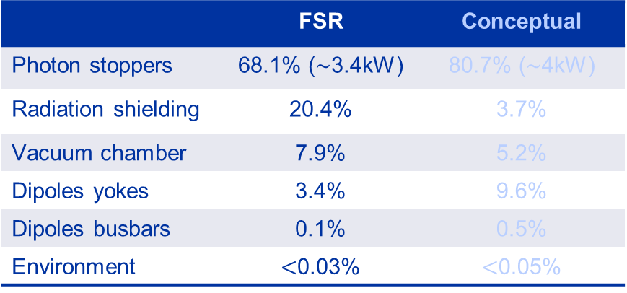
2. FCC-ee arc shielding design and development
Feasibility study report (FSR)
 | FSR | Conceptual
Photon stoppers | 68.1% ($\sim$3.4kW) | 80.7% ($\sim$4kW)
Radiation shielding | 20.4% | 3.7%
Vacuum chamber | 7.9% | 5.2%
Dipoles yokes | 3.4% | 9.6%
Dipoles busbars | 0.1% | 0.5%
Environment | $<$0.03% | $<$0.05%
Busbar
Shielding
Vacuum chamber
Current Conceptual design
Higher energy deposited on shielding units.
Very complex integration within the dipole.
Higher complexity for series production.
Shielding
Yoke
Photon stopper

Slide 7
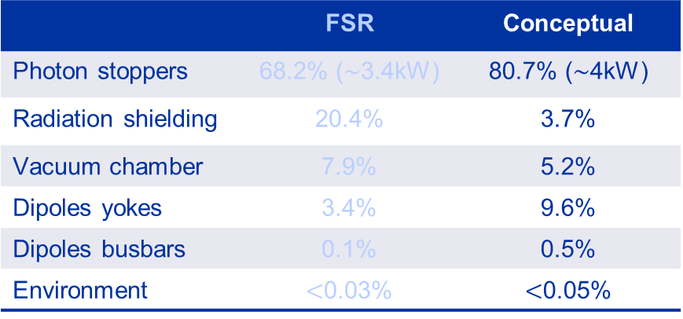
2. FCC-ee arc shielding design and development
Feasibility study report (FSR)
 | FSR | Conceptual
Photon stoppers | 68.2% ($\sim$3.4kW) | 80.7% ($\sim$4kW)
Radiation shielding | 20.4% | 3.7%
Vacuum chamber | 7.9% | 5.2%
Dipoles yokes | 3.4% | 9.6%
Dipoles busbars | 0.1% | 0.5%
Environment | $<$0.03% | $<$0.05%
Busbar
Shielding
Vacuum chamber
Current Conceptual design
Lower energy deposited on shielding units.
Easier integration within the dipole.
Lower complexity for series production.
Shielding
Yoke
HEAT CANNOT BE RELEASED TO THE TUNNEL!
Photon stopper

Slide 8
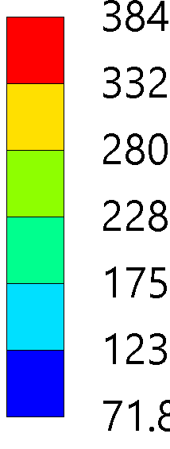
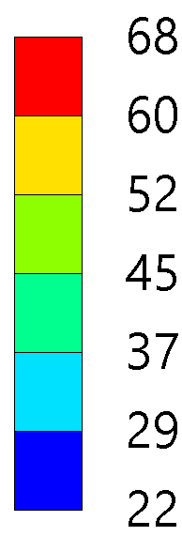
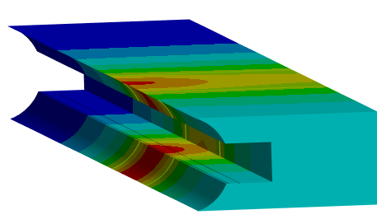
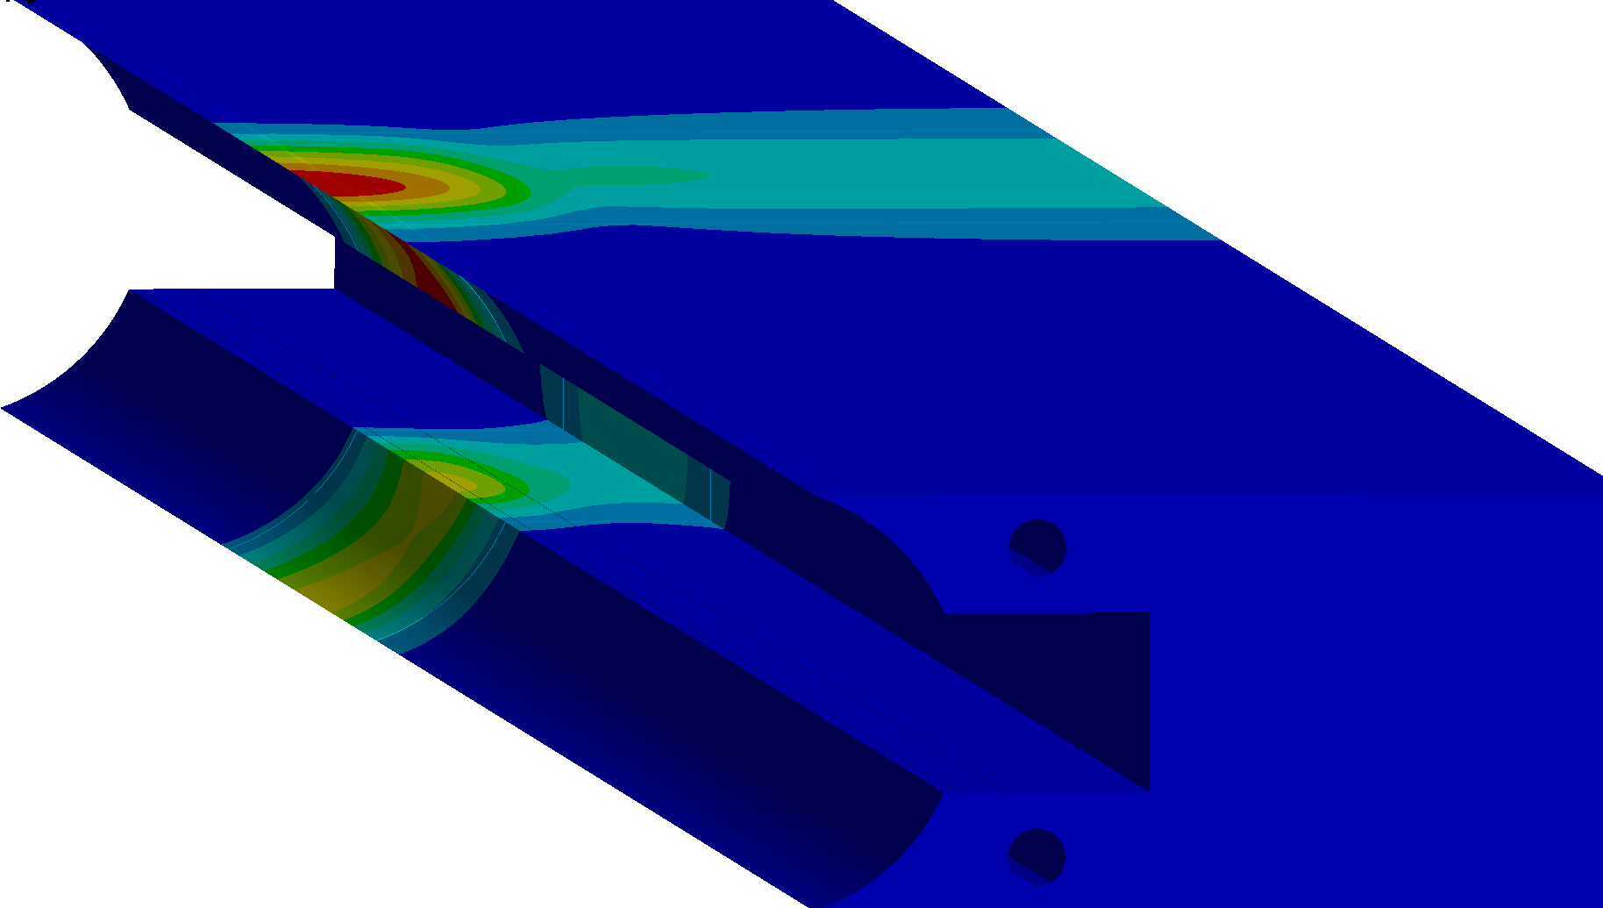


2.1 FSR shielding thermal management
Feasibility study report (FSR) shielding
Shielding block with peak energy deposition $\sim$ 640 W.
Only this block was modelled, as this conceptual approach is impractical to implement.
Calculations in steady state ttbar mode.
8-mm diameter SS pipes in cast lead.
Forced Convection water (0.75l/min)
MELTING (327 °C)!
Pure Lead
Pure Lead
Adding cooling
Cooling pipes
Only natural convection
Temperature [$°$C]
Temperature [$°$C]
natural convection + water cooling
Input energy maps by B.Humann and A.Lechner

Slide 9
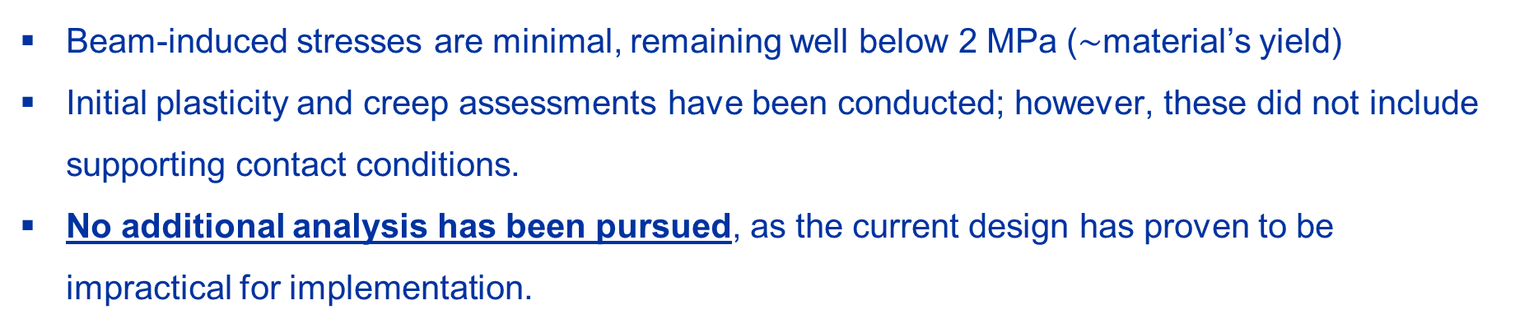
2.1 FSR shielding structural behavior
Feasibility study report (FSR) shielding
Shielding block with peak energy deposition $\sim$ 640 W.
Only this block was modelled, as this conceptual approach is impractical to implement.
Calculations in steady state ttbar mode.
Beam-induced stresses are minimal, remaining well below 2 MPa ($\sim$material’s yield)
Initial plasticity and creep assessments have been conducted; however, these did not include supporting contact conditions.
No additional analysis has been pursued, as the current design has proven to be impractical for implementation.

Slide 10
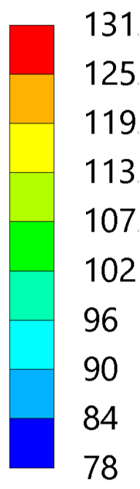
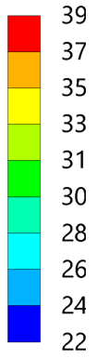
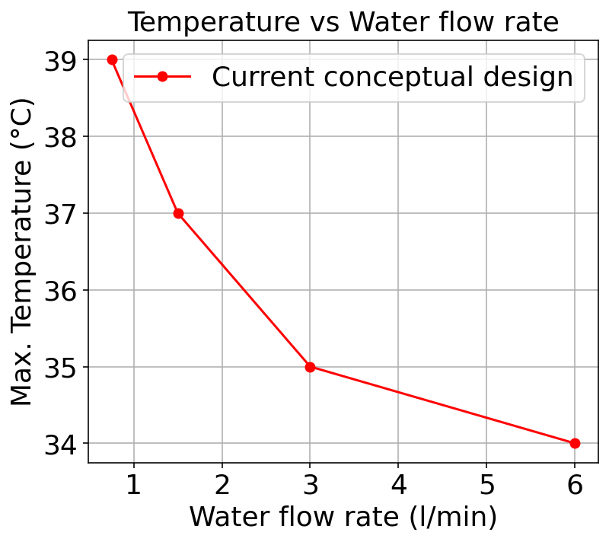
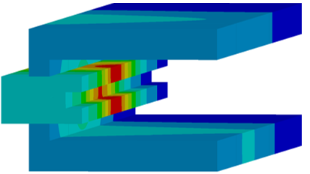
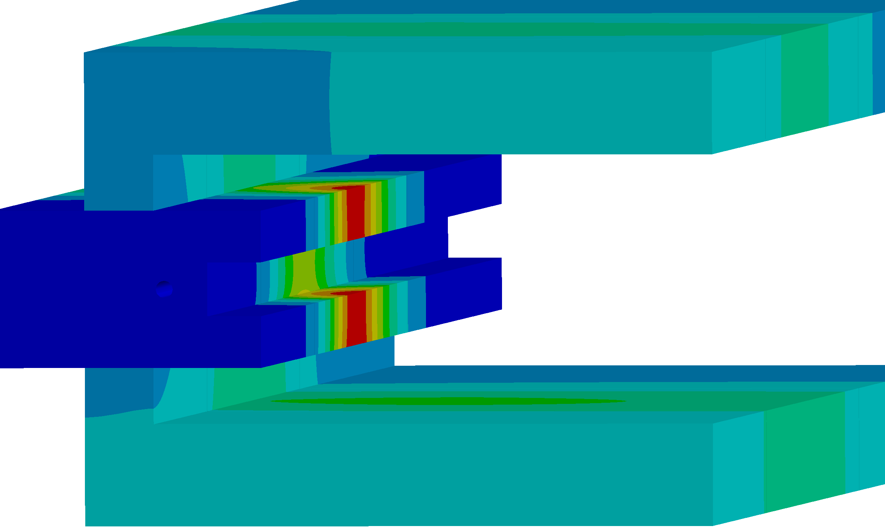


2.2 Conceptual shielding thermal management
Current conceptual design
Shielding block with peak energy deposition $\sim$ 130 W.
Entire shielding unit modelled.
Calculations in steady state ttbar mode.
NO MELTING!
Pure Lead
Pure Lead
Pure Lead
Adding cooling
Cooling pipe
Only natural convection
Temperature [$°$C]
Temperature [$°$C]
natural convection + water cooling
Input energy maps by B.Humann and A.Lechner

Slide 11
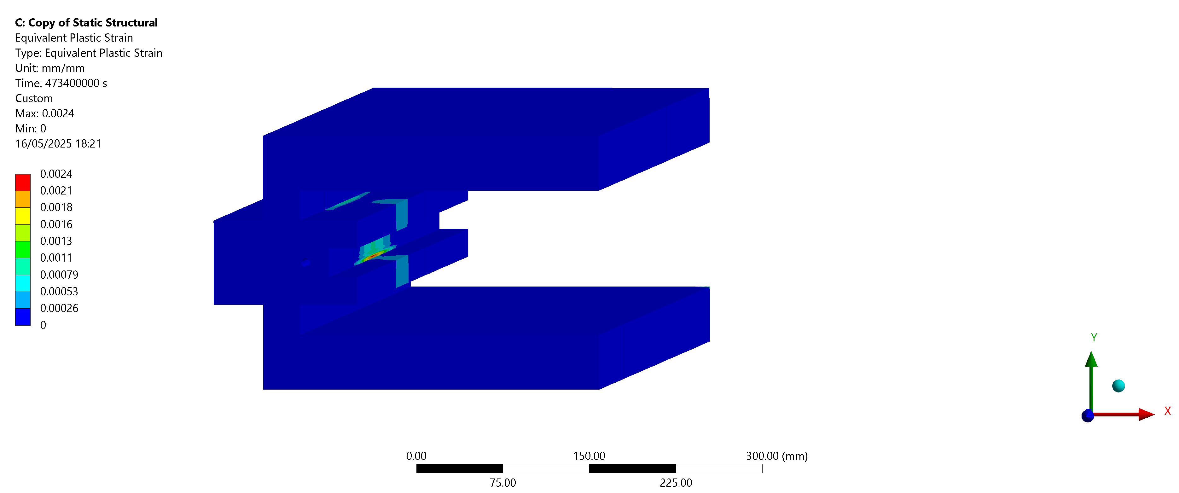
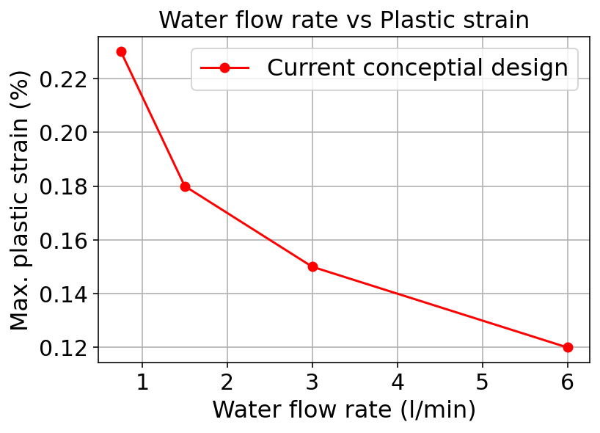


2.2 Conceptual shielding structural behavior
Beam-induced plastic deformation
Calculations in steady state ttbar mode.
Pure Lead
Cooling pipe
Equivalent plastic strain [mm/mm]
Water flow rate $\sim$ 1 l/min

Slide 12
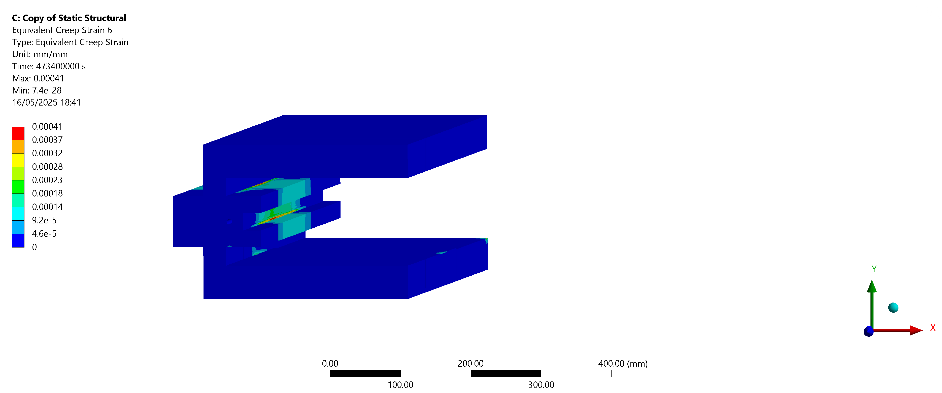
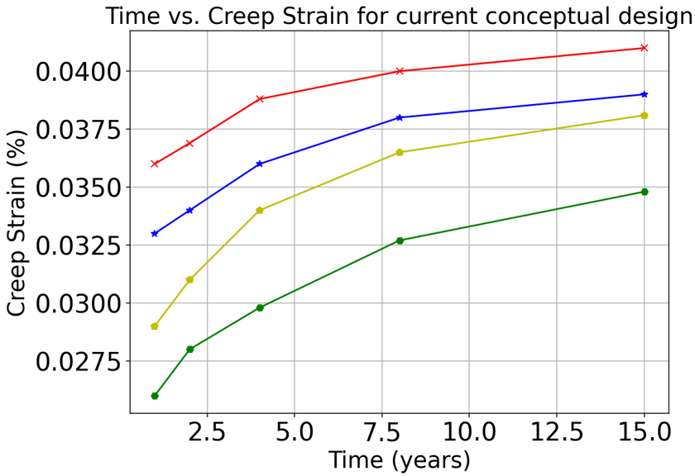
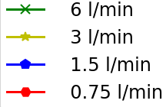
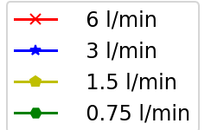
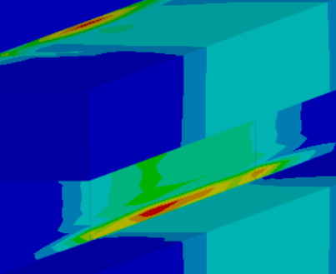
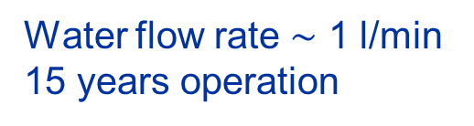
2.2 Conceptual shielding structural behavior
Beam-induced creep deformation
Calculations in steady state ttbar mode.
Pure Lead
Equivalent creep strain [mm/mm]
Water flow rate $\sim$ 1 l/min 15 years operation

Slide 13
Conclusions
from thermomechanical simulations…
The FSR shielding is impractical for implementation, though temperature and beam-induced stresses are manageable.
The conceptual design results in low beam-induced stresses, which means that after 15 years of steady operation, the structure does not experience significant deformation.

Slide 14
3. Challenges, production and logistics
Design and material selection
Pb
Pb
Due to in-series production, what are our design limitations?
Adding Sb into Pb improves strength, though its high-cost limits use to critical areas.
Pb(2-4%)Sb
Pb
Pb
Pb
Supports and interfaces
Example for material selection proposal.
The Pb shielding wraps around the dipole magnet, fully encasing it. However, it must not support its weight, as this would lead to deformation over time due to creep.
Integration within the dipole
The shielding fits well around the dipole, but contact points need definition. Top/bottom plate cooling relies on surrounding components to be cooled.

Slide 15
3. Challenges, production and logistics
Actively cooled plates
Embedded stainless steel pipe in cast lead
Stainless steel pipe cladded into two plates
Lowest thermal contact resistance.
Involves casting: higher complexity and cost.
Requires of a mould.
Higher thermal contact resistance.
Lower complexity.
Does not require of a mould.
Other options…
Cooling by forced gas convection instead of water (no stainless-steel pipes needed *).
Cooling by conduction, attaching a high conductivity body to the shield.
*: Water cannot be in contact with activated lead to avoid erosion-corrosion problems, as maintenance in the cooling loops would be extremely challenging (experience from nTOF#2).

Slide 16
3. Challenges, production and logistics
Transport, storage and installation
Transport capacity: 10k–15k t of Pb, using dedicated trucks (~25 t per transport).
With a 3 - 5 year production timeline, Pb must be stored in dedicated facilities.
Heavy Pb plates can imply significant deformations; straightening capability required before installation.
Safety, dismantle and recycle
Pb is a toxic material for humans. Radioactive resistance coatings are being studied to avoid direct contact with operators.
Pb is to be re-used/recycled after FCC-ee.
Next steps
Prototype construction and potential implementation in the arc cell mock-up.

Slide 17
4. Conclusions
Ongoing work focuses on optimizing the radiation shielding for the FCC-ee arc. Design implementation in collaboration with MME, VSC and MSC.
Thermomechanical simulations conducted so far have not revealed any critical issues.
Active cooling of the shielding is necessary to manage temperature, limit beam-induced stresses, and prevent heat dissipation into the tunnel environment.
Investigations are underway into methods for integrating stainless steel cooling pipes within the lead shielding.
The logistical challenges associated with large-scale production are currently being assessed; ongoing studies to optimize cost and design efficiency.

