Slide 1
Magnet's circuits and system optimisation update
FCC Week 2025
19 – 23 May 2025
Vienna, Austria
B. Wicki, S. Pittet, D. Aguglia, M. Colmenero Moratalla
CERN
Accelerator Systems (SY Dept.), Electrical Power Converter (EPC Group)
Many thanks to:
J. Bauche, C. Jaermyr Erikson, L. Von Freeden and H. Deveci, TE-MSC
M. Parodi and C. Marcel, EN-EL
J.-P. Burnet, ATS-DO
S. Valette and B. Bouvet, HSE-ENV
G. Peon and I. Martin Melero, EN-CV
T. Paul Watson and L. Bromiley, SCE-DOD
F. Valchkova-Georgieva, EN-ACE

Slide 2
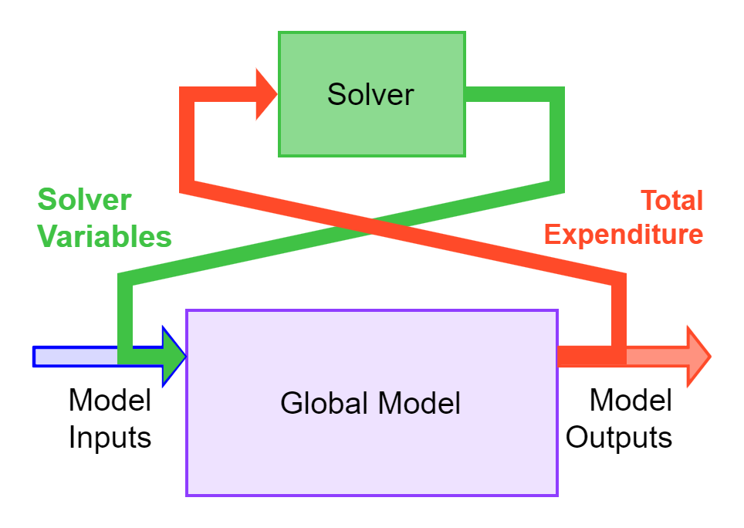
Table of Contents
  Global Model :
    Submodels
    Parameters Consideration
    Price and Constraints Consideration
  Power Converters Submodel :
    Top-Down Price Estimation
    Circuits Optimisation
  What's new from 2024
  Global Optimisation Scenarios Results :
    Minimising TOTEX
    Minimising CO2 Equivalent Mass
    Changing OPEX Weighting Factor
  Conclusion

Slide 3

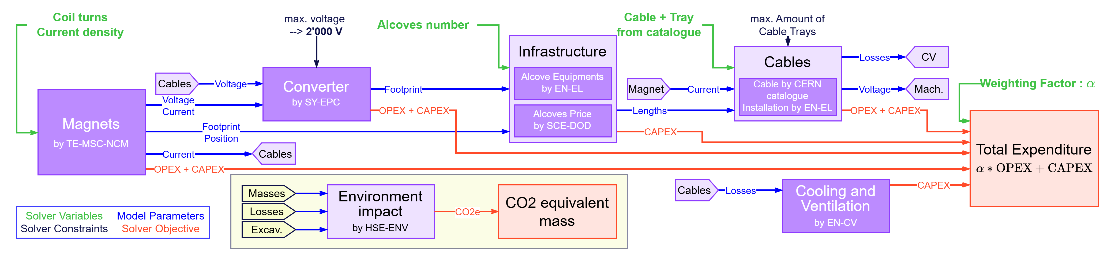
Submodels of Global Model
The global model is composed of multiple interconnected sub-models, each intricately linked.
Every sub-model is tailored to represent a distinct segment of the broader system.
The Total Expenditure is the Sum of the Capital and Operational Expenditure of each submodels :
  Magnets TE-MSC-NCM with script modelling MSC’s magnets.
  Power Converters SY-EPC with existing converters + adjustment to FCC’s need.
  Cables + Cable-Trays EN-EL with CERN Catalogue.
  Alcoves SCE-DO with Mid Term Review’s data given by SCE.
  Electrical Equipment EN-EL with EN-EL Catalogue.
  Cooling and Ventilation EN-CV with Mid Term Review’s data given by CV.

Slide 4
Parameter Consideration of Global Model
Parameters taken into account :
  Magnets : Material quantity, Power losses
  Power Converters : Material quantity, Power losses
  Cables + Cable-Trays : Material quantity, Power losses, Installation
  Alcoves : Volume, Schedule change
  Electrical Equipment : Equipment in alcoves
  Cooling and Ventilation : Equipment upgrade needed to accommodate Cable’s power losses
  Environment Impact : Material quantity, Power losses, Alcove excavation (excavation, transport and disposal)
The current submodels were chosen as most representative of current input parameters.

Slide 5
Price Consideration and Constraints of Global Model
Price consideration taken in the global model :
  Electricity cost for 15 years of operation, integrated energy levels considering machine OP cycles.
  Booster mean power with top-up filling scheme as OPEX.
  Length of cable for each circuit is considered as CAPEX and OPEX.
  Alcove volume and schedule change are considered as CAPEX.
    Schedule change has other impacts beyond cost.
Other parameters accounted for :
  Space taken in the cable trays
  Number of alcoves
  Power losses in the air for cooling limits
  Maximum voltage for cable isolation
  Water cooling performance of magnet
Pricing Model Not Accounted for :
  Uninstallation of equipment
  OPEX of Cooling and Ventilation
  Radiation protection
  …

Slide 6
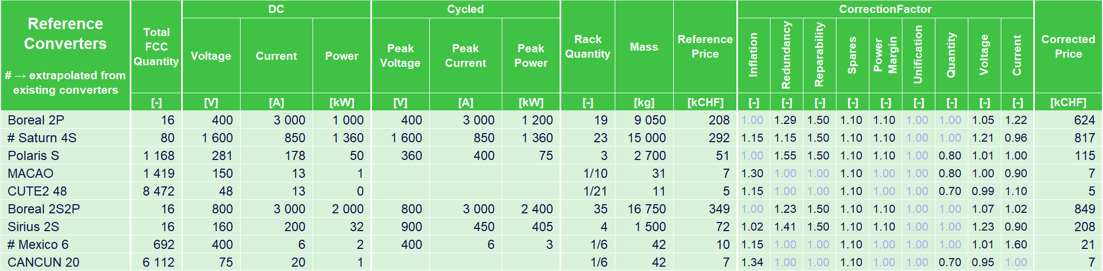
Power Converters : Top-Down Price Estimation
We use a top-down approach to estimate the price of the converters for each circuits:
  We listed all power converters built by the group with their parameters and price.
  The closest converter to the needed circuits parameters is found.
  Correction factors are applied the reference price, to suit the circuits need in term of availability, reparability, voltage difference, etc... → The corrected price is calculated.
A more refined approach will be realised in the future.
Sextupoles cost a lot
1 168
50
75
115
1 419
1.00
8 472
Lots of Sextupoles and Correctors
1.00
Correctors converters aren't redundant
692
1.00
6 112
1.00

Slide 7
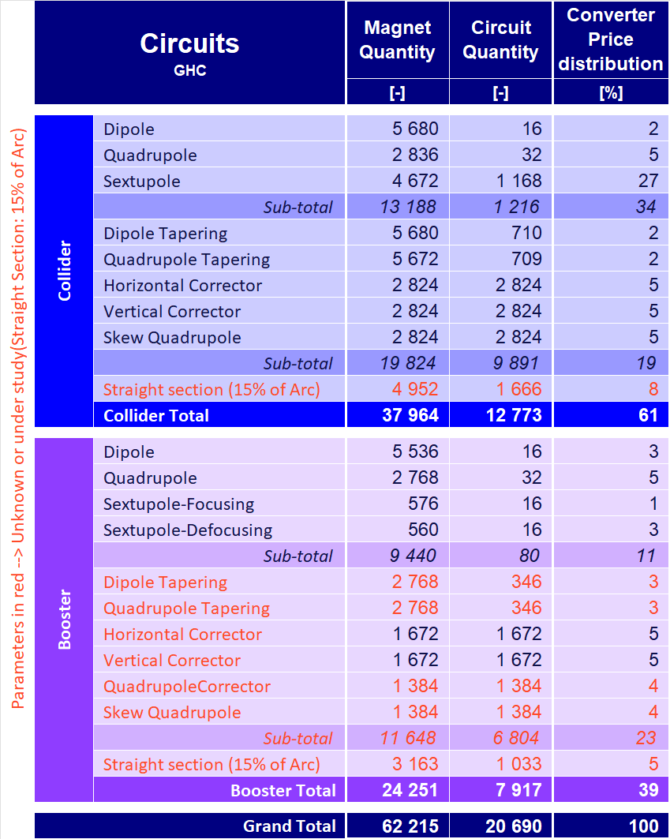
Power Converters : Circuits Optimisation
The collider and booster rely on many sextupole and correctors circuits, each of which cost a substantial amount.
Corrector magnets take 42% of total cost
With redundant converters, the price will increase significantly.
Circuit count vs consumption
Can we reduce the number of circuit or their power consumption ?
Criticality assessment
How many circuit can fail before we lose the beam ?
Targeted redundancy
By applying redundancy at the system level where possible and having redundant converters when needed, we can reduce considerably the overall cost.

Slide 8
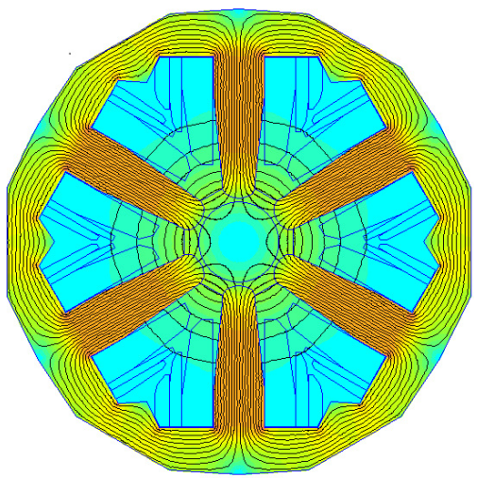
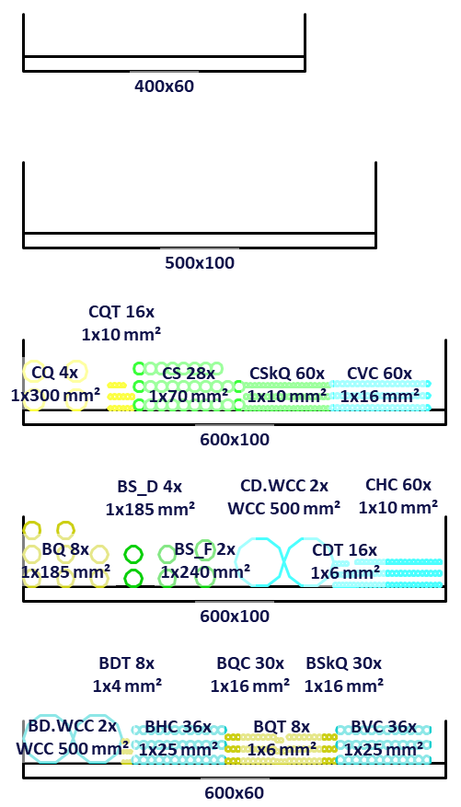
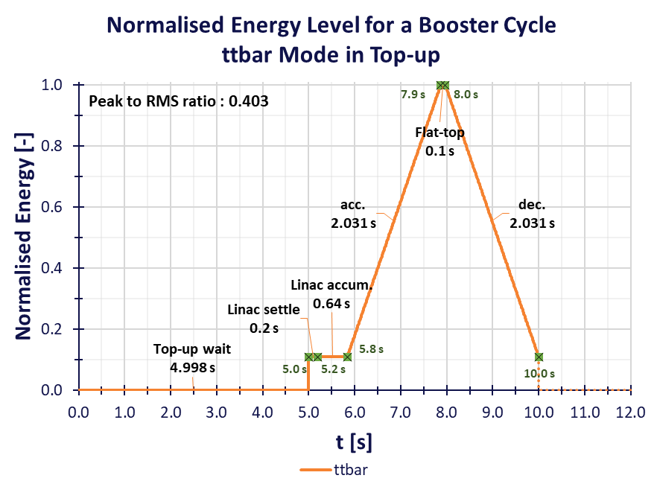
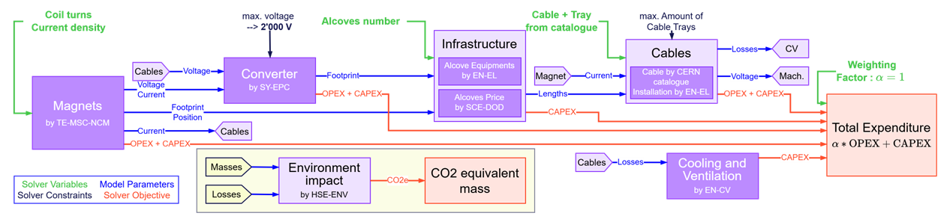
What's new from 2024
More space on cable trays
→Space constraint has lower impact on the price
Fixed Top-up mode on the booster cycle.
Modelling of the CO2 equivalent mass.
Collider and booster magnet parameters
tweaked and fixed with the magnet team.
Started development of python-based models
and solver.

Slide 9
Global Optimisation Scenarios Results
Following slides present optimised solutions, with varying constraints.
The objective being: reaching an Optimum Total Expenditure while complying with constraints.
But what is an optimum expenditure ? lowest TOTEX ? lowest OPEX ? lowest CAPEX ?
By minimising the expenditures, minimising the CO2 equivalent mass or by adjusting the OPEX weighting factor, we can achieve different optimum suiting to the needs of the project.

Slide 10
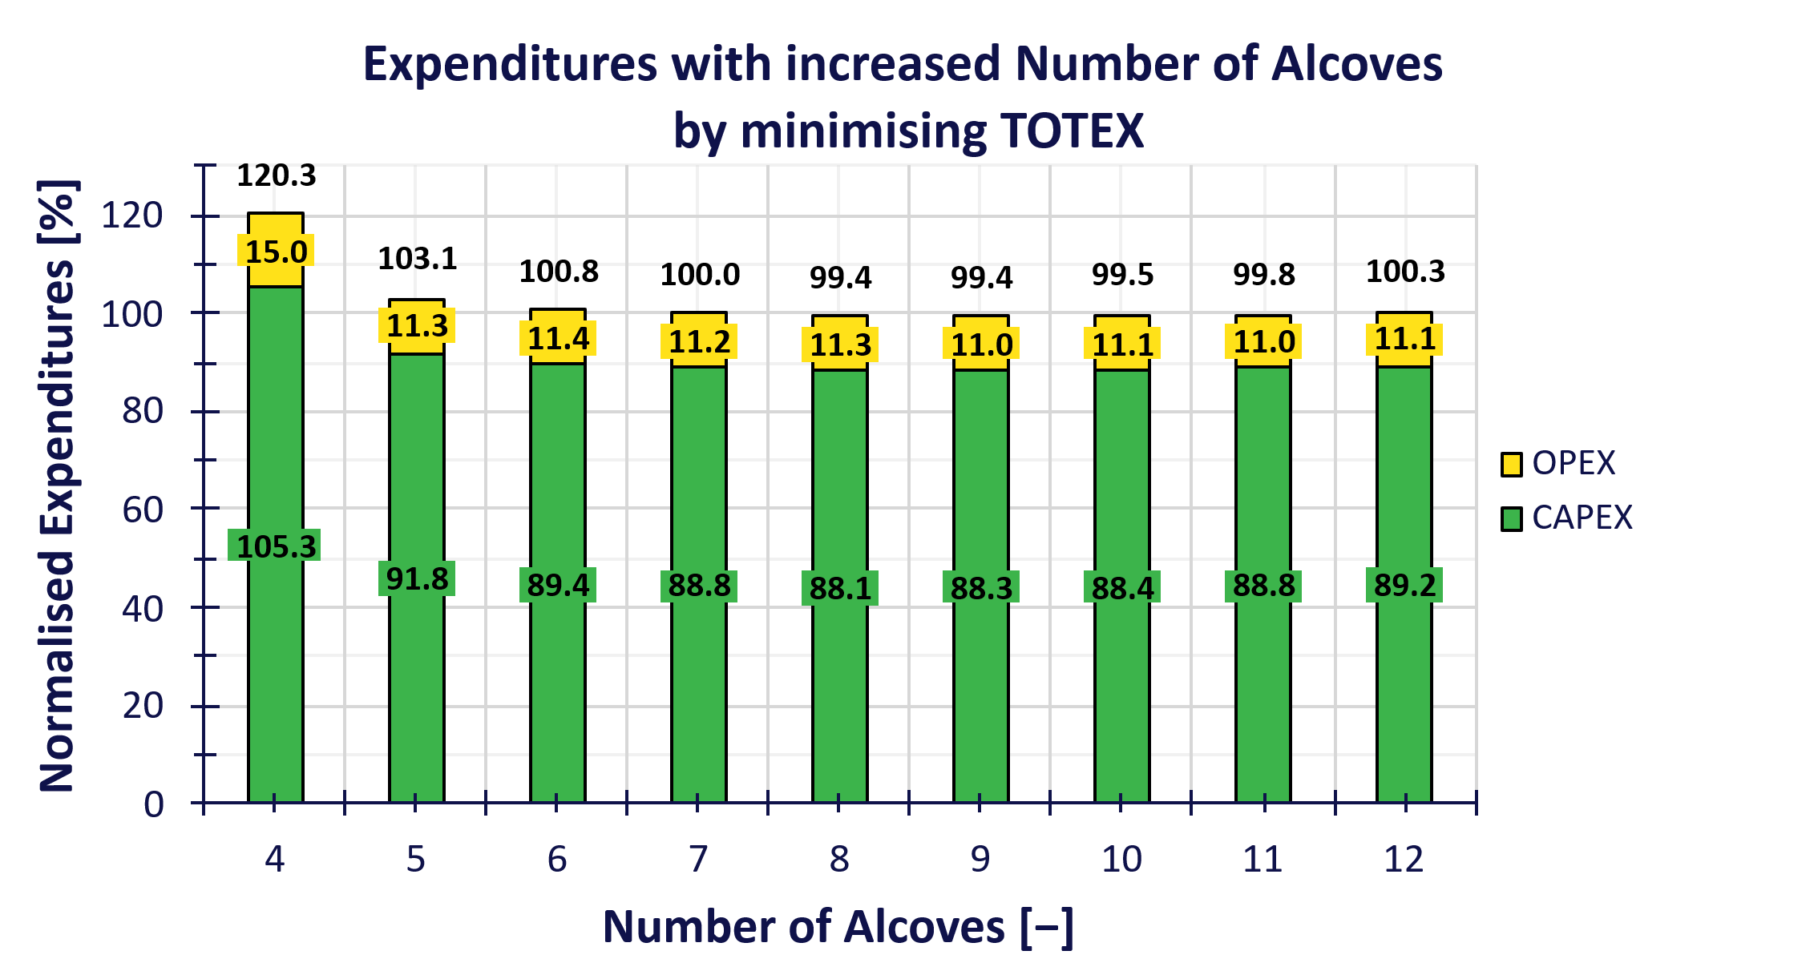
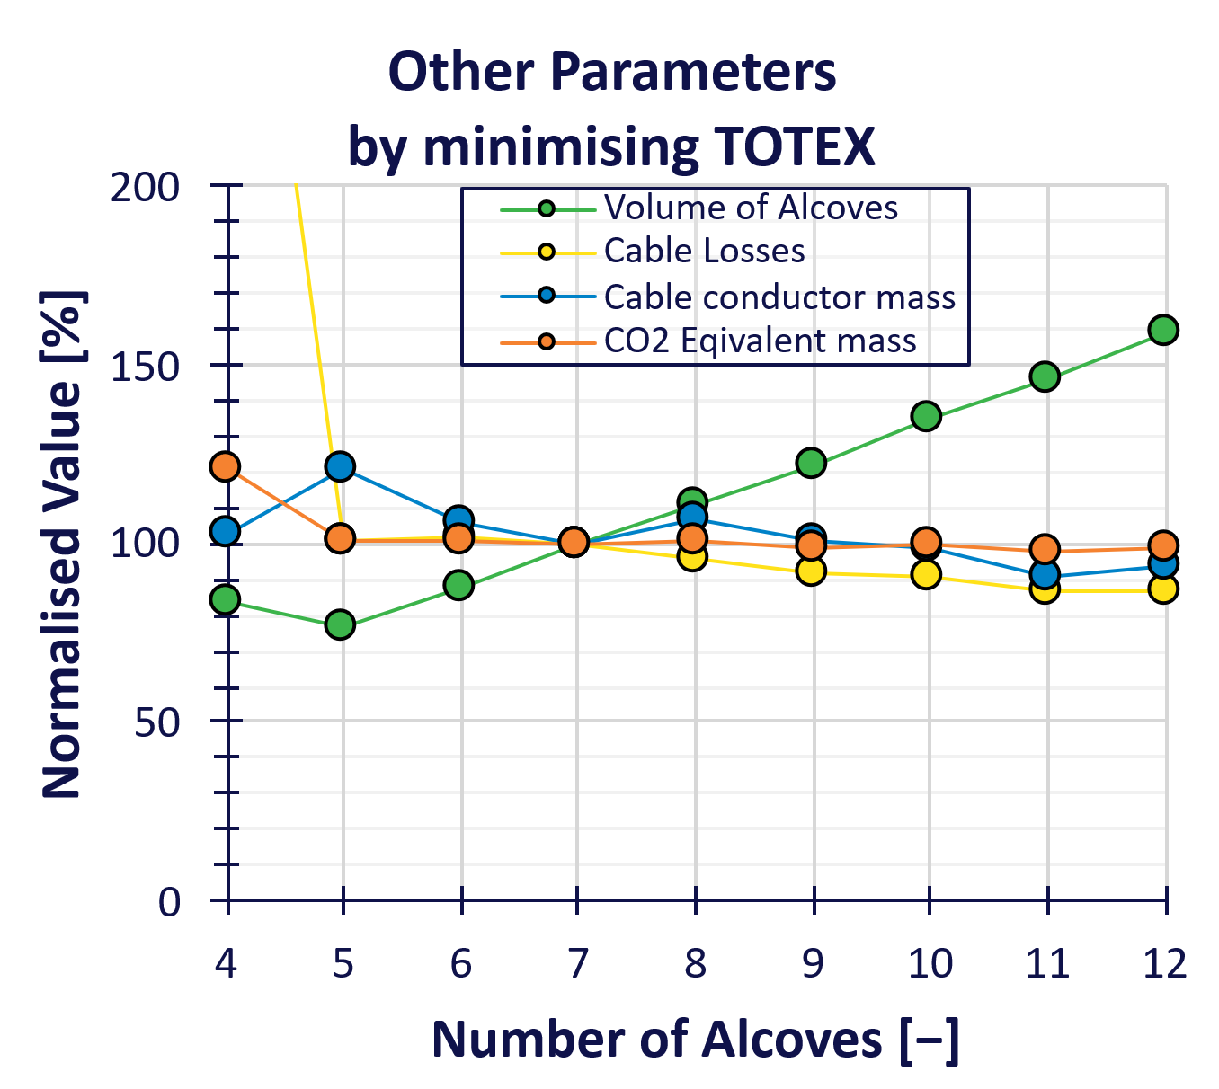

Varying Number of Alcoves by Minimising TOTEX
⮩ detailed expenditures
in annexe
$$TOTEX=α∗OPEX+CAPEX, α=1$$
Baseline
Impact on losses without change in expenditures.
With more space in the cable trays, the space constraint is relaxed.
And as such the total expenditure doesn't move as much with the increase in number of alcoves.
But we can still see an impact on the cable losses in the arc, with more alcoves.
Beyond the capital expenditure, the number of alcoves has a non-negligible impact on the schedule.

Slide 11
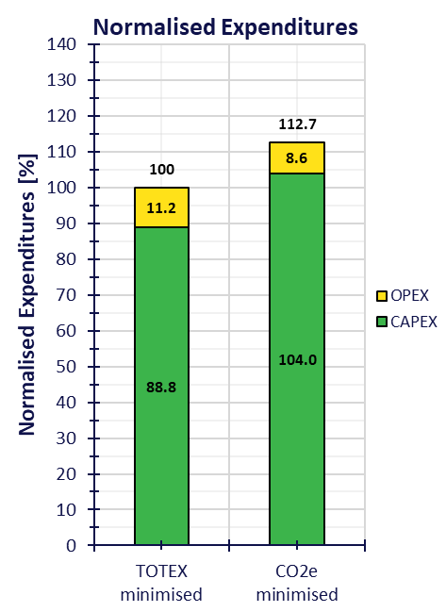
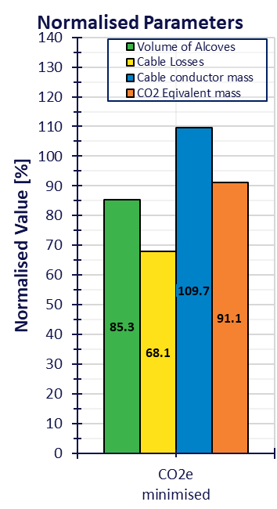
Minimising CO2 Equivalent Mass With 7 Alcoves
⮩ detailed expenditures
in annexe
Instead of minimising the total expenditure, we can optimise the CO2 Equivalent mass and still plot the total expenditure normalised to the baseline values at 7 alcoves when optimising TOTEX.
We can see that
with 10% increase in expenditure,
we reduce by 10% the CO2e mass
and by 30% the cable losses in the arc.
CO2e of alcoves excavation is included

Slide 12
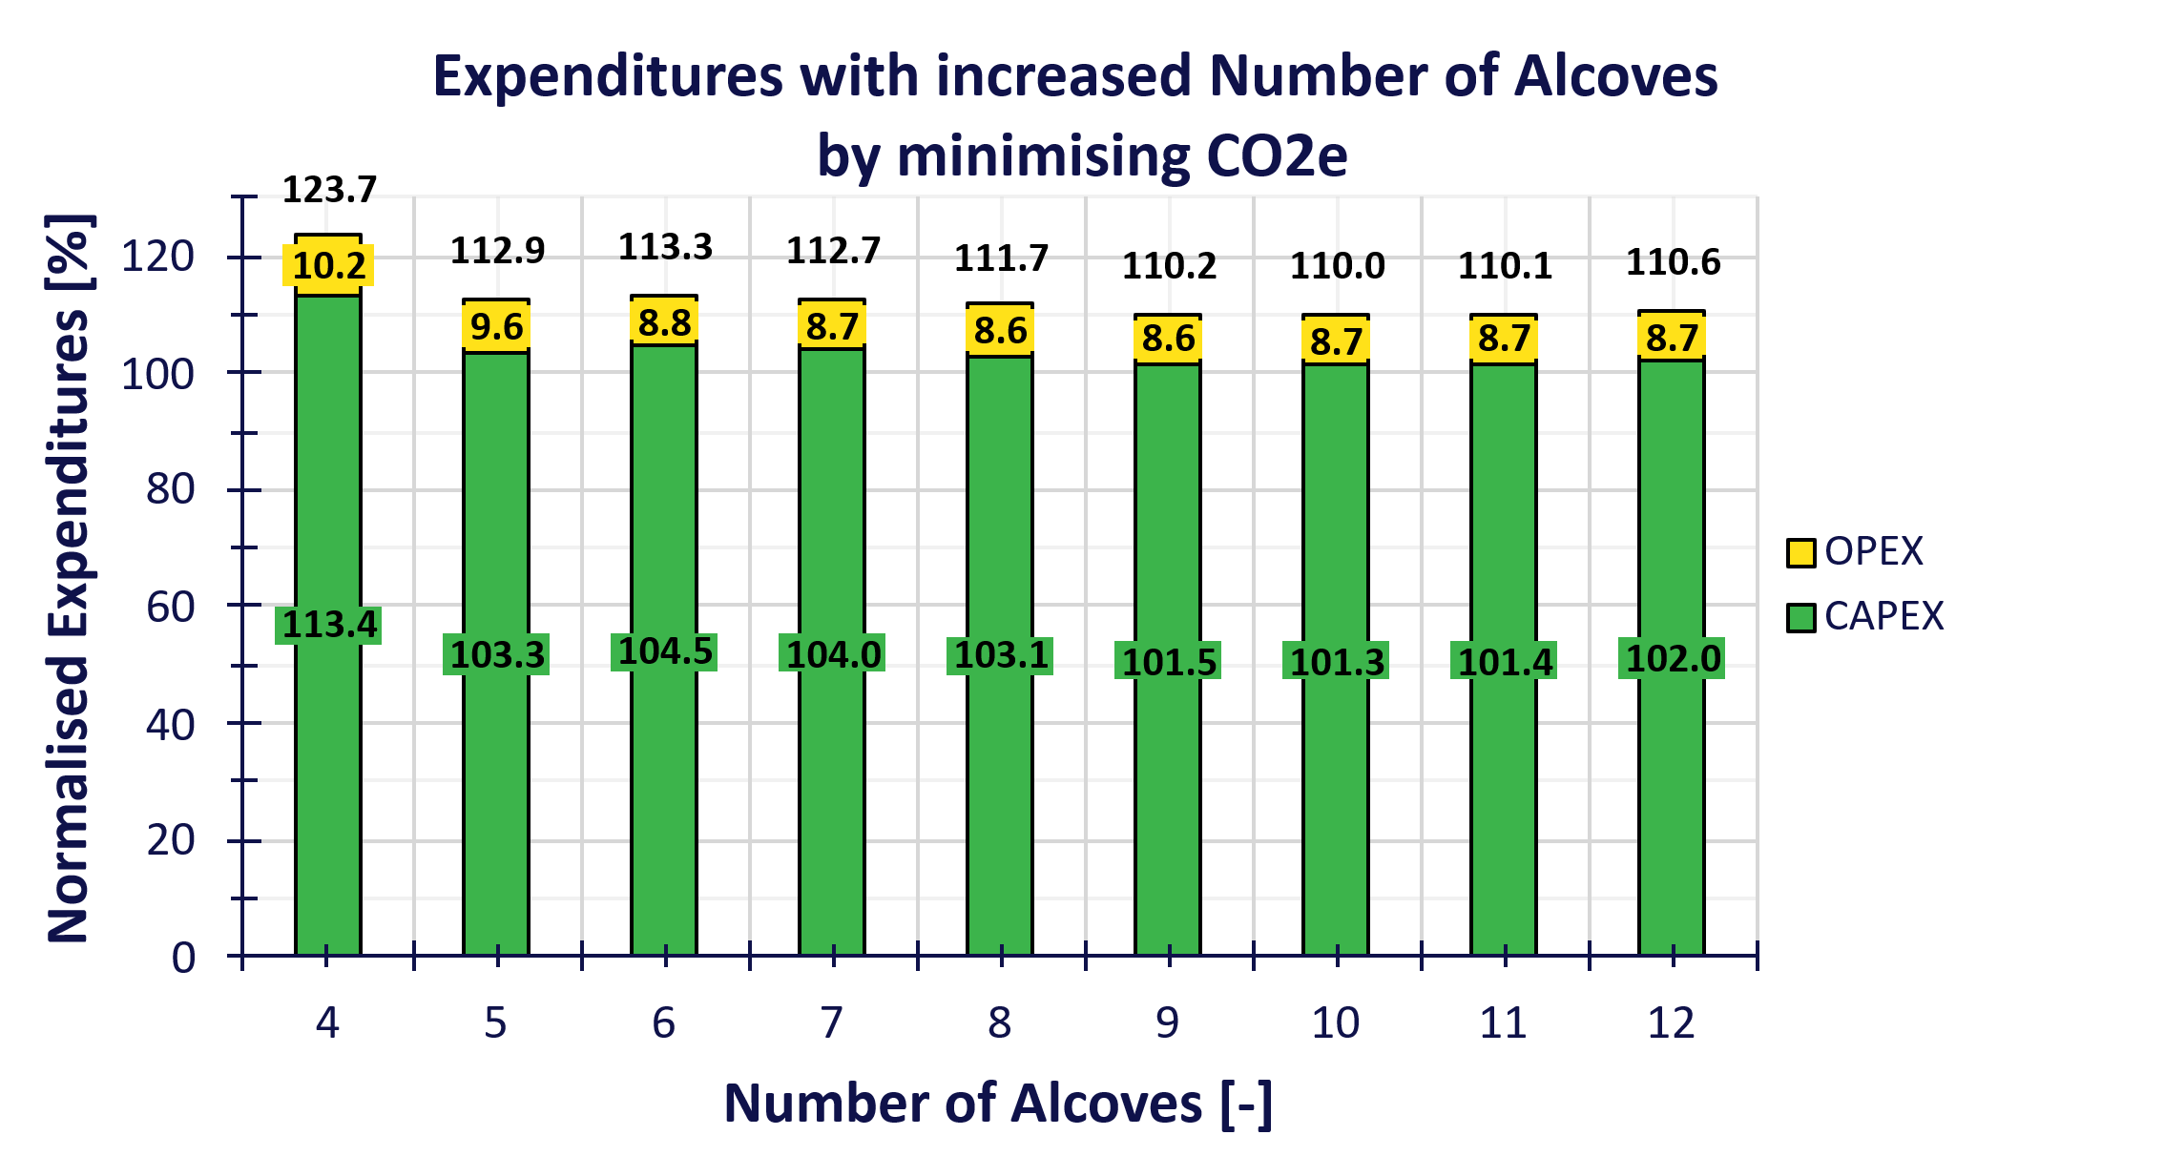
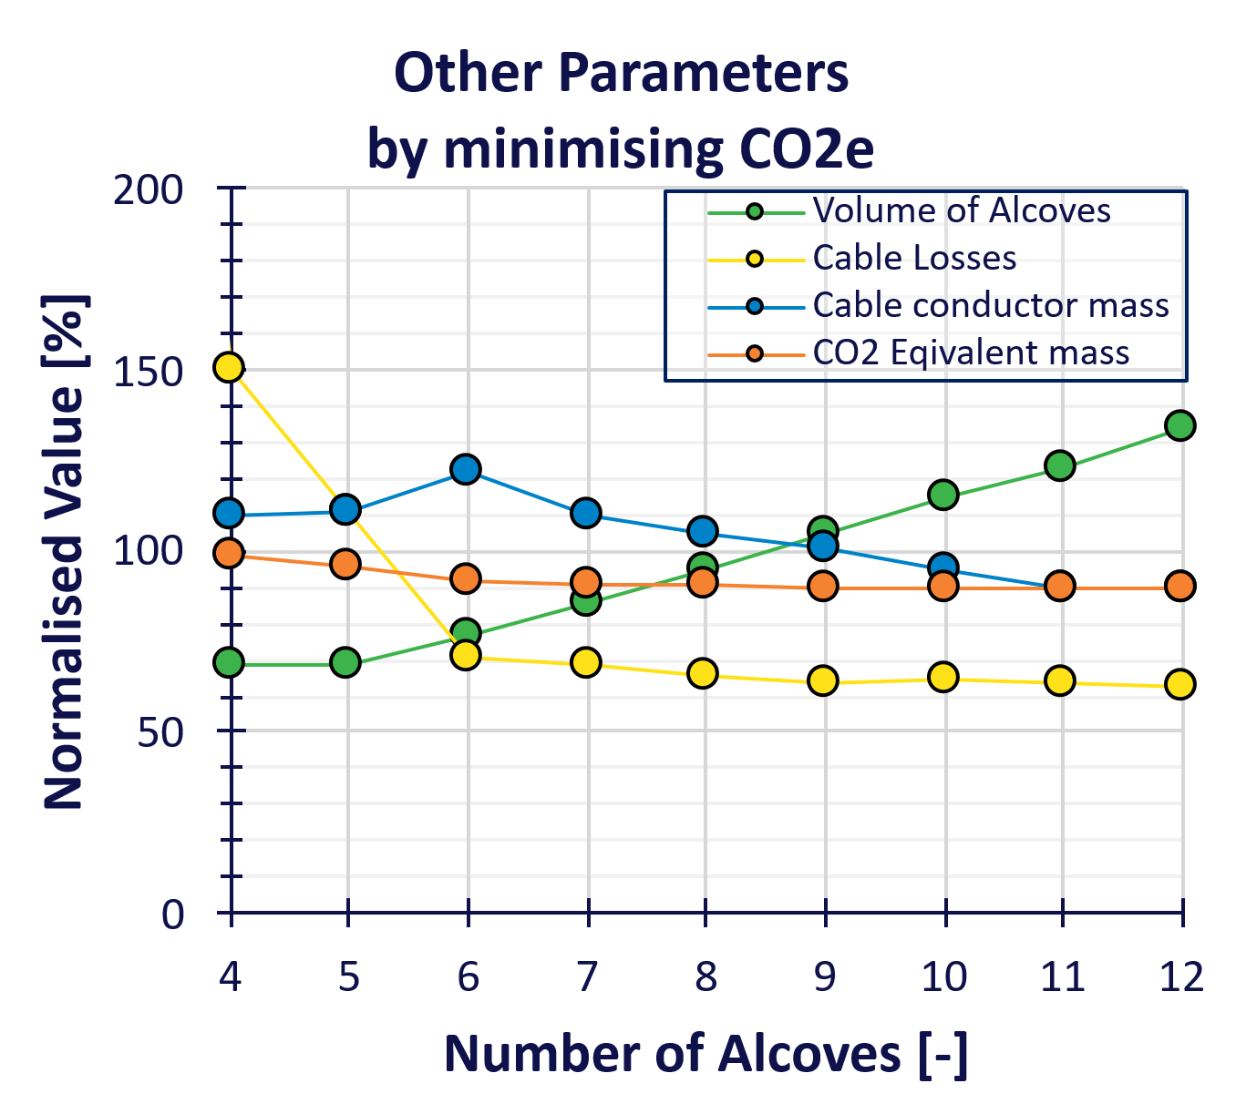
Minimising CO2e - Varying Number of Alcoves
⮩ detailed expenditures
in annexe
Results when varying the number of alcoves while minimising the CO2 equivalent mass, normalised to the 7 alcoves baseline with TOTEX minimisation.
Overall, to reduce by 10% the CO2e we need to pay 10% more.

Slide 13
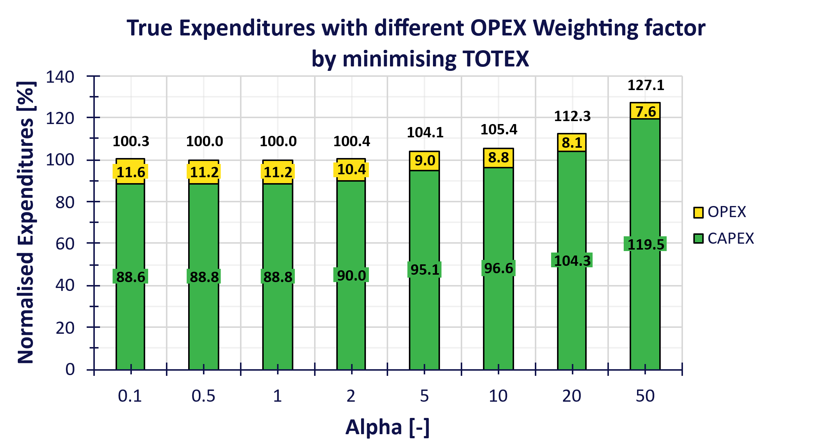
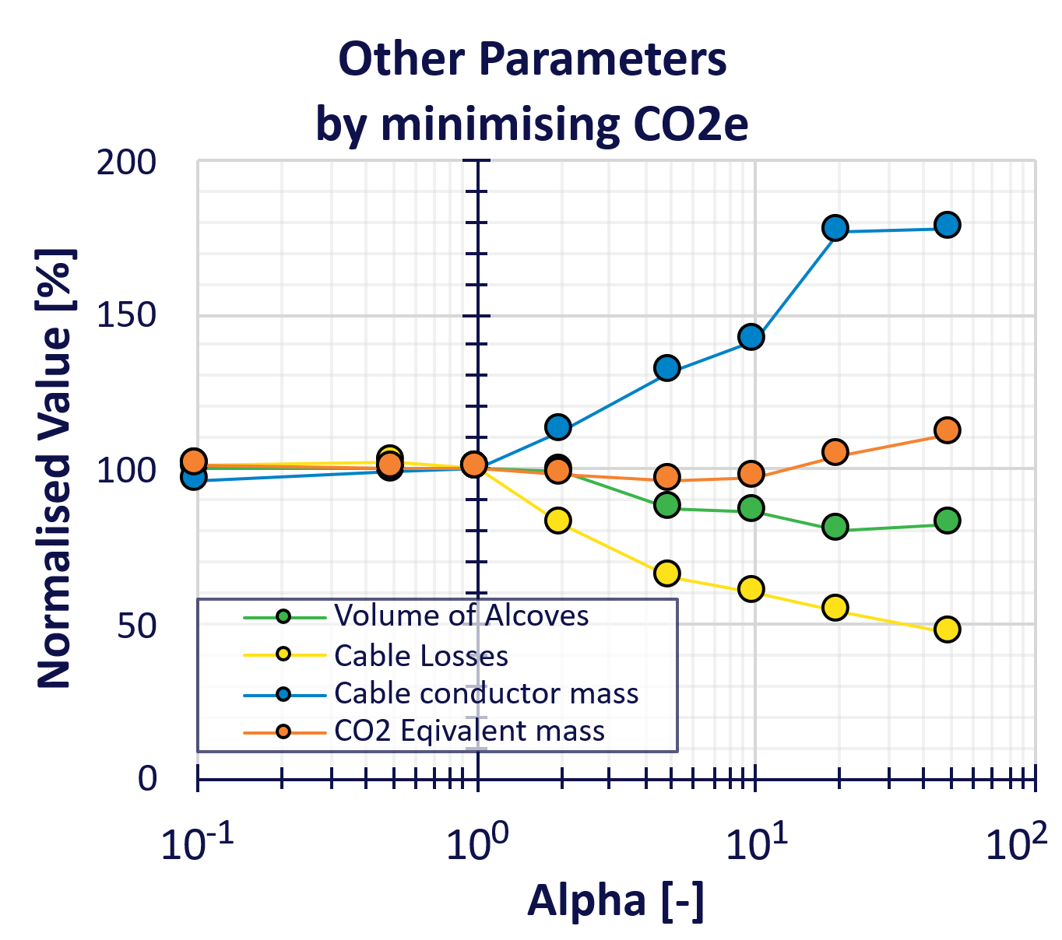
Changing OPEX Weighting Factor with 7 Alcoves
⮩ detailed expenditures
in annexe
$$TOTEX=α∗OPEX+CAPEX$$
The OPEX weighting factor is also a tool to steer decision;
by artificially inflating the OPEX, it increase its importance during the optimisation.
We plot the true expenditure (without the impact of the weighting factor)
With a factor of 2 the TOTEX doesn't change, but we see a lower power losses of 20% in the cables.

Slide 14
Conclusion
The Global Optimisation tool let us experiment scenarios and qualify the impact on the Total Expenditure and as such the sensibility of choices.
The ratio of OPEX vs CAPEX is a choice that needs to be taken by management.
Either having a lower investment cost and higher running cost
or a higher investment at the start for lower power consumption in operation.
With this tool, an environmentally friendlier FCC can be achieved
  by prioritising the operation expenditure with the OPEX weighting factor
  or by minimising the CO2 equivalent mass instead of the total expenditure.
What we need :
  Booster and Collider circuit definition
    Complete lattice including arcs + straight sections
    Criticality of the circuit, redundancy level
    Serial connection or single powering of magnet
What's the future :
  More refined cost estimate of the converters
  GHC vs LCC optics comparisons
  Continue exchange with other groups to integrate and refine their models.

Slide 16
Annexe

Slide 17
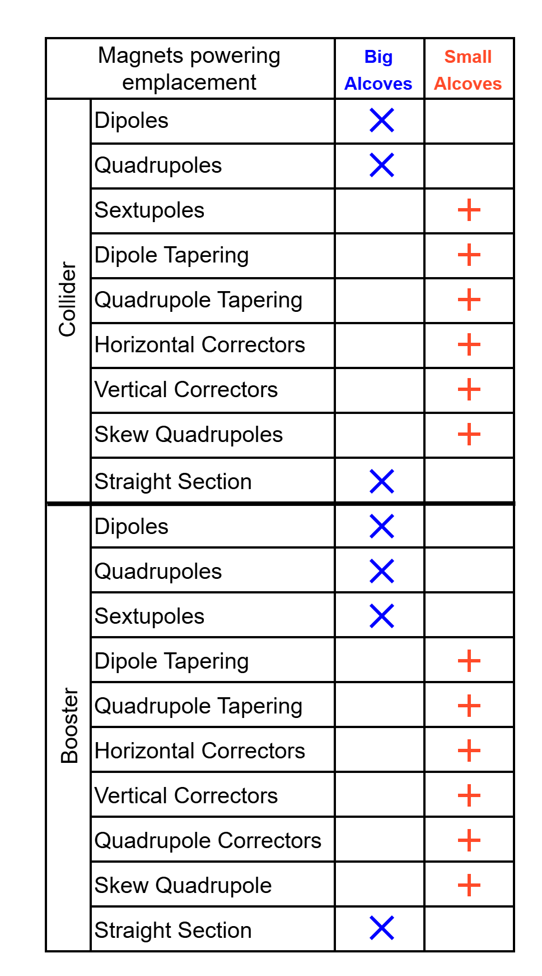
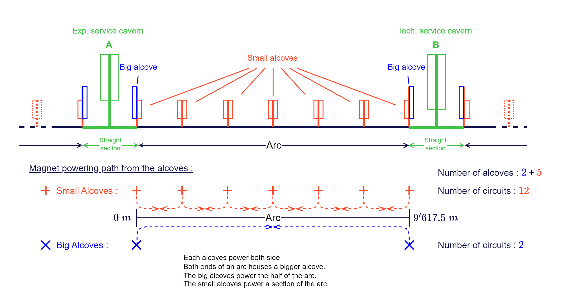
Small and Big Alcoves in the Arcs

Slide 18
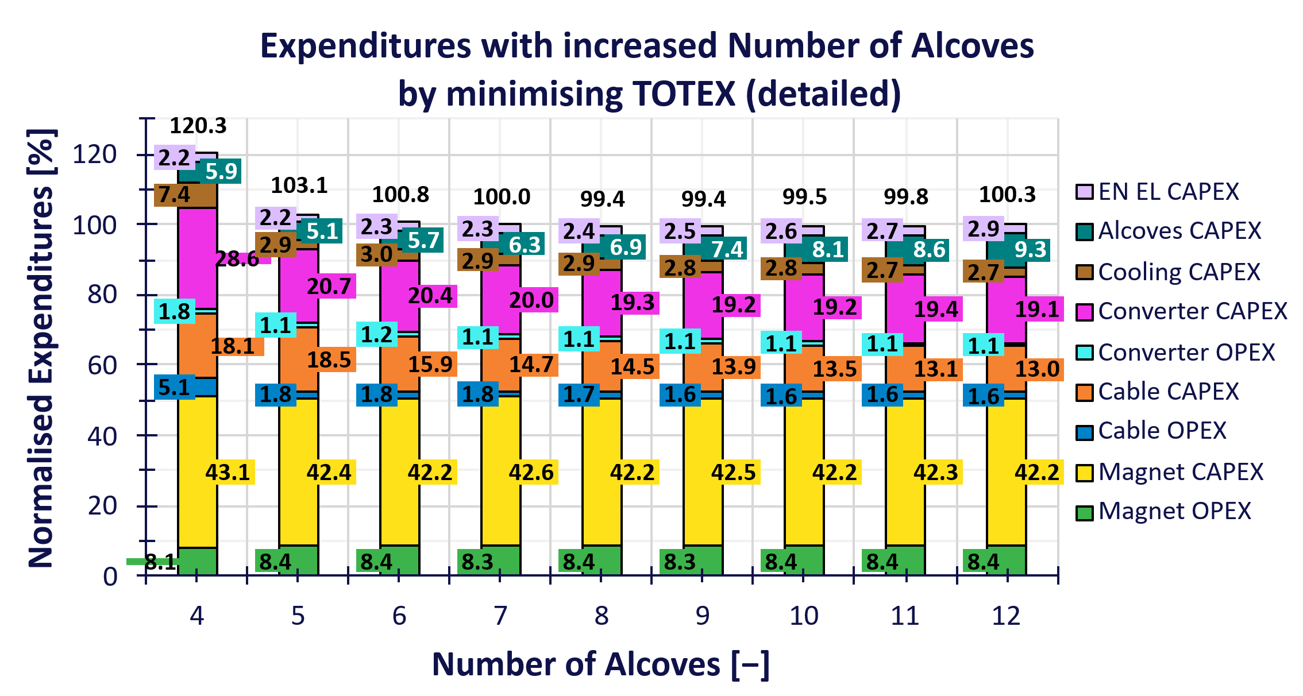
Increasing Number of Alcoves by Minimising TOTEX
With more space in the cable trays, the space constraint is relaxed.
And as such the total expenditure doesn't move as much with the increase in number of alcoves.
But we can still see an impact on the cable losses in the arc, with more alcoves.
Beyond the capital expenditure, the number of alcoves has a non-negligible impact on the schedule.
Baseline
Impact on losses without change in expenditures.

Slide 19
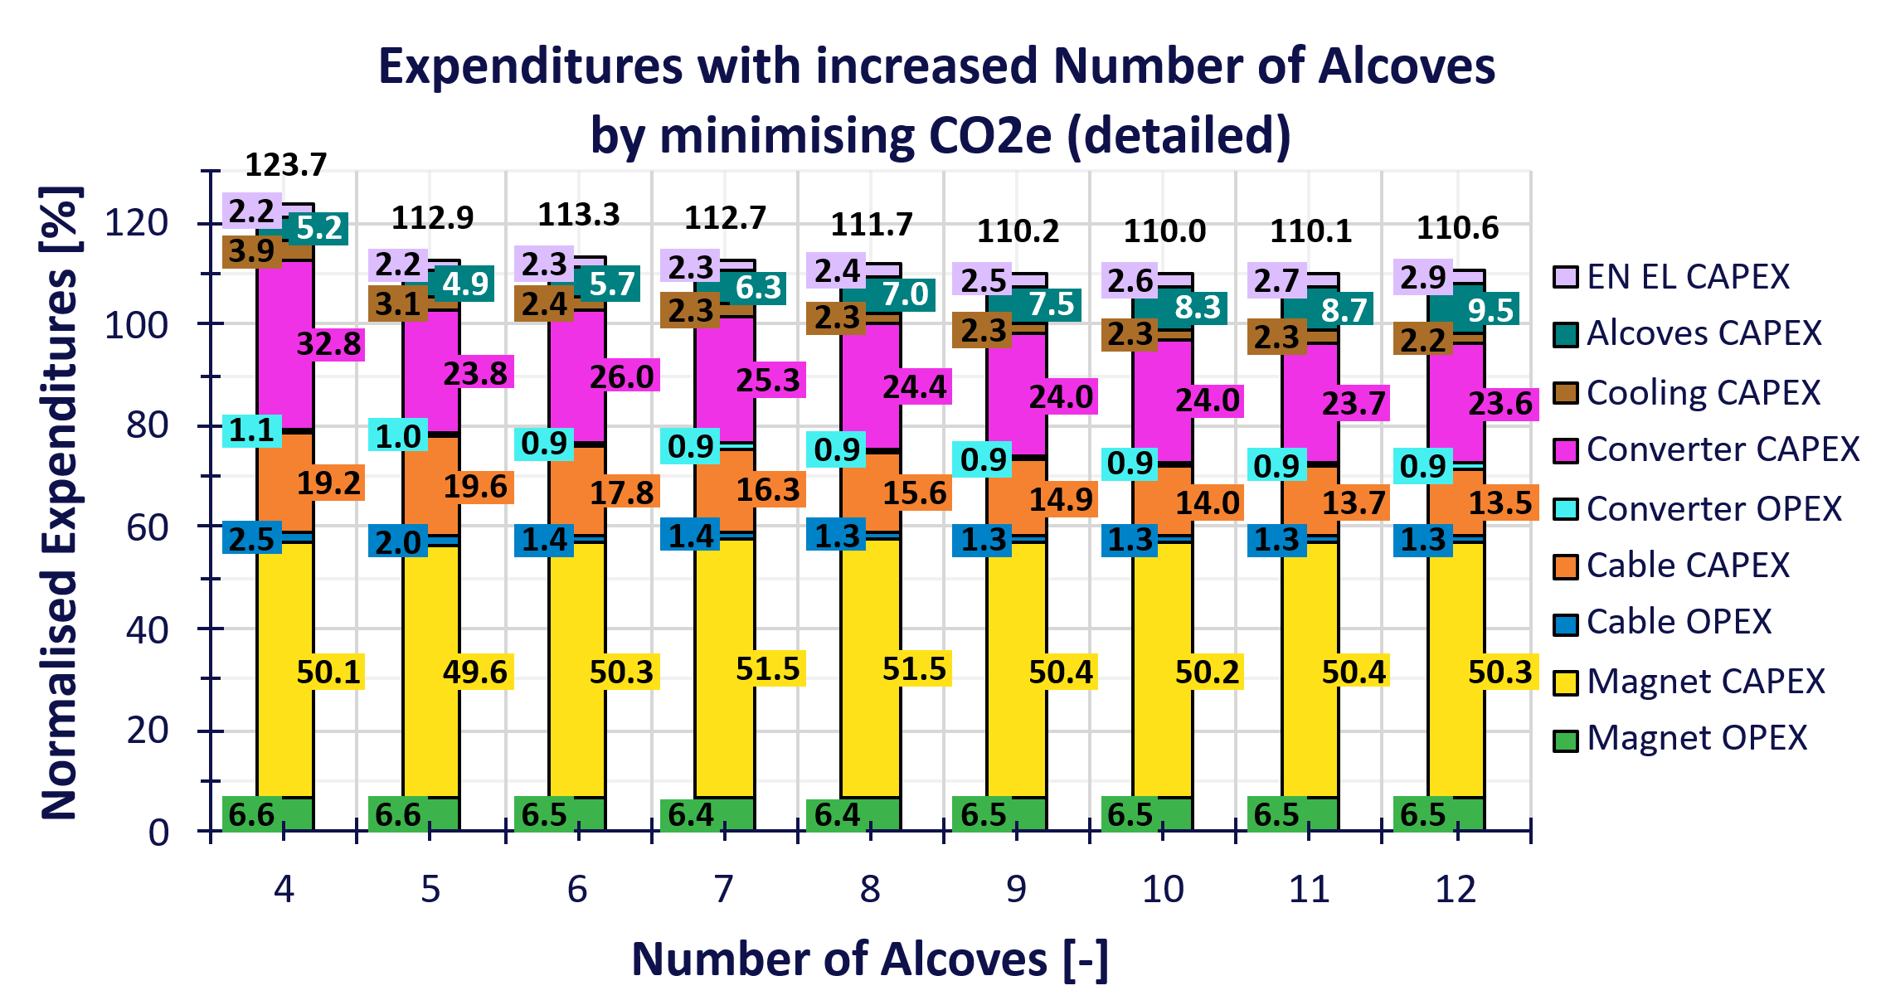
Minimising CO2 Equivalent Mass
Instead of minimising the total expenditure, we can optimise the CO2 Equivalent mass and still plot the total expenditure normalised to the baseline values at 7 alcoves when optimising TOTEX.
We can see that with 10% increase in expenditure, we reduce by 10% the CO2e mass and by 32% the cable losses in the arc.
CO2e of alcoves excavation is included

Slide 20
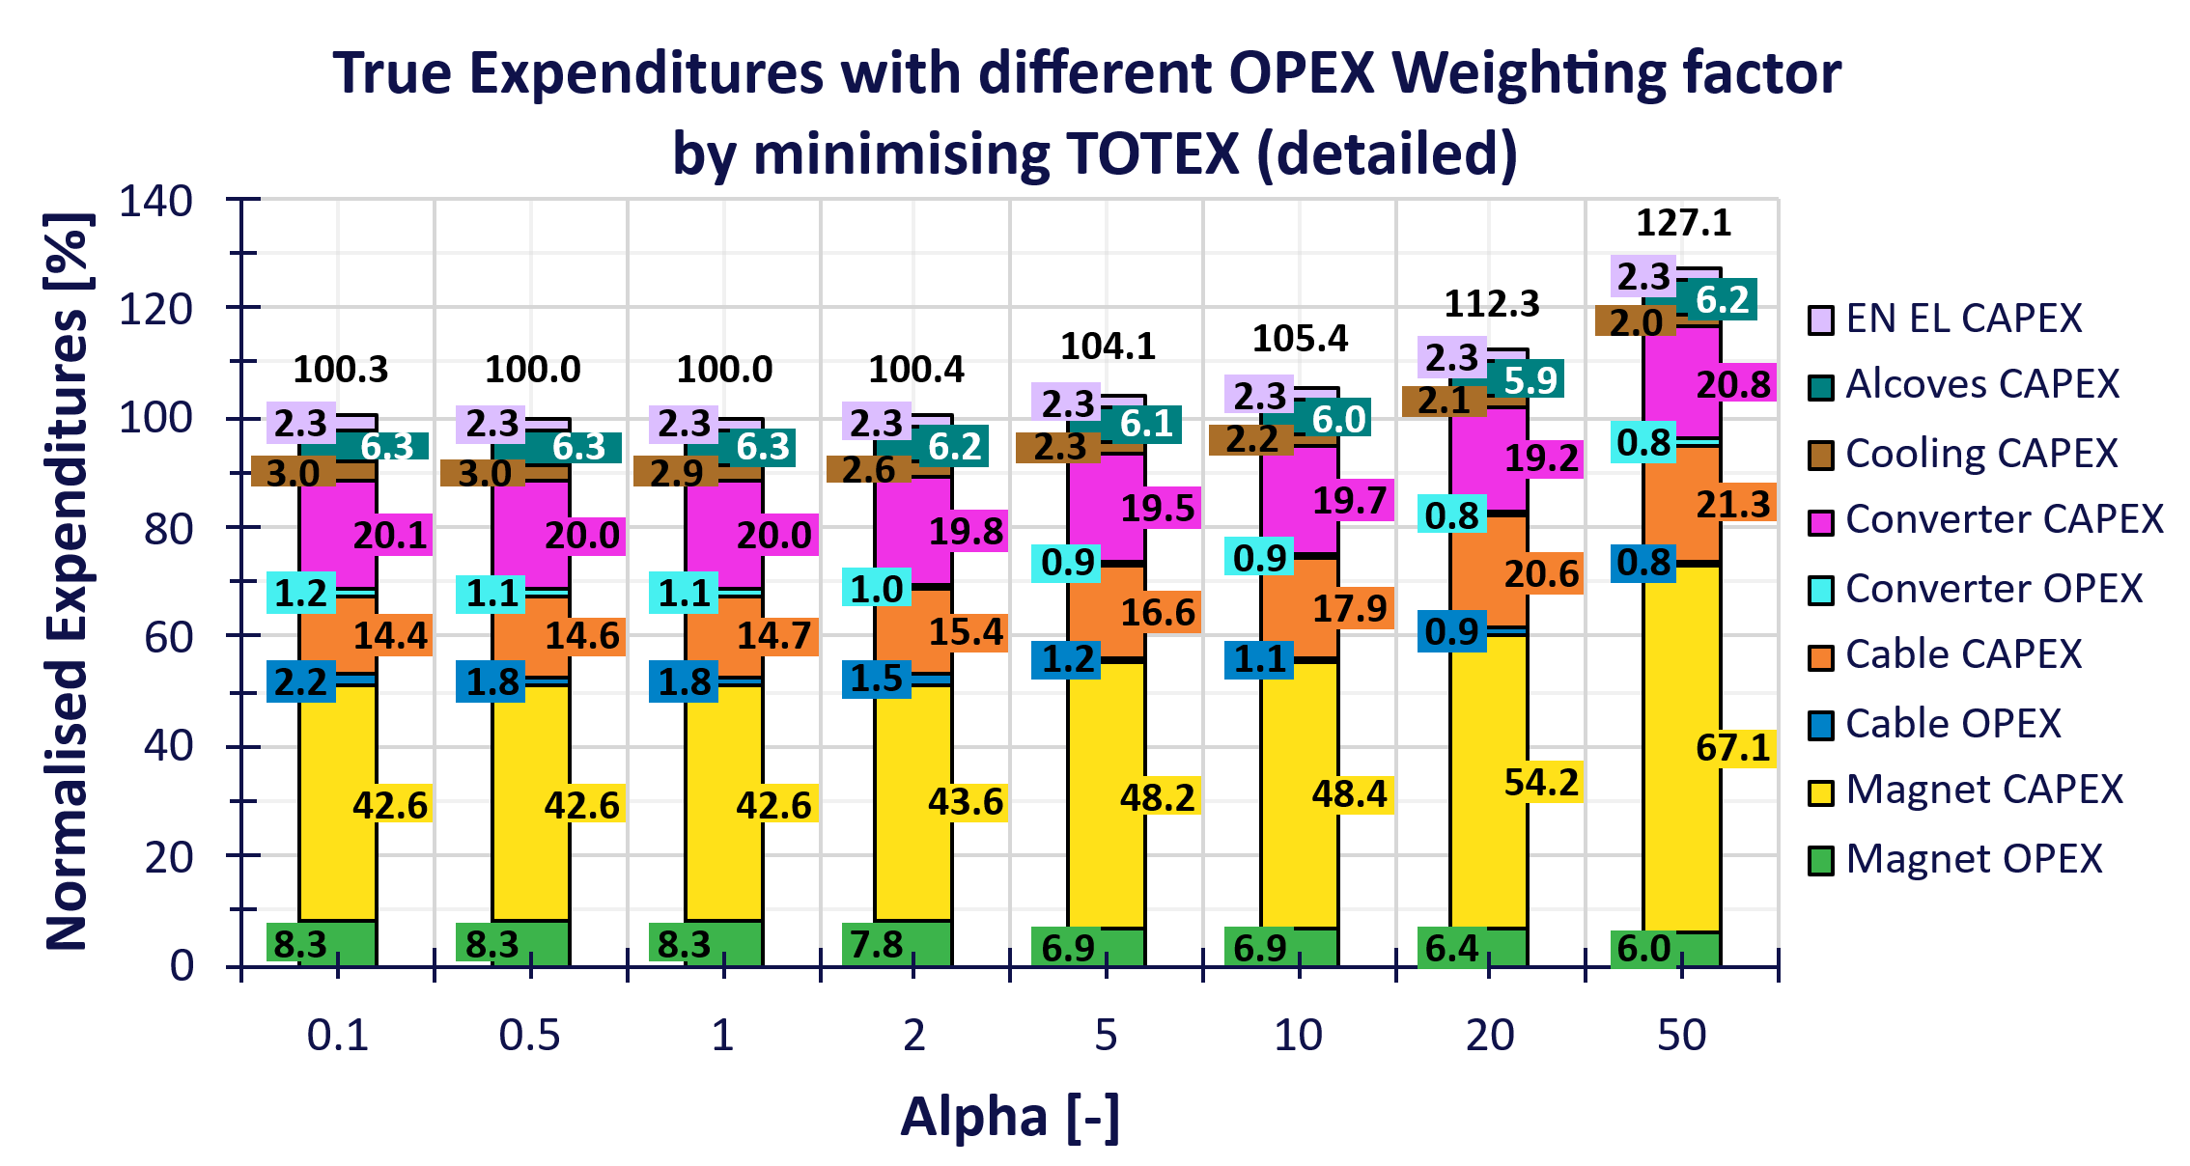
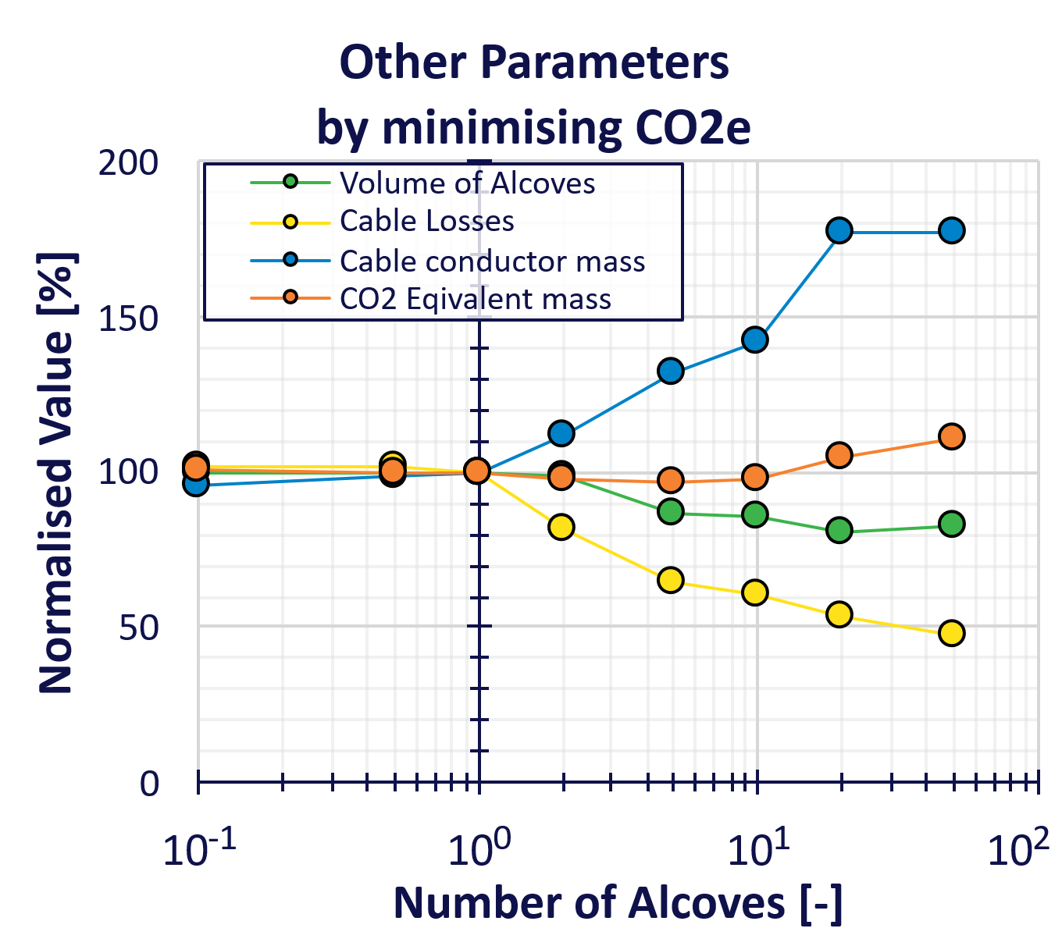

Changing OPEX Weighting Factor with 7 Alcoves
The OPEX weighting factor is also a tool to steer decision;
by artificially inflating the OPEX, it increase its importance during the optimisation.
We plot the true expenditure (without the impact of the weighting factor)
With a factor of 2 the TOTEX doesn't change, but we see a lower power losses of 20% in the cables.
$$TOTEX=α∗OPEX+CAPEX$$

