Slide 1
Synchrotron radiation management, pressure profiles
Marton ADY, CERN
FCC Week, Vienna, 21-05-2025

Slide 2
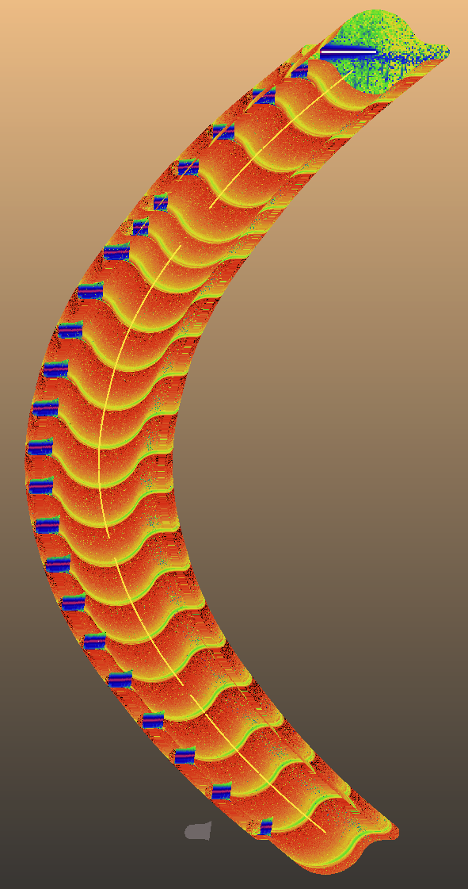
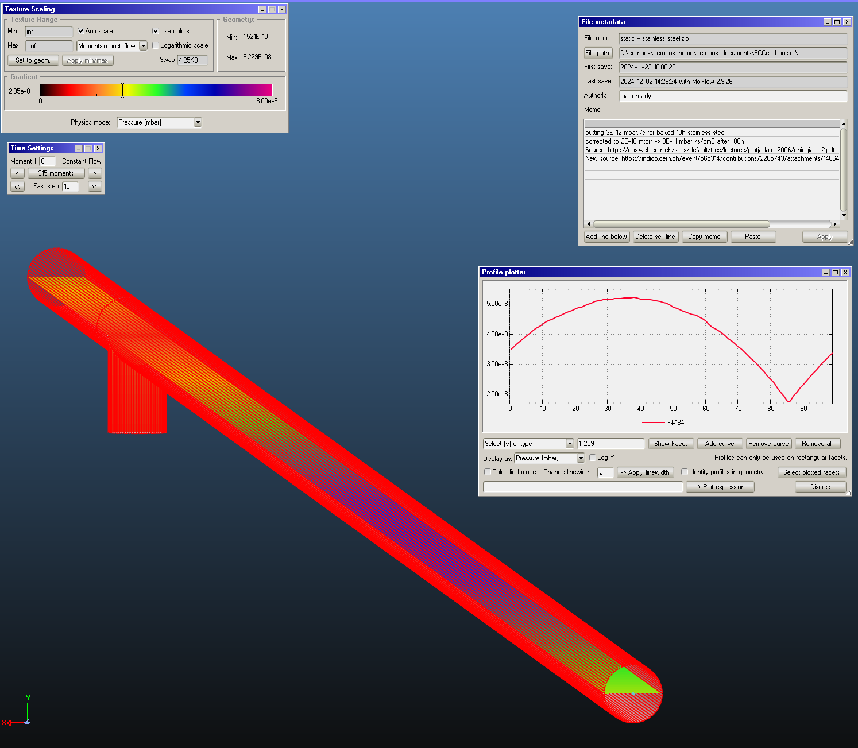
Collider ring
Booster ring
Absorber placement study
Dynamic and static pressures

Slide 3
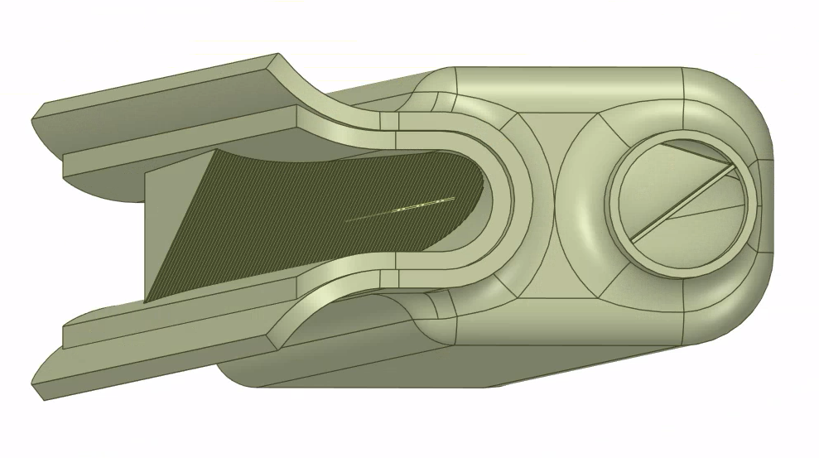
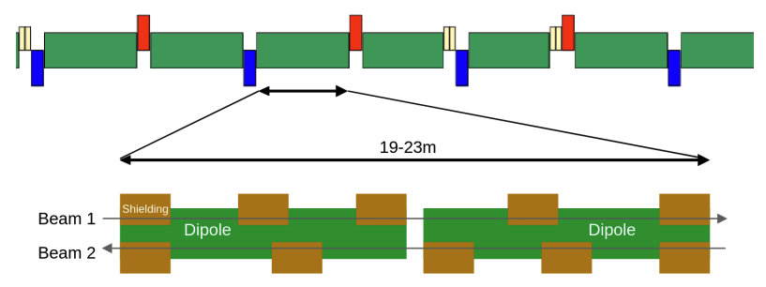
The task
~50MW/beam synchrotron radiation
FCC consists of 130m “supercells” with 5 magnets
place discrete absorbers, 4 per magnet?
“Find absorber placement as periodic solution”

Slide 4
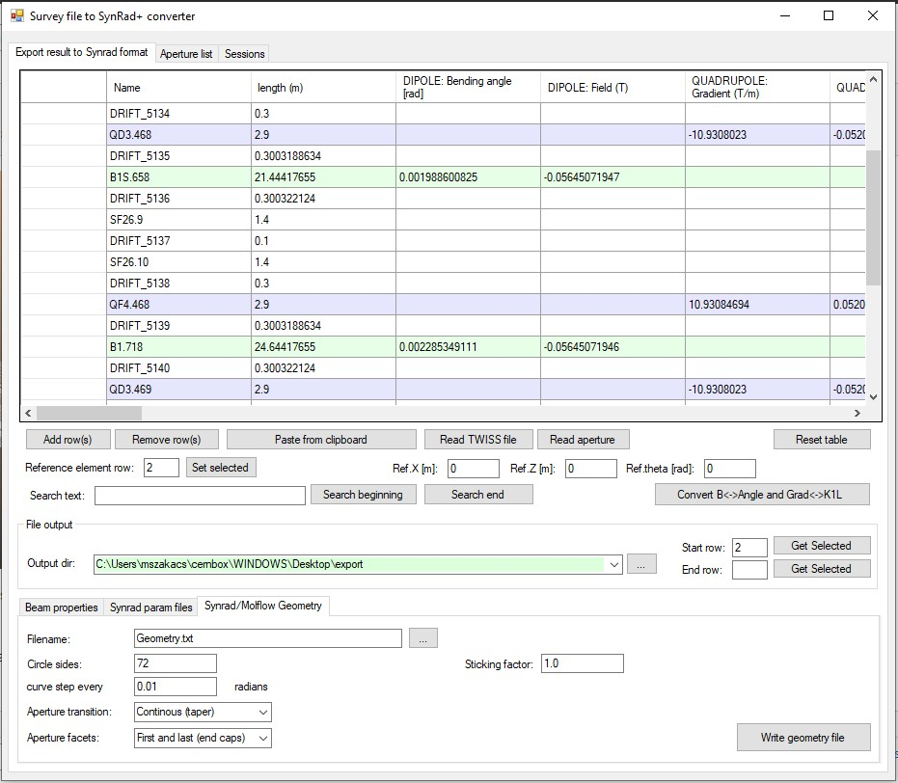
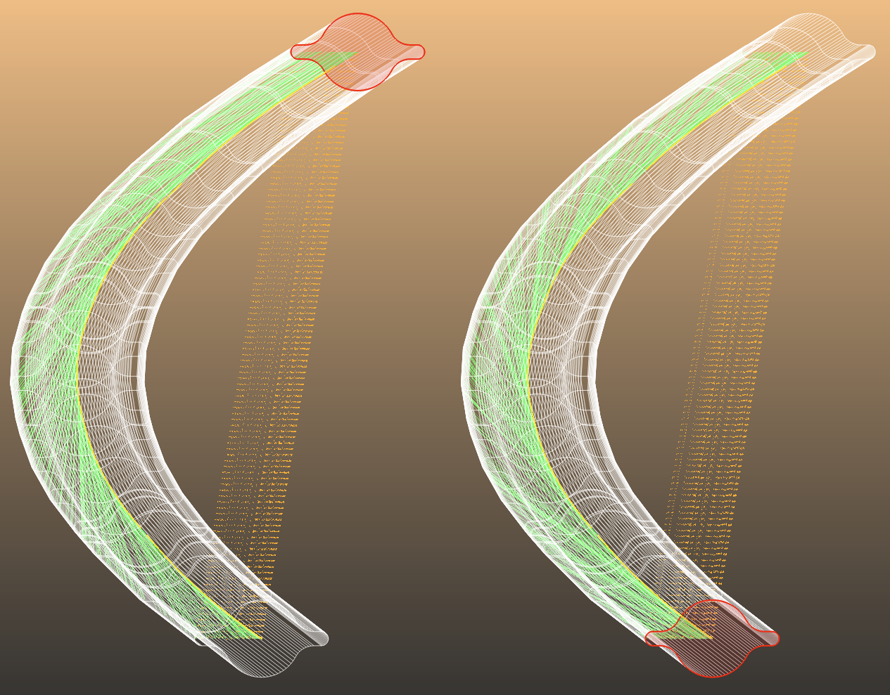
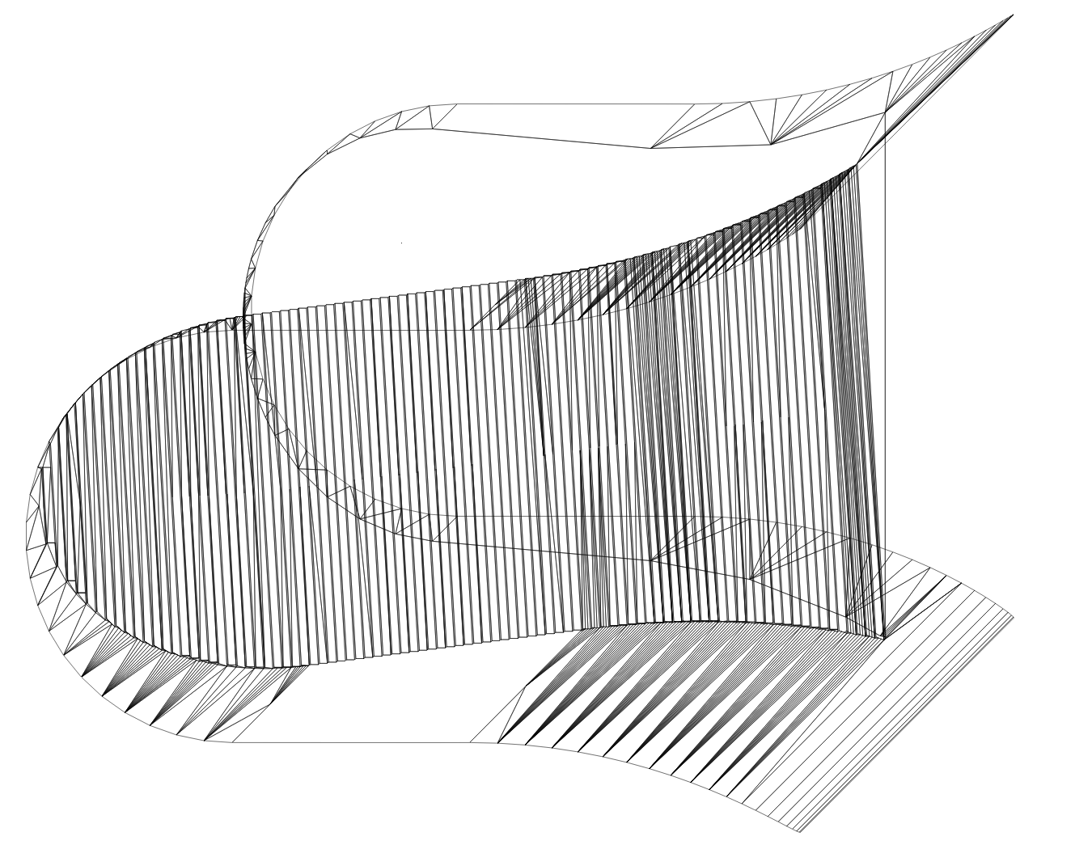
1-slide workflow overview
Get optics (MadX)
Convert to Twiss
Convert to Survey
Convert to Synrad
Add physics
Place absorbers
Get data
Opticsbuilder
Synrad geometry
Absorbers

Slide 5
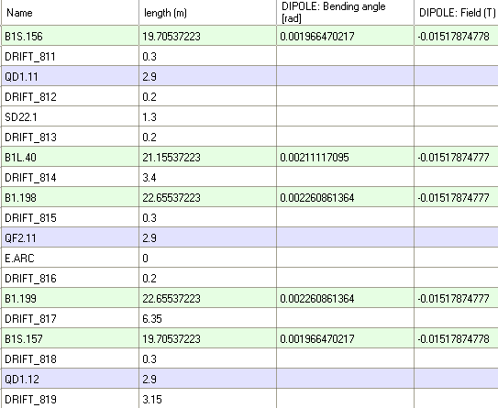
First step: manually edit magnets in OpticsBuilder
130.2m 5-cell pattern in OpticsBuilder:
dipole
dipole
gap
dipole
Lattice functions kept the same

Slide 6
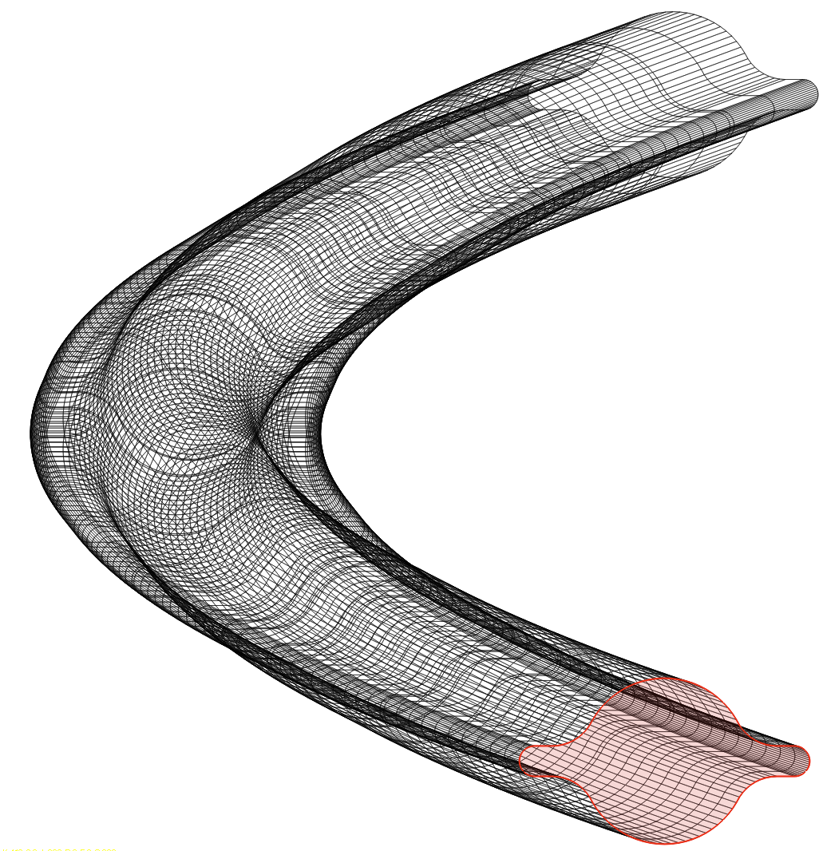
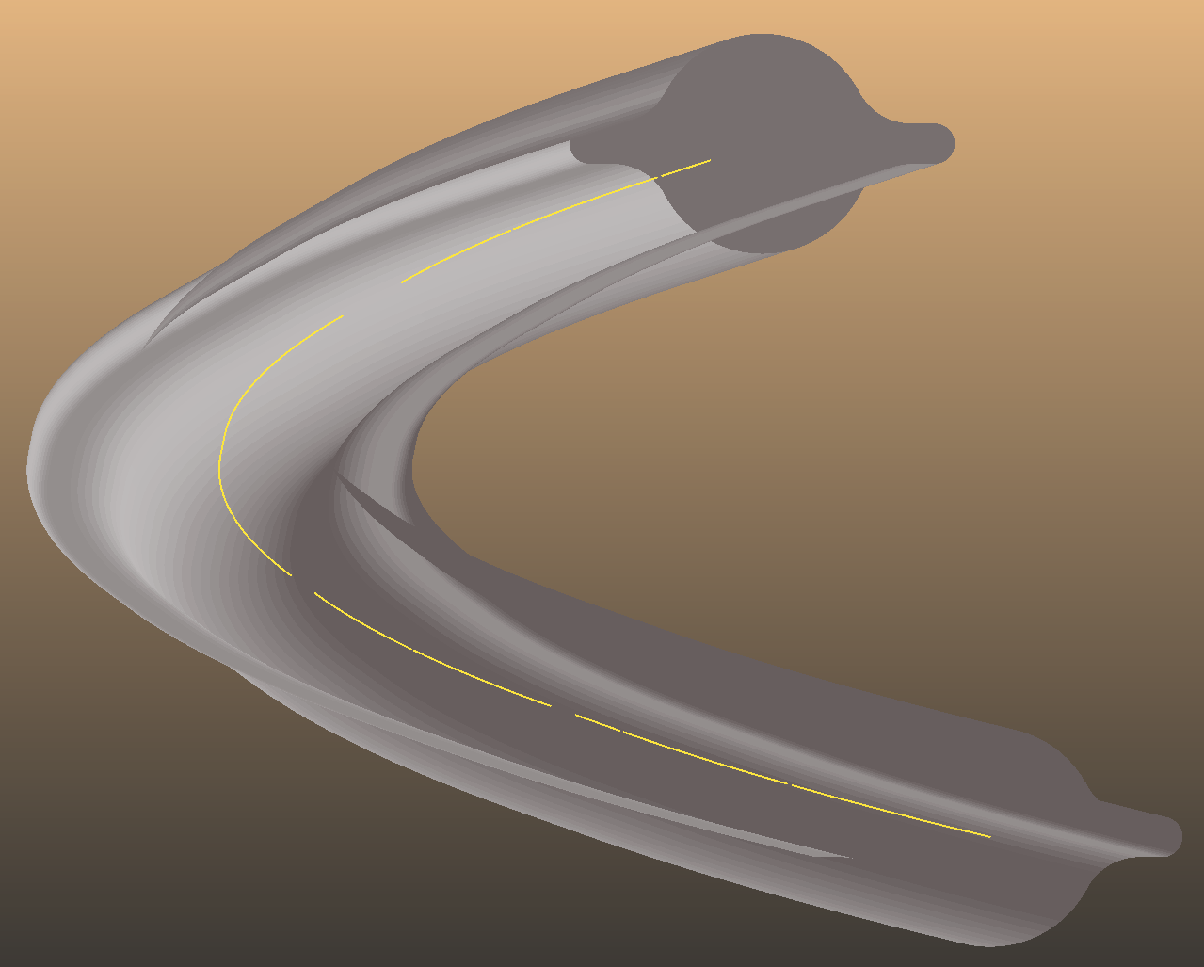
Generate SynRad geometry and optics
130.2m 5-cell
QF2
gap
B1S
gap
B1
gap
B1
gap
B1L
QD1
gap
B1S
Geometry: 17100 polygons
adding optics

Slide 7
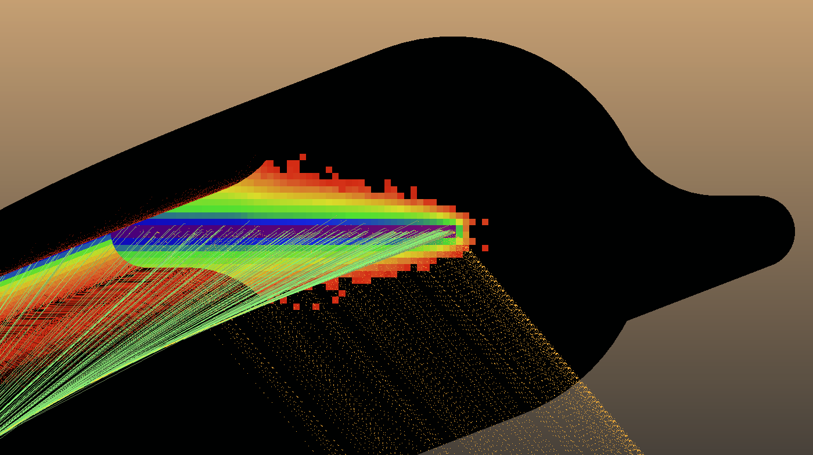
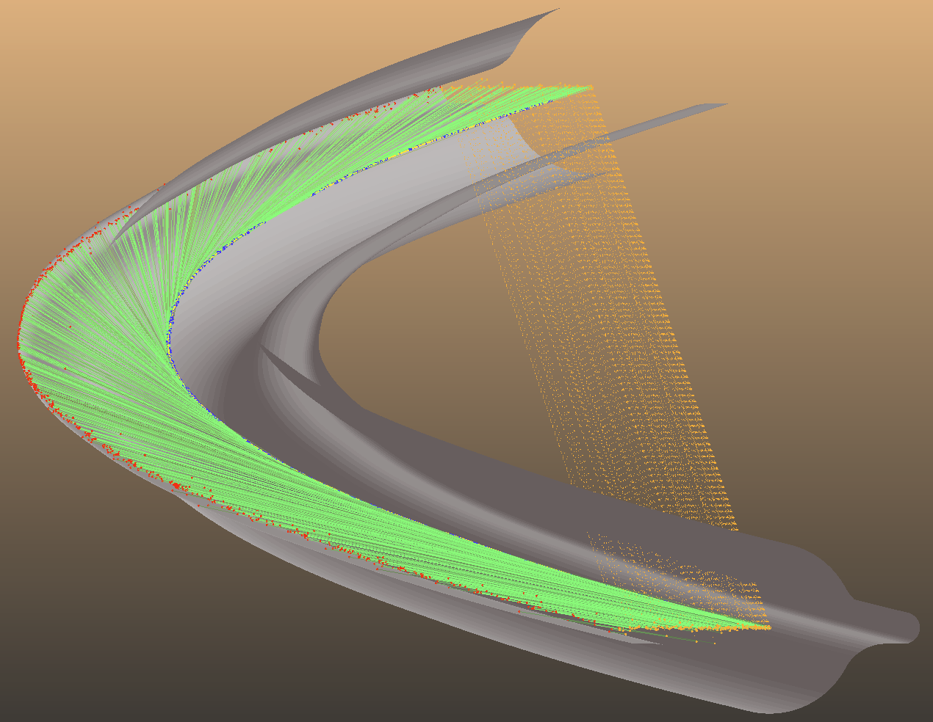
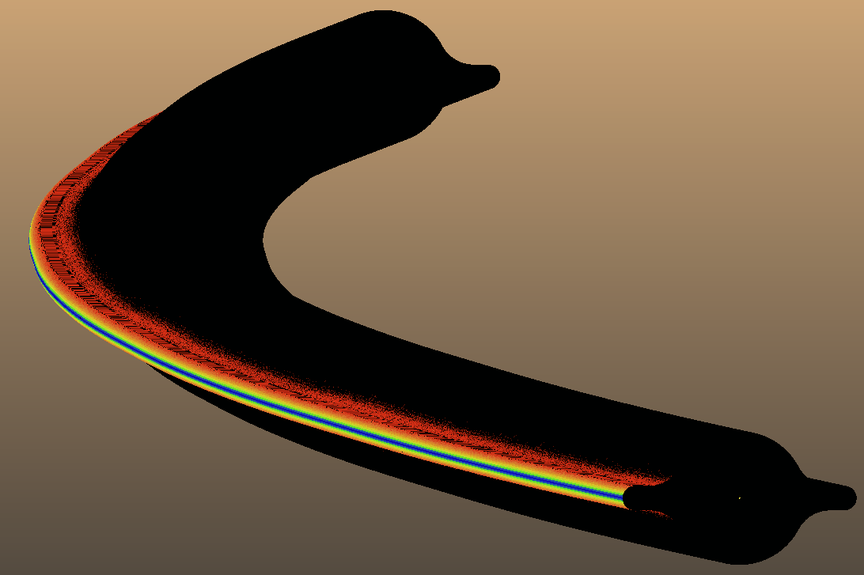
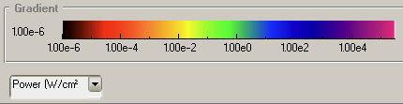
Simulation: verifying photon generation (no absorbers)
20kW downstream
periodic boundary condition
82.6kW generated
82.6kW deposited on walls

Slide 8
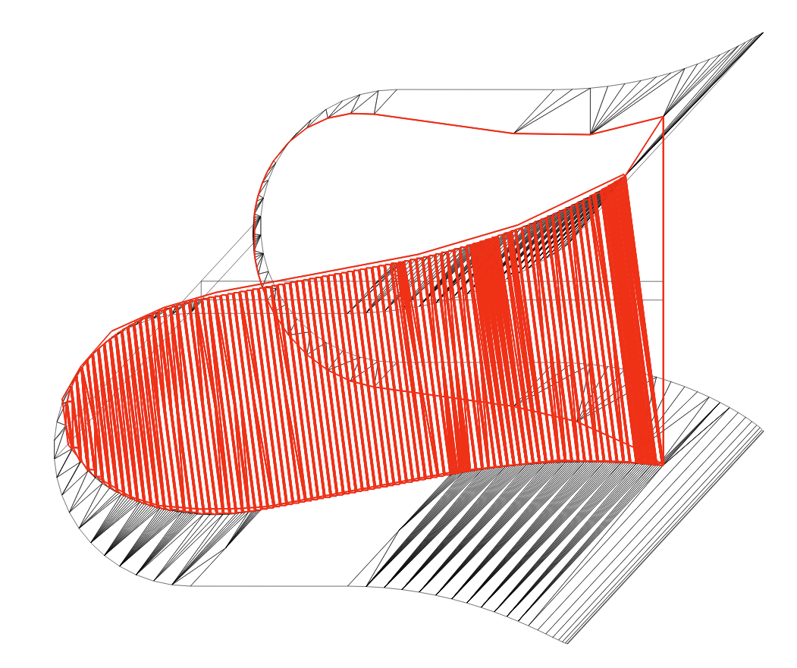
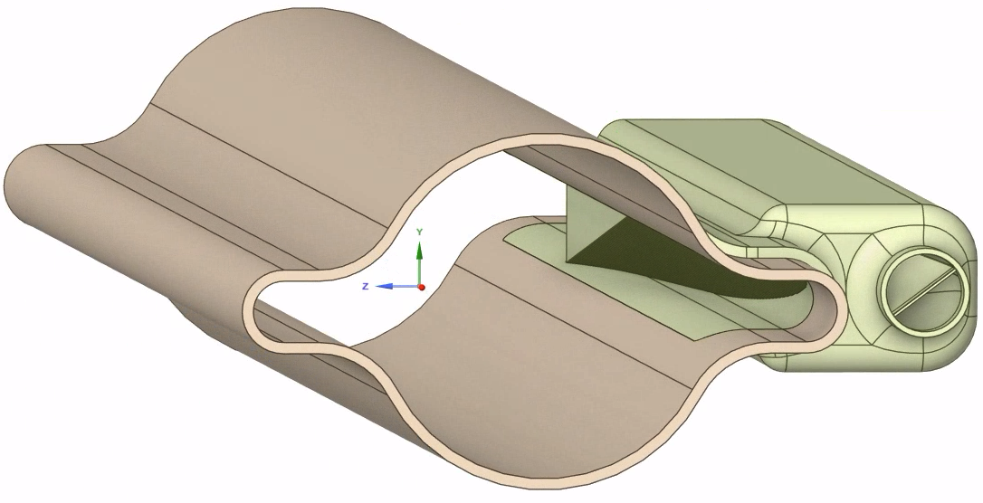
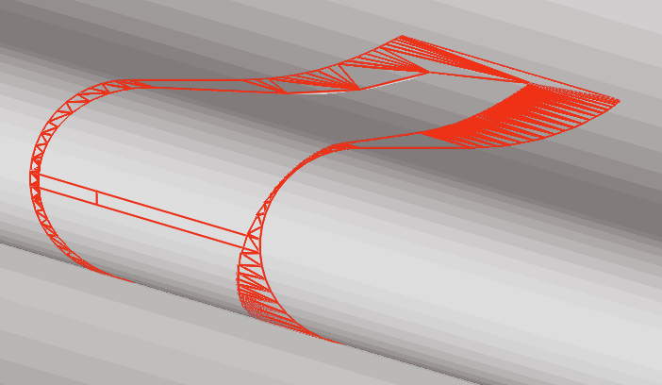
Adding the sawtooth* absorbers
transparent facets help align
Model (Fabrice Santangelo, TE-VSC)
1134 polygons
sawtooth modeled as-is
* Sawtooth details: see talks of Marco Morrone and Stefania Grozavu in this session

Slide 9
Add absorbers: first attempt – equal spacing
B1 (22.655m)
B1L (21.155m)
B1S (19.7m)
55cm / 75cm reserved for shielding

Slide 10
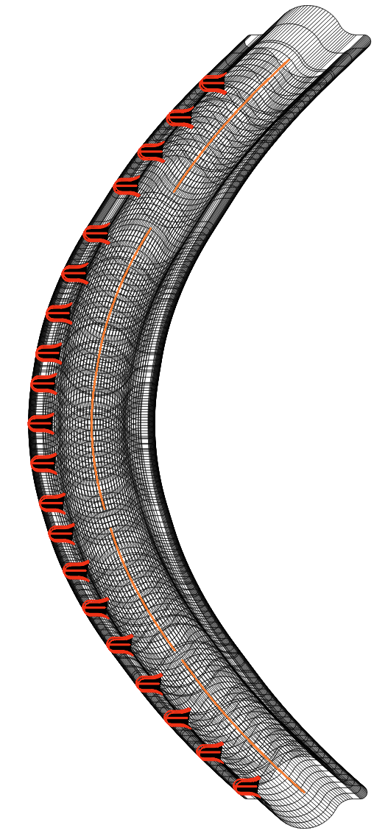
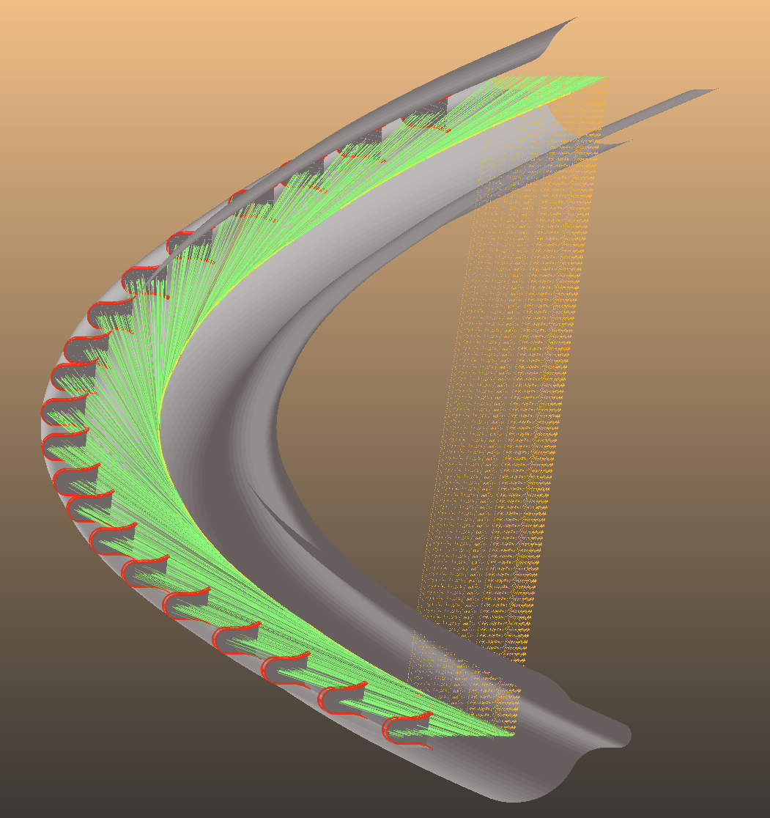
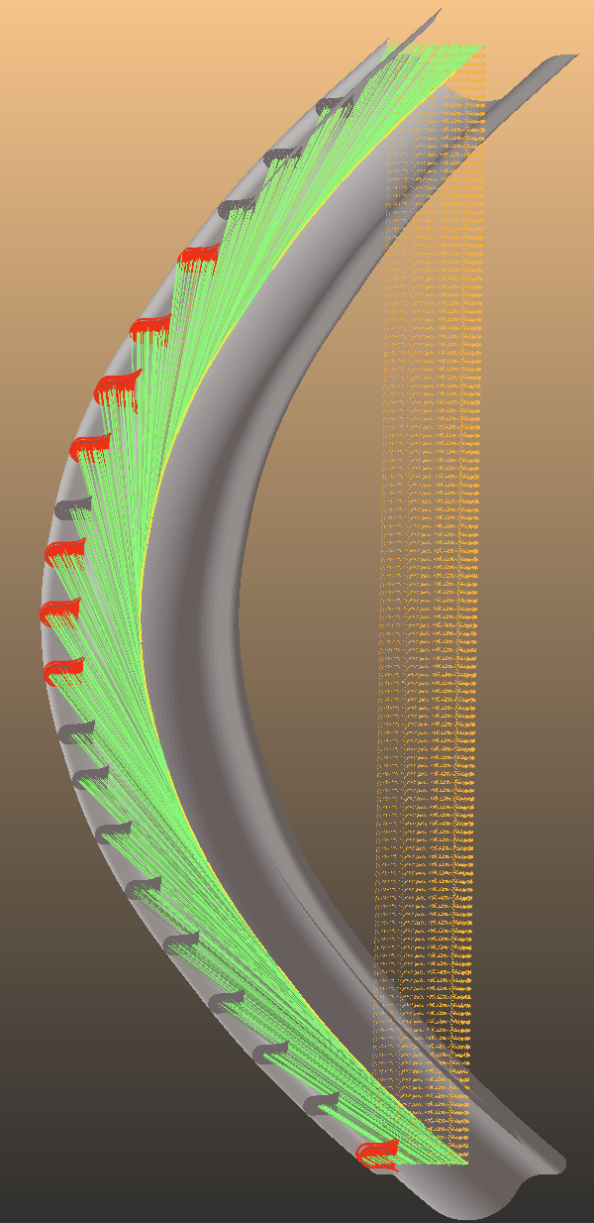
Simulation: equal spacing
19.8kW downstream
621W on walls
5 dipoles * 4 absorbers = 20 total
82kW on absorbers (4.1kW avg, 4.8kW max)
8 abs > 4.5kW

Slide 11
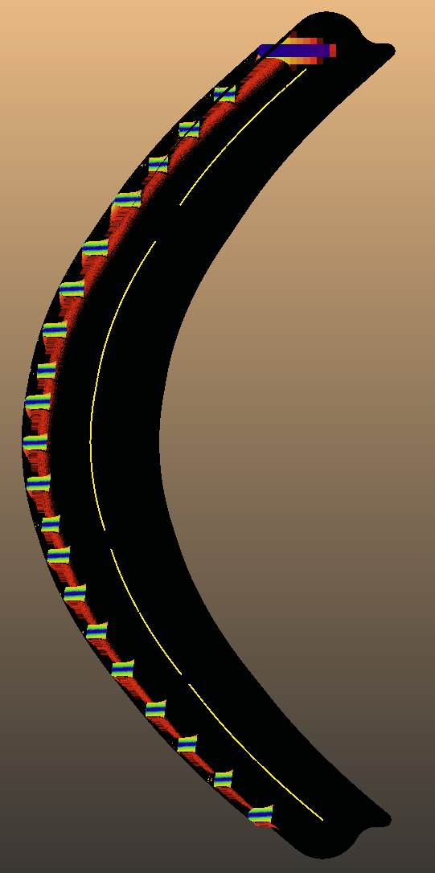
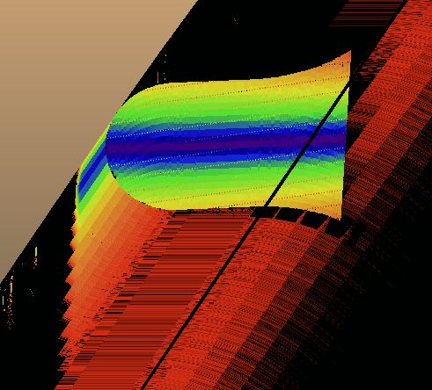
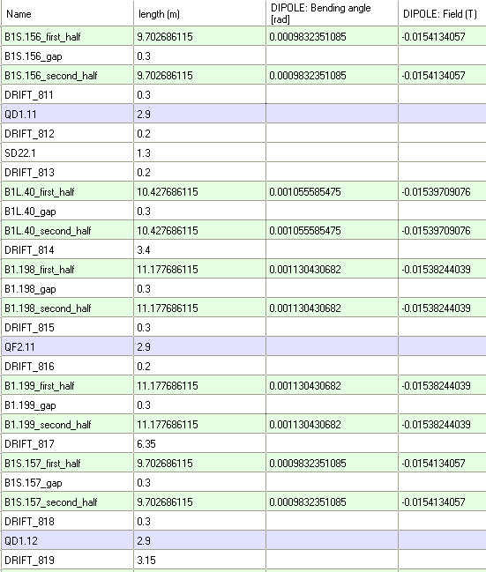
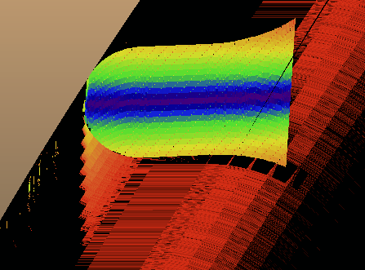
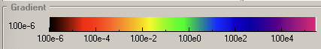
6.35m
Expected problems (>6m drift)
B1 magnets: too sparse spacing

Slide 12
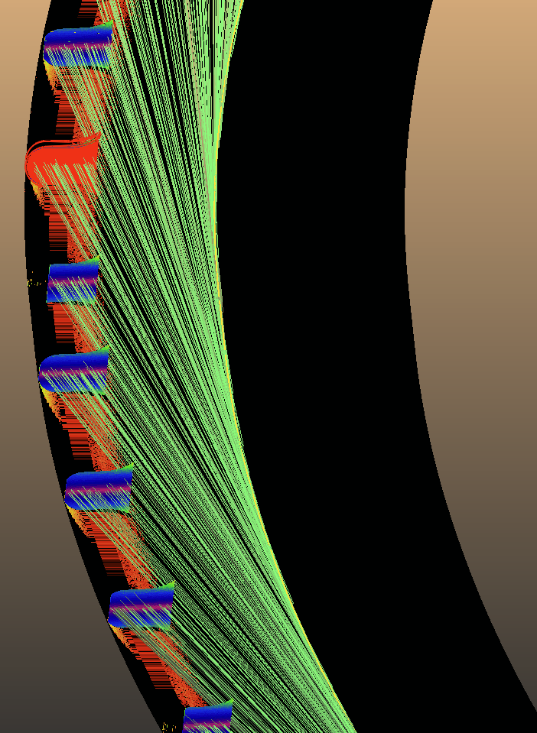
Solving the drift problem: increase absorber protrusion
6.7m
wall radius (10km + 52.5mm)
absorber tip radius (10km + 52.5mm – 19.25mm)
6.61m
shadow
photon
beam
absorber
beam radius (10km)
32.4m
wall
25.8m
source point
Conclusion: One absorber shades max. 6.6m of the wall
Source
shadowed length: 6.61m -> 7.85m = +19%
absorber protrusion: 19mm -> 23mm = +21%

Slide 13
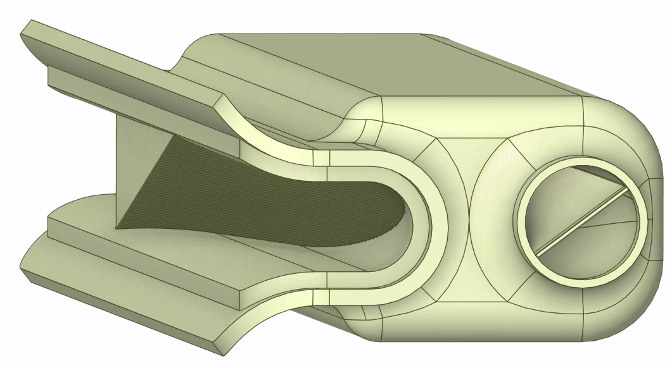
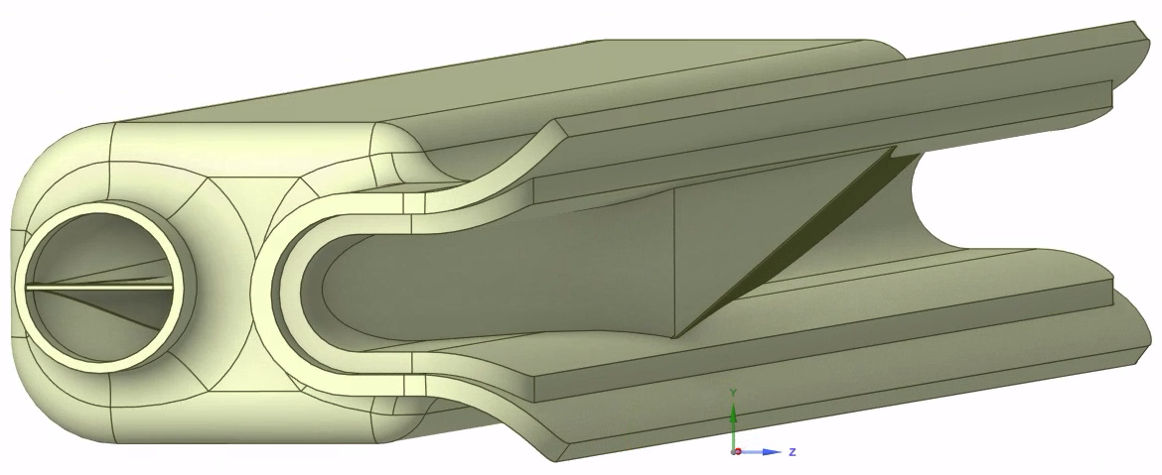
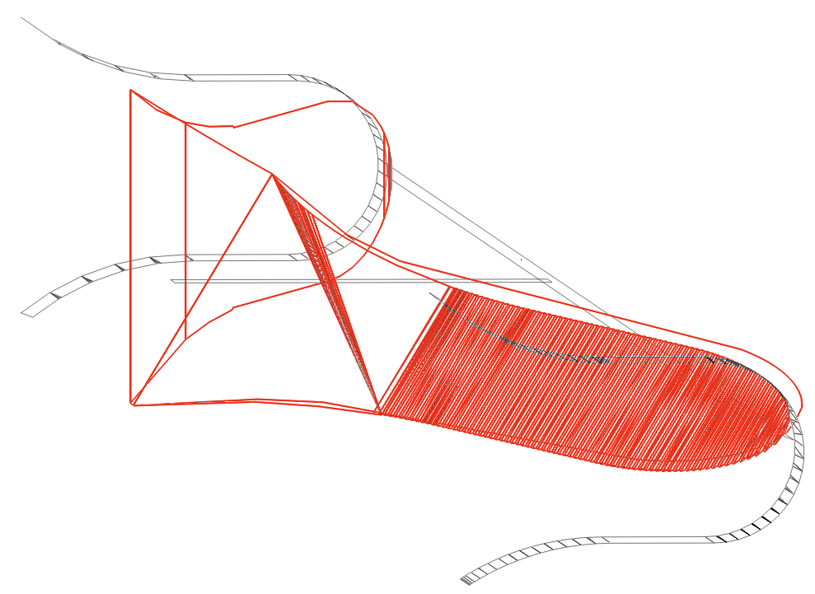
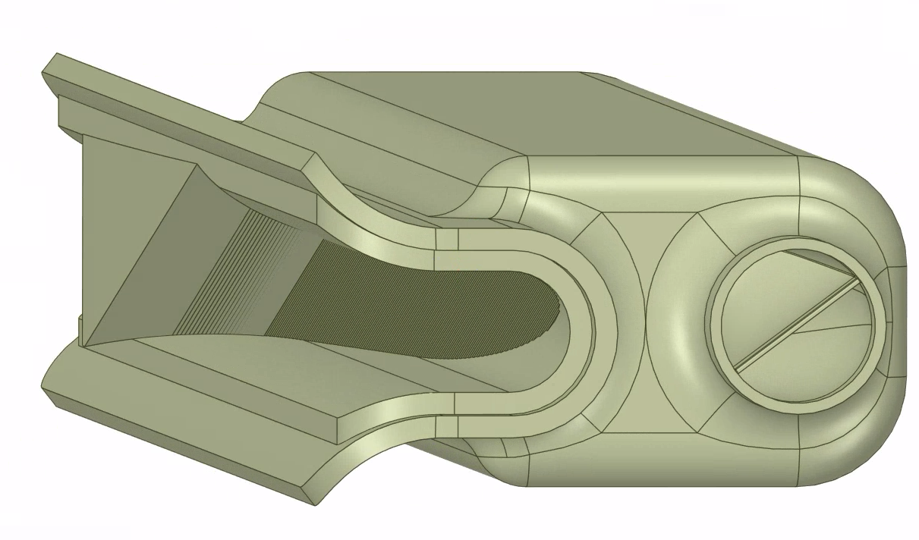
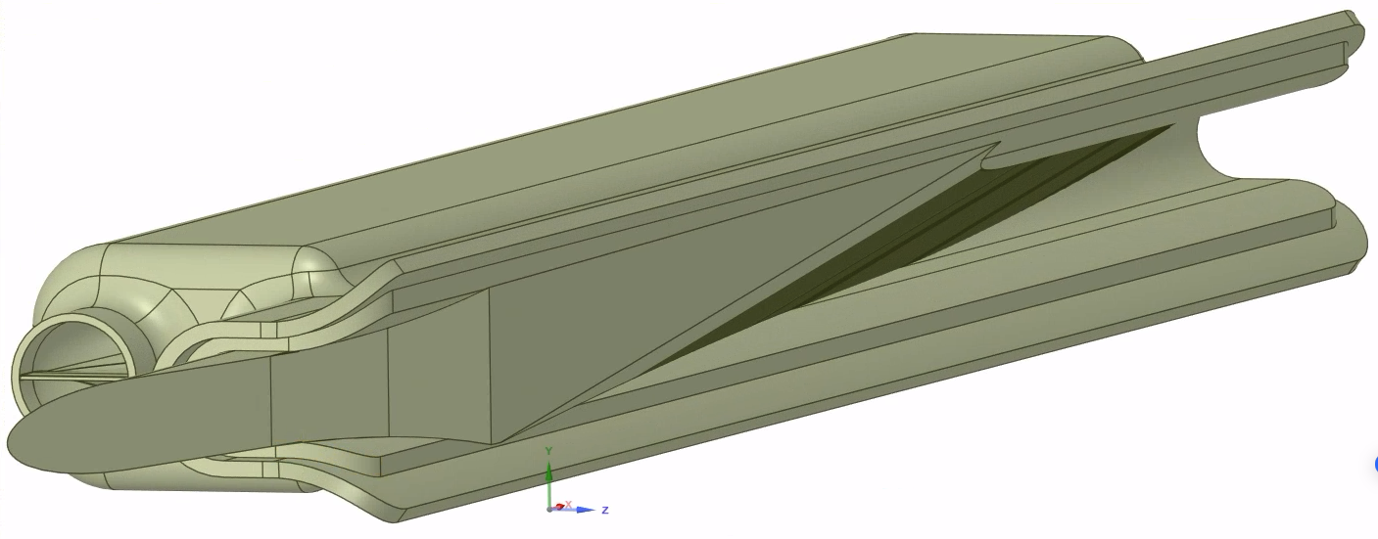
Original sawtooth absorber model (F. Santangelo)
L=38cm
Modification (preliminary, partial sawtooth)
+4mm
L=46.5cm

Slide 14
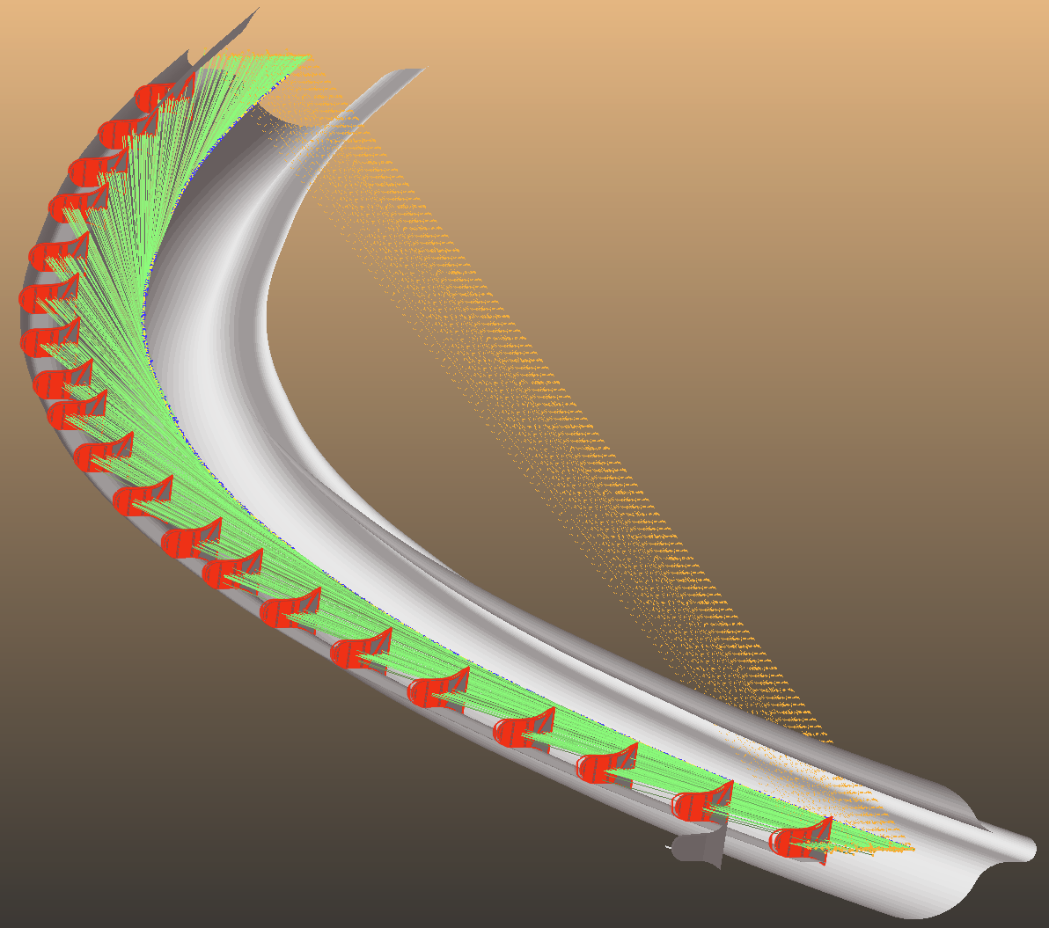
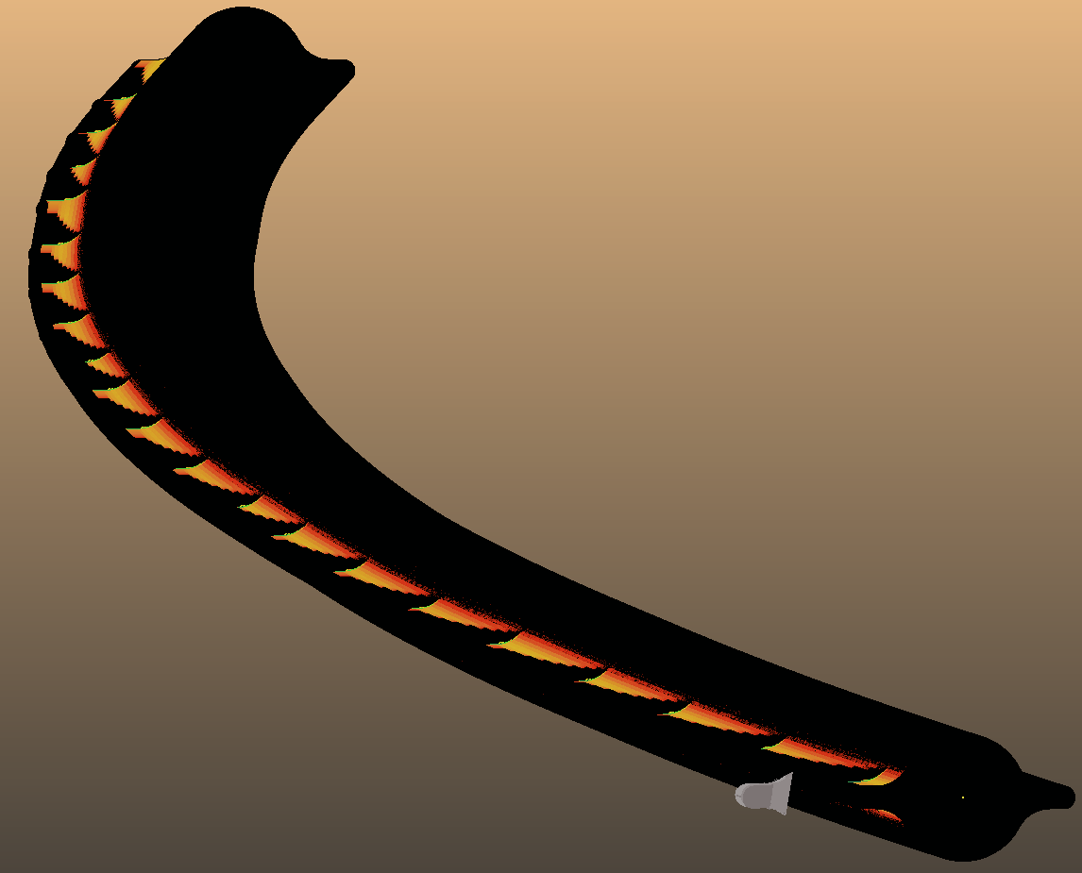

Larger absorbers:
Negligible direct hits on outer walls
W/cm²
Total on wall: 0.22W

Slide 15
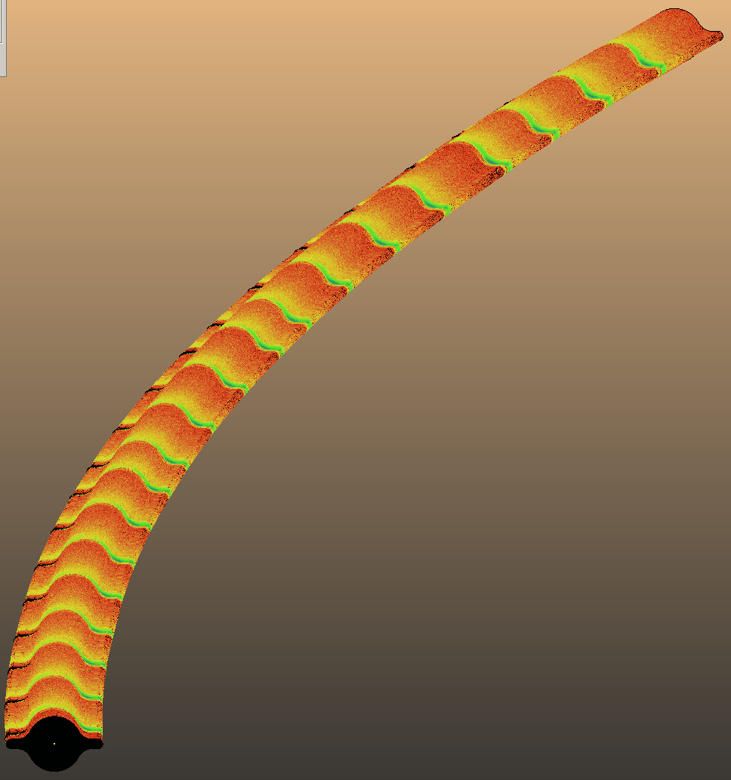
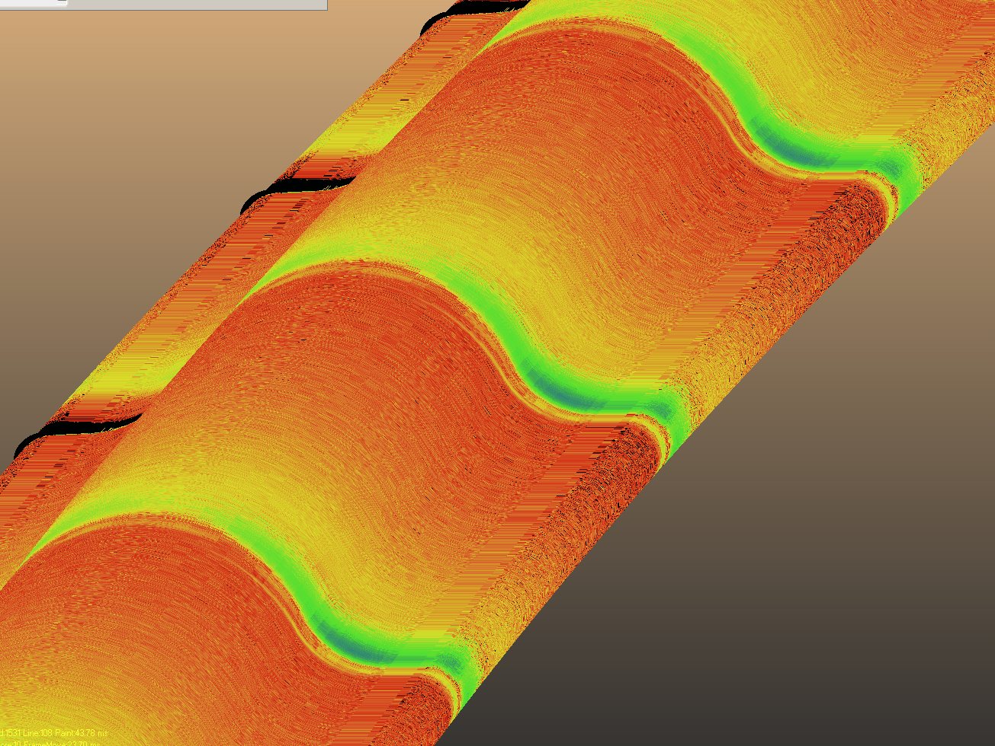
Secondaries: 380W (2.9W/m) on walls
absorber
absorber
absorber
Largest load opposite absorbers
W/cm²

Slide 16
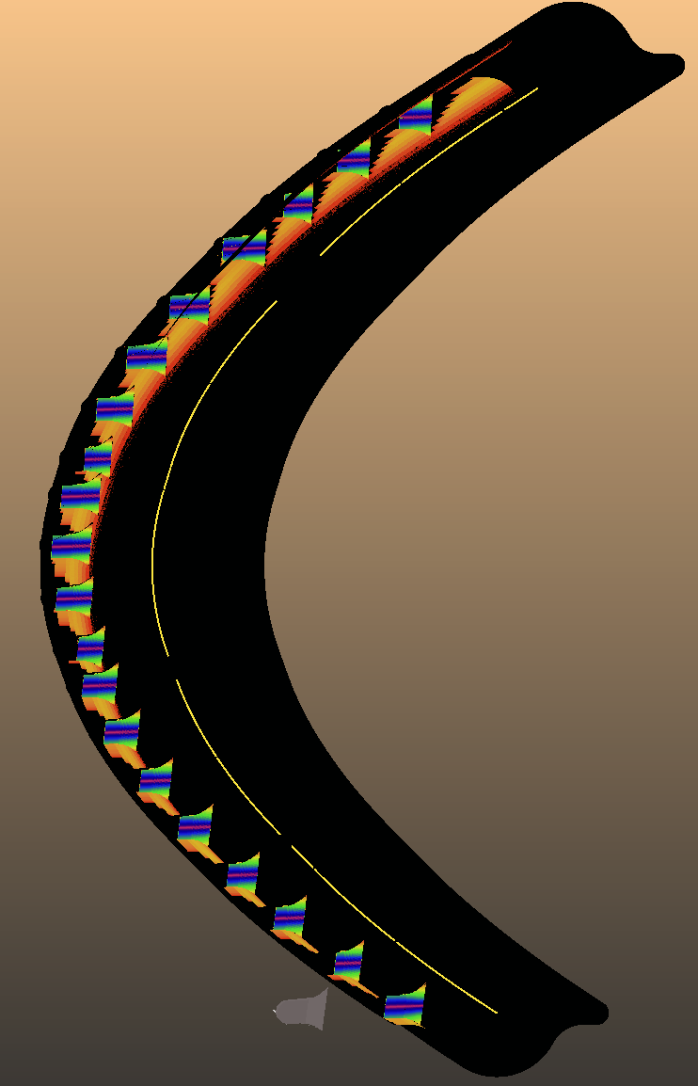
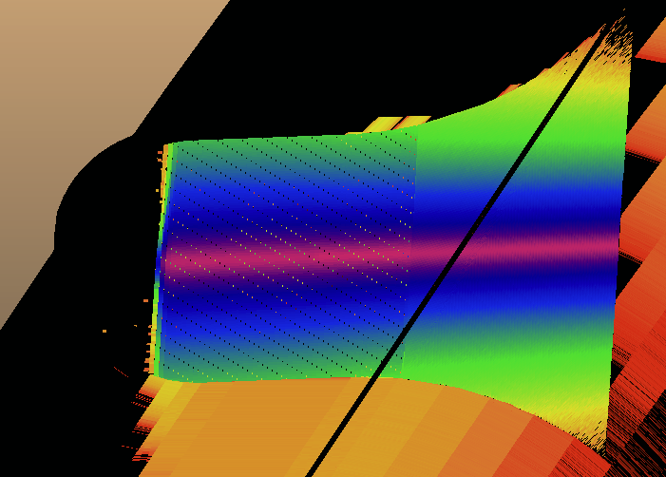
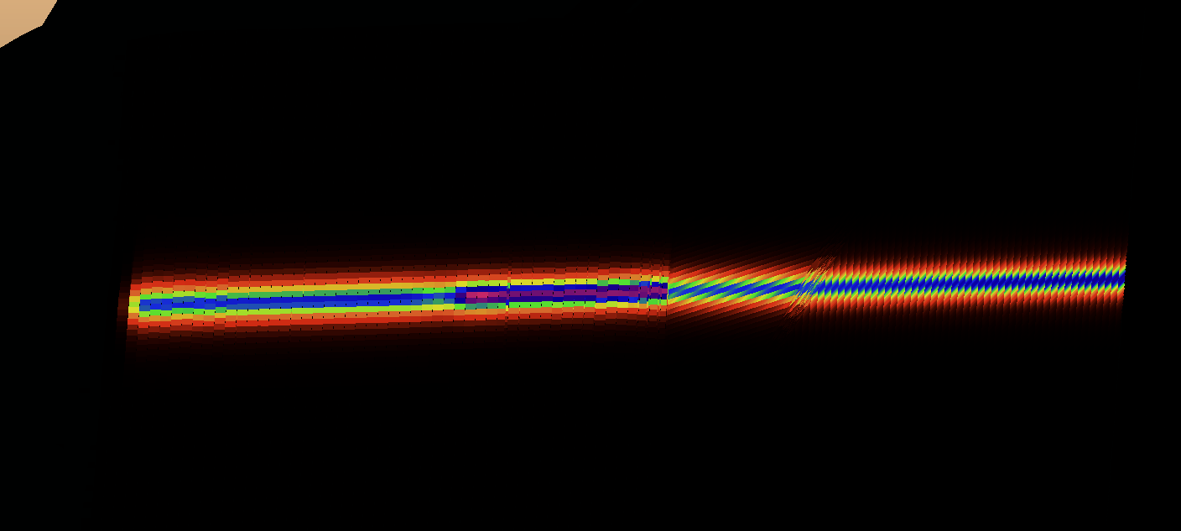

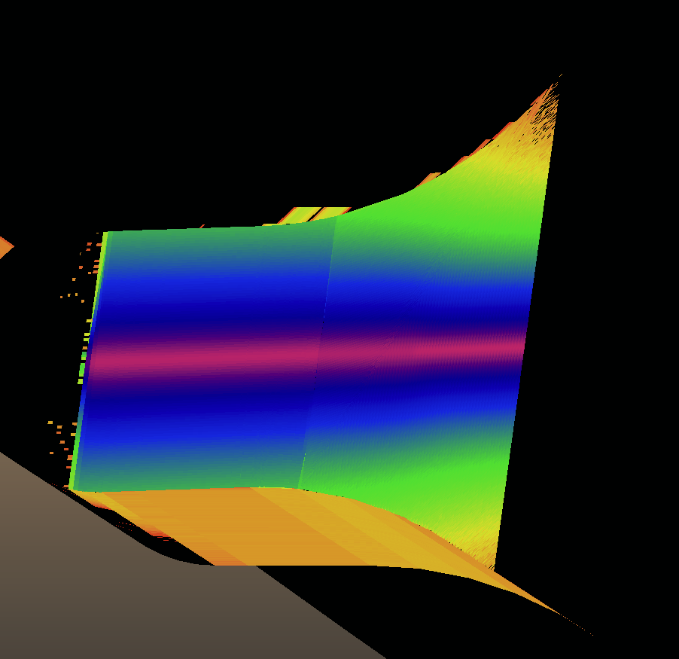
Load on absorbers: largest after drifts
66W/mm²
5200W
W/cm² (linear scale)
4580W
W/cm²

Slide 17
Conclusion (collider SR management)
Increasing the absorber protrusion shows complete shadowing
Should be repeated with real sawtooth (0.9mm sides)
Total power (5.3kW) – check with cooling simulations
Power density: decrease angle and make longer?
46.5cm too long for 3D printer
Impedance validation required
If above passed, 4 absorbers/magnet feasible

Slide 18
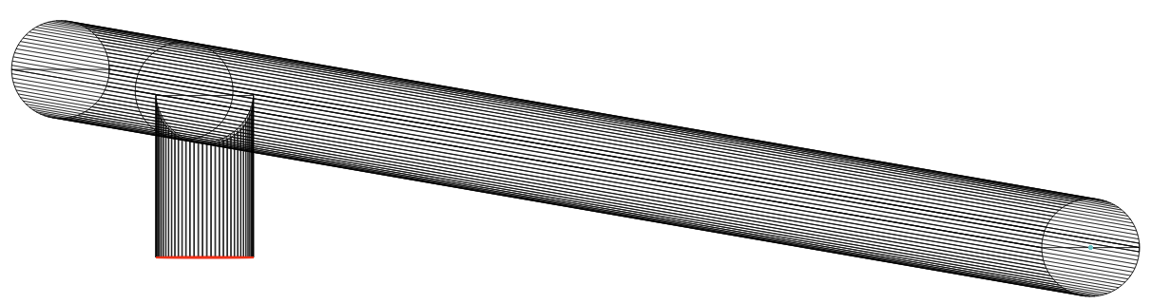
Second part: booster ring pressure profiles
Can we build the booster ring without bakeout and without NEG coating?
A representative 12.5 m-long "half-cell" model with a 60 mm inner diameter was analyzed, featuring a single 40 l/s ion pump placed between the dipole and quadrupole magnets (lumped pumps in absence of NEG)
L=12.5m
40 l/s
D=60mm
Calculation steps
Dynamic vacuum:
Scale with booster cycle
Calculate SR spectrum
Vacuum simulation
Static vacuum:
Get material outgassing
Vacuum simulation

Slide 19
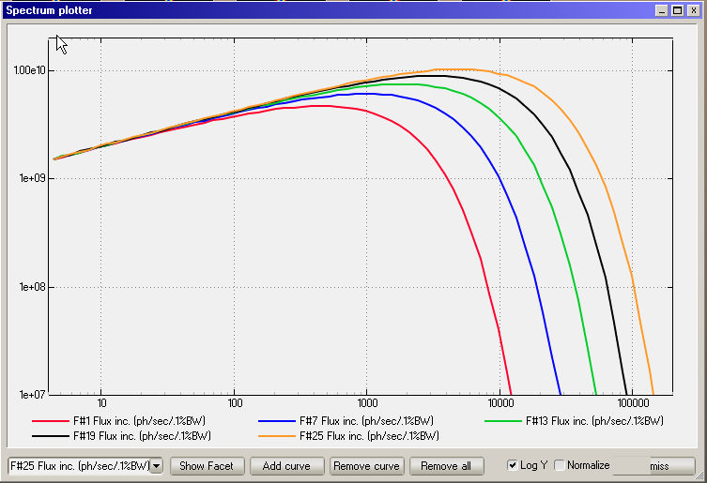
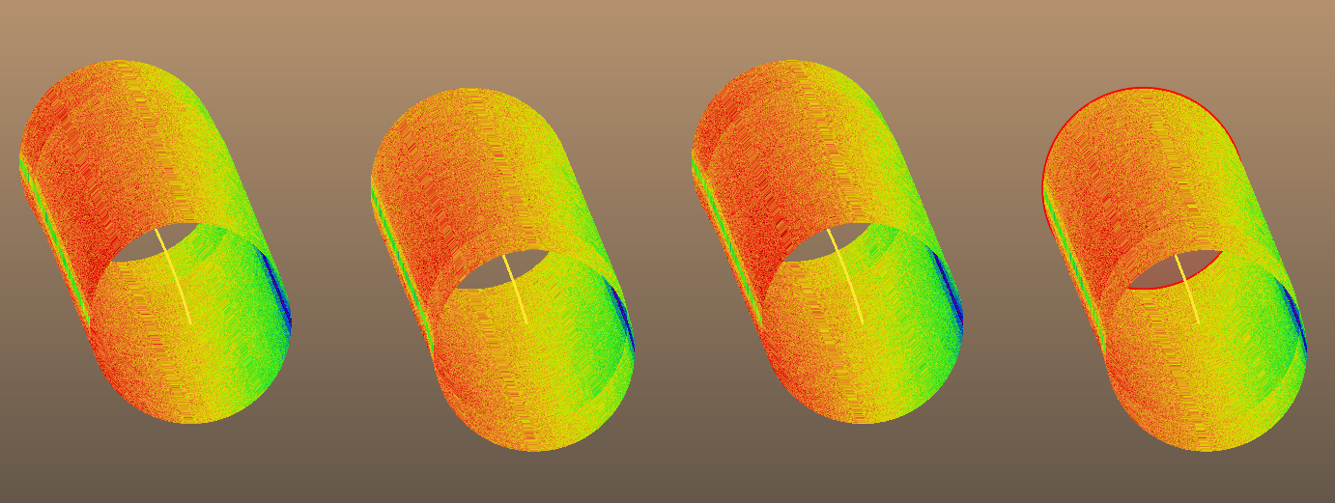
Dynamic vacuum
Step1: Estimate synchrotron radiation
Dipoles
45.6GeV
20GeV
D4
D3
D2
D1
Magnet parameters:
B=6.5mT at 20GeV
I=14.83mA*
L=4*11m
Part of SR above 4eV (“SR_factor”):
20 GeV: 83%
45.6GeV: 92%
took the average
Practical formula: Flux = 8.08E17 * E[GeV] * I[mA] * SR_factor * Ring_fraction = 2.36E17 photons/s (at mid-energy, full current)
SynRad result: 2.24E17 photons/s
44m modeled / 64486m magnetic circumference
SR flux: 5.3E15 photons/sec/m
*thank you Antoine Chance and Anton Lechner for the confirmation!

Slide 20
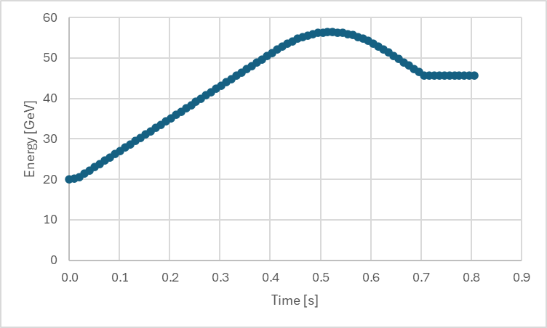
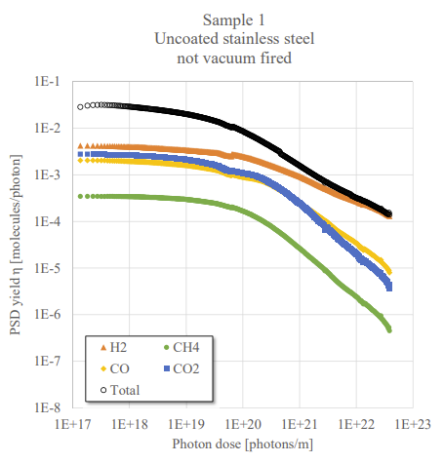
Dynamic vacuum
Step2: construct dynamic outgassing for vacuum simulation
Representative booster cycle (Z mode):
  2.8s accumulation: 0 to 14.83mA linear current increase
  0.8s ramp-up cycle with energy overshoot
  0.2s magnet ramp-down
Flux = 8.08E17 * E[GeV] * I[mA]
Outgassing: PSD_yield * Flux
  Choose η=3E-4 mol./photon for CO
digitized data: Antoine Chance (CEA)
100h: 1e21 photons/m

Slide 21
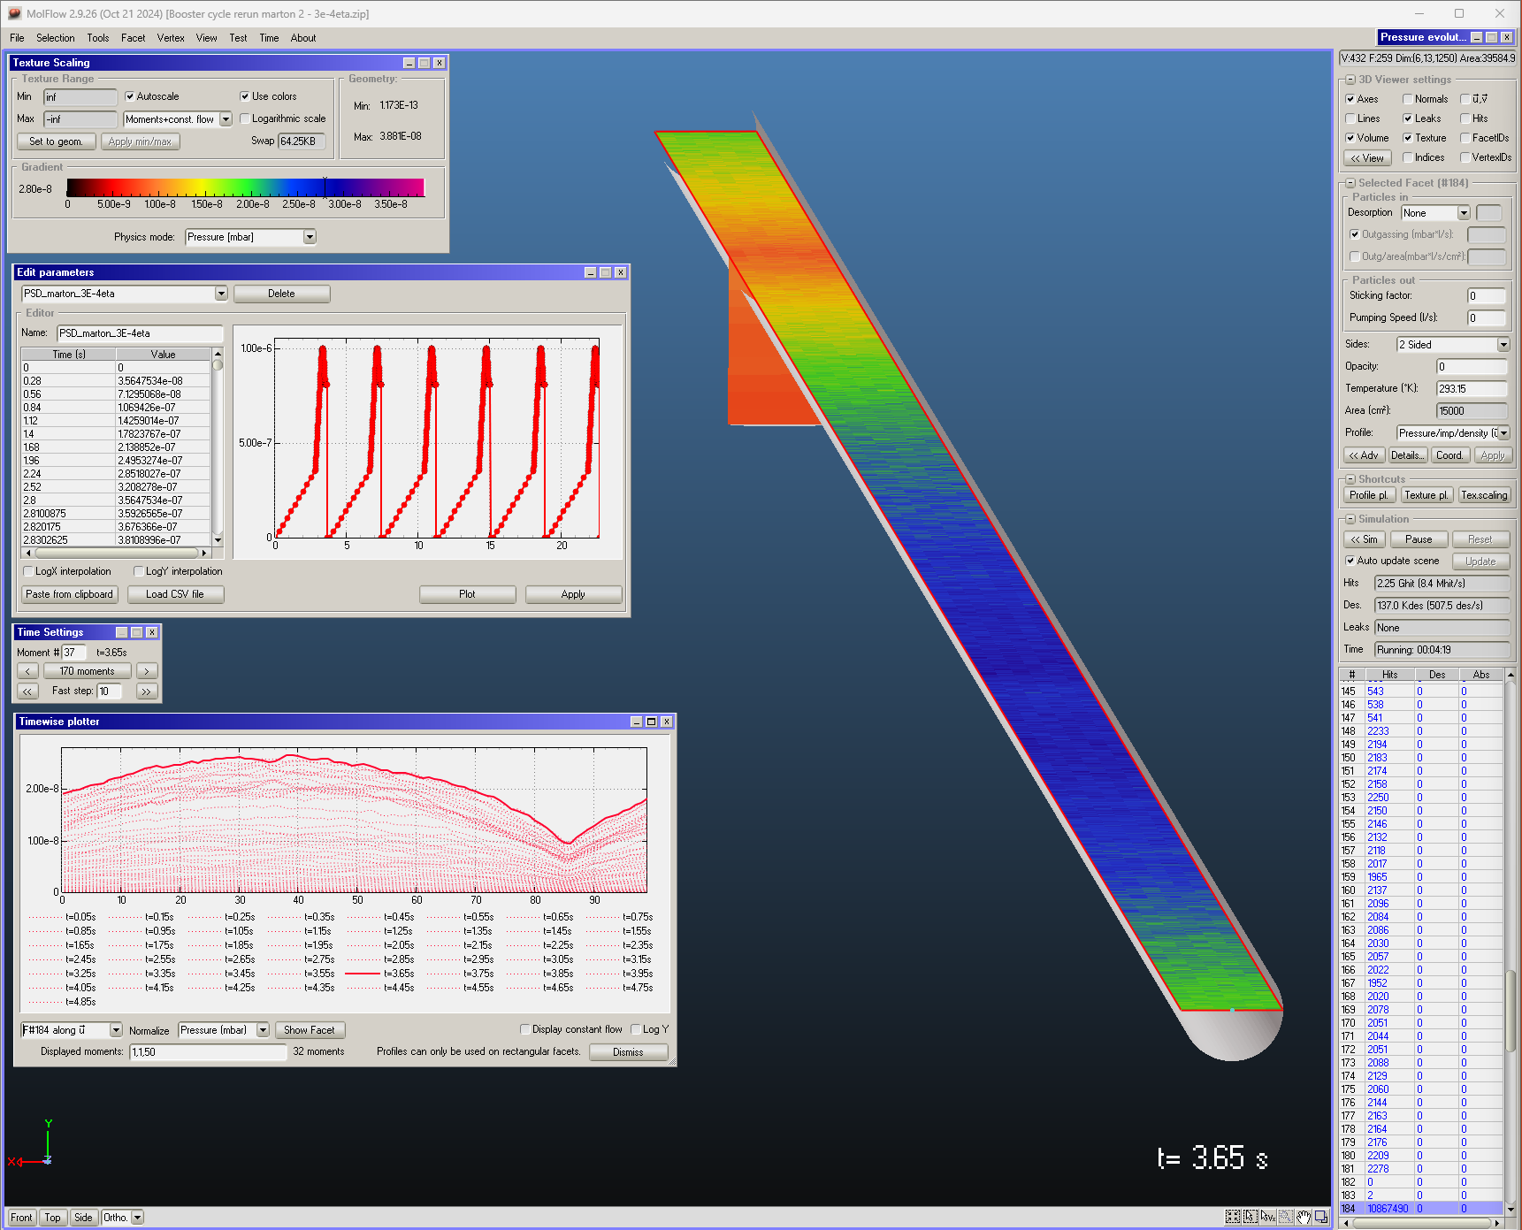
Dynamic vacuum
Step3: vacuum simulation
Mass: 28 (CO)
Temp: 300K
Typically, the gas species are (ordered per fraction): H2, CO, CO2, CH4 (baked system), plus H2O (if unbaked), which can initially be the predominant gas specie
➢ We have considered CO because it has an atomic number much higher than that of hydrogen, and therefore its effect in terms of beam bremsstrahlung (BS) is ~15x bigger then for H2… (Zeff*(Zeff+1) dependence for BS, Zeff =weighted effective atomic number for C and O)
Time-dependent outgassing
40 l/s ion pump
12.5m representative section
Pressure profiles at different moments
Snapshot displayed on model

Slide 22
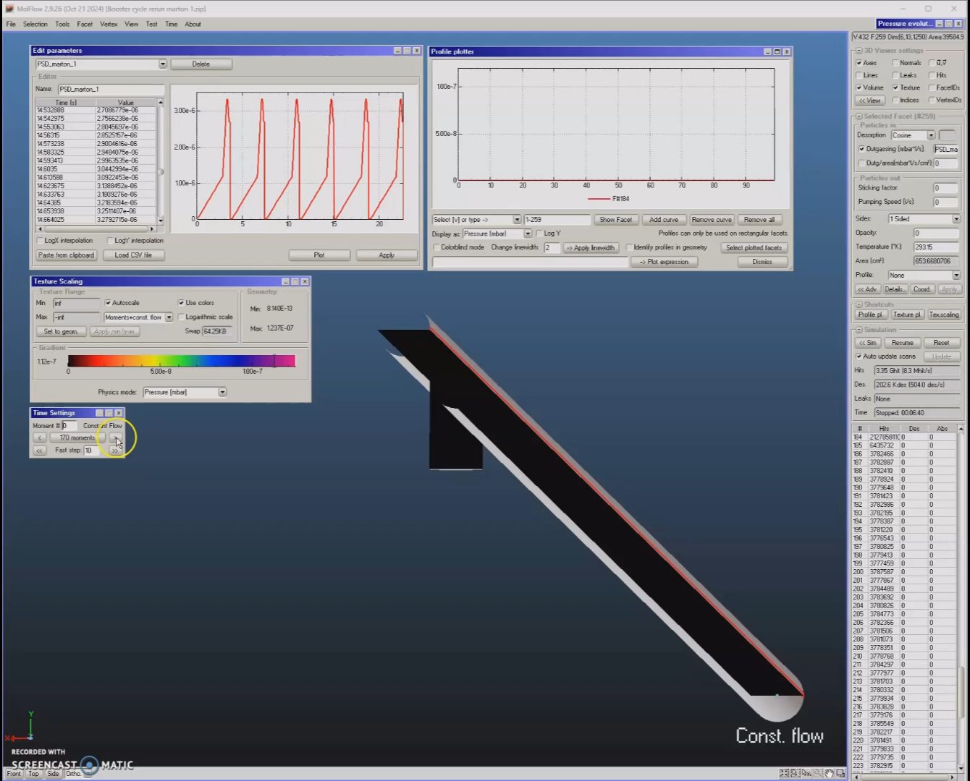
Dynamic vacuum
Step4: pressure results

Slide 23
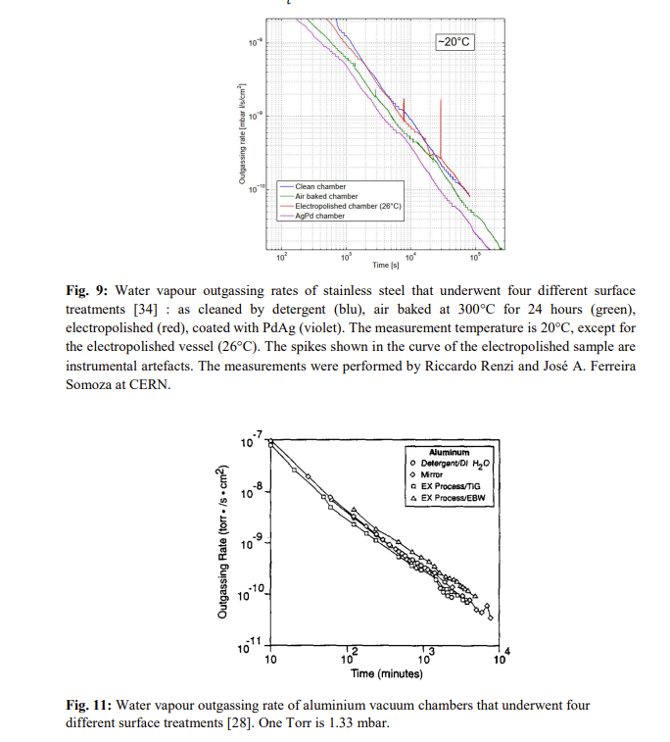
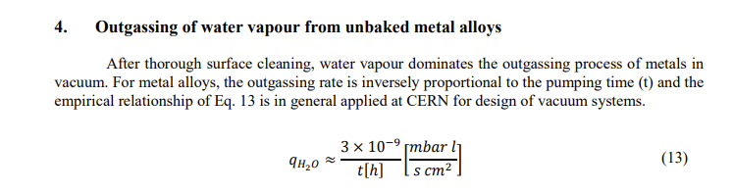
Static vacuum
Step1: material outgassing rate
Unbaked materials: dominated by water vapor
After 100 hours:
3E-11 mbar.l/s/cm²
Outgassing properties of vacuum materials for particle accelerators Paolo Chiggiato
Proceedings of the 2017 CERN–Accelerator–School course
https://cds.cern.ch/record/2723690/files/2006.07124.pdf?version=1

Slide 24
Static vacuum
Step2: static simulation

Slide 25
Static / dynamic pressure comparison
After 100h conditioning:
Q_{thermal}~t⁻¹
Q_{PSD}~t^{-0.6}
Outgassing properties of vacuum materials for particle accelerators, Paolo Chiggiato
Proceedings of the 2017 CERN–Accelerator–School course
https://cds.cern.ch/record/2723690/files/2006.07124.pdf?version=1
Monte Carlo simulations of ultra high vacuum and synchrotron radiation for particle accelerators
Marton Ady, CERN/EPFL, 2016
https://cds.cern.ch/record/2157666

Slide 26
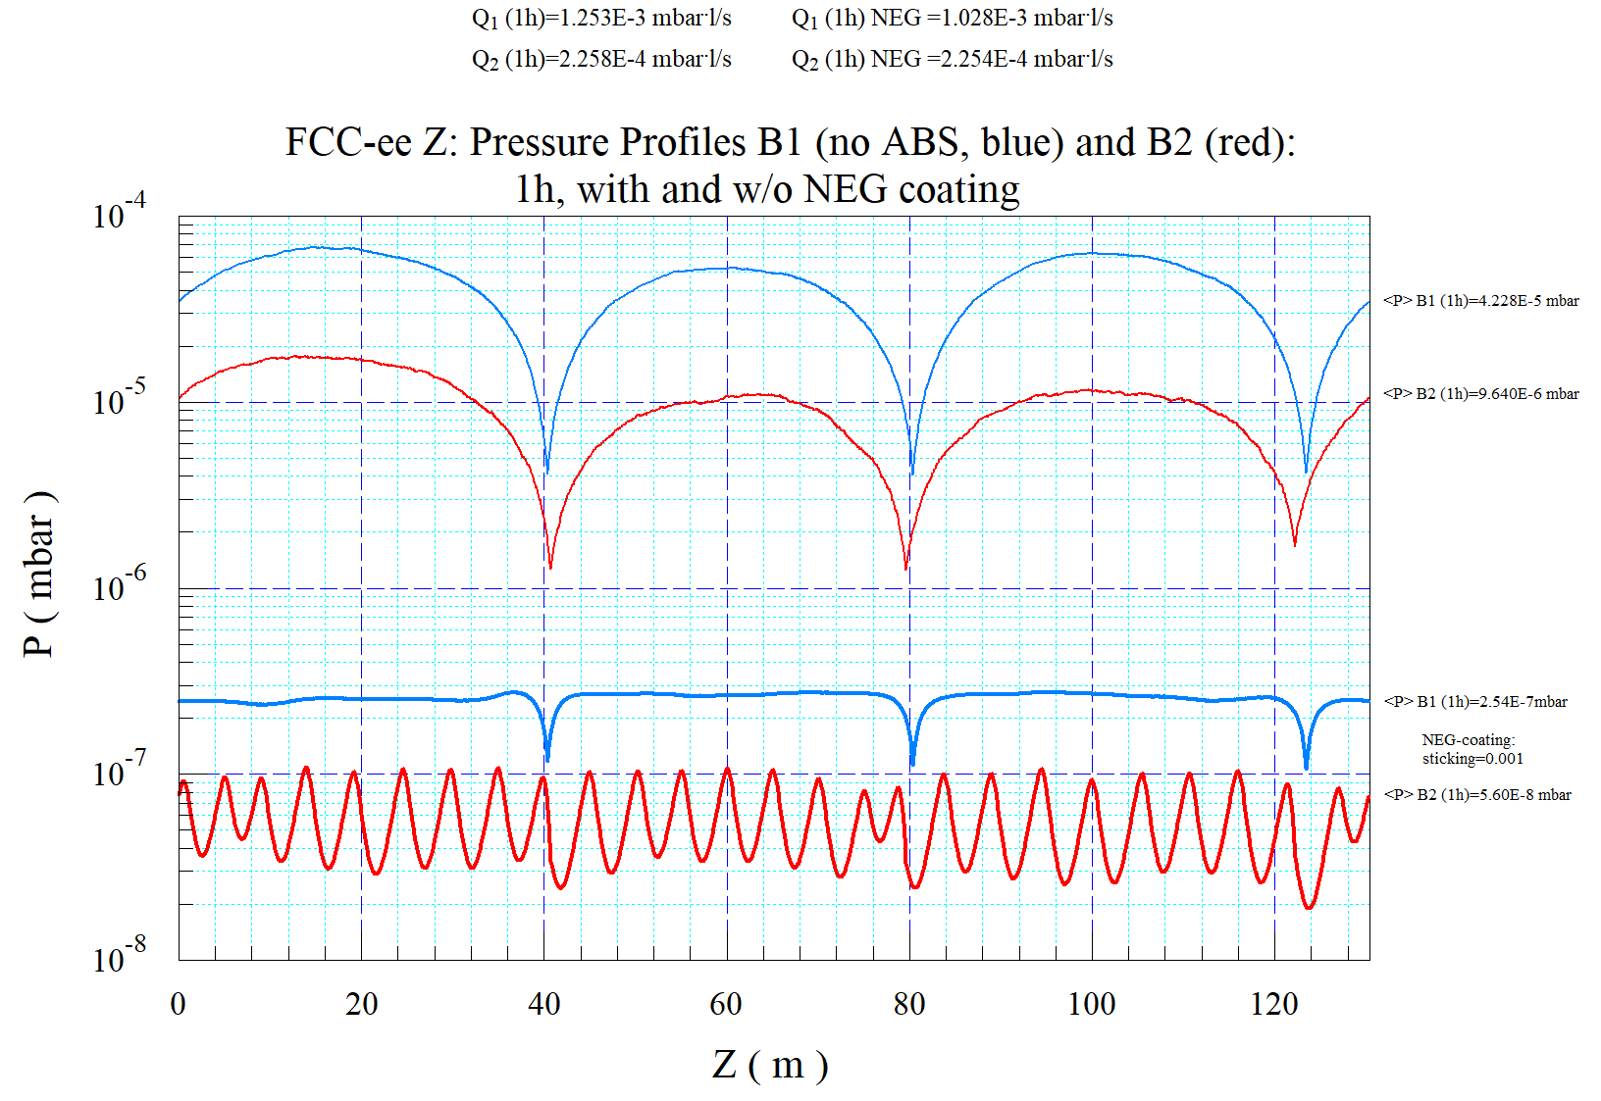
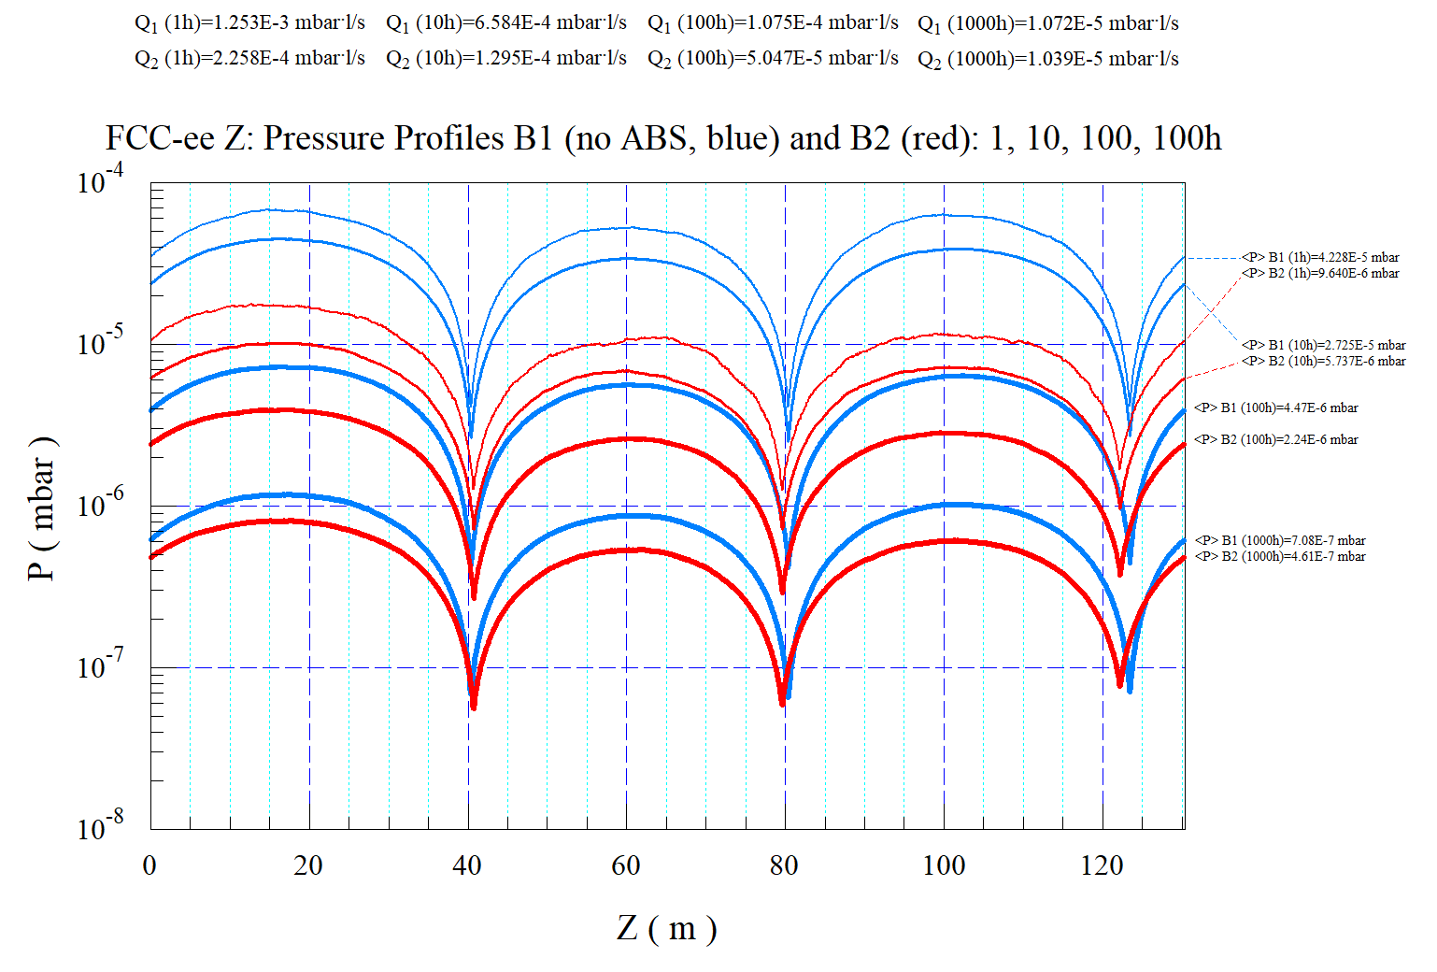
The case for NEG coating
Cedric Garion / Roberto Kersevan, FCC Week 2024:
NO NEG
~1/170
100h
effect of NEG coating (1h case)
The PSD pressure profiles have been calculated for 4 different beam doses, corresponding to times of 1 h, 10 h, 100 h, 1000 h at nominal current (1270 mA); Simulated gas: CO
case with 3x 100 (l/s) lumped pumps/beam, and no NEG-coating

Slide 27
Conclusion (booster vacuum)
The average pressure after around 100h (0.8Ah) of conditioning is around 3E-8mbar
This is exactly the max. pressure by the latest beam-gas calculations*
It would be preferable to have an in-situ bakeout system installed, and consequently NEG-coating of the vacuum chambers, as this would reduce the number of external pumps and their cabling by a factor of about 5
Additionally, the NEG-coated solution would guarantee very fast reconditioning of any vacuum sector needing venting during operation.
*F. Zimmermann. Update on booster vacuum system, operation mode and polarisation time estimate in the DR
Presented at the 183rd FCC-ee Optics Design Meeting & 54th FCCIS WP2.2 Meeting (2024)

