Slide 1
Fast readout system for beam signal digitalization in the FCC era
22.05.2025 / FCC Week 2025
Thibaut Lefevre, Tom Levens, Stefano Mazzoni, Andreas Schlögelhofer

Slide 2
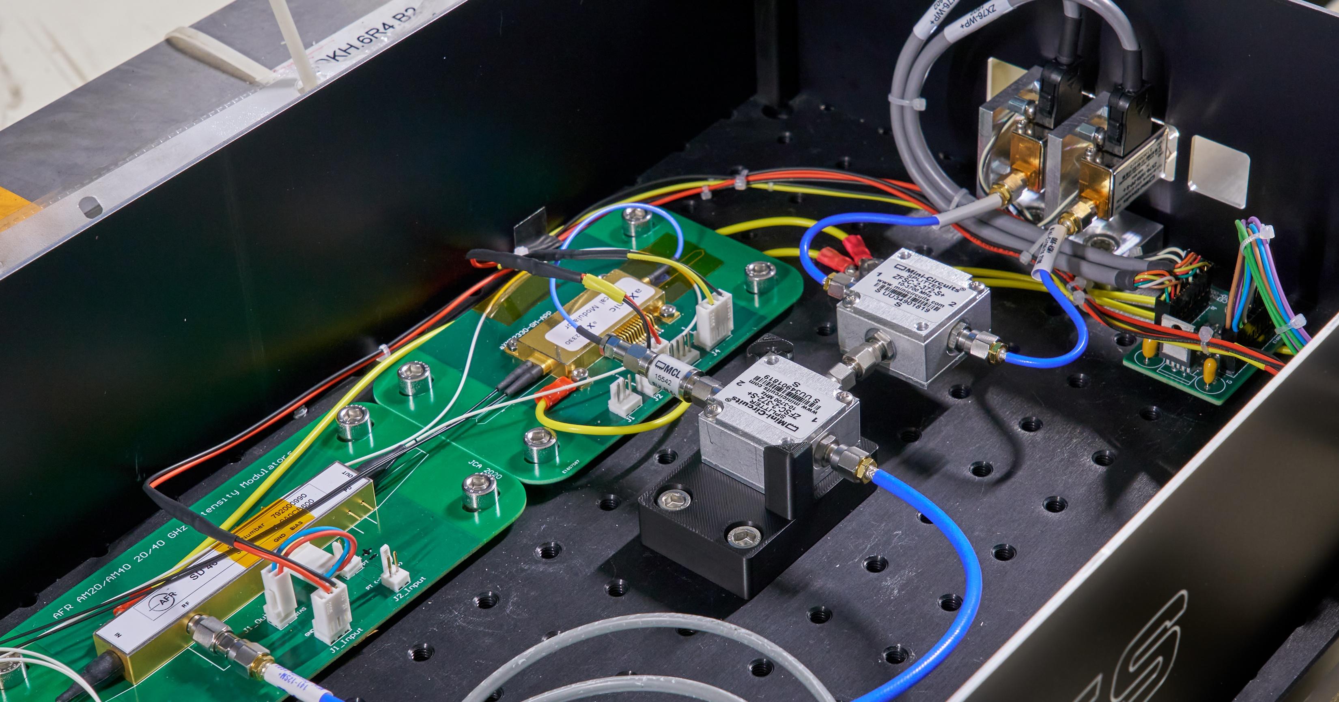
Table of contents
22.05.2025 / FCC Week 2025
Andreas Schlögelhofer
High bandwidth considerations
Fast readout using radio over fibre and time stretch
Test results from lab setup
Current LHC installation
Conclusion

Slide 3
How to maintain a high bandwidth?
22.05.2025 / FCC Week 2025
Andreas Schlögelhofer
  Short propagation distance for high frequency signals leads to the requirement of short transmission lines (~ 2 dB/m @ 20 GHz)
    radiation hardness of high frequency components
?
Can we avoid long distance
RF transmission?
What about resolution?
  Maintaining high resolution at high bandwidth
    limited by ADC performance
    comes at a high price (8 GHz, 20 GSa/s, 10-bit, EUR ~100k)
?
Can we overcome this limit?

Slide 4
How to maintain a high bandwidth?
22.05.2025 / FCC Week 2025
Andreas Schlögelhofer
  Short propagation distance for high frequency signals leads to the requirement of short transmission lines (~ 2 dB/m @ 20 GHz)
    radiation hardness of high frequency components
Radio-over-fibre
Encoding and transporting RF signal using an optical carrier
What about resolution?
  Maintaining high resolution at high bandwidth
    limited by ADC performance
    comes at a high price (8 GHz, 20 GSa/s, 10-bit, EUR ~100k)
?
Can we overcome this limit?

Slide 5
How to maintain a high bandwidth?
22.05.2025 / FCC Week 2025
Andreas Schlögelhofer
  Short propagation distance for high frequency signals leads to the requirement of short transmission lines (~ 2 dB/m @ 20 GHz)
    radiation hardness of high frequency components
Radio-over-fibre
Encoding and transporting RF signal using an optical carrier
What about resolution?
  Maintaining high resolution at high bandwidth
    limited by ADC performance
    comes at a high price (8 GHz, 20 GSa/s, 10-bit, EUR ~100k)
Time stretch
Lowering ADC requirements by stretching time

Slide 6
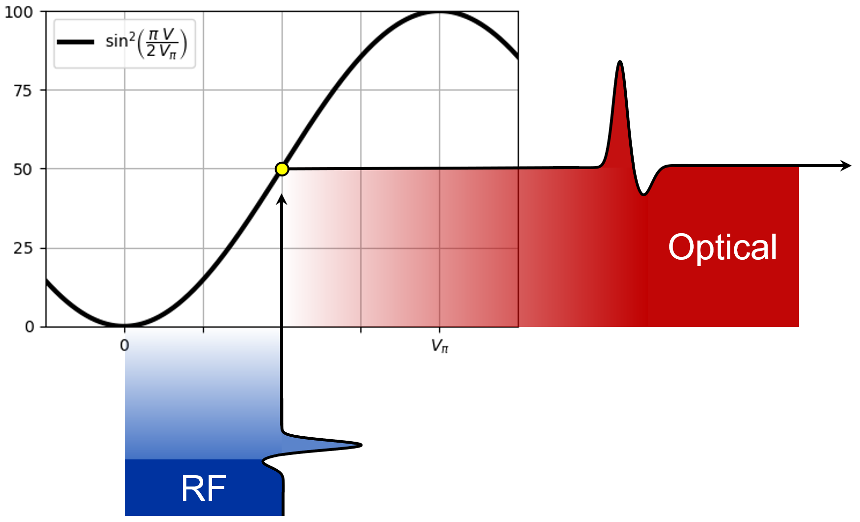
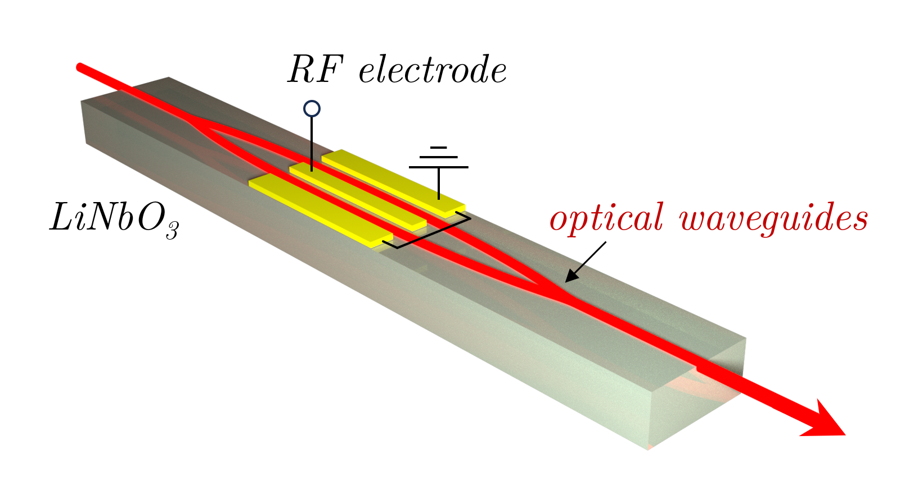
Radio-over-fibre with electro-optical modulators
22.05.2025 / FCC Week 2025
Andreas Schlögelhofer
Modulation due to Pockels effect
    linear variation of refractive index in response
    to an applied electric field
Electro-optic material
    Lithium niobate (LiNbO₃)
    Gallium arsenide (GaAs)
    …
Interference-based modulation of light
    laser light split into two arms, modulated, and recombined
    designed for continuous wave lasers
    large variety of off-the-shelf products for telecommunication

Slide 7
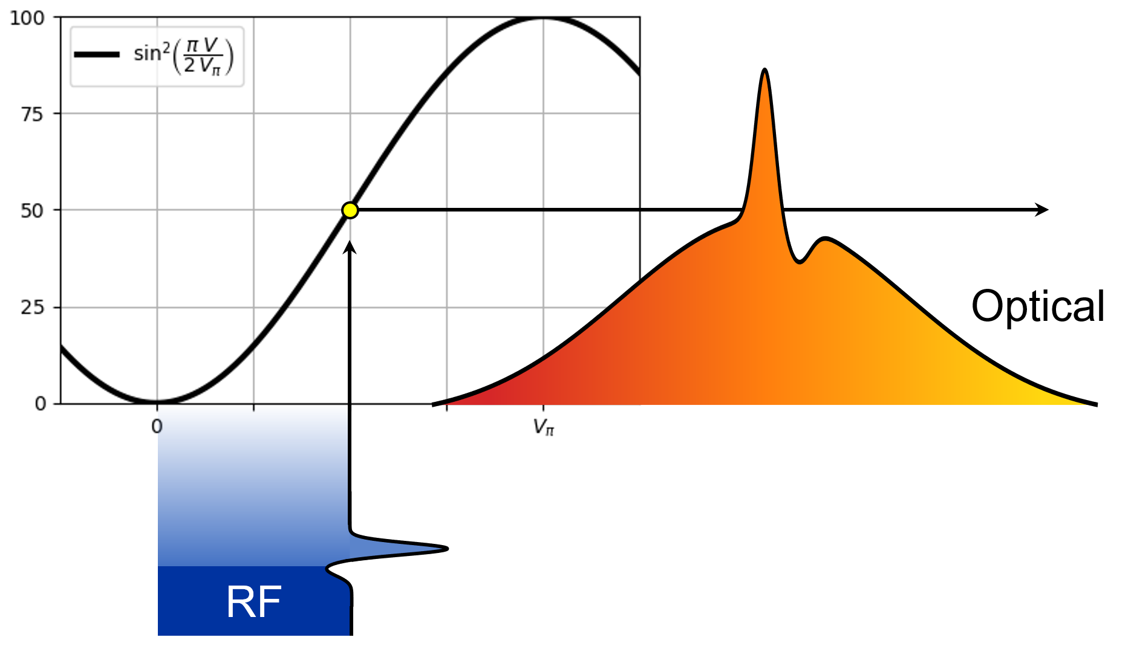
Spectral encoding
22.05.2025 / FCC Week 2025
Andreas Schlögelhofer
Use a chirped laser pulse instead of
a continuous wave laser
    increase power density of the laser
Narrow optical spectrum
    keep reasonable performance of Mach-Zehnder interferometer
Encode the signals on the laser spectrum
    possibility to use laser spectrum also for decoding

Slide 8

Time stretch through spectral encoding
22.05.2025 / FCC Week 2025
Andreas Schlögelhofer
Stretch the spectrum in time using dispersion in optical fibres
    moving away from real-time sampling
    opens up the possibility for lower bandwidth, continuous acquisition (RFSoC)
linear dispersion in optical fibre
~ km
real time
stretched time
radio-over-fibre
time stretch

Slide 9
Test setup
9

Slide 10




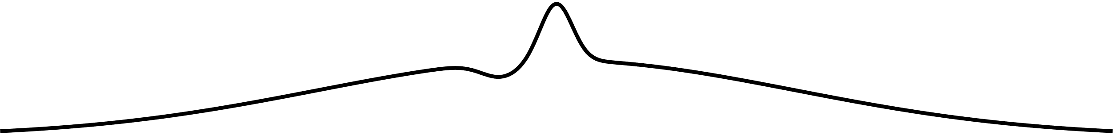

Test setup
22.05.2025 / FCC Week 2025
Andreas Schlögelhofer
Laser and electronics
Modulator and signal source
5 km
1 ns
DUT 1
PM fibre
DUT 2
DC bias voltage
EO modulator
RF signal
Femtosecond
laser
Chirped volume
bragg grating
pulse generator
5 ns
20 km
Read-out electronics
Stretching
$$1+\frac{20 km}{5 km} =5$$
Photodetector
stretched time

Slide 11




Time conversion
22.05.2025 / FCC Week 2025
Andreas Schlögelhofer
t
λ
time
spectrum
Establish relationship between
wavelength and time
Δt
Δt
Δλ
Δλ
t
-λ
$$e^{−}$$

Slide 12

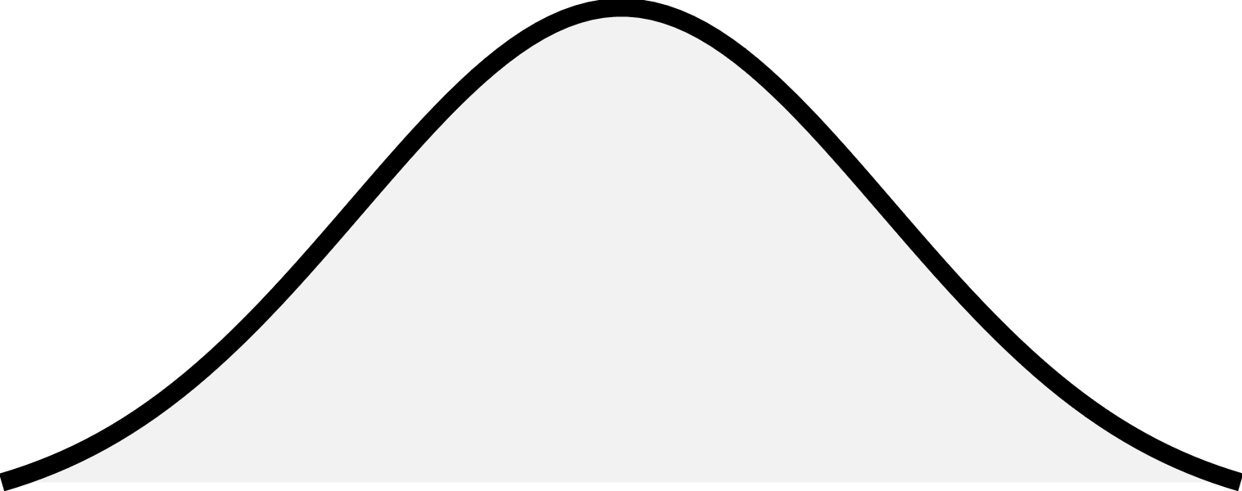
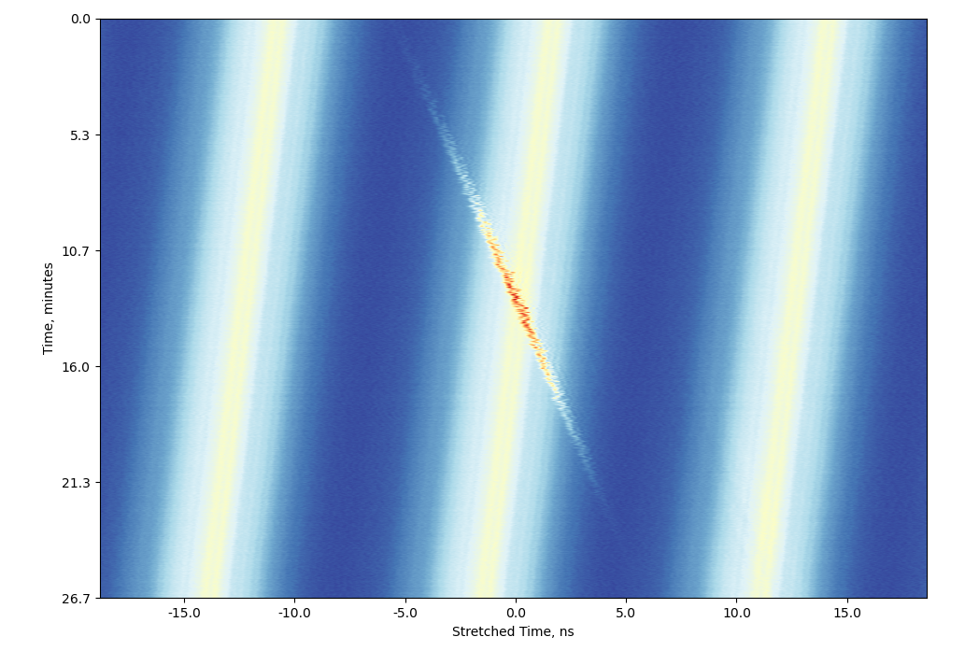

Time conversion
22.05.2025 / FCC Week 2025
Andreas Schlögelhofer
$$1+\frac{2nd Stretching}{1st Stretching}$$
signal
background
→ stretching factor 4.68 with test setup
?
Laser pulse spacing: 12.5 ns
LHC:
Bunch length (4σ): 920 to 1200 ps
Bunch spacing: 25 ns
Time delay of laser pulse
with respect to input signal
FCC-ee:
Bunch length (4σ): 25 to 200 ps
Bunch spacing: 25 ns
Factor 6 to 36 shorter bunch lengths in FCC-ee provide margin for much longer stretching
→ stretching factor in the order of 100 feasible
Stretched time, ns

Slide 13
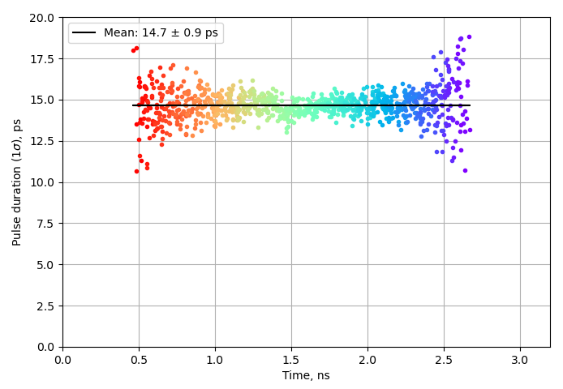

Stretching and bandwidth
22.05.2025 / FCC Week 2025
Andreas Schlögelhofer
$$1+\frac{2nd Stretching}{1st Stretching}$$
signal
background
14.7 ps (1 σ) ≈ 14.4 GHz
14.4 GHz / 4.68 ≈ 3.1 GHz
→ limited by the bandwidth of a 3 GHz oscilloscope
?
Current commercial Mach-Zehnder modulators
have an analog bandwidth of up to 50 GHz
FCC-ee:
Stretching factor in the order of 100 realistic with a 25 ns bunch spacing.
500 MHz ADC would be sufficient for a
50 GHz equivalent signal digitalization
1.0 ns

Slide 14
LHC installation
14

Slide 15

LHC installation
22.05.2025 / FCC Week 2025
Andreas Schlögelhofer
Surface (SX4 R-002)
Gallery (UA47/U0-001)
Tunnel (2438/U0-2438)
DCM 5 km
DUT 1
PM fiber
200 fs (FWHM)
30 GHz EO-modulator
1 ns (FWHM)
DUT 2
0.6 ns (FWHM)
DC bias voltage
RF signal
Femtosecond
laser
Chirped volume
bragg grating
1 ns (FWHM)
Attenuation (> 30 dB)
2.8 ns (FWHM)
SM fiber
BQK
4.7 ns (FWHM)
DCM 20 km
0.6 ns (FWHM)
Read-out electronics
$$p^{+}$$
Photodetector
stretched time
BQK
+12.5 ns

Slide 16
22.05.2025 / FCC Week 2025
Andreas Schlögelhofer
Main part of the setup on the surface is accessible 24/7
Gallery (UA47/U0-001)
Tunnel (2438/U0-2438)
DCM 5 km
DUT 1
PM fiber
200 fs (FWHM)
30 GHz EO-modulator
1 ns (FWHM)
DUT 2
0.6 ns (FWHM)
DC bias voltage
RF signal
Femtosecond
laser
Chirped volume
bragg grating
1 ns (FWHM)
Attenuation (> 30 dB)
2.8 ns (FWHM)
SM fiber
BQK
4.7 ns (FWHM)
DCM 20 km
0.6 ns (FWHM)
Read-out electronics
$$p^{+}$$
Photodetector
stretched time
BQK
+12.5 ns

Slide 17
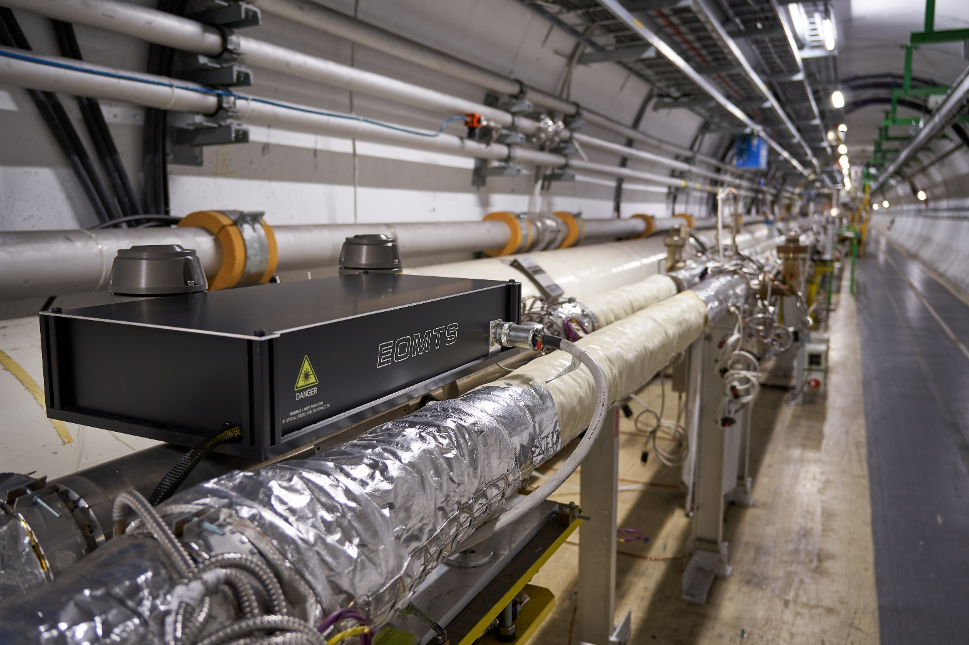
22.05.2025 / FCC Week 2025
Andreas Schlögelhofer
Tunnel (2438/U0-2438)
Enclosure
Strip-line (BQK)
PM fiber
30 GHz EO-modulator
0.6 ns (FWHM)
DC bias voltage
RF signal
1 ns (FWHM)
Attenuation (> 30 dB)
BQK
0.6 ns (FWHM)
$$p^{+}$$
+12.5 ns
BQK

Slide 18
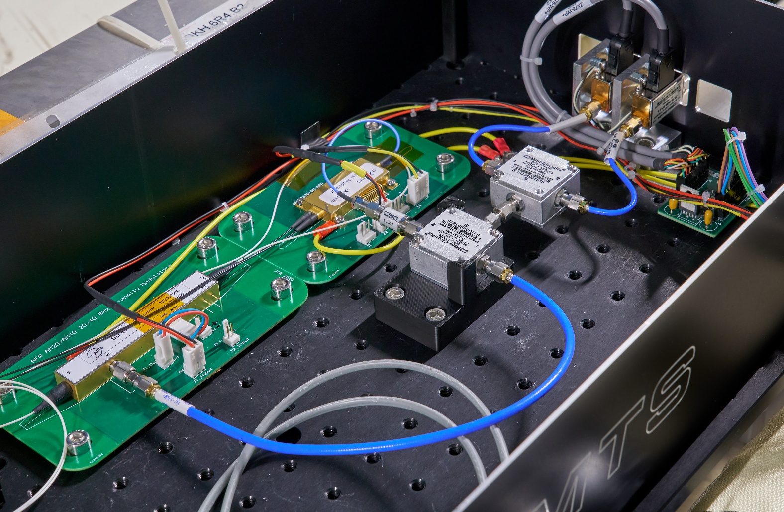
22.05.2025 / FCC Week 2025
Andreas Schlögelhofer
Modulators
Splitter / Combiner
Attenuators
Tunnel (2438/U0-2438)
PM fiber
30 GHz EO-modulator
0.6 ns (FWHM)
DC bias voltage
RF signal
GaAs
1 ns (FWHM)
Attenuation (> 30 dB)
LiNbO₃
BQK
0.6 ns (FWHM)
$$p^{+}$$
  Being tested with beam at the moment!
+12.5 ns
BQK

Slide 19
Setup considerations
22.05.2025 / FCC Week 2025
Andreas Schlögelhofer
Laser pulses need to be synchronized to particle beams
    e.g. for protons in the LHC: 40.078 885 MHz to 40.078 970 MHz (0.45 Hz/s during ramp)
    Not a problem in FCC-ee main ring
Radiation hardness of various parts still to be assessed
    GaAs vs. LiNbO₃ modulators
    Polarization maintaining fibers
Vertical resolution being tested with beam
    various detection schemes possible, in case the current setup underperforms in resolution:
    1) optical background subtraction using a balanced photodetector
    2) IQ modulator to encode difference and sum optically

Slide 20
Conclusion
22.05.2025 / FCC Week 2025
Andreas Schlögelhofer
High-bandwidth, high-resolution acquisition is challenging
  demonstrated high linearity of time stretching
    demonstrated an analog bandwidth of 14.4 GHz, which can be easily adapted with different stretching stages
    current modulator technology limits bandwidth up to 50 GHz
    time stretching can make efficient use of the ‘void’ created through bunch spacing
Versatile setup
    most critical components accessible 24/7
    modifications for various detection schemes possible (balanced detection, IQ modulation, …)
  Big scale projects
    long transmission lines part of the design
    fibres have a much smaller footprint than high-frequency cables
First proton beam tests ongoing right now

Slide 21
Thank you for your attention.
21

