Slide 1
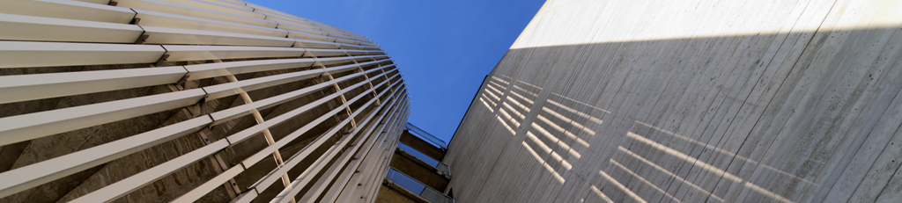



Flat racetrack HTS design option for the lattice combined function MQ/MS of the FCC-ee collider ring
22nd May 2025 | Wien, Austria
Simone Busatto
Samuele Mariotto
Lucio Rossi

Slide 2
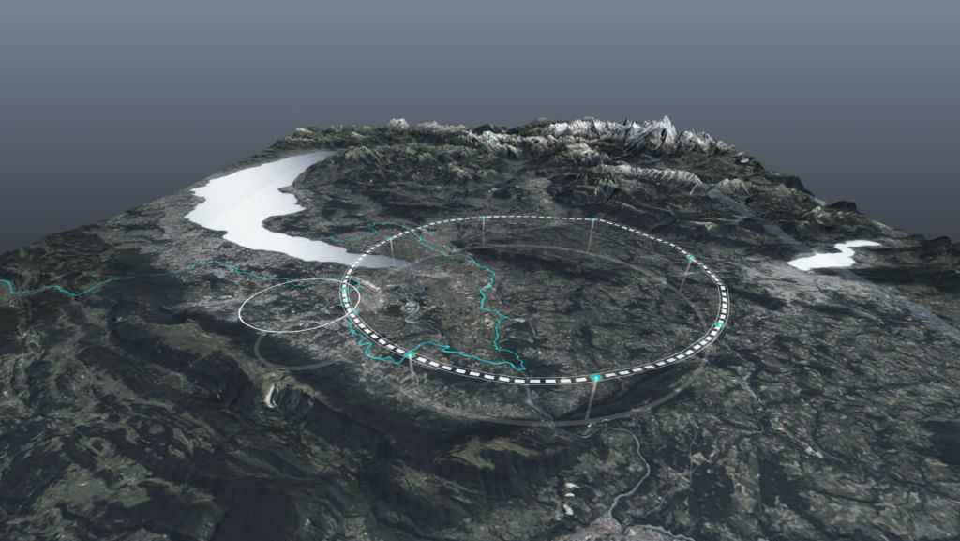
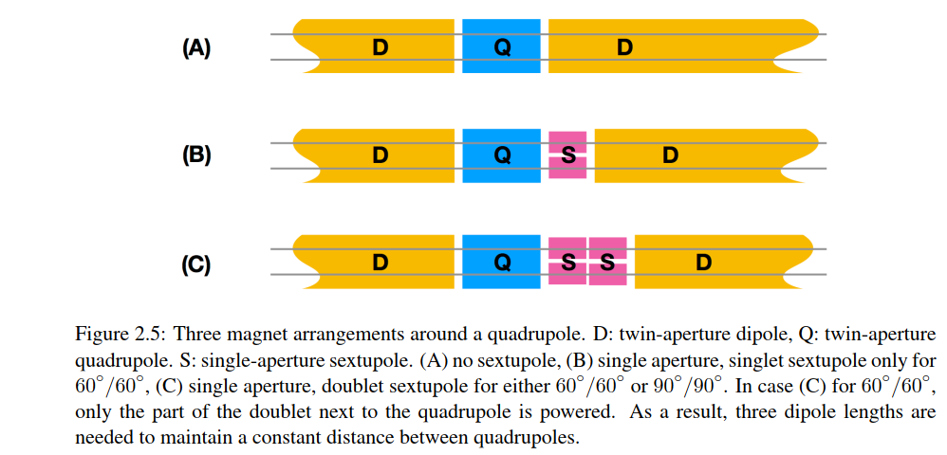
Introduction
Motivation of the contribution:
FCC-ee energy consumption 20 TWh (14 y)
  DC collider operation (high power consumption)
90+ km ring tunnel: thousands of resistive magnets
European Strategy for Particle Physics 2020
Need for «Improvement of energy efficiency»
PROPOSAL:
“Replacement of 2900 quadrupoles and
4700 sextupoles in the 80 km ARC cells”
HTS Superferric Magnets
Combined Magnets (reduced length)
High operating temperature (up to 50 K)
CDR arc lattice
Superconducting option

Slide 3
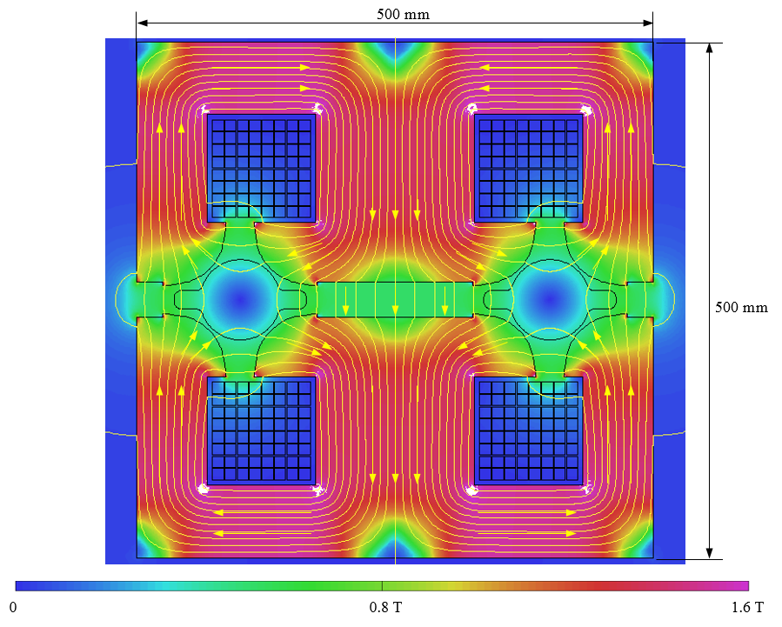
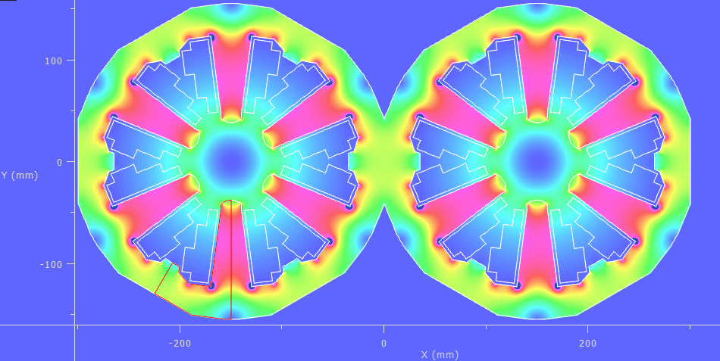
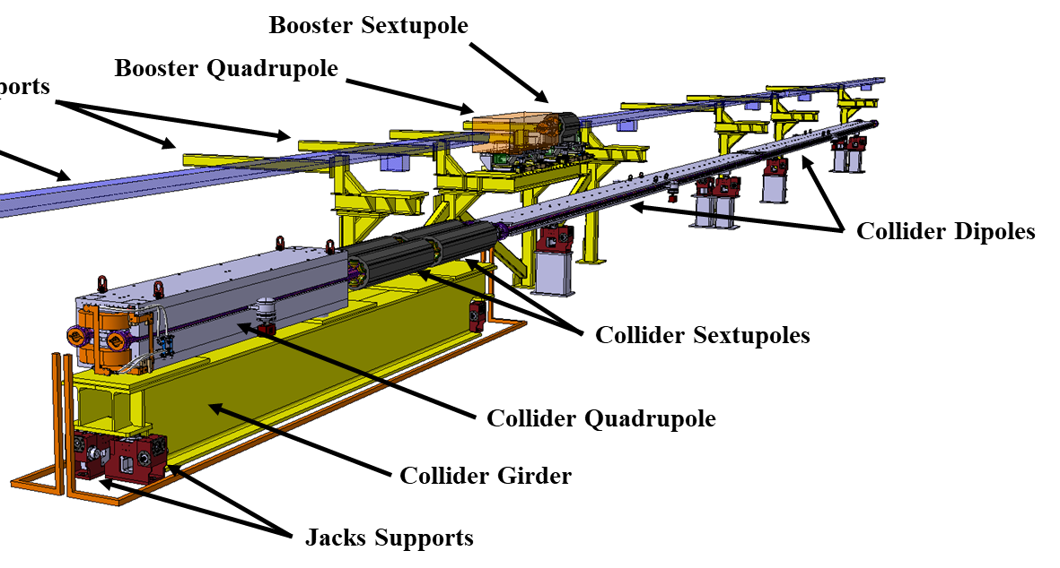


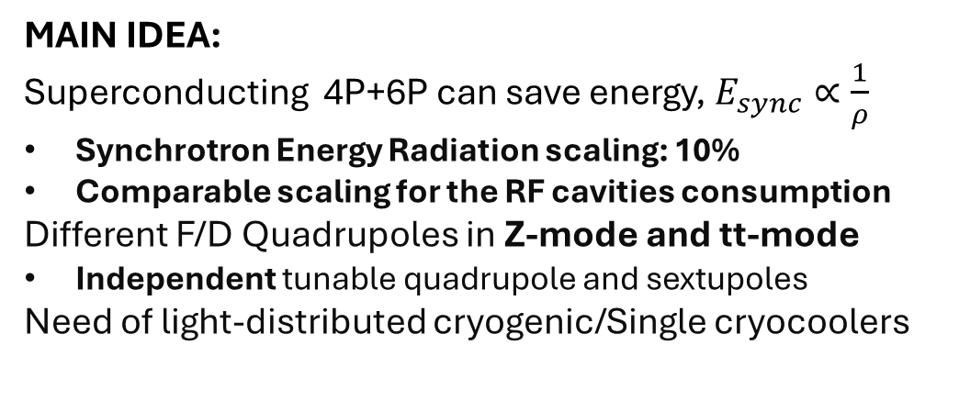
Starting Point
Twin F/D arc quad design
MAIN IDEA:
Superconducting 4P+6P can save energy, $E_{sync}∝\frac{1}{ρ}$
Synchrotron Energy Radiation scaling: 10%
Comparable scaling for the RF cavities consumption
Different F/D Quadrupoles in Z-mode and tt-mode
Independent tunable quadrupole and sextupoles
Need of light-distributed cryogenic/Single cryocoolers
Twin Sextupoles
Experience from HL-LHC corrector magnet:
Several families of magnets from 4P up to 12P
Racetrack coils suitable for HTS
Modular design
Easy mechanical assembly
Optimal Field Quality
Very good reproducibility (several magnets)
*Still to consider Cryogenic Consumption

Slide 4
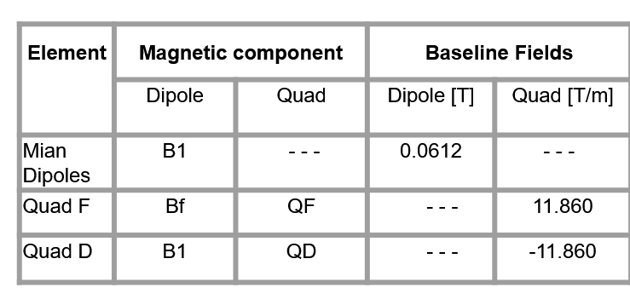
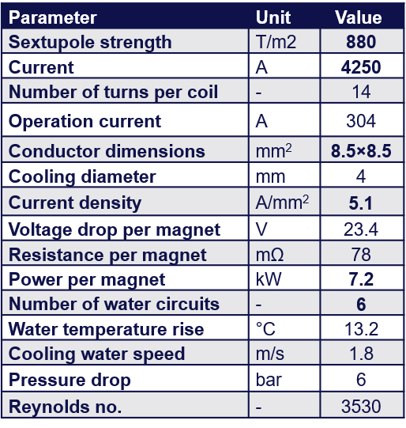

Requirements for the magnet
Sextupole
Quadrupole
$$t\overline{t}$$
Magnets for FCC-ee, J. Bauche et al.
Via EPFL (Leon Van Riesen-Haupt , Cristobal Garcia) through PSI
10 T/m design (CDR)
Property | CDR | LASA - HTS
Magnetic Length | 2.9 + 1.5 | 2.9
Max Quadrupole Gradient [T/m] | 11.86 | 11.86
Max Sextupole Strength [T/m^2] | 880 | 455
Integrated Sextupole Field [T m] | 0.132 | 0.13195

Slide 5
WHY HTS Magnet?
WHY Superferric Magnet?
Superconducting Magnet
  Increase Dipole Filling Factor, lower energy dispersion hence reducing the RF power consumption, can lead to an increased beam intensity
  Optics Flexibility
Higher Operating temperatures (20-50 K)
  Reduction of power consumption wtr LTS
  No need of LHe (cost reduction)
Parallel Synergies
  Detector Magnets
  Nuclear Fusion
  Medical Facilities
Iron Dominated Magnet
  Well Know design, like a resistive magnet
  No need of complicated geometries for the coils, HTS materials are fragile.
  Small amount of HTS (lower material costs)
Combined Magnet
  Low number of power supplier
  Reduce total number of magnets
  Increase of dipole filling factor
MAIN GOAL of the proposal:
Combined Sextupole and Quadrupole Superferric HTS magnet

Slide 6
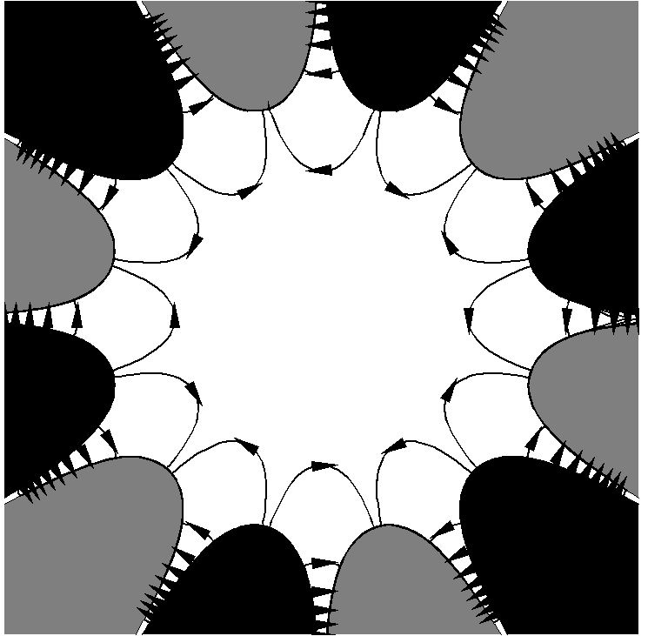
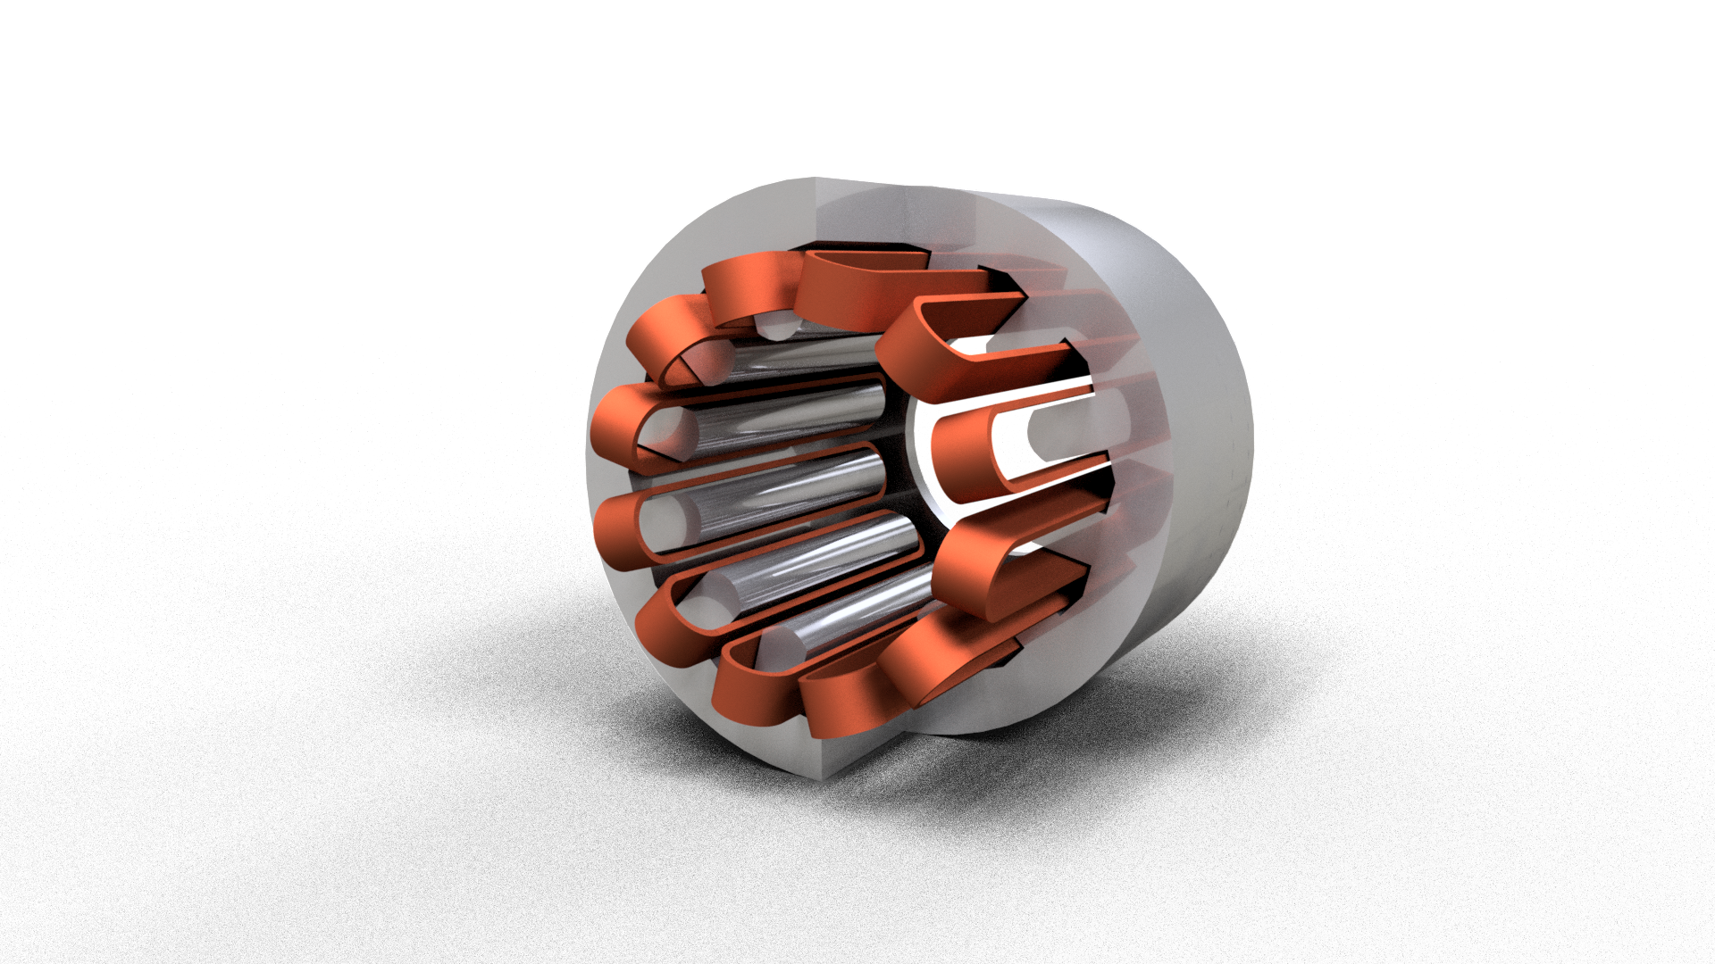
From Andrzej Wolski, CAS
LASA-proposal:
S
N
N
S
S
N
S
N
Requirements:
  Independent Quadrupole and Sextupole, have to work only as either a quadrupole or sextupole
  Minimum number of power supplier to lower energy consumption
  High field quality in the bore @Rref = 10mm
  Bore Dimension : 35 mm
  Quadrupole can not be shorter due to quadrupole synchrotron radiation (Open Challenge)
S
N
N
N
N
S
S
S
N
S
S
S
N
S
N
N
Quadrupole configuration
Sextupole configuration
L = 2.9 m
1
2
2
1
2
1
Solution:
  Dodecapole iron structure
  Two Independent power supplier
2
1
2
1
1
2

Slide 7
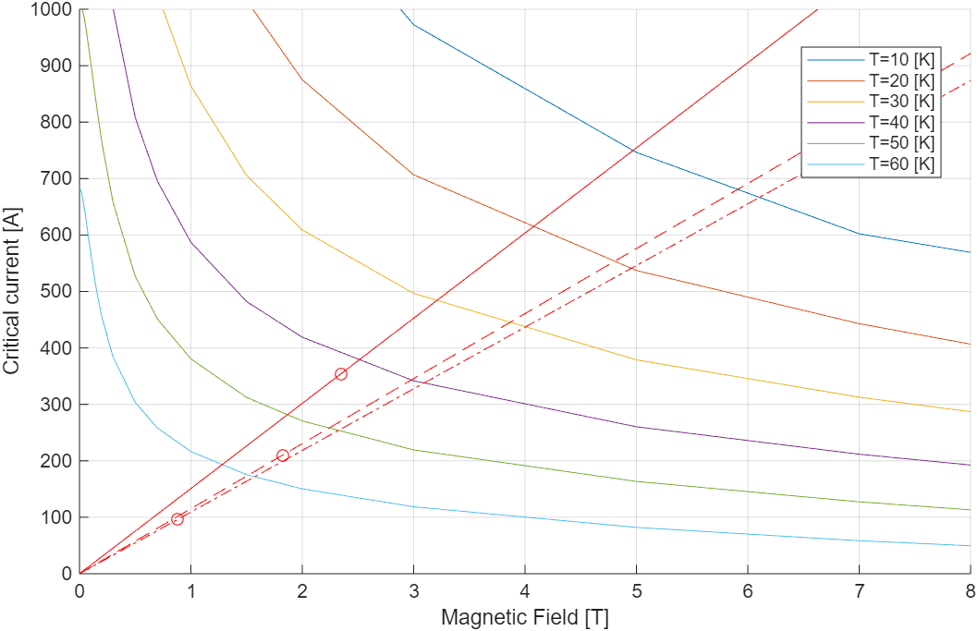
Combined HTS Superferric Design
Working @ 40K
Peak Field on the tape: 2.35 T
Current in each 4 mm tape:
power supplier 1: 354.6 A
power supplier 2: 103.1 A
Inductance: 0.0227 mH
Tape Used: FFJ - SuperOx YBCO 2G HTS
Combined: Margin = 10%
Quadrupole
Sextupole
Mode | Target Value | NI group 1 [Aturn] | NI group 2 [Aturn] | Dipole Field [T] | G [T/m] | S [T/m^2] | b4 [units]
Combined | 11.8 T/m 455 T/m^2 | 8510 | 2474 | -0.019 | 11.83 | 454.9 | 30.65
Quadrupole | 11.8 T/m | 5060 | 5060 | 1*10^-5 | 11.86 | 0.05 | 1.04
Sextupole | 455 T/m^2 | 2325 | -2325 | -2*10^- 6 | -5*10^- 4 | 455 | 0.84

Slide 8
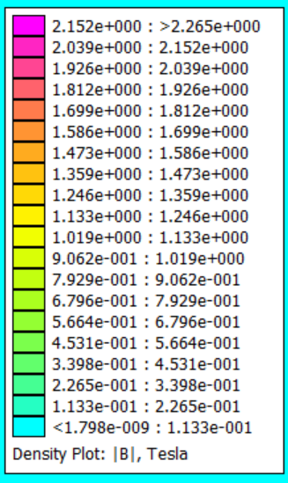
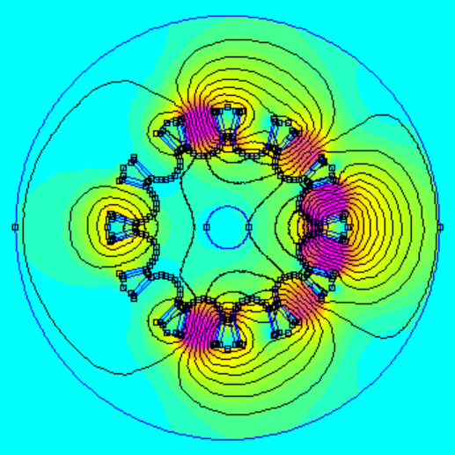
Combined HTS Superferric Design
Parameter | Value
Radius of the bore (r0) [mm] | 35
Radius of cut for the iron pole (rc) [mm] | 40.8
N° of 12 mm tapes turns per coil | 8
Tape bending radius [mm] | 9

Slide 9
Design Considerations
L = 2.9 m
Open Points:
Not tunable Dipole component comparable with the main dipole of the ring.
Possible Solutions:
In air coils to remove the iron pole, that is the main cause of non linearity -> high field quality and zero dipole field
Modify the power supplier introducing an asimmetry in the coils or introduce an external coil -> control the dipole field

Slide 10
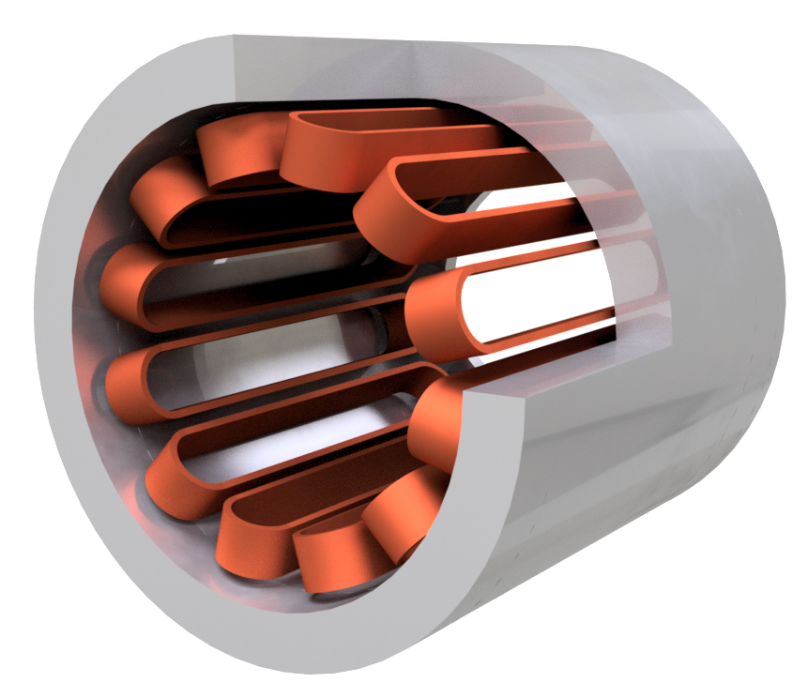
Design Proposal 1: In Air Coils
Main Features:
Field generated mainly by coils
High HTS use, up to 3 times the previews design
Low dipole component compared to the main dipole field, down to a fraction of percentage
Good Field Quality
Easy assembly and manufacturing of the coil, larger bending radius

Slide 11
Design Proposal 2: Three Power Supplier
Main Features:
Three power supplier, two main and a lower one to regulate
Slight increase on the HTS use wtr the two power supplier design
Able to cancel the dipole component
1+3
2+3
2
1
2
1
2
Future Developments:
How to control the dipole field
Analyze the full effect on the other high order harmonics
1
2
1
1+3
2+3

Slide 12

Open Points and Next Steps
Open exchange of ideas with PSI:
Compare our study with their proposals
Field Quality and Magnet optimization
Use of the combined magnet also as a dipole, to increase the filling factor
Update with the new main ring optics
Possible coupling between the two beam lines
Coil Construction
Is it possible to have such a narrow coil?
Insulated or Non insulated
Junction and winding
Energy Losses and Cryogenics
Quench Analysis
Cryocooling, Cryogen line?
Cooling methods and thermal isolation, Iron mass is cold?
Mechanical structure and Assembly
Supports, position of the walls and how to assemble it
Lorentz forces analysis ad effect on the HTS material
Open Points
}
ESMA project @ LASA plans to answer this questions
Demostrator @ LASA
~ 0.5 m 2025-2026
Next Steps

Slide 13

Thank You For Your Attention!

Slide 14



Energy Saving with HTS Magnet
Resistive filling factor | 0.797802773 | -
HTS filling factor | 0.890007847 | -
Resistive Synch. rad | 50 | MW turn
HTS Synch. rad | 44-46 | MW turn
$$\int{over the dipoles}$$
$$P_{sync}∝{filling factor}^{−2}$$
$$E_{sync}∝{filling factor}^{−1}$$
$$⟹$$
$$⟹$$

