Slide 2
Overview of and Challenges for the FCC-ee Fast Pulsed Beam Transfer Systems
G. Favia, W. Bartmann, J. Borburgh, L. Ducimetiere, Y. Dutheil, S. Yue, T. Kramer, J. Ruf, D. Standen, P. Trubacova
CERN, Geneva, Switzerland
21/05/2025
G. Favia – FCC Week 2025 - Kickers design and challenges
2

Slide 3
Outline
Outcome from feasibility study and kicker design outline
Challenges and need for R&D/prototyping
  Stripline kicker + Inductive adder
  Lumped inductance kicker + generator
  Other considerations
Conclusions
21/05/2025
G. Favia – FCC Week 2025 - Kickers design and challenges
3

Slide 4
Outline
Outcome from feasibility study and kicker design outline
Challenges and need for R&D/prototyping
  Stripline kicker + Inductive adder
  Lumped inductance kicker + generator
  Other considerations
Conclusions
21/05/2025
G. Favia – FCC Week 2025 - Kickers design and challenges
4

Slide 5
Feasibility study
Injection/Extraction Systems Across the Complex​, S.Yue
Kicker systems are designed based on the following key considerations:
  Optics design
  Cost, power consumption & environmental impact
  Integration
  Ionizing dose levels
  Machine protection impact
  Operational needs
  Collective effects
Operation
Multiple system specification changes have required a reconsideration of the design choices or design reiterations
Some parameters remain undefined or to be confirmed:
  Beam stay clear region
  Rise and fall time definition
  Flat top quality
No major showstoppers, but several challenges have been identified
21/05/2025
G. Favia – FCC Week 2025 - Kickers design and challenges
5

Slide 6
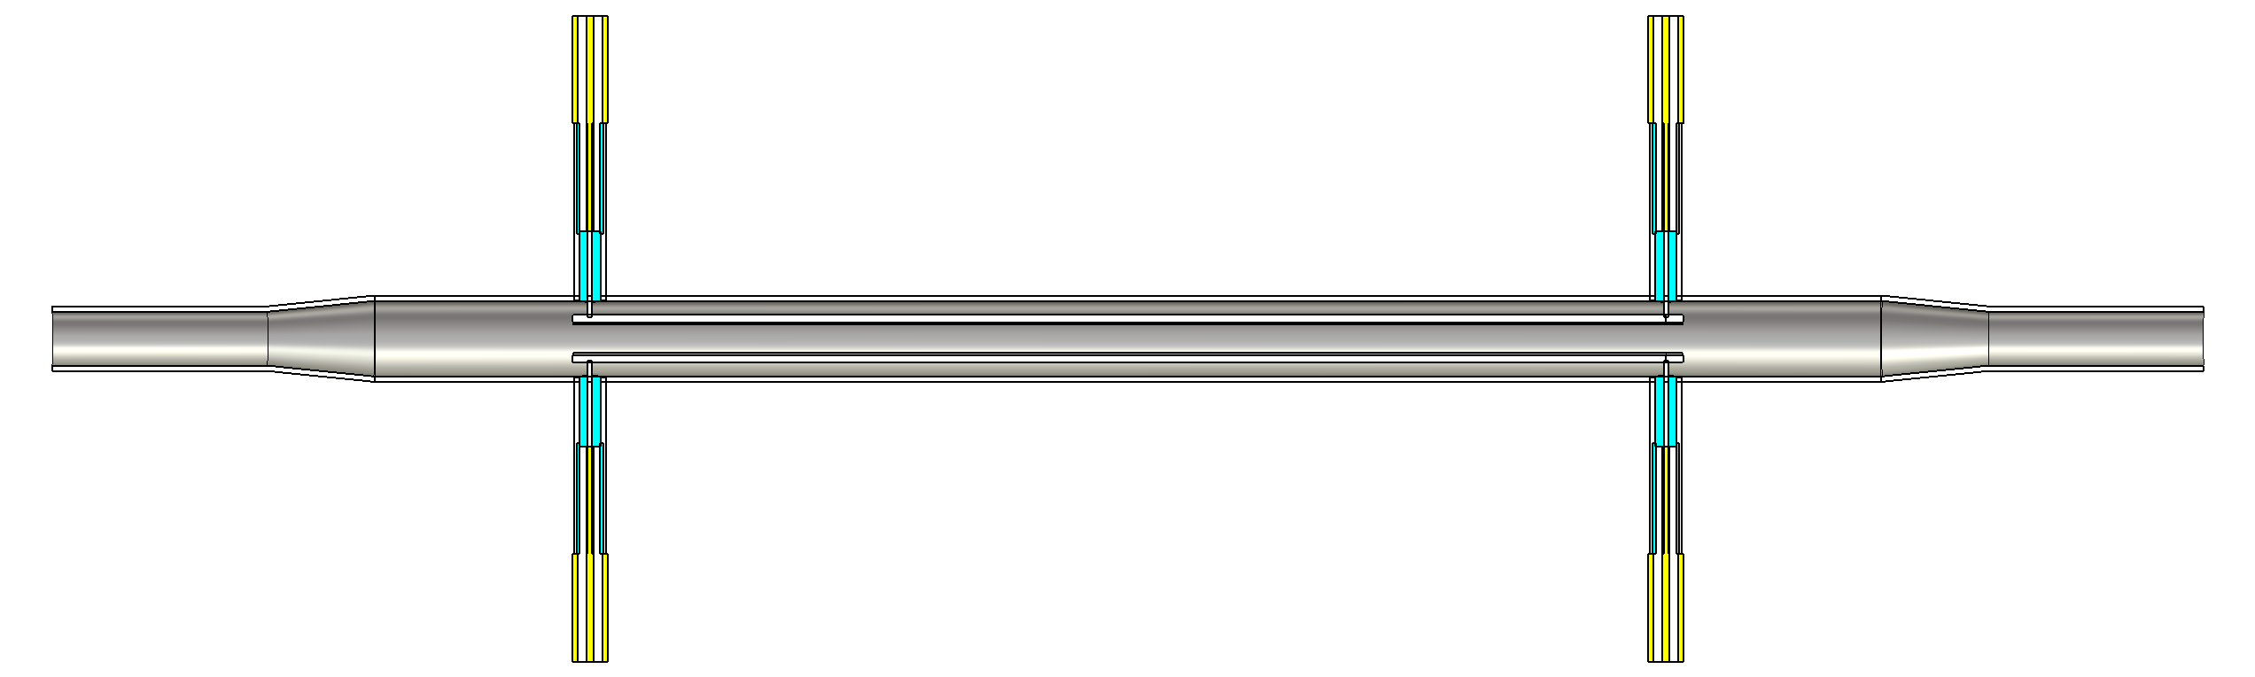
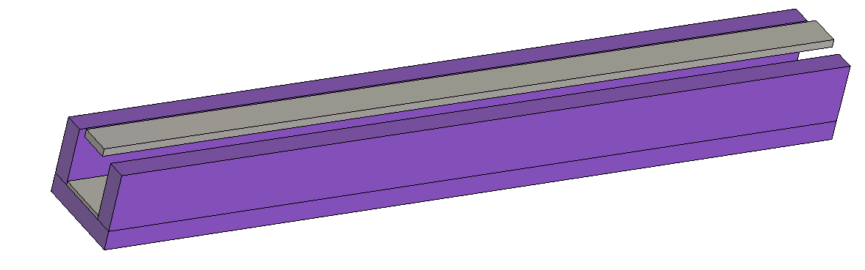
Kicker systems outline
 | Damping ring | Booster injection | Booster extraction | Booster Dump | Collider injection | Collider dump
Magnet topology | Stripline | Stripline | Lumped inductance | Lumped inductance | Lumped inductance | Lumped inductance
Generator topology | Inductive adder | Inductive adder | Marx generator | LBDS-like generator | Marx generator | LBDS-like generator
Element under vacuum | Yes | Yes | No | No | No | No
Elements / Systems | 2/4 | 1/2 | 14/2 | 9/2 | 6/2 | 9/2
Novel technology | Yes | Yes | Yes | No | Yes | No
R&D required/ Prototyping required/ Conventional technology | R&D - prototype required | R&D - prototype required | R&D - prototype Required | Prototype required | R&D - prototype required | Prototype required
Numerical model of a Stripline magnet
Numerical model of a lumped inductance magnet
21/05/2025
G. Favia – FCC Week 2025 - Kickers design and challenges
6

Slide 7
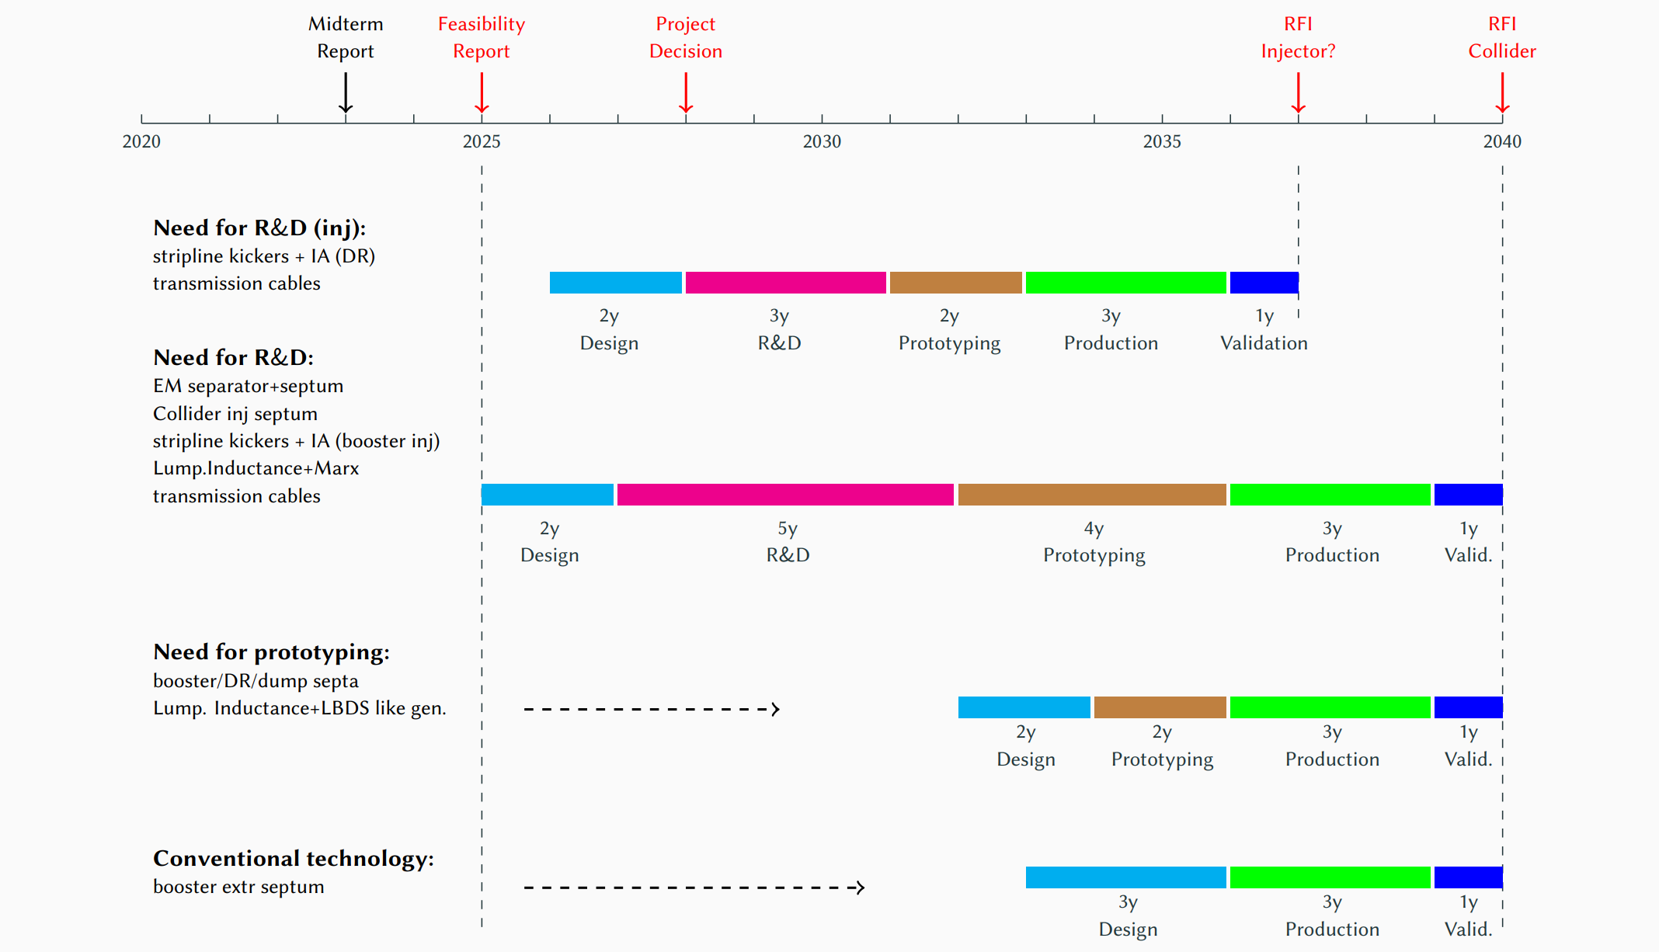
R&D and prototyping timeline
R&D and prototyping activities have been planned and a timeline has been established to ensure a timely systems readiness
Cost
Previous experience
Beam
Impedance
Machine Protection
Integration
21/05/2025
G. Favia – FCC Week 2025 - Kickers design and challenges
7

Slide 8
Kicker systems design choice criteria
Magnets and generator topologies have been designed to be cost-efficient, simplify their maintenance and improve machine protection aspects. Priorities are:
  Standardization of equipment
  Limited generator voltage solutions
  Avoidance of oil-filled generators or SF6 cables
  Limited power dissipation and cooling requirements
Looking back:
  Profited of LEP experience and considered similar kicker solutions
Looking ahead:
  Considered benefits and long-term availability of novel technologies
  i.e. solid state switches favoured over thyratrons; modular solutions preferred due to easier maintenance
21/05/2025
G. Favia – FCC Week 2025 - Kickers design and challenges
8

Slide 9
Outline
Outcome from feasibility study and kicker design outline
Challenges and need for R&D/prototyping
  Stripline kicker + Inductive adder
  Lumped inductance kicker + generator
  Other considerations
Conclusion
21/05/2025
G. Favia – FCC Week 2025 - Kickers design and challenges
9

Slide 10
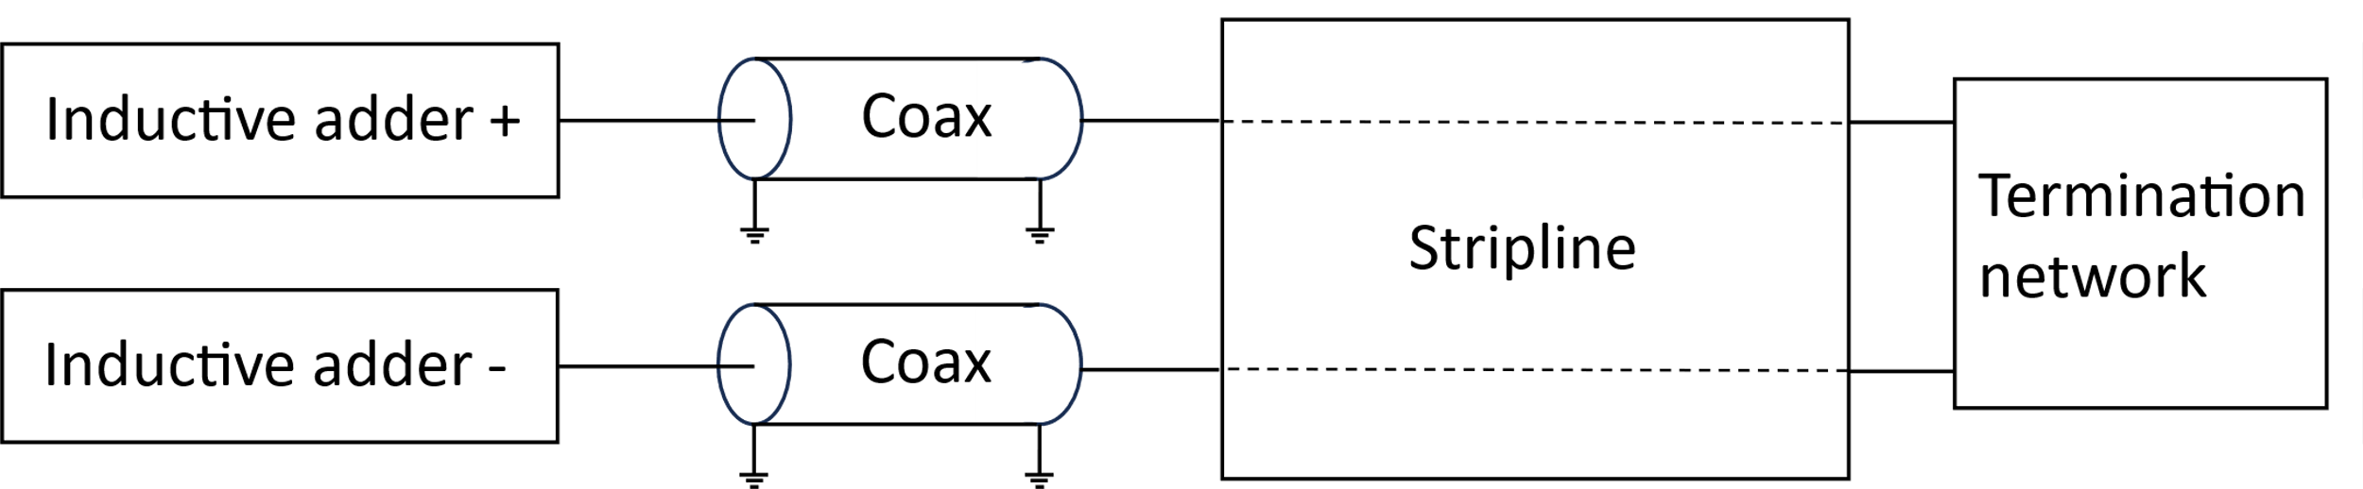
Stripline + Inductive Adder
Kicker: Stripline to satisfy fast rise and fall time requirements
Generator: Inductive adder can provide the short flat top and the required homogeneity
The coaxial cable length is based on integration constraints, but ≤30m needed to achieve rise time and field homogeneity
 | Damping ring | Booster injection
Requirements
Energy [GeV] | 2.86 | 20
Kick angle per unit [mrad] | 1.5 | 0.09
Rise / fall time [ns] | 82 | 25
Flat top length [ns] | 80 | 80
Flat top quality [%] | ±0.5 | ±0.7
Repetition rate [Hz] | 100 | 100
Available length [m] | 1.5 | 5.5
Design parameters
N. Of Magnets/ System(s) | 2 / 4 | 1 / 2
Impedance [Ω] | 50 | 50
Current [A] | 640 | 260
Voltage [kV] | ±32 | ±13.4
Plate separation [mm] | 30 | 30
Integrated E-field [MV] | 3 | 0.9
Integrated B-field [mT.m] | 7.1 | 3
Effective length [m] | 1 | 1
Physical length [m] | 1.5 | 1.5
21/05/2025
G. Favia – FCC Week 2025 - Kickers design and challenges
10

Slide 11
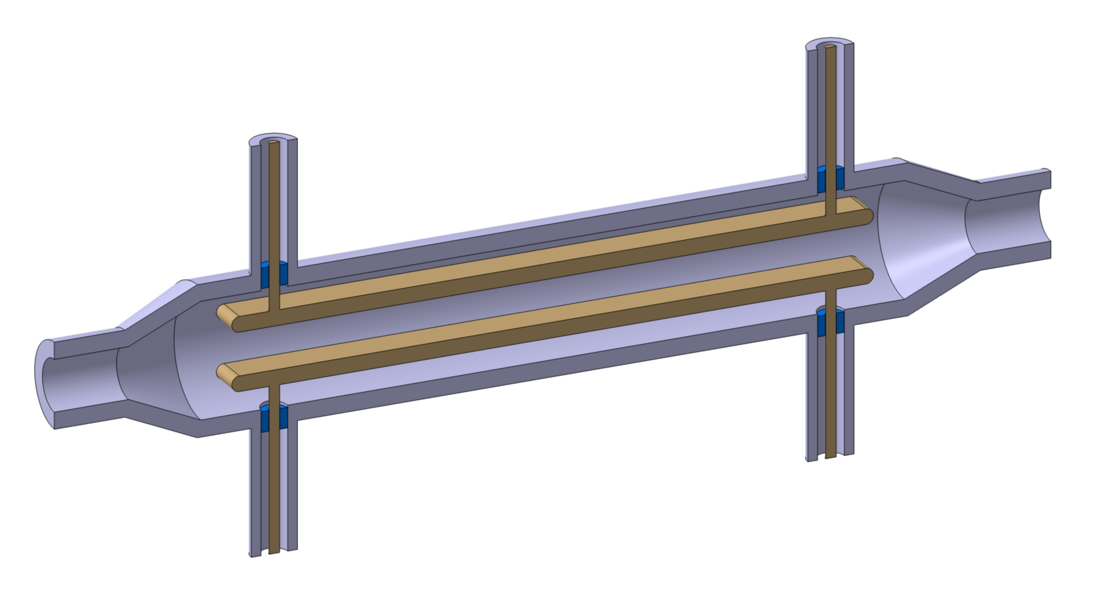
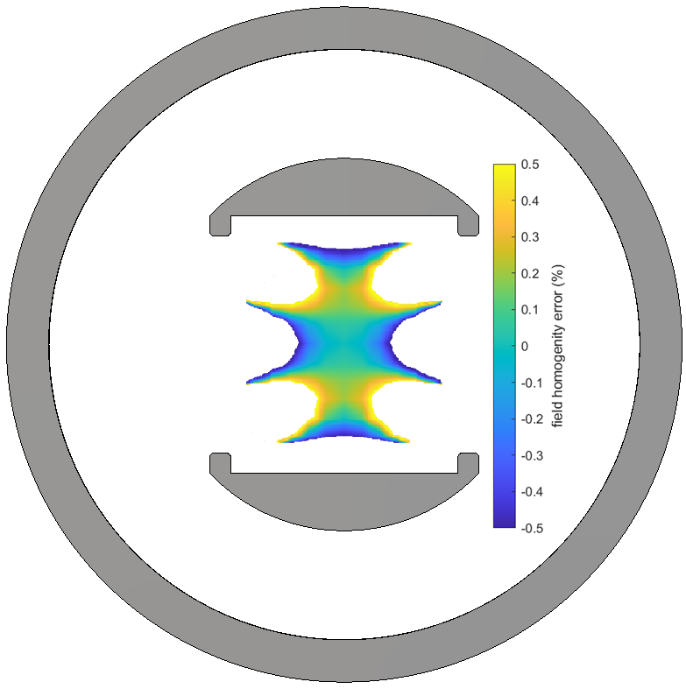
Stripline kicker
Relatively simple and compact kicker design
A preliminary design has been developed, with main challenges being identified:
  Field homogeneity
    → Optimized electrodes shape design
  HV issues
    → HV limited to < 50kV
    → SR impact?
  Operational experience
    → Magnet topology already prototyped for CLIC, but not currently operated
    → Learn from other electrons laboratory’ experience
  Impedance matching
21/05/2025
G. Favia – FCC Week 2025 - Kickers design and challenges
11

Slide 12
Stripline kicker – Impedance matching
Stripline kickers work in two operating modes, with two different characteristic impedances
  Odd mode
    Seen by the bipolar pulse from the generators when kicker is on
    Reflections affect the pulse quality
  Even mode
    Seen by the beam when kicker is off
    Reflections affect the beam coupling impedance
An optimization process is required to achieve the field tolerances and limit the beam impedance
  One impedance is matched by the terminations at the expense of the other
  Beam impedance limits not yet specified
A more complex matching network might be needed if a good compromise can’t be found:
  Need to design a termination element between the electrodes
  → in-vacuum: complex design due to concerns about power losses and vacuum compatibility
  → outside-vacuum: would be prone to mismatches at the feedthroughs
  R&D and prototyping is needed!
21/05/2025
G. Favia – FCC Week 2025 - Kickers design and challenges
12

Slide 13
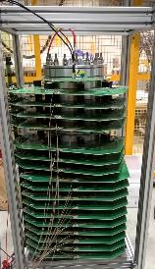
Inductive adder
Compact and modular design and only solid-state switches used
No operational experience
  Generator topology already prototyped but not yet implemented at CERN
A lot of know-how has been acquired from previous prototyping
The unprecedented specifications (<25ns rise time and 30m connecting cable length) require dedicated R&D and prototyping
Requirements
` | Booster injection | Damping ring | CLIC PDR-DR
Energy [GeV] | 20 | 2.86 | 2.86
Kick angle per unit [mrad] | 0.09 | 1.5 | 2-1.5
Rise / fall time [ns] | 25 | 82 | 700-1000
Flat top length [ns] | 80 | 80 | 160
Flat top quality [%] | ±0.5 | ±0.5 | ±0.01
Repetition rate [Hz] | 200 | 100 | 50
21/05/2025
G. Favia – FCC Week 2025 - Kickers design and challenges
13

Slide 14
Lumped inductance kicker – Generator
Kicker: a ferrite-loaded lumped-inductance magnet can still comply with the most recent and more stringent fast rise and fall time requirements
Generator:
  Marx generator for booster extraction and collider injection
  LBDS-type generator for dump systems, due to more relaxed flat-top homogeneity requirements
The length of the cable connecting the generator to the beamline elements is presently hundreds of meters:
  Resulting from the current integration scheme
  Impact on kicker pulse quality
Requirements
Design Paramets
 | Booster extraction | Collider injection | Booster dump | Collider dump
Energy [GeV] | 45 – 182.5 | 45 – 182.5 | 45 – 182.5 | 45 – 182.5
Kick angle per unit [mrad] | 0.014 | 0.013 | 0.033 | 0.033
Rise / fall time [ns] | 600 | 600 | 600 | 600
Flat top length [us] | 304 | 304 | 304 | 304
Flat top quality [%] | ±0.6 | ±1.5 | ±20 | ±20
Repetition rate [Hz] | 0.3 | 0.3 | 1 | 0.1
Beam aperture [mm] | 60 | 60 | 60 | 60
Available length [m] | TBD | TBD | TBD | TBD
 | Booster extraction | Collider injection | Booster dump | Collider dump
N. Of Magnets/ System(s) | 14 / 2 | 8 / 4 | 9 / 2 | 9 / 2
Impedance [Ω] | 10 | 10 | 10 | 10
Current [kA] | 0.7 | 0.7 | 1.7 | 1.7
Voltage [kV] | 7 | 7 | 17 | 17
Integrated B-field [mT.m] | 3 | 8.12 | 21 | 21
Element aperture [mm] | 70 | 70 | 70 | 70
Effective length [m] | 0.7 | 0.7 | 0.7 | 0.7
21/05/2025
G. Favia – FCC Week 2025 - Kickers design and challenges
14

Slide 15
Lumped inductance kicker
Simple and robust magnet, which can be operated out-of-vacuum
  Easier maintenance
  Reduced machine protection issues
Design re-iterations were needed as well as an increased number of magnets to adapt to the new 600ns abort gap requirement
  Impact on cost and integration
Beam impedance or Electron Cloud instabilities can be addressed employing surface coating:
  Dedicated simulations needed to assess coating impact, considering the faster rise time requirements
  Need to clarify beam impedance requirements
21/05/2025
G. Favia – FCC Week 2025 - Kickers design and challenges
15

Slide 16
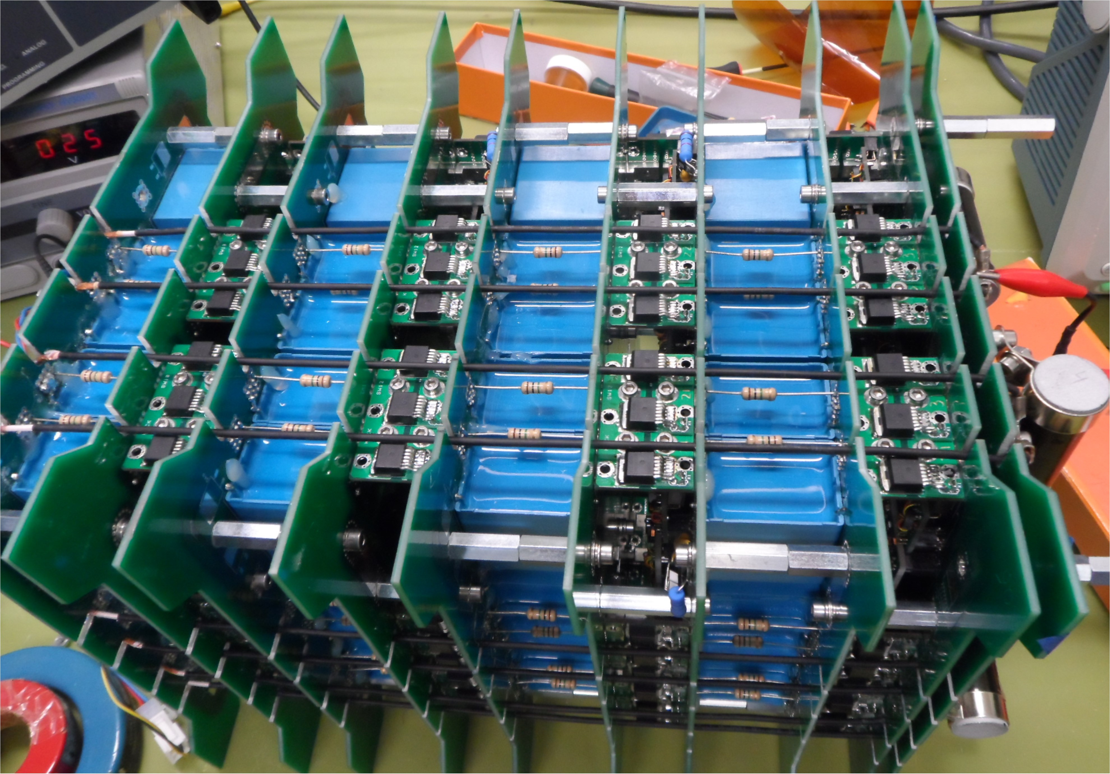
Generator for LI kicker
Marx generator (Booster extraction, Collider injection)
Compact and modular design using only solid-state switches
No operational experience but know-how acquired from previous prototyping
Unprecedented very challenging long flat top, combined with long cable length
  → Requires tests on real equipment, to eventually develop compensation solutions
Need of R&D and prototyping of a LI magnet driven by a Marx generator!
LBDS like generator (Booster and Collider dump)
Driven by a main capacitor discharge stage sustained by a droop compensation stage
Prototyping is necessary given the unprecedented requirements
21/05/2025
G. Favia – FCC Week 2025 - Kickers design and challenges
16

Slide 17
Other considerations
Other studies, supported by R&D are foreseen on:
  F-Gas free insulation solutions
  Radiation impact on components
  Control development for highly reliable systems
  Automatized maintenance and repair
  Interlock systems and/or absorbers for machine protection
FCC-ee Integration Requirements for Injection-Extraction Equipment, D. Standen
Detailed integration studies needed
  Review space requirements: accounting for magnets, generators, control systems, and any additional equipment facilitating maintenance, including spares
  → Cold spares vs Warm spares?
  Establish final length for cables connecting beamline elements to generators
21/05/2025
G. Favia – FCC Week 2025 - Kickers design and challenges
17

Slide 18
Outline
Outcome from feasibility study and kicker design outline
Challenges and need for R&D/prototyping
  Stripline kicker + Inductive adder
  Lumped inductance kicker + generator
  Other considerations
Conclusions
21/05/2025
G. Favia – FCC Week 2025 - Kickers design and challenges
18

Slide 19
Conclusions
Kicker systems have been designed accounting for cost, availability, reliability, and address integration, operational and radiation constraints
Design choices have been detailed in the FSR
The main design challenges have been identified and mitigating solutions already considered
Given the unprecedented specifications, R&D and prototyping are planned to develop new technologies and optimize existing ones to achieve target parameters
Cost
Previous experience
Beam
Impedance
Machine Protection
Integration
21/05/2025
G. Favia – FCC Week 2025 - Kickers design and challenges
19

Slide 20
Thank you for your attention!
21/05/2025
G. Favia – FCC Week 2025 - Kickers design and challenges

Slide 21
Spare slides

Slide 22
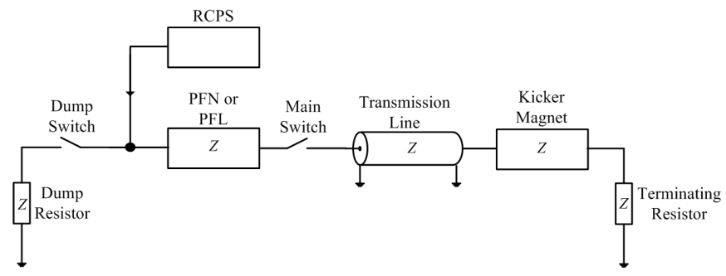
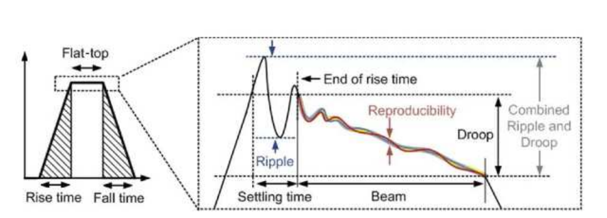
Kicker system design
A kicker magnet is designed to provide a required field magnitude, duration, rise and fall time and homogeneity
The pulse generator provides a certain current and voltage output to match the requirements for the needed pulse
Critical parameters are:
  current and voltage values
  system impedance
  pulse rise time and fall time, droop, flat-top stability, pulse-to-pulse stability
  repetition rate
22

Slide 23
Magnet topologies
 | PRO | CONS
Stripline | Compact design Very fast rise time (few ns) Low beam coupling impedance | Weaker deflection Impedance matching important Challenging flat-top stability More power consumption
Transmission line | Fast rise time << 1μs Strong deflecting field | Voltages up to 80 kV Complex to manufacture and costly Impedance matching important High beam coupling impedance
Lumped inductance | Strong deflecting field Simple and robust magnet design Can be out of vacuum | Needs minimizing interconnection inductance Suitable for rise time ≥ 1μs High beam coupling impedance
23

Slide 24
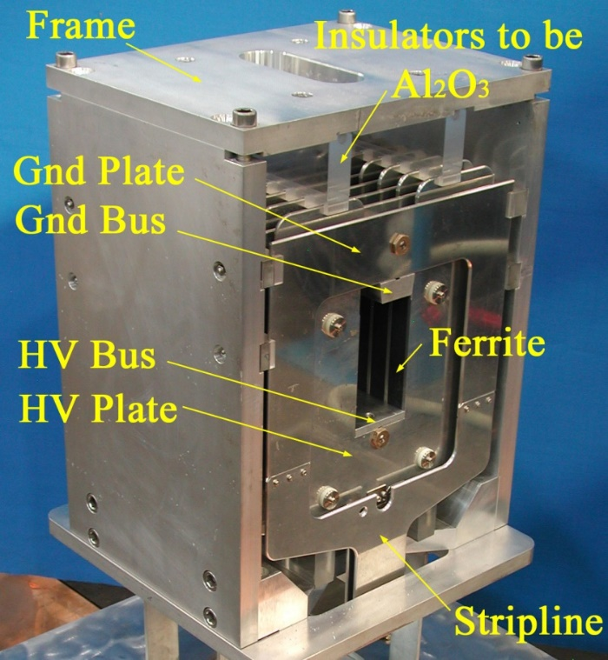
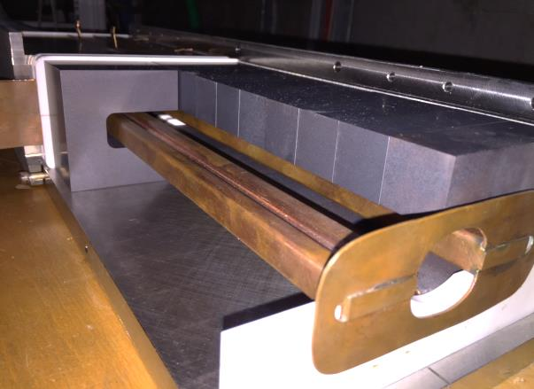
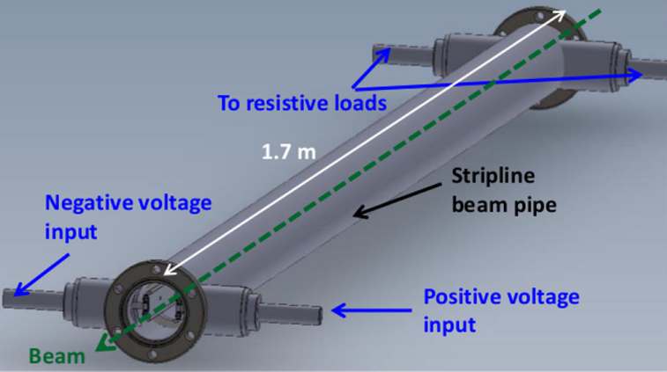
Magnet topologies
Transmission line
Lumped inductance
Stripline
24

Slide 25
Generator topologies
 | PRO | CONS
PFN | Compact design Low droop and long pulses > 3μs Voltage up to 80 kV | Complex constructions Risetime limited by cells cut-off frequency Pulses are prone to ripples - may require cells adjustment Require high voltage capacitors
PFL | Simple design Short pulses < 3μs Ripple-free (flat) pulses | Significant droop in pulses > 3μs Above 40 kV SF6 used at CERN Bulky: 3μs pulse 300 m of cable
Marx Generator | Long duration pulse capability High repetition-rate Low-voltage components Modular | Sensitive to radiation Complex triggering system
Inductive adder | Short and precise pulses Modular, redundant, scalable Easier triggering circuits | Available pulse duration is affected by magnetic material (<3μs) Sensitive to radiation
25

Slide 26
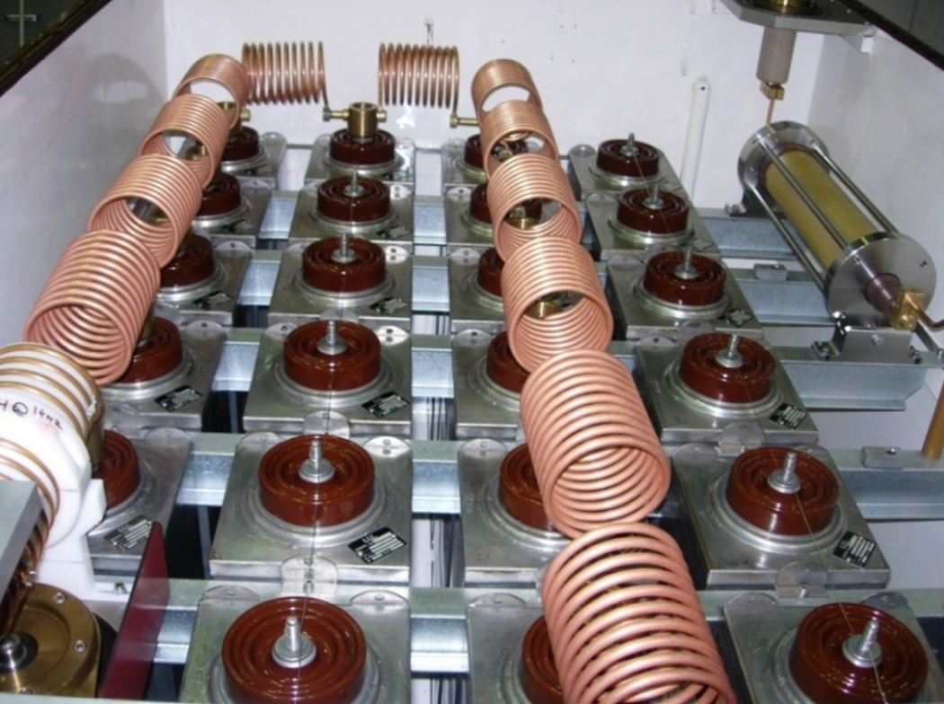
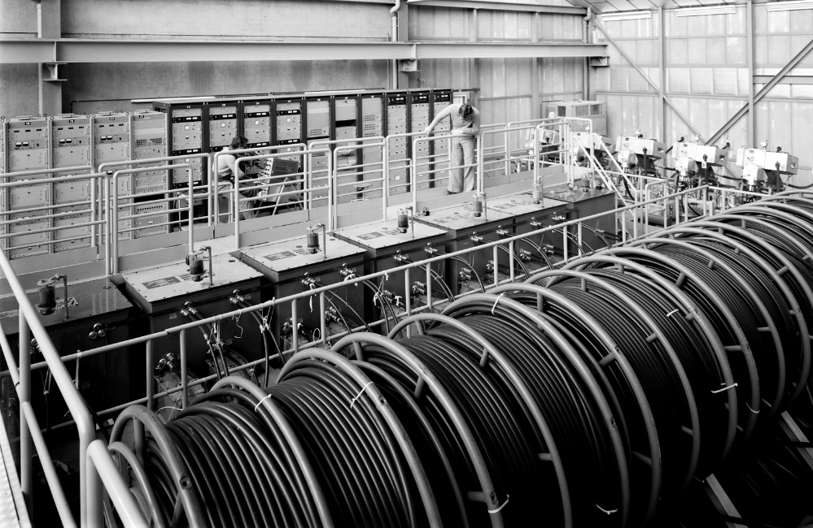
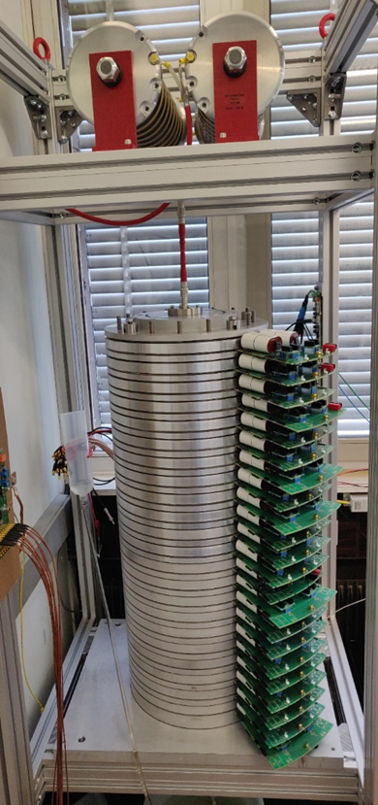
Generator topologies
PFN
PFL
INDUCTIVE ADDER
FCC GENERATOR
26

Slide 27
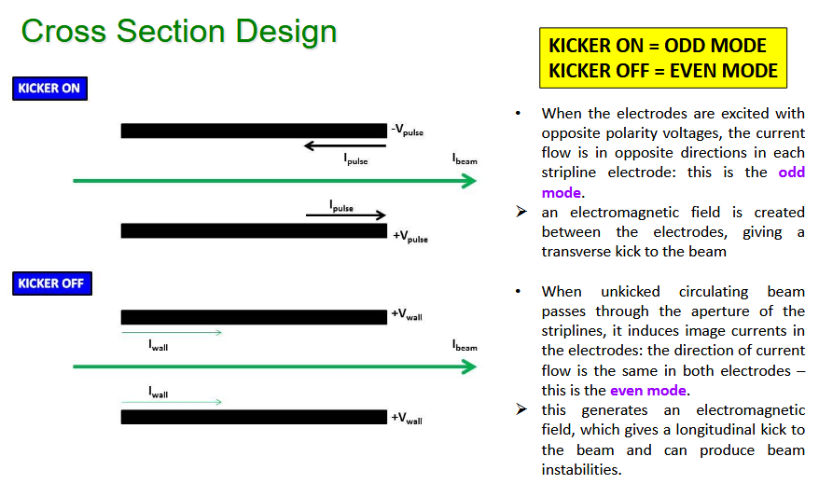

Slide 28
Marx generator
In a Marx generator n capacitors are charged in parallel from a relatively low-voltage DC power supply, and discharged in series into the load
The output voltage pulse has an amplitude approximately equal to the number of stages (n) times the input voltage (Vdc), Vmarx=n·Vdc
16 kV, 2.6 kA, 75 ns rise and fall prototype developed for FCC-hh
X
X
X
X
X

Slide 29



Inductive adder
The IA is a solid-state modulator, which can provide relatively short and precise pulses
An inductive adder consists of multiple parallel layers (also known as stages), each of which has a 1:1 transformer
The single turn primary totally encloses a magnetic core; hence, the leakage inductance of this geometry is negligible
The secondary winding of each of these transformers is connected in series: hence a step-up voltage ratio of 1:N is achieved by using N-layers, with adequate voltage isolation
pulse capacitor
stalk
magnetic core
$$I_{prim}$$
PCB
$$A_{c}$$
$$I_{sec}$$
stacked layers
primary winding
insulation
semiconductor switch
parallel branches

Slide 30
Thyratrons vs semiconductor switchesr
Semiconductor switches can be used in fast high current pulsed power accelerator applications to replace thyratrons and PFLs.
Thyratrons
Radiation resistant
Generally reliable
Robust (fault tolerant)
Relatively high voltage
Relatively high current
Long term availability
Spontaneous turn on
Can only be turned on
Solid-state
Cost-effective
Easy to use
Off-the-shelf
Flexible
Modular
Maintainability
Relatively low voltage
Relatively low current
Versus:
But…. Semiconductors have limited voltage and current rating. Hence, requires series and parallel connection of power semiconductors to achieve high pulsed power.
30

Slide 31
Machine Protection
Machine protection concerns start at booster extraction and Z-mode is the most critical
Failure types and probability depend on magnet kind and operational conditions:
  Iteration needed at design phase to find best tradeoff between magnets performance, reliability, availability and machine protection aspects
Potential failures have been estimated:
  They are typical of high voltage fast pulsed systems (see next slides)
  Additional challenges are introduced by synchrotron radiation, high stored energy and energy density
Mitigations consist in:
  Redundancy, monitoring and fast reaction to failures, passive protection, retriggering mechanism etc.
  Rad-hard electronics
  Segmentation and voltage reduction to reduce risk and consequence of failures
  Out of vacuum magnets, minimum beam coupling impedance design, etc.
  New concepts like sacrificial absorbers (for ultra-fast failures), chunk extraction etc. have to be considered (in booster extraction/dump, booster-to collider TL, collider injection and extraction)

Slide 32
Machine Protection – Booster Failures
Failure | Consequence | # affected bunches
Asynchronous extraction | xx bunches swept in the machine aperture | It depends on reaction, re-triggering and rise time (e.g. 44 for 1.1 us and 60 for 1.5 us)
Large ripples of extraction kickers | bunches extracted with oscillations, losses at the septum, septum mask and/or the transfer lines, poor transmission to the collider, large injection oscillations and losses in the collider | It depends on the waveform shape but in principle up to all (1120 for Z mode)
Up to 1ooXX extraction kickers missing .or. 1ooYY extraction septa not pulsing at nominal strength (0-100%) | mis-kicked bunches➔ oscillations in TL, losses (also possible at one single location), poor or no transmission, injection oscillations and losses in the collider | All (1120 for Z mode)
32

Slide 33
Machine Protection – Colliders Failures
Failure | Consequence | # affected bunches
Asynchronous extraction | xx bunches swept in the machine aperture | It depends on reaction, re-triggering and rise time (e.g. 44 for 1.1 us and 60 for 1.5 us)
Large ripples of extraction kickers | bunches extracted with oscillations, losses at the septum, septum mask and/or the transfer lines | It depends on the waveform shape but in principle up to all (11200 for Z mode)
Up to 1ooXXextraction kickers .or. 1ooYY extraction septa not pulsing at nominal strength (0-100%) | mis-kicked bunches➔ oscillations in TL, losses (also possible at one single location) | All (11200 for Z mode)
1ooXX missing injection bumpers .or. pulsing with higher current than nominal | miss-kicked circulating bunches ➔ oscillations (bump amplitude/xx) and losses at collimators, septum and septum mask. | All (11200 for Z mode)
1ooYY septum not pulsing at nominal strength (0-100%) | injected bunches mis-kicked ➔ injection oscillations and losses in the collider | All (1120 for Z mode)
Sparks in electromagnetic separator | large kicks to the full circulating beam and ultra-fast losses | All (56 for ttbar and 380 for ZH modes)

Slide 34
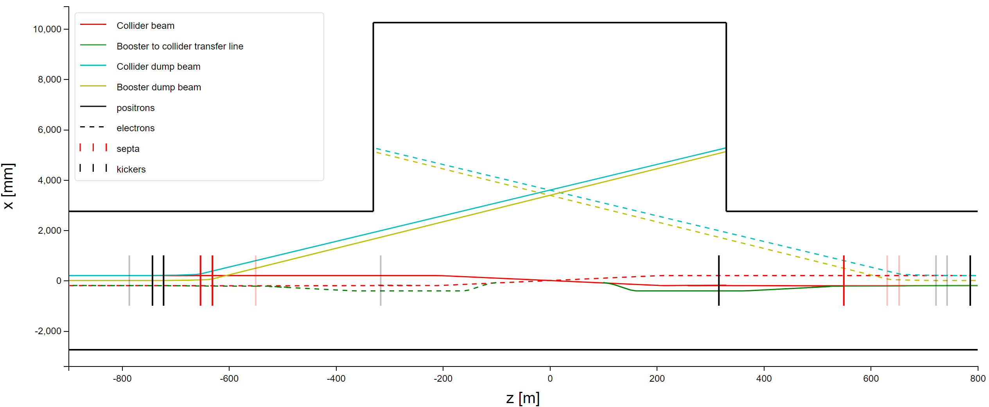
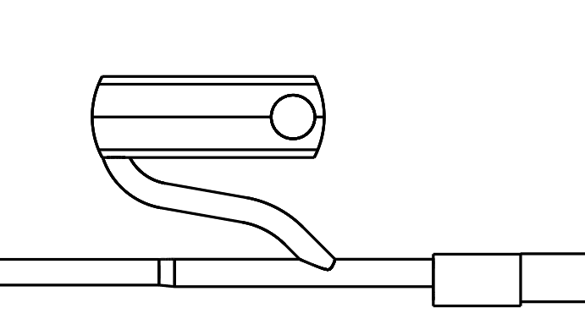
FCC Point B Magnet location (midpoint)
e⁻ Booster ext. septa (-99.05 m)
e⁻/e⁺ Booster ext. kicker (-4.85 m)
e⁻/e⁺ Booster ext. kicker (4.65 m)
e⁺ Booster ext. septa (98.85 m)
e⁺ Booster dump septa (-651.55 m)
e⁺ Collider dump septa (-657.26 m)
e⁻ Collider dump septa (657.26 m)
e⁻ Booster dump septa (651.35 m)
Confirmed to be moved sideways to not be directly on top of each other
e⁻ Collider inj. kicker (-314.26 m)
e⁺ Collider inj. kicker
(314.26 m)
e⁻ Collider inj. kicker (-784.26 m)
e⁺ Collider inj. kicker (784.26 m)
e⁺ Booster dump kicker (-744.75 m)
e⁺ Collider dump kicker (-745.26 m)
Service Cavern
75 m
e⁻ Collider dump kicker (745.26 m)
e⁻ Booster dump kicker (744.55 m)
e⁻ Collider thick inj. septa (-529.66 m)
e⁻ Collider thin inj. septa (-548.06 m)
e⁺ Collider thick inj. septa (529.66 m)
e⁺ Collider thin inj. septa (548.06 m)
-500 m
-300 m

