Slide 1

FCCee Machine Protection Considerations
Jan Uythoven, Christoph Wiesner,
Anton Lechner
With thanks to the other members of the FCC Machine Protection Task Force:
Chiara Bracco, Roderik Bruce, Xavier Buffat, Andy Butterworth, Brennan Goddard, Belen Salvachua
FCC week 2025
19 – 23 May, Vienna

Slide 2
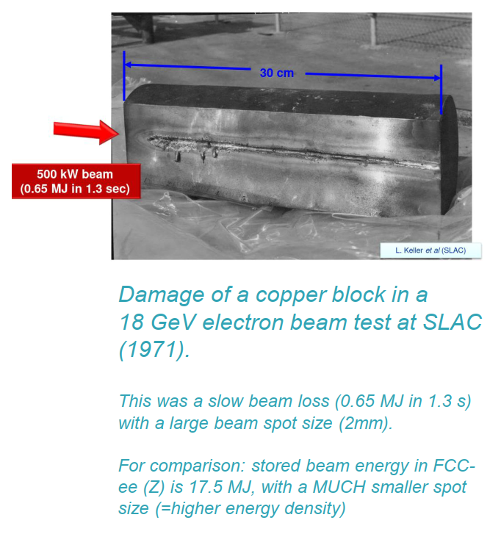
Machine Protection
Is important because:
The beams are very bright:
serious damage of the collider leading to important downtime and costs
There are many ways to lose the beams:
a complete inventory of failure scenarios needs to be made
Loss processes tend to be very fast:
the design of the machine protection system is not evident
  Need to define the detection system
  Need to define the transmission system
  Need to define the beam abort system

Slide 3
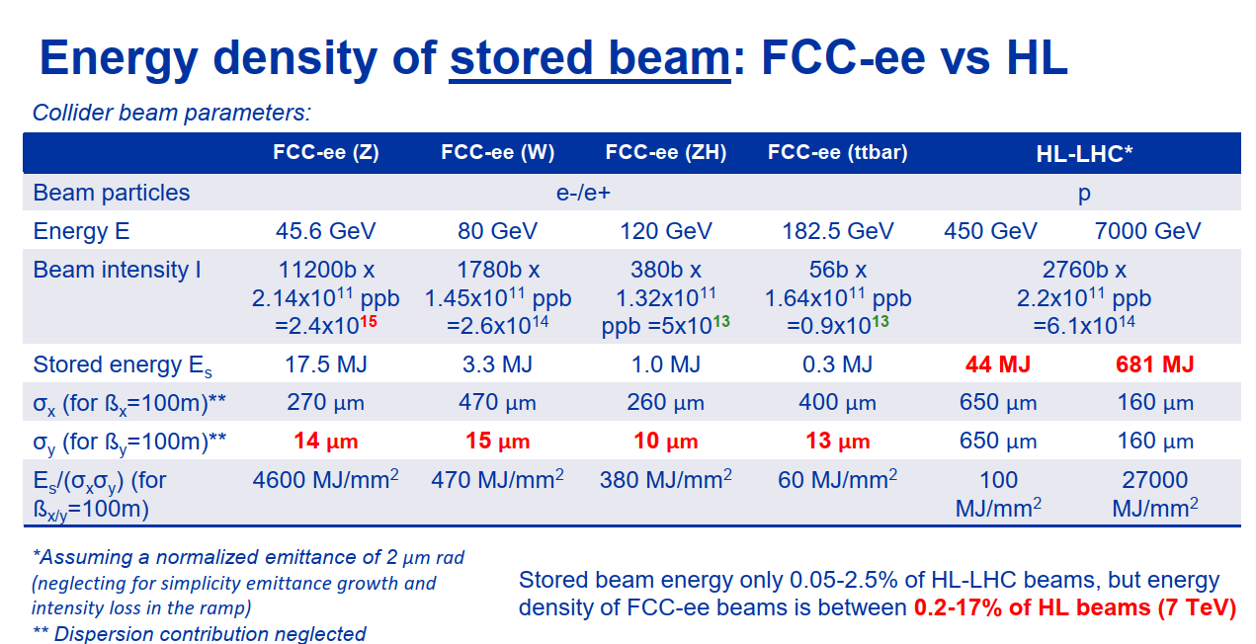

Slide 4
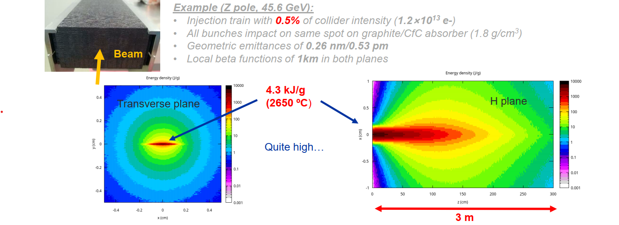
Energy deposition by an FCCee injection train in graphite/CfC absorber block
The energy density of the beam itself does not give the full picture → when comparing to HL beams, one needs to consider also the different shower development of lepton and hadronic showers (at largely different particle energies)

Slide 5
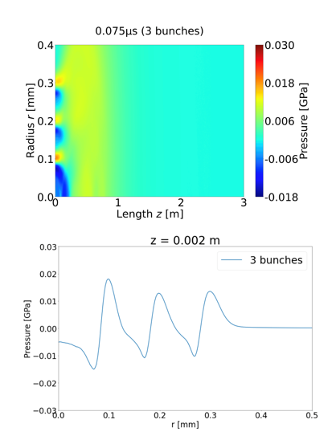
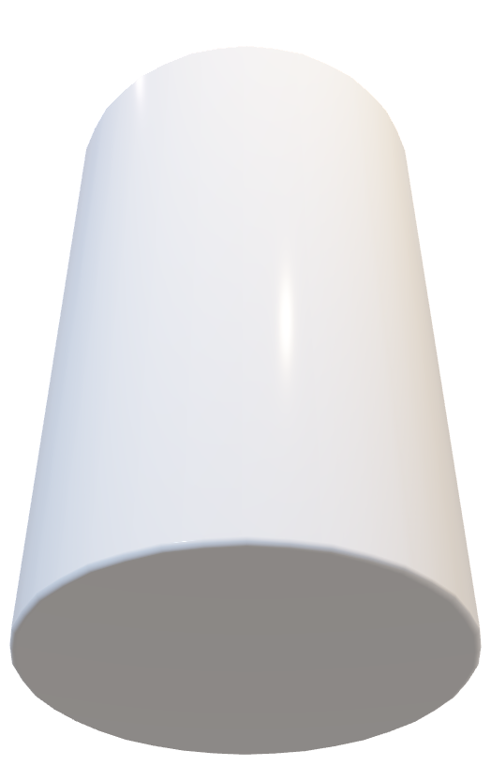
Coupling FLUKA and ANSYS simulations for many bunches impacting at the same position (‘tunnelling’)
Graphite target, 2.28 g/cm3
.
Impact point.
Particle bunches with 2.14e11 e⁻/e⁺
Ingrid M. Hjelle
CERN-THESIS-2024-357

Slide 6
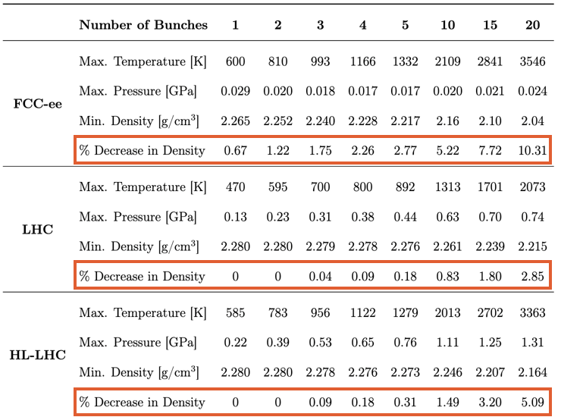
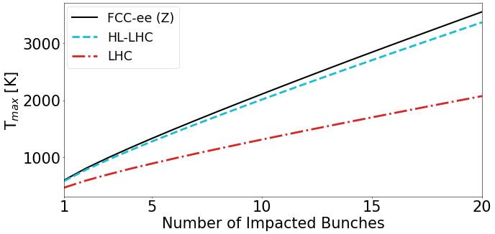
Coupling FLUKA and ANSYS simulations for many bunches impacting at the same position (tunnelling)
There will be many more bunches !!
Simulation of the initial impact of an approximated round FCC-ee beam (σ = 0.5 mm) has similar maximum energy deposition and temperature rise as the impact of the HL-LHC beam.
However the density is depleted faster, and the pressure waves differ with amplitudes ~10 times lower.
Ingrid M. Hjelle
CERN-THESIS-2024-357

Slide 7
Needed: Machine Protection
Not talking about Equipment Protection here….
Slides below refer for a large part to presentations made at the Machine Protection Task Force meetings (Indico)
Define the failure scenario’s
Failure mechanism and its impact
Timescale
Likelihood
Defence mechanism
Define the specific protection systems
Detection of the failure at the source
Detection of the effects on the beam
Transmission of beam abort request
Beam abort

Slide 8
Failures Detection & Protection
Hardware related failures
  Injection and extraction
  Powering failures
  Collimation system
  Radio frequency
  Transverse feedback
Beam related failures
  Beam instabilities
  Beam dust interaction
  Synchrotron radiation damage
Protection related failures
  Failure of protection systems
  Synchrotron light absorber
Definition of critical aperture
  Collimation system
Beam instrumentation
  Beam Loss Monitors (BLMs)
  Beam Position Monitors (BPMs)
  Beam Current Change Monitor (BCCM)
Other detection systems
  Fast Magnet Current change Monitor (FMCM)
  Warm magnet Interlock Controller (WIC)
Beam Interlock System (BIS)
  BIS and Safe Machine Parameter System (SMP)
Beam dumping system

Slide 9
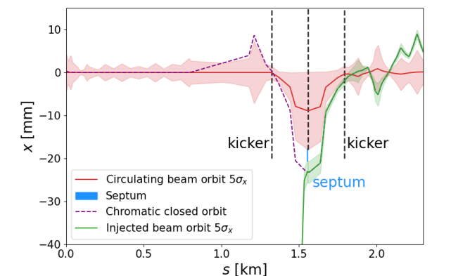
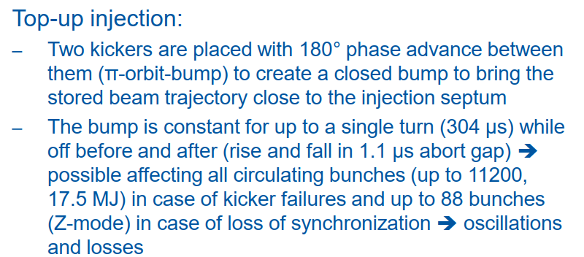
Injection from Booster to Collider
0.6
Presented at Task Force meeting by Chiara Bracco June ’24
The abort gap length has been reduced to 600 ns because of the RF system
Is it better to have a slow rising injection bump over many turns?
Impedance issues, radiation damping times
Inject on a flat machine (one vote on Tuesday)
Do we need highly segmented bumper systems?
Synchronisation issues
Passive absorbers for single turn failures – reduction of injection intensity
See also presentation Yann Dutheil, ‘Top-up injection status and studies’ on Tuesday

Slide 10
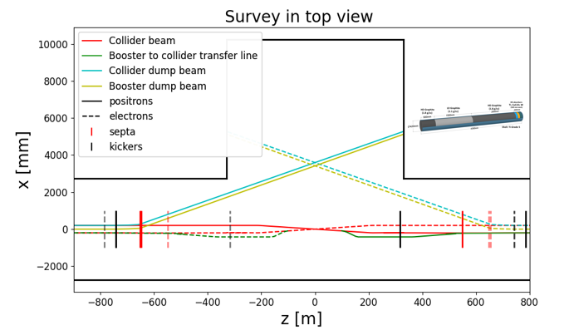
Extraction of the collider
Has to be extremely reliable
  This means that system will normally have to be redundant (like LHC can extract with 14/15 magnets)
  Has to pulse at the correct strength and at the right moment, synchronised with abort gap
Number of abort gaps – for kicker risetime – affect the reaction time between beam dump request and last particle extracted from the machine
Based on lumped inductance kickers and low power DC septa
Passive dilution using a spoiler looks sufficient to reduce energy density at the dump
For both injection and extraction, use passive (sacrificial?) absorbers in case of failures
List of failure modes to be established
Kickers / Systems | 6/2
Impedance [Ω] | 10
Current [kA] | 1.2
Voltage [kV] | 5
Element aperture [mm] | 70
Integrated field [mT.m] | 30
Effective length [m] | 1
Physical length [m] | 1.5
Total kick angle [mrad] | 0.3
Aperture (beam stay clear) (⌀) [mm] | 60
Rise / fall time [μs] | 1.100
Flat top length [μs] | 304
Flat top quality [%] | ±5
Repetition rate [Hz] | 0.1

Slide 11
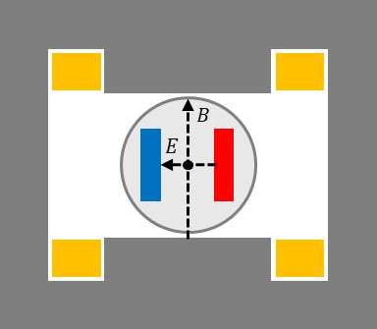
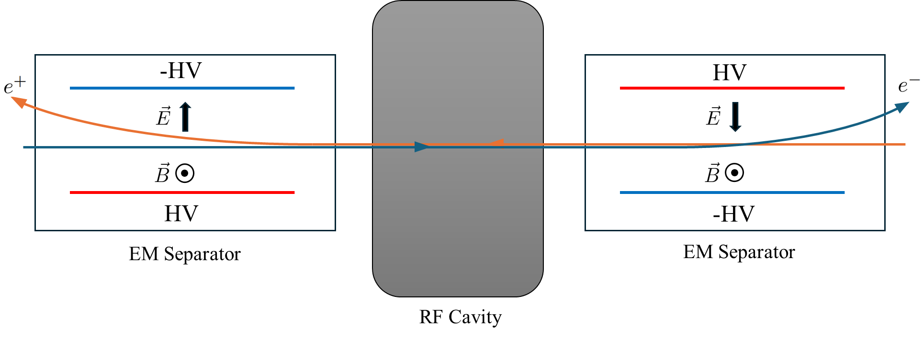


Electro-Magnetic Separators around the RF cavities
EMS cross section showing an outside vacuum dipole magnet and inside vacuum HV electrodes
EMS principle using combination of static electric and magnetic fields
C. Bracco at Task Force meeting,
L. Porta, presentation yesterday
Installed upstream and downstream of RF section in H and tt mode.
Used to assure both beams pass through centre of RF cavities, while avoiding synchrotron light hits the cavities.
Failures:
  B and E field longitudinal mismatch
  Synchrotron light on HV electrodes inducing sparks that could give large kicks to the beam (ultra-fast failure) – LEP experience
Mitigations:
  Fast detection of oscillations (interlock BPMS)
  Dedicated masks for synchrotron light

Slide 12
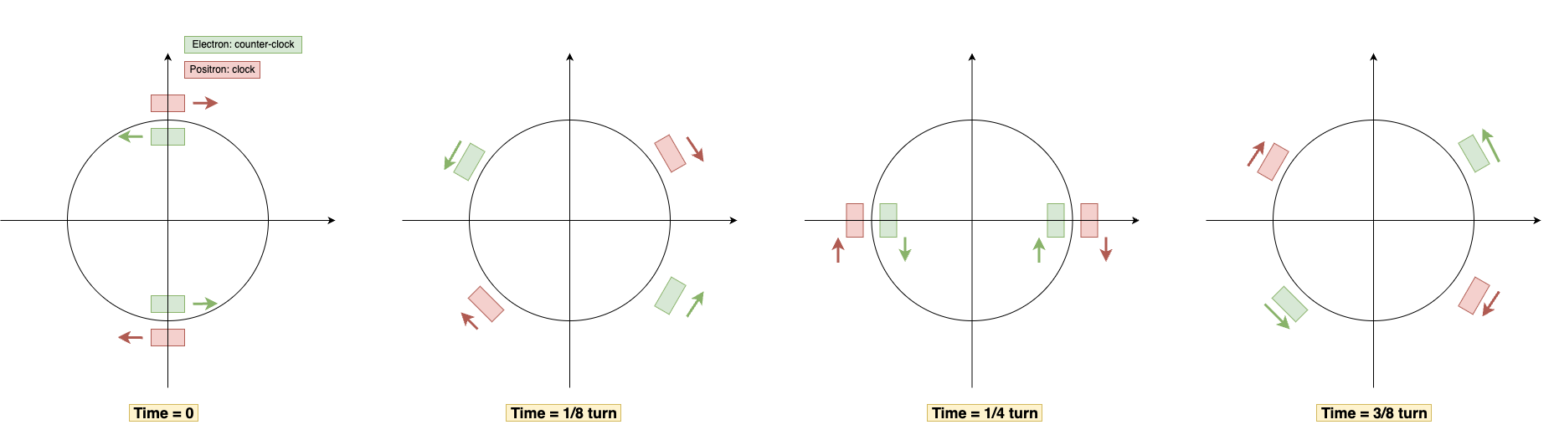
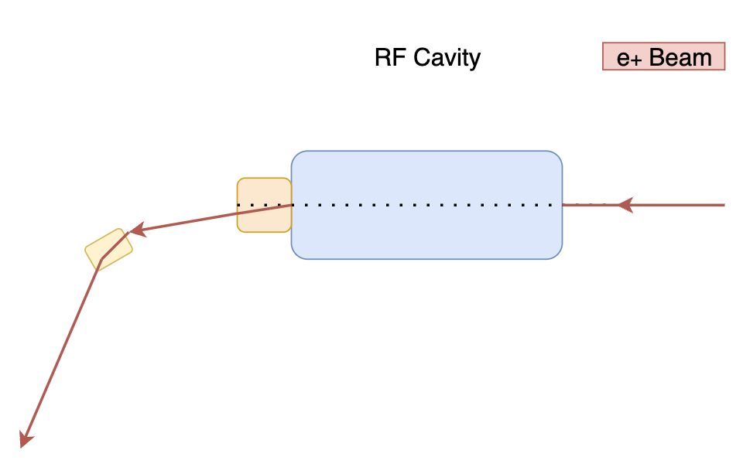
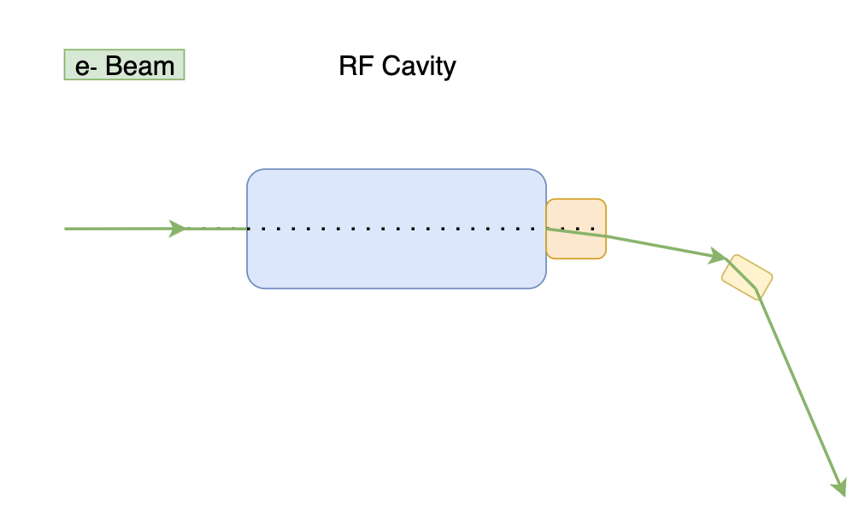


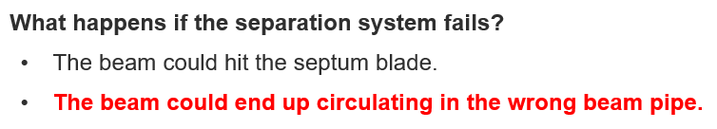
Electro-Magnetic Separators around the RF cavities
L. Porta, presentation yesterday
  Kicker System as alternative
  Kicker system has been very recently proposed as an alternative option to EMS
  The interest has been triggered by the CEPC project where they have similar approaches [8]
  Feasibility analysis is at a very early stage
interaction point
RF
Quotes from yesterday’s presentation:

Slide 13
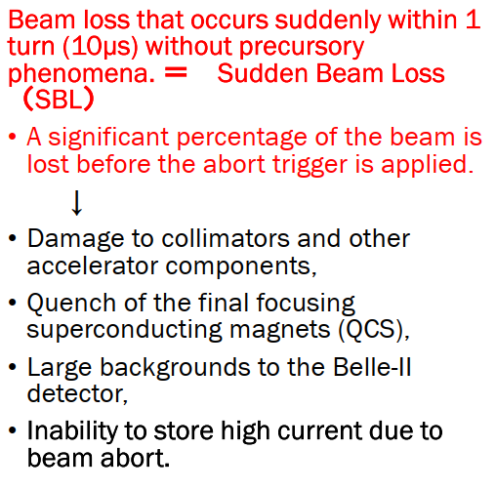
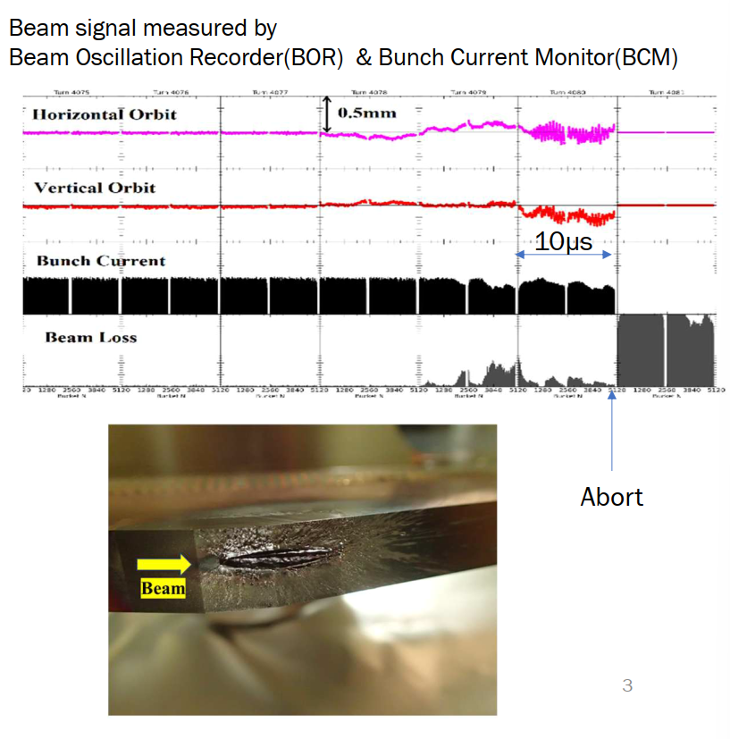
Sudden Beam Losses as seen at SuperKEKb
10 µs = 1 rev.
H. Ikeda at Mini SuperKEKb workshop 8/5/2025
Losses occur at the aperture limit, at the collimators

Slide 14
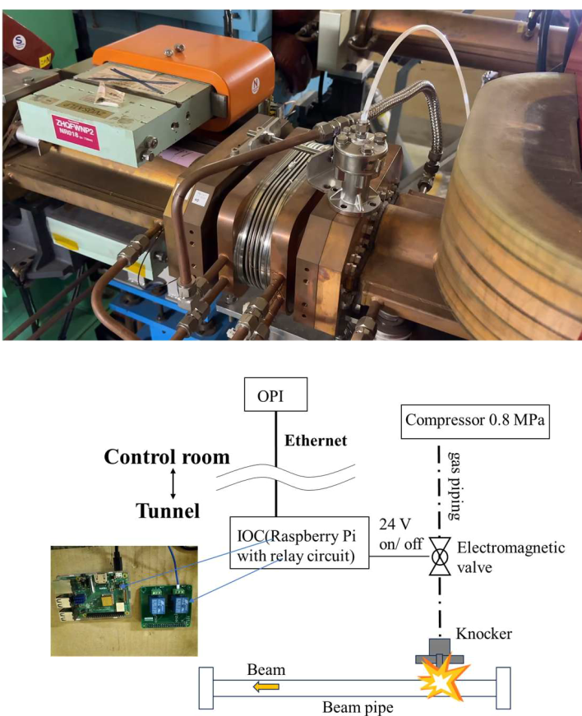
Sudden Beam Losses at SuperKEKb
Extremely important for FCCee – we should really understand it before we build the FCCee
  Beam losses go together with vacuum bursts
  Suspect to be a macro-particle – beam interaction
  Like the LHC UFOs, but different …
Workshop at CERN on Dust Charging and Beam-Dust Interaction at CERN 13th June 2023: https://indico.cern.ch/event/1272104/timetable/
Presentation at the Machine Protection Task Force 27/03/2025
Modelling is important. Difference between ‘UFOs’ as seen at the LHC – protons – and what is seen at SuperKEKb – electrons
Important for FCCee design
  Requirements on vacuum system
  Requirements on beam diagnostics (BLMs and BPMs), time resolution and sensitivity
  Requirements on delay before dumping the beam
Studies with ‘knocker’ in the SPS at CERN are being considered
H.Ikeda

Slide 15
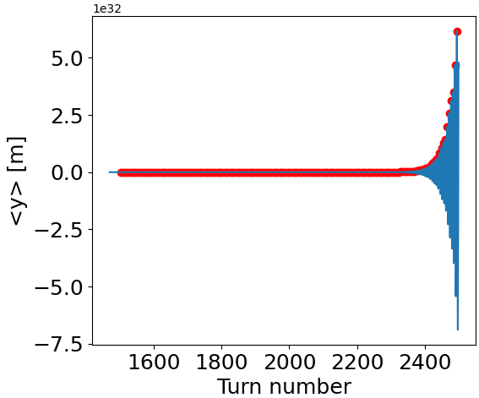
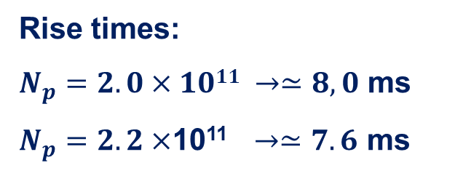
Impedance Induced Instabilities
CBI
Transverse Coupled Bunch Instabilities
Rise time – depending on the tune – around 1.3 ms = O(3 FCC turns)
Need a fast feedback (see later)
  That does not fail !!
Coupled bunch modes also to be damped by feedback
Rise times:
$N_{p}=2.0×1011 →≃8,0$ ms
$N_{p}=2.2×$10¹¹$→≃7.6$ ms
M. Migliorati, X Buffat

Slide 16
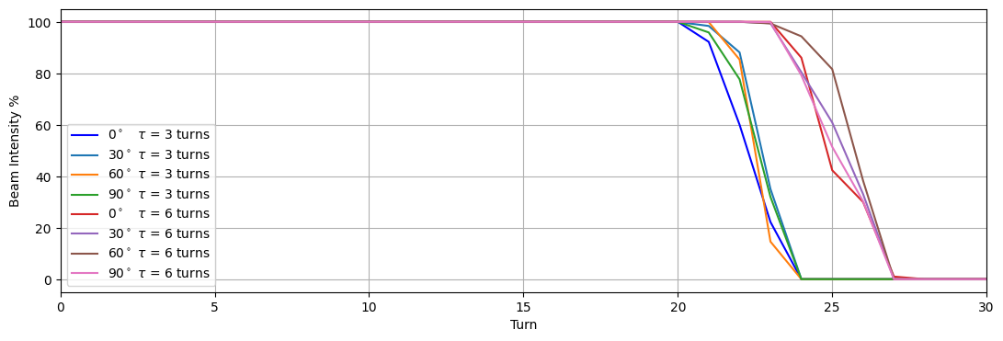
Instability Simulations with Collimation System
The beam must be dumped before any damage to the collimators can occur
Simulations confirm that the beam can be lost in only a few turns
Almost 50% of beam energy lost in one turn, losses of order of MJ in the collimator can be expected
Losses need to be detected in the first turn(s) !
Giulia Nigrelli in Task Force Meeting,
Result here for H-plane, similar V-plane

Slide 17
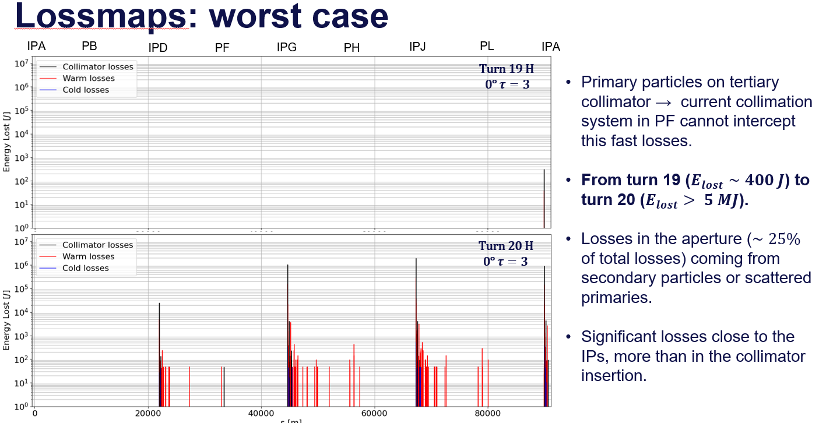
Instabilities and losses on collimators
Giulia Nigrelli in Task Force Meeting,
Result here for H-plane, similar V-plane

Slide 18
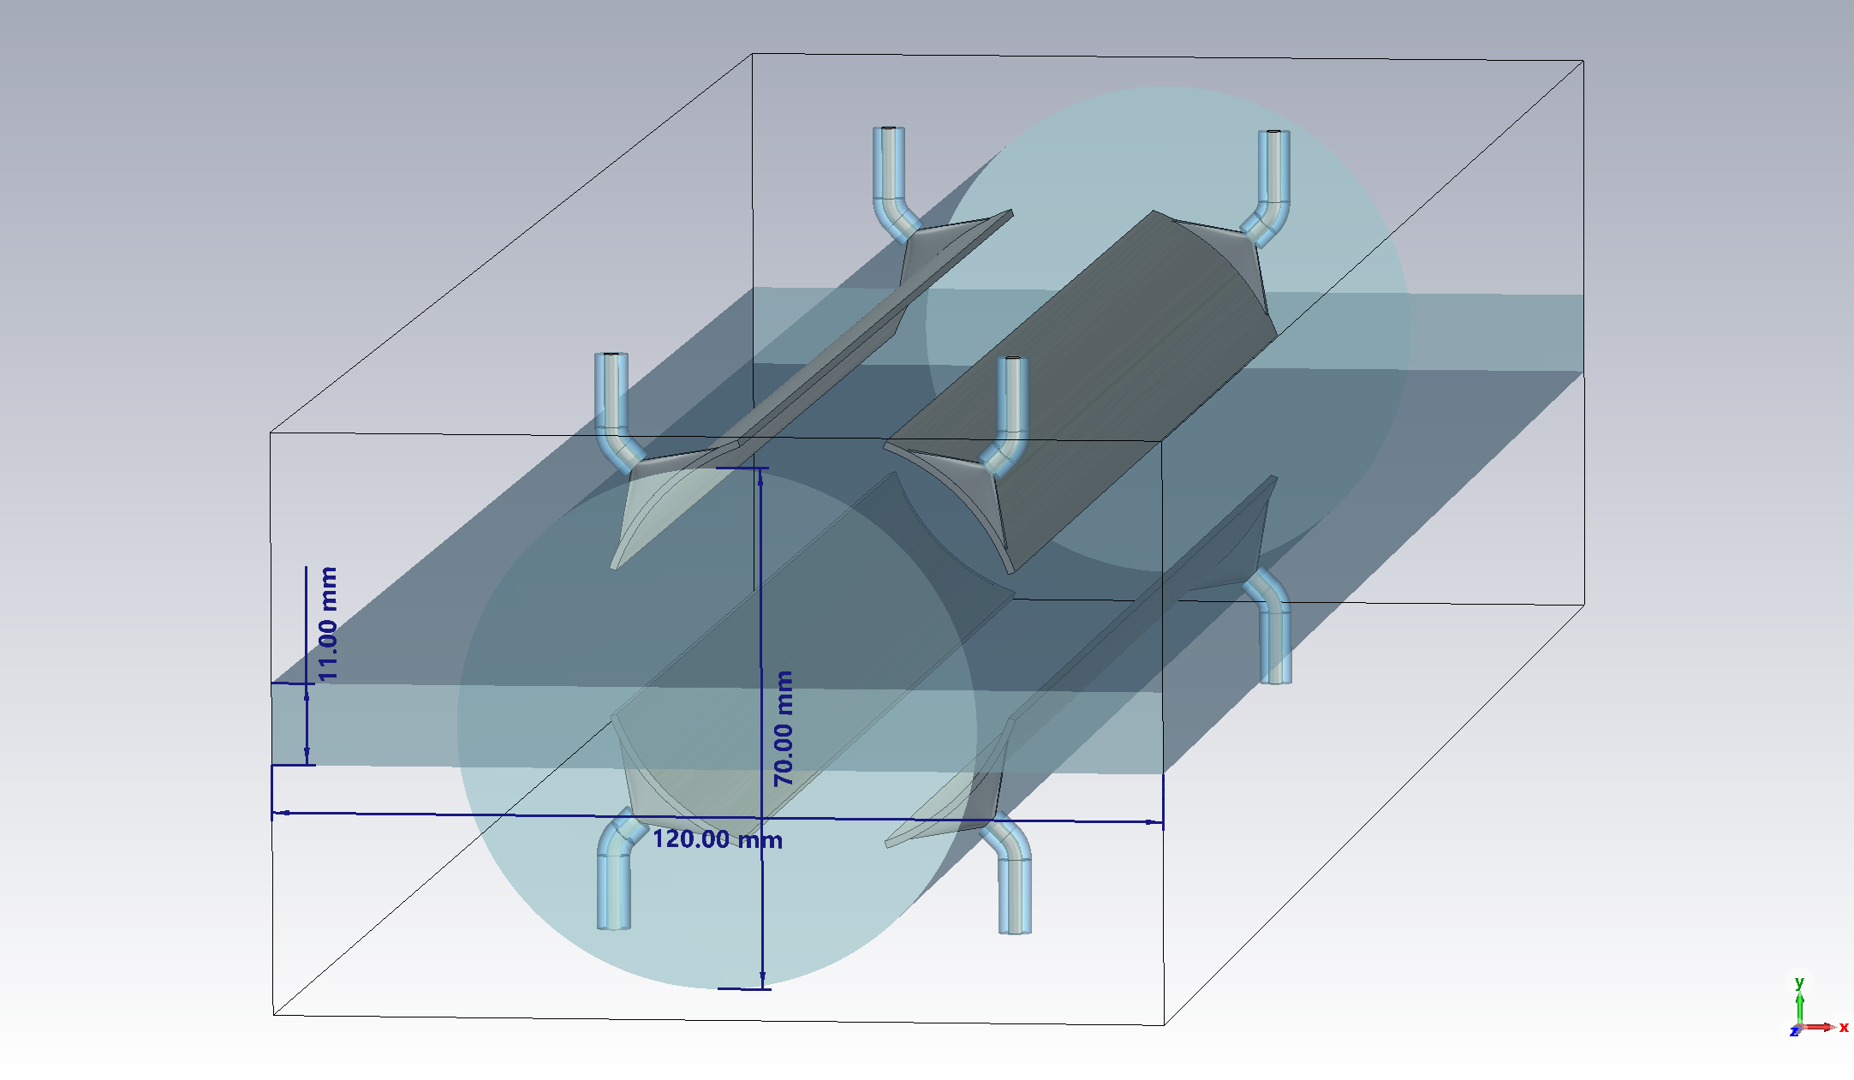
Transverse Feedback System & Depolarizer
One system for Transverse Feedback and Depolarisation kicker
Transverse feedback to counteract the TMCI (see ←)
  Especially at Z energy, due to the larger beam current
  For the Booster also injection oscillation damping
Depolarisation kicker to measure the beam energy at Z and W energies
Both need similar bandwidth, use the same system
If the Transverse Feeback stops working, the beam can be unstable in a few turns
  Ideally redundant systems, several locations spread around the ring
  Independent systems can start to interact and fight each other
Need to interlock at the source in case of failure but also interlock on the effects on the beam
RF power
up to 1m long
RF loads
RF power
RF loads
D. Sittard (CST)
W. Höfle at TF
Proposed Stripline Kicker

Slide 19
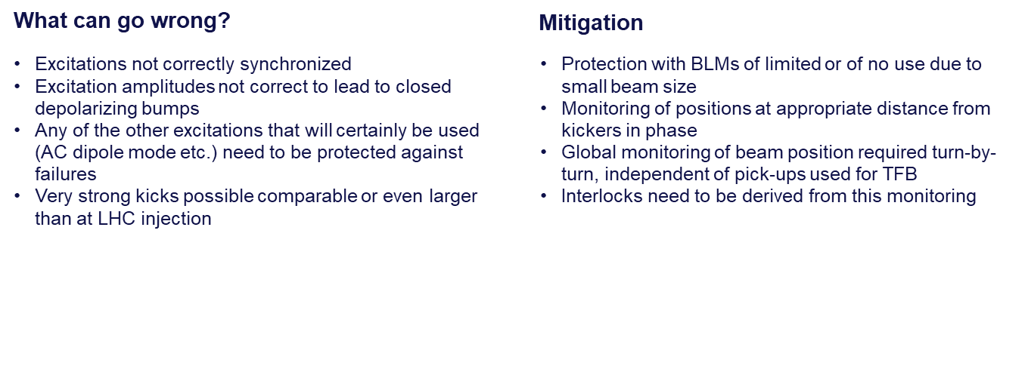
Transverse Damper Machine Protection Considerations
W. Höfle at Task Force meeting

Slide 20
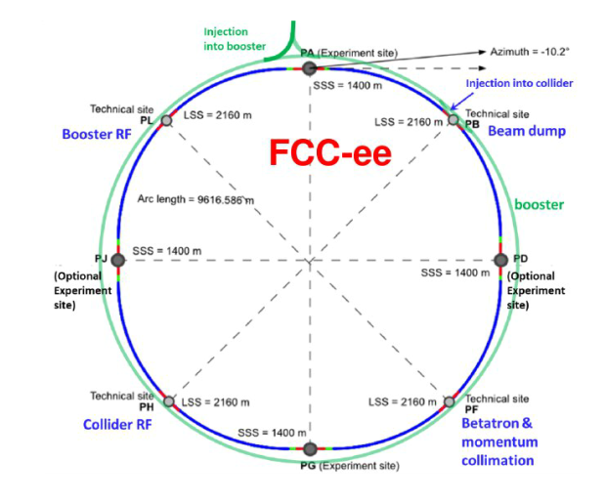
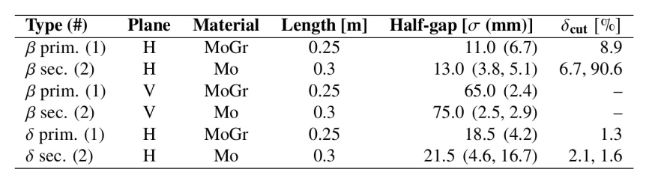
Protection: Collimation
System
Define the aperture of the collider and thus protect the machine
  On top: control experimental backgrounds
Baseline design is to have PF dedicated to collimation
Plus dedicated synchrotron radiation collimators upstream of the IPs
To be confirmed: Machine Protection prefers a (more) distributed system, to protect against local failures
  Failure simulations to be done
  Put this in the perspective of the sudden beam losses seen at SuperKEKb which damage their collimators

Slide 21
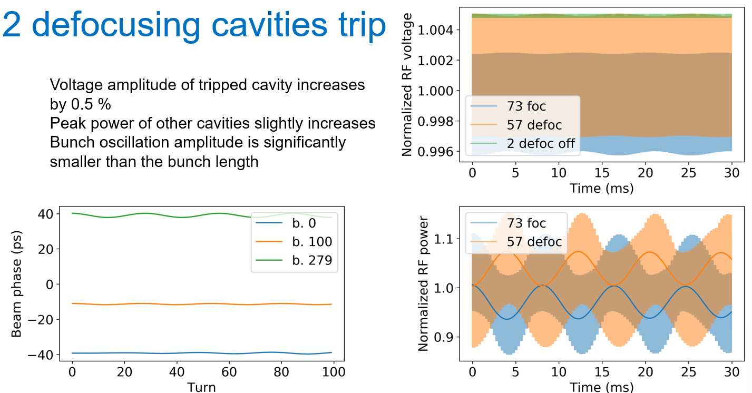
RF System – will dominate machine operation
Analysis of the failures for the Reverse Phase Operation system have started
  Reverse phase operation allows same hardware for Z, W and ZH mode
A 600 ns abort gap for the beam dump seems feasible
First results show no risk of too high induced voltages if a cavity trips
  Don’t need to abort the beam if sufficient cavities remain operational
  Mainly an availability issue, not a machine protection issue
Further analysis needed
I. Karpov at Task Force meeting

Slide 22
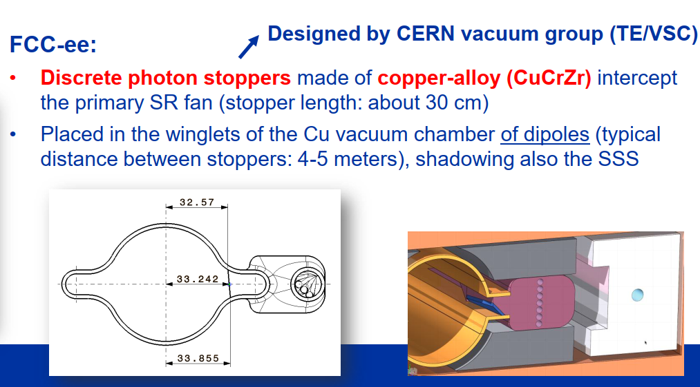
Synchrotron Radiation
What can possibly go wrong?
SR photons miss the photon stoppers and impact on the vacuum chamber or other sensitive equipment (e.g. due to machine misalignments, orbit excursions, unexpected SR sources)
Insufficient cooling of photon stoppers (e.g. failure of cooling circuit)
…..
Some questions for the design phase:
Which alignment tolerances for vacuum chambers/SR absorbers?
How can we monitor if SR photons impact on photon stoppers? Temperature monitoring?
Which interlocks are needed? Water flow rate measurement for photon stoppers?
Is all equipment sufficiently protected from SR, in particular in the insertion regions (special SR sources like wigglers, etc.)? Can we accurately model all SR sources?
Do we need additional SR collimators, for example in the technical insertions?
If SR impact on equipment cannot be fully avoided (e.g. beam instrumentation), which design guidelines should be followed?
A system, similar the Warm Magnet interlock Controller (WIC), presently used at all accelerators at CERN, might need to be used to interlock the synchrotron radiation absorbers
This will be a large distributed interlock system

Slide 23
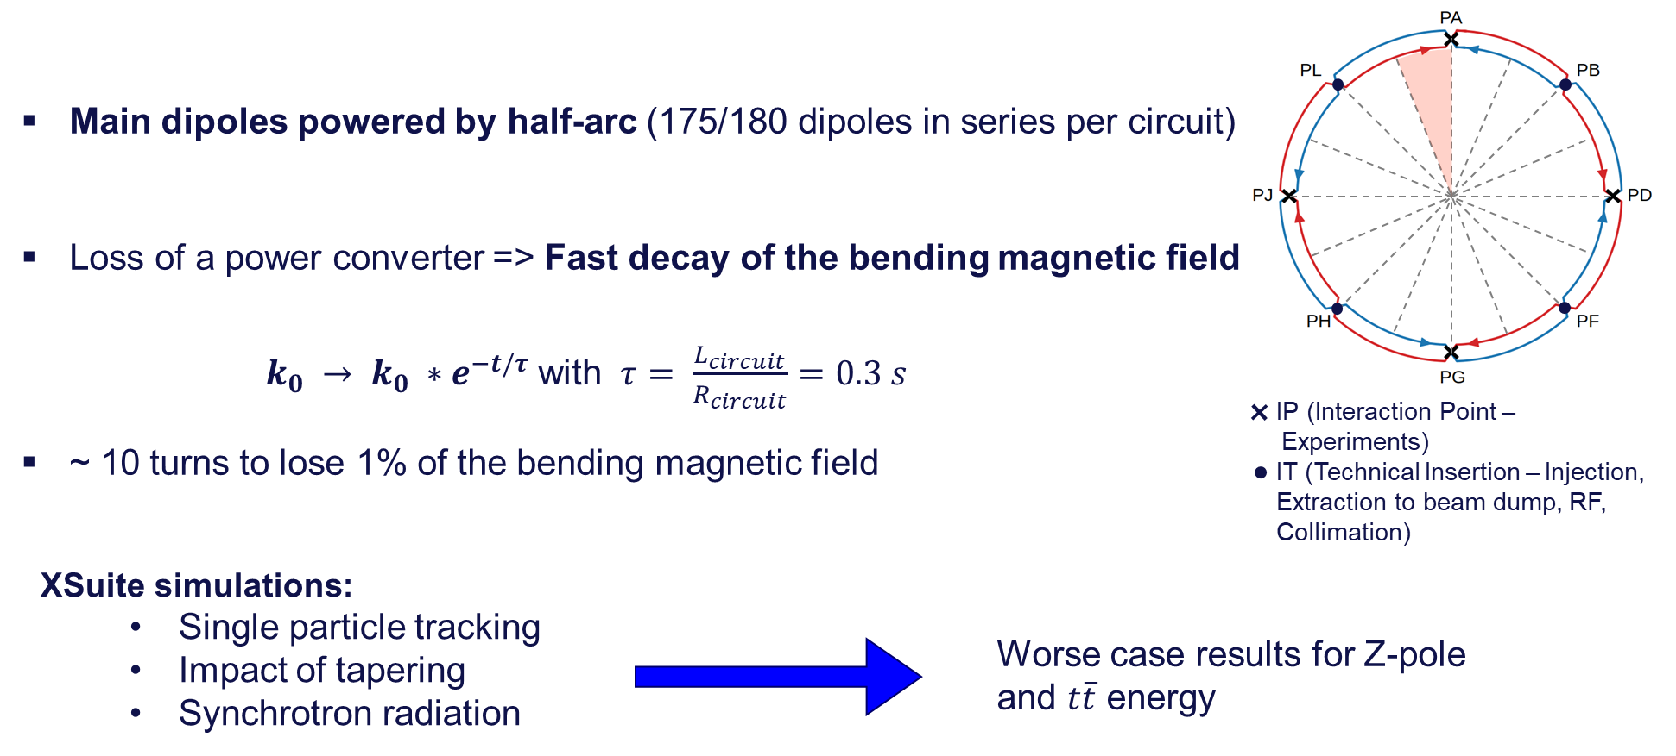
Main dipoles powering failure
See presentation Delphine Domange, this session

Slide 24
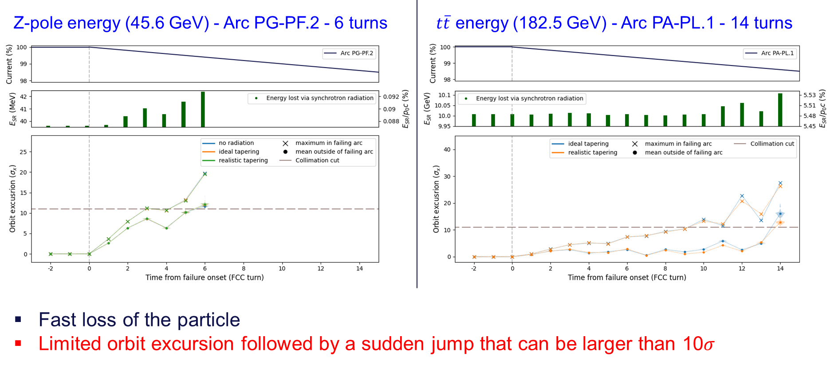
Main dipoles powering failure
See presentation Delphine Domange, this session
Detection by BLMs or BPMs might be too slow
Need to consider Fast Magnet Current Change Monitor – need to be reliable
Other option is to change time constant of the circuit, add large inductance

Slide 25
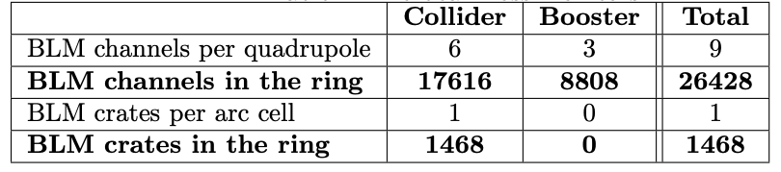
Beam Loss Monitors (and Beam Position Monitors)
Used as a general and very reliable safety net for the LHC with about 4000 monitors
Also for FCCee foresee a full coverage of the machine
  Need to define the spacial coverage → Initial proposal with more than 26’000 BLMs
  Need to define the sensitivity and dump limit
  Need to define the required time resolution and reaction time
  Need to be very reliable if a single BLM can dump the beam
Due to very small vertical beam size, part of this functionality might need to be completed by hardware interlocked Beam Position Monitors, distributed over the machine
The electronics needs to be shielded from synchrotron radiation
See B. Salvachua, later this session

Slide 26
Conclusions on Machine Protection
The beams are dangerous, very bright
The environment is hostile with a lot of synchrotron radiation
Several failure modes with a time scale of a few turns have been identified
The inherent delay of dumping a beam is four turns
  1 detection,1 transmission,1 for synchronization to the abort gap,1 to get the last electron/positron out
  Can gain on detection and number of abort gaps
A full inventory of failures needs to be made
  Specification of all hardware failure modes that can lead to beam loss and the equipment design aspects
  A good start has been made in the Machine Protection Task Force, a lot of work still outstanding
  Sudden beam losses as seen at SuperKEKb need to be understood, model to be applied to FCCee
Then a coherent machine protection system can be defined
  Detection of the failure by beam diagnostics, besides the detection by the hardware
  Definition of the Beam Interlock System, Warm Magnet Protection, BLMs, BPMs, Fast Magnet Current Change Monitor etc.
The protection system and all other hardware needs to provide a good balance between Protection/Reliability and Availability
  FCC work package covering both Availability and Machine Protection
All hardware teams to subscribe to a coherent approach across all systems
It will be challenging

