Slide 1

Preliminary design of FCCee collimators
A. Perillo-Marcone, R. Cowan, R. Seidenbinder, M. Calviani, A. Lechner, S. Marin, G. Broggi, R. Bruce, S. Redaelli
FCC week 2025

Slide 2
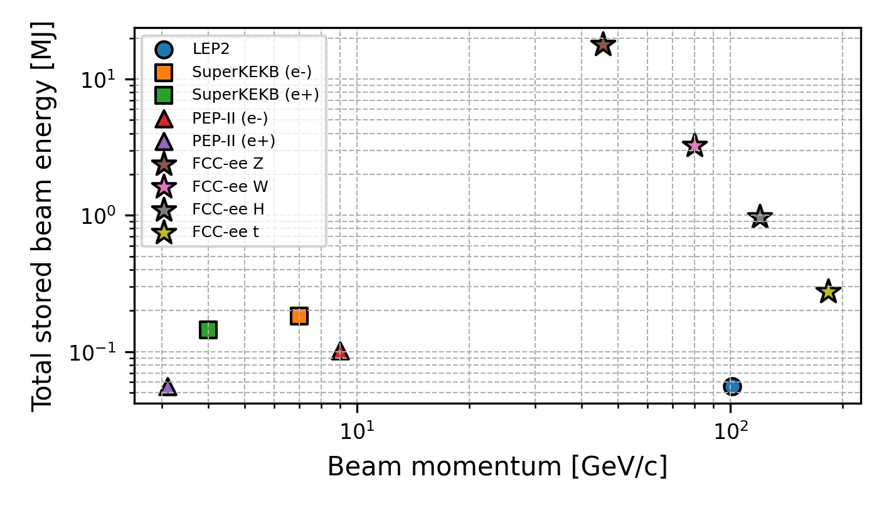
General Considerations
FCC-ee is the FCC first stage e⁺e⁻ collider
  90.7 km circumference, tunnel compatible with FCC-hh
  4 beam operation modes: Z (45.6 GeV), W (80 GeV), H (120 GeV), ttbar (182.5 GeV)
FCC-ee presents unique collimation challenges
  Unprecedented stored beam energy for a lepton collider
    17.5 MJ in the Z operation mode
  Highly destructive beams: collimation system indispensable
    Reduce background in the experiments
    Protect the machine from unavoidable beam losses
Collimation strategy for the FCC-ee
  Beam-halo (global) collimation
    + local protection collimation
  Secondary particle shower absorbers
  Synchrotron radiation (SR) collimation – upstream of the IPs
See G. Broggi’s presentation on Tuesday 20/05 for details on collimation studies

Slide 3
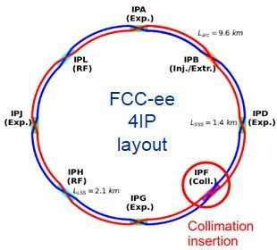
Devices considered
Halo cleaning collimators
  Primaries and Secondaries in PF straight section
  C and Mo based.
Shower absorbers
  Only few units
  Mo or W based
SR collimators and masks
  W based
Tertiary collimators
  C based

Slide 4
Hardware Requirements
UHV compatible
Low impedance (critical!)
  High conductivity absorbing materials
  Important consideration for jaw geometry/design
Movable jaws
  In-operation position and angular adjustment (BPM integrated in the jaws)
Competing requirements
  Short jaw length → Reduce impedance
  High electrical conductivity → Reduce impedance
  Low density (high radiation length) → Reduce energy density deposition in case of accidental beam impacts
  High enough density → Sufficient stopping capability for efficient halo cleaning
  Good thermal conductivity → Efficiently extract deposited heat

Slide 5
Requirements for design optimisation
Aperture and bellows movement
Nominal Ø60mm pipe (no wings)
What is the stay-clear aperture needed in each operation phase?
  Do we need to fully retract the jaws at any point?
  Currently we assume full aperture needed
What are the required jaw motions for each operation scenario?
  e.g. beam-on? parking/beam-off? MD? testing?
  Far off but important for bellows design + fatigue considerations

Slide 6
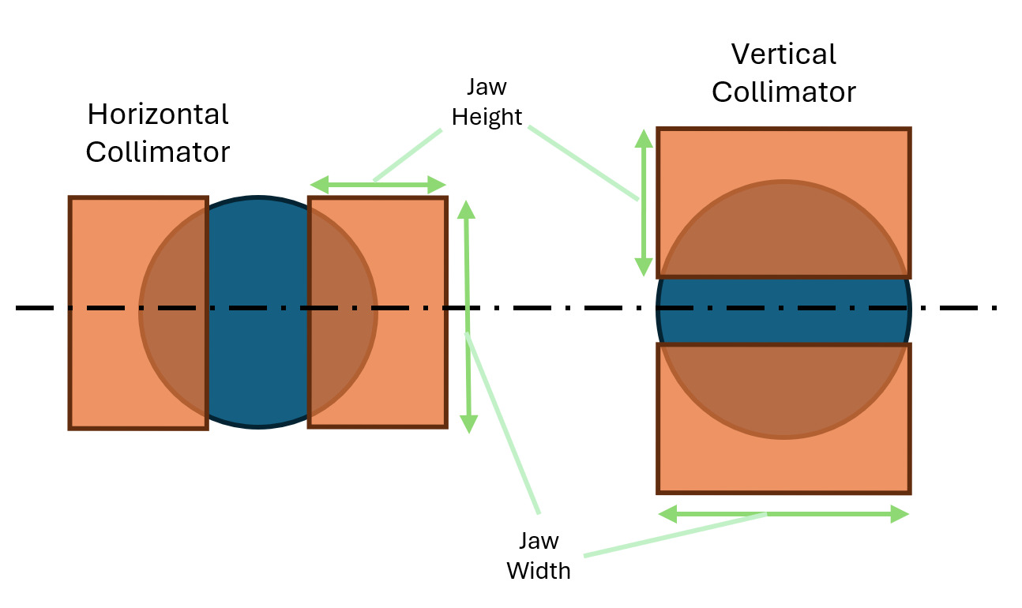
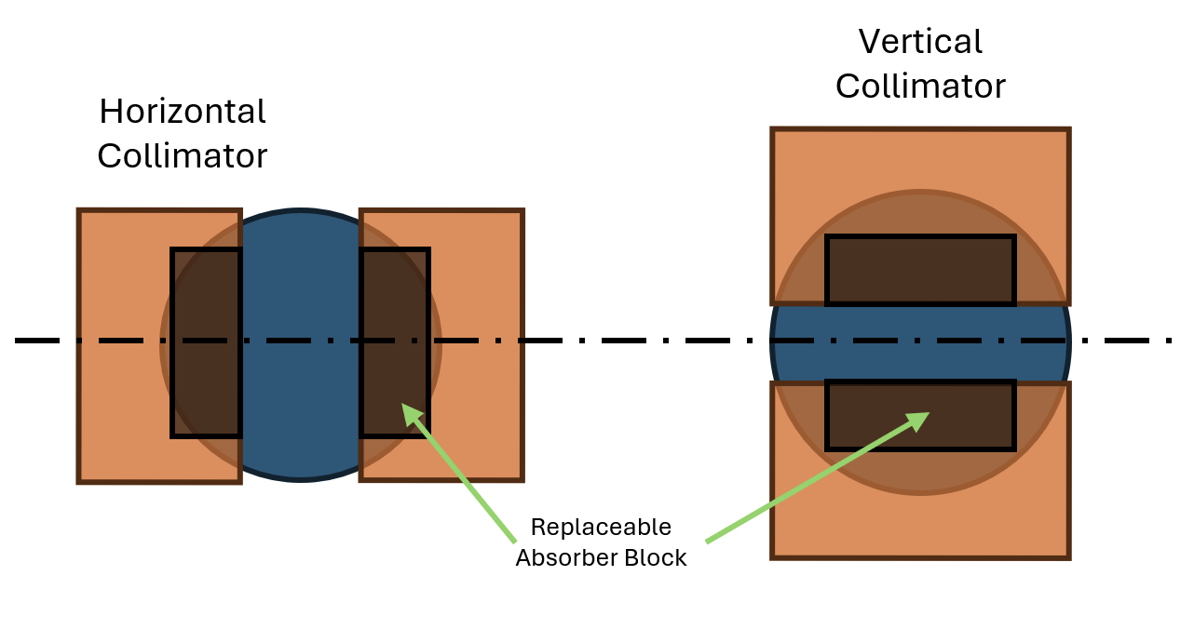
Beam and jaw position
Orbit variations in Vertical plane and in horizontal plane?
  For both nominal and accident conditions
Absorbing material cross-section required on primaries? secondaries? absorbers? tertiaries?
Currently:
  It covers the entire Ø60mm pipe
  30mm height, 60mm width

Slide 7
Tolerance and Angular tilt
Is it needed on all collimators?
  Cost and mechanical simplicity advantages of one motor – bellows.
  Looking at alternative designs to improve tilt motion accuracy.
Angular adjustment required for device placement accuracy?
  Geometry has accuracy of ~0.2mm → 400urad misalignment possible over 1m tank length
First draft tolerances (they can be improved!):
 | Gap | Tilt | Ra (roughness) | Flatness
Range | 40mm (30mm + 2 *5mm) | +/- 300urad ? | - | -
Tolerance | +/- 20um | +/- 10urad | 1.6 um | 20um

Slide 8
Absorbing materials considered for FCCee
 | Low density (primaries and tertiaries) |  |  | Medium/High density (Secondary, SR Masks & Shower Absorbers)
Properties | 3D CfC^{(1,2)} | Be | MoGr⁽¹⁾ | TZM | Ta | W⁽³⁾
Density (g/cm³) | 1.8 | 1.8 | 2.5 | 10.1 | 16.6 | 19.3
Electrical Resistivity (μΩ.m) | // 1 ┴ 30 | 0.04 | // 1 ┴ 15 | 0.06 | 0.13 | 0.05
Thermal Conductivity (W/m.K) | // 230 ┴ 55 | 216 | // 700 ┴ 50 | 118 | 54 | 164
Thermal shock resistance ⁽⁴⁾ | +++ | + | ++ | +++ | + | ++
NON-EXHAUSTIVE LIST – OTHER “INNOVATIVE” MATERIALS MAY BE CONSIDERED
Customised material – produced on request
R&D required
Depending on requirements, an alloy may be more adapted
Ranking within each category (compared with materials of similar density)

Slide 9
Other design considerations
Determine loads in nominal operation and accidental scenarios
  Thermal deformations
  Cooling requirements
Activation studies (to design handling, repair operations)
Impedance considerations (geometry and materials)
Other requirements:
  Maintainability
  Repairability
  Quick replacement or transversal shift (5th axis-like)?
  Failure acceptable in case of accident?
See D. Gibellieri’s presentation on Tuesday 20/05 for details on impedance studies

Slide 10
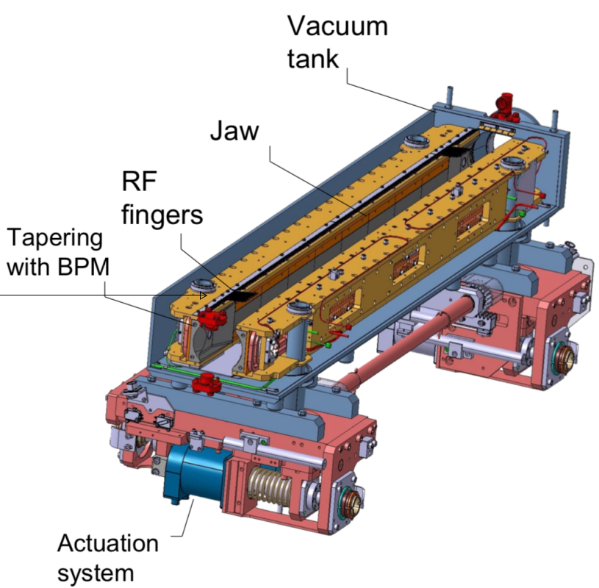
LHC Collimator Design
Main features
Long jaws (~1m active length)
High geometrical/positioning precision
Fully sealed (welded) UHV tank
Not openable (not repairable)
Geometry not adapted to FCCee

Slide 11
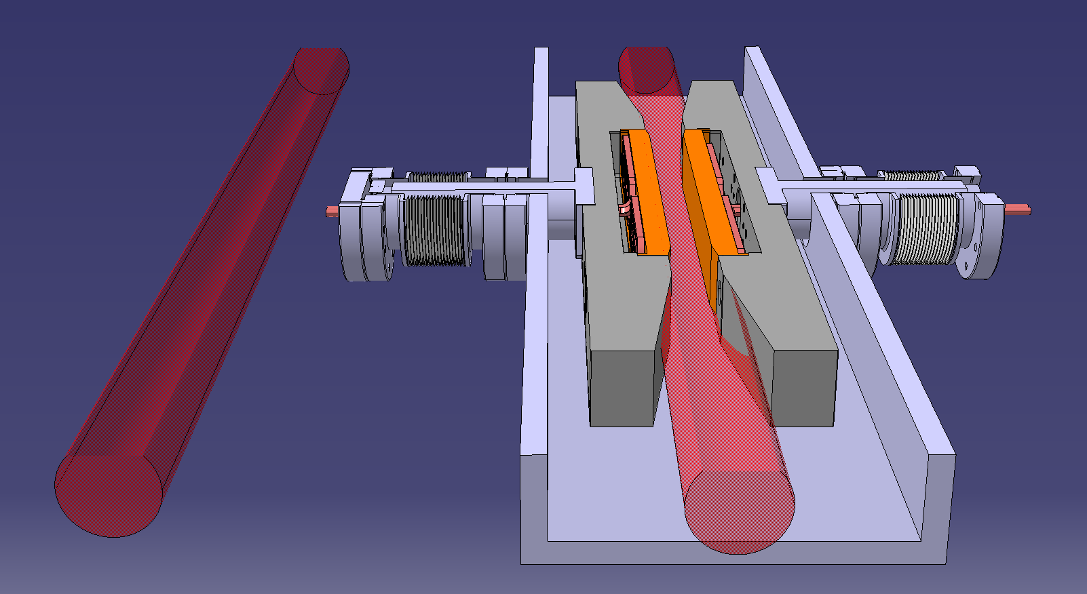
Initial Design – section view with beam pipes
Axial bellows limited by space available between beams
(stroke length critical)
Absorber block covers only a small portion of beam pipe
Impedance transition “unfinished”
Access available for replacement of blocks

Slide 12
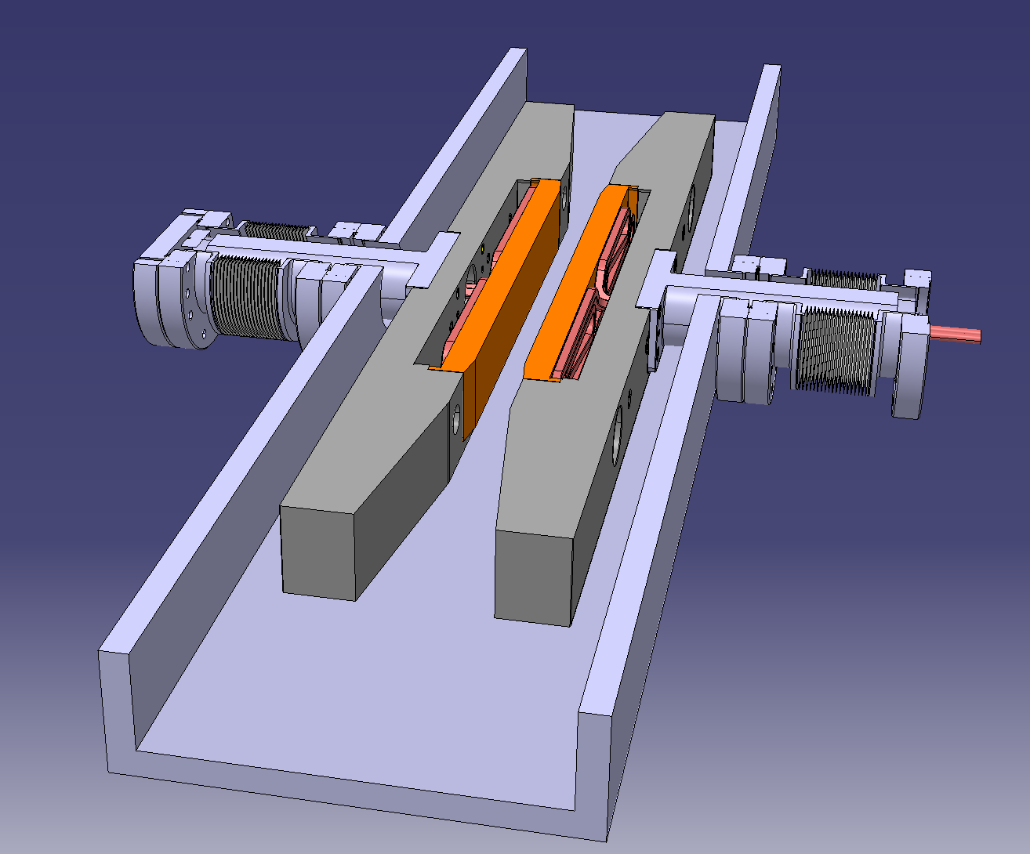
Lessons learnt from other collimators
From LHC:
Bellows lessons:
  Only standard axial motion
  Not welded to the tank
From SuperKEKB:
Risk of beam damage on active material
  Replaceable active block (or whole jaw)
  Also considering:
  Transversal jaw shift for fresh collimation surface
  Hot spares if necessary
BPM x4

Slide 13
Proposed Strategy and Timeline
Deliverable ⁽¹⁾ | Specific tasks | Proposed completion^{(2,3)}
Functional requirements for collimators | tracking studies, impedance constraints | 2027
Comparison of absorbing materials | Energy deposition studies (FLUKA), thermo-mechanical analyses and system engineering as well as lifecycle considerations. Need inputs from various groups on tracking and impedance. | 2027
Preliminary design | 3D Models, Materials, Manufacturing techniques | 2028
R&D, prototyping activities | Rectangular flanges, joining dissimilar materials, material characterisation/test | 2032
Full design (first version) System design (supports, alignment, handling) | Functional studies (protection, impedance), thermo-mechanical calculations, system engineering | 2034
Full system prototype – Mock-up test | Collimator, supports, handling equipment | 2036
Final design |  | 2038
DESIGN ENTIRELY BASED ON
FUNCTIONAL REQUIREMENTS
Deliverables are not sequential. They run in parallel – they are interdependent.
Dates are only tentative proposals. To be discussed with stakeholders.
Each task to start as soon as there is enough information

Slide 14
Conclusions
Different collimator designs could be envisaged depending on function
Competing functional requirements → best compromise to be found
A specific design for FCCee needed to best meet specifications
Several studies to be performed (energy deposition, thermo-mechanics, system engineering)
Prototyping and testing required
R&D necessary (materials and manufacturing techniques)

Slide 16
BACK-UP SLIDES

