Slide 1

Alignment system based on a Structured Laser Beam
Witold NIEWIEM
22/05/2025 Geodetic Metrology group - Future Projects section (BE-GM-FP)

Slide 2
Content
Alignment of particle accelerators
SLB-based reference line
Alignment system prototype

Slide 3
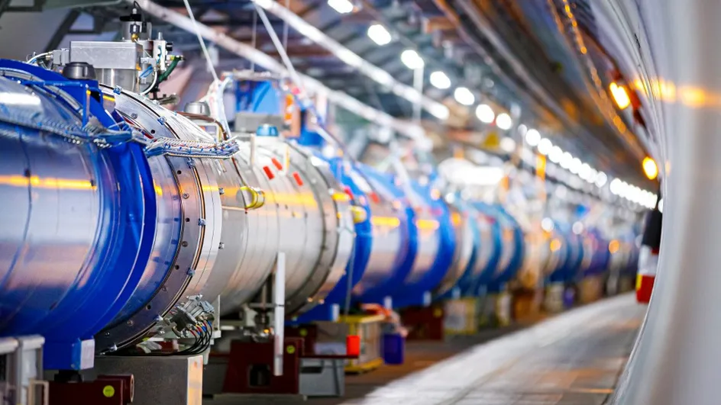
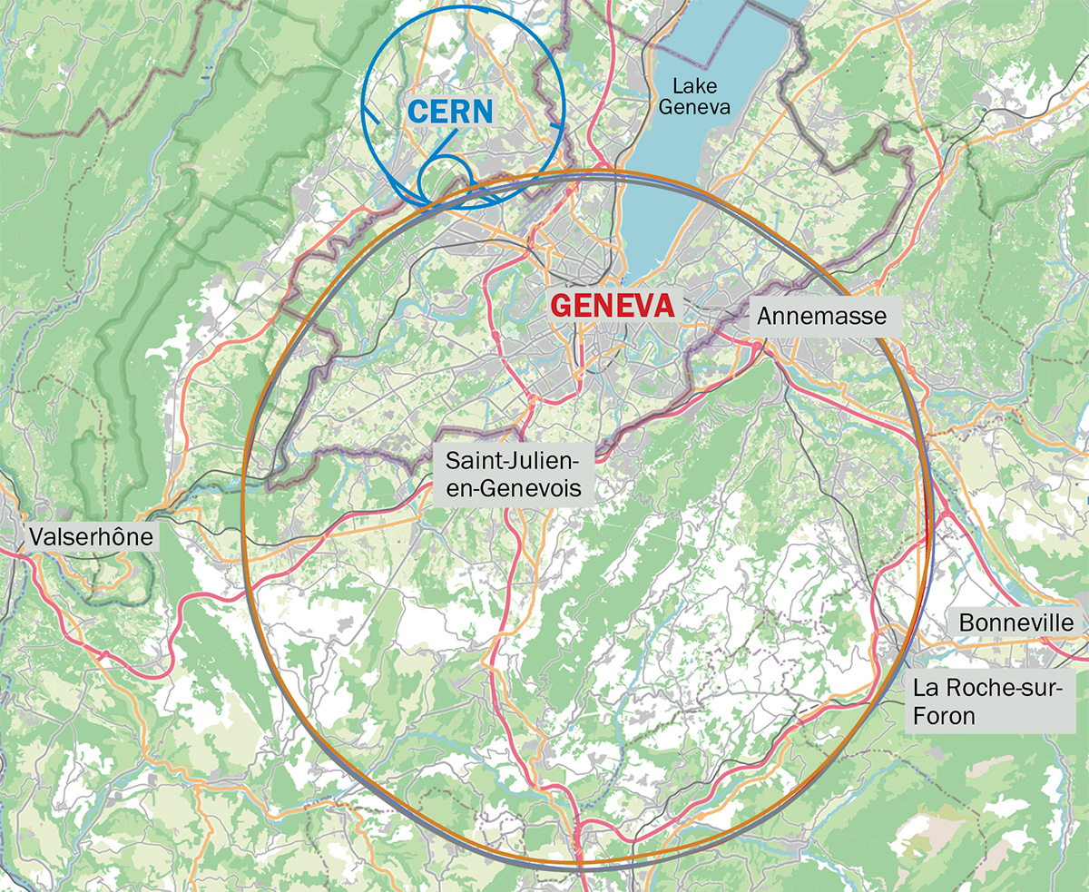
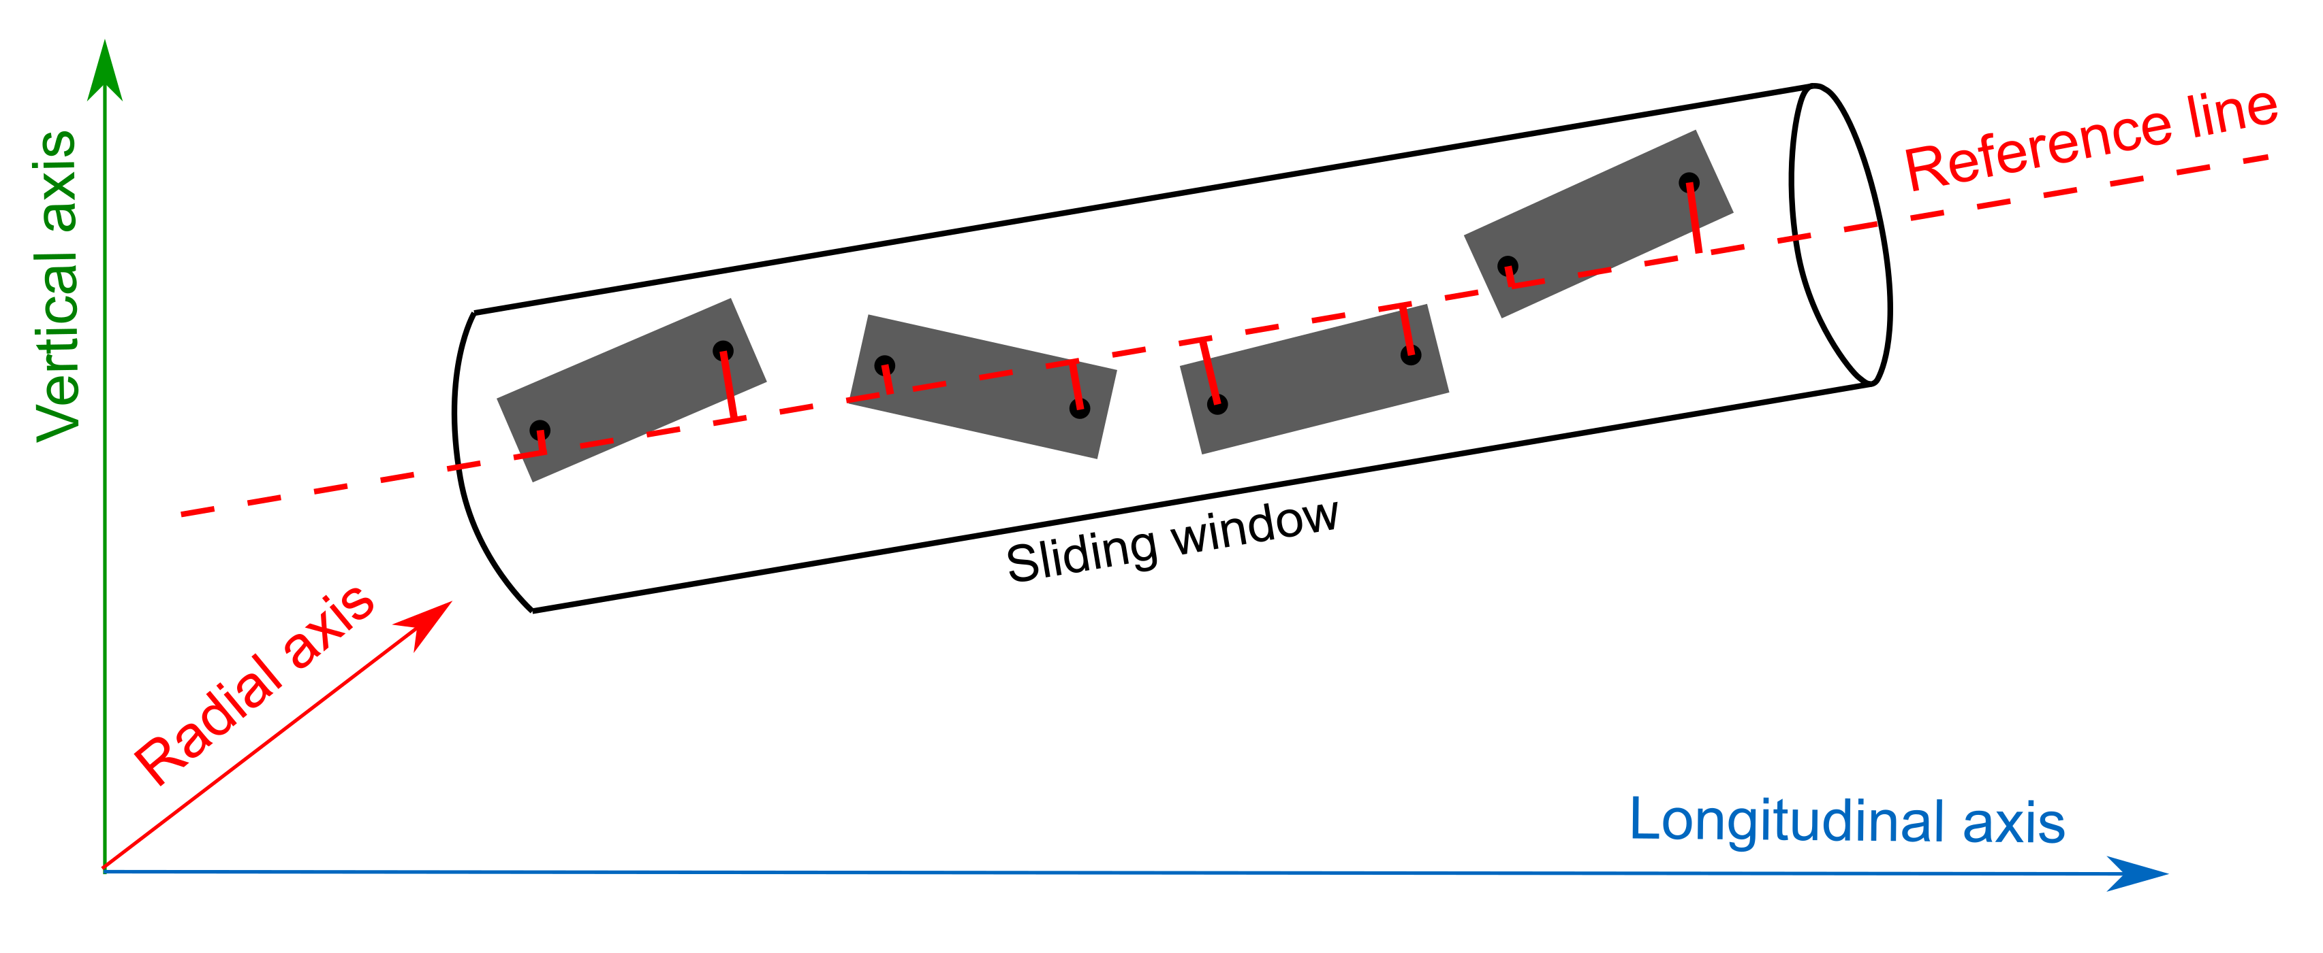
Alignment of particle accelerators
Large Hadron Collider (LHC)
Future Circular Collider (FCC)
Alignment of entire machine:
Accuracy LHC 200 μm / 150 m (sliding window)

Slide 4
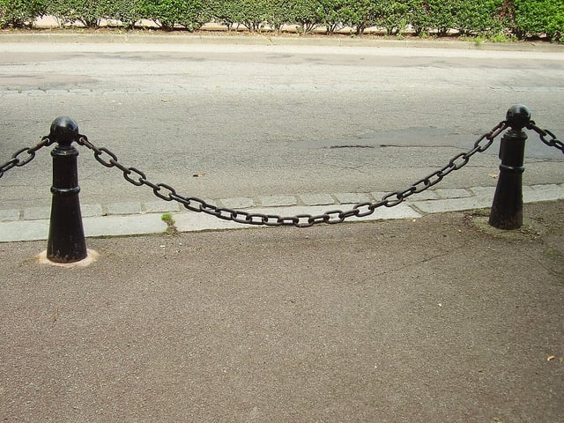
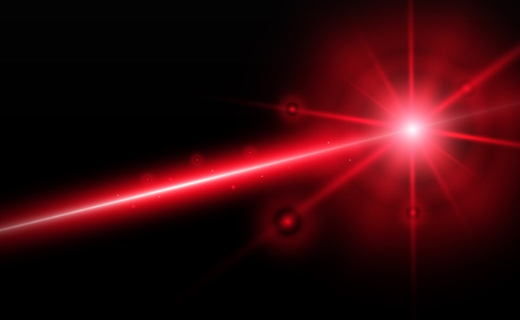
Reference line for alignment
Component I
Component II
Component III
Assumptions:
Line is straight
Offsets are perpendicular
Reference line
Wire measurement
Laser measurement

Slide 5
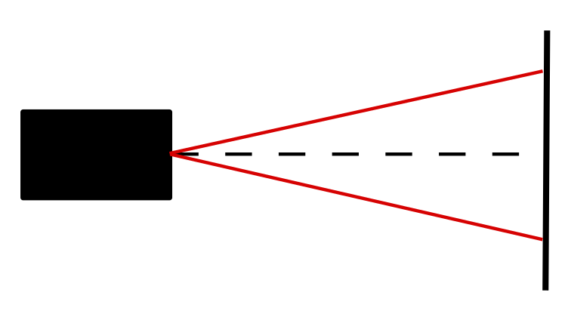
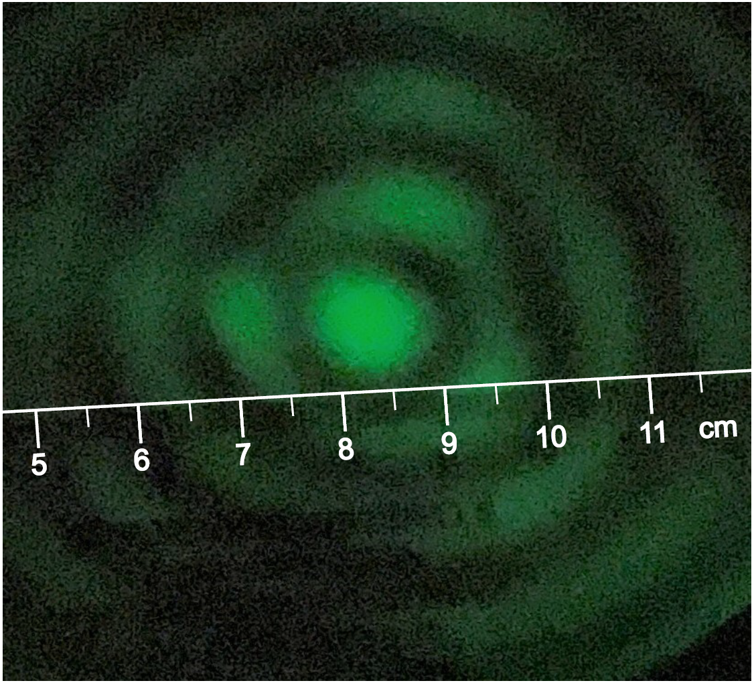
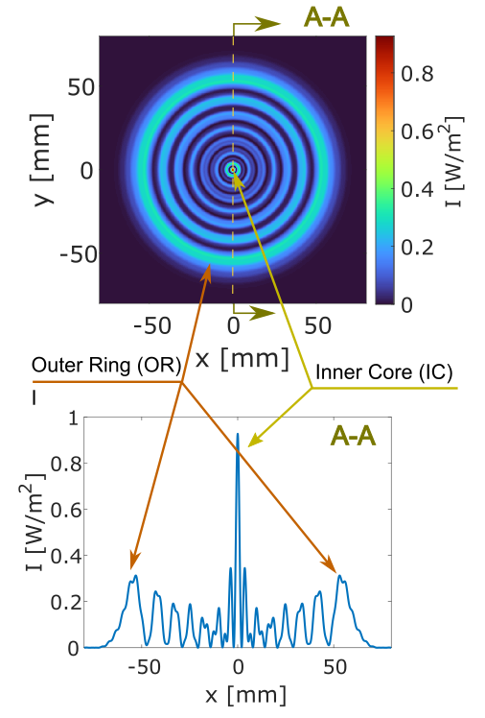
Structured Laser Beam (SLB)
  Laser divergence
Example of theoretical transverse profile of an SLB at 225 m - Inner core ⌀ 3 mm, Outer ring 100 mm
Acquired transverse profile at 900 m
IC divergence 10 µrad
Advantages of SLB for alignment:
Low divergence of the IC
Theoretically, propagation to infinity
Easy-separable IC

Slide 6
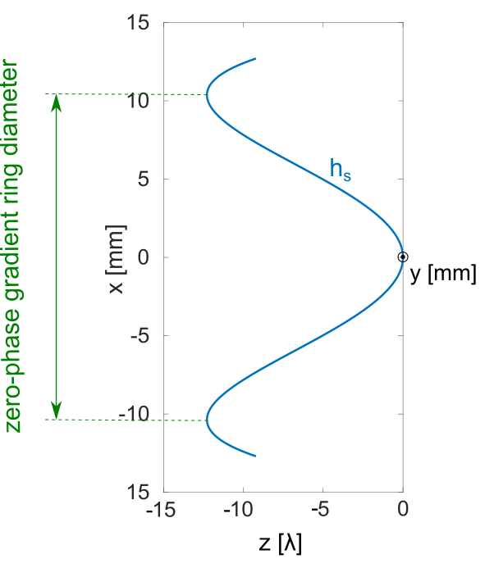
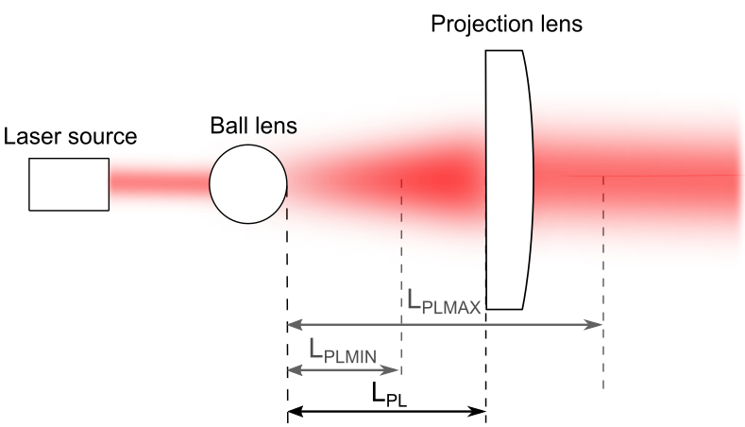
SLB generator and wavefront
  Laser divergence

Slide 7
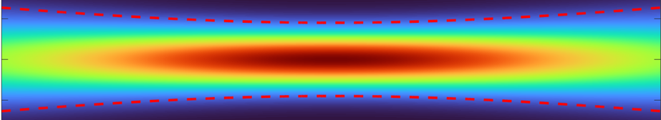
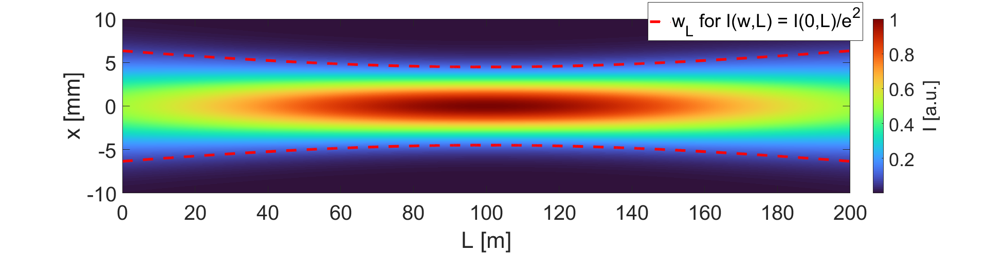
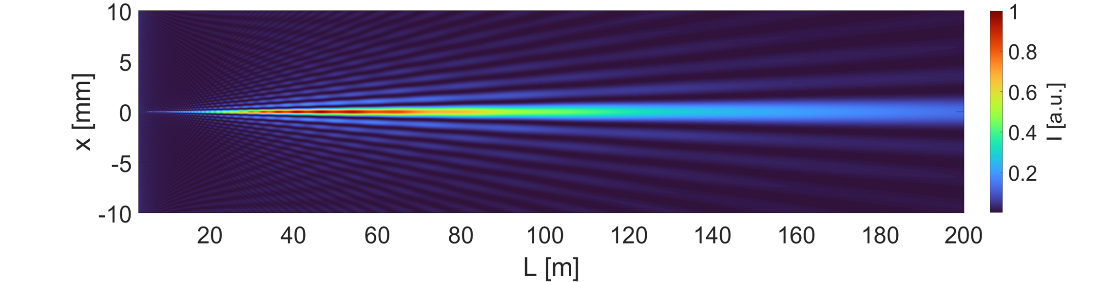
Alignment - SLB inner core reference
  Laser divergence
Component I
Component II
Component III
Reference line
Generator
Longitudinal profile of a Gaussian Beam
Longitudinal profile of an SLB

Slide 8
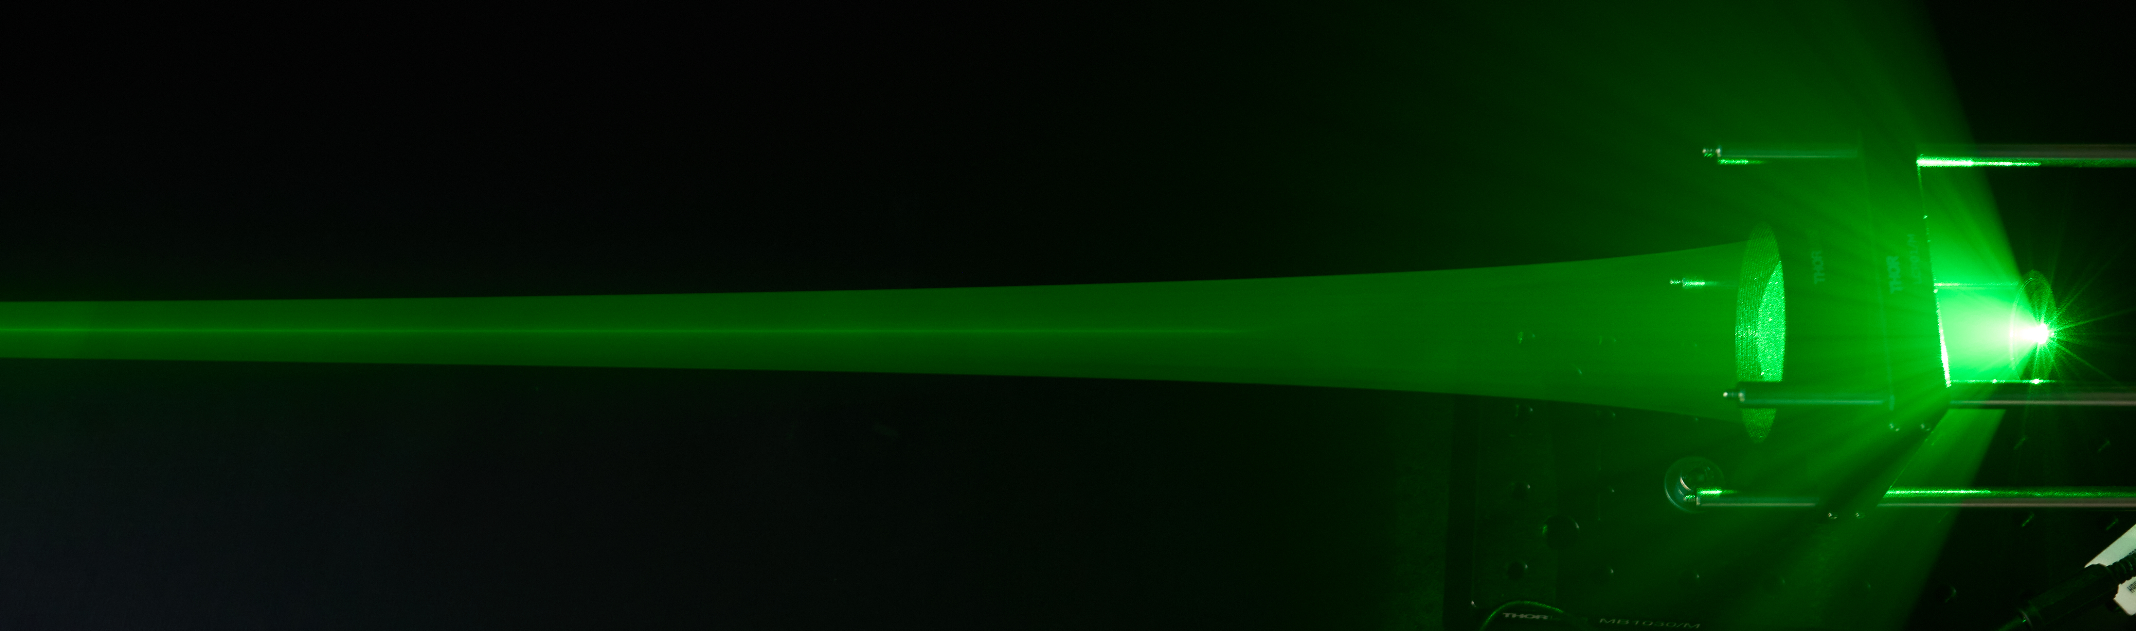
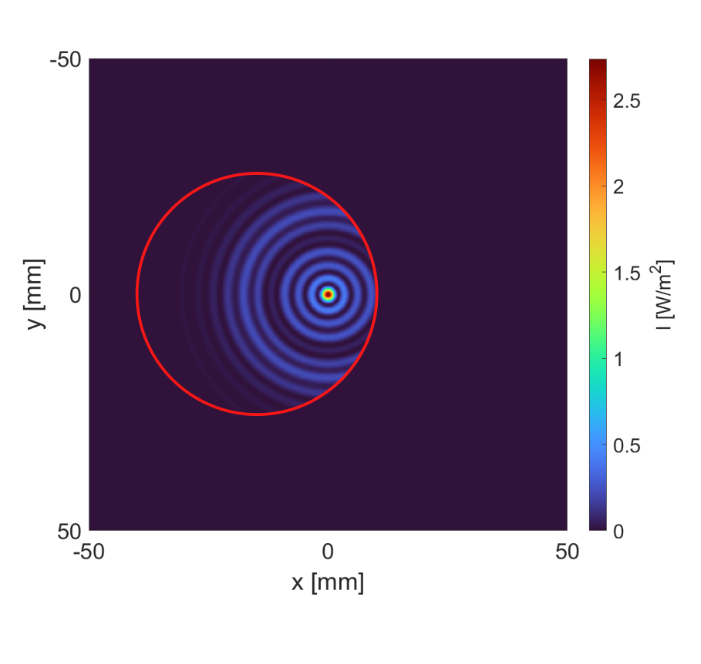
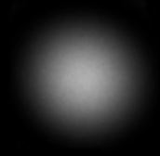

Challenges
Refraction - Vacuum system
Structured Laser Beam - Divergence
Symmetry breaking
Reflection

Slide 9
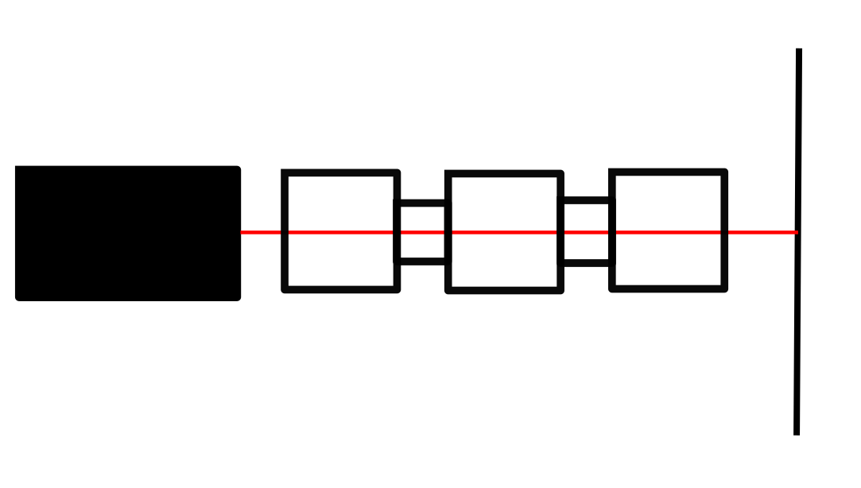
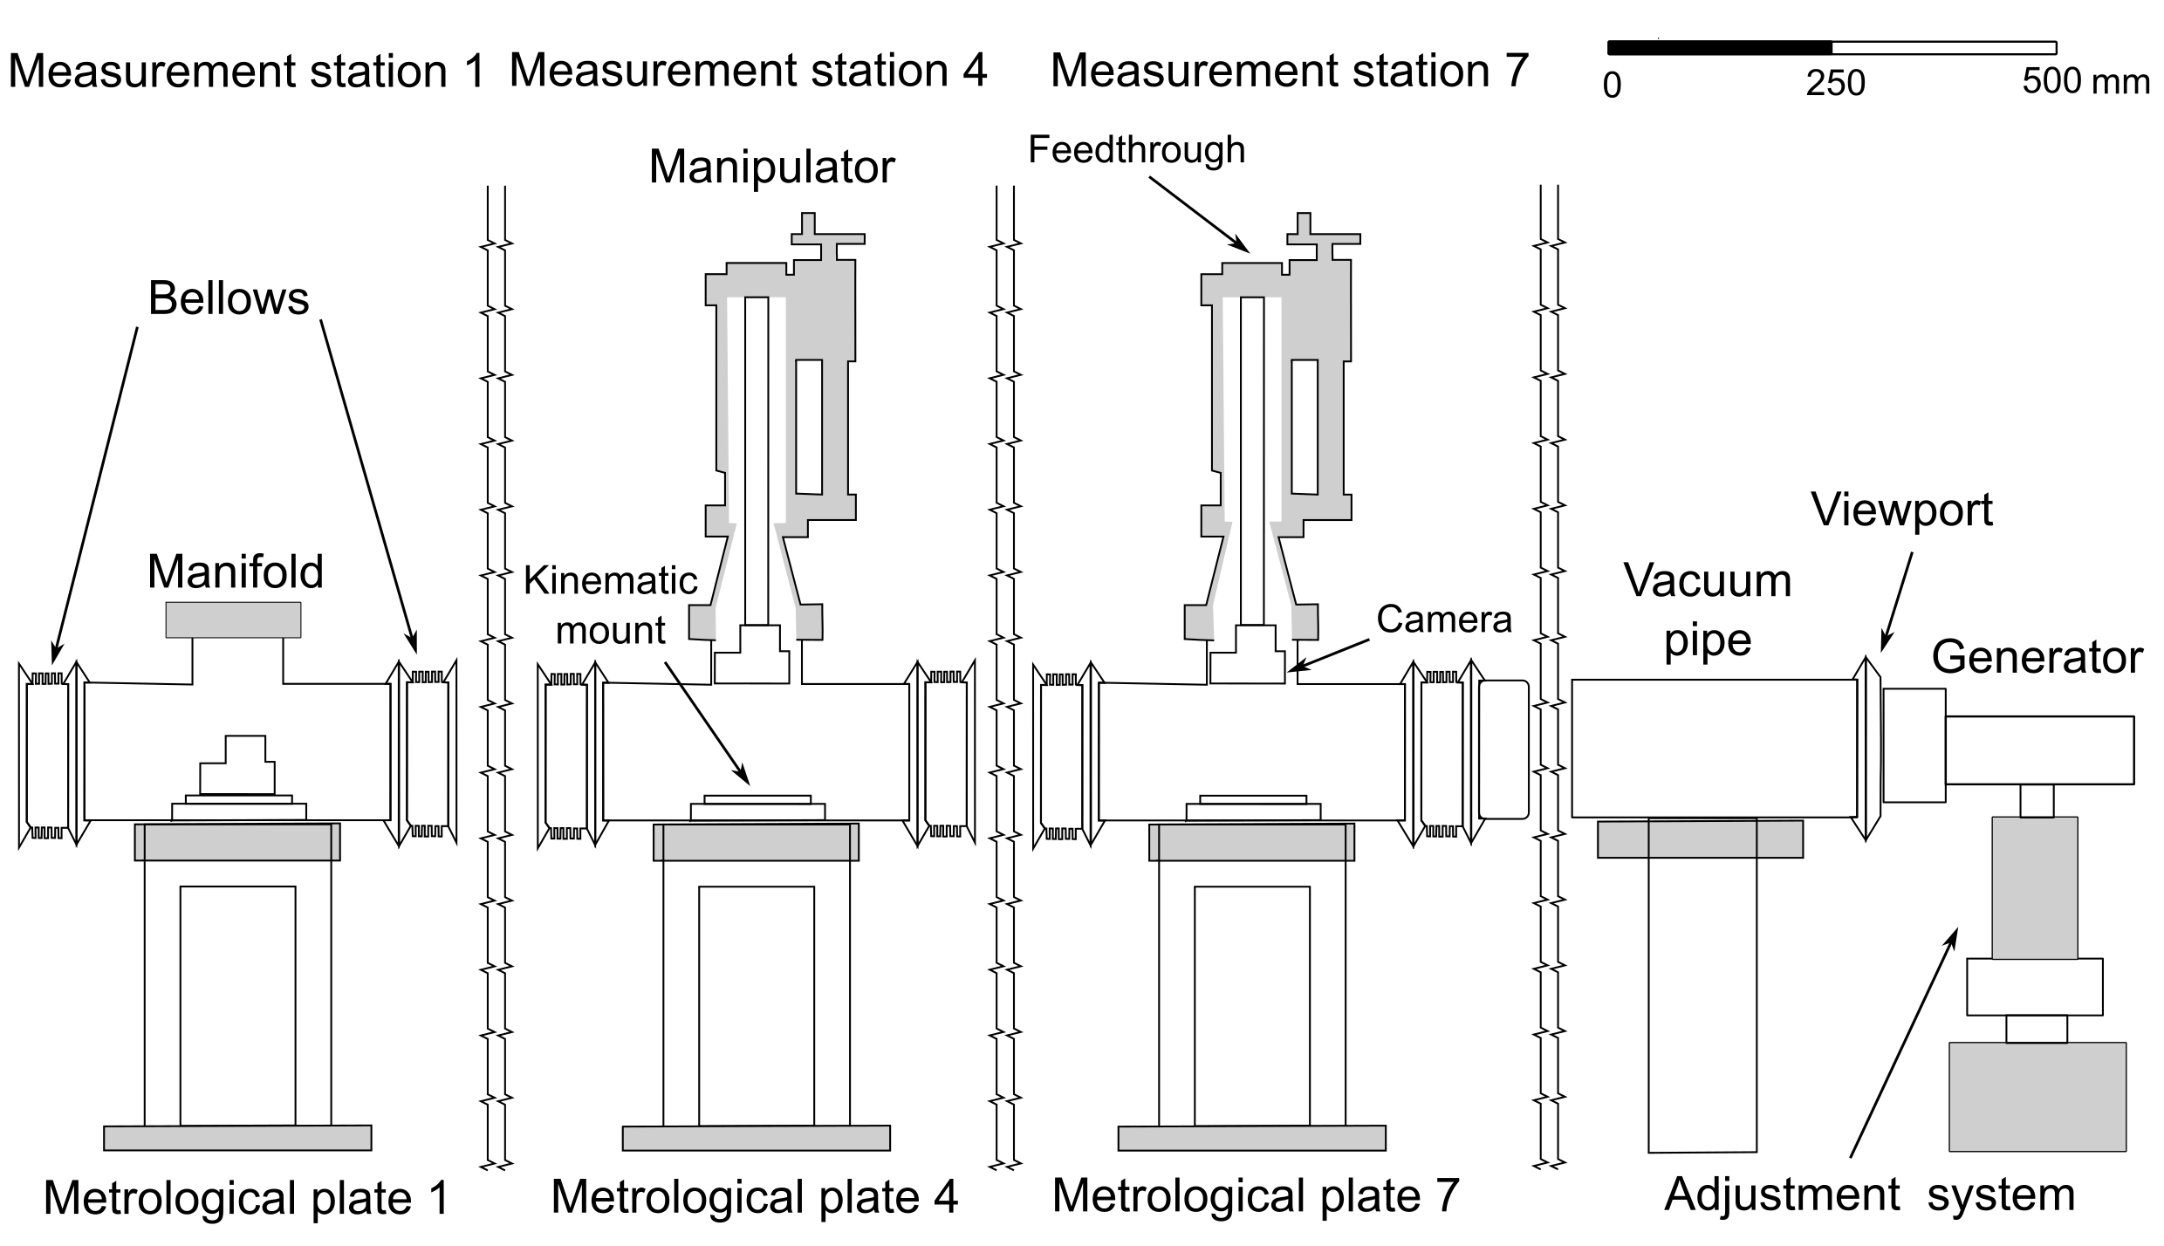
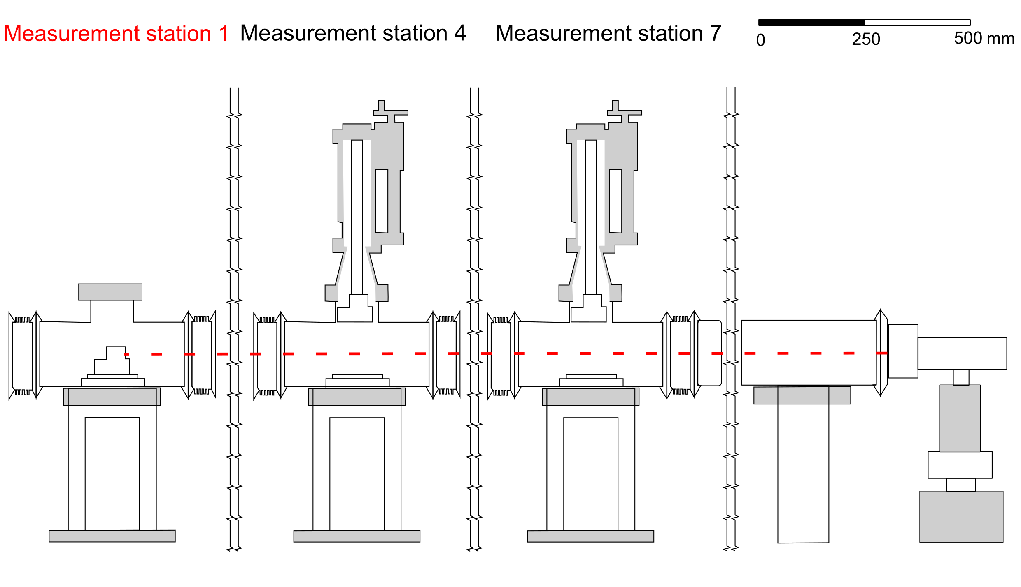
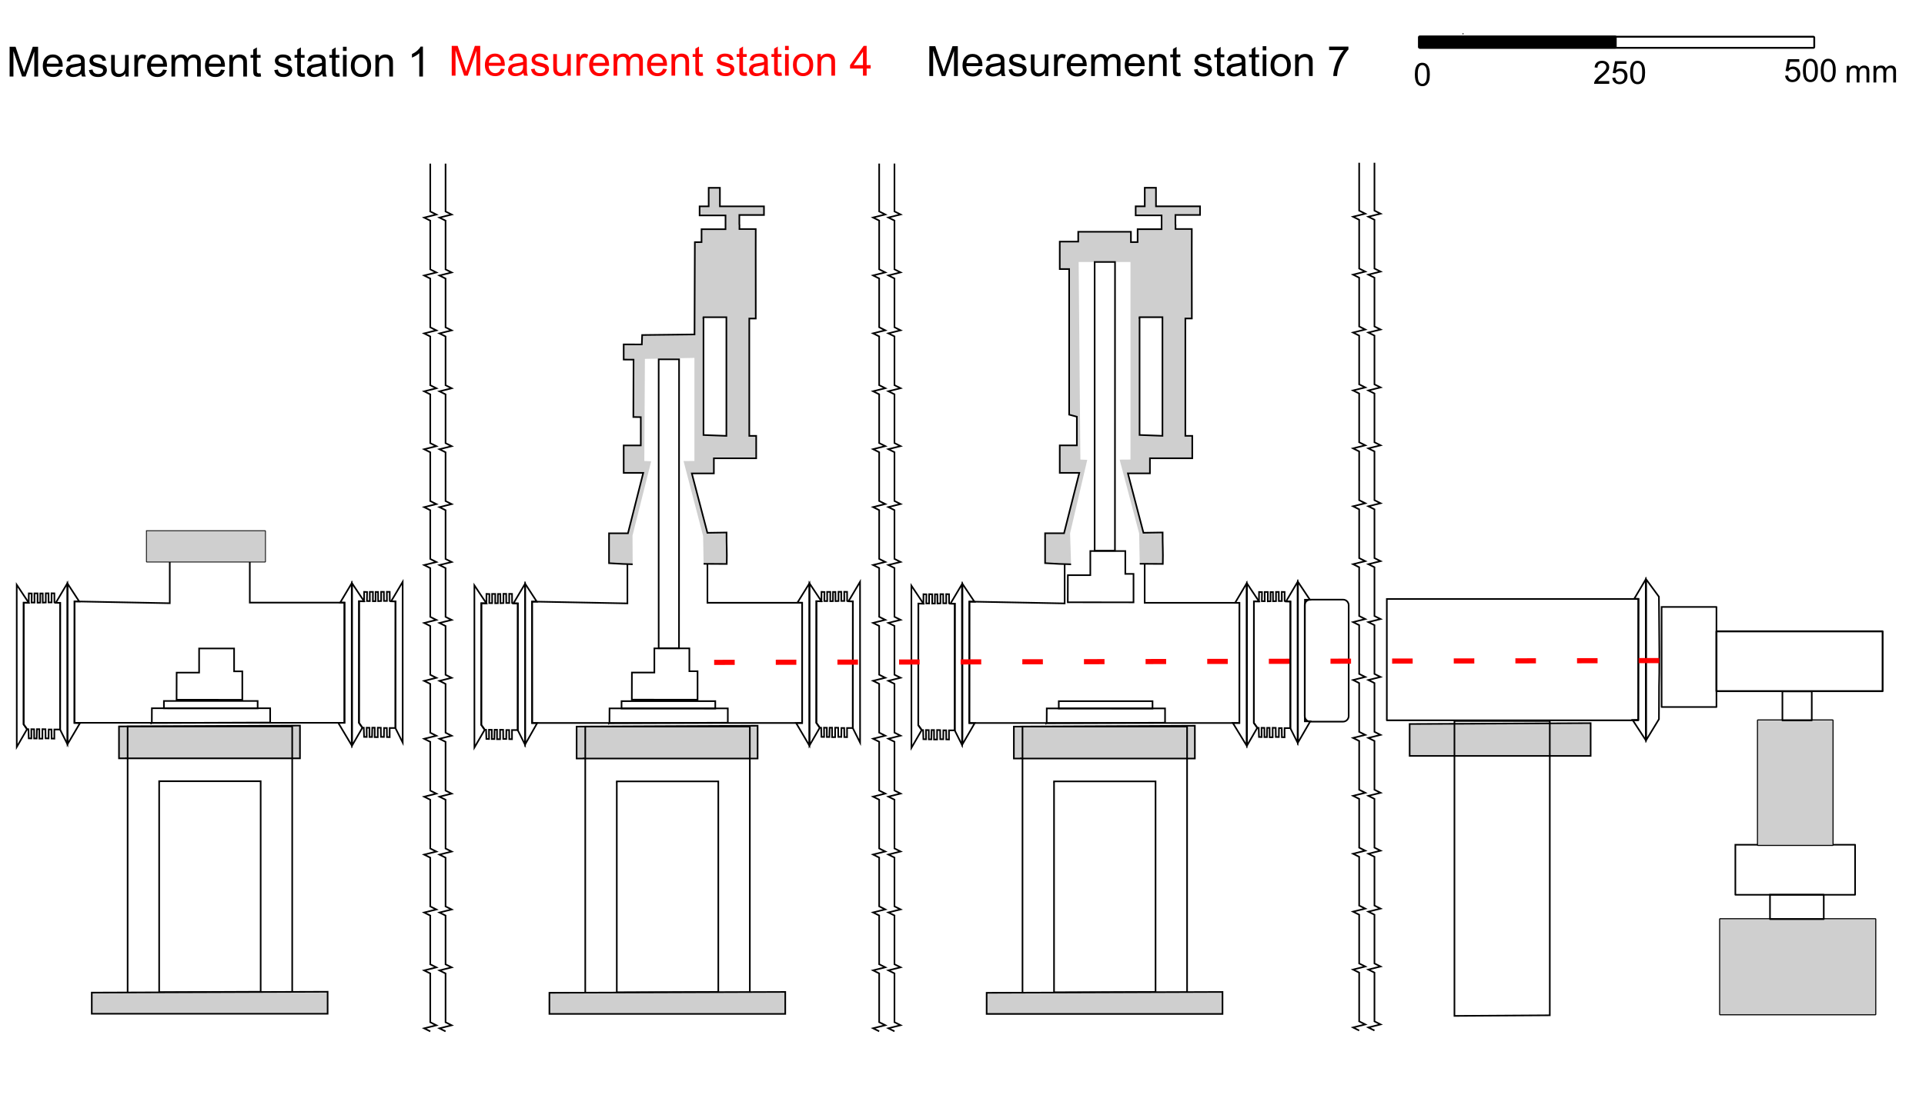
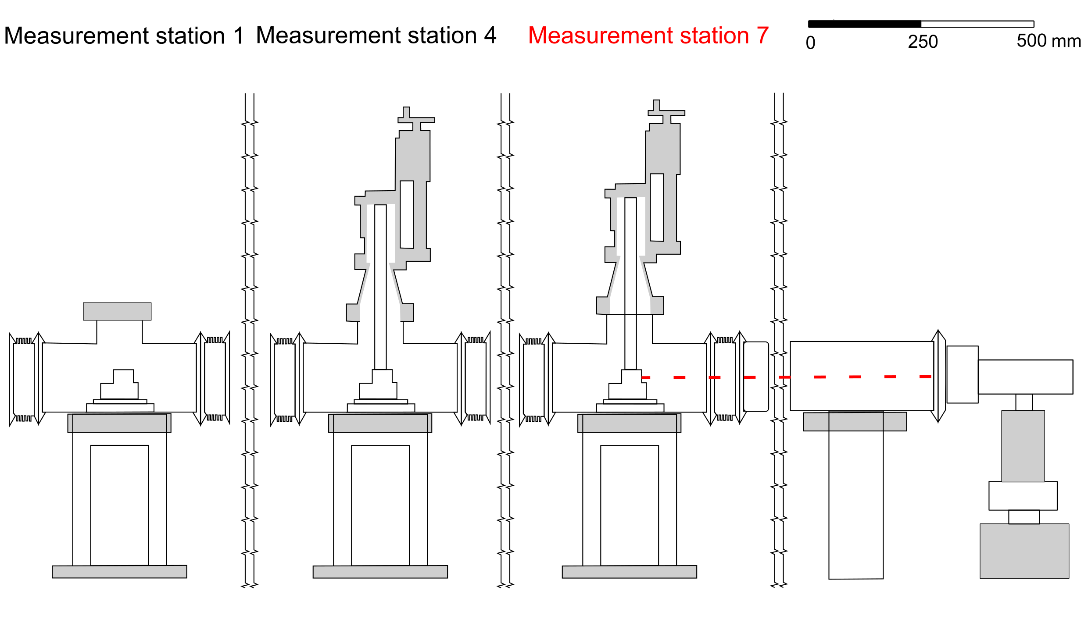
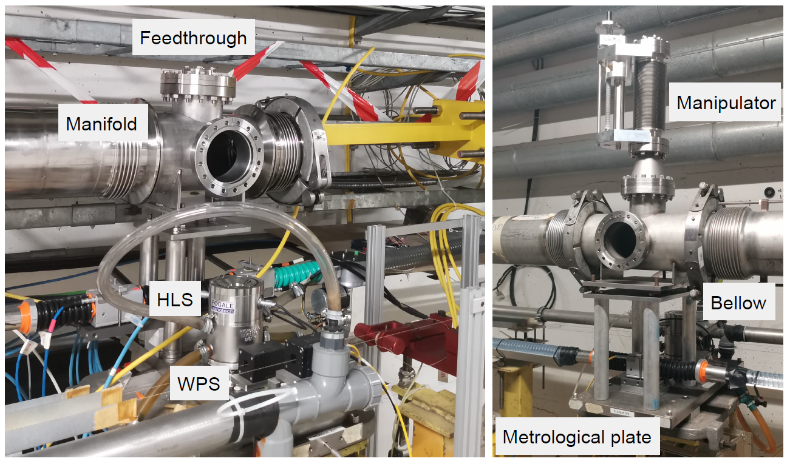
Shutter system - 140 m length
  Prototype setup
Measurement station 1
Measurement station 4

Slide 10
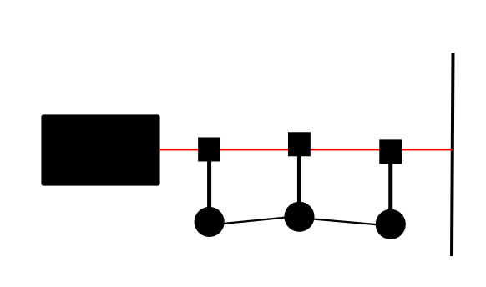
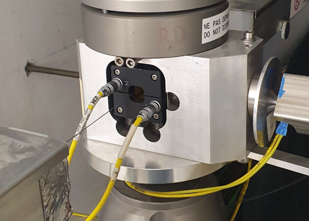
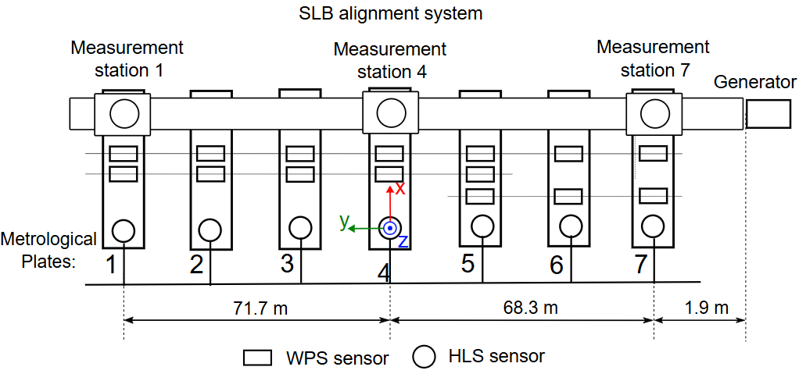
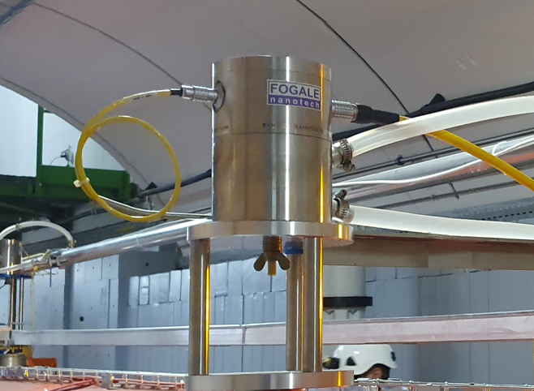
Experimental setup - Prototype evaluation
  Comparative assessment
Wire Positioning System (WPS)
electrode
Experimental setup for comparative assessment of the prototype with the WPS and HLS
wire
Hydrostatic Levelling System (HLS)
electrode
FSI

Slide 11
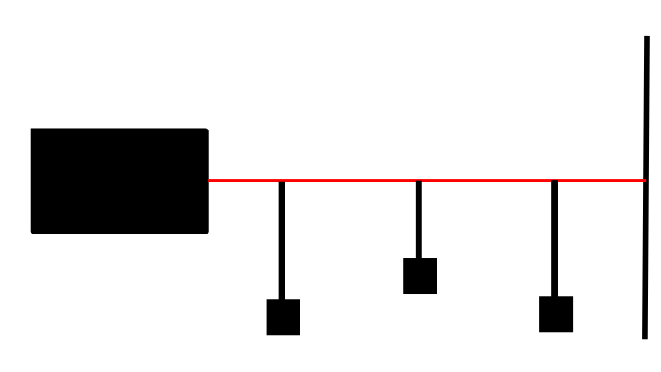
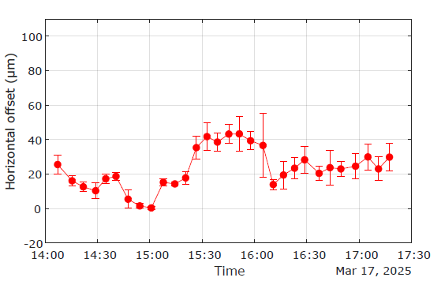
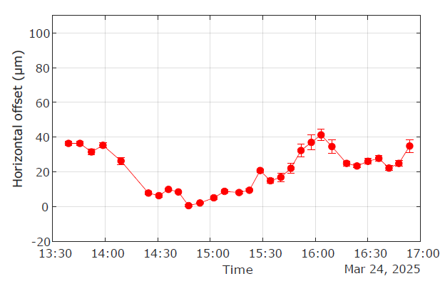
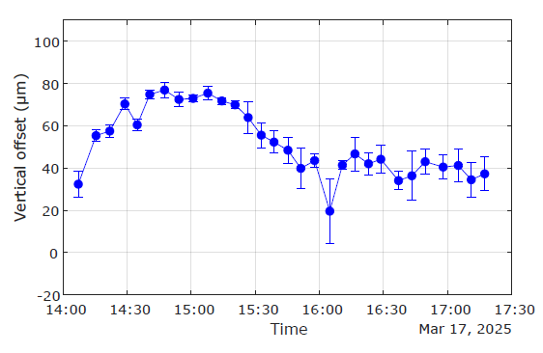
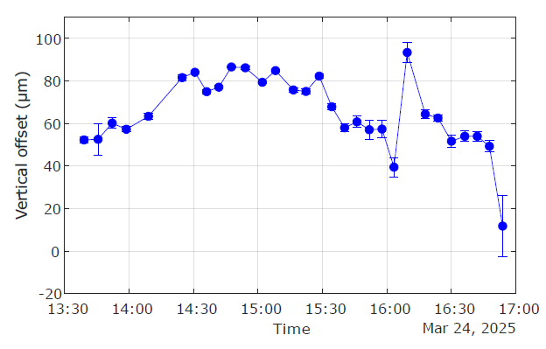
Assessment with WPS and HLS network
  Offset measurement
Offset of Station 4 relative to Stations 1 and 7
Two acquisition series of 3.5 hours each
Error bars based on SLB data variation
Precision
Standard deviation below 20 μm
Improvement: enhanced reference line stability by
extended vacuum system, thermal stabilisation,
multipoint measurement – Layers Beams.
Accuracy
Absolute bias horizontal 20 μm and vertical 50 μm
Improvement: modified the fiducialisation process by
lowering the vacuum system, fiducialisation in the metrology laboratory.

Slide 12
Conclusion
SLB can be used for alignment thanks to low divergence, high IC contrast, and long beam propagation.
Multiple challenges were overcome to construct the prototype using a vacuum system.
The prototype achieved high precision, showing strong potential for future systems.
Addressing challenges with radiation, multipoint alignment, and multiple lines is a priority for future implementations.

Slide 13
References:
W. Niewiem, K. Polak, M. Dusek, D. Mergelkuhl, J-Ch. Gayde, A. Wieser, M. Sulc, “Variation of structured laser beam pattern and optimization for an alignment reference line creation” Optics Express 31 (2023) https://doi.org/10.1364/OE.503016
W. Niewiem, K. Polak, S.Figura, D. Mergelkuhl, J-Ch. Gayde, A. Wieser, “The influence of symmetry breaking on the Inner Core of a Structured Laser Beam”, Express 33 (2025) https://doi.org/10.1364/OE.549391
W. Niewiem, S. Figura, D. Mergelkuhl, J-Ch. Gayde, A. Wieser, M. Sulc, “Speckle induced by reflections in pipe propagation of a Structured Laser Beams” Applied Optics 64 (2025), soon available
W. Niewiem, S. Figura, D. Mergelkuhl, J-Ch. Gayde, A. Wieser,, “Shutter-type multi-point optical alignment using a Structured Laser Beam in vacuum” JINST (2025), soon available

Slide 14
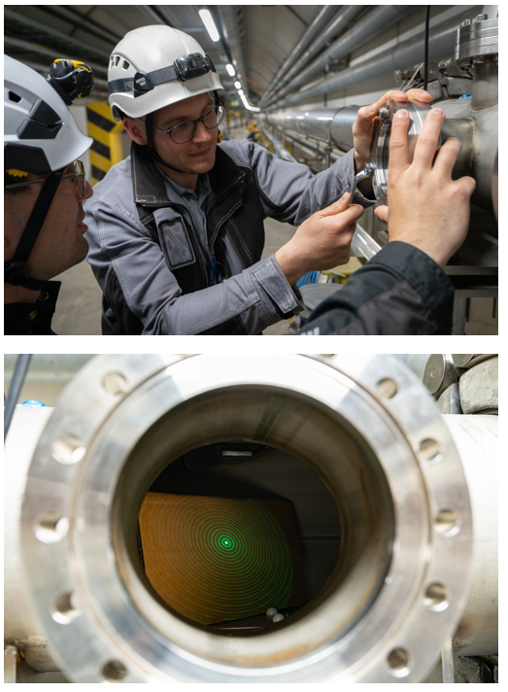
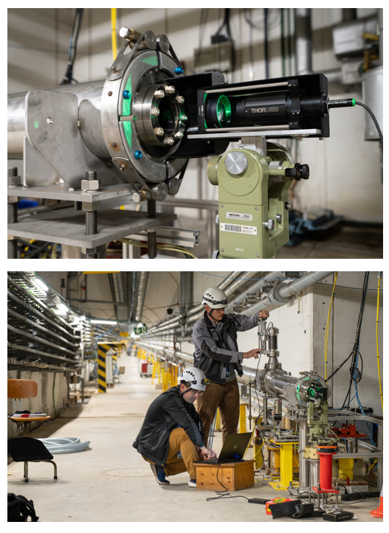



Witold Niewiem

Slide 16
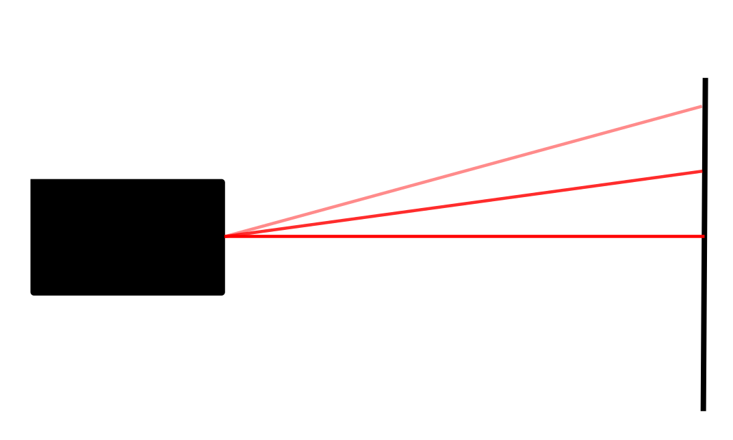
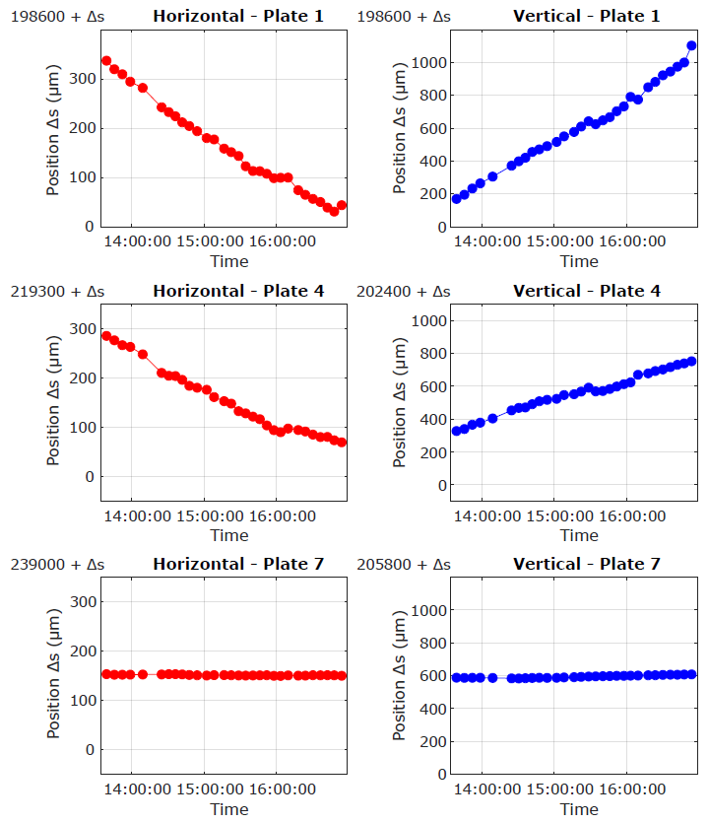
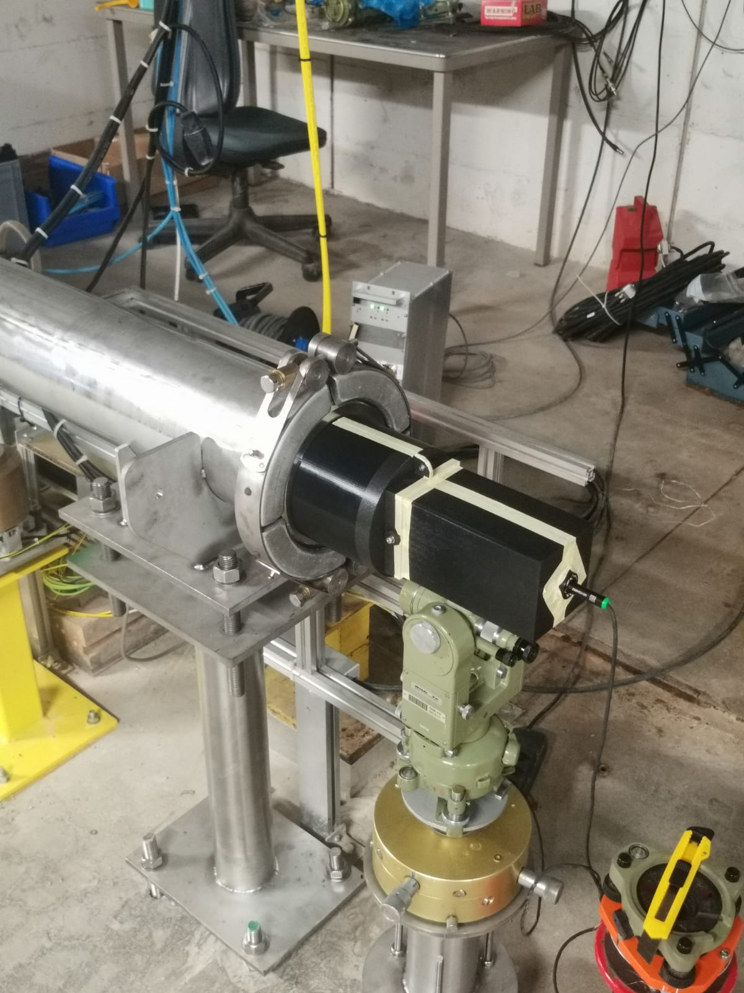
Precision - Stability of reference
  Reference line drift
Distance from the generator
IC position in global CS - drift
Support and SLB generator
141.9 m
70.2 m
1.9 m

Slide 17
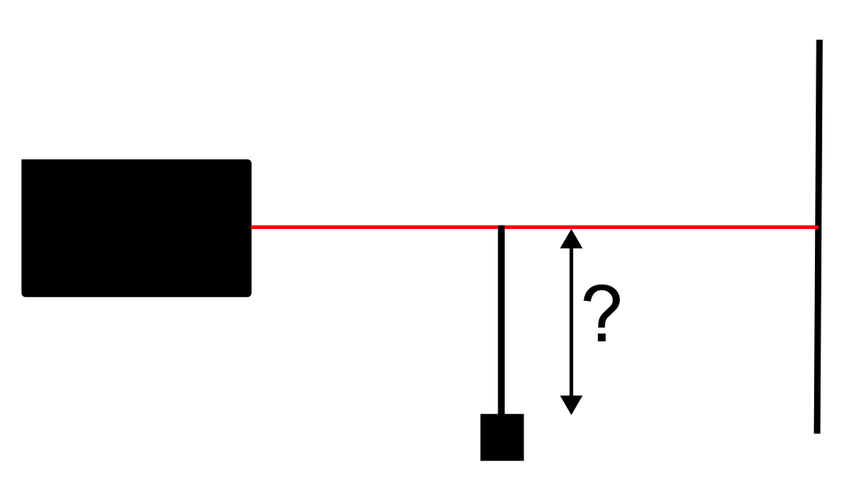
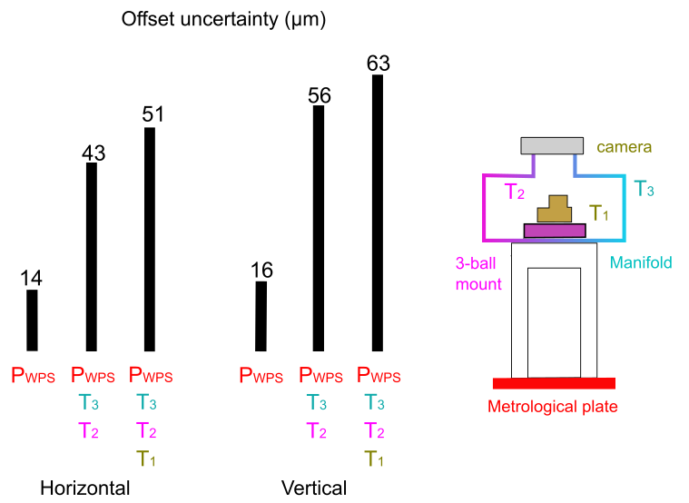

Accuracy - Systematic error
  Fiducialisation bias
Position of the IC in global coordinate system
Uncertainty propagation components
Laser tracker measurement – two steps
Least-squares (WPS, HLS) network with fiducialisation/calibrations
CMM verified by in-house method

Slide 18
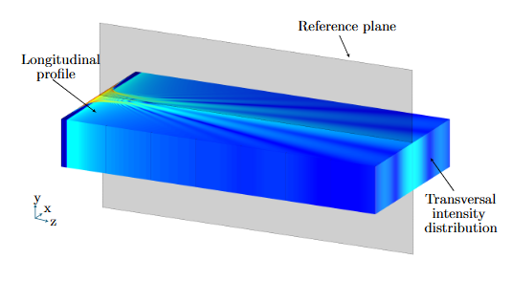
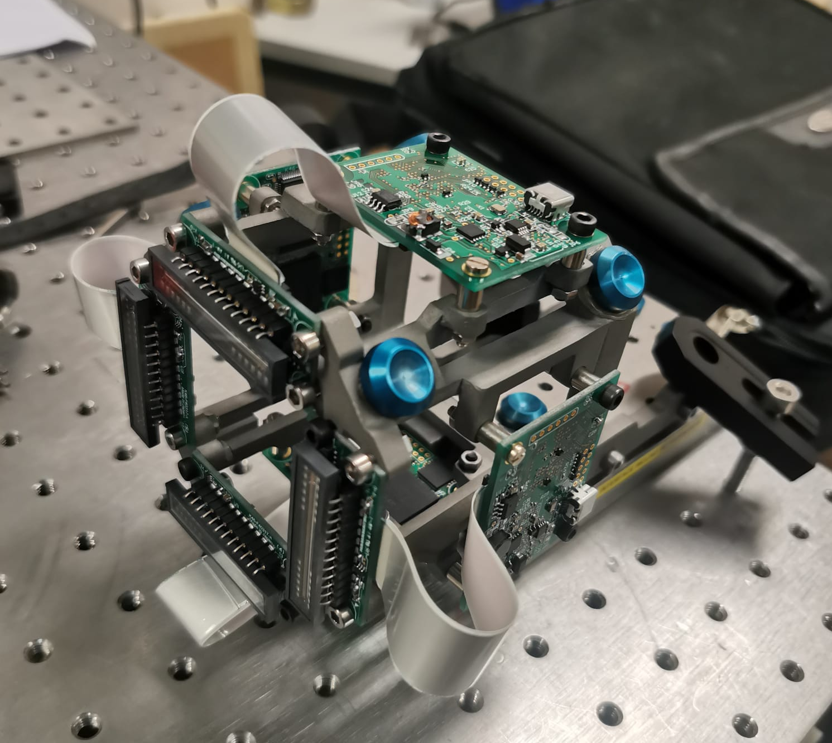
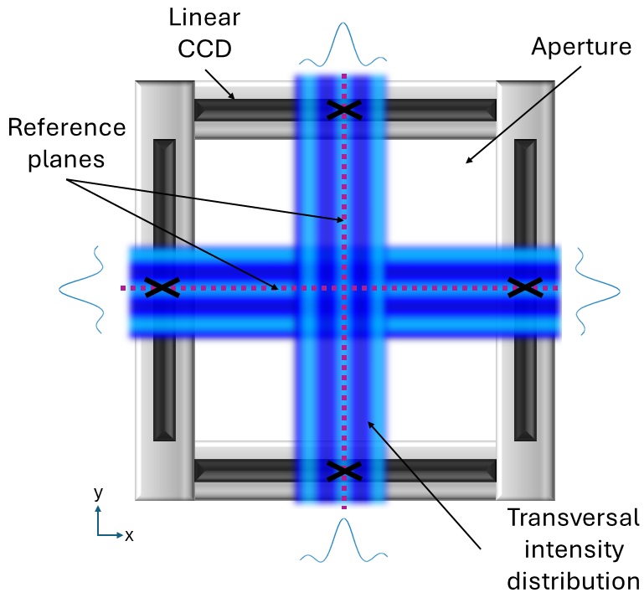
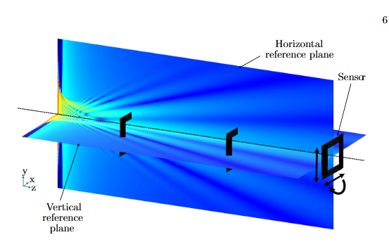
Layer beams – Martin’s Dusek doctorate
    Layer beams – linear chip sensor
      Prototyping of the sensor with 4 linear CCDs with an aperture (allows for multipoint measurements at one instance in time)
      Position of the CCD sensors will be measured in metrology lab to be ready for future absolute misalignment measurements
Reference planes created by a Layer Beams
Sensor prototype
Sensor mockup

Slide 19
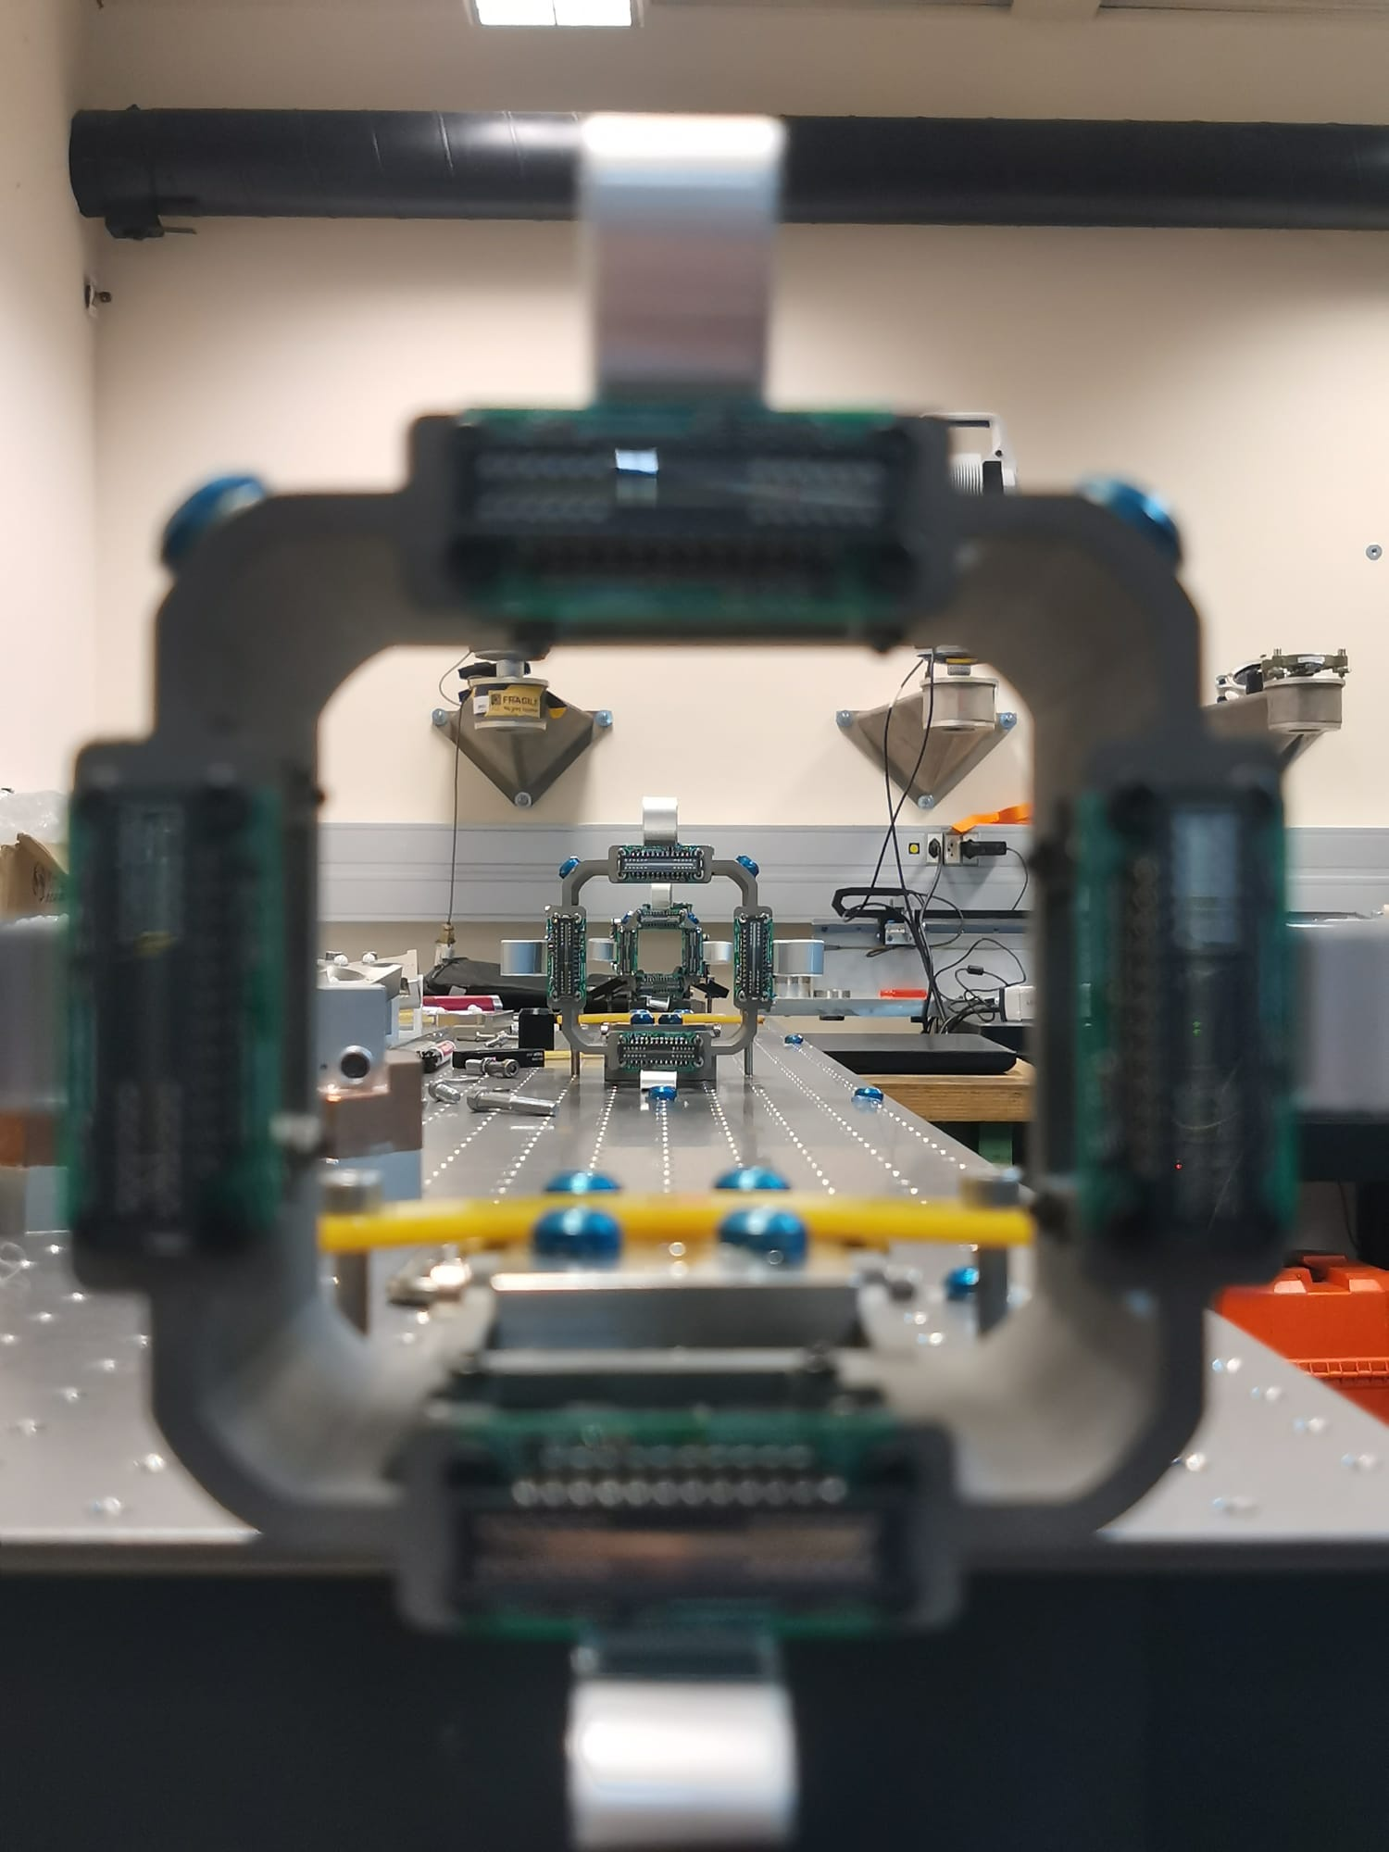
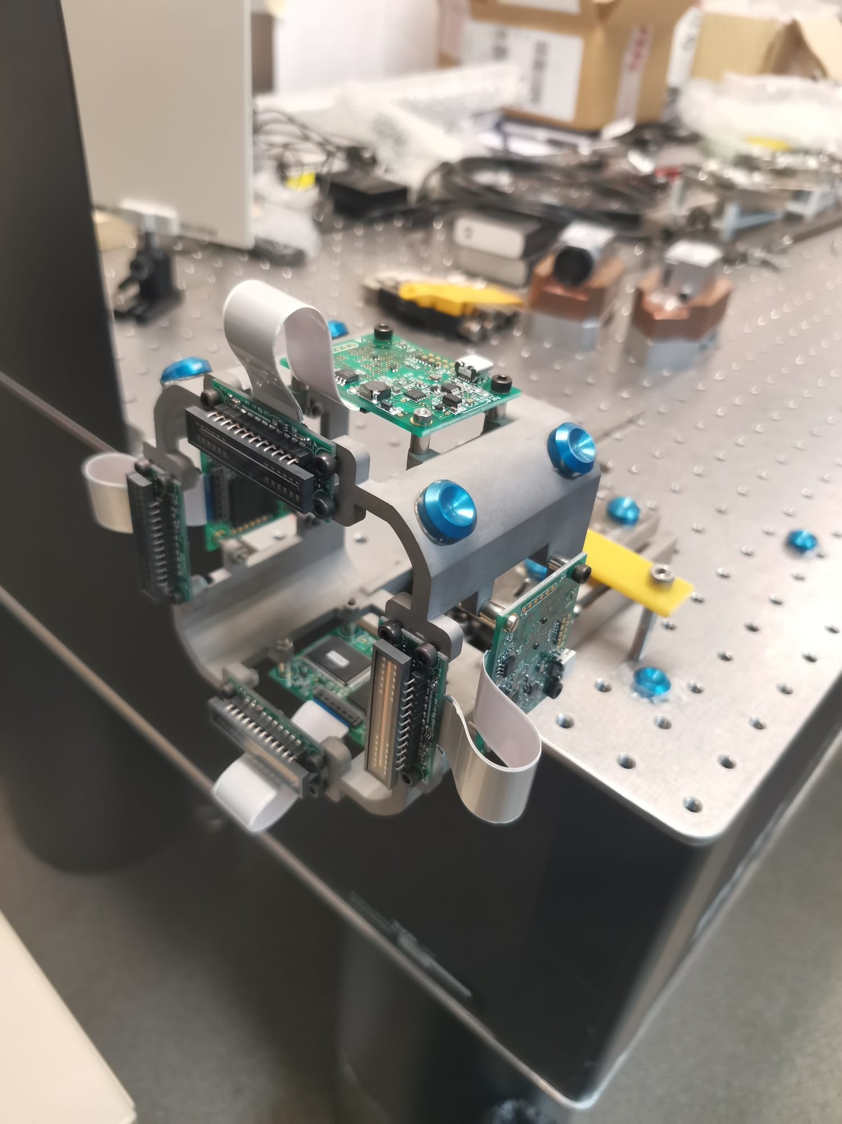
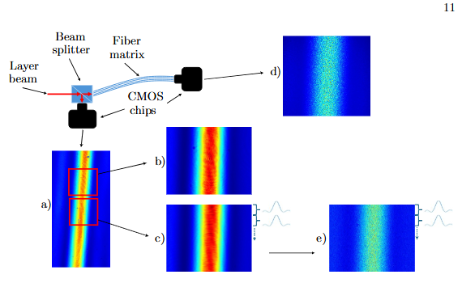
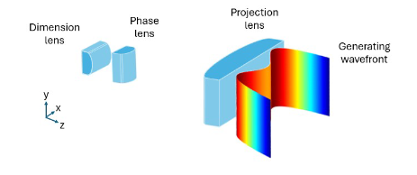
Layer beams – Martin’s Dusek doctorate
Laboratory setup
Sensor mockup

Slide 20
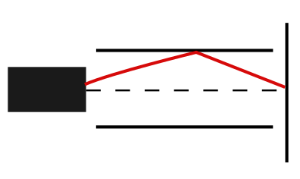
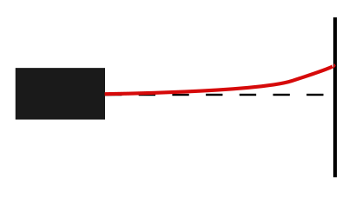
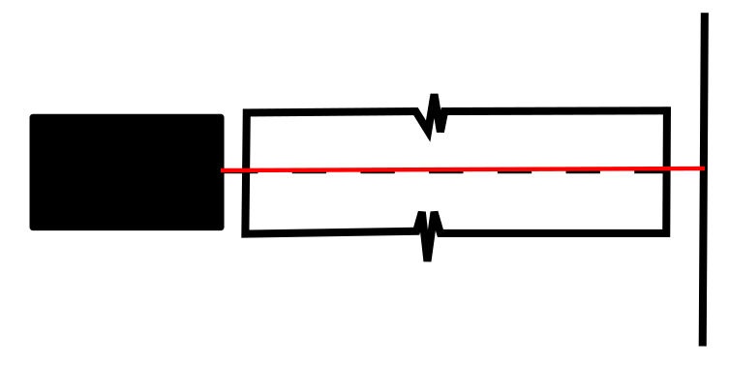
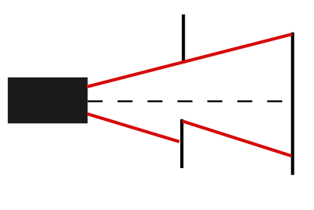
  1. Laser divergence
  5. Reflection speckle
  2. Atmospheric refraction
  Project challenges and solutions
  4. Vacuum forces
  3. Symmetry breaking

Slide 21

Generator, intensity profile and wavefront
  Laser divergence

Slide 22




Wavefront and profile
  Laser divergence
Large zero-phase gradient ring:
Small IC
Large OR
ξ = 0.1
ξ = 0.5
ξ = 0.9

Slide 23

Inner Core and Outer Ring diameters
  Laser divergence

Slide 24
Refraction and Vacuum
  Atmospheric refraction
Component I
Component II
Component III
Generator
Reference line
Component I
Component II
Component III
Reference line
Generator
Vacuum pipe

Slide 25

Symmetry breaking - Vacuum pipe
  Symmetry breaking
Component I
Component II
Component III
Generator
Reference line
Inner Core and Outer ring vs Vacuum Pipe and Sensor size
Vacuum Pipe
SLB
Sensor

Slide 26





Symmetry breaking - Far zone
  Symmetry breaking
Aperture
⌀ 50 mm

Slide 27



Symmetry breaking - Near zone
  Symmetry breaking
Aperture
⌀ 50 mm

Slide 28




Symmetry breaking - IC deformation
  Symmetry breaking
Rectangular obstacle in the near zone

Slide 29


Vacuum forces - System defromation
  Vacuum forces
Constraint on the mechanical link between the vacuum system and measured components
Component I
Component II
Component III
Vacuum forces
Vacuum pipe
Bellows
Parameters for the vacuum system:
156 mm diameter
140 m length
23 segments
1 fix point

Slide 30


Source of reflection - Speckle
  Reflection speckle
Propagation in free air 140 m
Propagation in vacuum pipe 140m

Slide 31



Reflection reduction - Methods
  Reflection speckle
Pipe
Laser
Color
Structure
Temporal coherence
Spatial coherence
Black
Rough
Baffles
Wavefront (t)
Wavefront (t)
Black undulated
He Ne laser
Laser Diode

Slide 32



Reflection reduction - Results
  Reflection speckle
Inner Core
Reflective vacuum pipe
Free space
Black pipe
140 m propagation
Correlation index*
2 m propagation
Pipe radial position [mm]
Correlation index* - Structure Similarity Index Measure (SSIM) between photos in free space and in the pipes (test at 2 m)

Slide 33

IC position in global CS - drift
  Prototype evaluation
Mar 17th
Mar 24th

Slide 34

Near and far optical zones
Add the wavefront

Slide 35
Laser alignment systems - elsewhere
Institute* | Date | Divergence mitigation | Light sensor | Refraction mitigation ** | Expected accuracy | Current state
SLAC | 1960 – now partialy | Fresnel plates Poisson pattern | Manual readout | Vacuum 1.333 Pa | 250 microns 3,2 km | 2/3 of length disassembled | Test with classical methods Accuracy 5mm-3.2km 0.23mm-1.5
KEK | 1990 - 2010 | Fresnel plates Airy pattern | Quadrant Photodiode | Vacuum 1 Pa | 100 microns 500 m | Non-operational | Lack of testing method relative 0.1 on 268 m
DESY | 2000 - now | Poisson pattern | CCD camera | Vacuum 10 Pa | 200 microns 600 m | Operational | Relative 25 and 50 microns just by moving. Accuracy 0.18mm – 500 m there are 3 systems with differn lenght
* The works on the laser alignment systems were also conducted at: SPring, CERN, CSNS, Dubna, Argonne and Nikhef
** Standard atmosphere (atm) is defined as 101 325 Pa

Slide 36


Shutter system principle
Feedthrough
Manipulator
Adapter flanges
Extension
Camera
Groove
Kinematic mount
Manipulator
Manipulator
Metrological plate
SLB generator
Setup side view

Slide 37


Heat dissipation - simulation

Slide 38



Camera calibration
Differences in-house method and CMM
Corner point name | X difference (μm) | Y difference (μm) | Z difference (μm)
TL | 6 | 11 | -4
TR | 14 | 10 | -2
BL | 8 | 5 | -4
BR | 15 | 5 | -2

Slide 39


Free air propagation

Slide 40





Optical beams GB and Bessel Beam
Forms of light waves propagating with small divergence
Gaussian beam
small focus
significantly diverges
Bessel beam
long longitudinal focus
limited range
zero divergence

Slide 41


Field contribution – SLB applications
Laser pointer in a total station and LiDAR
Military and civil targeting and follow-up
Precise rotary level for civil engineering
Wireless communication
Precision cutting and engraving

