Slide 1
Collider Magnet Designs for FCC-ee
J. Bauche, C. Järmyr Eriksson, on behalf of the CERN Magnet Team
FCC Week 2025, 21st May 2025.
With acknowledgement to many members of the FCC collaboration for their contributions.

Slide 2
Outline
Arc magnets for GHC optics - FSR baseline
Dipole
Quadrupole
Sextupole
Arc magnets for LCC optics - conceptual design
Comparison GHC / LCC magnet parameters
Concepts of twin quadrupoles
Single aperture quadrupoles
Magnet development during pre-TDR phase
Summary

Slide 3
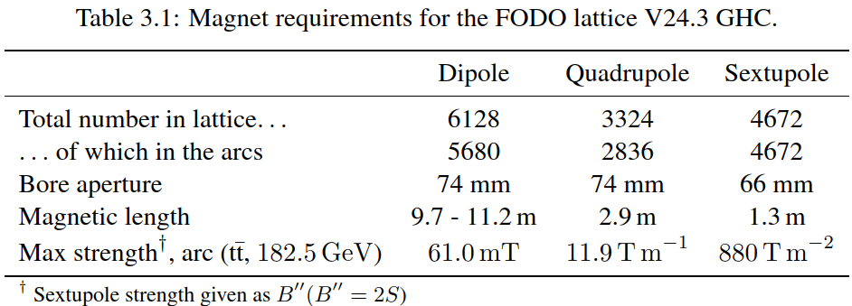
Magnet functional specifications from optics
  Baseline specifications – GHC optics¹
  Long low field dipoles (split in 2 units) with 3 length variants depending on sextupole presence
  Short SSS (larger field) to maximize dipole filling (SR losses)
  → More than 13000 magnets
  Alternative specifications
  LCC optics²
  Combined function (resistive) magnets
  Under study by beam dynamics team
  *
  * 2 dipole units per arc half-cell / quantity varies between Z/W and H/tt phases
Arc magnet specifications - GHC V24.3 baseline, FCC FSR, pp.115.
  1: see presentation K. Oide on Tuesday 08:30
  2: see presentations K. André and G. Roy on Tuesday 10:30

Slide 4
Collider dipole
(Baseline optics GHC 24.3)

Slide 5
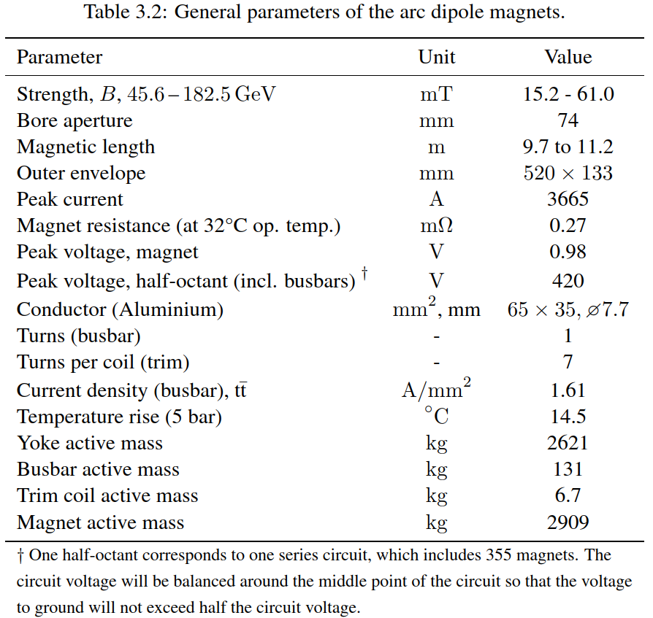
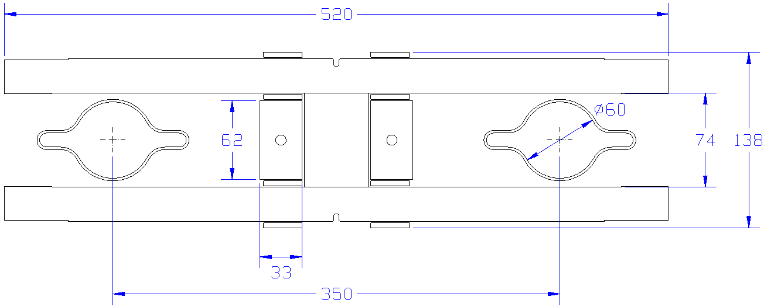
Dipole mechanical design and parameters
  Yoke assembled from solid iron machined plates and central bar, bolted
  Water cooled busbars, aluminium with embedded copper cooling tube
  Trim coils wound with solid copper conductor or anodized aluminum strips (under study)
  Inorganic insulation (air + ceramic spacers)
Yoke plates
Yoke central bar
Busbar (aluminium)
Trim coils
Dipole magnetic model, FCC FSR, pp.117.
Dipole parameters, FCC FSR, pp.116.

Slide 6
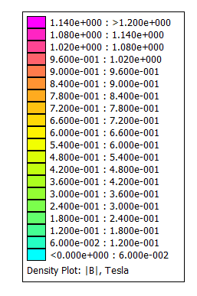
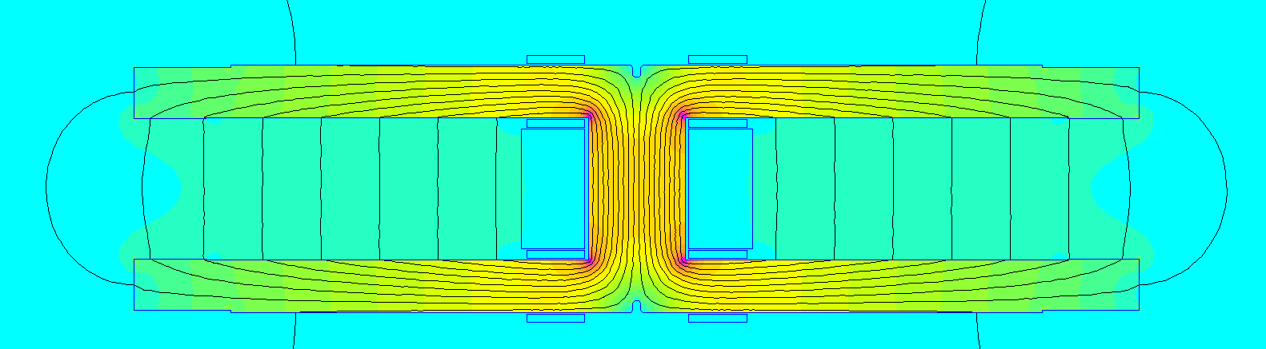
Dipole magnetic design
Magnetic model cross-section (tt_{bar} excitation, B = 61 mT)
  Trim coils for field tapering + tuning (J ≈ 1 A/mm²)
  Design field quality below 1 unit (mostly b2 due to C-shape aperture)

Slide 7
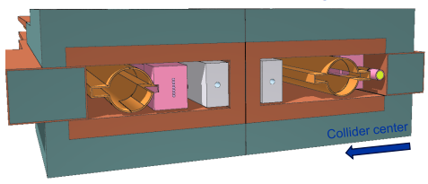
SR absorbers and shielding
  SR absorbers and shielding design studies in progress*
  Dipole yoke design will follow the design evolutions of the shielding to minimize deformations from its lumped masses:
    Reinforcing the yoke (could also improve shielding effect)
    Defining a suitable positioning scheme of the dipole supports
  Design of the dipole assemblies under study within specific WG
SR absorbers and shielding
Courtesy: B. Humann, A. Lechner
  * see presentations of B. Humann on Thursday 9:35
  and M. Morrone on Wednesday 10:30

Slide 8
Collider quadrupole
(Baseline optics GHC 24.3)

Slide 9
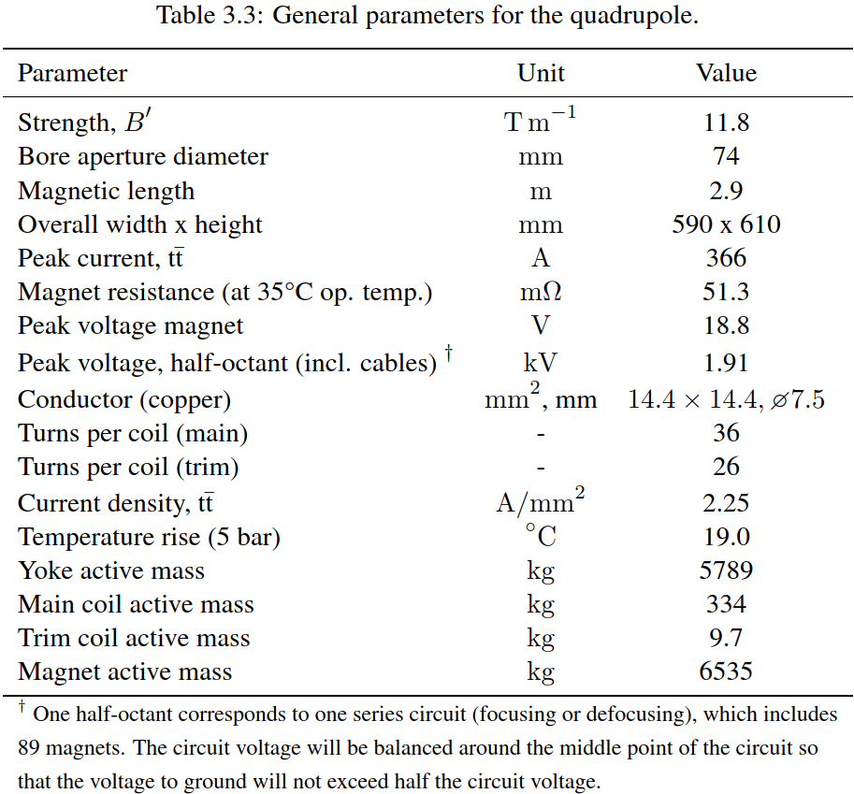
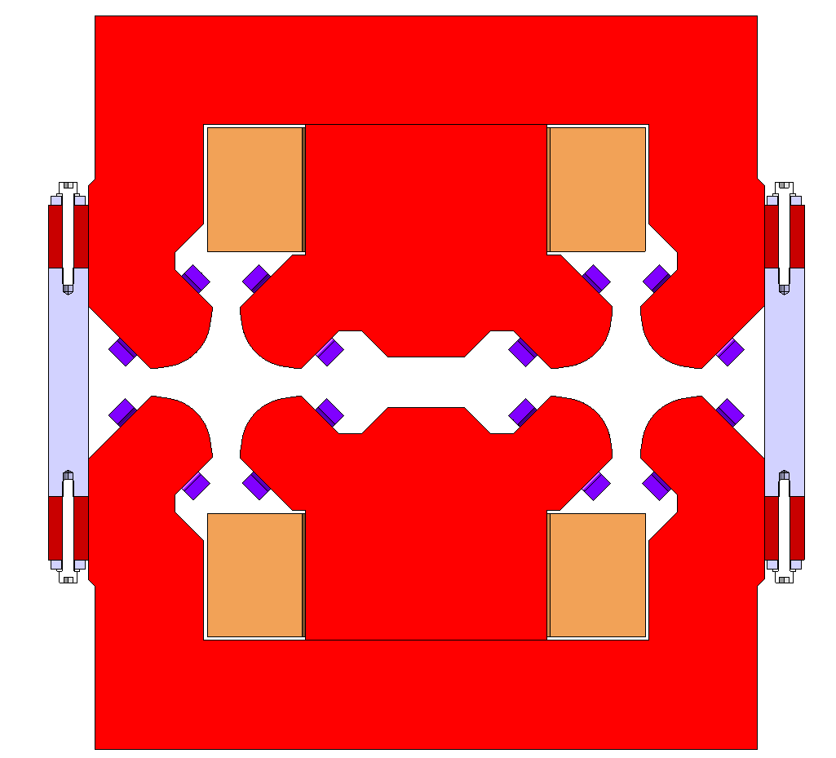
Quadrupole mechanical design and parameters
  Laminated yoke construction
  Assembly of yoke parts with bolts / pins / keys and non-magnetic spacers
  Hollow copper conductor for main coils
  Solid copper conductor or aluminum anodized strips for trim coils
Trim coil
External half-yoke
350 mm
Internal half-yoke
610 mm
Non-magnetic spacer
Quadrupole parameters, FCC FSR, pp.118.
Main coil
590 mm

Slide 10
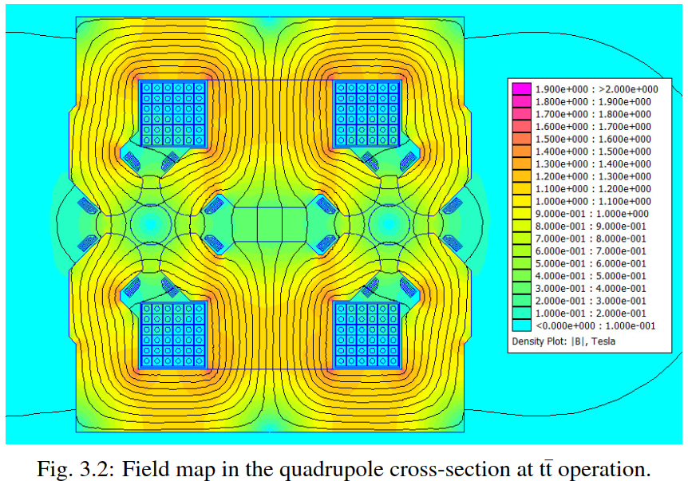
Quadrupole magnetic design – 2D
  Trim coils for field tapering + tuning (J ≈ 1 A/mm²)
  Magnetic axis shift due to aperture coupling
  Reminder: V orbit correction with trims is not an option (impact on DA)
  *
Quadrupole magnetic model, FCC FSR, pp.118.
  * 10 units of b₁ = 10 µm axis shift

Slide 11
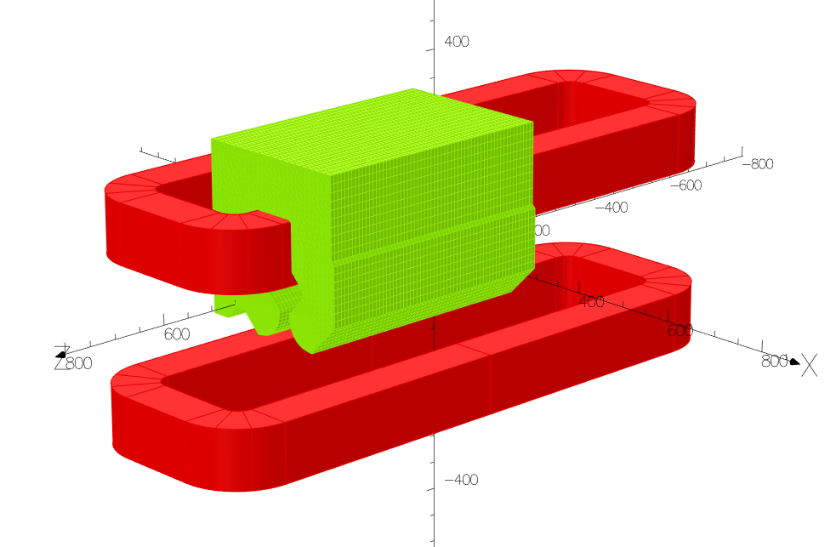
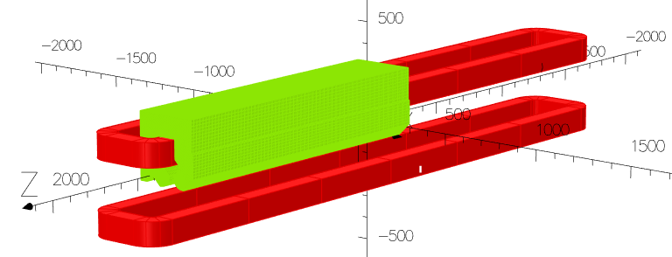
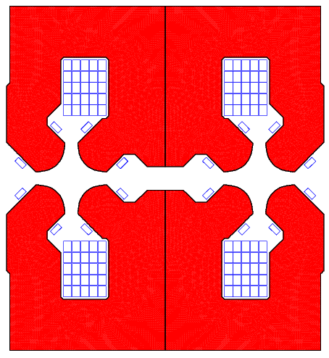
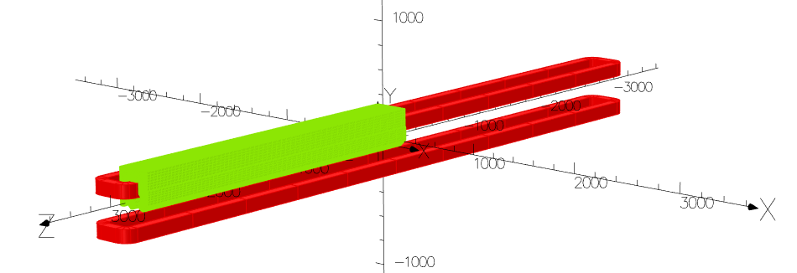
Quadrupole magnetic design – 3D
  Mismatch between harmonics in centre of 3D model and harmonics in 2D model (equivalent to infinitely long)
    Dependency of B1 to iron length inside the magnet, but not in stray field region
    Can be mitigated at one powering level, but not suppressed
900 mm long yoke
B1 along the iron can be modified by changing the gap in the central magnetic by-pass
2.9 m long yoke
6 m long yoke

Slide 12
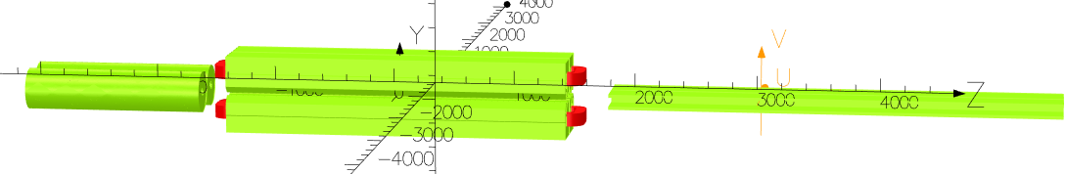
Quadrupole magnetic design – 3D
  Sensitivity to adjacent magnets
    Extended stray field absorbed by neighbouring yokes
    The compensation between B1 inside and outside the yoke is variable with the environment

Slide 13
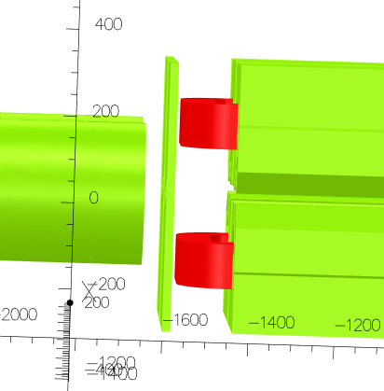
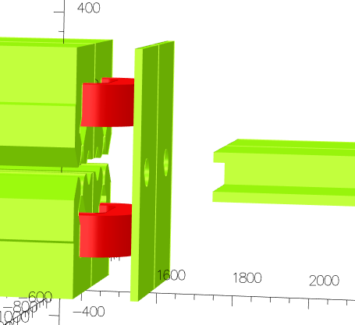
Quadrupole magnetic design – 3D
  Option to mitigate sensitivity to environment: installation of mirror plates at magnet extremities
  Scale 1:1 prototype magnet under preparation to validate design and axis shift mitigation options

Slide 14
Collider sextupole
(Baseline optics GHC 24.3)

Slide 15
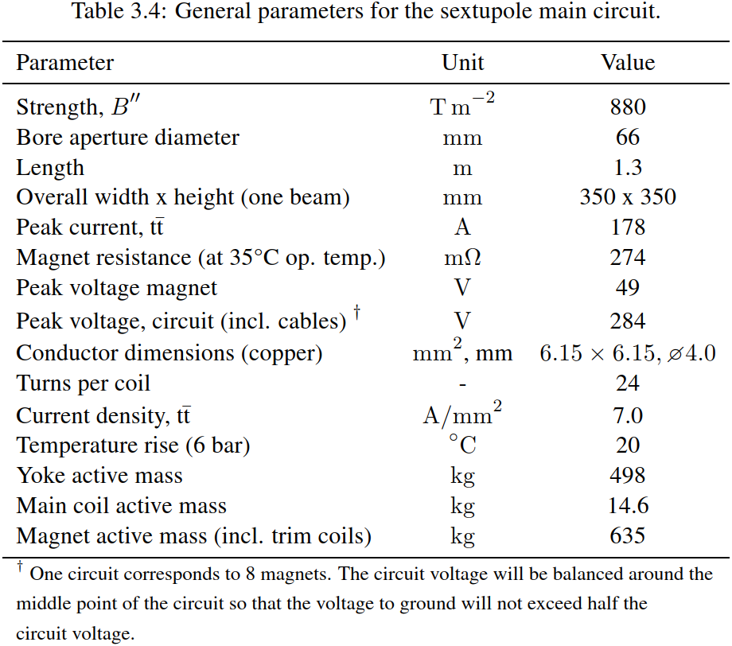
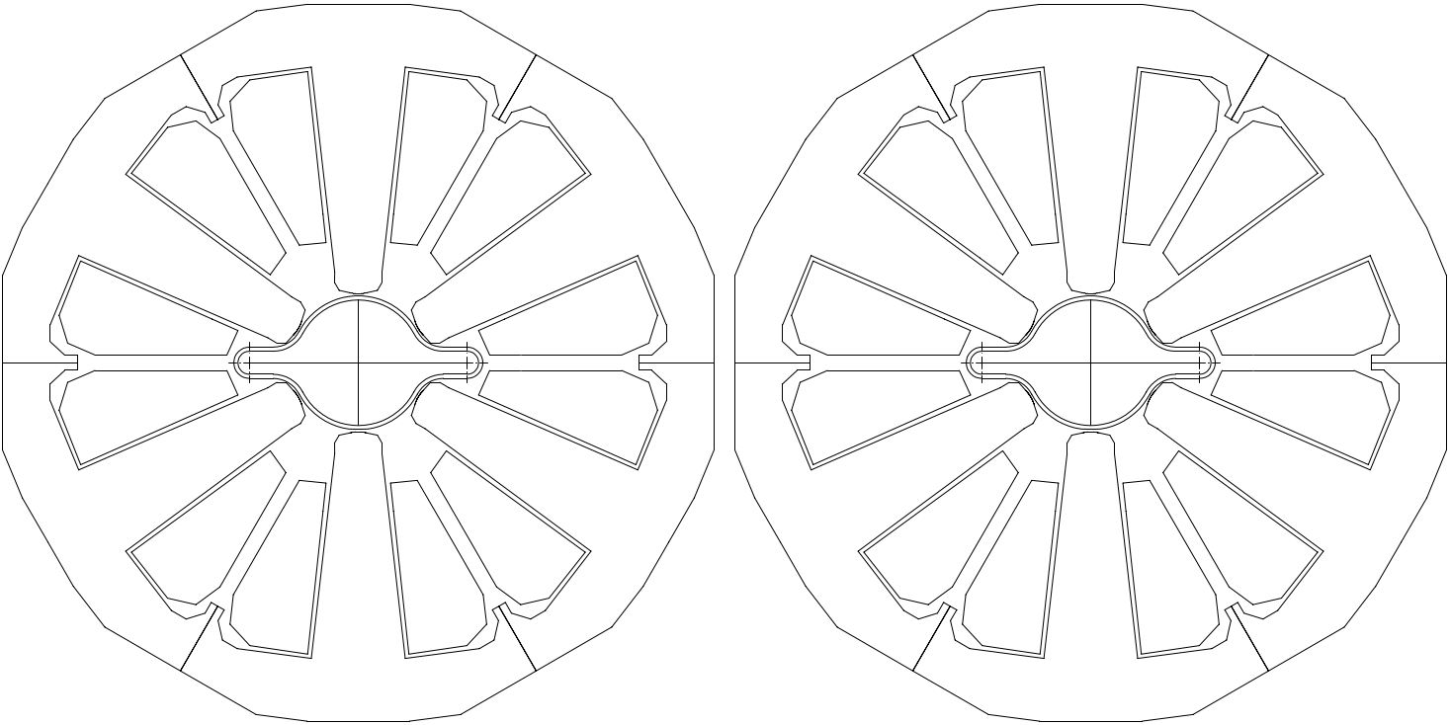
Sextupole mechanical design
  * Collaboration with CMU, Thailand
  Single aperture magnet, laminated yoke construction
  Hollow copper conductor for main coils; solid copper conductor or aluminium anodized strips for trim coils
  Yoke assembly under study (two single on a craddle or twin configuration) → prototype to be manufactured in 2026 *
Yoke sextant
Sextupole parameters, FCC FSR, pp.119.
Yoke winglets for
bolted assembly
Assembled yoke
sextants
Coil (main + trims)

Slide 16
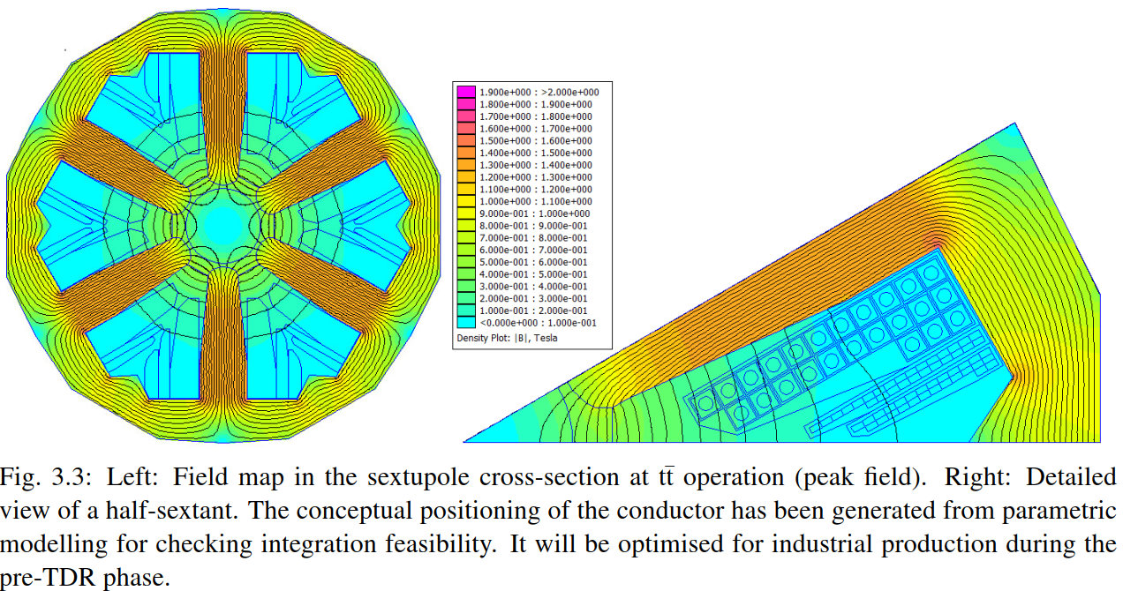
Sextupole magnetic design
  Magnet designed to opertate below iron saturation (necessary to operate linearly with trims)
  All allowed multipoles below 1 unit in 2D
Sextupole magnetic model, FCC FSR, pp.120.

Slide 17
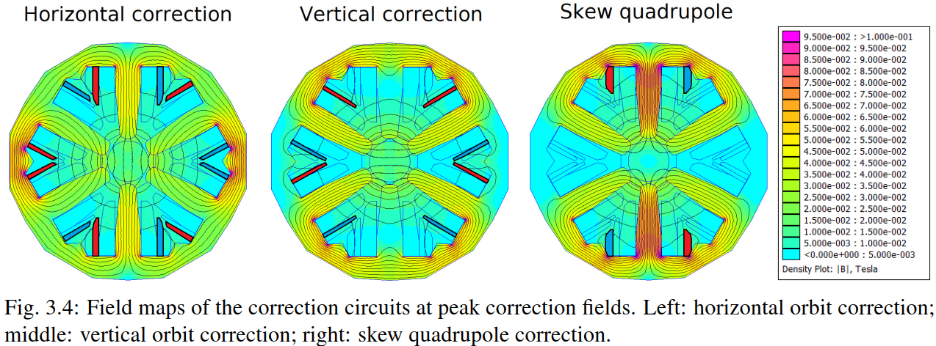
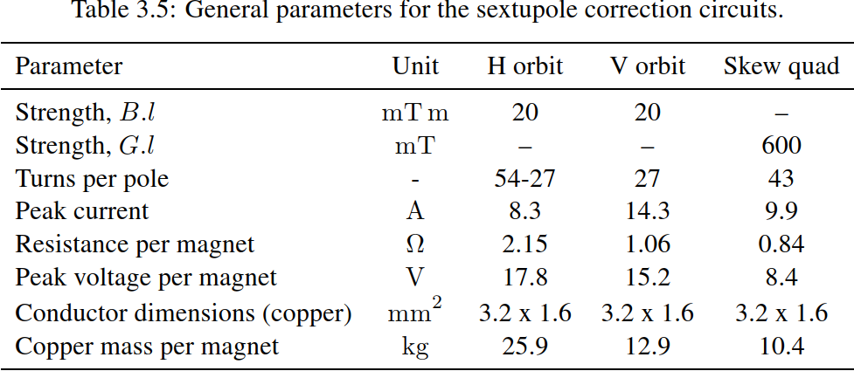
Correctors
  Baseline design with correction circuit as trim coils embedded in the sextupole
  They generate quite large multipoles*:
    ~40 units of b₅ for H orbit and of a₅ for V orbit corrections
    ~70 units of a₄ for skew quadrupole correction
  Beam dynamics are reevaluating the needs (e.g. 1 plane corrector per arc half-cell may be suffucient) and acceptable field errors
  * see presentation at FCCIS WS 2023
Sextupole correctors, FCC FSR, pp.120.

Slide 18
Comparison GHC / LCC magnet parameters

Slide 19
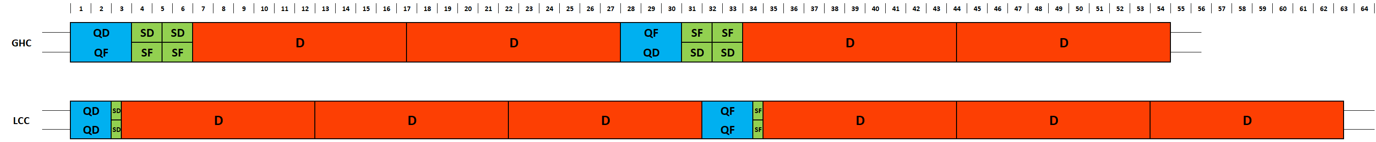
LCC vs. GHC layout
  Longer arc cells in LCC optics
    Up to ~30 m dipole / half-cell (vs. ~24 m for GHC) → 3 dipole units of ~10 m / half-cell required (instead of 2x 12m in GHC) since ~12 m considered maximum length feasible for vacuum chamber production, and overall logistics (containers, tunnel shafts, etc.)
  Shorter SSS in LCC optics
    1.8 m QD / 2.4 m QF (vs. 2.9 m QF & QD for GHC)
    0.52 m SD / 0.3 m SF (vs. 1.3 m SF & SD for GHC)
    Same polarities (FF or DD) for e+ / e- beams at same location not compatible with twin quadrupole design of GHC
  OR… e+ or e- lattices could be shifted by 1 half-cell to recover GHC polarities, but QD – QF lengths not matching, so:
    60 cm of dipole field (1%) would be ”lost” at each cell (... or could be used for separate correctors or other equipment?)
    A single aperture QF of 60 cm would be needed in addition to each 1.8 m twin aperture quadrupole

Slide 20
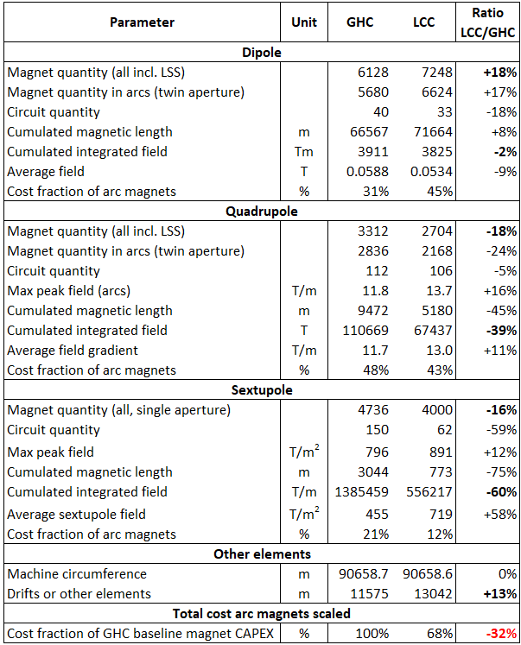
LCC magnet parameters (vs. GHC )
  Magnet quantities
    More dipole units, but less SSS magnets
    Dipole are much cheaper to produce than the SSS magnets
  Cumulated integrated field
    Most relevant parameter for cost comparison (CAPEX)
    Significantly smaller quadrupoles (-39%), sextupoles (-60%) in LCC optics; saves space for drifts (+13%) and longer dipoles (B_{avg} -9%)
    SSS magnets are however about 10% stronger
  Number of circuits
    Significantly less sextupole circuits in LCC optics, thanks to long strings of magnets connected in series in the arcs
  Potential magnet CAPEX cost saving of LCC: ~30% (if scaled to cumulated integrated field)

Slide 21
Concepts of twin quadrupoles

Slide 22
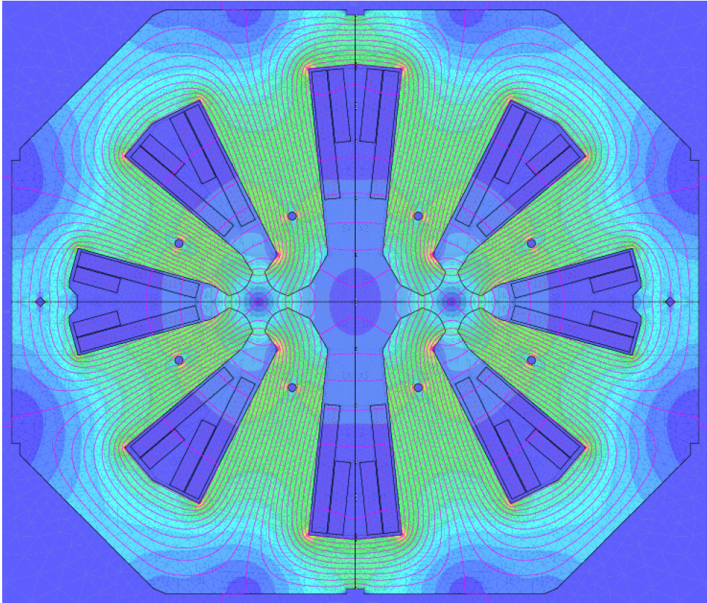
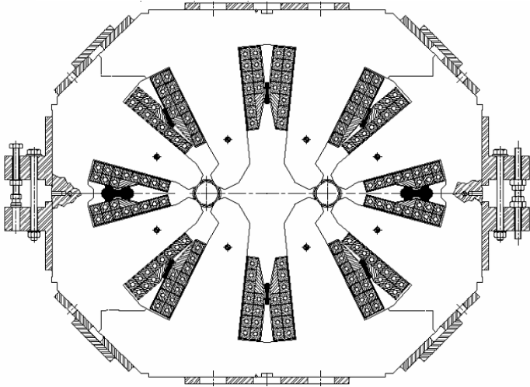
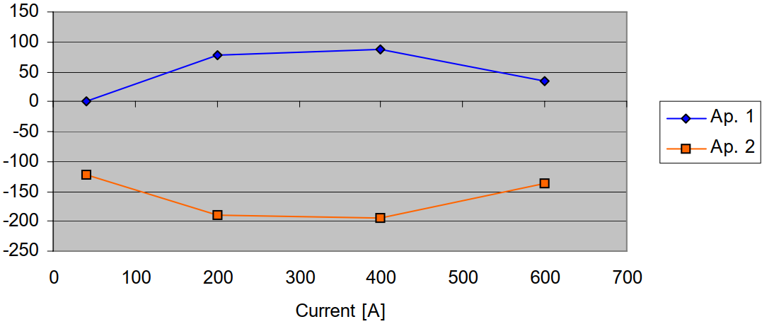
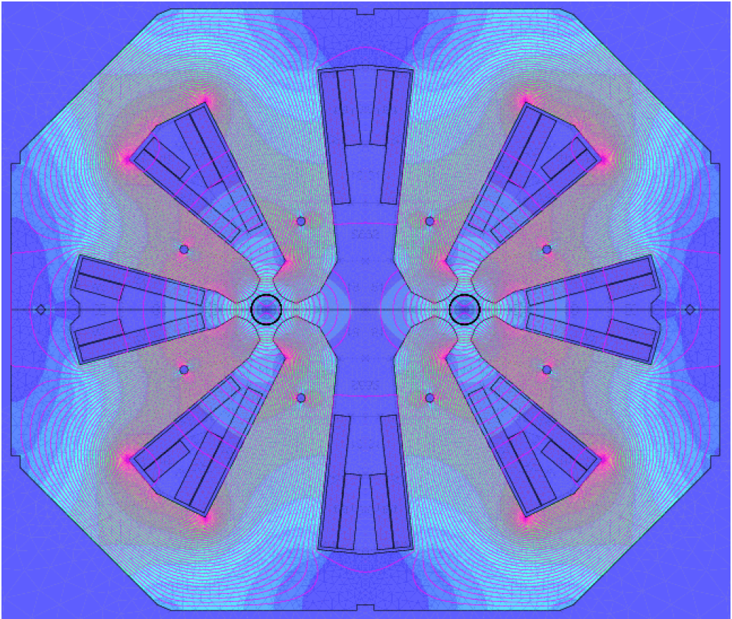
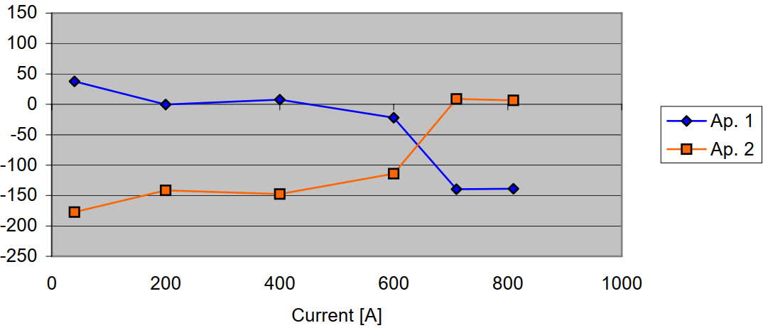
Twin aperture quadrupoles with configurable aperture powering
  Example: MQW magnets in LHC
  8 coils in series; 2 different coil types
  MQWA configuration F/D or D/F
  Field lines ⊥ to vertical mid-plane
  Would be F/F (or D/D) for e+/e- beams
  MQWB configuration F/F or D/D
  Field lines // to vertical mid-plane
  Would be F/D (or D/F) for e+/e- beams
N
S
S
N
Magnetic axis shift
N
S
S
N
ΔX [µm]
Axis shift 90 µm
N
N
S
S
Magnetic axis shift
N
N
S
S
ΔX [µm]
Axis shift 180 µm

Slide 23
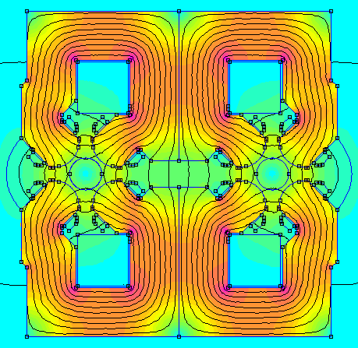
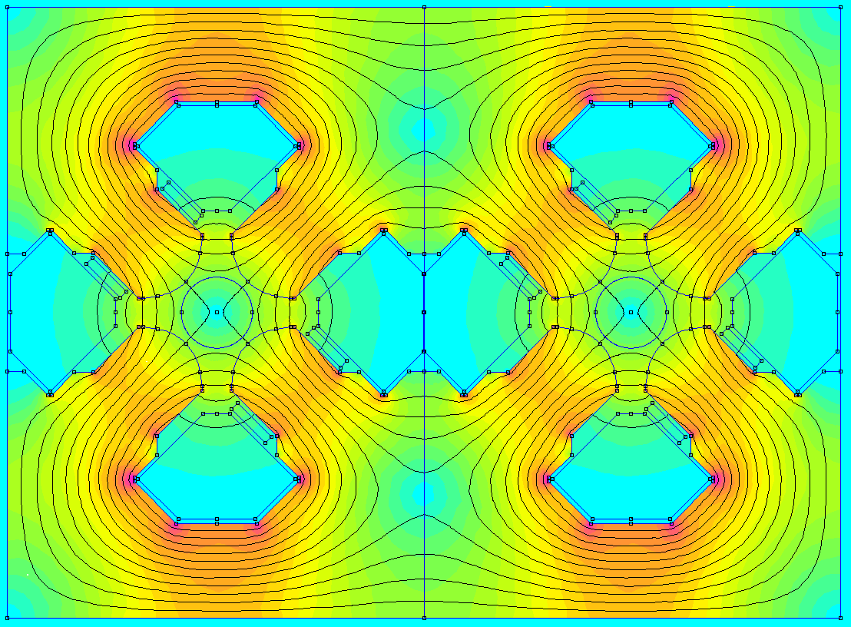
Twin aperture quadrupoles with configurable aperture powering
  Present design, F/D (or D/F) configuration
  2 main coils; 8 separate trim coils
  (10 impregnated objects of 2 types)
  Design with F/F (or D/D) configuration
  4 main coils with 4 embedded trim coils (4 identical impregnated objects)
Coil 1
Fixed polarity, NOT configurable!
Configurable polarity!
Coil 1
Coil 3
N
S
S
N
N
S
N
S
Coil 2
Coil 4
S
N
N
S
S
N
S
N
Coil 2

Slide 24
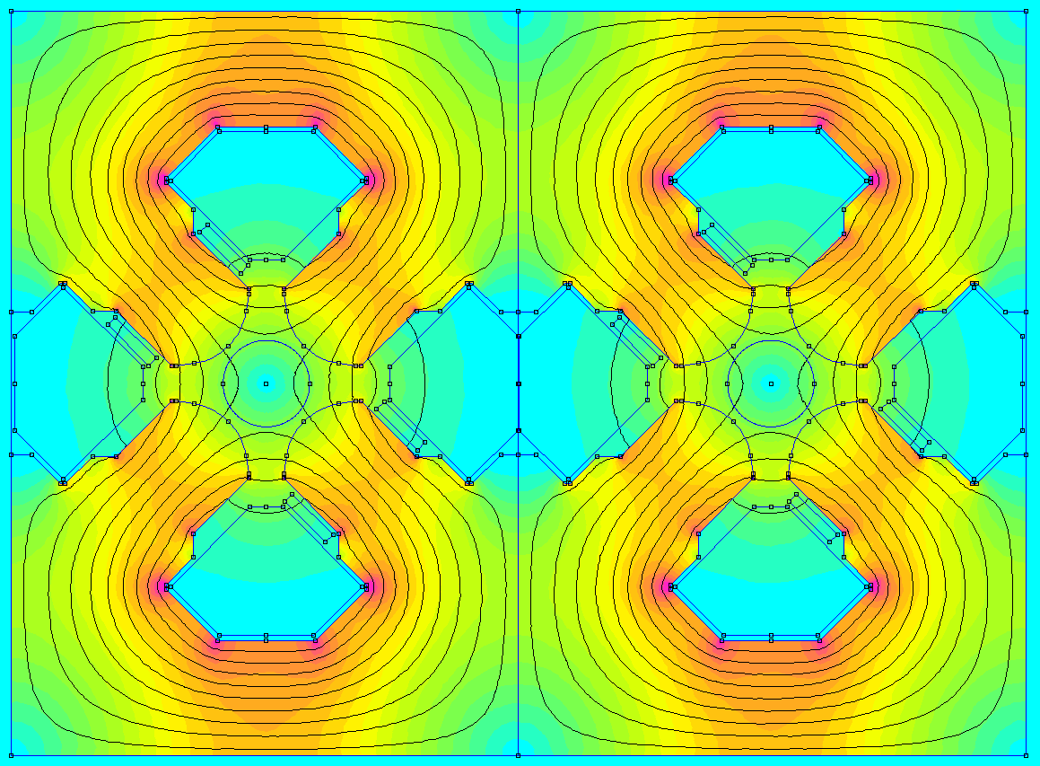
Twin aperture quadrupoles with configurable aperture powering
  Present design, F/D (or D/F) configuration
  2 main coils; 8 separate trim coils
  (10 impregnated objects of 2 types)
  Design with F/D (or D/F) configuration
  4 main coils with 4 embedded trim coils (4 identical impregnated objects)
N
S
S
N
N
S
S
N
S
N
N
S
S
N
N
S

Slide 25
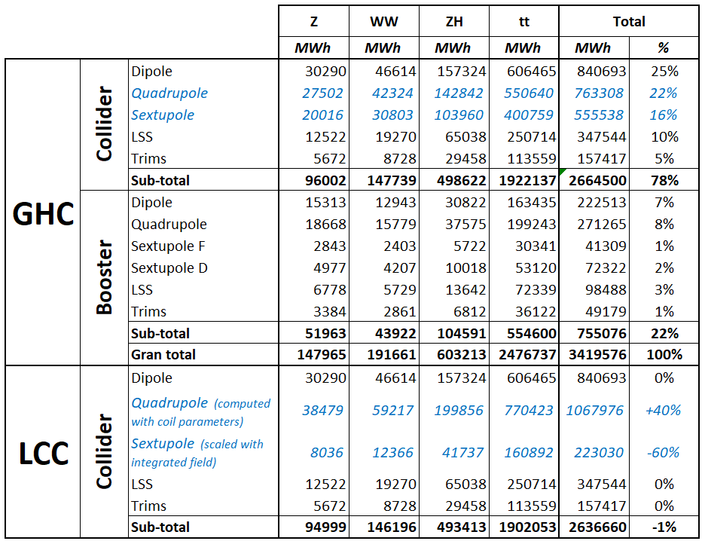
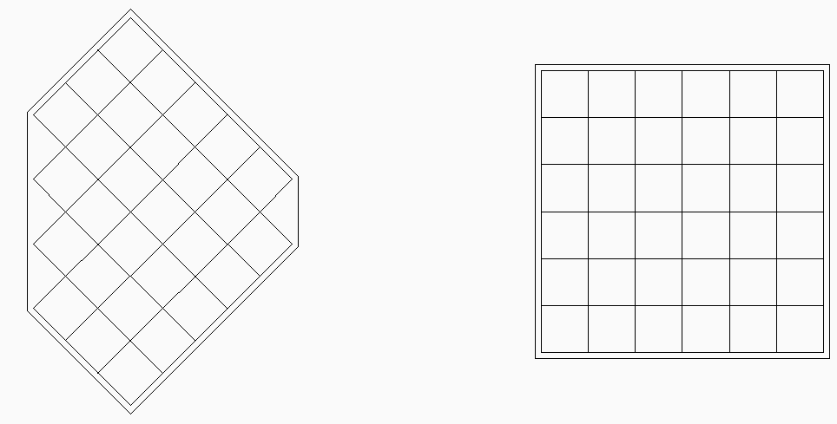
Electrical parameters and power consumption
  Same polarities
  Opposite polarities
Parameters not optimized yet!
  29 turns
  Conductor size [mm] 14 x 14 x d.6/7 mm
  J = 3.6 A/mm²
  36 turns
  Conductor size [mm] 14.4 x 14.4 x d.7.5 mm
  J = 2.25 A/mm²
  → The larger consumption of the twin quadrupoles with same polarities is recovered by the shorter and less numerous SSS magnets

Slide 26
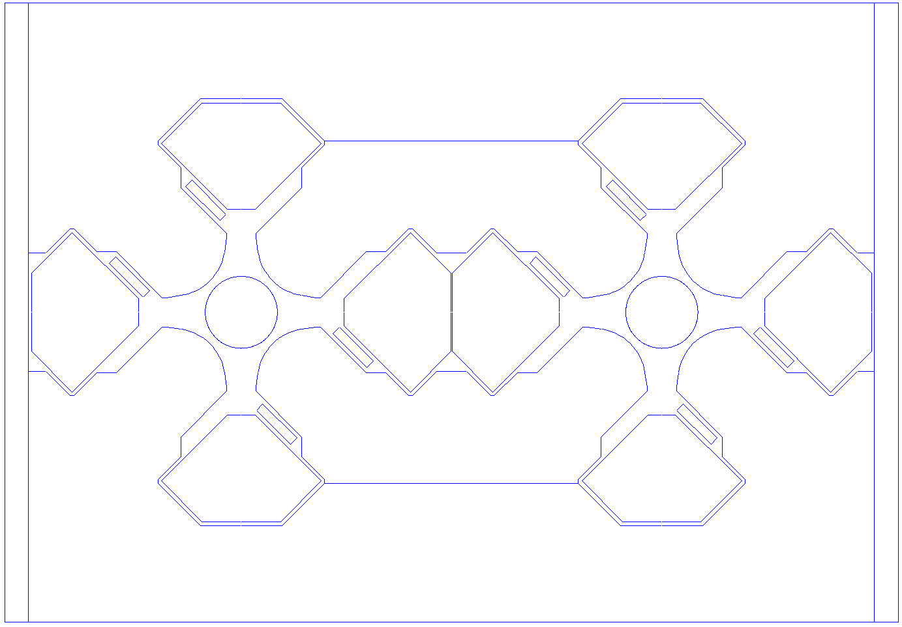
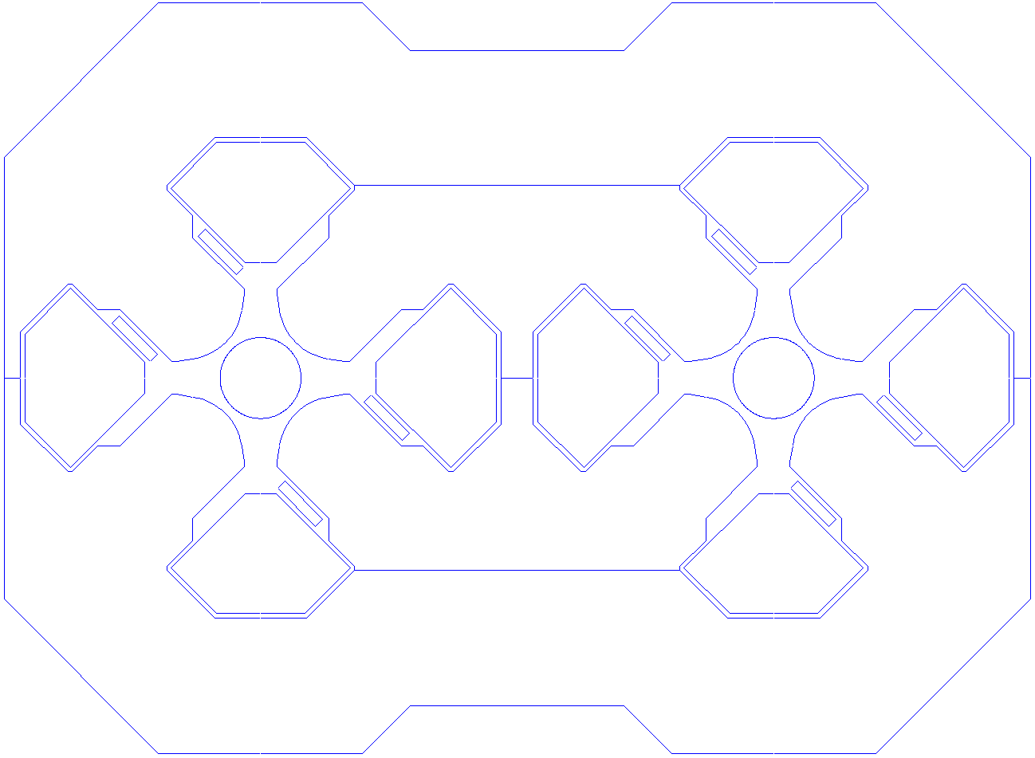
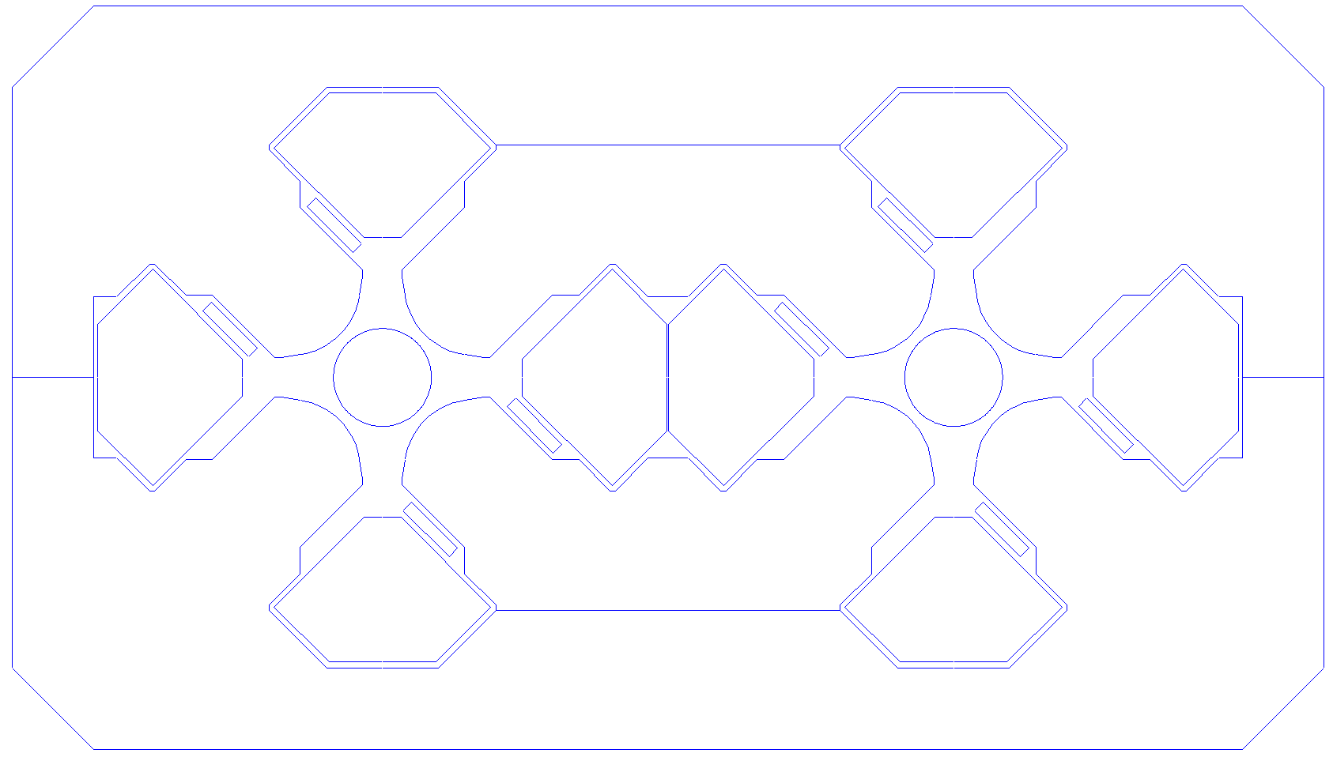
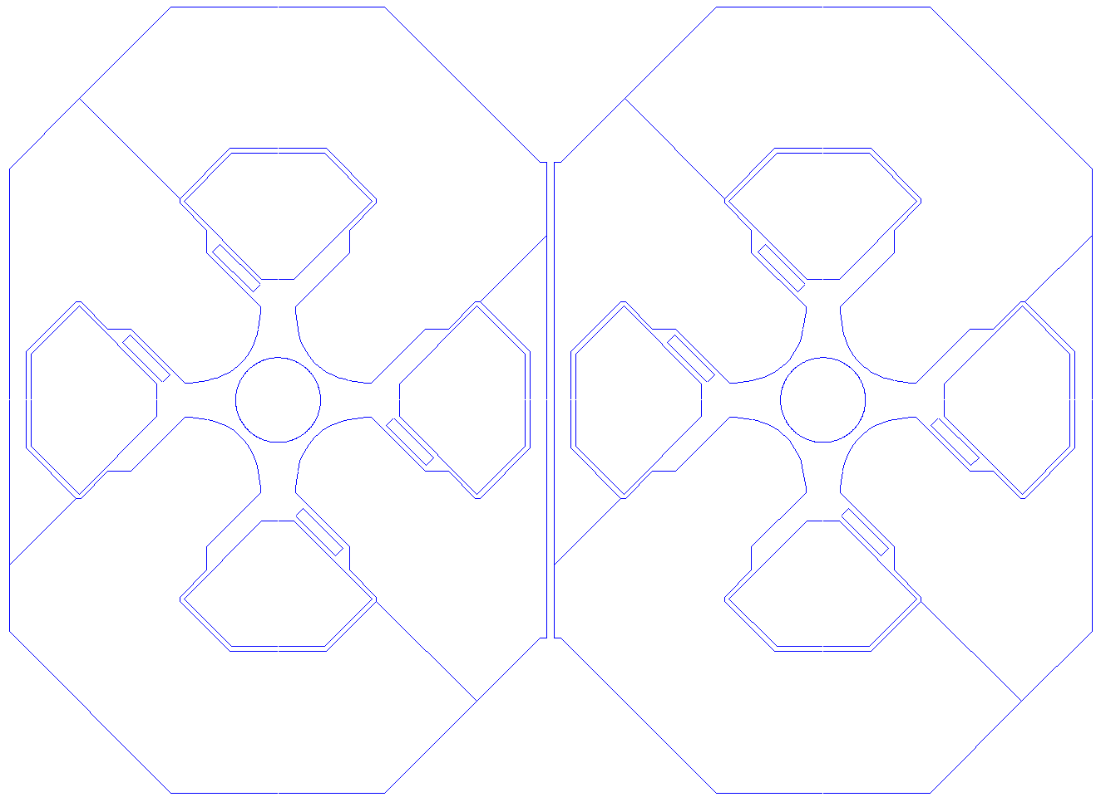
Twin aperture quadrupoles with configurable aperture powering
350 mm
380 mm
  Assembled
  Open mid-plane
  Non-magnetic spacers on the sides
  Possible magnetic interference with surrounding equipment
520 mm
550 mm
  Fully-closed mid-plane
  External sides closed
  No magnetic interference with surrounding equipment
  Magnetic material along vertical mid-plane
  350 mm inter-beam distance gets too short (to be optimized)
750 mm
770 mm
350 mm
  Semi-closed mid-plane
  External sides closed
  No magnetic interference with surrounding equipment
385 mm
460 mm
550 mm
  Separated with 5 mm air gap
800 mm
765 mm

Slide 27
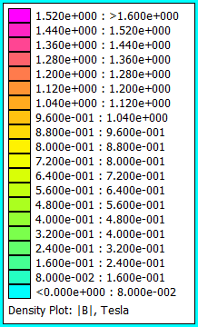
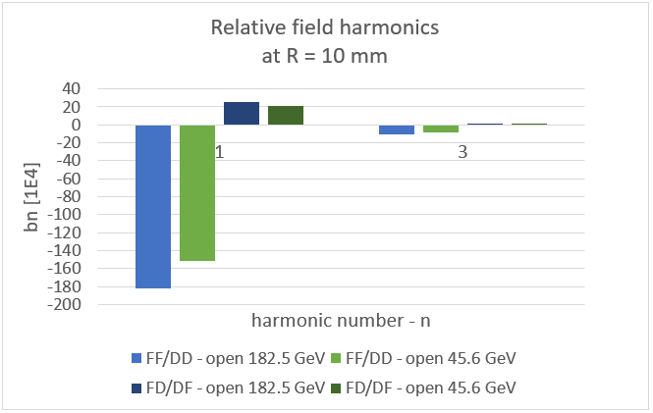
Open mid-plane twin aperture quadrupole
  FF/DD configuration
  Axis shift between Z and tt operation:
  30 µm
  FD/DF configuration
  Axis shift between Z and tt operation:
  4 µm

Slide 28
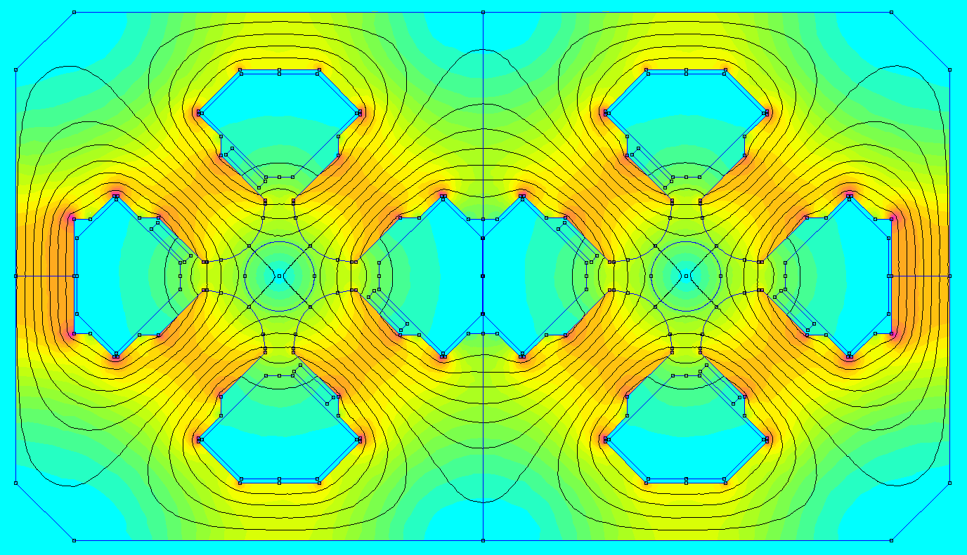
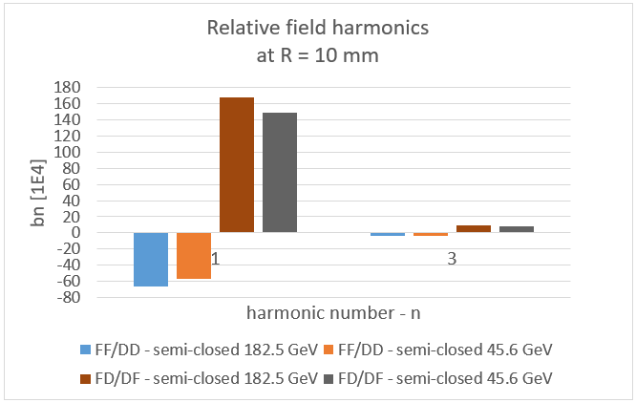
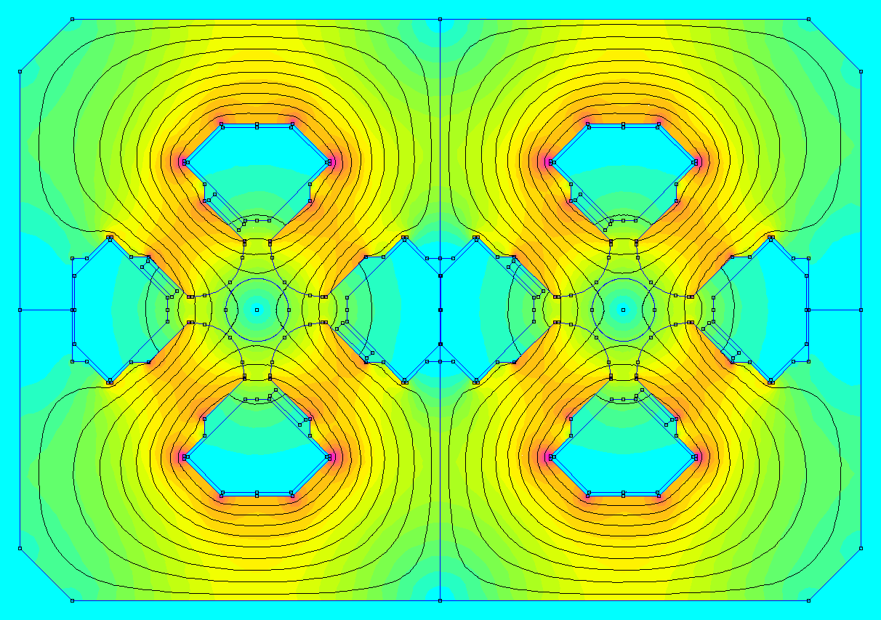
Semi-closed mid-plane twin aperture quadrupole
  FF/DD configuration
  Axis shift between Z and tt operation:
  9 µm
  FD/DF configuration
  Axis shift between Z and tt operation:
  20 µm

Slide 29
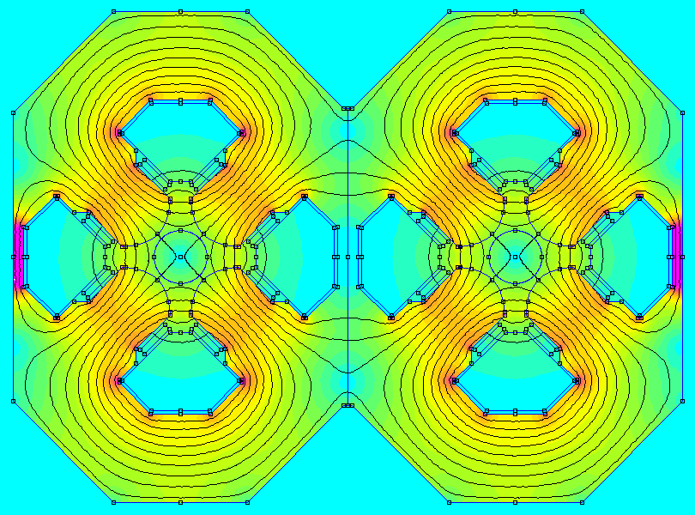
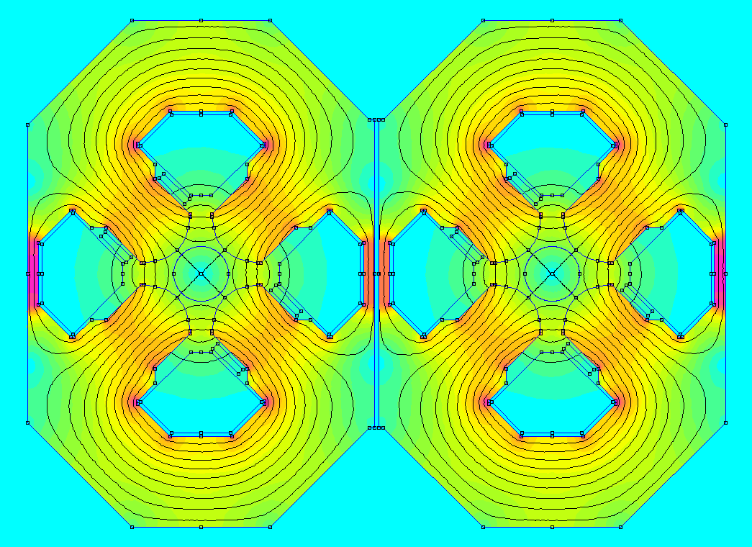
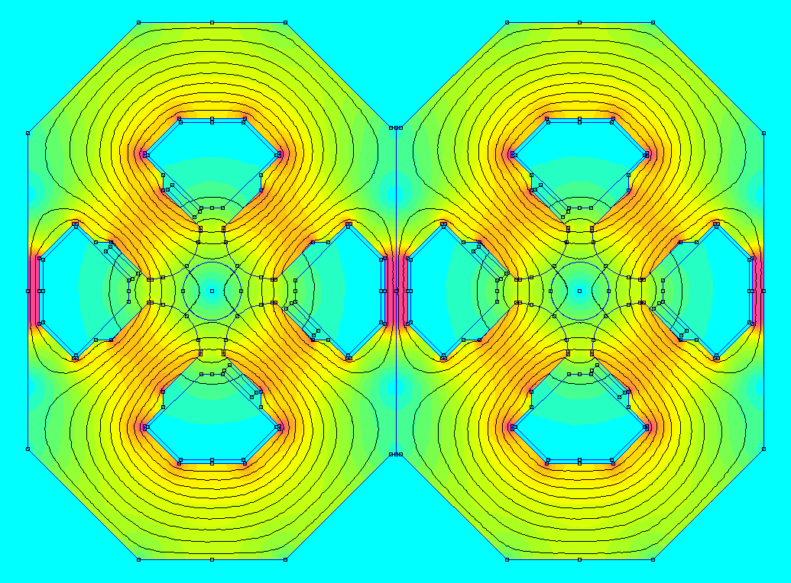
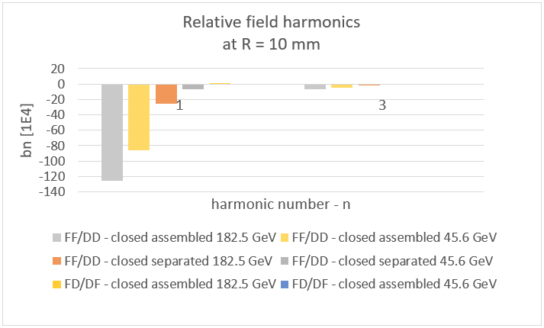
Fully closed mid-plane twin aperture quadrupole
  FF/DD configuration
  Assembled magnetic circuits
  Axis shift between Z and tt operation:
  40 µm
  FF/DD configuration
  5 mm air gap between magnetic circuits
  Axis shift between Z and tt operation:
  19 µm
  FD/DF configuration
  Assembled magnetic circuits
  Axis shift between Z and tt operation:
  1 µm

Slide 30
Concepts of single aperture quadrupoles

Slide 31
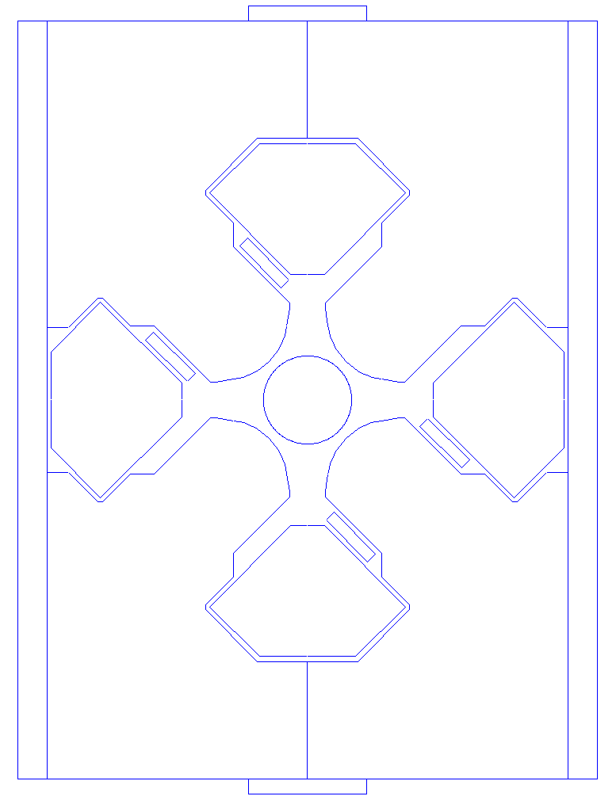
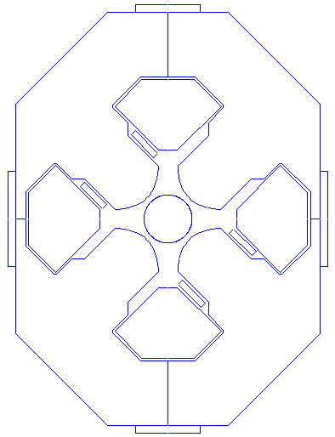
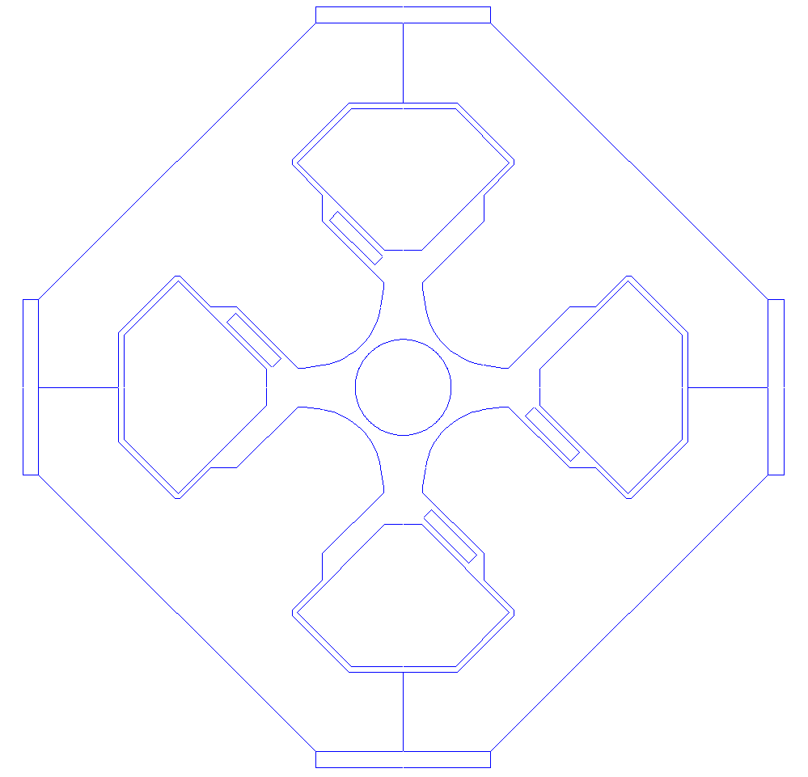
Single aperture quadrupoles topologies (for LCC or RF LSS)
540 mm
540 mm
480 mm
480 mm
400 mm
400 mm
  Closed symmetric
  External sides closed
  No magnetic interference with surrounding equipment
  Open mid-plane
  Non-magnetic spacers on the sides
  Possible magnetic interference with surrounding equipment
  Closed figure-of-eight
  External sides closed
  No magnetic interference with surrounding equipment

Slide 32
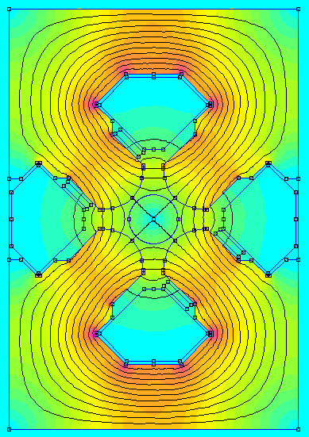



Magnetic performance of single aperture quadrupoles
  Closed symmetric
  Open mid-plane
  Simulation results
  All harmonics are below 1 unit
  Harmonics b1 to b5 may come partially from numerical noise (should be 0 on the closed symmetric design)
  No dependency on powering level observed
  Closed figure-of-eight

Slide 33
Next steps for magnet development

Slide 34
Collider magnets development during pre-TDR
  Design
    Detailed mechanical design of magnet assemblies
      Dipole assembly with vacuum chambers, synchrotron radiation absorbers and shielding
      Assemblies of quadrupoles / sextupoles pairs
      Interconnections
    Evaluation of magnet design (and cost) alternatives to support optics baseline selection (incl. parameters optimisation), also including a study for separate correctors
    Refine cost evaluation model
  Manufacture
    Magnet prototypes for performance validation and arc half-cell mock-up (e.g. twin aperture quad)
    Manufacturing processes for large series (automatized machining, assembly and measurements) and procurement strategies. Collaboration with TU Wien from September 2025.
    R&D on inorganic coatings for conductor insulation (dipole busbars, trim coils, sextupole coils)

Slide 35
Summary

Slide 36
The collider magnet designs reported in the Feasibility Study Report have been based on the GHC baseline optics. They will continue to evolve during the pre-TDR phase to address the requirements of the machine which are still under evaluation (e.g. optics choice, integration of the radiation shielding in the dipoles, supporting scheme, separated orbit correctors, etc.)
The LCC optics with its shorter SSS show potential for savings on the magnet CAPEX:
The dipoles and sextupole cross-section designs are rather similar as for the GHC optics, but
  The dipole arc half-cell longer length imposes splitting it in three units
  The sextupoles are much shorter
Two options are possible for the quadrupoles:
  Twin aperture with opposite polarities (like GHC baseline design), followed by a short single aperture QF
  Twin aperture with same polarities, which require twice the ampere-turns of the opposite polarity version
  → The power consumption difference is however compensated by the shorter magnets of the LCC optics
The most significant benefits of the LCC optics are:
The magnet CAPEX could be much reduced (as well as the power converters and cabling)
A single configuration which covers all phases of the operation from H to tt_{bar}

Slide 37
Thank you for your attention!
Questions?
37

Slide 38
Spare slides

Slide 39




Aperture coupling of LHC MQW twin quadrupoles
MQWA configuration
MQWB configuration

Slide 40
Aperture coupling of FCC-ee twin quadrupole (open mid-plane design, for FD/DF polarity)
IBD 350 mm = no separation
between magnets
IBD 850 mm = 500 mm separation
between magnets

