Slide 1
Challenges for the EM-Separator and its Alternatives
21 May 2025
SY-ABT
L. Porta, B. Balhan, J. Borburgh, Y. Dutheil, G. Favia, T. Kramer, J. Ruf, S. Yue

Slide 2
Contents
Introduction
Electromagnetic Separator (EMS)
  Principle
  Requirements and Specifications
  Technical Challenges
  Prototyping Needs
Kicker as an alternative to EMS
  Principle
  Requirements
  Technical Challenges
Comparison of EMS and Kicker
Outlook

Slide 3
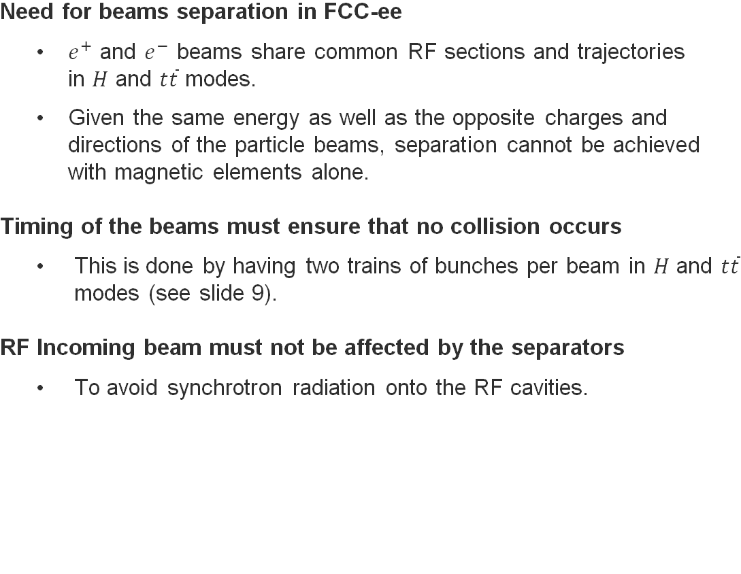
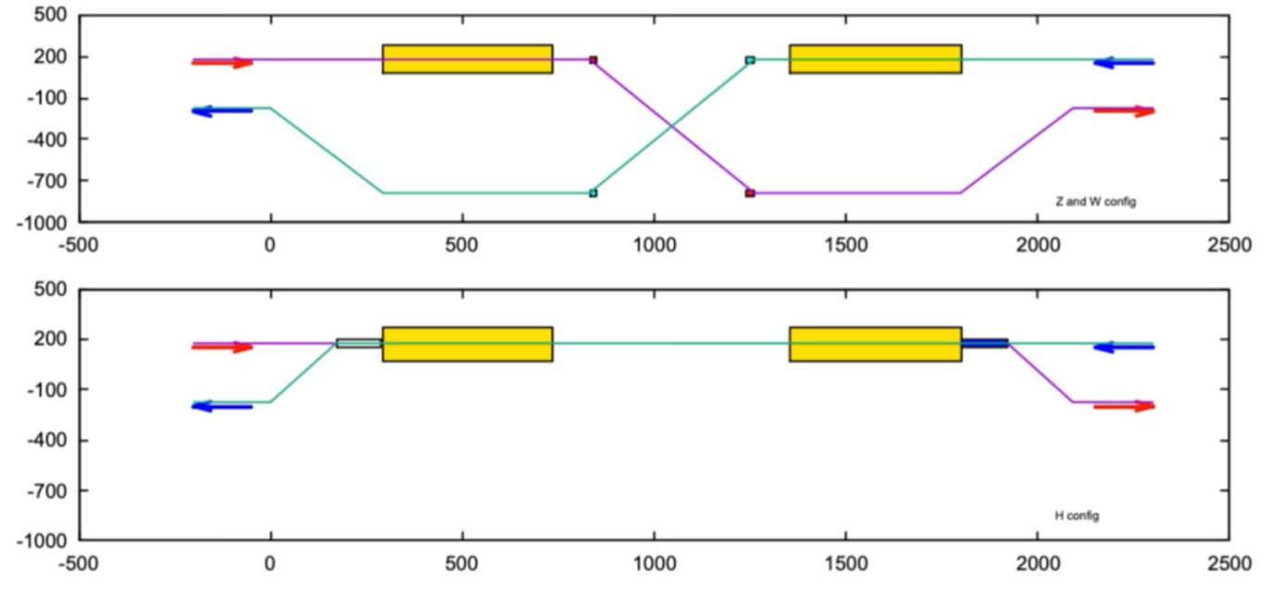
Introduction
Z and W modes
RF cryomodules
Separators
High Energy modes
Schematics of the beam path configurations in the RF section at FCC Point PH [3]

Slide 4
Contents
Introduction
Electromagnetic Separator (EMS)
  Principle
  Requirements and Specifications
  Technical Challenges
  Prototyping Needs
Kicker as an alternative to EMS
  Principle
  Requirements
  Technical Challenges
Comparison of EMS and Kicker
Outlook

Slide 5
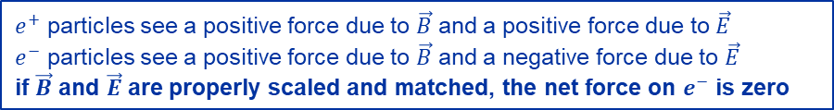
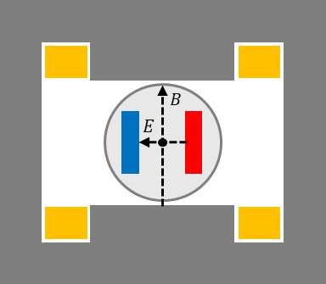
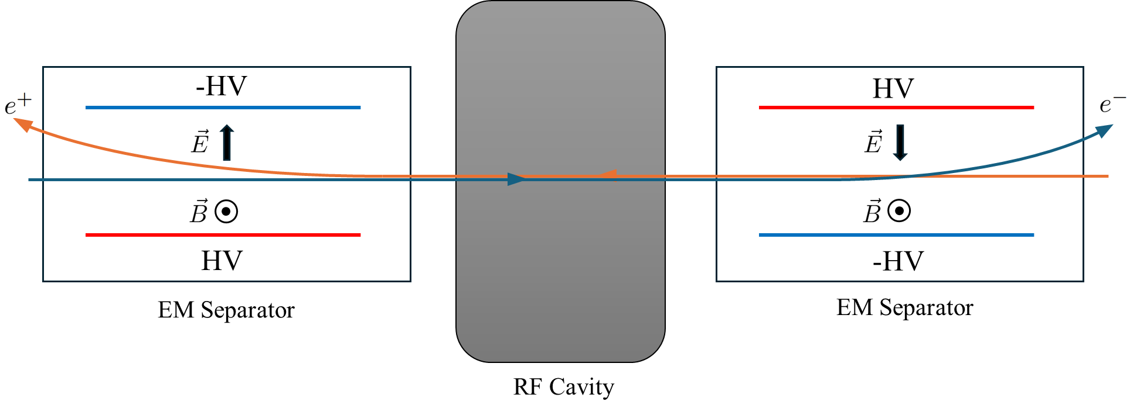
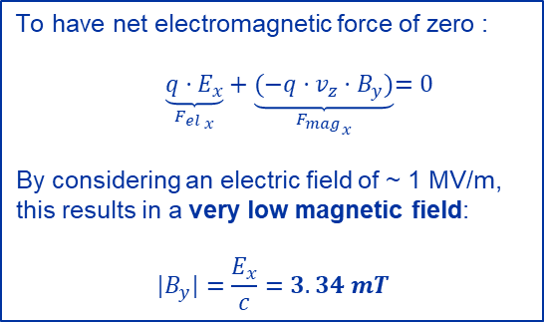


EMS | Principle
Combination of static electric and magnetic fields achieves the desired separation effect.
The Electro-Magnetic Separator (EMS) is operated at constant energy for each mode, i.e. in a pure DC application.
EMS cross section showing an outside vacuum dipole magnet and inside vacuum HV electrodes
EMS principle using combination of static electric and magnetic fields

Slide 6
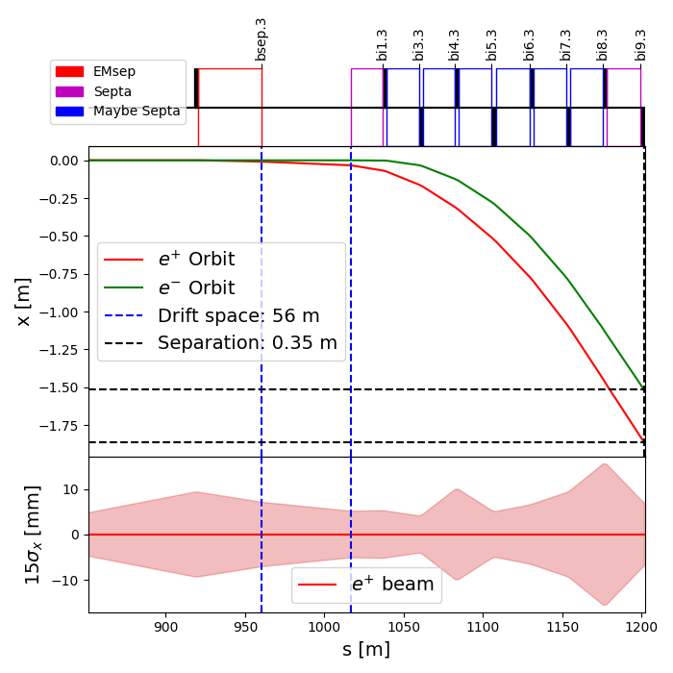
EMS | Requirements and Specifications
Requirements were based on lattice version GHC V25.1 [1] with an RF section of 1790 m.
With 44 m allocated for the EMS and assuming an average field of 1 MV/m, beam deflection is 0.44 mrad.
After a drift space of 56 m, the beam separation is 33 mm at the first septum.
Separator
Septa magnet
To be determined if these are septa or dipole magnets.
Requirements for each of the devices remain to be clarified.
Parameter | Value | Unit | Comment
Total length | 44 | m
Segmentation | 11 | units | Segmentation assures the required mechanical manufacturing tolerances. Between devices : 0.1m for vacuum bellows, 0.4m for radiation masks
Device length | 3.5 | m
Magnetic/Electric length | 2.5 | m
Beam acceptance (Ø) | 60 | mm
Beam deflection per element | 40 | µrad
Electrode gap (H) | 120 | mm | Electrode gap larger than beam acceptance to reduce HV breakdown due to secondary electron emission
E₀ | 1.44 | MV/m
B₀ | 4.80 | mT | Very low magnetic field to match 1MV/m (B=E/c)
V_{nominal} electrodes | ± 86.4 | kV
I_{nominal} magnet | 87 | A | power requirement is low (<10V, <1kW per device)
Beams separation layout
EM-Separator Specifications

Slide 7
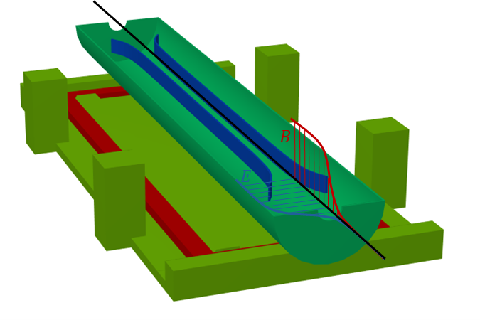
EMS | Technical Challenges
Vacuum vessel
Under vacuum system requires consideration for:
Bakeout equipment
Beam impedance preservation due to large cavity
HV electrodes
Subject to :
Electron field emission due to high electric field
Secondary electron emission due to radiation and particle strike
Electrodes heating
Breakdown would lead to beam disturbances and synchrotron radiation production
→ Risk of breakdown must be mitigated
Electromagnetic dipole
Working at very low magnetic field:
Effect of hysteresis, remanence and external disturbances must be considered to minimize field error
E and B Fields
Must be matched everywhere to avoid synchrotron radiation production
→ Fields matching error to be minimised by design
basic representation of the EMS toplogy
Importance of mapping of E and B fields – magnetic field clamps are also electric field clamps -> limited flexibility.
Operating at low magnetic fields -> either air dipole (all tools and components close to device should be non-magnetic (including the tooling used to assemble!), or use magnetic material (yoke) and deal with operation very low in the non-linear BH curve (hysteresis, remanence).

Slide 8
EMS | Prototyping Needs
Local matching of Electric and Magnetic fields
  Adressed by CERN by optimisation of the system topology and design
  Remaing error after optimisation and impact on synchrotron radiation is under study with numerical model
  First electromagnet prototype can be implemented on the LEP Electrostatic Separator
  Accuracy and repeatability of the low-field (<5mT) electromagnet will be tested
High-Voltage breakdown rate in vacuum and radiation environment
  Studies are ongoing in collaboration with University of Tartu (Estonia) to better understand and quantify the breakdown rate depending on X-Ray impact on electrodes, PhD student will join the section in 2025
  Breakdown rate can be mitigated by design (avoiding field enhancement, radiation shielding, electrodes cooling, good vacuum), by material (surface roughness, work function) and
  by HV conditioning
  LEP Electrostatic Separator is available for HV testing
Beam impedance preservation of EMS
  Study has to be launched
LEP electrostatic separator as a basis for EMS prototype
Prototyping necessary to confirm its feasibility!

Slide 9
Contents
Introduction
Electromagnetic Separator (EMS)
  Principle
  Requirements and Specifications
  Technical Challenges
  Prototyping Needs
Kicker as an alternative to EMS
  Principle
  Requirements
  Technical Challenges
Comparison of EMS and Kicker
Outlook

Slide 10
Kicker | Introduction
  Kicker system has been very recently proposed as an alternative option to EMS
  The interest has been triggered by the CEPC project where they have similar approaches [8]
  Feasibility analysis is at a very early stage

Slide 11
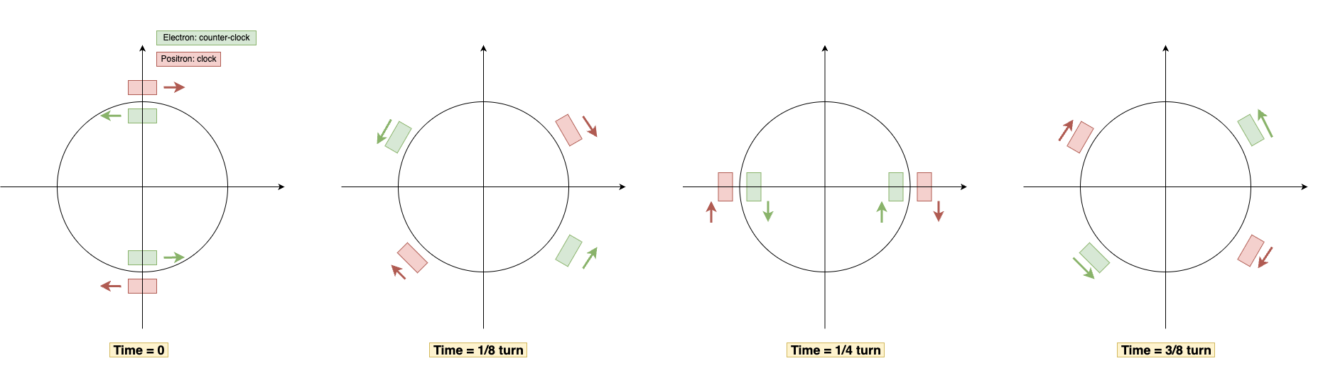
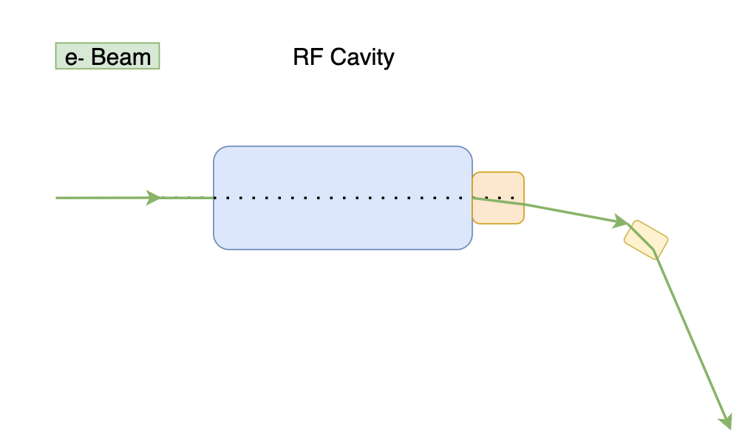
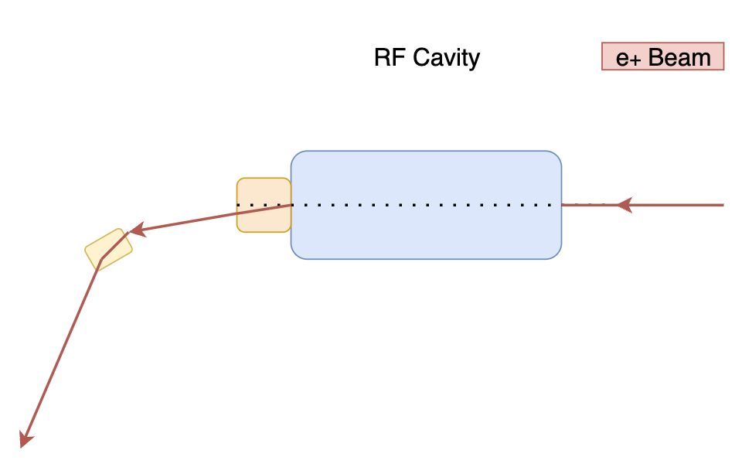
Kicker | Principle
interaction point
RF
enabled kicker
RF
disabled kicker
Kicker only works on the outgoing beam
and must deflect 2 bunch trains per turn
[2]

Slide 12
Kicker | Requirements
Kicker requirements depend on:
filling scheme (baseline and alternative options have been investigated)
how beams are deflected (train by train, batch by batch or bunch by bunch)
Deflection method | Train by Train
Filling scheme | Baseline (feasibility report)
Maximum repetition rate | 6618 Hz
Flat-top time | 58 μs
Rise time | 25 μs
Fall time | 9 μs
Flat-top stability (Higgs) | Approx. < 0.04% (0.1 𝜎𝑥)
Flat-top stability (ttbar) | Approx. < 0.06% (0.1 𝜎𝑥)
Train by Train
Short batch spacing 25 ns | Long batch spacing H : 850, ttbar : 4600 ns
6618Hz
3.75 μs | 64.78 μs
79.6 μs | 18.6 μs
63.6 μs | 2.6 μs
Approx. < 0.04% (0.1 𝜎𝑥)
Approx. < 0.06% (0.1 𝜎𝑥)
Batch by Batch | Bunch by Bunch
25 to 4600 ns batch spacing | 25 ns bunch spacing
215kHz - 20 MHz | 40 MHz
25 ns | 0.1ns
12.5 ns - 2300 ns | 12.5 ns
12.5 ns - 2300 ns | 12.5 ns
Approx. < 0.04% (0.1 𝜎𝑥)
Approx. < 0.06% (0.1 𝜎𝑥)
Alternatives filling schemes explored by ABT
RF technology more suitable ?
Most feasible case for a kicker,
because of short flat-top and long rise/fall time compared to other cases
[2]

Slide 13
Kicker | Technical Challenges
Kicker acts on the beam at every turn
  Not a typical mode of operation for conventional beam transfer equipment
Extremely strict requirements on flattop stability and repeatability (typical kicker: ±1% but <0.04% is required)
  Would need significant R&D to ensure and verify if achievable (metrology)
  Longer required flattop length makes achieving the stability requirements much more difficult
A fast-acting system is always a concern for machine protection
  Risks include mis-kicks, erratic kicks, missing kicks, and synchronization errors
Needs short cable between kickers and generators → Alcove location is to be optimized.
Batch by Batch and Bunch by Bunch are not feasible with beam-transfer kicker systems
  Given the high integrated field requirements in combination with tens of megahertz repetition rates
Feasibility needs to be assessed in detail and much R&D would be needed!

Slide 14
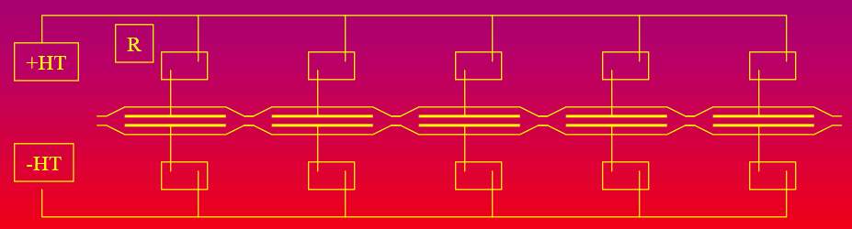
System Reliability
What happens if the separation system fails?
  The beam could hit the septum blade.
  The beam could ends up circulating in the wrong beam pipe.
Reliability will be critical
EMS:
Risk of failure mainly come from HV breakdown:
- HV breakdown rate must be minimized by design.
- Consequence of failure can be mitigated by decoupling segmented EMS devices so that it does not affect the entire system.
decoupling resistor
HV-DC generator
EMS
Kicker:
A pulsed system requires more advanced control and involve more potential sources of failure such as:
Mis-kick, erratic kick, missing kick, synchronization
- Risk analysis will have to be conducted in details at an early stage.
HV-DC supply scheme showing generator, decoupling resistors and EMS devices [9]

Slide 15
Comparison of EMS and Kicker
 | EMS | Kicker
Maturity | Novel equipment type Needs R&D and prototyping LEP experience is an advantage | Novel application for beam-transfer kickers needs R&D and prototyping if first feasibility analysis is approved
Complexity | Simple DC operation Complexity in the design, geometric tolerances and HV phenomena Limited power dissipation (20kW) | Pulsed system operation with strict timing Very high field stability requirements More complex system (kicker, gen., ctrl.) Higher power dissipation (100kW, t.b.c)
Integration | Easy integration in the current baseline | Can require special alcoves due to short cables requirement
Feasibility | Technical concept is under devlopment Prototyping is the next step | Initial feasibility analysis to be continued Strongly dependant on filling scheme
EMS probably constitutes a simpler system,
but both options still present uncertainties that need to be clarified.

Slide 16
Outlook
EMS:
Development will continue as the baseline solution
Design concept is under active development and will keep going
Main challenges have been identified and must be adressed
(e.g. field quality, HV breakdown rate, system integration, beam impedance)
EMS requires prototyping
LEP electrostatic separator will be used as a basis
Kicker:
Studies will be launched to determine the feasibility of kicker system
This will include the cost, the impact on the required space in the FCC tunnel and the required space in alcoves
It would be of interest to investigate other technologies than beam-transfer kicker
e.g. feasibility and impact of kicking at higher frequencies (bunch by bunch or batch by batch), see [7] and [8]
Filling scheme (bunch train length) has a major impact on kicker requirements and feasibility

Slide 17
Back-up slides

Slide 18
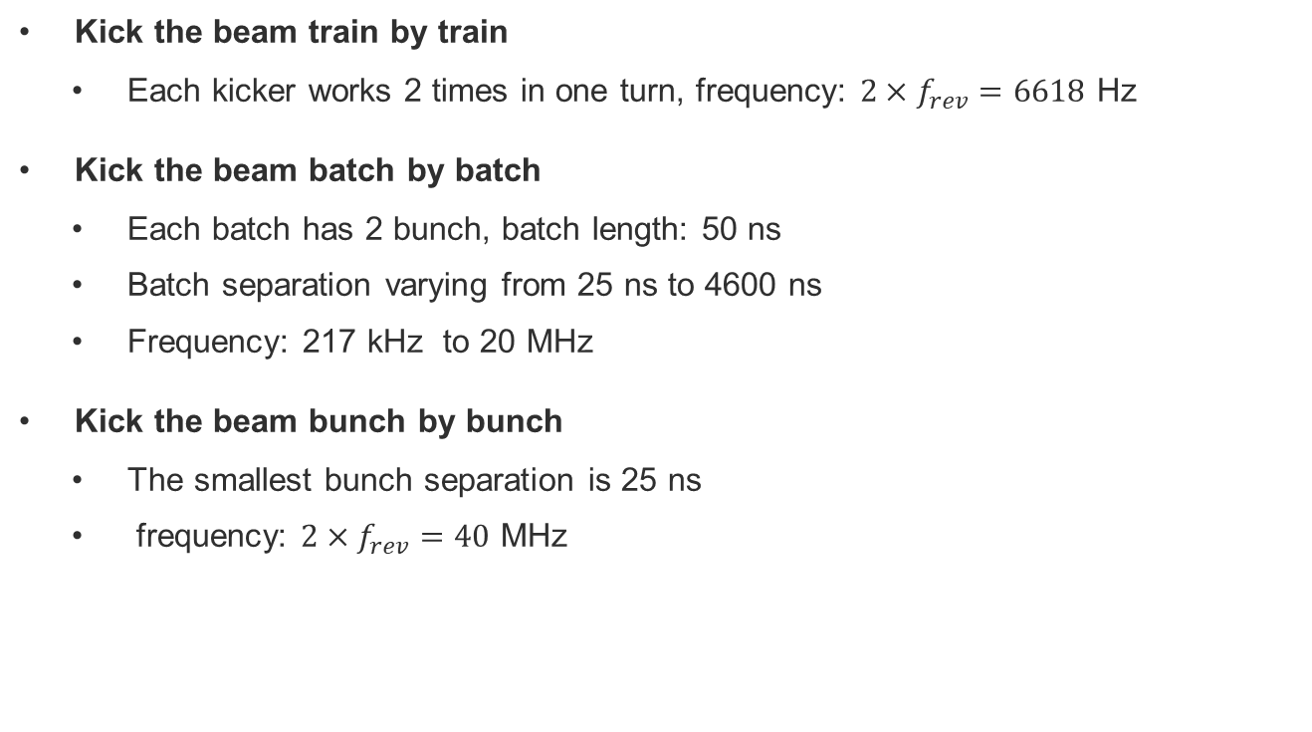
Kicker | Repetition frequency

Slide 19
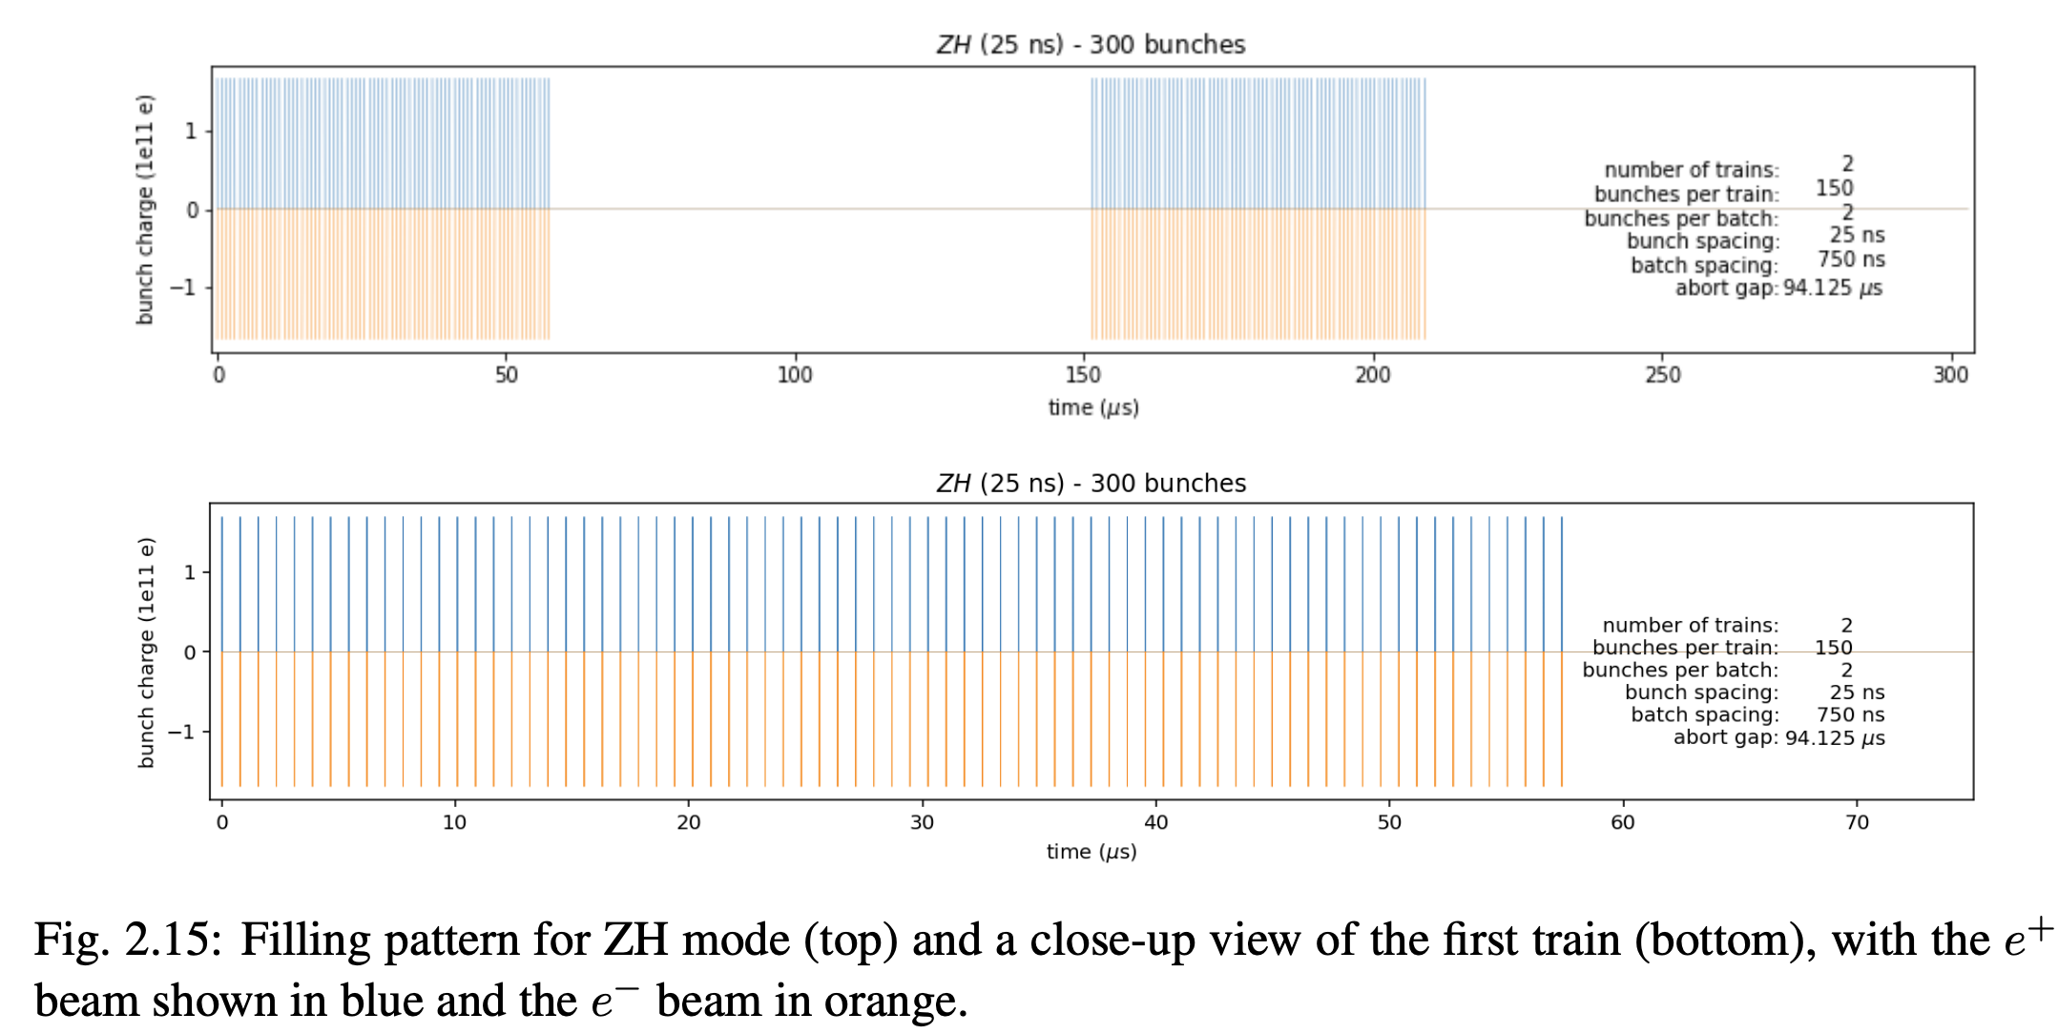
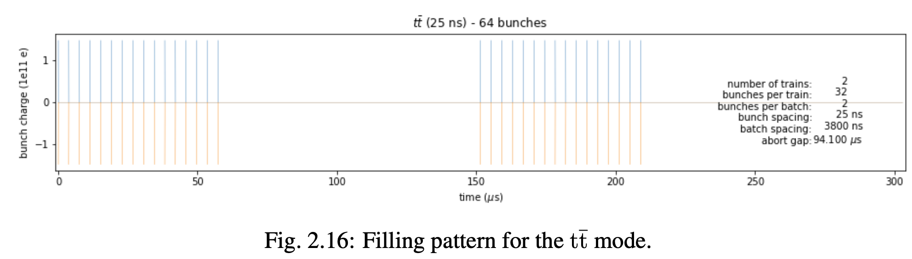
Train by train：Baseline
Each beam only has two bunch trains
Higgs mode:
  Number of trains: 2
  Bunch train length: 57.4 us
  Batch spacing: 750 ns
    Bunches per batch: 2
    Bunches spacing: 25 ns
ttbar mode:
  Number of trains: 2
  Bunch train length: 57.4 us
  Batch spacing: 3800 ns

Slide 20
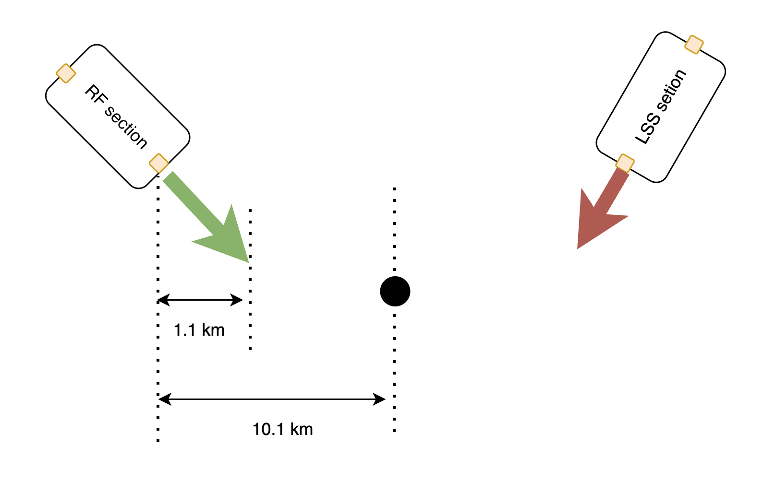
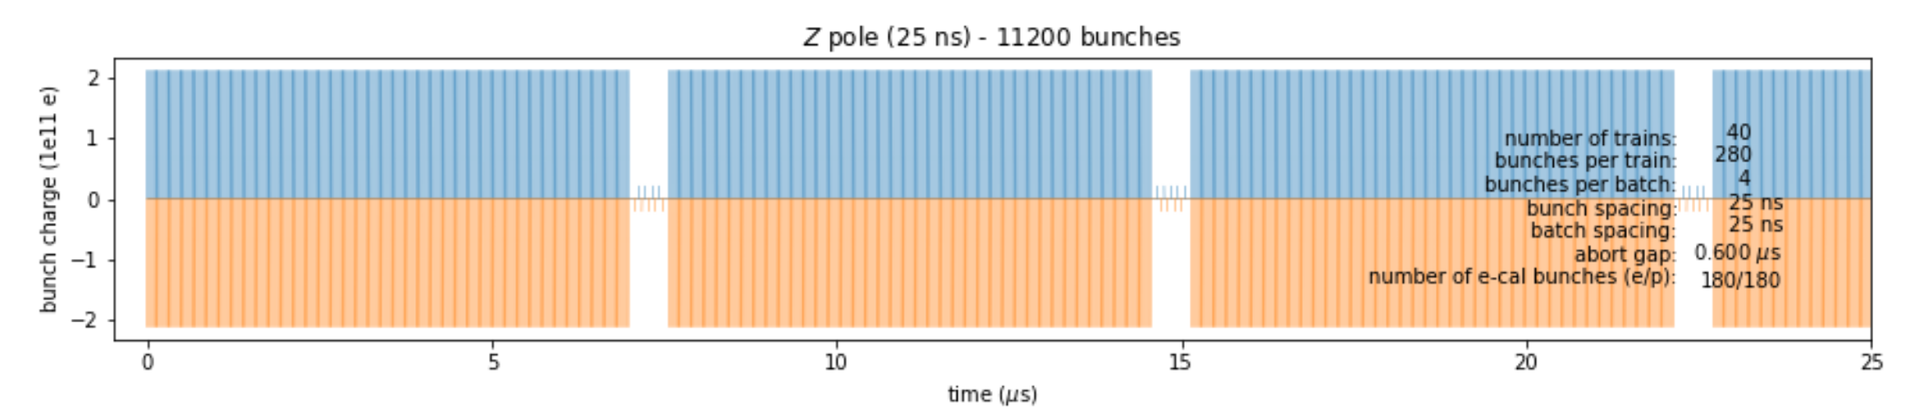
Train by train：Short bunch spacing 25 ns
Each beam only has two bunch trains
Higgs mode:
  Number of trains: 2
  Bunch number: 300
  Bunch train length: 1.1 km
  Bunches/Batch spacing: 25 ns
    Bunches per batch: 2
Similar filling structure with Z mode, but much less bunch number

Slide 21
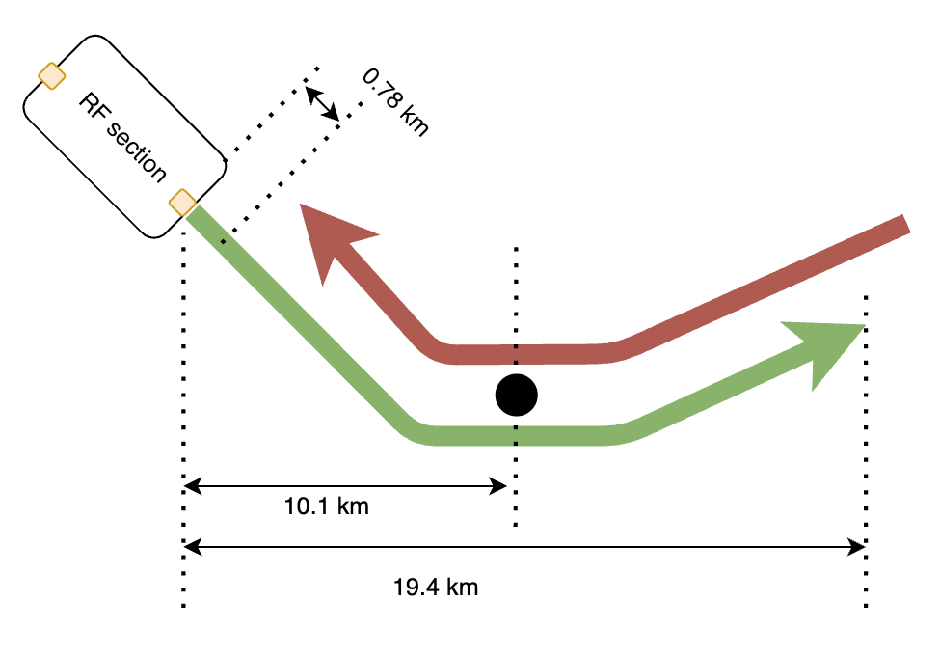
Train by train: Long batch spacing
Higgs mode:
  Number of trains: 2
  Bunch number: 300
  Bunch train length: 19.42 km
  Batch spacing: 850 ns
    Bunches per batch: 2
    Bunch spacing: 25 ns
ttbar mode
  Number of trains: 2
  Bunch number: 60
  Batch spacing: 4600 ns
  Bunch train length: 19.42 km
Beam collision occurs when bunch train length larger than 20.2 km

Slide 22
Kicker | Technology Options
Stripline kicker
  Similar challenges than EMS related to under vacuum HV system + additional challenges
Impedance matched transmission line type kicker
  Complex under vacuum magnet.
  High duty cycle (2.5% for 25 ns bunch spacing, 38% for Baseline) leads to very high-power loss per termination
  E.g., 20 single turn kicker magnets with 1 m magnetic length and 30 mm aperture, Z = 10 Ω:
  370 kW (2,5% duty cycle) to 7,4 MW (38% duty cycle) total losses in terminations.
  However, termination beneficial for flattop quality.
Lumped inductance kicker magnet
  Multiturn option, short circuit termination
  Needs large rise and fall time budget (~20 µs)
  Significant power flow between kicker and generator (>>kW range), need for cooling
  Challenges regarding flattop, repeatability and machine protection remain
Other types of kicker technologies to be explored ?
  For example: ‘resonant kicker’, see [7] and [8]
  To be verified whether faster system (e.g. by batch or by bunch) could offer any advantages
◄ Not followed-up further
◄ Not followed-up further
◄ Most promising option
Feasibility needs to be assessed in detail, much R&D would be needed!

Slide 23
Kicker | Multiturn Lumped Inductance System
Currently favored option for possible further studies
Needs large rise and fall time budget (~20 µs)
  To accommodate settling times for flat top and flat bottom ringing
  To allow for higher inductance kicker magnets at moderate driving voltages
  To cope with effects of eventual long cables
Significant power flow between kicker and generator (>>kW range)
  Due to high repetition rate combined with the energy stored in the magnetic field to be ramped up and down
  leads to cooling requirements to be assessed
Challenges regarding flattop, repeatability and machine protection remain
  Complex power modulator would be required, probably with droop compensation, flattop regulation, energy recovery, …
Feasibility needs to be assessed in detail and much R&D would be needed!

Slide 24
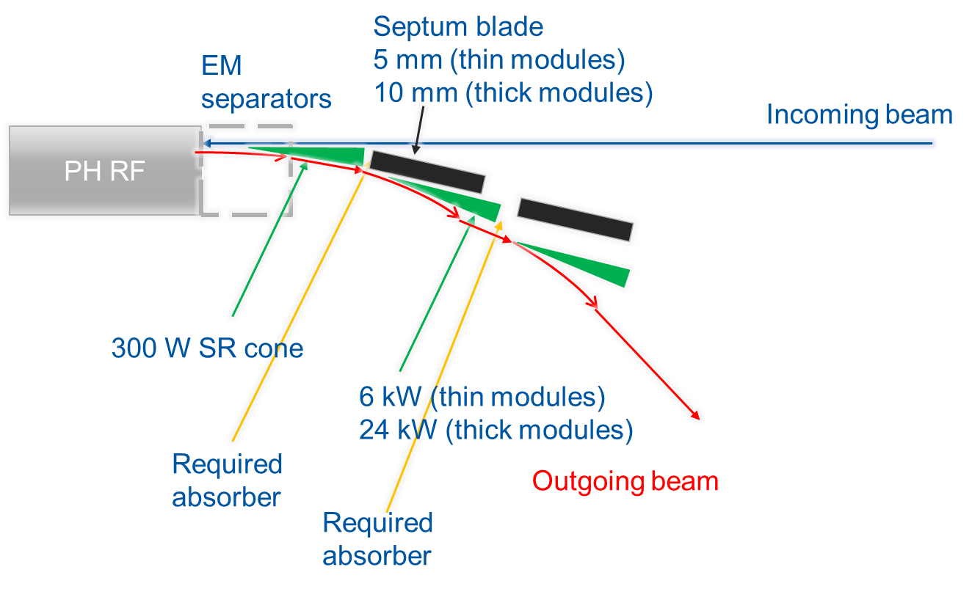
SR shielding considerations
Total synchrotron radiation power of ~200 kW from the outgoing beam and critical photon 2-4 times higher than arc
  Mature concept will need to handle the SR of the outgoing beam
  Possible iteration between field/design and constraints
EM-Separators very sensitive to SR:
Absorber between separator devices and in front of EMS to be considered
To be continued towards the pre-TDR
Synchrotron radiation from the outgoing beam (Illustration not showing the number of module nor correct scales) [5]

Slide 25
EMS | Principle
Combination of static electric and magnetic fields achieves the desired separation effect.
The Electro-Magnetic Separator (EMS) is operated at constant energy for each mode, i.e. in a pure DC application.
EMS principle using combination of static electric and magnetic fields

Slide 26
References
K. Oide, “Lattice progress and main parameters update”,
202nd FCC-ee Accelerator Design Meeting & 73rd FCCIS WP2.2 Meeting (12 February 2025), Indico
S. Yu (2025), “Functional specifications of separation kickers”,
FCC ABT General meeting (16 April 2025), Indico
CERN (2025), “Future Circular Collider Feasibility Study Report Volume 2: Accelerators, technical infrastructure and safety”
B. Balhan (2025), ‘Future Circular Collider Pre-TDR Description ’,
Y. Dutheil (2024), ‘Requirement for shielding EM separators from synchrotron radiation’,
11th FCC-ee Radiation and Shielding Meeting (27 November 2024), Indico
Y. Dutheil (2024), “Beam Transfer Systems Feasibility Study input for FCC-ee”, Zenodo
Paul Scherrer Institut (2017), “Resonant kicker system with sub-part-per-million amplitude stability”, IPAC 2017
CEPC (2025), “Research of resonant kicker for CEPC RF region beam separating system”, IPAC 2025
J. Borburgh (2006), “Electrostatic separator limits and R&D”, ILC workshop (20 October 2006), linearcollider

