Slide 1



Status of the Beamstrahlung Dump Design
S. Candido, R. Ximenes, R. Seidenbinder, A. Frasca, A. Lechner,
G. Lerner, A. Perillo-Marcone, M. Widorski, G. Lavezzari,
M. Calviani (CERN), C. Carrelli, L. Tricarico, M. Tarantino (ENEA)
FCC week 2025 – Vienna

Slide 2
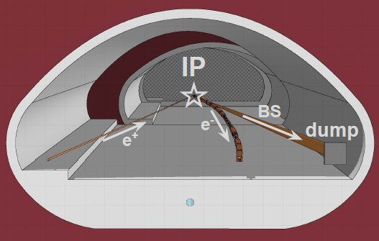
Introduction
Operation of FCCee will involve the production of a high-energy, high-power photon beam both sides of the IP*
As proposed preliminary at FCC week 2024, Liquid Metal Pb technologies are promising for use in particle accelerators, specifically for cases of a quasi-CW energy deposition as the BS radiation, offering advantages that traditional solid technologies cannot provide.
Since FCC week 2024, major developments were made with the collaboration with ENEA Brasimone on enhancement of the liquid lead hydraulic system and its feasibility
* M. Boscolo, A. Ciarma, Phys. Rev. Acc. Beams 26, 111002 (2023)

Slide 3
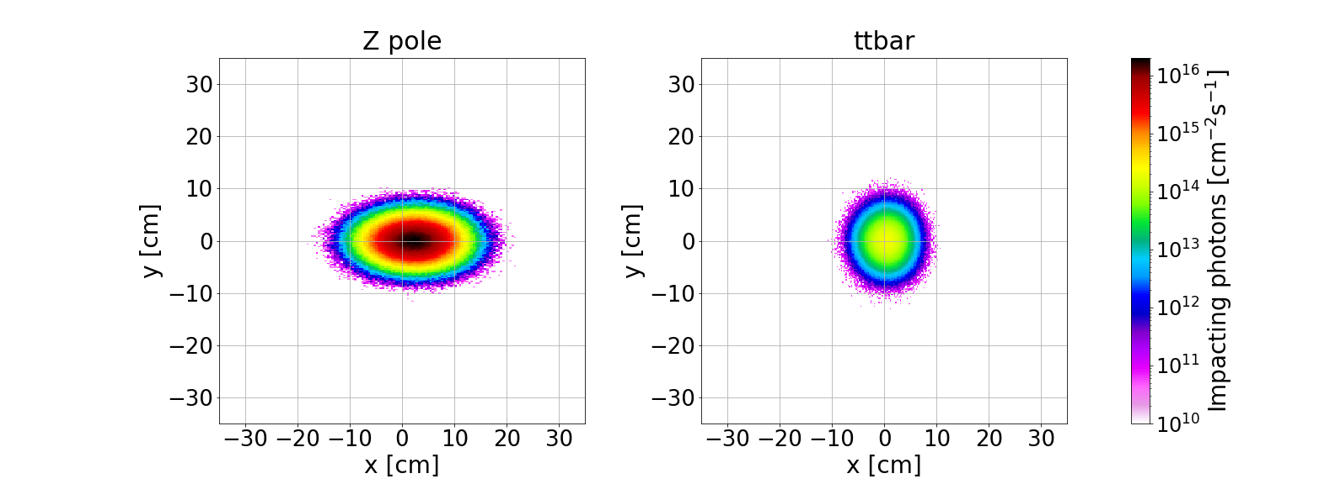
Beamstrahlung photon beam spot on dump (at 500m)
Its located at 500 m from IP, to have sufficient separation between the beamstrahlung (BS) line & booster line & as much diluted beam as possible
Nominal power ~370 kW for Z0 and ~80kW for ttbar, with very high energy photons (~100 MeV for Z0)
In case of vertical offsets, up to 500kW
From FLUKA calculations
Operation Mode | Z pole | ttbar
Mean energy [MeV] | 1.78 | 62.28
Power per beam [kW] | 370.21 | 77.06
Power abs. in windows | 4.01% | 0.41%
Power required for the Dump [kW] | 355.163 | 74.0348
σ_{x} ~4.6 cm σ_{y} ~2.5 cm
Considering the v22 optics: Beam Intensity 1.3 × 10¹⁸ photons/s (@ Z pole)

Slide 4
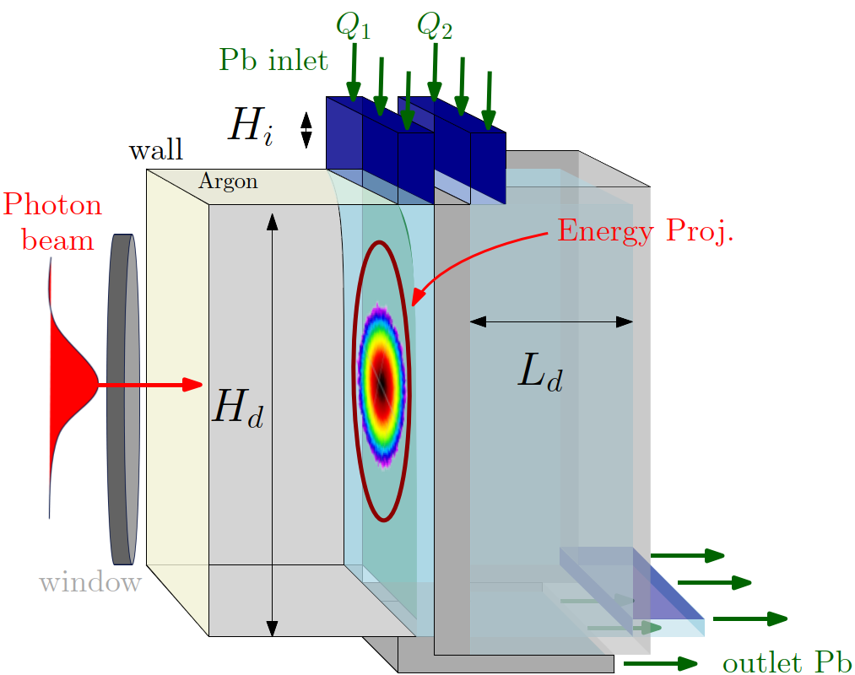
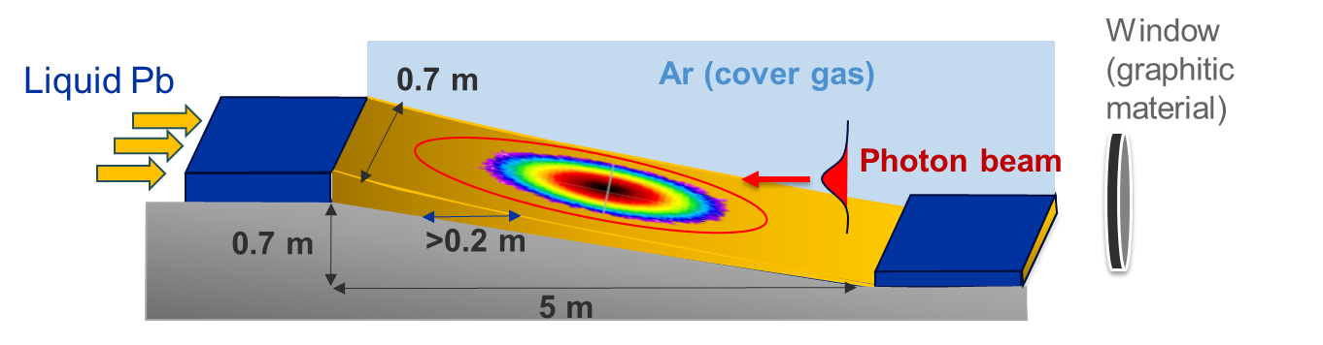
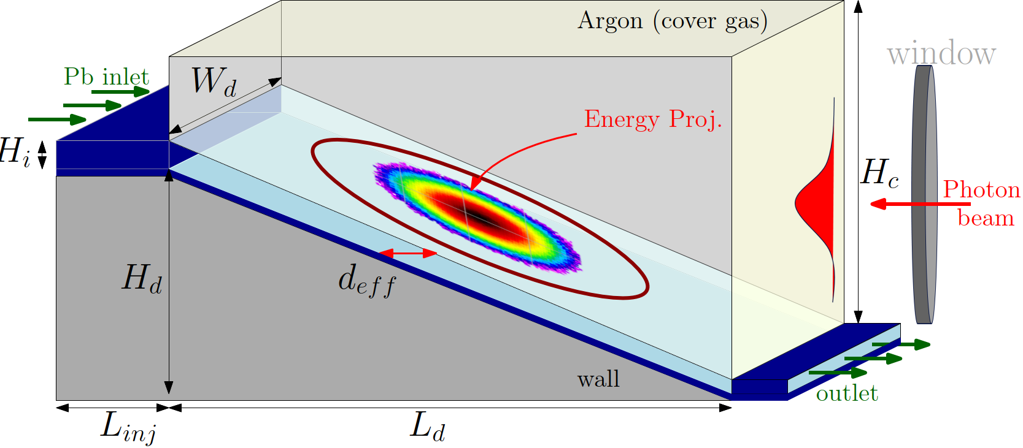
Concepts for Liquid Lead Beamstrahlung dump
Monte Carlo FLUKA simulations* showed that it is required a volume of 70x70 x 20 cm for the full absorption of the BS radiation
(Transverse)
Effective thickness (direction of the beam)
A first concept of a single vertical curtain flow as proven to be unfeasible due to the required high flow rate (>1500kg/s)
*A. Frasca, IPAC24
Option B
Option A
Free-Falling Thin Curtain + Box
Slope System
~ 0.7m
~ 0.7m
~ 5m
~ 1m

Slide 5
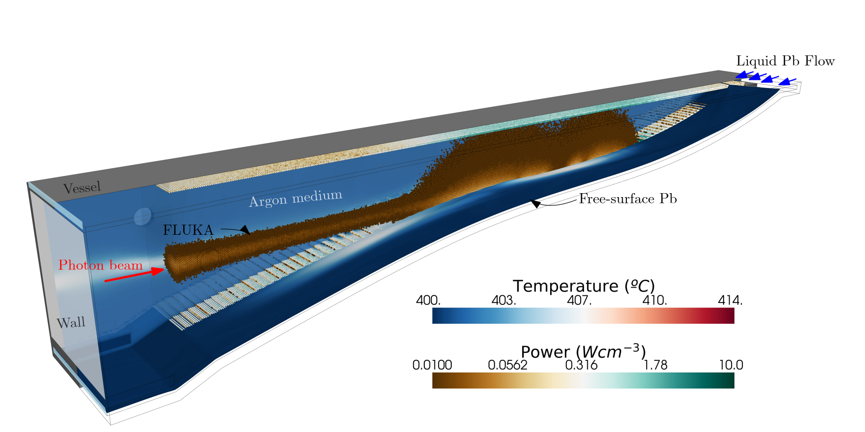
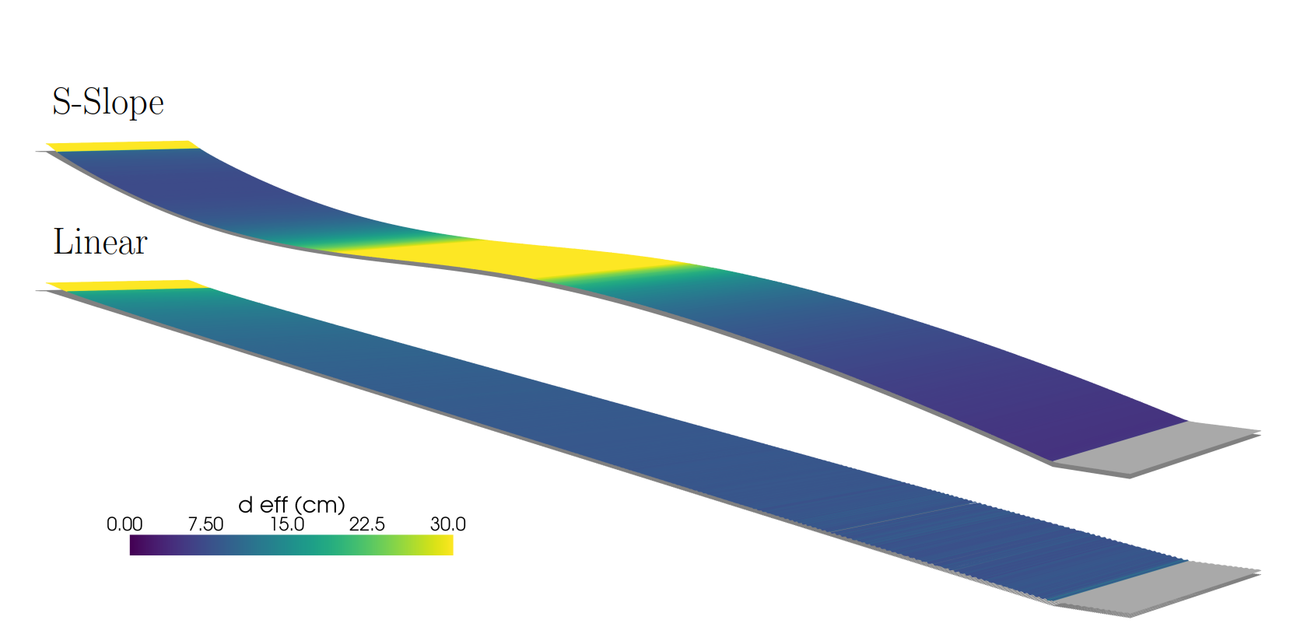
Optimization of the Slope Concept
Linear vs S-Curve
Optimization objective is to maximize the effective thickness of the liquid Pb flow while keeping a maximum flow rate of 300 kg/s*.
A “S” curve is optimized, achieving a high effective thickness in the centre of the beam (>20cm)
Decrease of the necessary inlet mass flow rate compared with a free-falling curtain
* Due to constrains of the hydraulic system (space/pump)

Slide 6
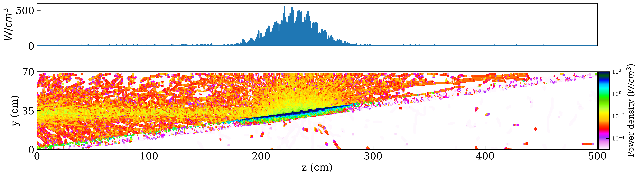
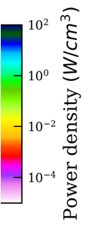
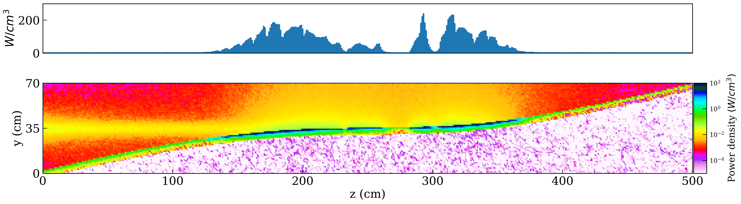

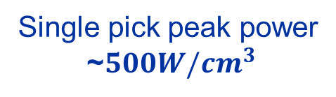
Monte Carlo Simulations for Power Deposition
Option A: Linear Slope (8º inclination)
Single pick peak power
~$500W/cm^{3}$
Some very small penetration bellow the liquid lead
Option B: Optimized S Curve Slope
Peak “dituled” in two ~$250W/cm^{3}$
Due to shallow angle of interaction, photon beam is scattered upwards!

Slide 7
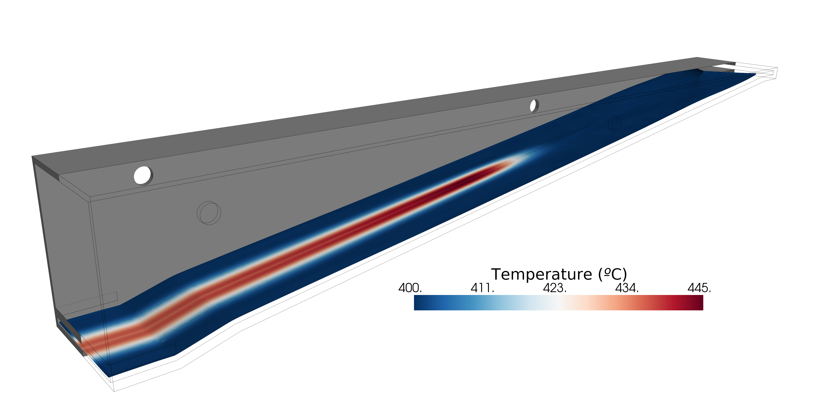
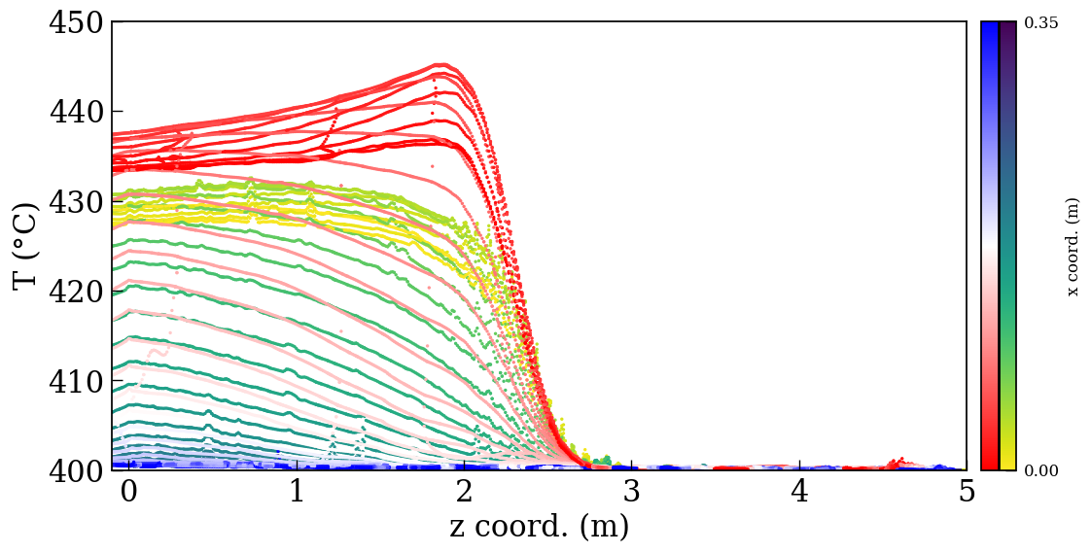
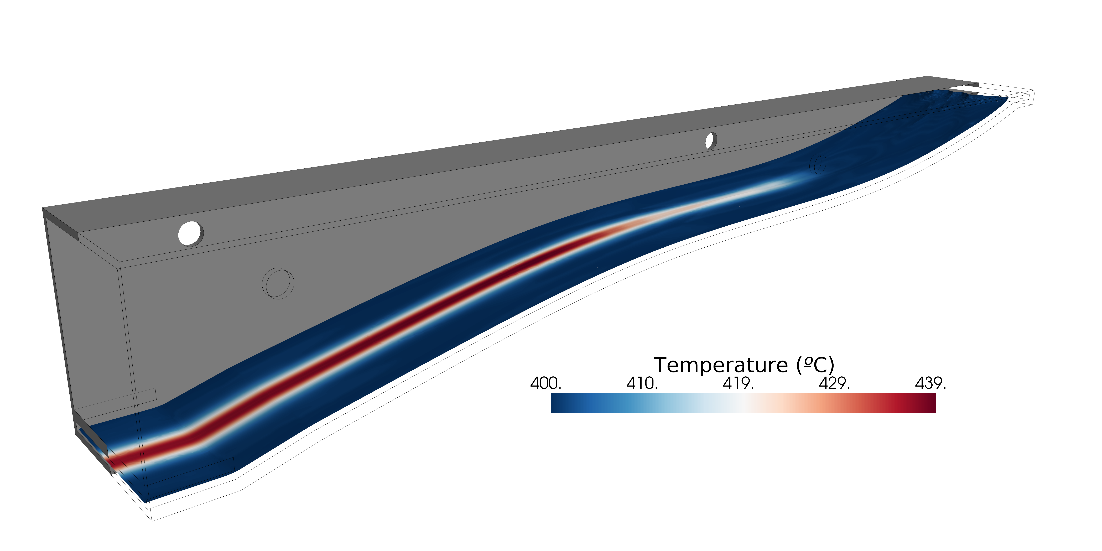
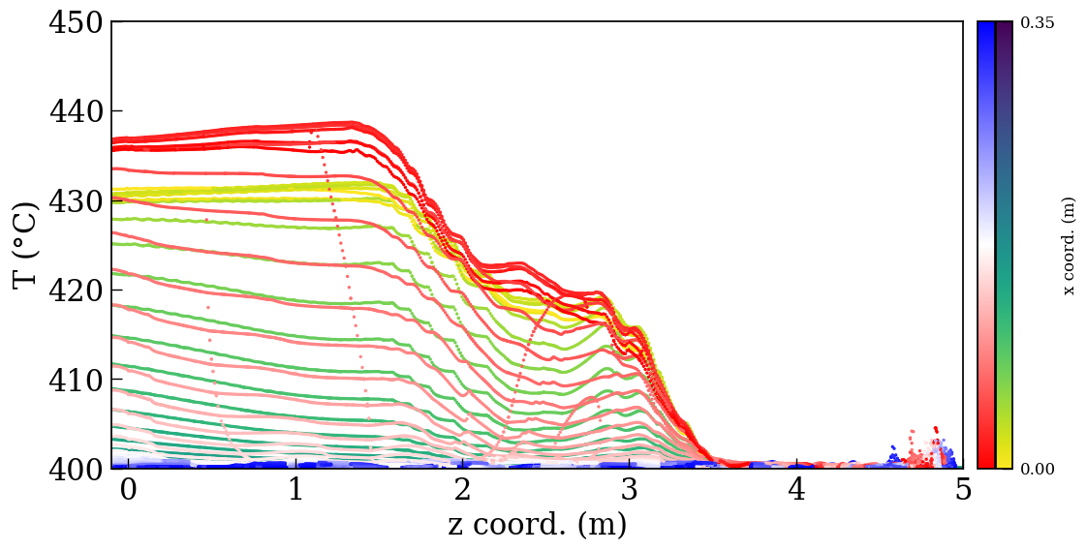
Thermofluid dynamics Liquid Pb Slope
The S Slope can manage and dilute the energy deposition of the photon beam with values bellow 450ºC, for having low rates of erosion (O) 0.1 µm/year.
Linear 8º Slope
Free surface
Steel Wall
S Curve Slope

Slide 8

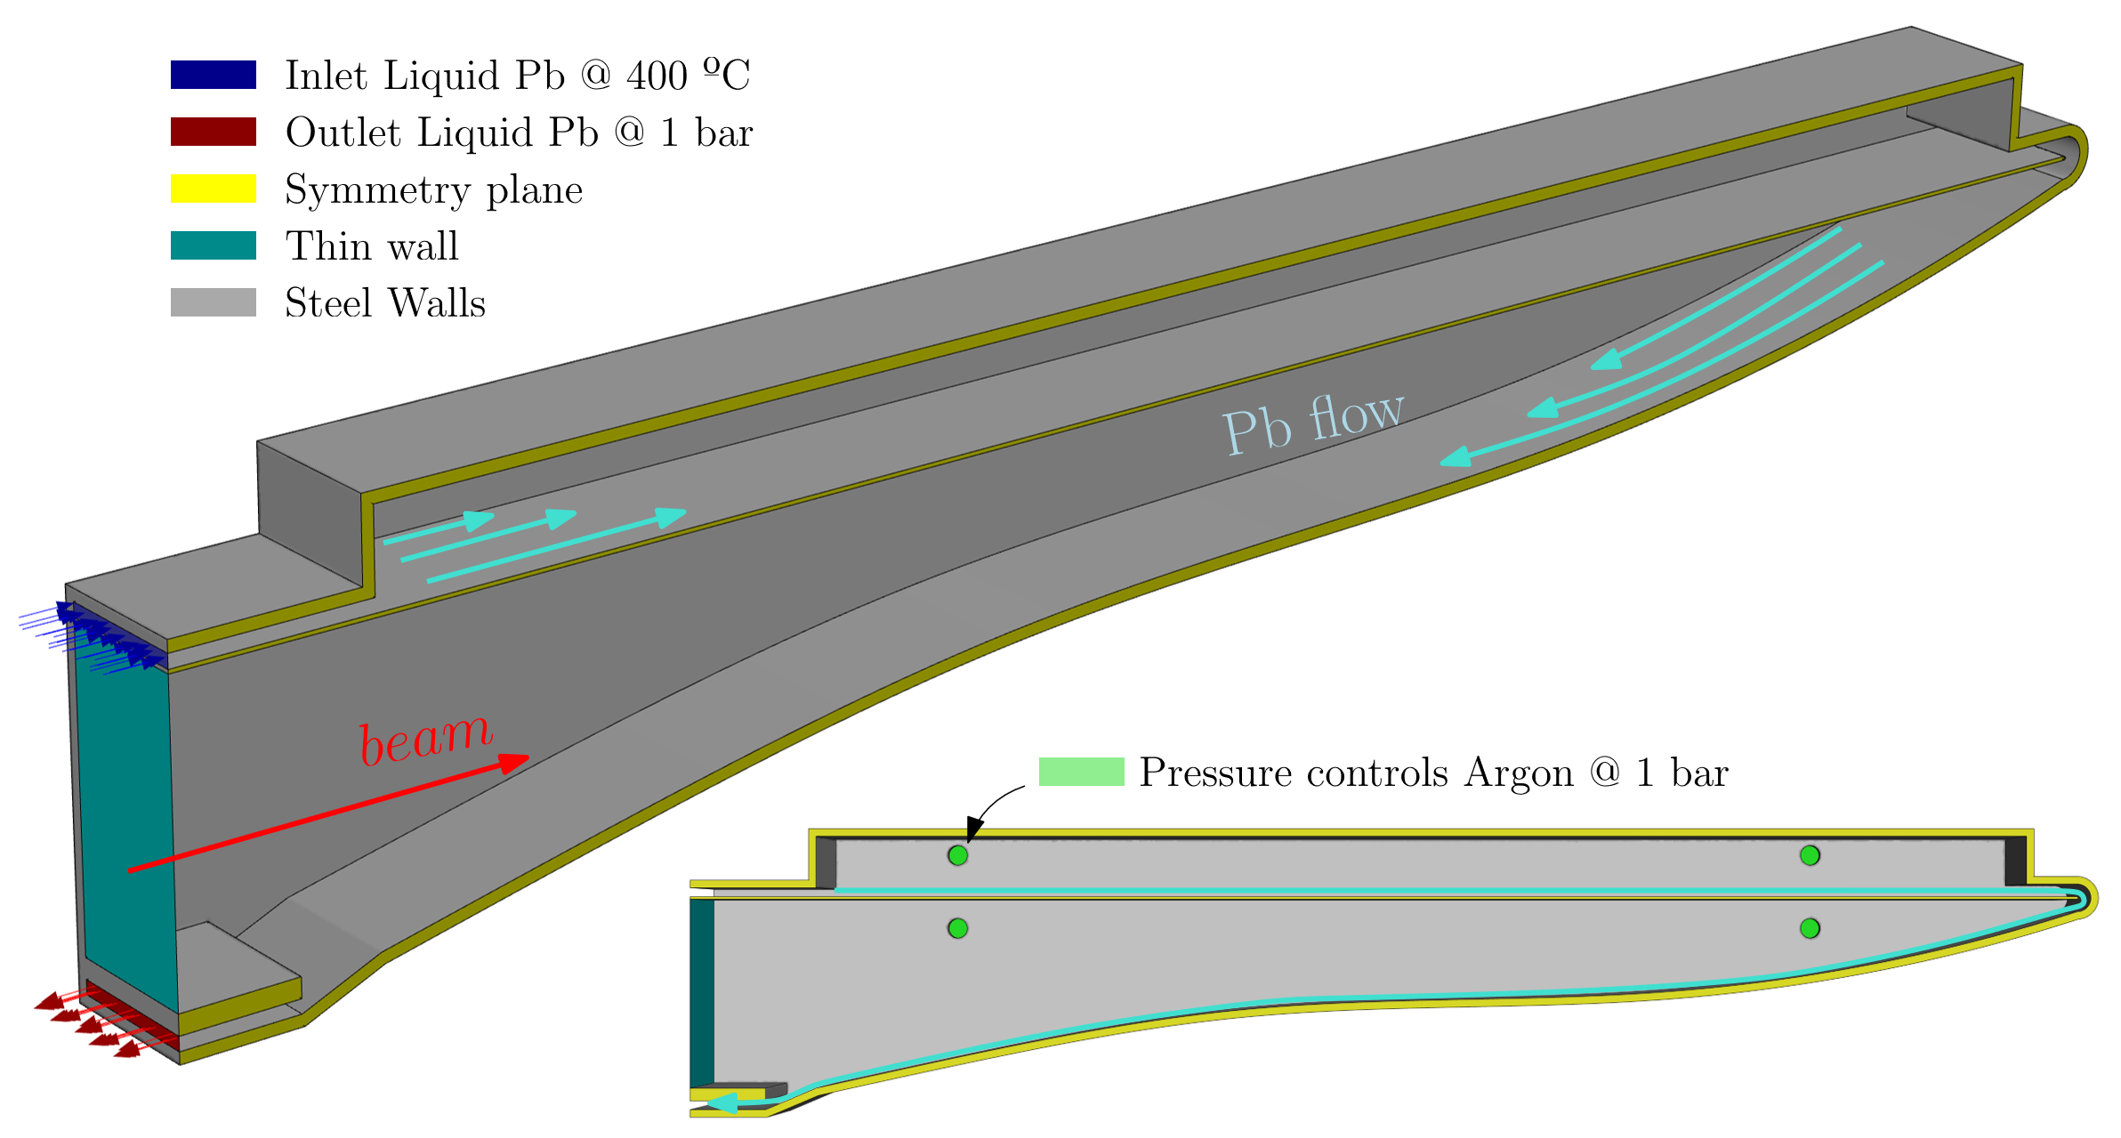
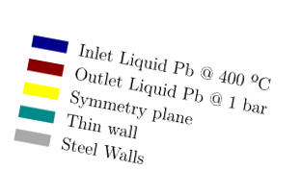
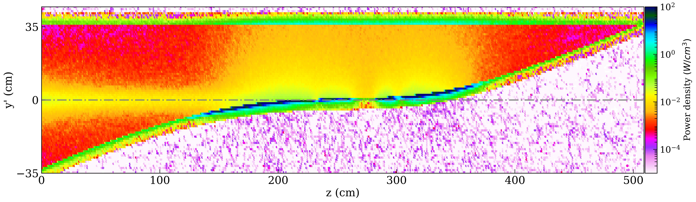
Double Slope for Backscattering Solution
A second upper slope is added to absorb the backscattering radiation
The backscattered radiation is mitigated
Inlet Pb
@ 400ºC
Outlet
1cm steel plate
Power absorption in each component*
CFC window = 13.7kW
«Main» Liquid lead: 248.1 kW
SS upper support: 36.45 kW
Upper liquid lead slope: 13.86 kW
Side walls: ~10 kW
AISI 304/316
total: 345.8 kW (~94% of BS)
* ~24kW are dispersed around the dump, check https://indico.cern.ch/event/1483148/

Slide 9
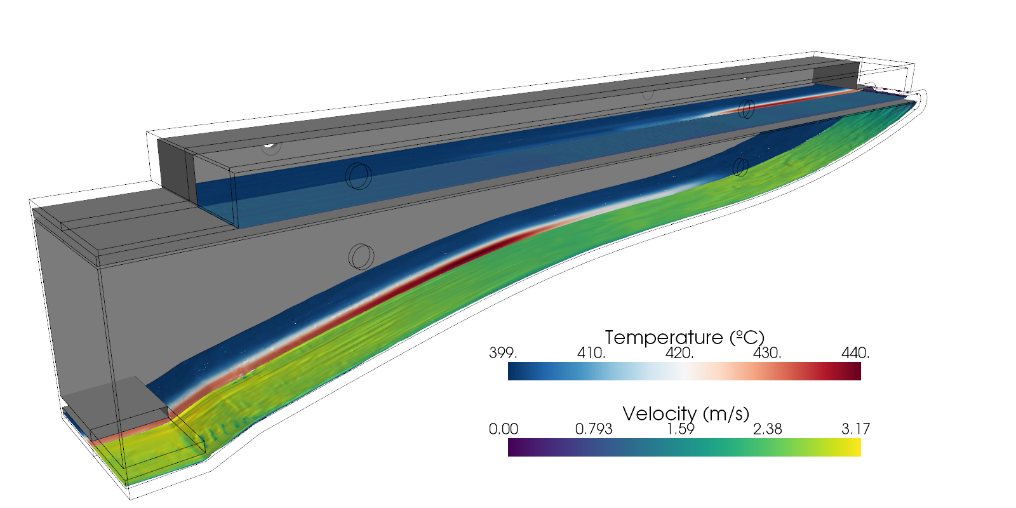
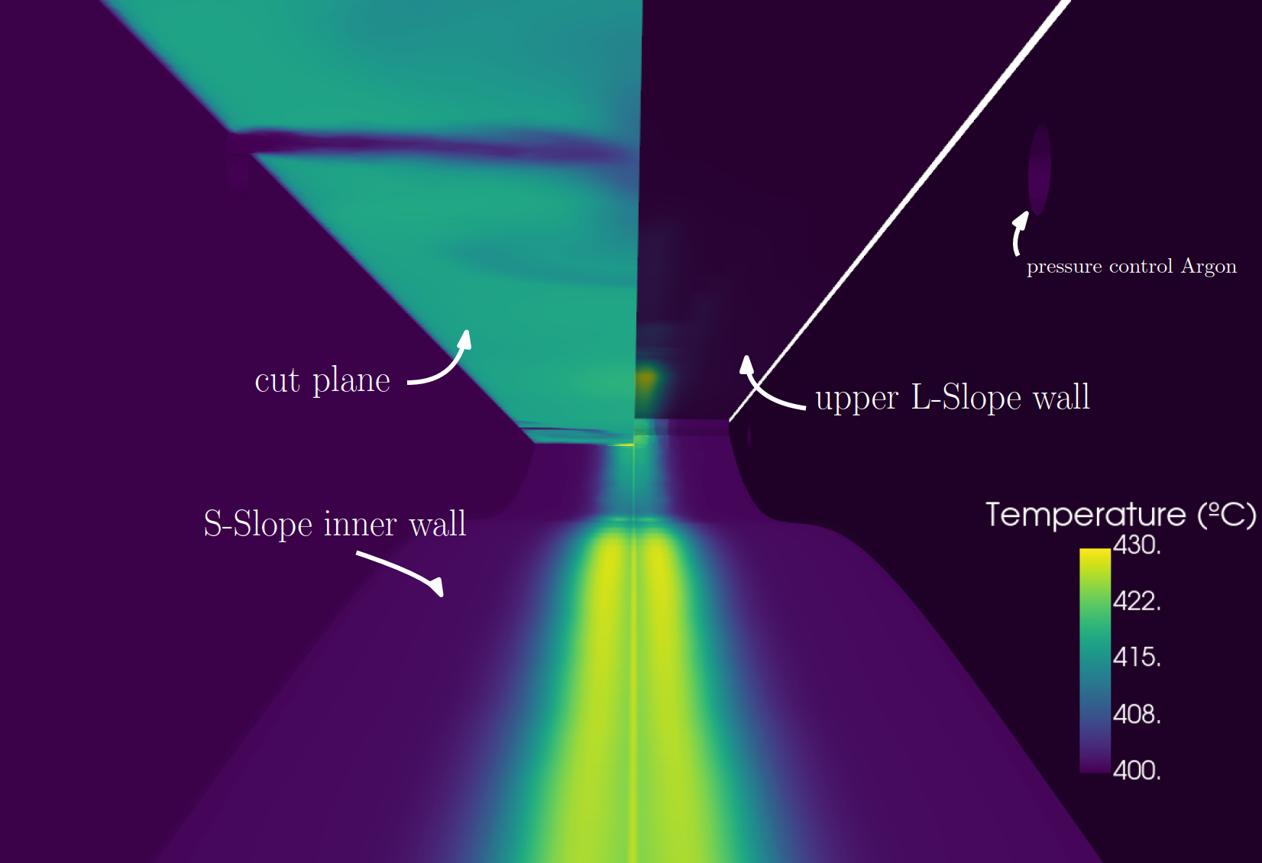
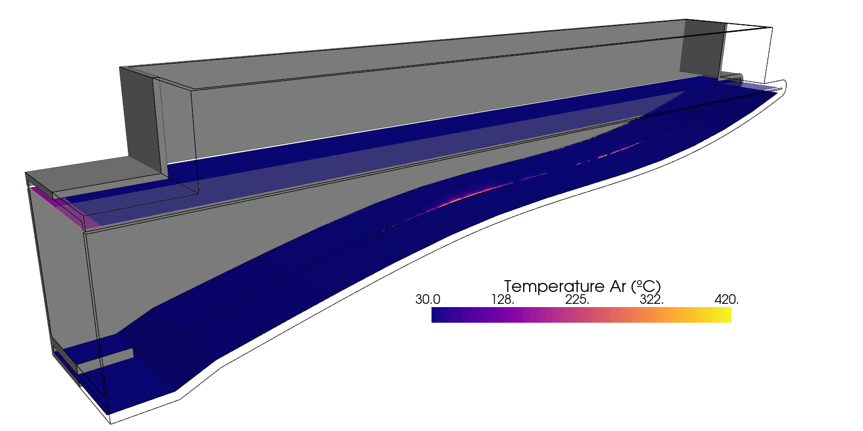
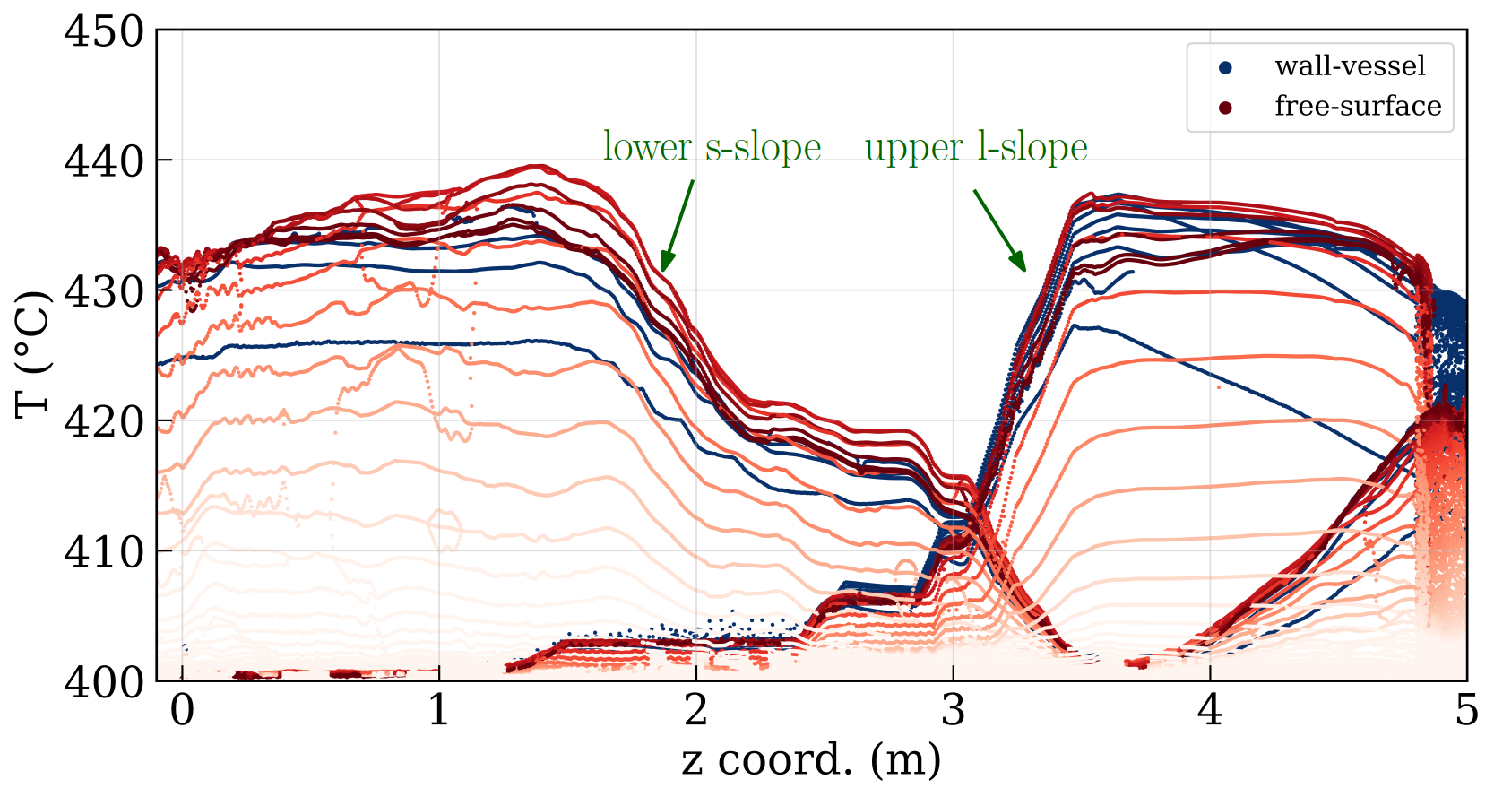
Double-Slope dump concept: Thermal and Structural
Double slope is capable of “trap” all the energy from the backscattering!
Temperature Inside Dump
Thermofluid simulations shows acceptable range of temperature and velocity of the liquid lead
Thermomechanical simulation shows an acceptable stress (11MPa von mises max stress) due to the heat and weight of the Pb (~.8ton) in the upper steel plate

Slide 10
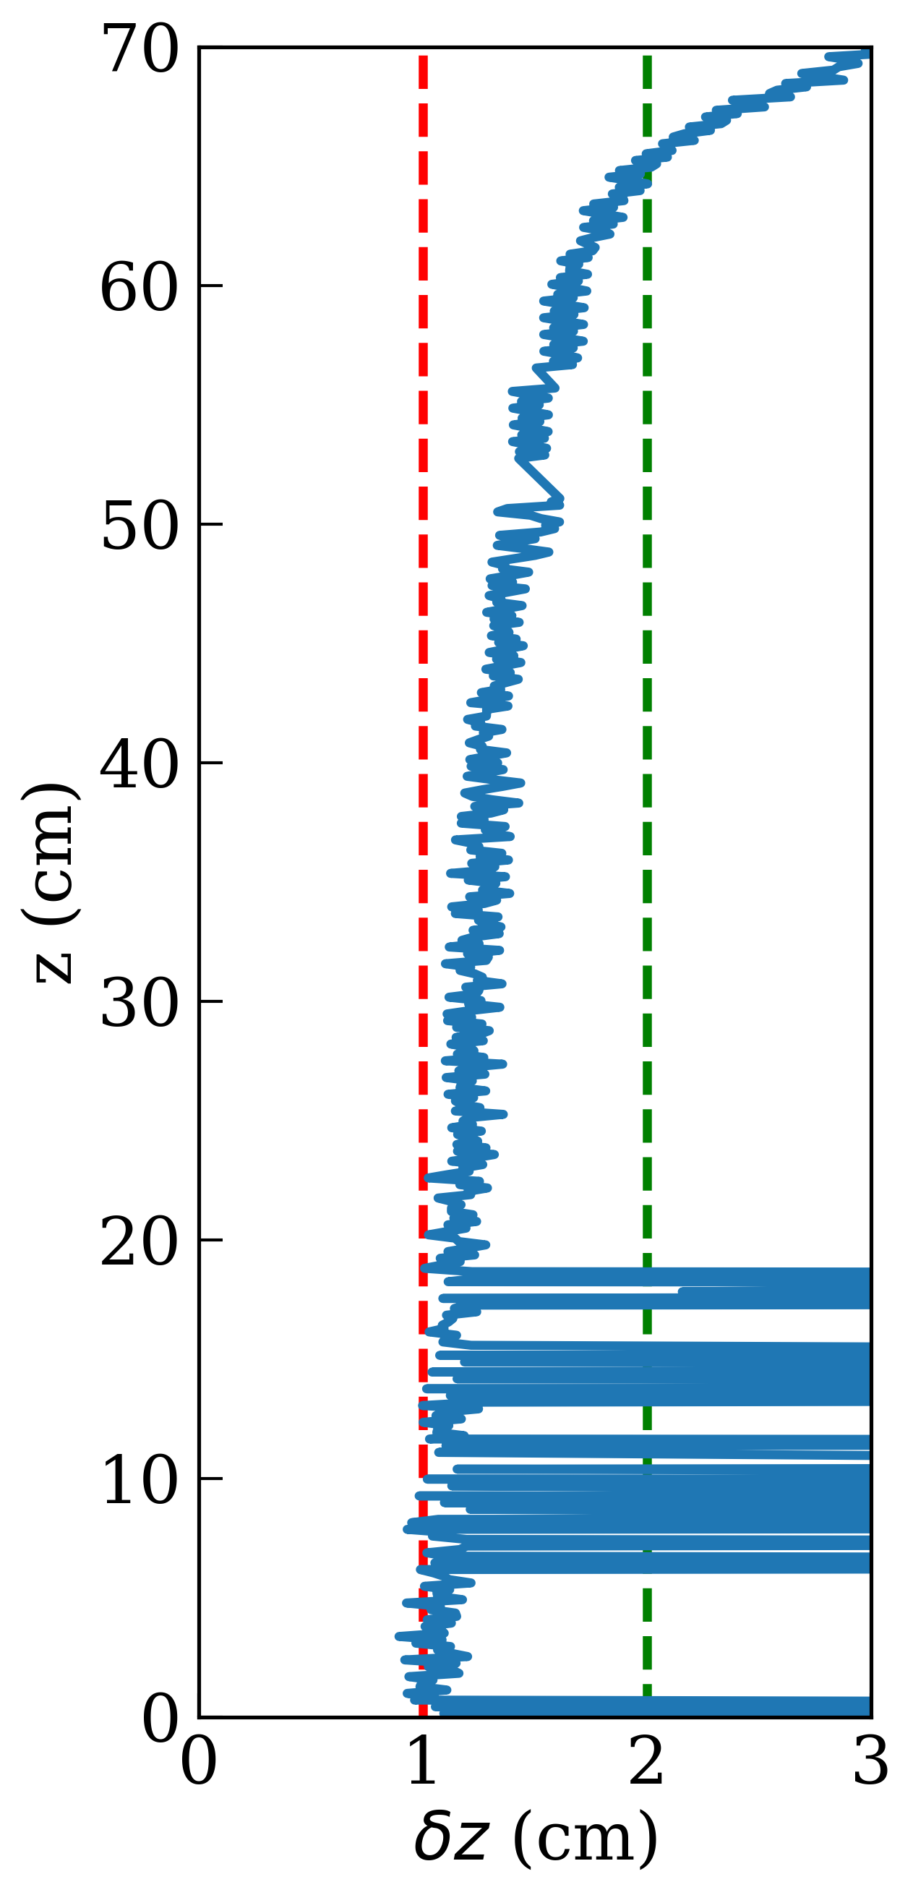
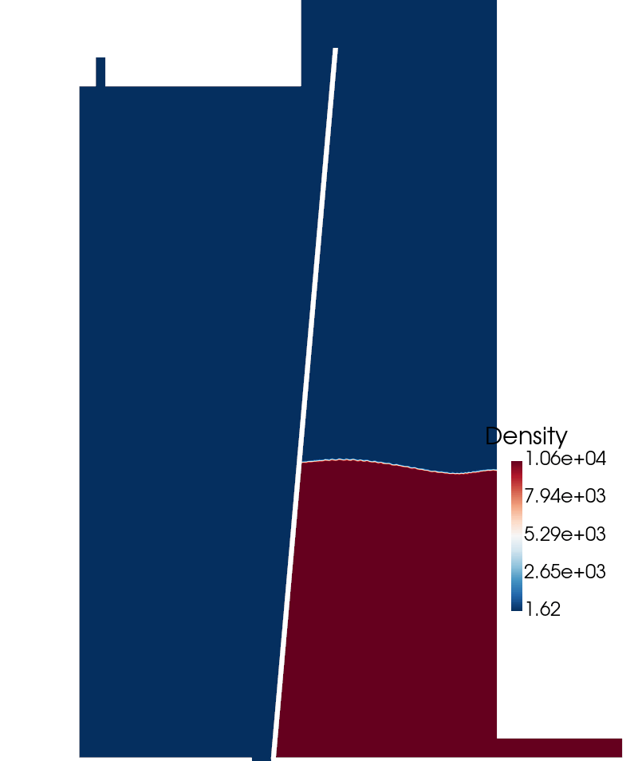
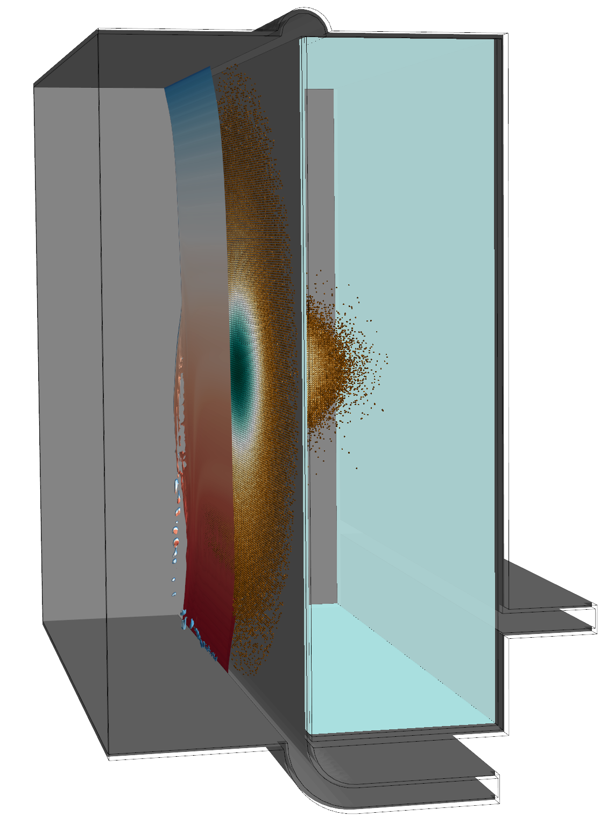
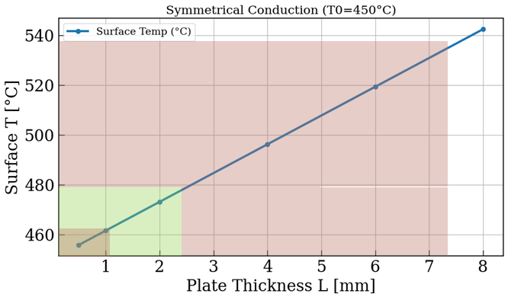
Compact Liquid Lead Concept
A fully vertical curtain is not stable and detachment from the wall is not controllable
A tilted steel wall can be used to generate the “curtain” more stably, keeping a very small inclination to prevent the backscattering effect
85º ~1cm curtain
Concept design
Effect of Thickness of the supporting wall
curtain
Photon
beam
Pb in
Higher thickness of the steel wall will increase the temperature and lower compromise structural integrity
Pb out

Slide 11
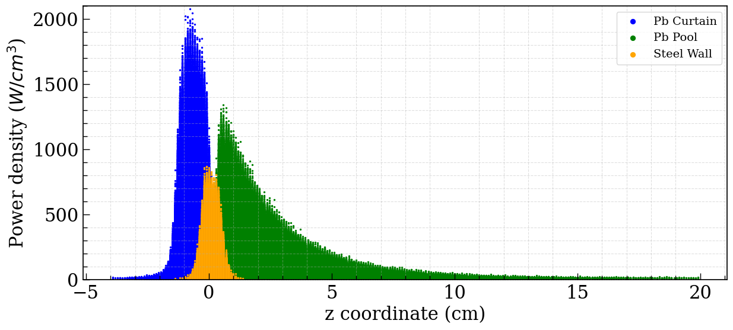
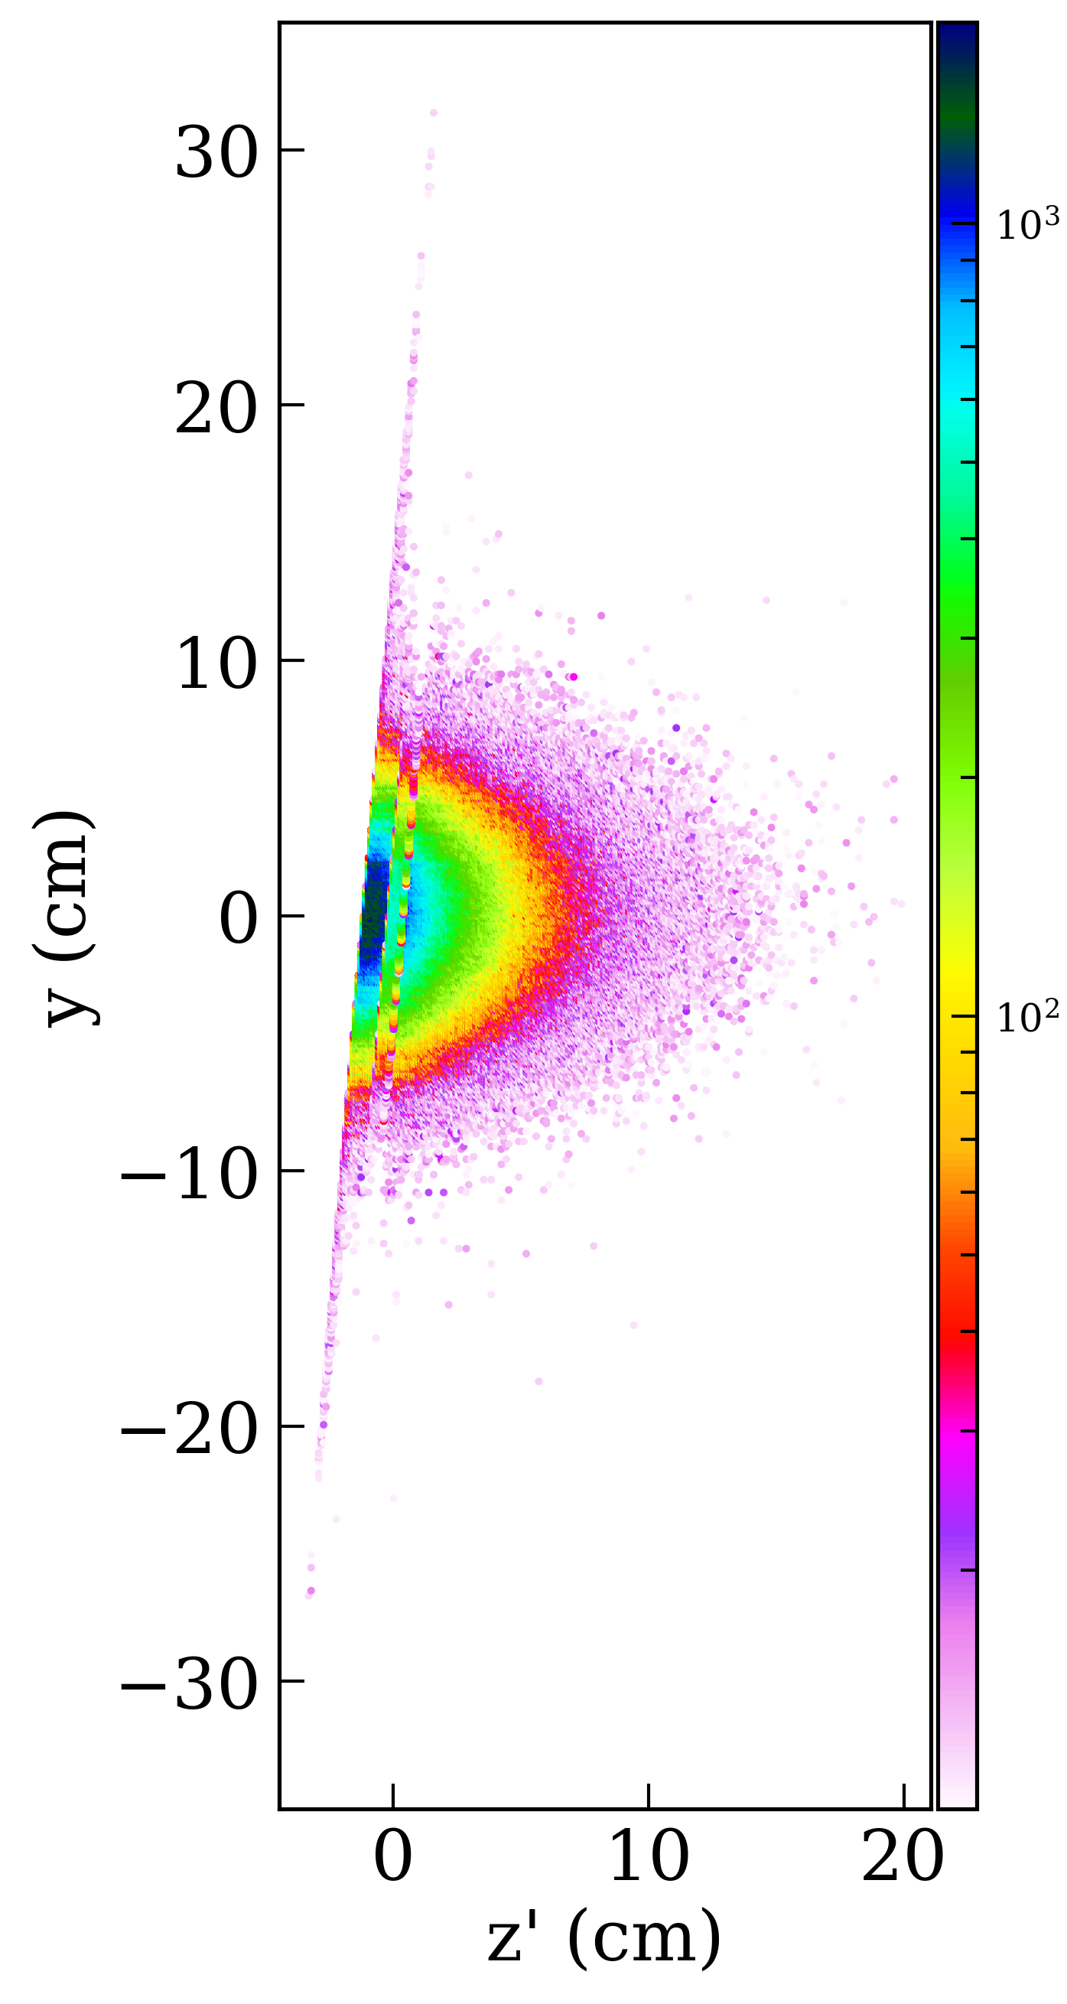
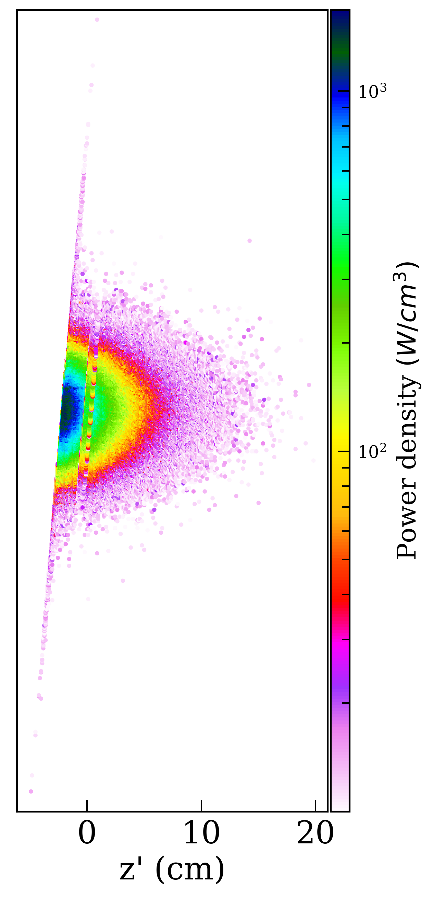
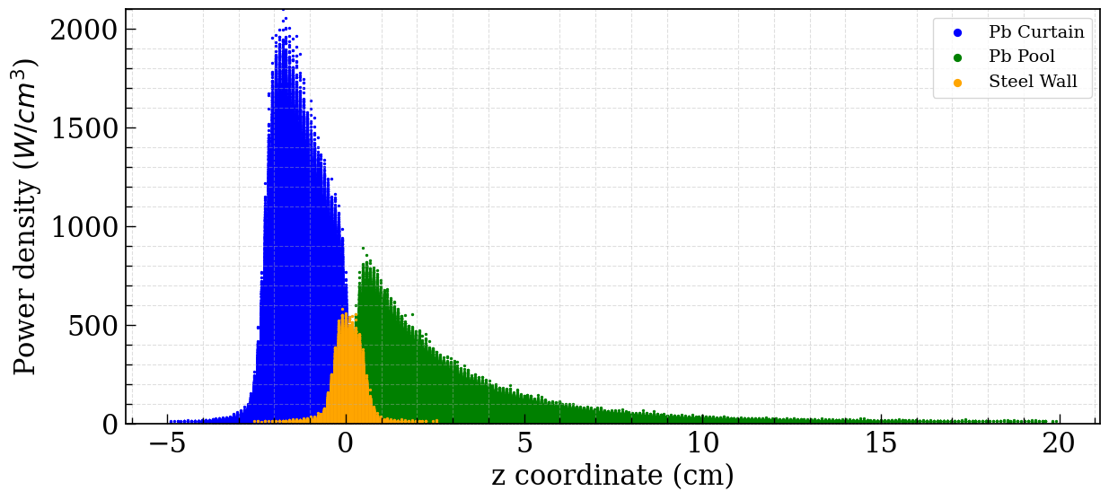


Tilted Curtain + Pool of Liquid Pb
The front wall of the box is tilted 5º to ensure a stable flow and no backscattering
1cm curtain
1cm curtain
2cm curtain
$$\sim 900 W/cm^{3}$$
To High temperature on steel wall
2cm curtain
Acceptable but still Challenge on stabilizing a 2cm curtain
$$\sim 600 W/cm^{3}$$

Slide 12

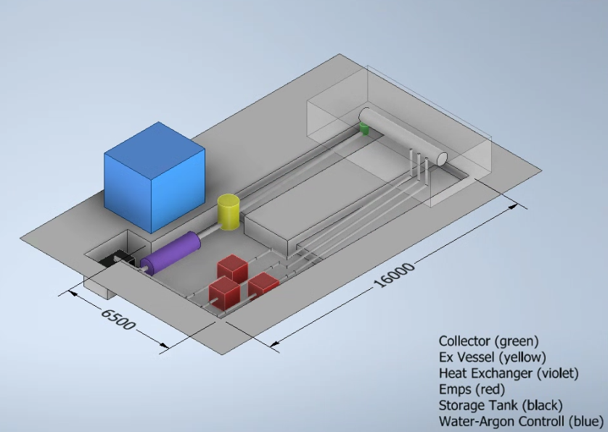
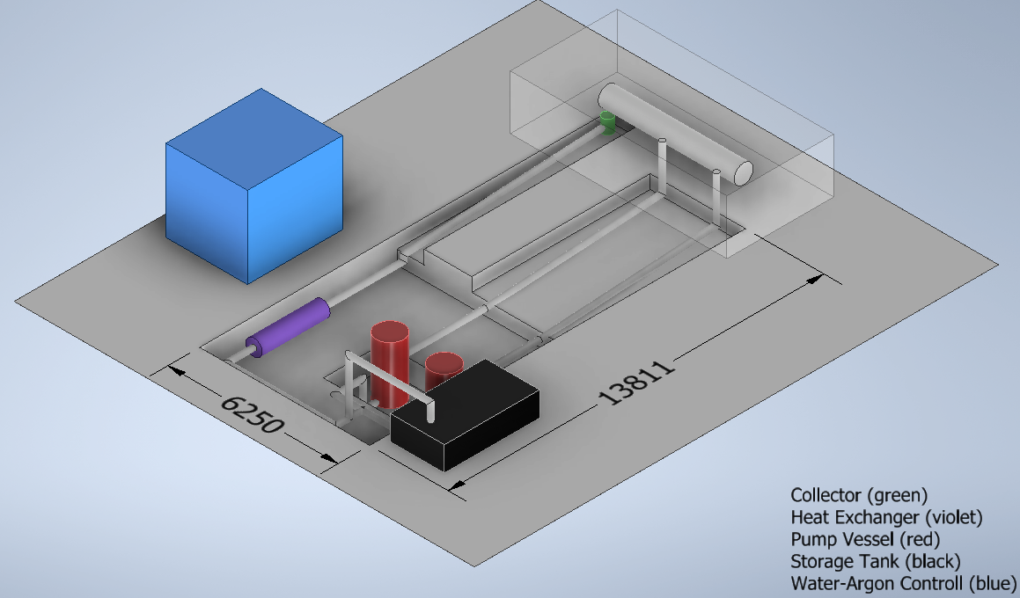
Concepts for Hydraulic System Integration
Option A:
Electromagnetic pumps in parallel
Option B:
Centrifugal pumps
Still required to integrate a dedicated water-cooling skid for the Heat exchanger
Two centrifugal pumps: 1.5 m of NPSH.
Pump vessel: 3000 dm3.
Storage tank: 6000 dm3.
Three pumps in parallel to achieve 350 kg/s.
Exchanger vessel: 700 dm3.
Storage Tank: 2500 dm3.
Centrifugal pumps are less recommended (moving parts) while EMP pumps are separated from the lead flow (better for operation)

Slide 13
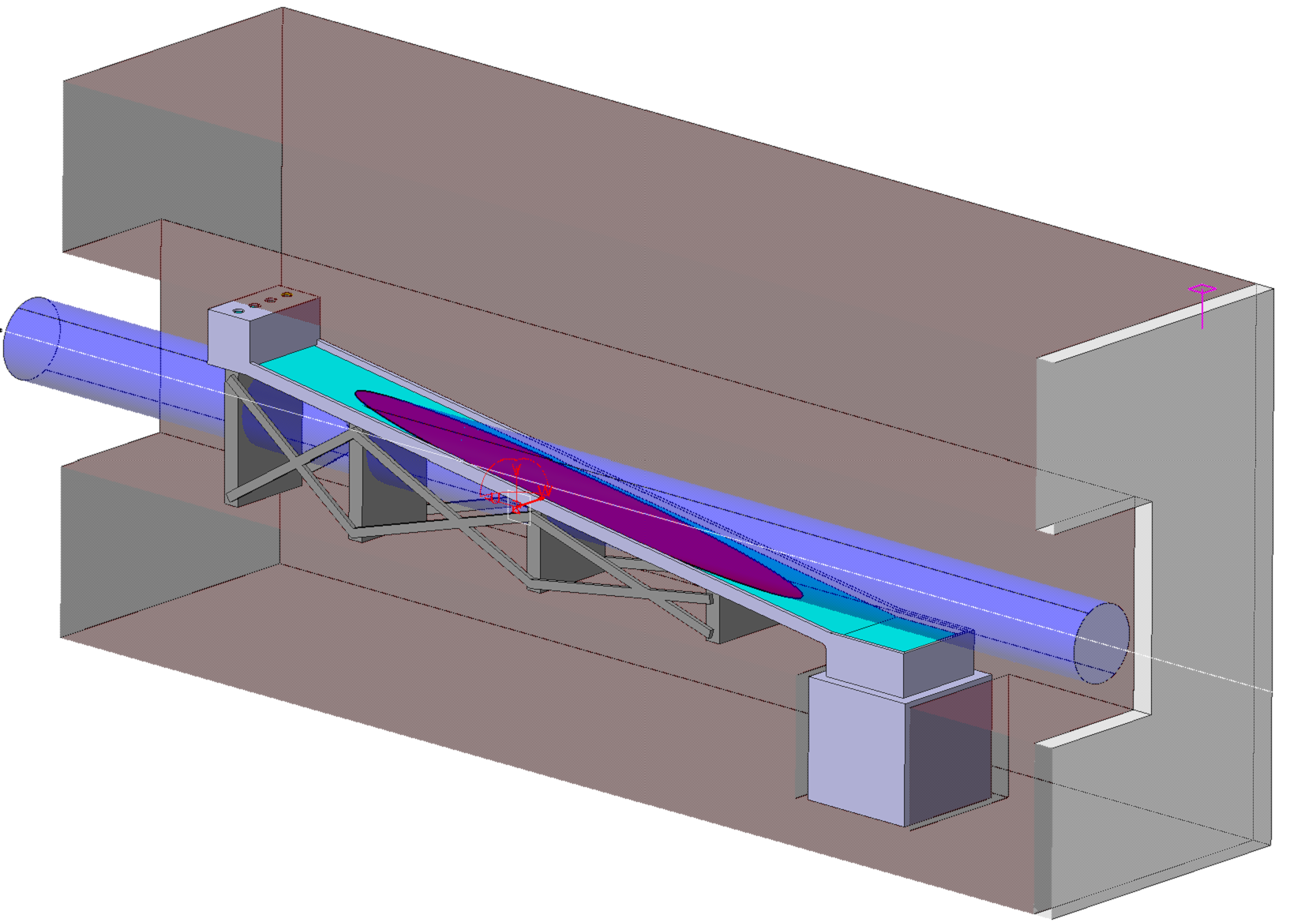
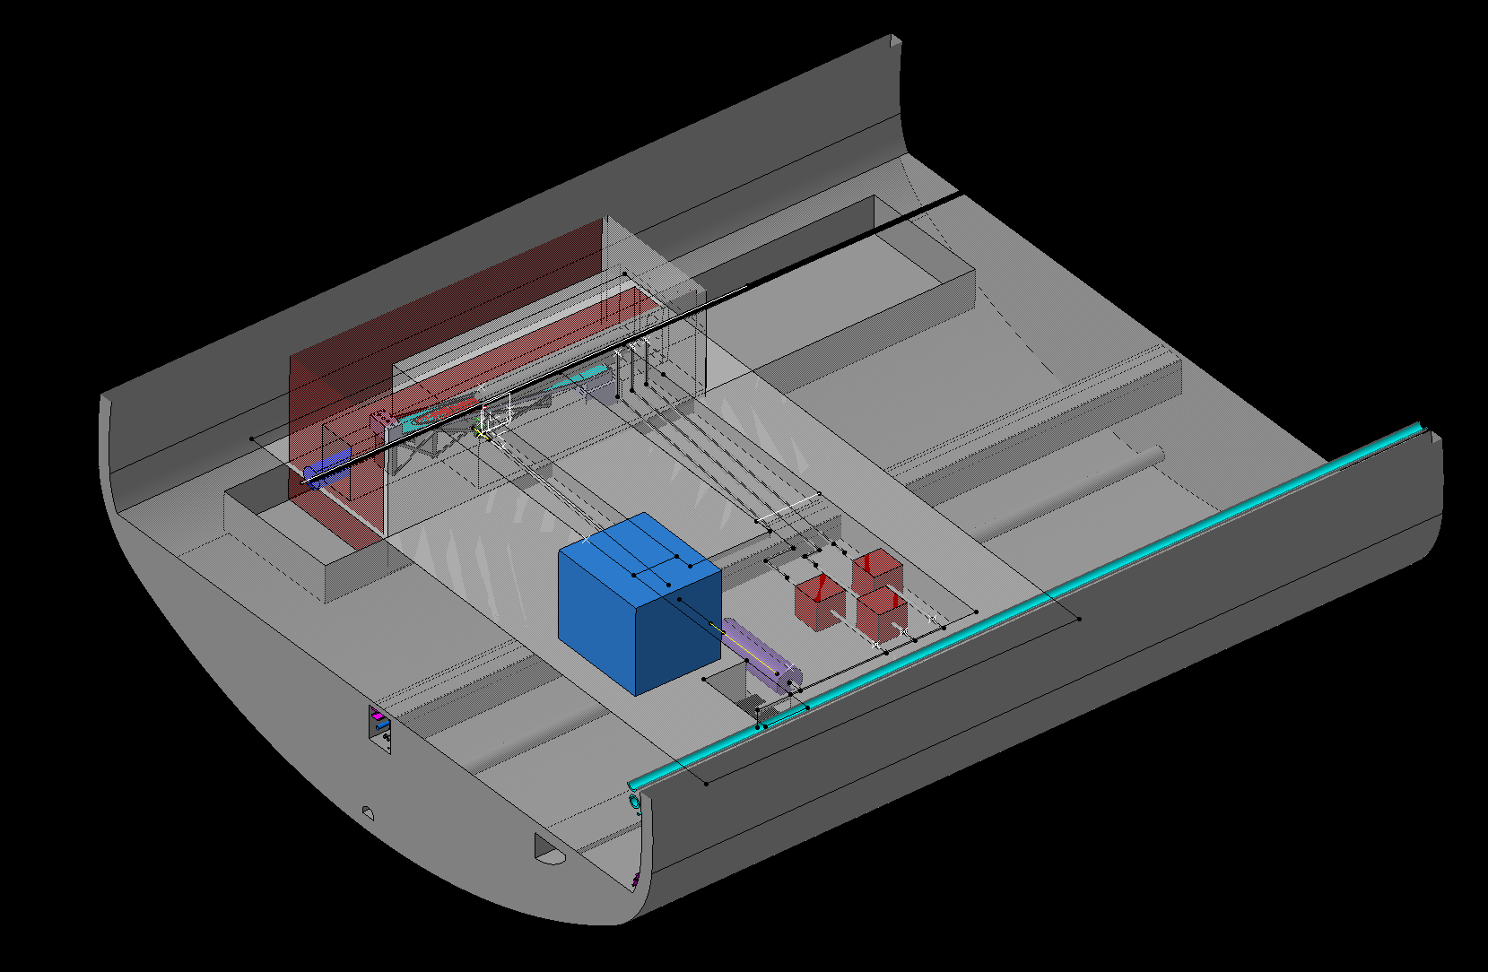
Hydraulics & Integration
Integration model for single linear slope
Our present integration model (still ongoing)
Injection system
700 mm diameter footprint
S. Sorlut
Liquid Pb free surface
Pb collection system
Flow rate: up to 350 kg/s (~ 1 m/s pipes)
Deposited power max: 500 kW
Avg. temp. : 400-460 °C (no corrosion)
Piping: DN100/DN300 Material: AISI 304/316
Pressure losses: < 1.5 bar
Shielding around the dump of 150 cm of Fe in all direction but, not yet dimensioned/integrated
Vacuum window(s) required upstream

Slide 14
Summary
Double slope configuration
Maintains the necessary effective thickness to absorb all the beam energy and maintaining acceptable values for temperature and velocity.
Requires a longer dump
Ensures full, unobstructed free surface contact with the beam
Thin curtain + Box/Pool concept
One centimeter of Pb in front (curtain) is insufficient, as 900 W/cm³ peak on steel wall remains excessively high. Photon decrease in lead is roughly exponential with thickness, so +1cm/1.5cm increase on the curtain thickness would be enough, although some design needs to be done to achieving this.
Practical experience on building and operating HLM systems in the sizes/specifications that we require is proven and showed by ENEA experience
  Liquid option is flexible in terms of power absorption, due to its material properties, but a robust closed control loop needs to be established to make sure that the liquid Pb temperature is well controlled under many circumstances.

Slide 15
Mid-term goals What we are looking for
Conceptual system design for the final FCC Beamstrahlung dumps
  Choice between the different designs from thermomechanical and hydraulic points of view
  Consideration on the variation of the required Power with the optics. v24 showed a power decrease to 240.97 kW @Z pole, 20% reduction on the considered v22.
  Design needs to consider enough margin to absorb additional heat loads (e.g. SR)
  Clear understanding of the operating regimes and accidents are required in order to design such lead system (temporal and nominal)
Advanced system design for a reduced scale (1:2 or 1:3) prototype
  Prototyping a reduced scale (>1:2) experimental model is required to gain expertise at CERN on liquid Pb hydraulic systems, reliability, instrumentation, etc.
  Engineering design for the development of a prototype loop for Horizon 2030
Investigate other R&D threads related with the CERN application (e.g. materials compatibility, reliability of components, reduced/remote maintenance, instrumentation, etc)

Slide 17
Extra Details

Slide 18
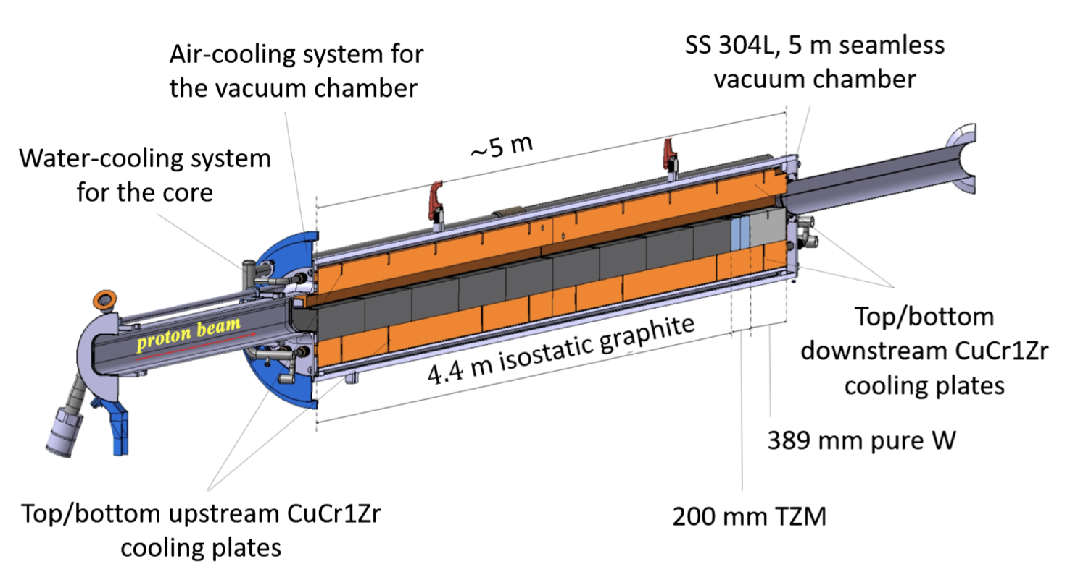
Comparison with solid absorbers
CERN’s experience is vast in solid state absorbers*, e.g., graphite. Although, liquid heavy metal flows requires new expertise to the design, implementation and operation of hydraulic system and the BID itself.
SPS internal beam dump ±5 MJ, O(300) kW
Liquid Pb system combines high-temperature hydraulics, two-phase flow, thermal stress, and radiation transport in a single system - never implemented in large accelerator facilities for photon dump
A. Francia et al, Phys. Rev. Acc. Beams 27, 043001 (2024)

Slide 19
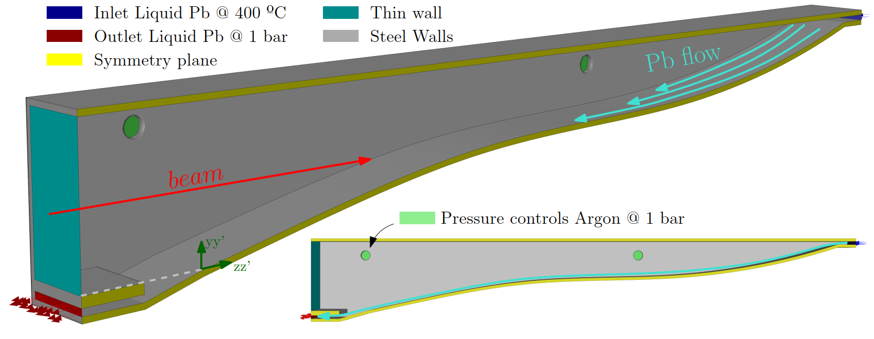
CFD Numerical details
Proposed CFD Model
Solver Type: Pressure-based / Transient
Multiphase Model: Volume of Fluid (VOF) with Level-Set interface capturing (CSF method)
Turbulence model: k–ω SST with (y⁺ ≈ 1-5, due to low Pr number ~0.02)
Liquid Lead inlet Temperature: 400º (Physical properties in function of T)
Simulation Time: 0 – 3.0 s (Transient)
Time Stepping: Adaptive time step to maintain CFL < 1
Convergence Criteria: Residuals < 1e-5 / Mass conservation checked
Energy Source Term
FLUKA → x, y, z, Power Density MAP
Energy Source Term: Volumetric power density [W/m³] applied via UDF.
Phase-specific deposition controlled using local volume fractions (α_i):
source_i = P_i(x, y, z) * alpha_i;
Ensures physically consistent energy input in each phase.

Slide 20
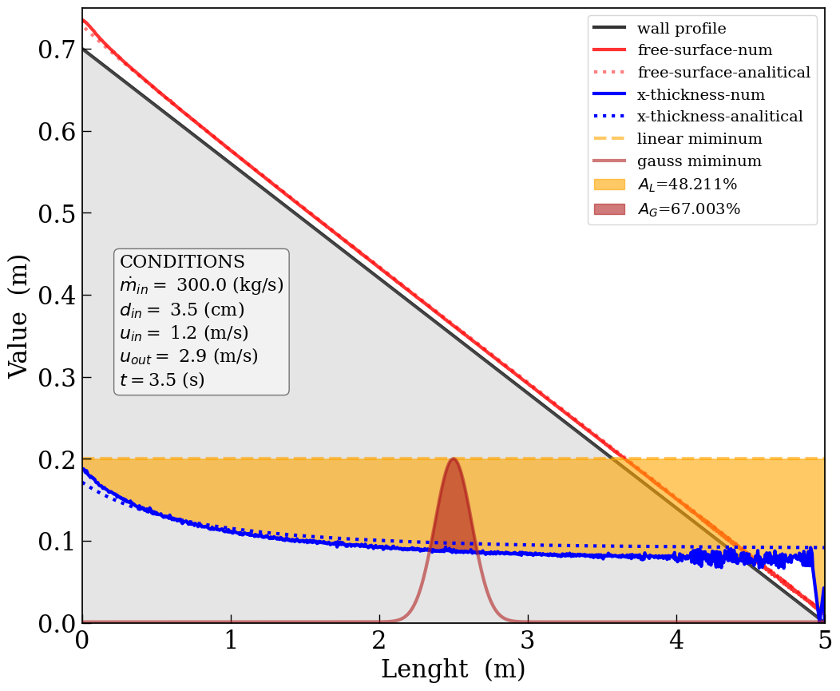
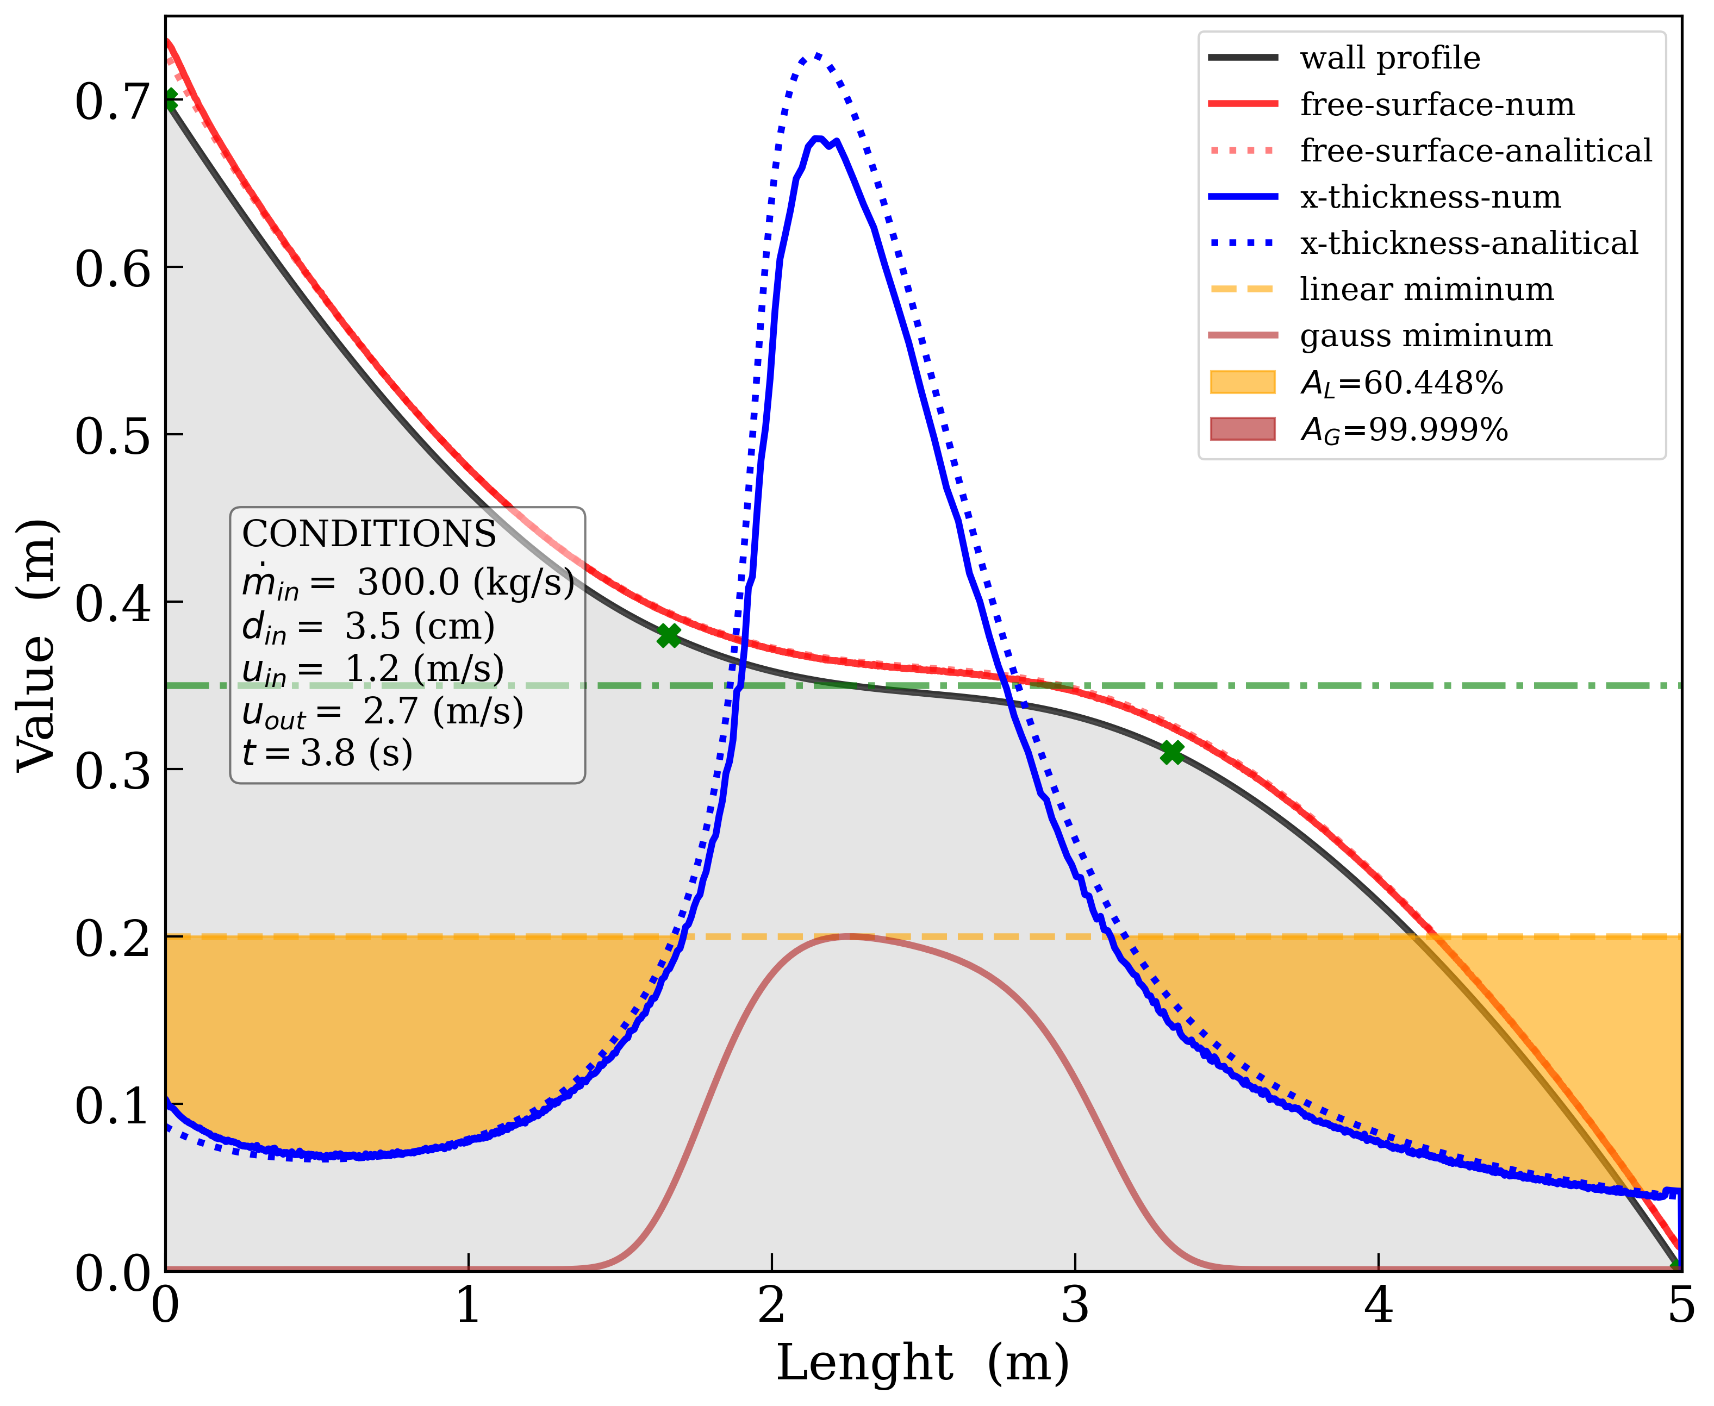
Optimization of the Slope
Linear vs S-Curve
Optimization of the slope considering a Gauss distribution of the energy in the x direction
LINEAR | S-Curve
Validation with analytical prediction considering head loss due to friction using the Colebrook-White formula (a three-parameter approximation for free-surface flow) by V. Bellos et al. (2018).

Slide 21
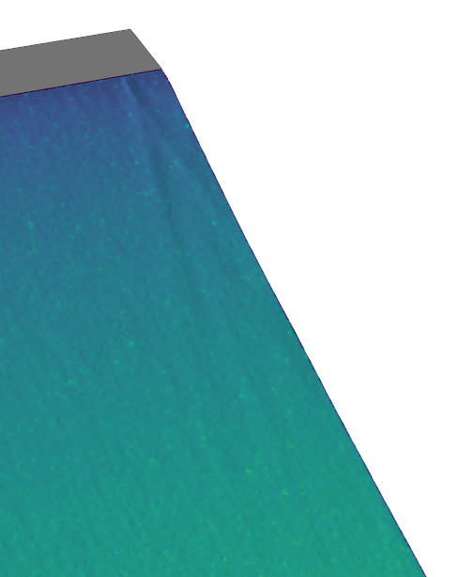
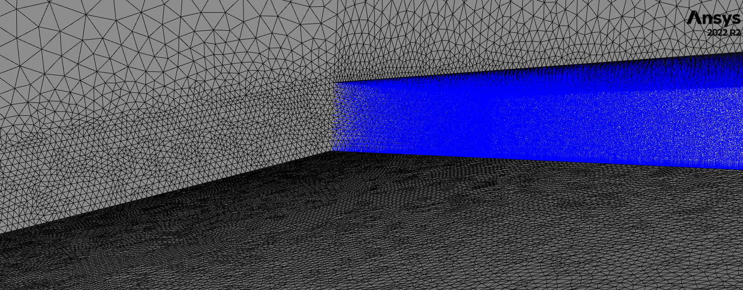
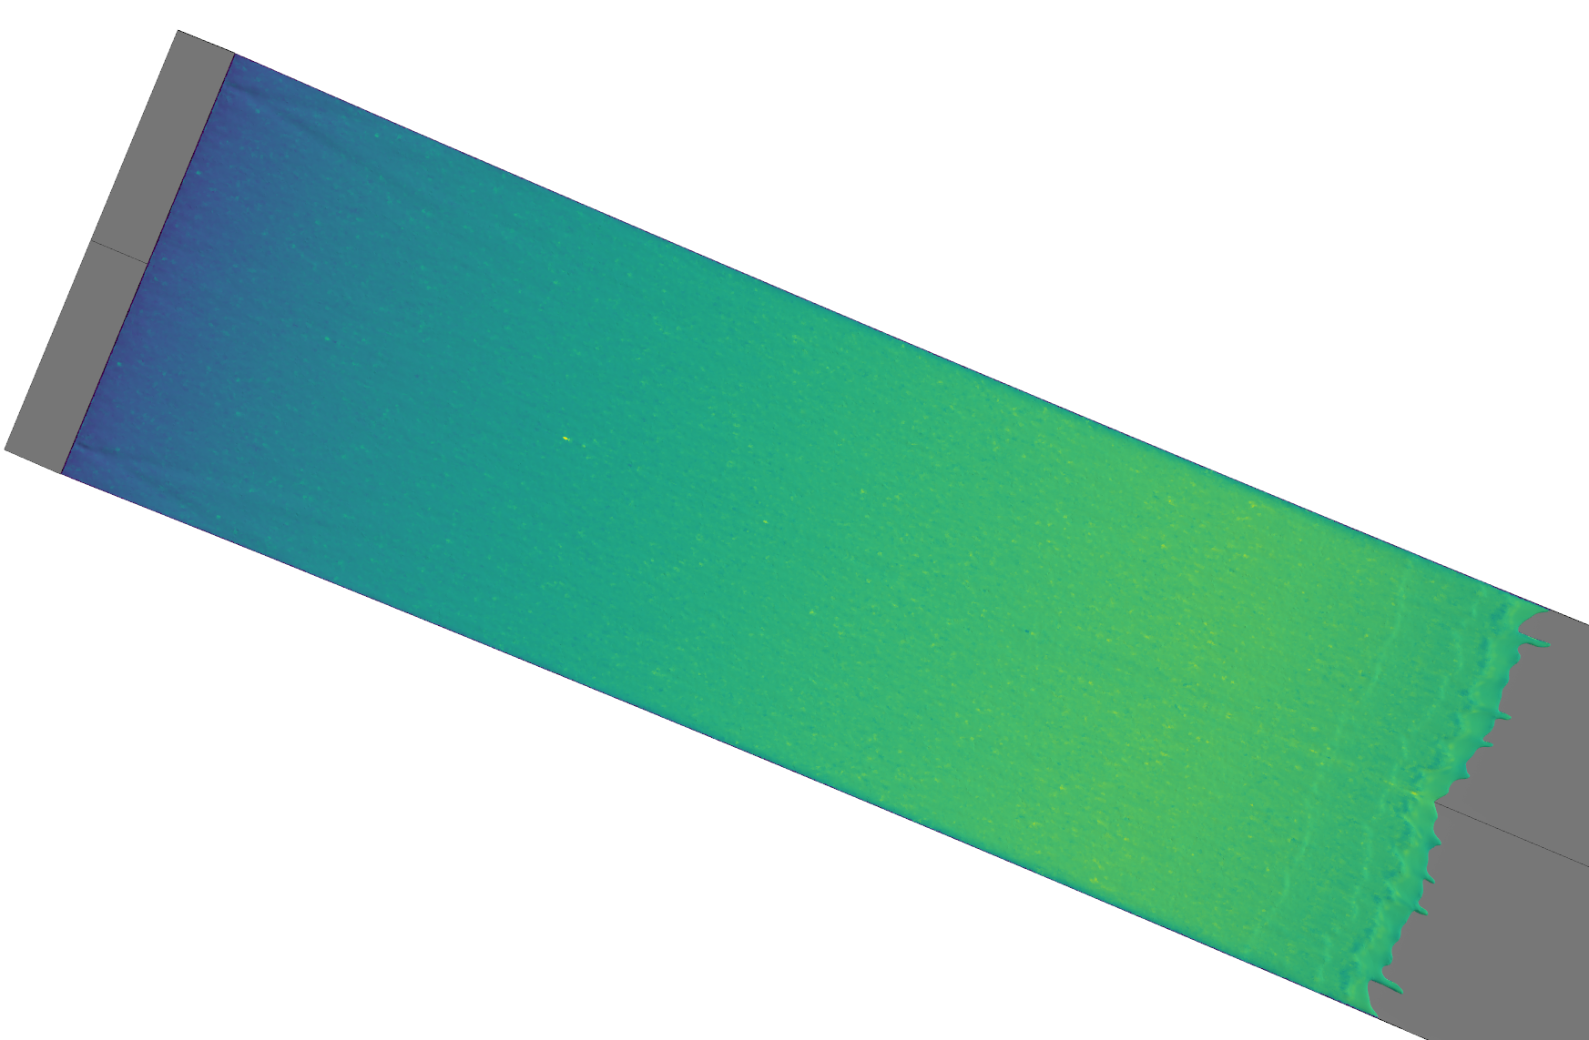
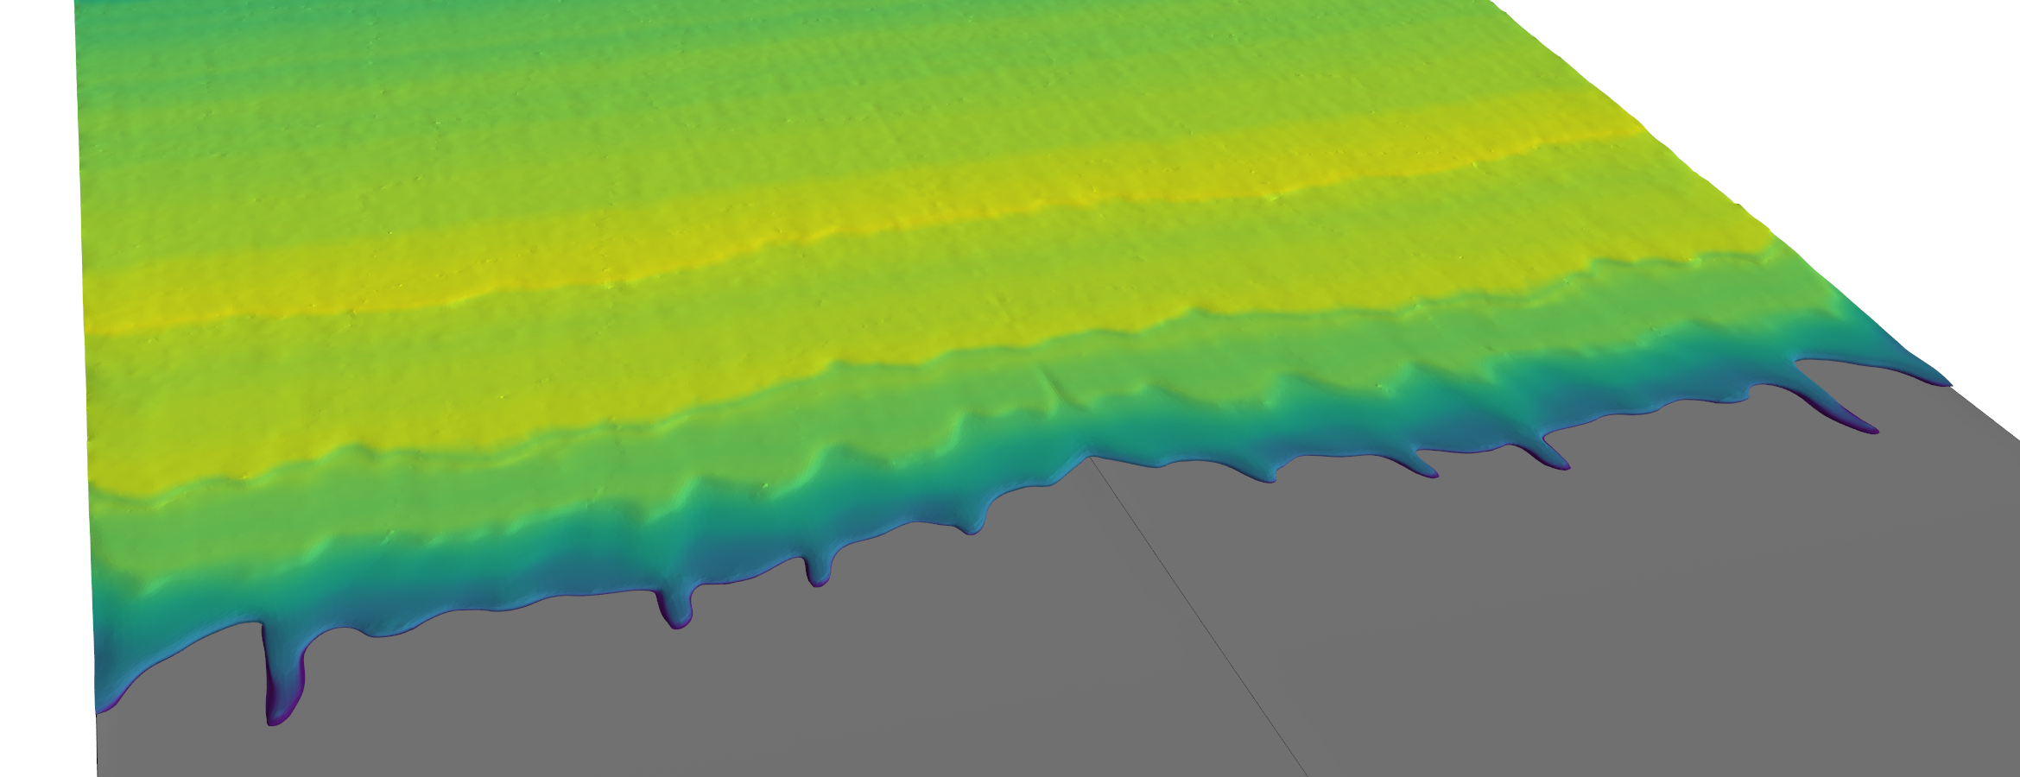
3D Fluid Dynamics
Additional Driving Factors captured only in 3D:
Side Wall Friction
Three-Dimensional Flow Structures
Surface Tension Variations
Boundary Layer Development
Tridimensional two phase flow requires a extreme refinement level for accurate resolution of the curvature of the free-surface
Due to high Reynold number (Re > 1e5) and low Pr number increase of the refinement on the wall is necessary
$$𝒪 1m$$
Surface tension deformation
Inlet region visualization
Wave instabilities
! Upon the injection of the liquid lead, it is necessary to ensure the uniformity of the flow.
Viscous effects can lead to bubbles or imperfections in the profile.
Viscous Fingering

Slide 22
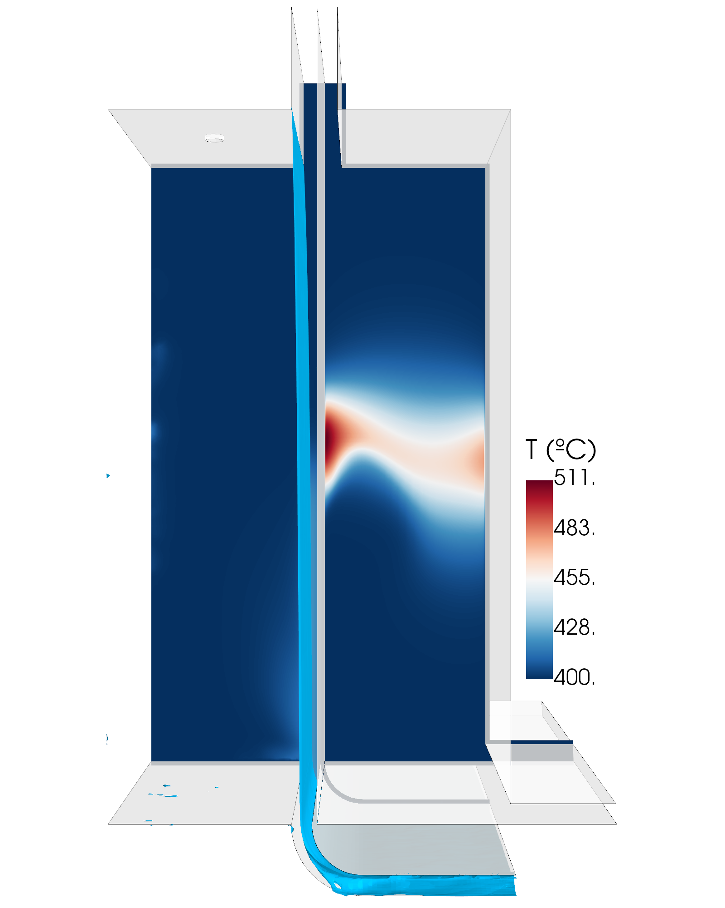
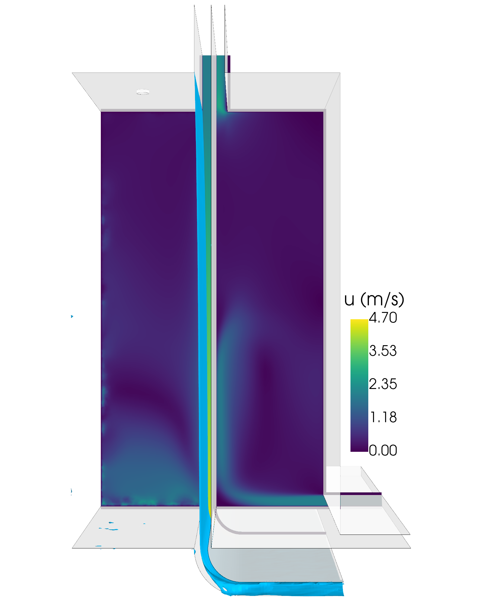
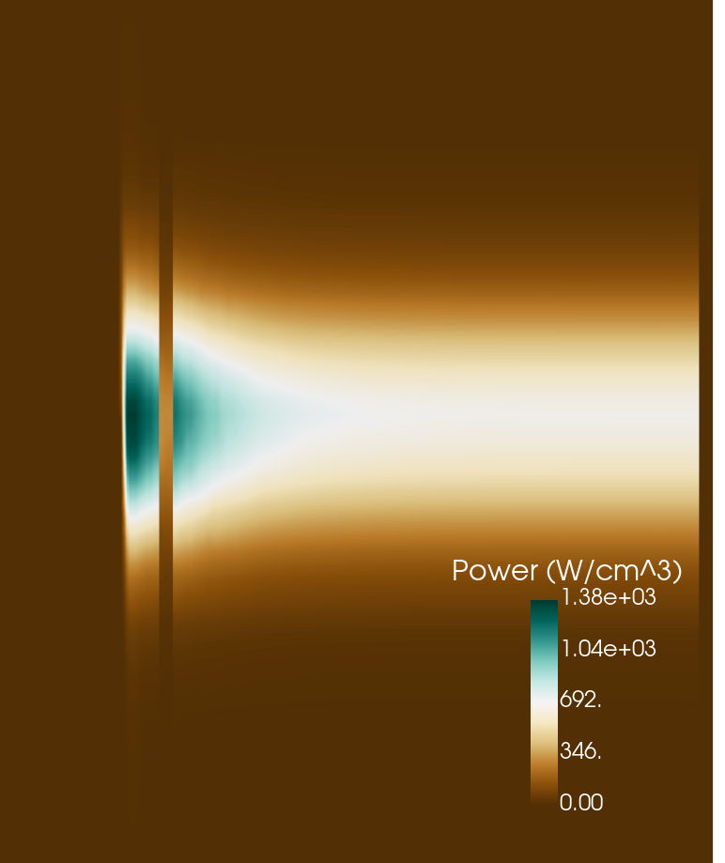
Compact Liquid Lead Concept – Thermofluids
40 cm
70 cm
Stagnation point! To be avoid in Pb flow

Slide 23
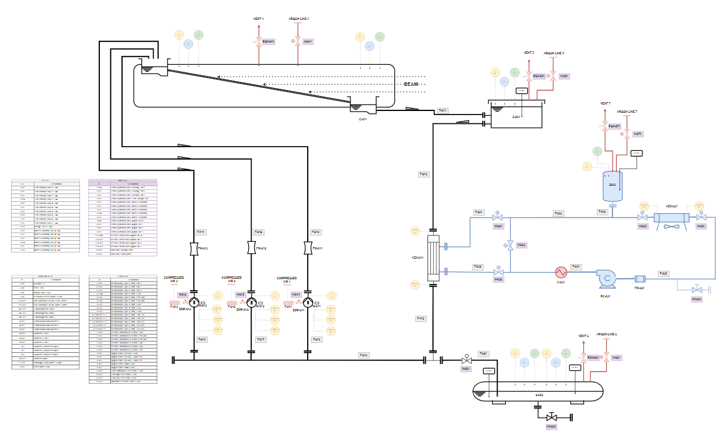
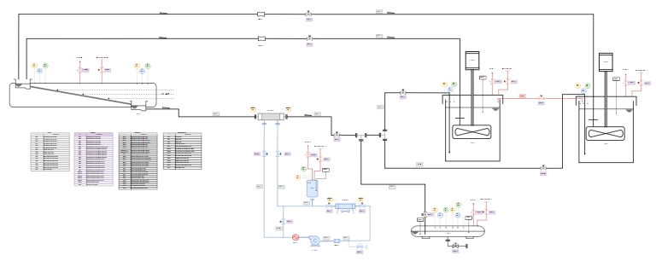
Conceptual P&ID
The liquid lead loop must be positioned below the collector's free surface.
Water-Argon control: ~ L(3.5m),L1(3.5m),H(3m).
Heat exchanger: water 16 bar.
Collector: 75 dm3.
Conceptual P&ID for the 2 hydraulic proposals
Electromagnetic Pumps
Centrifugal Pumps
BS dump
Centrifugal PUMPS
BS dump
Heat exchanger
EMP PUMPS
Fill & Drain
Heat exchanger
(500 kW)
Fill & Drain

Slide 24
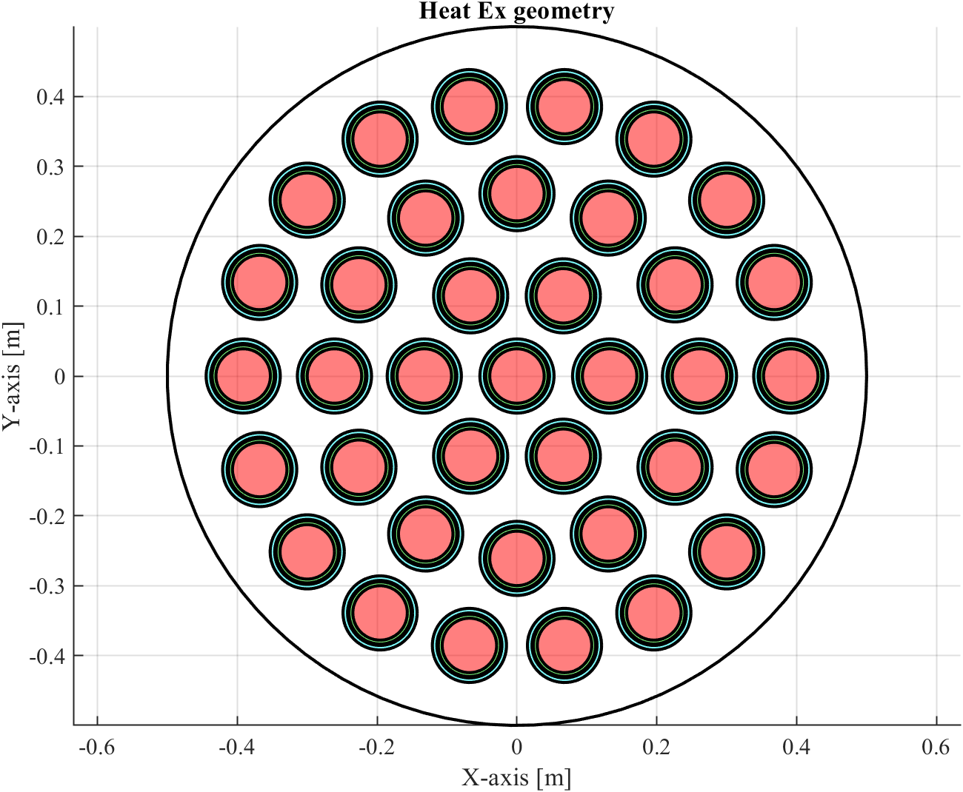
Heat Exchanger
Heat Exchanger Details
Main data
Shell in tube exchanger: 37 tubes, 500 kW.
Thermal gap helium 1 bar (k=0.24 W/Km): 4mm.
Liquid lead loop (350 kg/s) – 16 bars water loop (20 kg/s).
Piping: 3’’ S40 (lead pipe), 4’’ S80(water pipe)
Water temperature: 120°C (inlet) – 125°C (outlet).
Pressure drops: Lead (0.01 bars), Water (negligible).
Overall dimensions: D~1m, L~3.1m.
May 2025
FCCee beamstrahlung dump @FCC week 2025

Slide 25
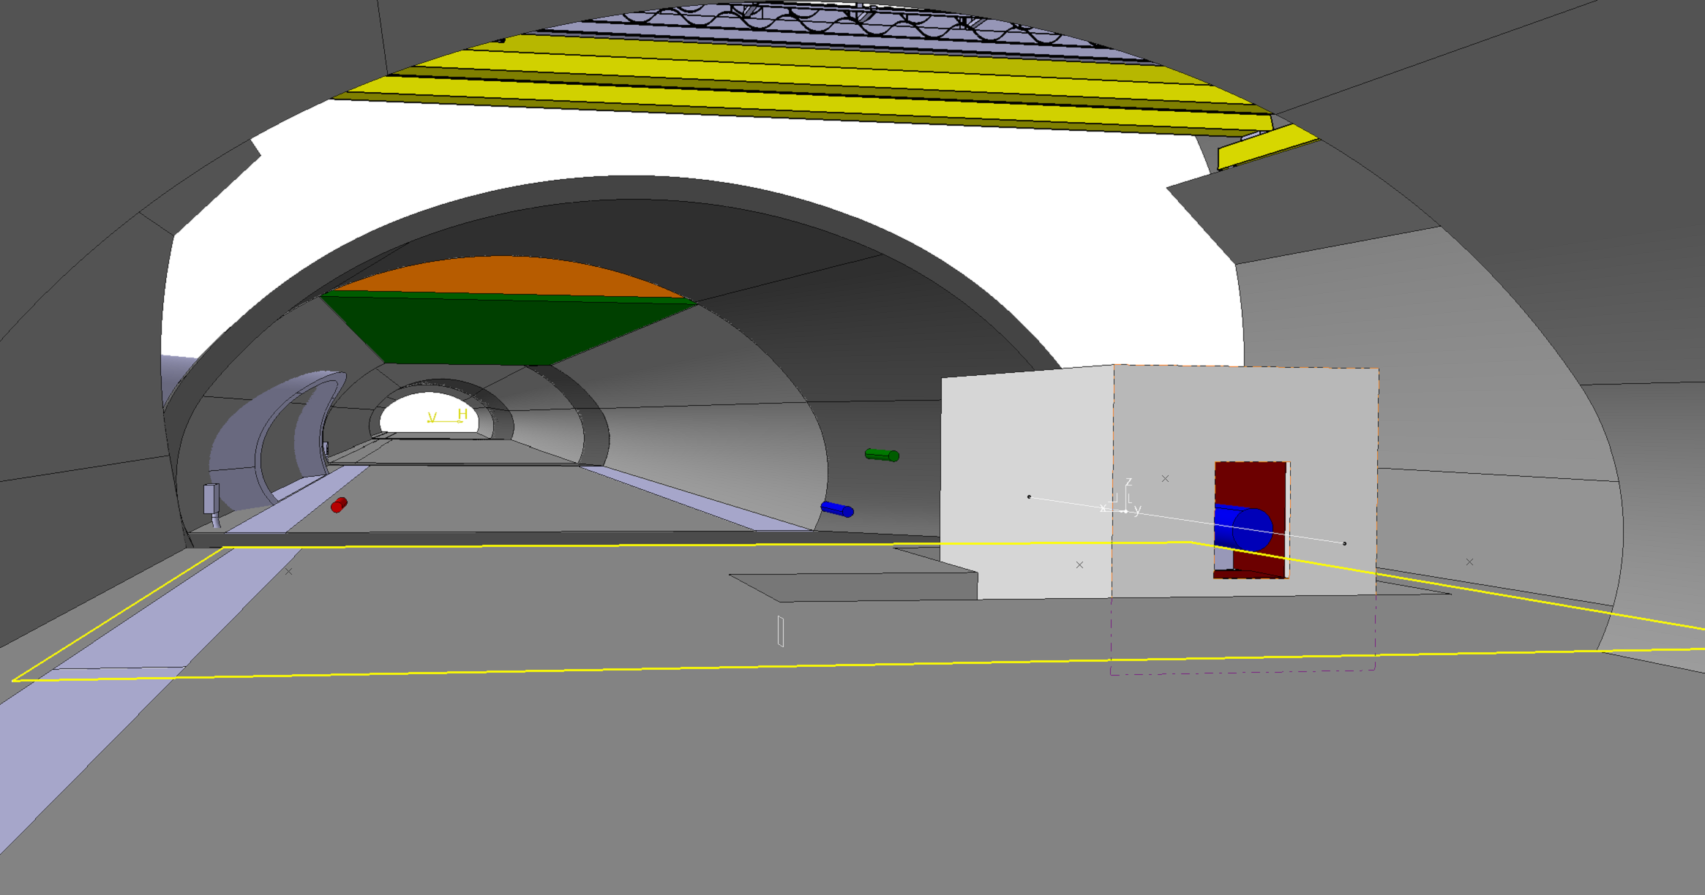
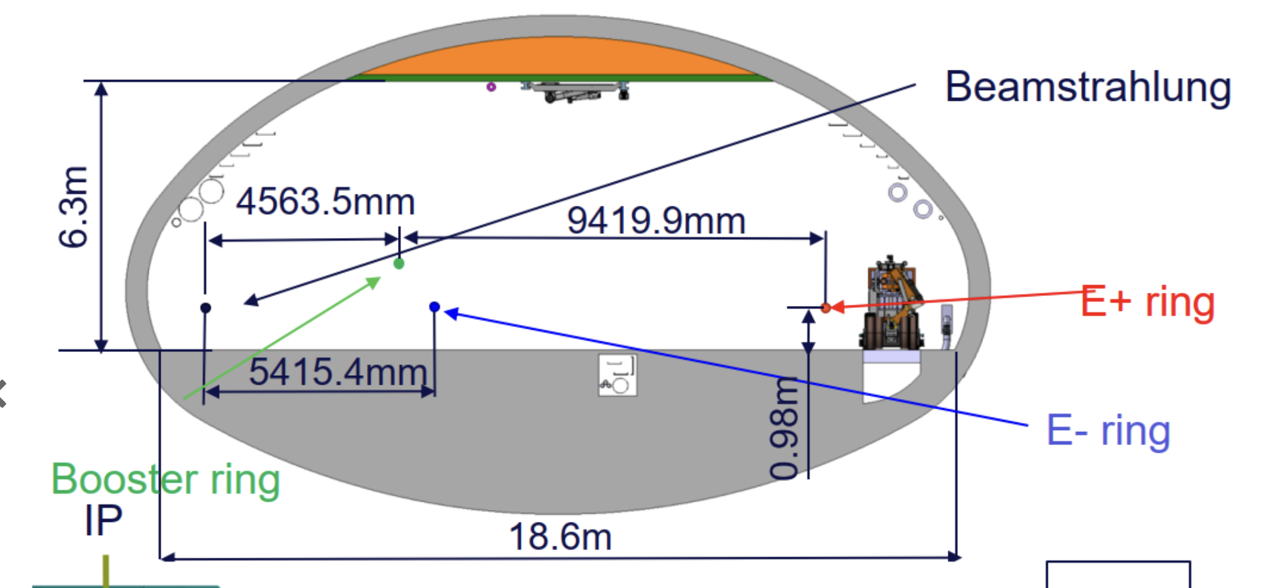
Dumper cavern
Visualization of the integration on the tunnel
R. Seidenbinder, S. Sorlut
May 2025
FCCee beamstrahlung dump @FCC week 2025

Slide 26
Advantages of a liquid Pb absorber
Heavy Liquid Metal (eg Pb) technologies are promising for use in particle accelerators, specifically for cases of a quasi-CW energy deposition as the BS radiation, offering advantages that traditional solid technologies cannot provide as,
No long-term degradation of dump materials (radiation damage, fatigue, etc.)
Dilution of radionuclide inventory within the total absorber volume
Flexible waste disposal preparation
No need for vacuum vessel nor pressure vessel – operation at atmospheric pressure with cover gas
Absence of beam-induced thermo-mechanical stresses
Since FCC week 2024, major developments were made with the collaboration with ENEA Brasimone on liquid lead hydraulic system (pumps, heat exchanger, etc.)

Slide 27



Two-slope dump concept – Thermofluid dynamics
The double slope concept maintains the temperature of lead bellow the 450ºC.
Thermomechanical simulation show an acceptable stress due to the heat and weight of the Pb (~.8ton) in the upper steel plate
Von mises stress [MPa]

