Slide 1


FCC-ee RF operation scenarios - new baseline
Ivan Karpov and Franck Peauger for FCC SRF WP1 with input from:
Xavier Buffat, Yann Dutheil, Giorgia Favia, Jiquan Guo (JLAB), Mauro Migliorati (INFN),
Katsunobu Oide, Luca Sabato, Roxana Soos, Jorg Wenninger, Frank Zimmermann, Mikhail Zobov (INFN)
FCC Week 2025, 21.05.2025

Slide 2
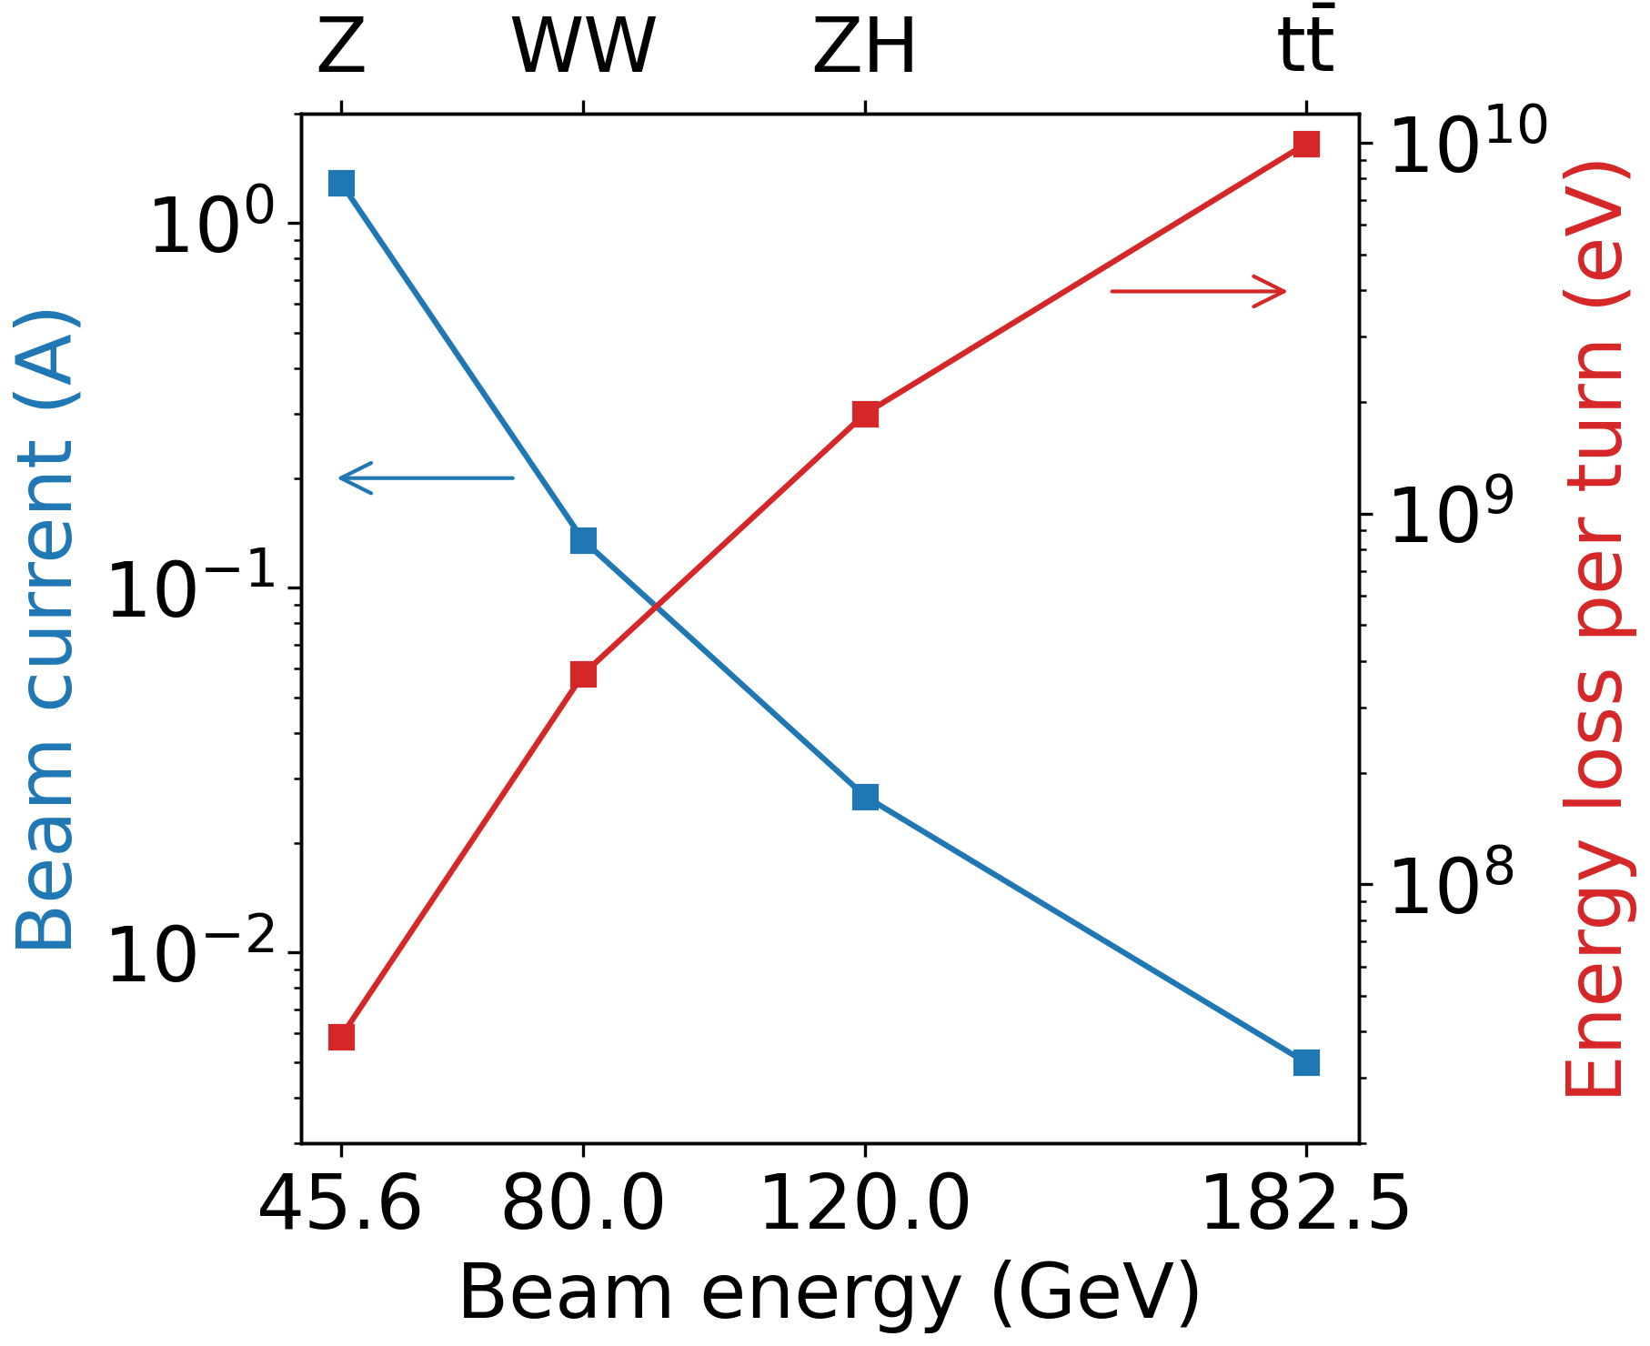
Challenging requirements for RF system
Beam current and energy loss for
50 MW synchrotron radiation (SR) budget
Low energy operating points:
High beam current and weak SR
Low RF voltage
Beam instabilities
Significant power losses due to high-order modes (HOM)
High energy points:
Low beam current and strong SR
High RF voltage to be reached with a small footprint
Instabilities suppressed by SR
Small power losses due to low beam current
A few single-cell cavities at low RF frequency (400 MHz)
Many multi-cell cavities at higher RF frequency (800 MHz)

Slide 3
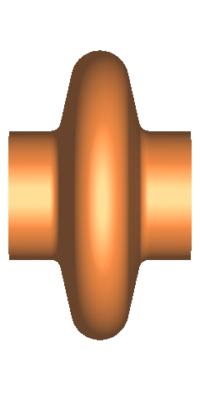
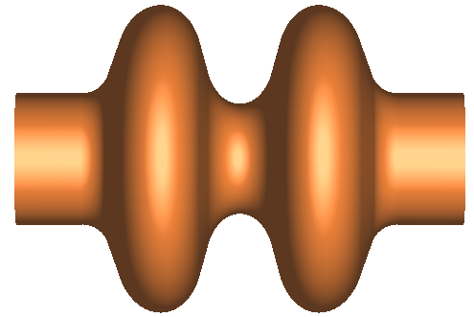
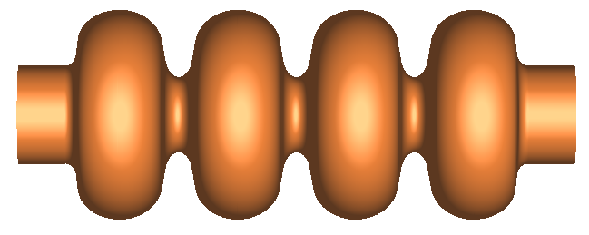
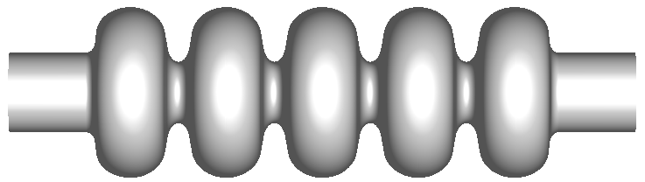
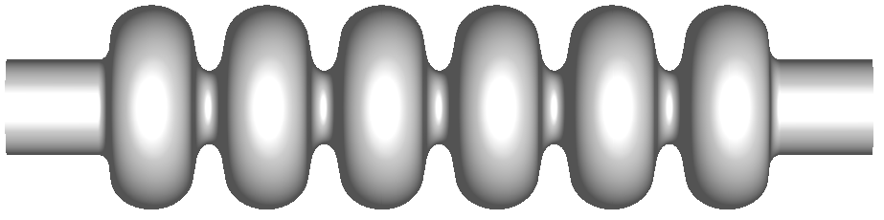
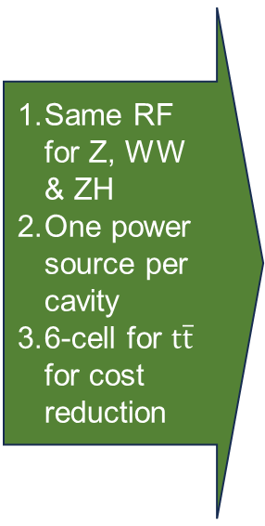

RF baseline evolution for collider
FCC Conceptual design report (2018)
F. Peauger, FCC Week 2022
& FCC FS MTR (2024)
FCC FS Final Report (2025)
Operational margins
Less HOM power for WW with 2-cell cavities
Same RF for WW
& ZH
Same RF for Z, WW
& ZH
One power source per cavity
6-cell for $t\overline{t}$ for cost reduction
Z
×104
×112
×264
WW
×104
×264
×264
ZH
×272
×264
×264
Common RF for 2 beams
Common RF for 2 beams
$$t\overline{t}$$
×272
×264
×264
+
Common RF for 2 beams
+
+
×372
×488
×408
Reverse Phase Operation (RPO) mode for Z is required to unify Z-WW-ZH RF system

Slide 4
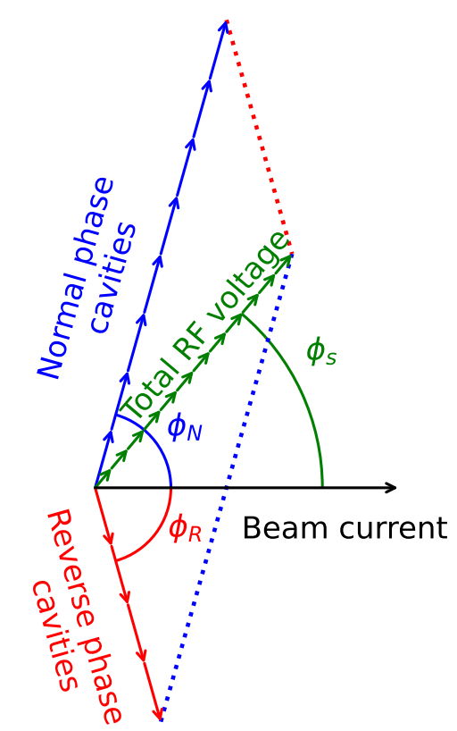
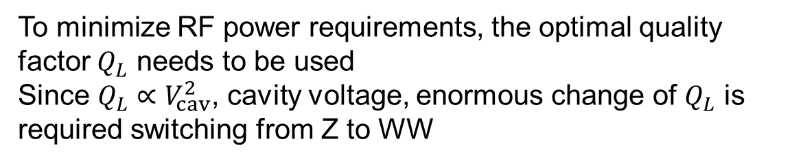
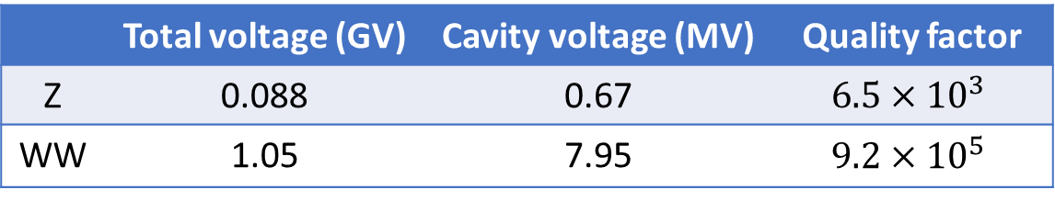
Reverse phase operation
To minimize RF power requirements, the optimal quality factor $Q_{L}$ needs to be used
Since $Q_{L}∝V_{cav}^{2}$, cavity voltage, enormous change of $Q_{L}$ is required switching from Z to WW
A sketch of RPO mode for 12 RF cavities
 | Total voltage (GV) | Cavity voltage (MV) | Quality factor
Z | 0.088 | 0.67 | $$6.5×{10}^{3}$$
WW | 1.05 | 7.95 | $$9.2×{10}^{5}$$
Reverse phase operation (RPO) mode allows for increasing RF cavity voltage, having optimal static beam loading compensation (Y. Morita et al., SRF, 2009)
Experimentally verified with high beam loading in KEKB
(Y. Morita et al., IPAC, 2010)
Baseline solution for EIC ESR (e.g., J. Guo et al., IPAC, 2022)
$→$ Applicability of RPO for FCC-ee needs to be confirmed

Slide 5
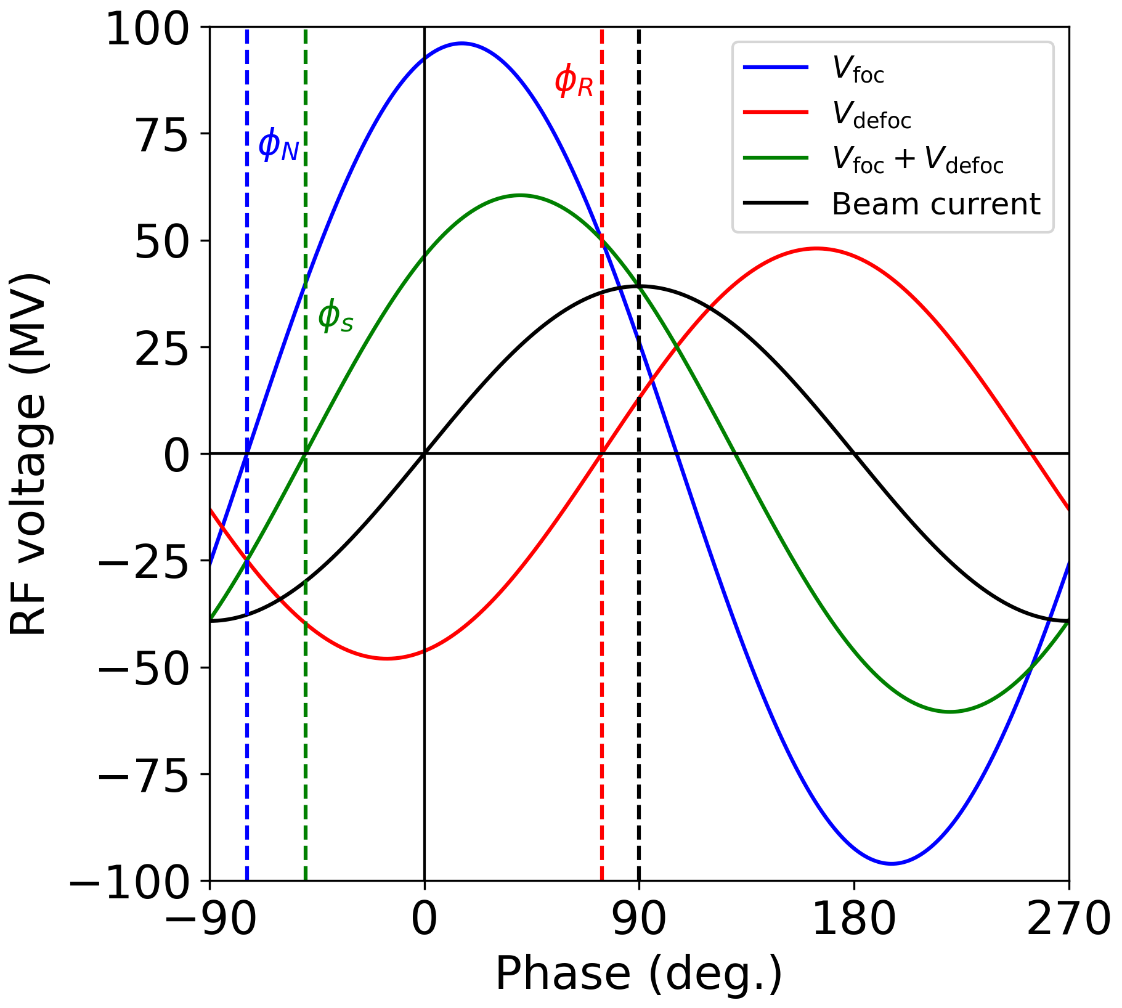
Reverse phase operation
To minimize RF power requirements, the optimal quality factor $Q_{L}$ needs to be used
Since $Q_{L}∝V_{cav}^{2}$, cavity voltage, enormous change of $Q_{L}$ is required switching from Z to WW
A sketch of RPO mode for 12 RF cavities
 | Total voltage (GV) | Cavity voltage (MV) | Quality factor
Z | 0.088 | 0.67 | $$6.5×{10}^{3}$$
WW | 1.05 | 7.95 | $$9.2×{10}^{5}$$
Reverse phase operation (RPO) mode allows for increasing RF cavity voltage, having optimal static beam loading compensation (Y. Morita et al., SRF, 2009)
Experimentally verified with high beam loading in KEKB
(Y. Morita et al., IPAC, 2010)
Baseline solution for EIC ESR (e.g., J. Guo et al., IPAC, 2022)
Focusing cavities
Defocusing cavities
$→$ Applicability of RPO for FCC-ee needs to be confirmed

Slide 6
RPO validation checklist
Static beam loading
Transient beam loading
Coupled-bunch instabilities
Higher-order-mode power losses
Availability aspects

Slide 7
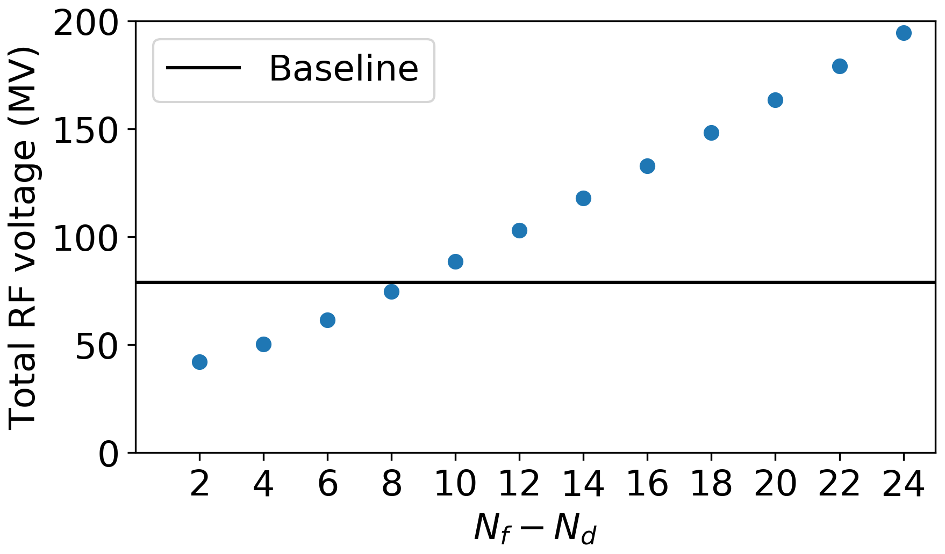
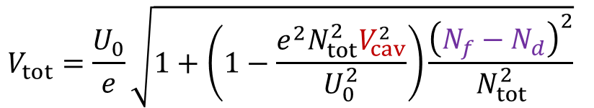
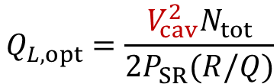
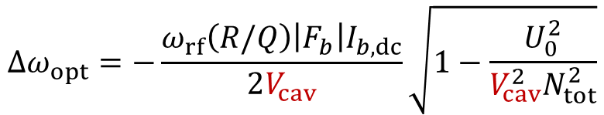
Static beam loading compensation
To minimize RF power requirements optimal quality factor and optimal detuning must be used
$$Q_{L,opt}=\frac{V_{cav}^{2}N_{tot}}{2P_{SR}(R/Q)}$$
$$Δω_{opt}=−\frac{ω_{rf}\left(R/Q\right){\left|F_{b}\right|I}_{b,dc}}{2V_{cav}}\sqrt{1−\frac{U_{0}^{2}}{V_{cav}^{2}N_{tot}^{2}}}$$
To avoid a movable fundamental power coupler design, $Q_{L,opt}$ and $V_{cav}$must be the same for all cavities for Z,WW, and ZH
Possible RF voltages for Z
Total RF voltage (e.g., A. Blednykh et al, 2022)
$$V_{tot}=\frac{U_{0}}{e}\sqrt{1+\left(1−\frac{e^{2}{N_{tot}^{2}V}_{cav}^{2}}{U_{0}^{2}}\right)\frac{{\left(N_{f}−N_{d}\right)}^{2}}{N_{tot}^{2}}}$$
New proposal
can be changed in discrete steps of $N_{f}−N_{d}$ $=2, 4,…$
Closest but reduces RF acceptance
$→$ RF voltage at Z needs to be slightly increased (89 vs 79 MV)

Slide 8
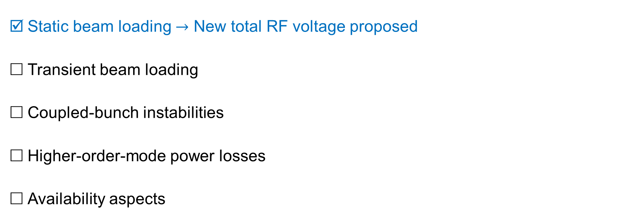
RPO validation checklist
Static beam loading $→$ New total RF voltage proposed
Transient beam loading
Coupled-bunch instabilities
Higher-order-mode power losses
Availability aspects

Slide 9
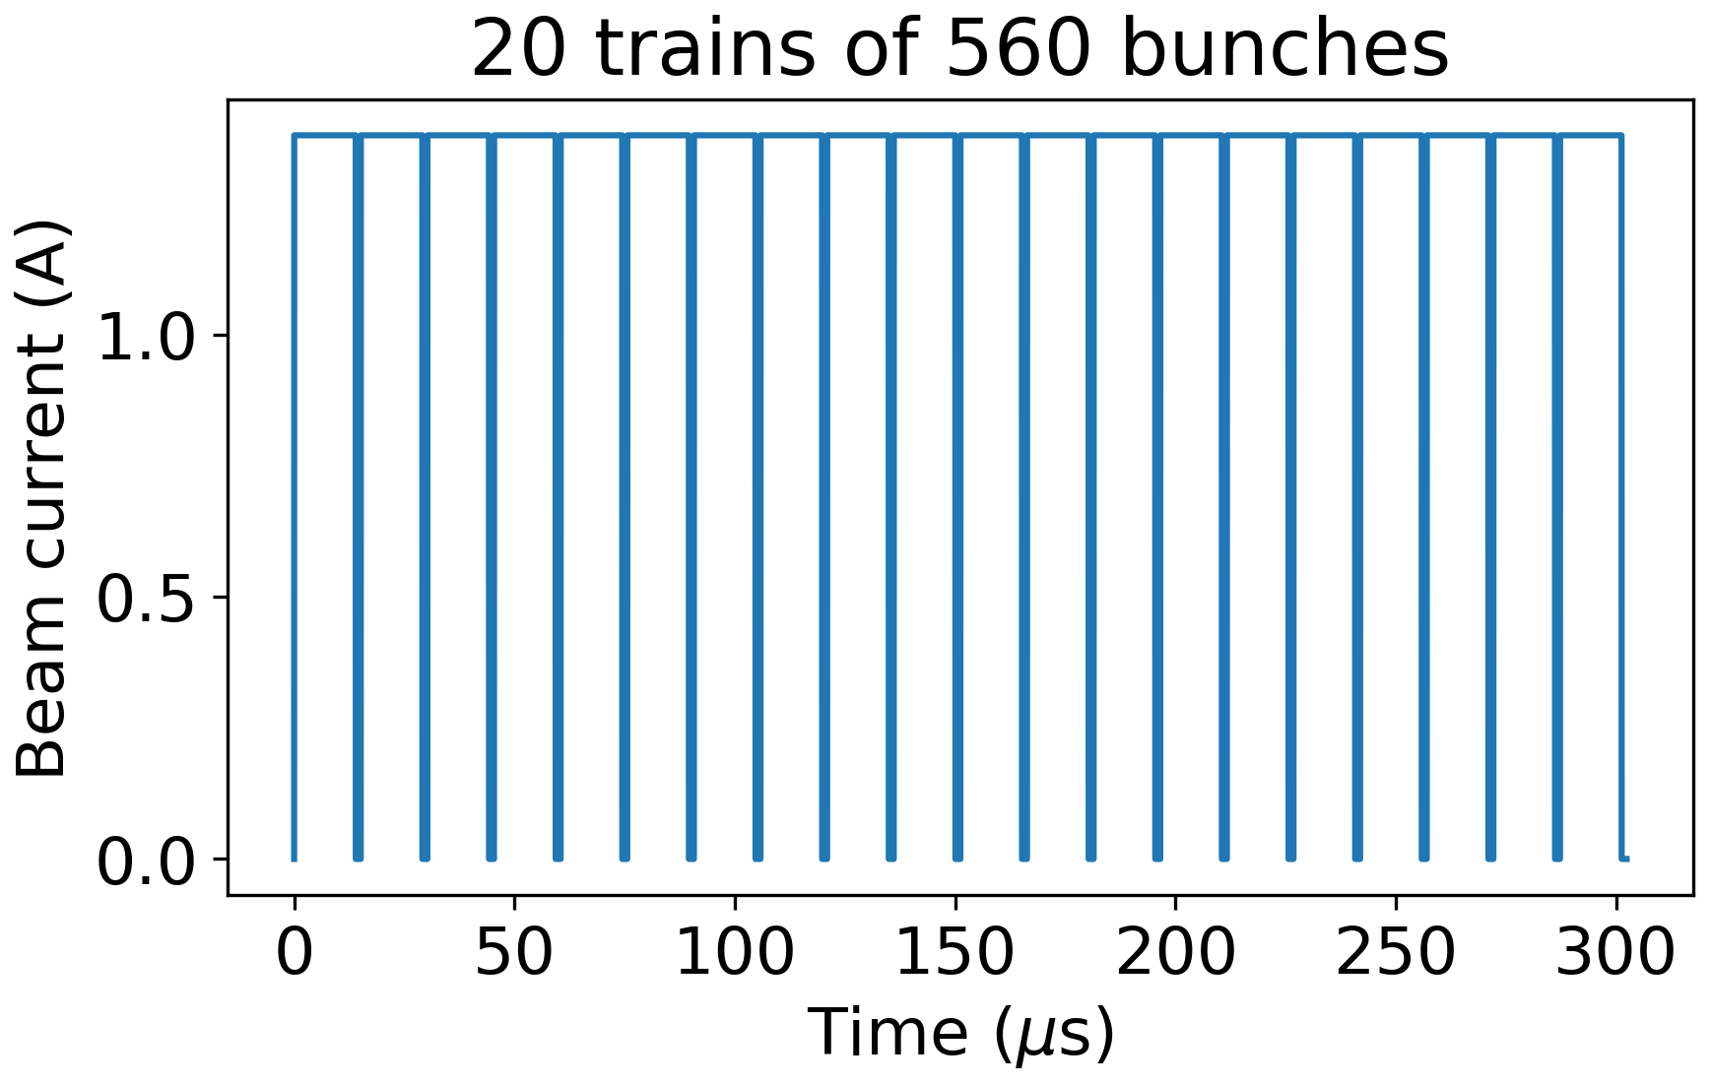
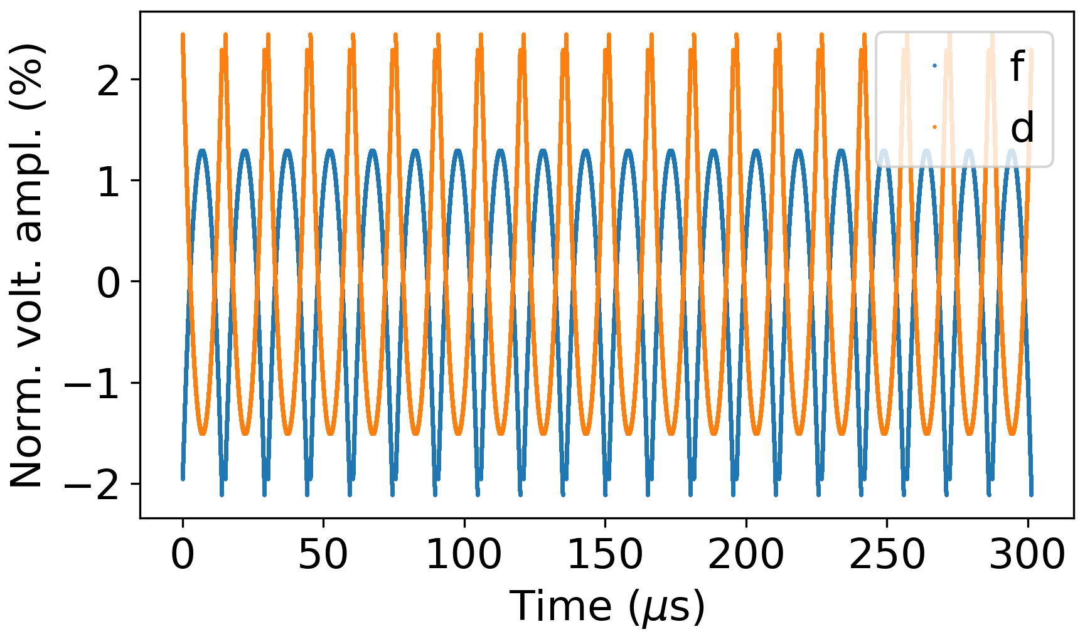
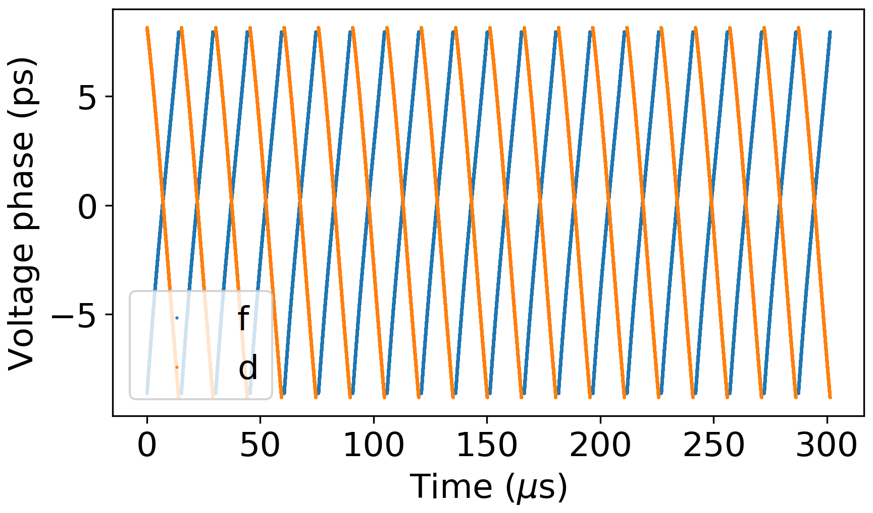
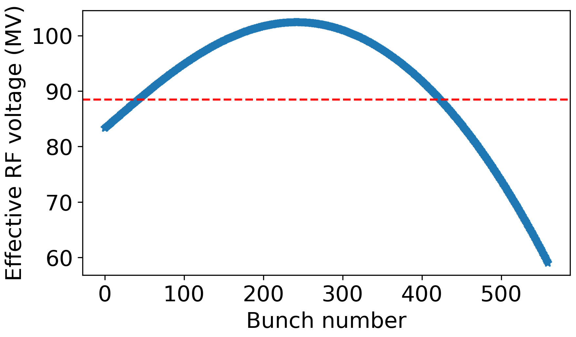
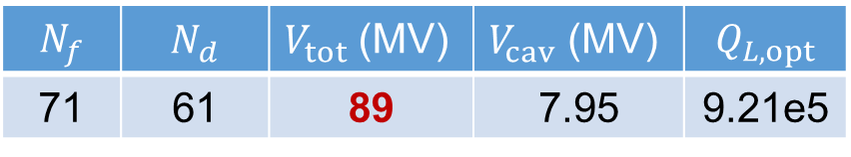
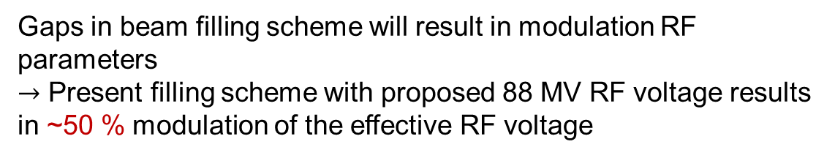
Transient beam loading
Voltage amplitude and phase transients from small-signal model
(F. Pedersen, 1992)
$$N_{f}$$ | $$N_{d}$$ | $V_{tot}$(MV) | $V_{cav}$ (MV) | $$Q_{L,opt}$$
71 | 61 | 89 | 7.95 | 9.21e5
Gaps in beam filling scheme will result in modulation RF parameters
$→$ Present filling scheme with proposed 88 MV RF voltage results in ~50 % modulation of the effective RF voltage

Slide 10
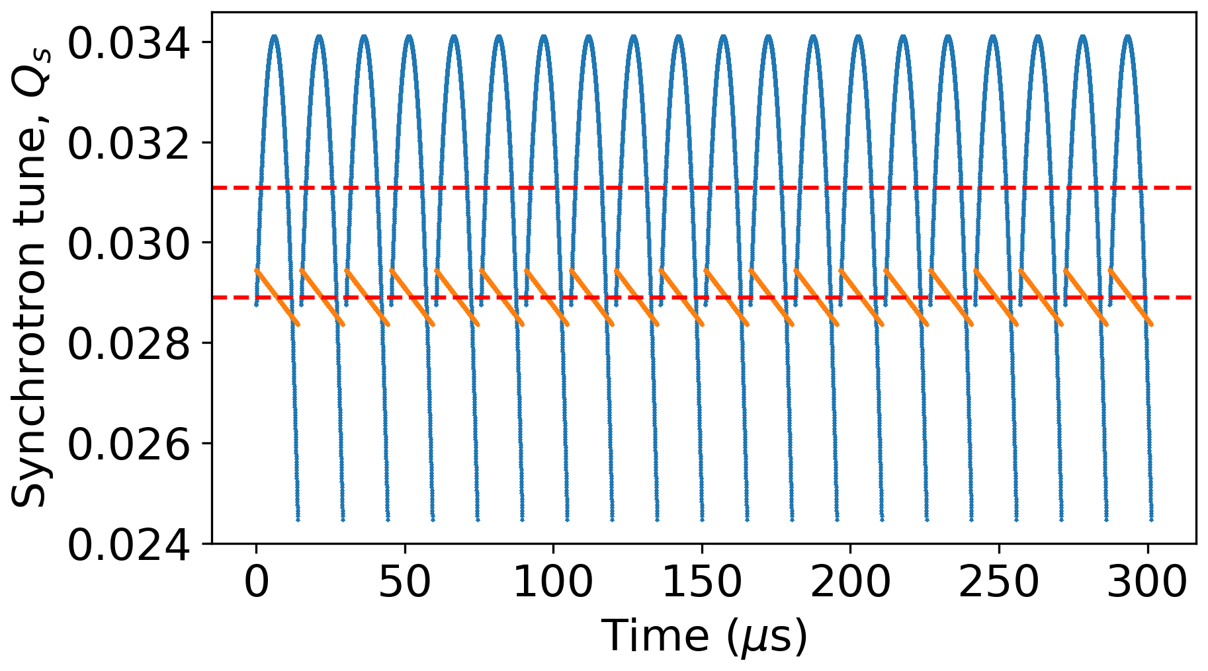
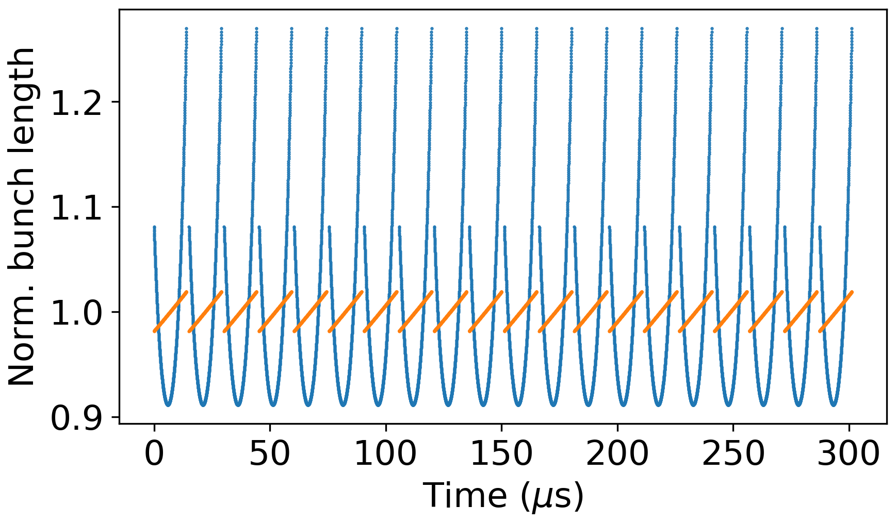
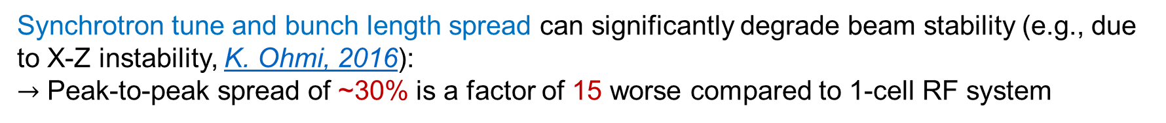
Bunch-by-bunch spread of beam parameters
132 2-cell cavities RPO, 56 1-cell cavities normal phase
-21/+10 %
-9/+27 %
Synchrotron tune and bunch length spread can significantly degrade beam stability (e.g., due to X-Z instability, K. Ohmi, 2016):
$→$ Peak-to-peak spread of ~30% is a factor of 15 worse compared to 1-cell RF system

Slide 11
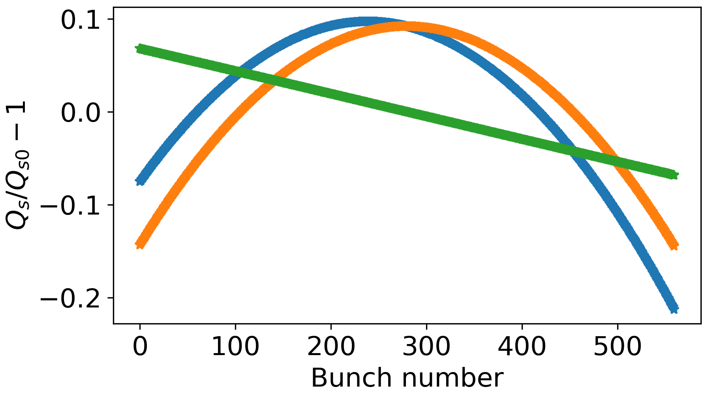
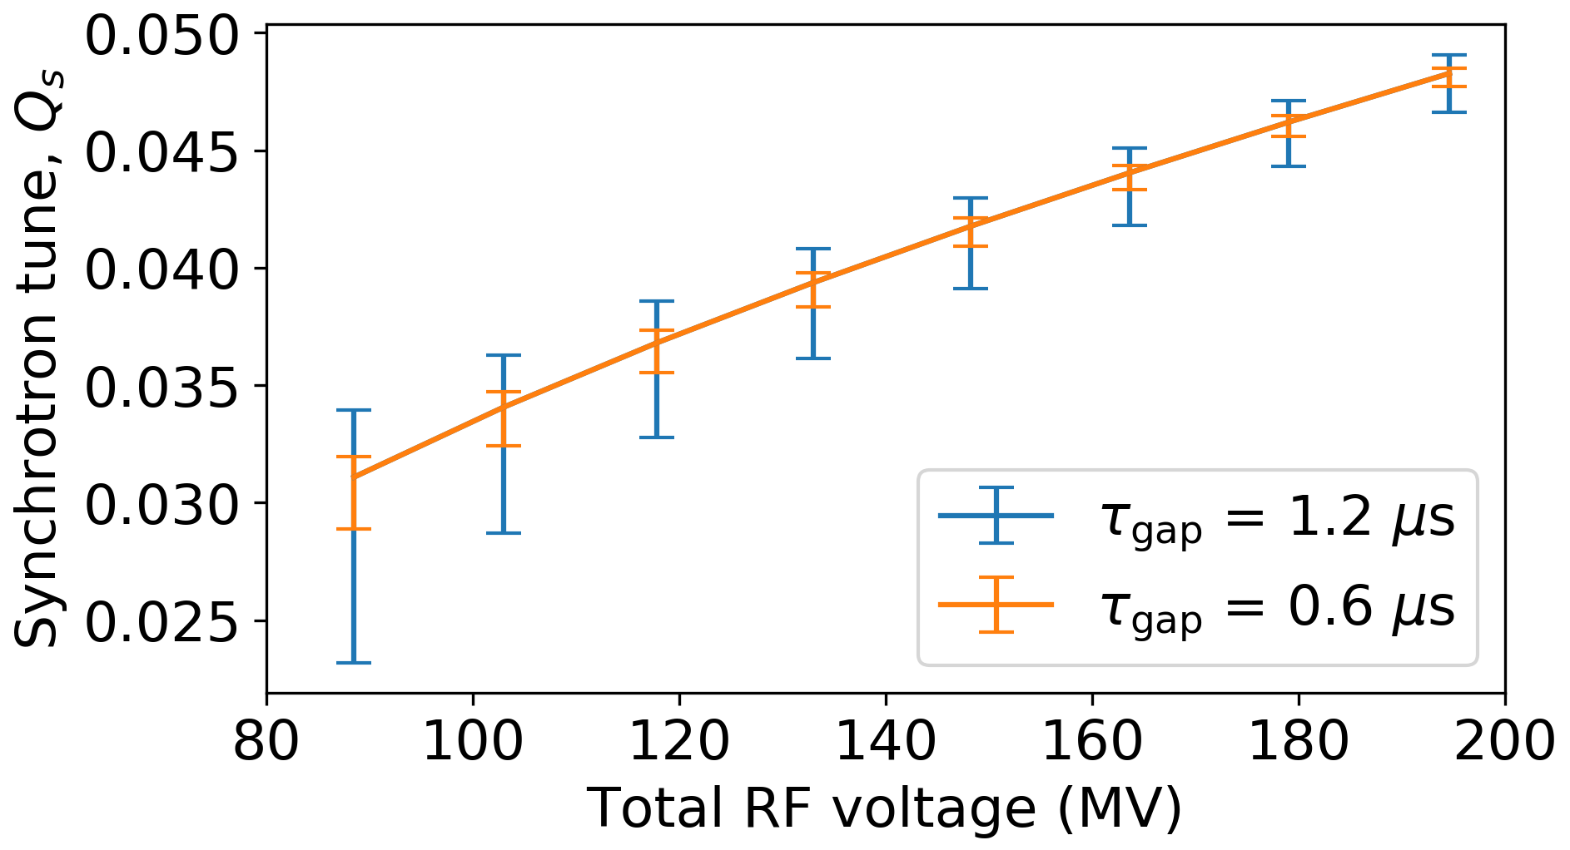

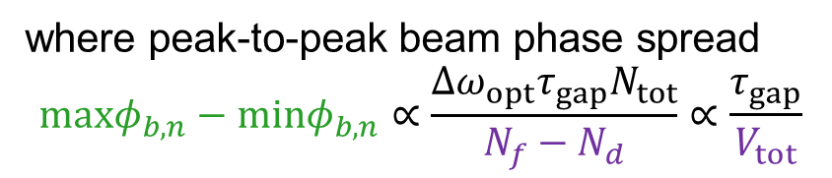
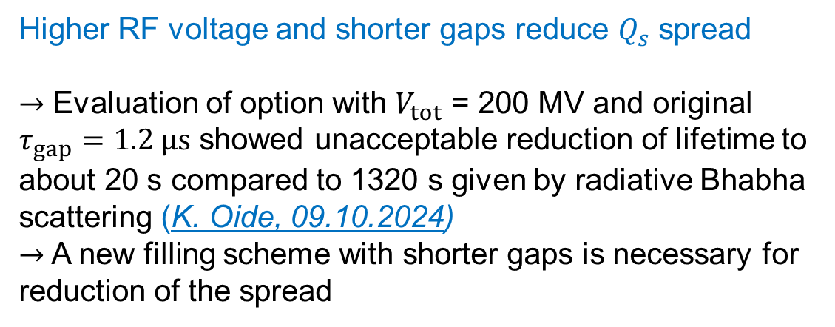
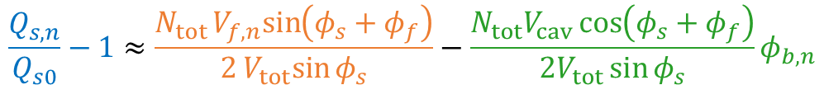

Possible mitigations
Relative contributions to $Q_{s}$ spread
Synchrotron tune spread according small-signal model
$$\frac{Q_{s,n}}{Q_{s0}}−1≈\frac{N_{tot}V_{f,n}sin\left(φ_{s}+φ_{f}\right)}{2V_{tot}sin{φ_{s}}}−\frac{N_{tot}V_{cav}\cos\left(φ_{s}+φ_{f}\right)}{2V_{tot}\sin{φ_{s}}}φ_{b,n}$$
where peak-to-peak beam phase spread
$$maxφ_{b,n}−minφ_{b,n}∝\frac{Δω_{opt}τ_{gap}N_{tot}}{N_{f}−N_{d}}∝\frac{τ_{gap}}{V_{tot}}$$
Higher RF voltage and shorter gaps reduce $Q_{s}$ spread
$→$ Evaluation of option with $V_{tot}$ = 200 MV and original $τ_{gap}=1.2 μs$ showed unacceptable reduction of lifetime to about 20 s compared to 1320 s given by radiative Bhabha scattering (K. Oide, 09.10.2024)
$→$ A new filling scheme with shorter gaps is necessary for reduction of the spread
$Q_{s}$ spread for 1.2 µs gap length
30%
5%

Slide 12
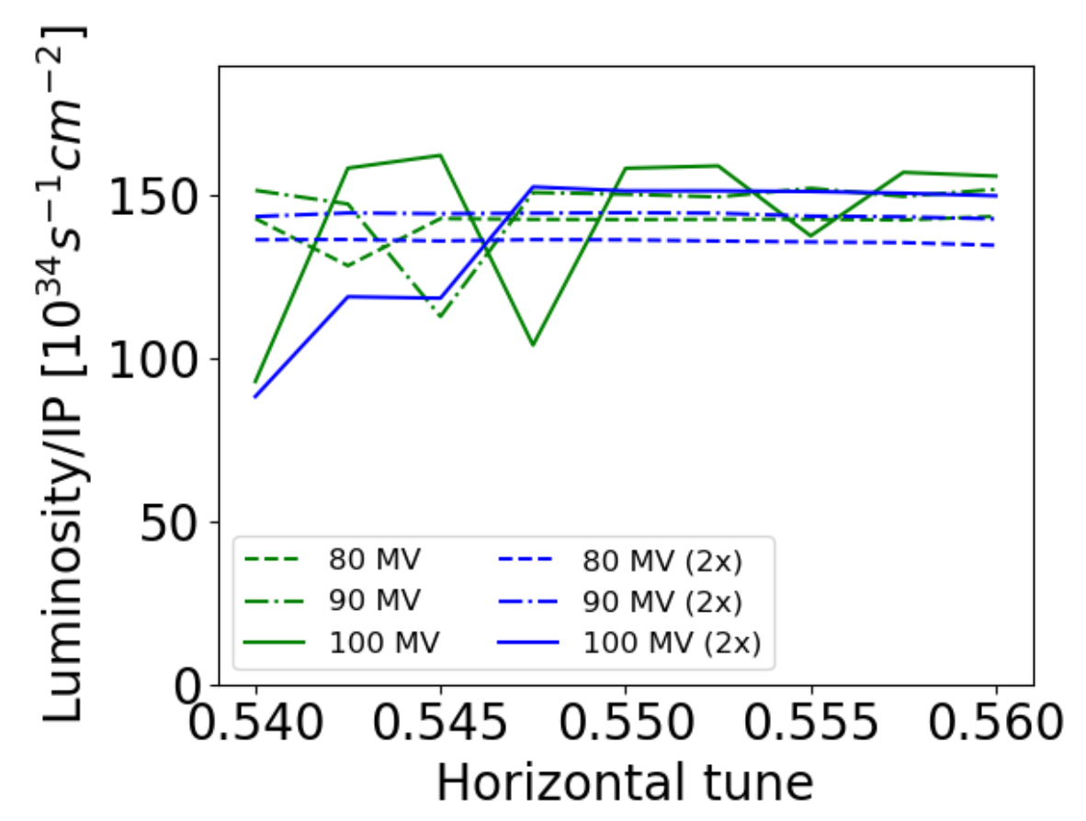
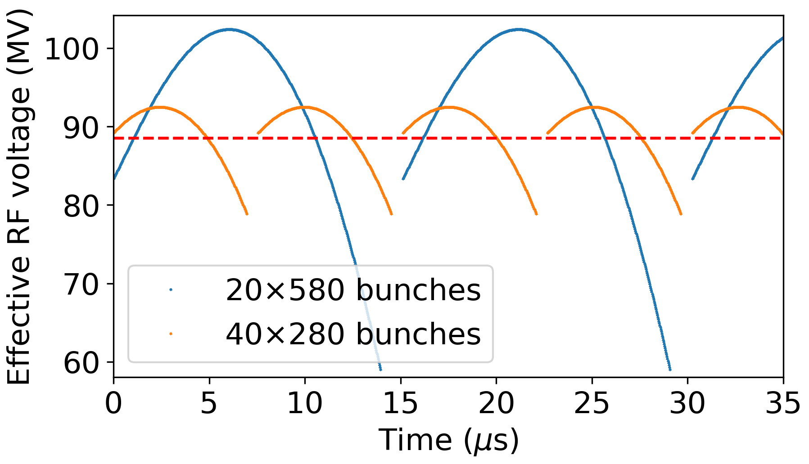
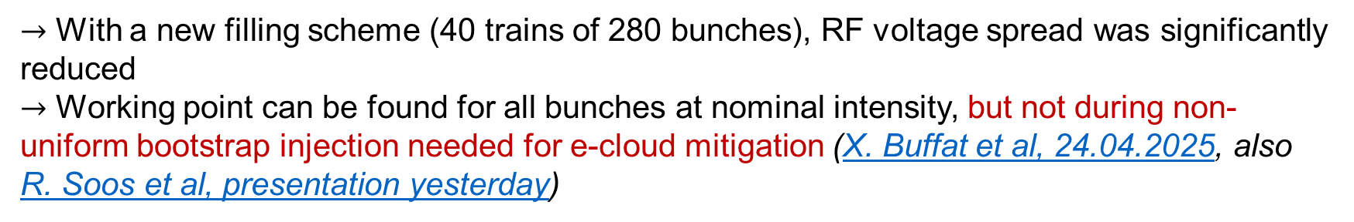
Results for smaller gaps between trains
Injection and extraction systems were adapted to decrease the rise time below 600-ns
(G. Favia, presentation this afternoon)
FSR
$→$ With a new filling scheme (40 trains of 280 bunches), RF voltage spread was significantly reduced
$→$ Working point can be found for all bunches at nominal intensity, but not during non-uniform bootstrap injection needed for e-cloud mitigation (X. Buffat et al, 24.04.2025, also R. Soos et al, presentation yesterday)

Slide 13
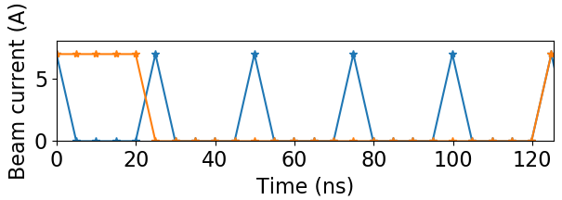
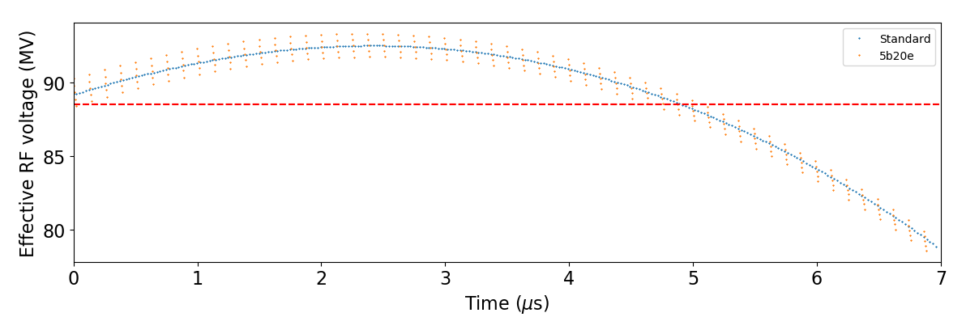
Alternative filling schemes
Hybrid filling schemes with 5-ns spacing micro-trains can suppress e-cloud limitations (L. Sabato, presentation yesterday)
$→$ Negligible impact on the RF voltage spread (15.3 % $→$ 16.8 %)

Slide 14
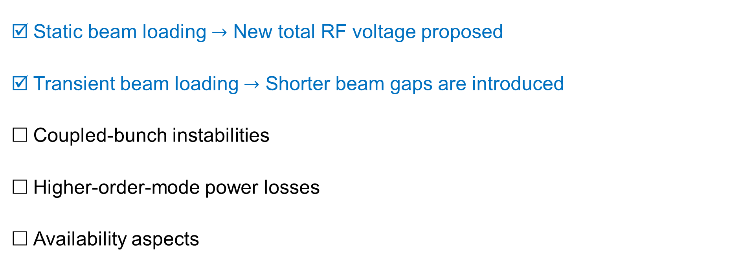
RPO validation checklist
Static beam loading $→$ New total RF voltage proposed
Transient beam loading $→$ Shorter beam gaps are introduced
Coupled-bunch instabilities
Higher-order-mode power losses
Availability aspects

Slide 15

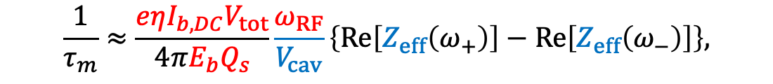
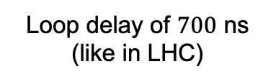
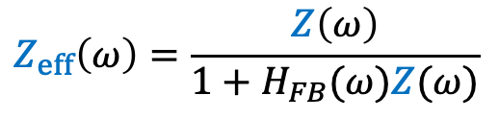

Coupled–bunch instabilities due to fundamental mode
Standard analysis: compute growth rates and compare them with synchrotron radiation damping time
For short Gaussian bunches, the growth rate of the mode m is (J. L. Laclare, 1985)
Cavity impedance at fundamental, $Z\left(ω\right)$
$$\frac{1}{τ_{m}}≈\frac{eηI_{b,DC}V_{tot}}{4πE_{b}Q_{s}}\frac{ω_{RF}}{V_{cav}}\left\{Re\left[Z_{eff}\left(ω_{+}\right)\right]−Re\left[Z_{eff}\left(ω_{−}\right)\right]\right\},$$
Loop delay of $700$ ns
(like in LHC)
with $ω_{±}=ω_{RF}±(m+Q_{s})ω_{rev}$
Direct (DFB) and long-delay feedback (OTFB) systems can reduce impedance “seen” by the beam
(F. Pedersen, 1992)
$$Z_{eff}\left(ω\right)=\frac{Z\left(ω\right)}{1+H_{FB}(ω)Z(ω)}$$
Feedback transfer function

Slide 16
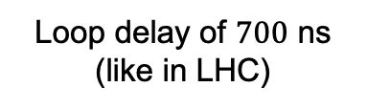

Coupled–bunch instabilities due to fundamental mode
Standard analysis: compute growth rates and compare them with synchrotron radiation damping time
For short Gaussian bunches, the growth rate of the mode m is (J. L. Laclare, 1985)
Cavity impedance at fundamental, $Z\left(ω\right)$
$$\frac{1}{τ_{m}}≈\frac{eηI_{b,DC}V_{tot}}{4πE_{b}Q_{s}}\frac{ω_{RF}}{V_{cav}}\left\{Re\left[Z_{eff}\left(ω_{+}\right)\right]−Re\left[Z_{eff}\left(ω_{−}\right)\right]\right\},$$
with $ω_{±}=ω_{RF}±(m+Q_{s})ω_{rev}$
Loop delay of $700$ ns
(like in LHC)
Direct (DFB) and long-delay feedback (OTFB) systems can reduce impedance “seen” by the beam
(F. Pedersen, 1992)
$$Z_{eff}\left(ω\right)=\frac{Z\left(ω\right)}{1+H_{FB}(ω)Z(ω)}$$
Feedback transfer function

Slide 17
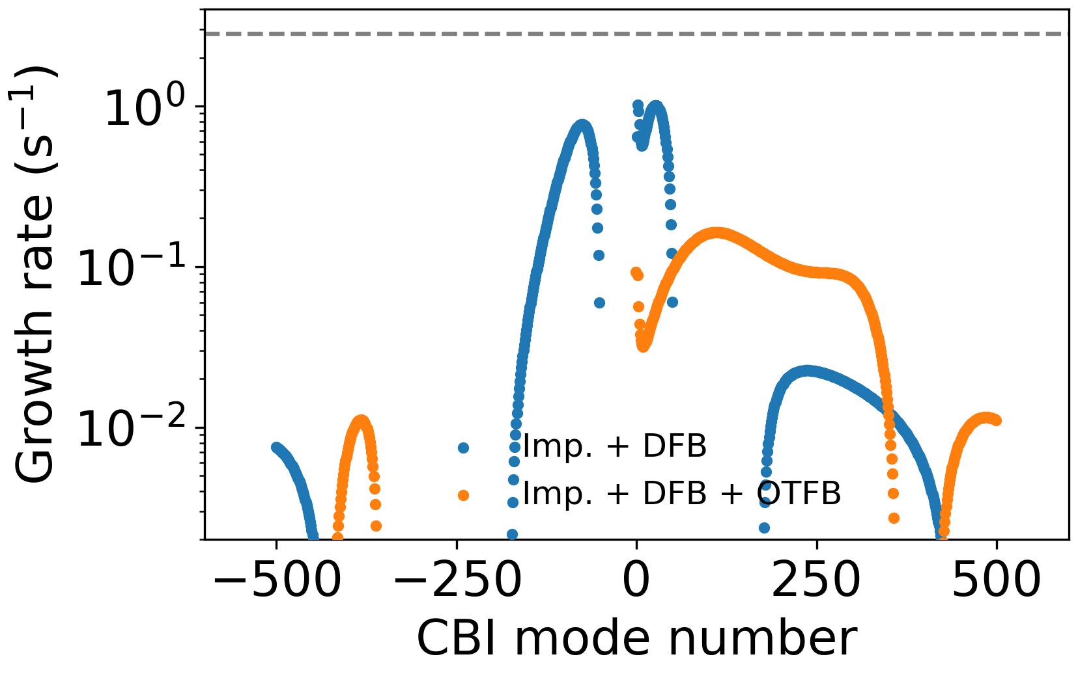
Instability growth rates
132 2-cell cavities with RPO
SR limit
Calculations for loop delay of $700$ ns, DFB gain 10, OTFB gain 20:
$→$ LCBI can be suppressed already with DFB, while OTFB gives additional stability margin

Slide 18
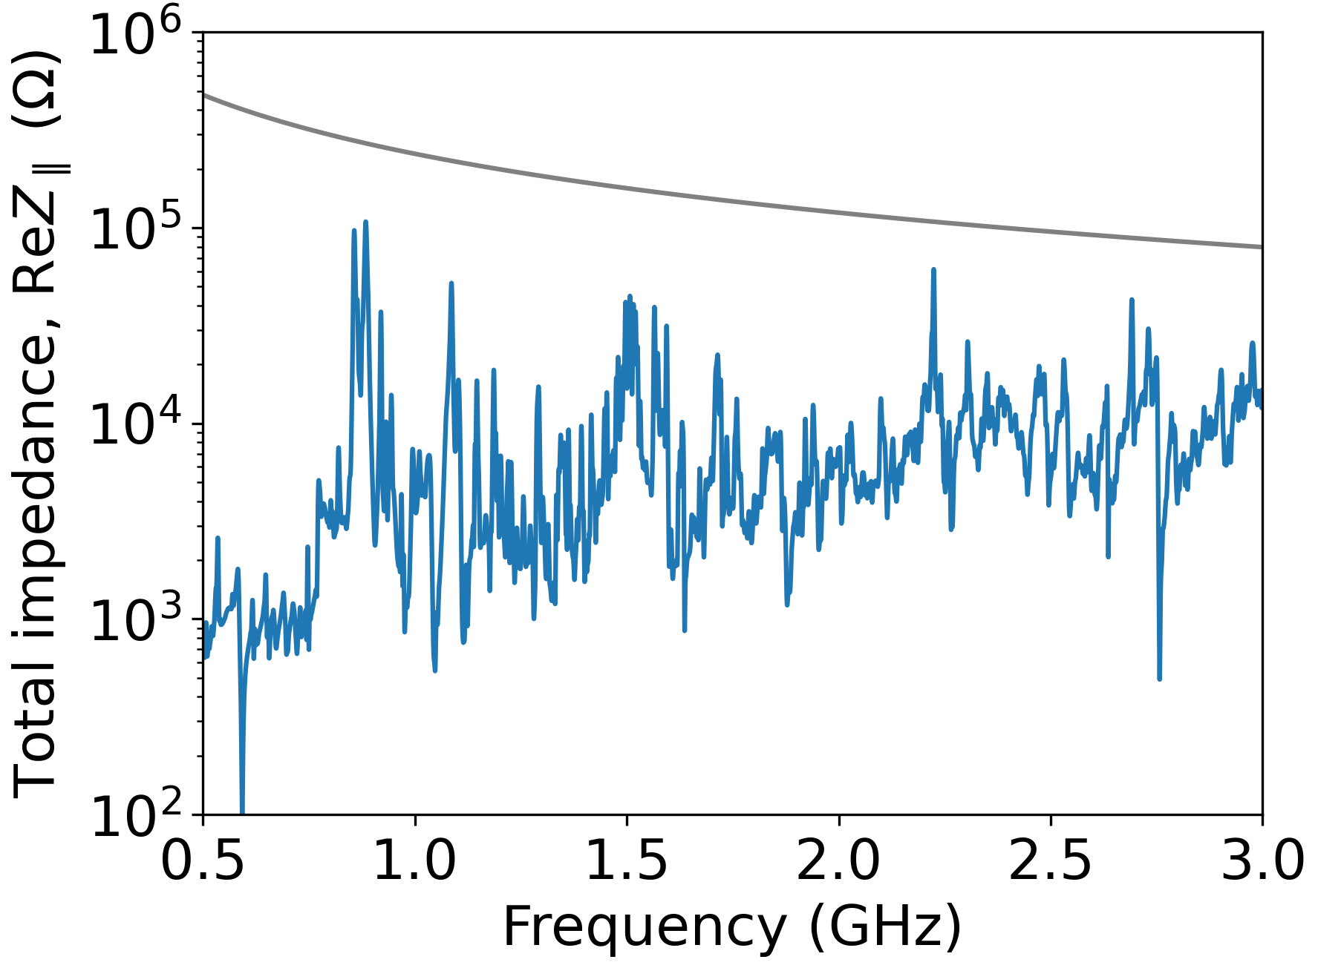
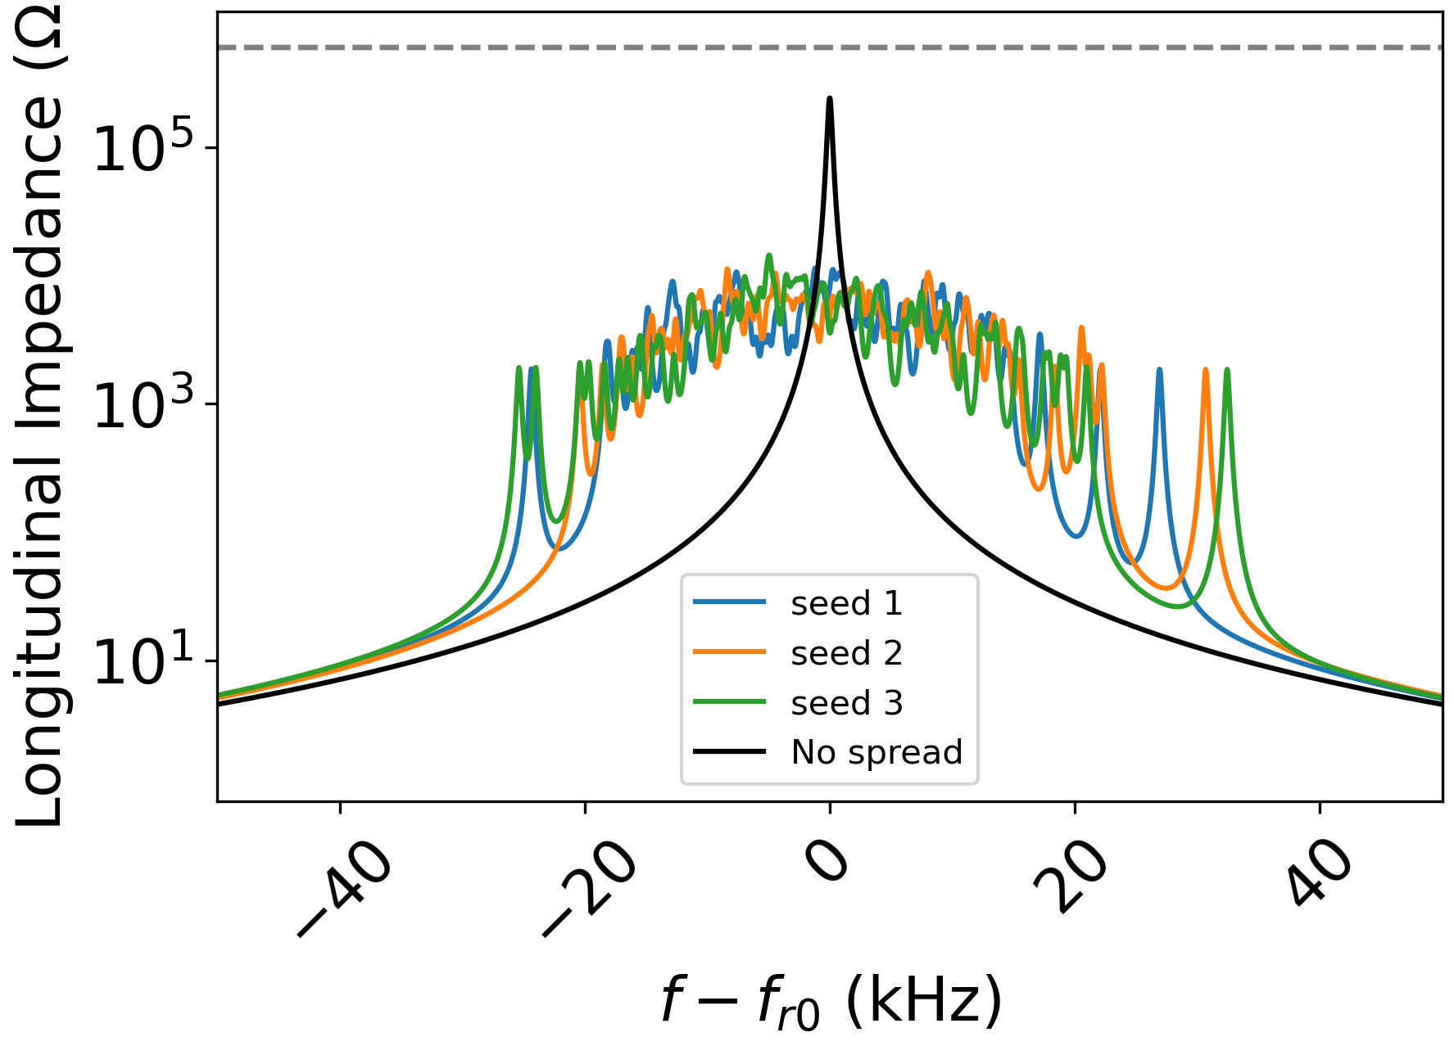
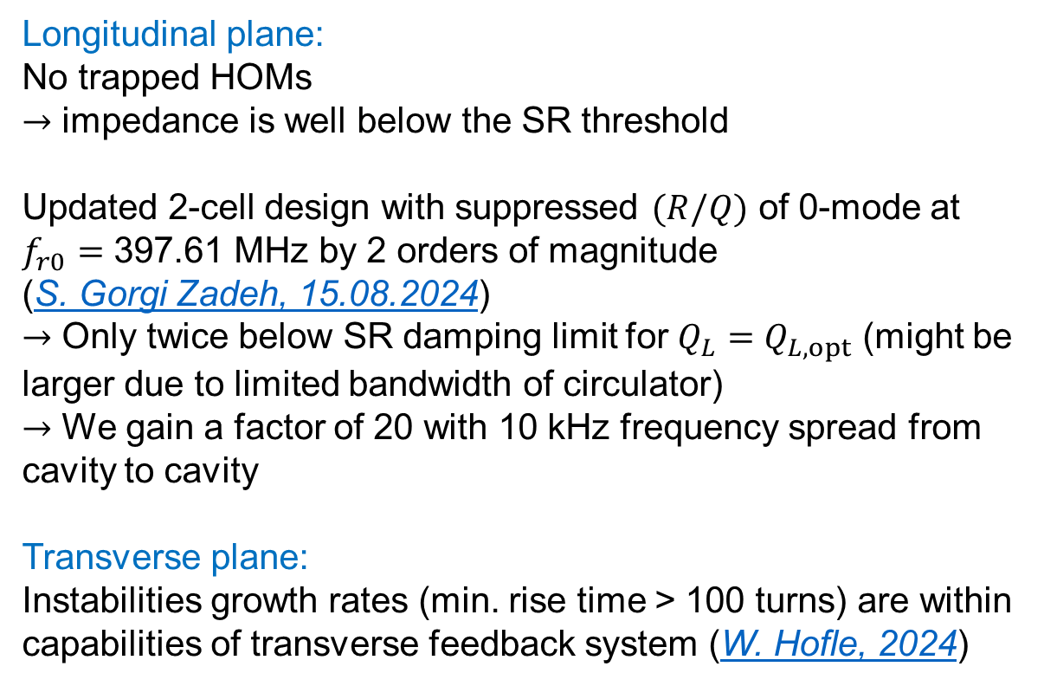
HOM-driven coupled-bunch instabilities
Longitudinal plane:
No trapped HOMs
$→$ impedance is well below the SR threshold
Updated 2-cell design with suppressed $(R/Q)$ of 0-mode at $f_{r0}=\text{39}\text{7}\text{.}\text{61}$ MHz by 2 orders of magnitude
(S. Gorgi Zadeh, 15.08.2024)
$→$ Only twice below SR damping limit for $Q_{L}=Q_{L,opt}$ (might be larger due to limited bandwidth of circulator)
$→$ We gain a factor of 20 with 10 kHz frequency spread from cavity to cavity
Transverse plane:
Instabilities growth rates (min. rise time > 100 turns) are within capabilities of transverse feedback system (W. Hofle, 2024)
SR damping
SR damping

Slide 19
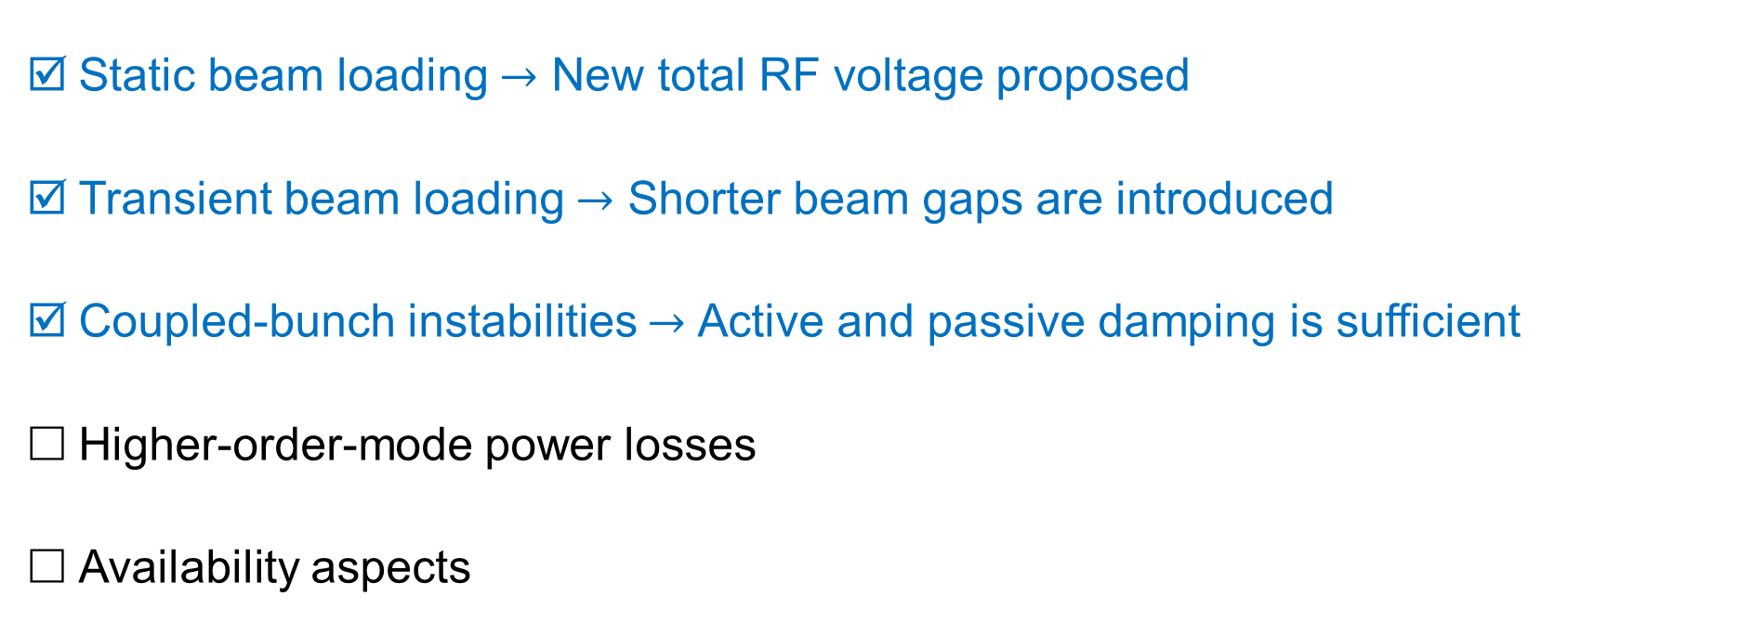
RPO validation checklist
Static beam loading $→$ New total RF voltage proposed
Transient beam loading $→$ Shorter beam gaps are introduced
Coupled-bunch instabilities $→$ Active and passive damping is sufficient
Higher-order-mode power losses
Availability aspects

Slide 20
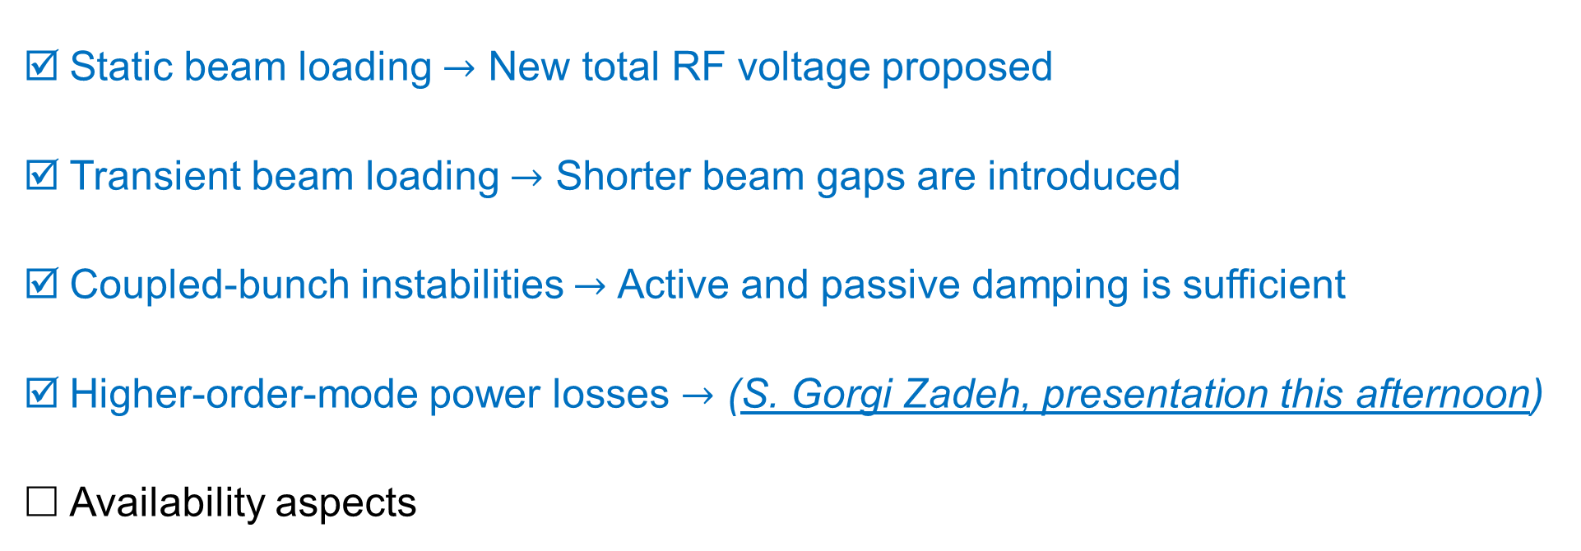
RPO validation checklist
Static beam loading $→$ New total RF voltage proposed
Transient beam loading $→$ Shorter beam gaps are introduced
Coupled-bunch instabilities $→$ Active and passive damping is sufficient
Higher-order-mode power losses $→$ (S. Gorgi Zadeh, presentation this afternoon)
Availability aspects

Slide 21
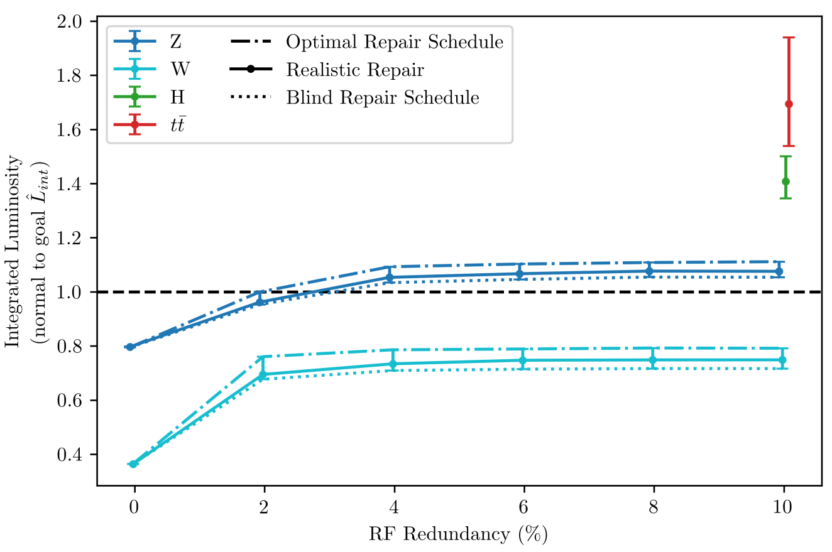
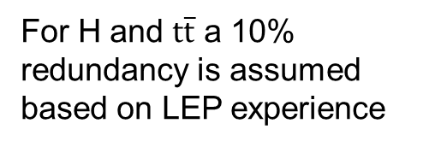
Availability challenges
For H and $t\overline{t}$ a 10% redundancy is assumed based on LEP experience
Availability goals require 10% (minimum 4%) redundancy of the RF system (J. Heron, FCC Week 2024)
Critical questions for Z mode with RPO:
Coupled-bunch instability due to fundamental impedance
Cavity damage due to strong beam-induced fields
Missing RF voltage (RF power margin)
Consider only the case of RF source or LLRF trip (not a quench of the cavity)

Slide 22
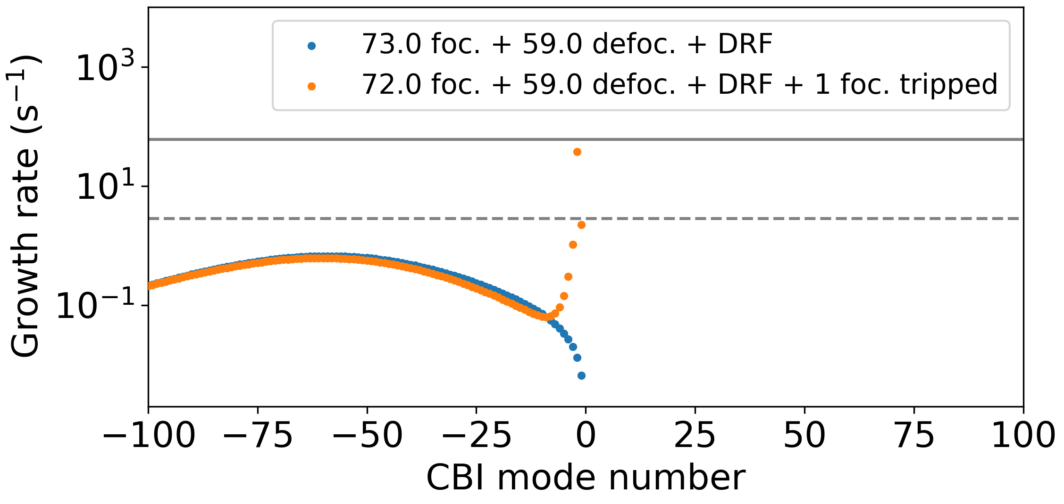
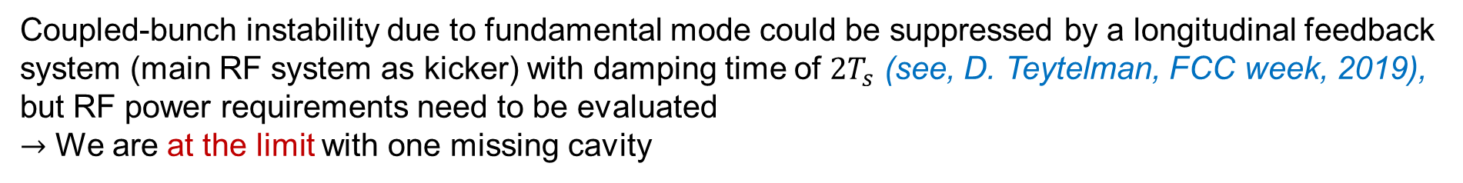


Longitudinal coupled-bunch instability
Cavity impedance at fundamental, $Z\left(ω\right)$
Instability growth rates with 1 tripped focusing cavity
Loop delay of $700$ ns
(like in LHC)
Longitudinal damper limit
SR limit
Coupled-bunch instability due to fundamental mode could be suppressed by a longitudinal feedback system (main RF system as kicker) with damping time of $2T_{s}$ (see, D. Teytelman, FCC week, 2019), but RF power requirements need to be evaluated
$→$ We are at the limit with one missing cavity

Slide 23



Simplified beam-cavity interaction model
Coupled differential equations are solved for four groups:
Focusing ($N_{f}$ cavities)
Defocusing ($N_{d}$ cavities)
Tripped focusing ($N_{off1}$ cavities)
Tripped defocusing ($N_{off2}$ cavities)
Combined with longitudinal equations
of motion for one particle per bunch
Longitudinal damper is not implemented yet
Tuner
Circulator
Forward wave
Generator
RF cavity
Reflected wave
Load
Delay
Cavity voltage
Direct RF feedback
–
Beam
$$Σ$$
Error signal
+
Reference signal
+
$$Σ$$
+
Longitudinal damper
Phase pickup

Slide 24





Trip of focusing cavity
Reaction time
Controlled voltage increase
Trip
Short RF voltage transients ~6%
Peak power of other cavities is modulated at synchrotron frequency (avg. <15%, peak <32%)
Initial bunch oscillation amplitude is <10% of rms bunch length
$→$ New RF power have sufficient margin for a single cavity trip (I. Syratchev, next presentation)
$σ_{z}$ ~ 48 ps

Slide 25





Trip of focusing and defocusing cavities
Reaction time
Controlled voltage increase
Trip
Short RF voltage transients ~6%
Peak power of other cavities is modulated at synchrotron frequency (avg. <45%, peak <80%)
Initial bunch oscillation amplitude is <8% of rms bunch length
$→$ Not enough power margin to handle simultaneous trip of two cavities
$σ_{z}$ ~ 48 ps

Slide 26




Higher total RF voltage
Reaction time
Controlled voltage increase
Trip
$σ_{z}$ ~ 48 ps
Moving from 89 to 195 MV reduces RF power transient:
$→$ Is there a room for this in LCC optics?
$→$ Can we profit from relaxed bunch charge for non-uniform filling schemes?

Slide 27

RPO validation checklist
Static beam loading $→$ New total RF voltage proposed
Transient beam loading $→$ Shorter beam gaps are introduced
Coupled-bunch instabilities $→$ Active and passive damping is sufficient
Higher-order-mode power losses $→$ ~50 % increase wrt 1-cell design
Availability aspects: $→$ Beam can be preserved only in case of a single cavity trip

Slide 28
Summary
Reverse Phase Operation (RPO) mode was the final ingredient to have the same 2-cell 400 MHz RF system for Z, WW, and ZH operating points.
Main aspects were evaluated, and the most critical item was identified:
Required 4% redundancy to achieve integrated luminosity goals cannot be achieved according to dynamic beam-cavity interaction model. RF power margins could be sufficient to preserve the beam only in the case of a single RF source trip. Higher total RF voltage is beneficial for reduction of RF power transients.
Not covered in this talk:
RPO is an essential part of FCC-ee high-energy booster (HEB) operation (L. Valle, presentation tomorrow)
Increased longitudinal impedance requires special attention for Z operating point of HEB (S. Gorgi Zadeh, presentation this afternoon)
Thank you for your attention!

Slide 29
Backup slides

Slide 30



Trip of focusing cavity
Short RF voltage transients ~6%
Peak power of other cavities is modulated at synchrotron frequency (avg. <15%, peak <32%)
Initial bunch oscillation amplitude is <10% of rms bunch length
Beam is unstable without longitudinal damper due to uncompensated impedance
$σ_{z}$ ~ 48 ps

Slide 31



Trip of defocusing cavity
$σ_{z}$ ~ 48 ps
Similar results to the case of focusing cavity trip
Simultaneous trip of two cavities of any type leads to significant RF power overshoot

Slide 32



Trip of 3 single-cell cavities (4% redundancy)
$σ_{z}$ ~ 48 ps
Smaller relative transient compared RPO scheme
Absolute peak power modulation exceeds 1 MW level

Slide 33













Reverse phase operation
Reverse phase operation (RPO) mode allows for increasing RF cavity voltage having optimal static beam loading compensation (Y. Morita et al., SRF, 2009)
Experimentally verified with high beam loading in KEKB (Y. Morita et al., IPAC, 2010)
Baseline solution for EIC ESR (e.g., J. Guo et al., IPAC, 2022)
Phasors
RF waves
$$N_{f}+N_{d}=N_{tot}$$
$$N_{f}V_{cav,RPO}$$
$$φ_{f}$$
$$φ_{s}^{∗}+π/2$$
$$N_{f}V_{cav,RPO}$$
$$N_{tot}V_{cav,NPO}$$
$$φ_{s}$$
$$N_{d}V_{cav,RPO}$$
$$N_{d}V_{cav,RPO}$$
$$φ_{d}$$
$$N_{tot}V_{cav,NPO}$$
*Electron convention for synchronous phase: $φ_{s,proton}=\frac{π}{2}+φ_{s,electron}$

Slide 34

RF baseline evolution
Z
WW
ZH
$$t\overline{t}$$
FCC Conceptual design report (2018)
Separate RF systems
Common RF system
F. Peauger, FCC Week 2022 &
FCC FS Mid-Term Report (2024)
Separate RF systems
Common RF system
FCC FS Final Report (2025)
Separate RF systems
Common RF system

Slide 35









Higher-order mode power
$$P_{HOM}=I_{b,DC}^{2}\sum_{k=−∞}^{∞}{Re\left[Z\left(kf_{rev}\right)\right]{\left|I_{k}\right|}^{2}}$$
HOM power equation
Option | $V_{tot}$(MV) | $σ_{z,BS}$ (mm)
1 | 103.00 | 14.6
2 | 117.86 | 13.7
In absence of resonant modes $→$
$P_{HOM}=k_{∥,HOM}I_{b,DC}Q_{b}$
Option 1: $P_{HOM}≈57.2 kW$
K. Oide, 06.11.2024
3.7 kW
3.7 kW
4.5 kW
4.9 kW
4.2 kW
1.9 kW
5.3 kW
6.1 kW
5.3 kW
5.8 kW
5.5 kW
5.7 kW
Tapers contribution to the HOM power
2 coaxial
HOM couplers
Option 2: $P_{HOM}≈65.1 kW$
4.2 kW
4.3 kW
5.1 kW
5.5 kW
4.8 kW
2.3 kW
6.4 kW
6.8 kW
5.9 kW
6.5 kW
6.1 kW
6.4 kW
Unavoidable 15 kW increase in HOM power compared to single-cell design for option 1 and potentially up to 10 kW deposited in resonance mode (S. Gorgi Zadeh, 23.01.2024)
$→$ Verification of possible reduction of the tapering angle at the extremities of the cavity string is ongoing (K. Canderan, 29.10.2024)

Slide 36

Baseline collider RF system configuration
 | Energy (GeV) | Current (mA) | RF voltage (GV)
Z | 45.6 | 1283 | 0.079
W | 80 | 135 | 1.05
H | 120 | 26.7 | 2.1
MTR recommendation:
Study options to avoid the 1-cell/2-cell RF cavity reconfiguration between Z and H/WW running to simplify the SRF system implementation and improve flexibility in the physics programme.
K. Oide, 29.05.2024
Courtesy of O. Brunner

Slide 37

Baseline collider RF system configuration
MTR recommendation:
Study options to avoid the 1-cell/2-cell RF cavity reconfiguration between Z and H/WW running to simplify the SRF system implementation and improve flexibility in the physics programme.
Proposed solution:
Installation of 2-cell cavities with individual RF power sources (~0.5 MW level) from the beginning
Reverse phase operation (RPO) mode for Z, normal mode for W and H (combined RF system for 2 beams)
$→$ Applicability of RPO for FCC-ee needs to
be confirmed
66
Extra year of operation?
Courtesy of O. Brunner

Slide 38



Beam loading model: main equation
$$I_{g}=\frac{V}{2(R/Q)}\left(\frac{1}{Q_{0}}+\frac{1}{Q_{ext}}−2i\frac{Δω}{ω_{rf}}\right)+\frac{I_{b,rf}}{2}$$
Generator current
$$P_{g}=\frac{1}{2}Z_{ext}{\left|I_{g}\right|}^{2}=\frac{1}{2}{(R/Q)Q}_{ext}{\left|I_{g}\right|}^{2}$$
Generator power
Fixed parameters are $V$, $(R/Q)$, $Q_{0}$, $ω_{rf}$, $I_{b,rf}$, while $V$, $Δω$, and $Q_{ext}$ can be adjusted
See, e.g., J. Tückmantel, CERN Report No. CERN-ATS-Note-2011- 002 TECH, 2011

Slide 39






Derivations for arbitrary cavity phase (1/2)
$$I_{g}=\frac{V}{2(R/Q)}\left(\frac{1}{Q_{0}}+\frac{1}{Q_{ext}}−2i\frac{Δω}{ω_{rf}}\right)+\frac{I_{b,rf}}{2}$$
Generator current
0
Complex quantities: $I_{g}$, $V$, and $I_{b,rf}$ $→$
$I_{g}=\left|I_{g}\right|e^{iφ_{L}}$, $V=\left|V_{cav}\right|e^{iφ_{c}}$, $I_{b,rf}=\left|F_{b}\right|I_{b,dc}e^{−iφ_{s}}$
$$\left|I_{g}\right|e^{iφ_{L}}=\frac{\left|V_{cav}\right|e^{iφ_{c}}}{2(R/Q)}\left(\frac{1}{Q_{ext}}−2i\frac{Δω}{ω_{rf}}\right)+\frac{\left|F_{b}\right|I_{b,dc}e^{−iφ_{s}}}{2}$$
$${×e}^{−iφ_{c}}$$
$$\left|I_{g}\right|e^{iφ_{L}−iφ_{c}}=\frac{\left|V_{cav}\right|}{2(R/Q)}\left(\frac{1}{Q_{ext}}−2i\frac{Δω}{ω_{rf}}\right)+\frac{\left|F_{b}\right|I_{b,dc}e^{−iφ_{s}−iφ_{c}}}{2}$$
Then splitting in real and imaginary parts:

Slide 40





Derivations for arbitrary cavity phase (2/2)
$$\left|I_{g}\right|e^{iφ_{L}−iφ_{c}}=\frac{\left|V_{cav}\right|}{2(R/Q)Q_{ext}}+\frac{\left|F_{b}\right|I_{b,dc}\cos\left(φ_{s}+φ_{c}\right)}{2}−i\left[\frac{\left|V_{cav}\right|}{\left(R/Q\right)}\frac{Δω}{ω_{rf}}+\frac{\left|F_{b}\right|I_{b,dc}\sin\left(φ_{s}+φ_{c}\right)}{2}\right]$$
$$P_{g}=\frac{1}{2}{(R/Q)Q}_{ext}{\left|I_{g}\right|}^{2}=\frac{1}{2}{(R/Q)Q}_{ext}{\left[\frac{\left|V_{cav}\right|}{2\left(R/Q\right)Q_{ext}}+\frac{\left|F_{b}\right|I_{b,dc}\cos\left(φ_{s}+φ_{c}\right)}{2}\right]}^{2}$$
$$+\frac{1}{2}{(R/Q)Q}_{ext}{\left[\frac{\left|V_{cav}\right|}{\left(R/Q\right)}\frac{Δω}{ω_{rf}}+\frac{\left|F_{b}\right|I_{b,dc}\sin\left(φ_{s}+φ_{c}\right)}{2}\right]}^{2}$$
Minimized for $Q_{ext,opt}=\frac{\left|V_{cav}\right|}{\left|F_{b}\right|\left(R/Q\right)I_{b,dc}\cos\left(φ_{s}+φ_{c}\right)}$
= 0 for $Δω_{opt}=−\frac{ω_{rf}\left(R/Q\right){\left|F_{b}\right|I}_{b,dc}\sin\left(φ_{s}+φ_{c}\right)}{2\left|V_{cav}\right|}$
Setting $φ_{c}=0$ recovers classical equations for optimal parameters
Adjusting $φ_{c}$, $Q_{ext,opt}$ can be modified to meet certain constraints
$$P_{g,opt}=\frac{\left|V_{cav}\right|{\left|F_{b}\right|I}_{b,dc}\cos\left(φ_{s}+φ_{c}\right)}{2}$$
The minimum power

Slide 41









RF power requirements
Constraints:
- The same $Q_{ext,opt}$ for all cavities to avoid a movable fundamental power coupler design
- The same $P_{g,opt}$ to have the identical power sources and uniform power distribution (role of variations is under study)
$$Q_{ext,opt}=\frac{\left|V_{cav}\right|}{\left|F_{b}\right|\left(R/Q\right)I_{b,dc}\cos\left(φ_{s}+φ_{c}\right)}$$
$$P_{g,opt}=\frac{\left|V_{cav}\right|\left|F_{b}\right|I_{b,dc}\cos\left(φ_{s}+φ_{c}\right)}{2}$$
$→$ Cavity voltage must be the same for all cavities: $\cos\left(φ_{s}+φ_{foc}\right)$= $\cos\left(φ_{s}+φ_{defoc}\right)$ $→$ $φ_{foc}=−2φ_{s}−φ_{defoc}$
Starting with energy
gain per turn
$$×\frac{{\left|F_{b}\right|I}_{b,dc}}{2}$$
$$N_{foc}\left|V_{cav}\right|\cos\left(φ_{s}+φ_{foc}\right)+N_{defoc}\left|V_{cav}\right|\cos\left(φ_{s}+φ_{defoc}\right)=V_{tot}\cos{φ_{s}}$$
$$N_{foc}\frac{{\left|V_{cav}\right|\left|F_{b}\right|I}_{b,dc}cos\left(φ_{s}+φ_{foc}\right)}{2}+N_{defoc}\frac{\left|V_{cav}\right|{\left|F_{b}\right|I}_{b,dc}\cos\left(φ_{s}+φ_{defoc}\right)}{2}=\frac{{\left|F_{b}\right|I}_{b,dc}}{2}V_{tot}\cos{φ_{s}}$$
$$\cos{φ_{s}}=\frac{U_{0}}{V_{tot}}$$
$$\left|F_{b}\right|≈2$$
$$P_{g,foc}=P_{g,defoc}=P_{g,opt}$$
$$N_{foc}P_{g,foc}+N_{defoc}P_{g,defoc}=I_{b,dc}U_{0}=P_{SR}$$
$$N_{foc}+N_{defoc}=N_{tot}$$
$$P_{g,opt}=\frac{P_{SR}}{N_{tot}}$$
$→$ No RF power overshoot is needed for RPO if optimal detuning and optimal quality factor are used

Slide 42






Reverse phasing mode equations
Preservation of energy gain
$$N_{foc}\left|V_{cav}\right|\cos\left(φ_{s}+φ_{foc}\right)+N_{defoc}\left|V_{cav}\right|\cos\left(φ_{s}+φ_{defoc}\right)=V_{tot}\cos{φ_{s}}$$
Preservation of synchrotron tune
$$N_{foc}\left|V_{cav}\right|\sin\left(φ_{s}+φ_{foc}\right)+N_{defoc}\left|V_{cav}\right|\sin\left(φ_{s}+φ_{defoc}\right)=V_{tot}\sin{φ_{s}}$$
$$\left|V_{cav}\right|=\frac{V_{tot}}{N_{tot}}\sqrt{\frac{U_{0}^{2}}{V_{tot}^{2}}+\left(1−\frac{U_{0}^{2}}{V_{tot}^{2}}\right)\frac{N_{tot}^{2}}{{\left(N_{foc}−N_{defoc}\right)}^{2}}}$$
$→$ Cavity voltage
$$Δω_{opt}=−\frac{ω_{rf}\left(R/Q\right){\left|F_{b}\right|I}_{b,dc}}{2V_{cav}}\sqrt{1−\frac{U_{0}^{2}}{V_{cav}^{2}N_{tot}^{2}}}$$
Optimal detuning
See, also A. Blednykh et al, EIC-ADD-TN-33, 2022
Phases
$$φ_{foc}=−φ_{s}+\arccos\left(\frac{V_{tot}\cos{φ_{s}}}{N_{tot}V_{cav}}\right)$$
$$φ_{defoc}=−φ_{s}−\arccos\left(\frac{V_{tot}\cos{φ_{s}}}{N_{tot}V_{cav}}\right)$$
The aim is to keep $V_{cav}$, $P_{g,opt}$, and $Q_{ext,opt}$ for Z, W, and ZH modes
$→$ Cavity voltage can be change in discrete steps of $N_{foc}−N_{defoc}=2, 4,…$

Slide 43


Critical impact of spread
A coherent beam-beam instability, X-Z instability (K. Ohmi, 2016)
Threshold $∝\frac{Q_{s}}{ξ_{x}}$
Working point chosen between resonances $nQ_{x}+mQ_{s}=1$ and $nQ_{x}+(m+1)Q_{s}=1$
Higher $Q_{s}$
  $→$ stronger low order resonance but more space available between them
Bunches are ~50% shorter (assuming the same $σ_{δ}$)
  $→$ stronger beamstrahlung
  ($ξ_{y}$ increase is smaller)
  $→$ stronger impact of longitudinal impedance?
M. Migliorati, 2024

Slide 44




Parameter sensitivity of RPO
Small, but visible impact of parameter spread on global parameters (e.g., $Q_{s}$)

Slide 45




Steady-state beam loading
RF power for SRF cavities with circulators is minimized for optimal parameters:
Optimal detuning
$$Δω_{opt}=−\frac{ω_{RF}\left(R/Q\right){ I}_{b,DC}\sin{φ_{s}}}{V_{cav}}$$
Optimal parameters for different scenarios
$$Q_{L,opt}=\frac{V_{cav}}{2\left(R/Q\right)I_{b,DC}\cos{φ_{s}}}$$
Optimal quality factor
Increasing $\left(R/Q\right)$ (43.8$→$90.6 Ohm) and reducing $V_{cav}$:
$→$Large range for $Q_{L,opt}$ adjustment (a factor of ~75-600) starting from $\sim 5×{10}^{3}$: possible FPC solutions under study (S. Gorgi Zadeh and E. Montesinos, CERN SRF, 2024;
see also slides of F. Gerigk, FCC week 2024)
$→$ Incresed detuning enhances instability due to fundamental mode
Can the total voltage be increased for Z mode?

Slide 46










New adjustable power coupler concept
$$W_{tune}$$
$$L_{tune}$$
  Two windows (LINAC4-like) are placed outside the cryomodule → integration challenge after cryostating
  A more robust and easier-to-cool down window design → easier to cover all four working points
  Providing ~1 MW in CW operation with variable coupling for Z, W, H, ttbar.
  HOM power see: F. Peauger & I. Karpov
  Prototyping starting.
t
W
This length can be increased by λ/2 (374 mm) and get similar results
Z
Z
W
$L_{tune}=450 mm$,
$W_{tune}=55 mm$,
$Q_{ext}=1.33e$4,
$E_{pk−window}=0.18 MV/m$,
$$E_{pk−air}=0.22 MV/m$$
$L_{tune}=250 mm$,
$W_{tune}=127 mm$,
$Q_{ext}=8.48e5$,
$E_{pk−window}=0.35 MV/m$,
$$E_{pk−air}=0.61 MV/m$$
$E$ normalized to 1J stored energy

