Slide 1




FCC_{ee} RF power sources and powering schemes
I. Syratchev, CERN

Slide 2
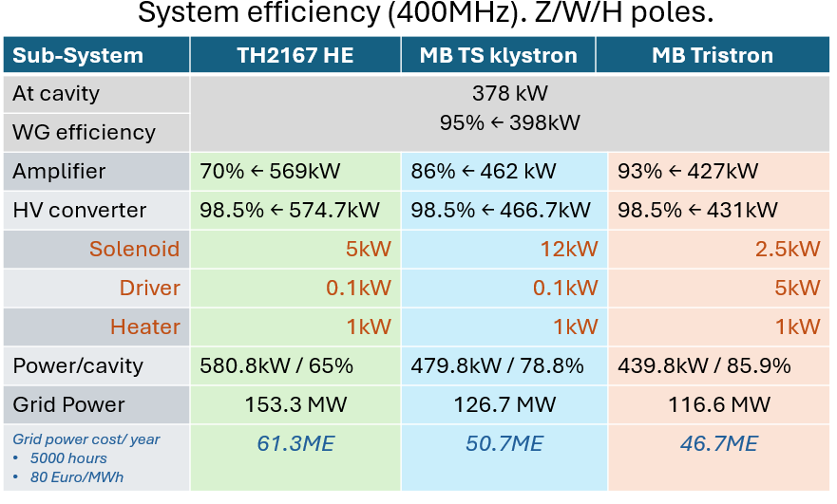
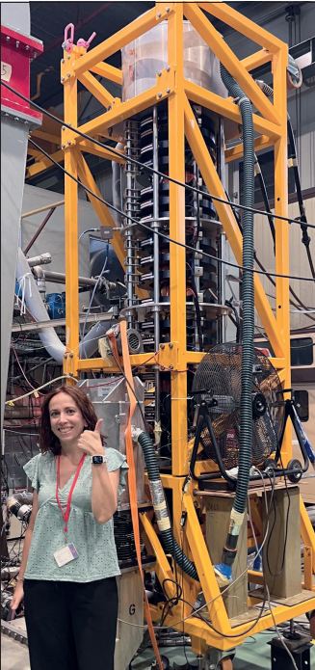
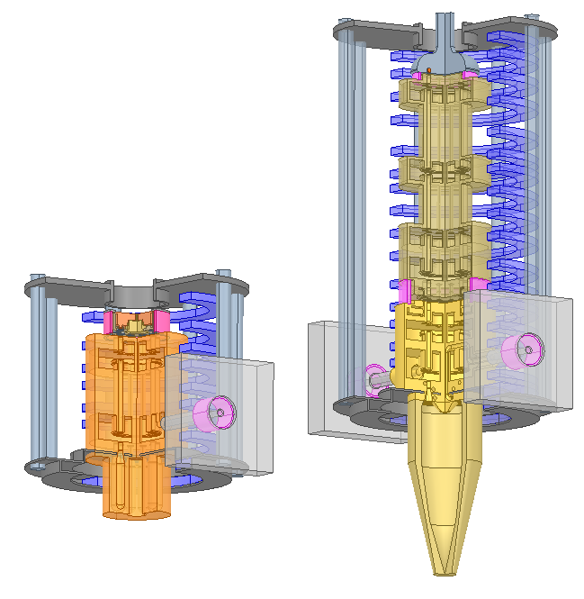
TH2167 HE klystron
(HL-LHC)
MB TS Klystron
(design)
MB Tristron (concept)
Electro-vacuum tubes technologies for FCC_{ee} developed at CERN.
Fully compatible with HL-LHC power needs and infrastructure.

Slide 3
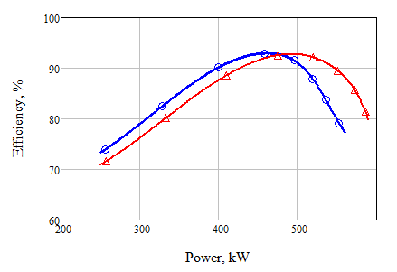
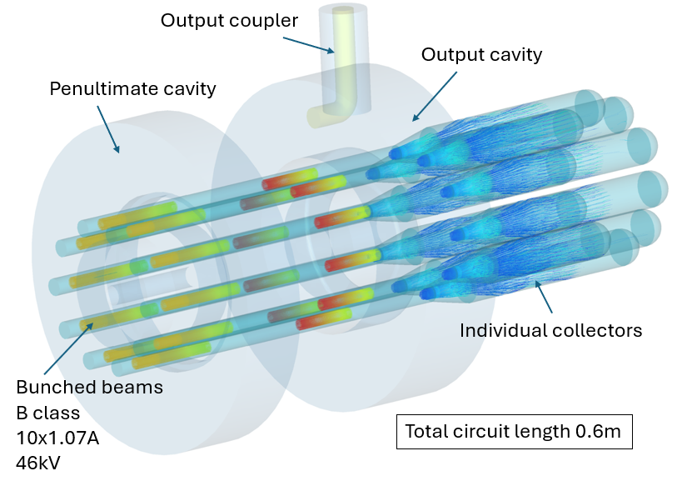
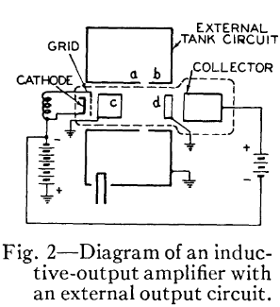
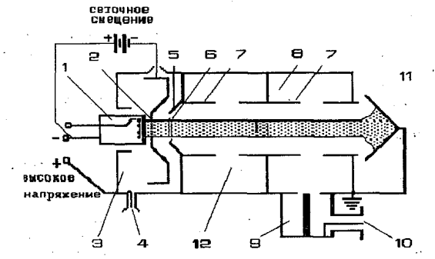
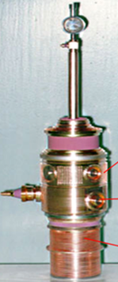
400 MHz FCC tristron power /efficiency performance
FCC_{ee} MB Tristron.
B class
46kV
48kV
Alike IOT, Tristron (a hybrid between triode and klystron) is a gridded tube with additional penultimate cavity that boosts the RF power production efficiency from 75% (IOT) to above 90%.
Tristron concept is almost 60 years old, but it never been fully commercialized before.
Tristron (A.D. Sushkov et. al. 1967)
MB Prototype tested in 1997, V. Tsarev:
IOT (A. Haeff, 1939)

Slide 4
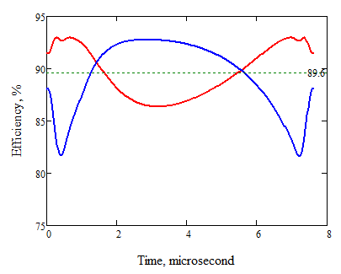
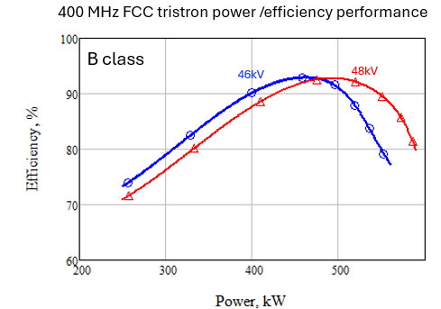
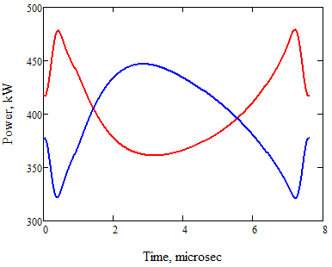
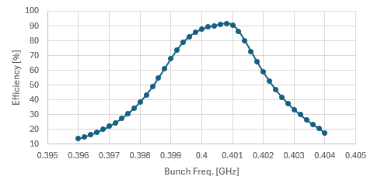
MB Tristron operational efficiency for FCC: Z-pole/RPO.
Cavities RF power modulation, 4 MHz filtered; 88MV
Tristron transient efficiency
Z, DeFOC,88MV
Z, FOC, 88MV
46kV
+/- 20% modulation depth
+/- 20% modulation depth
For the required RF power modulation (by LLRF only), the HV set point can be selected (46kV is an example) so that average efficiency will stay ultimately high: 89.6% . With TS MBK klystron average operational efficiency will be dropped from 86% (tube in saturation) down to 67%.
MB tristron is now select as a baseline option for 400MHz (500kW) and 800MHz (250kW) FCC_{ee} RF powers sources.
Transient RF power modulation will impose certain requirement on the HV supply bandwidth, for details see the talk by D. Aguglia.
Tristron bandwidth
46kV
4MHz@-3dB

Slide 5
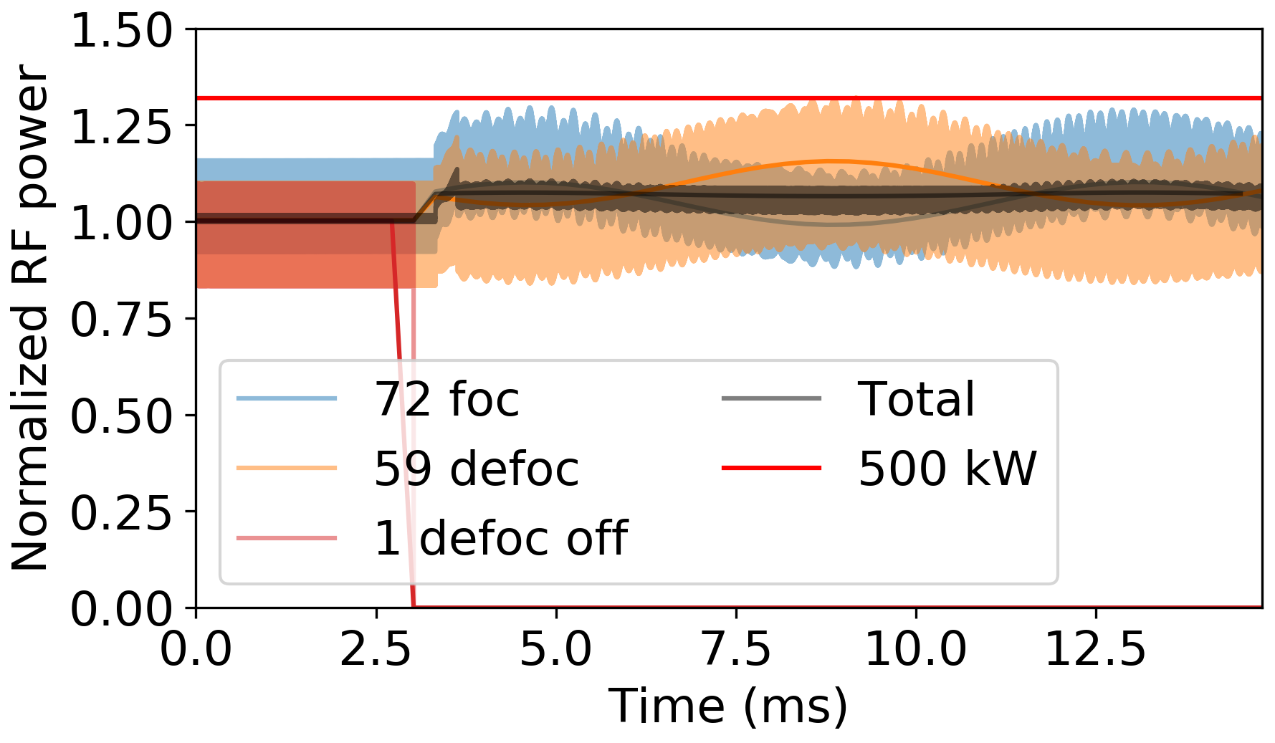
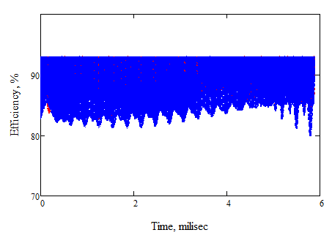
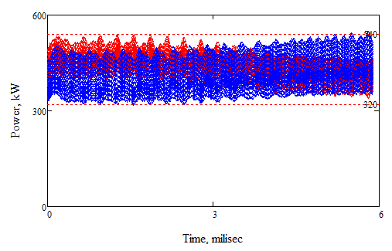
Failure mitigation mode
One cavity out of operation;88MV
Tristron transient efficiency
46V
Eff. _{FOC}= 91%
Eff. _{DEFOC}= 89.6%
Required RF power modulation; 88MV
With a single cavity failure, required power modulation will be provided by LLRF system and tristrons will preserve overall very high operating efficiency.
Power sweep range: 320kW-540kW!

Slide 6
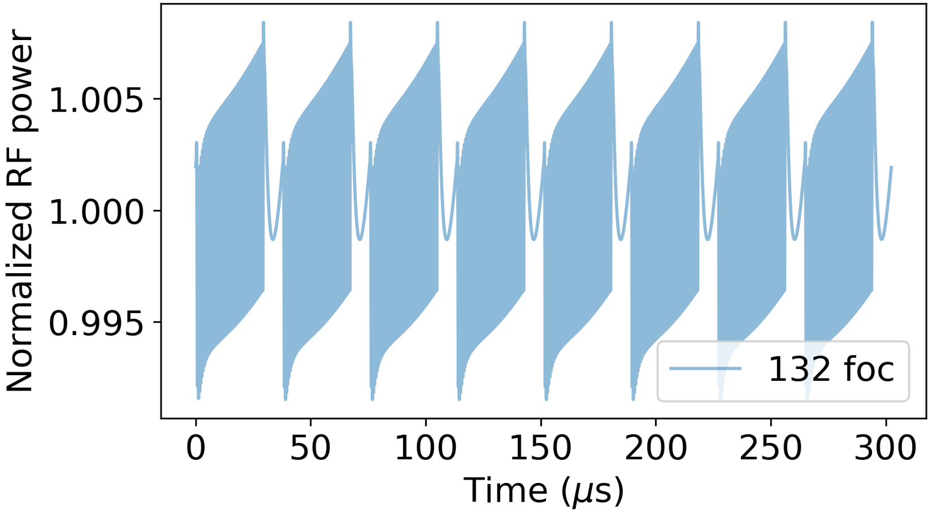
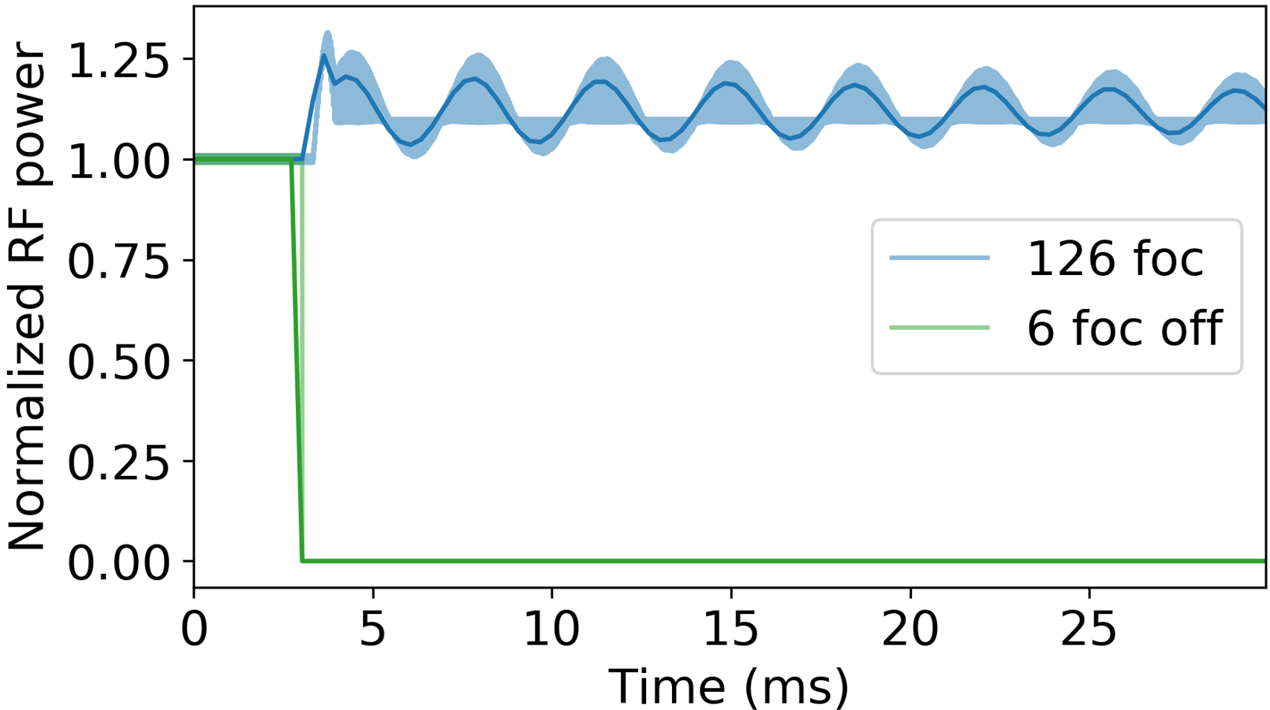
MB Tristron operational efficiency for FCC: W,H-poles.
Nominal operation
nominal
6 cavities failure
Failure mode: 6 cavities off
With nominal operation tristron will be set to its optimal voltage/efficiency point. In case of failure LLRF will be able to compensate the effect providing operational efficiency above 90% (6 cavities failure case is shown as an example).

Slide 7

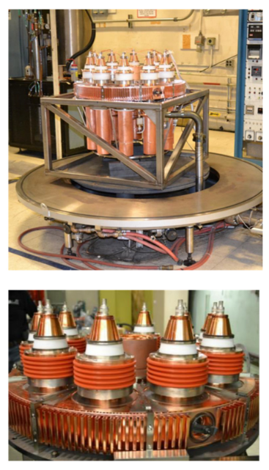


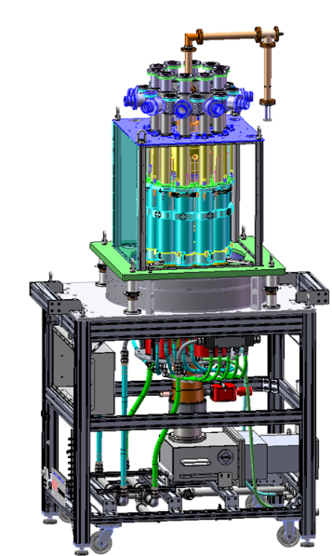

Technology readiness.
State of the art.
Multibeam gridded tubes technology is well established in industry. Two MB IOT (1.2 MW, 0.7GHz, 10% duty) prototypes were built and successfully tested about 10 years ago.
MB tristron has similar topology as an MB IOT with an additional cavity located before the output cavity.
The major cost/complexity of existing MB IOT is driven by an array of 10 separate input cavities (one per beam) that must be tuned to be almost identical.

Slide 8
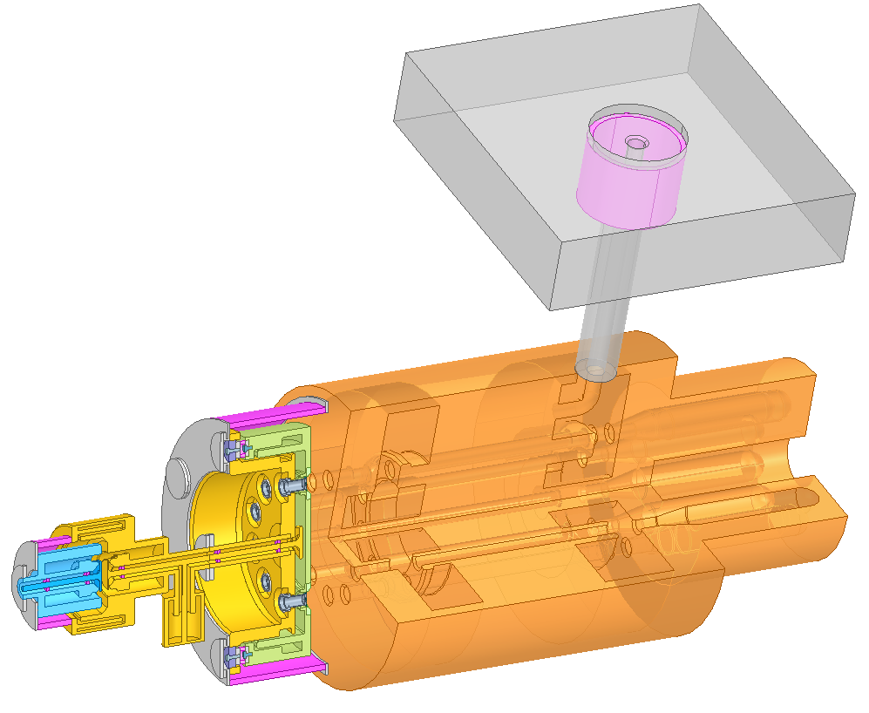
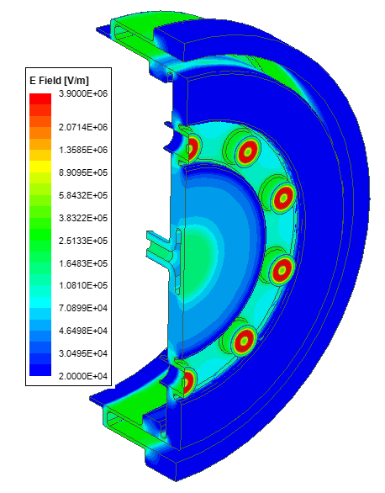
FCC_{ee} 400MHz, 0.5MW MB Tristron design with a common input cavity (CERN).
Completed:
RF design
Systems integration
Tolerances analysis
With-beam simulations
RF output
400MHz, 500kW, η=92%
Input cavity
Output cavity
DC/RF breaker
Penultimate cavity
Individual collector x 10
RF input
RF E-field in the input cavity
Total length 1.49m. External solenoid is not shown

Slide 9
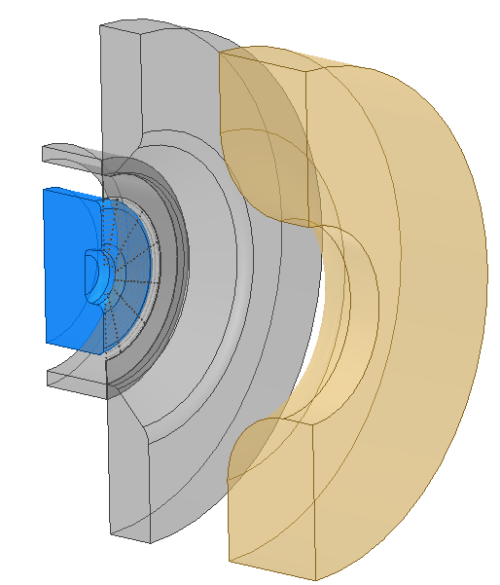
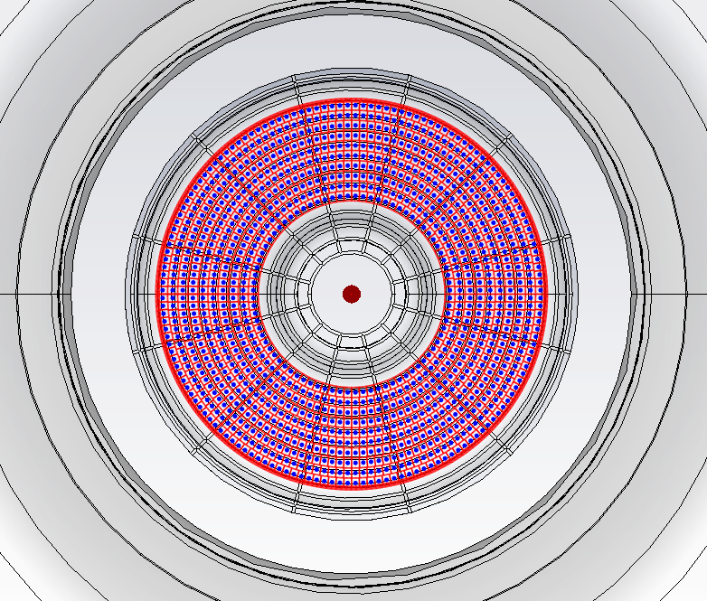
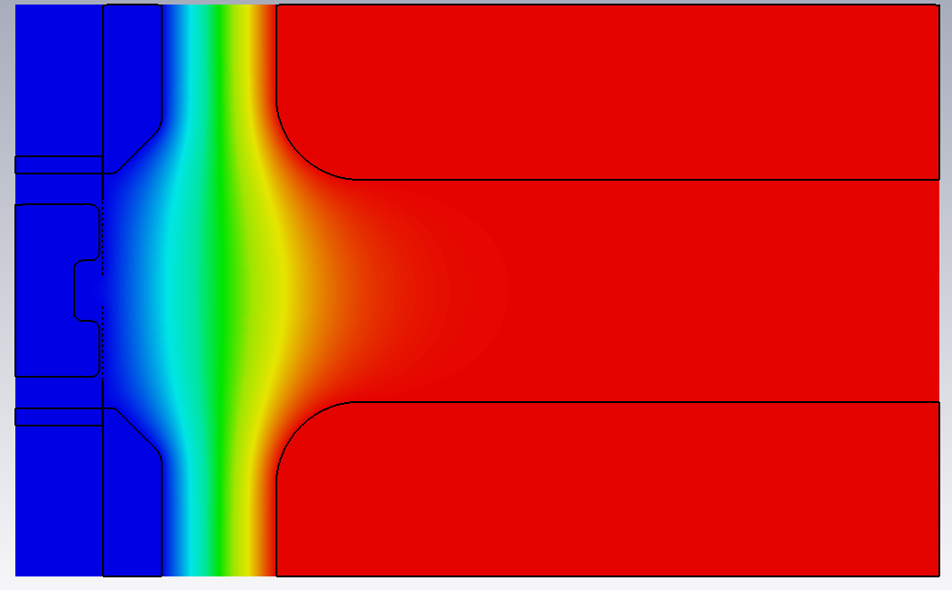
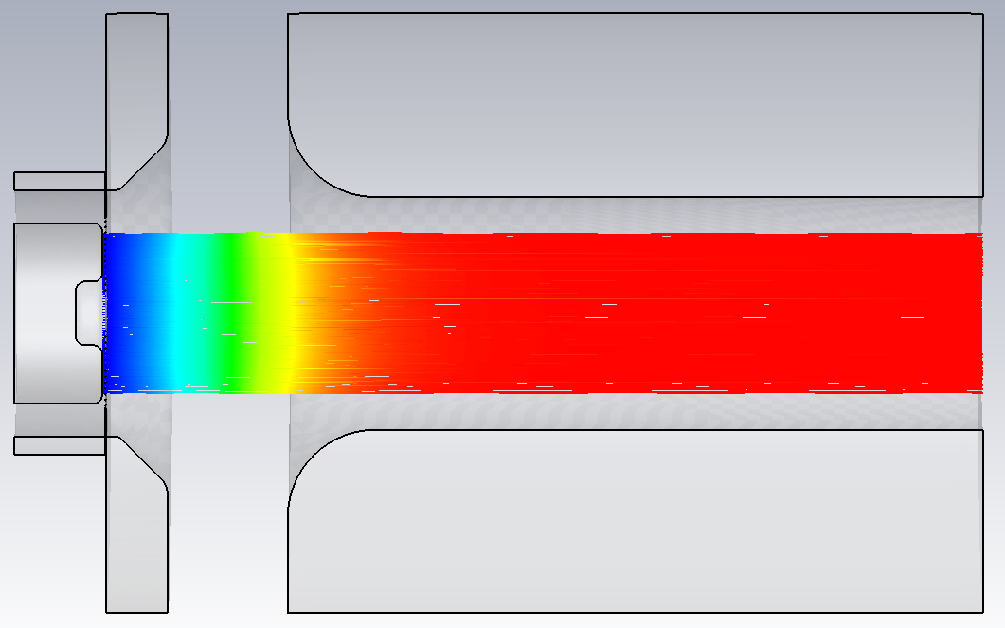
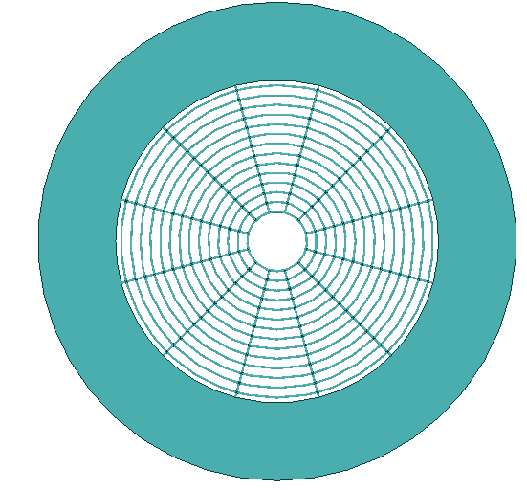
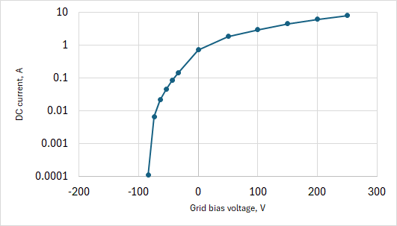
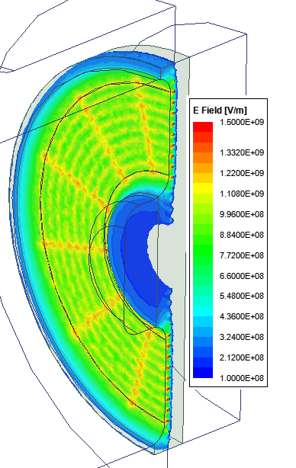
Tristron's gridded cathode optics simulations in CST TRK (DC)
Current emission sites
0.026T external B_{z} -field
V1+/- V _{bias}
DC E-field
DC current
At ground
No beam area compression!
V1=46kV
Flat grid topology
Grid gap=300µm
Grid wire ∅150µm
This topology is used now for thermal stresses and mechanical deformation simulations.
Next step will be import of RF fields
and full PIC simulation of the bunching processes.
External solenoid and collector designs are in progress.
RF E-filed in the gap area of the input cavity

Slide 10
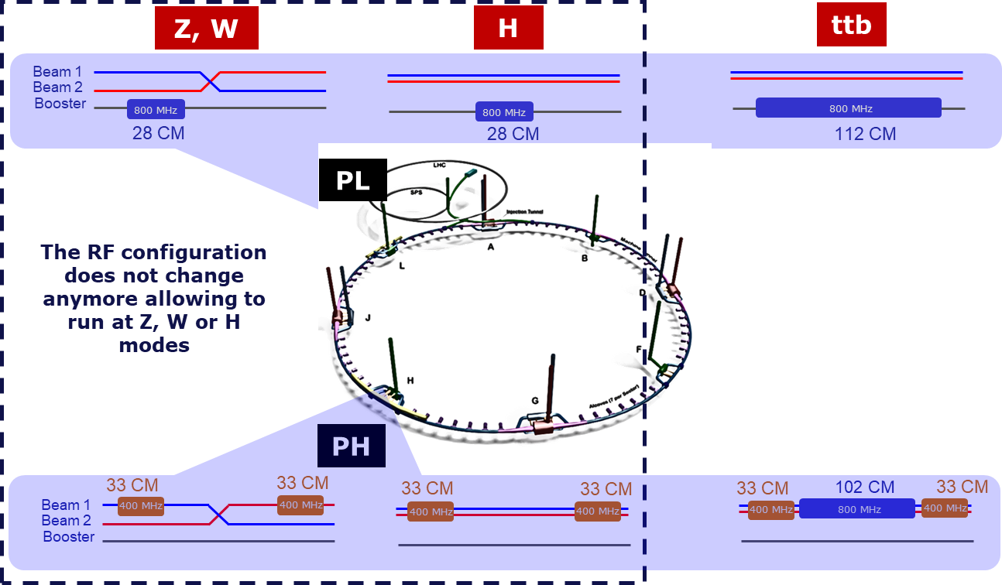
Layout of the FCC_{ee} SRF system
  Start operation in March 2047
  Duration: 10 years
  Start operation in March 2058 Duration: 5 years
10

Slide 11
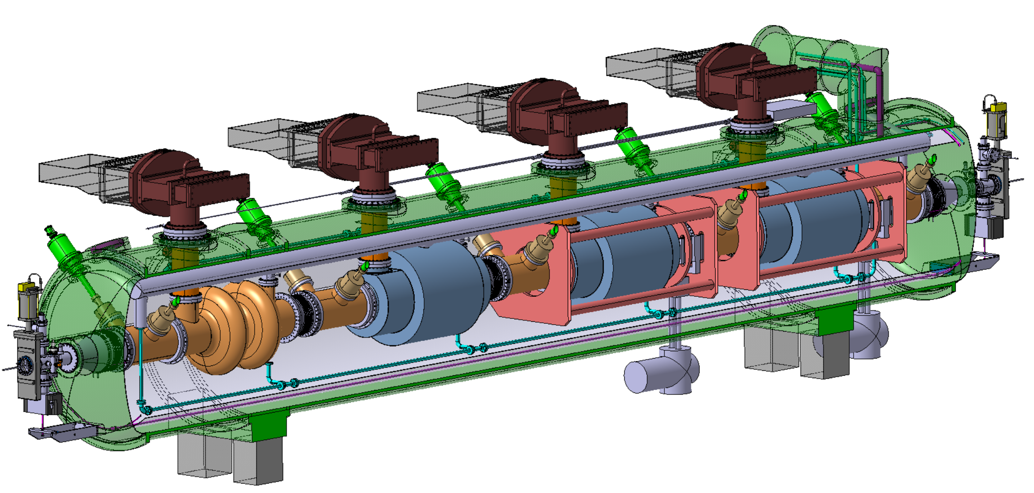
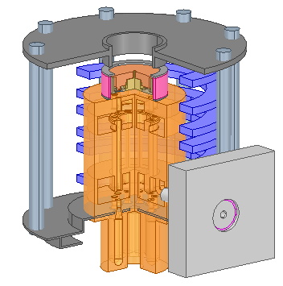
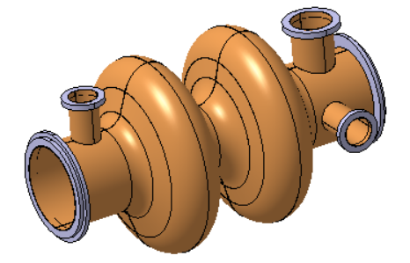
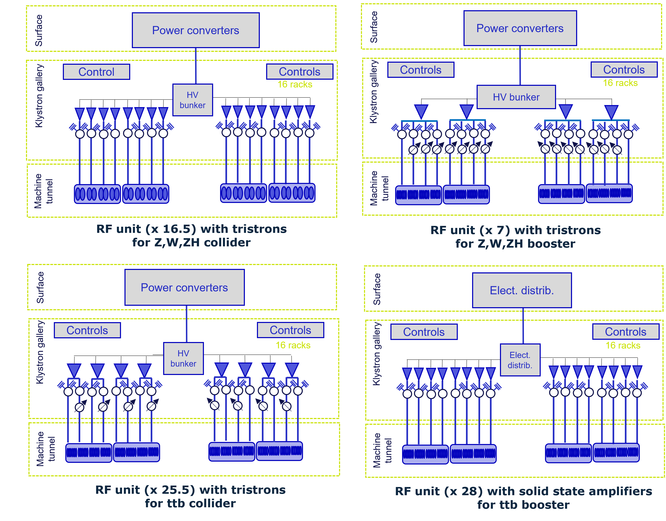
400 MHz system – collider Z, W, ZH
X 264
Superconducting elliptical cavity
400 MHz, 2-cell
1.5 m. long
Electropolished and seamless RF surface
Niobium thin film with HiPIMS
X 66
Cryomodule
Segmented design, 4 cavities
Vertical FPC, HOM damping and extraction
Frequency tuning system
Thermal and magnetic shielding
Multibeam Tristron
400 MHz
46 kV
500 kW, CW
X 264
Collider | Z | W | ZH
 | 1 beam RPO | 1 beam | 2 beams
Total RF voltage [MV] | 89 | 1049 | 2098
Beam current [mA] | 1292 | 135 | 2 x 26.8
RF Frequency [MHz] | 400.79
Operating temp. [K] | 4.5
Cavity voltage [MV] | 7.95
# cell/cavity | 2
Eacc [MV/m] | 10.6
Q0 | 2.70E+09
RF power [kW] | 380
Optimum coupling QL | 9.2E+05
# CM (with 4 cav/CM) | 66
# cavities | 264
RF Unit
RPO at Z
2 beams at ZH
500 kW per cavity with overhead
500 kW MB Tristrons
1 cavity + 1 circulator per RF source
16 cavities (4 CM) per RF unit
WR2300 WG
X 16.5

Slide 12
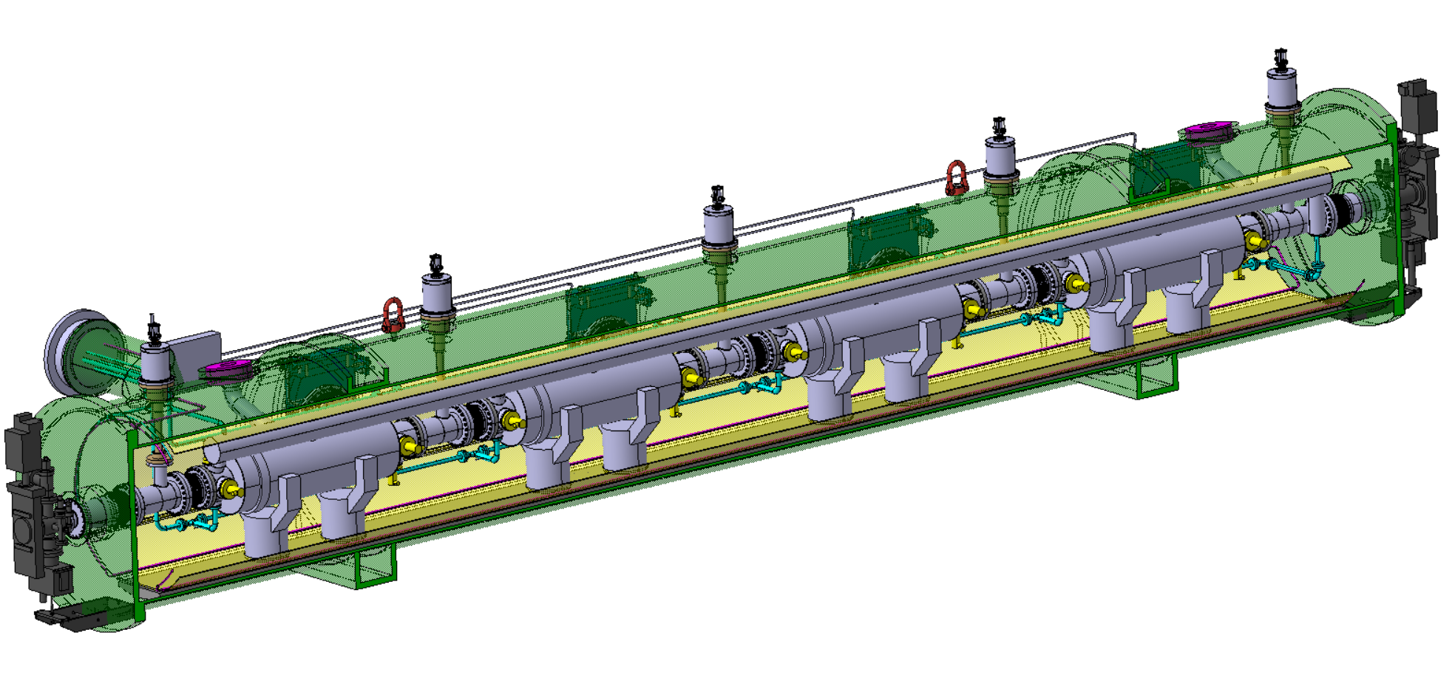
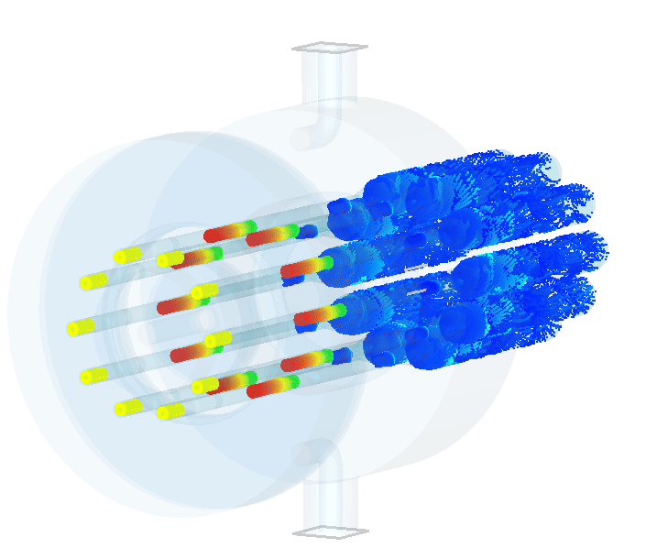
800 MHz system – booster Z, W, ZH
800 MHz system – booster Z, W, ZH
X 112
Superconducting elliptical cavity
800 MHz, 6-cell
1.5 m. long
Bulk Niobium with electropolished and doped RF surface (mid T baked)
X 28
Cryomodule
Segmented design, 4 cavities
FPC on side, HOM damping and extraction
Frequency tuning system
Thermal and magnetic shielding
Multibeam Tristron
800 MHz
250 kW, pulsed (high duty cycle)
X 28
Booster | Z | W | ZH
 | RPO | RPO
Total RF voltage [MV] | 80 | 401.9 | 1961
Beam current [mA] | 16.2 | 6.2 | 2
RF Frequency [MHz] | 801.58
Operating temp. [K] | 2
Cavity voltage at extraction [MV] | 5.6 | 13.5 | 17.5
# cell/cavity | 6
Eacc [MV/m] | 4.9 | 12 | 15.6
Q0 | 3E+10
Max RF power [kW] | 42
Coupling QL | 1E+07
# CM (with 4 cav/CM) | 28
# cavities | 112
Could be replaced by SSPA (1/cav) if RF efficiency is good and solution is economically feasible and reliable.
RF Unit
RPO at Z&W booster
50 kW per cavity
200 kW MB tristrons
4 cavities per tristron
16 cavities (4 CM) per RF unit
WR 1150 WG
X 7

Slide 13
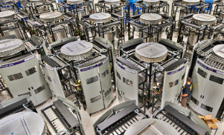
800 MHz system – ttb (collider and booster)
Multibeam Tristron
800 MHz
250 kW, CW
X (408 + 448)
X 408
X (102 + 112)
Superconducting elliptical cavity
800 MHz, 6-cell
Nb3Sn if R&D is successful
Cryomodule
Segmented design, 4 cavities, 2 K
Operation at 4.5 K is R&D successful
Solid State Amplifier (SSA)
800 MHz
10-15 kW pulsed
X 448
RF Units
 | ttb collider |  |  | ttb booster
 | 2 beams |  |  | 1 beam
Total RF voltage [MV] | 2098 | 9202 |  | 10180
Beam current [mA] | 10 |  |  | 0.4
RF Frequency [MHz] | 400.79 | 800.58 | 800.58
Operating temp. [K] | 4.5 | 2 | 2
Cavity voltage [MV] | 7.95 | 22.5 | 22.5 | 22.8
# cell/cavity | 2 | 6 | 6
Eacc [MV/m] | 10.6 | 20.1 | 20.1 | 20.3
Q0 | 2.7E+9 | 3E+10 | 3E+10
RF power [kW] | 78 | 195 | 195 | 8.9/12.7
Optimum coupling QL | 4.5E+06 | 4.1E+06 | 4.1E+06 | 9.2E+07/2.7E+07
# CM (with 4 cav/CM) | 66 | 102 | 102 | 112
# cavities | 264 | 408 | 408 | 448
Collider (800 MHz tristrons)
X 26
X 28
Booster (SSA)

Slide 14
Spare slides

Slide 15
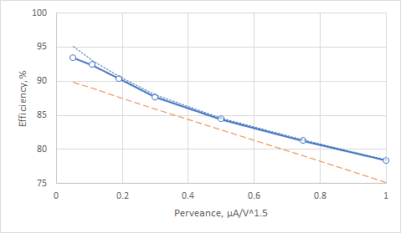
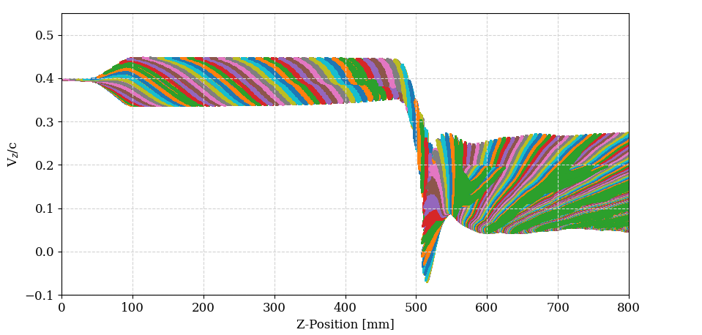
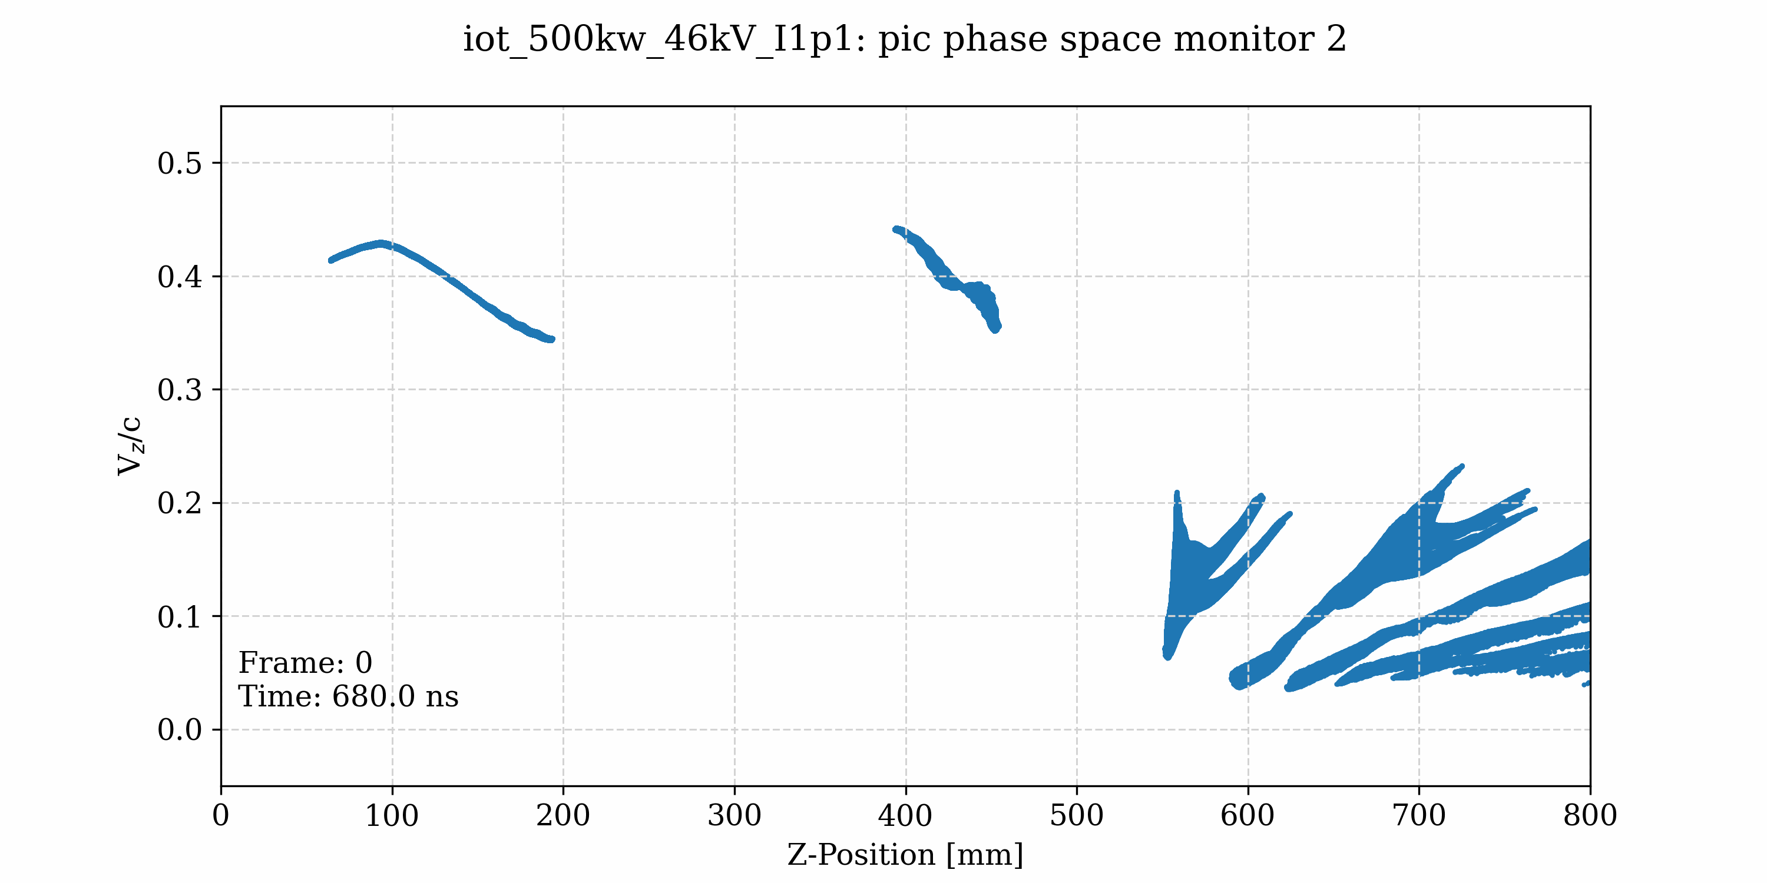
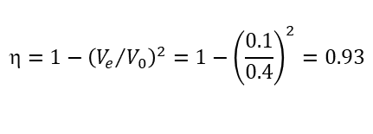
Why MB Tristron can be so efficient?
Multi-beam technology -> low perveance per beam
Gridded cathode provides fully saturated bunches -> 75% (best IOT performance)
Penultimate cavity controls optimal velocity spread (congregation) within the bunch, followed by bunch length compression in the drift -> 85% (basic of the Tristron concept).
‘Very’ long gap in the output cavity with negative detuning allows partial electrons bouncing -> 91% (discovered in our studies of the HE klystrons at CERN).
Hollow beam configuration reduces radial bunch stratification -> 93%.
Optimized MB Tristron efficiency vs. perveance
Electron bunches velocity modulation in tristron
Output cavity
Phase space animation
FCC MB tristron
Optimal congregation
Drift length provides optimal bunch length compression
Spent beam
FCC TS klystron
Tristron (fixed beam power)
CEPC CSM klystron
Klystrons theoretical limit
Penultimate cavity
Average velocity (0.1Ve/c)
Bouncing electrons
$$=1−{\left({V_{e}}/{V_{0}}\right)}^{2}=1−{\left(\frac{0.1}{0.4}\right)}^{2}=0.93$$

Slide 16
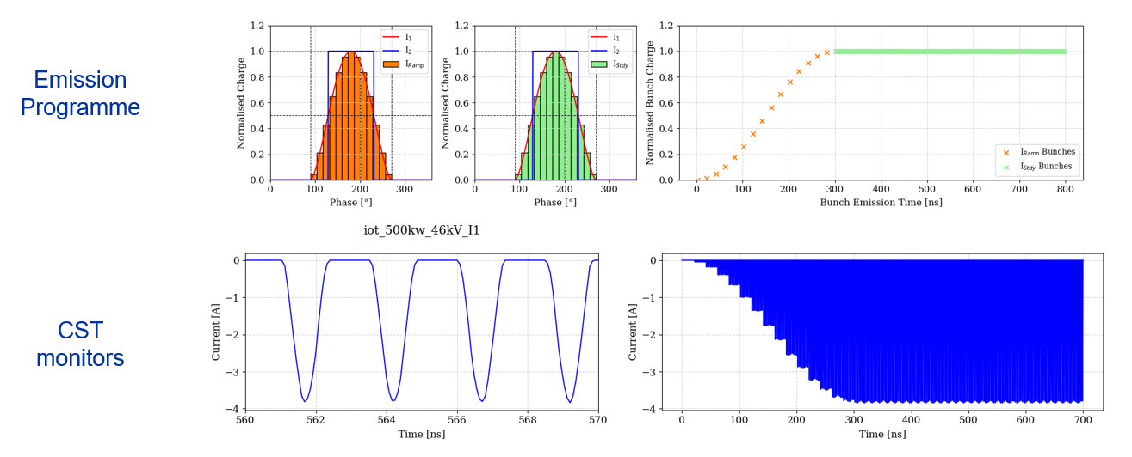
Gridded tube bunch current generation B CLASS in CST PIC, design point 46kV, 1.07A/beam
$$I\left(t\right)=I_{0}{×(U_{bias}+U_{RF}×\sin\left(ωt\right))}^{1.5};=0 if I\left(t\right)<0$$
I _{av.}=1.07A

Slide 17
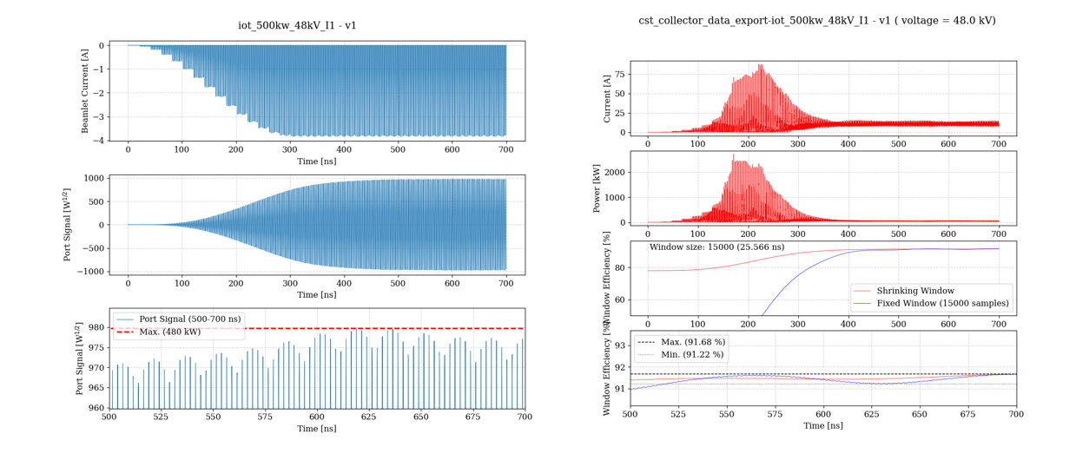
RF power / efficiency measurement in CST
Balanced efficiency calibration (beam in a collector)
Beam current
RF power at port

Slide 18
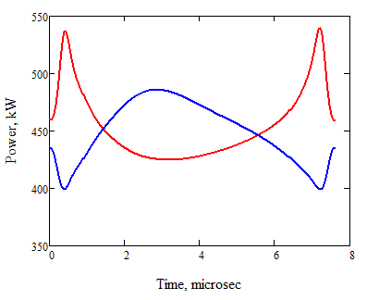
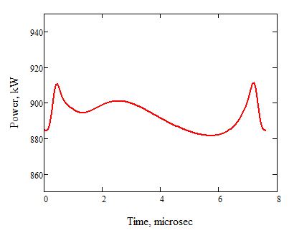
Issues with transient loading of the HV power supply (Z pole)
Common HV
Tristron#1
HV
Tristron
Tristron#2
Transient power drain from HV power supply
Transient power drain from common HV power supply
46kV, 88MV

