Slide 1
Electropolishing of large copper substrates for FCC
FCC-ee 400 MHz double cell
L. Ferreira, FCC Week 2025 | Electropolishing of large copper substrates for FCC

Slide 2
L. Ferreira, FCC Week 2025 | Electropolishing of large copper substrates for FCC 21st of May 2025
Content
Tools and expertise
  Electropolishing set-up, Interfaces and Simulation
Simulation vs real data
Main issues and achievements
Preparation for the 2-cells 400 MHz FCC-ee cavities
Main challenges & strategies
Conclusions

Slide 3
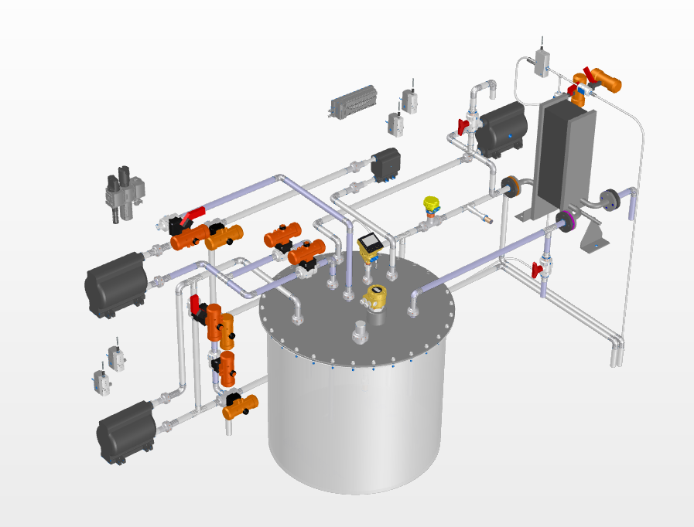
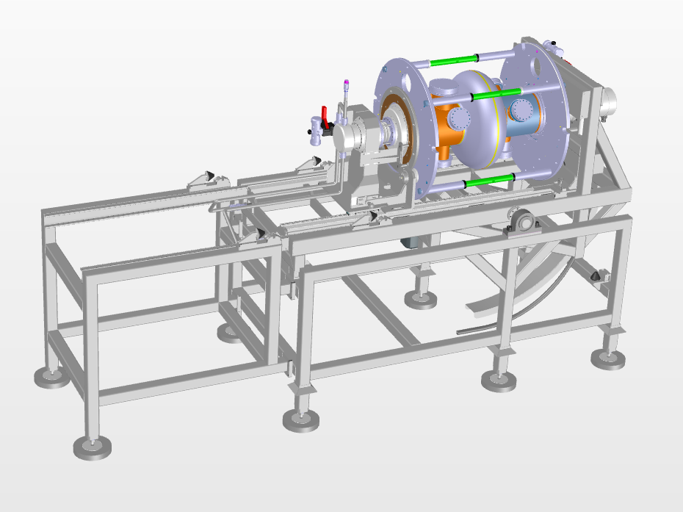
L. Ferreira, FCC Week 2025 | Electropolishing of large copper substrates for FCC 21st of May 2025
Tools and expertise
Electropolishing set-up & Interfaces
Bath handling chemical facility
Cavities handling machine

Slide 4
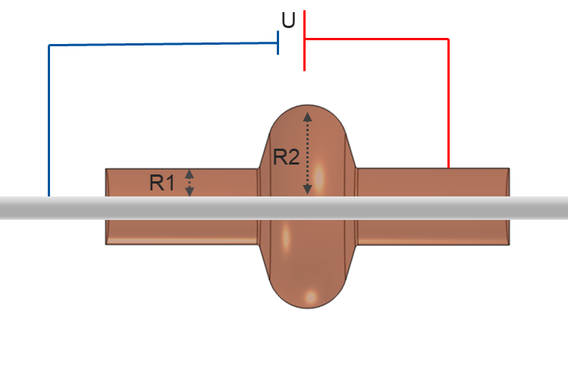
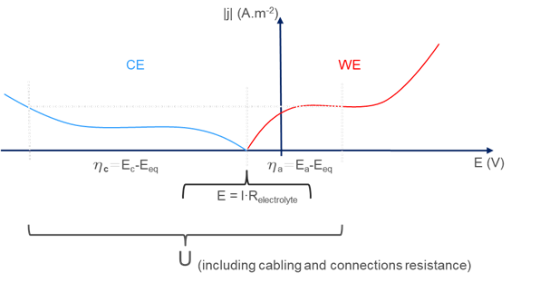
L. Ferreira, FCC Week 2025 | Electropolishing of large copper substrates for FCC 21st of May 2025
Tools and expertise
Simulation
# working parameters
j = f(U, T, v_{b}, S_{c}/S_{a}, σ_{l}, [b])
- j, Current density
- U, Overall applied tension
- T_{b}, Bath temperature
- v_{b}, Bath fluid dynamics
- Sc/Sa, Cathode geometry & Cathodic/Anodic surface ratio
- σ_{l}, Bath conductivity
- [b], Bath composition
Anode: Cu_{(s)} → Cu²⁺_{(aq)} + 2e⁻ 2H₂O_{(l)} → O_{2(g)} + 4H⁺_{(aq)} + 4e⁻
Cathode: Cu²⁺_{(aq)} + 2e⁻ → Cu_{(s)} 2H⁺_{(aq)} + 2e⁻ → H_{2(g)}
Mass transport controlled
Charge transfer controlled

Slide 5
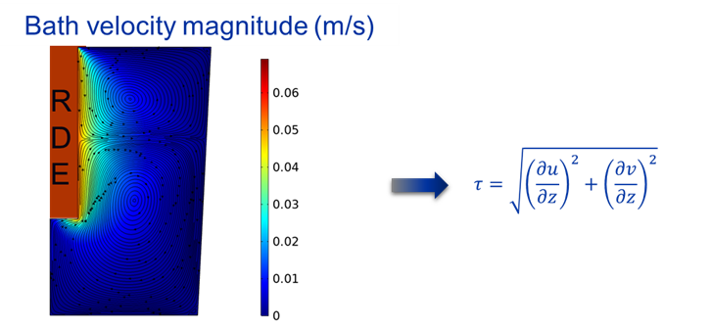
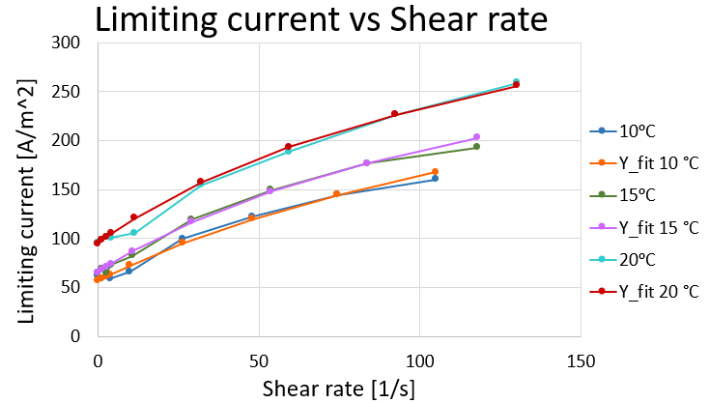
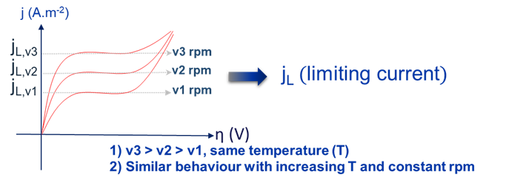
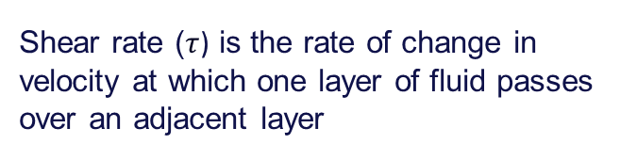
L. Ferreira, FCC Week 2025 | Electropolishing of large copper substrates for FCC 21st of May 2025
Tools and expertise
Shear rate ($τ$) is the rate of change in velocity at which one layer of fluid passes over an adjacent layer
Simulation
Shear rate
RDE experimental data
RDE model data

Slide 6
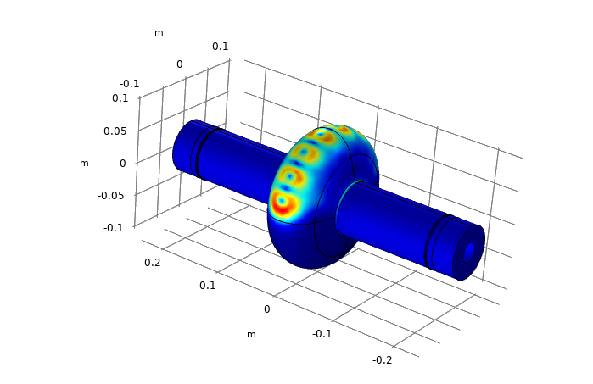
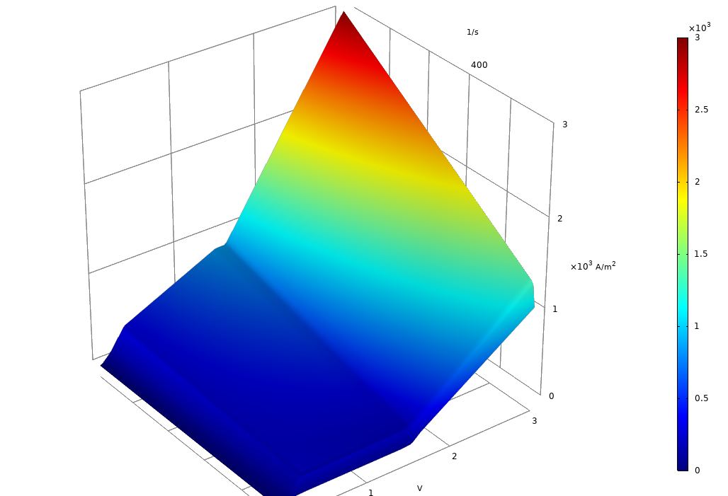
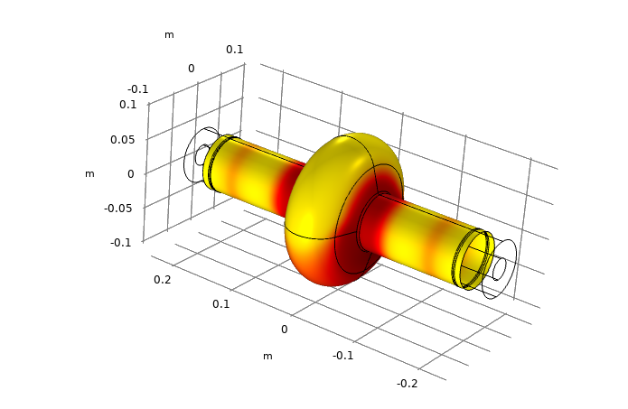

L. Ferreira, FCC Week 2025 | Electropolishing of large copper substrates for FCC 21st of May 2025
Tools and expertise
Shear rate (τ)
Simulation
Creation of a new anodic current density function to be used for any geometry, using the results obtained with the RDE:
$$j=f(η,τ)$$
Overpotential (η)
Current
density (j)
Shear rate (τ)
Overpotential (η)

Slide 7
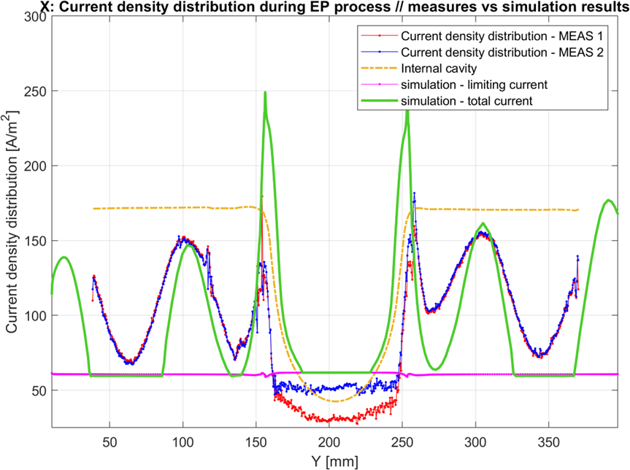
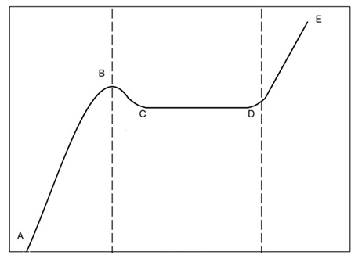
L. Ferreira, FCC Week 2025 | Electropolishing of large copper substrates for FCC 21st of May 2025
Simulation vs Real data
Benchmarking on 1.3 GHz copper monocell
POLISHING
j_{lim}
Current density (A/m²)
POLISHING & OXYGEN FORMATION
Overpotential (V)

Slide 8
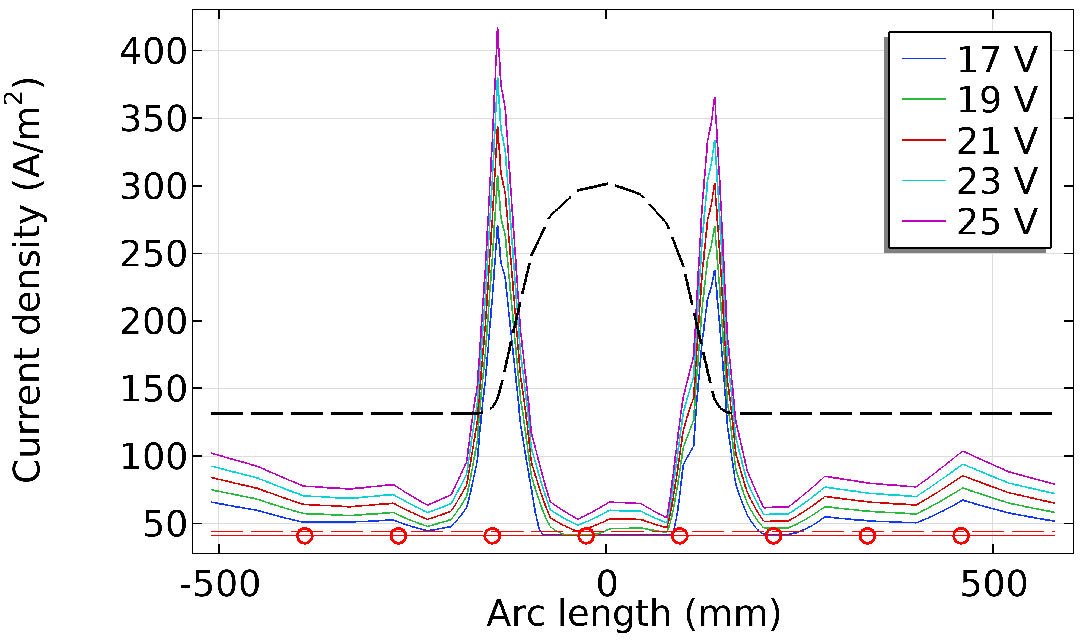
L. Ferreira, FCC Week 2025 | Electropolishing of large copper substrates for FCC 21st of May 2025
Simulation vs Real data
Data from simulation:
400 MHz Current density distribution at 10 °C
Data from 400 MHz monocell processing
Cavity | Tension / V | Current / A | Temperature / °C *
PC04#1 | 21 | 81.8 | 15.4
PC04#2 | 21 | 72.5 | 14.0
PC06#1 | 21 | 75.0 | 15.2
PC06#2 | 21 | 75.9 | 14.8
*) Temperature readings from the chemical
facility are not in line with the ones measured
on the test cavity (~10 °C). dT within the chemical
facility is below 1.6 °C.
Simulation total current, corrected to estimated
wet surface: 84 A at 21 V
Average polishing rate: 0.1 µm/min

Slide 9
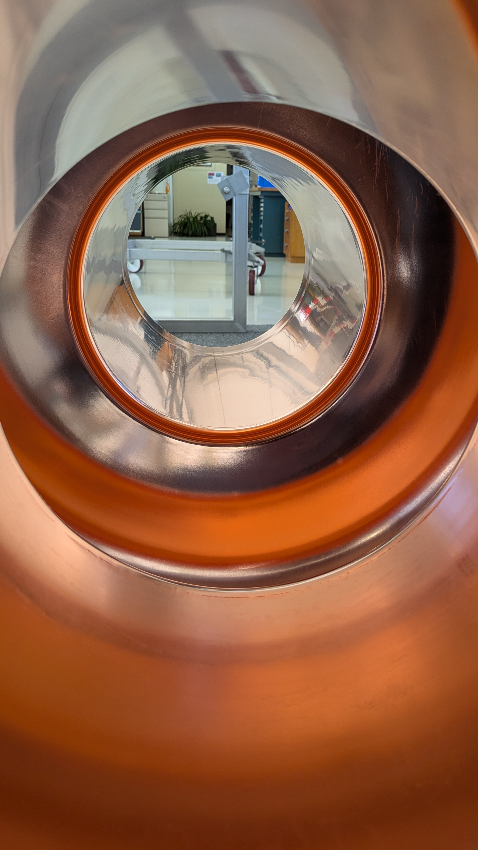
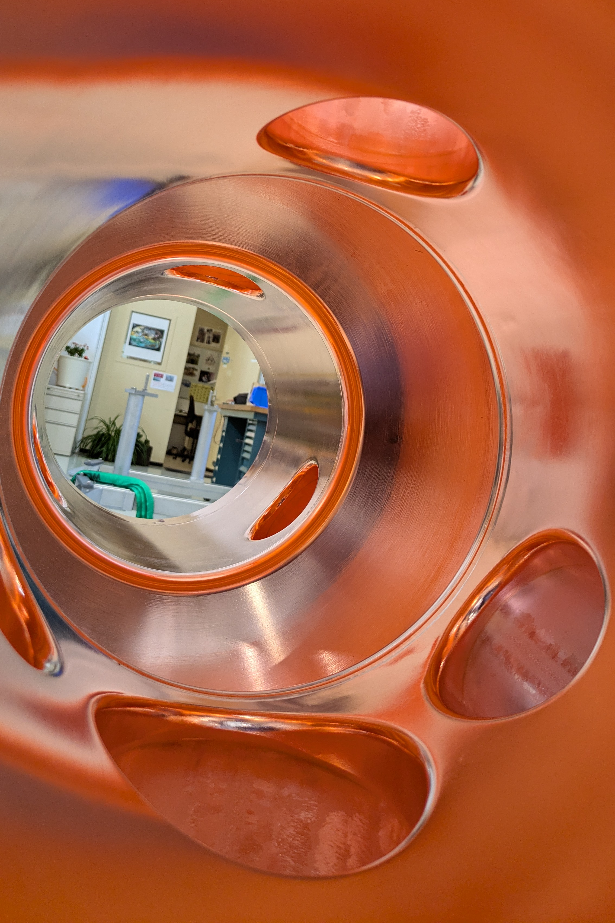
L. Ferreira, FCC Week 2025 | Electropolishing of large copper substrates for FCC 21st of May 2025
Main issues and achievements
1st Ever electropolishing of a 400 MHz monocell copper cavity
1st Ever electropolishing of a 400 MHz LHC monocell copper cavity

Slide 10
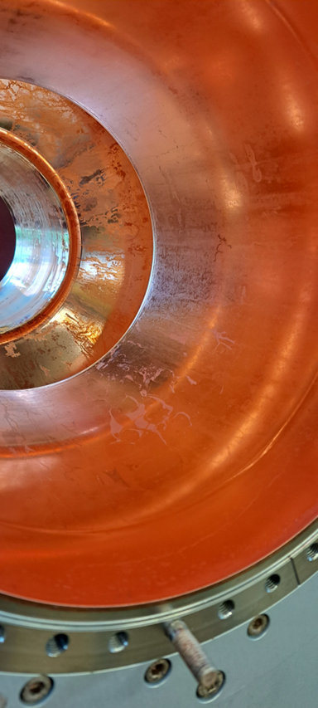
L. Ferreira, FCC Week 2025 | Electropolishing of large copper substrates for FCC 21st of May 2025
Main issues and achievements
Main issue: Passivate the copper
  Neutralisation before disassembly

Slide 11
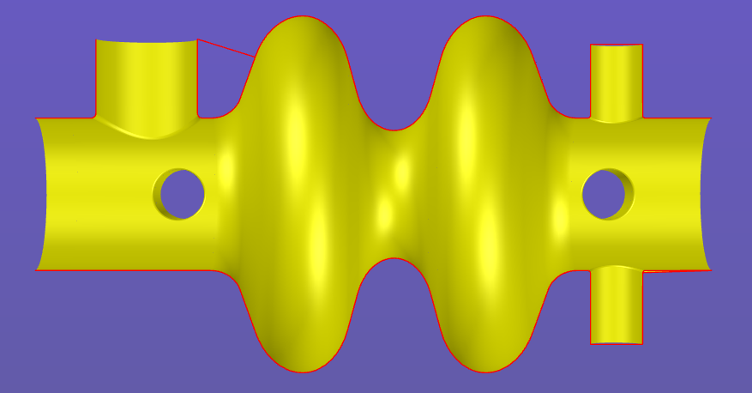
L. Ferreira, FCC Week 2025 | Electropolishing of large copper substrates for FCC 21st of May 2025
Preparation for the 2-cells 400 MHz FCC-ee cavities
Main challenges
  Power input (+ surface & + distance)
Strategy
  Cathode optimisation
  Increase bath flow
  Exploit existing working window

Slide 12
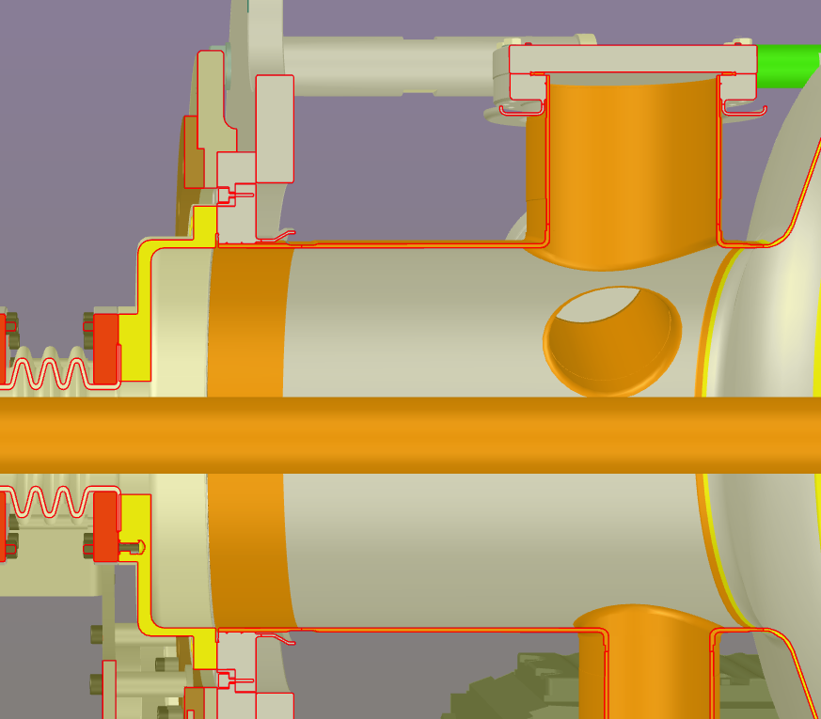
L. Ferreira, FCC Week 2025 | Electropolishing of large copper substrates for FCC 21st of May 2025
Preparation for the 2-cells 400 MHz FCC-ee cavities
Main challenges
Strategy
  Reduce retentions
  Reduce back flow
  Keep neutralisation step
  Passivation of copper
New
Existing

Slide 13
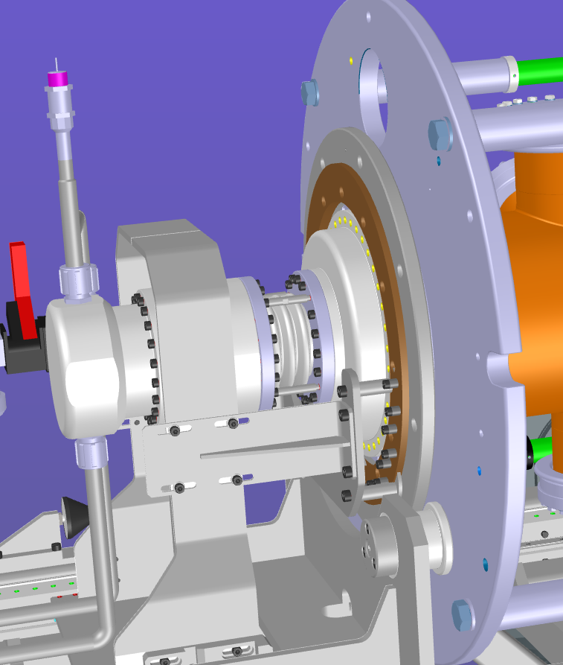
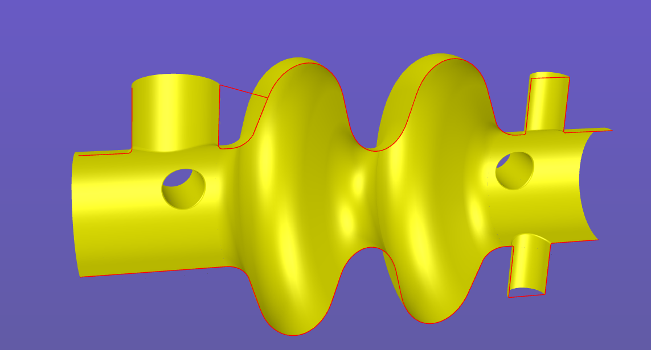
L. Ferreira, FCC Week 2025 | Electropolishing of large copper substrates for FCC 21st of May 2025
Preparation for the 2-cells 400 MHz FCC-ee cavities
Main challenges
Strategy
  Assemble 2nd contact ring
  Electropolishing of ports

Slide 14
L. Ferreira, FCC Week 2025 | Electropolishing of large copper substrates for FCC 21st of May 2025
Conclusions
Electropolishing process is well mastered
Data from 400 MHz monocell processing ensures 2-cell geometry EP feasibility
Main challenge remains the copper surface passivation
Impact of non electropolished (EP) ports still to be assessed

Slide 15
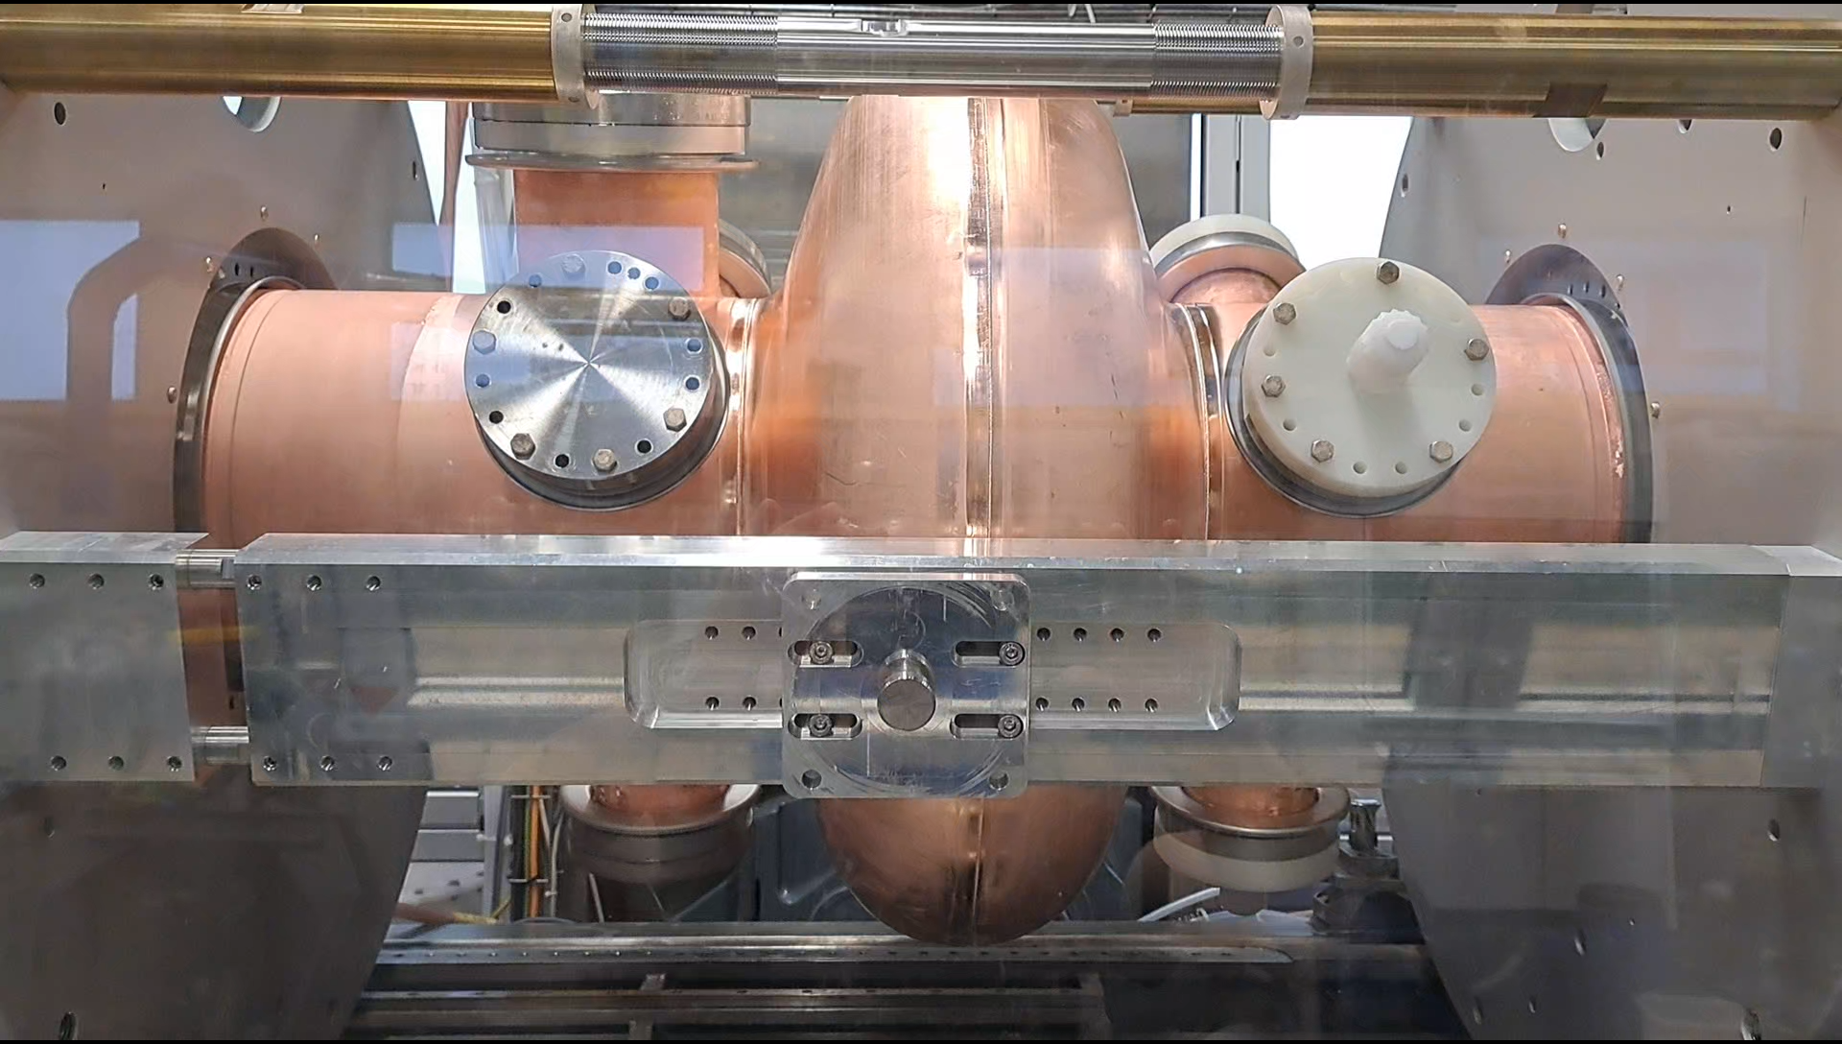
L. Ferreira, FCC Week 2025 | Electropolishing of large copper substrates for FCC 21st of May 2025
Thank you for your attention

