Slide 1
Cavity substrate development
21st May 2025 / FCC Week 2025
Marco GARLASCHE’ - CERN
Marco Garlaschè
On behalf of CERN EN-MME Group & FCC SRF Res.&Dev. Work Packages

Slide 2
FCC SRF Fab WP: Towards Cavity (Substrate) Manufacturing
End goal is to provide cavities conform to FCC baseline requirements. In order to do this:
Supporting R&D of all stakeholders involved
Identify the best manufacturing strategy in view of SRF performance, series production
Provide substrates for RF & coating studies | Surface quality, Reliability
Validate best manufacturing processes for series | Benchmark fabrication processes (especially if uninfluenced by the size of the cavity) : …internal EB welding, machining of RF surfaces, spinning, necking, deep drawing… Fabrication cost reduction studies & Industrialization of sub-elements…
Activities involve: 1.3 GHz, 800 MHz, 400 MHz (LHC & FCC Design)
Cut-Offs : industrialization study of 400 MHz design → Done

Slide 3
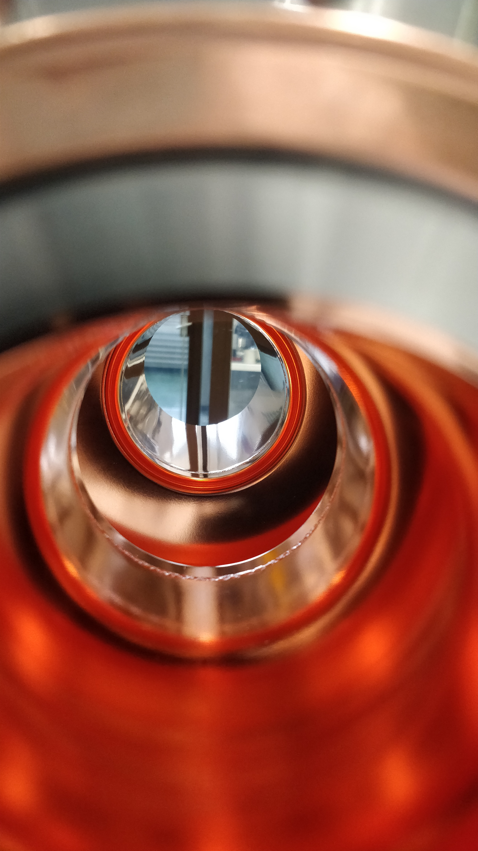
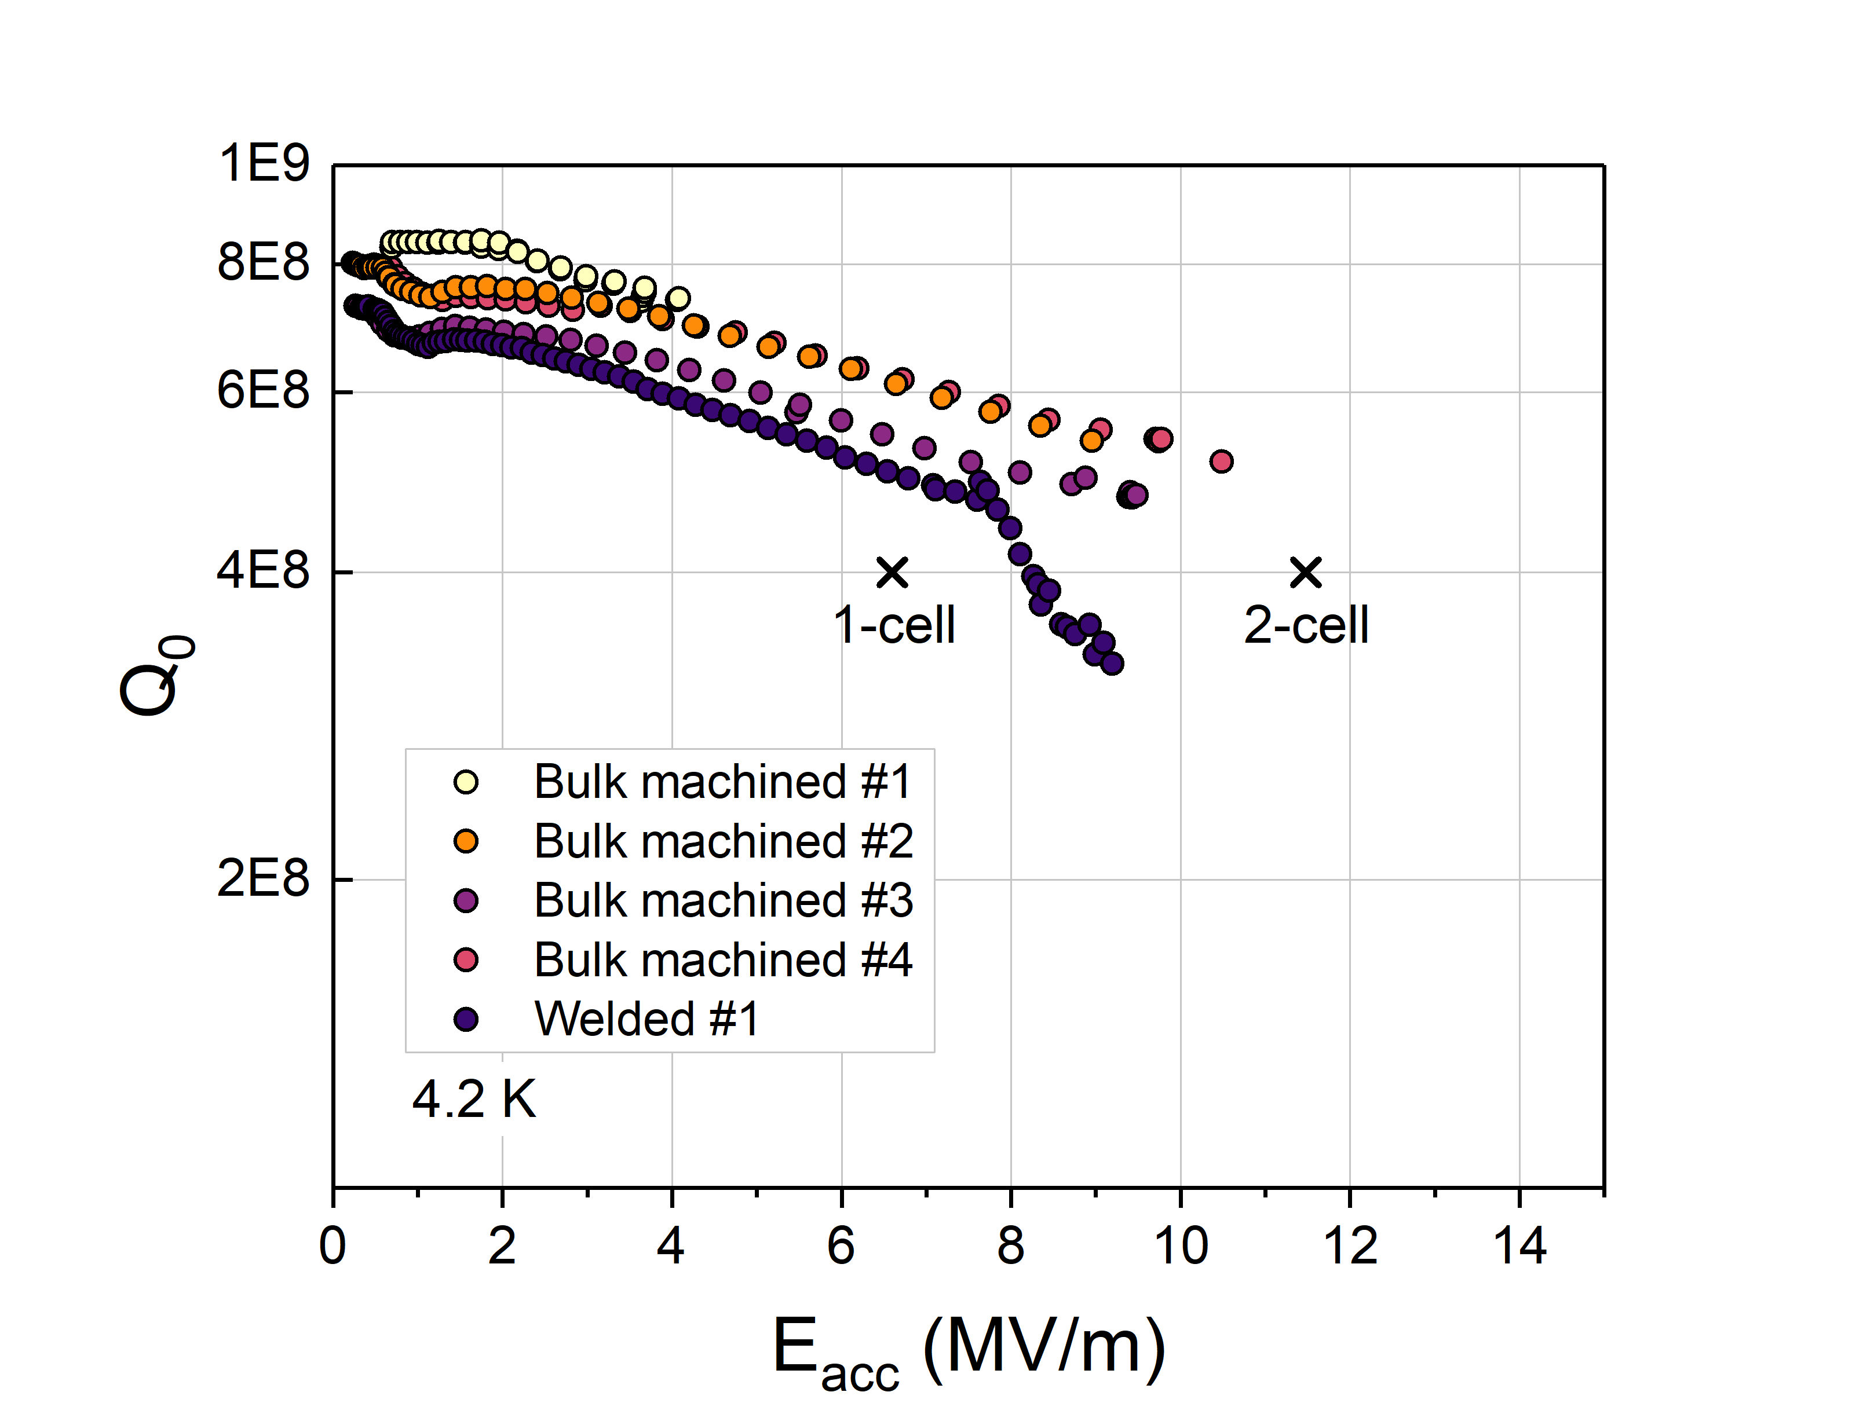
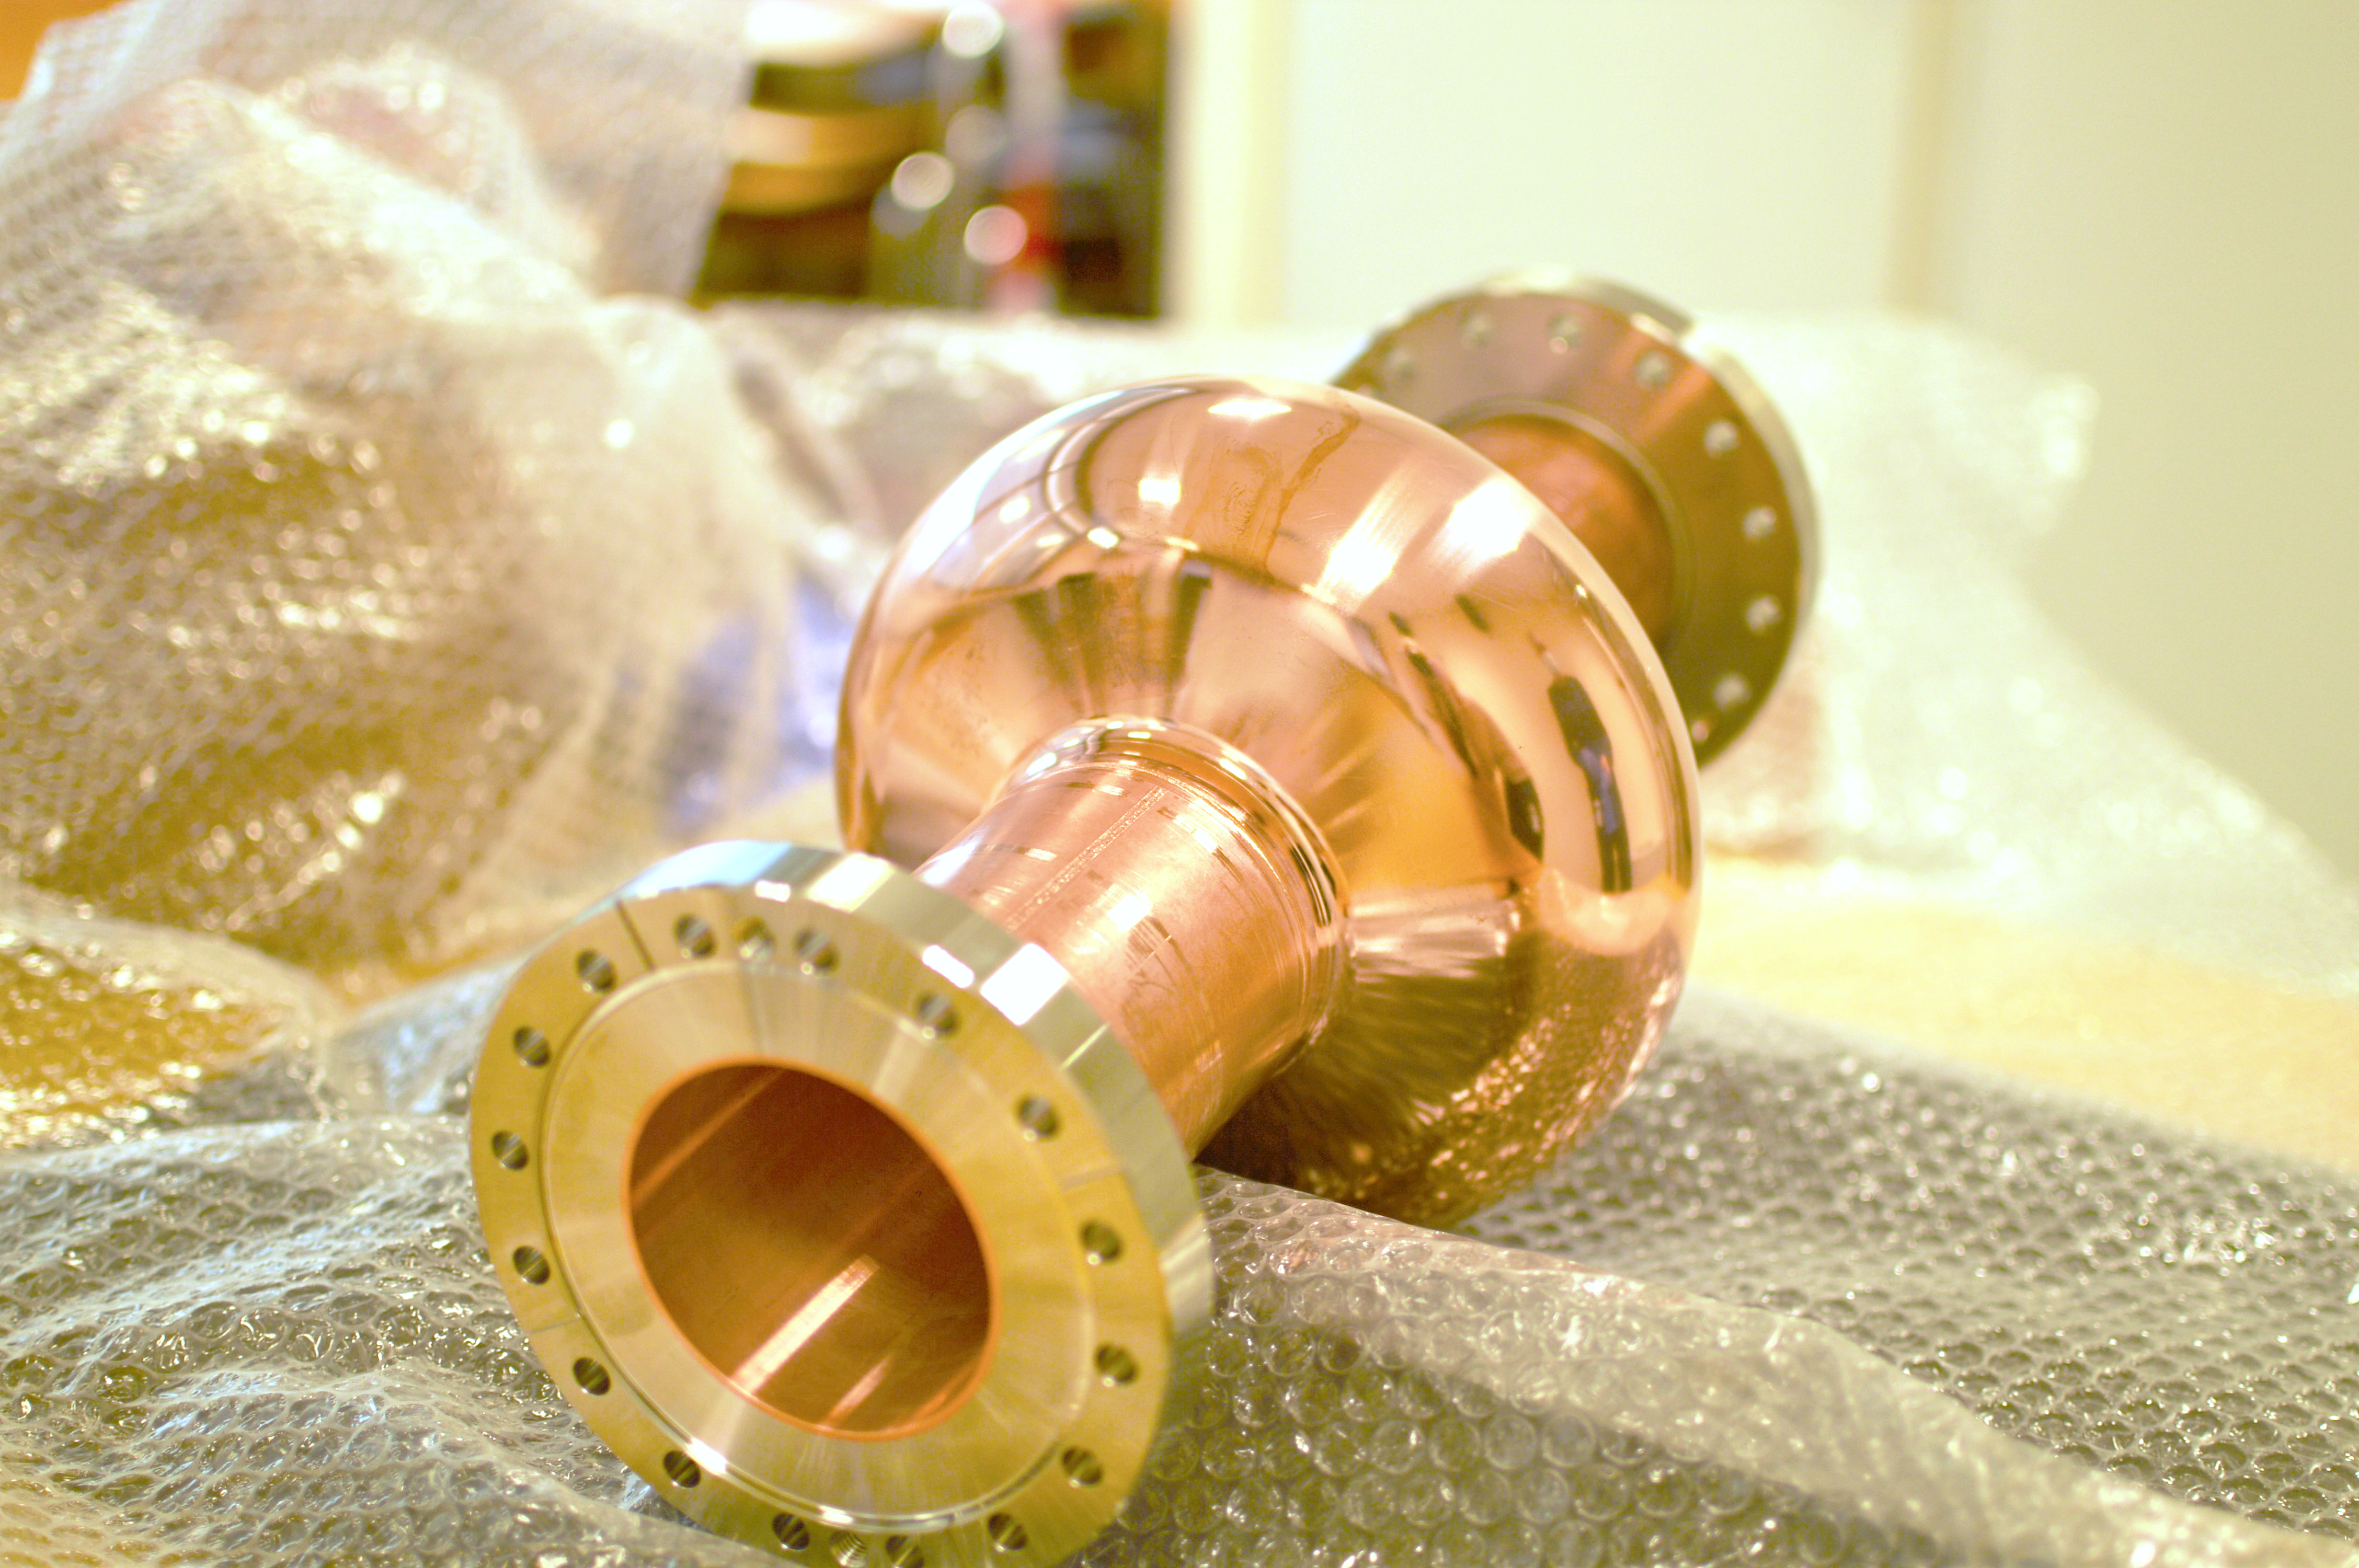
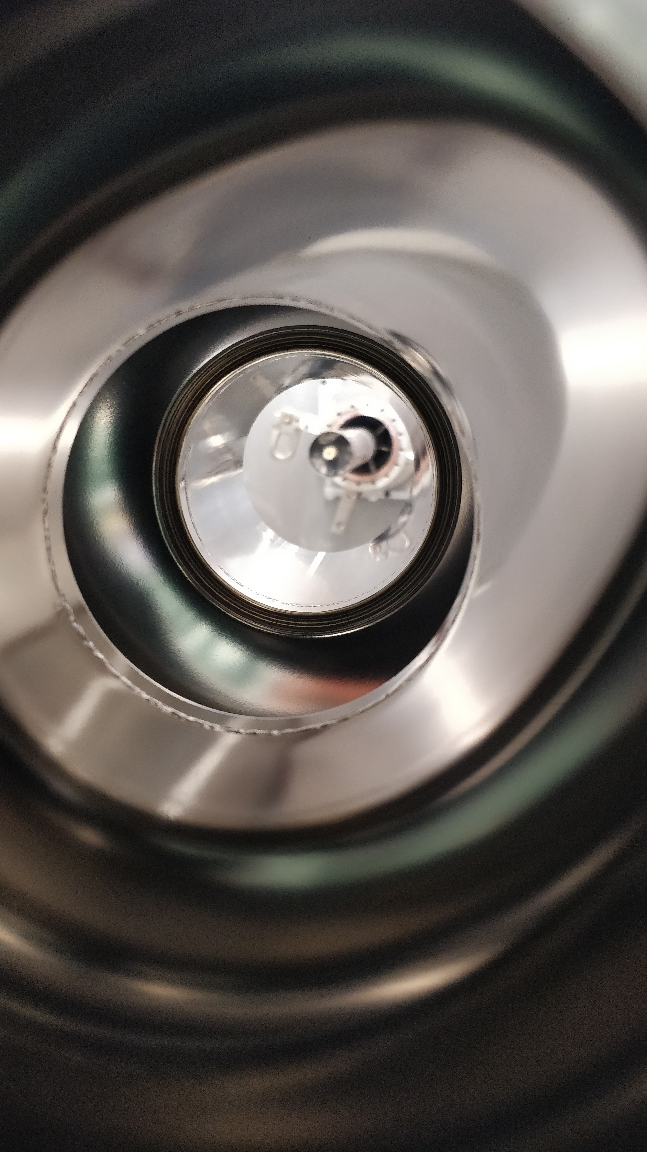
Machining from Bulk
Roughness Ra after machining
Beam tube (Iris) | Equator
0.15÷0.25 µm
Max Geom. Deviations
RF Shape | Wall thickness
~ 20 µm | < 20 µm
Monoblock cavities :
Optimal surface and shape conformity
Best & Reproducible for Nb coating R&D
Damaged Layer : L₁ ~0.5 µm / L₂ ~4 µm
Provide substrates for RF & coating studies
Minimization of surface removal processes
AFTER SURFACE TREATMENT
1.3 GHz Ellipt. Monoblock
[1]
Reduce qty subcomponents & multi-technology
.. some major fab costs, welds, surface treatments, pretuning, …
Now established fabrication strategy @ CERN.
Currently produced also for Collabs (JLAB, STFC)
Nb COATING

Slide 4
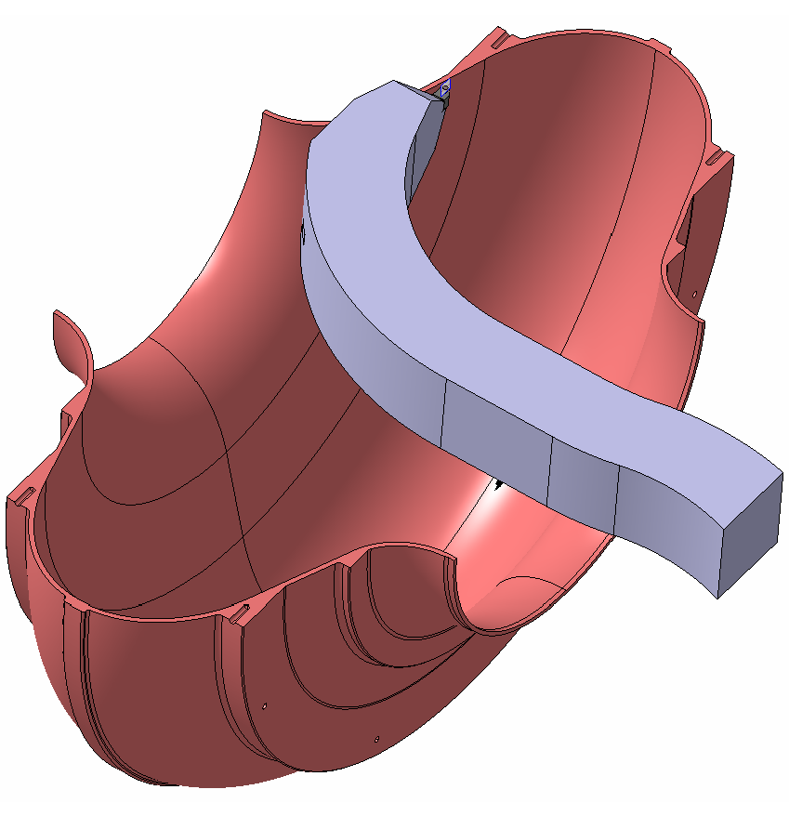
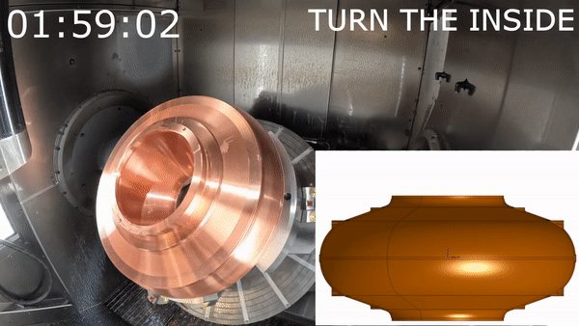
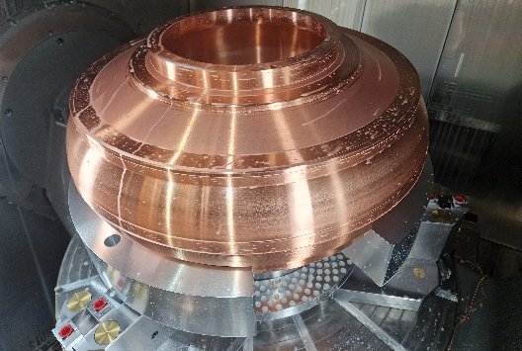
Machining from Bulk
400 MHz LHC Ellipt. Monoblock
Confirm scalability of optimized Nb-coating process
Comparable with available data
Status: to be welded next week → Nb coating …
400 MHz FCC Ellipt. Monoblock
Development of product for HTCryomodule
Validate FCC design
Safety net for series

Slide 5
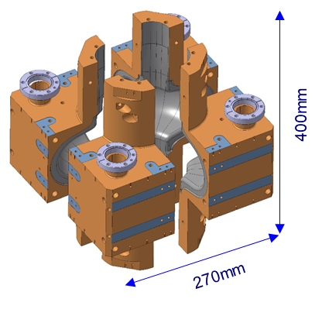
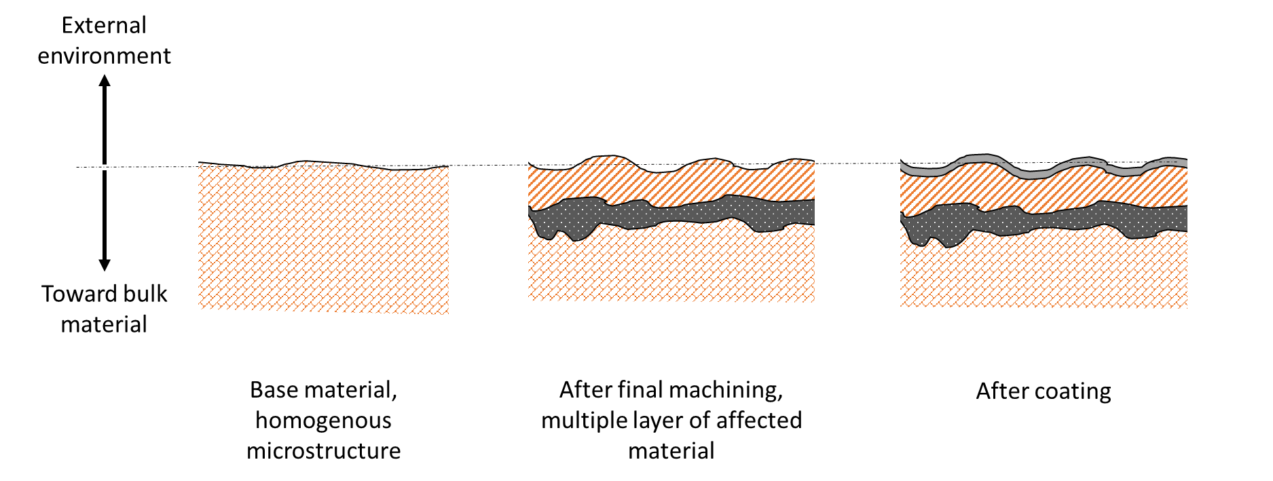
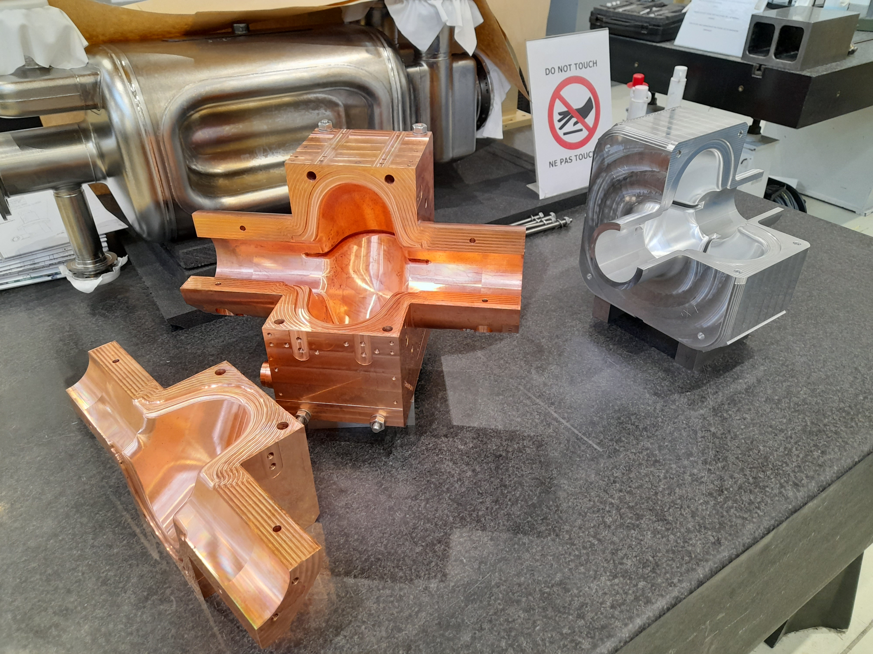
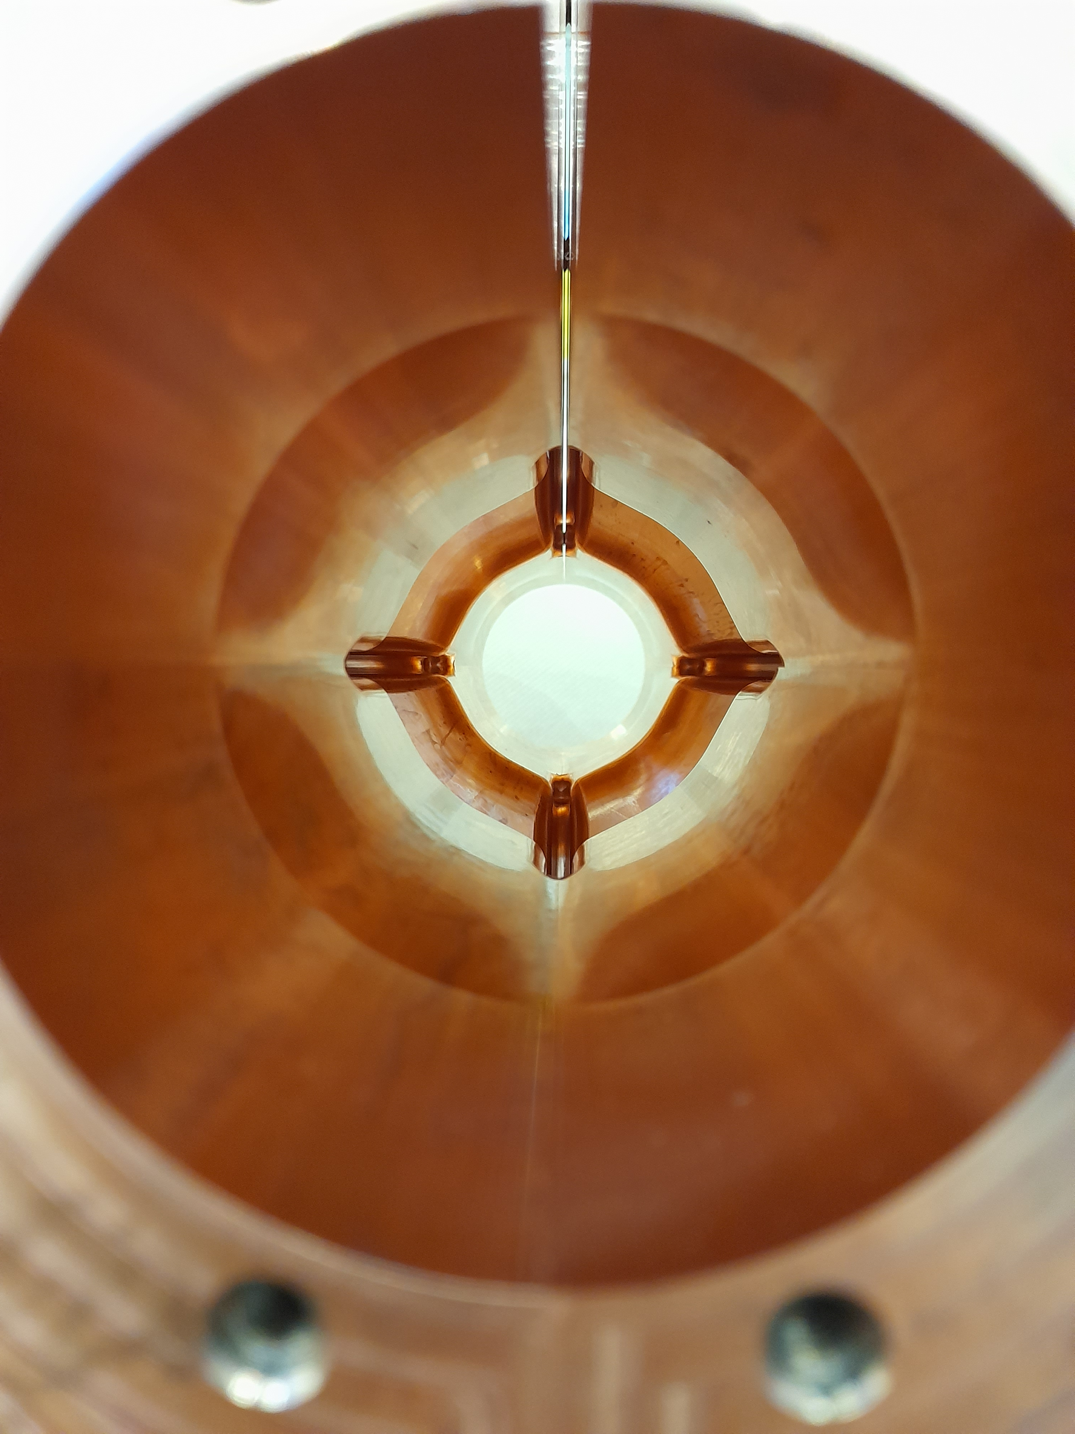
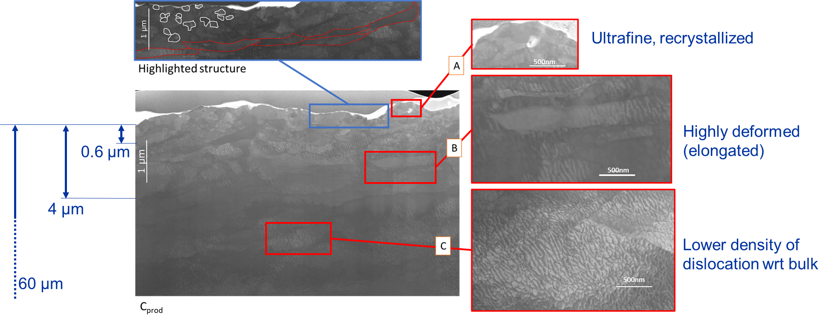
R&D and Process Characterisation : Machining
Study & define machining parameters (lubricant, tool, cutting parameters,..)
Aim: master & minimise the impact of machining on the surface layer (thus influence on coating performance
FCC SWELL 1.3 GHz
Cu OFE
Turning
Cu OFE
Milling
Damaged Layer
L1 | L2
0.5 µm | 4 µm
[2]
L₁
[3,4]
L₂
Roughness Ra
Beam tube (Iris) | Equator
0.2 µm | 0.2 µm
Damaged Layer
L1 | L2
0.5 µm | Few µm

Slide 6
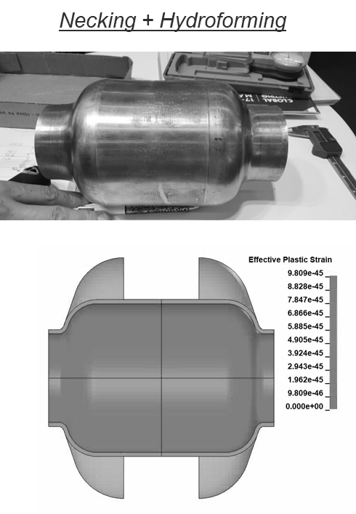
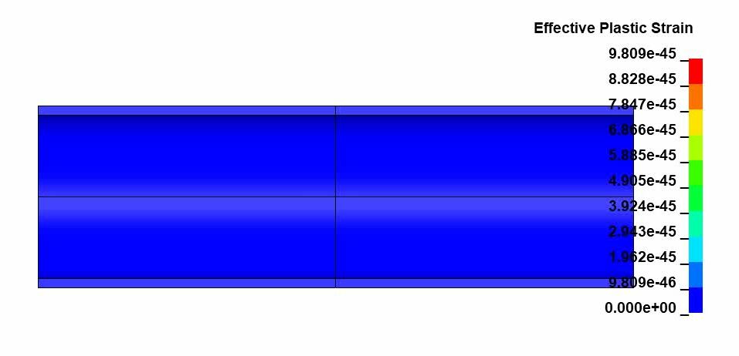
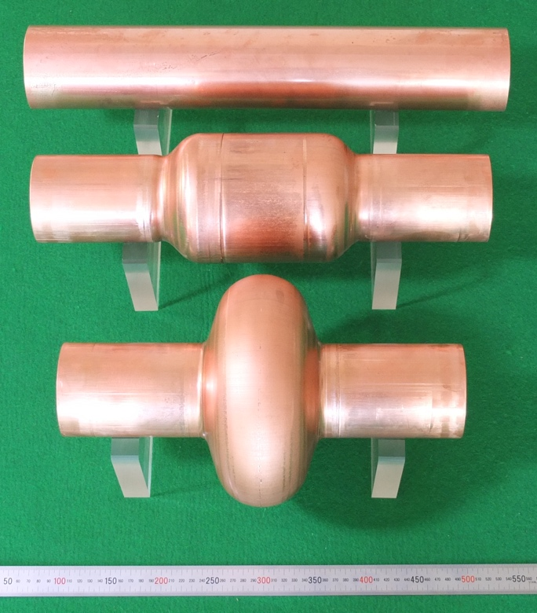
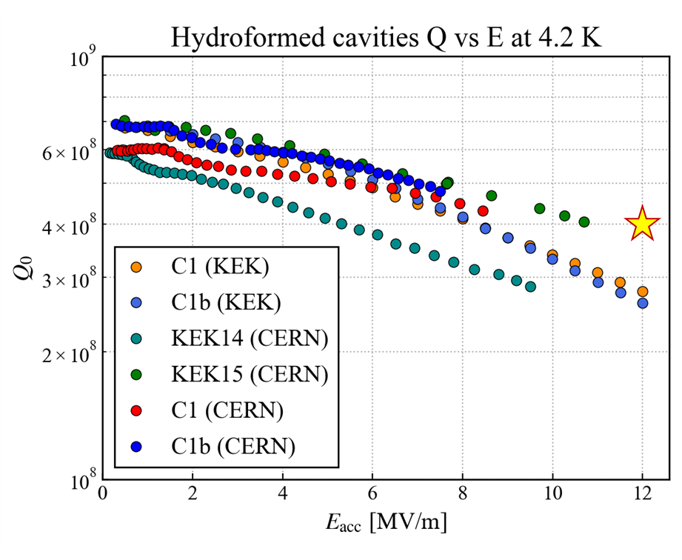
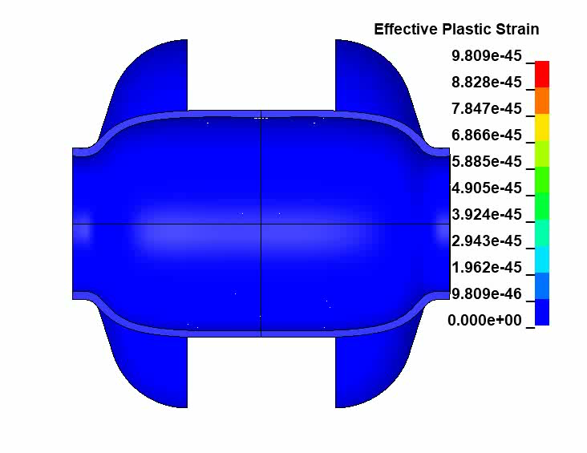
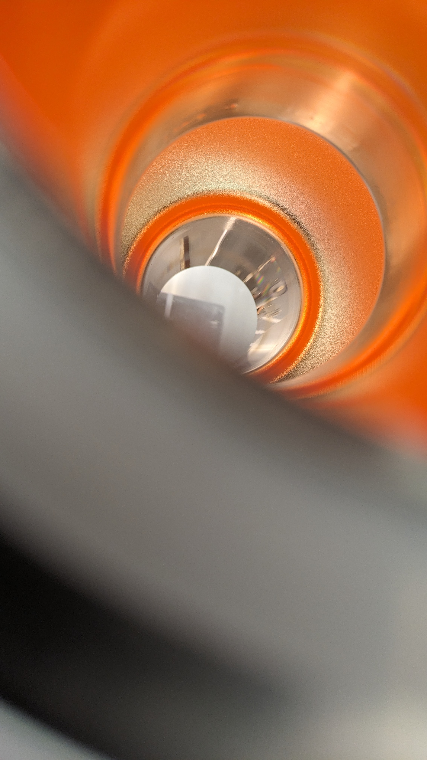
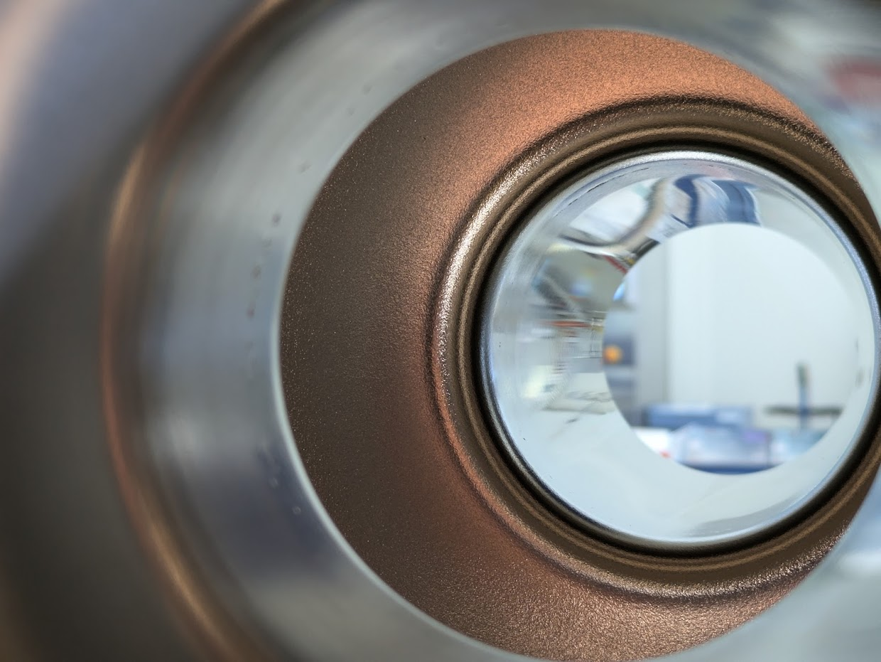
Shaping Processes
Multi-step Hydroforming
1.3 GHZ KEK –CERN
[5,6,7]
Reviving technology of the past millennium (DESY, CERN, KEK) …
Augmented: process design, testing, process control
Status: successful forming. Further cold testing + R&D for amelioration surface treatments
1ST hydroforming
HF1
$$∅ initial$$
Annealing
2ND hydroforming
HF2
Roughness Ra after forming
Beam tube (Iris) | Equator
1.0 µm | 3.0 µm
Currently shelved:
[+] reduced strains @ shaping
[-] Added Multi-technology
[-] Poor surface results in compression
[-] Material availability for lower frequencies
12

Slide 7
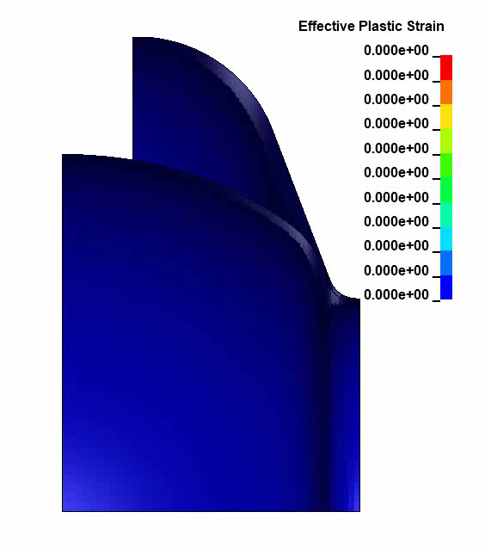
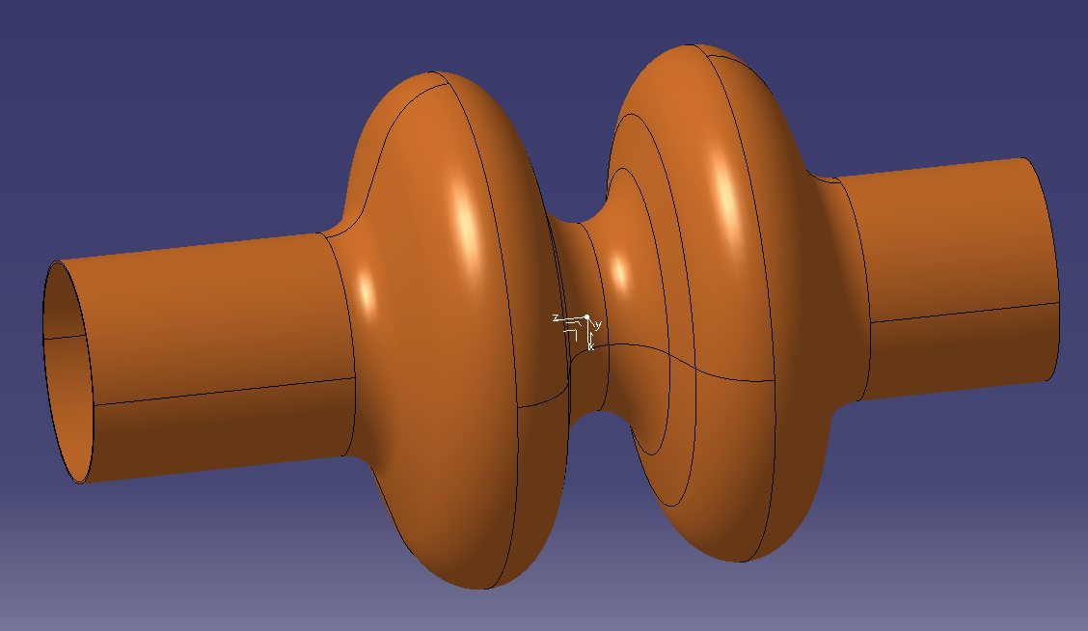
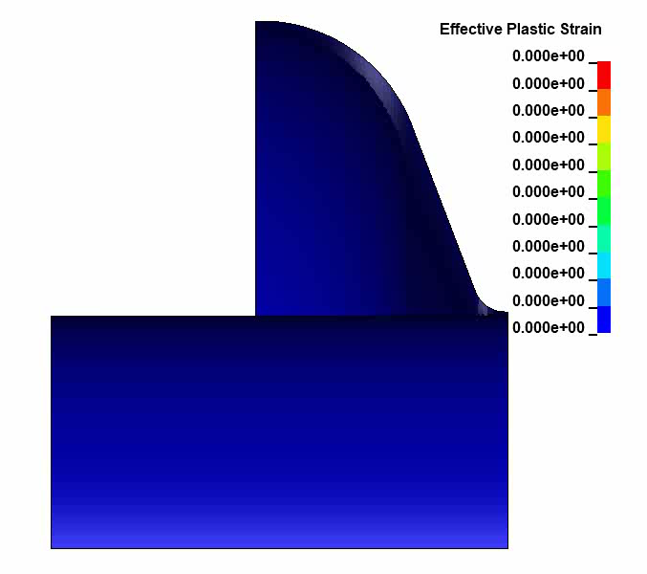
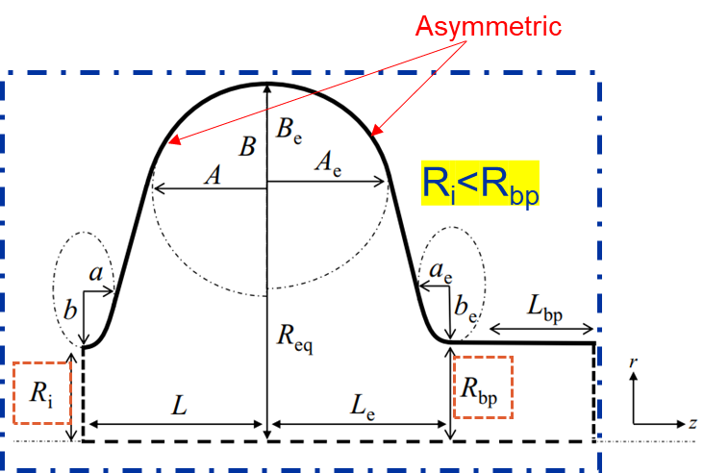
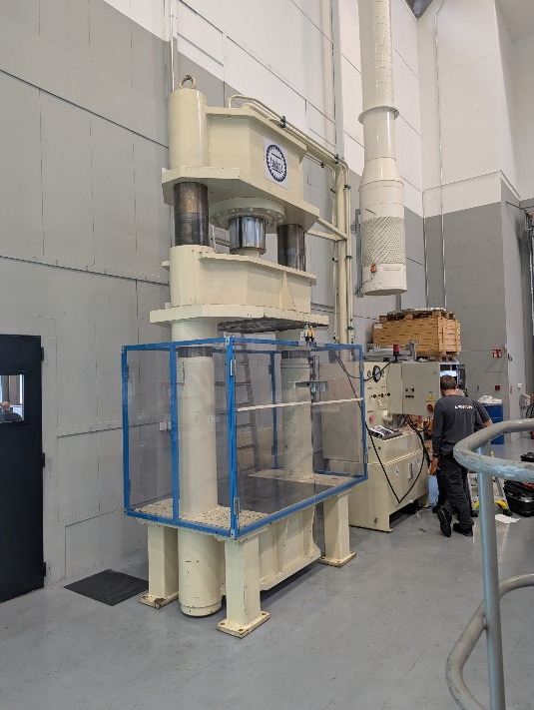
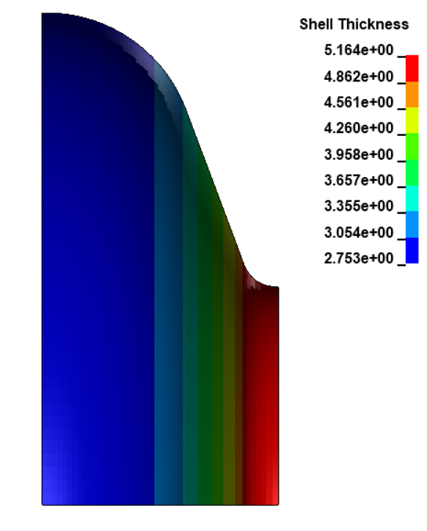
Hydroforming : 400 MHz Strategy
1ST hydroforming
HF1
2ND hydroforming
HF2
Annealing
LHC Design:
Successful within the FE realm
→ CERN in-house trials
Current FCC Design:
Challenging asymmetry and ratios
Study ongoing with industry (DE)
Thinning ~ 50%

Slide 8
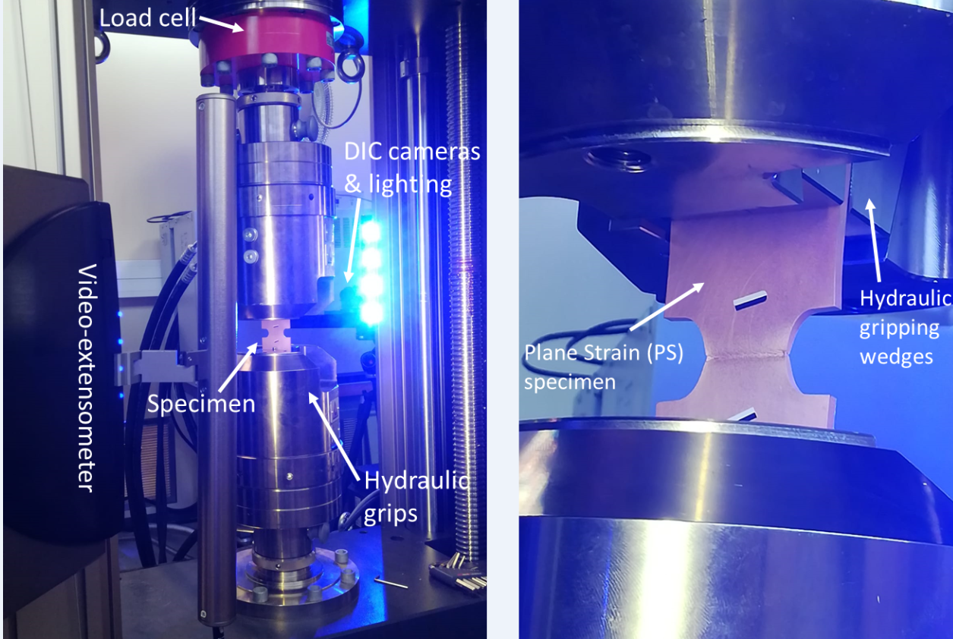
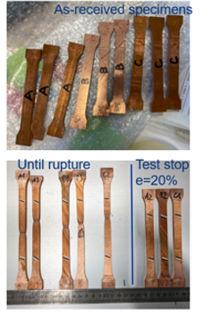
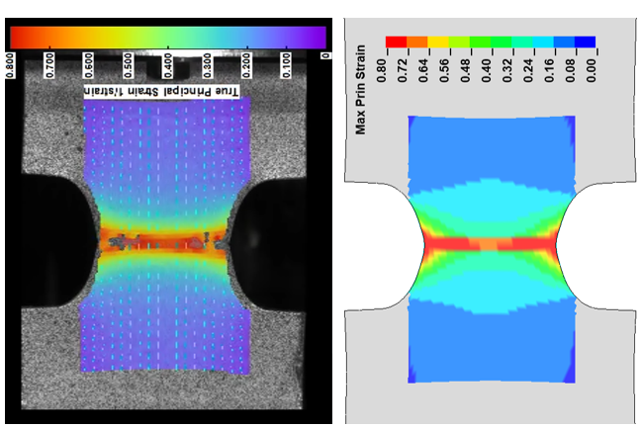
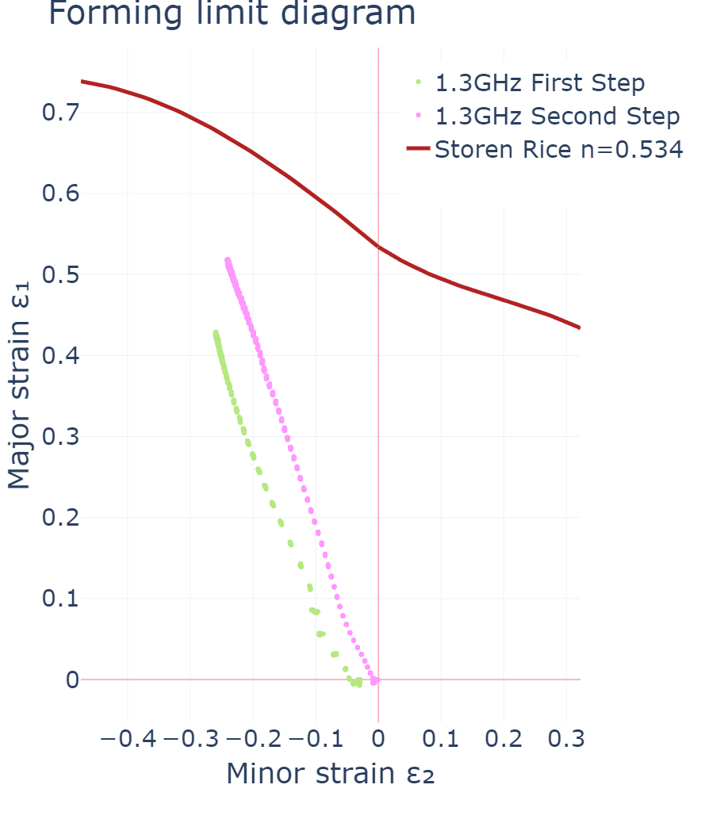
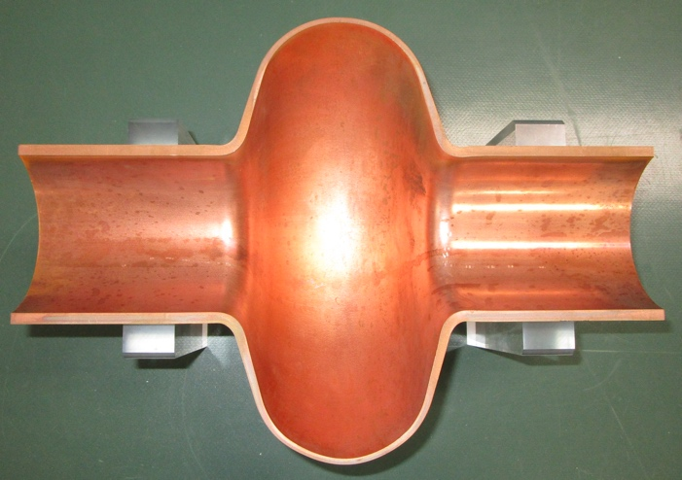
R&D and Process Characterisation : Hydroforming
Material characterization:
Structural behavior
Failure model
Targeted response strain vs. thermal annealing
Process characterization
@ different steps of fab (raw→full cavity)
Surface properties (roughness, orange peel)
Hydrogen content
[8]

Slide 9
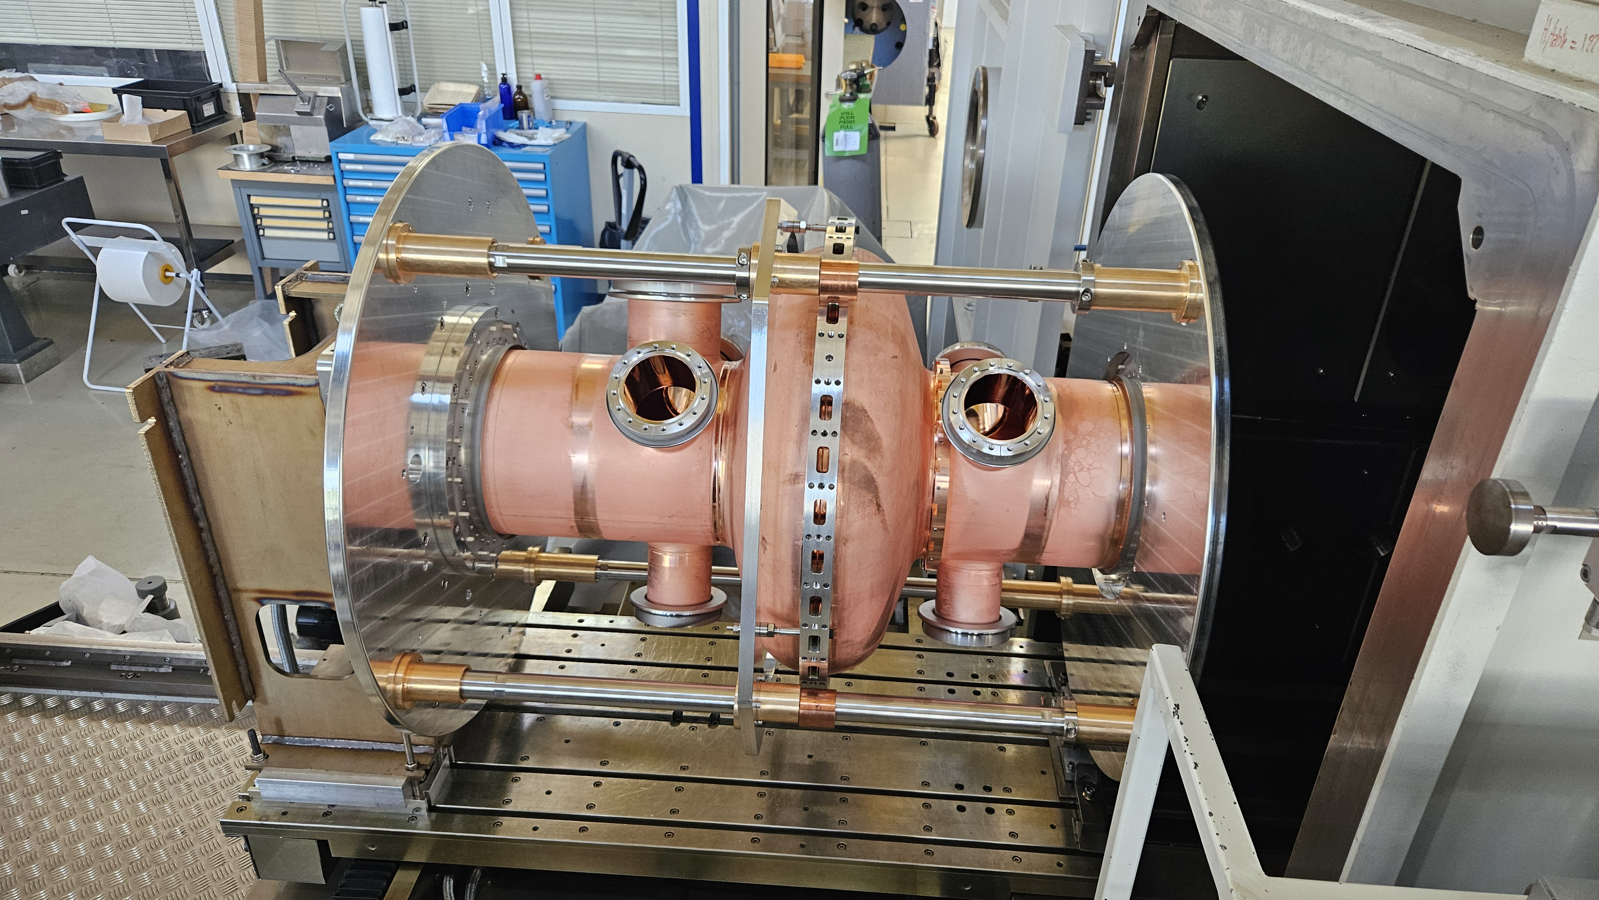
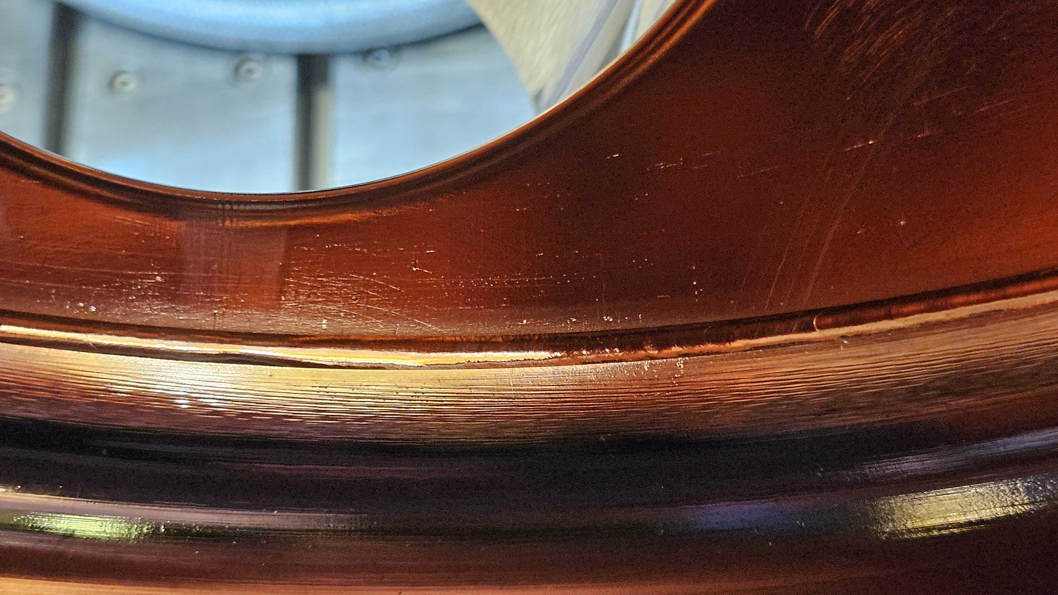
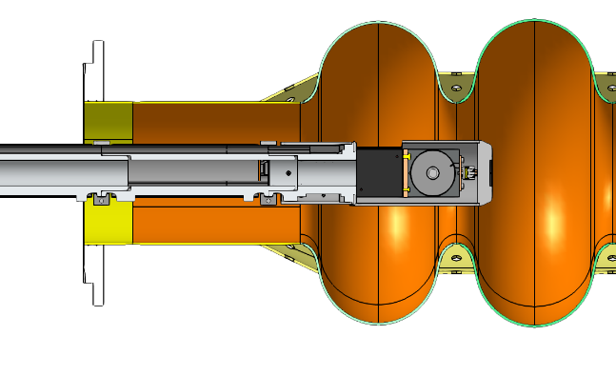
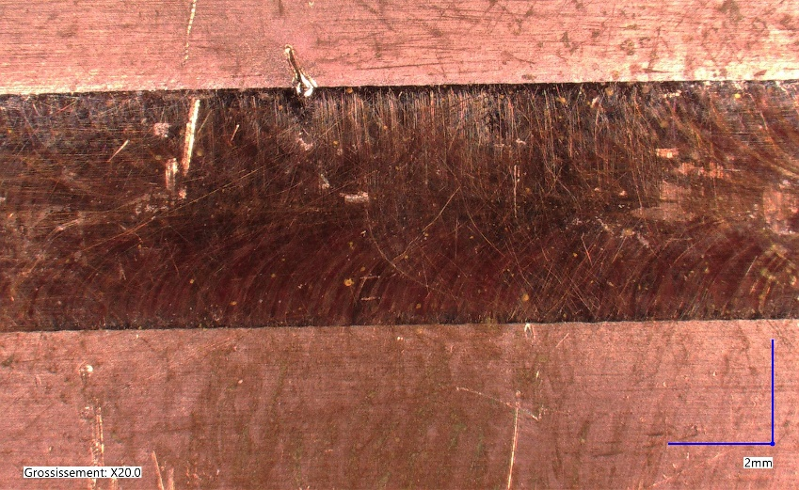
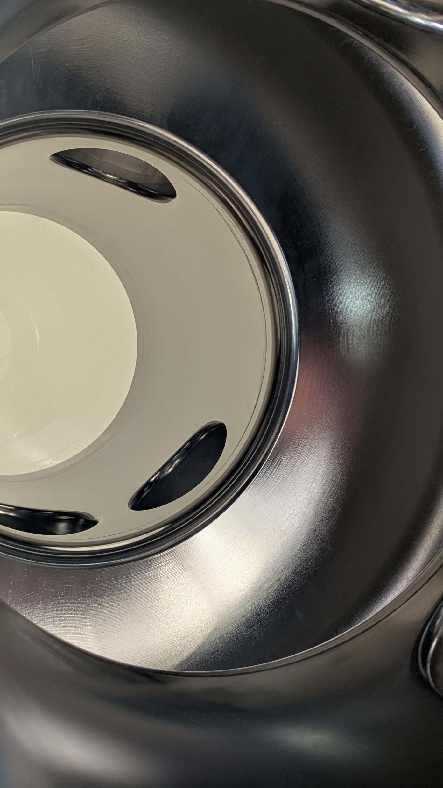
EB Welding
e⁻
  Schema on 800 MHz multi-cell cavity
  Final welding on SRF cavities is a challenging step:
  RF-compatible full penetration welds are difficult to obtain
  Complex access to perform cosmetic pass
Ra ~1 µm
Solution: EB deflector to bend the electron beam 90° from the source
Interest: gives access to RF side (internal surface) for cosmetic pass
Status:
400 MHz : 1x+1x (LHC geo) cavities successfully welded, coated and ready for RF test
Other frequencies : 800MHz, 1.3 GHz, both Cu OFE & Nb
Next:
Development of local repair strategy using deflector (lack of fusion, undercuts & repair of holes)

Slide 10
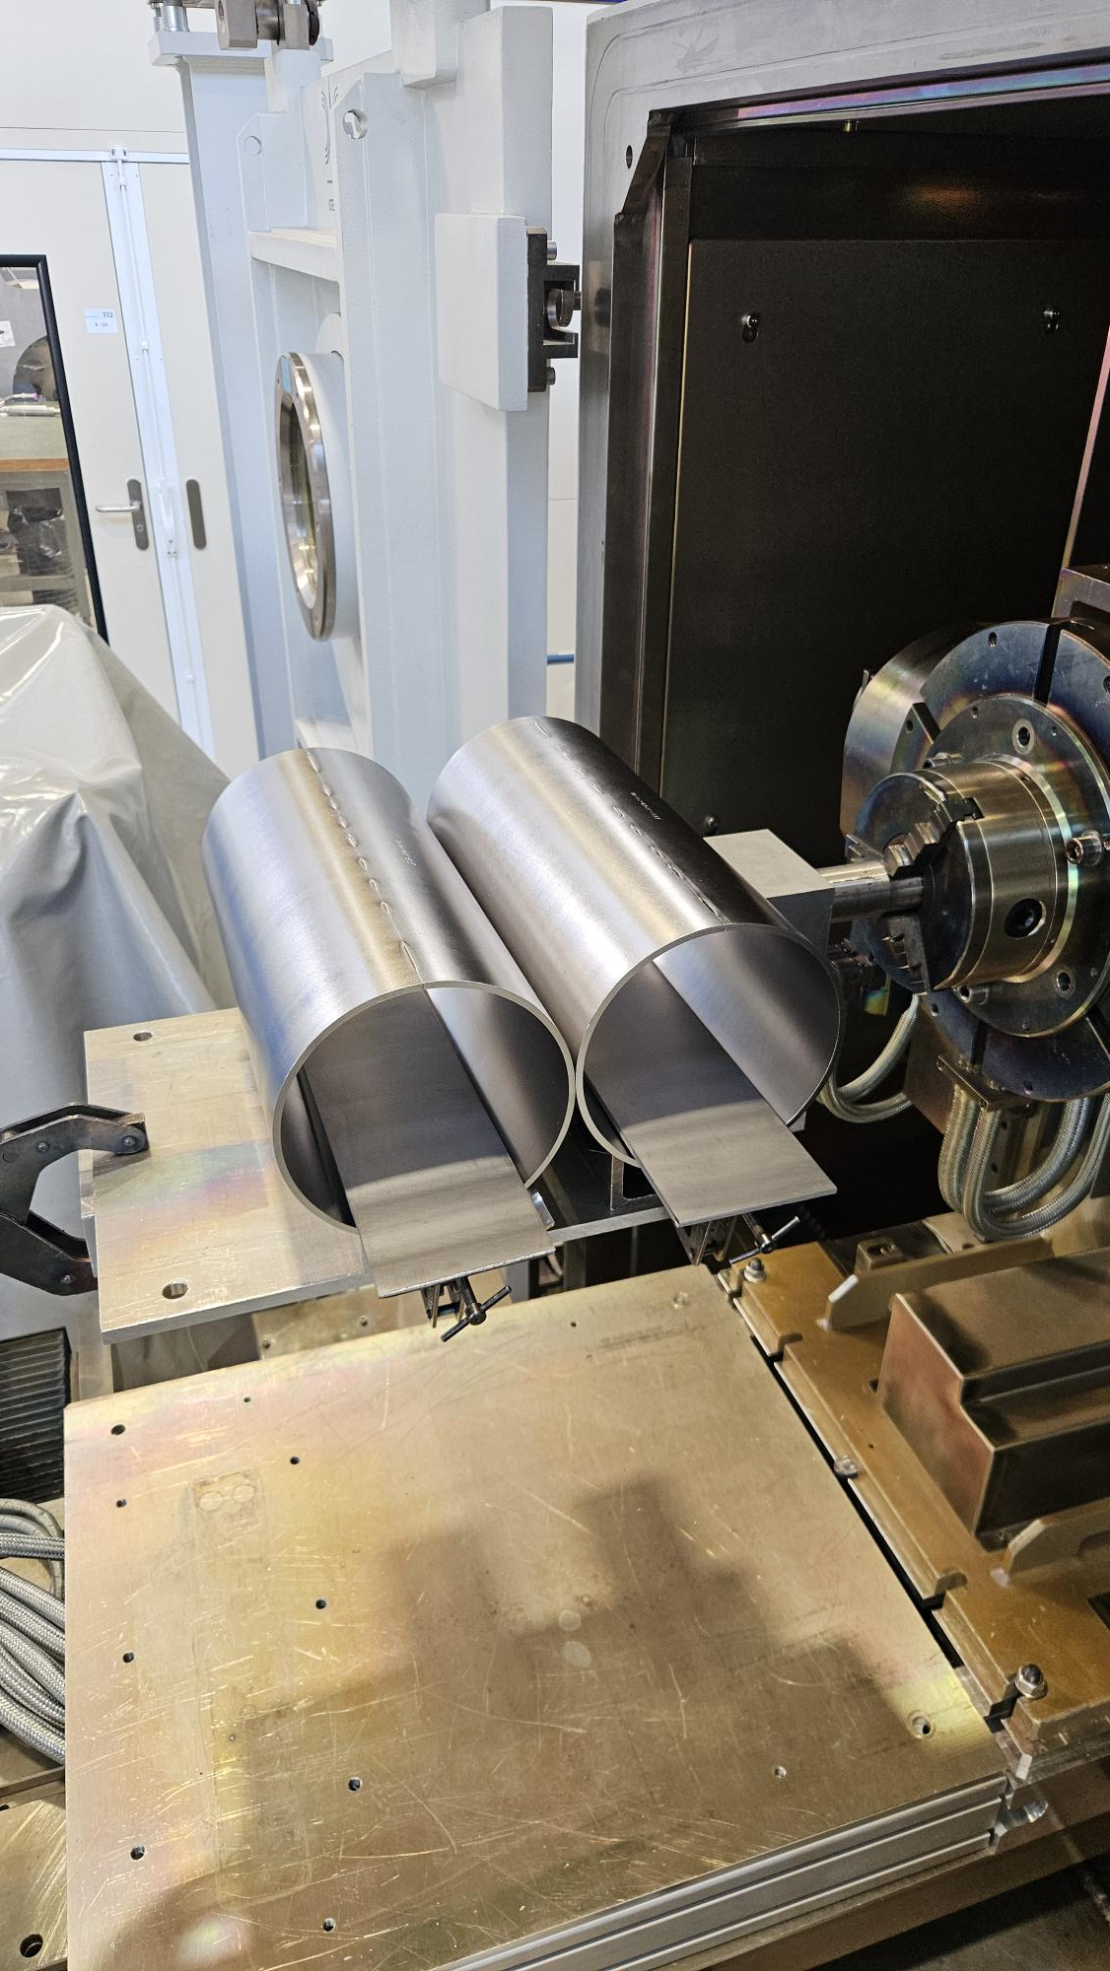
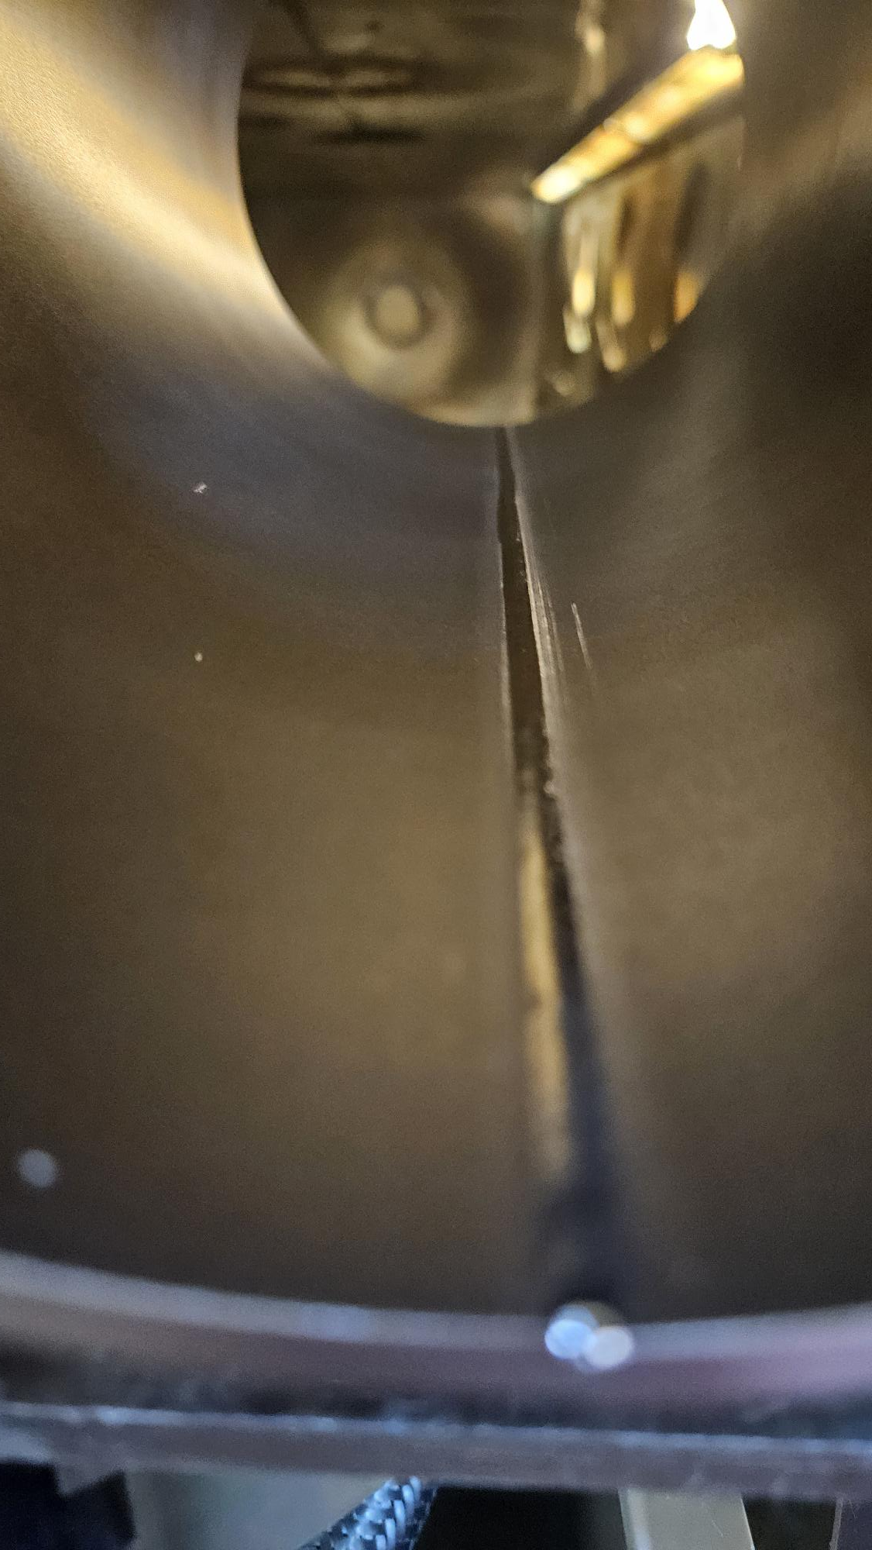
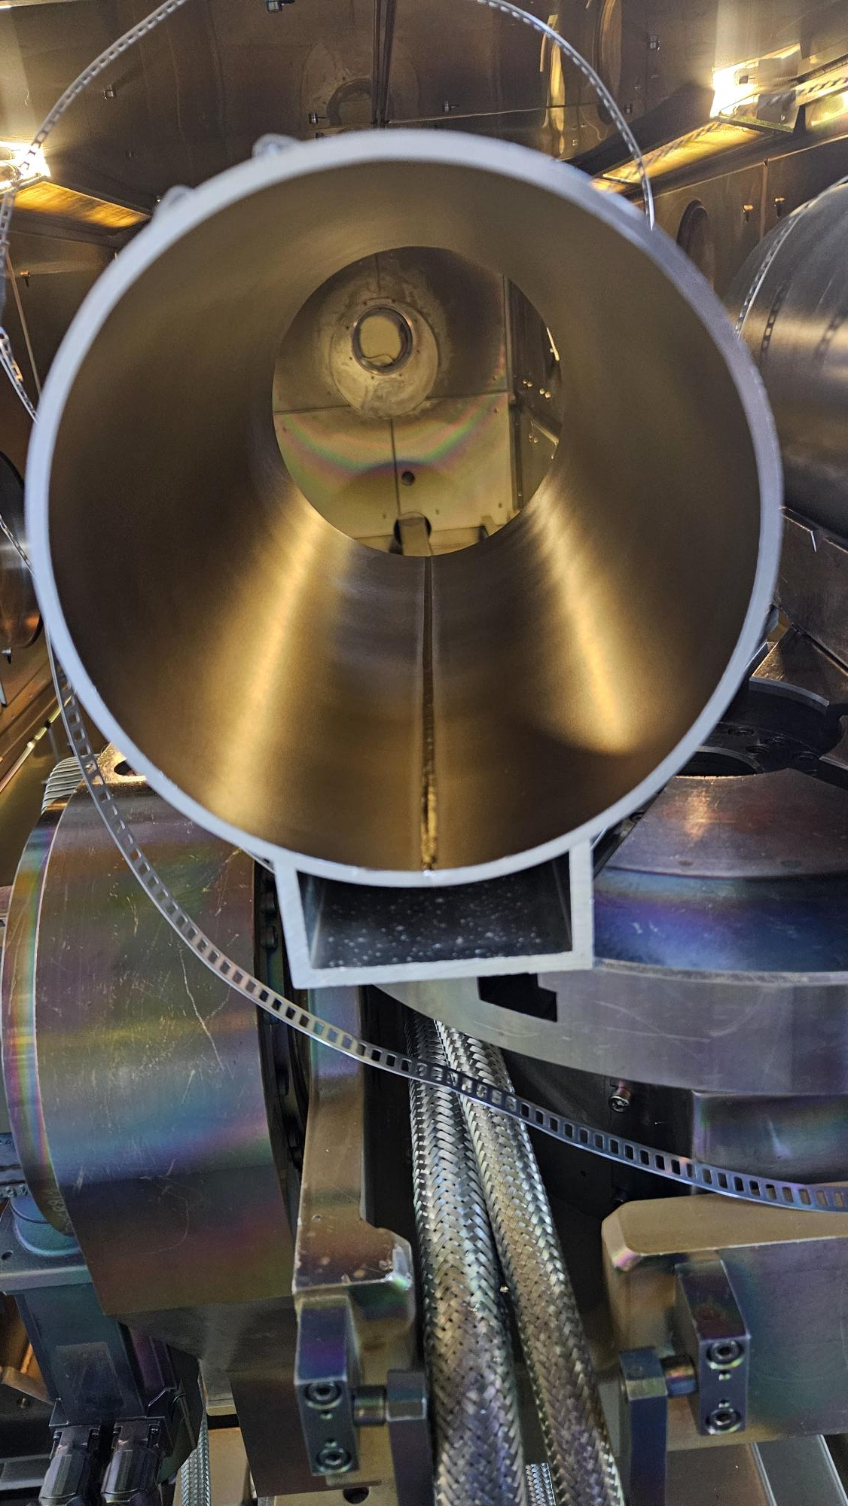
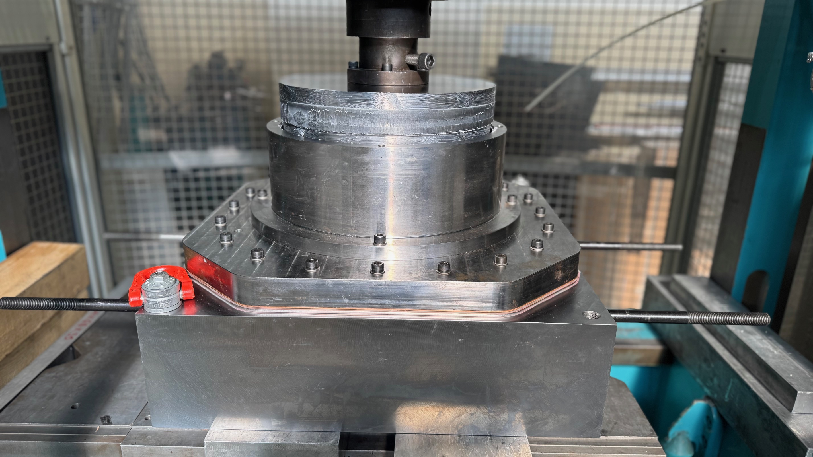
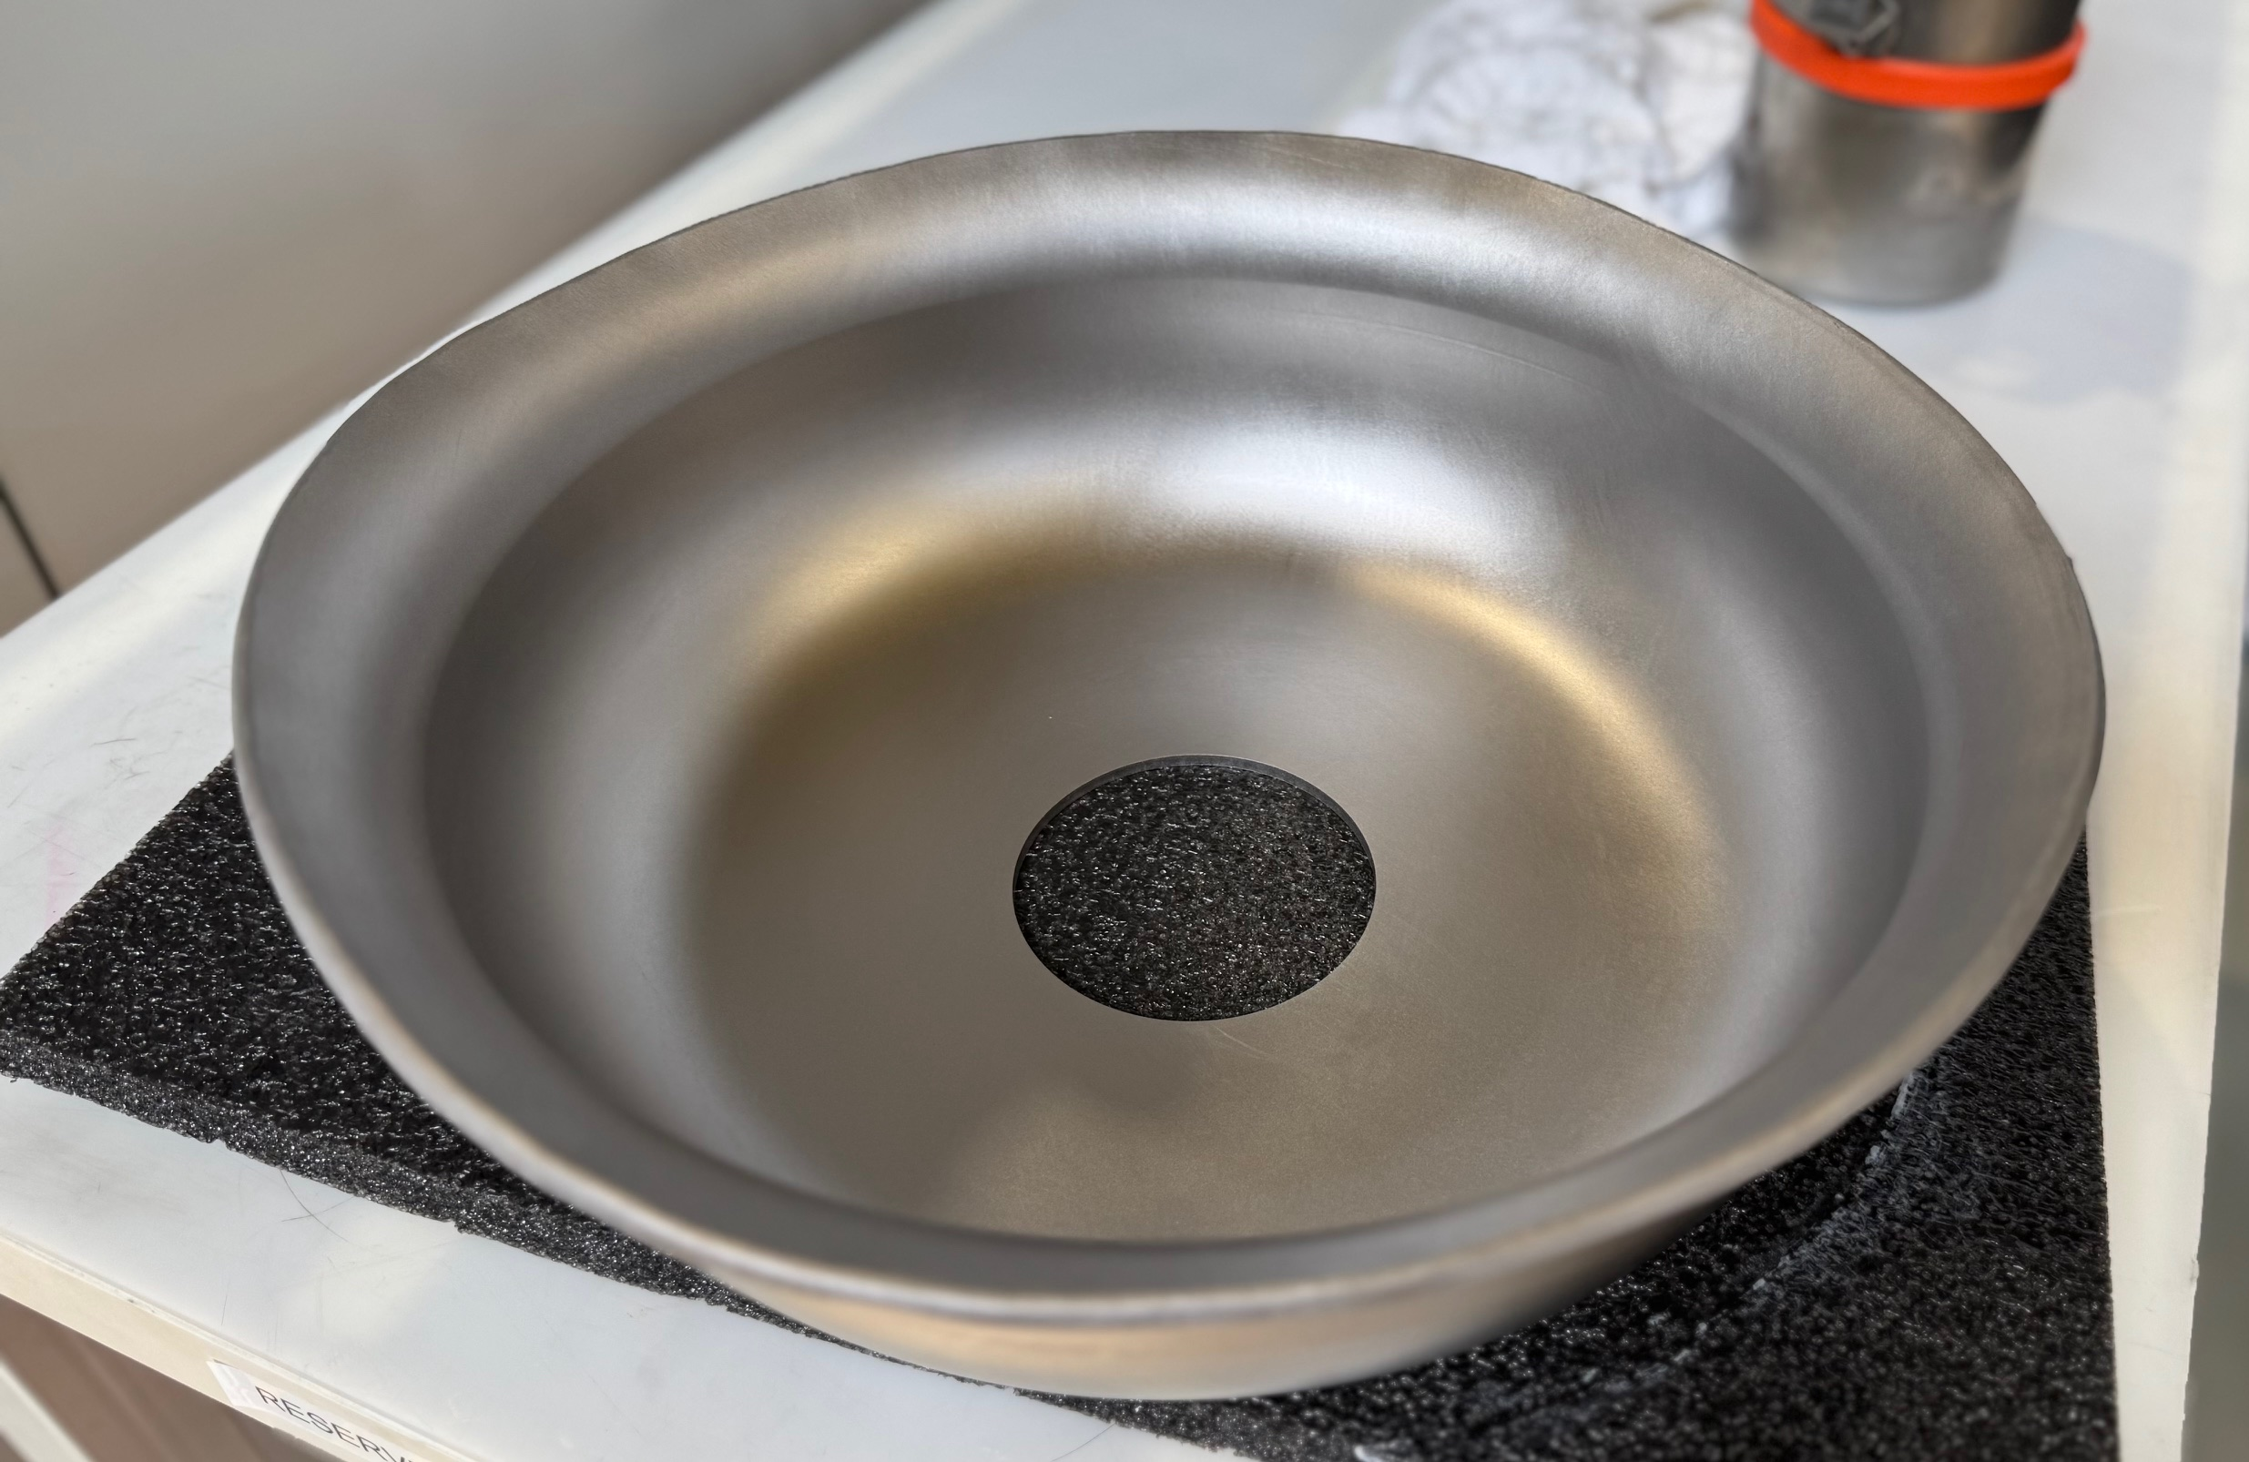
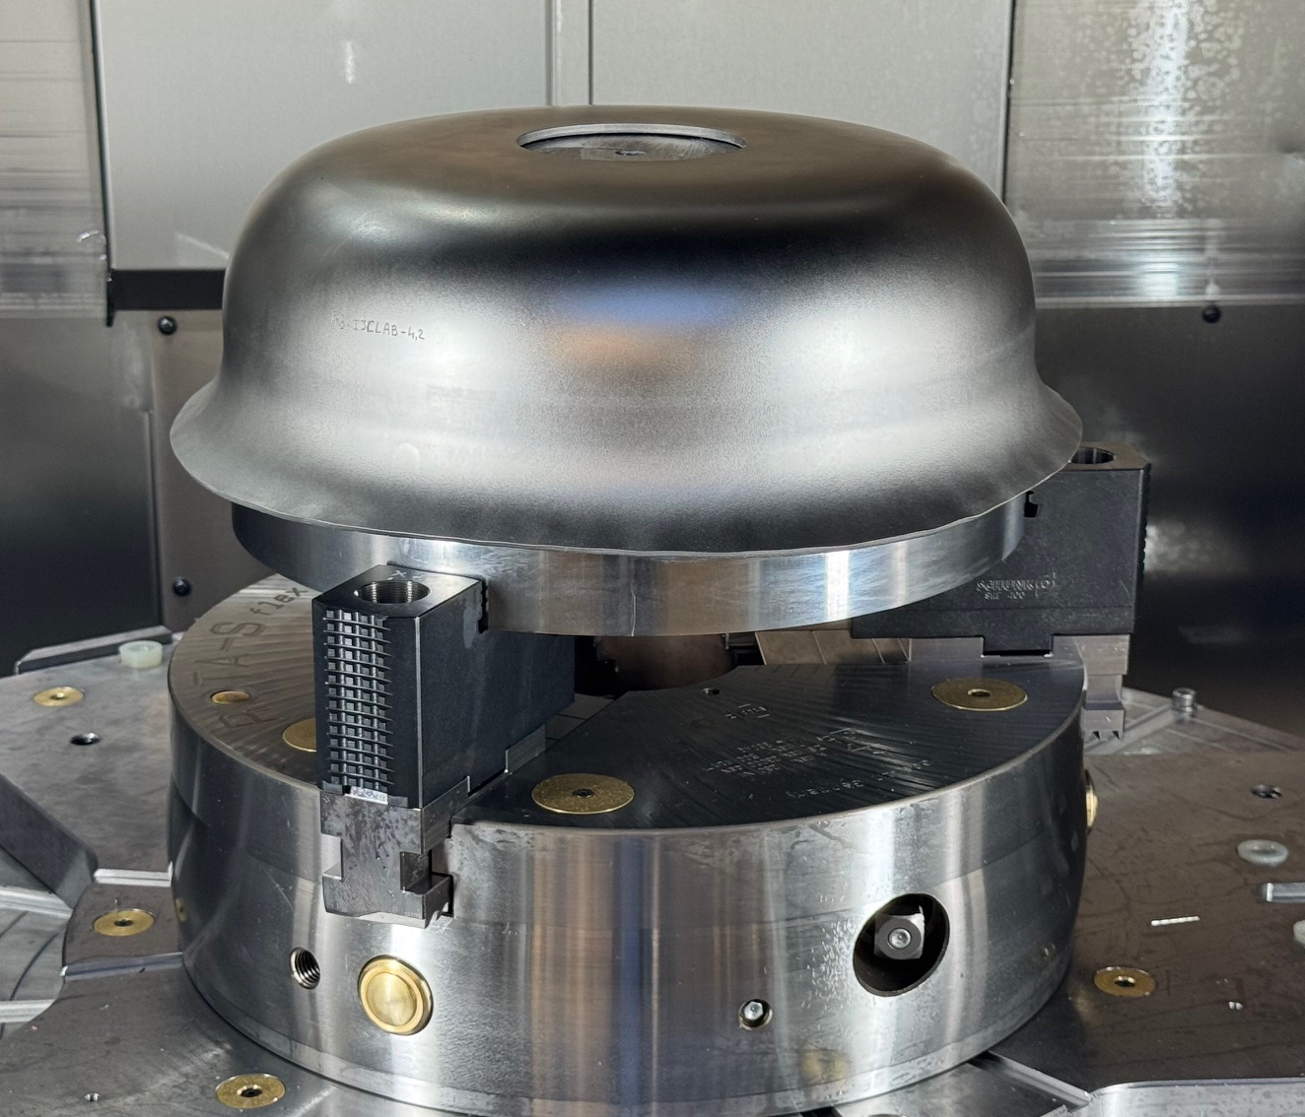
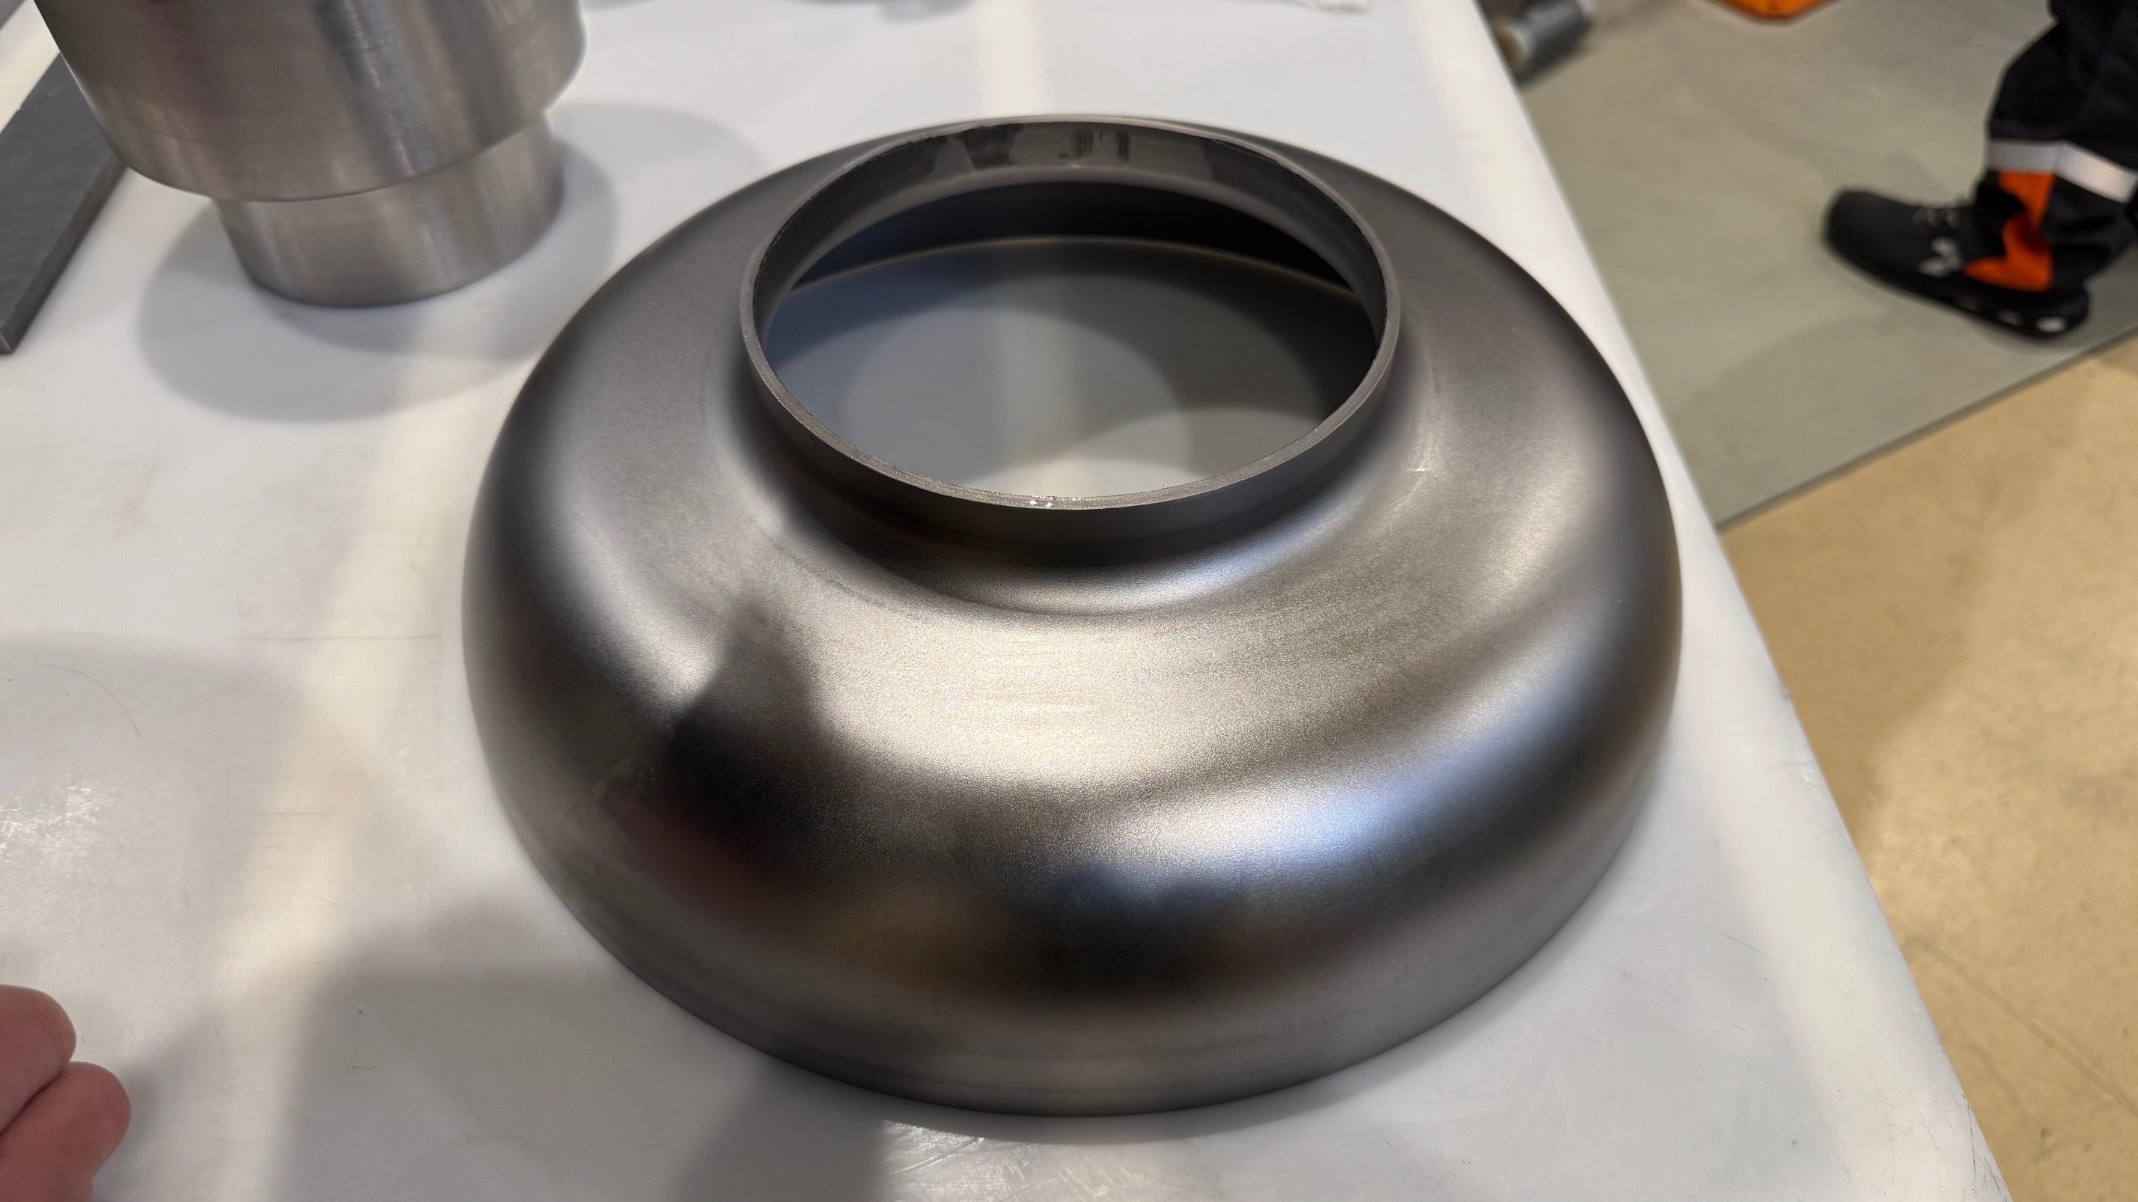
800 MHz
Production of 10x Bulk Nb Prototypes
Collab. FNAL, IJCLab, CORNELL, CERN
Status : first two half-cells @ calibration

Slide 11
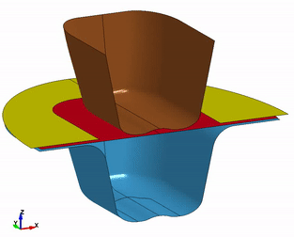
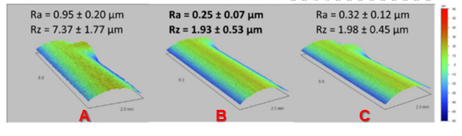
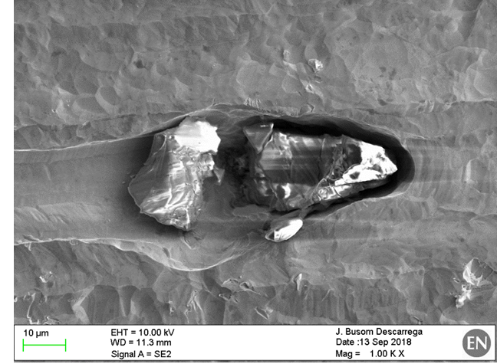
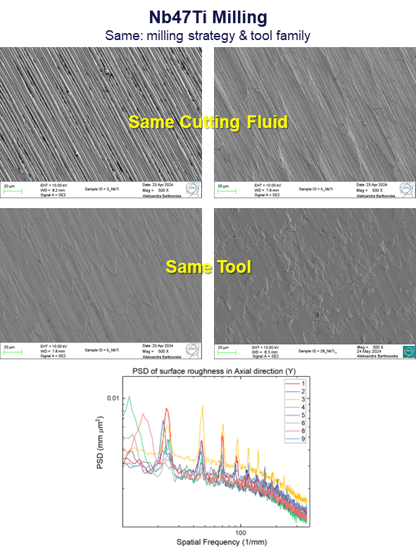
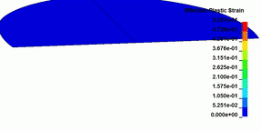
R&D and Process Characterisation : Bulk Nb Production
Stemming from different CERN projects
Established strategy on:
pollution of Niobium surface by different materials employed in manufacturing
ability to remove such pollution
Niobium Hook Milling [10]
Same : milling strategy & tools
Different : cutting fluids (A, B, C)
Alumina incrustation in Nb sheet (25 µm)
[9]
CERN strategy
Light BCP
Bulk BCP
Raw Mat.
Shaping
Welding

Slide 12
Thank you for your attention!
References:
[1] | Courtesy of F. Peauger, G. Rosaz [CERN]
[2] | “Experimental analysis of subsurface integrity during fine turning of OFE copper for radiofrequency cavity manufacturing” / A. Camellin et al. // https://www.sciencedirect.com/science/article/pii/S092401362100443X
[3] | “SWELL and Other SRF Split Cavity Development” / F. Peauger et. al. // https://cds.cern.ch/record/2844840
[4] | “Impact of machining strategy on OFE copper for SRF applications” / F. Belkhir et al. / https://mrforum.com/product/9781644903131-215/
[5] | “Novel Approaches in Characterization and Modelling of Fabrication Processes for SRF Components” / J.S. Swieszek et al. // https://doi.org/10.18429/JACoW-SRF2023-TUPTB038
[6] | Q0_E plot courtesy of H. Araki [KEK], K. Brunner [CERN]
[7] | “Full seamless copper substrate accelerator cavity manufactured by tube hydroforming” / M. Yamanaka et al. / International Journal of Advanced Manufacturing Technology // https://doi.org/10.1007/s00170-025-15686-6
[8] | “Forming Limit Diagram of Annealed Copper OFE Thick Sheets: A Novel Approach for the Manufacturing Design of Superconducting RF Cavities” / A. Gallifa et al. // https://dx.doi.org/10.2139/ssrn.4756181
[9] | “Technical progress of crab cavity in fabrication and tests at CERN” / M. Garlaschè // TTC Meeting 2018
[10] | “State Of The Art Of Niobium Machining For SRF Applications” / P. Naisson et al. / https://cds.cern.ch/record/2712606?ln=fr

