Slide 1
Strategy for SRF R&D at CERN
Walter Venturini Delsolaro
On behalf of CERN SRF R&D-R teams

Slide 2
FC RF project coordination
FCC
RF studies
SA18
project
SRF R&D-D
project
HEK
project
SRF R&D-R
project
Steering Committee
Organization of RF R&D at CERN
Pole 0
(RF)
RF parameters and design
Beam dynamics studies
Pole 1
(MME)
Cavity mechanical design and manufacturing
Pole 2
(RF,MME,CRG,VSC)
Cryomodule design and construction
Pole 5
(VSC)
Cavity surface preparation
Pole 7
(RF, VSC)
SRF infrastructure
Pole 6
(RF)
Non mechanical tuning
Pole 8
(RF)
High power RF systems
Pole 3
(RF, CRG,MME )
Cavity coating
SRF thin films
Pole 4
(RF)
FPC and HOM
SM18 SRF test infrastructure
SA18 equipment
HTC

Slide 3
SRF R/D-R aims at strengthening the know-how, the facilities and in general the capabilities in the field of superconducting RF at CERN, for its present and future accelerators
The main direction is to push performance of thin films on copper cavities (Nb and Nb₃Sn):
High Q (understand mechanisms of spurious losses/residual resistance)
  Tuning substrate preparation and coating parameters
  thermal mapping + optical inspection
  flux trapping in different SRF structures
High field:
  Improving cleanliness chain, SRF process infrastructure
  Moderate activity on bulk Nb and SIS structures
Explore novel fabrication methods: Bulk machining, Hydroforming, Electro-forming
Develop non mechanical tuning
Explore novel cooling methods

Slide 4
Work Package Structure
More highlights in talks by M. Garlasche, F. Peauger, K. Brunner, A. Miyazaki, G. Rosaz, L. Ferreira,
and T. Koettig at this event
WP2 objectives:
  Fundamental understanding of RF losses and surface field limitations in superconducting materials
  RF tests and Diagnostics, particulate control
WP3 objectives:
  Studying, benchmarking and pushing the limits of known fabrication technologies: seamless, EB welding, high precision machining.
  Promote R&D Activities on alternative fabrication technologies, such as additive manufacturing, alternative welding processes, mechanical surface finishing and studies on corresponding surface quality
WP4 objectives:
  Optimize surface preparation method on high conductivity substrates (Cu, Al)
  Optimize Nb/Cu coating recipe at 1.3 GHz
  Scaling of Nb/Cu on large cavities (400 MHz)
  Synthesis of Nb₃Sn thin films on copper for RF applications, method optimization on samples
WP5 objectives:
  Transient Detuning demonstrator (TDD) applied to the LHC cavities at injection settings
  FE-FRT use case applications including microphonics compensation, discrete tuning and cavity trip mitigation.
  Development of SRF set ups for PBC and QTI:
WP6 objectives:
  Develop cooling schemes alternative to helium baths
  Diagnostics and calorimetry for SRF
  Thin film contactless Tc determination
WP1: Management and coordination-
W Venturini Delsolaro (SY-RF)
WP3: SRF fabrication engineering- M. Garlasche (EN-MME)
WP5 Non mechanical tunng-
A. Macpherson
(SY-RF)
WP2: SRF methods & studies
F. Peauger
(SY –RF)
WP4: SRF thin films- G. Rosaz (TE-VSC)
WP6: SRF cryogenics
T. Koettig
(TE-CRG)
Notes:
Added WP6 for cryogenics studies related to SRF cavities (conduction cooling, etc)
New budget codes for each WP
New budget code for the contribution to SA18

Slide 5
Cavity performance goals
 | Frequency | Technology | T operation | Qo |  | Ep (MV/m) | Bp (mT) | Ea (MV/m)
1.3 GHz |  | Nb/Cu | 2 K | 10¹⁰ | 50 |  | 106.5 | 25
400 MHz |  | Nb/Cu | 4.5 K | 3.3 10⁹ | 26 |  | 69.3 | 13
800 MHz |  | Nb3Sn/Cu | 4.5 K | 10¹⁰ | 50 |  | 100 | 20
800 MHz |  | Bulk Nb | 2 K | 3 10¹⁰ | 50.8 |  | 108 | 25
800 MHz |  | Nb/Cu | 2 K | 2 10¹⁰ | 50.8 |  | 108 | 25

Slide 6
Strategy
Develop Nb/Cu HIPIMS through the1.3 GHz program for fast turnaround from coating to RF test
  Scaling specs at 4.5 K to 400 MHz from theory and QPR results
  Study separately surface resistance components
  Study high field behaviour at 2 K in view of possible use at 800 MHz for ttbar
Scale up to 400 MHz using LHC single cells substrates until FCC prototypes are ready
  Transfer lessons learned (seamless, HIPIMCS, EP, mitigation of thermal currents, etc.
  Aiming at "proof of principle"
  Measurement campaigns to define key specifications for the cryomodule (Ba, ∇ Τ , etc)
  The large cavity surface is prone to "random" defects: rationale behind integrated process in the new SRF building:
  Push success yield and define protocol for industrialisation
Nb3Sn/Cu: from small samples, to QPR
  Collaborations for sample studies (UNIGE, TUWIEN, CEA, …)
  Directly aiming at 800 MHz cavities as possible use case
  Collaborations: INFN, Cornell
Nb bulk at 800 MHz, 2 K, through collaborations (FNAL, IJCLab, …)
See talk by G. Rosaz at this event

Slide 7
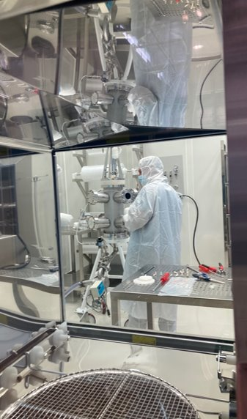
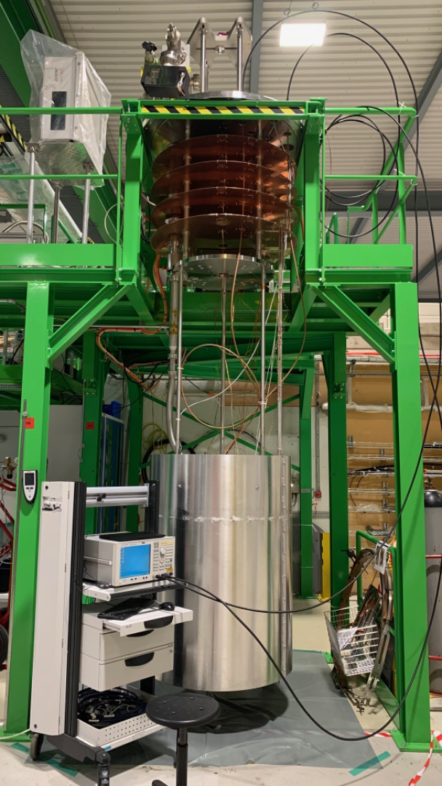
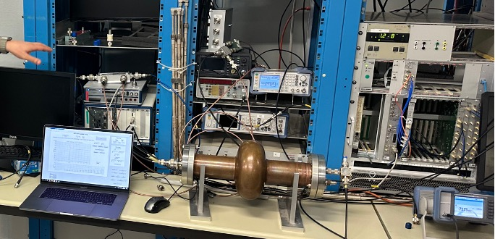
SRF facilities upgrades
New clean booth with automatic washer
New vertical cryostat with magnetic compensation and cavity thermal shield, dedicated to 400 MHz cavity testing
Development of independent LLRF systems, based on different methods to reduce systematic uncertainties

Slide 8
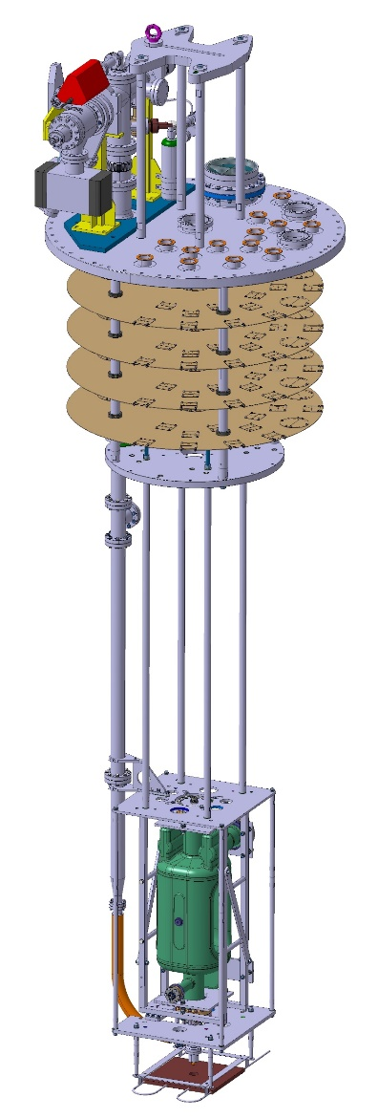
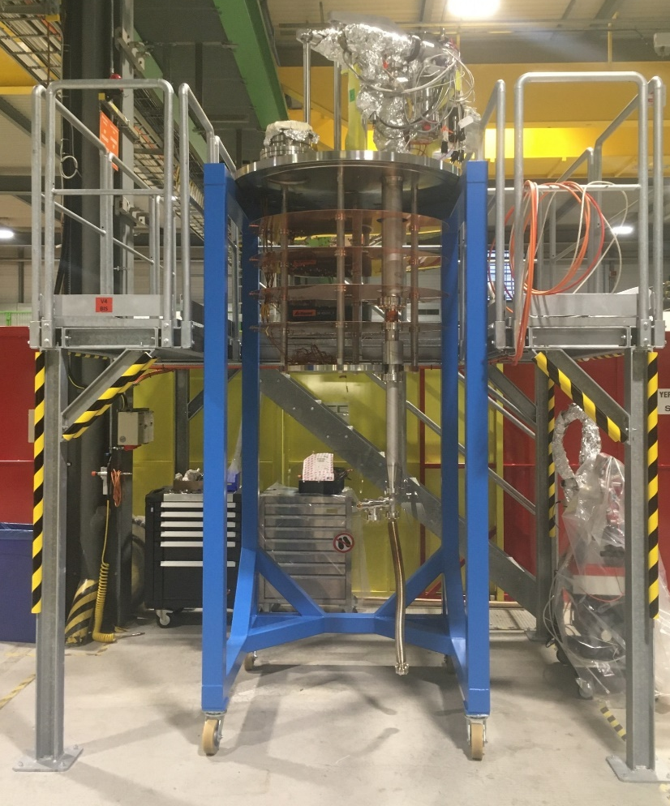
Upgrades of RF cold testing facility
Vertical inserts
V3
V4
V4bis
V5
Isolde
V5
Swell
V6
V3
V4
V5
V6
Cryostats
  ⇒ This will allow to have a stock of prepared cavities “ready to be tested”
New V4bis insert and preparation area
V3 / V6 insert with RFD crab bare cavity

Slide 9
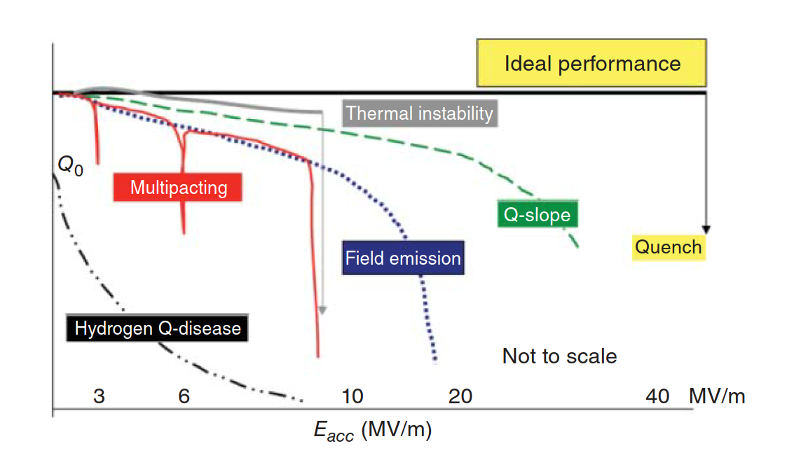
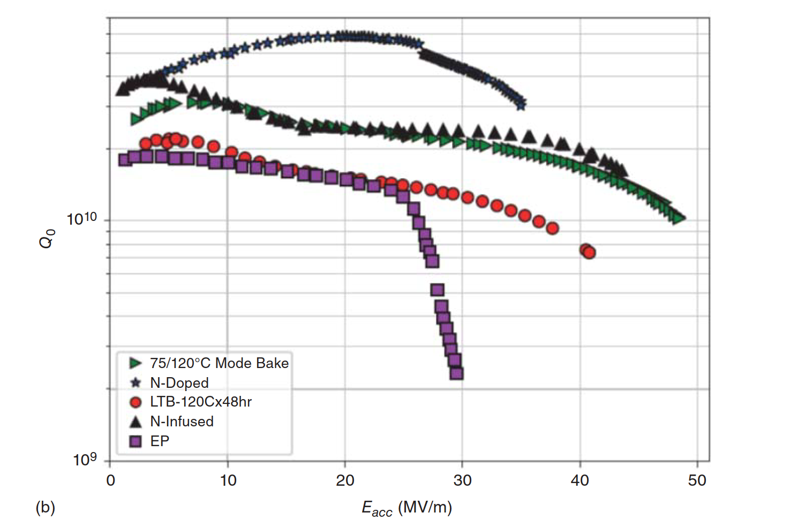
Scientific challenge: understand and control R_{s}(H): bulk Nb
No universally accepted theory exists to date for the shape of R_{s}(B)
Known knowns and known unknowns:
many different “recipes” to improve bulk Nb performance
Sign of MF Q slope (and quench field) modulated by disorder,
existence of optima
introducing “disorder” in the RF layer yielded a surprising variety of behaviors
Anti Q slope originates from the temperature dependent component (so called BCS), doping also reduces R_{res} and increases sensitivity to trapped flux
High field Q slope (> 100 mT)
derives from R_{res}
role of hydrogen and hydrides
Notes:
Many years ago, people thought that the ideal performance was a flat Q up to quench and all the deviations observed where considered (and were) degradations.
Frequency dependence (nonlinear effects increase at high frequencies).
120 C bake removes HFQS if oxide layer is present

Slide 10
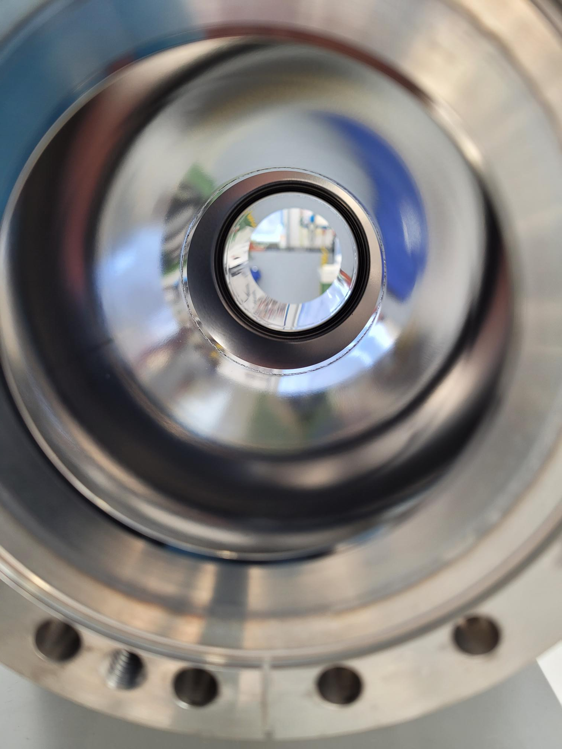
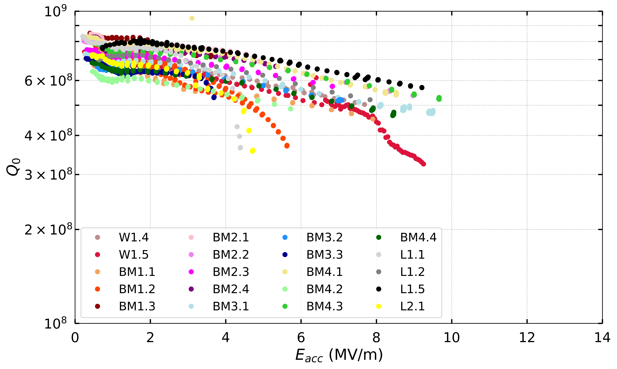
Scientific challenge: understand and control R_{s}(H) in Nb thin films
No universally accepted theory exists to date for the shape of R_{s}(B)
Degree of disorder in thin films still higher than the most aggressive recipes for bulk Nb
Anti Q slope was never observed in thin films, only LFQS (explained by TLS from pentoxide)
Nb/Cu BCS parameters well under control and reproducible, but “classical” MFQS
The main problem is the erratic R_{res} (what are the hidden variables?)
Role of hydrogen deserves further investigations
Thermal mapping → localized losses
Substrate under control, some residual doubts on raw material
Established role of thermal currents
“cleaner “ films may enter in the anti Q slope regime?
Optical inspection → features

Slide 11
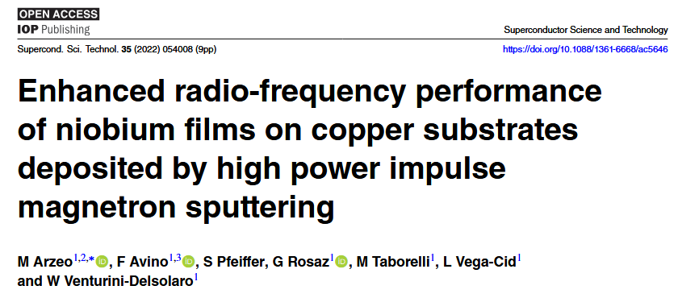
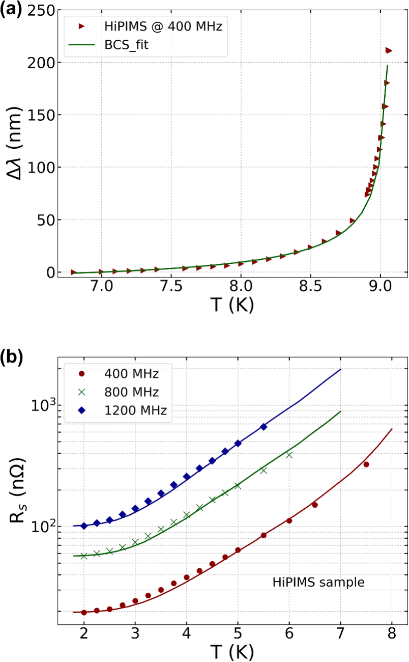
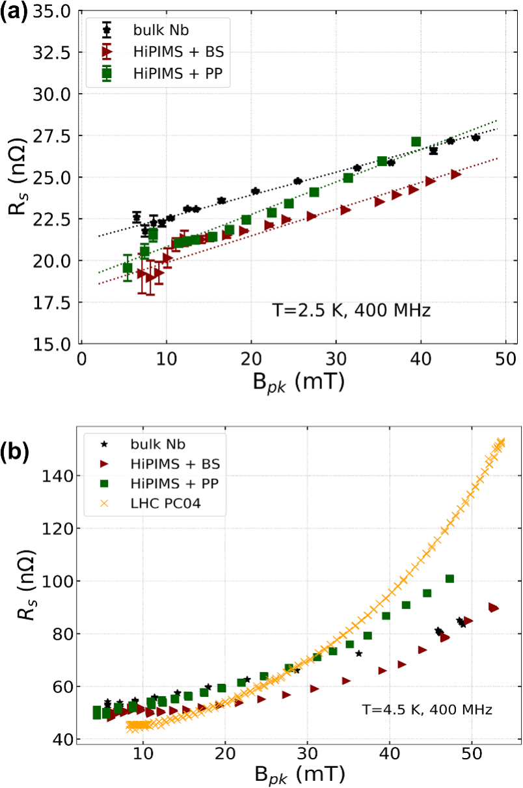
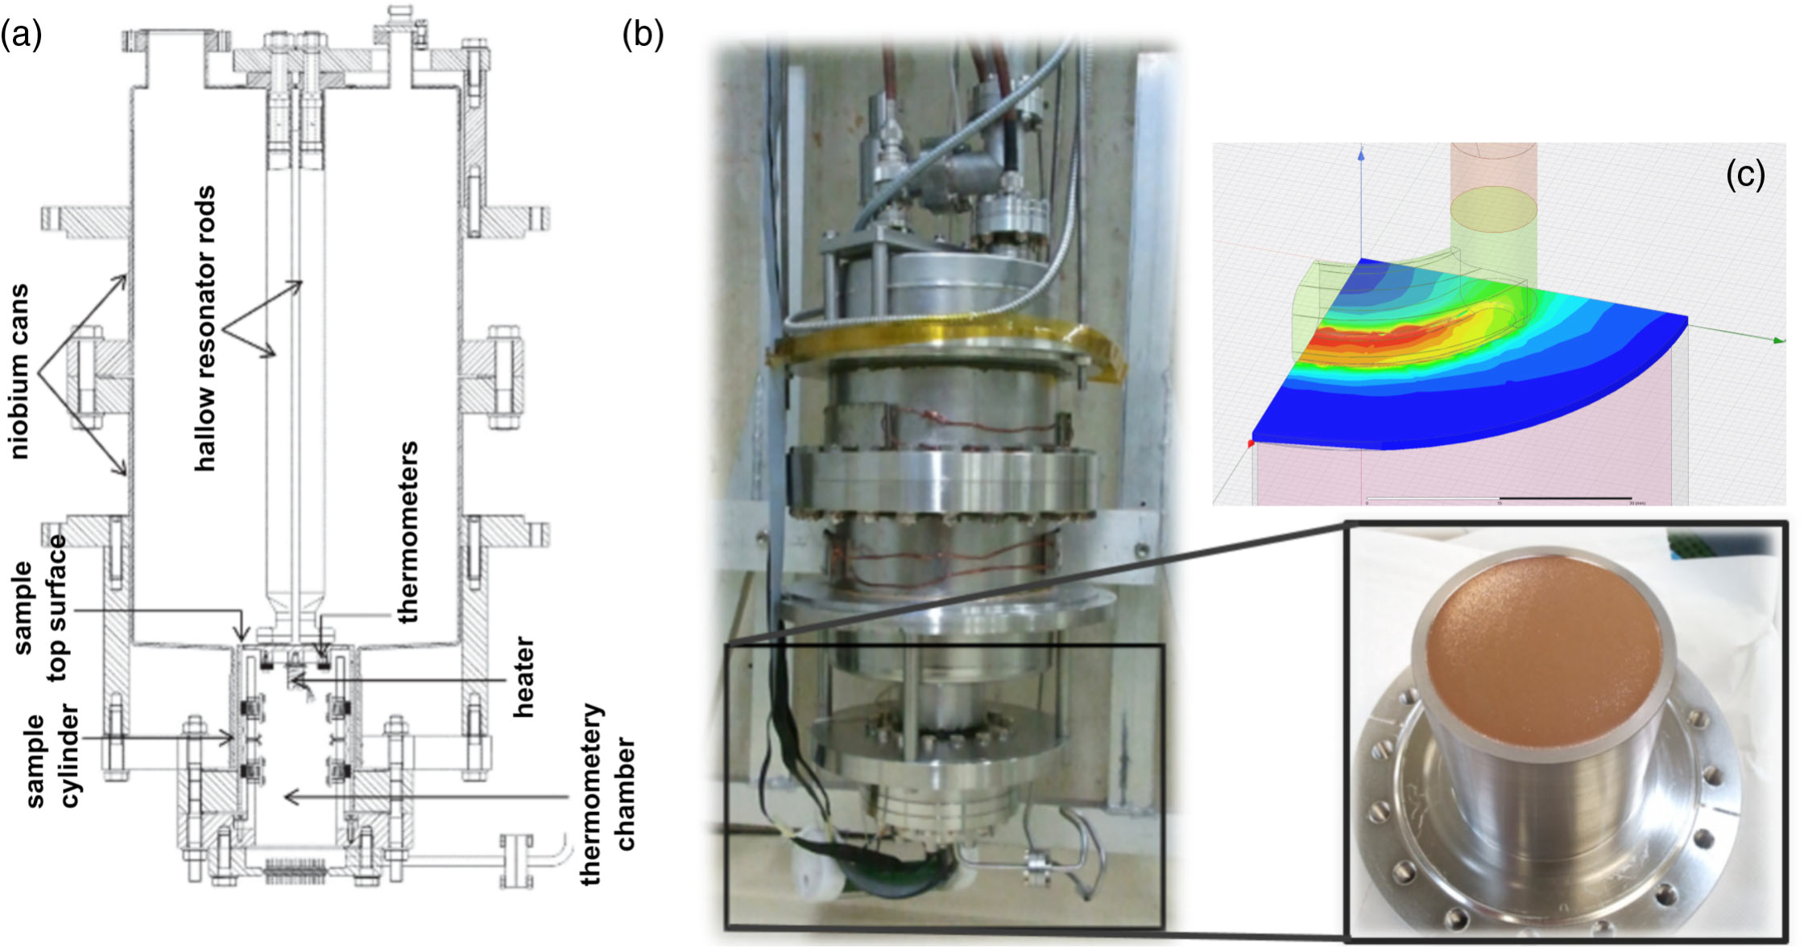
Sample studies of HIPIMS Nb on QPR
QPR measurements of complex surface impedance versus T, Brf, Ba, f

Slide 12
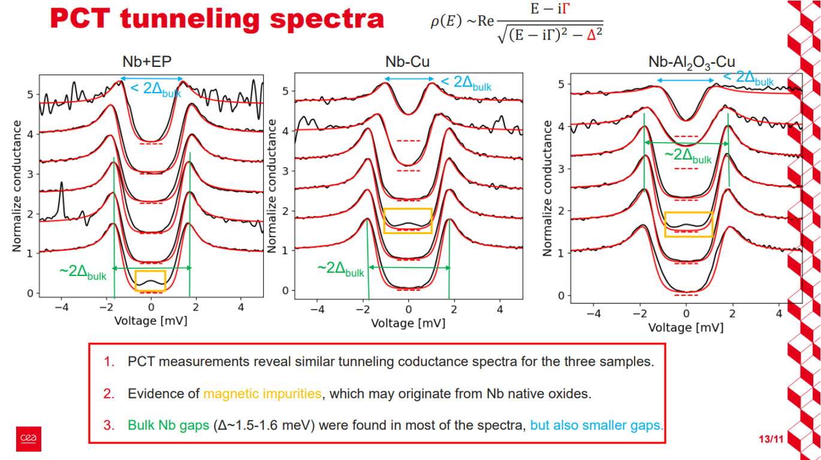
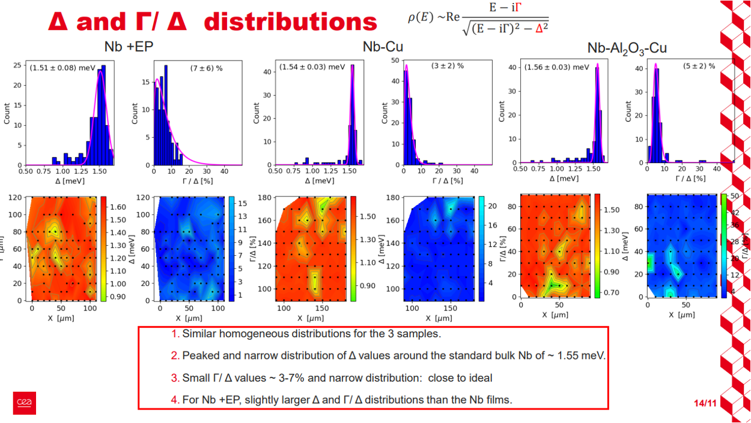
G. Rosaz (CERN), T. Proslier (CEA), S. Leith (CERN), I. Curci (CEA)
Point contact Tunneling study of Nb films
Confirms no differences in fundamental SC properties between Nb bulk and Nb/Cu
Rs=RBCS+ Rflux+ Rres

Slide 13
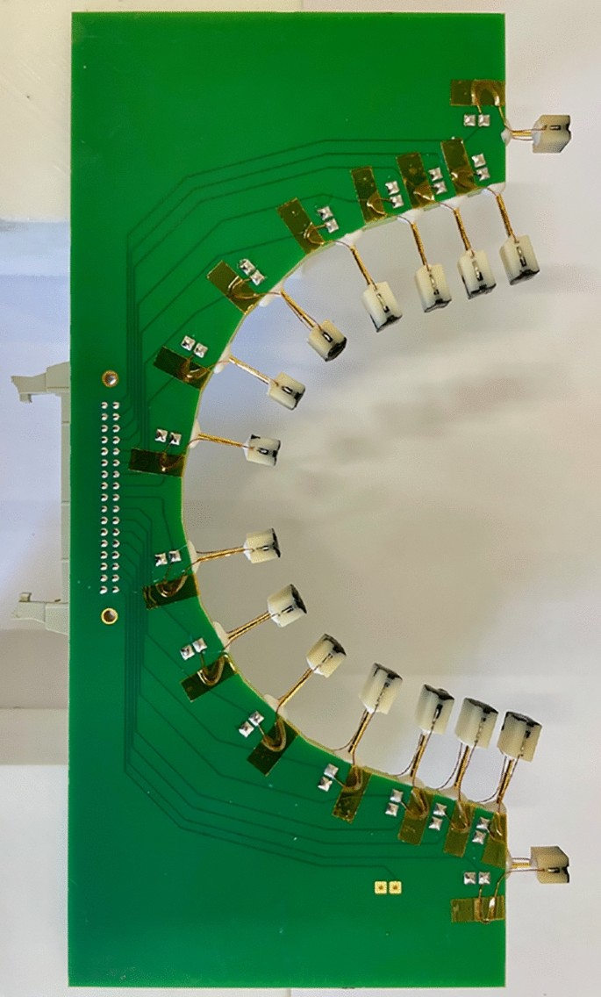
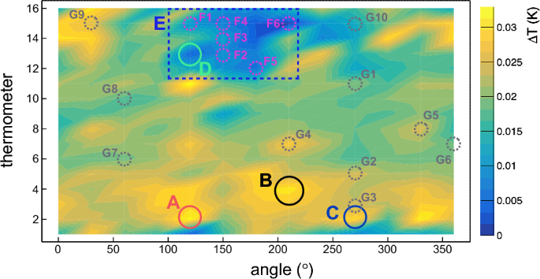
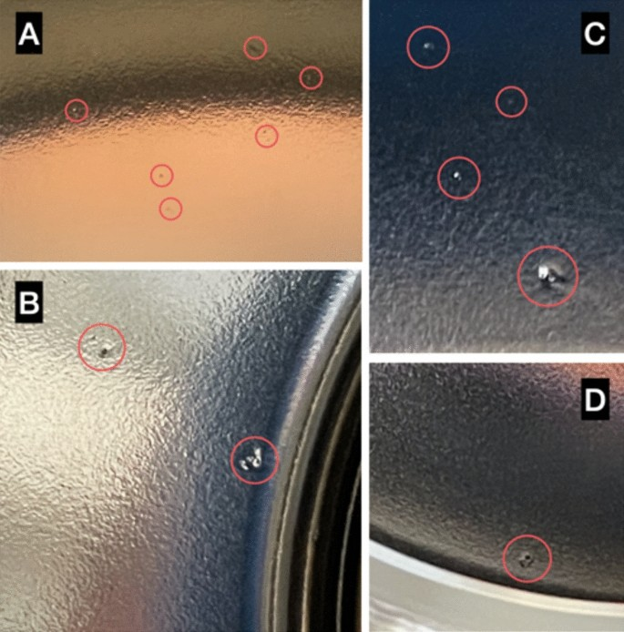
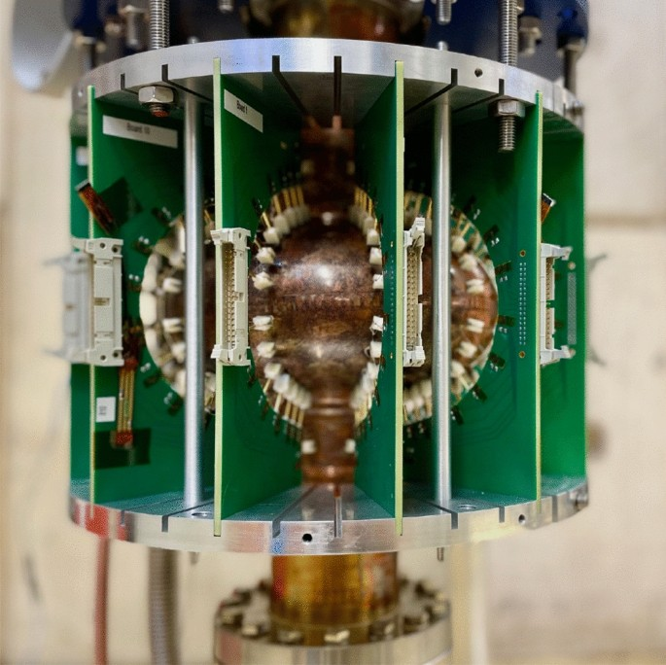
Temperature mapping and spurious losses
New T mapping system adapted for copper substrates (hot spot detection more challenging )
Bianchi, A., Vandoni, G. & Venturini Delsolaro, W. Temperature measurement on copper surfaces for superconducting thin film cavity applications. Meas. Sci. Technol. 35, 015901. https://doi.org/10.1088/1361-6501/acfba2 (2024)
Established correlation between hot spots, cold spots and surface defects
A. Bianchi, W. Venturini Delsolaro Temperature mapping on a niobium-coated copper superconducting radio-frequency cavity Scientific Reports volume 13, Article number: 17075 (2023)

Slide 14
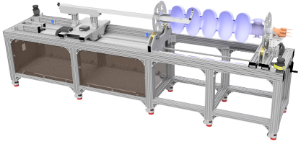
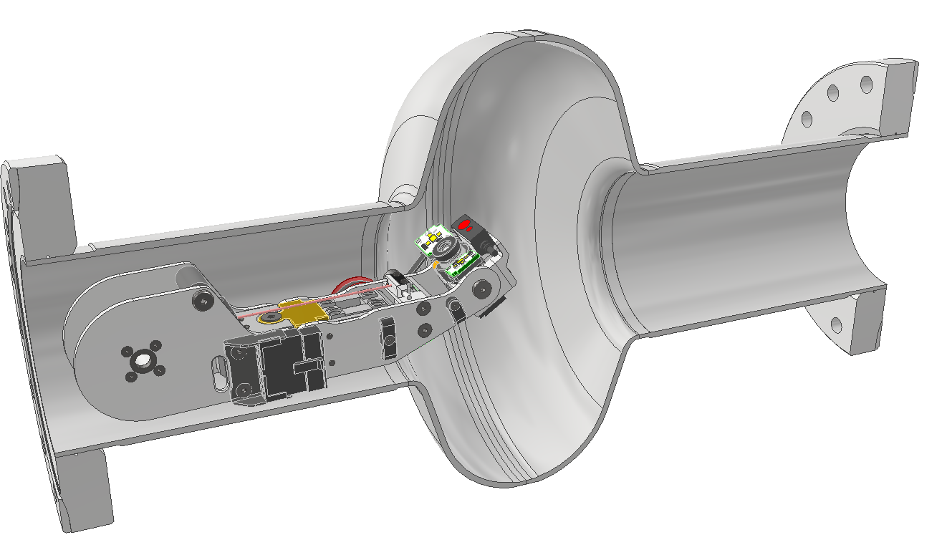
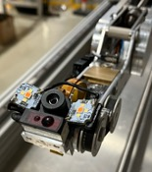
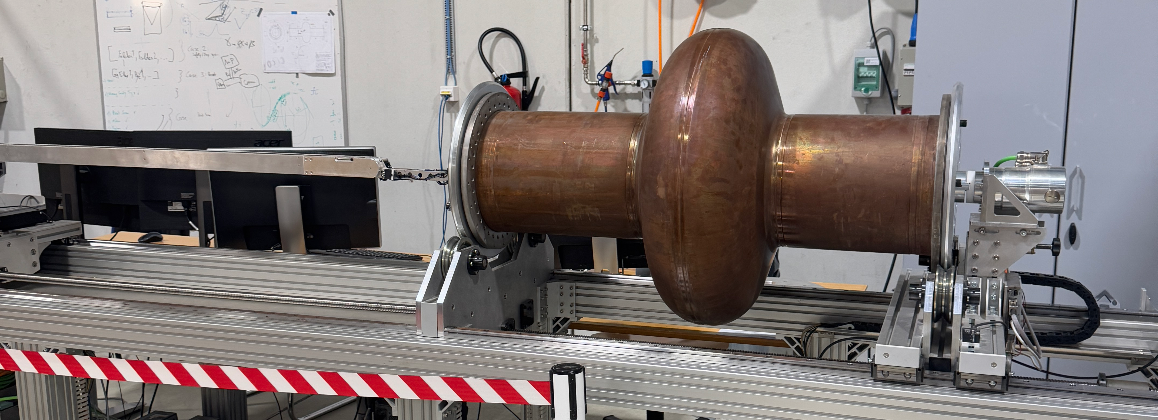
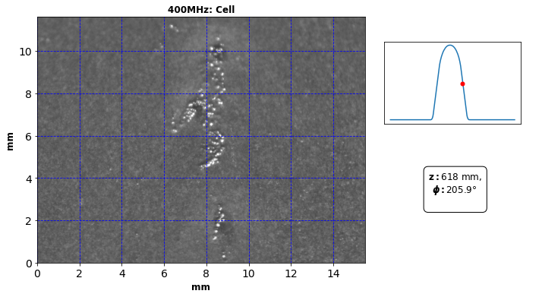
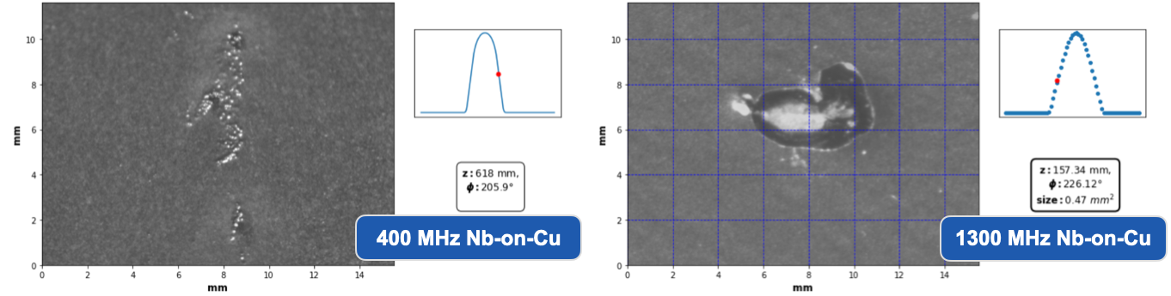
Optical inspection bench
BE-CEM-MRO & SY-RF-SRF
S. R. Mathews, A. Macpherson, et al.
Fixed short focus camera mounted on robotic arm
    Precision imaging over full RF surface
System capable of scanning Elliptical Cavities
    LHC cavity: ~30000 images for full coverage
Defect Analysis: AI driven defect detection in development
400 MHz Nb-on Cu Nb-on-Cu

Slide 15
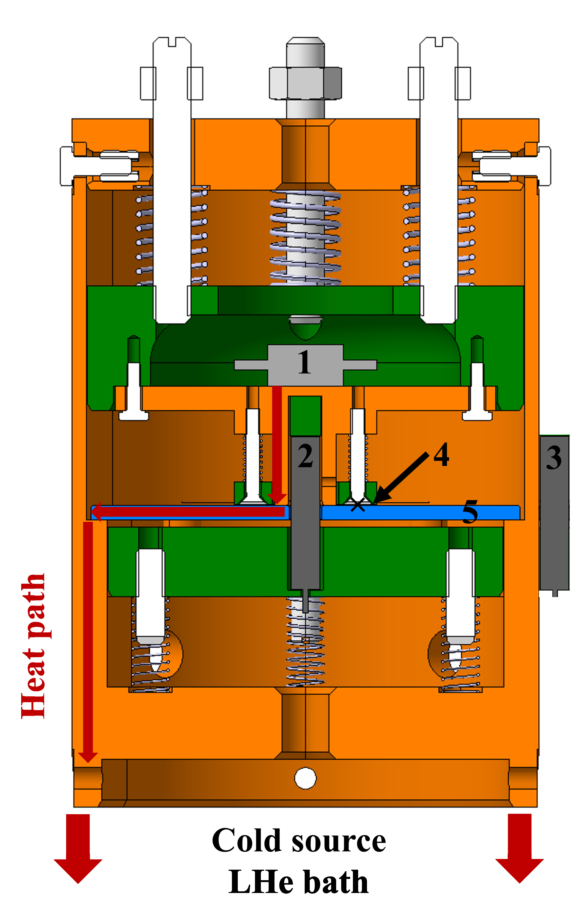
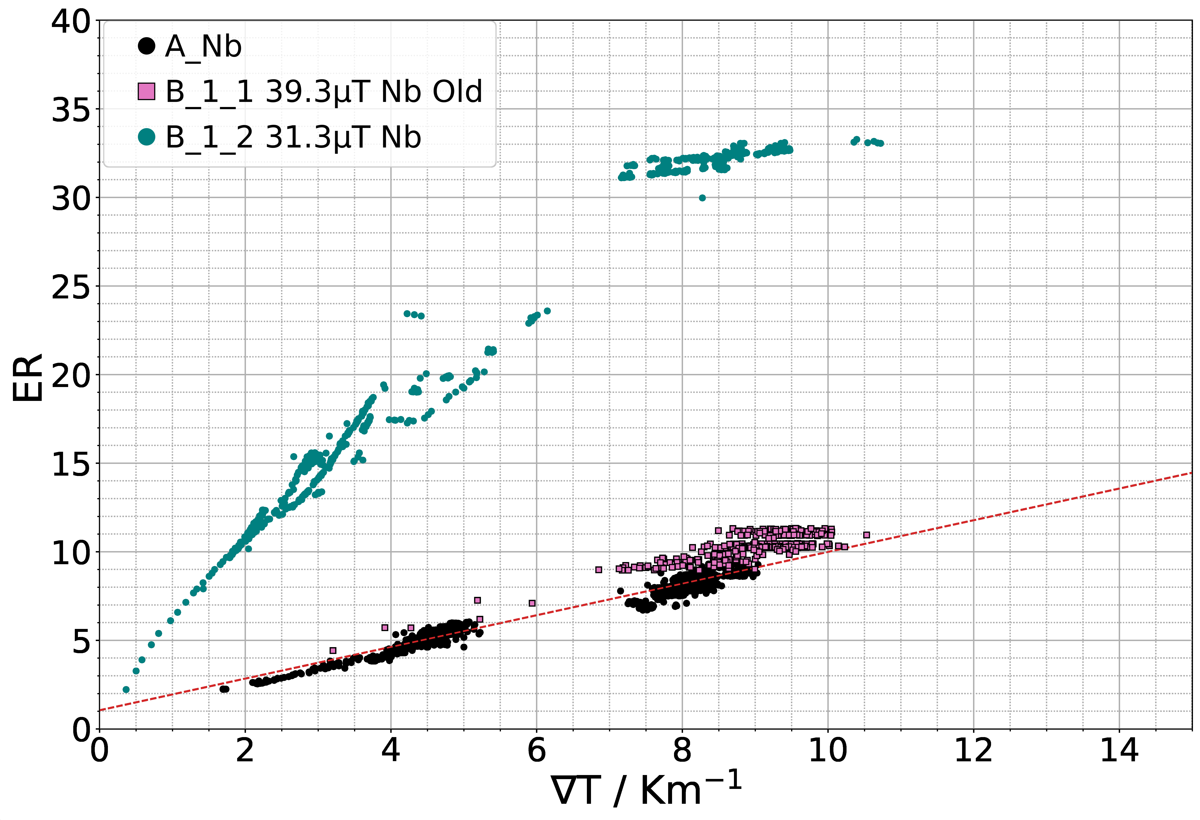
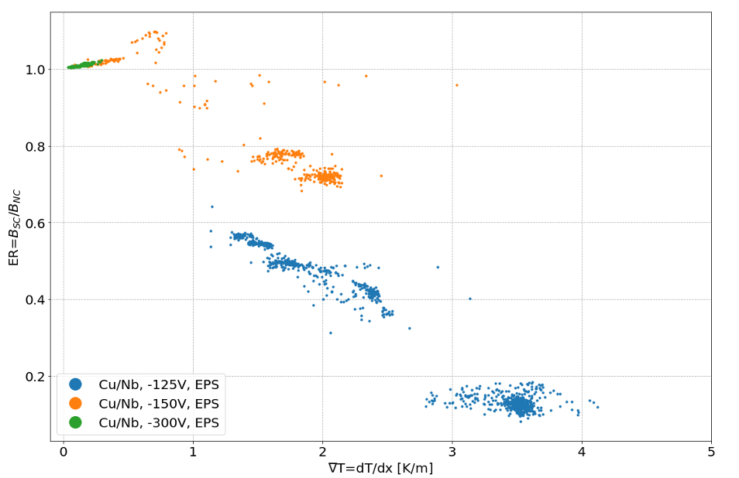
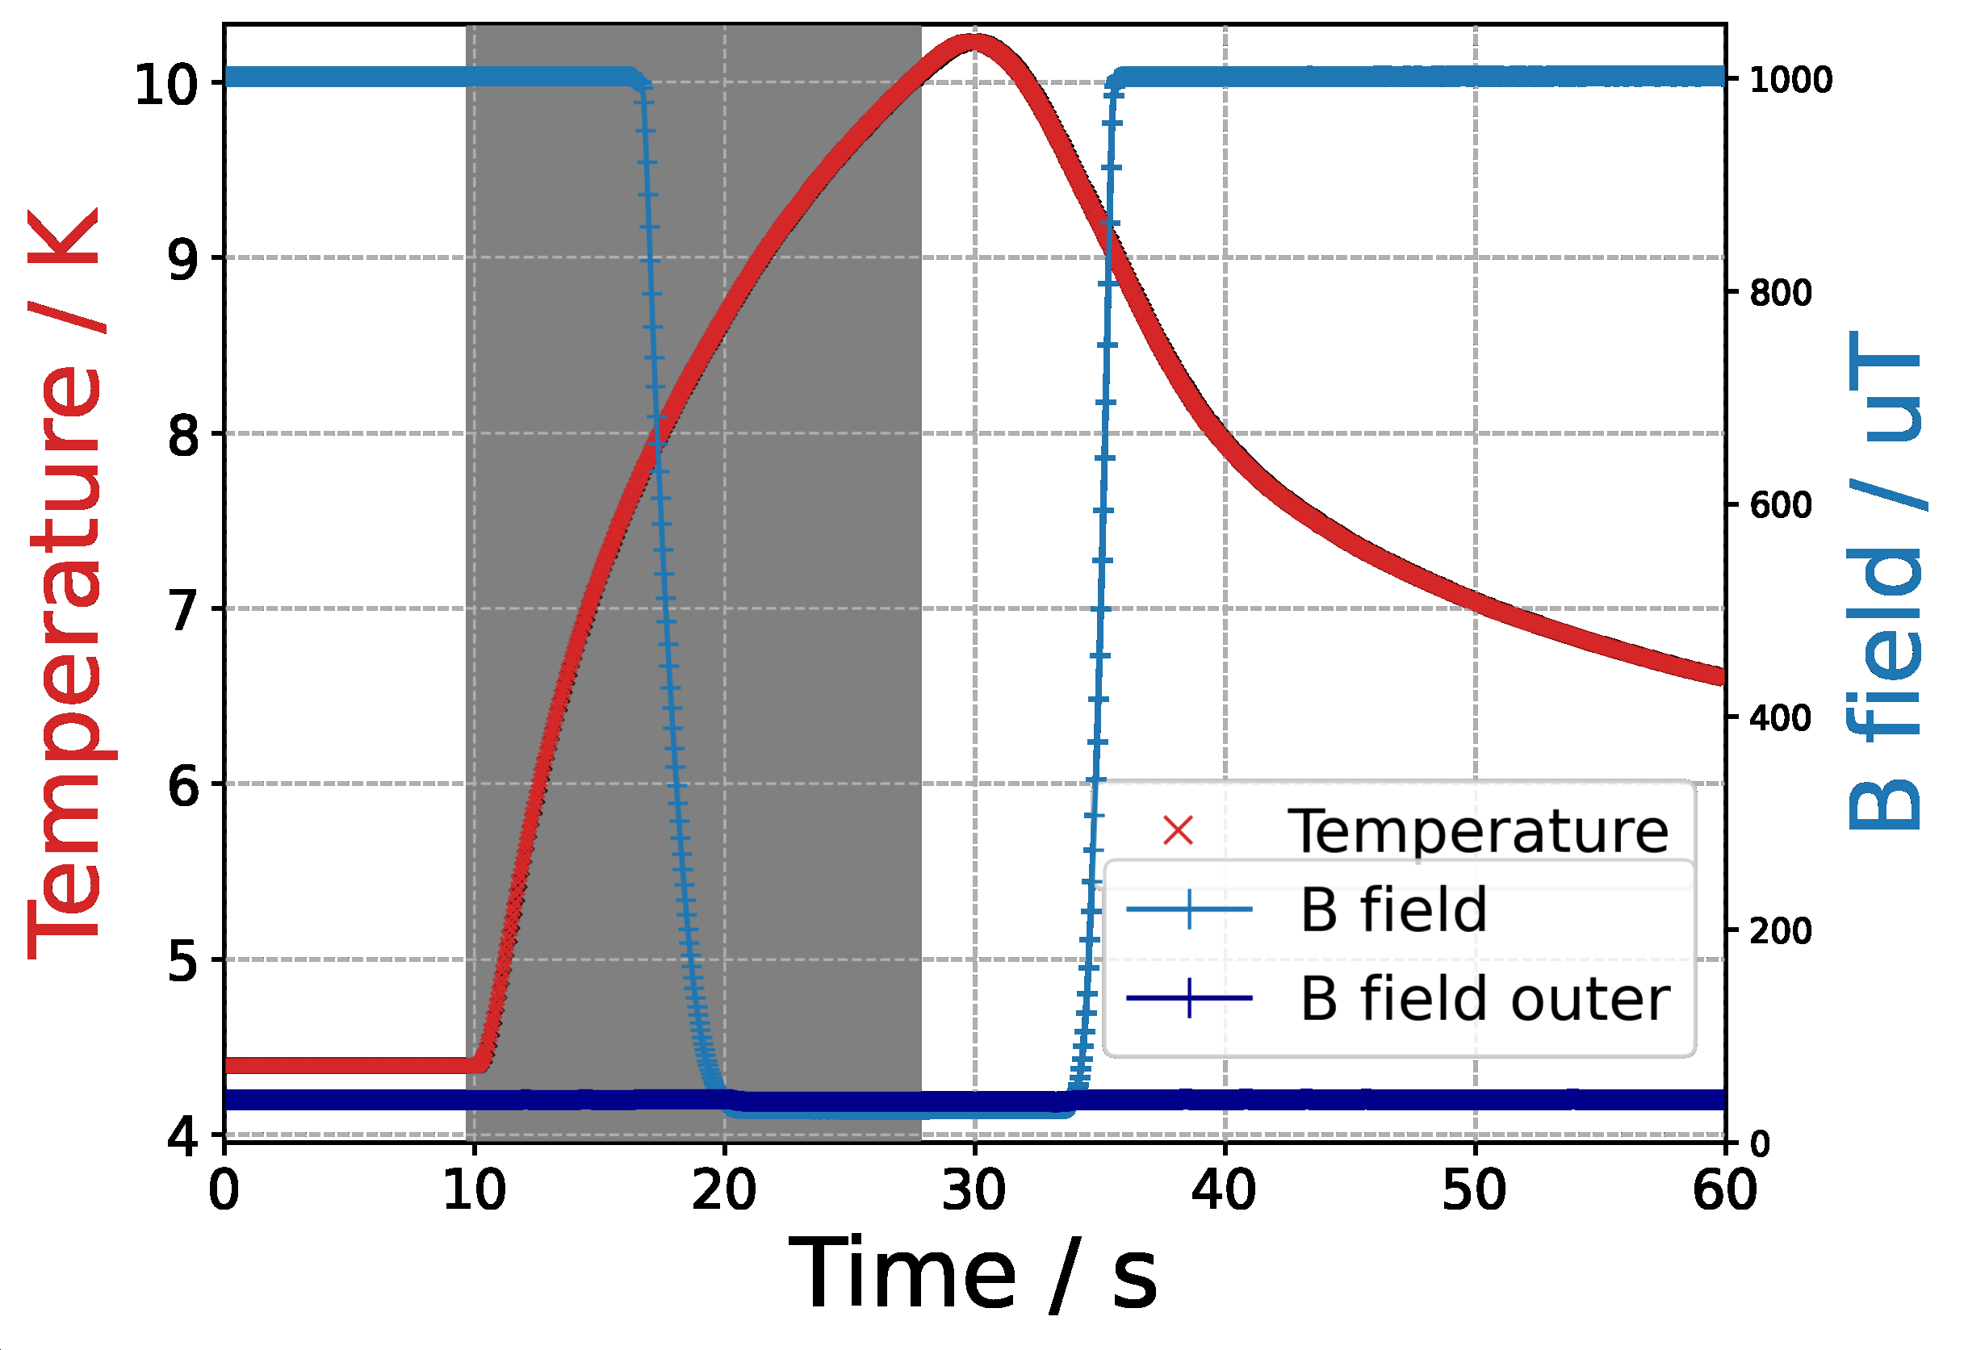
Flux expulsion studies with flux lens
Normal behavior for Nb: expulsion ratio ∼∇ Τ
Evidence of thermoelectric currents in Nb/Cu : flux trapping at high ∇ Τ
D. Turner, A: Macpherson, et al.

Slide 16
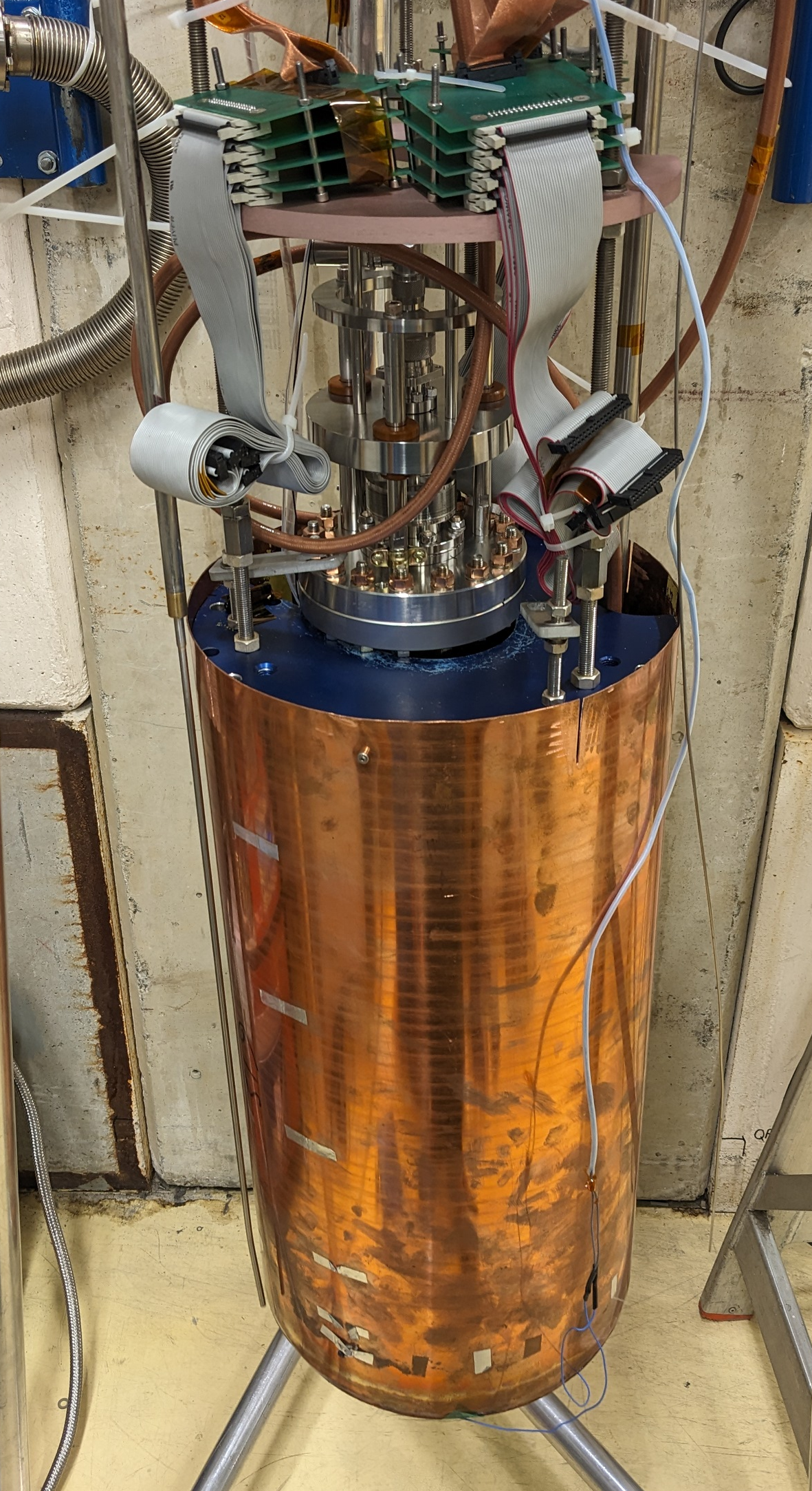
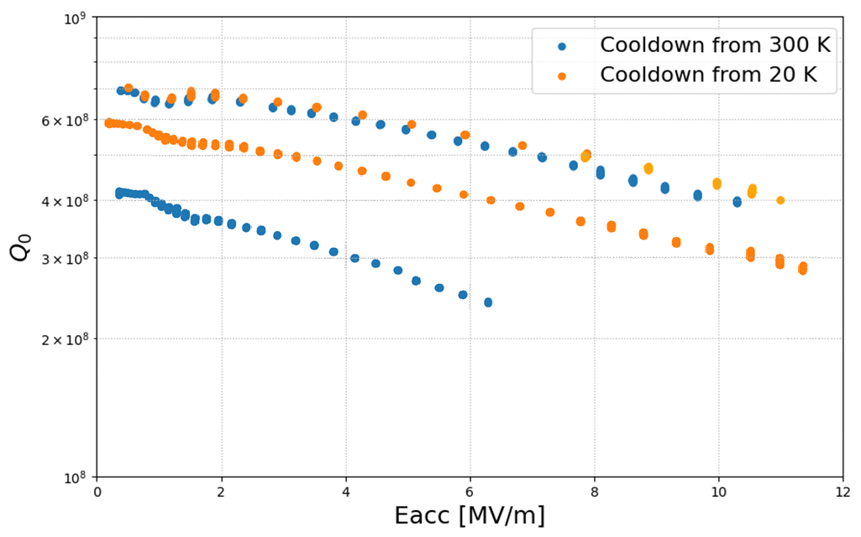
Importance of controlling thermal currents
Contrary to bulk Nb, minimizing T gradient at Tc is required to optimize performance
CAV1 (cool down without shield)
CAV2 (cool down with shield)
K. Brunner, H. Araki, et al.

Slide 17
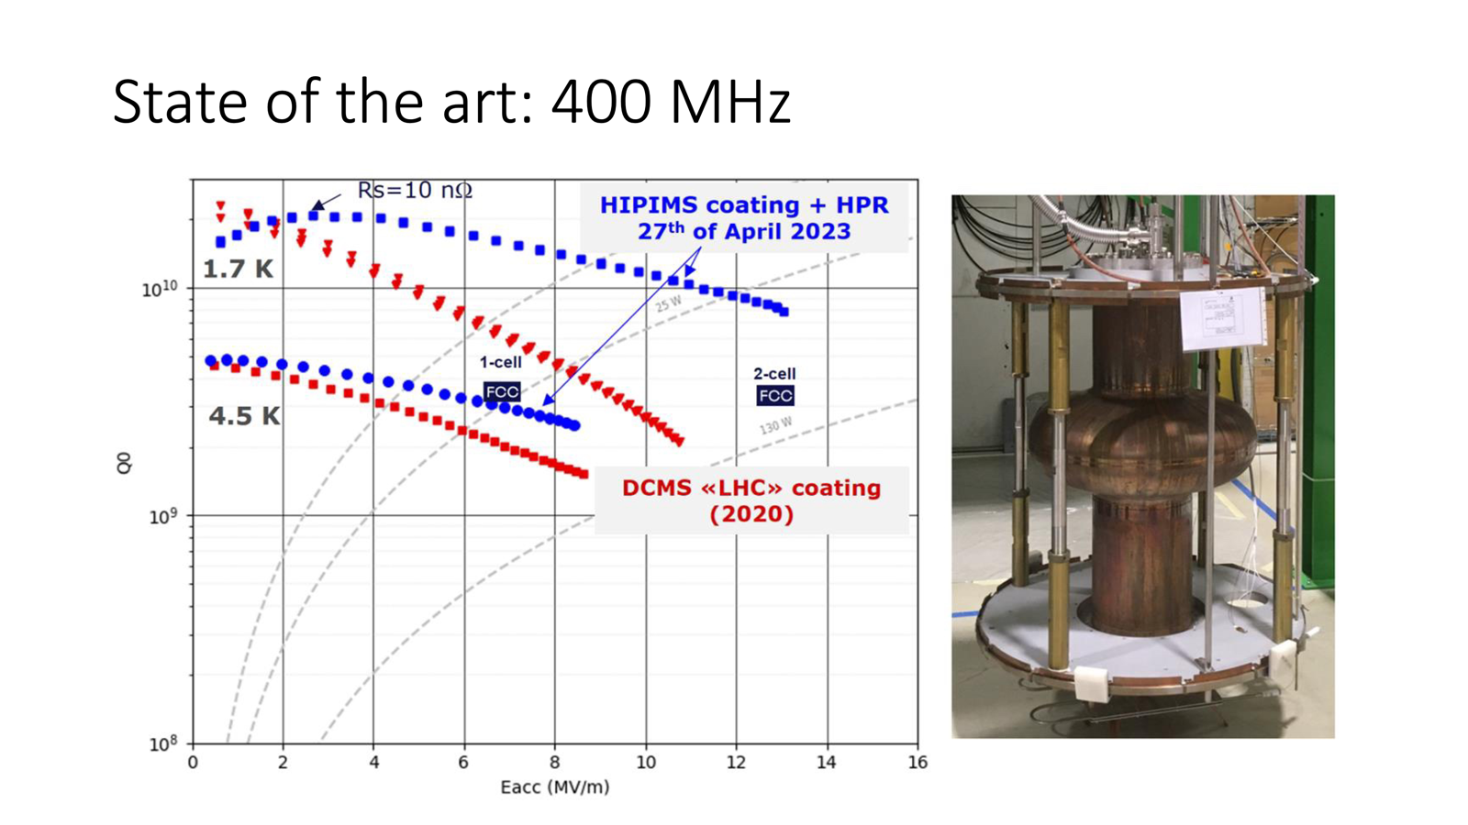

Slide 18
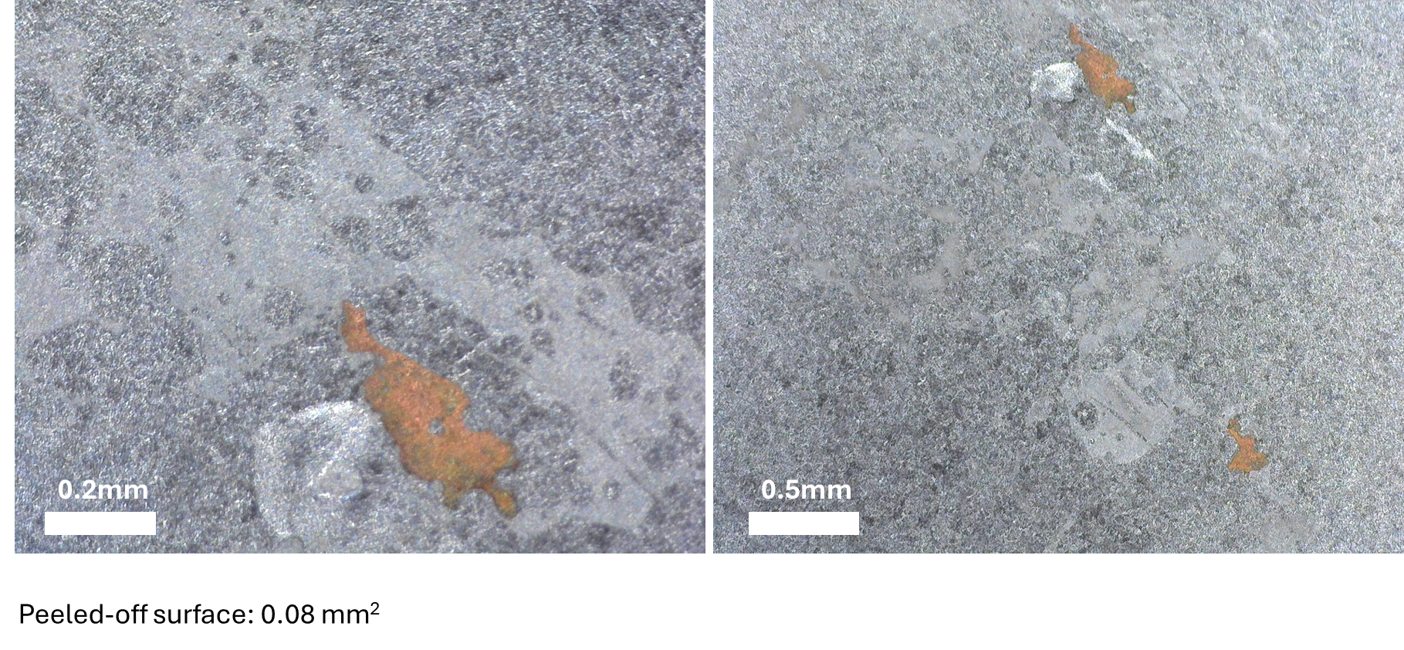
Situation of 400 MHz tests
Of the four good practices so far identified (use seamless substrates, electropolishing, HIPIMS, thermal shield) until end 2024 only HIPIMS was implemented.
Recently two cavities received EP, PC04 and PC06 (with HOM ports)
PC04 was tested with thermal shield. It had poor performance, explained by localized peel off
PC06 is presently under test in SM18 (with TS)
Crab cavities will now use the chemical lab until end of June at least....

Slide 19
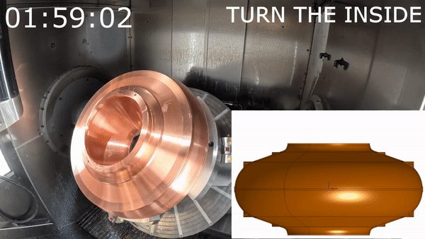
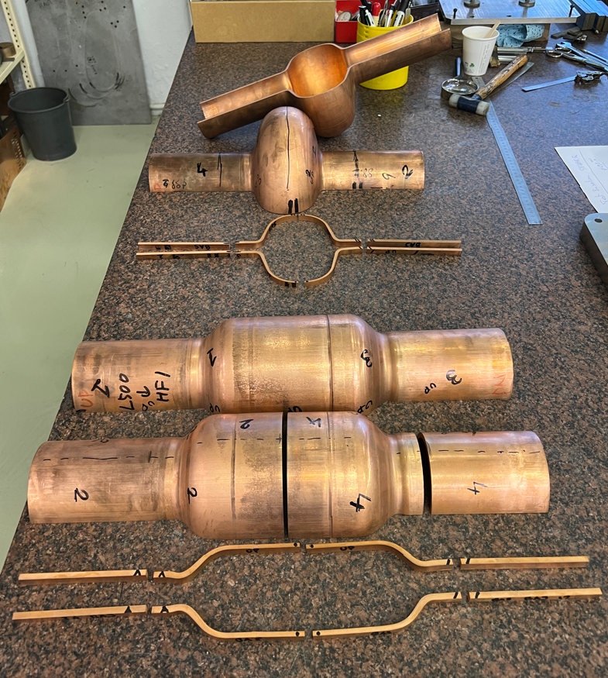
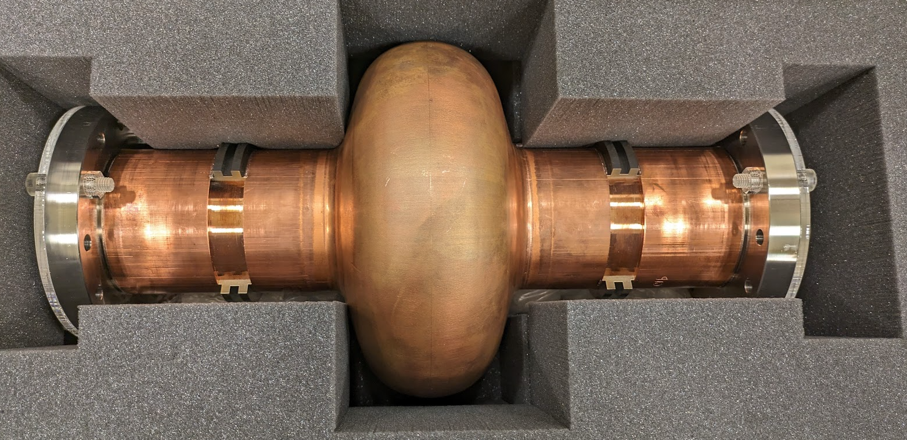
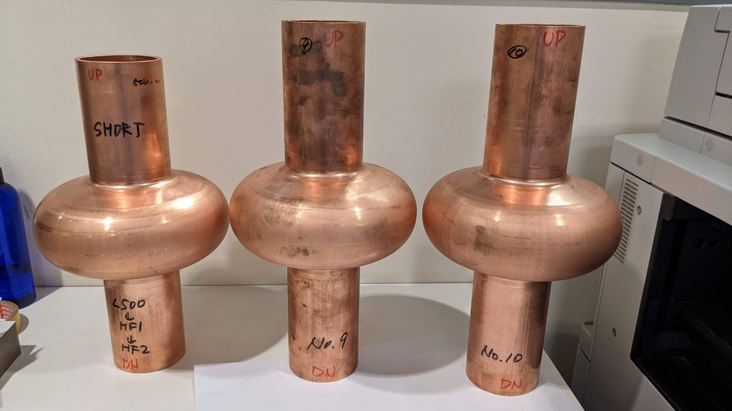
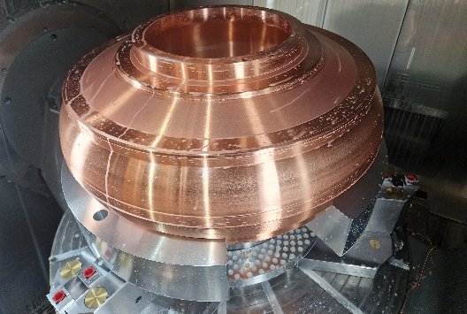
Cavity manufacturing
M. Garlasche, S. Atieh, et. al
400 MHz Monoblock prototype
1.3 GHz hydroforming (KEK Collaboration)

Slide 20
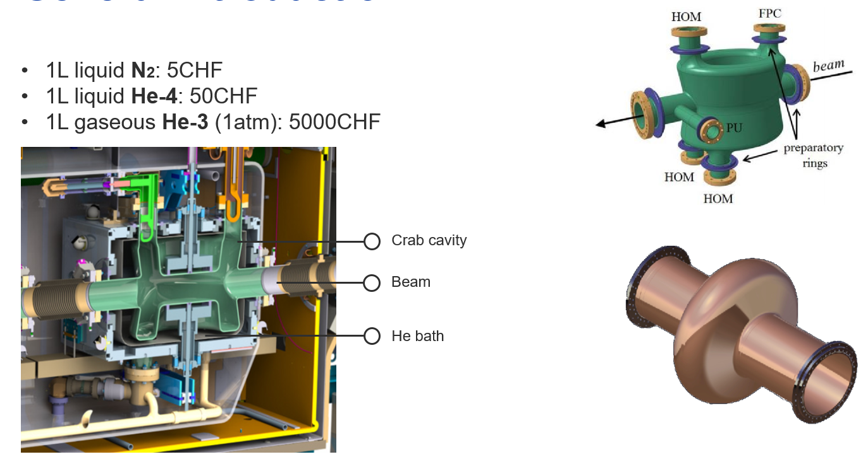
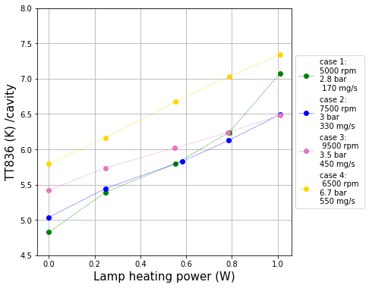

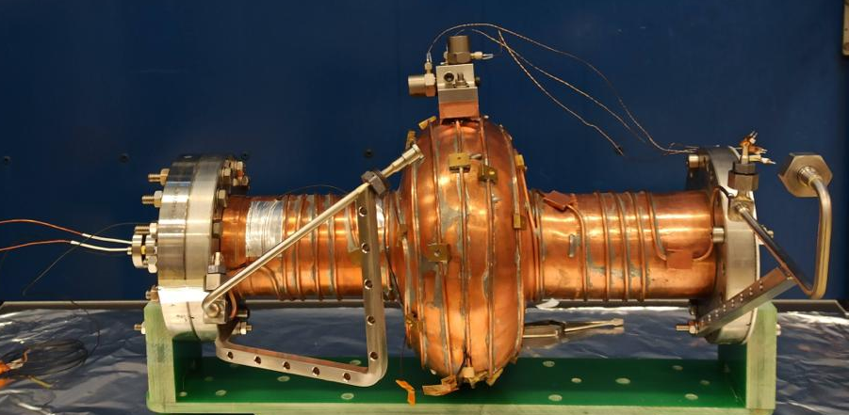
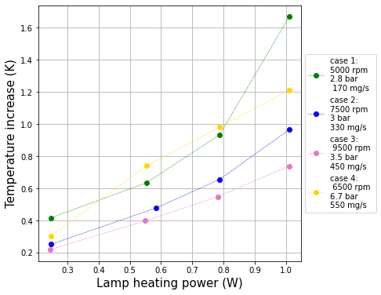
Dry cavity cooling
1.3 GHz Cu cavity with cooling capillary and vibration sensors
Cavity absolute temperature
vs. heat load
TT836 / Cavity temp. (Equator)
TT857 / Supply Temp.
TT858 / Return Temp.
TT826 / Inlet Temp. (Capillary)
TT827 / Outlet Temp. (capillary)
Cavity temperature increase vs. heat load
Demonstrated feasibility of remote cavity cooling systems
Tested different flow conditions for cooling (pressure, temp. and mass flow)
Low noise cooling achieved
6.5 K cavity temperature reached with 1 W + residuals
Integration of booster HEX finished
Week 5 ‘24 => Start calibration procedure/pump down
T. Koettig, M. Chioteli, et. al

Slide 21
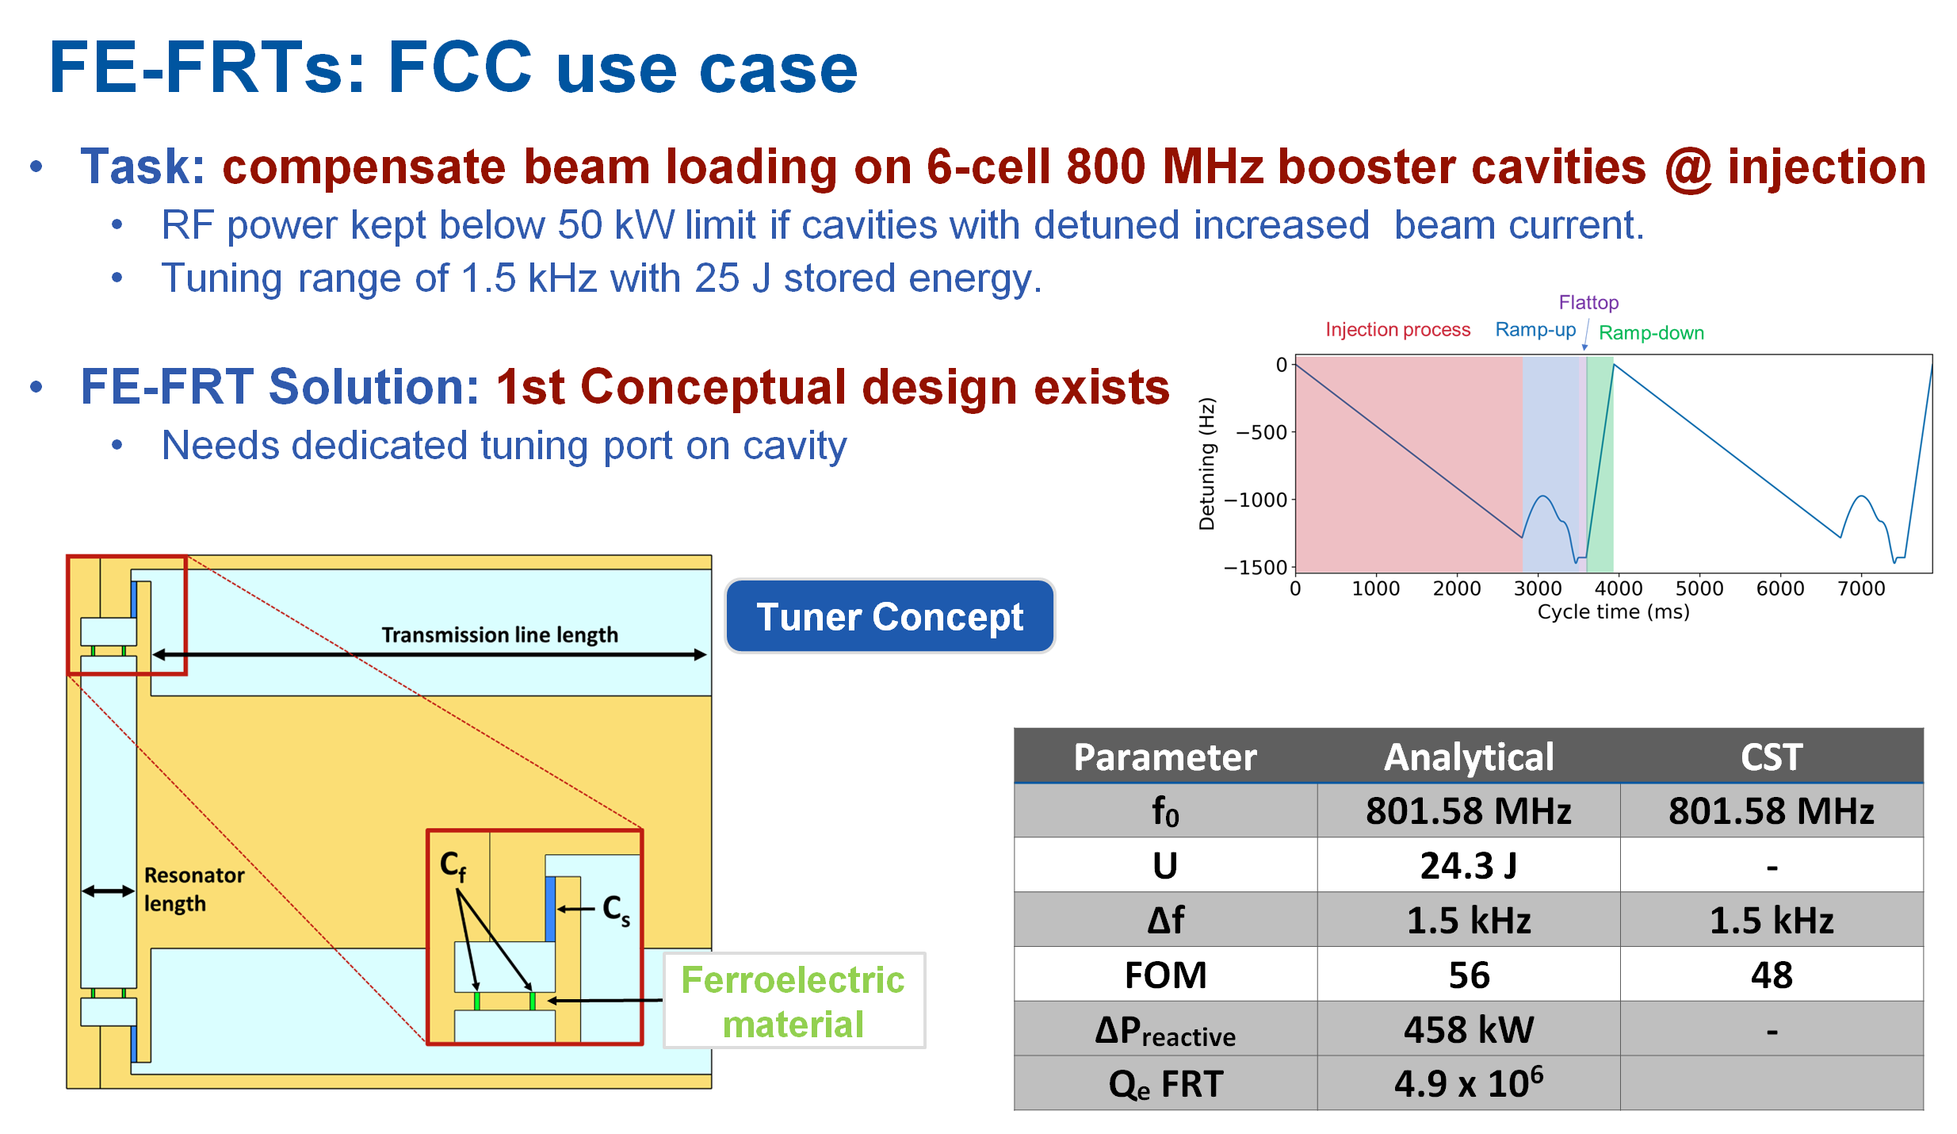
S. Smith, I. Ben Zvi, A. Macpherson &ISAS

Slide 22
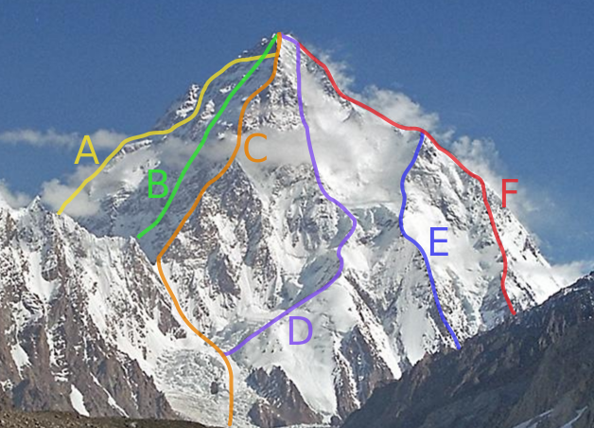
Q₀> 3 10⁹, E_{a}> 10 MV/m @ 400 MHz and 4.5 K
internal welding, spinning, hydroforming, electroforming, bulk machining
Non mechanical tuning
Conduction cooling
Bulk Nb
Nb coatings
Nb3Sn coatings

