Slide 1
Accelerating cavities with HOM damping for FCC-ee
Shahnam Gorgi Zadeh
With inputs from: F. Peauger, I. Karpov, R. Calaga, M. Garlasche, M. Timmins, F. Cottenot, S. Jerome Calvo, V. Parma. K. Canderan, L.P. Loiri

Slide 2
Overview
400 MHz RF system
  Cavity design
  HOM damping
  Sensitivity analysis
800 MHz RF system
  Cavity design
  HOM damping
  Sensitivity analysis

Slide 3
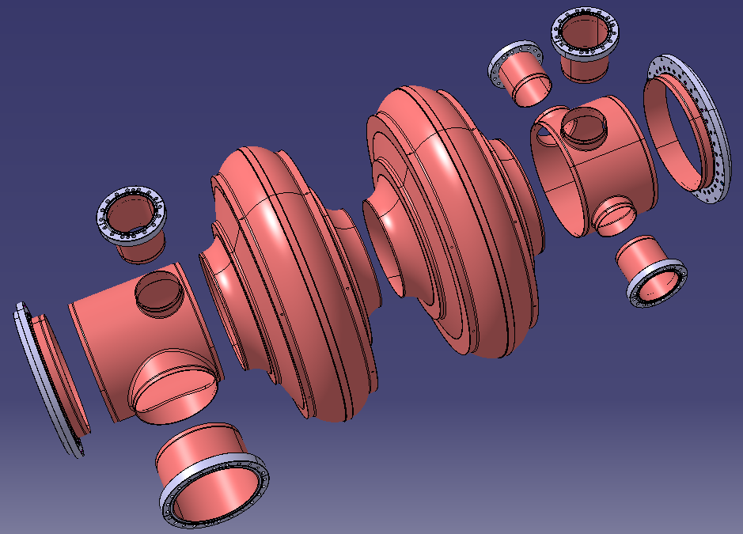
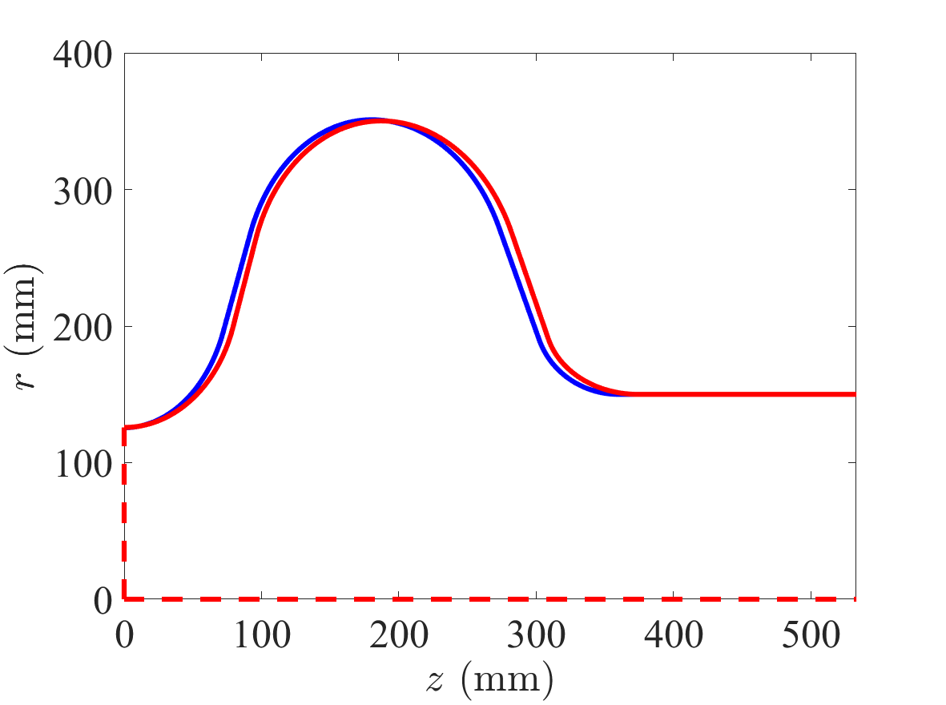
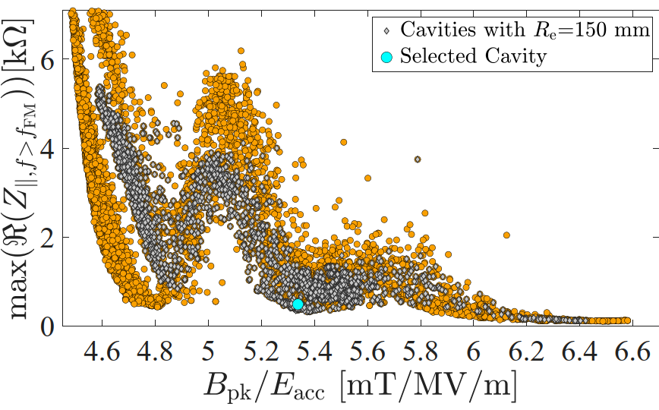

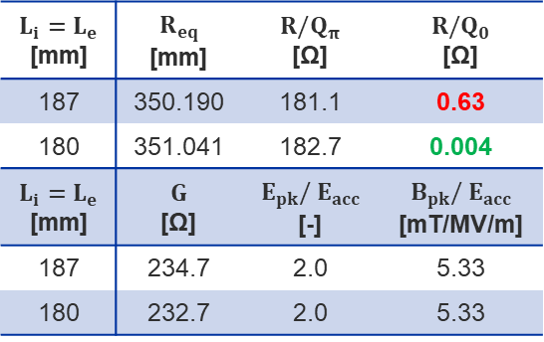

2-cell 400 MHz cavity shape
  Initial Cavity Optimization: $\operatorname{minimize}{ (B_{pk}/E_{acc}, max⁡(ℜ\left(Z_{∥, f>f_{FM}}\right))}$
  Re-optimization for RPO Requirement: also reduce the R/Q of the 0-mode in the FM passband → Resulting half-cell length of 180 mm
  Material and target Q₀ → Nb/Cu at 4.5 K aiming for Q₀=2.7e9 at $E_{acc}$=10 MV/m
  Ports: 1 Port for FPC, two ports for HOM couplers, 1 port for pick up antenna and one port for possible use of FRT
Bulked machined model
Marc Timmins
Fabien Cottenot
$$Li=180 mm$$
$$Li=187 mm$$
$$L_{i}=L_{e}$$ [mm] | $$R_{eq}$$ [mm] | $$R/Q_{π}$$ [Ω] | $$R/Q_{0}$$ [Ω]
187 | 350.190 | 181.1 | 0.63
180 | 351.041 | 182.7 | 0.004
$$L_{i}=L_{e}$$ [mm] | $$G$$ [Ω] | $$E_{pk}/ E_{acc}$$ [-] | $$B_{pk}/ E_{acc}$$ [mT/MV/m]
187 | 234.7 | 2.0 | 5.33
180 | 232.7 | 2.0 | 5.33

Slide 4
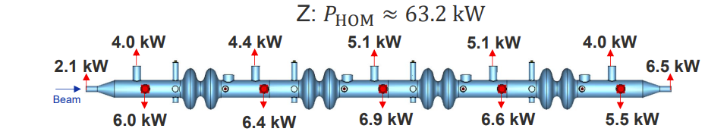
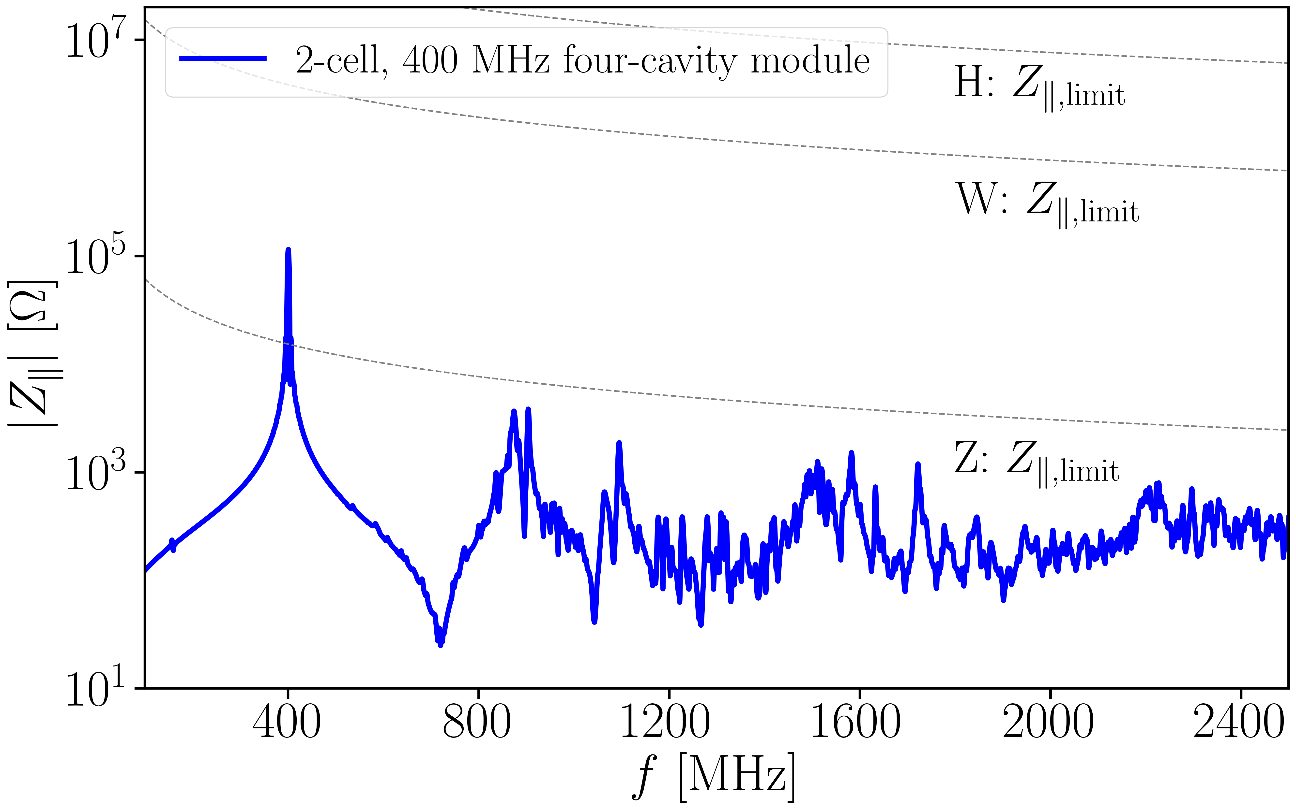
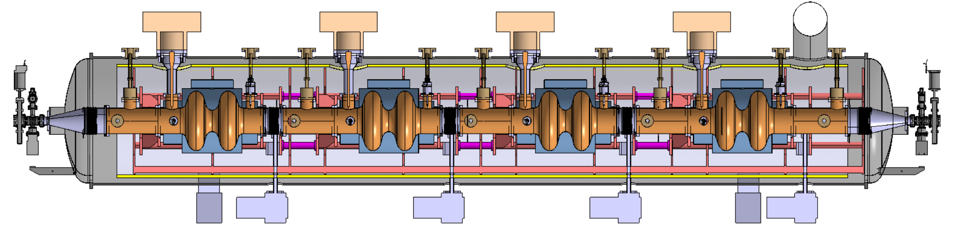
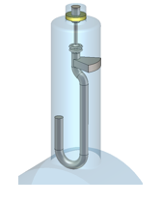
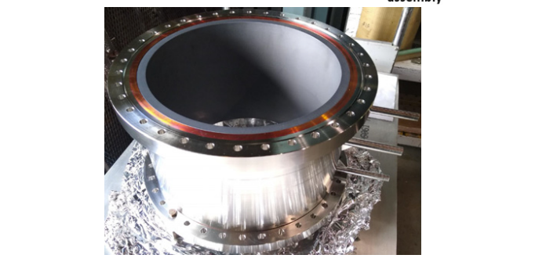
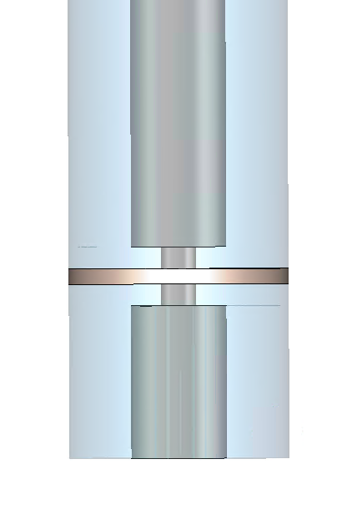
HOM study of 400 MHz cavities
Two hook-type coaxial couplers per cavity used for trapped dipole mode damping. Total numbers: 8×66=528
Two coaxial lines between cavities for high-power HOM extraction. Total numbers: 10×66=660
(possibility of reducing this number should be checked)
BLA between modules to absorb power propagating from modules out. Total numbers=66+1=67
HOM power of all 8 hook-type HOM couplers combined is around 0.7 kW (not shown in the figure above)
Water cooled BLA between modules
Coaxial lines terminated by water-cooled absorbers
Window to separate air and vacuum compromises broadband transmission (design study ongoing)
EIC BLA

Slide 5
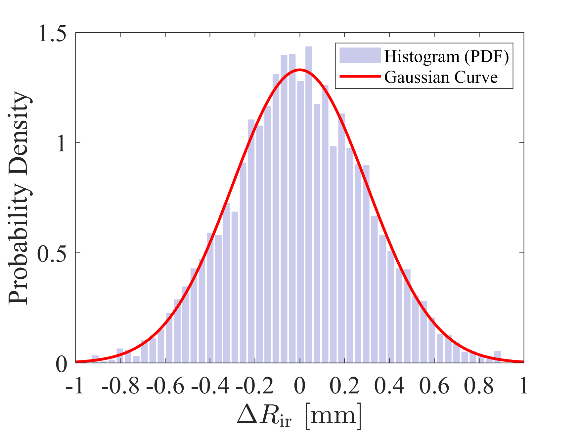
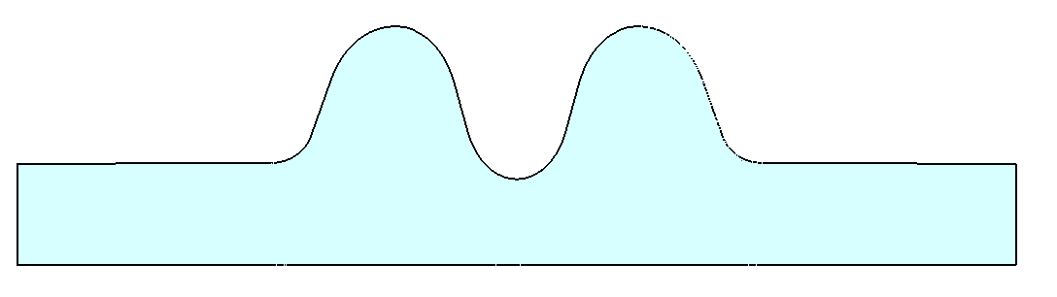
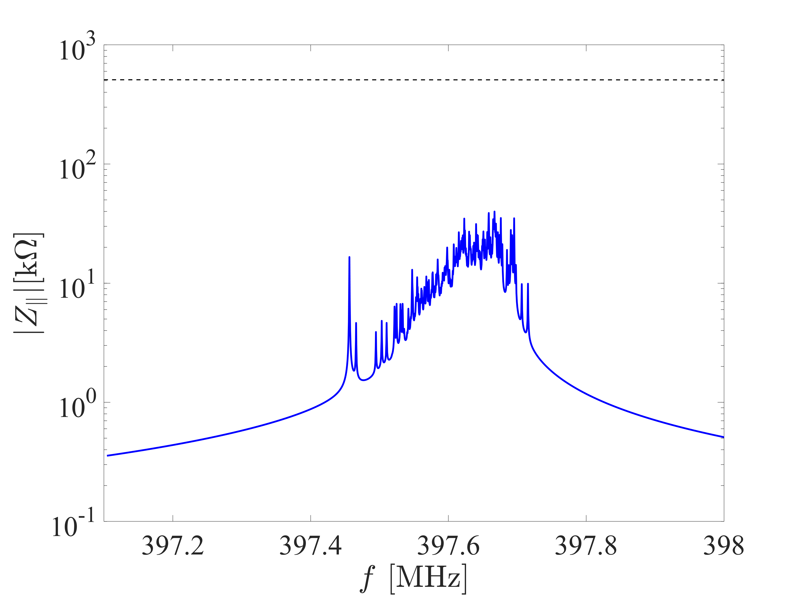
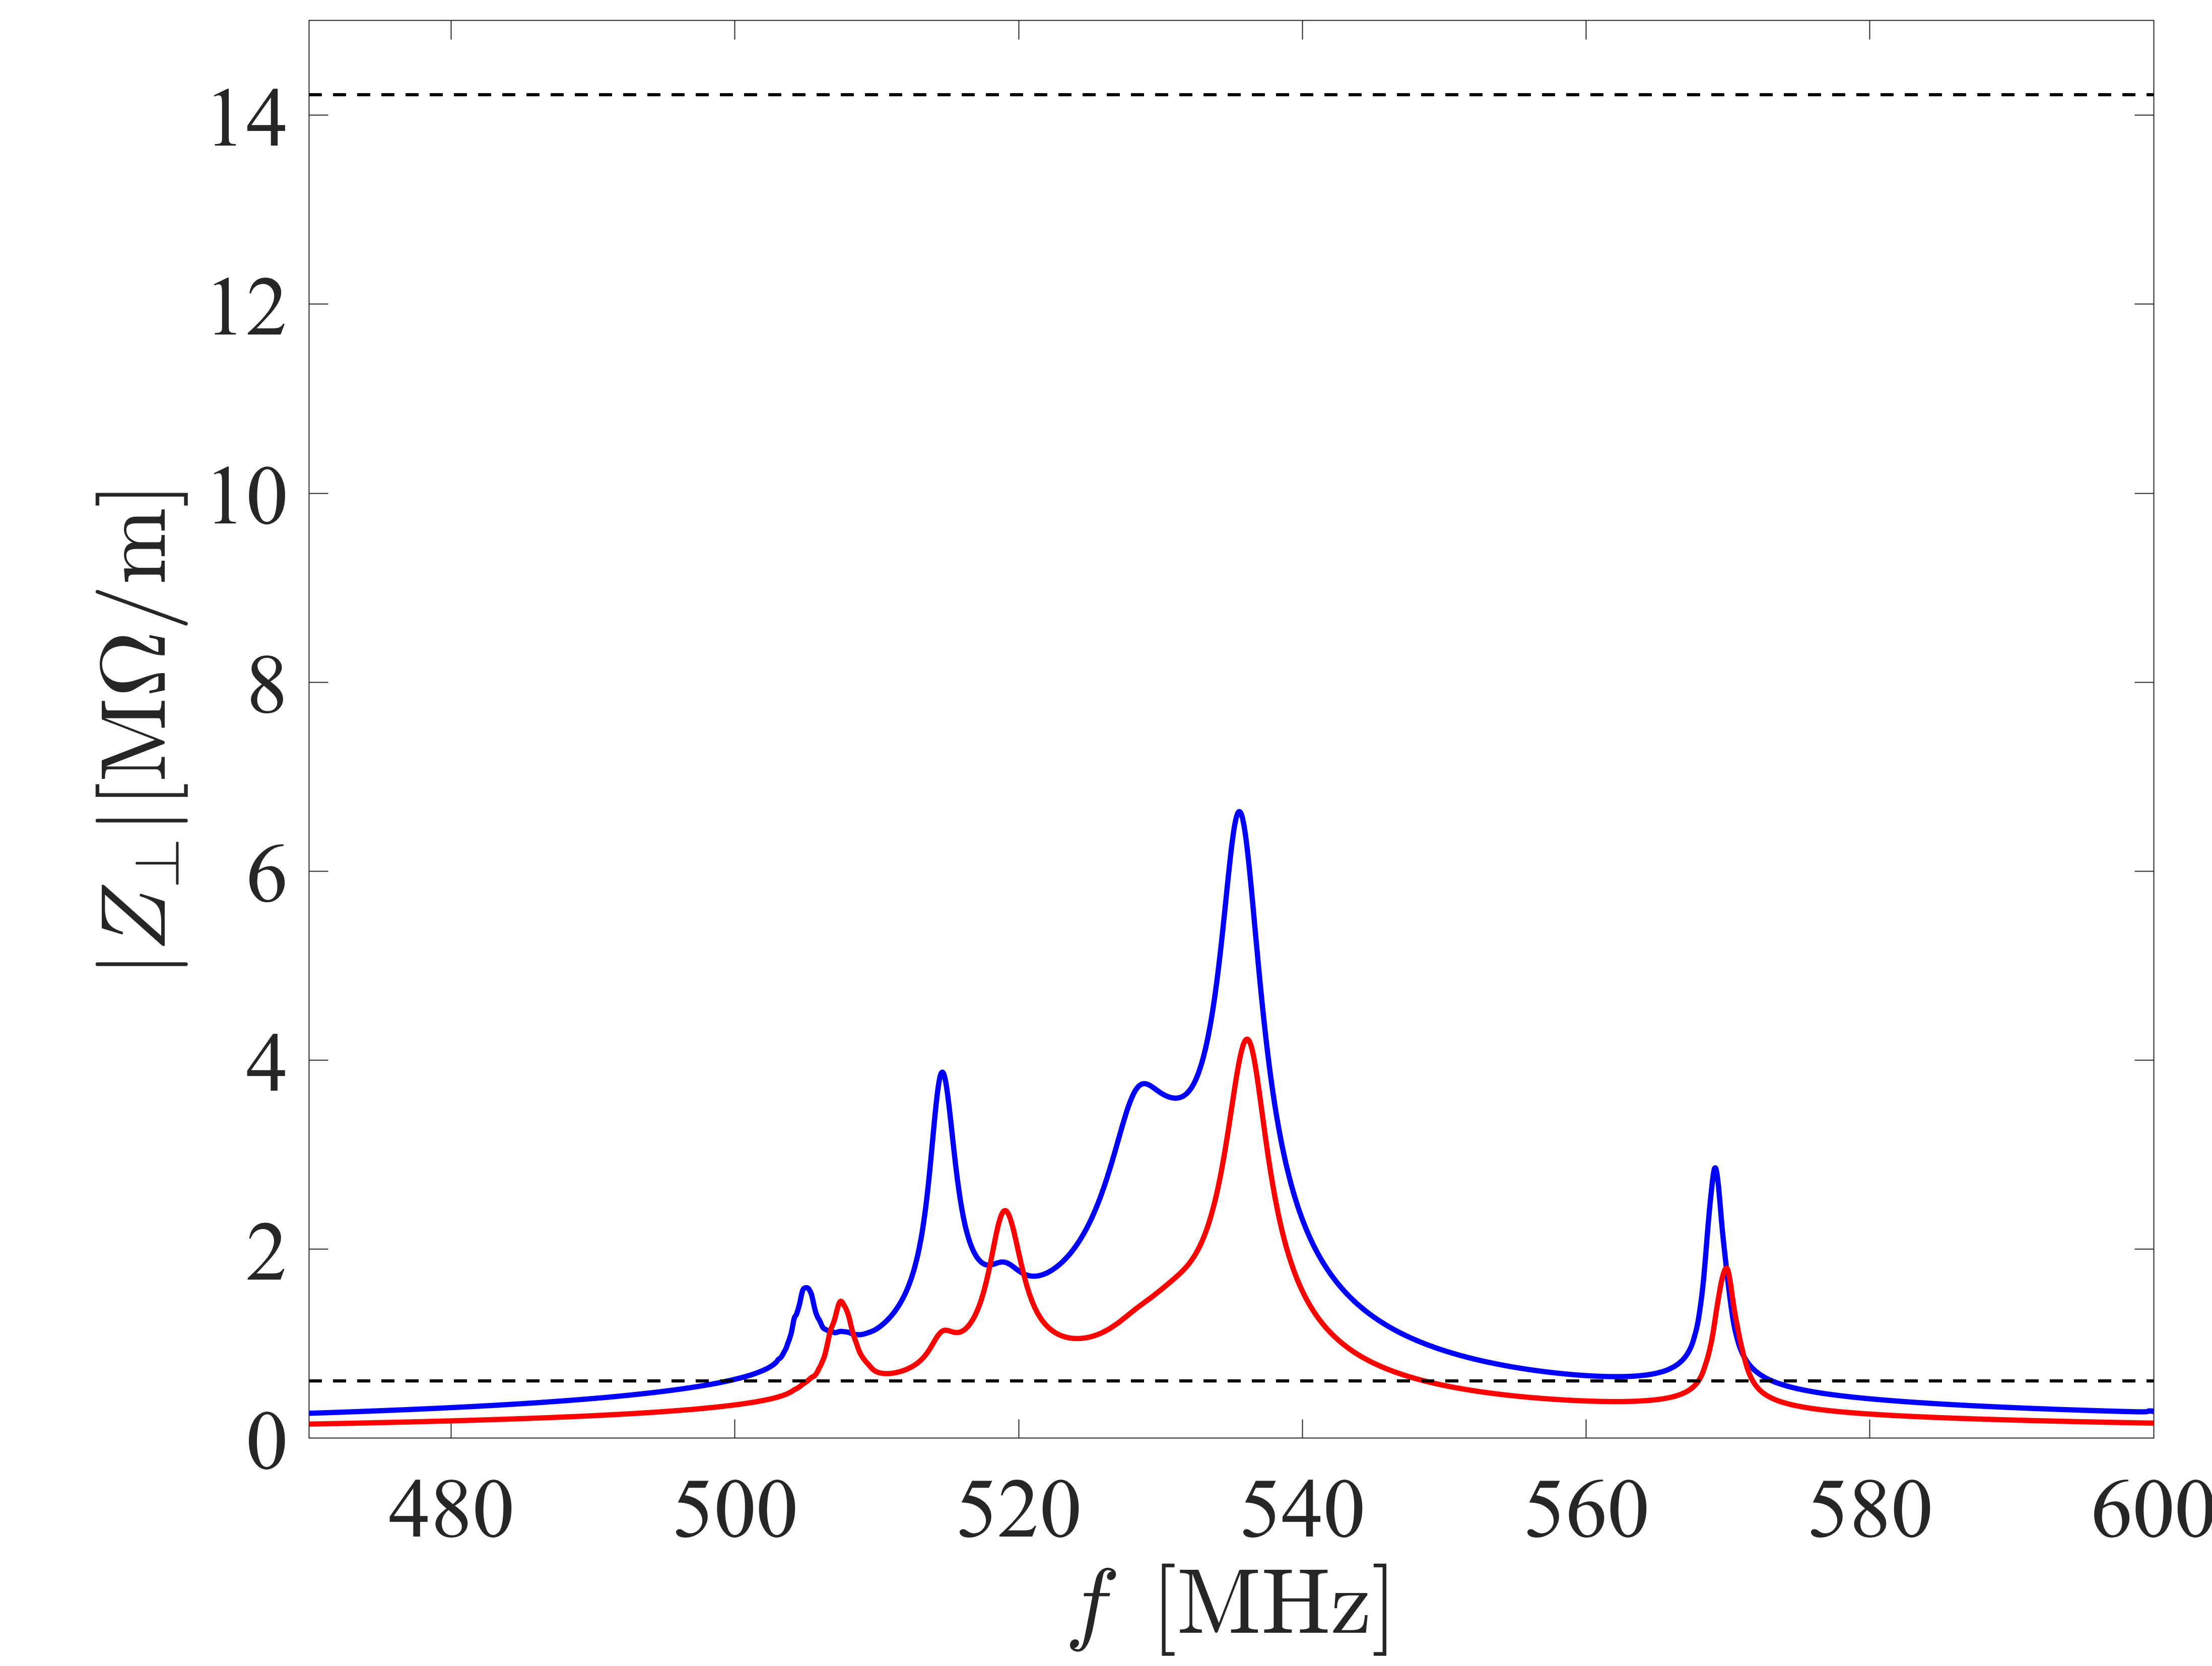



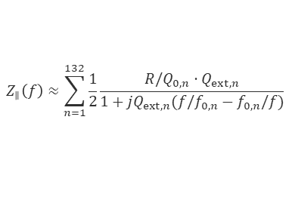








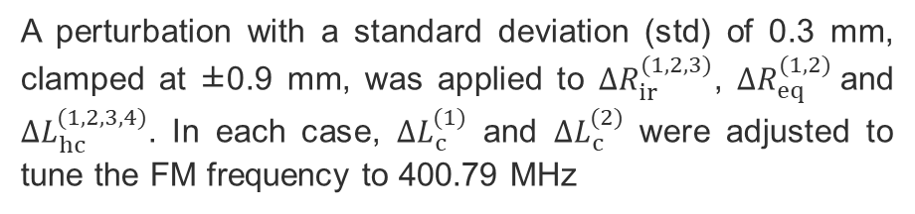







Sensitivity analysis of the 2-cell 400 MHz cavity
$$∆L_{c}^{(1)}$$
$$∆L_{c}^{(2)}$$
A perturbation with a standard deviation (std) of 0.3 mm, clamped at ±0.9 mm, was applied to $∆R_{ir}^{(1,2,3)}$, $∆R_{eq}^{(1,2)}$and $∆L_{hc}^{(1,2,3,4)}$. In each case, $∆L_{c}^{(1)}$ and $∆L_{c}^{(2)}$ were adjusted to tune the FM frequency to 400.79 MHz
$$∆R_{eq}^{(1)}$$
$$∆R_{eq}^{(2)}$$
$$∆R_{ir}^{(1)}$$
$$∆R_{ir}^{(2)}$$
$$∆R_{ir}^{(3)}$$
$$∆L_{hc}^{(1)}$$
$$∆L_{hc}^{(2)}$$
$$∆L_{hc}^{(3)}$$
$$∆L_{hc}^{(4)}$$
SR: $Z_{∥}^{th}$ for Z working point
$Z_{⊥}^{th}$:FB with $τ_{x,y}=100 turns$
$$Z_{⊥,x}$$
$Z_{⊥,y}$
 | $$f_{0}$$ $$[MHz]$$ | $R/Q_{0}$ $$[Ω]$$ | $$E_{pk}/ E_{acc}$$ [-] | $$B_{pk}/ E_{acc}$$ [mT/MV/m] | $$R/Q_{FM}$$ $$[Ω]$$ | $$G$$ $$[Ω]$$
Mean | 397.604 | 0.014 | 1.97 | 5.34 | 182.5 | 232.8
Std. | 0.045 | 0.016 | 0.01 | 0.01 | 0.24 | 0.75
Worst case | - | 0.10 | 2.02 | 5.38 | - | 230.2
$Z_{∥}$ of 0-mode for 132 cavities
$Z_{⊥}$ of 1st dipole band for 132 cavities
$$Z_{∥}\left(f\right)≈\sum_{n=1}^{132}{\frac{1}{2}\frac{ R/Q_{0,n}⋅Q_{ext,n} }{1+jQ_{ext,n}(f/f_{0,n}−f_{0,n}/f)}}$$
$Z_{⊥}^{th}$:SR
Statistical data for 264 samples

Slide 6
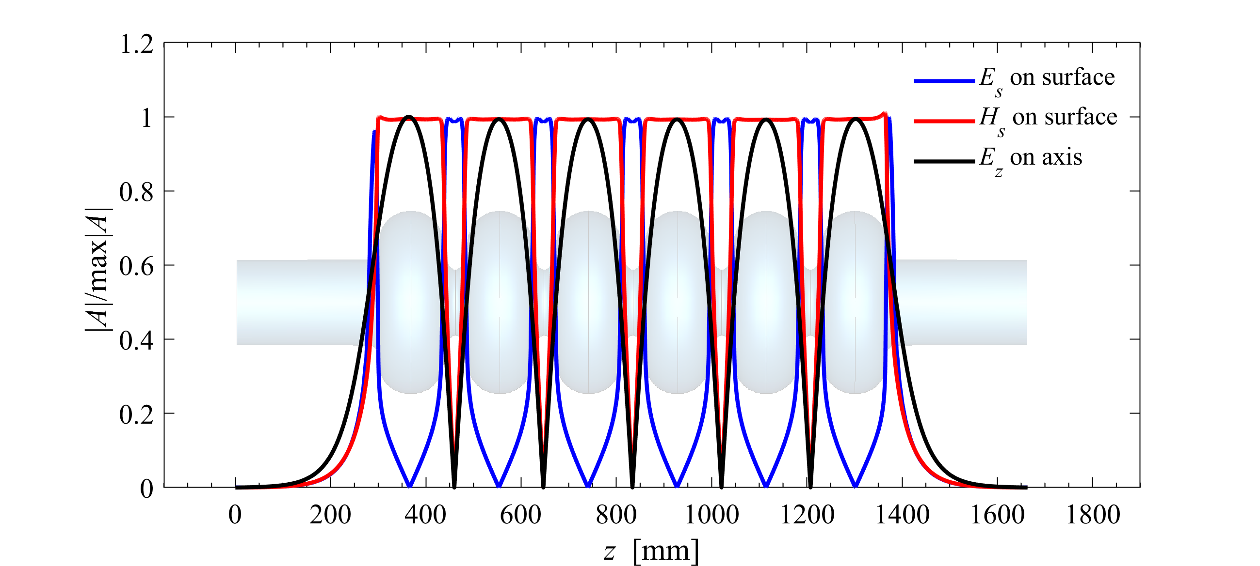
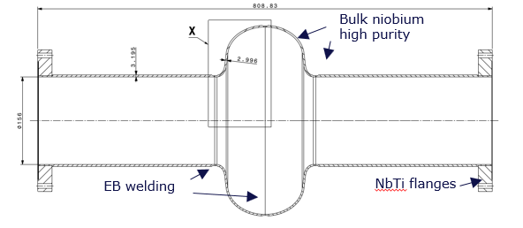
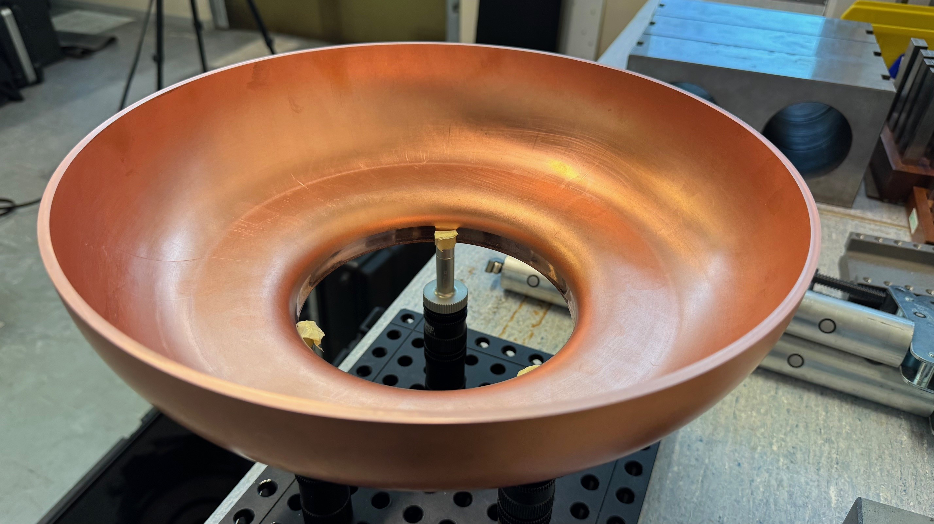
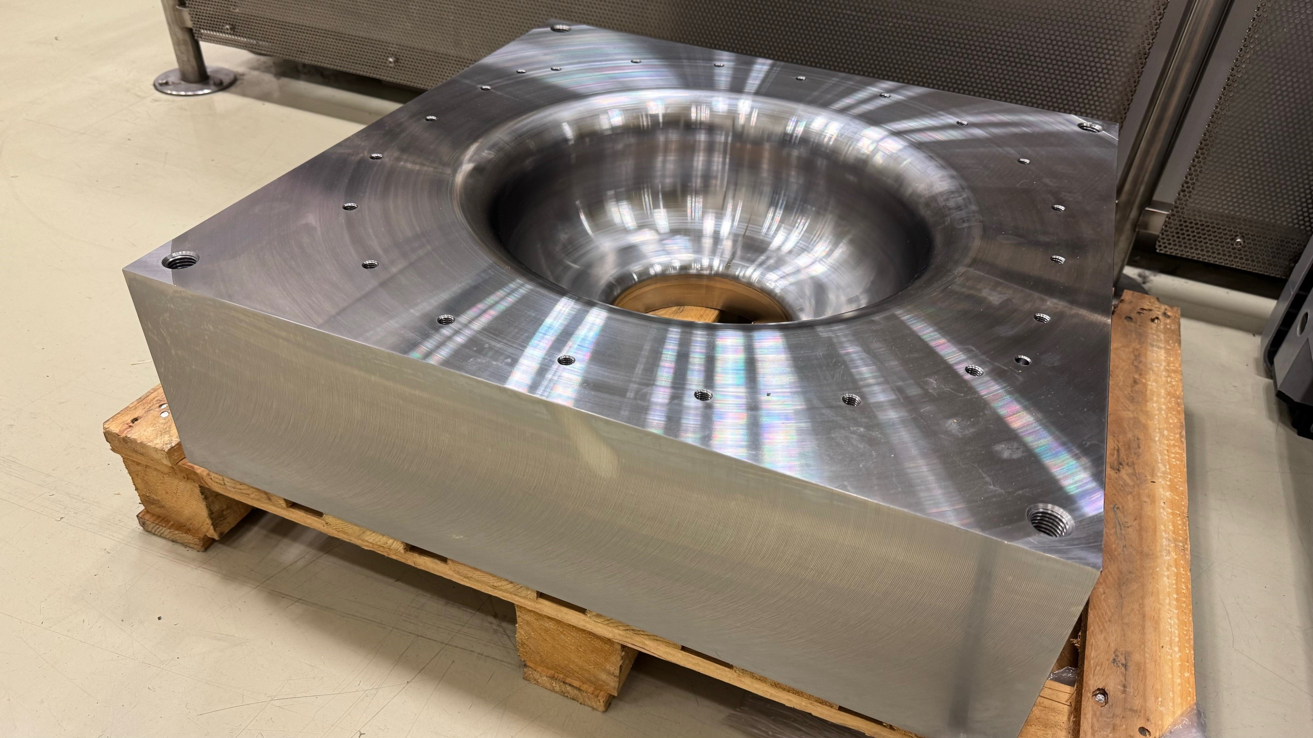
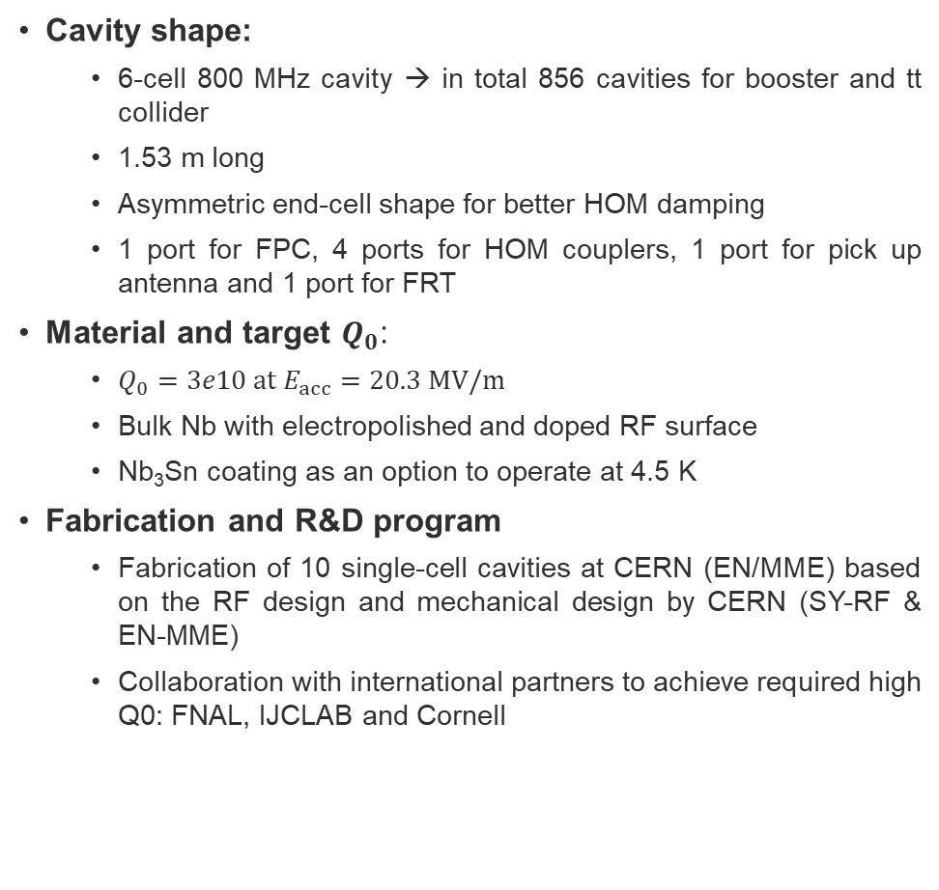
6-cell 800 MHz cavity
Cavity shape:
  6-cell 800 MHz cavity → in total 856 cavities for booster and tt collider
  1.53 m long
  Asymmetric end-cell shape for better HOM damping
  1 port for FPC, 4 ports for HOM couplers, 1 port for pick up antenna and 1 port for FRT
Material and target $Q_{0}$:
  $Q_{0}=3e10 at E_{acc}=20.3 MV/m$
  Bulk Nb with electropolished and doped RF surface
  Nb₃Sn coating as an option to operate at 4.5 K
Fabrication and R&D program
  Fabrication of 10 single-cell cavities at CERN (EN/MME) based on the RF design and mechanical design by CERN (SY-RF & EN-MME)
  Collaboration with international partners to achieve required high Q0: FNAL, IJCLAB and Cornell
Courtesy Marco Chiodini
112 cavities for Z, W and H booster
408+336 additional cavities for ttbar operation
Courtesy Laurent Prever-Loiri
Courtesy F. Peauger
Deep drawing tests performed on copper sheets

Slide 7
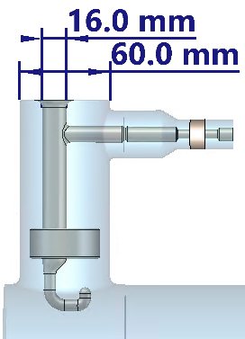
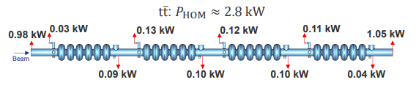
HOM study of 6-cell 800 MHz cavity
HOM power:
  tt collider highest HOM power. On average 0.7 kW per cavity
  Up to 200 W per DQW HOM coupler
Total number of HOM couplers:
  Z/W/H booster: 4 DQW couplers per cavity → 4×112=448
  tt collider & booster: 2 DQW per cavity → 2×(408+336)=1488
  BLA between cryomodules: 113 for Z/W/H booster, 409 for tt collider; likely not needed for tt booster.
Impedance limit:
  Despite 100-turn transverse feedback and 3× energy loss/turn from wigglers in the longitudinal plane, the impedance limit remains very low for the Z booster in RPO
  Frequency spread from cavity manufacturing tolerances can lower the total impedance of dangerous modes by a factor of 5–8
RPO: W_{B}
H_{B} and tt_{B}
H_{B} and tt_{B}
RPO: W_{B}
RPO: Z_{B}
RPO: Z_{B}

Slide 8
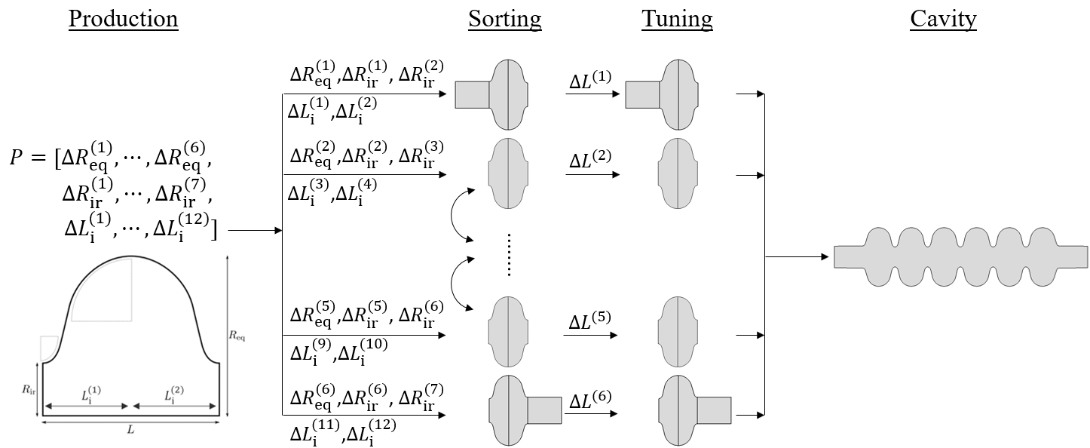
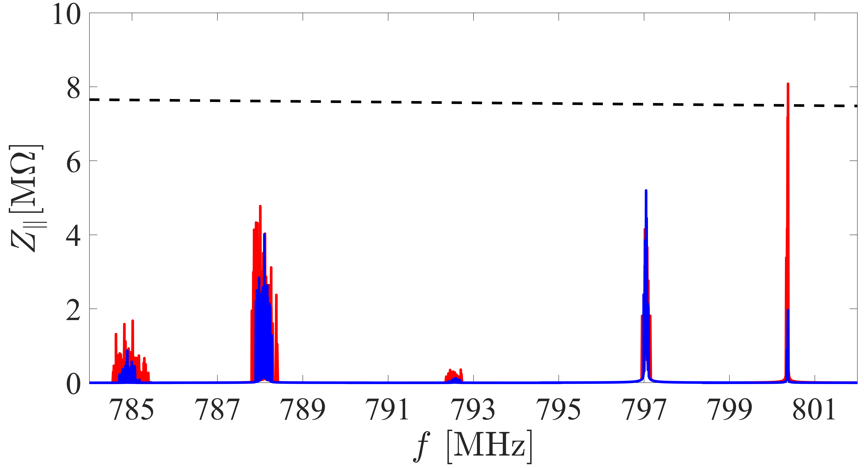
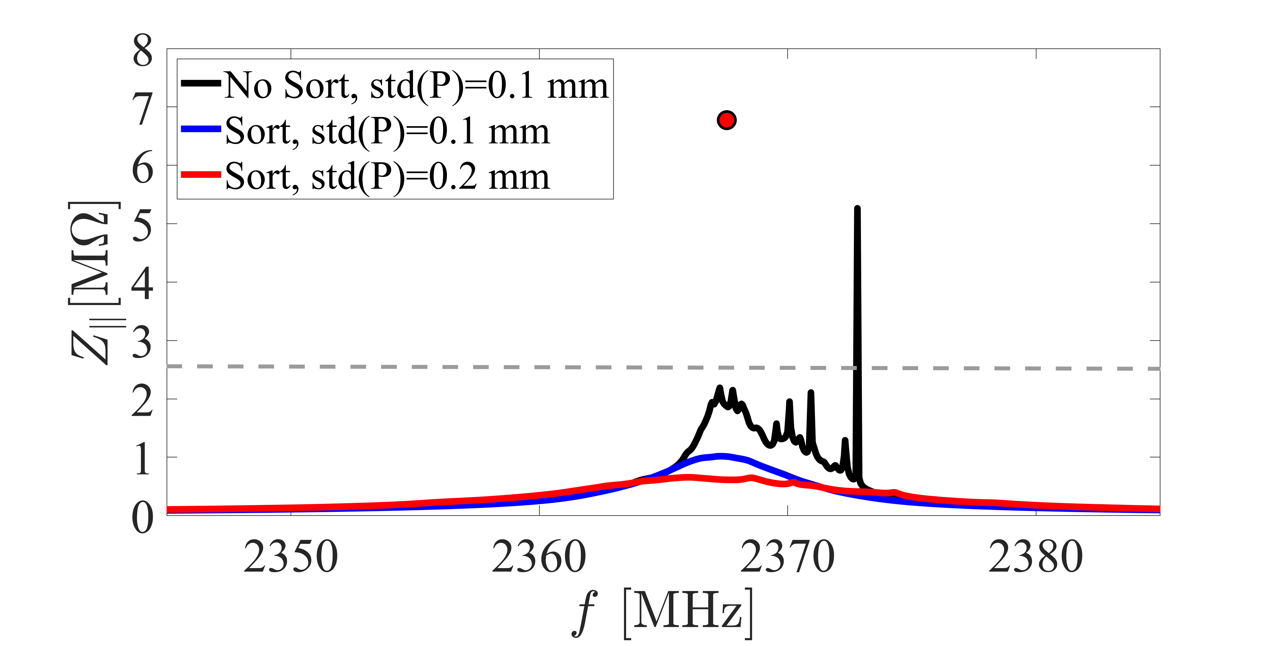

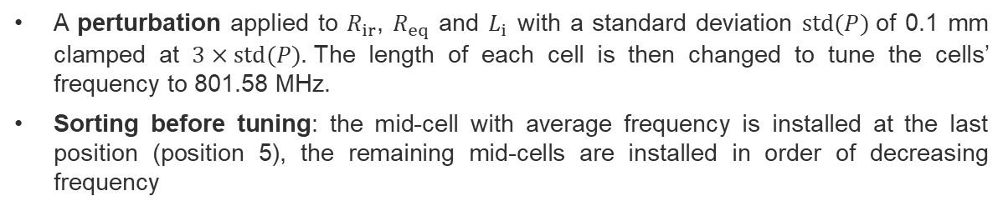

Perturbation analysis
$Z_{∥}$ at FM passband with $Q_{ext}=1.1e7$for FM
$Z_{∥}^{th}$ with $τ_{z}=1.51 s$ for Z_{B}
Sort, std(P)=0.1 mm
Sort, std(P)=0.2 mm
Impedance peak in worst-case deterministic scenario
A perturbation applied to $R_{ir}$, $R_{eq}$ and $L_{i}$ with a standard deviation $std(P)$of 0.1 mm clamped at $3×std(P).$The length of each cell is then changed to tune the cells’ frequency to 801.58 MHz.
Sorting before tuning: the mid-cell with average frequency is installed at the last position (position 5), the remaining mid-cells are installed in order of decreasing frequency
$Z_{∥}^{th}$ with $τ_{z}=1.51 s$ for Z_{B}
A similar study on XFEL cavities: J. Corno, et al.Uncertainty modeling and analysis of the European X-ray free electron laser cavities manufacturing process, 2020
Impedance of TM012 passband of 112 bare cavities with open BC
Notes:
In the end, by such sorting and then tuning the cells are ordered by increasing length, and the one with average length comes in position 5. Large cells are located in the middle.

Slide 9
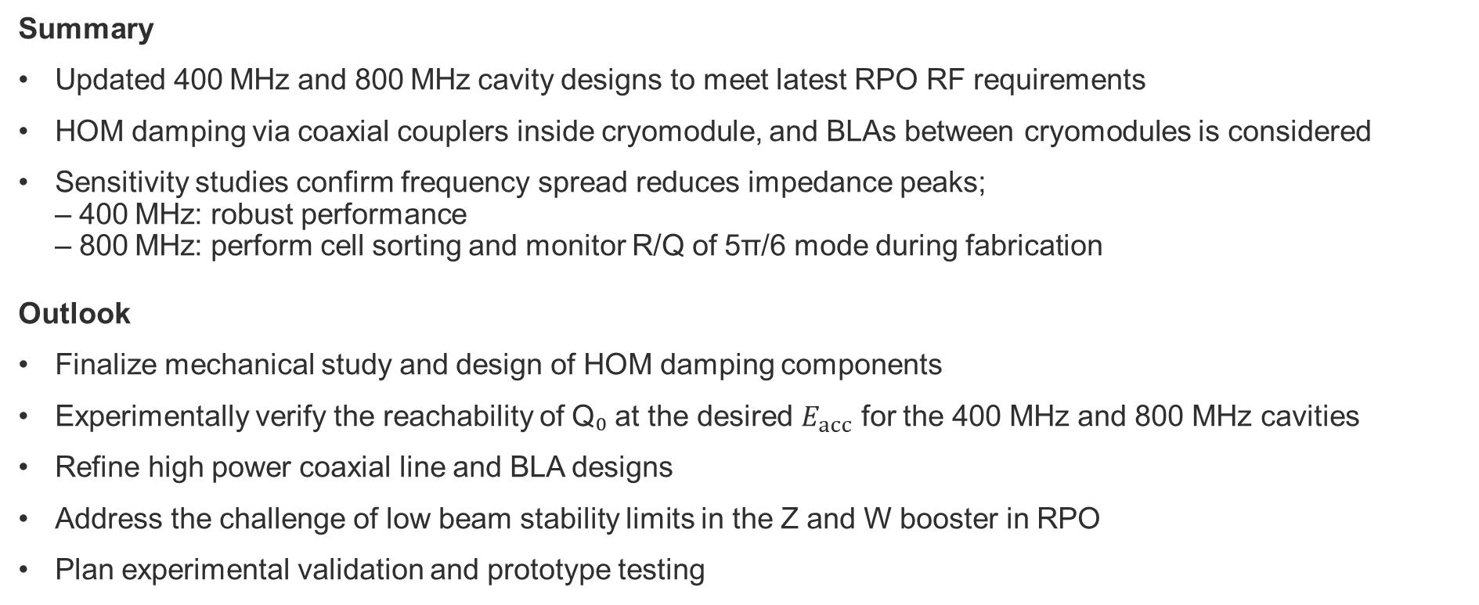
Summary and outlook
Summary
Updated 400 MHz and 800 MHz cavity designs to meet latest RPO RF requirements
HOM damping via coaxial couplers inside cryomodule, and BLAs between cryomodules is considered
Sensitivity studies confirm frequency spread reduces impedance peaks;
– 400 MHz: robust performance
– 800 MHz: perform cell sorting and monitor R/Q of 5π/6 mode during fabrication
Outlook
Finalize mechanical study and design of HOM damping components
Experimentally verify the reachability of Q₀ at the desired $E_{acc}$ for the 400 MHz and 800 MHz cavities
Refine high power coaxial line and BLA designs
Address the challenge of low beam stability limits in the Z and W booster in RPO
Plan experimental validation and prototype testing

Slide 10
Appendix

Slide 11
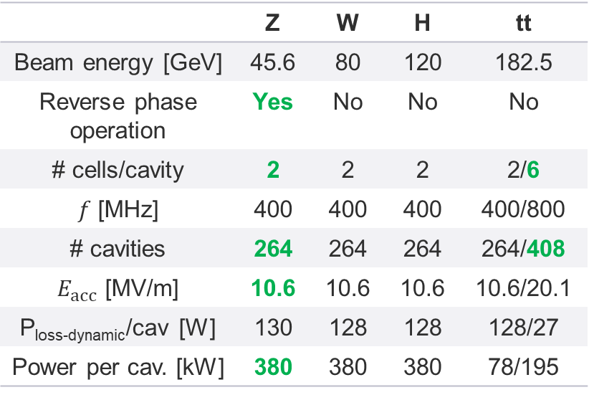
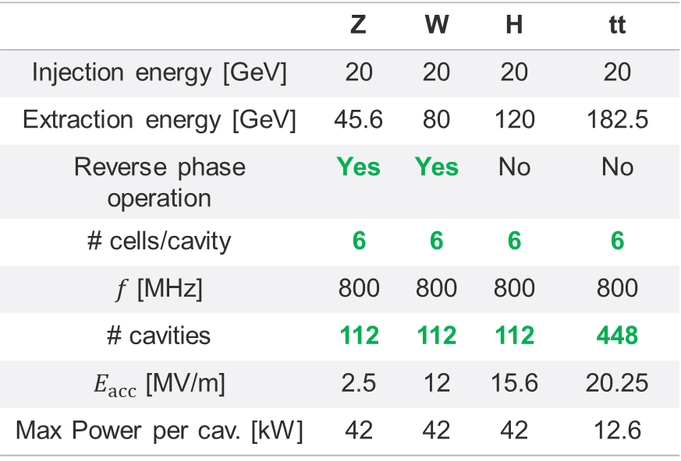
RF baseline updates
Collider cavities
Booster cavities
 | Z | W | H | tt
Beam energy [GeV] | 45.6 | 80 | 120 | 182.5
Reverse phase operation | Yes | No | No | No
# cells/cavity | 2 | 2 | 2 | 2/6
$f$ [MHz] | 400 | 400 | 400 | 400/800
# cavities | 264 | 264 | 264 | 264/408
$E_{acc}$ [MV/m] | 10.6 | 10.6 | 10.6 | 10.6/20.1
P_{loss-dynamic}/cav [W] | 130 | 128 | 128 | 128/27
Power per cav. [kW] | 380 | 380 | 380 | 78/195
 | Z | W | H | tt
Injection energy [GeV] | 20 | 20 | 20 | 20
Extraction energy [GeV] | 45.6 | 80 | 120 | 182.5
Reverse phase operation | Yes | Yes | No | No
# cells/cavity | 6 | 6 | 6 | 6
$f$ [MHz] | 800 | 800 | 800 | 800
# cavities | 112 | 112 | 112 | 448
$E_{acc}$ [MV/m] | 2.5 | 12 | 15.6 | 20.25
Max Power per cav. [kW] | 42 | 42 | 42 | 12.6

Slide 12
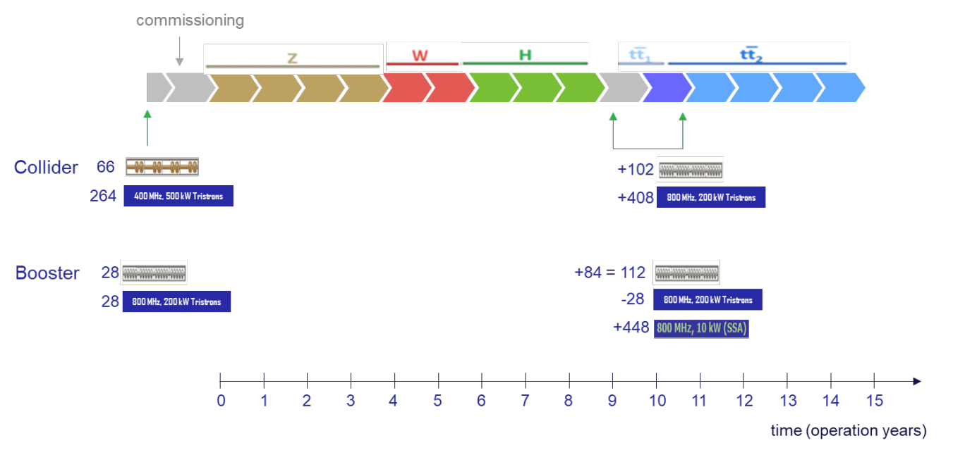
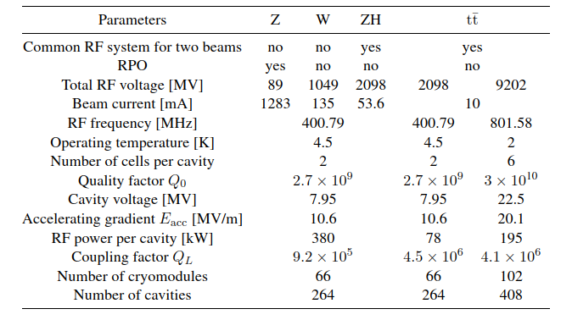
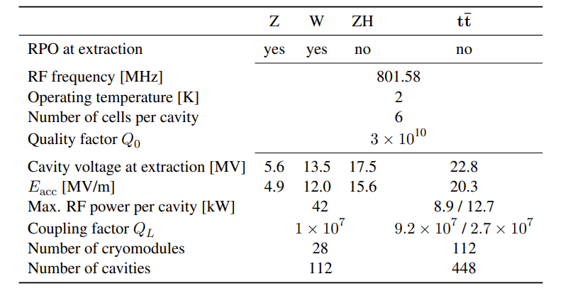
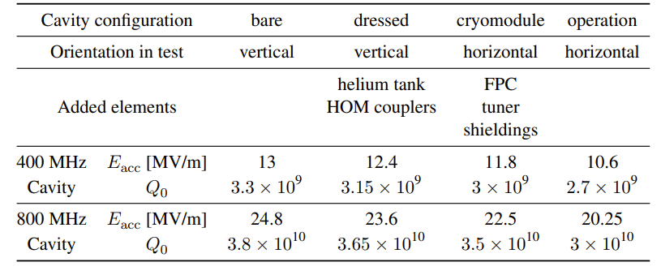

SRF layout
RF parameters of the collider cavities
RF parameters of the booster cavities
$Q_{0}$ target values
FCC feasibility study report, March 2025

Slide 13
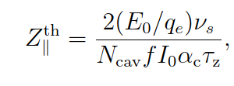
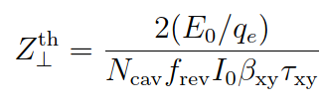
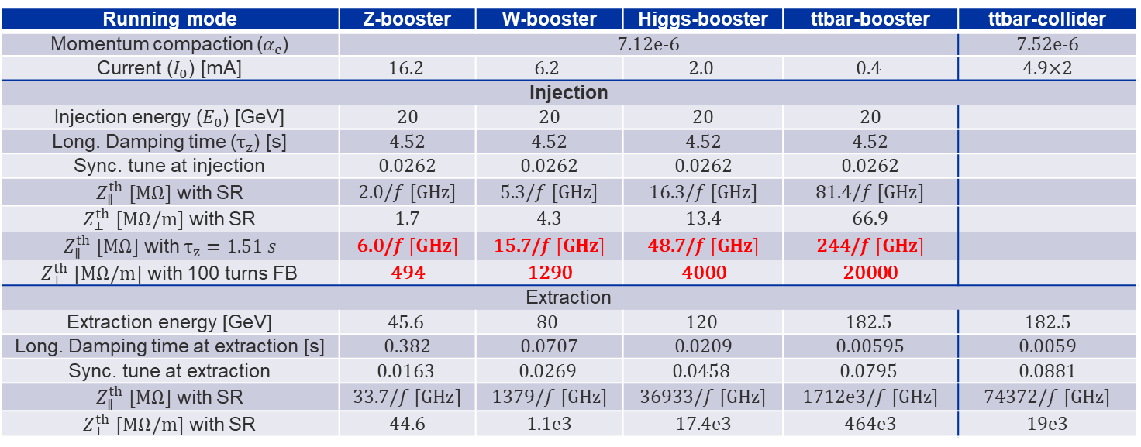

$t\overline{t}$ and booster stability parameters
Low energy and long damping time at injection leads to a low beam instability impedance limit for the booster cavities
A 100-turn feedback for the transverse plane, and a factor of three energy loss per turn from wigglers considered in the longitudinal plane impedance
Running mode | Z-booster | W-booster | Higgs-booster | ttbar-booster | ttbar-collider
Momentum compaction ($α_{c}$) | 7.12e-6 |  |  |  | 7.52e-6
Current ($I_{0}$) [mA] | $$16.2$$ | $$6.2$$ | $$2.0$$ | $$0.4$$ | 4.9×2
Injection
Injection energy ($E_{0}$) [GeV] | 20 | 20 | 20 | 20
Long. Damping time ($τ_{z}$) [s] | 4.52 | 4.52 | 4.52 | 4.52
Sync. tune at injection | 0.0262 | 0.0262 | 0.0262 | 0.0262
$Z_{∥}^{th}$ $[MΩ]$ with SR | 2.0/$f [GHz]$ | 5.3/$f [GHz]$ | 16.3/$f [GHz]$ | 81.4/$f [GHz]$
$Z_{⊥}^{th}$ $[MΩ/m]$ with SR | 1.7 | 4.3 | 13.4 | 66.9
$Z_{∥}^{th}$ $[MΩ]$ with $τ_{z}=1.51 s$ | 6.0/$f [GHz]$ | 15.7/$f [GHz]$ | 48.7/$f [GHz]$ | 244/$f [GHz]$
$Z_{⊥}^{th}$ $[MΩ/m]$ with 100 turns FB | 494 | 1290 | 4000 | 20000
Extraction
Extraction energy [GeV] | $$45.6$$ | $$80$$ | $$120$$ | $$182.5$$ | 182.5
Long. Damping time at extraction [s] | 0.382 | 0.0707 | 0.0209 | 0.00595 | 0.0059
Sync. tune at extraction | $$0.0163$$ | $$0.0269$$ | $$0.0458$$ | $$0.0795$$ | 0.0881
$Z_{∥}^{th}$ $[MΩ]$ with SR | 33.7/$f [GHz]$ | 1379/$f [GHz]$ | 36933/$f [GHz]$ | 1712e3/$f [GHz]$ | 74372/$f [GHz]$
$Z_{⊥}^{th}$ $[MΩ/m]$ with SR | 44.6 | 1.1e3 | 17.4e3 | 464e3 | 19e3
$Transversal damping time \left(τ_{xy}\right)=2× longitudinal damping time (τ_{z})$
$β_{xy}=50 m$ for all working points, $f_{rev}=3307 Hz$, $N_{cav}$ is assumed 1 (a normalization to the number of cavities is needed)

Slide 14
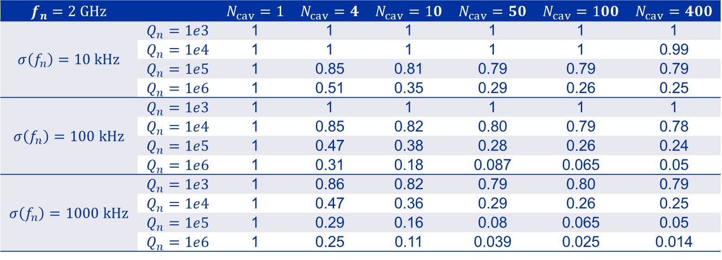
Frequency spread coefficient
If impedance for mode $m$ modelled by $Z_{∥,m}\left(f\right)≈\frac{1}{2}\frac{ R/Q_{∥,m}⋅Q_{m} }{1+jQ_{m}(f/f_{m}−f_{m}/f)}$ → $c=\frac{\sum_{n=1}^{N_{cav}}{Z_{∥,n,m}}}{N_{cav}Z_{∥,1,m}}$: the ratio of the total impedance of $N_{cav}$ cavities, each with a perturbed shape, to the impedance of $N_{cav}$ cavities with identical shape
$$f_{n}=2 GHz$$ |  | $$N_{cav}=1$$ | $$N_{cav}=4$$ | $$N_{cav}=10$$ | $$N_{cav}=50$$ | $$N_{cav}=100$$ | $$N_{cav}=400$$
$$σ\left(f_{n}\right)=10 kHz$$ | $$Q_{n}=1e3$$ | 1 | 1 | 1 | 1 | 1 | 1
 | $$Q_{n}=1e4$$ | 1 | 1 | 1 | 1 | 1 | 0.99
 | $$Q_{n}=1e5$$ | 1 | 0.85 | 0.81 | 0.79 | 0.79 | 0.79
 | $$Q_{n}=1e6$$ | 1 | 0.51 | 0.35 | 0.29 | 0.26 | 0.25
$$σ\left(f_{n}\right)=100 kHz$$ | $$Q_{n}=1e3$$ | 1 | 1 | 1 | 1 | 1 | 1
 | $$Q_{n}=1e4$$ | 1 | 0.85 | 0.82 | 0.80 | 0.79 | 0.78
 | $$Q_{n}=1e5$$ | 1 | 0.47 | 0.38 | 0.28 | 0.26 | 0.24
 | $$Q_{n}=1e6$$ | 1 | 0.31 | 0.18 | 0.087 | 0.065 | 0.05
$$σ\left(f_{n}\right)=1000 kHz$$ | $$Q_{n}=1e3$$ | 1 | 0.86 | 0.82 | 0.79 | 0.80 | 0.79
 | $$Q_{n}=1e4$$ | 1 | 0.47 | 0.36 | 0.29 | 0.26 | 0.25
 | $$Q_{n}=1e5$$ | 1 | 0.29 | 0.16 | 0.08 | 0.065 | 0.05
 | $$Q_{n}=1e6$$ | 1 | 0.25 | 0.11 | 0.039 | 0.025 | 0.014

Slide 15
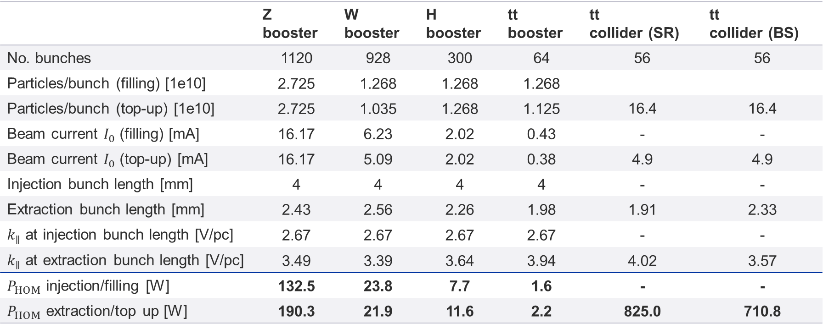
HOM power 800 MHz cavity
 | Z booster | W booster | H booster | tt booster | tt collider (SR) | tt collider (BS)
No. bunches | 1120 | 928 | 300 | 64 | 56 | 56
Particles/bunch (filling) [1e10] | 2.725 | 1.268 | 1.268 | 1.268
Particles/bunch (top-up) [1e10] | 2.725 | 1.035 | 1.268 | 1.125 | 16.4 | 16.4
Beam current $I_{0}$ (filling) [mA] | 16.17 | 6.23 | 2.02 | 0.43 | - | -
Beam current $I_{0}$ (top-up) [mA] | 16.17 | 5.09 | 2.02 | 0.38 | 4.9 | 4.9
Injection bunch length [mm] | 4 | 4 | 4 | 4 | - | -
Extraction bunch length [mm] | 2.43 | 2.56 | 2.26 | 1.98 | 1.91 | 2.33
$k_{∥}$ at injection bunch length [V/pc] | 2.67 | 2.67 | 2.67 | 2.67 | - | -
$k_{∥}$ at extraction bunch length [V/pc] | 3.49 | 3.39 | 3.64 | 3.94 | 4.02 | 3.57
$P_{HOM}$ injection/filling [W] | 132.5 | 23.8 | 7.7 | 1.6 | - | -
$P_{HOM}$ extraction/top up [W] | 190.3 | 21.9 | 11.6 | 2.2 | 825.0 | 710.8
HOM power of 6-cell 800 MHz bare cavity using formula $P_{HOM}=\left(k_{∥}−k_{0}\right)qI_{0}$

Slide 16
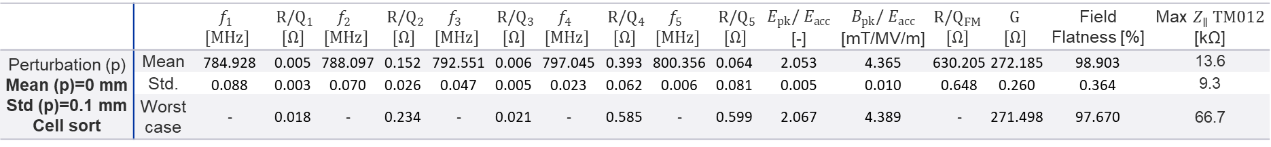
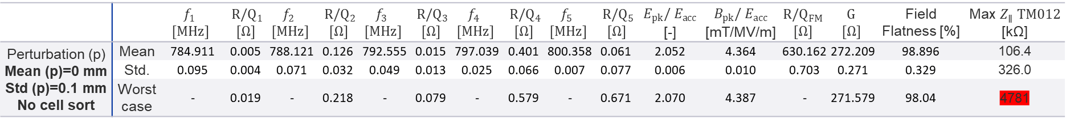
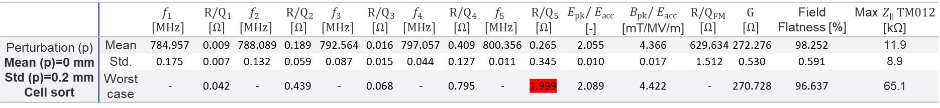
Perturbation analysis 6-cell 800 MHz (I)
 |  | $$f_{1}$$ $$[MHz]$$ | $R/Q_{1}$ $$[Ω]$$ | $$f_{2}$$ $$[MHz]$$ | $R/Q_{2}$ $$[Ω]$$ | $$f_{3}$$ $$[MHz]$$ | $R/Q_{3}$ $$[Ω]$$ | $$f_{4}$$ $$[MHz]$$ | $R/Q_{4}$ $$[Ω]$$ | $$f_{5}$$ $$[MHz]$$ | $R/Q_{5}$ $$[Ω]$$ | $$E_{pk}/ E_{acc}$$ [-] | $$B_{pk}/ E_{acc}$$ [mT/MV/m] | $$R/Q_{FM}$$ $$[Ω]$$ | $$G$$ $$[Ω]$$ | Field Flatness [%] | Max $Z_{∥} TM012$ [kΩ]
Perturbation (p) Mean (p)=0 mm Std (p)=0.1 mm No cell sort | Mean | 784.911 | 0.005 | 788.121 | 0.126 | 792.555 | 0.015 | 797.039 | 0.401 | 800.358 | 0.061 | 2.052 | 4.364 | 630.162 | 272.209 | 98.896 | 106.4
 | Std. | 0.095 | 0.004 | 0.071 | 0.032 | 0.049 | 0.013 | 0.025 | 0.066 | 0.007 | 0.077 | 0.006 | 0.010 | 0.703 | 0.271 | 0.329 | 326.0
 | Worst case | - | 0.019 | - | 0.218 | - | 0.079 | - | 0.579 | - | 0.671 | 2.070 | 4.387 | - | 271.579 | 98.04 | 4781
 |  | $$f_{1}$$ $$[MHz]$$ | $R/Q_{1}$ $$[Ω]$$ | $$f_{2}$$ $$[MHz]$$ | $R/Q_{2}$ $$[Ω]$$ | $$f_{3}$$ $$[MHz]$$ | $R/Q_{3}$ $$[Ω]$$ | $$f_{4}$$ $$[MHz]$$ | $R/Q_{4}$ $$[Ω]$$ | $$f_{5}$$ $$[MHz]$$ | $R/Q_{5}$ $$[Ω]$$ | $$E_{pk}/ E_{acc}$$ [-] | $$B_{pk}/ E_{acc}$$ [mT/MV/m] | $$R/Q_{FM}$$ $$[Ω]$$ | $$G$$ $$[Ω]$$ | Field Flatness [%] | $$\text{Max} Z_{∥} TM012$$ [kΩ]
Perturbation (p) Mean (p)=0 mm Std (p)=0.1 mm Cell sort | Mean | 784.928 | 0.005 | 788.097 | 0.152 | 792.551 | 0.006 | 797.045 | 0.393 | 800.356 | 0.064 | 2.053 | 4.365 | 630.205 | 272.185 | 98.903 | 13.6
 | Std. | 0.088 | 0.003 | 0.070 | 0.026 | 0.047 | 0.005 | 0.023 | 0.062 | 0.006 | 0.081 | 0.005 | 0.010 | 0.648 | 0.260 | 0.364 | 9.3
 | Worst case | - | 0.018 | - | 0.234 | - | 0.021 | - | 0.585 | - | 0.599 | 2.067 | 4.389 | - | 271.498 | 97.670 | 66.7
 |  | $$f_{1}$$ $$[MHz]$$ | $R/Q_{1}$ $$[Ω]$$ | $$f_{2}$$ $$[MHz]$$ | $R/Q_{2}$ $$[Ω]$$ | $$f_{3}$$ $$[MHz]$$ | $R/Q_{3}$ $$[Ω]$$ | $$f_{4}$$ $$[MHz]$$ | $R/Q_{4}$ $$[Ω]$$ | $$f_{5}$$ $$[MHz]$$ | $R/Q_{5}$ $$[Ω]$$ | $$E_{pk}/ E_{acc}$$ [-] | $$B_{pk}/ E_{acc}$$ [mT/MV/m] | $$R/Q_{FM}$$ $$[Ω]$$ | $$G$$ $$[Ω]$$ | Field Flatness [%] | $$\text{Max} Z_{∥} TM012$$ [kΩ]
Perturbation (p) Mean (p)=0 mm Std (p)=0.2 mm Cell sort | Mean | 784.957 | 0.009 | 788.089 | 0.189 | 792.564 | 0.016 | 797.057 | 0.409 | 800.356 | 0.265 | 2.055 | 4.366 | 629.634 | 272.276 | 98.252 | 11.9
 | Std. | 0.175 | 0.007 | 0.132 | 0.059 | 0.087 | 0.015 | 0.044 | 0.127 | 0.011 | 0.345 | 0.010 | 0.017 | 1.512 | 0.530 | 0.591 | 8.9
 | Worst case | - | 0.042 | - | 0.439 | - | 0.068 | - | 0.795 | - | 1.999 | 2.089 | 4.422 | - | 270.728 | 96.637 | 65.1
Data from 250 samples

Slide 17
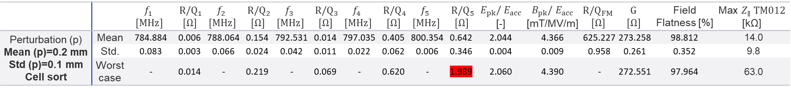


Perturbation analysis 6-cell 800 MHz (II)
 |  | $$f_{1}$$ $$[MHz]$$ | $R/Q_{1}$ $$[Ω]$$ | $$f_{2}$$ $$[MHz]$$ | $R/Q_{2}$ $$[Ω]$$ | $$f_{3}$$ $$[MHz]$$ | $R/Q_{3}$ $$[Ω]$$ | $$f_{4}$$ $$[MHz]$$ | $R/Q_{4}$ $$[Ω]$$ | $$f_{5}$$ $$[MHz]$$ | $R/Q_{5}$ $$[Ω]$$ | $$E_{pk}/ E_{acc}$$ [-] | $$B_{pk}/ E_{acc}$$ [mT/MV/m] | $$R/Q_{FM}$$ $$[Ω]$$ | $$G$$ $$[Ω]$$ | Field Flatness [%] | $$\text{Max} Z_{∥} TM012$$ [kΩ]
Perturbation (p) Mean (p)=0 mm Std (p)=0.3 mm Cell sort | Mean | 784.957 | 0.016 | 788.050 | 0.240 | 792.557 | 0.045 | 797.061 | 0.464 | 800.354 | 0.625 | 2.059 | 4.374 | 629.127 | 272.235 | 97.370 | 16.7
 | Std. | 0.279 | 0.016 | 0.212 | 0.105 | 0.139 | 0.048 | 0.069 | 0.213 | 0.018 | 0.819 | 0.012 | 0.026 | 2.426 | 0.837 | 0.965 | 31.8
 | Worst case | - | 0.084 | - | 0.662 | - | 0.309 | - | 1.370 | - | 5.274 | 2.101 | 4.470 | - | 269.834 | 94.643 | 421.6
 |  | $$f_{1}$$ $$[MHz]$$ | $R/Q_{1}$ $$[Ω]$$ | $$f_{2}$$ $$[MHz]$$ | $R/Q_{2}$ $$[Ω]$$ | $$f_{3}$$ $$[MHz]$$ | $R/Q_{3}$ $$[Ω]$$ | $$f_{4}$$ $$[MHz]$$ | $R/Q_{4}$ $$[Ω]$$ | $$f_{5}$$ $$[MHz]$$ | $R/Q_{5}$ $$[Ω]$$ | $$E_{pk}/ E_{acc}$$ [-] | $$B_{pk}/ E_{acc}$$ [mT/MV/m] | $$R/Q_{FM}$$ $$[Ω]$$ | $$G$$ $$[Ω]$$ | Field Flatness [%] | $$\text{Max} Z_{∥} TM012$$ [kΩ]
Perturbation (p) Mean (p)=0.2 mm Std (p)=0.1 mm Cell sort | Mean | 784.884 | 0.006 | 788.064 | 0.154 | 792.531 | 0.014 | 797.035 | 0.405 | 800.354 | 0.642 | 2.044 | 4.366 | 625.227 | 273.258 | 98.812 | 14.0
 | Std. | 0.083 | 0.003 | 0.066 | 0.024 | 0.042 | 0.011 | 0.022 | 0.062 | 0.006 | 0.346 | 0.004 | 0.009 | 0.958 | 0.261 | 0.352 | 9.8
 | Worst case | - | 0.014 | - | 0.219 | - | 0.069 | - | 0.620 | - | 1.989 | 2.060 | 4.390 | - | 272.551 | 97.964 | 63.0
 |  | $$f_{1}$$ $$[MHz]$$ | $R/Q_{1}$ $$[Ω]$$ | $$f_{2}$$ $$[MHz]$$ | $R/Q_{2}$ $$[Ω]$$ | $$f_{3}$$ $$[MHz]$$ | $R/Q_{3}$ $$[Ω]$$ | $$f_{4}$$ $$[MHz]$$ | $R/Q_{4}$ $$[Ω]$$ | $$f_{5}$$ $$[MHz]$$ | $R/Q_{5}$ $$[Ω]$$ | $$E_{pk}/ E_{acc}$$ [-] | $$B_{pk}/ E_{acc}$$ [mT/MV/m] | $$R/Q_{FM}$$ $$[Ω]$$ | $$G$$ $$[Ω]$$ | Field Flatness [%] | $$\text{Max} Z_{∥} TM012$$ [kΩ]
Perturbation (p) Mean (p)=-0.2 mm Std (p)=0.1 mm Cell sort | Mean | 784.989 | 0.004 | 788.149 | 0.155 | 792.586 | 0.004 | 797.063 | 0.401 | 800.361 | 0.327 | 2.062 | 4.366 | 634.024 | 271.226 | 98.971 | 13.8
 | Std. | 0.085 | 0.002 | 0.062 | 0.026 | 0.045 | 0.004 | 0.022 | 0.061 | 0.006 | 0.246 | 0.006 | 0.010 | 0.526 | 0.269 | 0.362 | 9.6
 | Worst case | - | 0.014 | - | 0.259 | - | 0.020 | - | 0.590 | - | 1.320 | 2.078 | 4.392 | - | 270.484 | 97.990 | 61.4
Data from 250 samples

Slide 18
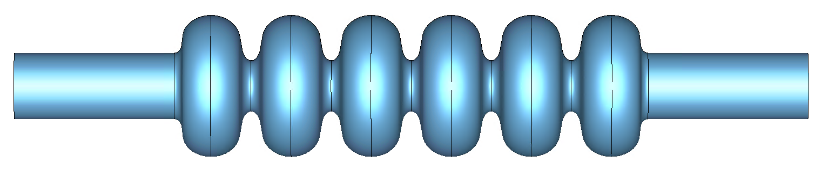
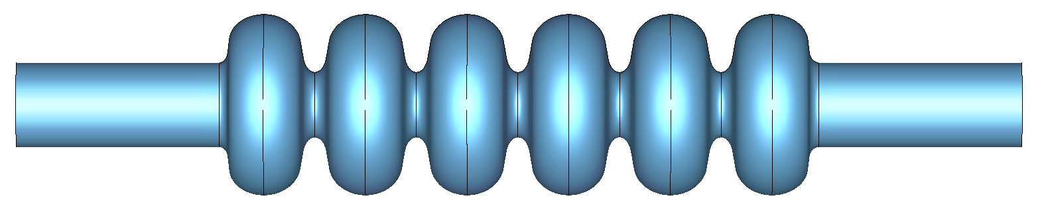
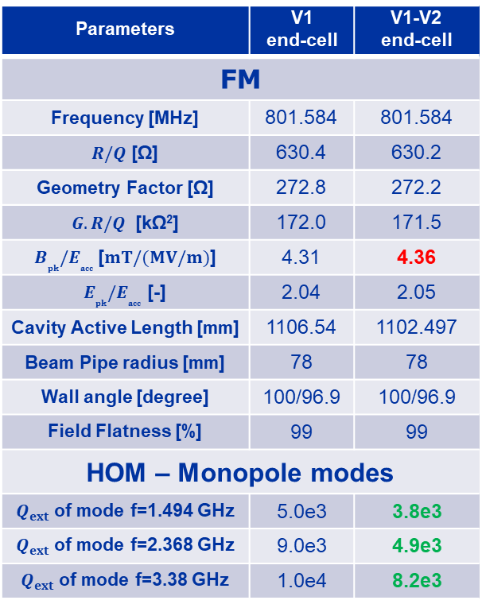
FM parameters of the 6-cell with asymmetric end-cells
Parameters | V1 end-cell | V1-V2 end-cell
FM
Frequency [MHz] | 801.584 | 801.584
$R/Q$ [Ω] | 630.4 | 630.2
Geometry Factor [Ω] | 272.8 | 272.2
$G.R/Q$ [kΩ²] | 172.0 | 171.5
$B_{pk}{/E}_{acc}$ [$mT/(MV/m)$] | 4.31 | 4.36
$E_{pk}{/E}_{acc}$ [-] | 2.04 | 2.05
Cavity Active Length [mm] | 1106.54 | 1102.497
Beam Pipe radius [mm] | 78 | 78
Wall angle [degree] | 100/96.9 | 100/96.9
Field Flatness [%] | 99 | 99
HOM – Monopole modes
$Q_{ext}$ of mode f=1.494 GHz | 5.0e3 | 3.8e3
$Q_{ext}$ of mode f=2.368 GHz | 9.0e3 | 4.9e3
$Q_{ext}$ of mode f=3.38 GHz | 1.0e4 | 8.2e3
V1 end-cell
V1 end-cell
V1 end-cell
V2 end-cell
Selected design

Slide 19
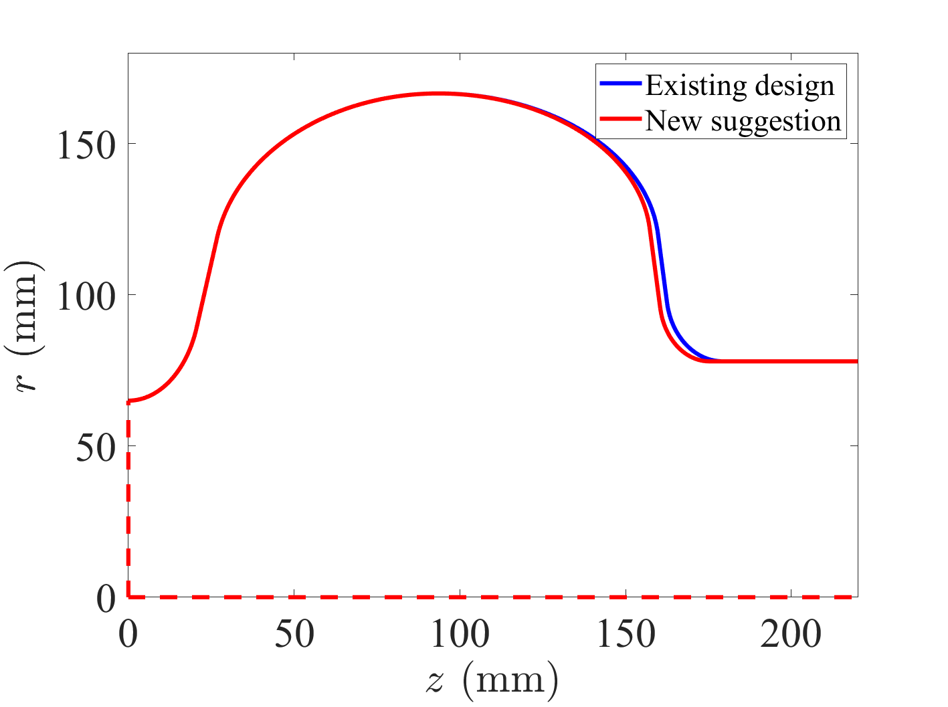



800 MHz Cavity parameters
V1 End-cell
V2 End-cell
B
B_{e}
$$α_{e}$$
A
A_{e}
a
a_{e}
b
b_{e}
L_{bp}
R_{eq}
R_{i}
L
L_{e}
R_{bp}
 | $$A/A_{e} [mm]$$ | $$B/B_{e} [mm]$$ | $$a/a_{e} [mm]$$ | $$b/b_{e} [mm]$$ | $$R_{i}/R_{bp} [mm]$$ | $$L/L_{e} [mm]$$ | $$R_{eq} [mm]$$ | $$α/α_{e} [°]$$
V1 End-cell | 67.72/66.5 | 57.45/51.0 | 21.75/17.0 | 35.6/23.0 | 60.0/78.0 | 93.5/85.77 | 166.591 | 100.0/96.9
V2 End-cell | 67.72/64 | 57.45/49 | 21.75/15 | 35.6/21 | 60.0/78.0 | 93.5/81.727 | 166.591 | 100.0/96.9

Slide 20




$Z_{∥}$ of asymmetric end-cells with 4 DQW couplers
Two additional DQW couplers, tuned for better damping of the 2.368 GHz mode, were added to the empty ports
The impedance peak remains slightly above the limit; however, considering the frequency spread between cavities ($c = 0.12$for this mode), stability is expected to be maintained in RPO
1
RPO: W_{B}
H_{B} and tt_{B}
RPO: Z_{B}
1
$$f=2.3676 GHz, R/Q=18.0 Ω, Q_{L}=22.4e3,c=0.12$$

Slide 21





$Z_{⊥}$ of asymmetric end-cells with 4 DQW couplers
H_{B} and tt_{B}
For transverse impedance we are also close to the stability limit, but the frequency spread between cavities can improve the stability limit by at least a factor five
RPO: W_{B}
1
2
RPO: Z_{B}
1
$$f=1.154 GHz,R/Q_{⊥}=54.0 Ω, Q_{L}=2.2e4$$
$$c\left(σ=0.5 MHz\right)=0.18$$
$$c\left(σ=1.0 MHz\right)=0.12$$
2
$$f=1.574 GHz,R/Q_{⊥}=53.5 Ω, Q_{L}=3.6e4$$
$$c\left(σ=0.5 MHz\right)=0.17$$
$$c\left(σ=1.0 MHz\right)=0.11$$

Slide 22
400 MHz Module length consideration
8895 mm
7170 mm
Depending on the radius and length of the taper and the length of bellows this length should be re-evaluated
720 mm
1430 mm

