Slide 1
FCC-ee Power Coupler Design Overview
Shahnam Gorgi Zadeh
With inputs from: E. Montesinos, F. Peauger, R. Calaga, S. Jerome Calvo, C. Sharp, M. Timmins, V. Parma. K. Canderan

Slide 2
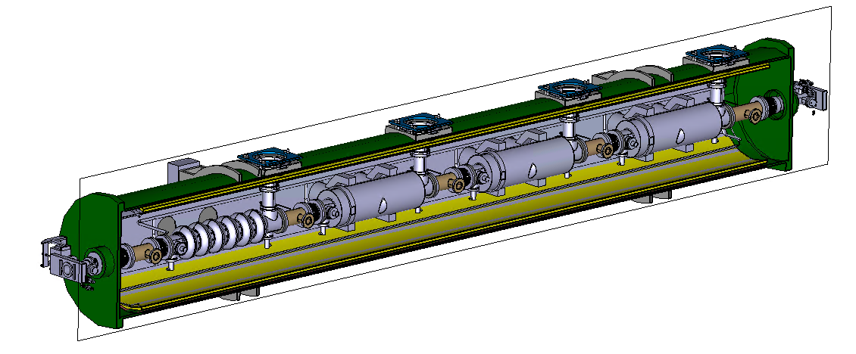
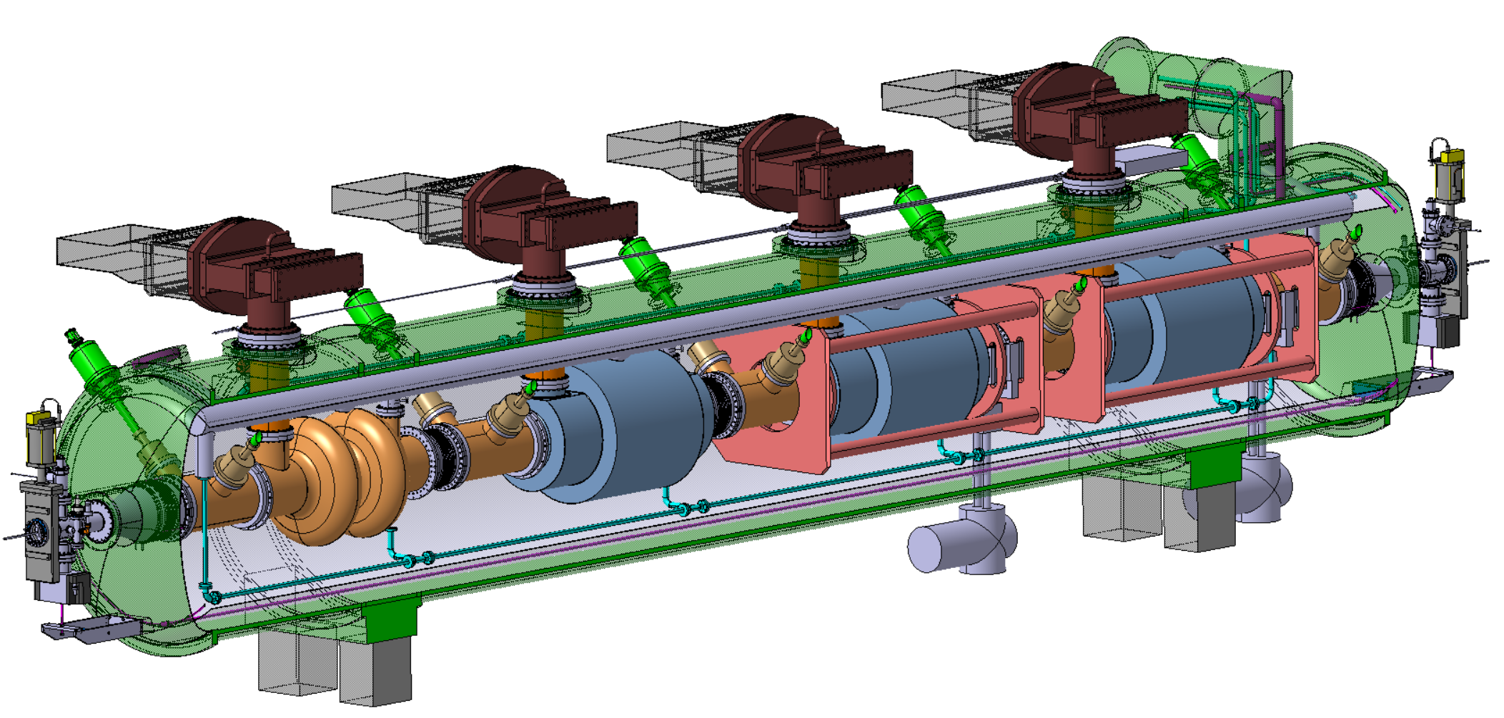
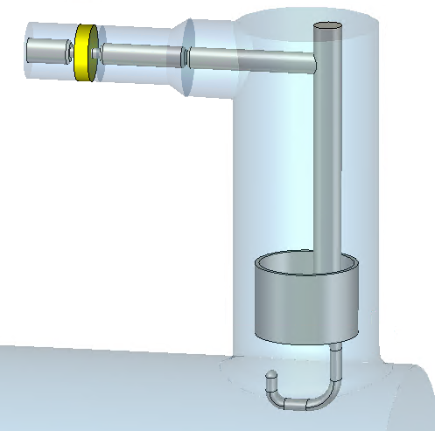
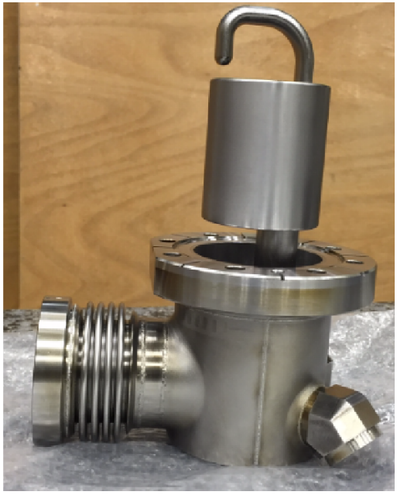
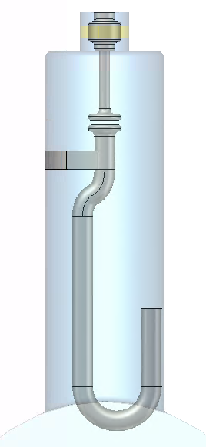
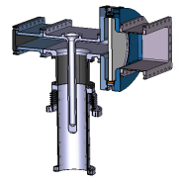
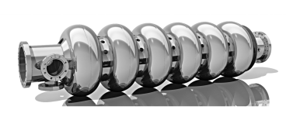
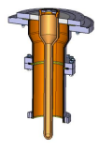
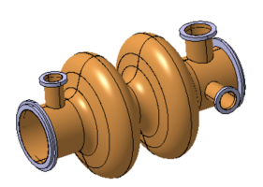
Some cryomodule RF components
400 MHz cryomodule
800 MHz cryomodule
HOM coupler
Fundamental Power coupler
6-cell cavity
Fundamental Power coupler
2-cell cavity
HOM coupler
Fundamental power coupler is a critical component that transfers high levels of RF power from the generator to the cavity and ultimately to the beam.
Mainly RF aspects covered in this presentation.

Slide 3
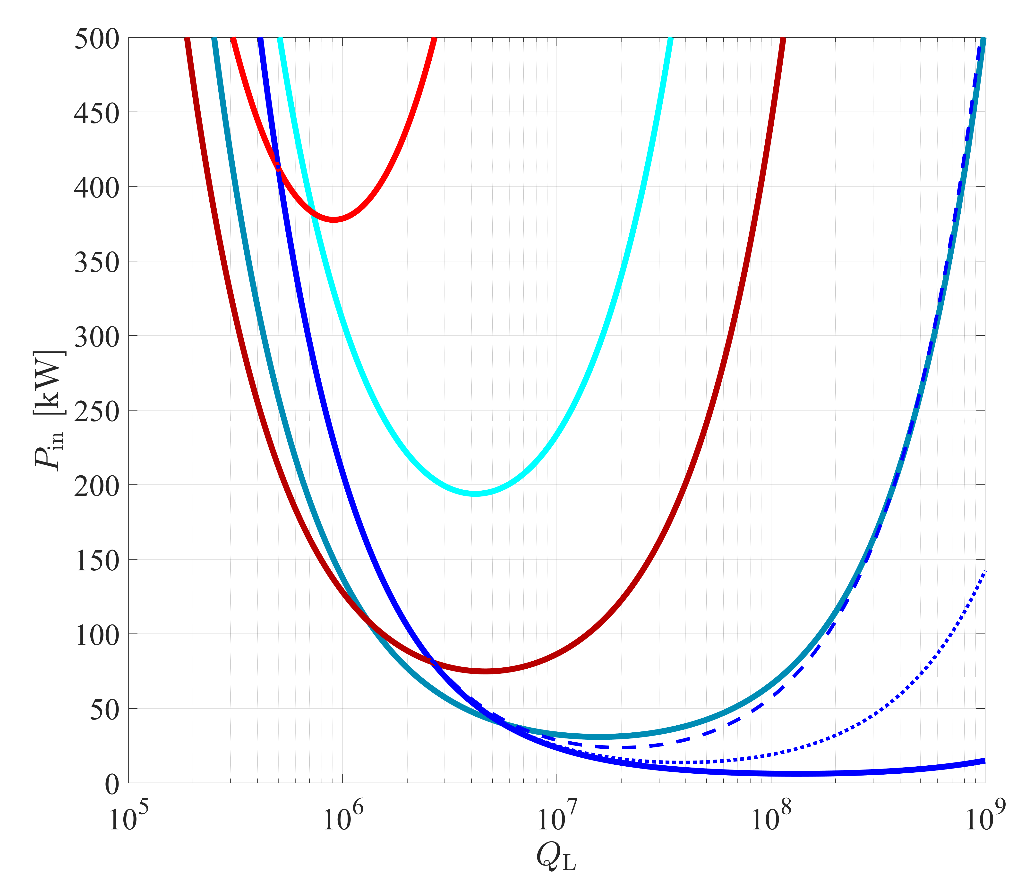
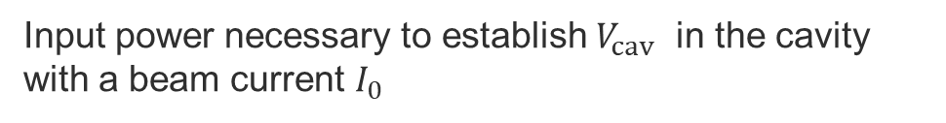
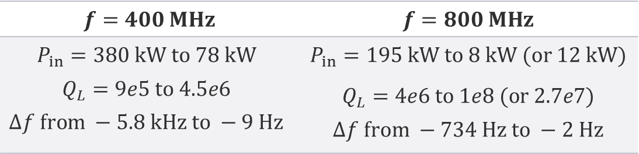

FCC-ee power requirement
Input power necessary to establish $V_{cav}$​ in the cavity with a beam current $I_{0}$
Z, W, H
400 MHz
tt, 400 MHz
tt_{b}: 20 Hz detuning
Make this term minimum by choosing optimum $Q_{L}$
Make this term zero by right detuning
tt, 800 MHz
tt_{b}: 10 Hz detuning
$$f=400 MHz$$ | $$f=800 MHz$$
$$P_{in}=380 kW to 78 kW$$ $$Q_{L}=9e5 to 4.5e6$$ $$∆f from −5.8 kHz to −9 Hz$$ | $$P_{in}=195 kW to 8 kW (or 12 kW)$$ $Q_{L}=4e6 to 1e8 (or 2.7e7)$ $$∆f from −734 Hz to −2 Hz$$
Z, W, H booster
800 MHz
tt booster
800 MHz

Slide 4
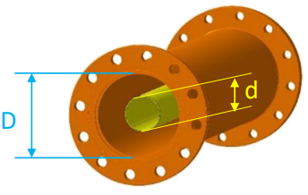
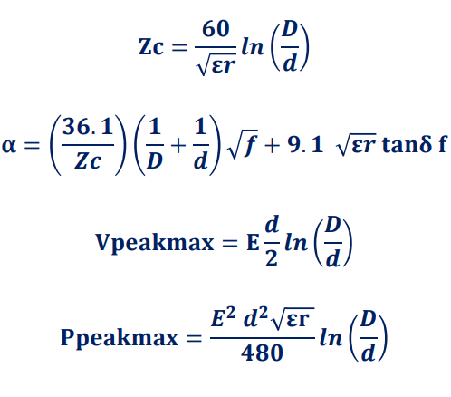
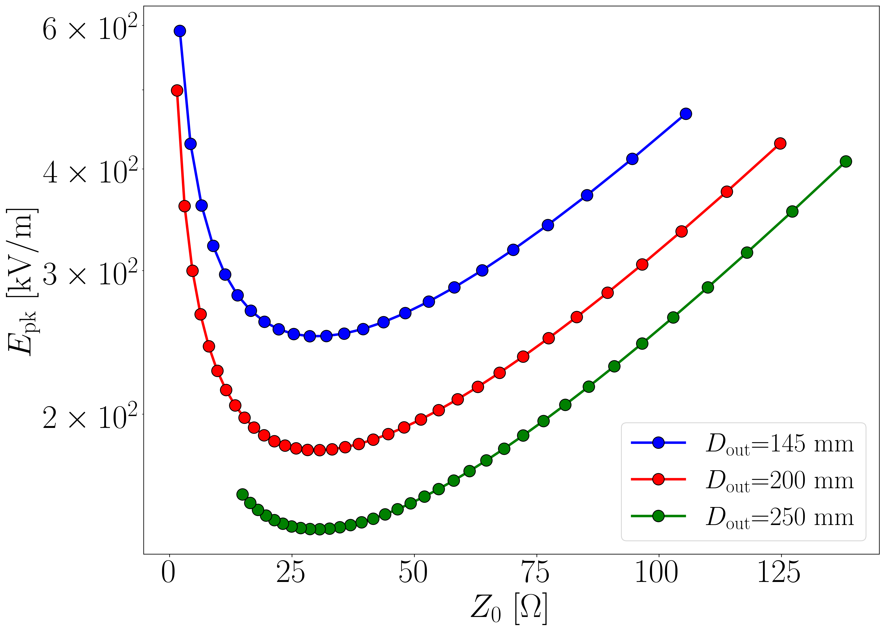
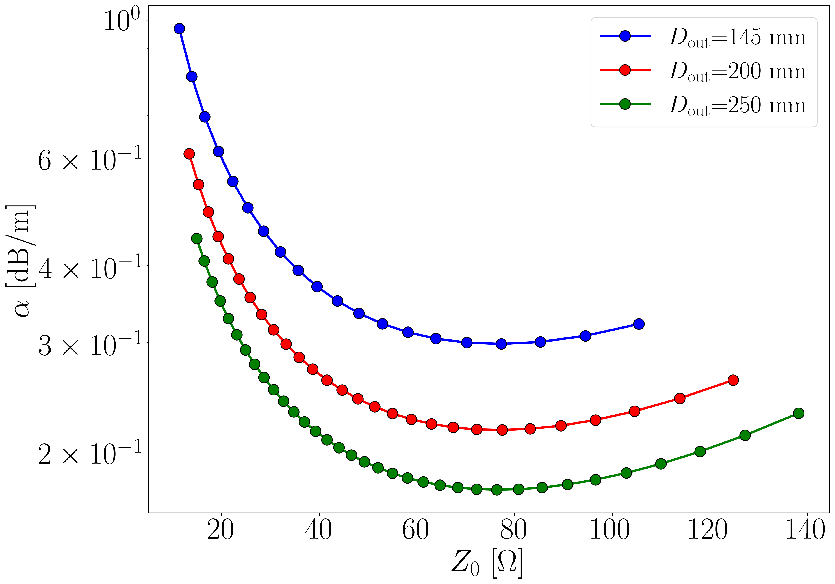
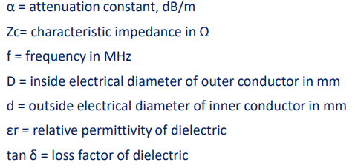


Peak field in coaxial lines
$E_{pk}$ at $P_{max}$ of 500 kW
$$f=400 MHz$$
Minimum peak electric field occurs near 30 Ω impedance, while conductor losses are minimized around 77 Ω
Multipacting onset power is higher at larger impedances, due to the increased gap between inner and outer conductors
E. Montesinos, RF power transport, CAS course on RF for Accelerators, Berlin July 2023

Slide 5
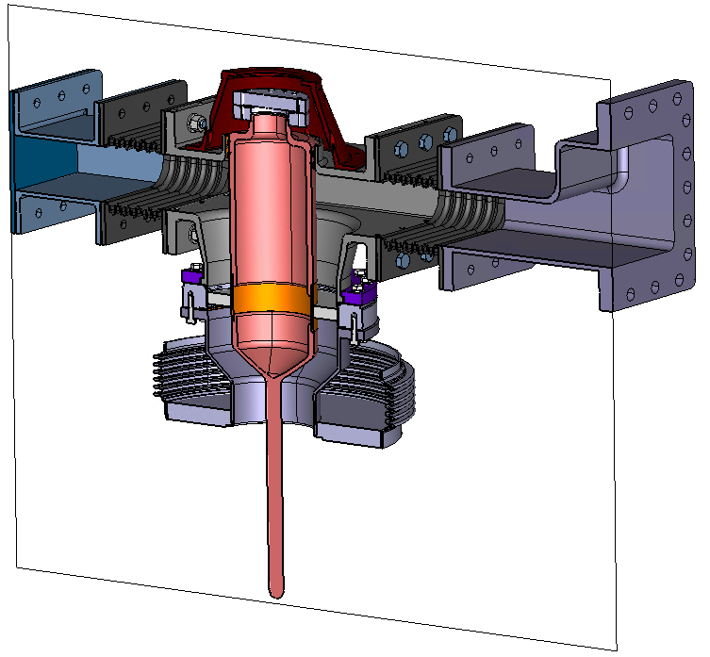
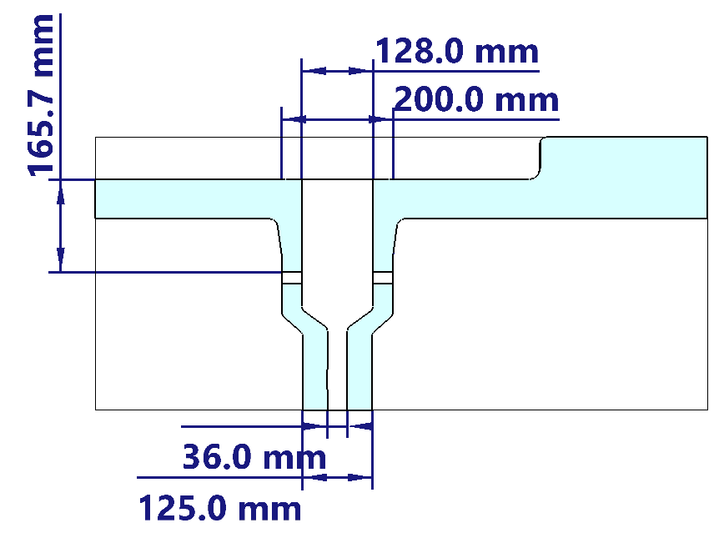
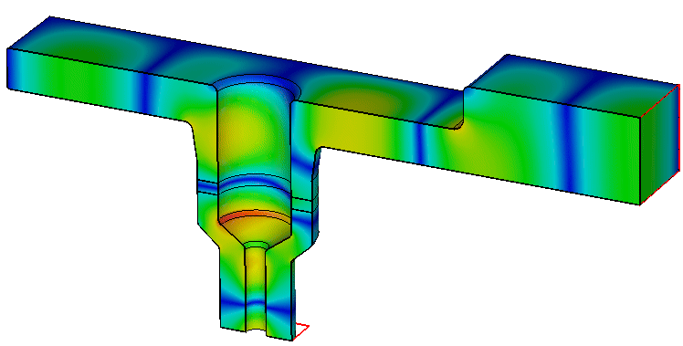
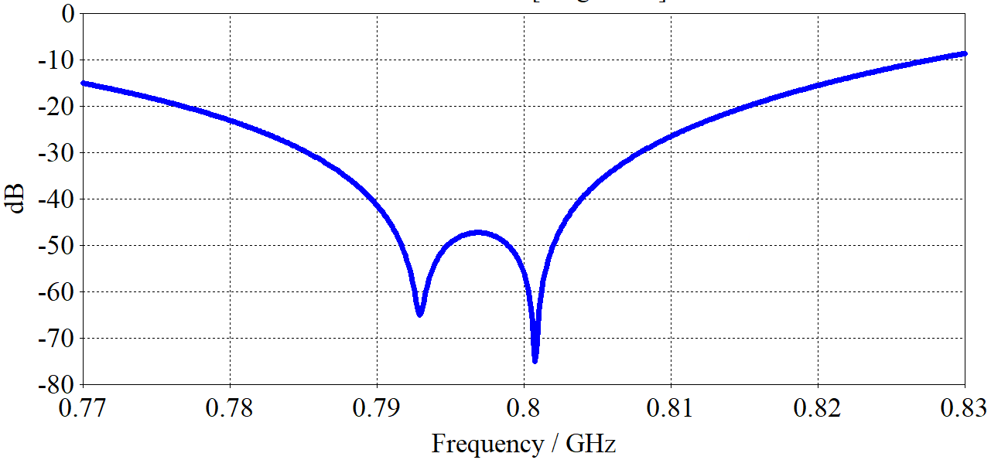

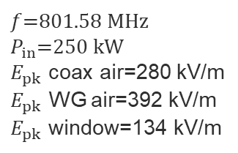

Coaxial coupler update at 800 MHz
Coaxial disk window is used in the coupler design
The cone shape helps lower peak fields on the window by reducing impedance to ~27 Ω on the upper part; the lower part maintains 75 Ω to reduce coaxial line losses on the vacuum side and avoid direct line-of-sight between the window and the cold cavity surface & beam
Coupler shape, waveguide height, step, and window location are optimized as part of the matching section to ensure low transmission at 801.58 MHz
The bandwidth is wide enough to damp lower-order modes of the cavity in the 785 MHz to 800 MHz range
WR1150
$$Z_{0}=75 Ω$$
Courtesy: S. Calvo
$$S1,1$$
P1
$f$=801.58 MHz
$P_{in}$=250 kW
$E_{pk}$ coax air=280 kV/m
$E_{pk}$ WG air=392 kV/m
$E_{pk}$ window=134 kV/m
P2
Notes:
31W loss in alumina at 250kW input power for tan delta of 1e-4

Slide 6
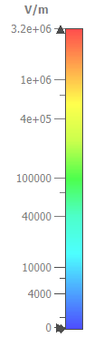
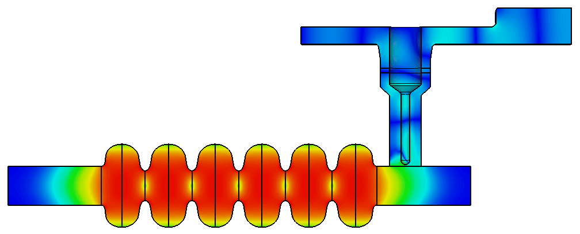
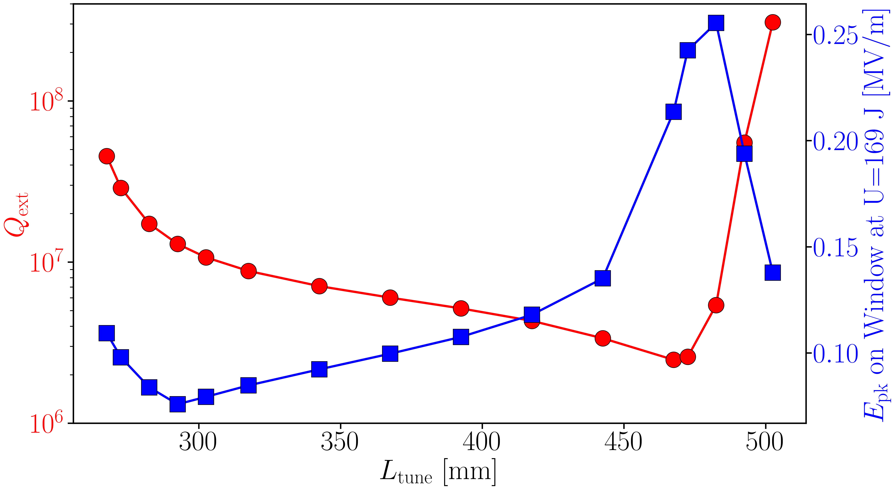
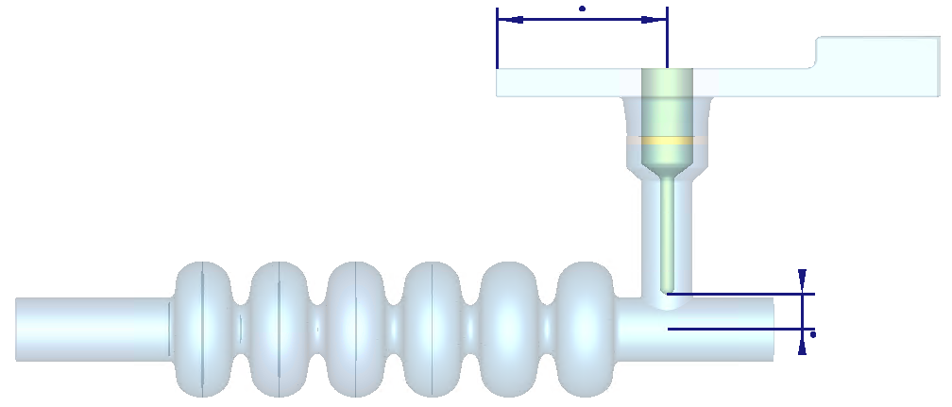


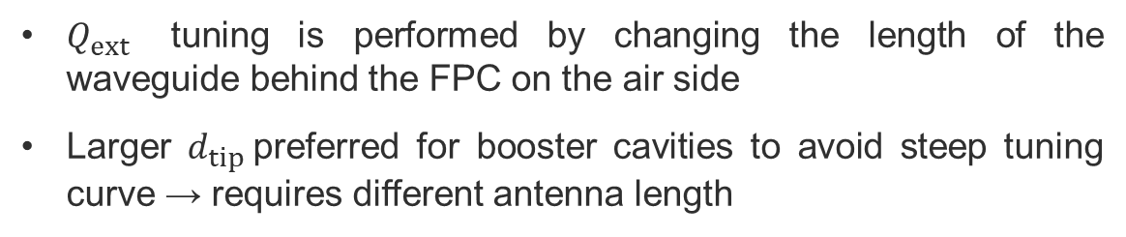
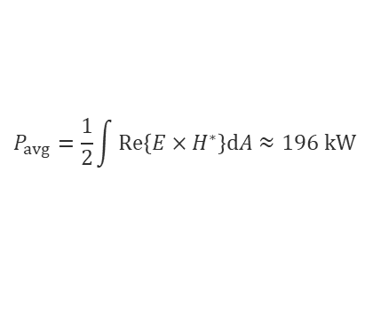


$Q_{ext}$ tuning of 800 MHz FPC
$Q_{ext}$ tuning is performed by changing the length of the waveguide behind the FPC on the air side
Larger $d_{tip}$preferred for booster cavities to avoid steep tuning curve → requires different antenna length
$$P_{avg}=\frac{1}{2}\int{Re\left\{E×H^{∗}\right\}dA}≈196 kW$$
Booster
cavities
tt collider
U=169 J, $Q_{ext}$=4.3e6
$$L_{tune}$$
E field at U=1 J
$$d_{tip}=85 mm$$
Notes:
23W power loss on the WG behind FPC

Slide 7
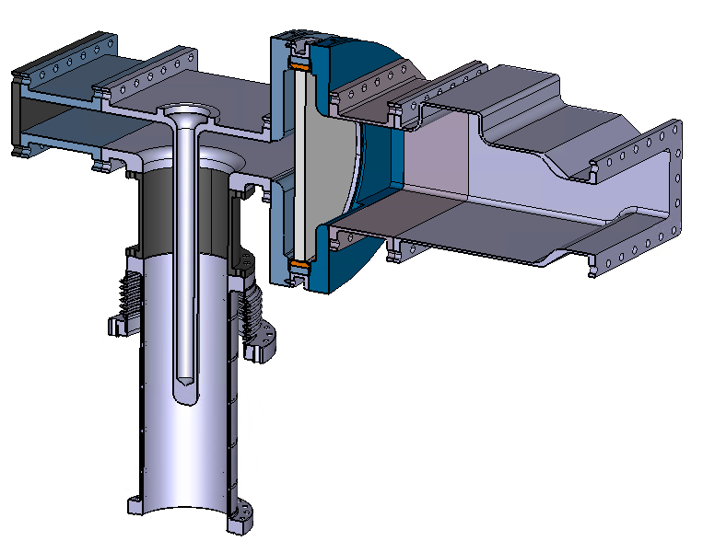
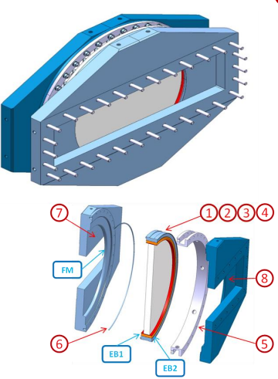
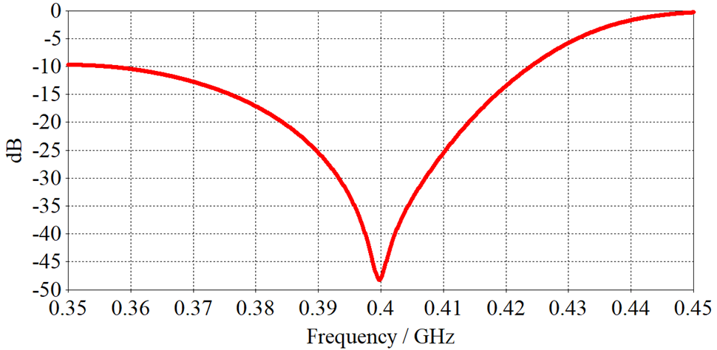
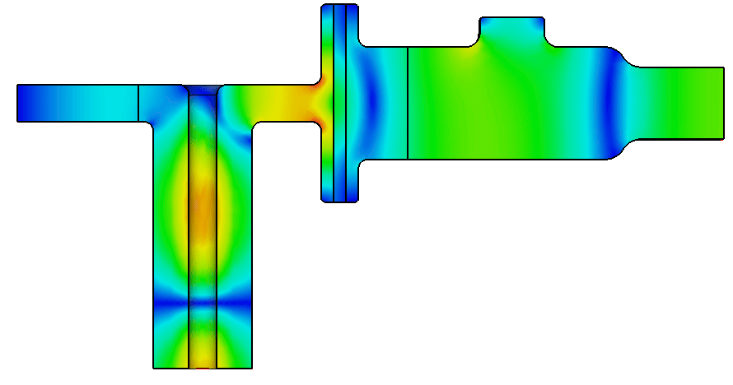
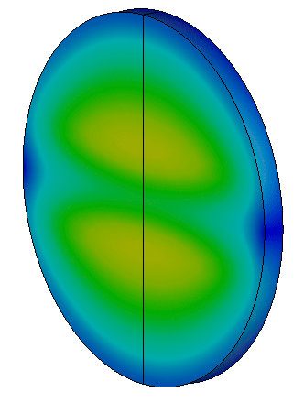
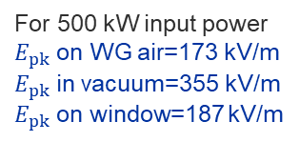


400 MHz power coupler
Disk window based on the LINAC4 window design
The matching is done by adjusting the waveguide height and length, window location and the step size in front of the window
Robust design with large bandwidth. Peak fields centered, away from brazing joints. High thermal losses at window demand air-side cooling
Challenging to integrate into cryostat → see Karin’s presentation
Courtesy: S. Calvo
Half-height WR2300
$$S_{1,1}$$
400 mm
$$Z_{0}=75 Ω$$
For 500 kW input power
$E_{pk}$ on WG air=173 kV/m
$E_{pk}$ in vacuum=355 kV/m
$E_{pk}$ on window=187 kV/m
F. Gerigk, et al. The LINAC4 power coupler
200 mm
Notes:
95W loss in alumina at 500kW input power for tan delta of 1e-4

Slide 8
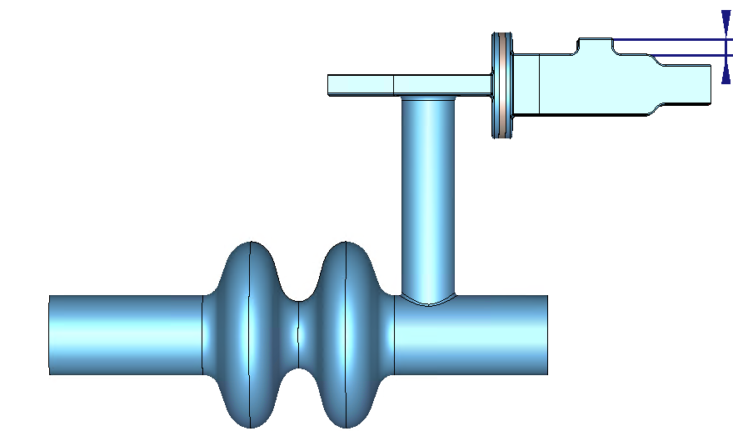
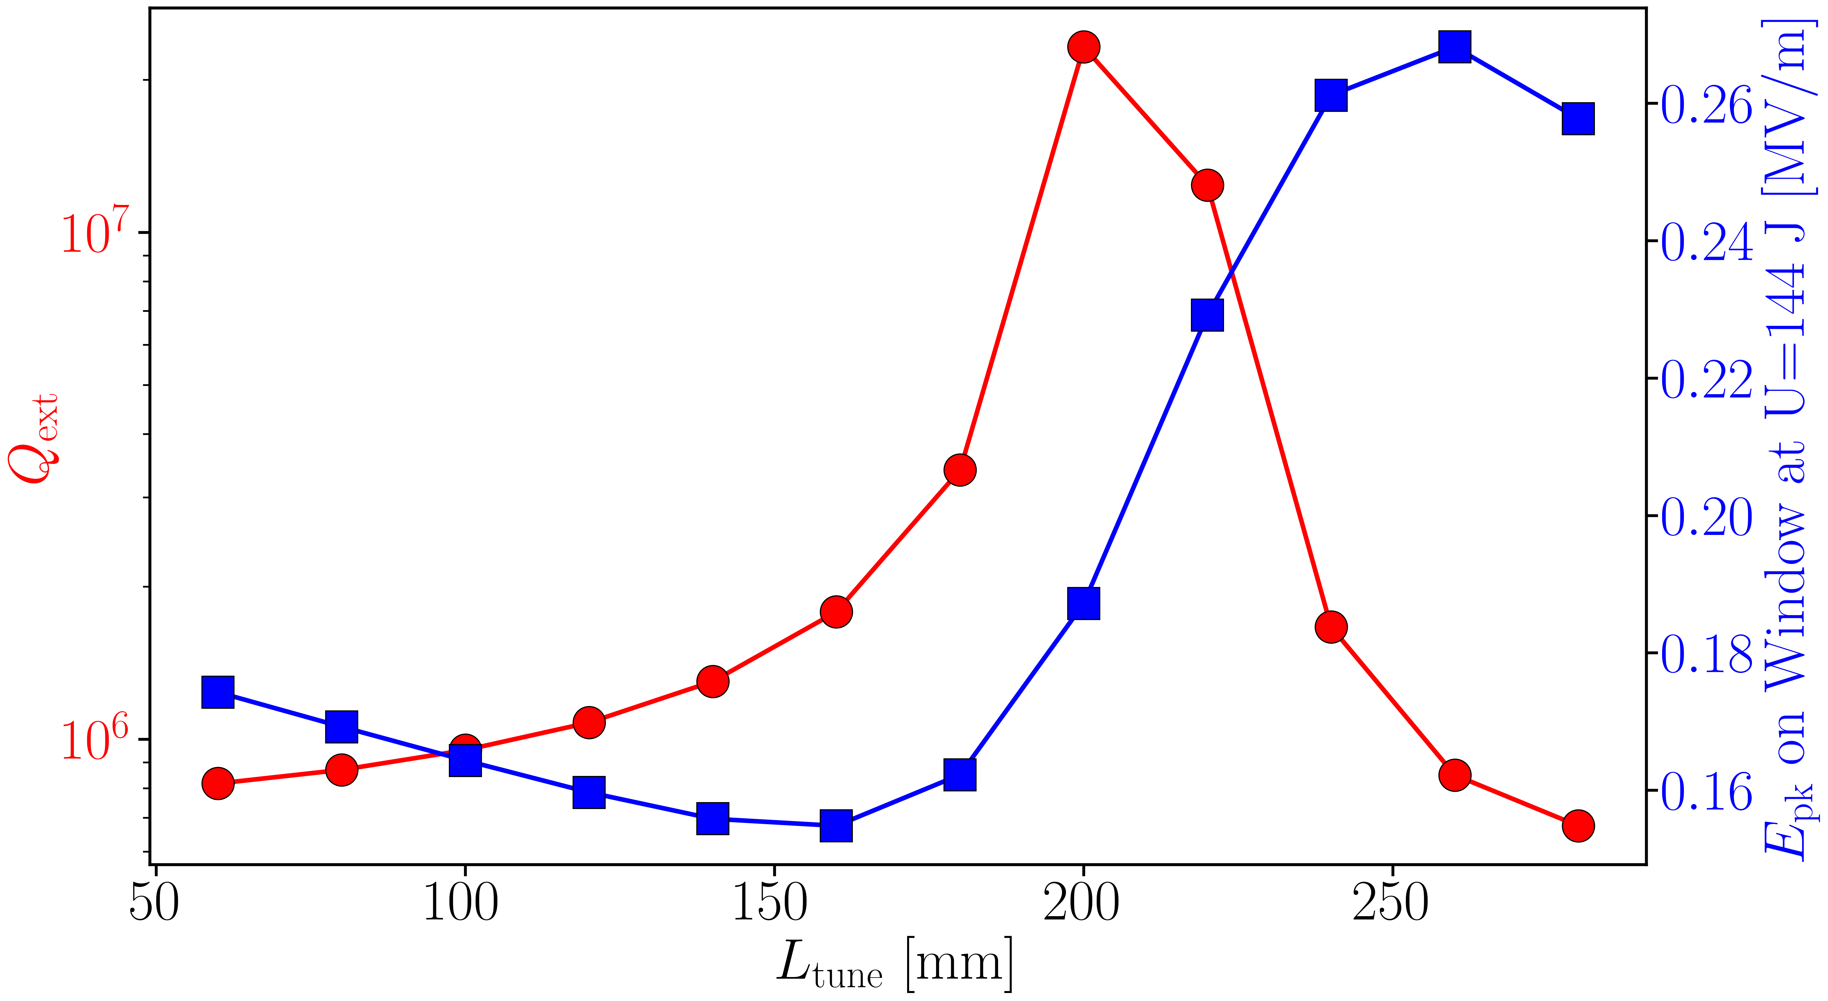
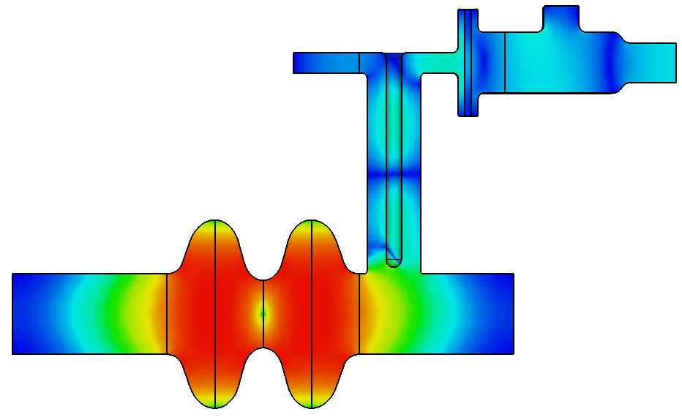
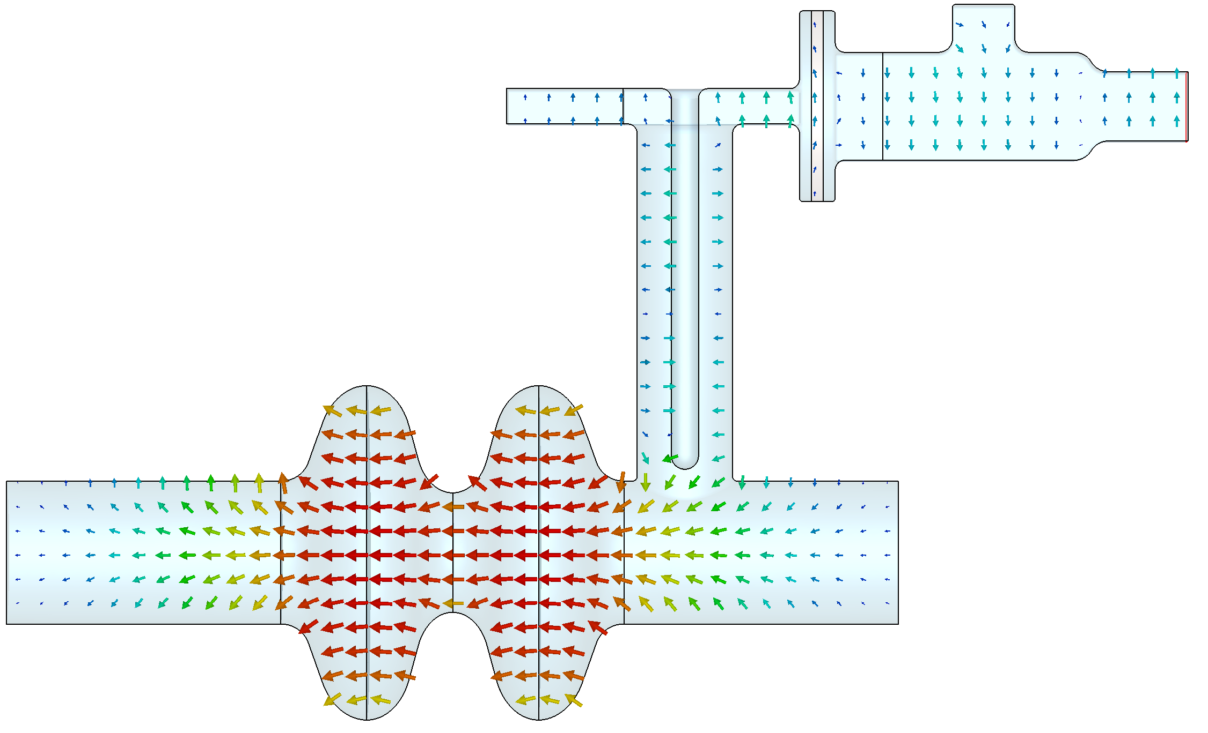


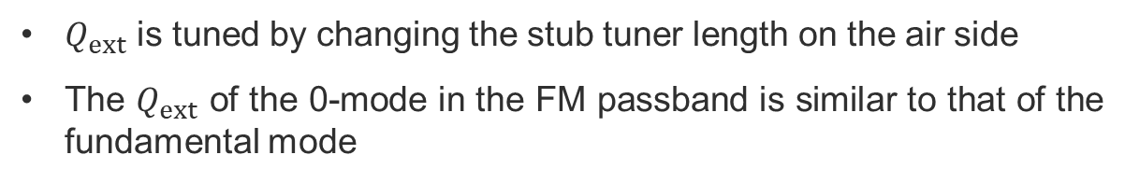



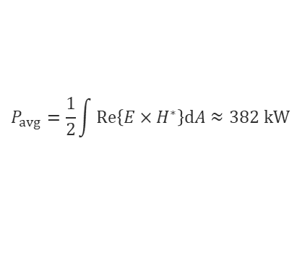

$Q_{ext}$ tuning of 400 MHz FPC
$$L_{tune}$$
$Q_{ext}$ is tuned by changing the stub tuner length on the air side
The $Q_{ext}$ of the 0-mode in the FM passband is similar to that of the fundamental mode
Vacuum side
Air side
tt collider
$$P_{avg}=\frac{1}{2}\int{Re\left\{E×H^{∗}\right\}dA}≈382 kW$$
Z,W, H collider
U=144 J
$Q_{ext}$=9.49e5
$$f=397.6 MHz$$
$$Q_{ext}=9.45e5$$
FM: $π−mode$
$$0−mode$$

Slide 9
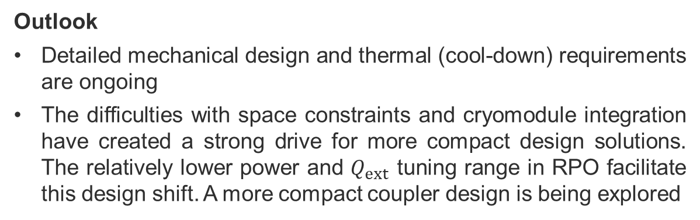
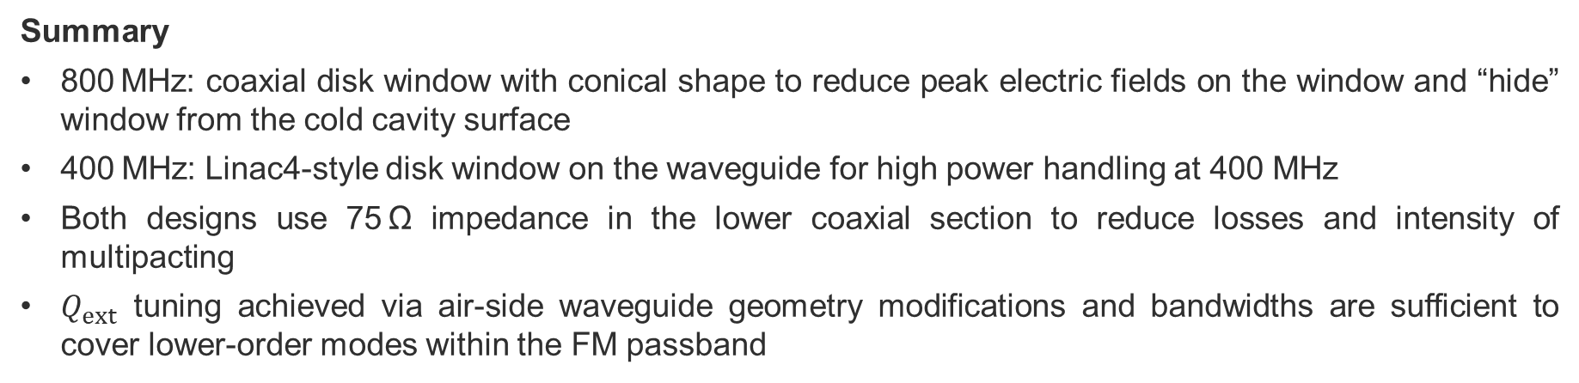
Summary and outlook
Summary
800 MHz: coaxial disk window with conical shape to reduce peak electric fields on the window and “hide” window from the cold cavity surface
400 MHz: Linac4-style disk window on the waveguide for high power handling at 400 MHz
Both designs use 75 Ω impedance in the lower coaxial section to reduce losses and intensity of multipacting
$Q_{ext}$ tuning achieved via air-side waveguide geometry modifications and bandwidths are sufficient to cover lower-order modes within the FM passband
Outlook
Detailed mechanical design and thermal (cool-down) requirements are ongoing
The difficulties with space constraints and cryomodule integration have created a strong drive for more compact design solutions. The relatively lower power and $Q_{ext}$ tuning range in RPO facilitate this design shift. A more compact coupler design is being explored
Courtesy: S. Calvo
400 MHz FPC concept similar to the 800 MHz FPC design

Slide 10
Appendix

Slide 11
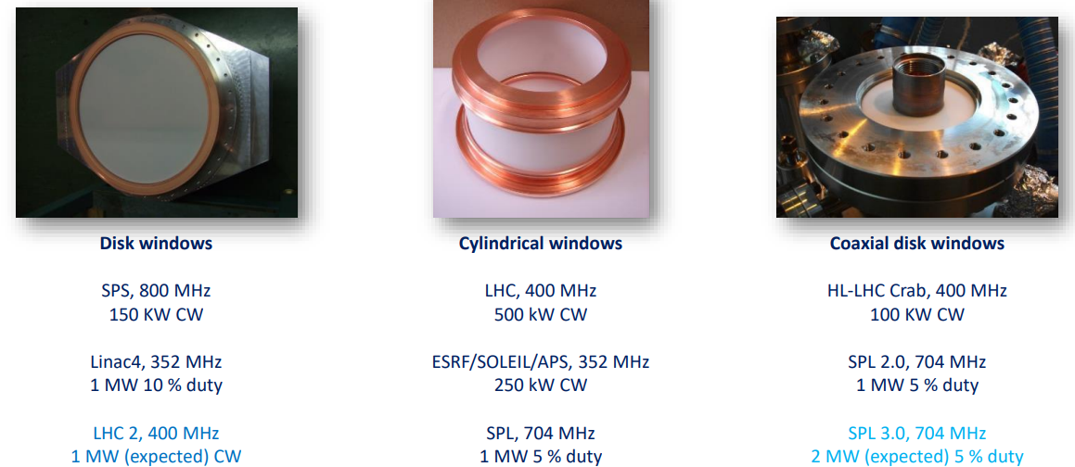
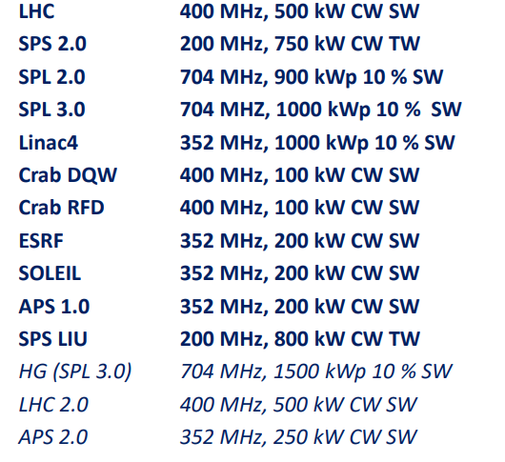
Window families at CERN
CERN power couplers since 2000’s
E Montesinos, FCC couplers, SRF workshop CERN, 2024
E. Montesinos, RF power transport, CAS course on RF for Accelerators, Berlin July 2023

Slide 12

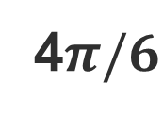
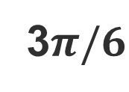




800 MHz FM passband
$$π/6$$
$$Q_{ext}$$
$$2π/6$$
3$π/6$
4$π/6$
$$π$$
$$5π/6$$
FM

Slide 13
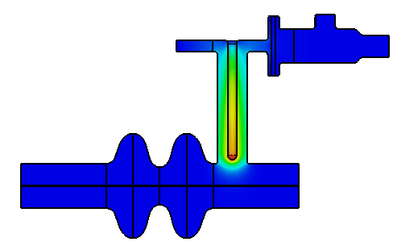
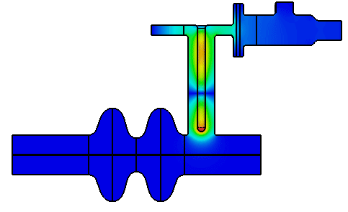
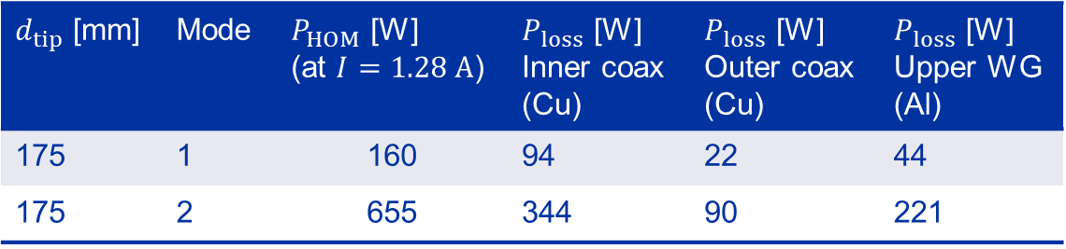
Lower order modes (I)
Mode 1
Mode 2
$d_{tip}=175 mm$, $f=83.55 MHz, Q_{0}=7.5e3,R/Q=0.013 Ω$
$d_{tip}=175 mm$, $f=243.45 MHz, Q_{0}=12.5e3,R/Q=0.032 Ω$
If one of the two modes trapped in the FPC gets excited by the beam, additional power could be induced and dissipated on the FPC outer wall and inner coax.
$d_{tip}$ [mm] | Mode | $P_{HOM}$ [W] (at $I=1.28 A$) | $P_{loss}$ [W] Inner coax (Cu) | $P_{loss}$ [W] Outer coax (Cu) | $P_{loss}$ [W] Upper WG (Al)
175 | 1 | 160 | 94 | 22 | 44
175 | 2 | 655 | 344 | 90 | 221
$$P_{HOM}=R/Q∙Q_{0}∙I^{2}$$

Slide 14
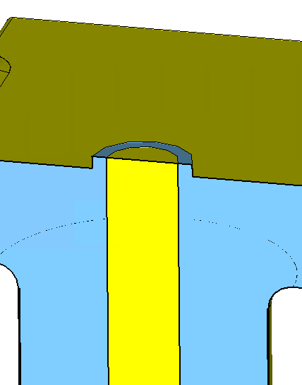










LOM frequency shift
To address LOM excitation and potential coupler overheating in worst-case scenarios:
If beam spectral lines are known: Slightly adjust the inner antenna length in the initial design to shift the LOM frequency away from the beam spectral lines.
If beam spectral lines are unknown: Introduce flexibility in the geometry e.g., changing the volume above the FPC by 1 mm (as shown in the figure below by moving a short plane or membrane above inner coax) can shift mode frequencies by more than one bandwidth.
Mode 1: $f_{BW}=f/Q≈11 kHZ$
Mode 2: $f_{BW}=f/Q≈19.5 kHZ$
$$d_{shift}$$
$$∆f [kHz]$$
$$∆f [kHz]$$
$$d_{shift} [mm]$$
$$d_{shift} [mm]$$

Slide 15







MP in conical coax
Z0=75 Ω
Z0=50 Ω
P=200 kW, f=400.79 MHz, growth factor=5
Z0=75 Ω
Z0=50 Ω
Z0=50 Ω
Z0=50 Ω
Z0=75 Ω
Z0=75 Ω

Slide 16



Multipacting analysis of the disk window
$$P=400 kW$$
Average Multipacting order =9.1
There are hot zones of high order multipacting on the margins of the window

Slide 17







MP in different LHC coupler zones
Zone 3
https://edms.cern.ch/ui/file/194664/AE/lhcacsmc0069-vAE.pdf
Zone 1
Zone 2
Zone 2
Zone 4
Zone 3
Zone 3
Zone 1
150 kW input power

