Slide 1
Beam dynamics and RF requirements for the high-energy booster
Lina Valle, Ivan Karpov, Antoine Chance, Frank Peaguer, Heiko Damerau, Rama Calaga …….
Acknowledgments: Elleanor Lamb, Luke von Freeden, Yann Dutheil, …

Slide 2
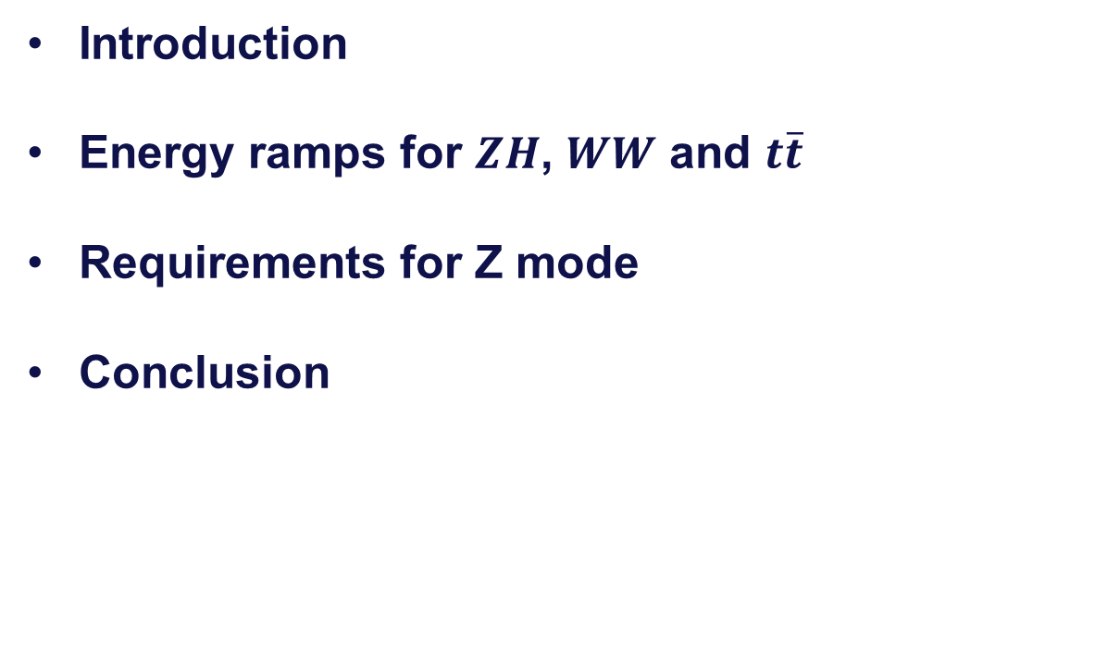
Outline
Introduction
Energy ramps for $ZH$, $WW$ and $t\overline{t}$
Requirements for Z mode
Conclusion

Slide 3
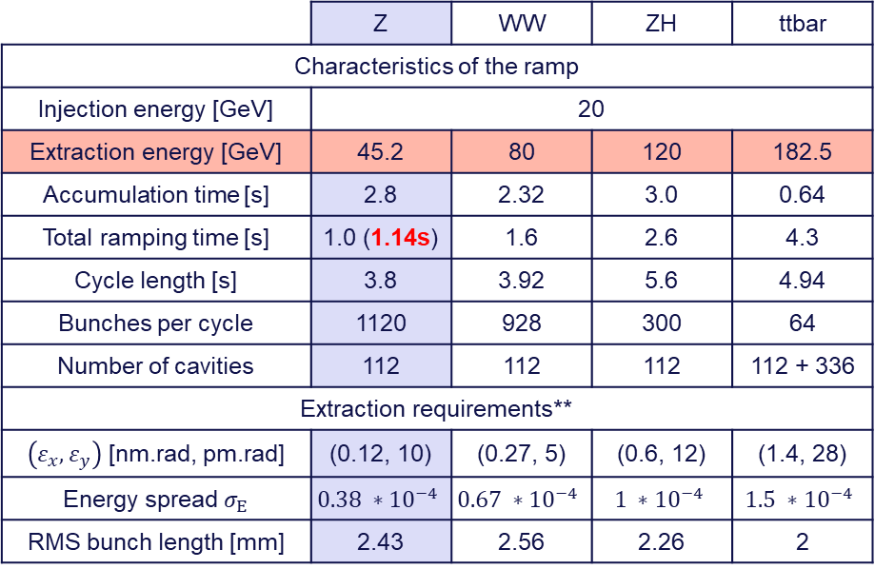
Changes from FCC week 2024
Energy ramps for the high-energy booster
Booster operation mode selected parameters
Motivation: Optimization of the energy and voltage ramps for all four modes, including Reverse Phase Operation (RPO)*, homogenize dynamic losses and reduce RF requirements.
Analytical tools to compute the energy and voltage ramps of the high-energy booster
Faster optimization including dynamic effects.
Single bunch, no intensity effect, no beam loading
 | Z | WW | ZH | ttbar
Characteristics of the ramp
Injection energy [GeV] | 20
Extraction energy [GeV] | 45.2 | 80 | 120 | 182.5
Accumulation time [s] | 2.8 | 2.32 | 3.0 | 0.64
Total ramping time [s] | 1.0 (1.14s) | 1.6 | 2.6 | 4.3
Cycle length [s] | 3.8 | 3.92 | 5.6 | 4.94
Bunches per cycle | 1120 | 928 | 300 | 64
Number of cavities | 112 | 112 | 112 | 112 + 336
Extraction requirements**
$\left(ε_{x}, ε_{y}\right)$ [nm.rad, pm.rad] | (0.12, 10) | (0.27, 5) | (0.6, 12) | (1.4, 28)
Energy spread $σ_{E}$ | $$0.38 ∗{10}^{−4}$$ | $$0.67 ∗{10}^{−4}$$ | $$1 ∗{10}^{−4}$$ | $$1.5 ∗{10}^{−4}$$
RMS bunch length [mm] | 2.43 | 2.56 | 2.26 | 2
* I. Karpov, FCC week 2025, 21/05/2025
** Specified by Y. Dutheil, FCCee injectors parameters - Google Sheets and presented in 3rd Meeting of the FCC-ee Layout and Optics Design (30 avril 2025) · Indico

Slide 4
Energy ramps for all modes

Slide 5
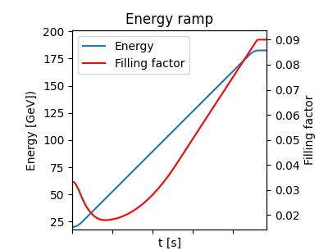

Energy ramp proposal for $ZH$, $WW$ and $t\overline{t}$
“Double parabolic” energy ramps
Example of 𝑡𝑡 ̅
Double parabolic for adiabatic acceleration at the start and end of the ramp
Energy gain dominated by the compensation of synchrotron radiation losses
Larger filling factor at the beginning of the ramp for ‘adiabatic capture’
Natural transverse emittances and natural energy spread reached by the end of the ramp
Voltage at flat top adjusted to match bunch length requirements

Slide 6
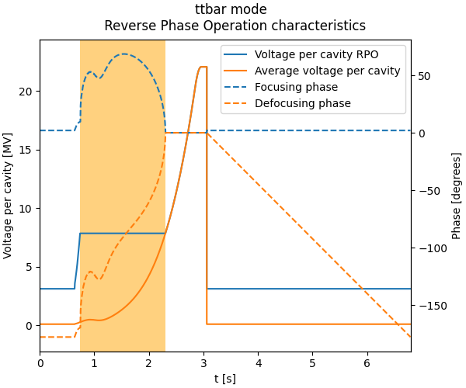

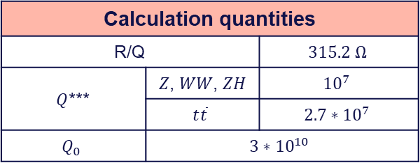
Voltage per cavity with Reverse Phase Operation
Voltage per cavity during the ramp ($t\overline{t}$)
  Reverse Phase Operation* to maintain a minimum voltage per cavity $\left(V_{cav}^{min}≈2 MV\right)$**
  $ΔN=N_{f}−N_{d}=16$ between focusing and defocusing cavities
Constant voltage
Phase reset
RPO
Calculation quantities
R/Q |  | $$315.2 Ω$$
$Q$*** | $Z$, $WW$, $ZH$ | $${10}^{7}$$
 | $$t\overline{t}$$ | $$2.7∗{10}^{7}$$
$$Q_{0}$$ | $$3∗{10}^{10}$$
* I. Karpov, FCC_optics_meeting_08082024_IK.pdf
** S. Gorgi Zadeh, FM passband
*** I. Karpov, FCC_optics_meeting_27022025_IK.pdf

Slide 7
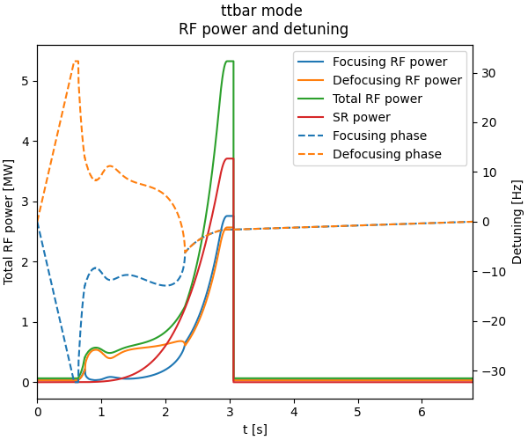

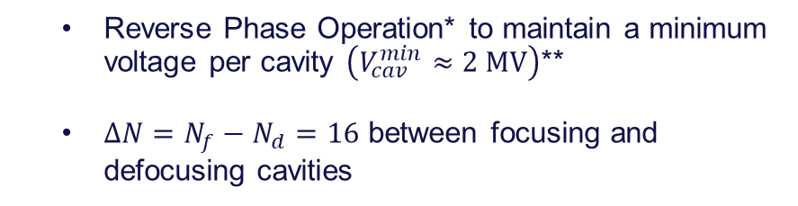
RF power requirements for $t\overline{t}$ mode
Voltage per cavity during the ramp ($t\overline{t}$)
  Reverse Phase Operation* to maintain a minimum voltage per cavity $\left(V_{cav}^{min}≈2 MV\right)$**
  $ΔN=N_{f}−N_{d}=16$ between focusing and defocusing cavities
Calculation quantities
R/Q |  | $$315.2 Ω$$
$Q$*** | $Z$, $WW$, $ZH$ | $${10}^{7}$$
 | $$t\overline{t}$$ | $$2.7∗{10}^{7}$$
$$Q_{0}$$ | $$3∗{10}^{10}$$
43% RF power overshoot at flat top
* I. Karpov, FCC_optics_meeting_08082024_IK.pdf
** S. Gorgi Zadeh, FM passband
*** I. Karpov, FCC_optics_meeting_27022025_IK.pdf

Slide 8
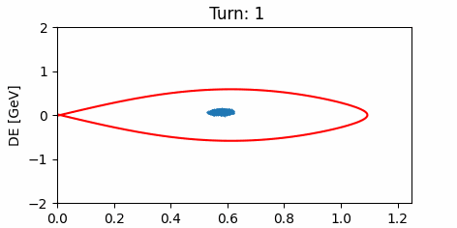
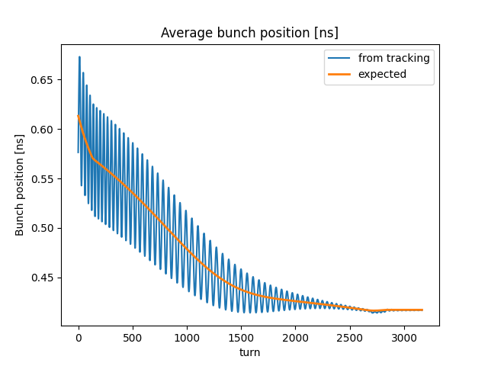
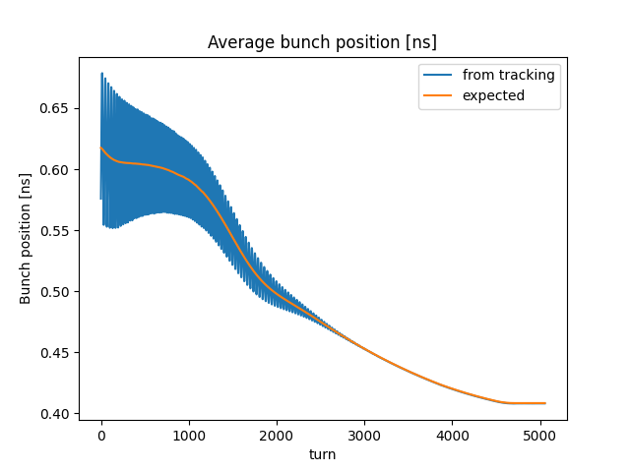
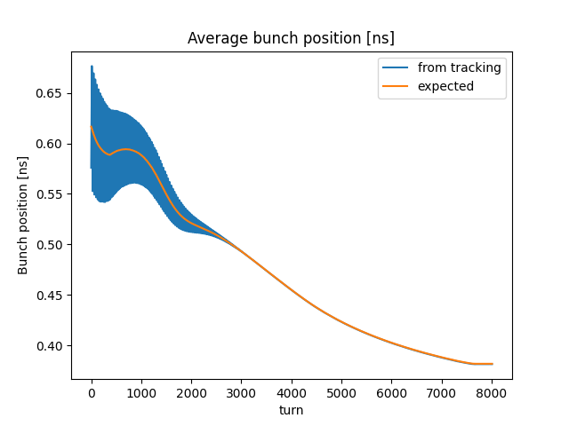
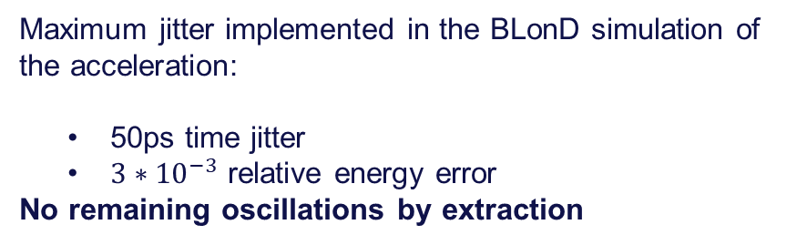
Injection error in the booster: WW ramp
Acceleration of an early-injected bunch
Maximum jitter implemented in the BLonD simulation of the acceleration:
  50ps time jitter
  $3∗{10}^{−3}$ relative energy error
No remaining oscillations by extraction
$$WW$$
$$ZH$$
$$t\overline{t}$$

Slide 9
Booster ramping strategies for Z mode

Slide 10
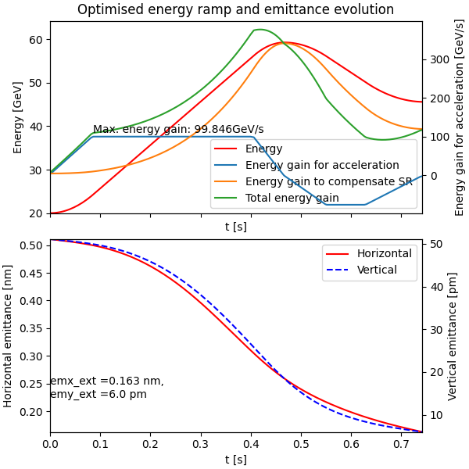
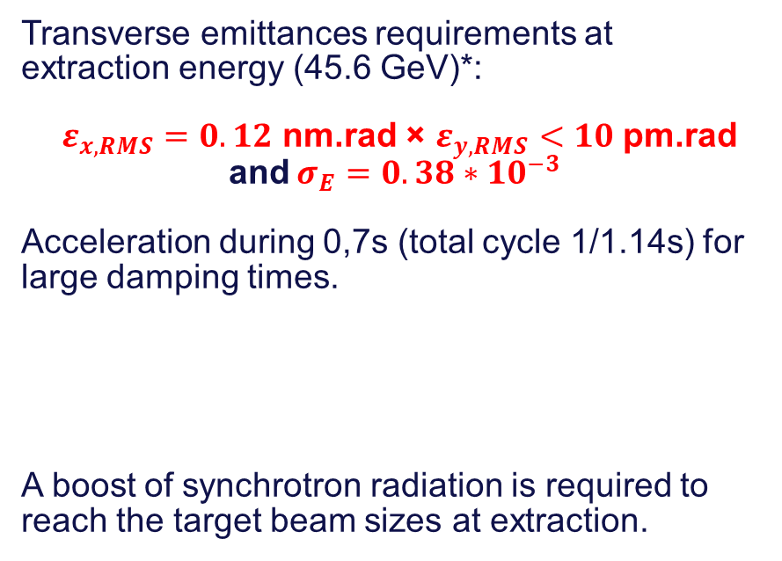
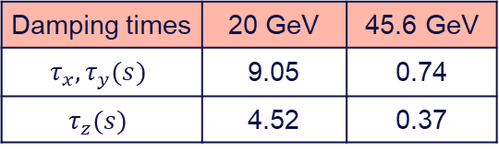
Booster ramping strategies for Z mode
Maximum energy gain: 100 GeV/s
Transverse emittances requirements at extraction energy (45.6 GeV)*:
$ε_{x, RMS}=0.12$ nm.rad × $ε_{y, RMS}<10$ pm.rad
and $σ_{E}=0.38∗10^{−3}$
Acceleration during 0,7s (total cycle 1/1.14s) for large damping times.
A boost of synchrotron radiation is required to reach the target beam sizes at extraction.
Damping times | 20 GeV | 45.6 GeV
$$τ_{x}, τ_{y}(s)$$ | 9.05 | 0.74
$$τ_{z}(s)$$ | 4.52 | 0.37
Horizontal emittance remains above requirements.
* Specified by Y. Dutheil, FCCee injectors parameters - Google Sheets and presented in 3rd Meeting of the FCC-ee Layout and Optics Design (30 avril 2025) · Indico
** L.Valle, FCC_WP1_25_03_2025.pdf
Optimized overshoot energy ramp with Particle Swarm Optimization (PSO)**
for lower transverse emittances at extraction

Slide 11
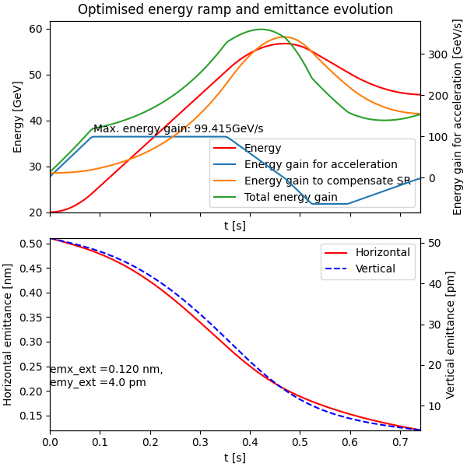
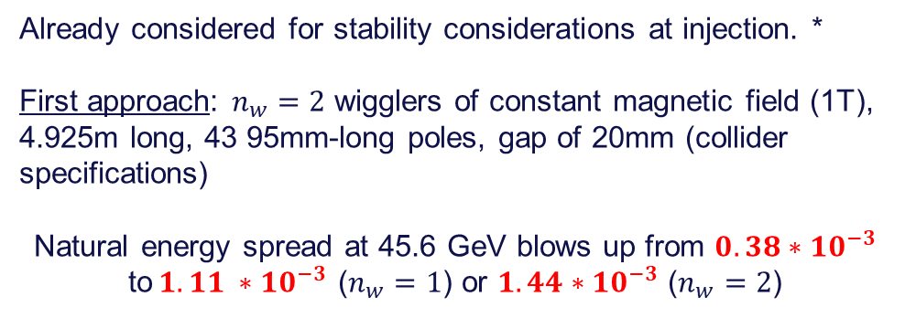
Booster ramping strategies for Z mode
Maximum energy gain: 100 GeV/s
Adding damping wigglers…
Already considered for stability considerations at injection. *
First approach: $n_{w}=2$ wigglers of constant magnetic field (1T), 4.925m long, 43 95mm-long poles, gap of 20mm (collider specifications)
Natural energy spread at 45.6 GeV blows up from $0.38∗10^{−3}$ to$1.11 ∗10^{−3}$ ($n_{w}=1$) or $1.44∗10^{−3}$ ($n_{w}=2$)
* S. Gorgi Zadeh, FM passband
**L.Valle, FCC_WP1_25_03_2025.pdf
Optimized overshoot energy ramp with Particle Swarm Optimization (PSO)**
including two damping wigglers

Slide 12
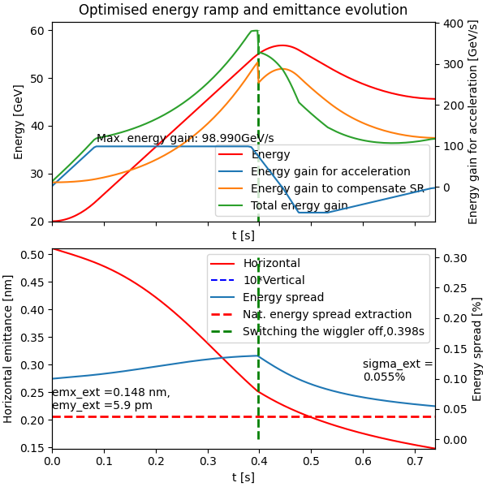
Booster ramping strategies for Z mode
Maximum energy gain: 100 GeV/s
Adding damping wigglers…
Already considered for stability considerations at injection. *
First approach: $n_{w}=2$ wigglers of constant magnetic field (1T), 4.925m long, 43 95mm-long poles, gap of 20mm (collider specifications)
Natural energy spread at 45.6 GeV blows up from $0.38∗10^{−3}$ to$1.11 ∗10^{−3}$ ($n_{w}=1$) or $1.44∗10^{−3}$ ($n_{w}=2$)
Idea: Switch the wigglers off during the ramp to restore the expected natural energy spread or move the beam away from the wiggler.
Acceleration and deceleration in 1.14s
Getting closer to the target parameters. Wiggler parameters to be optimized.
Optimized overshoot energy ramp with Particle Swarm Optimization (PSO)**
including two damping wigglers disabled during the ramp
* S. Gorgi Zadeh, FM passband
**L.Valle, FCC_WP1_25_03_2025.pdf

Slide 13
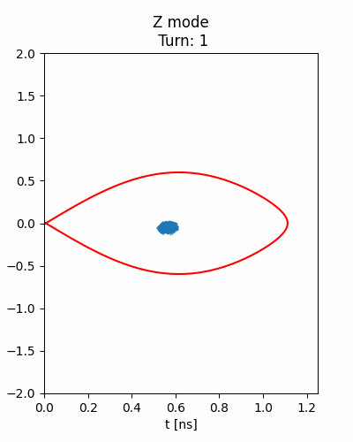
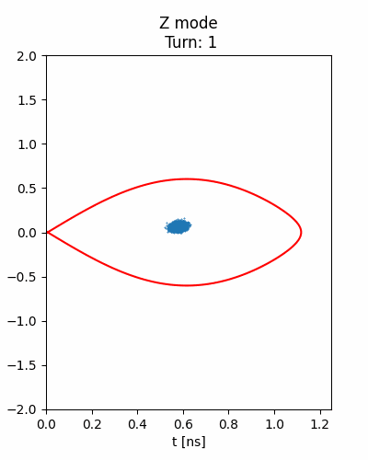
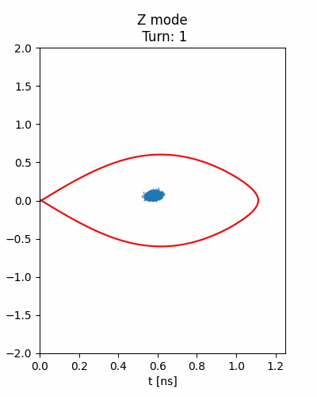
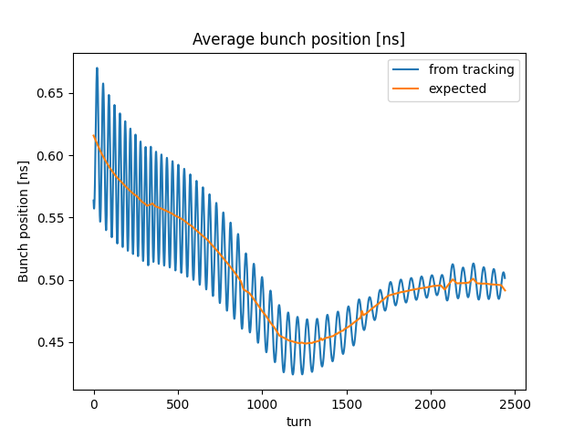
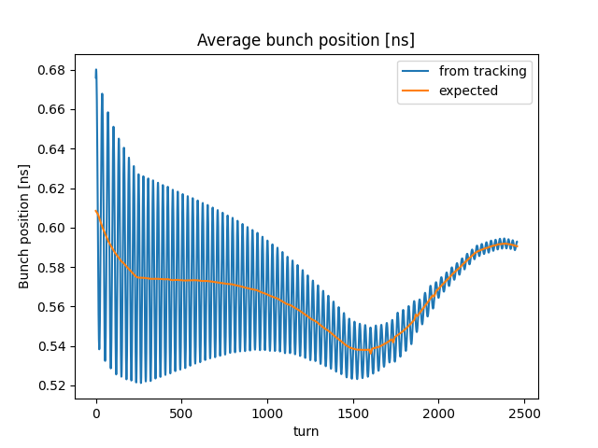
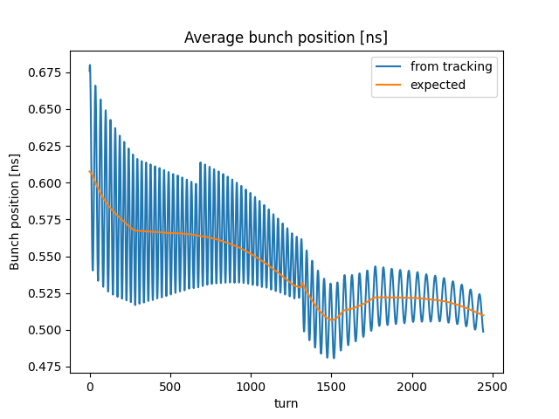




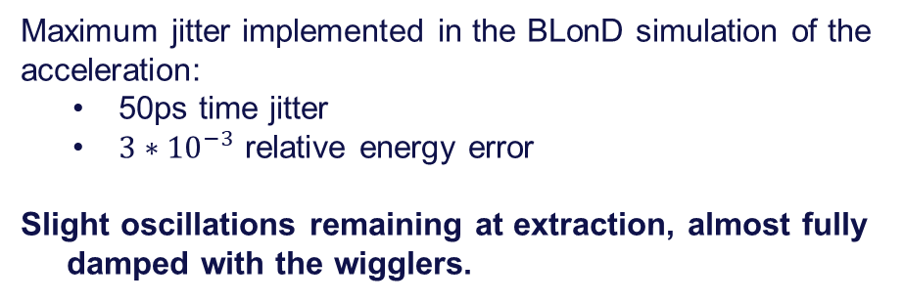
Injection error in the booster: Z ramp
Acceleration of an early-injected bunch
$$n_{w}=0$$
$$n_{w}=2$$
Maximum jitter implemented in the BLonD simulation of the acceleration:
  50ps time jitter
  $3∗{10}^{−3}$ relative energy error
Slight oscillations remaining at extraction, almost fully damped with the wigglers.
$n_{w}=2$ disabled at t = 0.4s
$$n_{w}=0$$
$$n_{w}=2$$

Slide 14
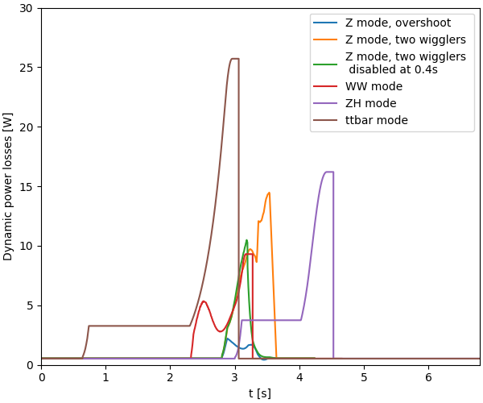
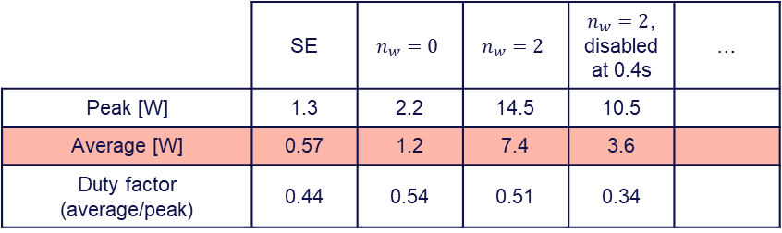
Dynamic losses for cryogenics of all presented ramps
Dynamic power losses during a total cycle
 | Z | WW | ZH | ttbar
Peak [W] | … | 9.29 | 16.2 | 25.7
Average [W] | … | 4.54 | 5.9 | 6.4
Duty factor (average/peak) | … | 0.49 | 0.37 | 0.25
Dynamic power losses for shown Z mode energy ramps
 | SE | $$n_{w}=0$$ | $$n_{w}=2$$ | $n_{w}=2$, disabled at 0.4s | …
Peak [W] | 1.3 | 2.2 | 14.5 | 10.5
Average [W] | 0.57 | 1.2 | 7.4 | 3.6
Duty factor (average/peak) | 0.44 | 0.54 | 0.51 | 0.34

Slide 15
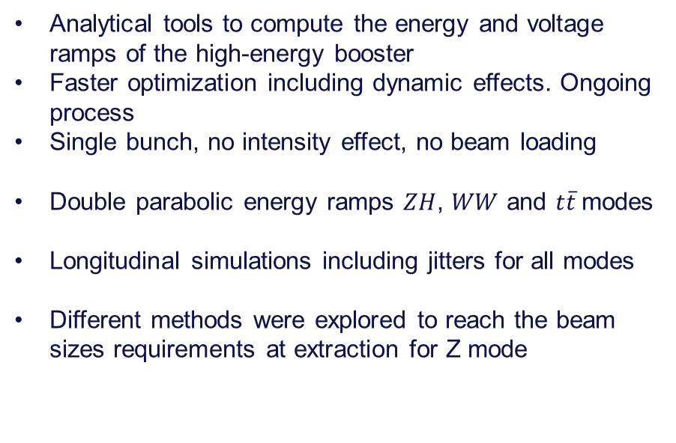
Conclusions
Summary
Next steps…
Analytical tools to compute the energy and voltage ramps of the high-energy booster
Faster optimization including dynamic effects. Ongoing process
Single bunch, no intensity effect, no beam loading
Double parabolic energy ramps $ZH$, $WW$ and $t\overline{t}$modes
Longitudinal simulations including jitters for all modes
Different methods were explored to reach the beam sizes requirements at extraction for Z mode
Further optimisation of all energy ramps to homogenise RF requirements through all modes
Study RF power transient during injection in the booster
Energy ramp for Z mode in progress.
  Overshoot energy to be mitigated with maximum energy gain,
  Damping wigglers requirements to meet the extraction targets to be determined,
  Bunch rotation at flat top to transfer energy spread into bunch length,

Slide 16
THANK YOU

Slide 17
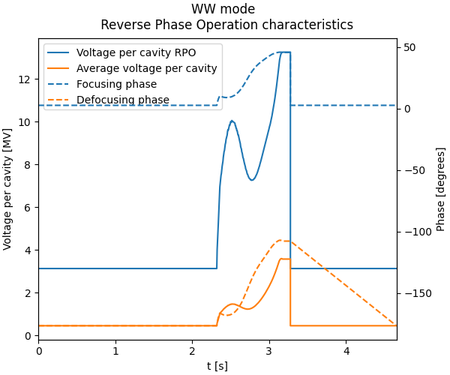
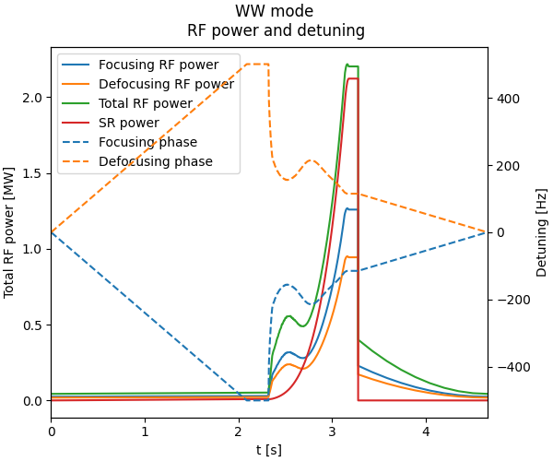
WW voltage per cavity for RPO and RF power
Phase reset
RPO
4.5% RF power overshoot at flat top

Slide 18
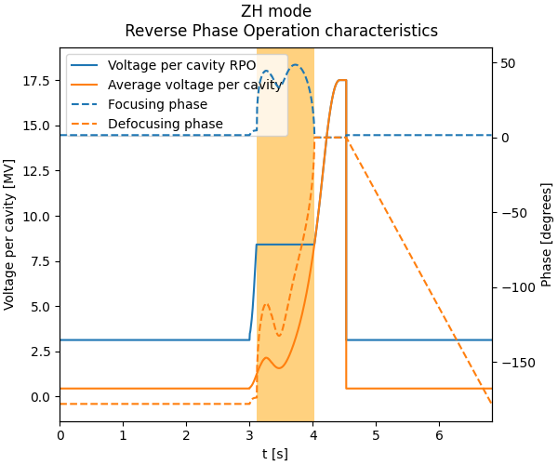
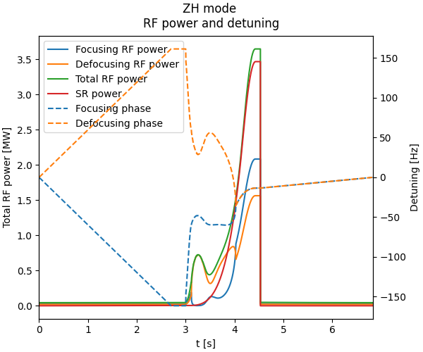
ZH voltage per cavity for RPO and RF power
Phase reset
RPO
Constant voltage
5% RF power overshoot at flat top

Slide 19
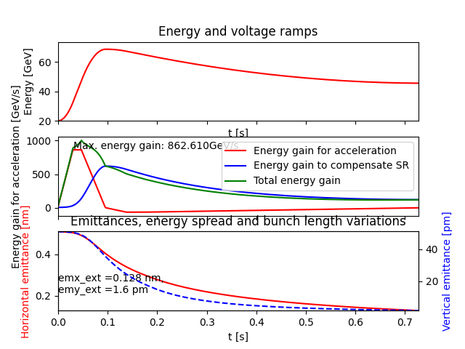
Z mode overshoot
Overshoot energy ramp could meet the requirements on the extraction transverse emittance…
with at least 850 GeV/s energy gain in less than 0.05s!

Slide 20
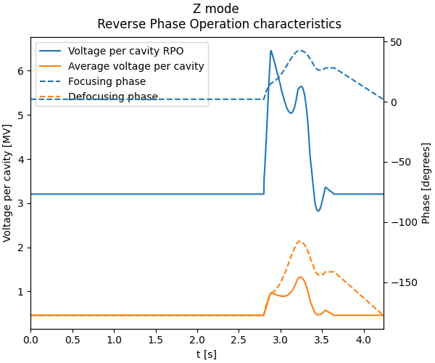
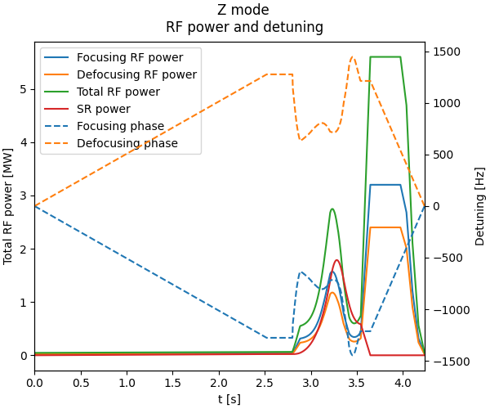
Z voltage per cavity for RPO and RF power
Clamp at 50kW per cavity
(overshot to be verified dynamically)
Optimized overshoot, no wigglers

Slide 21
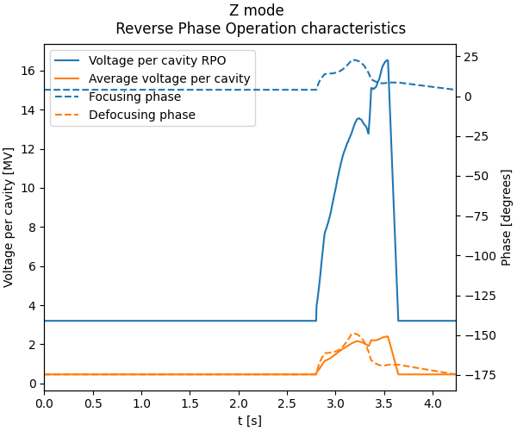
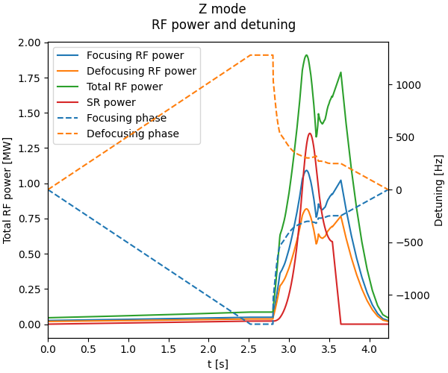
Z voltage per cavity for RPO and RF power
Optimized overshoot, two wigglers

Slide 22
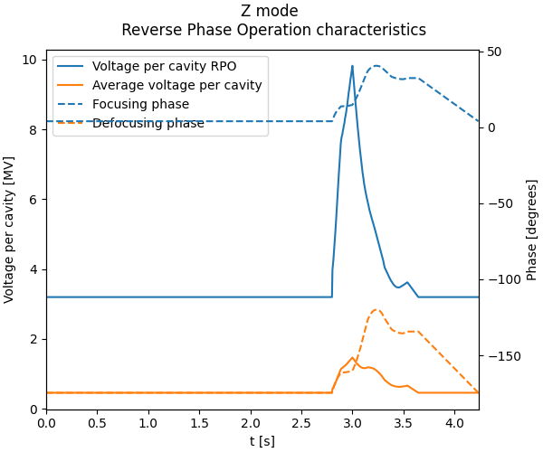
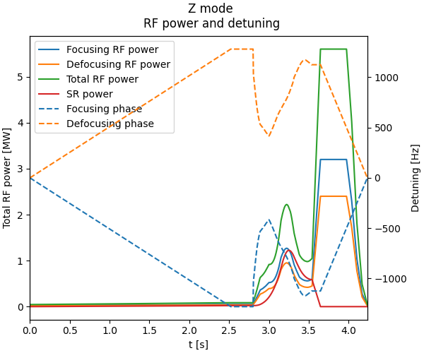
Z voltage per cavity for RPO and RF power
Clamp at 50kW per cavity
(overshot to be verified dynamically)
Optimized overshoot, two wigglers, disabled at 0.20s

