Slide 1
HOM coupler sensitivity analysis and uncertainty quantification for FCC-ee operation points’ cavity assemblies
Sosoho-Abasi Udongwo, Shahnam Gorgi Zadeh,
Ursula van Rienen

Slide 2
Motivation
Coaxial higher-order mode (HOM) couplers can be designed to high precision, which would reduce errors due to uncertainties. However,
Some geometric perturbations may occur
  during the installation
  during operation, due to background vibrations or
  electromagnetic pressure due to the Lorentz force
Owing to the orientation of the HOM coupler on the cavity, there may be some deflections induced by gravity

Slide 3
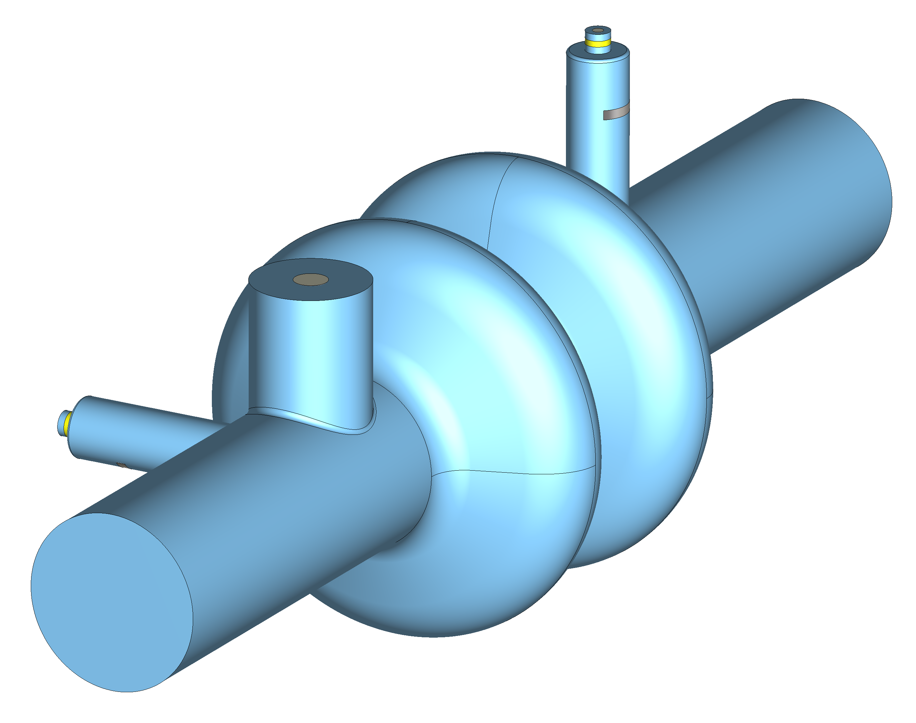
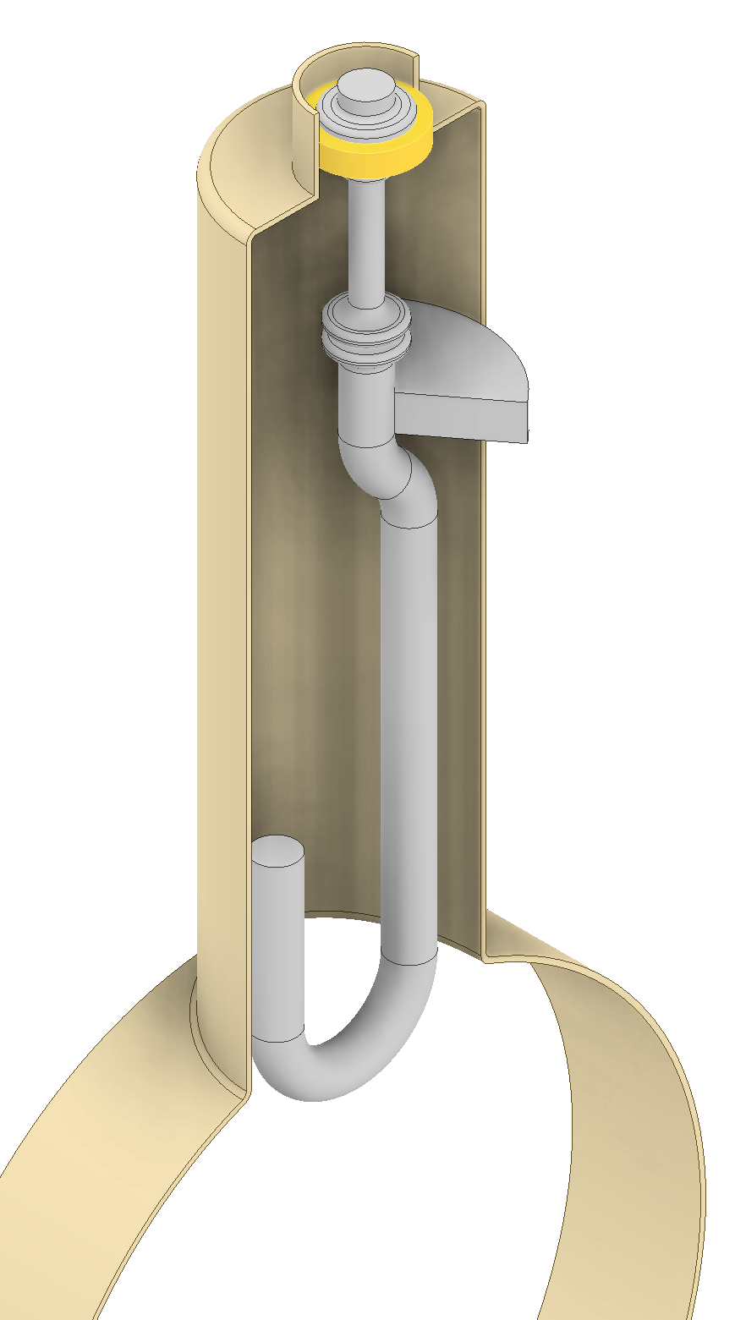
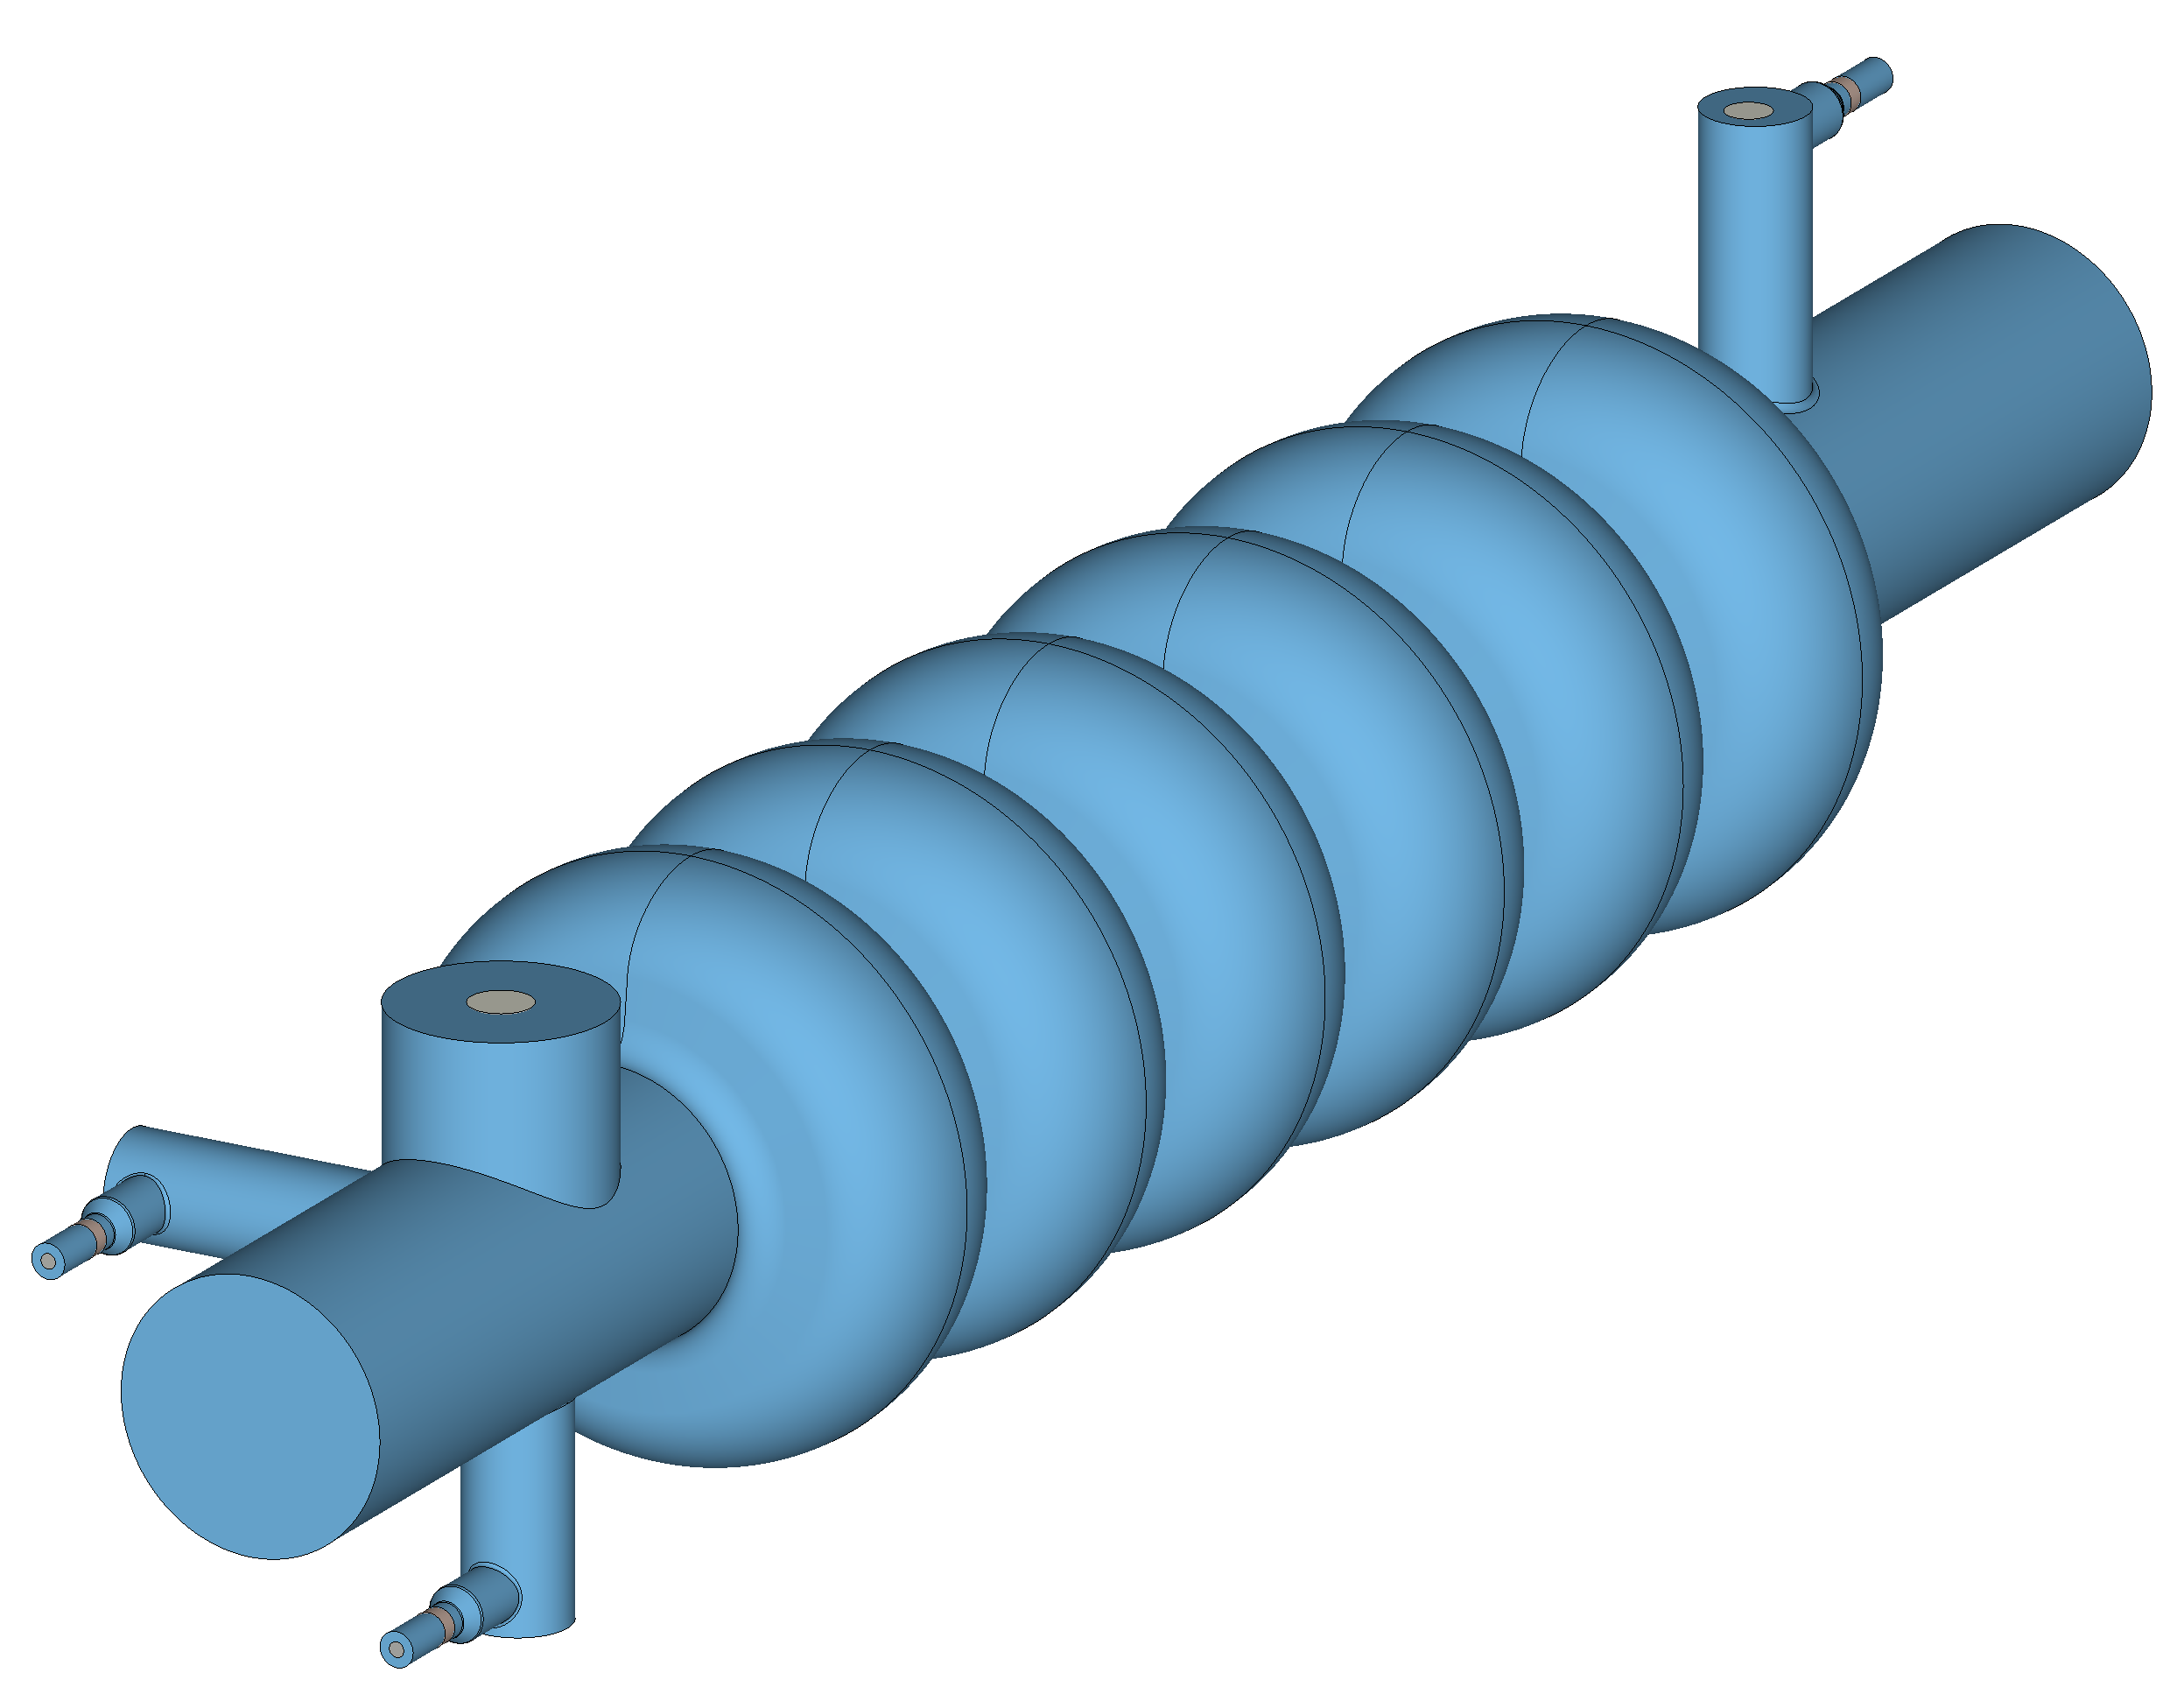
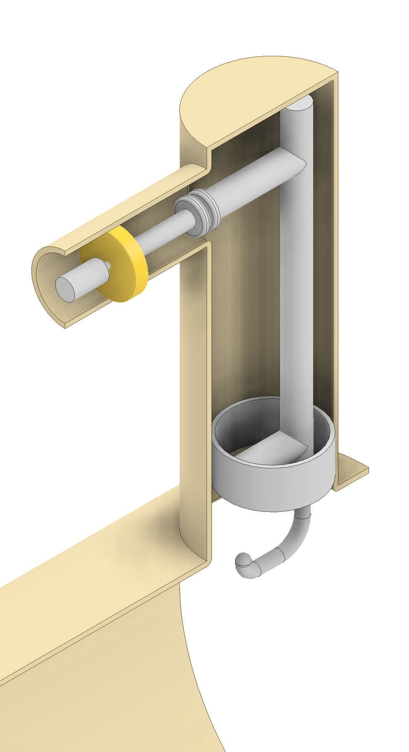
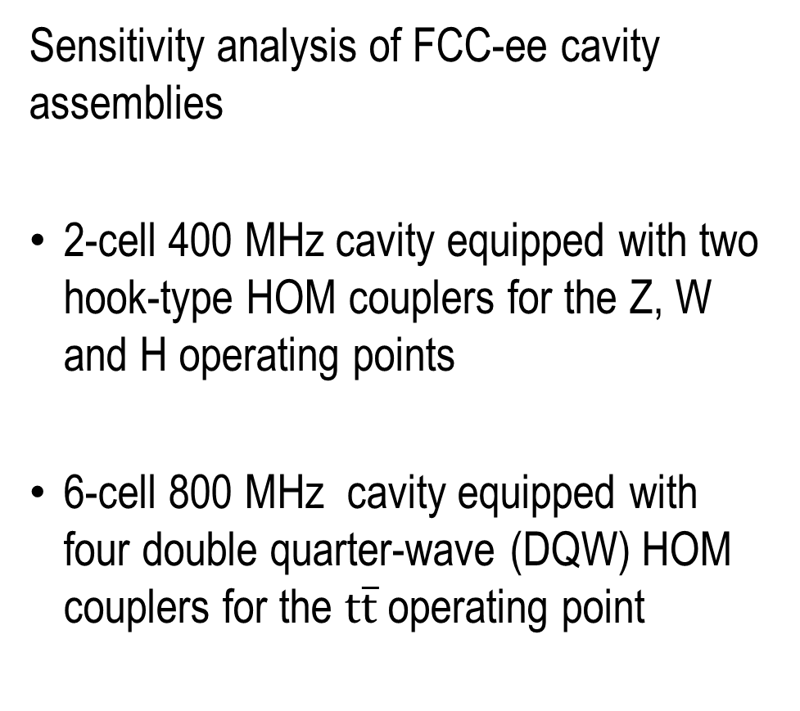
Aim
Sensitivity analysis of FCC-ee cavity assemblies
2-cell 400 MHz cavity equipped with two hook-type HOM couplers for the Z, W and H operating points
6-cell 800 MHz cavity equipped with four double quarter-wave (DQW) HOM couplers for the $t\overline{t}$ operating point
Shahnam
Shahnam

Slide 4
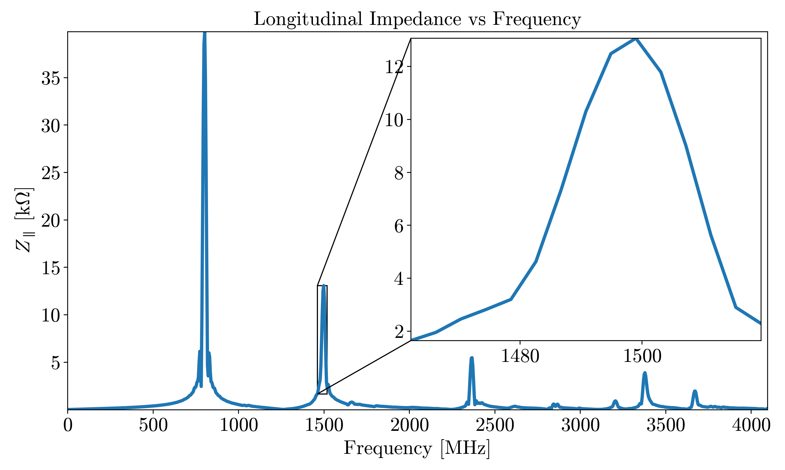
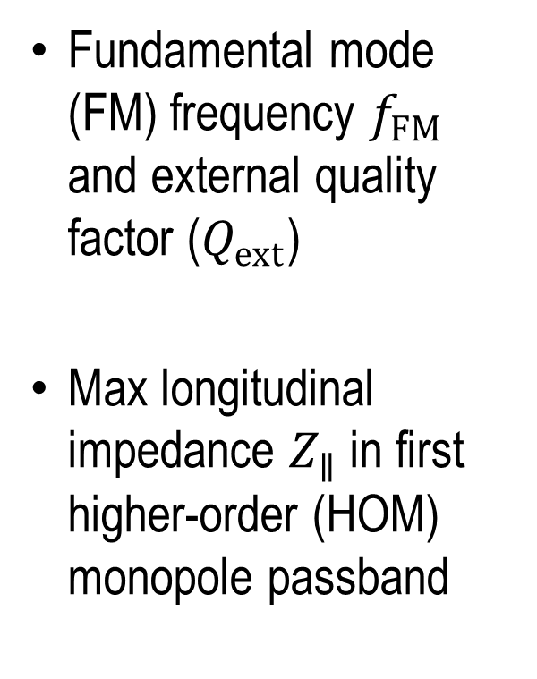
Quantities of interest
Fundamental mode (FM) frequency $f_{FM}$ and external quality factor ($Q_{ext}$)
Max longitudinal impedance $Z_{∥}$ in first higher-order (HOM) monopole passband

Slide 5
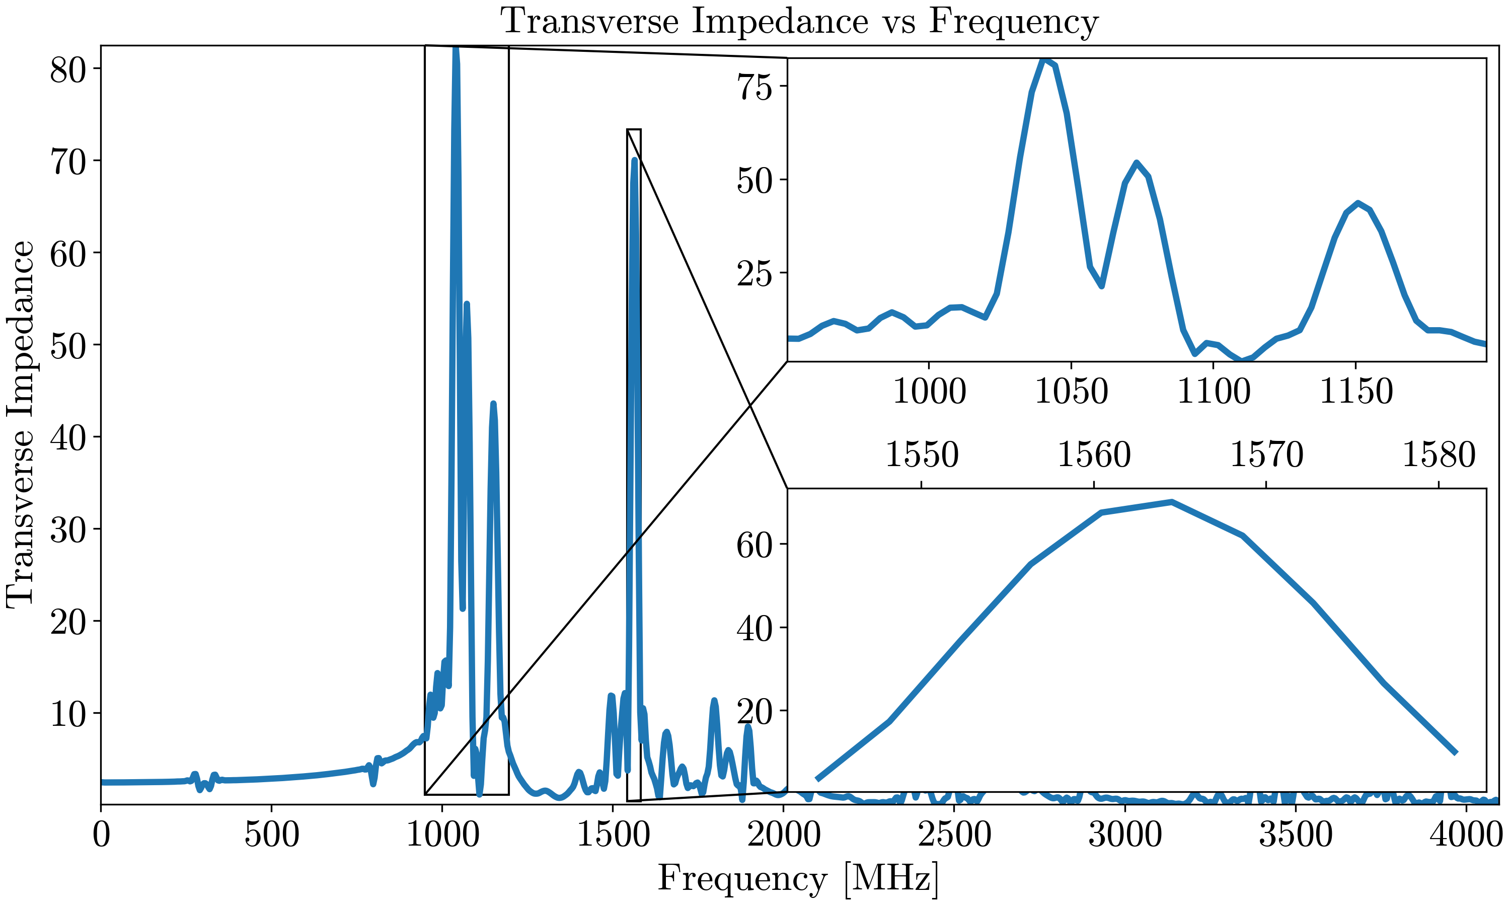
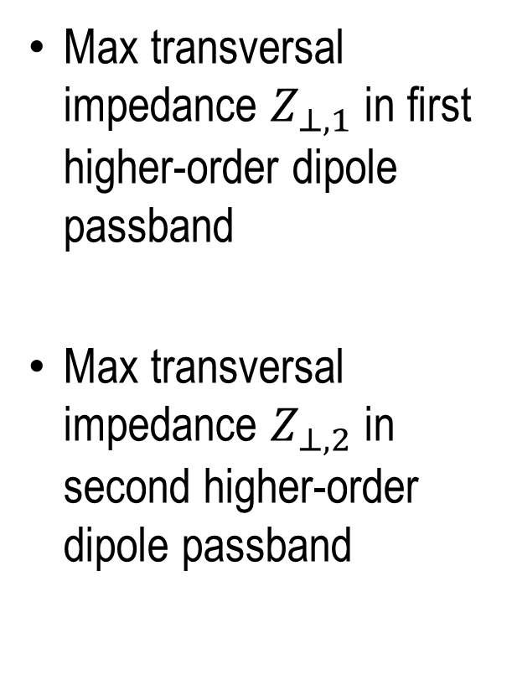
Quantities of interest
Max transversal impedance $Z_{⊥,1}$ in first higher-order dipole passband
Max transversal impedance $Z_{⊥,2}$ in second higher-order dipole passband

Slide 6
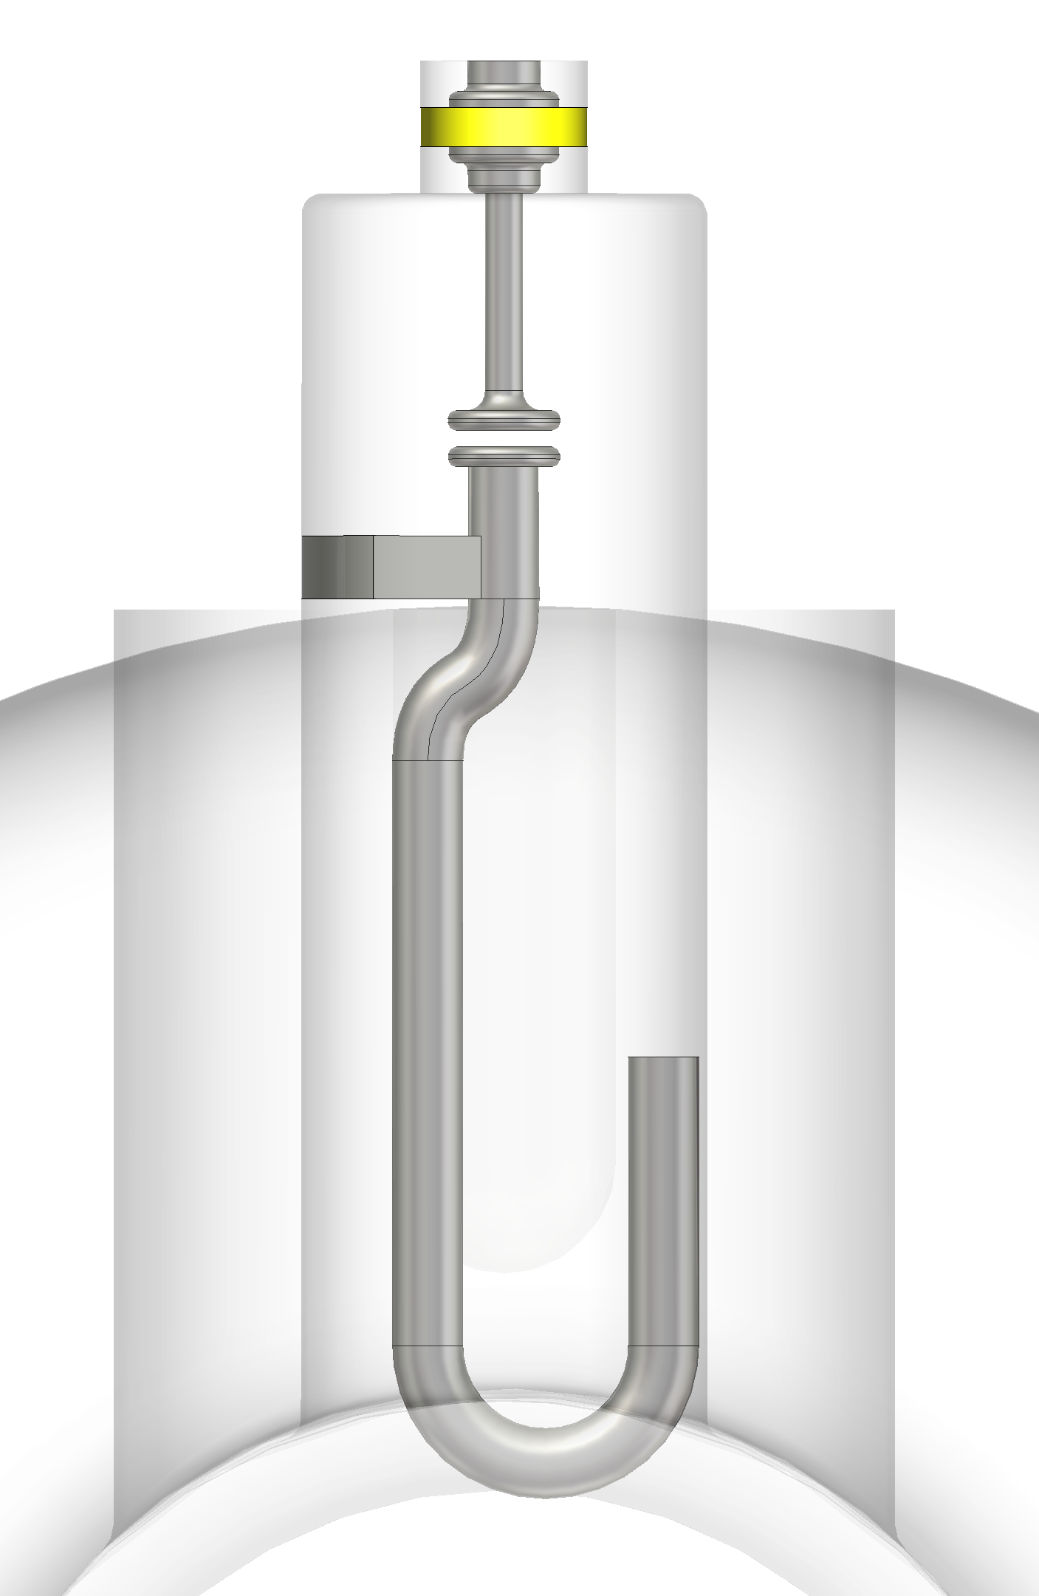
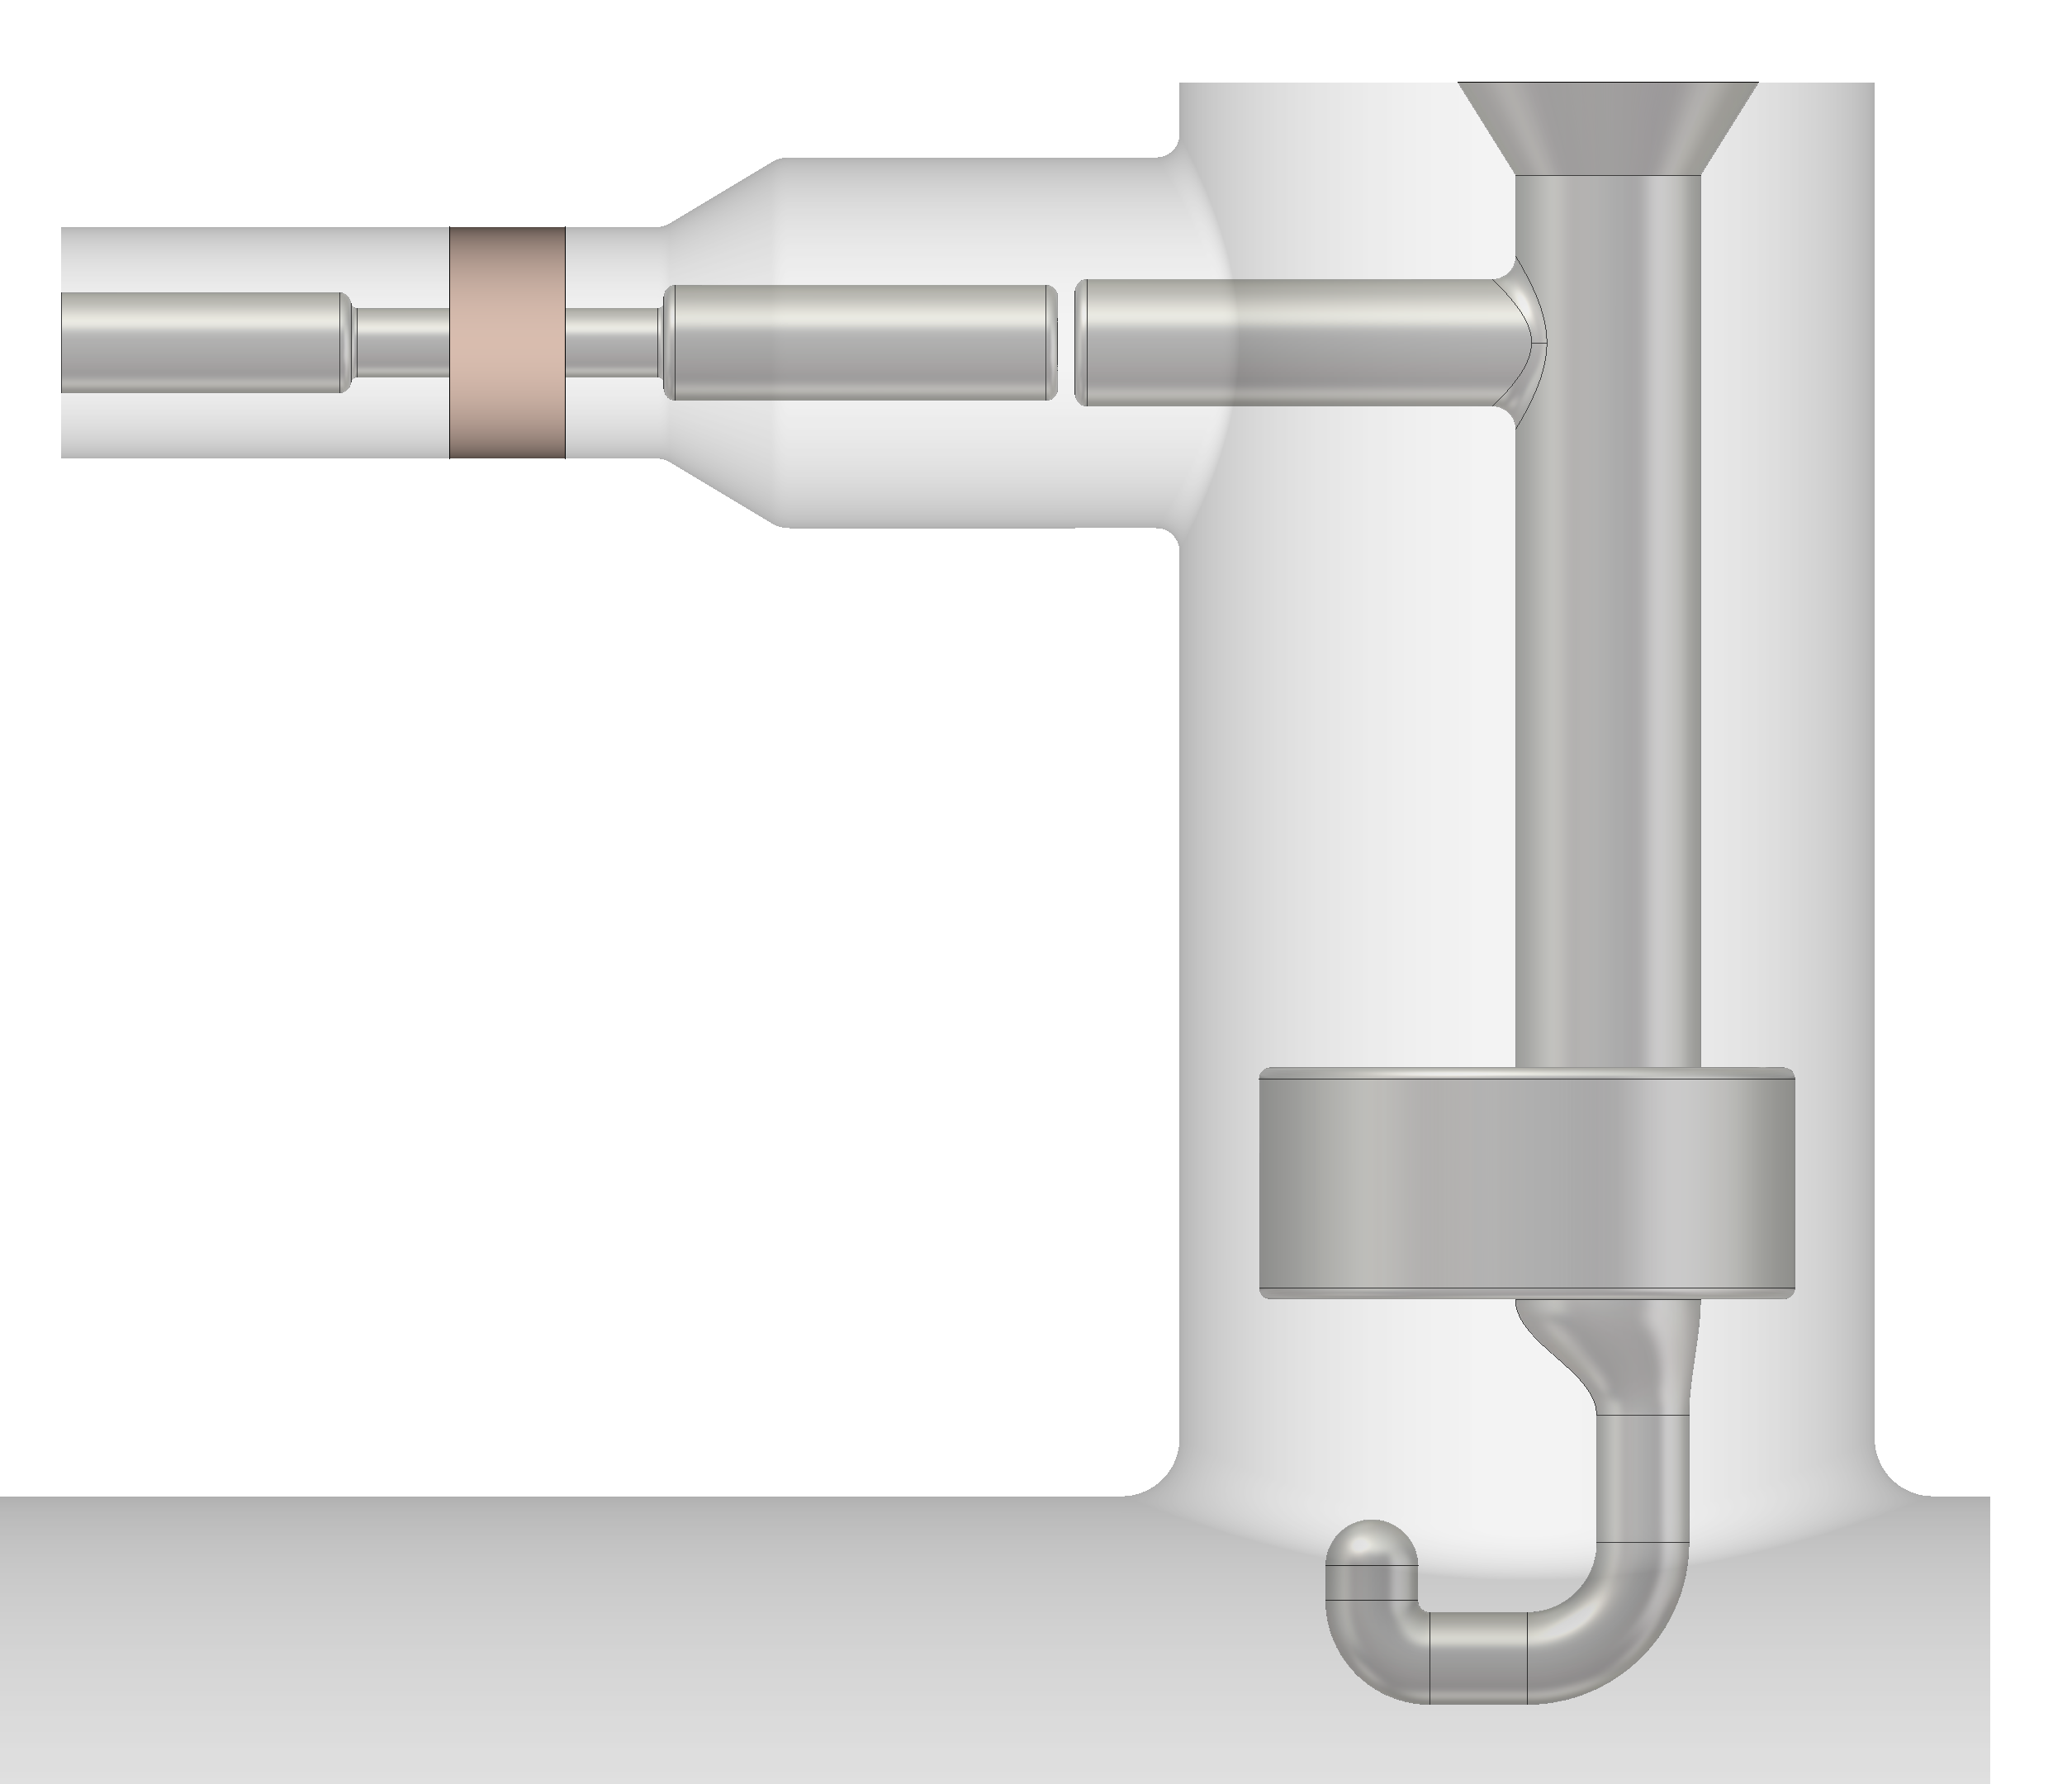
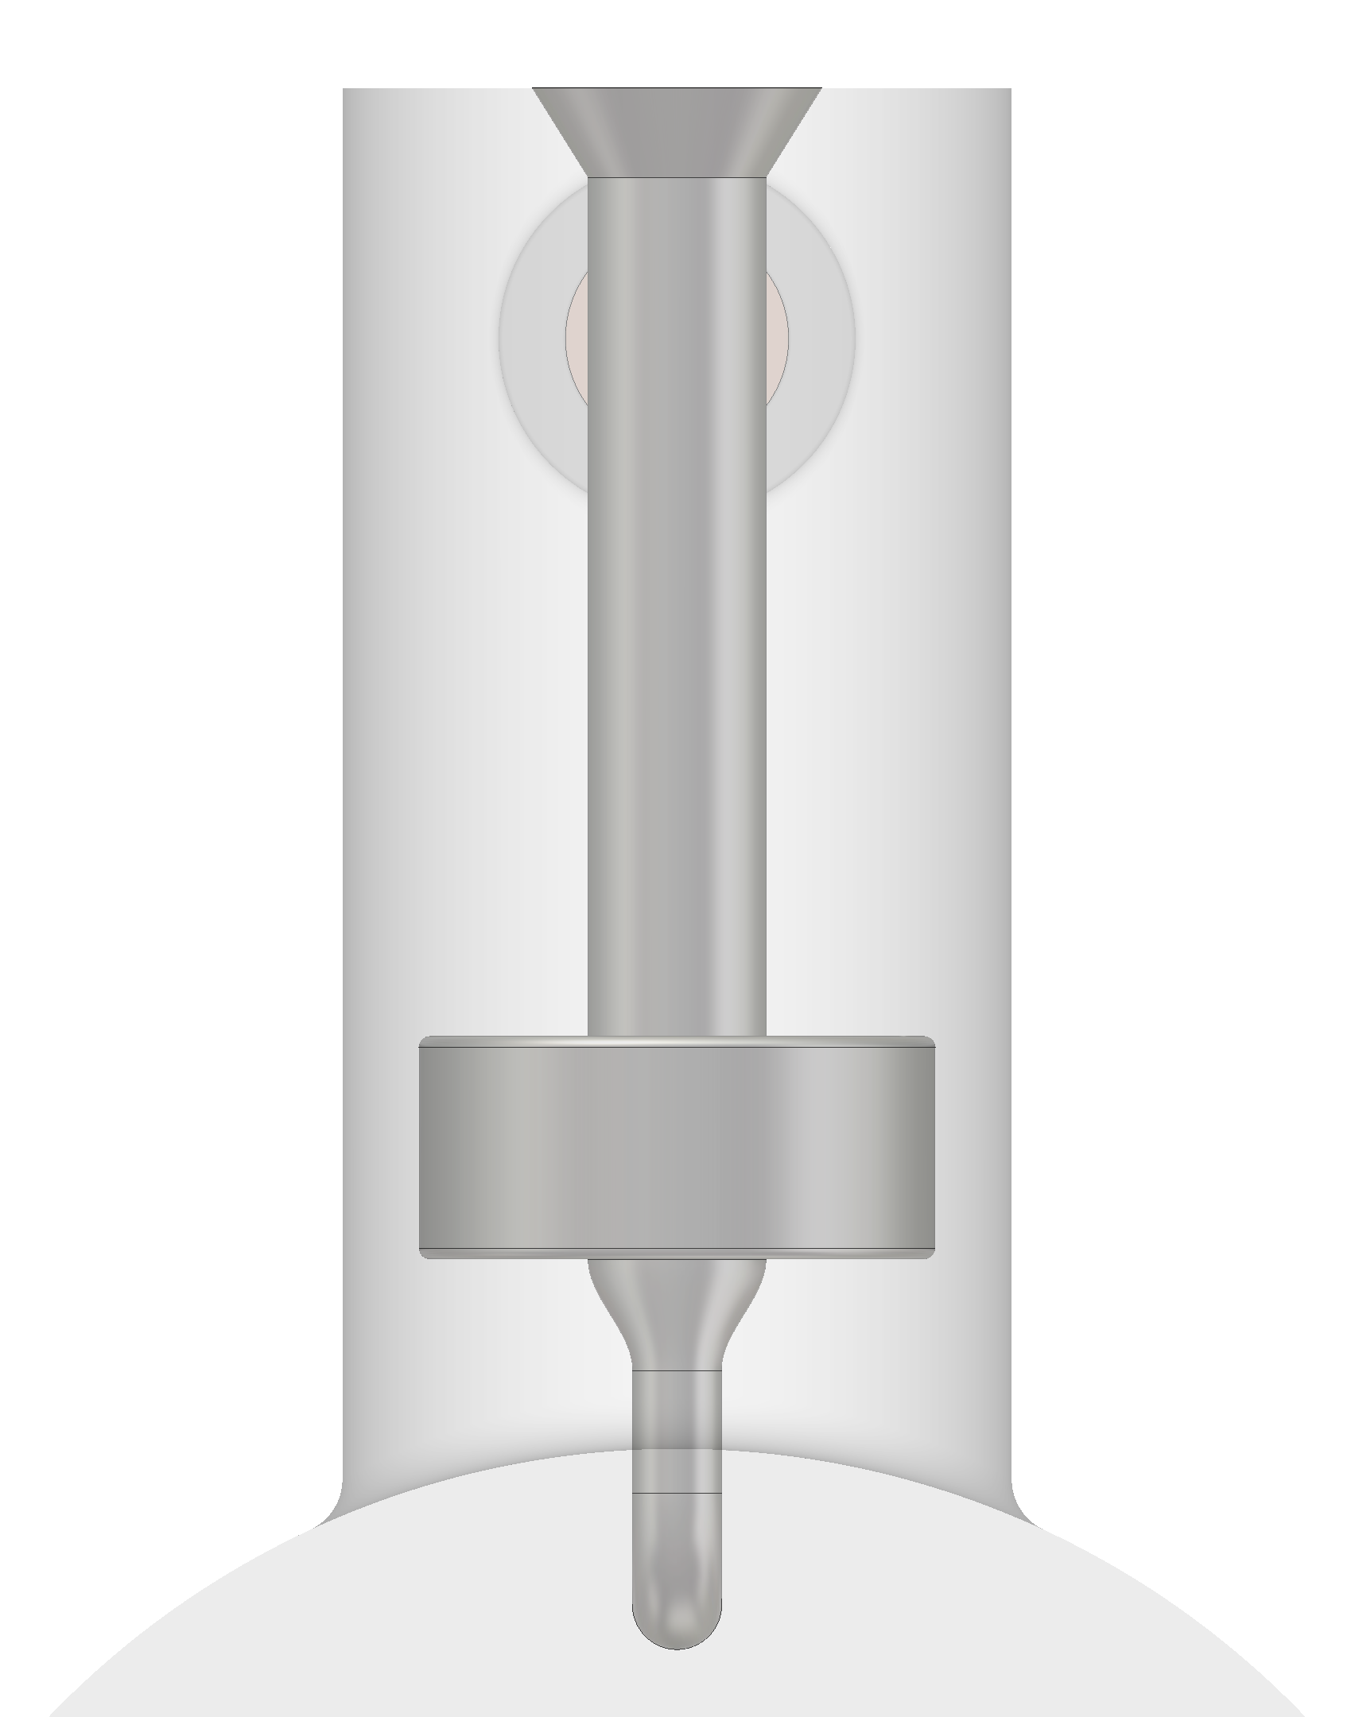



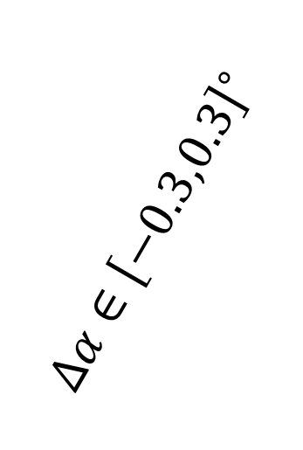


Geometric parameters
$$Δch∈\left[−1,1\right]mm$$
$$Δα∈{\left[−0.3,0.3\right]}^{∘}$$
$$Δch∈\left[−1,1\right]mm$$
$$Δα∈{\left[−0.3,0.3\right]}^{∘}$$
$$Δp∈\left[−1,1\right]mm$$
$$Δp∈\left[−1,1\right]mm$$
Double Quarter-Wave HOM Coupler
Hook-Type HOM Coupler

Slide 7
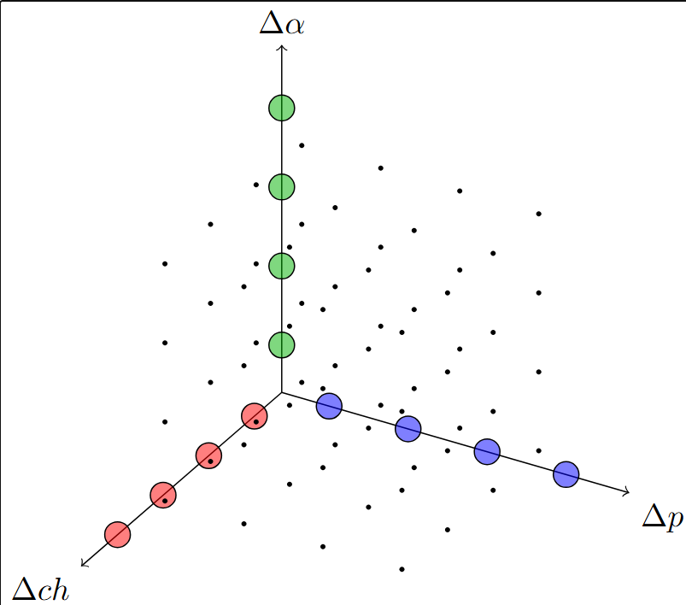
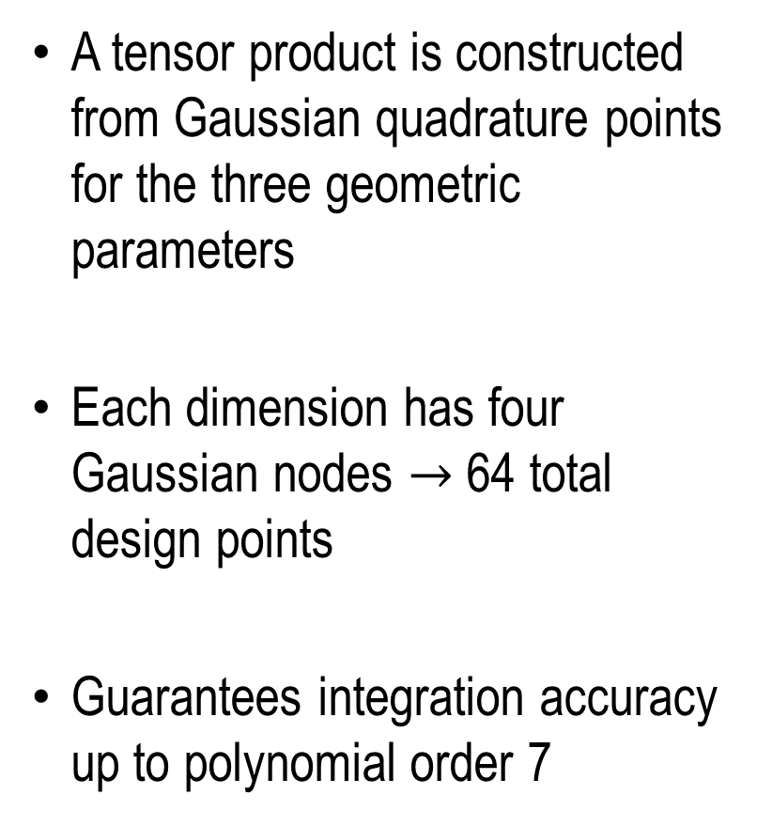
Method
A tensor product is constructed from Gaussian quadrature points for the three geometric parameters
Each dimension has four Gaussian nodes $→$ 64 total design points
Guarantees integration accuracy up to polynomial order 7

Slide 8
2-Cell Cavity Assembly

Slide 9
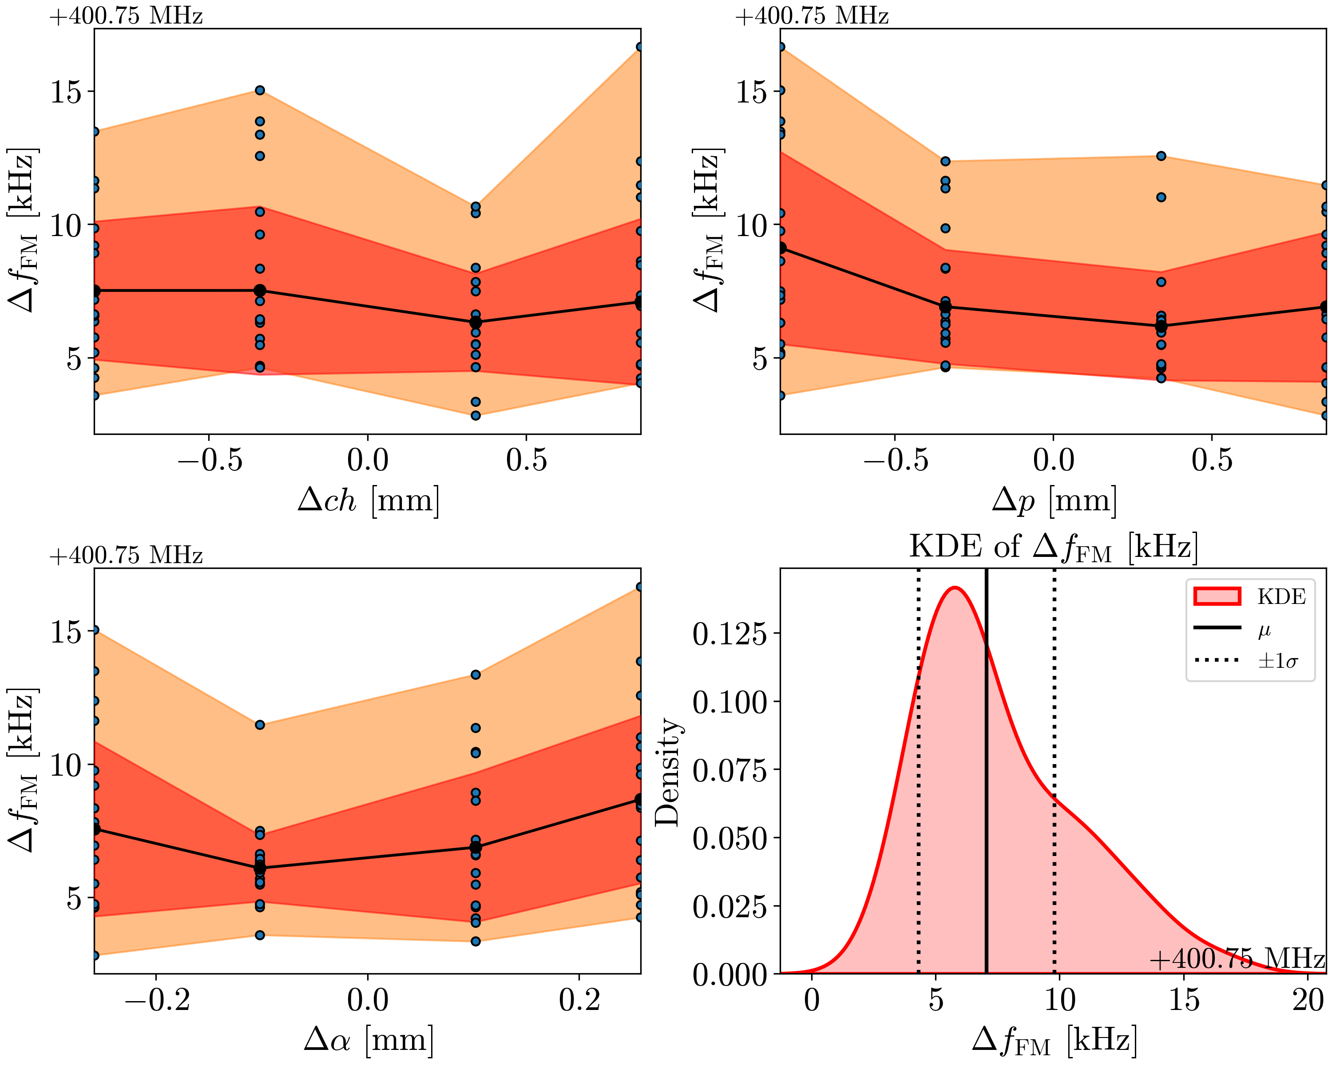
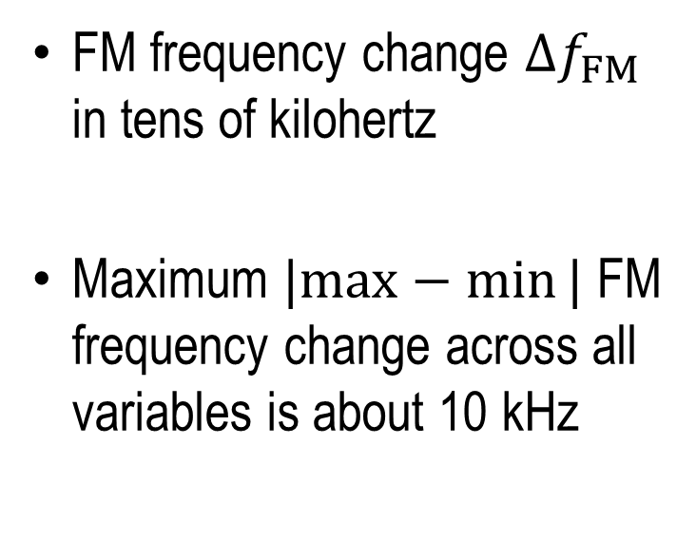
FM Frequency
FM frequency change $Δf_{FM}$ in tens of kilohertz
Maximum $|max−min⁡|$ FM frequency change across all variables is about 10 kHz

Slide 10
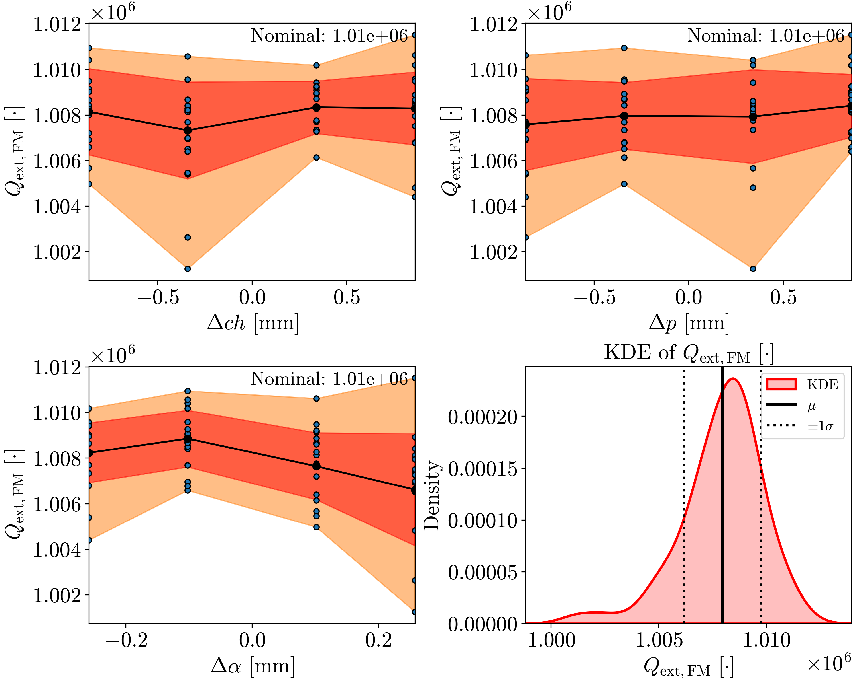
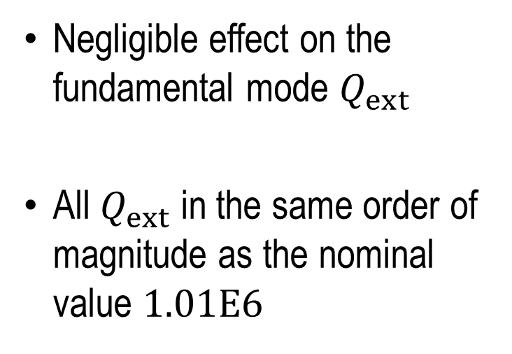
FM Qext
Negligible effect on the fundamental mode $Q_{ext}$
All $Q_{ext}$ in the same order of magnitude as the nominal value $1.01E6$

Slide 11
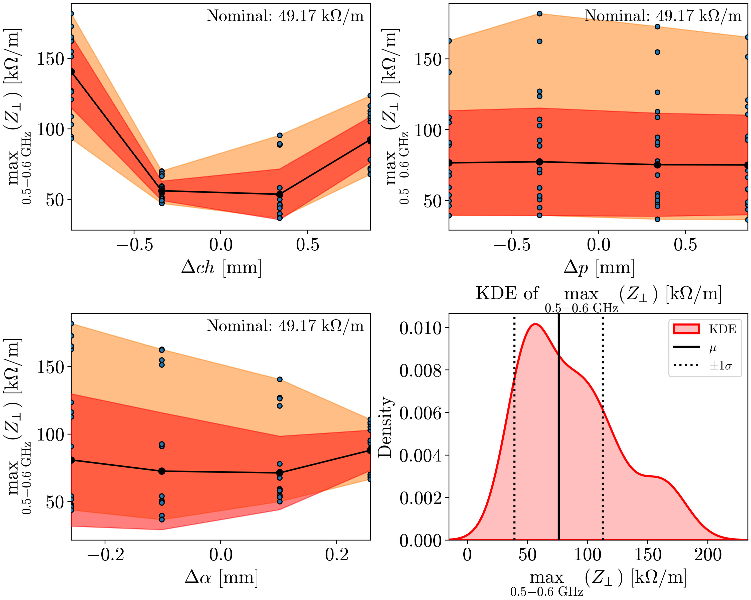
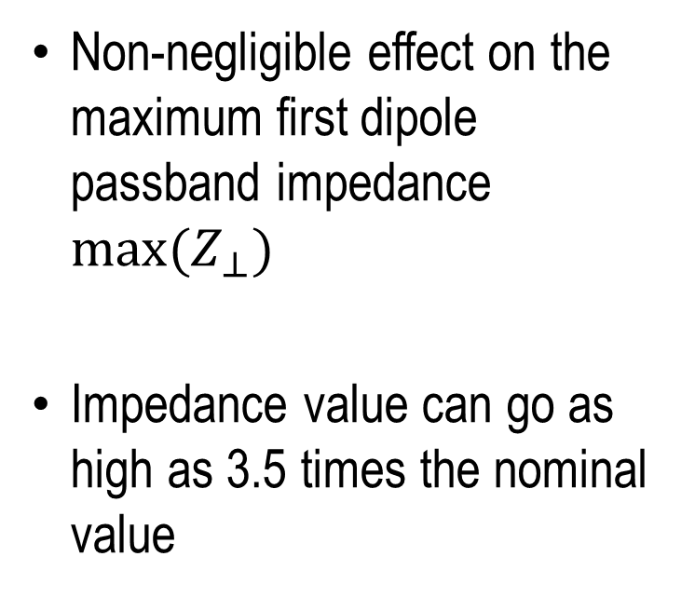
Max Transverse Impedance – First HOM Dip. Passband
Non-negligible effect on the maximum first dipole passband impedance ${max(Z}_{⊥})$
Impedance value can go as high as 3.5 times the nominal value

Slide 12
6-Cell Cavity Assembly

Slide 13
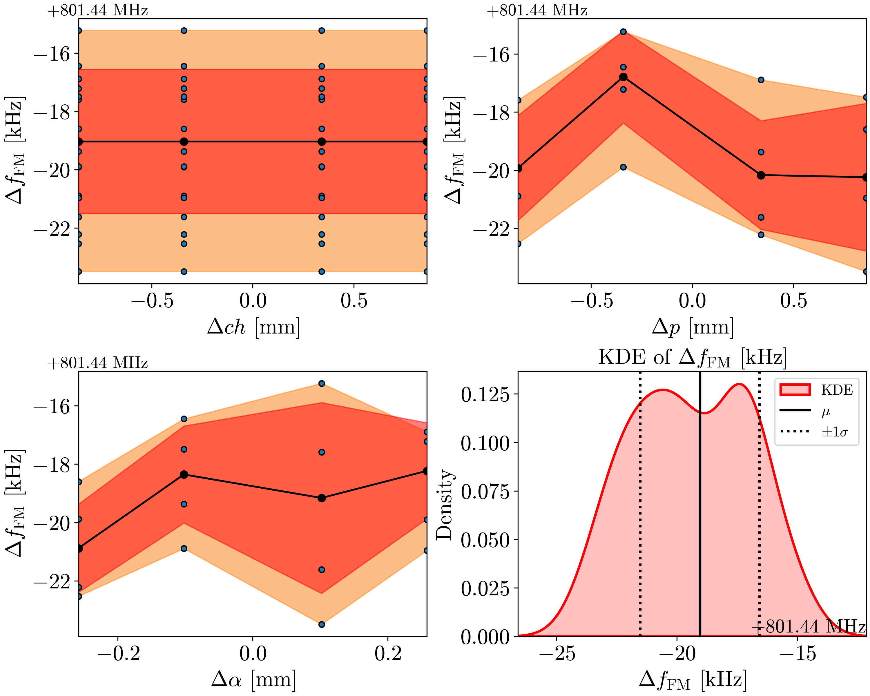
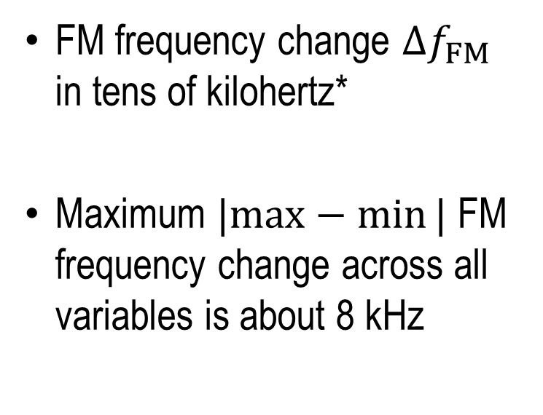
FM Frequency
FM frequency change $Δf_{FM}$ in tens of kilohertz*
Maximum $|max−min⁡|$ FM frequency change across all variables is about 8 kHz

Slide 14
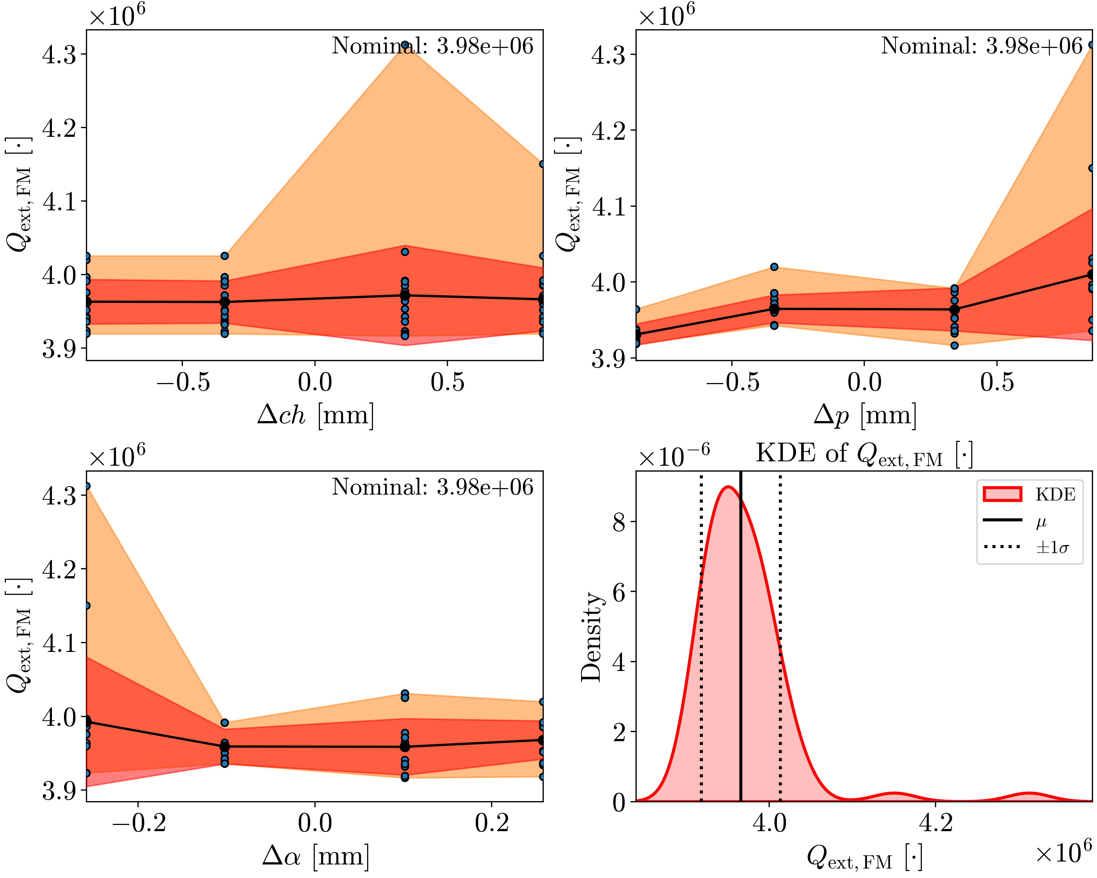
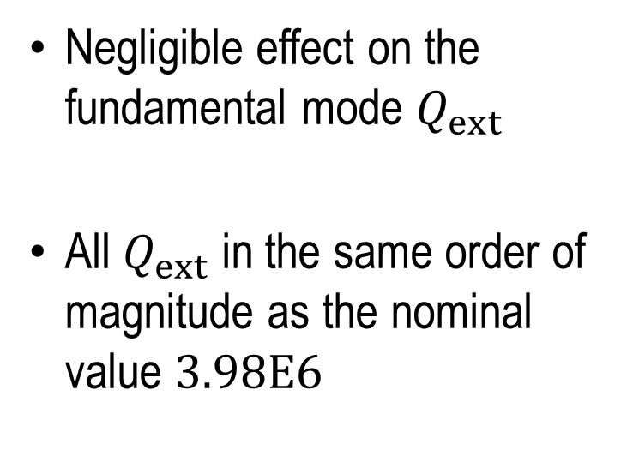
FM Qext
Negligible effect on the fundamental mode $Q_{ext}$
All $Q_{ext}$ in the same order of magnitude as the nominal value $3.98E6$

Slide 15
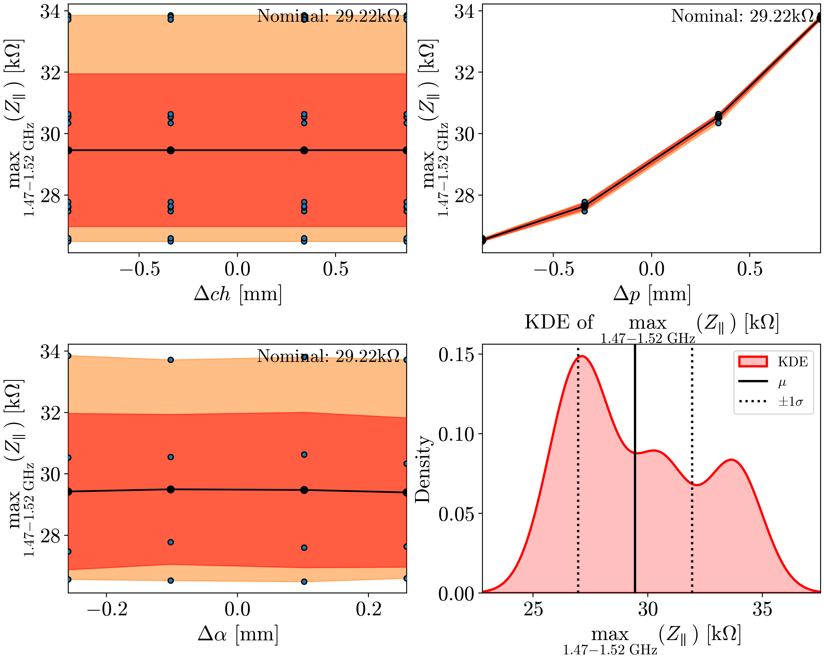
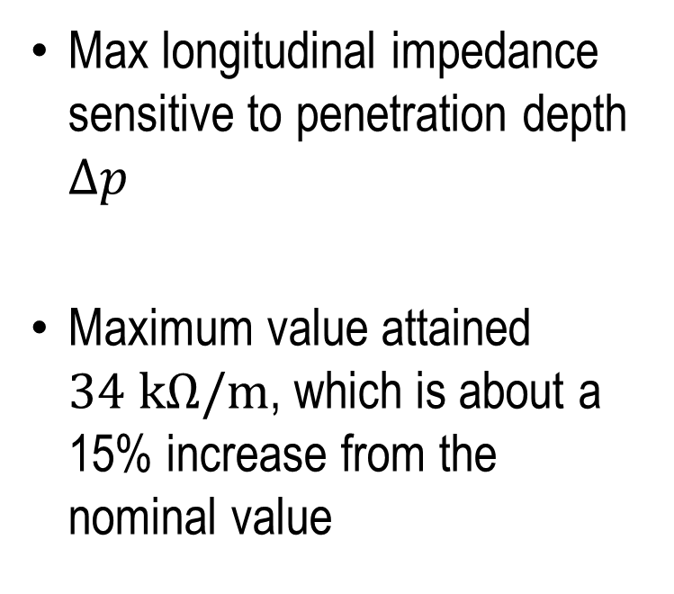
Max Long. Impedance – First HOM Mon. Passband
Max longitudinal impedance sensitive to penetration depth $Δp$
Maximum value attained $34 kΩ/m$, which is about a 15% increase from the nominal value

Slide 16
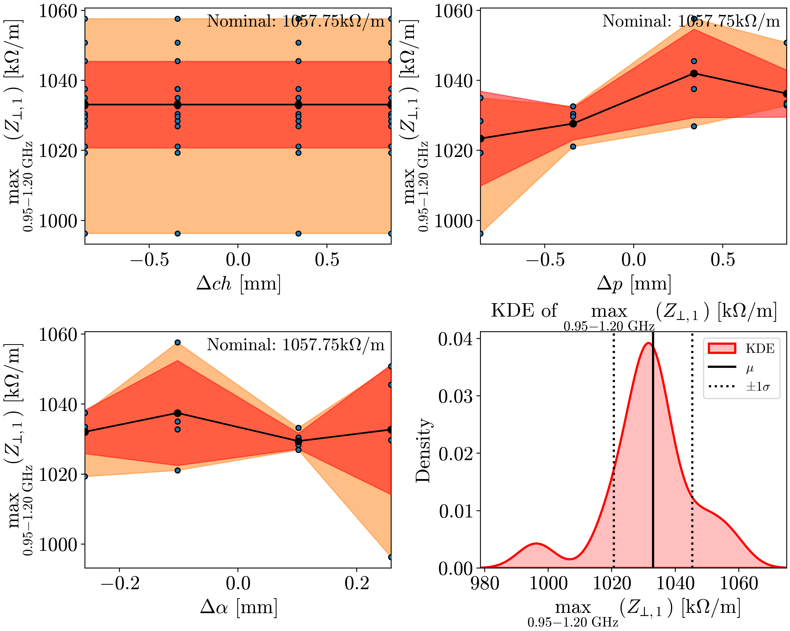
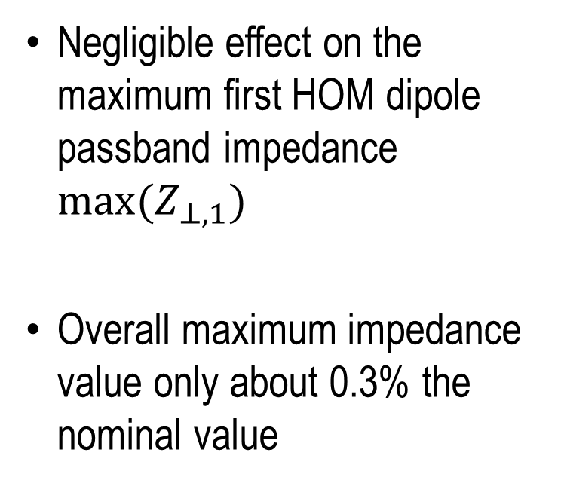
Max Trans. Impedance – First HOM Dipole Passband
Negligible effect on the maximum first HOM dipole passband impedance ${max(Z}_{⊥,1})$
Overall maximum impedance value only about 0.3% the nominal value

Slide 17
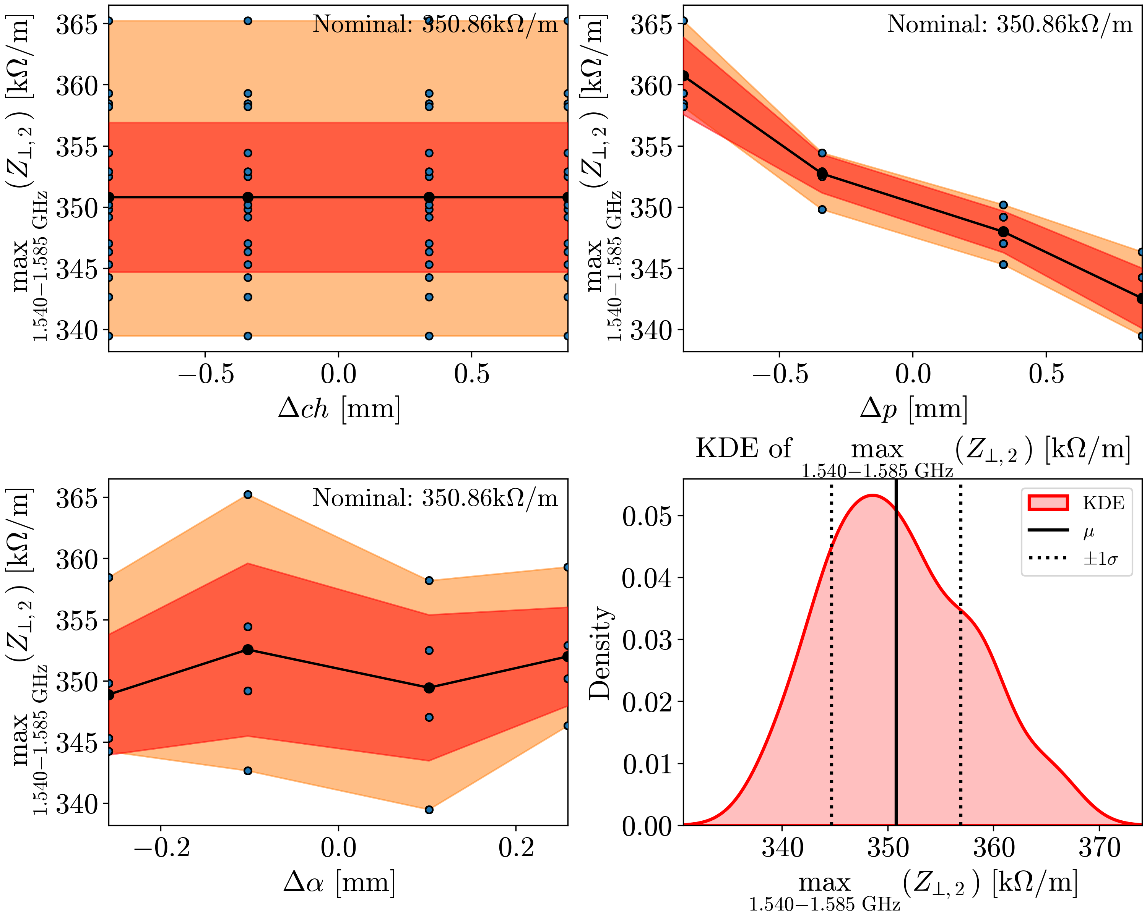
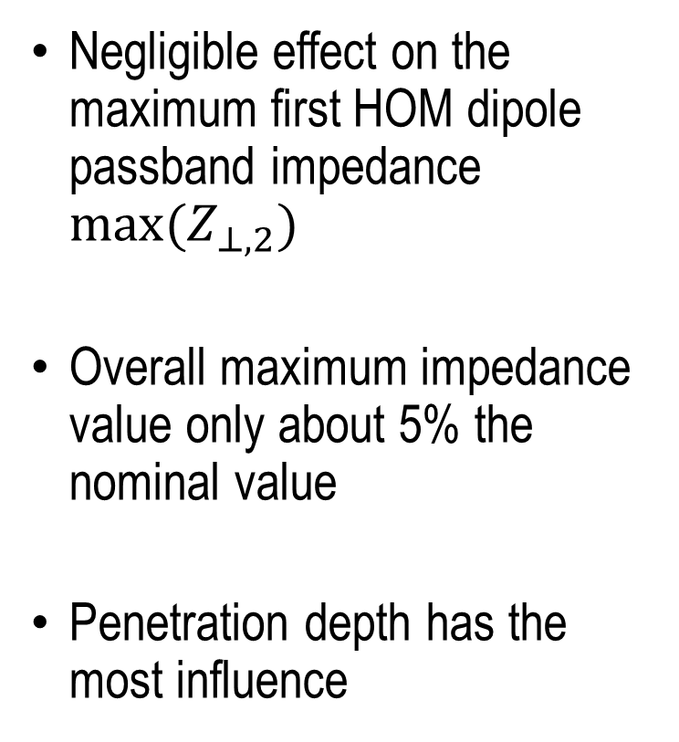
Max Trans. Impedance – 2nd Dip. Passband
Negligible effect on the maximum first HOM dipole passband impedance ${max(Z}_{⊥,2})$
Overall maximum impedance value only about 5% the nominal value
Penetration depth has the most influence

Slide 18
Conclusion
For almost all of the considered quantities, deviations in the considered HOM coupler geometric parameters do not lead to a substantial change in the analysed quantities of interest
The maximum transverse impedance due to perturbation of the 2-cell cavity assembly is 3.5 times the design value. This may be problematic if the mode is the performance-limiting mode

