Slide 1

TEM analysis of coatings for RF cavities
J. Bernardi, A. Steiger-Thirsfeld – USTEM / TU Wien
S. Leith, G. Rosaz, C. P. A. Carlos - CERN
F. Semper, M. Asiyaban and M. Eisterer –Atominstitut / TU Wien

Slide 2
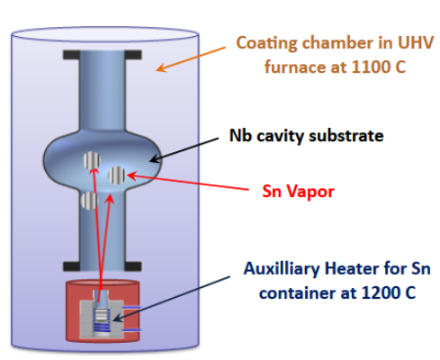
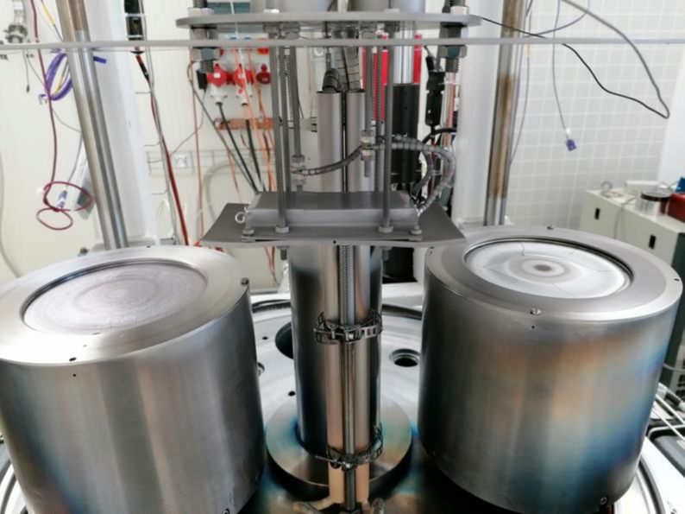
Thin film Nb₃Sn RF cavities
Vapor diffusion coating
High Power Impulse Magne-
tron Sputtering (HiPIMS)
M.Liepe, Cornell University, FCC Week 2015
Challenges:
Homogeneity, constant Sn concentration
Surface roughness
Localized defects

Slide 3
The perfect cavity coating
Thin Nb₃Sn coating
  higher operating temperature than pure Nb
  low surface resistance
  high acceleration gradients
Homogeneous microstructure, no defects
Smooth surface
Constant Nb:Sn ratio
No Cu diffusion into A15 film
Ta interlayer
Low costs
Nb₃Sn
Cu
Cu substrate with high heat conductance

Slide 4
Preparation conditions
Ta Interlayer Kr atmosphere, 0.001 mbar
  High temperature Deposition @ 750 °C + annealing @ 750 °C
  Low temperature Deposition @ 175 °C
Nb-Sn target Sn 25 at% or Sn 27 at%
Nb-Sn coating pressure
  High pressure 2.50x10⁻² mbar
  Low pressure 7.00x10⁻⁴ mbar
Annealing of Nb-Sn
  reaction during coating Deposition @ 750 °C / 2 hrs
  reaction after coating Deposition @ 260 °C / 2 hrs
  + annealing @ 750 °C / 24 hrs

Slide 5
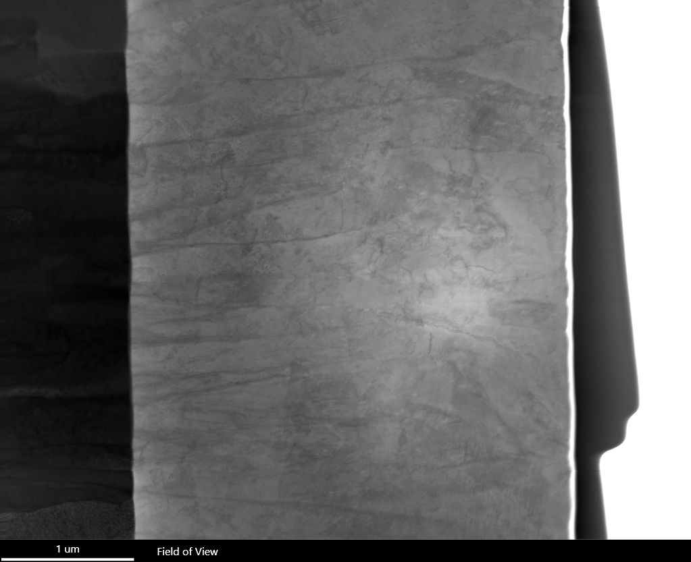

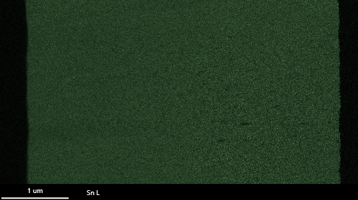
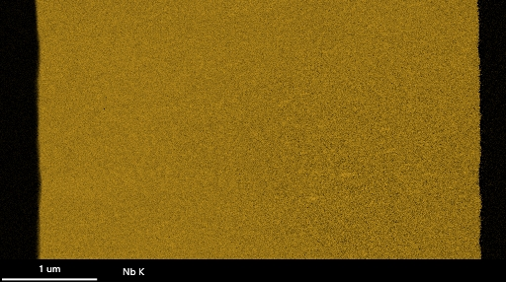
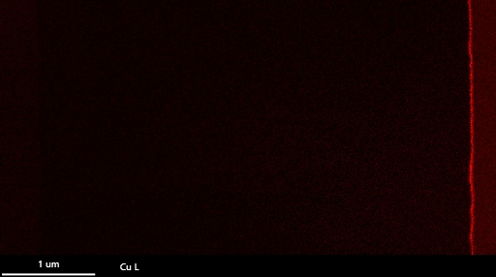
A perfect microstructure?
Ta
Nb₃Sn
Ta-M
Sn-L
EDX maps
ABF
Nb-K
Cu-L
SUBU, 25% Sn, Ta 750°C, Nb₃Sn 8.0E-03, reaction during coating (at 750 °C)

Slide 6
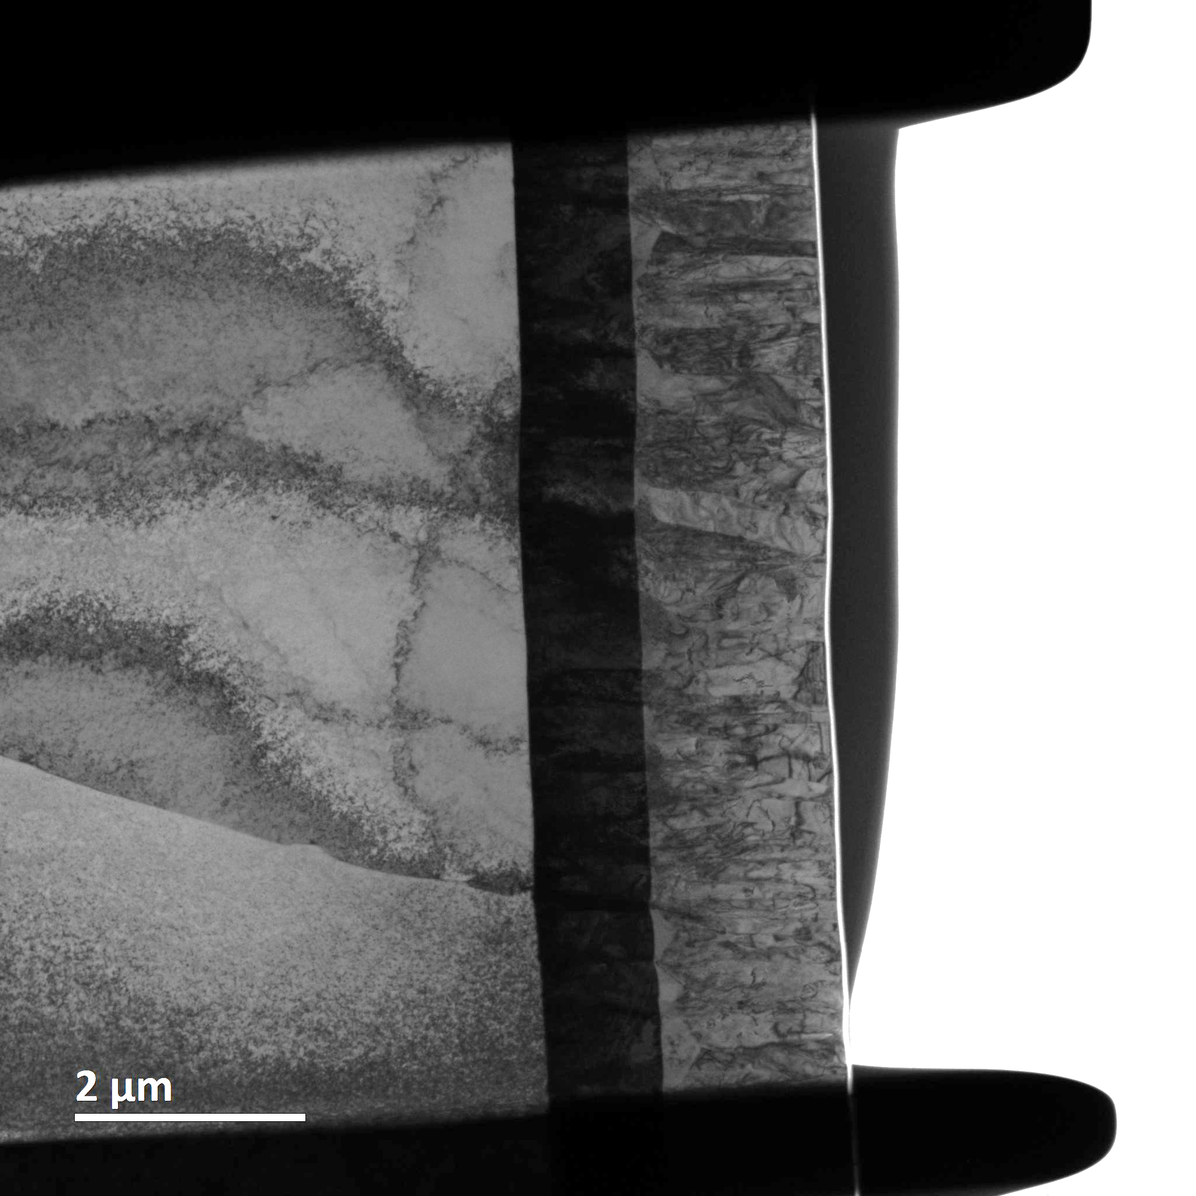
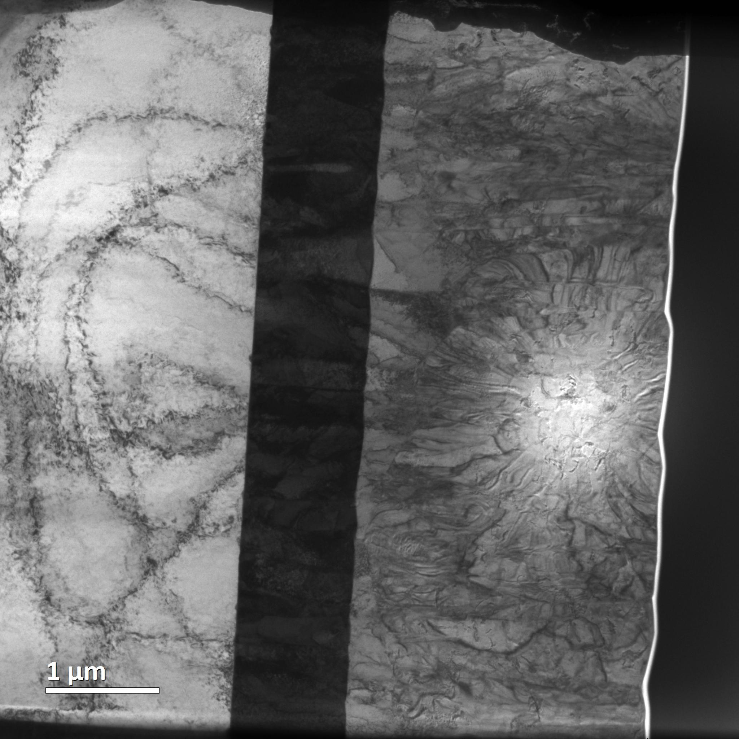
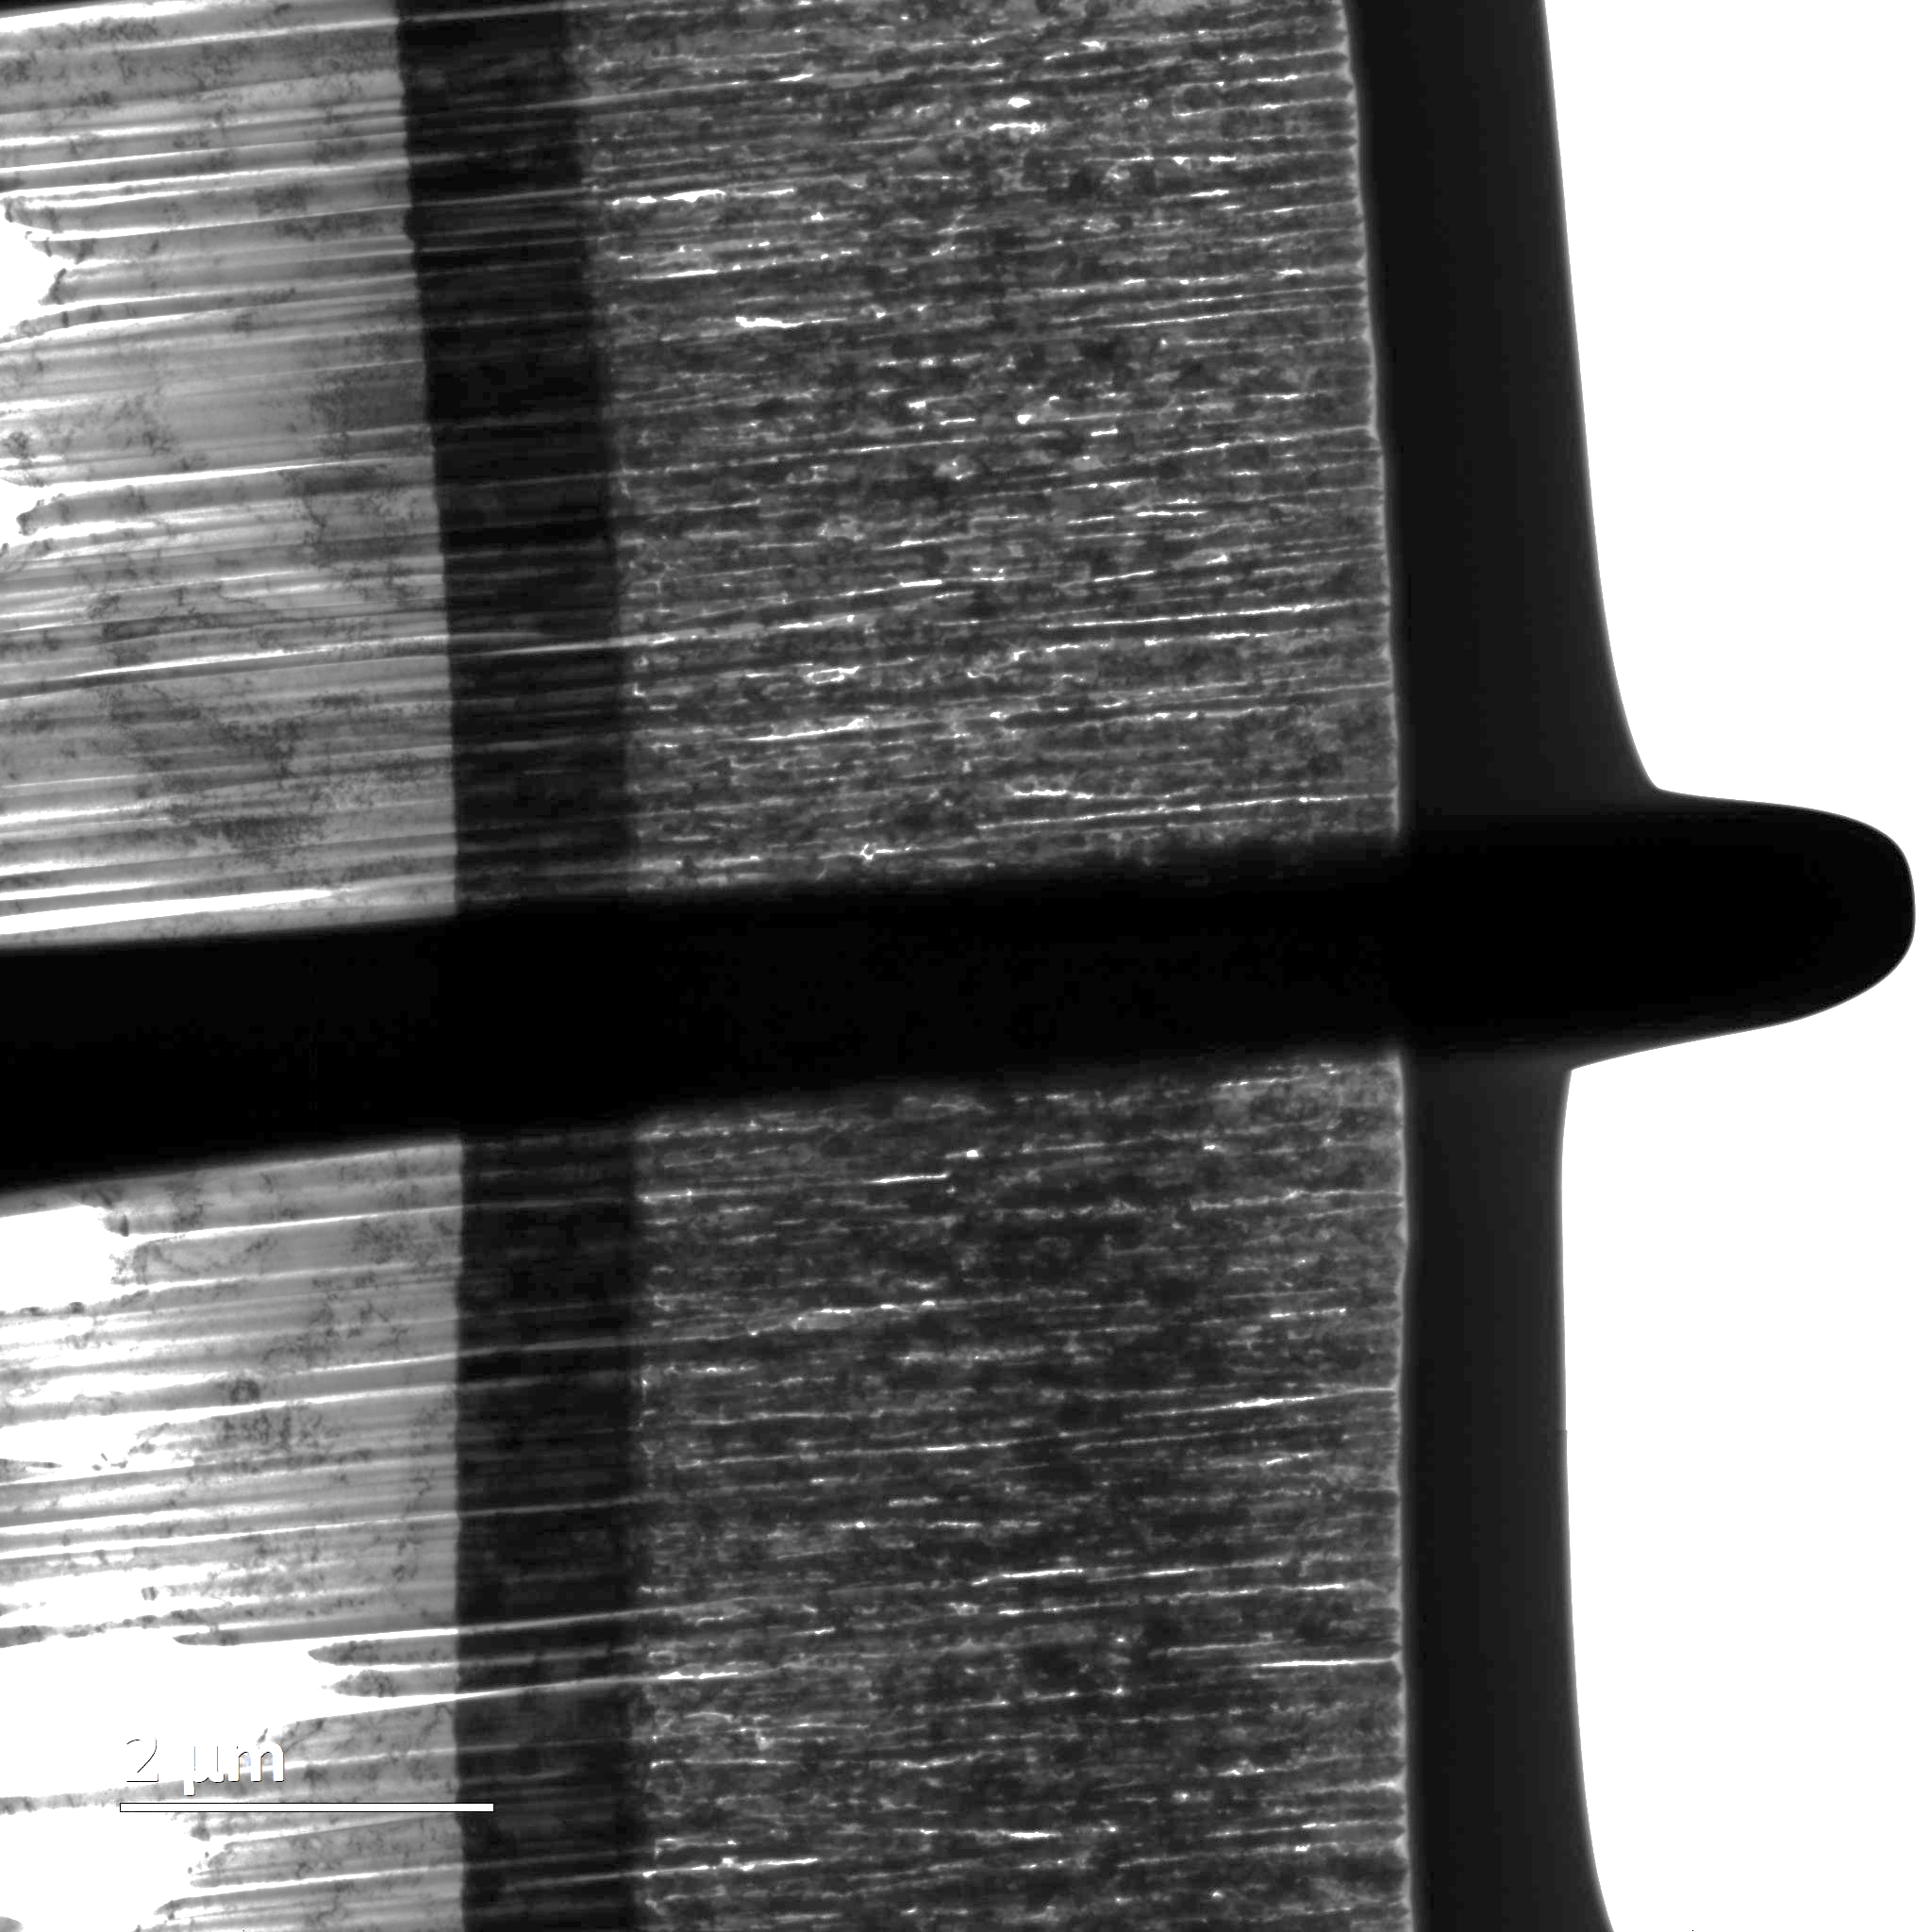
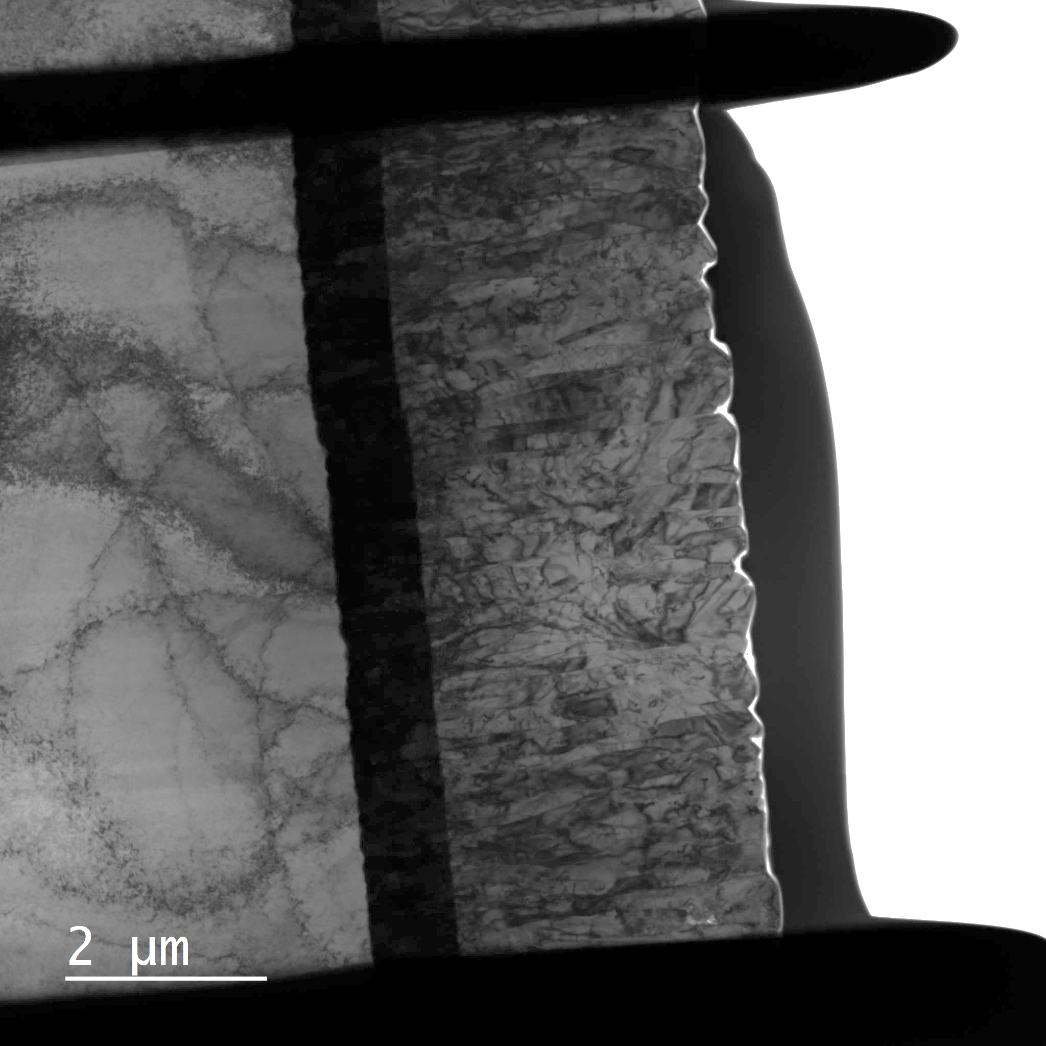
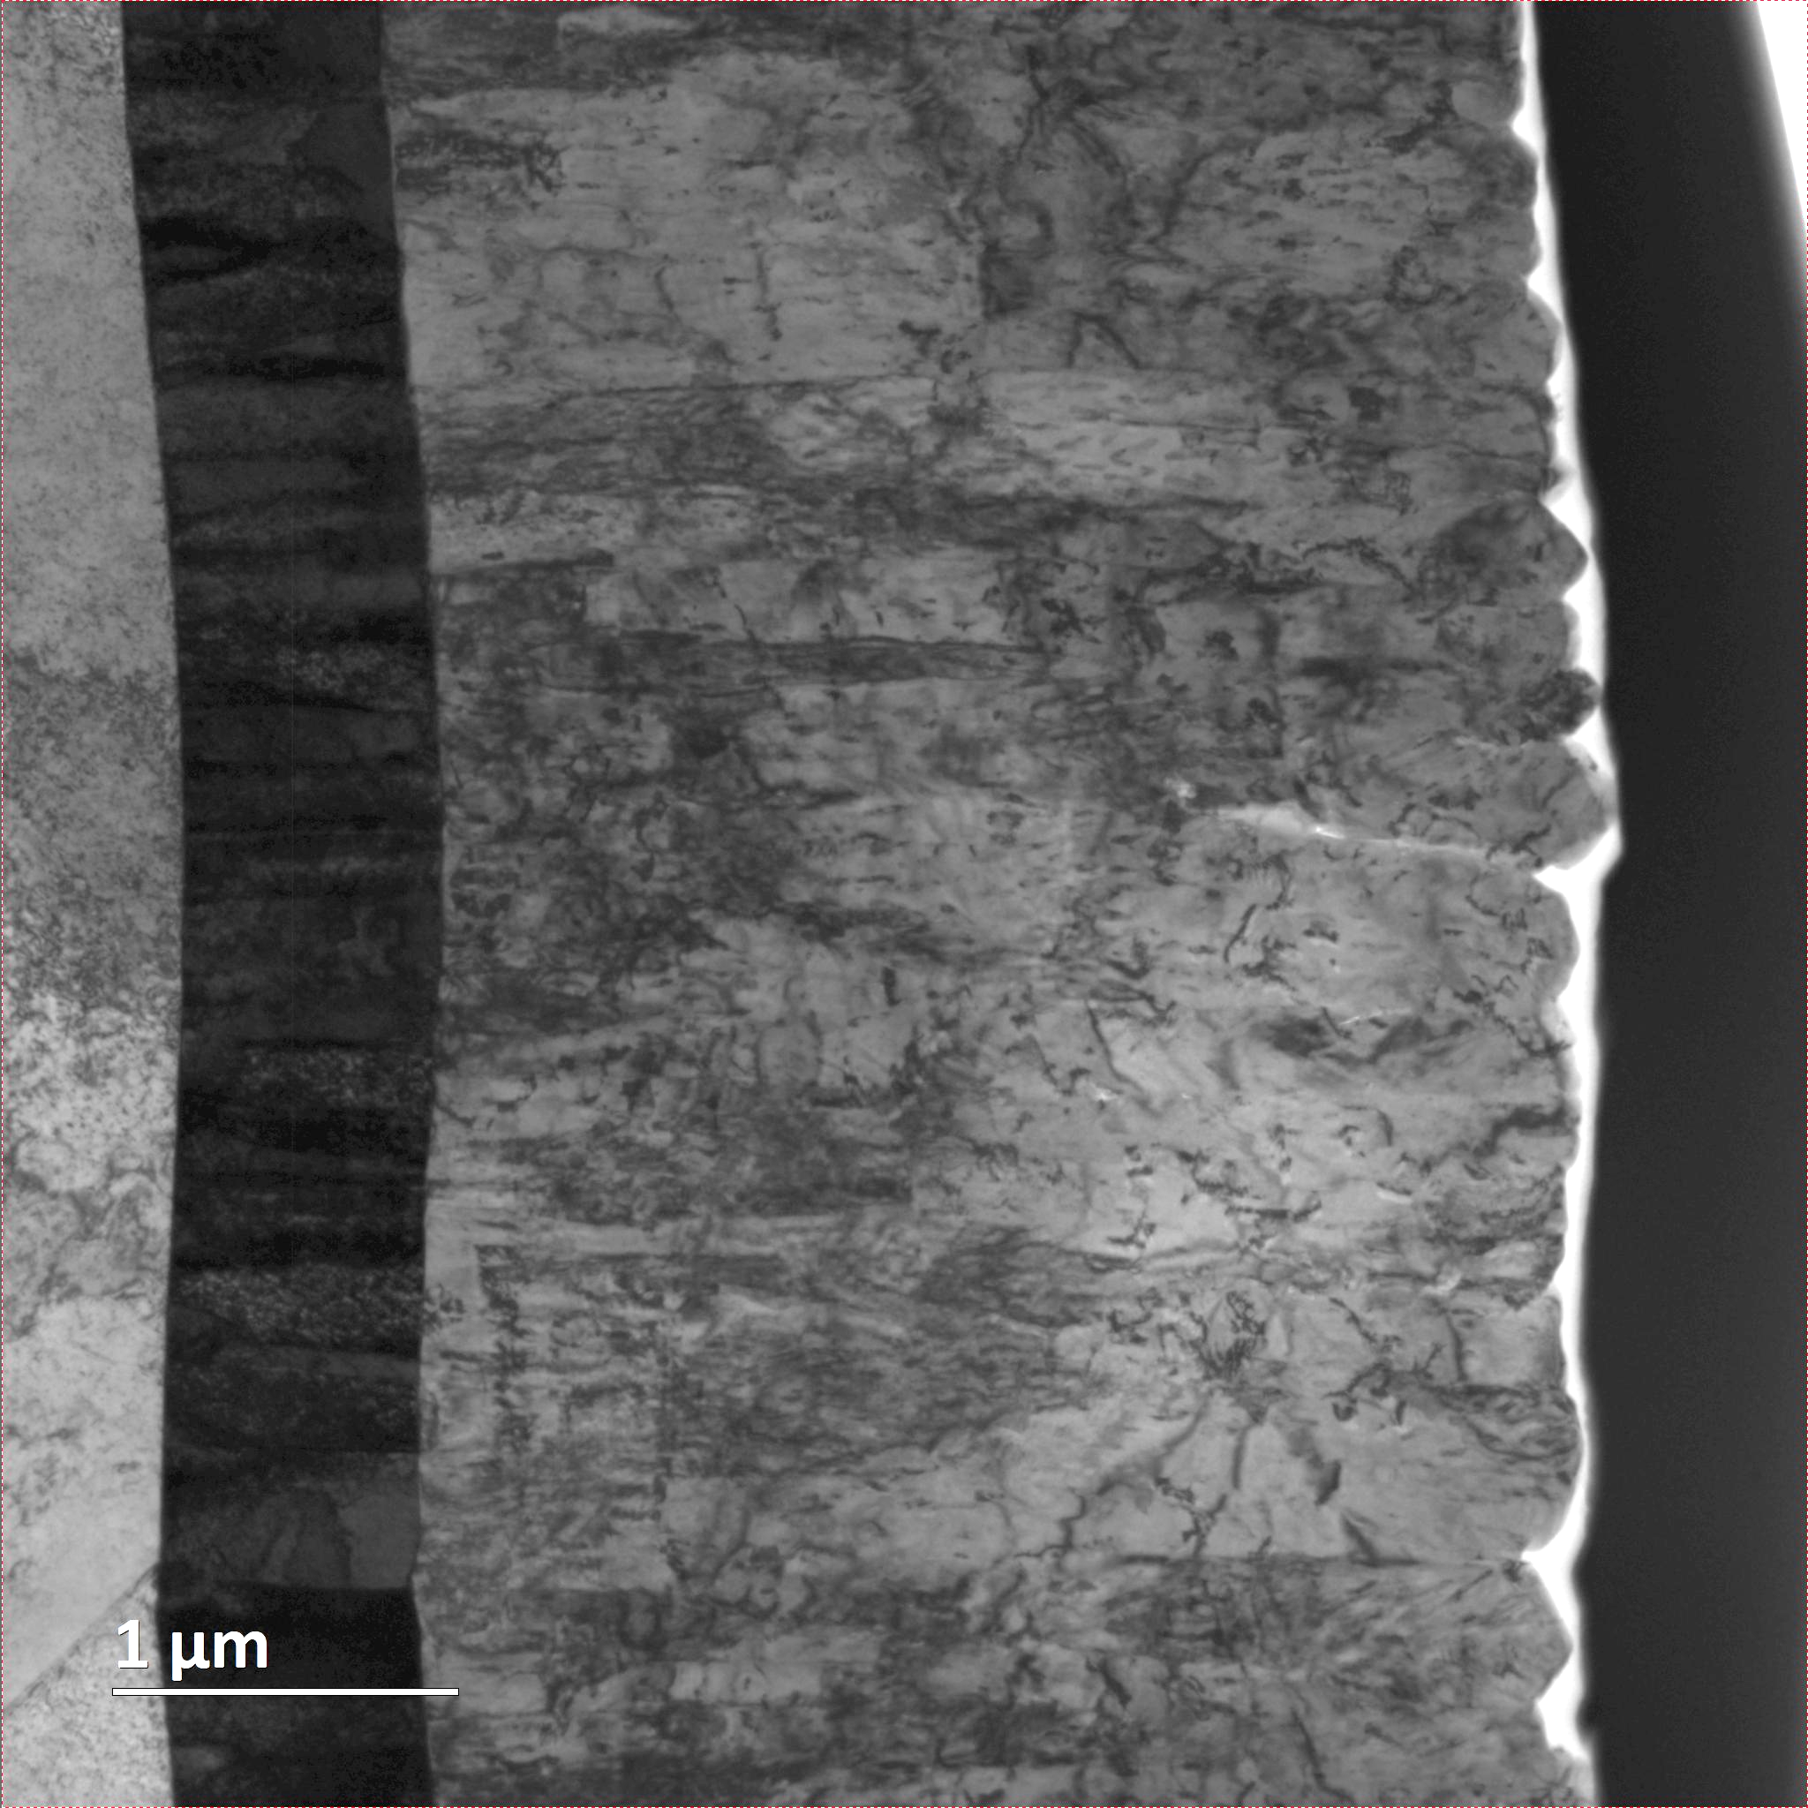
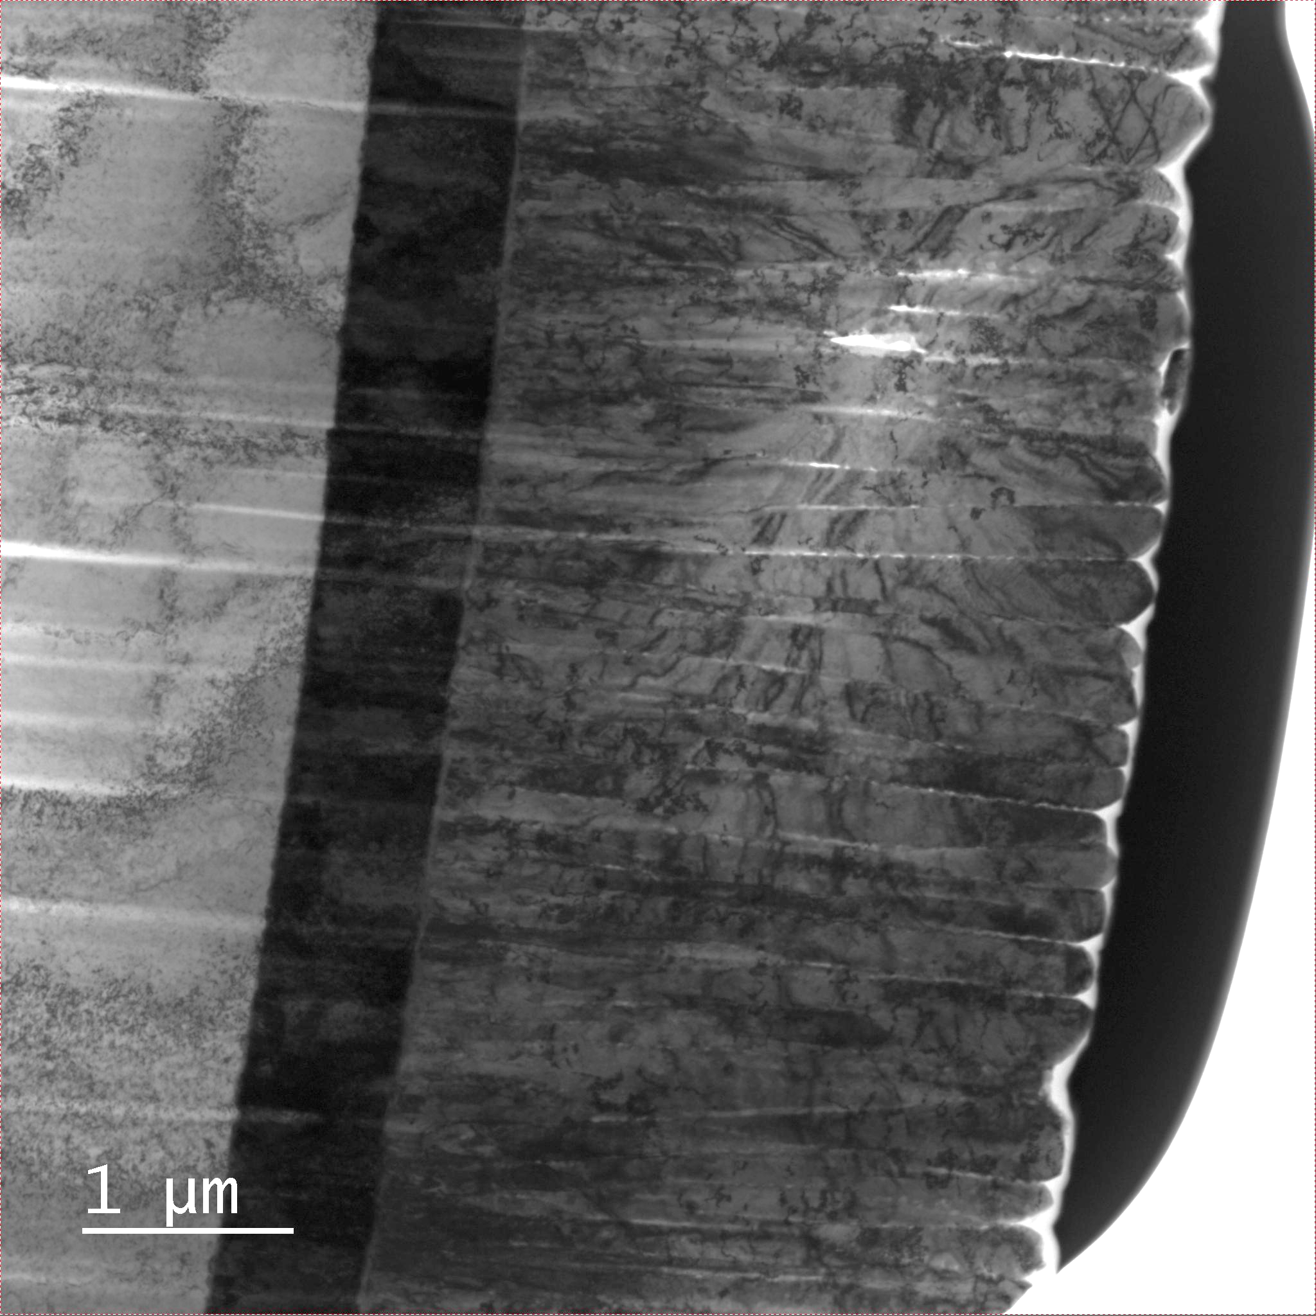
The real surface (microscopically)
Cu
Ta
A15
Smooth surface
Smooth surface
Smooth surface
Voids
Rough surface
Rough surface
Cracks
Rough surface
Voids and cracks

Slide 7
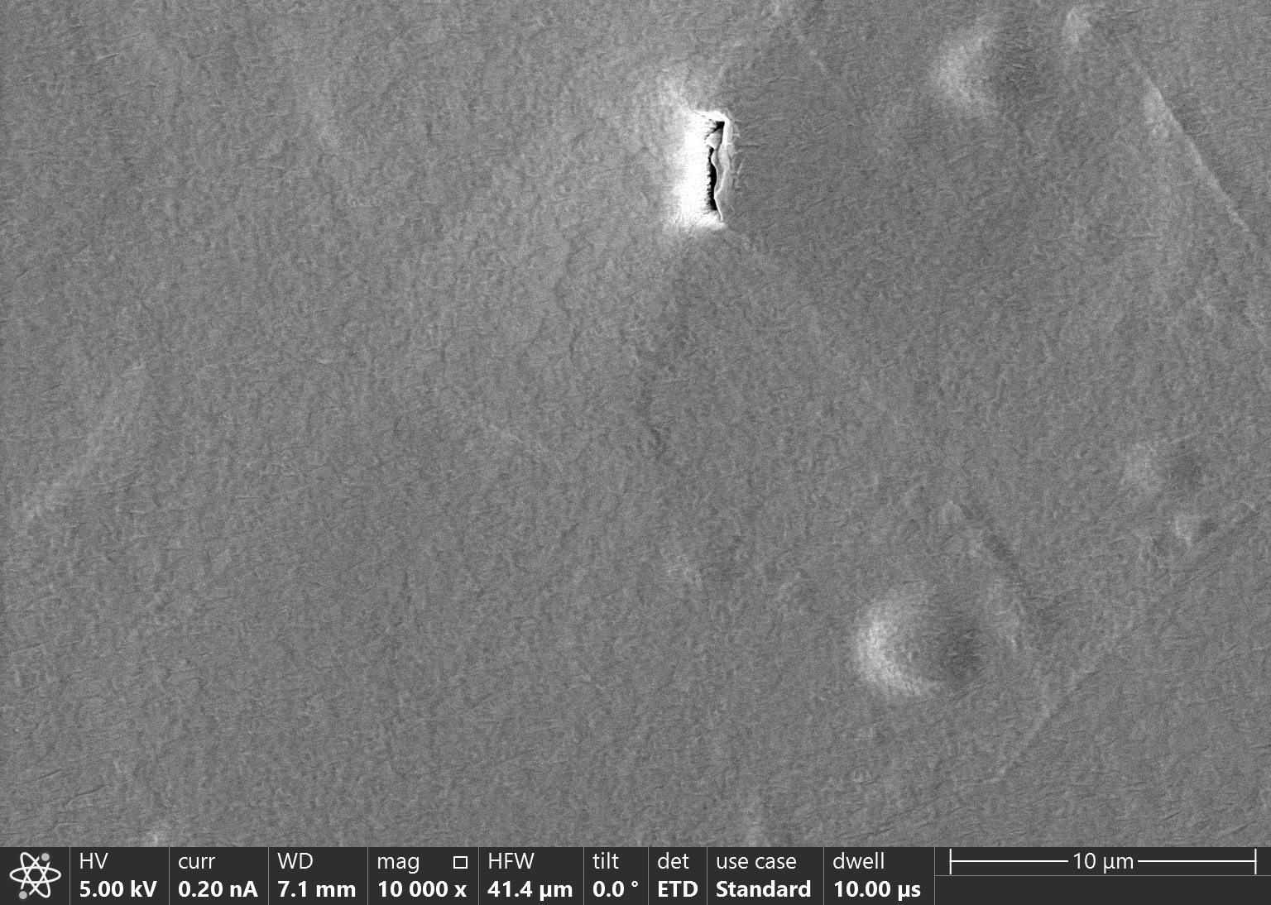
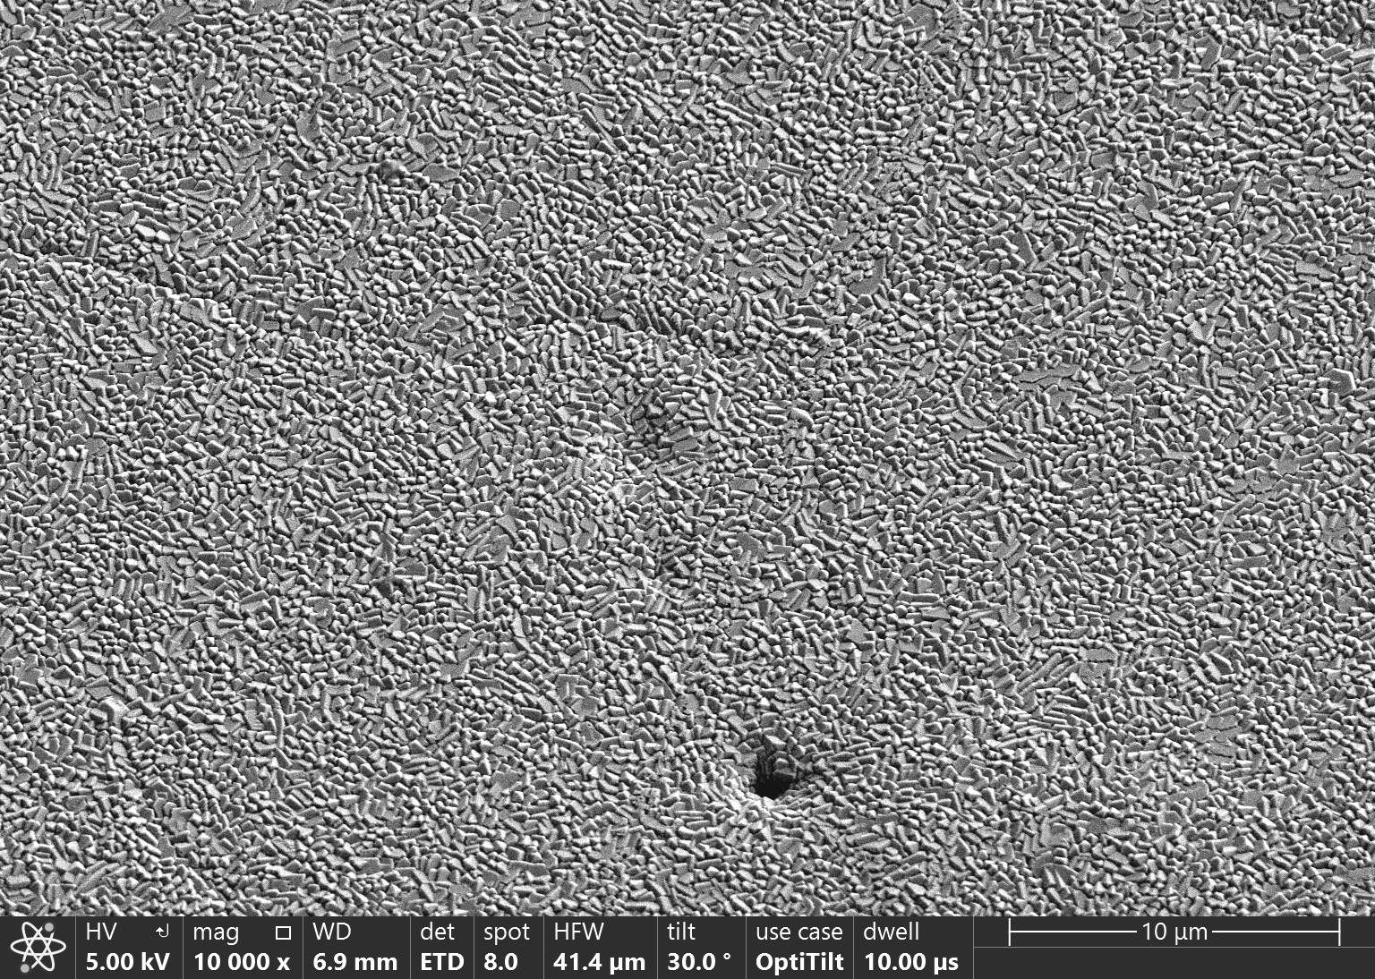
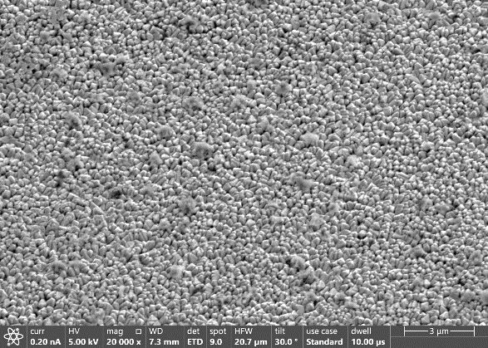
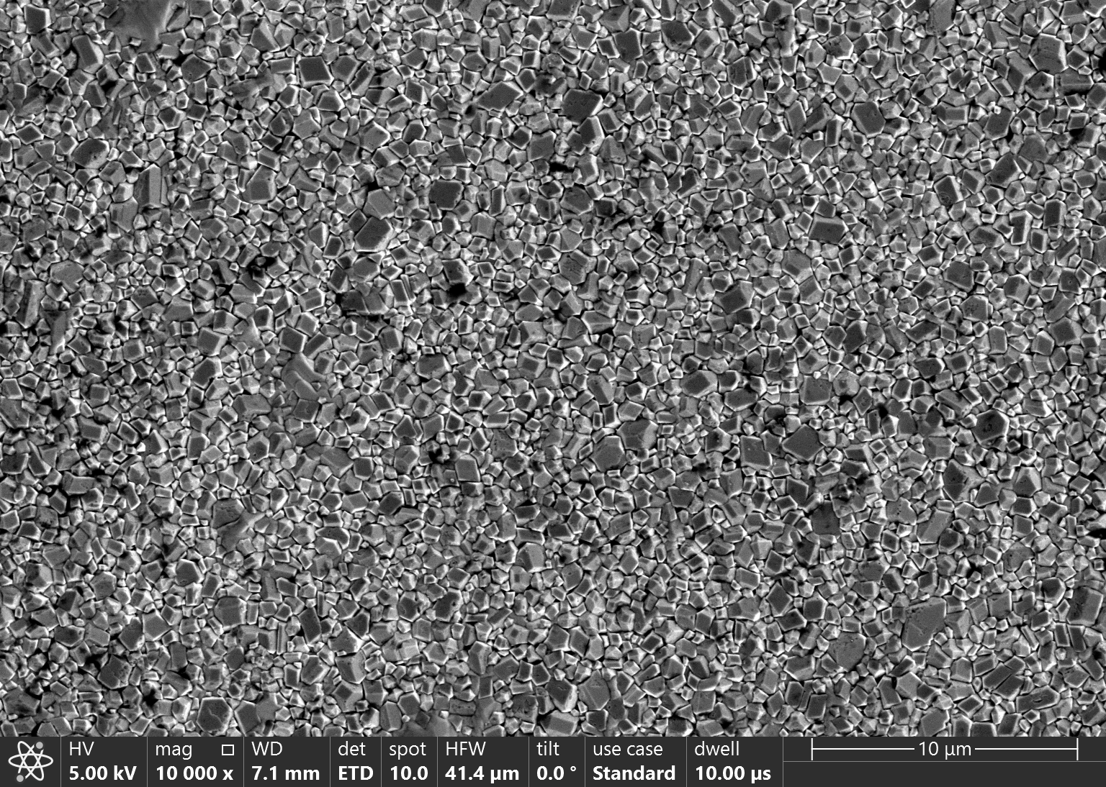
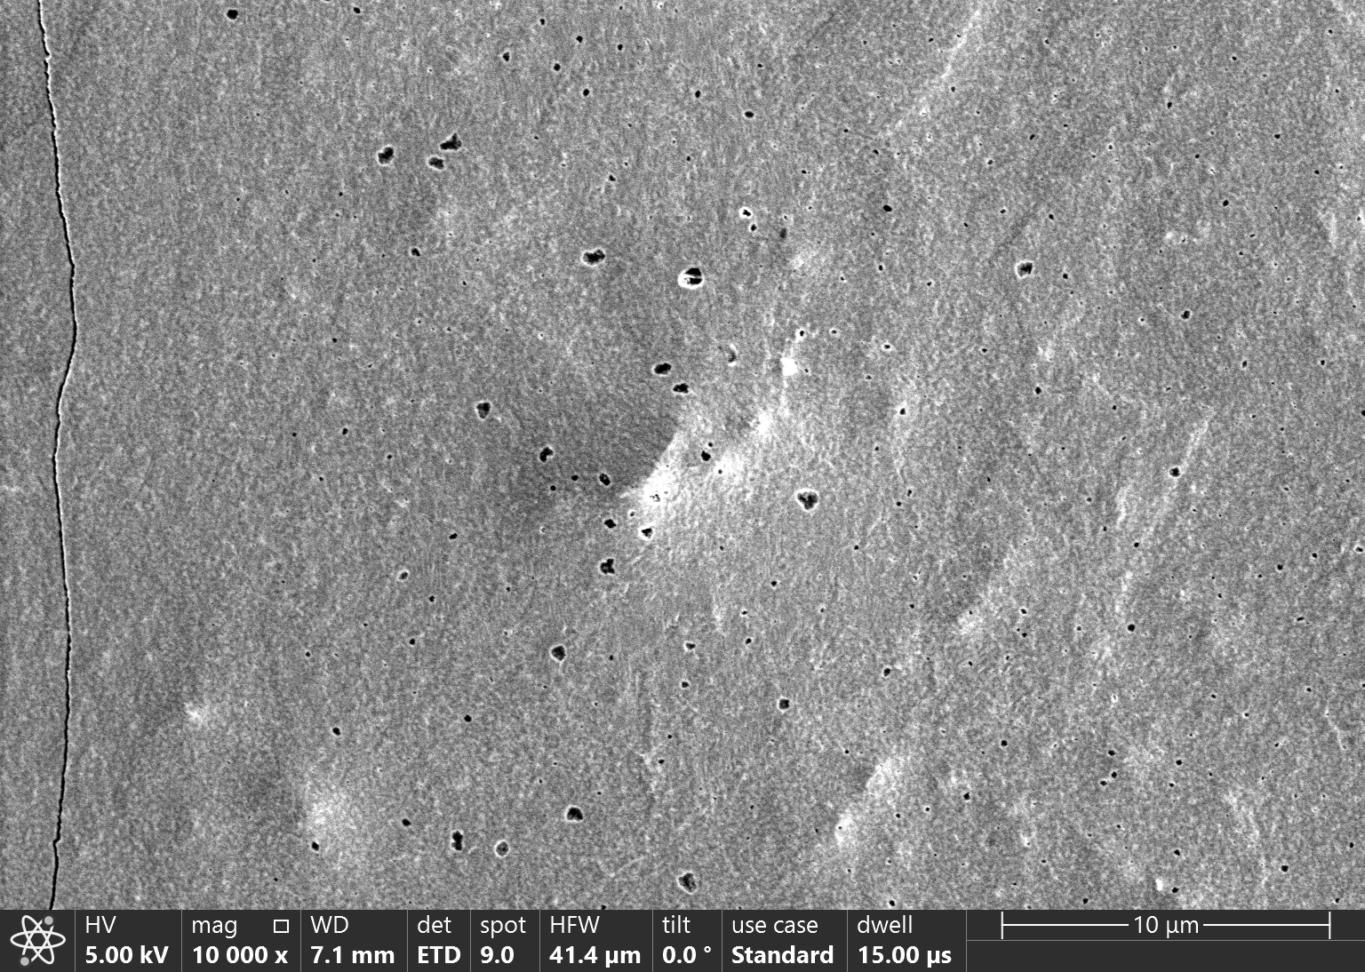
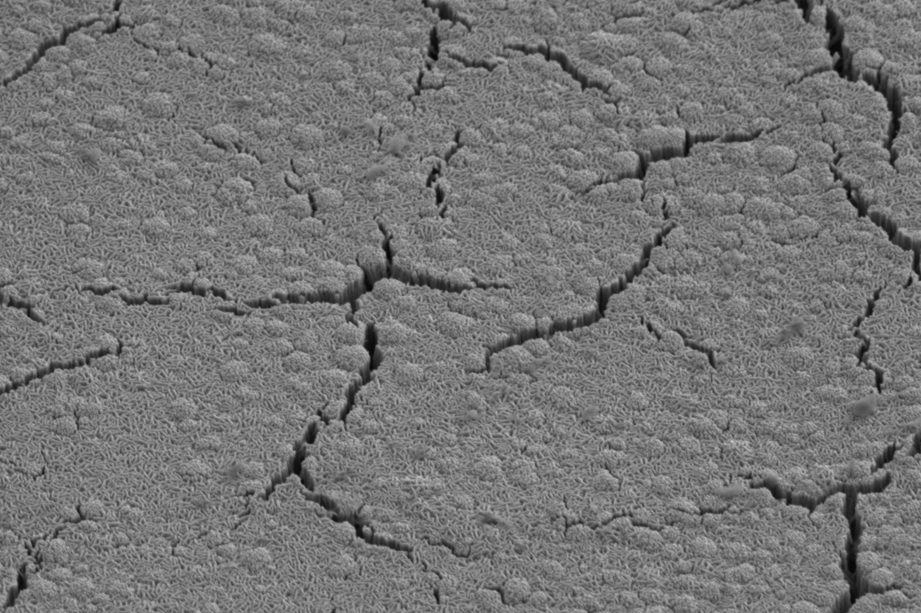
The surface (macroscopically)
low pressure coating
high pressure coating
high pressure coating
FoV 40 µm
FoV 40 µm
FoV 20 µm
high pressure coating
low pressure coating
reaction after annealing
high pressure coating
reaction after annealing
FoV 40 µm
FoV 40 µm
FoV 20 µm
What‘s beneath the surface?
What causes the defects (hillocks, hollows, cracks)?

Slide 8
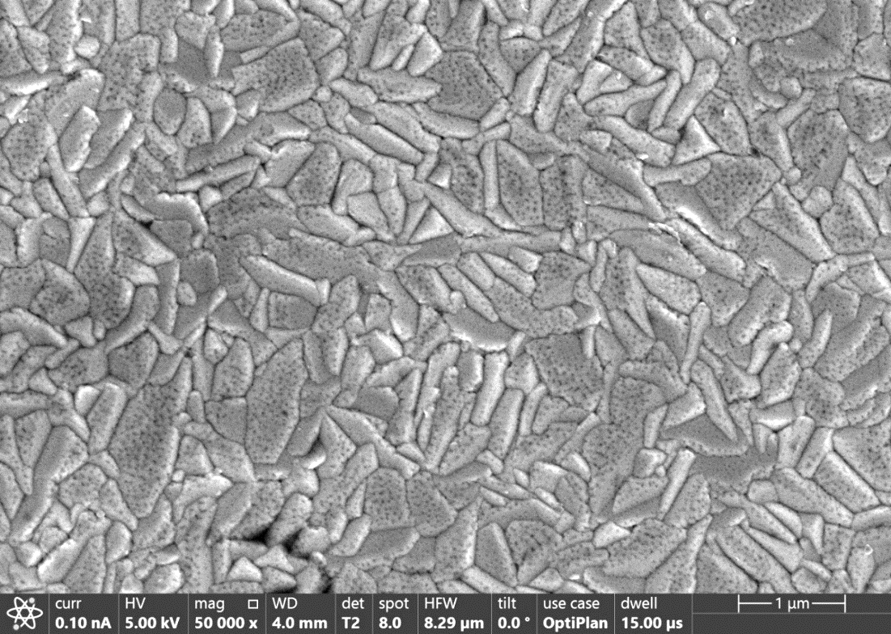
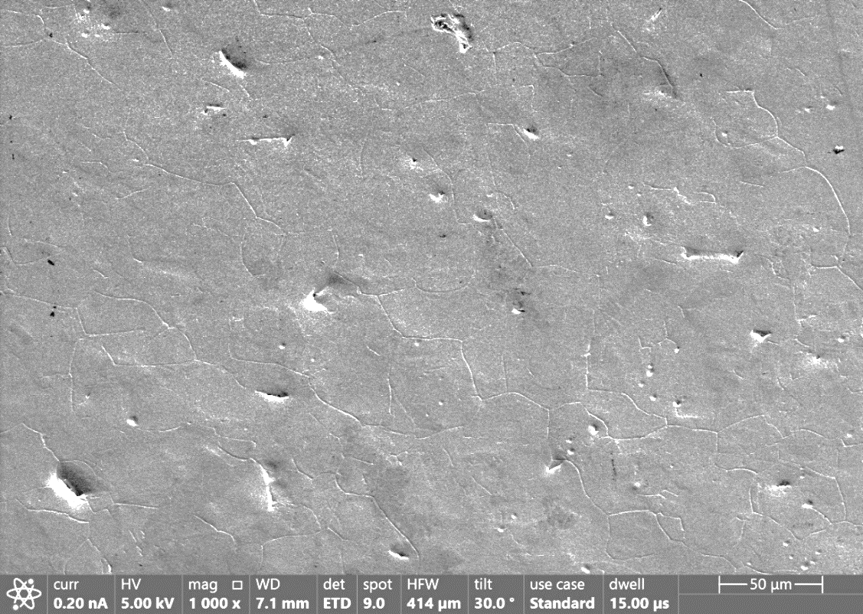
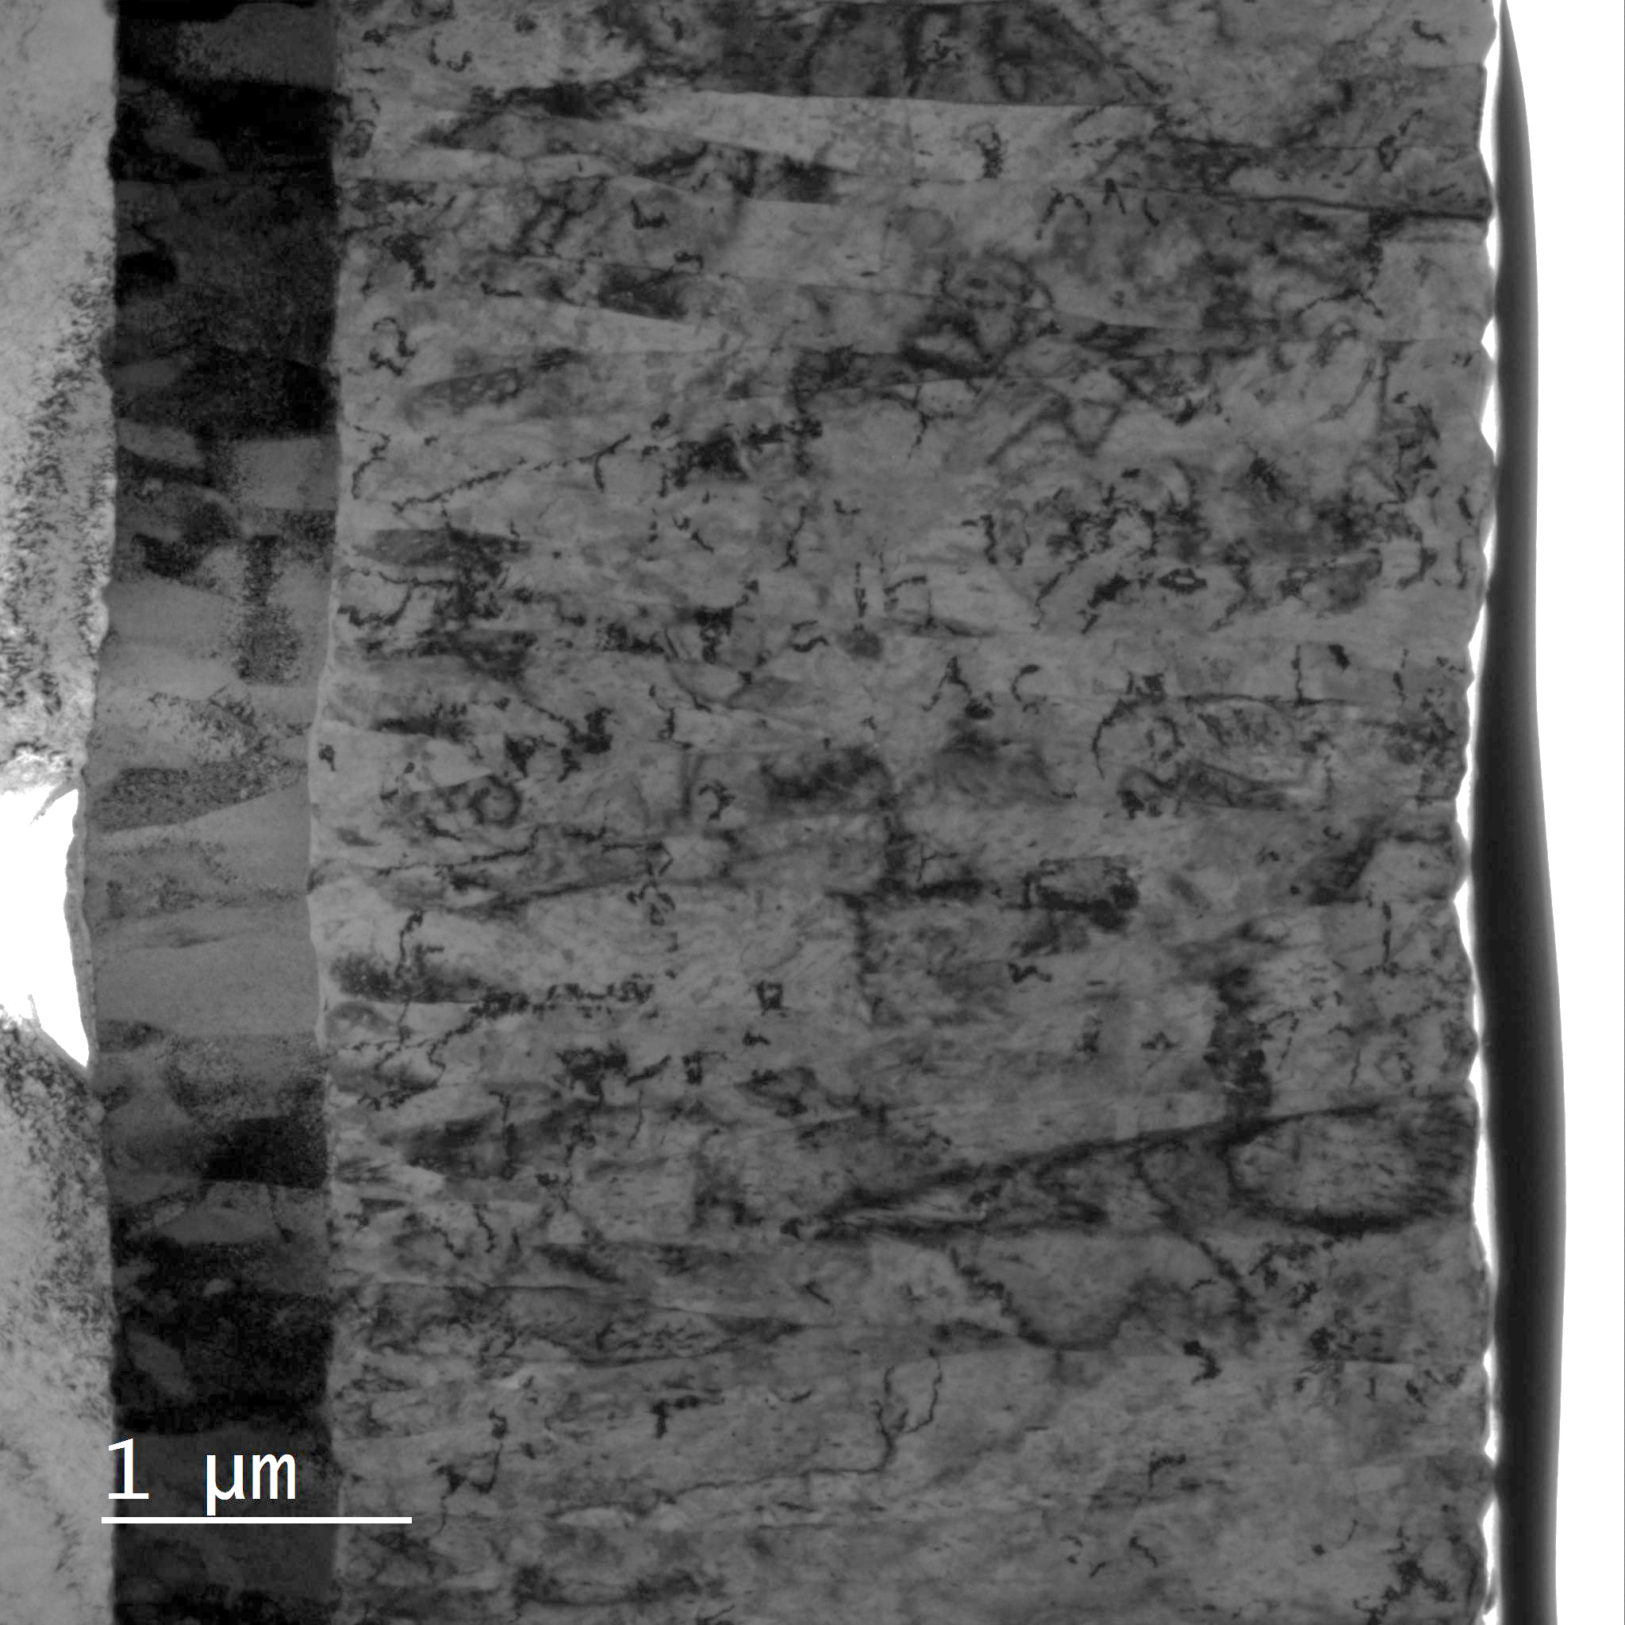
Hillocks and hollows
Hollows in the Nb₃Sn caused by voids in the Cu substrate.
Sn 25%
Reaction during coating
Medium pressure

Slide 9
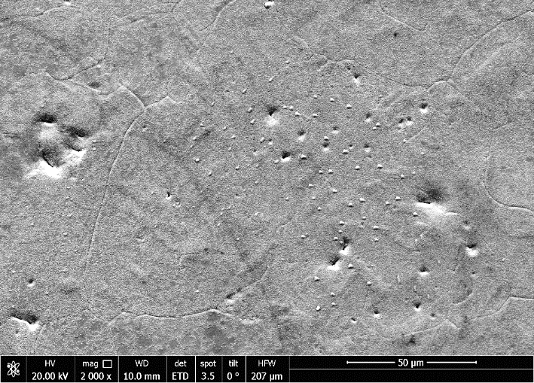
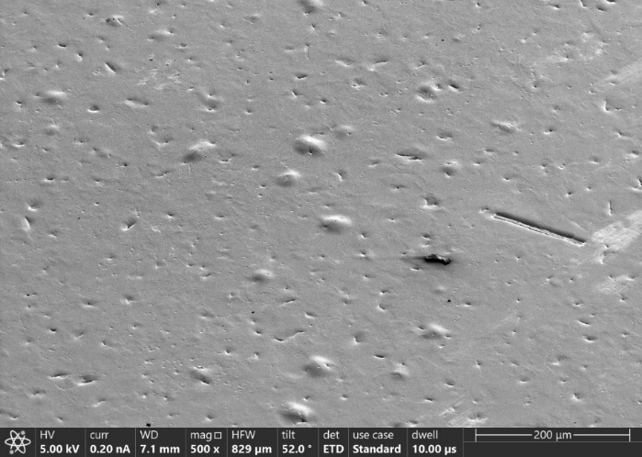
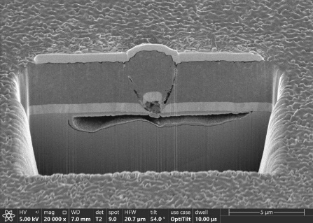
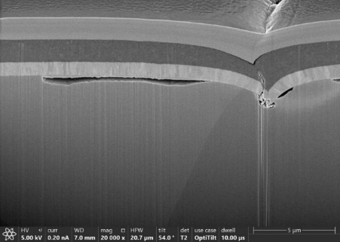
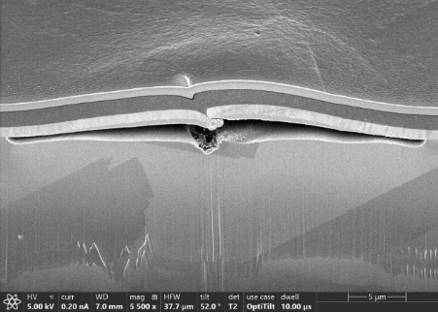
Damages in Cu substrate
FoV: 830 µm
FoV: 200 µm
Nb₃Sn
Ta
Cu
FoV: 20 µm

Slide 10
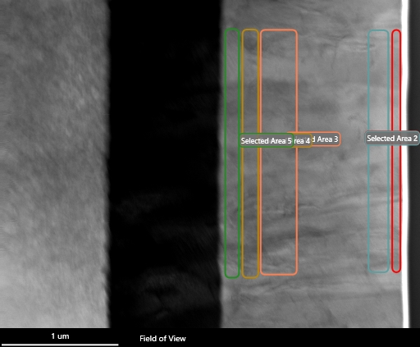
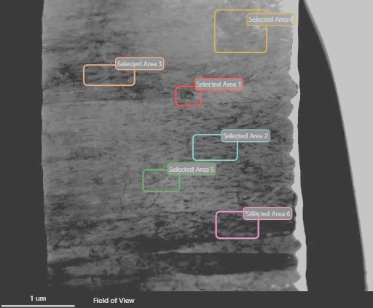
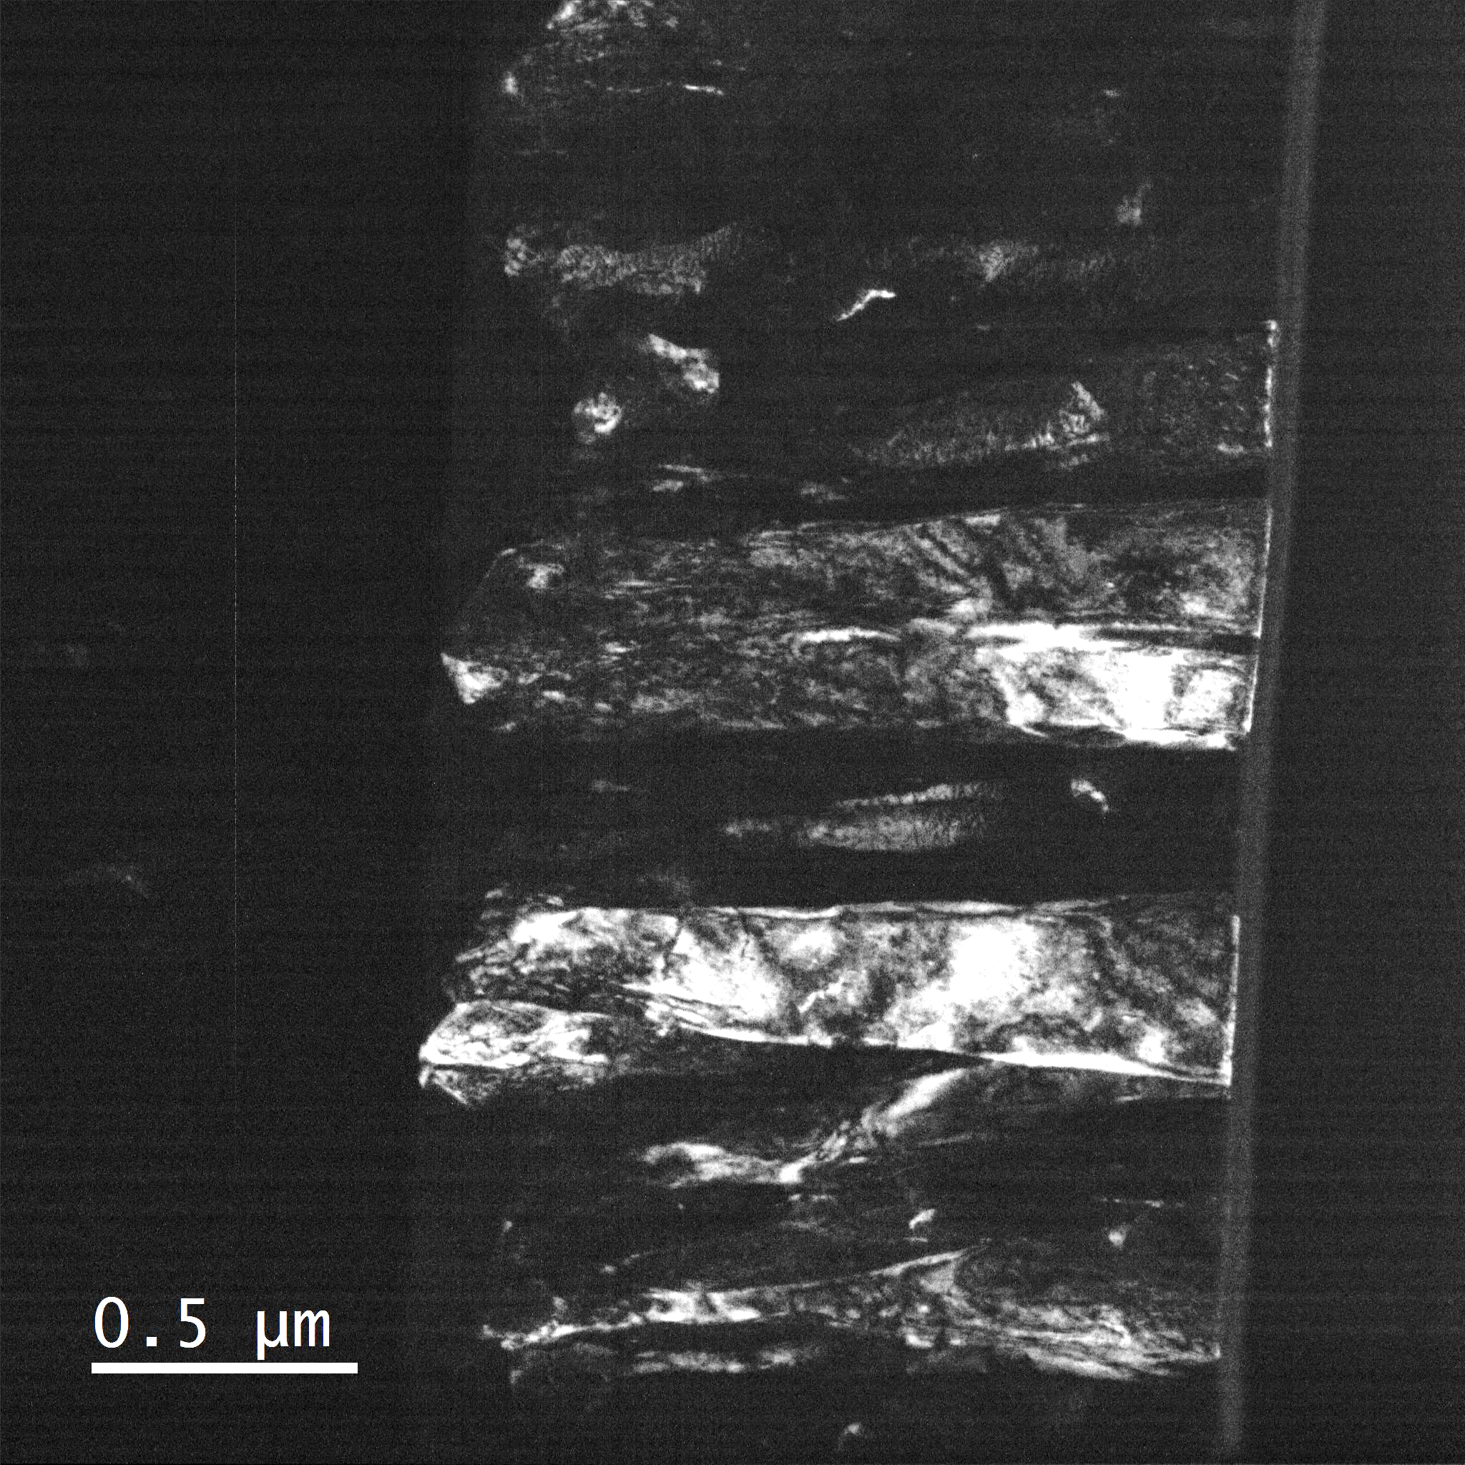
Homogeneity of Nb₃Sn film
Cu
Ta
Nb:Sn
3.5
3.2
Ta
Nb₃Sn
2.9
3.2
2.9
2.8
3.05
2.8
3.03
2.9
3.0
DarkField
Smooth surface
Large columnar grains
No Cu at GB
But: Inhomogeneous Nb:Sn ratio
Ta
Nb₃Sn
Rougher surface
Defects on Cu → surface defects
Homogeneous Nb:Sn ratio

Slide 11
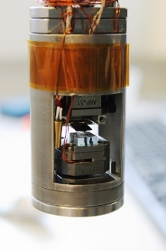
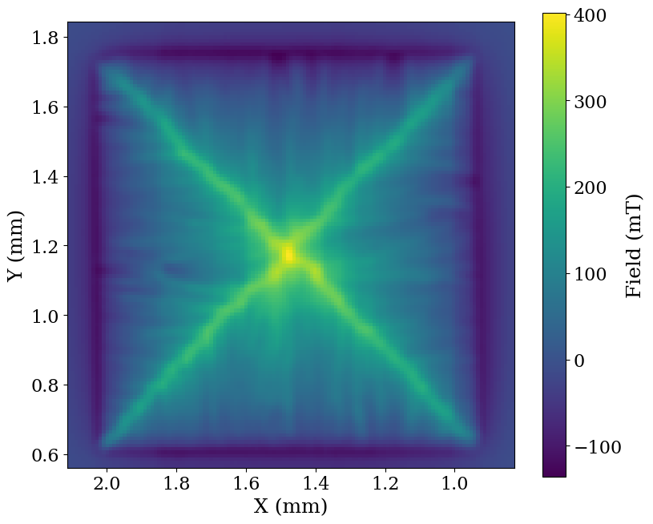
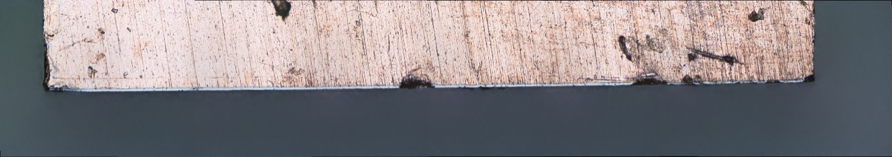
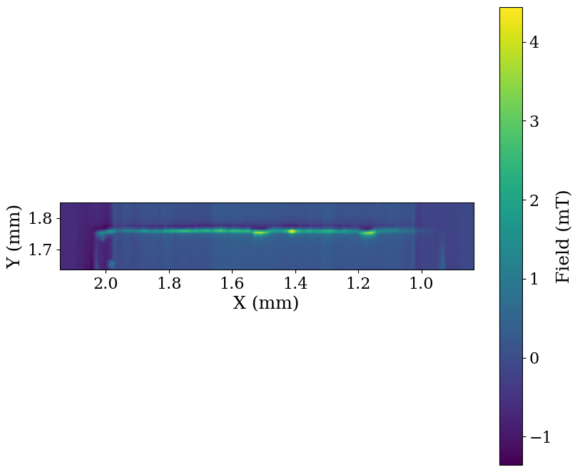
Remnant (trapped) field at one edge
Scanning Hall measurements
Macroscopically homogeneous sample
1.6 mm
Cu
Nb₃Sn
Porosity of copper substrate
Damages due to
sample preparation
Defect in Ta layer
Cu Substrate
Superconducting
Surface
Applied Field:
10 mT
T: 5 K
Superconductor
Trapped field
Points of preferred flux entry

Slide 12
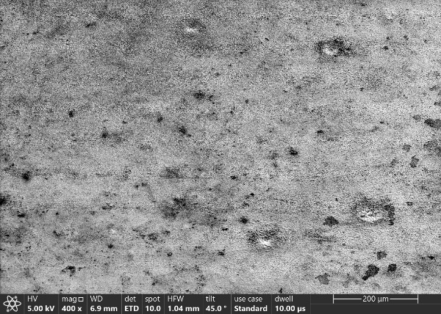
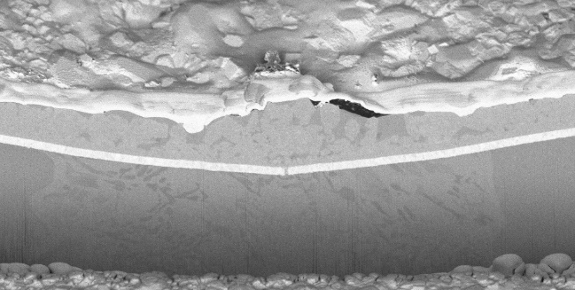
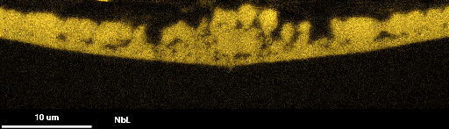
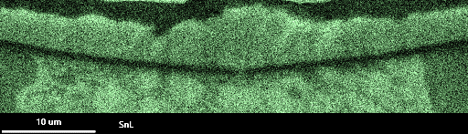
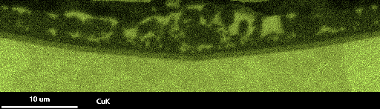
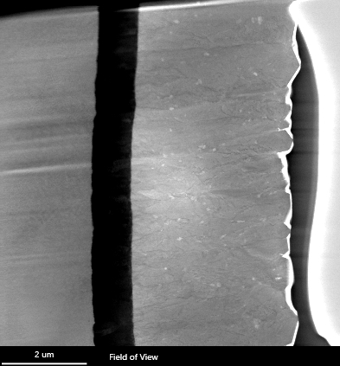
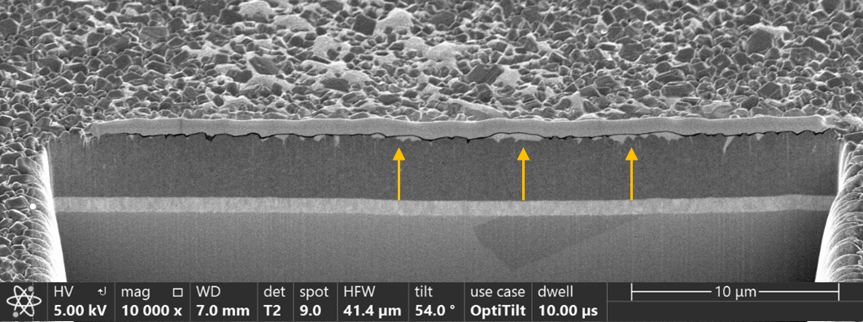
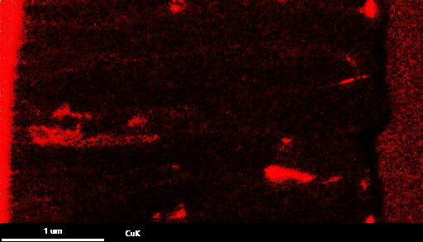
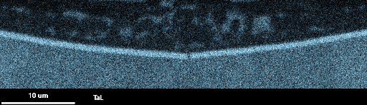
Damaged Ta interlayer
A15
Interdiffusion zones
NbL
Cu-Sn enriched spots
A15
SnL
Cu
CuK
CuK
CuSn
Ta
TaL
Crack in Ta layer → interdiffusion of Cu
High pressure coating → rough surface
Cu and Sn enriched areas on the surface

Slide 13
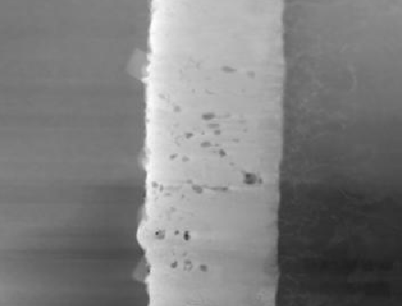
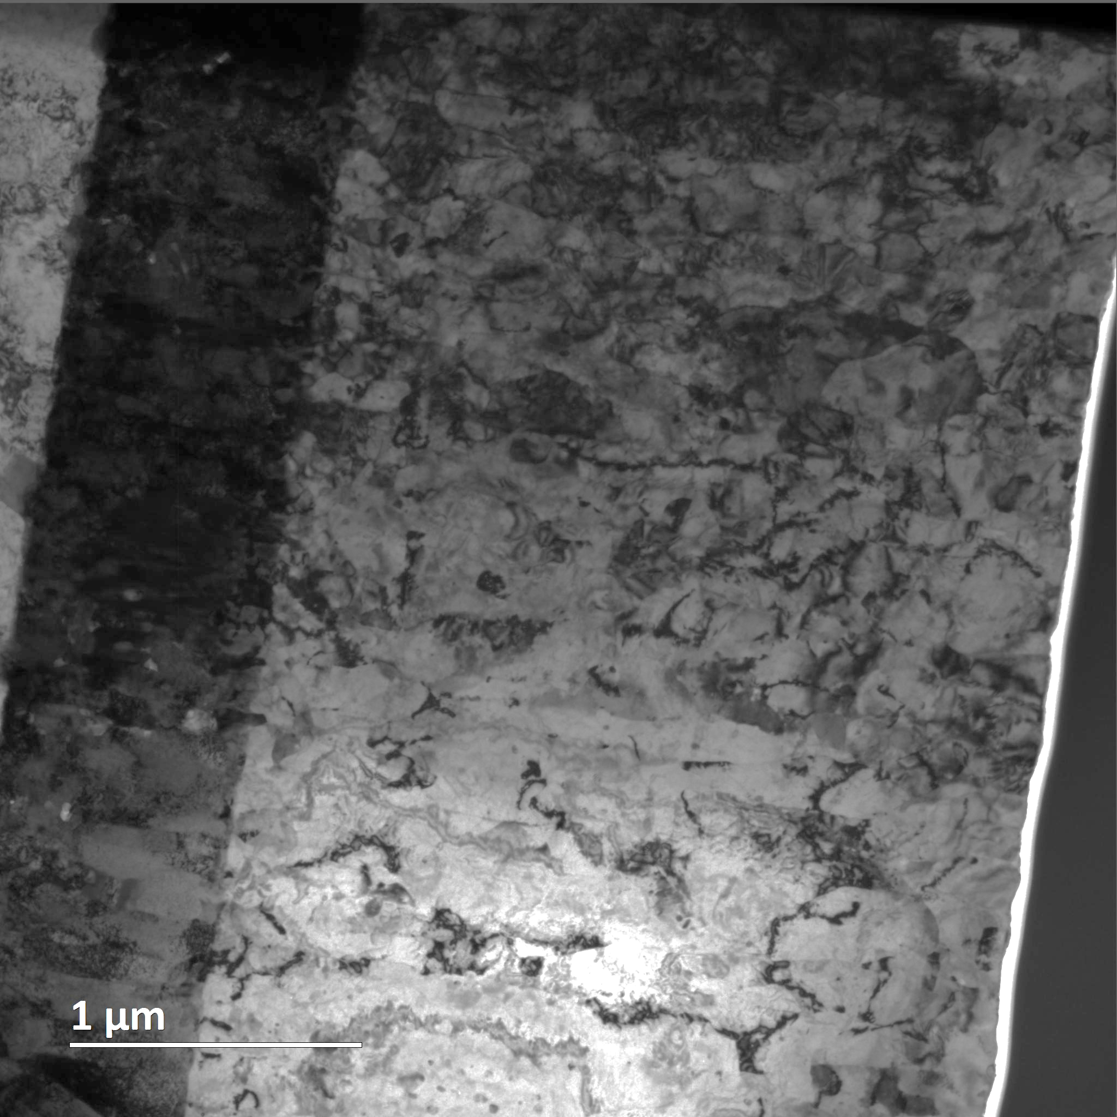

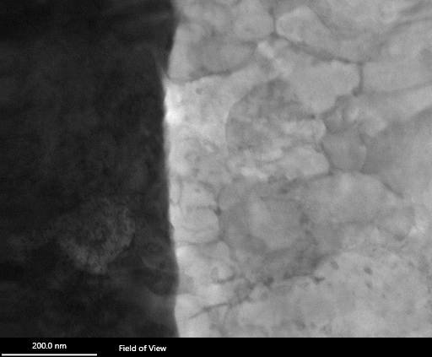
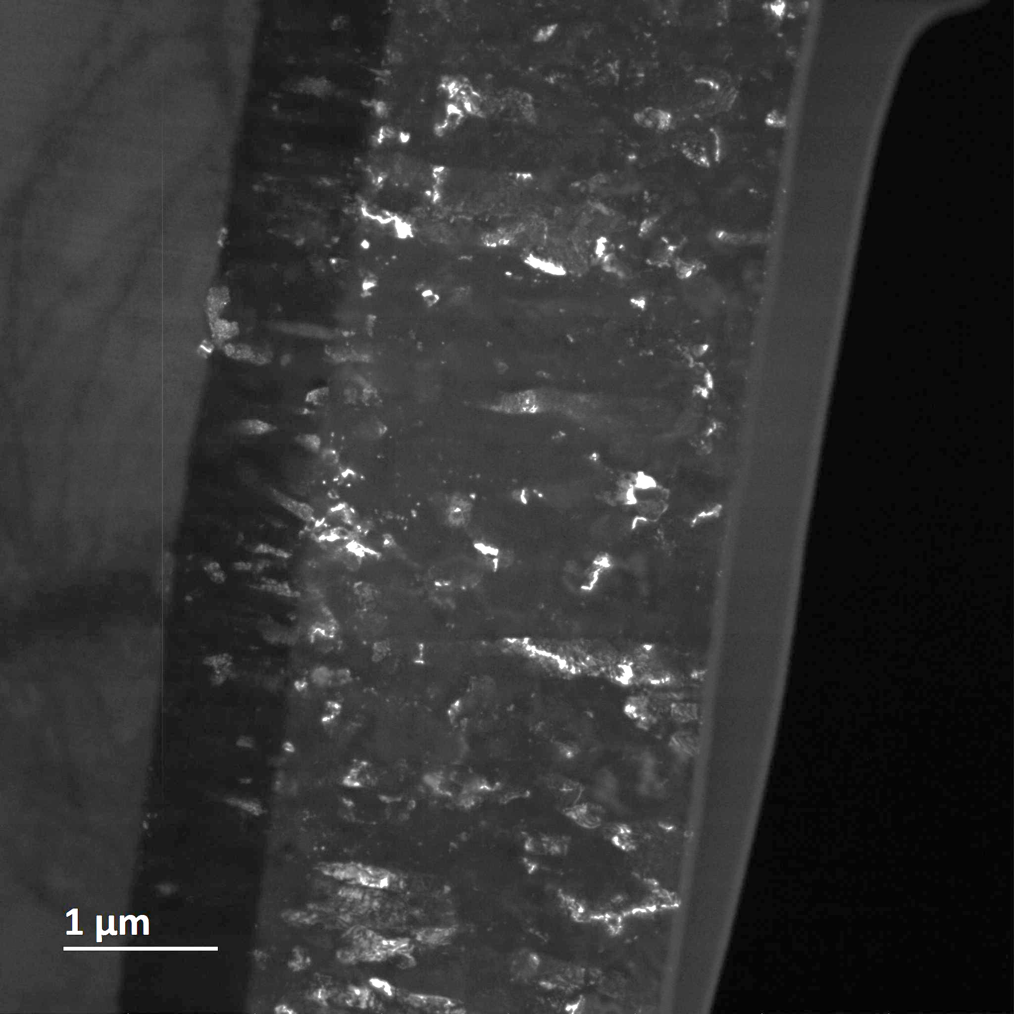
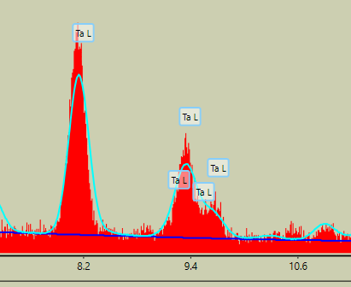
Imperfect Ta interlayer
HAADF
Imperfect
Ta layer
Ta
A15
TEM
A15
TlL map
Cu
Ta
Ta
A15
DF
Ta
A15

Slide 14
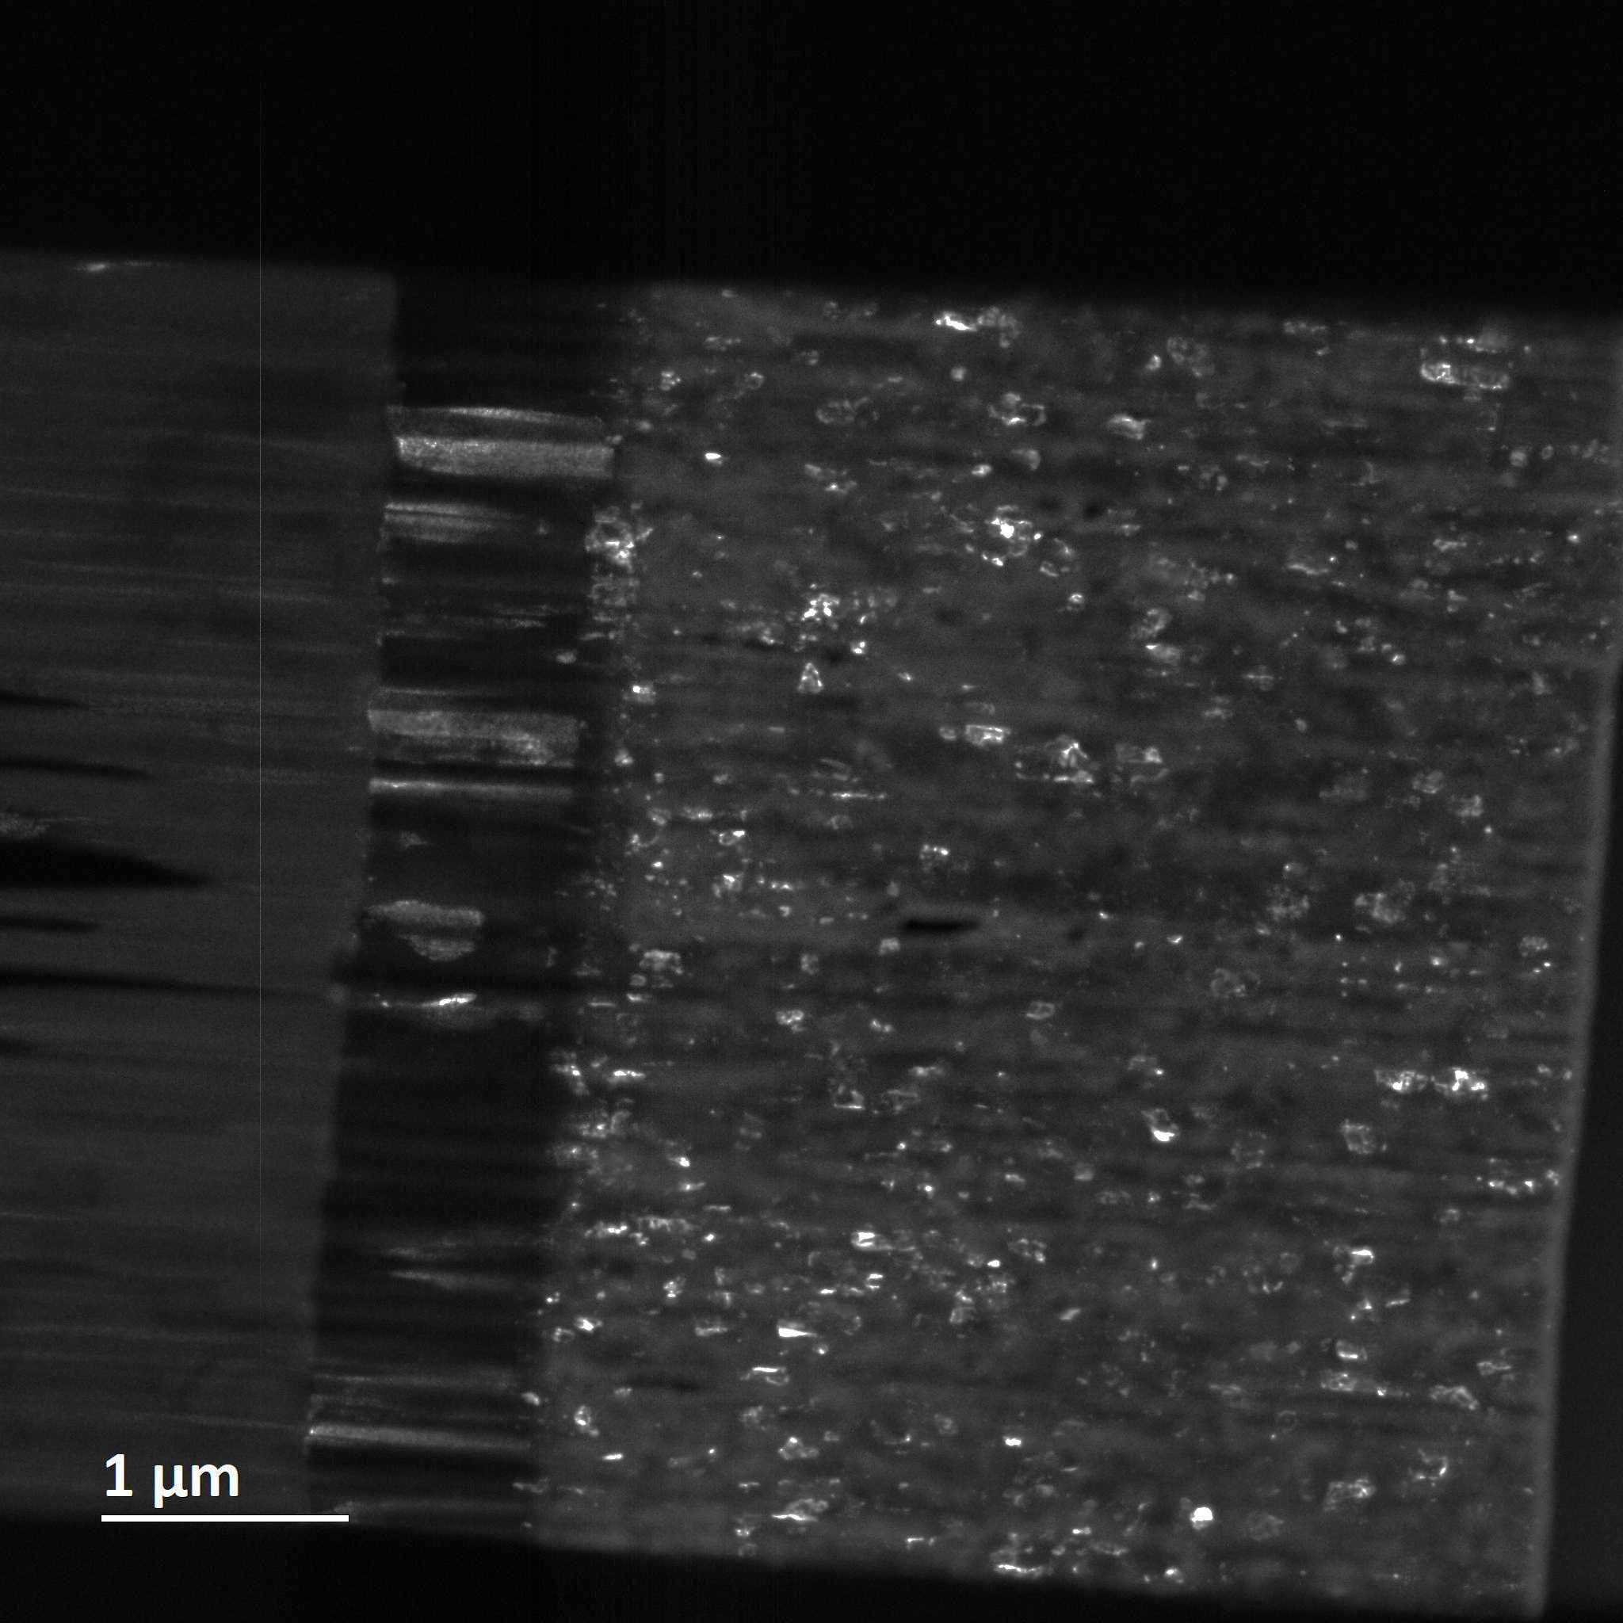
Microstructure of Nb₃Sn layer
Columnar growth
Columnar growth
Smooth surface
Columnar growth with voids along columns
Rough surface
Ta grain influence A15 formation
Fine A15 grains

Slide 15
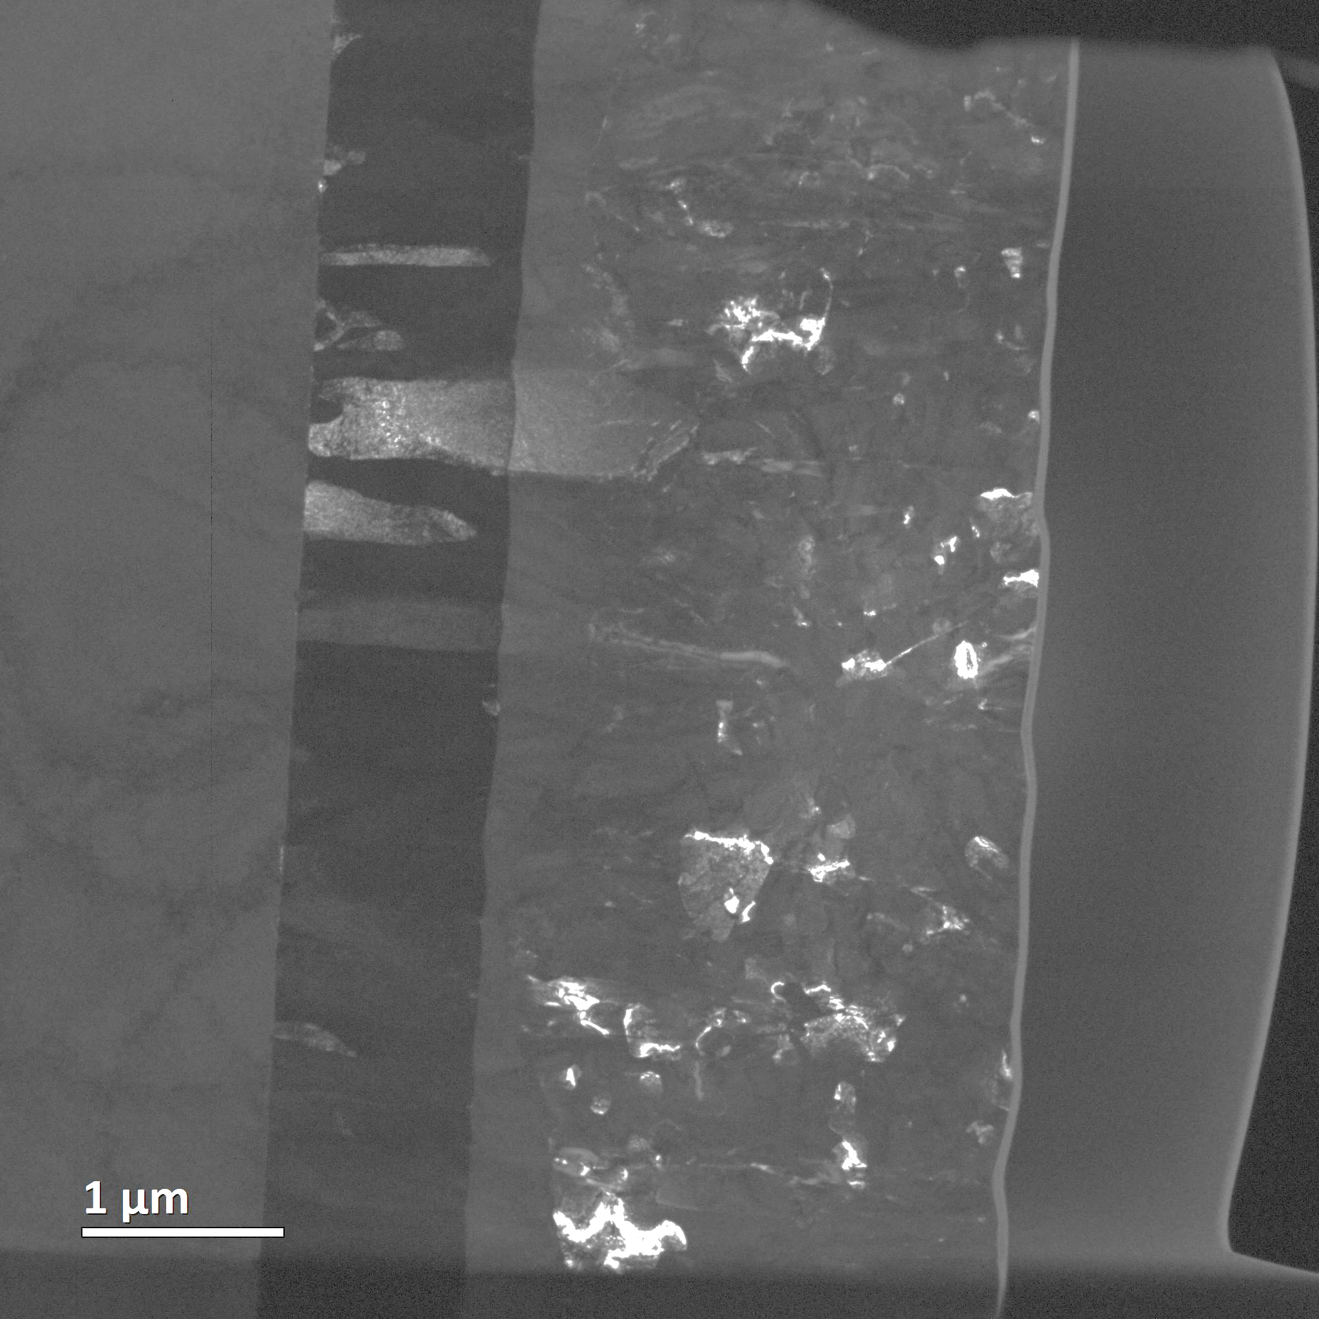
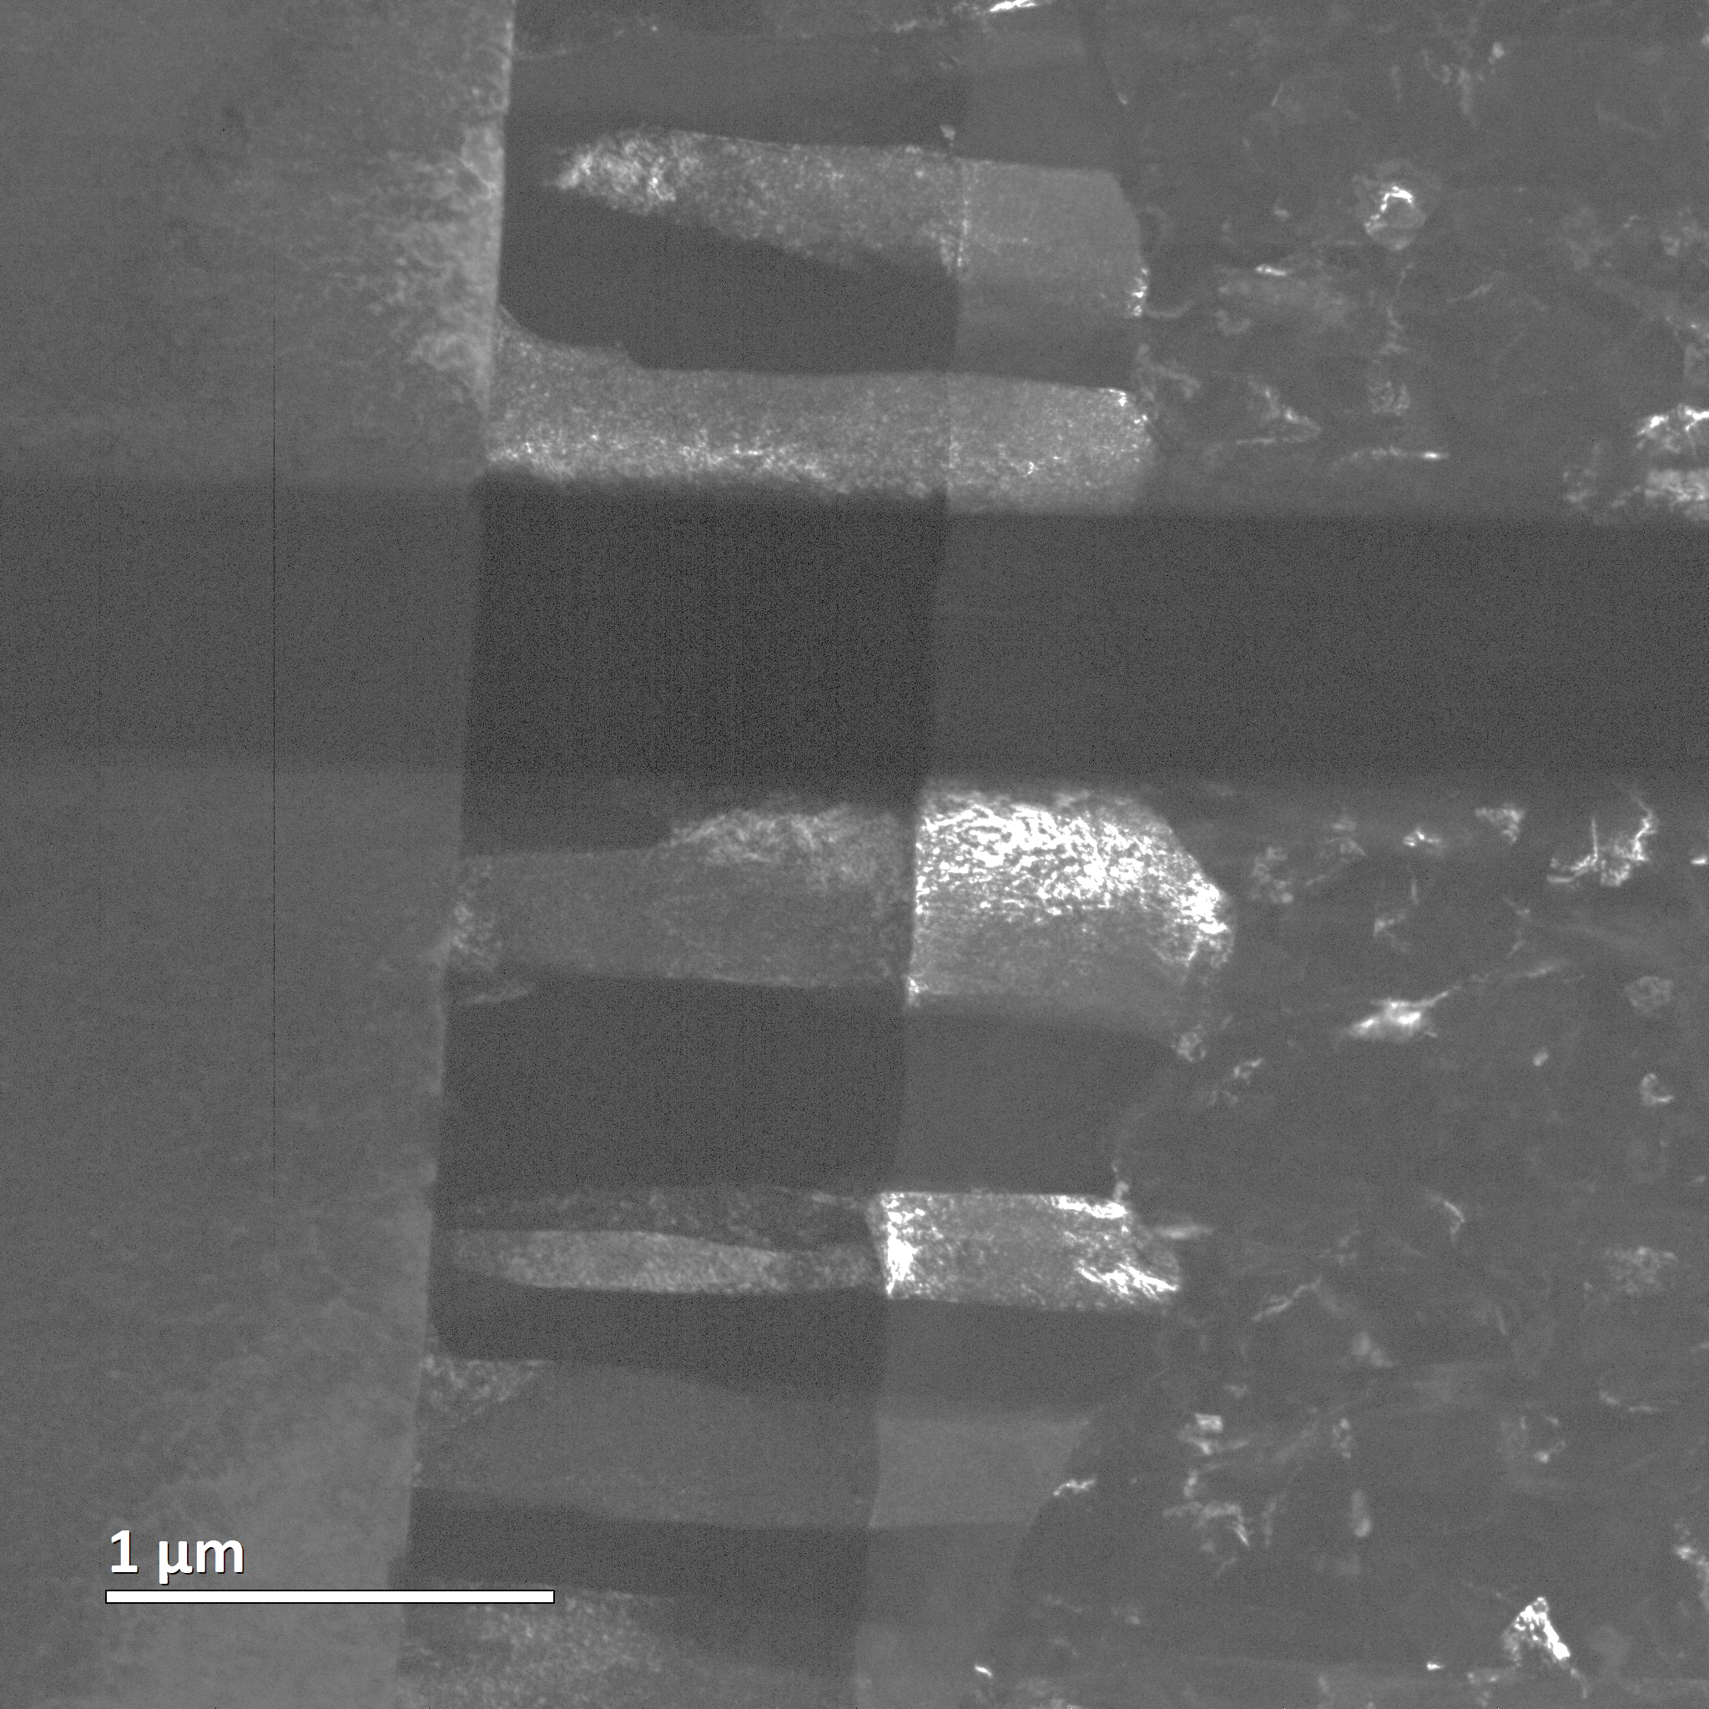




Ta - A15 interface
DF TEM
DF TEM
DF TEM
Cu
Ta
A15
Ta
A15
TaL
SnL
NbK
The orientation of the Ta grains appears to influence the orientation of the A15 grains.

Slide 16


Summary RF cavities
Bipolar HIPIMS: suitable technique for producing good Nb₃Sn layers
Homogeneous Nb₃Sn layers can be formed
Surface quality depends on pressure during coating
Quality of the Ta interlayer is decisive for homogeneous Nb₃Sn layers
Purity of the Cu surface is the top priority

