Slide 1
Availability, Efficiency and Integrated Luminosity:
Rising to the challenge in the FCC-ee
Jack Heron, Hannah Dostmann, Lukas Felsberger, Daniel Wollmann, Jan Uythoven
22nd May 2025

Slide 2

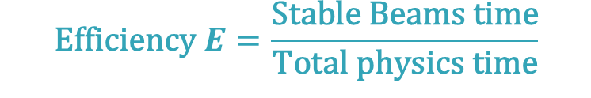
Availability and Luminosity
$$\text{Efficiency} E=\frac{\text{Stable} \text{Beams} \text{time}}{\text{Total} \text{physics} \text{time}}$$
FCC-ee:
365 days
−120 (extended shutdowns)
− 30 (annual commissioning)
− 20 (machine development)
− 10 (technical stops)
185 days for physics
$$\text{Availability} A=\frac{\text{Up} \text{time}}{\text{Total} \text{physics} \text{time}}$$
Operation
Stable Beams
Down Time

Slide 3
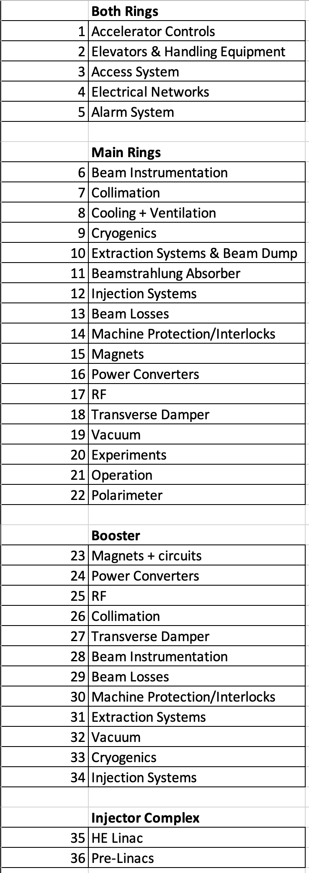

Breakdown into Systems and Subsystems
Extrapolate from reliability performance of existing accelerator systems
1) System failure rate
Failure Rate
FCC-ee
Availability
Integrated Luminosity
Repair Duration

Slide 4

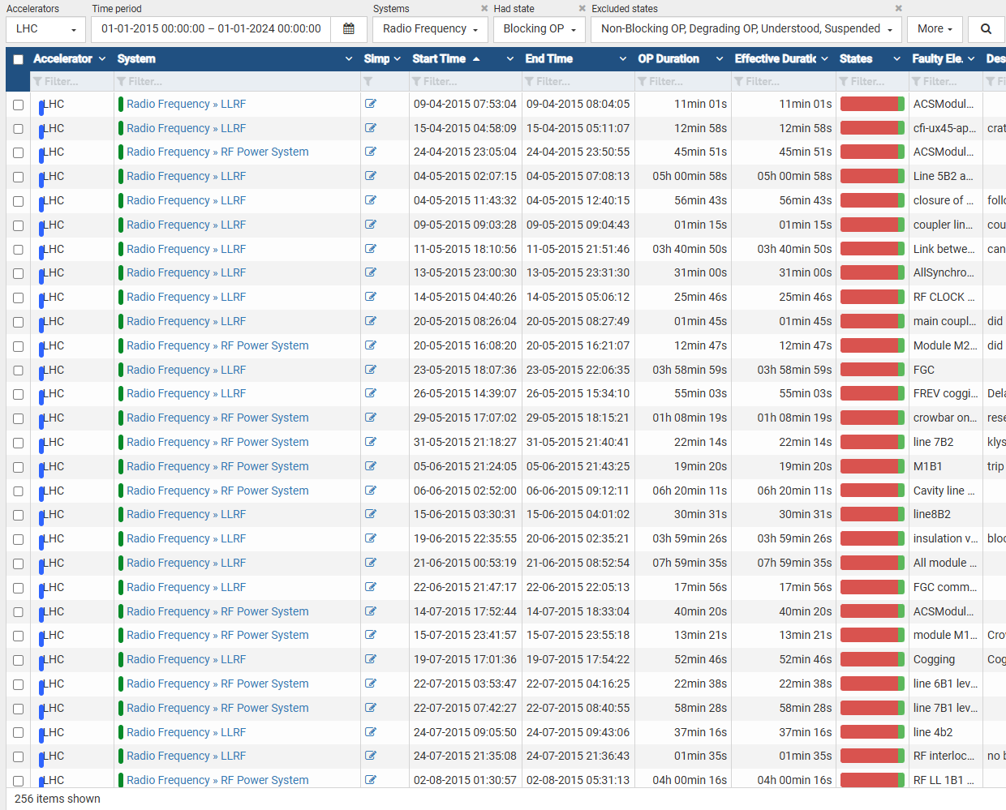
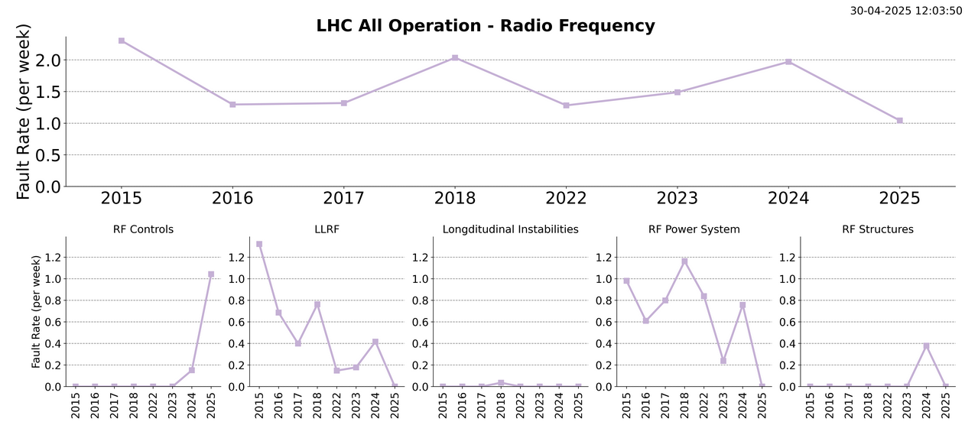
RF System
aft.cern.ch
aft-stats.web.cern.ch
Using AFT fault data 2015-2024
LHC:
  16 SRF cavities
FCCee:
 | Z |  | W |  | ZH |  | tt̄
 | collider* | booster | collider* | booster | collider** | booster | collider** | booster
Cavities [#] | 132 | 112 | 132 | 112 | 264 | 112 | 672 | 448
Redundancy [cavities] | 1 | 0 | 6 | 0 | 26 | 11 | 67 | 44
Redundancy [%] | 0.75 | 0 | 4.5 | 0 | 10 | 10 | 10 | 10
* Per beam ** Both beams
Acknowledgement: Olivier Brunner, Andy Butterworth, Franck Peauger, Ivan Karpov

Slide 5
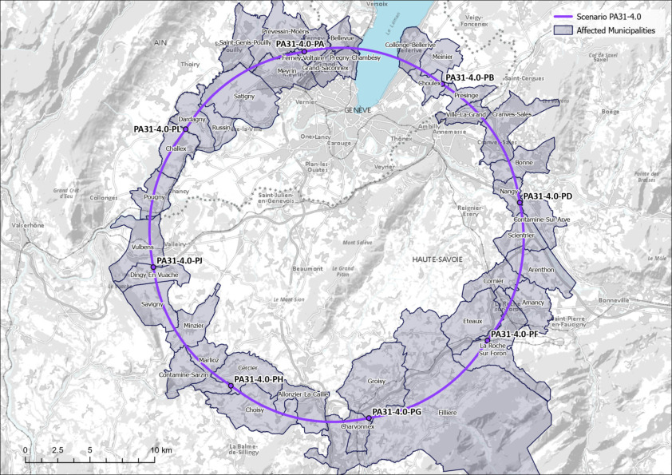
Electrical Network
# substations
External Network Perturbations:
  Independent at PA and PH-PD
Internal Equipment Faults:
  Scaled by number of Substations
Redundant link PA-PD:
  Only for non-child down time
  Changeover ~1 h
  Not applicable to PH
PA
Line 1
x4
x3
PD
3
PD
Genissiat
PH
Line 2
x1.34
See presentation:
Hannah Dostmann
Technical Infrastructure Availability
Technical Infrastructure: Electricity & Energy Management
Tuesday 20th May
Acknowledgement: Charline Marcel, Mario Parodi
Jack Heron | Availability, Efficiency and Integrated Luminosity in the FCCee
22 May 2025

Slide 6
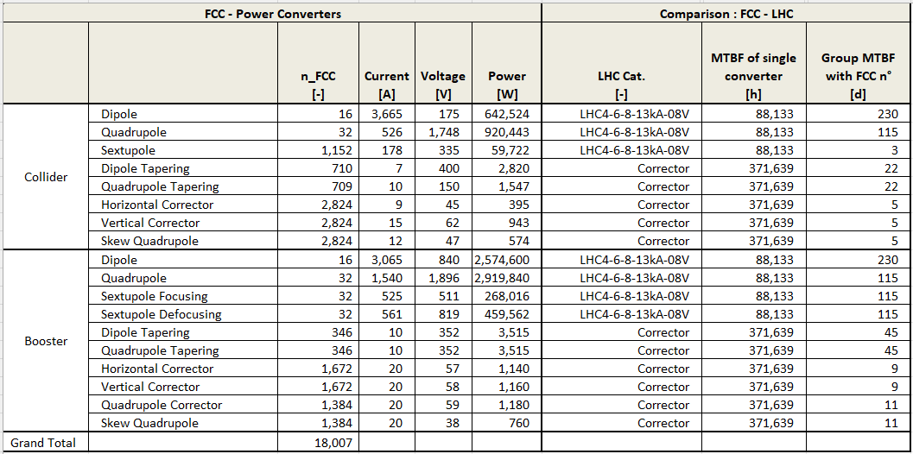
Power Converters
LHC fault data
Same level of redundancy as LHC
One dump every 3 days
5 days
9 days
0.6 days
Acknowledgement: Byamba Wicki, Serge Pittet

Slide 7
Breakdown into Systems and Subsystems
Extrapolate from reliability performance of existing accelerator systems
1) System failure rate
Failure Rate
FCC-ee
Availability
Integrated Luminosity
Repair Duration
2) System repair duration

Slide 8


Two fault types:
Remote Repair Faults
Human Repair Faults
  Repair achieved from the control room
  E.g. by resetting components
  Requires human intervention
  Approach time and/or cool down time
https://www.istockphoto.com/vector/isometric-control-center-gm164401684-15526568
https://www.flaticon.com/free-icon/technician_6342684

Slide 9
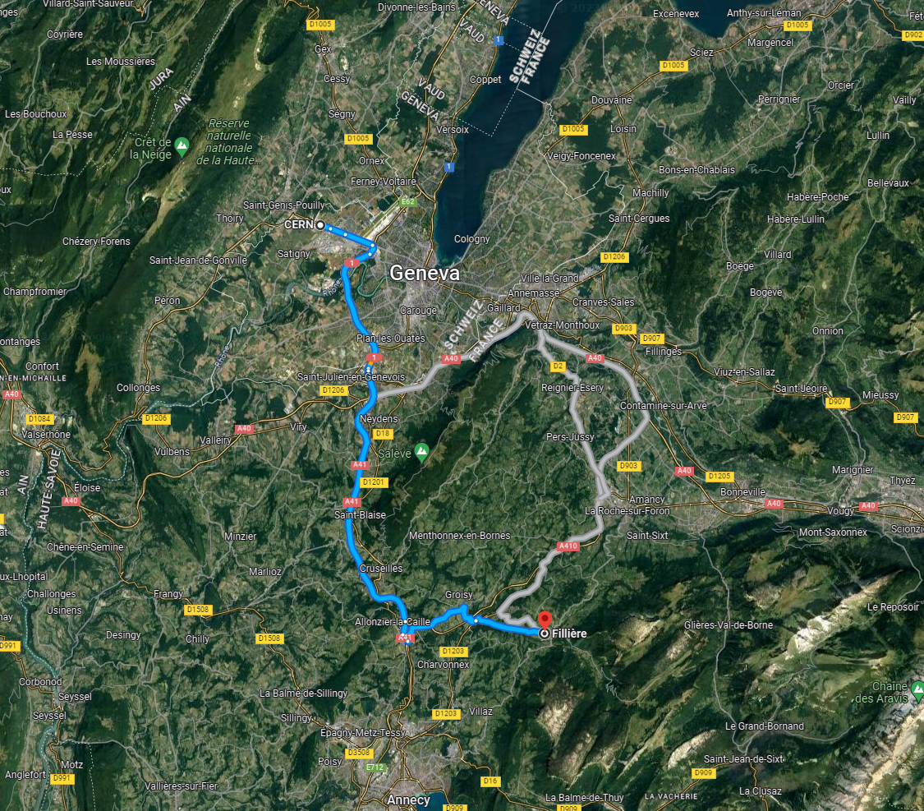
Human Repair Faults
LHC
FCC
  Requires human intervention
  Approach time 0.3-1.5 h
  Cool down time 1-24 h
Drive time
1h+
https://www.istockphoto.com/vector/isometric-control-center-gm164401684-15526568
https://www.flaticon.com/free-icon/technician_6342684

Slide 10


“Realistic” Repair Timeline:
Operation resumes if possible before humans are in the tunnel
Once human repairs start, they will finish.
Operation
resumes here
Fault
1 h
Diagnosis + attempts to reset from control room
We can’t fix it from here. Get someone out there!
Remote repairs
20 min – 1.5 h
Repair
Human repairs
Approach time
Humans in tunnel
Cool-Down time
1 - 24 h

Slide 11
Breakdown into Systems and Subsystems
Extrapolate from reliability performance of existing accelerator systems
1) System failure rate
Failure Rate
FCC-ee
Availability
Integrated Luminosity
Repair Duration
3) Accelerator Performance
2) System repair duration
Remote repairs
Human repairs
  Approach time
  Cool down time

Slide 12


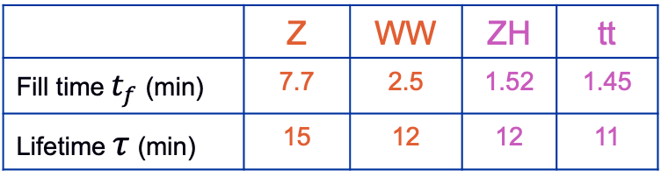

FCC-ee Operation Cycle
  $ZH$,$t\overline{t}$
Resonant depolarization is impossible
  Z,WW
Dump
Pilot bunch injection
Set Up
Physics
Polarisation
Fill
Adjust
Burn Off
10 min
10 min
1.5 h
$$t_{f}$$
10 min
20 h
$$τ$$
Down for Repair
Default
 | Z | WW | ZH | tt
Fill time $t_{f}$ (min) | 7.7 | 2.5 | 1.52 | 1.45
Lifetime $τ$ (min) | 15 | 12 | 12 | 11
Repair completed
Stable Beams
Operation
Collider failure
Injector Complex failure
Down
Time
Acknowledgement: Jacqueline Keintzel

Slide 13
Acknowledgements
Jacqueline Keintzel
Franck Peauger
Olivier Brunner
Andy Butterworth
Ivan Karpov
Serge Pittet
David Nisbet
Davide Aguglia
Ben Todd
Byamba Wicki
Jean-Paul Burnet
Klaus Hanke
Chris Roderick
Ioan Kozsar
Alessandro Masi
Damien Lafarge
Tomasz Ladzinski
Verena Kain
Frank Zimmerman
Markus Zerlauth
Jesper Nielsen
Mario Parodi
Charline Marcel
Manfred Wendt
Roderik Bruce
Anton Lechner
Marco Calviani
Antonio Perillo Marcone
Guillermo Peon
Inigo Martin Melero
Laurent Delprat
Yann Dutheil
Christoph Wiesner
Jan Uythoven
Jeremie Bauche
Wolfgang Hofle
Roberto Kersevan
Gregory Pigny
Rudiger Schmidt
Arjan Verweij
Benoit Salvant
Bernhard Holzer
Bettina Mikulec
Cedric Hernalsteens
Rama Calaga
Roberto Losito
Katsunobu Oide
Hannes Bartosik
Paolo Craievich (PSI)
Masanori Sato (KEK)
Sharon Vetter (SLAC)
William Corocho (SLAC)
Matt Gibbs (SLAC)
Ralph Boespflug (DESY)
Rainer Wanzenberg (DESY)
Michaela Schaumann (DESY)
Cristian Maccarrone (ESRF)
Laurent Hardy (ESRF)
Antoine Chance (CEA)
Jorg Wenninger
Gijs de Rijk
Daniel Valuch
Belen Maria Salvachua Ferrando
Matteo Solfaroli Camillocci
Alice Vanel
Luke Von Freeden
Robert Kieffer
Igor Syratchev
Helga Timko
Rafaele Tegas
Giacomo Lavezzari
Manuel Colmenero Moratalla
Milosz Blaszkiewicz
Markus Widorski
Andrew Coleman

Slide 14
Results

Slide 15
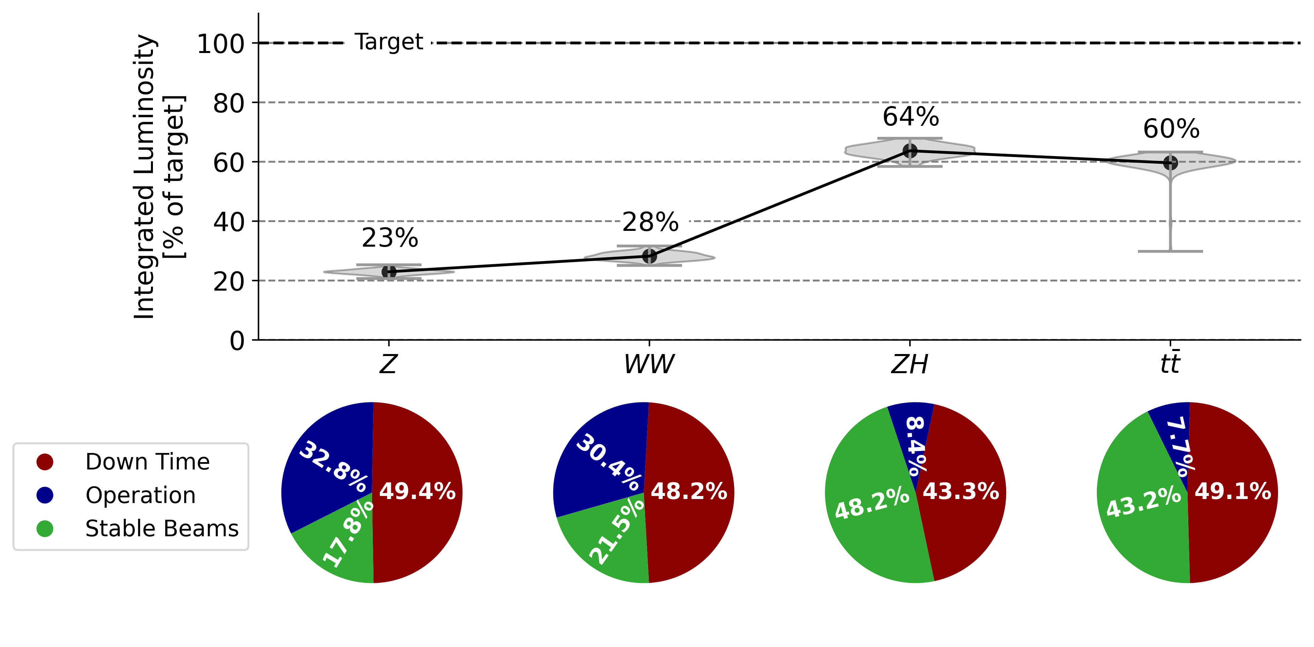
Overall Performance
Delivered integrated luminosity below design in all energy modes
Due to low availability and low efficiency
Particularly in Z and W modes due to long turnaround time following dump
 | Z | W | H | tt
Integrated luminosity target [ab-1] | 205 | 19.2 | 10.8 | 3.12

Slide 16
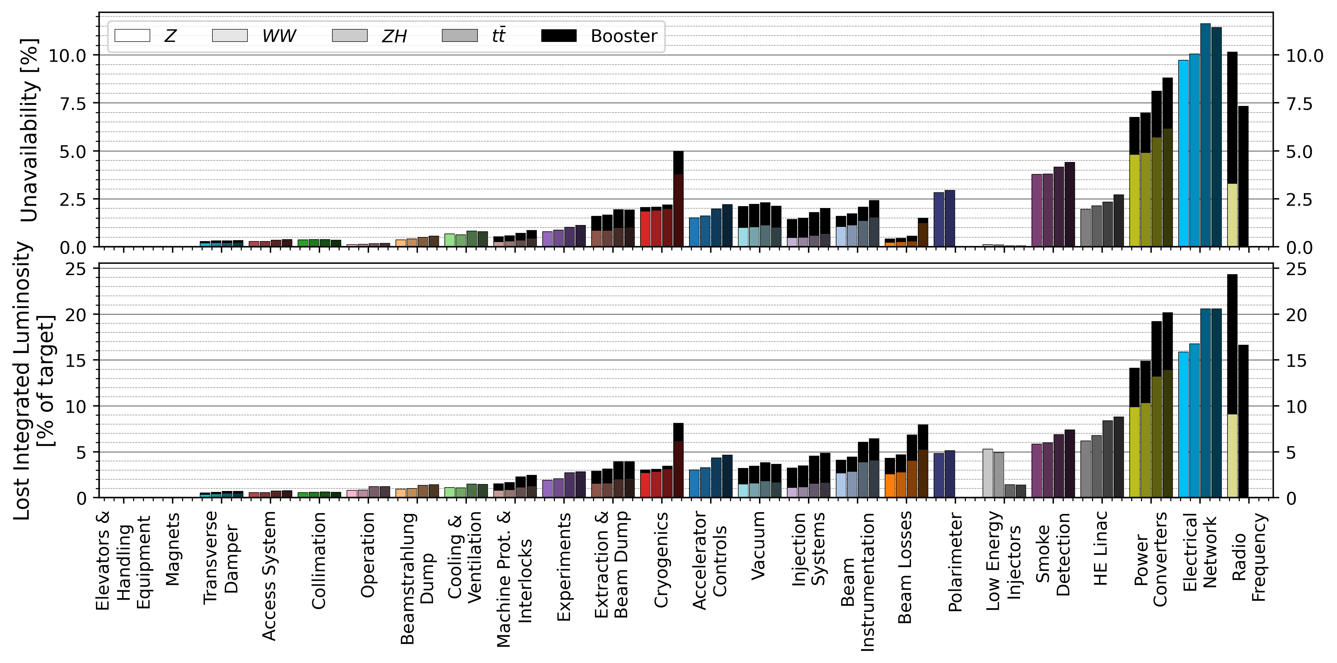
Unavailability & Lost Luminosity
Injector Complex

Slide 17
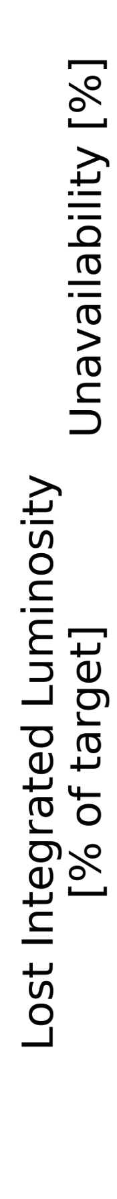
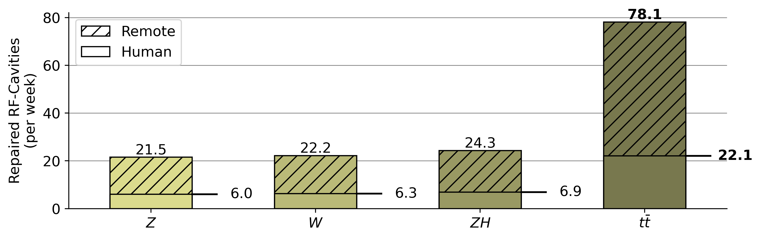
RF System
 | Z |  | W |  | ZH |  | tt̄
 | collider | booster | collider | booster | collider | booster | collider | booster
Cavities [#] | 132 | 112 | 132 | 112 | 264 | 112 | 672 | 448
Redundancy [cavities] | 1 | 0 | 6 | 0 | 26 | 11 | 67 | 44
Redundancy [%] | 0.75 | 0 | 4.5 | 0 | 10 | 10 | 10 | 10
Collider
Booster
Z
W
Redundancy eliminates down time completely
Redundancy
Results assume perfect redundancy (invisible to operation, no common mode failures)
We need to look closer at subsystems + auxiliaries
H
tt
Z
Operational Cost Factors:
High failure rate of cavities, esp. in tt (1120 cavities) - hard-working maintenance service
W
Failed RF cavities each week
H
tt
Repairs needing human tunnel access

Slide 18
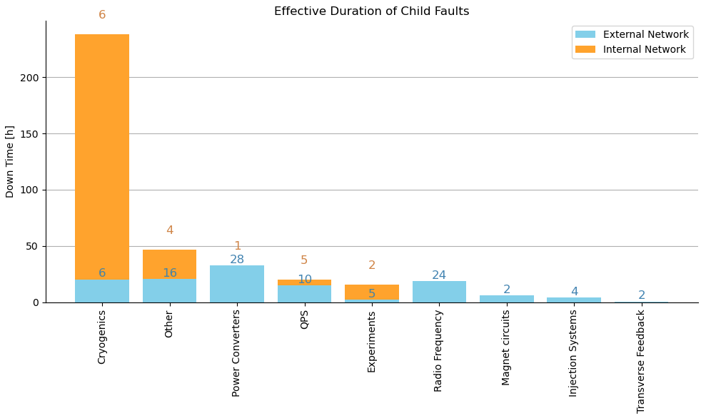
Electrical Network
LHC Child Down Time (h, #)
External Perturbations
Internal Equipment
External Perturbations
2%
Child faults in other systems
40%
58%
Internal Equipment
Redundancy in the internal network could be powerful
However – we need a solution for child faults!
  Rigorous design requirements for resilience to power disturbance
  How to dampen voltage deviations (internal + external) ?
See presentation:
Hannah Dostmann
Technical Infrastructure Availability
Technical Infrastructure: Electricity & Energy Management
Tuesday 20th May

Slide 19
Power Converters
Collider
Booster
H
tt
W
Huge number of converters due to many sextupole & corrector magnets
Z
Assumes the same degree of redundancy as exists currently in LHC
H
tt
W
Z
Current optics configuration:
  Sextupoles powered in groups of four
  Correctors powered individually
How many power converters can we lose without dumping the beam?
  Needs a detailed study from optics and machine protection

Slide 20
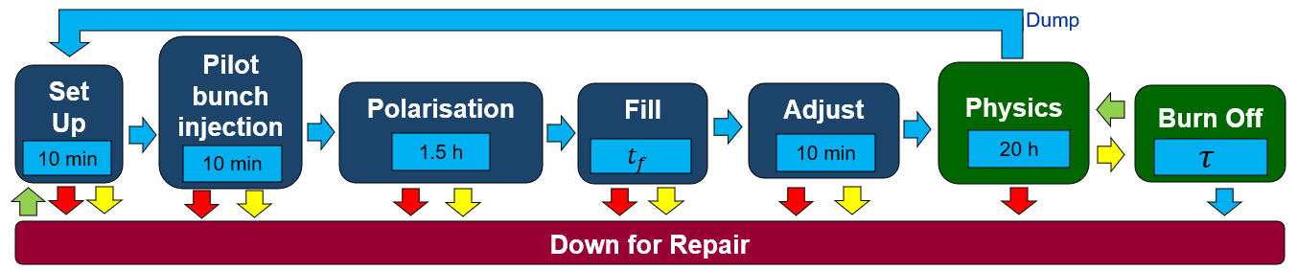
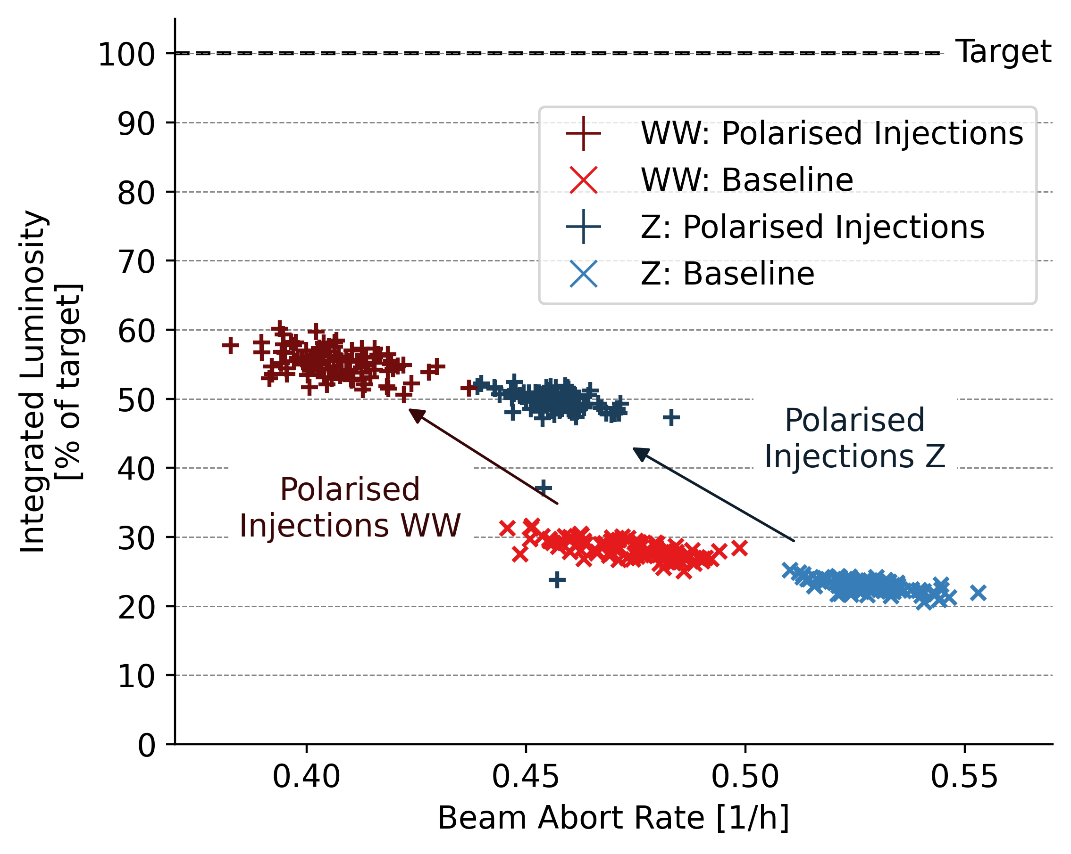
Solution: Injection of Polarised Bunches
  Z,W
More than doubles delivered integrated luminosity

Slide 21
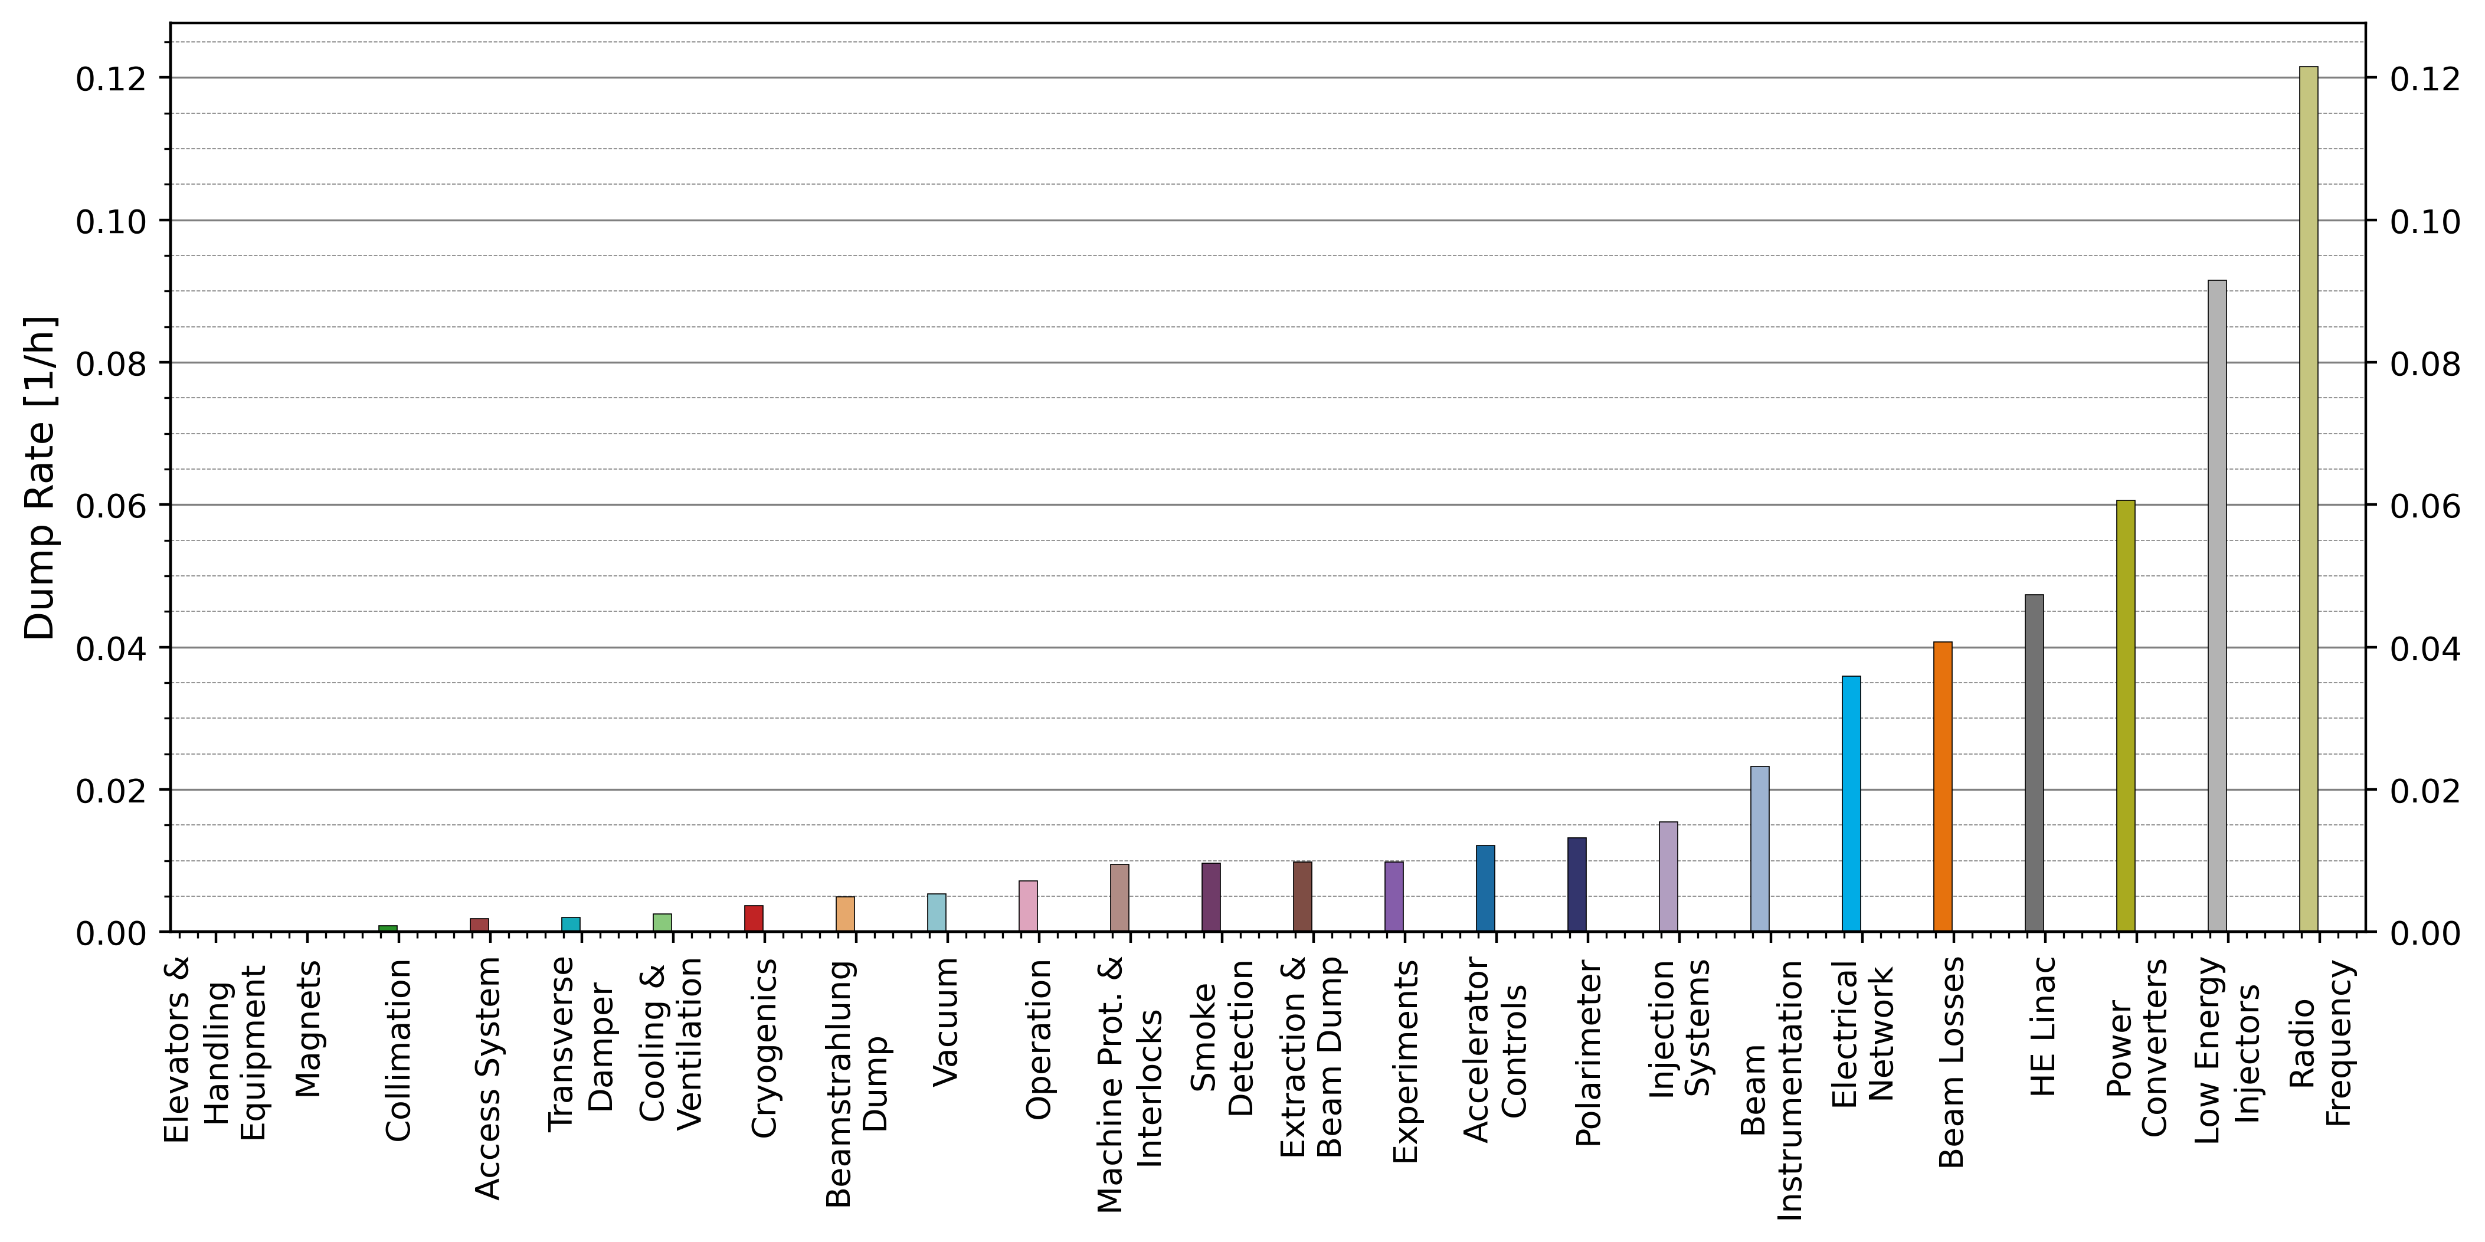
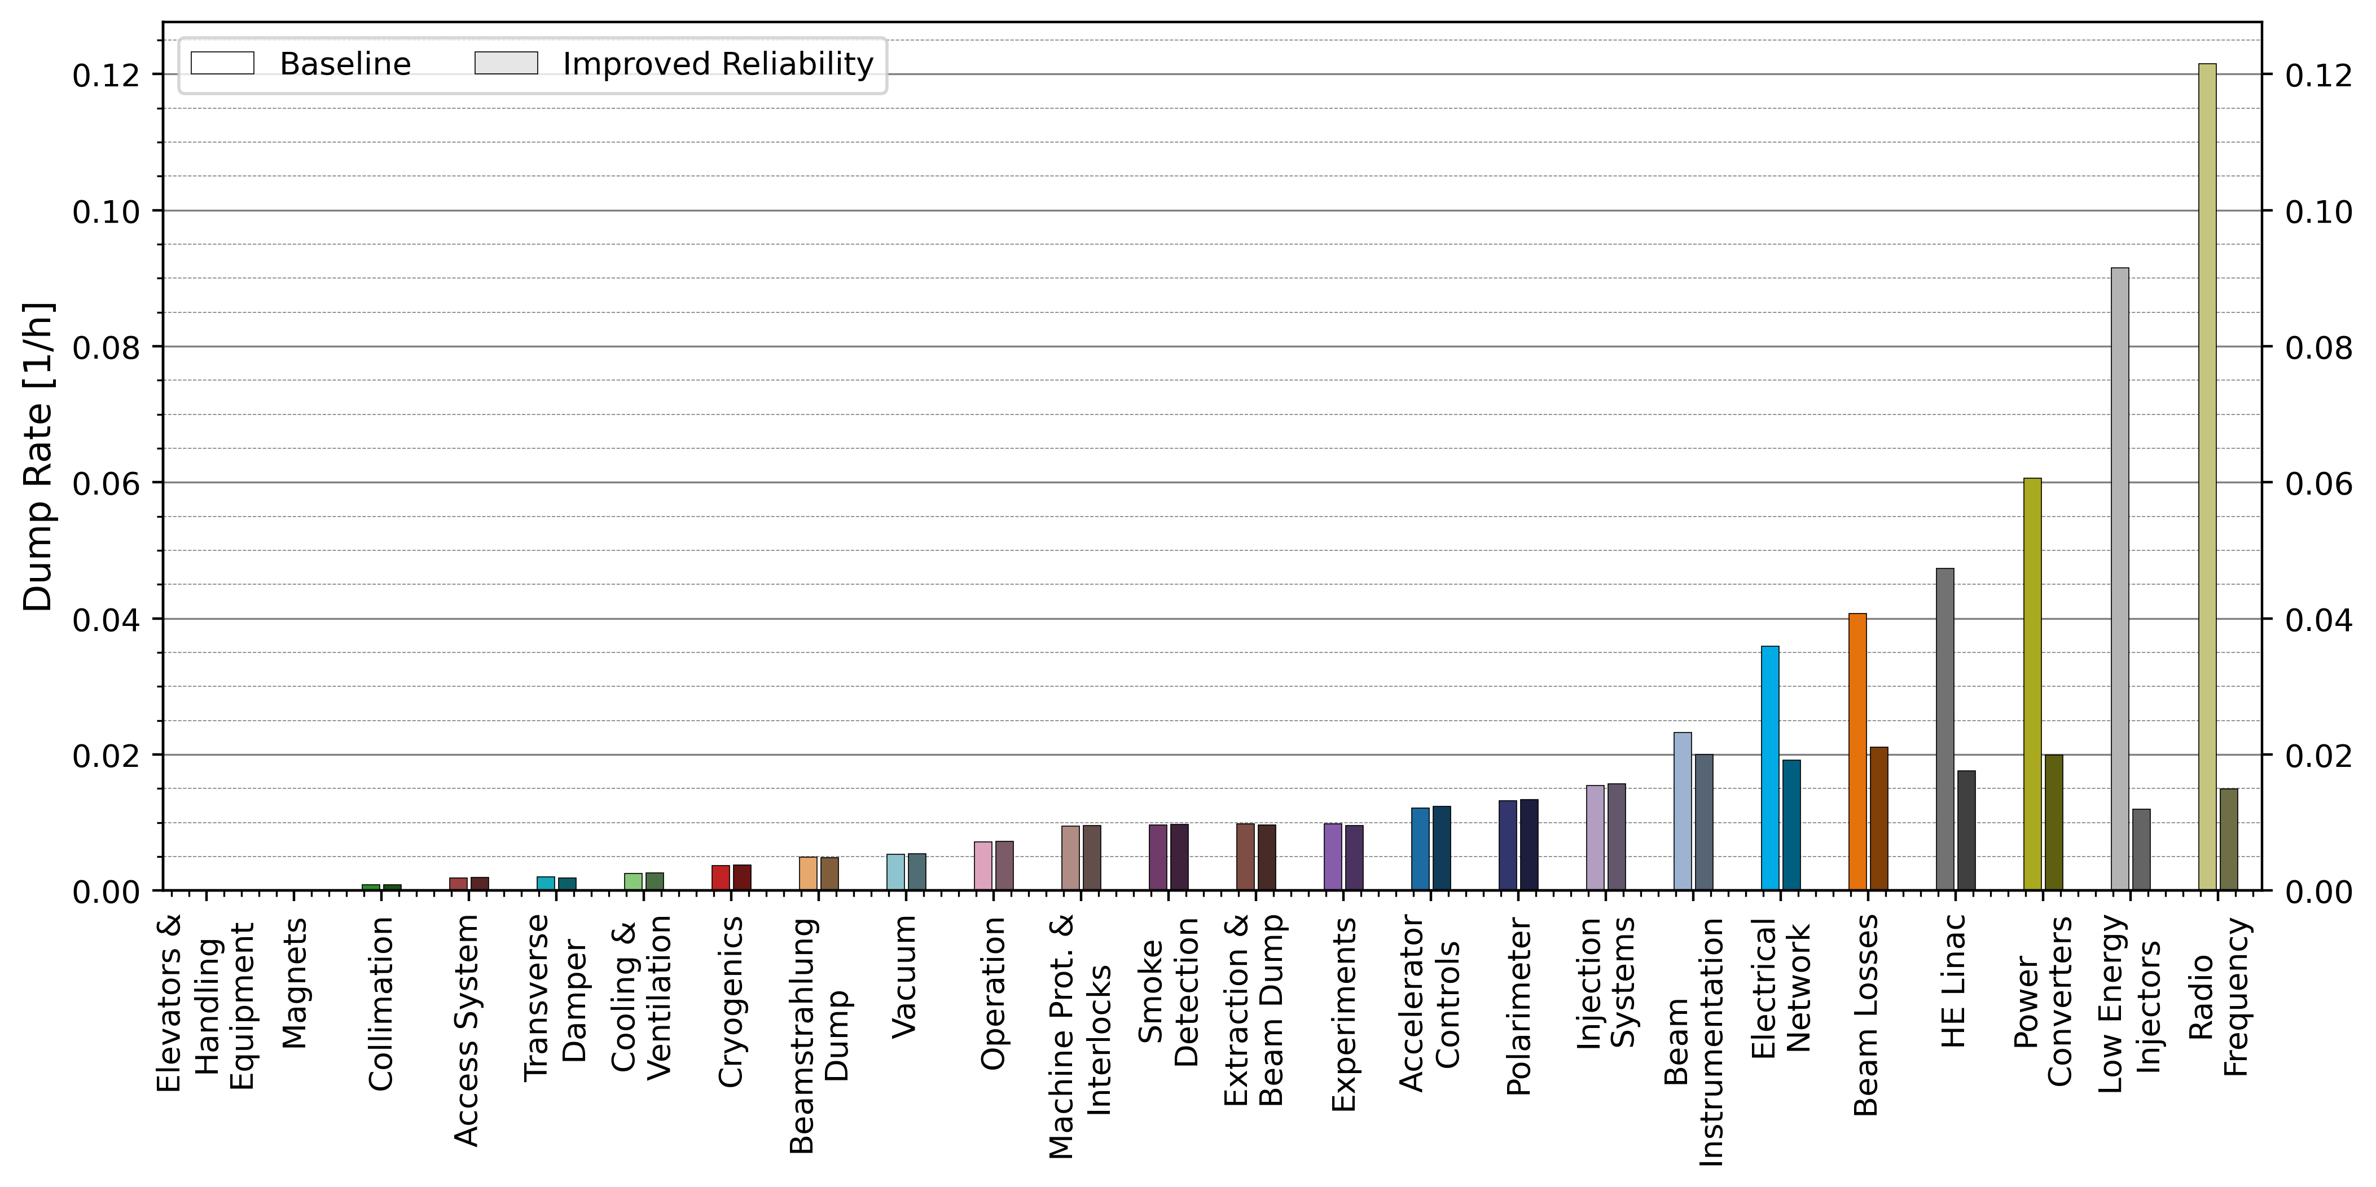

Parameter Scan: Reliability
Unreliability
$$\frac{\text{Machine} \text{dump} \text{rate}}{\text{\# }\text{systems}}$$
Most efficient way to allocate resources for reliability consolidation:
Only systems above the required dump rate need to improve

Slide 22
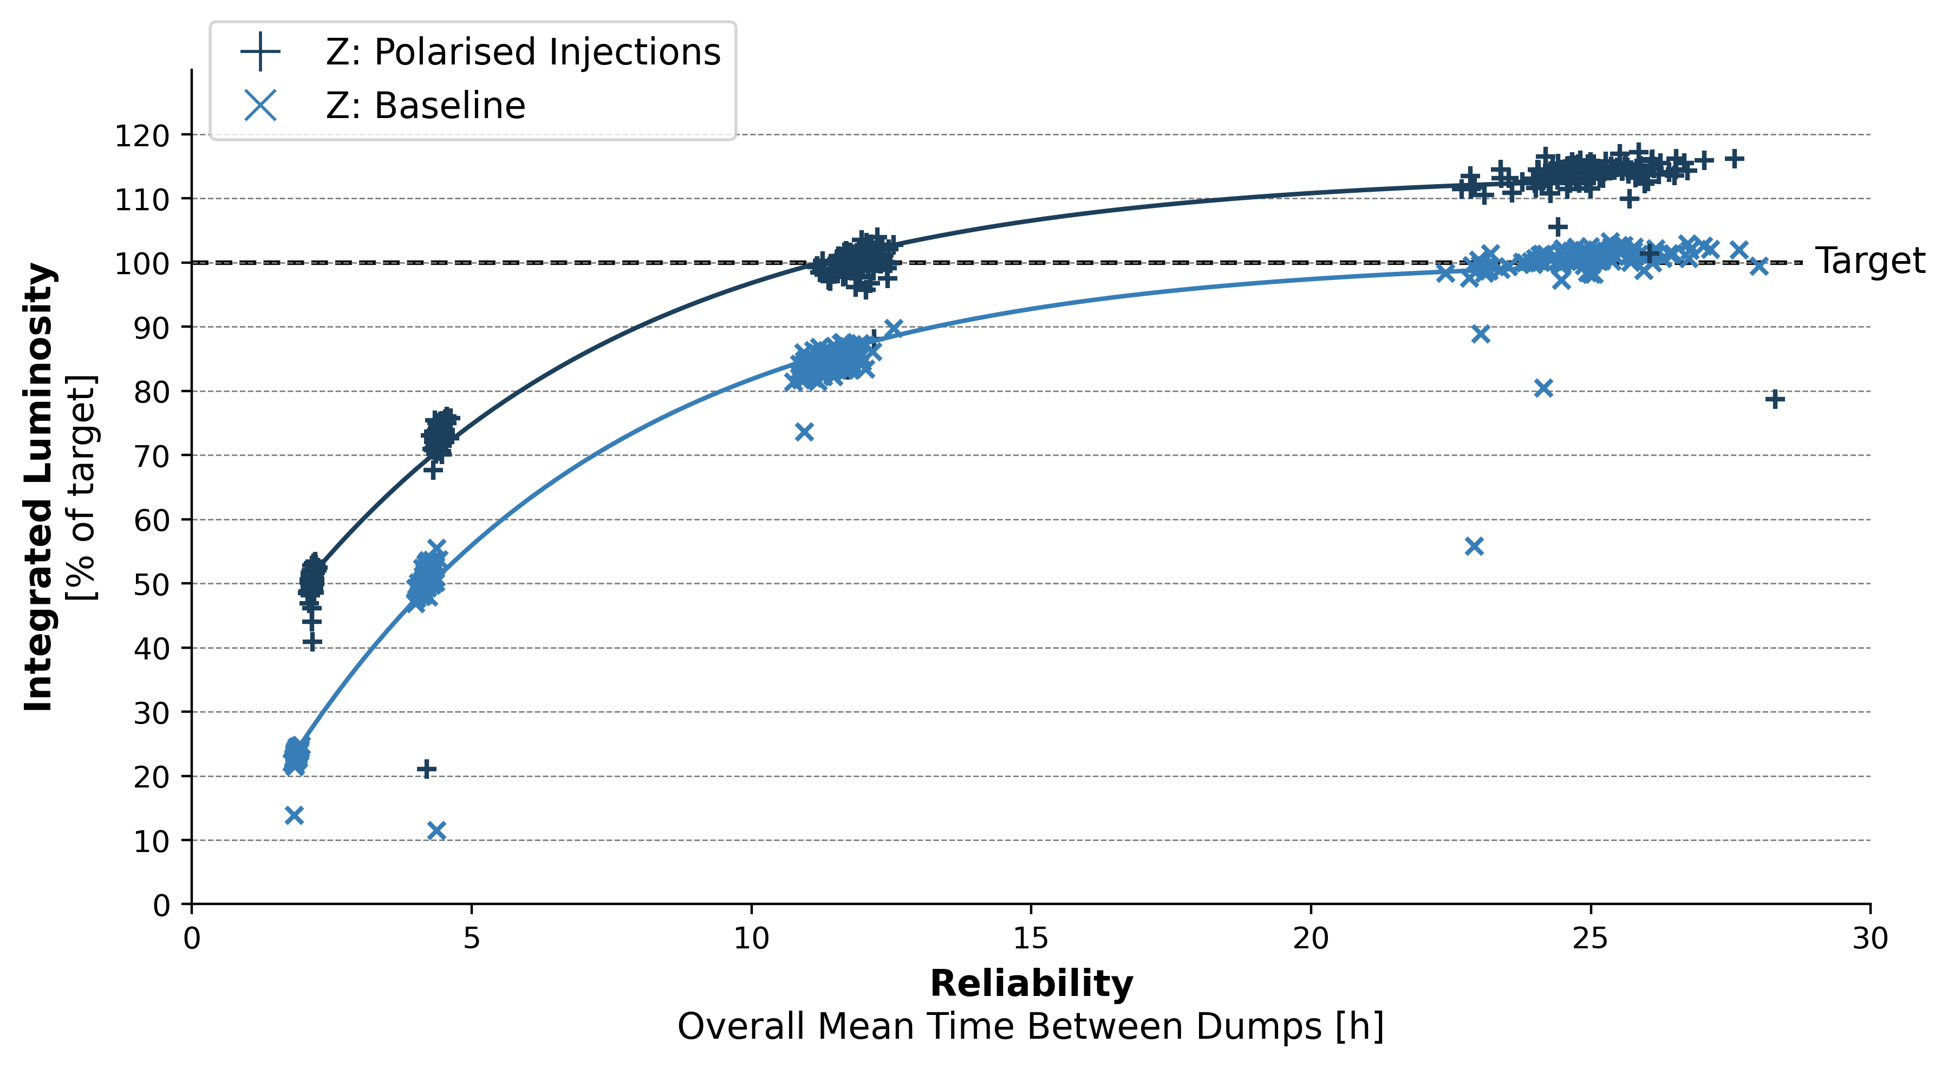
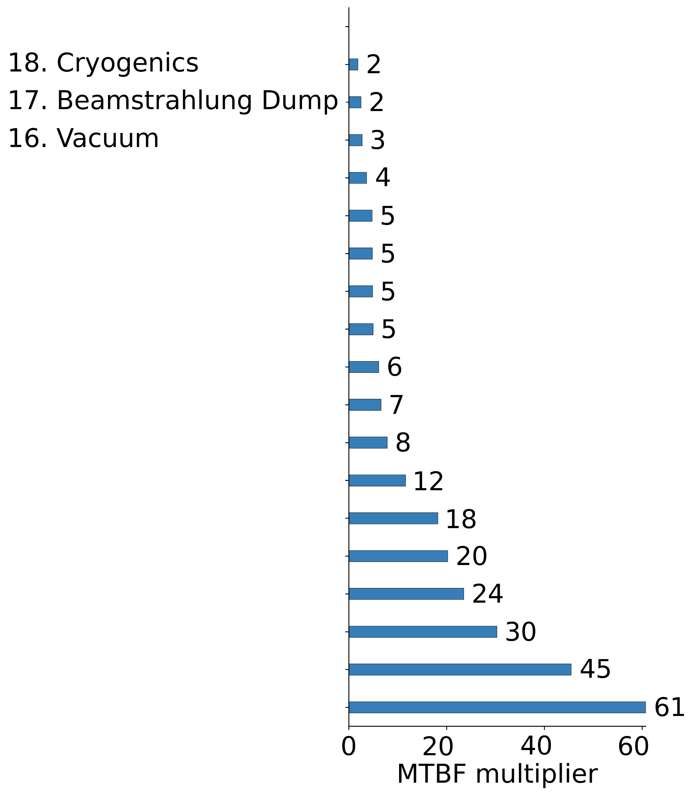
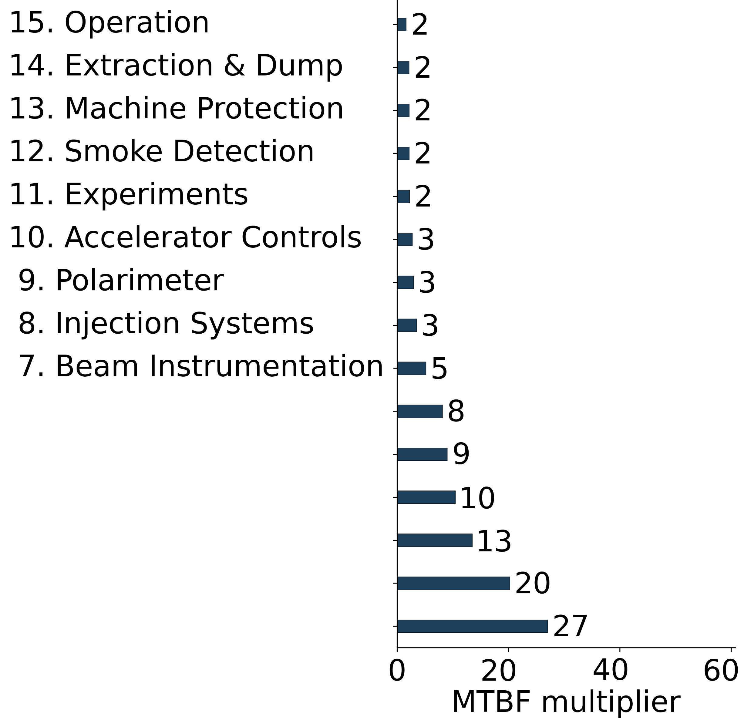
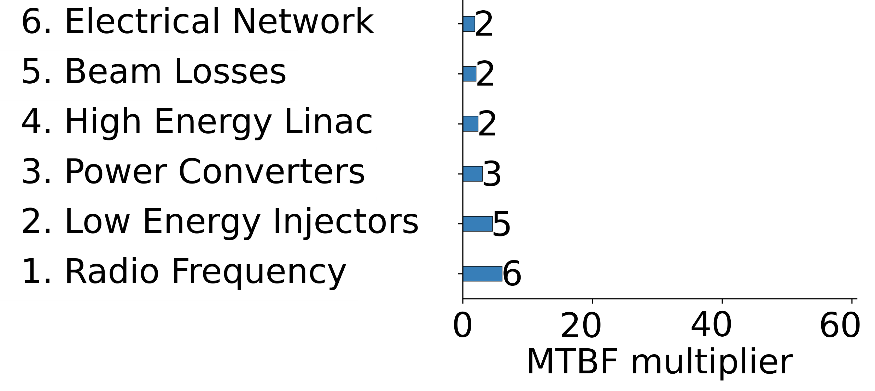
Parameter Scan: Reliability
Target Achieved with polarised injections
Target Achieved with reliability only
Reliability equivalent to polarised injections
2025

Slide 23
Conclusions
Forecasted integrated luminosity is below design in all energy modes
  Low availability and low efficiency
Systems of highest concern:
  RF
  Power Converters
  Injector Complex
  Technical Infrastructure
  Beam Losses
R&D Opportunity:
  Injection of polarised bunches

Slide 24
Outlook
Success in FCC requires machine-wide improvement in reliability
Systematic Reliability / Availability Support Framework
TDR & Beyond:
  Design for reliability:
    Detailed modelling
    Redundant / modular / hot-swappable paradigm
    Interfacing between systems
  Tools, training, expertise
  Extensive hardware testing & validation
  Diagnostics & Health Monitoring
  Fault prediction
  Fault tracking & Analytics
  Lifecycle Reliability
Short Term:
Requirements and milestones, performance benchmarking
More nuanced reliability models in parallel with design process
“Low-hanging fruit” – R&D opportunities evaluation
Performance/Cost optimisation over the whole machine
Develop a coherent support framework for all system designs

