Slide 1
Progress of the EIC Superconducting RF Systems
Silvia Verdú-Andrés
EIC L2 RF Systems – Manager Deputy
FCC Week 2025
Session SRF Technology #1
Vienna, 21 May 2025

Slide 2
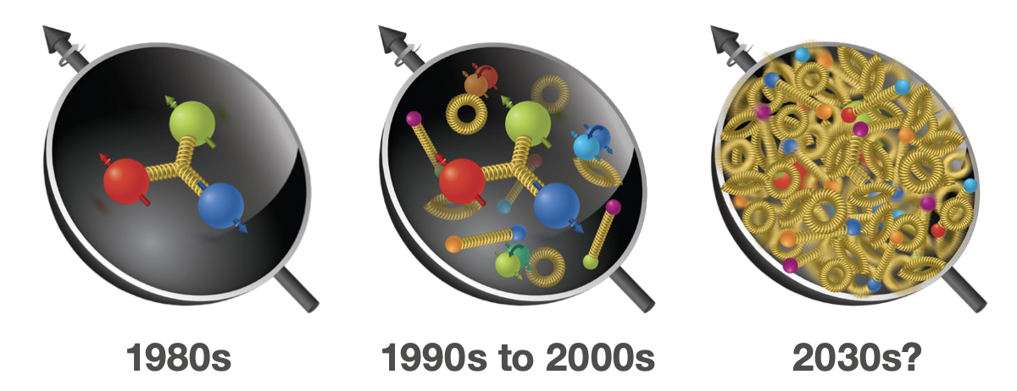
The Electron-Ion Collider – Motivation
Evolving understanding of the Proton has shown great progress…
Still, our understanding of visible matter’s mass and proton spin does not add up
https://www.bnl.gov/eic/

Slide 3
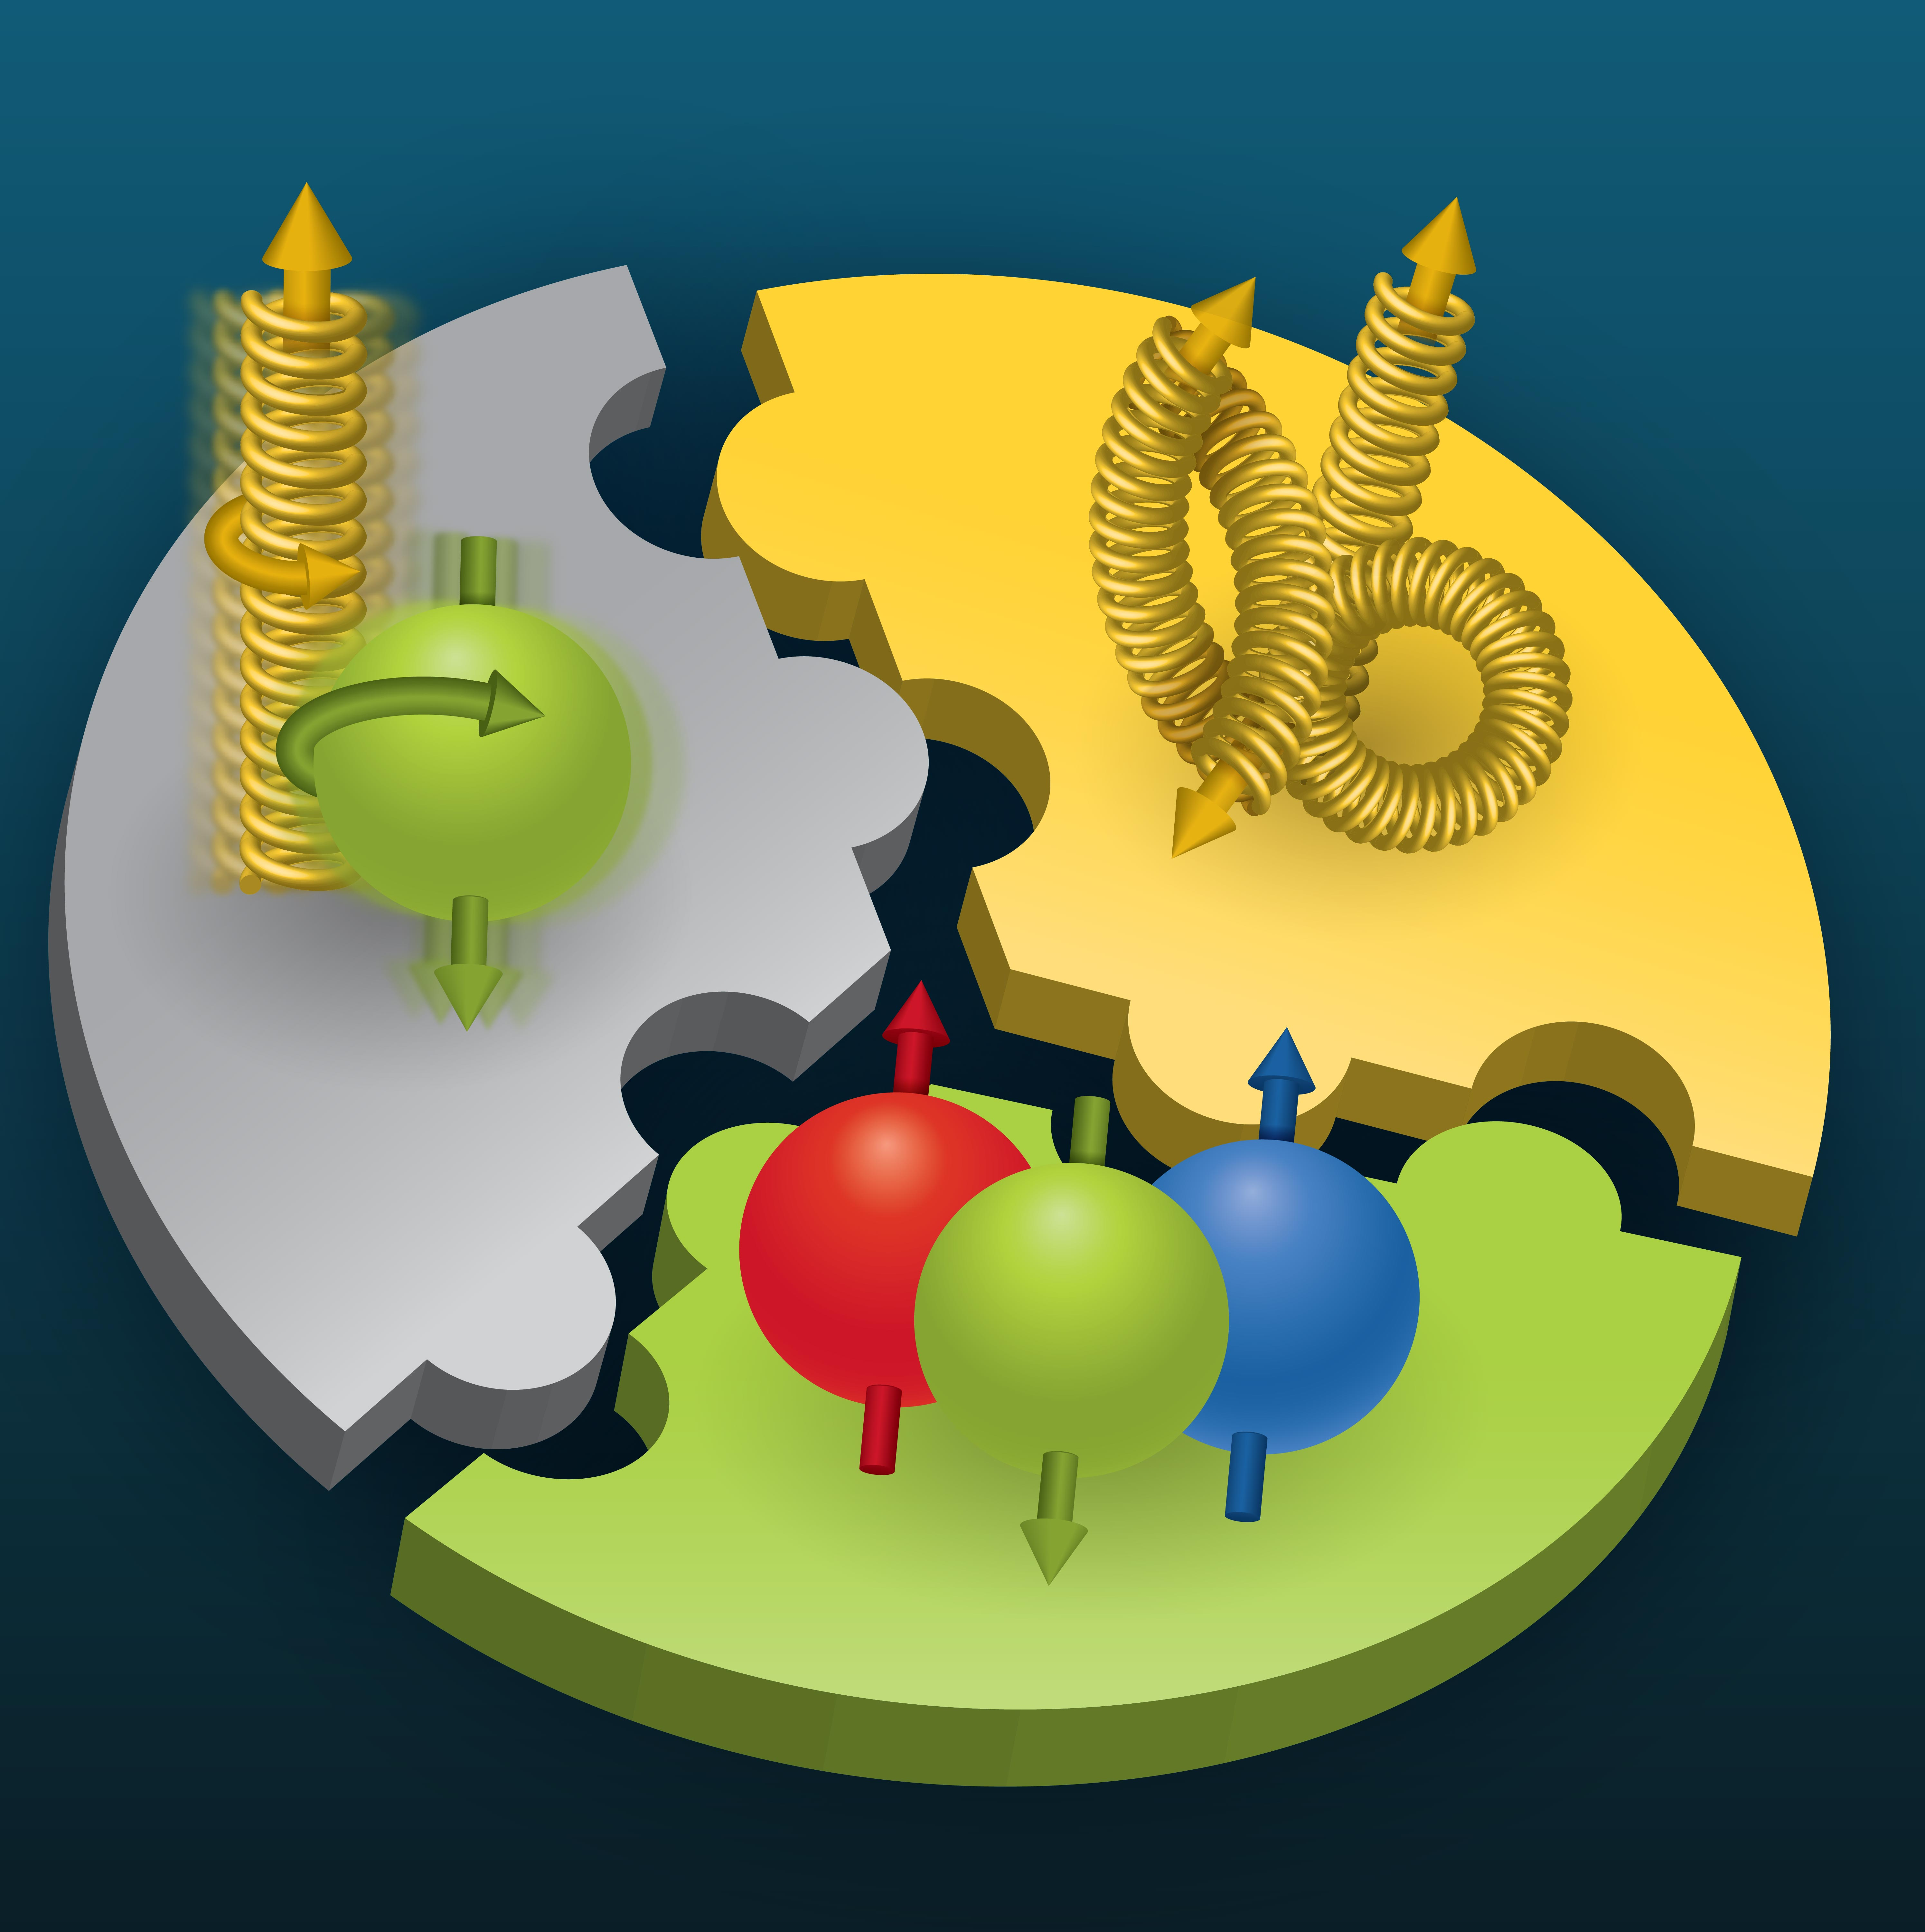

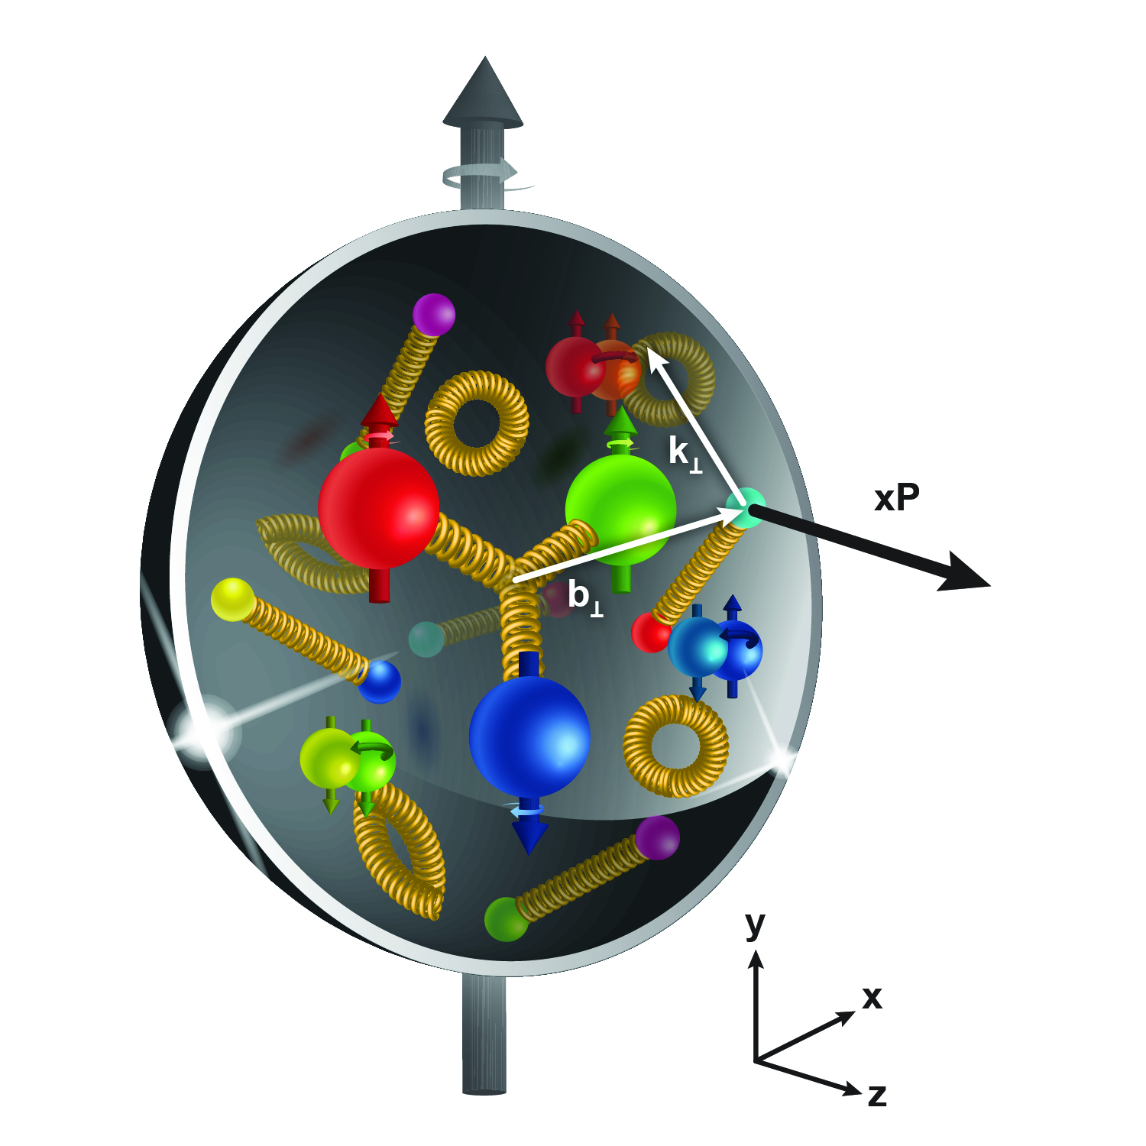
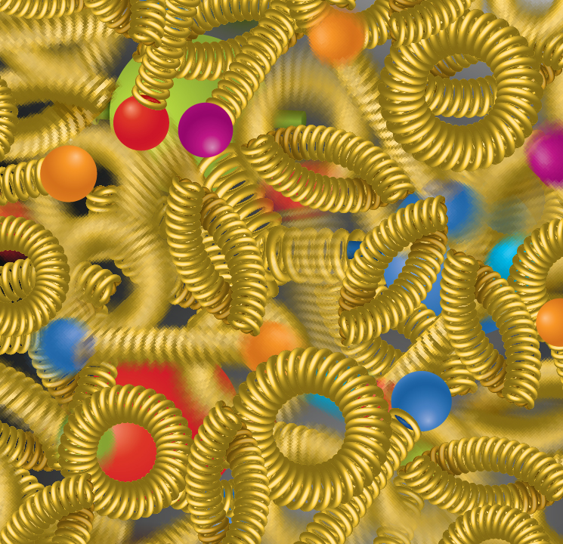
The Electron-Ion Collider – Compelling Science
Compelling EIC Scientific Case built over decades (U.S. National Academy Report)
How do quarks, gluons, and orbital angular momentum contribute to proton spin? | Does the mass of visible matter emerge from quark-gluon interactions? | How can we understand QCD dynamics and the relation to confinement? | How do quark-gluon interactions create nuclear binding? | Does gluon density in nuclei saturate at high energy?
EIC will be the only operating particle collider in the U.S. and
– maybe? – the only large collider to be built in the world in the next 10 years.
Notes:
EICUG: 1550 collaborators, 41 countries, 305 institutions (as of April 2025)

Slide 4
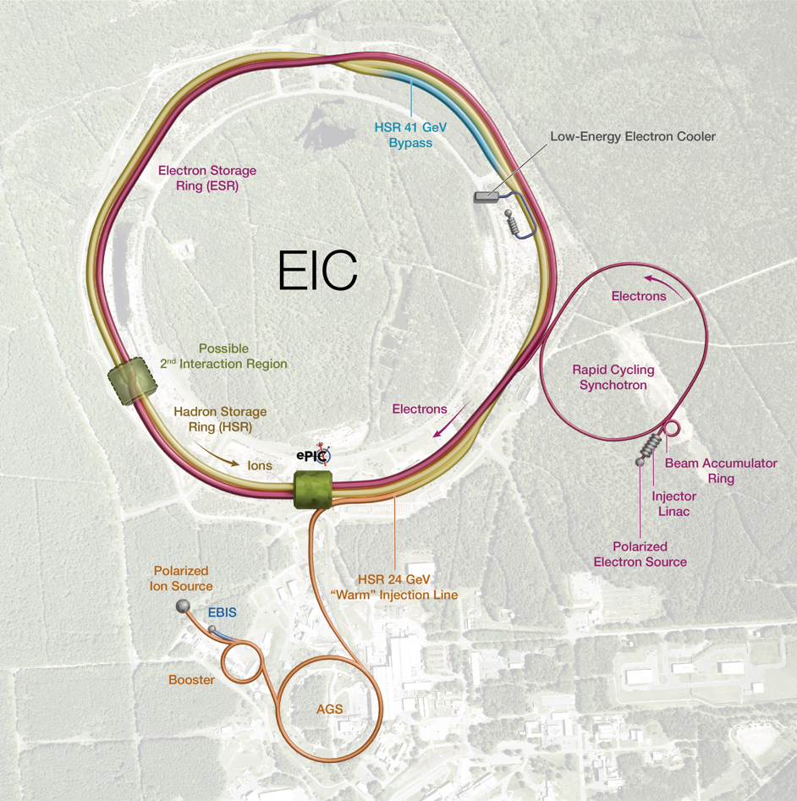
The Electron Ion Collider – Facility Performance
High Luminosity: | L = 10³³ – 10³⁴ cm⁻² s⁻¹
Highly Polarized Beams: | 70%
Large Center-of-Mass Energy Range: | E_{cm} = 20 – 140 GeV
Large Ion Species Range: | Protons – Uranium
Possibility to include a Second Interaction Region (IR)
Large Detector Acceptance, Good Background Conditions
Aerial view of the RHIC Accelerator Complex with EIC diagram superposed
Versatile.
Relevant.
Challenging!

Slide 5

The Electron Ion Collider – The Accelerator
Reuse injection system and parts of the Relativistic Heavy Ion Collider (RHIC) for Hadron Storage Ring (HSR)
Add Electron Storage Ring (ESR) to the RHIC tunnel
High luminosity Interaction Region (IR)
  Crab cavities (local scheme)
Major recent EIC scope changes:
  New electron injector chain (Apr. 2025 Review)
    RCS outside the RHIC tunnel
    New Beam Accumulator Ring (BAR) concept
    New Tunnel and “bigger” LINAC and BAR buildings
  No Strong Hadron Cooling (SHC) needed
    Add Low Energy Electron Cooling (LEC) (Apr. 2025 Review)
    Stochastic Cooling (SC) under consideration
Aerial view of the RHIC Accelerator Complex with EIC diagram superposed
Facility built at
Notes:
RHIC successful operation since 2000s.
Highlight constraint of existing RHIC accelerator complex

Slide 6
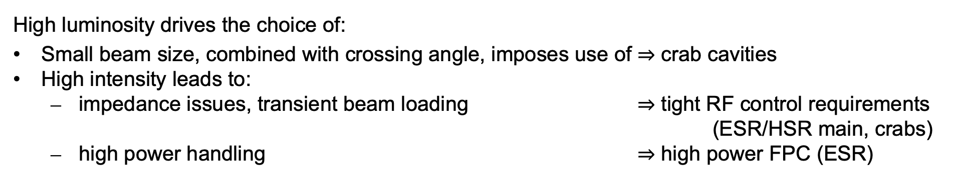
The Electron Ion Collider – Beam Scenarios & RF
 |  | High Lumi |  | High E_{cm}
 |  | e- | p+ | e- | p+
CoM Energy | (GeV) | 105 |  | 140
Luminosity | (cm⁻² s⁻¹) | ~10³⁴ |  | ~10³³
Energy | (GeV) | 10 | 275 | 18 | 275
No. bunches |  | 1160 | 1160 | 290 | 290
Bunch charge | (nC) | 28 | 11 | 10 | 30
Beam Current | (A) | 2.5 | 1 | 0.23 | 0.69
Bunch length | (rms mm) | 7 | 60 | 7 | 60
High luminosity drives the choice of:
Small beam size, combined with crossing angle, imposes use of $⇒$ crab cavities
High intensity leads to:
  impedance issues, transient beam loading $⇒$ tight RF control requirements (ESR/HSR main, crabs)
  high power handling $⇒$ high power FPC (ESR)
Notes:
Most demanding beam scenarios

Slide 7



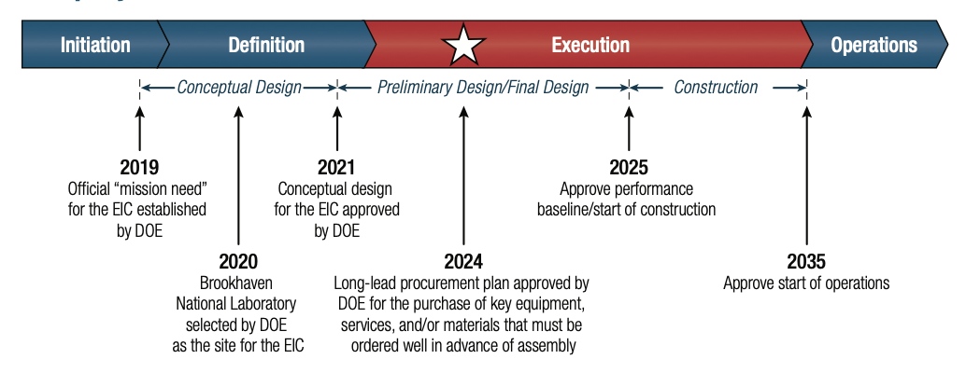
The Electron Ion Collider – The Project
A DOE project to be delivered by a special partnership between BNL and JLab
Steady progress:
DOE Critical Decision (CD) gateways
2025 CD-3b*
CD-0
CD-1
2026
Planned start of construction
CD-3a
2nd half 2030
Planned start of operations
Long-lead procurement plan
waiting formal approval
The EIC Project is proposing a staged approach to move as soon as possible into construction and operations. While science progresses, we plan to continue construction to meet Mission Needs.
Notes:
Received approvals for CD-1 (20XX) and CD-3a (20XX); Successful review of CD-3b (2025) waiting formal approval.
Phase I: Start of Science (start with ions…, install additional RF systems and power in Year 4-5 to reach design energy and current) and Phase II: Full Scope.
Future is to deliver in sub-projects to navigate uncertainty in funding.
Go as soon as possible into operation. Moving things into construction. For that we need … Bring facility in operation in second half of FY30. While physics progresses, we continue CM to deliver facility to fulfill Mission Needs.
You should NOT say: we will receive money to complete. nothing about funding profile, nothing about Early Science and Full Scope; nothing about KPP or closing project; nothing about CD-4 or date of approval for baseline.
Example about in-kind: Discussions with France about in-kind scope. You can NOT say: France will deliver.

Slide 8
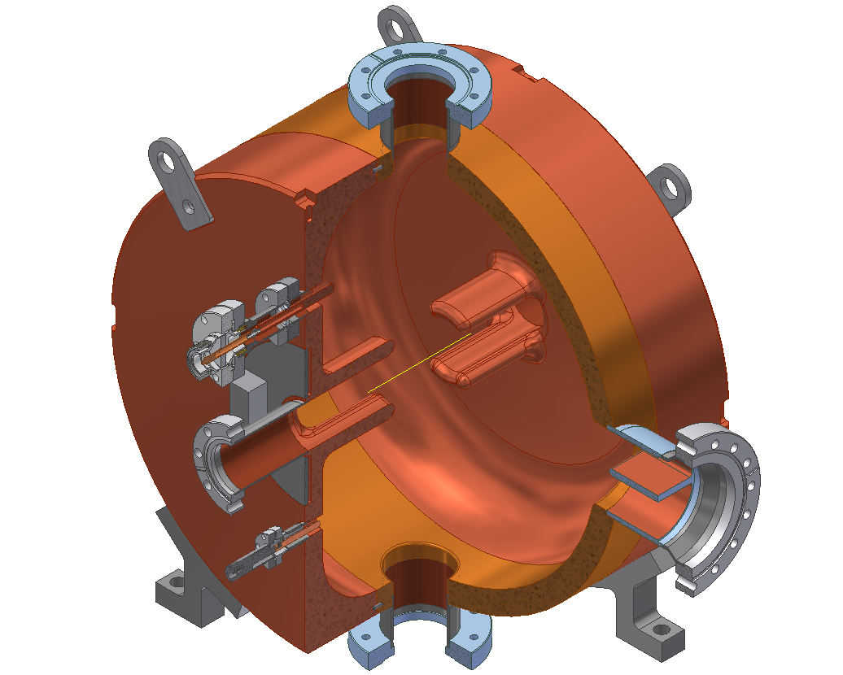
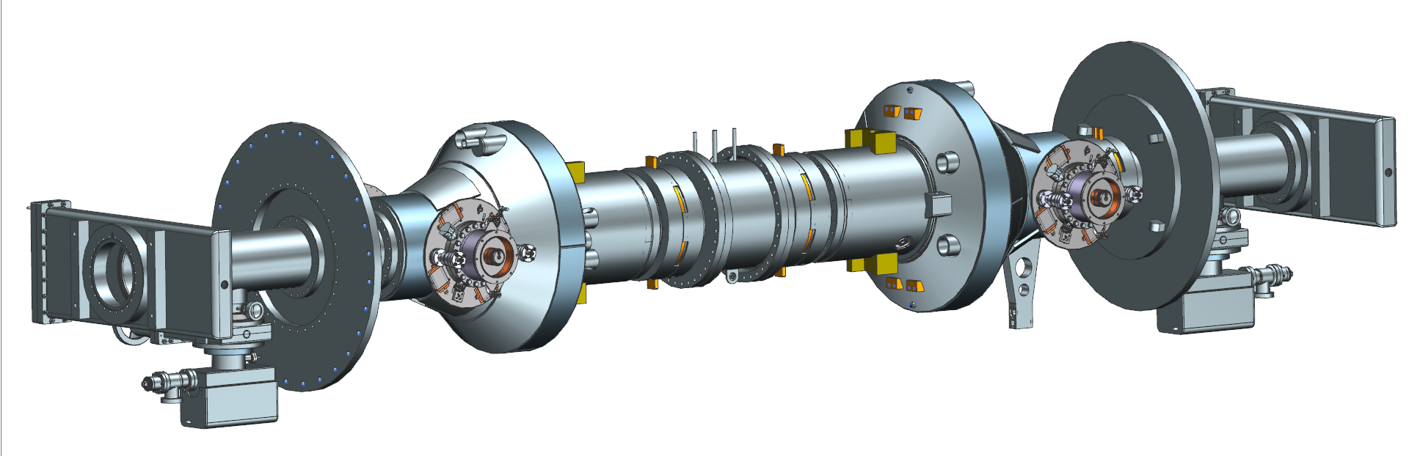
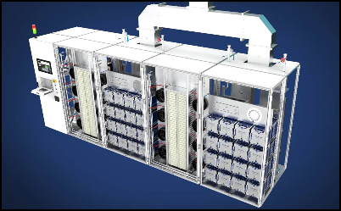
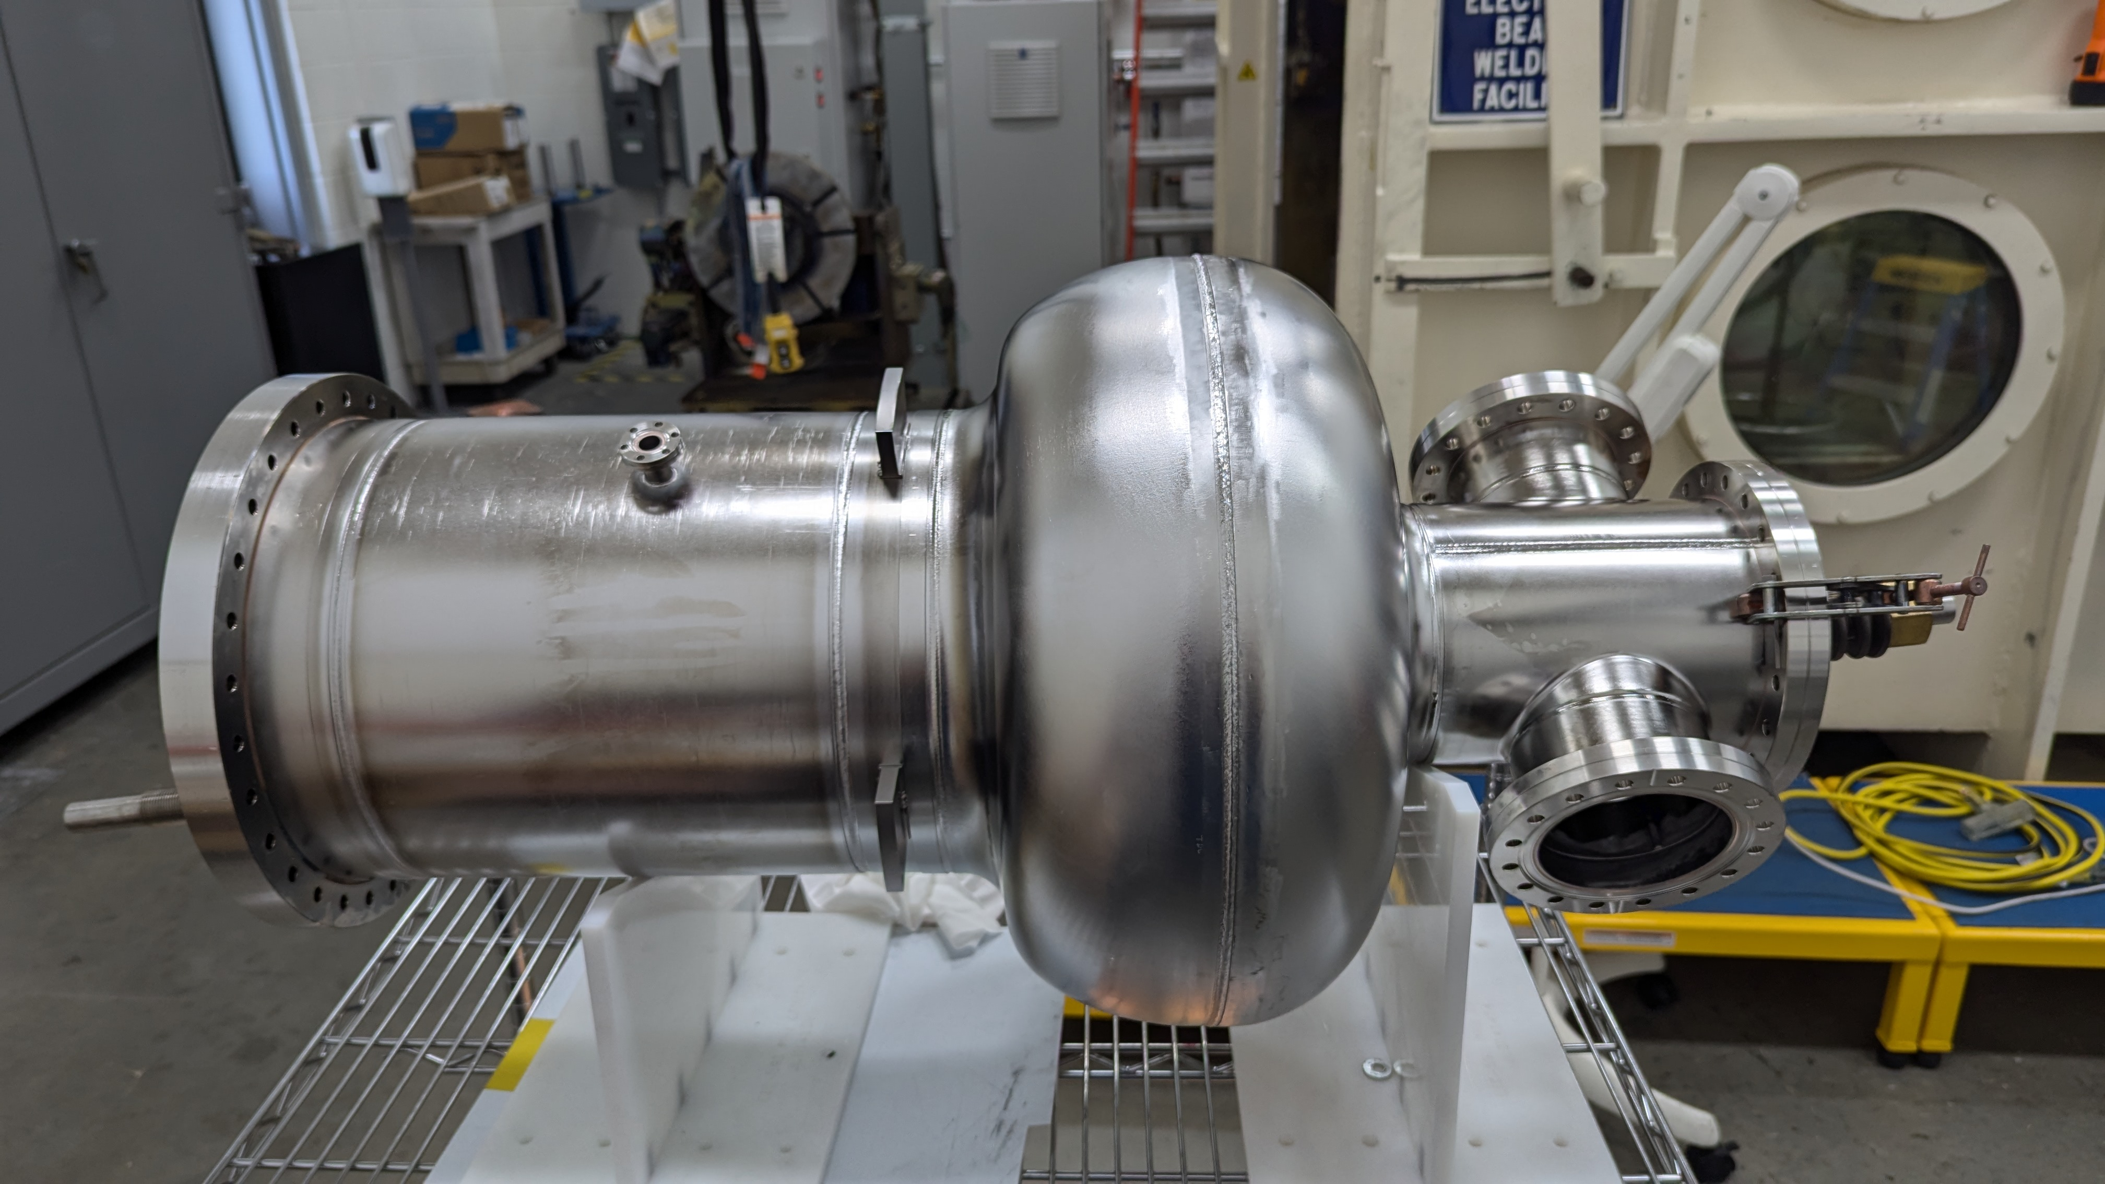
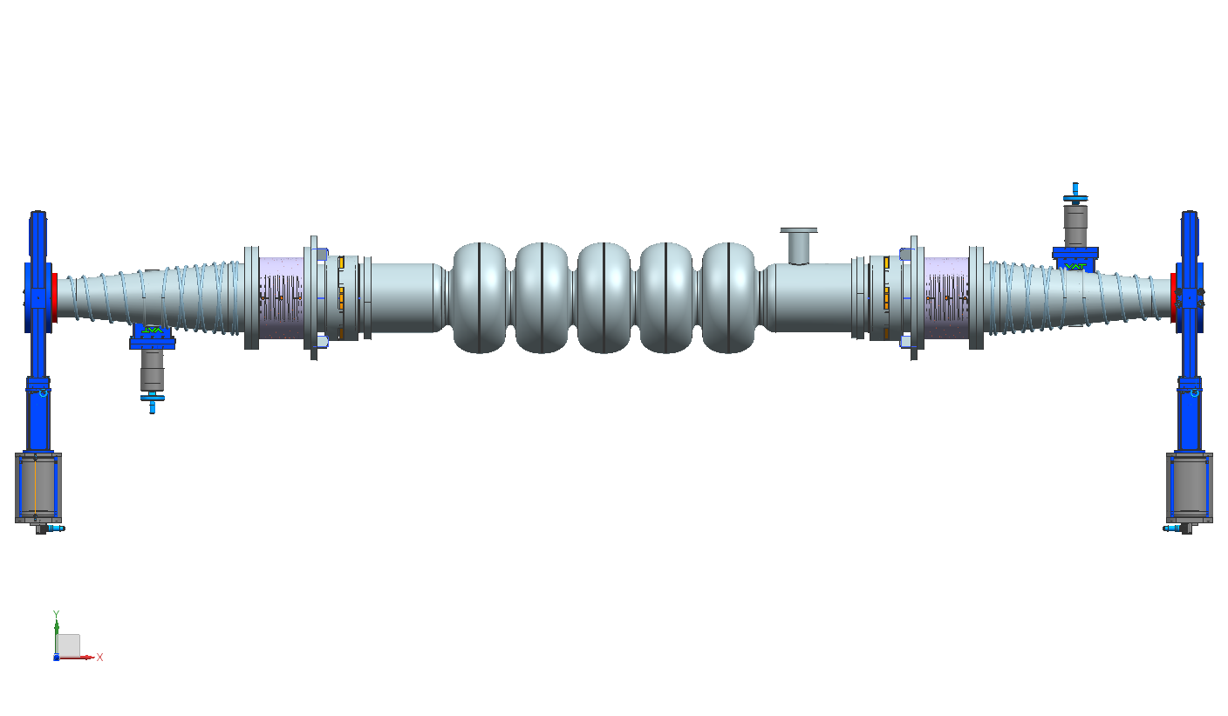
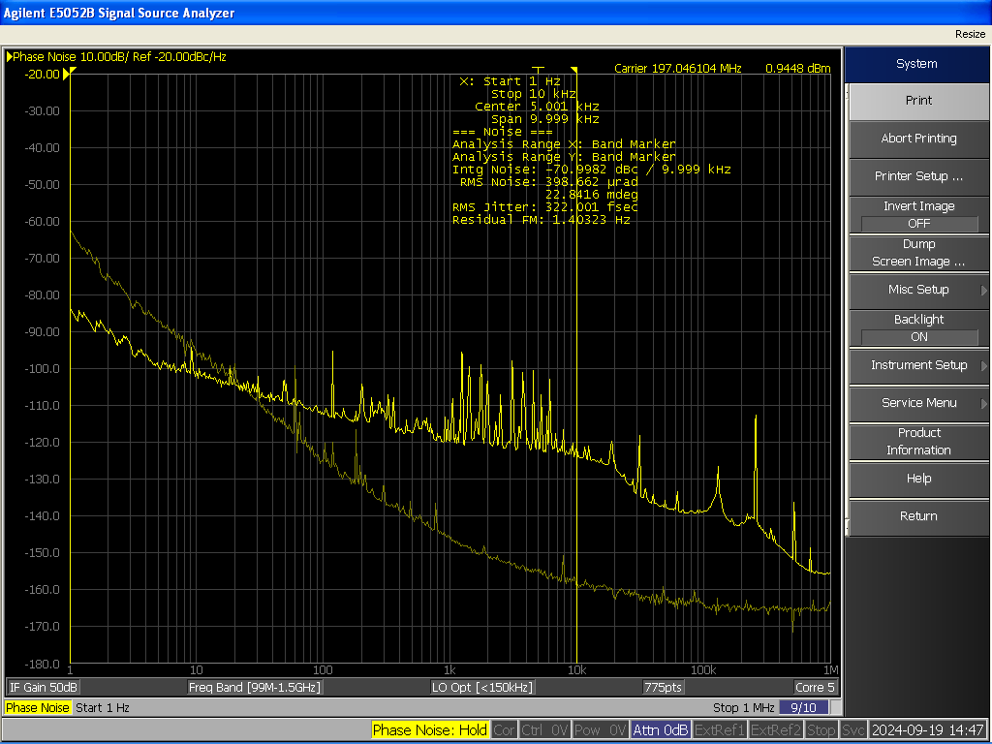
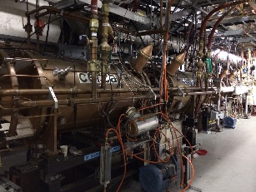
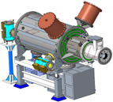
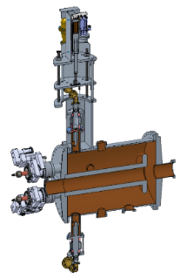
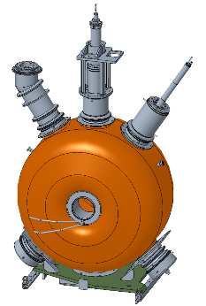
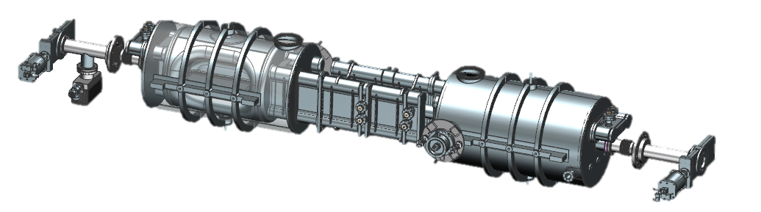
RF Systems in the EIC
The Project is pre-CD2 and in the design phase. Many systems are still developing.
IR10
Electron Storage Ring (ESR) &
Hadron Storage Ring (HSR)
591 MHz 800 kW 2 K 1-Cell 2-Cavity Cryomodules
ESR = 9 CMs and HSR = 3 CMs
IR02
Low-Energy electron Cooler (LEC)
197 MHz NCRF 1-cell Acceleration Cavity
591 MHz NCRF Correction Cavity
24 MHz NCRF Compensation Cavity
591 MHz Deflecting Cavity
400 kW Amplifier
591 MHz 1-cell prototype
RCS
Rapid Cycling Synchrotron (RCS)
591 MHz 5-Cell Acceleration Cavity Cryomodule 8 CMs
197 MHz & 394 MHz Crab System
IR06
Hadron Storage Ring (HSR)
IR04
Per IP | HSR (#Cav/#CM) | ESR (#Cav/#CM)
197 MHz | 8/4 | –
394 MHz | 4/4 | 2/2
HSR – 197 MHz bunch compression cavity
HSR – 49.2 MHz and 98.5
MHz bunch splitter cavities
RHIC – 28 MHz acceleration cavity
HSR – 24.6 MHz
Accelerating Cavity
EIC LLRF DAC Clock for Crab Cavities
Emergent scope not listed.

Slide 9
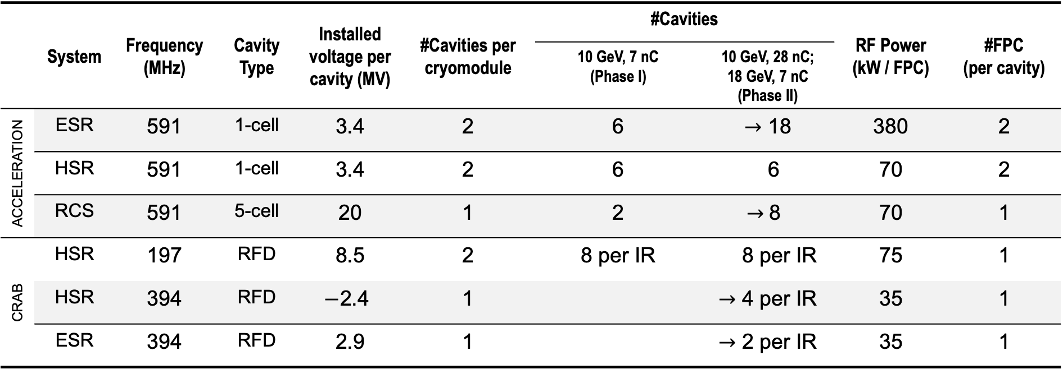
SRF Systems in the EIC
 | System | Frequency (MHz) | Cavity Type | Installed voltage per cavity (MV) | #Cavities per cryomodule | #Cavities |  | RF Power (kW / FPC) | #FPC (per cavity)
 |  |  |  |  |  | 10 GeV, 7 nC (Phase I) | 10 GeV, 28 nC; 18 GeV, 7 nC (Phase II)
ACCELERATION | ESR | 591 | 1-cell | 3.4 | 2 | 6 | $→$ 18 | 380 | 2
 | HSR | 591 | 1-cell | 3.4 | 2 | 6 | 6 | 70 | 2
 | RCS | 591 | 5-cell | 20 | 1 | 2 | $→$8 | 70 | 1
CRAB | HSR | 197 | RFD | 8.5 | 2 | 8 per IR | 8 per IR | 75 | 1
 | HSR | 394 | RFD | $−$2.4 | 1 |  | $→$ 4 per IR | 35 | 1
 | ESR | 394 | RFD | 2.9 | 1 |  | $→$ 2 per IR | 35 | 1
All 2 K Nb cavities. RCS SRF system will be operated at 4K in Phase I.
ESR and HSR 591 MHz SRF systems use the same design, with small variations to the FPC antenna.
Same 394 MHz crab design for HSR and ESR.

Slide 10



ESR 591 MHz SRF System
Highest power and highest voltage appear at different beam scenario (high Luminosity and high Ecm)
Assume 18 cavities, 2 FPC per cavity |  | 10 GeV | 18 GeV
Beam current | (A) | 2.5 | 0.23
Synchrotron radiation power | (MW) | 8.8 | 8.4
HOM power per cavity | (kW) | 33.5 | 1.0
Total power loss | (MW) | 9.37 | 8.4
Power per cavity | (kW) | 520 | 466
Power per FPC | (kW) | 344 | 307
dE per turn | (MeV) | 3.5 | 37
Total voltage | (MV) | 20.3 | 61.5
Voltage per cavity | (MV) | 1.2 | 3.4
Peak E | (MV/m) | 13 | 37
Peak B | (mT) | 24.7 | 70
$→$ 400
with 20% overhead
+ 10% transmission loss
$<$ 40
$<$ 80
GOAL
Notes:
Focus on the 591 MHz ESR SRF system

Slide 11
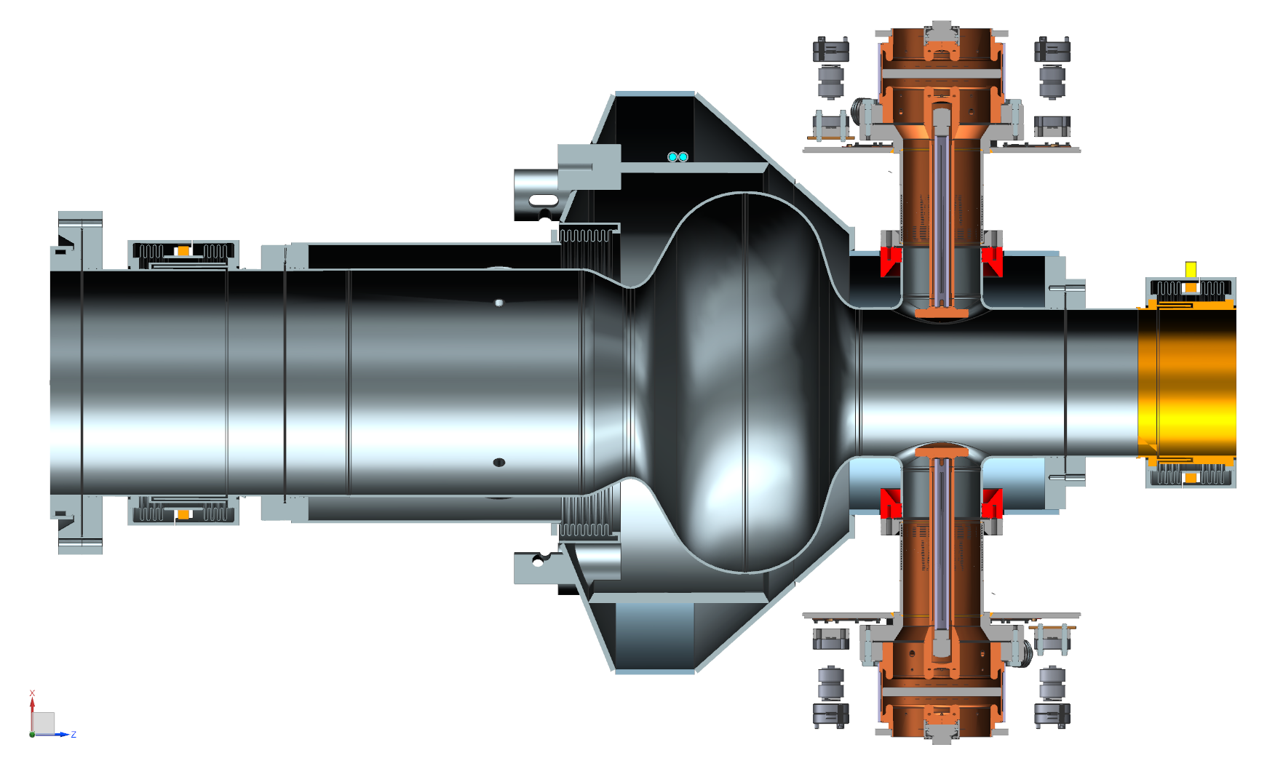
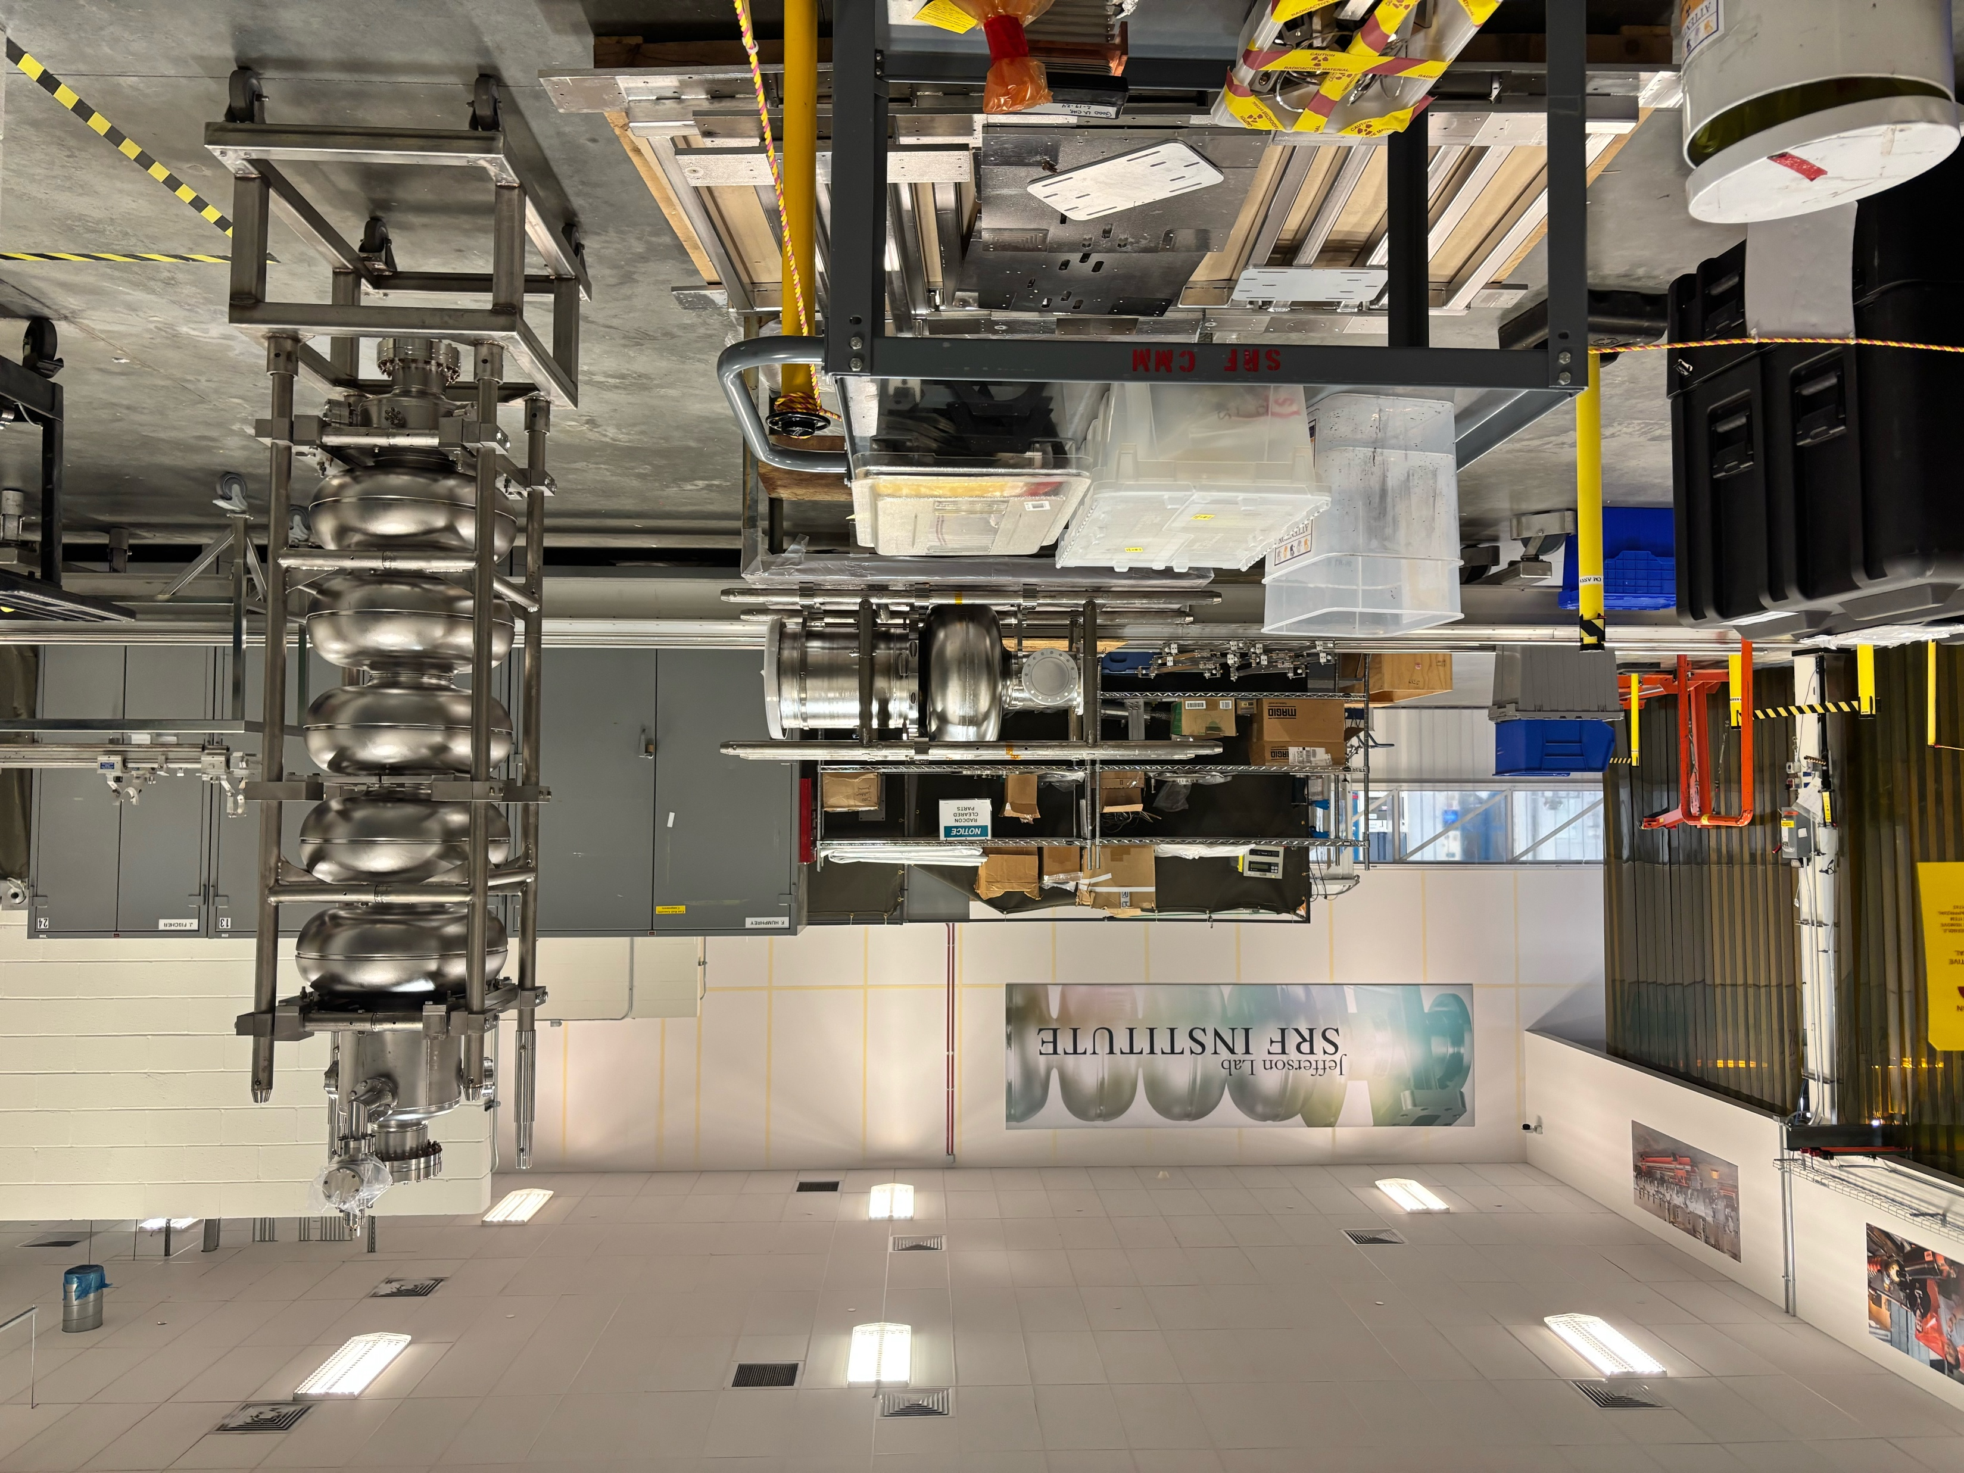
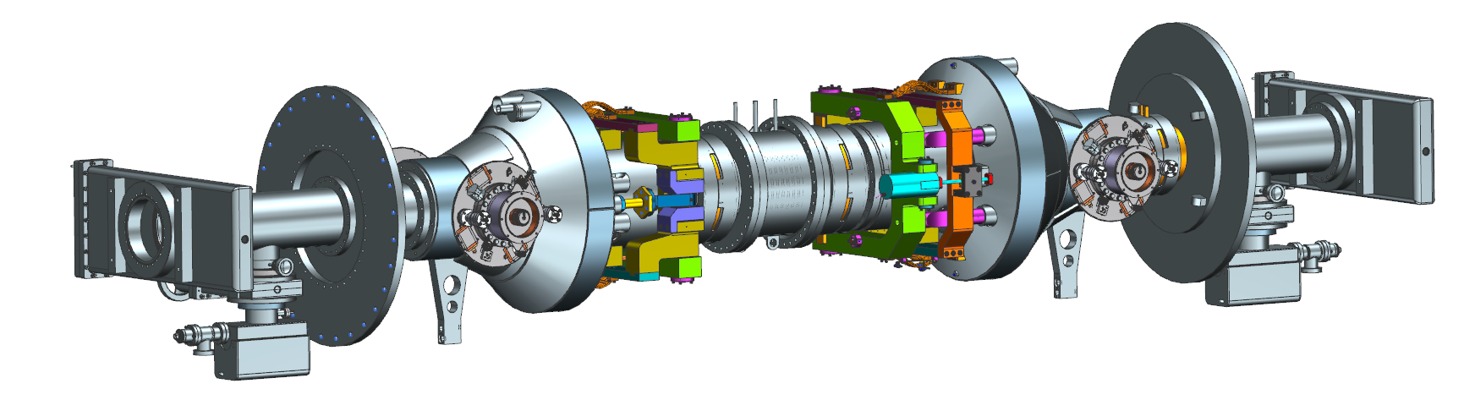
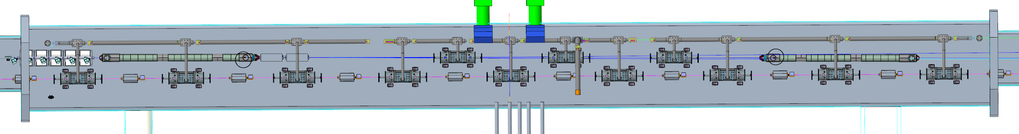
ESR 591 MHz Single-Cell 2-Cavity Cryomodule
Each single-cell cavity powered by two 400 kW CW disk-type coaxial Al₂O₃ window fundamental power couplers
The two cavities in a cryomodule are connected by large beam pipe hosting room-temperature SiC beam line absorber
Dressed 1-cell cavity with dual FPC
(J. Guo, W. Xu, et al.)
Prototype 591 MHz
single-cell cavity
(D. Savransky et al.)
Construction of First Article ESR 591 MHz CM is one of the CD-3A Long Lead Procurements
String assembly with tuners (J. Matalevich et al.)
HSR
Well integrated team effort of BNL and JLab led by JLab
ESR
IR10 ESR and HSR Cryomodule integration
(G. Dacos, D. Holmes)

Slide 12
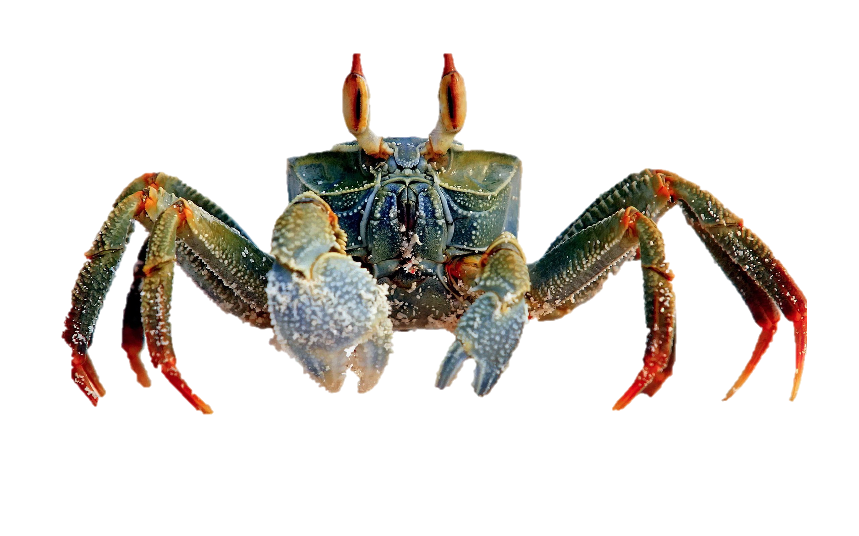
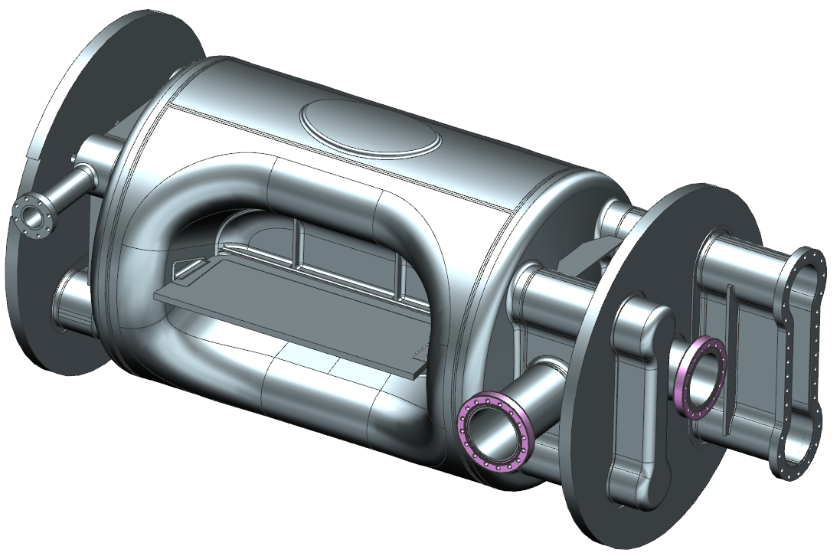
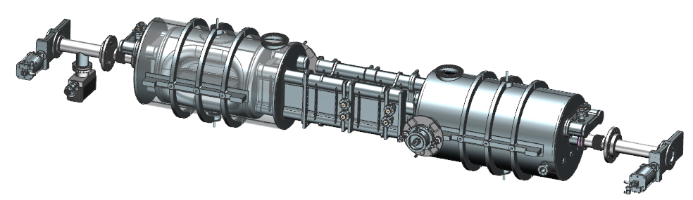
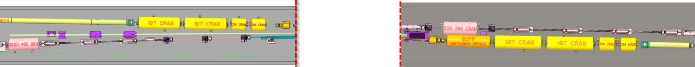
Crab Cavities
Horizontal crabbing kick to maximize luminosity at 25 mrad crossing angle
Limited space and high voltage required motivate the use of compact SRF crabs (RFD)
Prototyping started.
Radio-Frequency Dipole
(RFD) crab cavity
(S. De Silva, B. Xiao,
Z. Li, et al.)
 |  | HSR |  |  | ESR
Frequency | (MHz) | 197 | 394 |  | 394
Total voltage | (MV) | 33.8 | -4.7 |  | 5.8
#Cavities/CM |  | 2 | 1 |  | 1
#Cavities/IP |  | 8 | 4 |  | 4
HHOM
VHOM
String assembly
(N. Huque et al.)
FPC
IR06 ESR and HSR Crab Cryomodule integration (K. Hamdi)
ESR
IP06
HSR

Slide 13
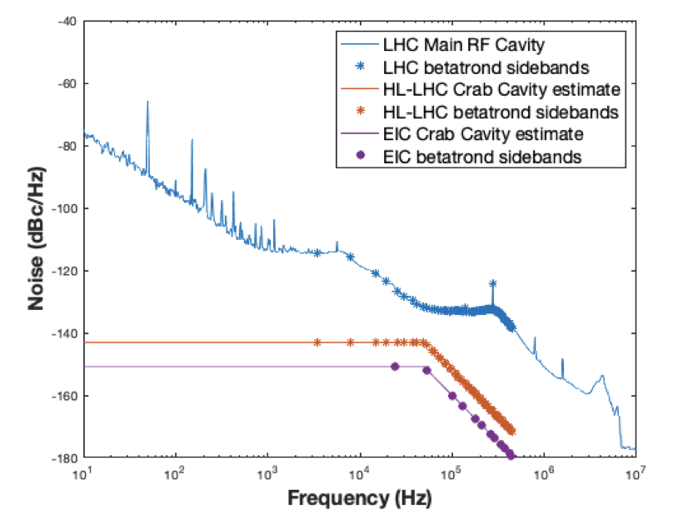
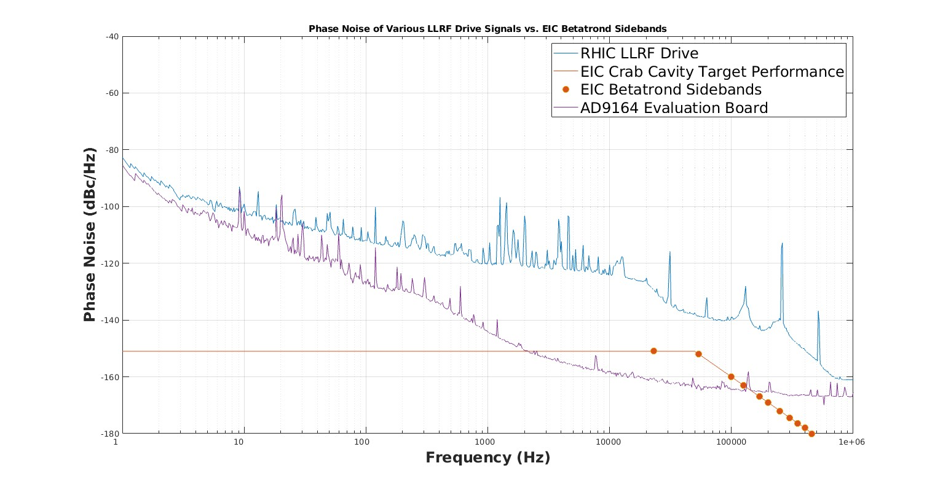

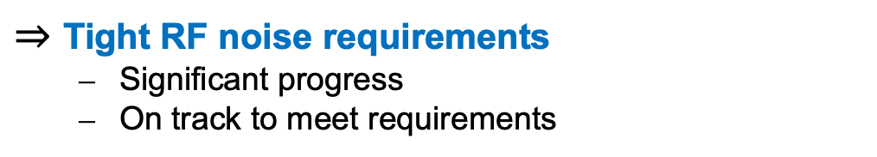
Crab Cavity RF Field Control
Crab cavities have large transverse impedance and are at large $β$ locations $⇒$ fundamental crab mode can drive strong transverse instabilities
  High-gain RF feedback required to reduce effective cavity impedance by ~2500 (68 dB)
  One-Turn Delay Feedback (OTFB) required to further reduce impedance at betatron sidebands for additional x10 (20 dB)
Low-noise injected into fundamental crab mode can limit luminosity lifetime
$⇒$ Tight RF noise requirements
  Significant progress
  On track to meet requirements
Lab measured
with new LLRF drive
LHC Main
HL-LHC
EIC Target
EIC Target
M. Blaskiewicz, T. Mastoridis, F. Severino, K. Mernick, K. Smith
Modified from Z. Conway

Slide 14
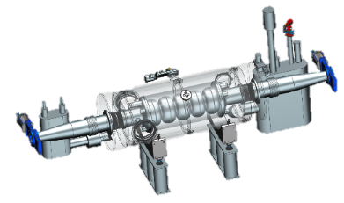
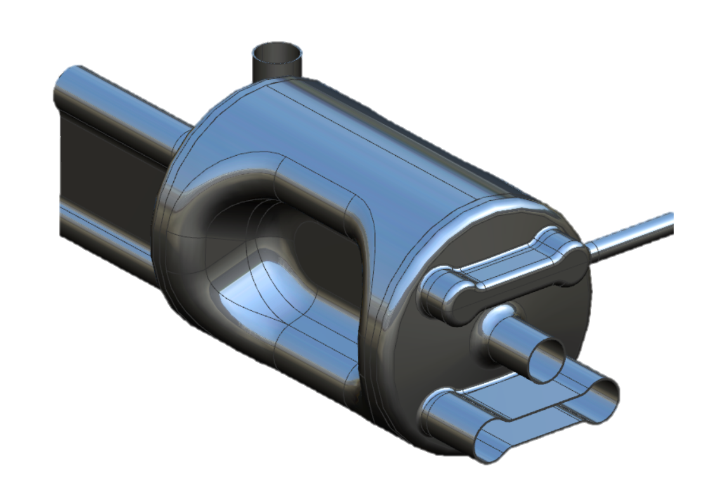



In-Kind Contributions
The EIC Facility is envisioned as “fully international in character”.
EIC Project In-Kind Contribution goals: 5% of the Accelerator
In-kind contributions from several countries are under discussion.
For SRF Systems – draft document preparation started for:
  394 MHz Crab cavity cryomodule from Canada and UK
  591 MHz 5-cell cavities cryomodule from France
Modified from P. Berrutti

Slide 15
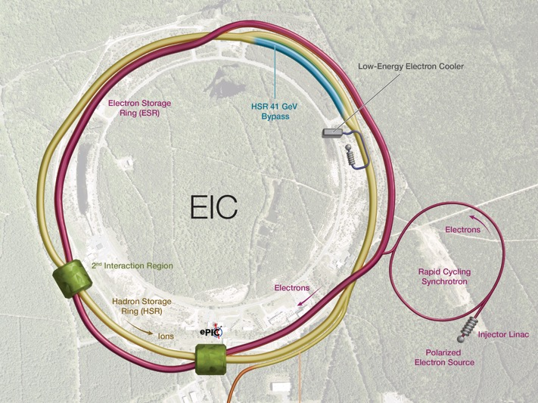
EIC – FCC Synergies
EIC Accelerator Science and Technology. Graphic is not latest design.
EIC-FCC Synergies
Operation with crossing angle
Crab cavity design and operation
Crab cavity low level RF control, beam loading, noise suppression …
Beam-beam simulations and beam dynamics
Electron cloud mitigation
Ion sources for d to Pb
Polarized light Ion sources, p,d, He-3
Machine – Detector protection, collimation, beam-dump…
Beam Instrumentation and Controls
Beam screens and coatings
Large bore SC magnets,
SRF cavities
ESR Cavity
Prototype
Low energy
electron cooling
ESR RF 500kW FPC
ESR Vacuum
Bunch by Bunch Hadron Polarimetry
HSR Vacuum Upgrade
ESR RF
HOM Damper
Electron Injection
Fast Kicker
Fast Proton Injection Kicker
Bunch by Bunch
Electron Polarimetry
IR Vacuum Chamber
Polarized e⁻ Source
Crab Cavities
IR Design and
large bore SC Magnets
Modified from E. C. Aschenauer

Slide 16
Overview
The EIC is an exciting machine that relies on cutting-edge technology.
Some long-lead procurements have already started.
The EIC and FCC share multiple synergies – also in RF Systems, where they also share common challenges (SRF, RF controls, crab cavities)
Reaching design performance will take time … and many großer Schwarzer!
Thanks to the FCC Week 2025 Organizing Committee for the invitation and
thanks to the EIC Team for all the effort to advance the EIC Project

Slide 17
Acknowledgements
Zack Conway, Bob Rimmer, Naeem Huque, George Dacos, Kevin Smith, Luisella Lari, Paolo Berrutti, Elke Aschenauer, Charlie Folz, Caitlin Hoffman, Wencan Xu, Jesse Fite, Doug Holmes, Cliff Brutus, Alex Zaltsman, Scott Seberg, Suba De Silva, Jean Delayen, Binping Xiao, Zenghai Li, Qiong Wu, Daniel Lukach, Geetha Narayan, Freddy Severino, Kevin Mernick, Themis Mastoridis, Mike Blaskiewicz, Alexei Blednykh, Karim Hamdi, Lin Guo, Katherine Wilson, Joe Matalevich, Levi Nicolai, David Savransky, Jiquan Guo, Sergei Kuzikov, Nabin Raut, Eric Link… and many others

