Slide 2
Injection/Extraction Systems Across the Complex
S. Yue, on behalf of SY-ABT
CERN, Geneva, Switzerland

Slide 3
Outline
Injection/Extraction of Damping Ring
Transfer Line Design
Booster Injection
Integration at PB
Dump & Booster Extraction
Conclusion

Slide 4
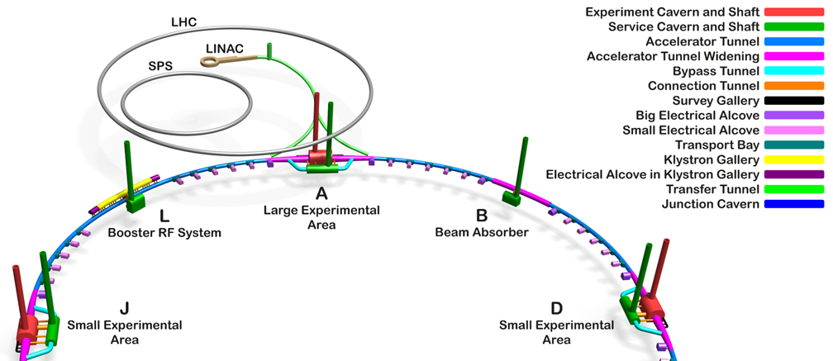
FCC-ee Underground Structure Overview
[1]
Damping ring injection and extraction
[1] F. Georgieva, Technical Infrastructures coordination meeting #86

Slide 5
Damping ring: Mid-term review 2023
Repetition rate: 200 Hz / 2-bunch per pulse
Bunch separation: 25 ns
Beam energy: 1.54 GeV
[1]
Concept developed by ABT
Stripline kicker is used
  injection / extraction is mirrored
Rise & Fall time: 50 ns
Deflection angle: 3 mrad
[1] FCC-ee Injector Design (CHART proposal) Coordination meeting
Notes:
Repetition rate: 200 Hz / 2 bunch per pulse
concept developed by ABT group

Slide 6
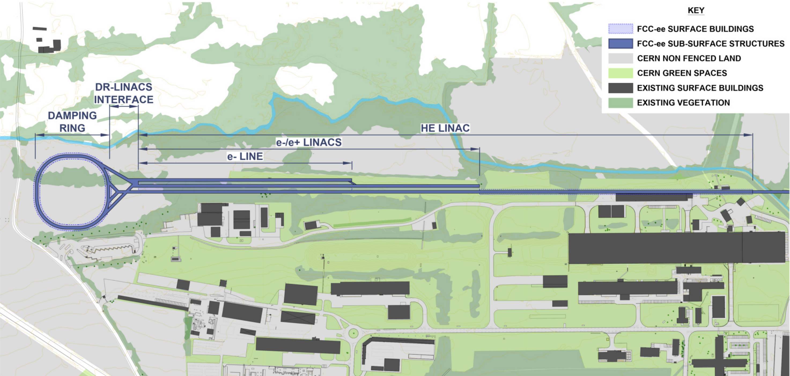
Damping ring : FSR High energy concept
[1]
Repetition rate: 100 Hz / 4-bunch per pulse
Beam energy: 2.86 GeV
Working for both beams
Hardware
  Kicker: ABT has already developed an injection/extraction concept for the PRD and DR of CLIC^{[2]}
  Septa: Need to be studied in detail
Next steps:
Specifications need to be established and shared if CERN is to work on the beam transfer hardware
[1] Future Circular Collider Feasibility Study Report Volume 2
[2] CLIC Pre-Damping and Damping Ring Kickers
Notes:
High energy concept to reduce repetition rate
Working for e- beam
Frozen baseline

Slide 7
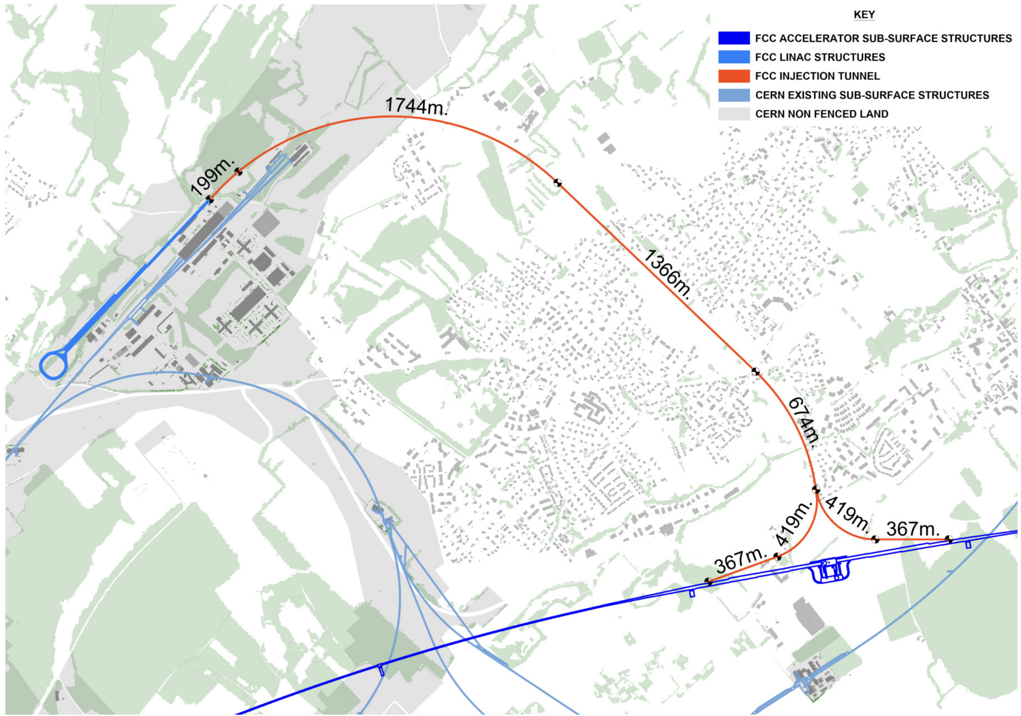
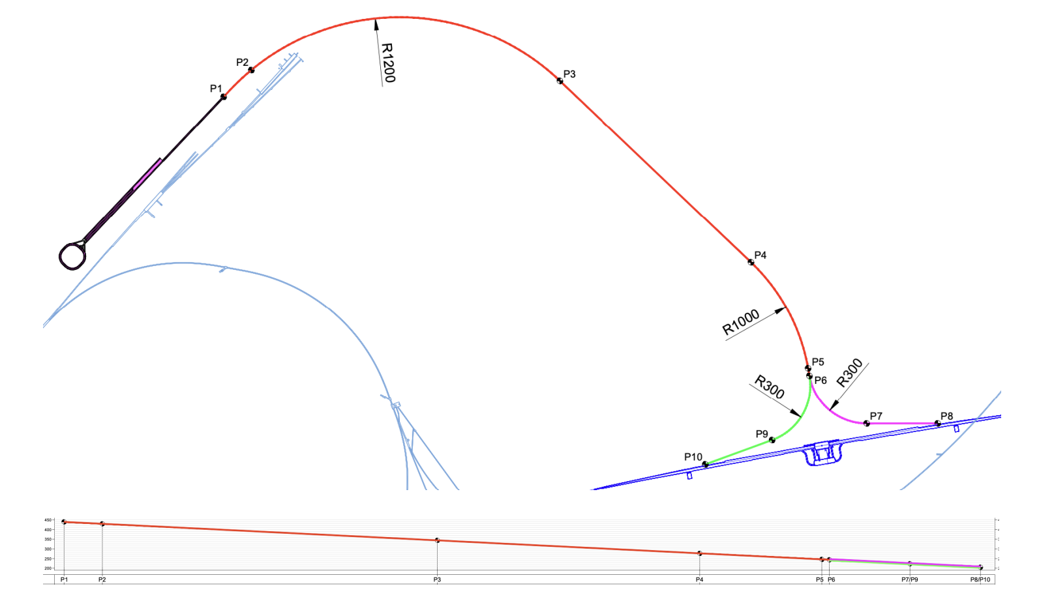
Transfer line from HE linac
[2]
Beam energy: 20 GeV
Design optimised exclusively for leptons
  No connection to SPS tunnel
Beam quality “budget”[1]:
  20% horizontal and vertical emittance increase
  No margin on energy spread and bunch length
Survey: 5 straight sections and 4 arc sections
  Investigation of shared e+/e- transport in straight sections and optimisation of arc geometry
  Constant negative vertical slope of −3 deg
    Vertical bending at begin and end point →
Injector complex
SPS
PA
Skew quadrupoles to correct H&V coupling
[1] FCCee injector parameters
[2] Future Circular Collider Feasibility Study Report Volume 2

Slide 8
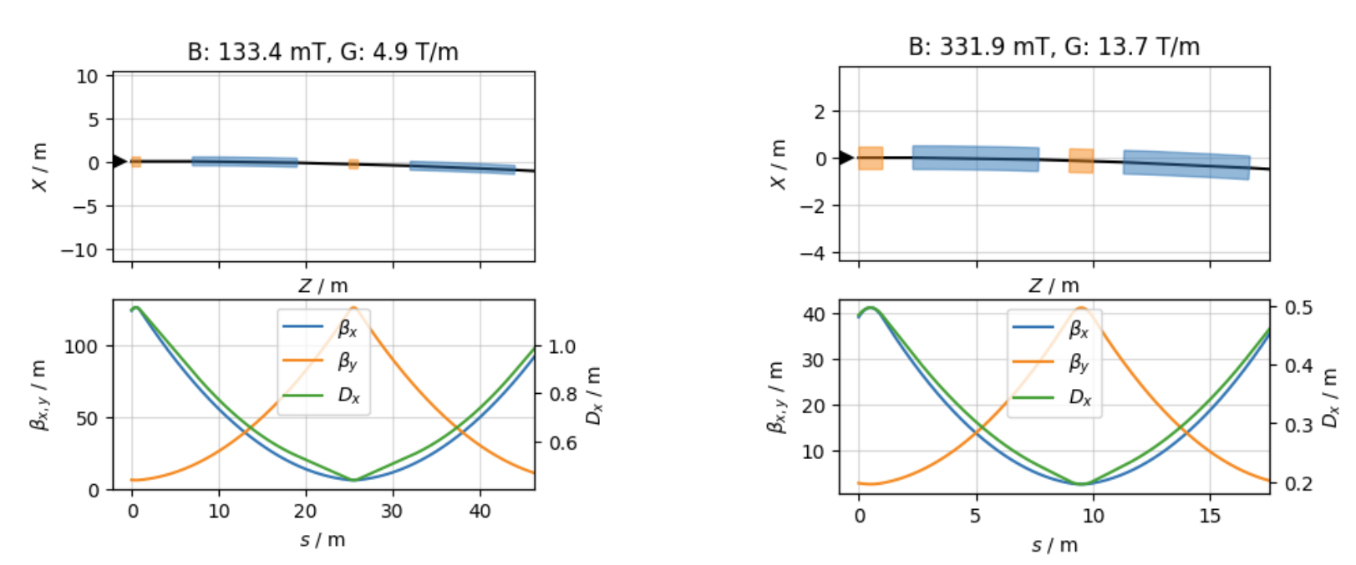
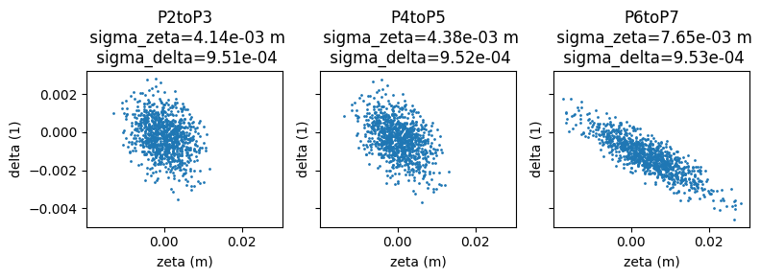
Transfer line from HE linac
Lattice design
  Two FODO cell for different arc sections
  Phase advance is 135° to minimize emittance blow up from SR
  Matching work and Beam rotation to be done
Bunch lengthening: from 4 mm to 8 mm
  Requires bunch compressor at end of TL
  Mainly from the end of TL→ Optics optimisation
    CSR has a small contribution
    Dipole fill factor: 0.5
    Cell Length: 50 m
    Dipole fill factor: 0.67
    Cell Length: 18 m
Next steps
  Complete real-space placement and connection to booster
  Optics matching and H/V plane rotation to booster injection
  Explore other cell types other than FODO (e.g. TME, DBA)

Slide 9
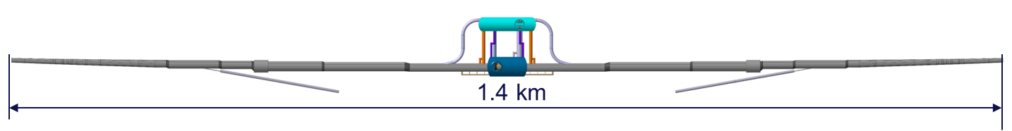
FCC-ee Underground Structure Overview
[1]
Point A: Booster injection
[1] F. Georgieva, Technical Infrastructures coordination meeting #86

Slide 10
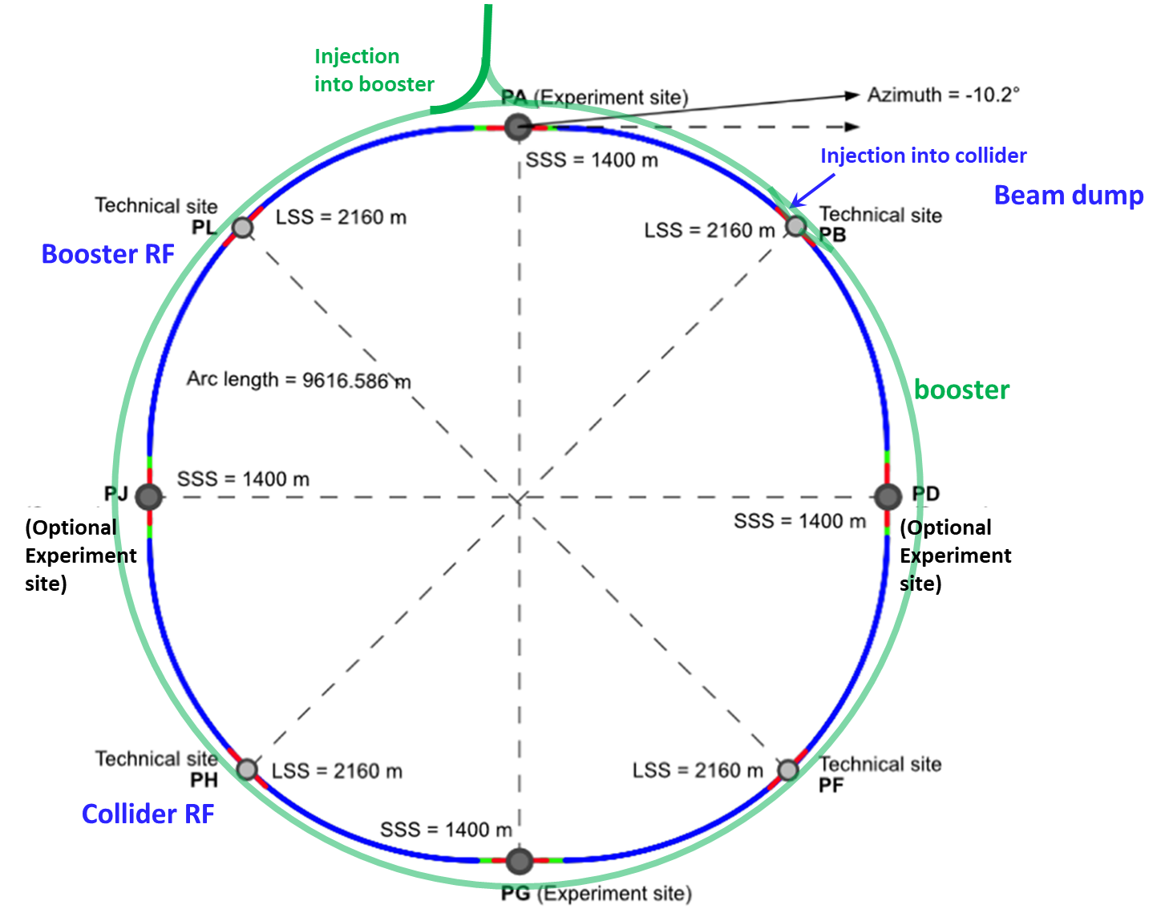
Booster Injection
Beam injection energy: 20 GeV
Positron (CW) and electron (CCW) injection in the PA
Baseline scheme of 4 bunches separated by 25 ns, injected at 100 Hz (Z mode)
  Not considering local machine protection system presently
Layout and geometry
  Booster passes on the outside of the experiment cavern
  150 mrad angle between transfer line and booster line
Injection constraints
  Large angle and thin blade septa
  High repetition rate of 100 Hz
  kicker with fast rise and fall time (<25 ns) with short flat-top (80 ns)
    Distance between kicker and its generator in alcove < 30 m
PA
Alcove
Notes:
Transfer line
CW injection and CCW injection, same design on both sides
Baseline scheme
Vertical injection

Slide 11
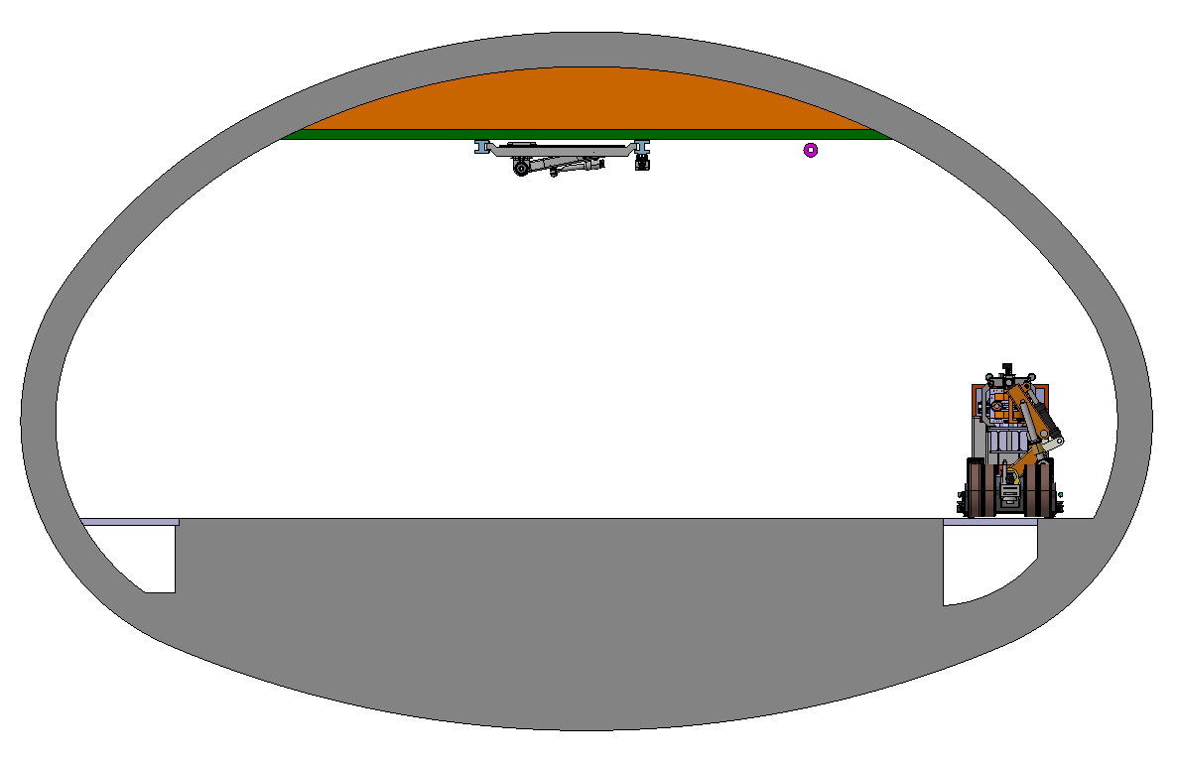
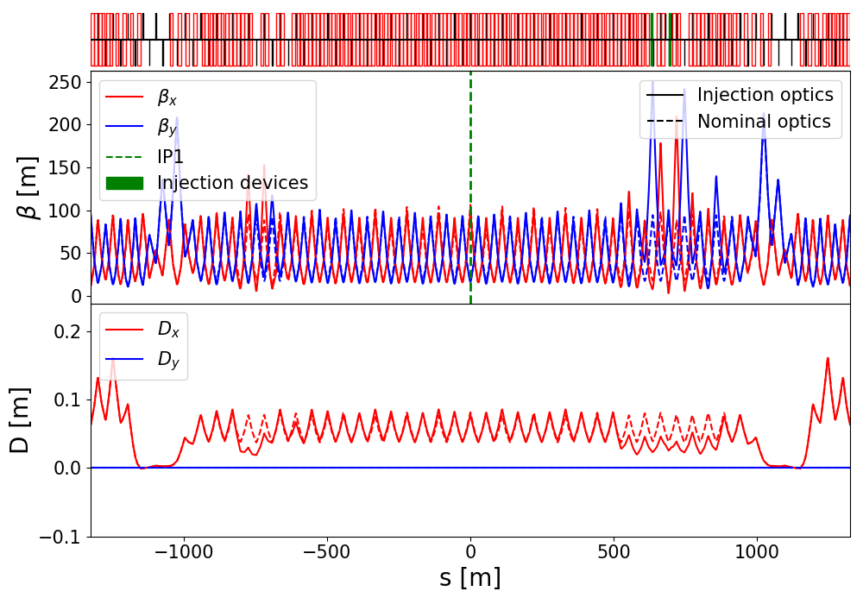
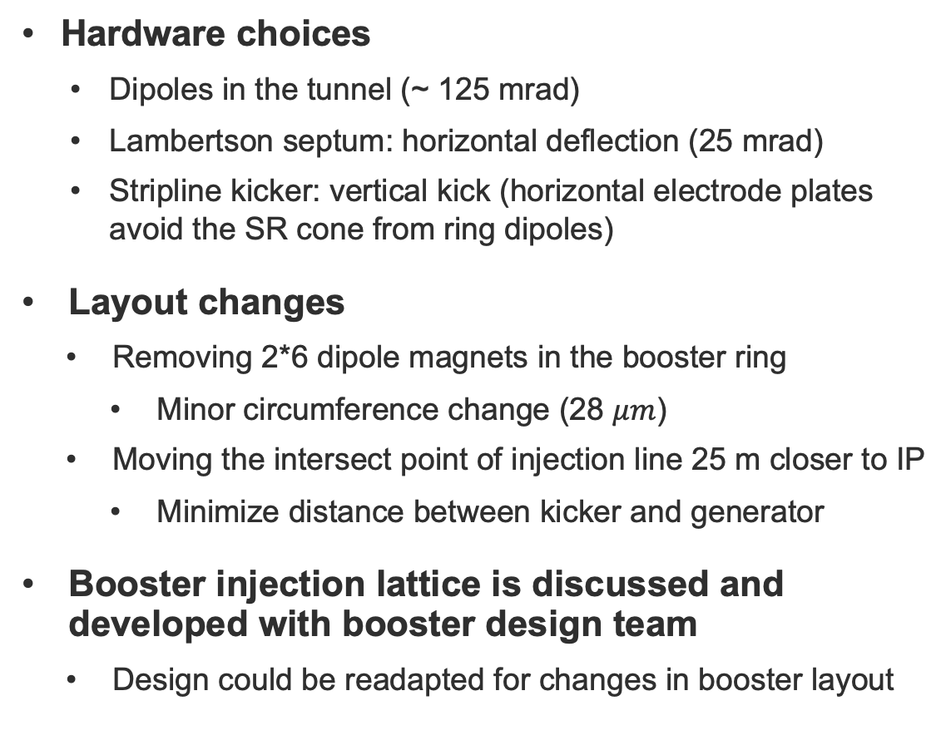
Booster Injection: Optics design (e+)
Booster ring
PA Section 5
[1]
E+ ring
Hardware choices
  Dipoles in the tunnel (~ 125 mrad)
  Lambertson septum: horizontal deflection (25 mrad)
  Stripline kicker: vertical kick (horizontal electrode plates avoid the SR cone from ring dipoles)
Layout changes
  Removing 2*6 dipole magnets in the booster ring
    Minor circumference change (28 $μm$)
  Moving the intersect point of injection line 25 m closer to IP
    Minimize distance between kicker and generator
Booster injection lattice is discussed and developed with booster design team
  Design could be readapted for changes in booster layout
E- ring
Lambertson septum
[1] F. Georgieva, Technical Infrastructures coordination meeting #86
Available in Gitlab

Slide 12
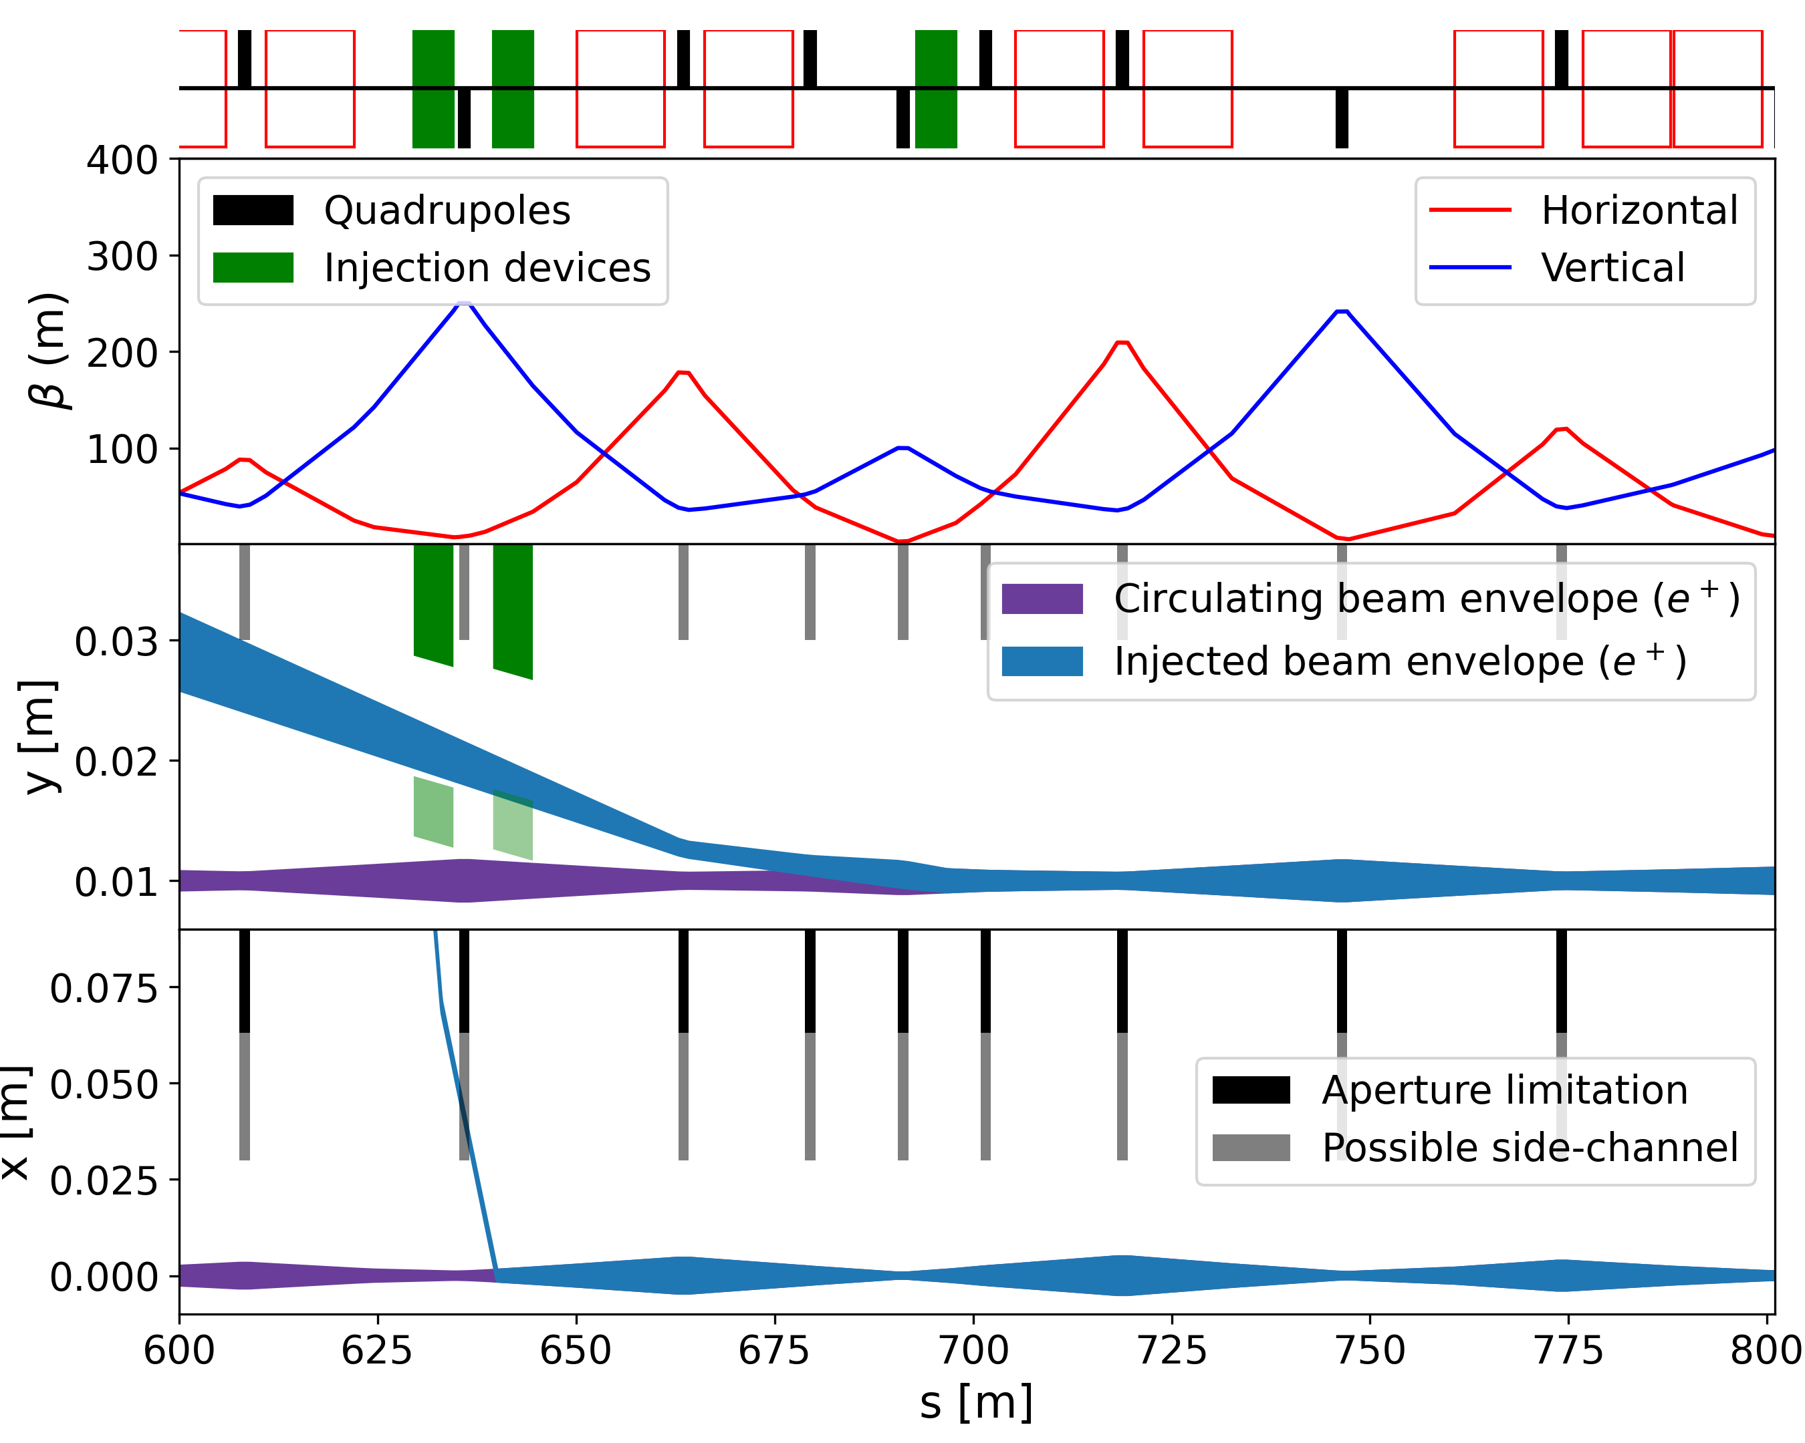
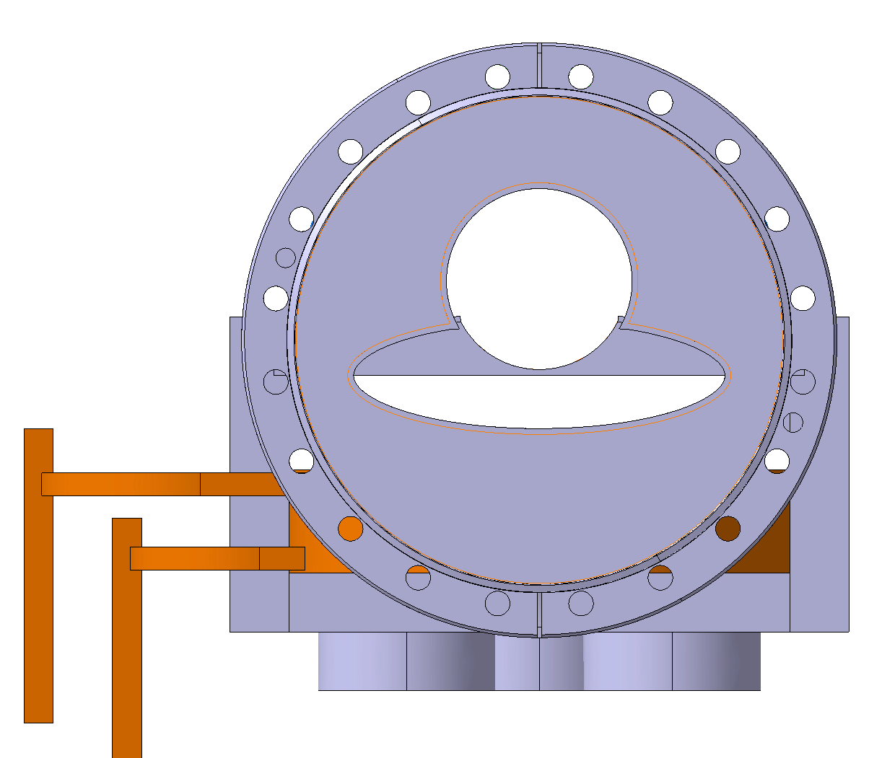
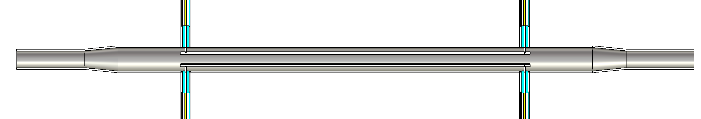
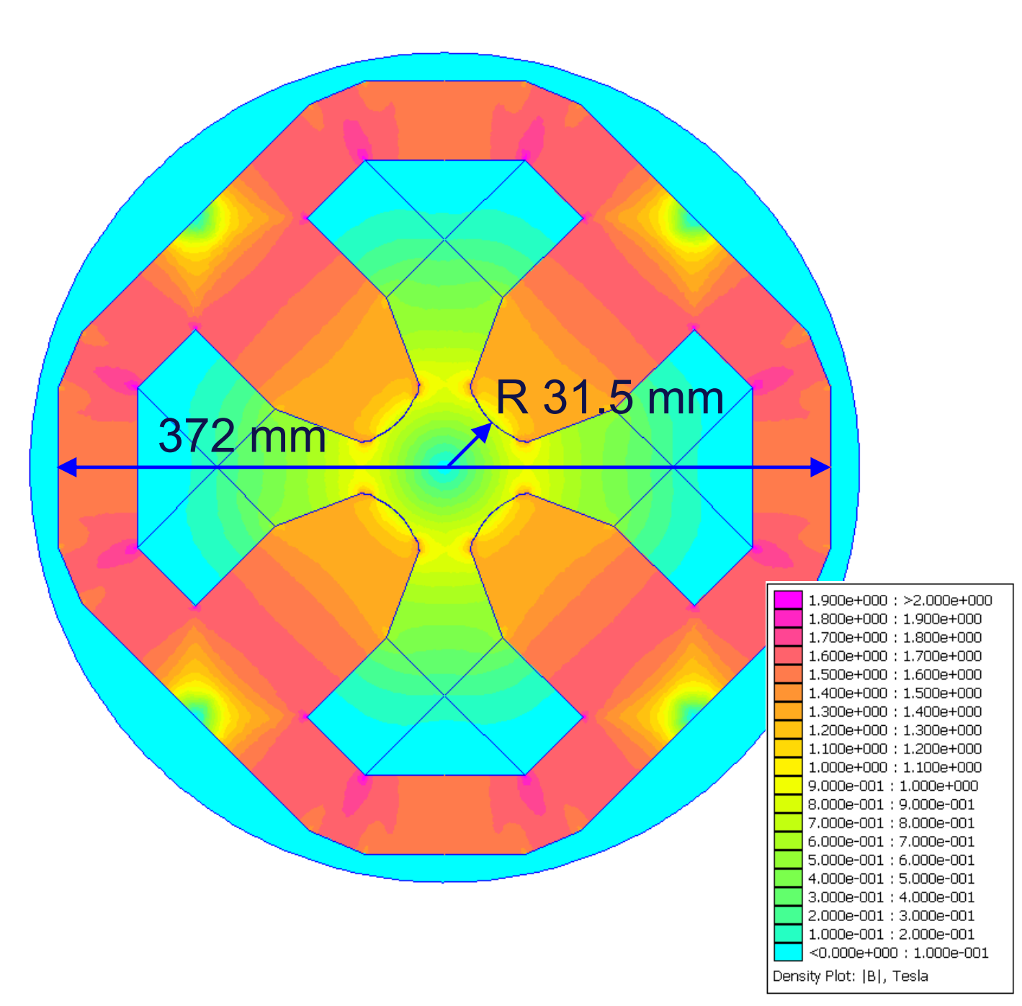
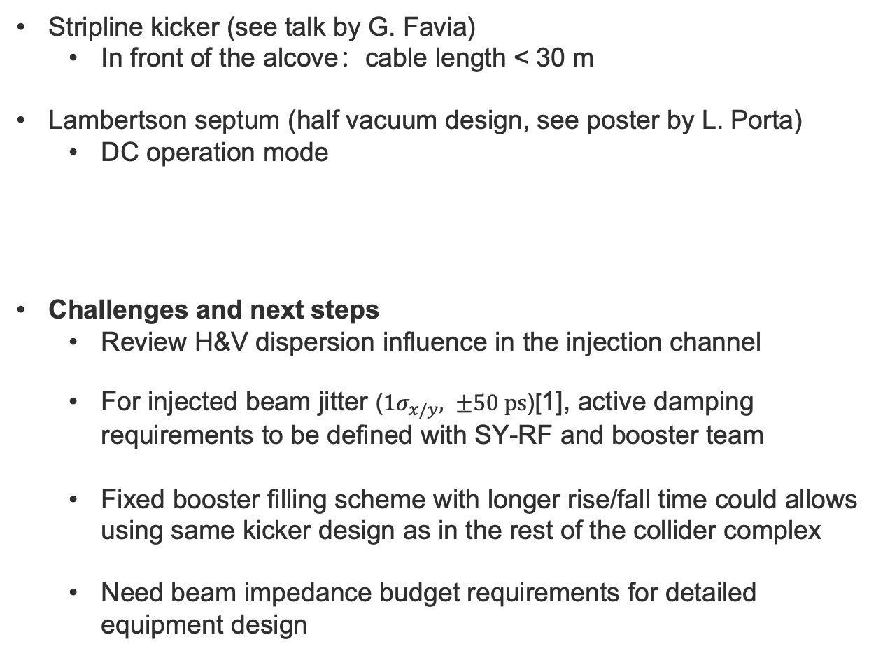
Booster Injection: Beam envelope
Stripline kicker (see talk by G. Favia)
  In front of the alcove：cable length < 30 m
Lambertson septum (half vacuum design, see poster by L. Porta)
  DC operation mode
Challenges and next steps
  Review H&V dispersion influence in the injection channel
  For injected beam jitter ($1σ_{x/y}, ±50 ps$)[1], active damping requirements to be defined with SY-RF and booster team
  Fixed booster filling scheme with longer rise/fall time could allows using same kicker design as in the rest of the collider complex
  Need beam impedance budget requirements for detailed equipment design
[2]
quadrupole with side channel for the injected beam
[1] FCCee injector parameters
[2] FCC-ee Magnet Developments, FCCweek2023

Slide 13
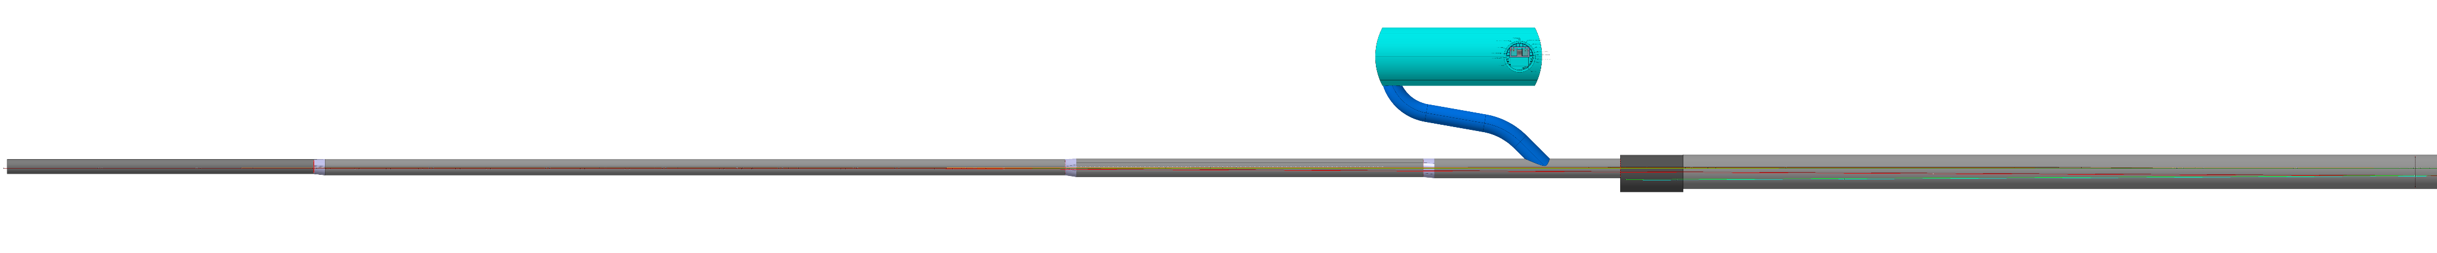
FCC-ee Underground Structure Overview
[1]
Point B: Beams transfer from booster to collider and dump systems for collider and booster
  Middle LSS
5m
5m
5m
138.5m
330m
155m
83m
28m
327m
[1] F. Georgieva, Technical Infrastructures coordination meeting #86

Slide 14
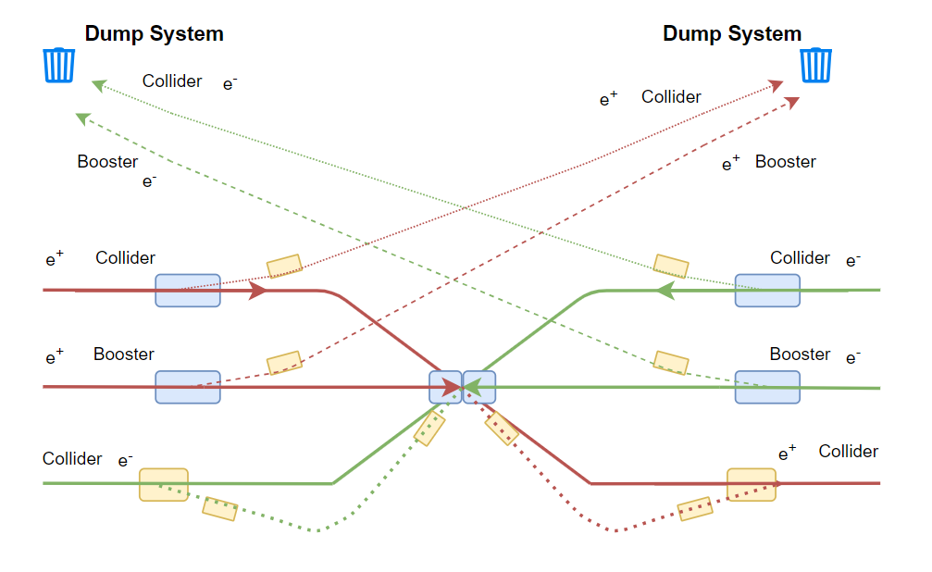
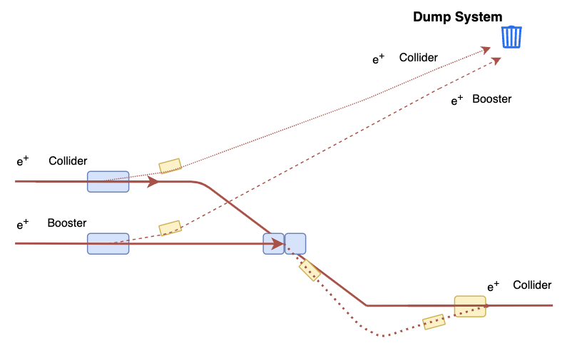
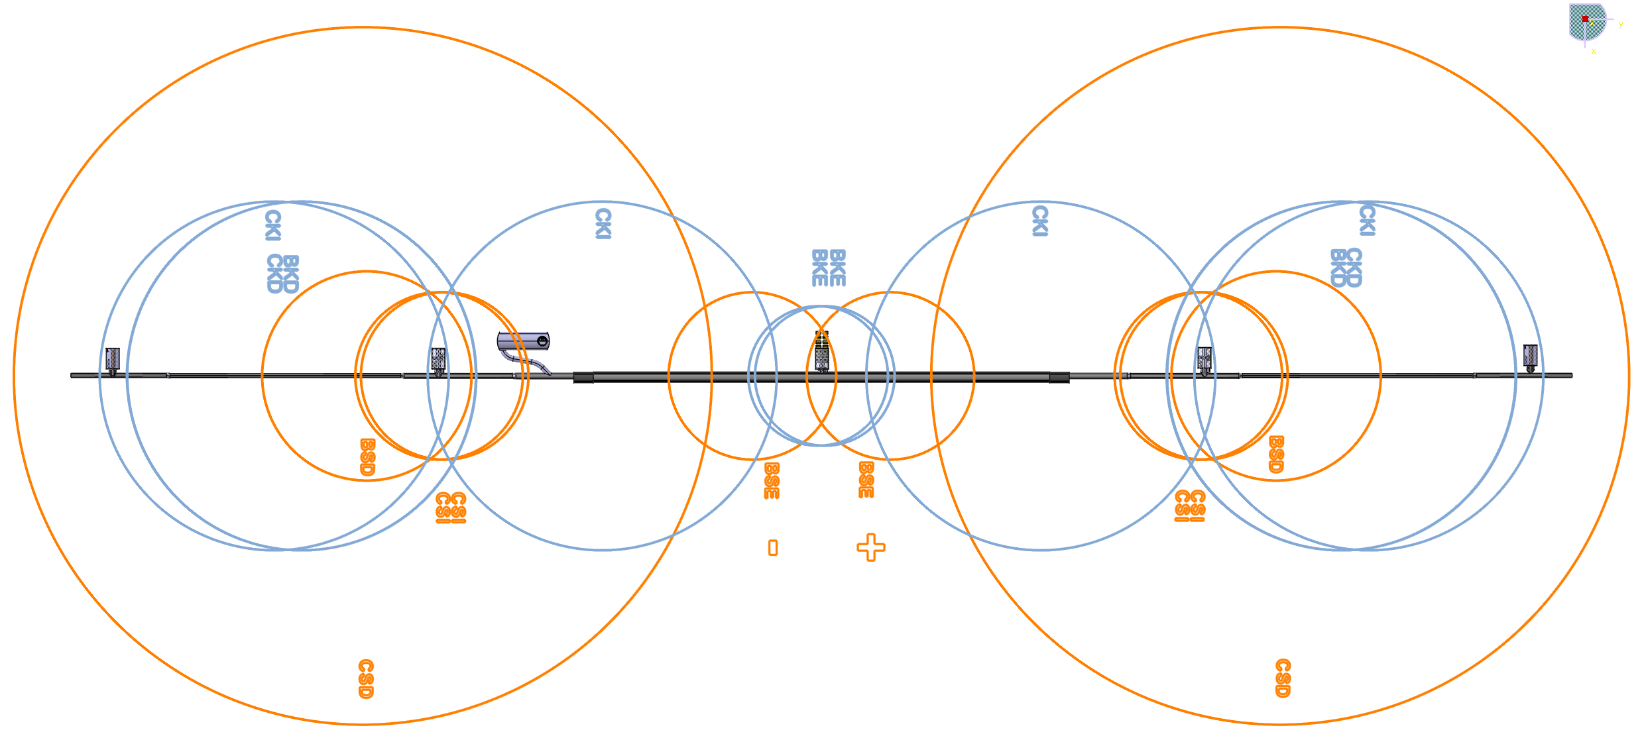
Integration at PB
Layout in PB
  Booster extraction, collider injection, collider and booster beam dumps, TLs for injection and dump (e+ & e-)
  Preliminary review of survey lines with integration did not show issues, but comprehensive integration of the elements and ancillary systems remains to be done
  Alcove placements: critical for cable lengths between kicker/septa and generators located in alcoves
Center
Kicker
Septa
  See Poster by D. Standen
  Layout available in Gitlab
Notes:
Systems in PB
Positron beam (introduction)
Sketch and layout

Slide 15
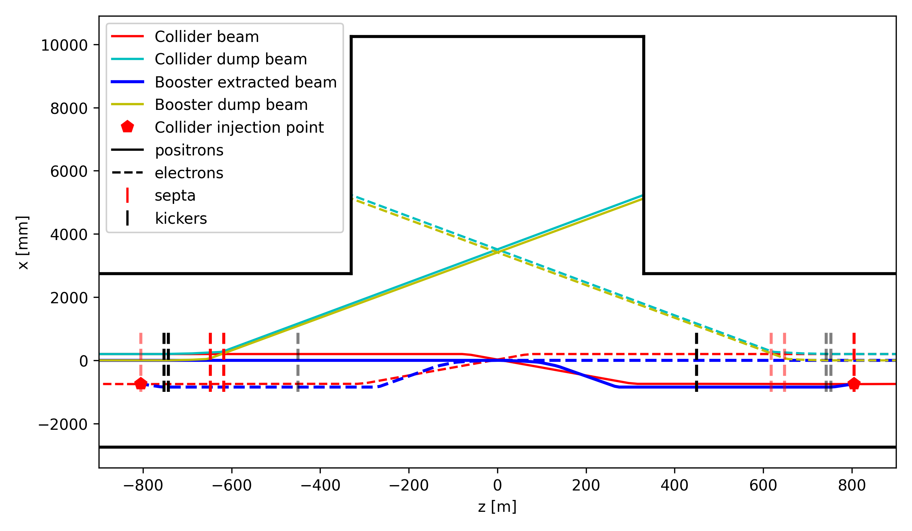
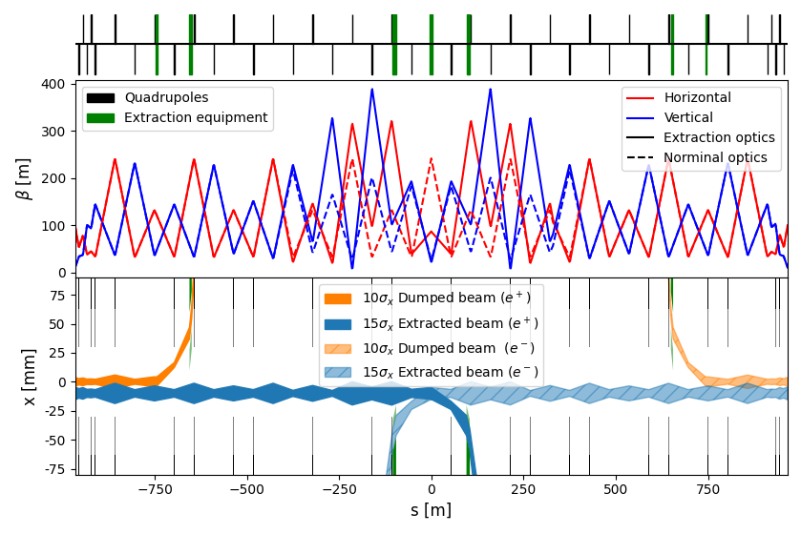
Booster extraction and dump
Booster accumulates 1/10 of the bunches in the collider ^{[1]}
  as outcome of machine protection discussions
Machine protection challenges due to the large beam energy (180 kJ)^{[2]}
  Failure cases and mitigation methods remain to be studied in detail
Booster doesn’t have dipoles at PB
  Wide space available for injection/extraction devices
Dumped and extracted beam envelope (e+ & e-) :
  4 septa systems, and 4 kicker systems
[1] FCCee beam transfer meeting #8 : special integration
[2] A. Abramov,_FCCee_Collimation, FCCweek23
Notes:
Dumped and extracted beam envelope
Machine protection is challenge
Reduce booster bunch

Slide 16
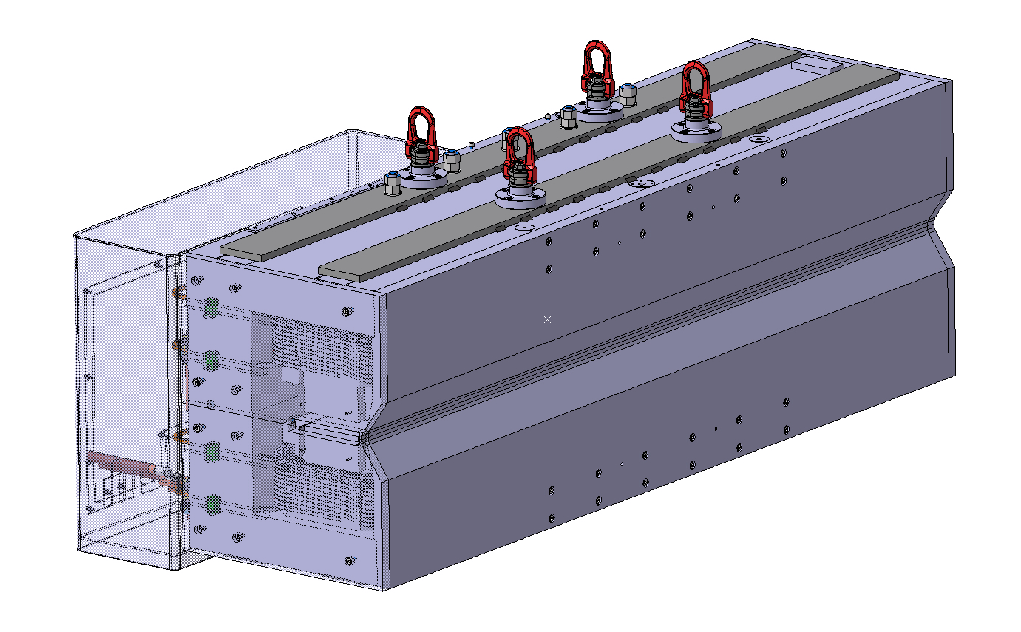
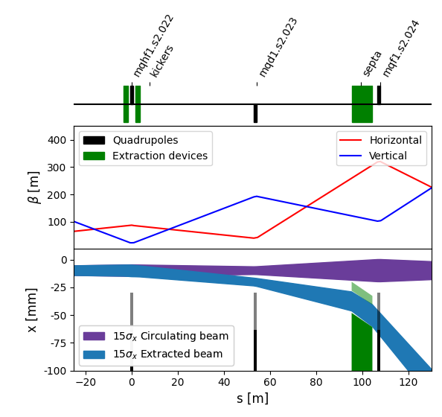
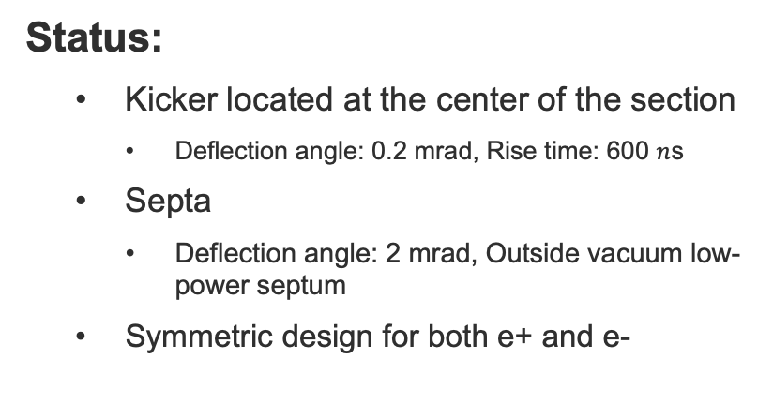
Booster horizontal extraction
Status:
    Kicker located at the center of the section
      Deflection angle: 0.2 mrad, Rise time: 600 $n$s
    Septa
      Deflection angle: 2 mrad, Outside vacuum low-power septum
    Symmetric design for both e+ and e-
Challenges and next steps:
  Need to conduct an error study to precisely establish the flat-top stability constraint for correct beam injection into the collider
  TL design for collider top-up injection
    Requires precise control of vertical dispersion
    Vertical: 1030 mm; Horizontal: ~ 500 m
    Ensure the emittances and bunch length are not degraded
Notes:
Close up for horizontal extraction
Enough for transfer line
Vertical dispersion

Slide 17
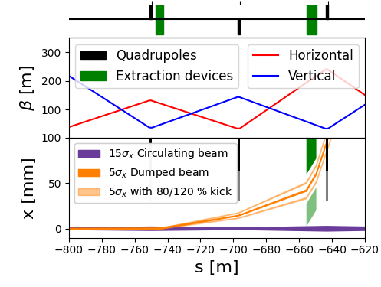
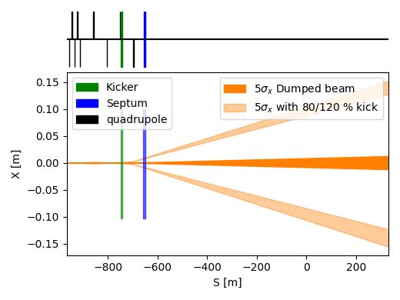
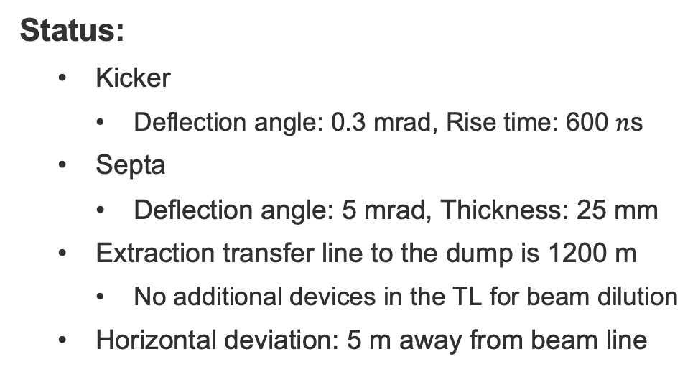
Booster dump
Status:
    Kicker
      Deflection angle: 0.3 mrad, Rise time: 600 $n$s
    Septa
      Deflection angle: 5 mrad, Thickness: 25 mm
    Extraction transfer line to the dump is 1200 m
      No additional devices in the TL for beam dilution
    Horizontal deviation: 5 m away from beam line
Challenges and next steps:
  Magnets current follows the beam energy
  Machine protection and error studies
  Large beam excursion at dump absorber when kicker failure and pulse ripple happens
Notes:
1200 m transfer line
Septa Follow energy
Ok for the 5 m distance

Slide 18
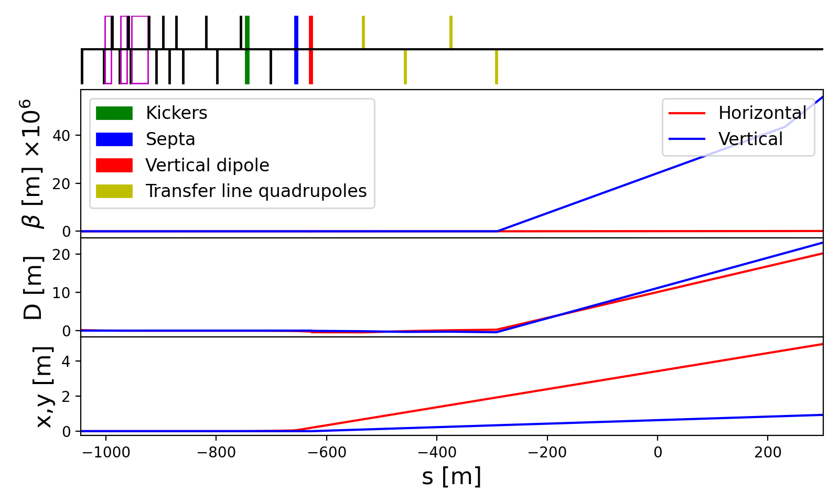
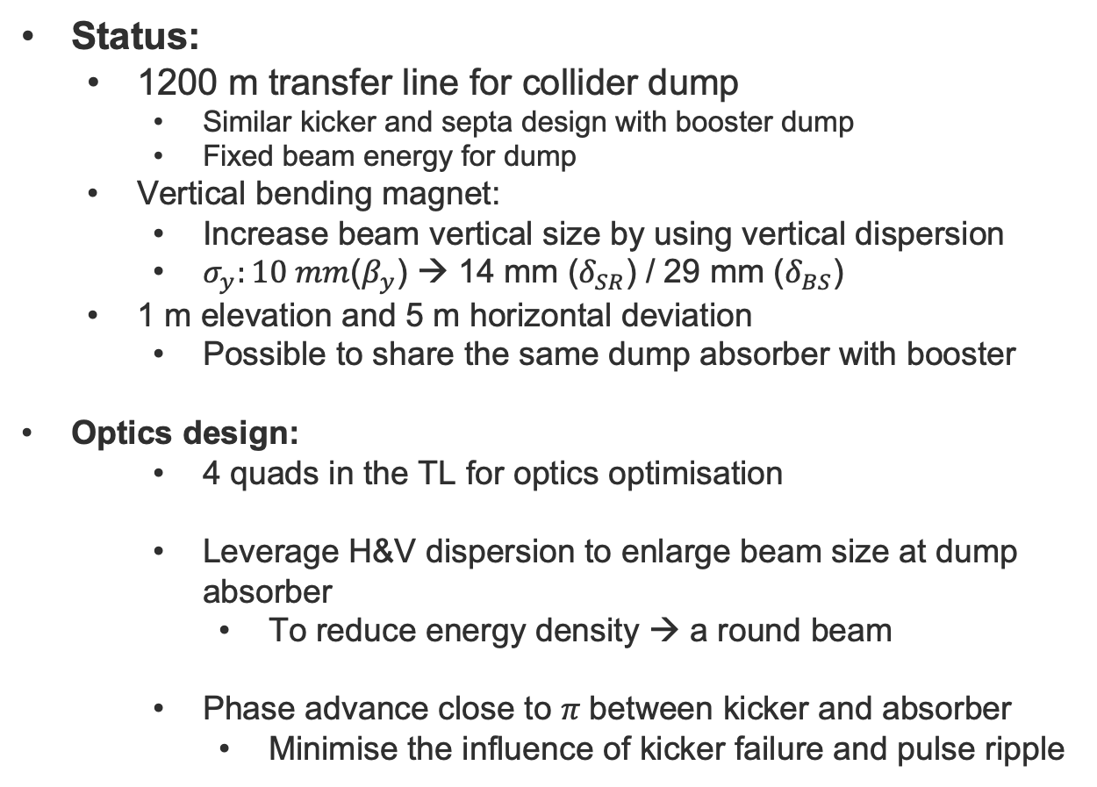
Collider dump
Status:
  1200 m transfer line for collider dump
    Similar kicker and septa design with booster dump
    Fixed beam energy for dump
  Vertical bending magnet:
    Increase beam vertical size by using vertical dispersion
    $σ_{y}:10 mm$($β_{y}$) → 14 mm ($δ_{SR}$) / 29 mm ($δ_{BS}$)
  1 m elevation and 5 m horizontal deviation
    Possible to share the same dump absorber with booster
Optics design:
    4 quads in the TL for optics optimisation
    Leverage H&V dispersion to enlarge beam size at dump absorber
      To reduce energy density → a round beam
    Phase advance close to 𝜋 between kicker and absorber
      Minimise the influence of kicker failure and pulse ripple
Notes:
Similar design with booster dump
beam dilution system
Vertical dispersion
Share same dump
Slow system

Slide 19
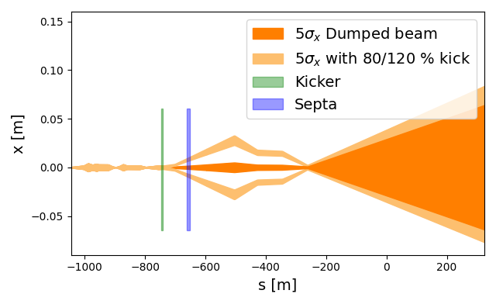
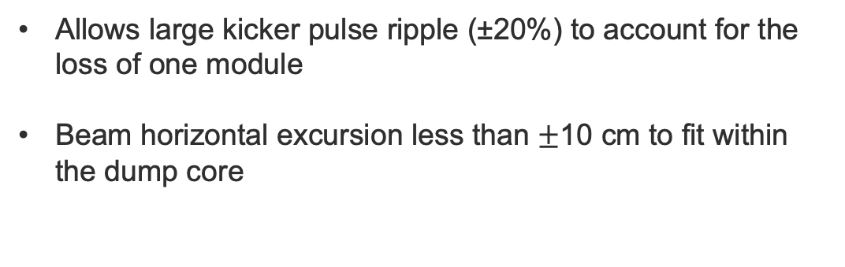
Collider dump
Allows large kicker pulse ripple (±20%) to account for the loss of one module
Beam horizontal excursion less than $±$10 cm to fit within the dump core
Challenges and next steps:
  Dump lines optics and beam specifications are being reviewed with CERN beam-matter interaction experts (SY-STI)
    Combining with the booster dump is investigated
  Machine protection and error studies to be done
  For slow systems: septa, dipoles, quadrupoles (also for booster dump)
    Failure could be mitigated by a fast dump trigger system (≤ 1 turn)
    Feasibility of a system with reaction time ≤ 1 turn remains to be studied
Notes:
Similar design with booster dump
beam dilution system
Vertical dispersion
Share same dump
Slow system

Slide 20
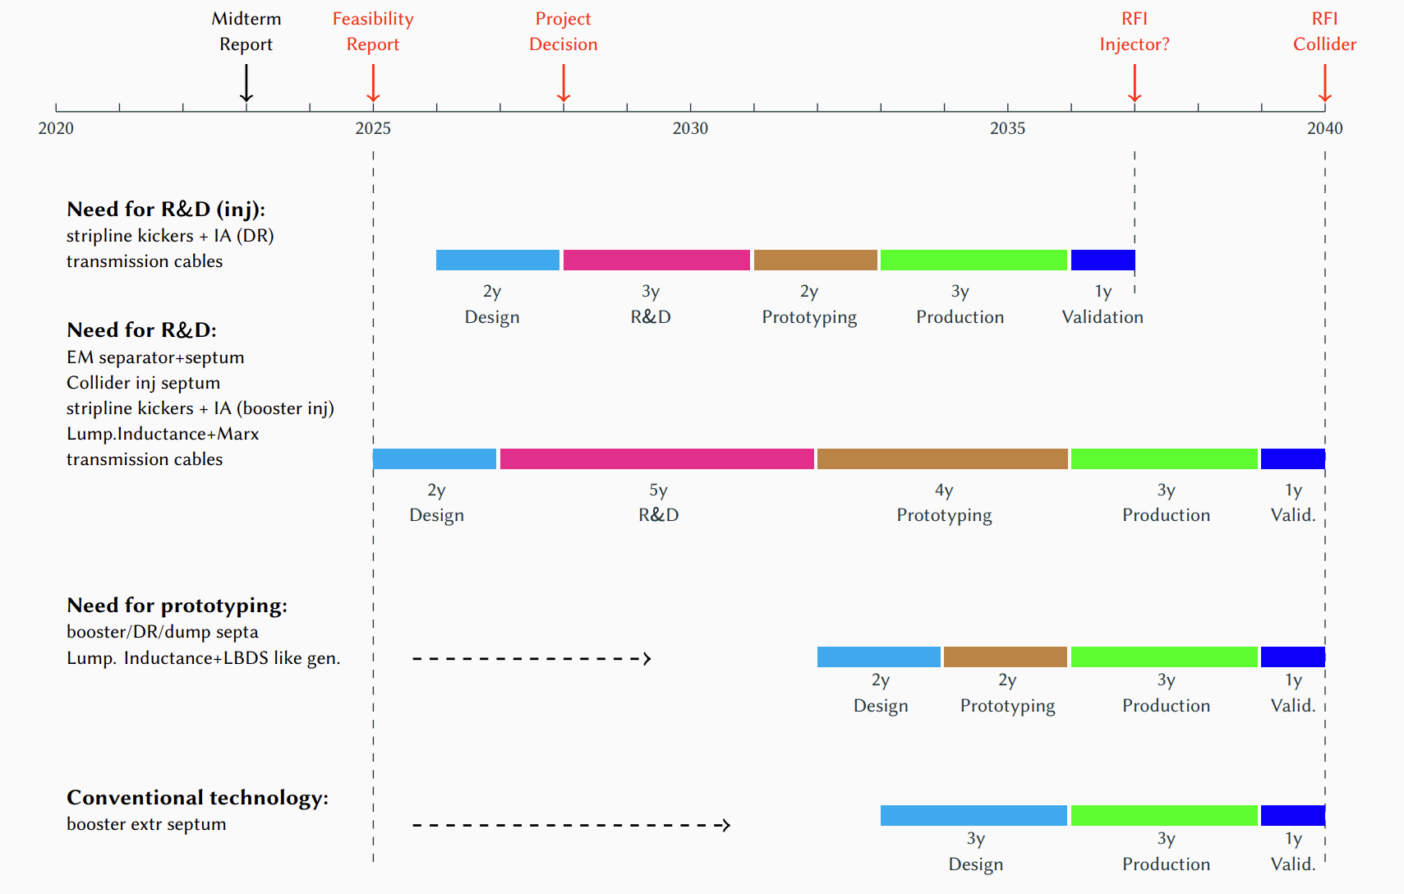
Timeline for Pre TDR
Activities of CERN ABT group:
  Beam injection/extraction in injector complex and collider complex
  Transfer line design: HE linac to booster, booster to collider, TL to dump
  Electromagnetic separation at PH section
  Injector complex siting
Objectives for pre-TDR:
  Work with injector and collider complex team to obtain stable design and coherent parameters
  The technology of injection and extraction devices should be frozen for R&D
  Transmission cables: lengths for performance, CE impact and radiation impact
Pre-TDR planning is detailed in 3 WP documents
Awaiting input from FCC coordination to confirm or adjust the timeline

Slide 21
Conclusion
  Damping ring: parameter and hardware concept need to be established if injection/extraction is built by CERN ABT group
  Requirements from TL & Booster injection:
    Survey point and optics parameters at the end of HE linac
    Alcove location for booster injection design
    Beam time jitter from HE linac, damper in booster ring
  Booster extraction:
    Symmetric design for e- and e+ extraction
    Precise vertical dispersion control in the transfer line to the collider injection
  PB Integration:
    Further in-depth integration studies are required due to the high system density and interdependence
    Cable lengths between kicker/septa and generators located in alcoves is crucial
  A failures study remains to be carried and mitigation methods established
  For polarized beams transport from booster to collider transfer line : spin transparency is ensured by avoiding interleaved H and V deflections

