Slide 1
Swap-out injection with beam recycling in the booster @ the High Energy Photon Source
Zhe Duan
on behalf of the HEPS team
May 21, 2025
FCC Week 2025，Vienna，Austria, May 19-23, 2025

Slide 2
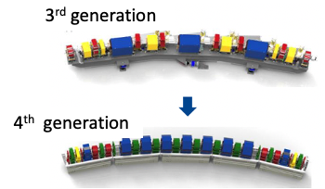
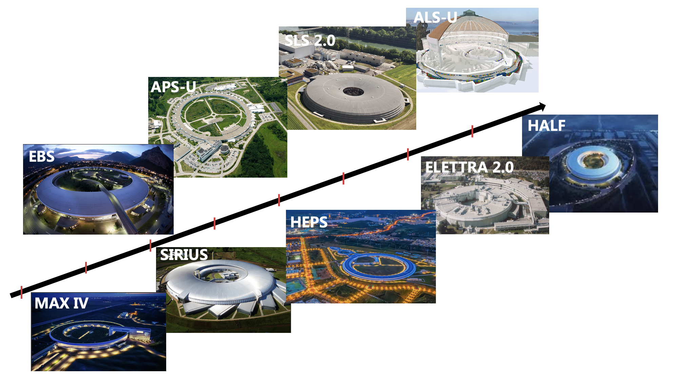
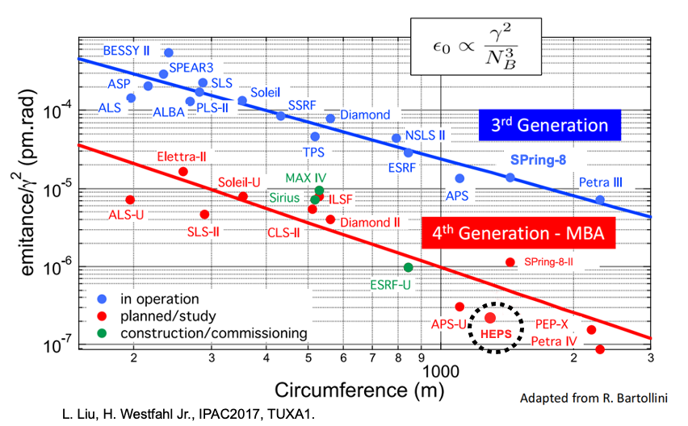
4th generation synchrotron radiation light sources
ALS-U
Natural emittance
1-2 order smaller compared to 3rd generation
approaching 10pm, diffraction limit of hard X-ray photons
More to come:
SKIF,
Diamond II, Spring8-II, SOLEIL-II,
Korea-4GSR,
PETRA-IV etc
First 4th Generation Synchrotron Source in Asia
Second Synchrotron Source achieving <100pm emittance in the world (following APS-U)
First high-energy Synchrotron Source in China

Slide 3
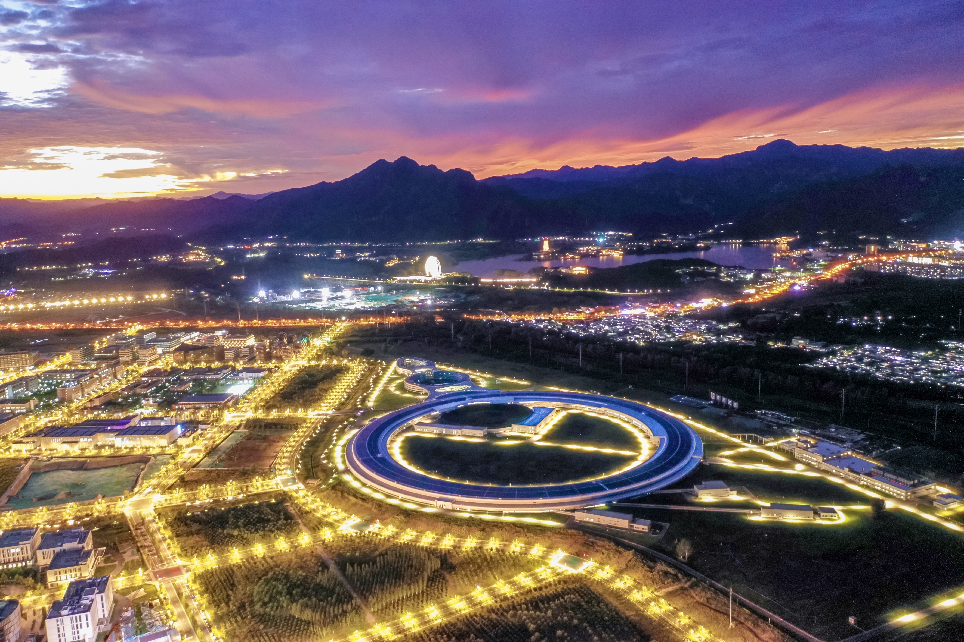
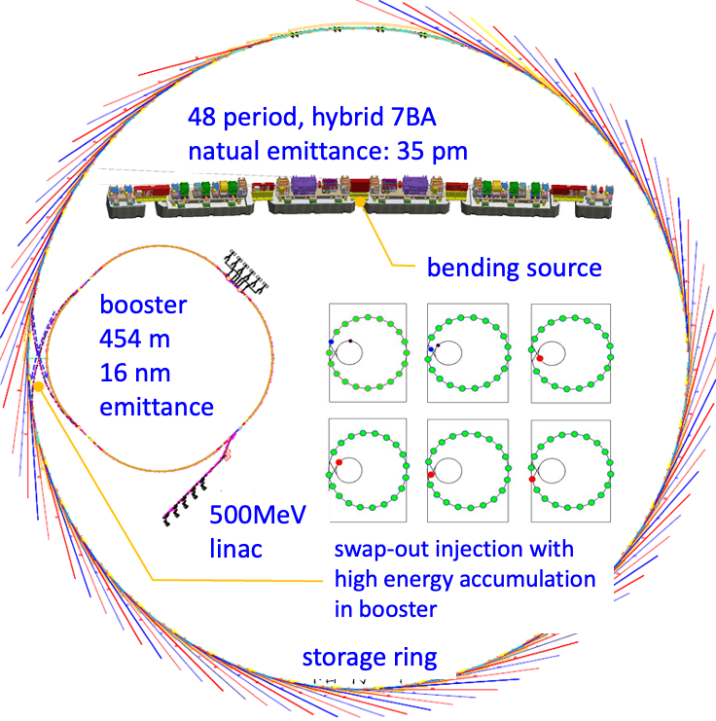
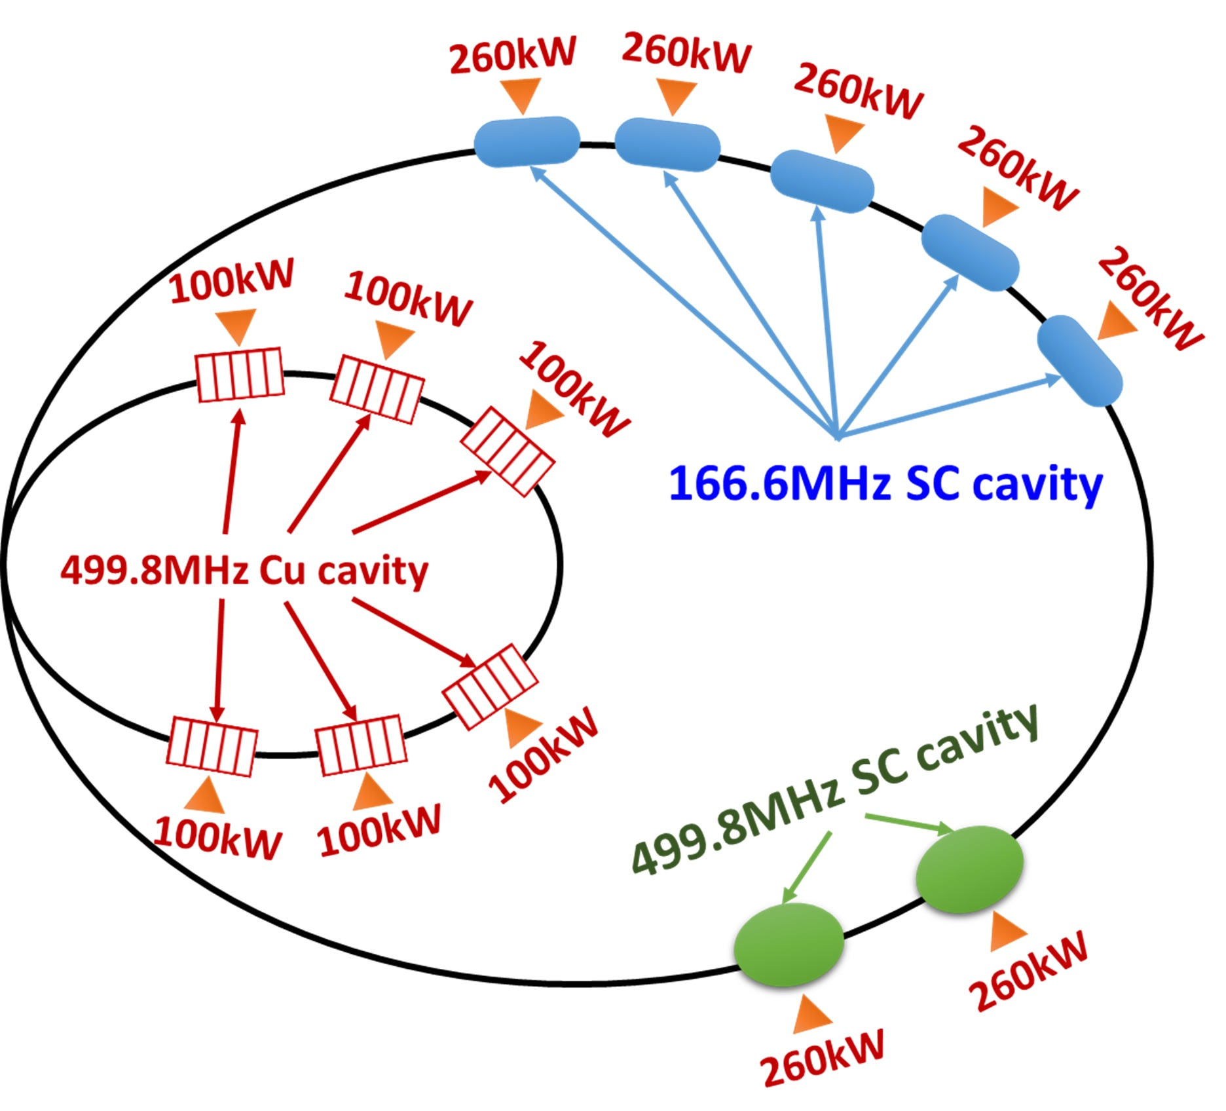
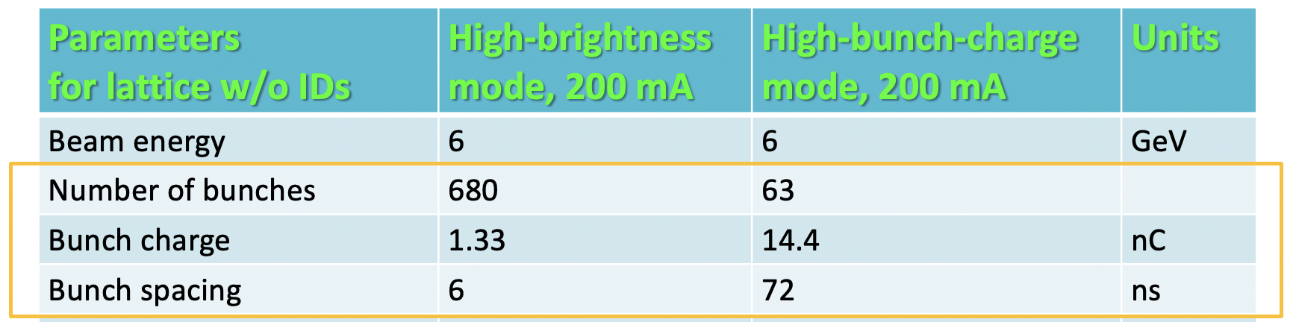
High Energy Photon Source
HEPS key indicators
circumference | 1360.4 | m
beam energy | 6 | GeV
natural emittance | ≤0.06 | nm·rad
brightness | >1×10²² | phs/s/mm²/mrad²/0.1%BW
max number of beamlines | ≥90 | 14 + 1 in Phase I
photon energy | 0.1-300 | keV
Construction period: 2019. 7 to 2025. 12
Location: Huairou Science city, Beijing
near Yanqi Lake, 70 km to city center

Slide 4
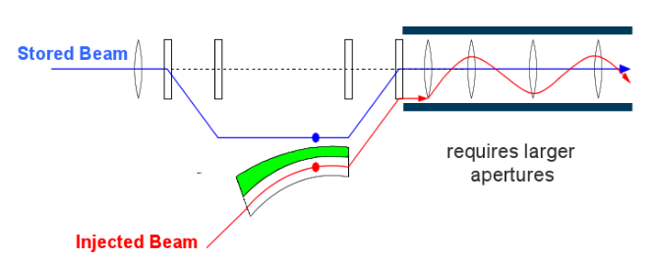
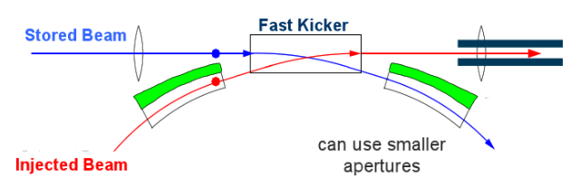
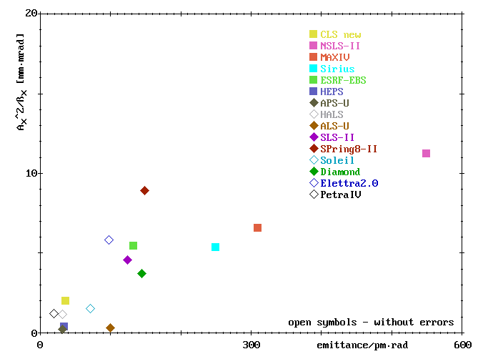
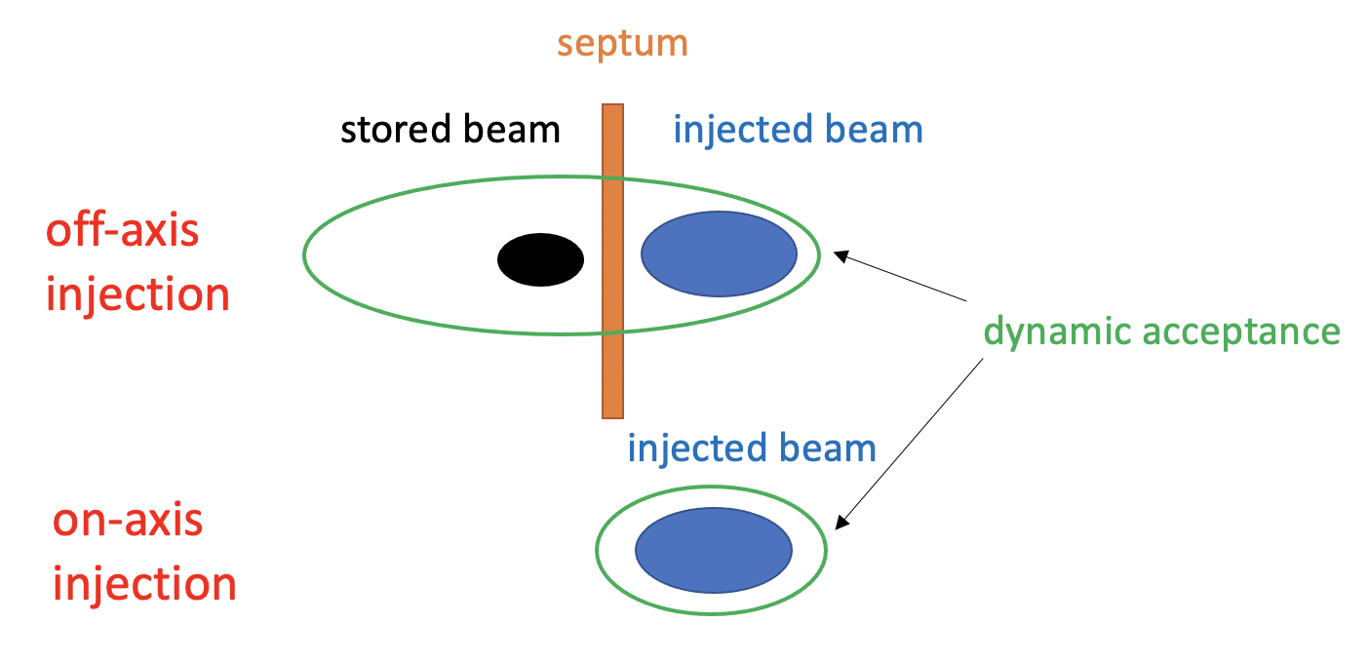
Injection challenges in 4th generation synchrotron sources
the smaller emittance,
the smaller horizontal acceptance
on-axis injection relaxes requirements on dynamic acceptance
Courtesy of P. Kuske
pursuing ultimate performance requires development of on-axis (swap-out) injection

Slide 5
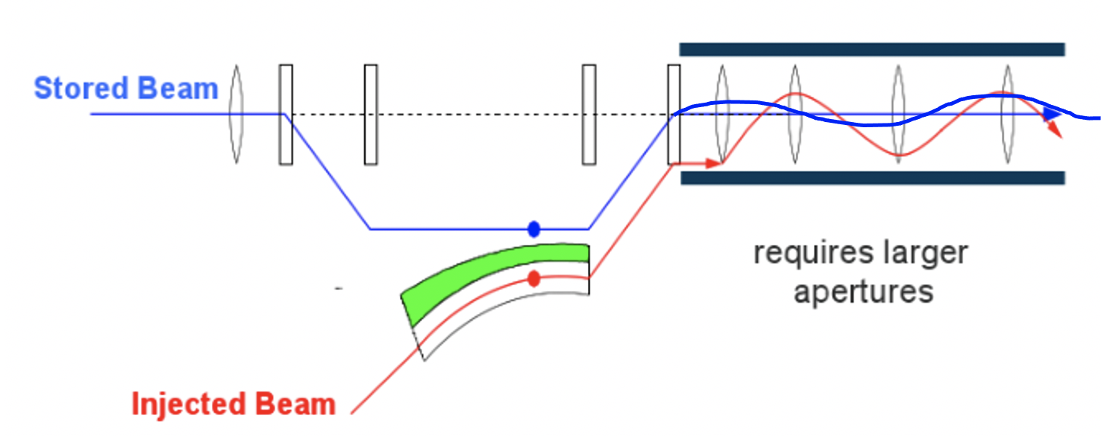
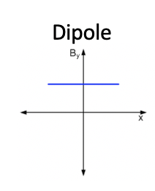
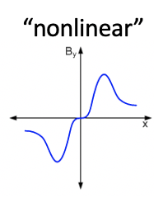
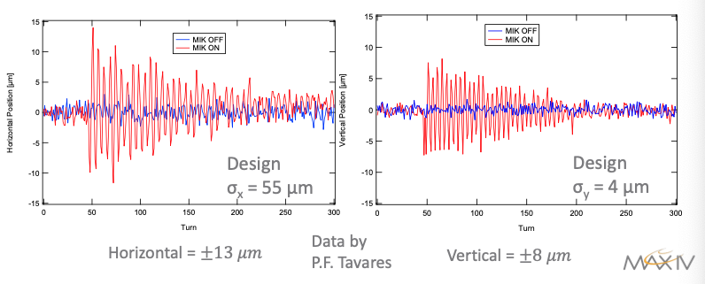

Injection challenges in 4th generation synchrotron sources
Transparent injection
  dipole injection kicker -> nonlinear injection kicker
  microsecond kicker pulse -> nanosecond kicker pulse
off-axis injection
single-bunch
swap-out injection
(APS-U, HEPS)
bunch-train
swap-out injection
(ALS-U)
longitudinal injection

Slide 6
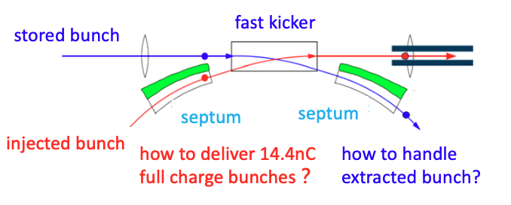
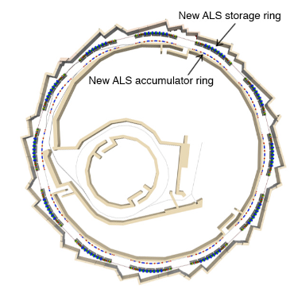
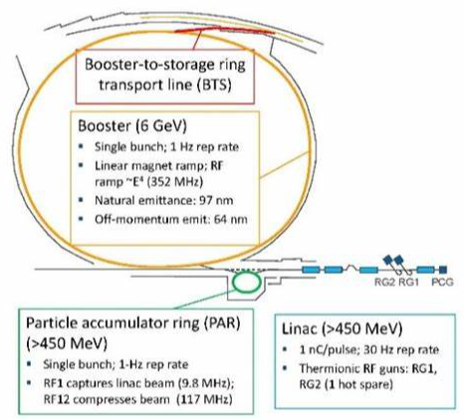
Challenges of swap-out injection
Ultra-fast kicker, compact injection straight section, no previous demonstration
Full-charge injected bunch
  very hard for convention linac + booster scheme
    For HEPS (APS-U), timing experiment requires 63 (48) bunches with ~15nC
  APS-U: linac + PAR (low-energy accumulator) + booster, dump the extracted depleted bunches
  ALS-U: linac + booster + full-energy accumulator , recycle the extracted delpeted bunches
  short time lifetime (~1h) requires very frequent injection to maintain almost constant beam current
APS-U scheme
ALS-U scheme

Slide 7
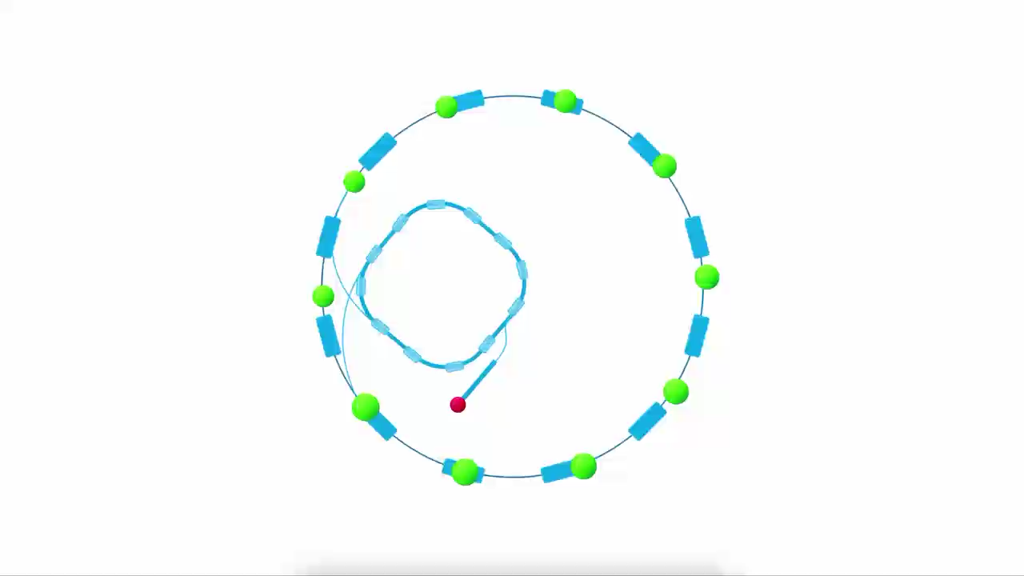
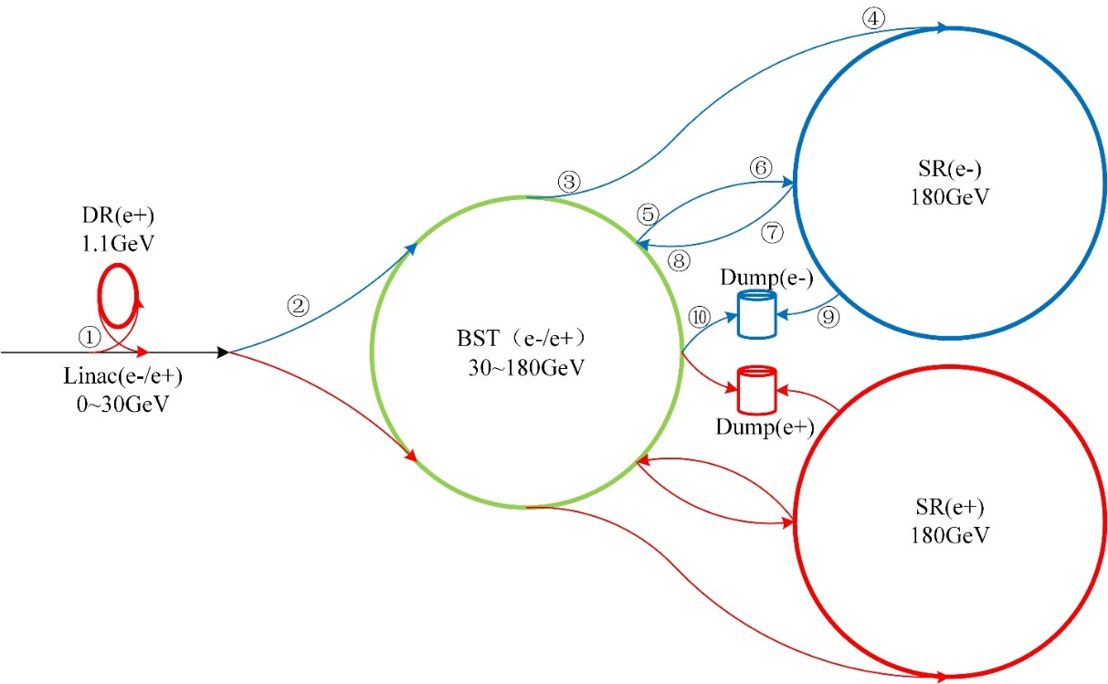
Injection scheme of HEPS
Swap-out injection, with bunch recycling in the booster as a full energy accumulator ring
  save ¾ costs relative to the scheme with a dedicated accumulator ring
  Decrease the bunch charge requirement of booster LE by ½, improving the reliability of booster design
CEPC injection & extraction systems
Note: similar injection scheme is adopted for CEPC at the Higgs energy

Slide 8
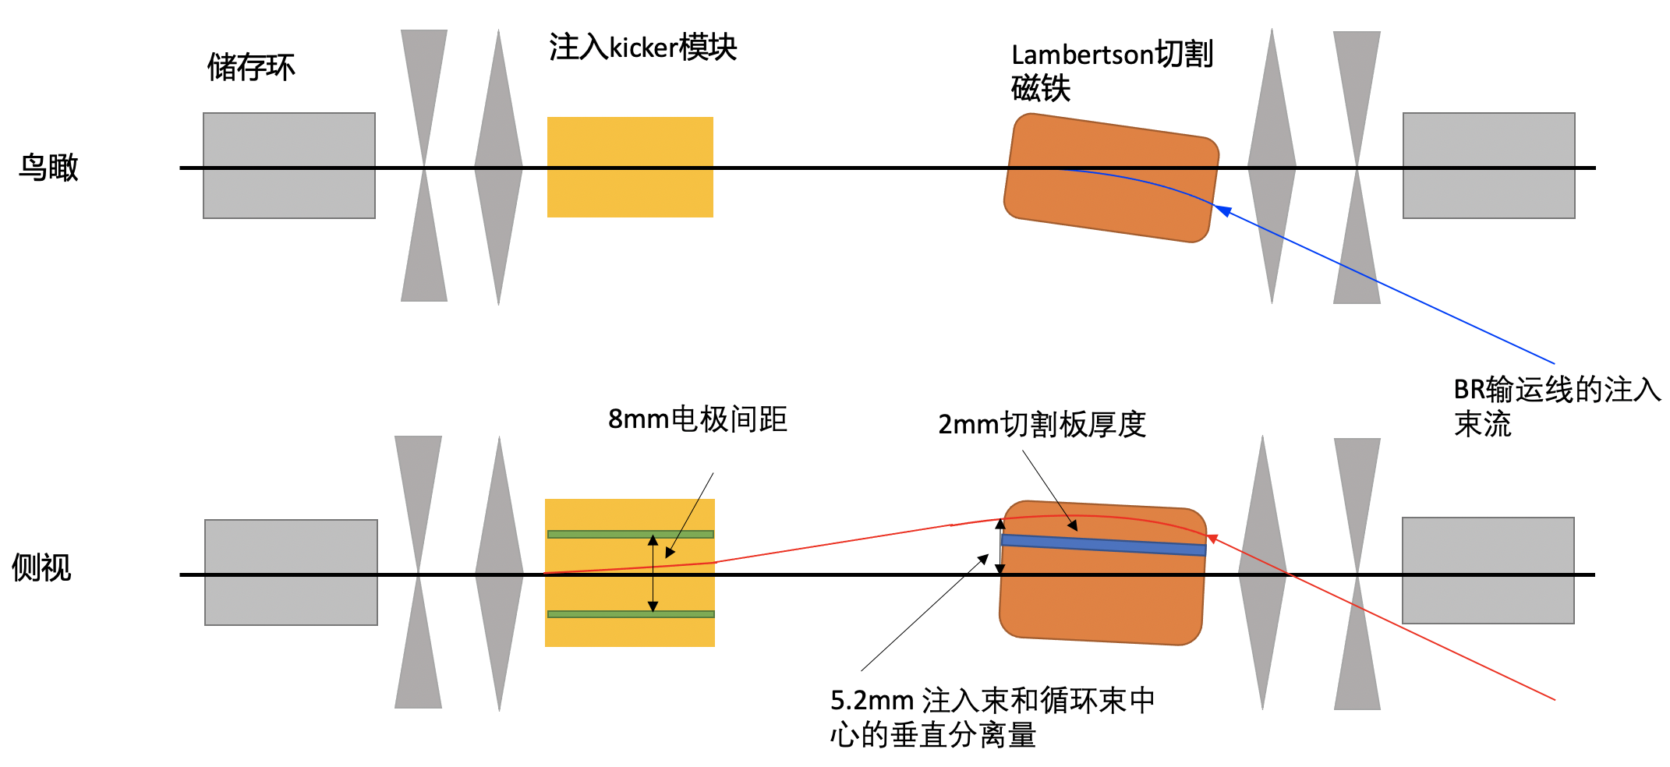
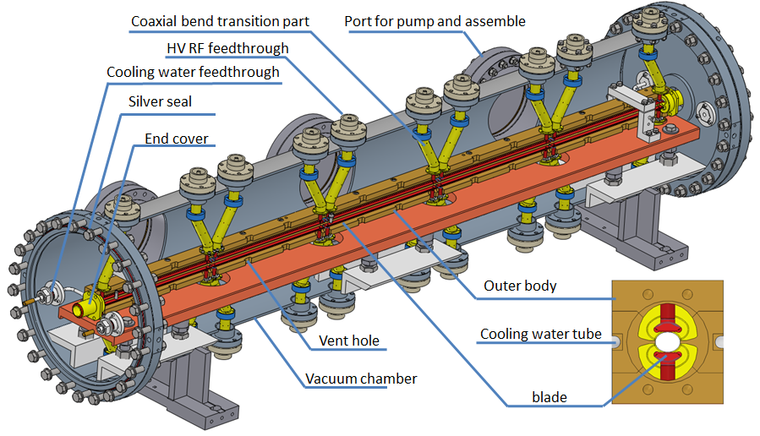
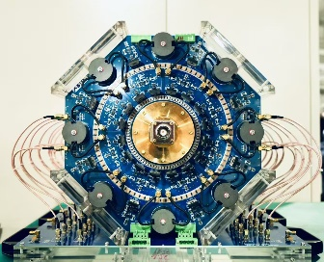
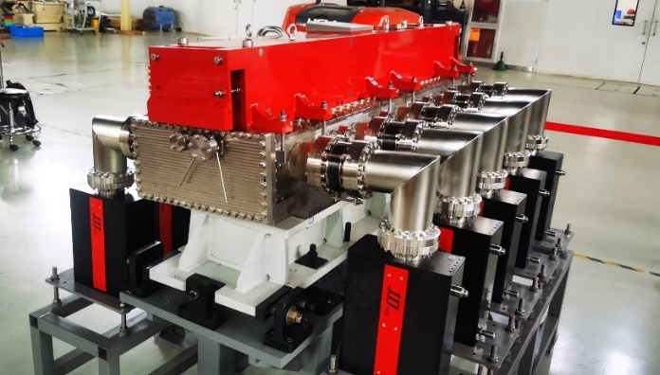
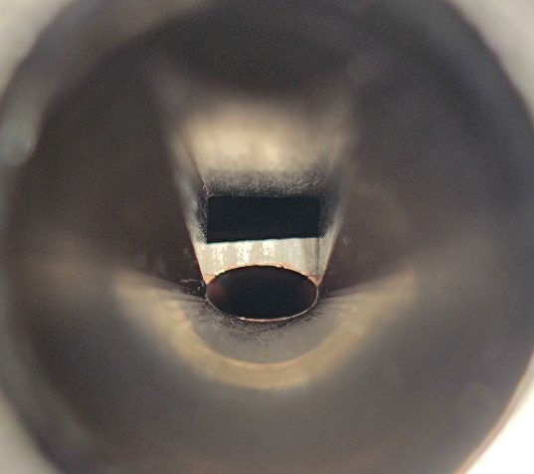
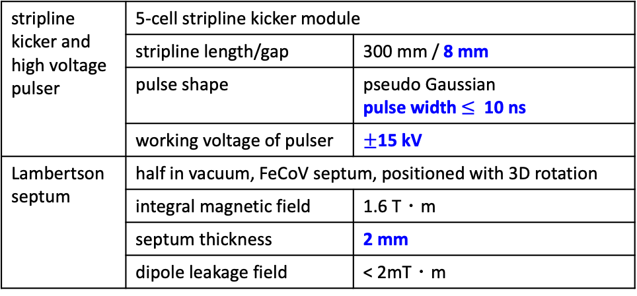
SR injection region design
storage ring
injection kicker
Lambertson
septum
stripline kicker and high voltage pulser | 5-cell stripline kicker module
 | stripline length/gap | 300 mm / 8 mm
 | pulse shape | pseudo Gaussian pulse width $≤$ 10 ns
 | working voltage of pulser | $±$15 kV
Lambertson septum | half in vacuum, FeCoV septum, positioned with 3D rotation
Lambertson 型切割磁铁 | integral magnetic field | 1.6 T・m
 | septum thickness | 2 mm
 | dipole leakage field | < 2mT・m
bird
view
8mm gap between
electrodes
2mm septum
thickness
injected beam from booster
side
view
5.2mm vertical separation
between injected & stored beam
5-cell stripline kicker module
10 ns HV kicker pulser
Lambertson septum
aperture @ exit of Lambertson septum
injected beam
5.2mm
2mm
stored beam
(HxV=10.5x5mm)

Slide 9
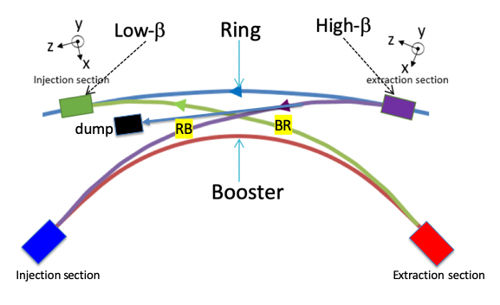
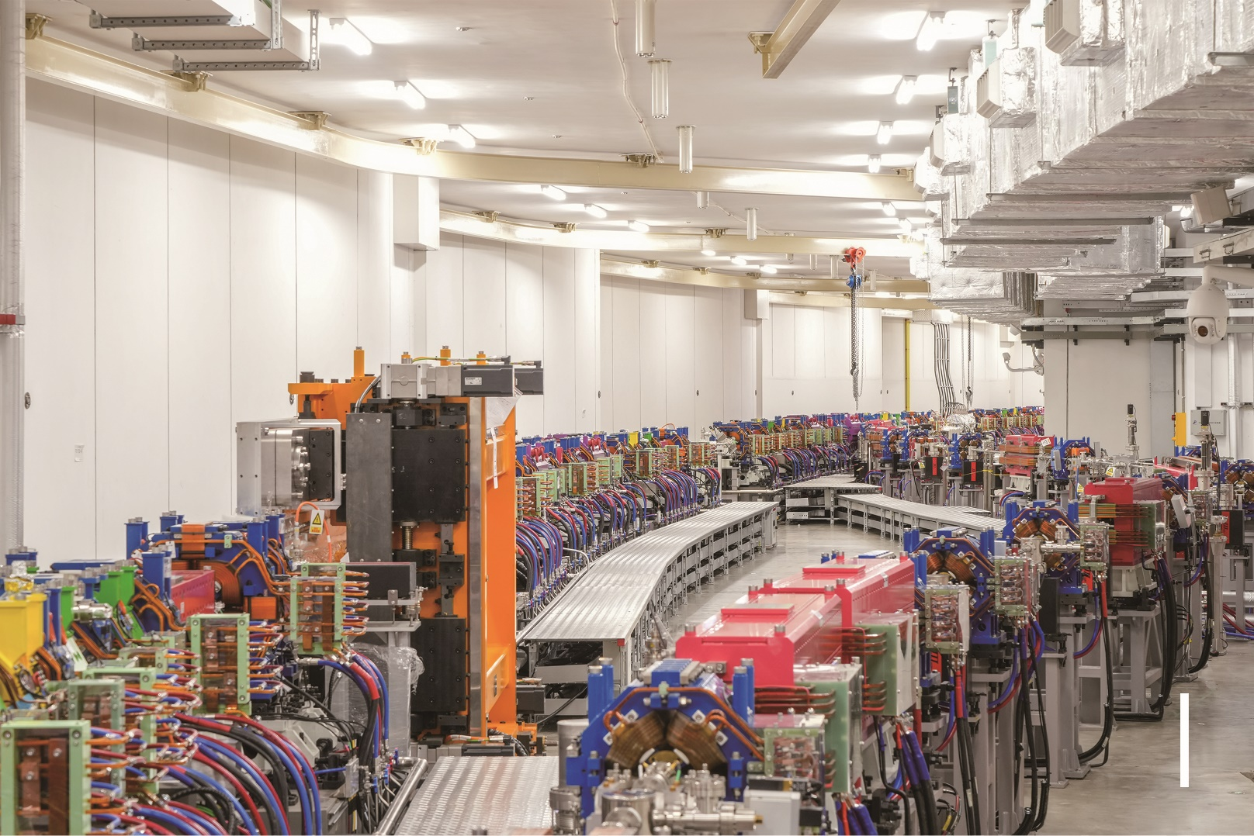
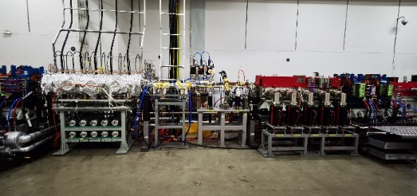
Symmetric injection & extraction region
booster
tunnel
Injection straight section: 6m
ring extraction
Beam direction
ring injection
ring-to-booster transport line
booster-to-ring transport line
stripline kicker
Pre-dump kickers
Lambertson septum

Slide 10
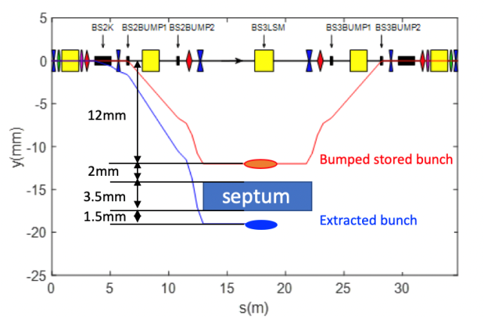
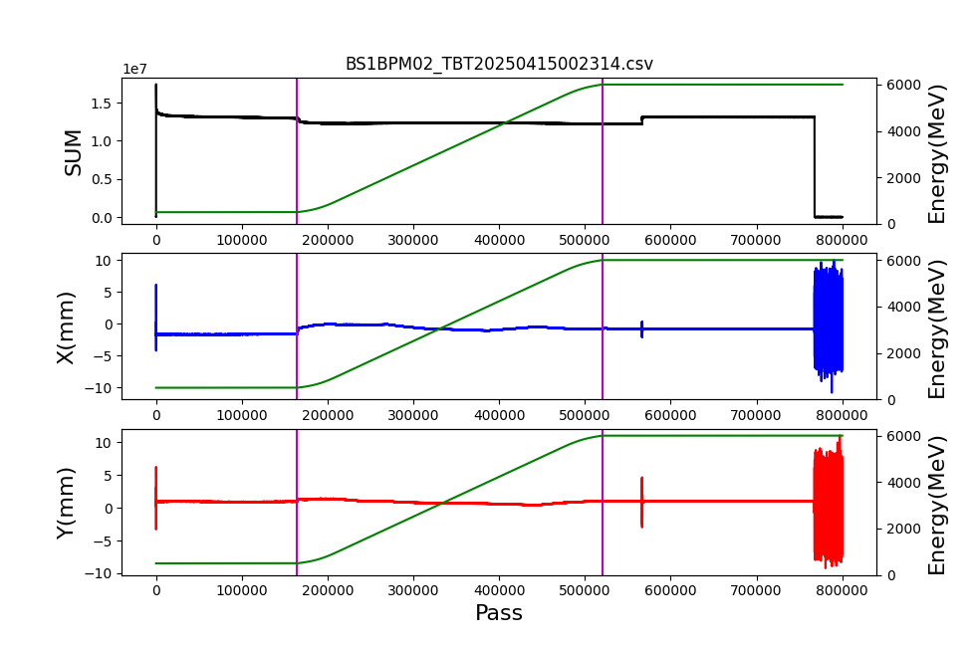
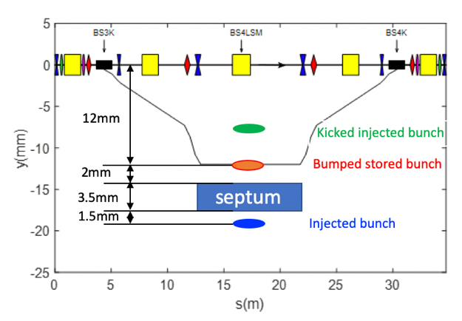
Booster high-energy extraction, re-injection design
Booster 6GeV re-injection
500MeV
injection
500MeV to 6GeV
ramping
6GeV
re-injection
6GeV
extraction
Booster 6GeV extraction

Slide 11
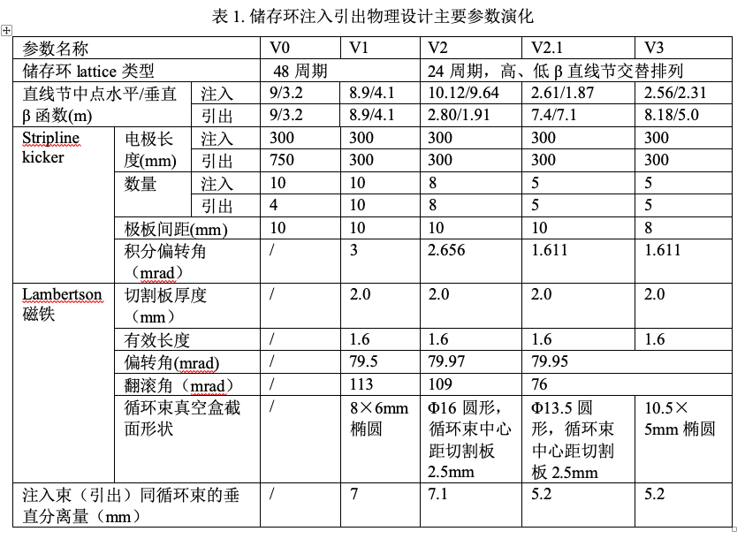
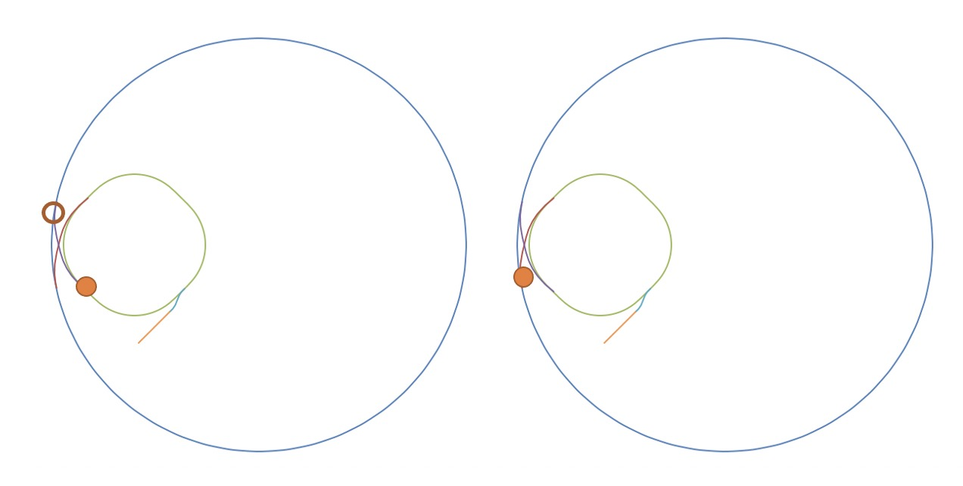
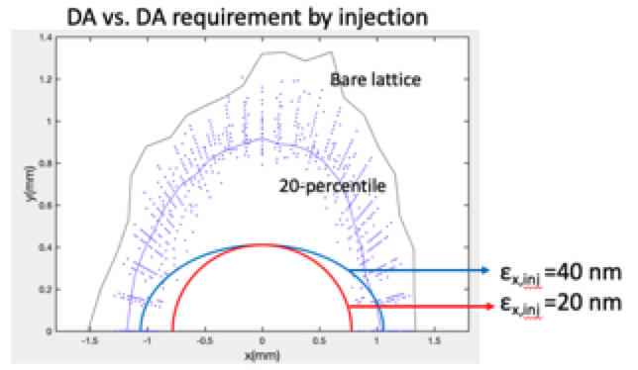
Key design issues
Synchronization
Wise choice of booster harmonic number & transport line lengths
Variation in the circumferences within error tolerance
transmission efficiency
trade-off between injected beam emittance, injection error and DA
mechanism & mitigation of injection trasient instabilities
hardware specs
challenging hardware
tolerance of pulse magnets
alignment tolerance of Lambertson septum

Slide 12
Design evolution
Injection timing sequence
Updates in kicker specs
Design of pre-extraction kicker
Commissioning simulation
  Lambertson alignment tolerance
  Injection tuning planning
Injection efficiency optimization
High-bunch charge mode tests
2018-2019
2020
2021
2022-2023
2024
2025
Hardware specs finalized
end-to-end injection simulations
Hardware joint tests
SR injection commissioning
Baseline scheme
Injector requirement
Hardware specs

Slide 13
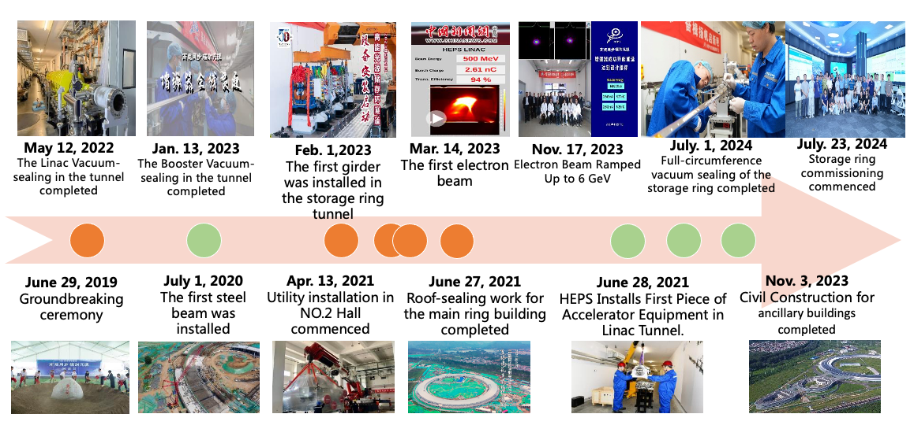
Milestones of the HEPS project

Slide 14
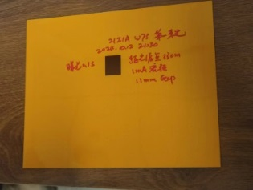
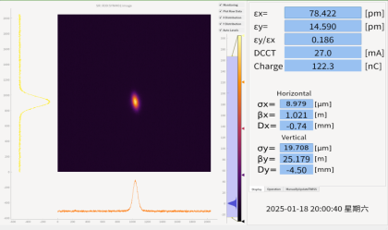
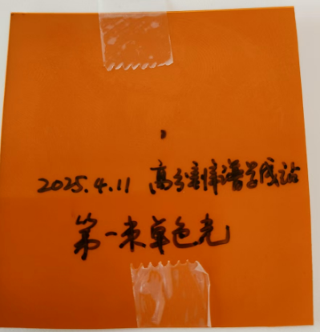
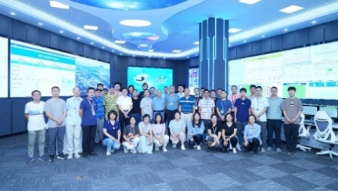
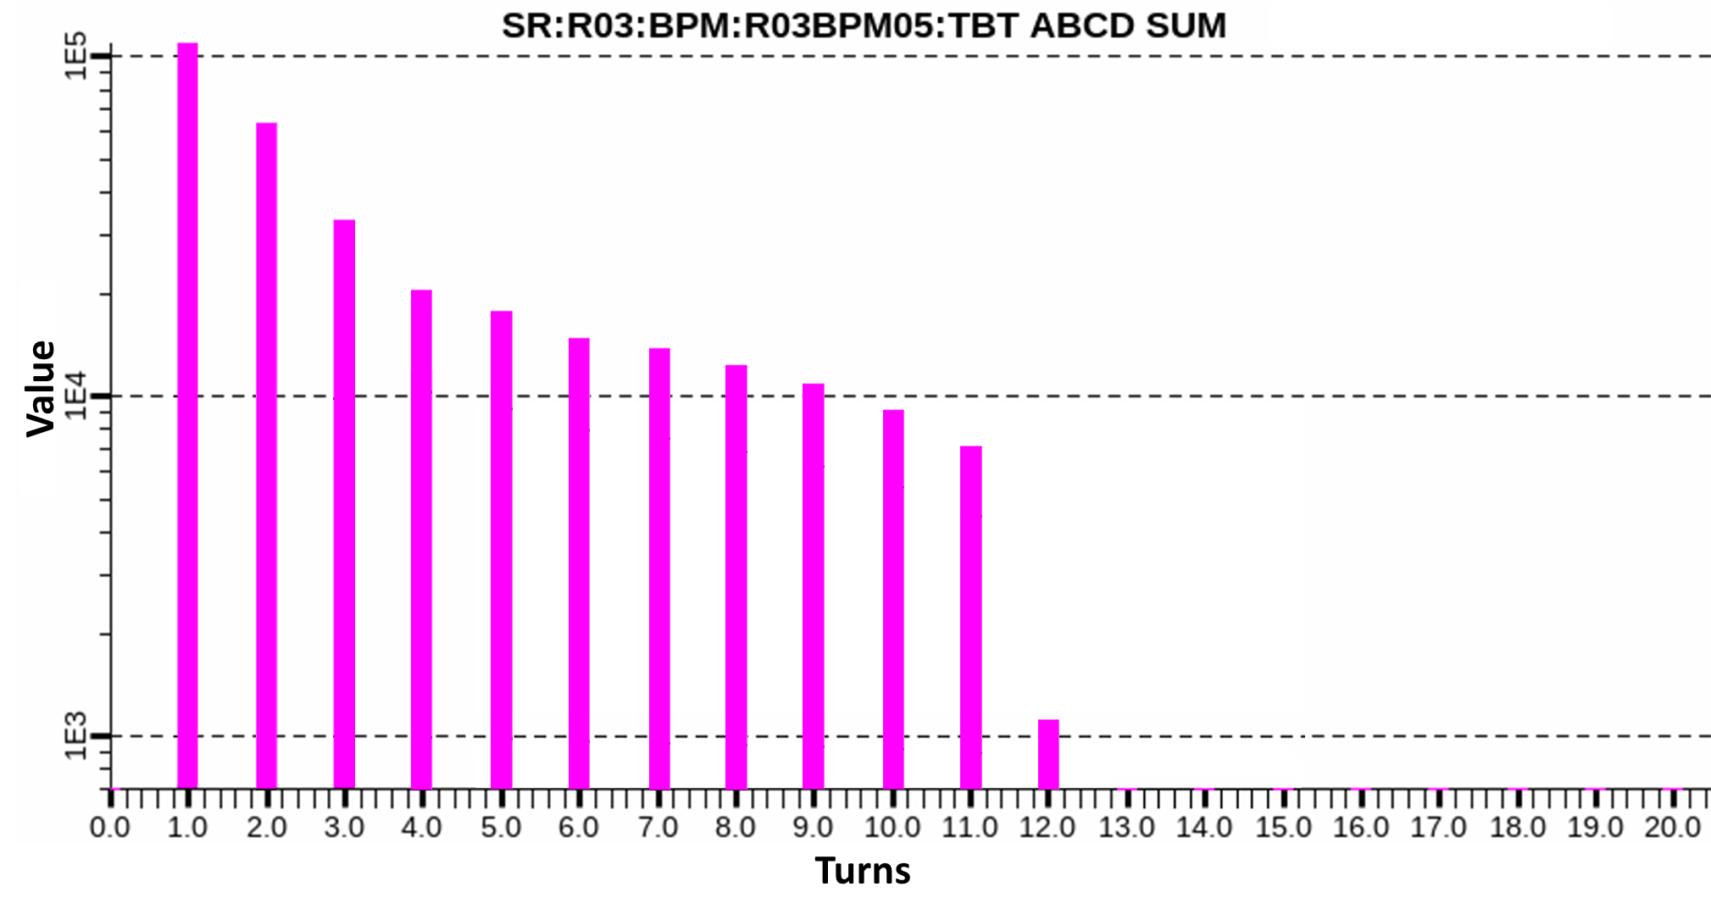
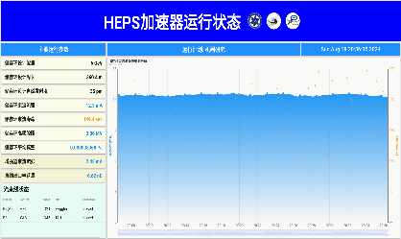
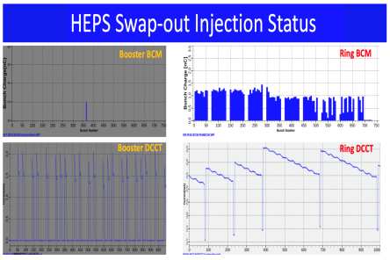
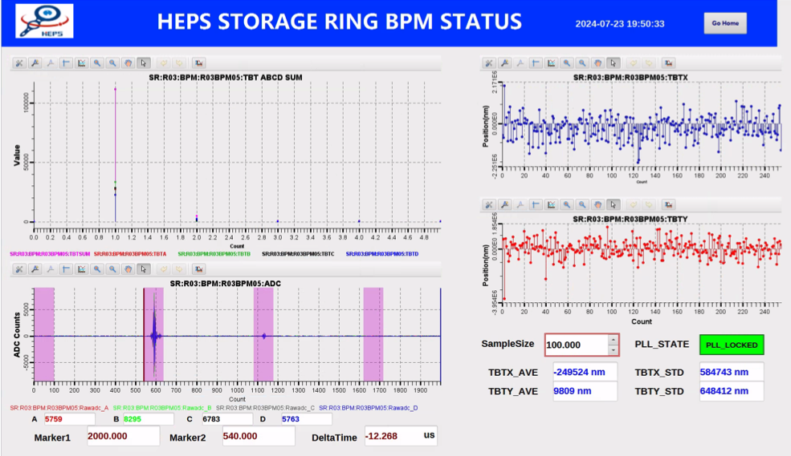
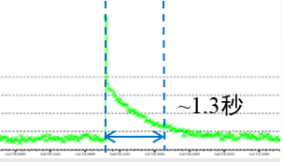
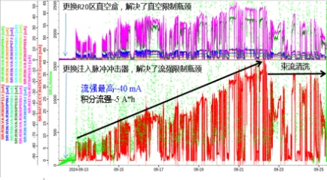
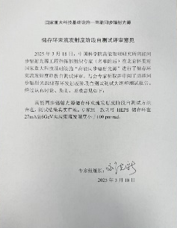
HEPS storage ring commissioning
12th turn signal
current > 12 mA
lifetime ~ 2 min
Commissioning
Commenced
circulation
>10 turns
beam current reaches 12mA
First light from ID
Emittance better than 100pm
First monochromatic light from ID
2024.07.23
2024.08.04
2024.09.22
2025.01.02
2025.03.18
2024.07.23
2024.07.29
2024.08.18
2024.10.12
2025.01.12
2025.04.11
1st complete turn
First stored beam
beam current reaches 40mA
injection scheme demonstrated
Emittance result passed review
2nd turn signal
HEPS is in shutdown for installation of 166 MHz SRF cavities, necessary to reach > 100mA beam current
Will resume operation in early September, aiming to pass the national acceptance test within 2025

Slide 15
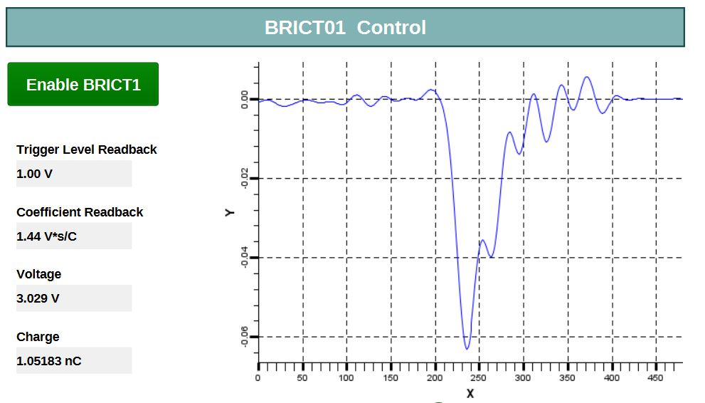
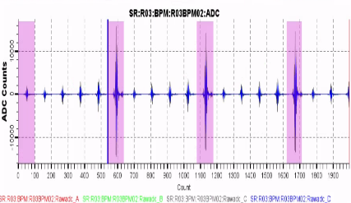
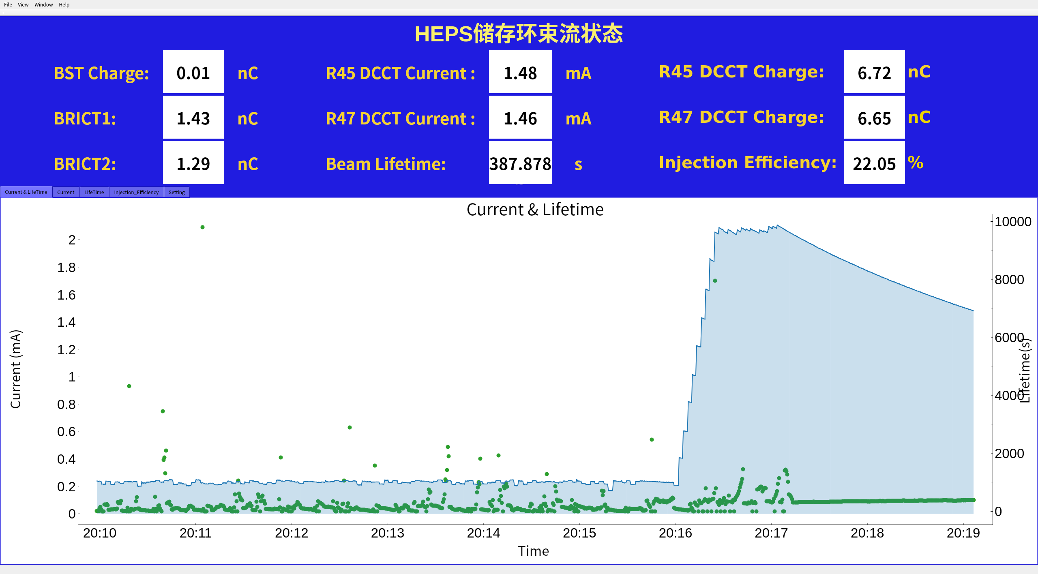




Commisioning of the injection scheme
first booster extraction
first multi-bunch injection
first SR injection w/ stripline kicker
first swap-out injection w/ high energy accumulation in booster
2024.05.17
2024.08.08
2024.09.12
2025. 01. 02
2024.07.23
2024.08.24
2024.12.28
first SR injection after 3 hours commissioning
first SR extraction w/ stripline kicker
first high energy injection into booster
with a slotted-pipe kicker

Slide 16

Swap-out with “booster high energy accumulation”
First demonstration in 2025. 01. 02.

Slide 17

Swap-out injection in operation
HEPS Swap-out injection status monitor
Booster Bunch Current Monitor
SR Bunch Current Monitor
Booster DCCT
SR DCCT
Note: transmission efficiency is not fully optimized.

Slide 18



Lessons learned in the commissioning
Progressive beam tests of key hardware and the timing system
Oscilloscope is essential in debugging and delay measurement
Swap-out injection requires more from beam diagnostics
  Turn-by-turn & bunch-by-bunch BPM provides real-time measurements of injection effciency / residual oscillation / energy oscillation
  streak camera ( and maybe beam size monitor ) captures the transient effect
Manual optimization -> (semi)-auto optimization
bunch-by-bunch BPM for injection diagnostics

Slide 19
Summary
The swap-out injection scheme with beam recycling in the booster has been demonstrated and utilized in routine operation at HEPS
Novel injection hardware (stripline kicker module, half-in-vacuum Lambertson, HV pulser based on DSRD & inductive adder ) has been fully tested and running smoothly
Next step
  Realize 100mA beam current goal for national acceptance test
  High-bunch-charge mode commissioning
  Continue injection efficiency optimization
  evaluate potential influences to users

Slide 20

Thanks!

Slide 21
References
Z. Duan et al., “The swap-out injection scheme for the High Energy Photon Source”, Proc. IPAC 2018, THPMF052
Z. Duan et al, “Injection beam instabilities for HEPS”, 8th Low Emittance Ring Workshop, online, Indico
Z. Duan, Swap-out injection using the booster as an accumulator at the High Energy Photon Source, Low Emittance Ring Lattice Design Workshop, ALBA, 2022, Indico
J.H. Chen*, H. Shi , L. Wang, Z. Duan, N. Wang, L.H. Huo, G.W. Wang, X.L. Shi, P. Liu, "Strip-line kicker and fast pulser R&D for the HEPS on-axis injection system", NIMA 920, 1-6 (2019).
Zhe Duan*, Jinhui Chen, Hua Shi, Guangyi Tang, Lei Wang, Yuwen Wu, “Using a pre-kicker to ensure safe extractions from the HEPS storage ring”, Nuclear Science and Techniques 32, 136 (2021).
Lei Wang*, Jinhui Chen, Hua Shi, Guanwen Wang, Na Wang, Zhe Duan, Saike Tian, Lihua Huo, Peng Liu, “A novel 5-cell strip-line kicker prototype for the HEPS on-axis injection system”, NIMA992, 165040 (2021).
Peng Liu*, Guanwen Wang, Jinhui Chen, Lei Wang, Hua Shi, Lihua Huo, “A precision clock source design”, RDTM 5, 238-244 (2021).
L.H. Huo*, H. Shi*, J.H. Chen, L. Wang, G.J. Wu, X.Z. Zhai, G.W. Wang, “Development of Radio Frequency Feedthrough Prototype with High Voltage and High Vacuum for the HEPS Strip-line Kicker”, NIMA 1056, 168691 (2023). .

Slide 22
References
Guanwen Wang, A pulser R&D for the HEPS booster bumper magnet，Journal of Physics: Conference Series，2687 (2024) 022025
Huoli Hua, Development of the pulse bump magnet in HEPS, Radiation Detection Technology and Methods, (2023) 7:521–530
Peng Liu, Design of local control system for injection of fast pulse power supply for HEPS, IPAC2024
Yuwen Wu, Physical Design and Prototype Development of Septum Magnet for HEPS Storage Ring , MT-28 international conference on magnet technology
Chen Jinhui, Wang Lei, Shi Hua, Huo Lihua, Wang Guanwen, Liu Peng, Shi Xiaolei, " Application of fast pulsed power supply to high energy photon source ", High Power Laser and Particle Beams 31, 040017 (2019).
Shi Xiaolei, Chen Jinhui, Wang Guanwen, Wang Lei, Zeng Tao, Yang Wei, Wang Xu, Su Wentong, Wu Guanjian. Design of drift step recovery diode pulse power generator based on magnetic saturation transformer[J]. High Power Laser and Particle Beams, 2020, 32: 025020
Shi Xiaolei, Chen Jinhui, Wang Guanwen, Wang Lei, Liu Peng, “Application of nonlinear transmission line in DSRD pulse generator” [J]. High Power Laser and Particle Beams, 2023, 35: 105002.
Wang Guanwen, Chen JinHui, Huo Lihua, Liu Peng, Wang Lei, Shi Xiaolei, Duan Zhe, Shi Hua, Wu Guanjian, Zhai Xinzhe, “ Design and implementation of HEPS booster bumper pulser” [J]. High Power Laser and Particle Beams, 2024, 36: 025014.

