Slide 1


FCC-ee injector linacs: design and RF frequency choices for the TDR
Alexej Grudiev on behalf of the FCC-ee injector linac design WG
S. Bettoni, I. Chaikovska, P. Craievich, S. Doebert, A. Kurtulus, A. Latina, J.-Y. Raguin, Y. Zhao, and friends

Slide 2
Outline: from the past to the future
Overview of the Feasibility Study Report baseline for the FCC-ee injector complex linacs
New design of the injector linacs for the TDR
  New RF frequency European S-band versus FCC CR harmonic S-band
  New damping ring design and final placement on CERN site
Conclusion

Slide 3
FSR baseline layout
4 AS/module, 4 bunches@100 Hz
2.8 GHz, 215m
2.0 GHz, 319m
DR @ 2.86 GeV
G
e-linac
C
e+ linac
EC
2.8 GHz, 1080m
HEC
HE-linac
BC
20 GeV
Max. Klystron Power: 80 MW, Operating Klystron Power: 64 MW i.e. 20 % Margin
Linac | <a/λ> | Bunch Charge [nC] | Kly. power per structure [MW] | Loaded acc. gradients [MV/m] | Nb. modules | Linac lengths [m] | Oper. power consumptions [MW] | Max. power consumptions [MW]
e-linac * | 0.15 | 5 | 14.2 | 19.5 | 14+1 | 215 | 2 | 2.5
e+ linac** | 0.2 | 15 | 15.4 | 13.3 | 21 | 304 | 8 | 8.5
HE-linac * | 0.12 | 5 | 14.2 | 21.1 | 72 | 1080 | 9.5 | 11.5
* 3 µs RF pulse length, 6 µs HV pulse length
Assumes 25 m WR284 waveguide system length for one RF module
** 5 µs RF pulse length, 8 µs HV pulse length,
Assumes 25 m WR510 waveguide system length for one RF module
Assumes 6 structures (2 modules) for Capt. Linac, 20 structures (5 modules) for S1 Linac and 260 solenoids

Slide 4
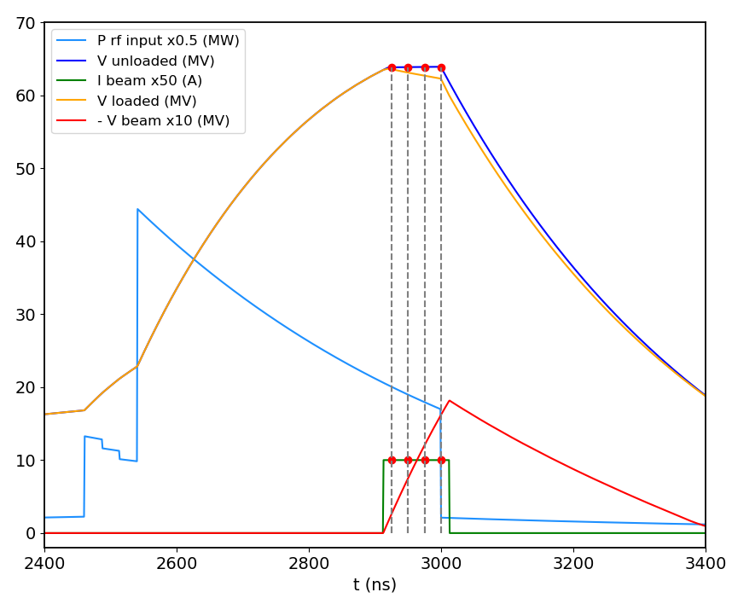
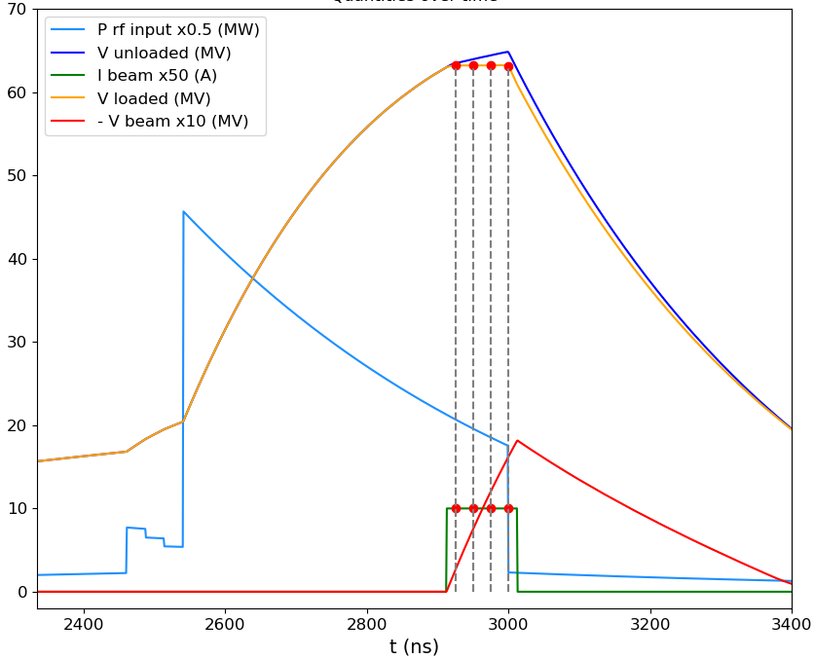
HE Linac: CR filling mode
4 Bunches case:
Unloaded Voltages | 1st Bunch | 2nd Bunch | 3rd Bunch | 4th Bunch | Rsh
Single Bunch | 66 MV |  |  |  | 102.25 MΩ/m
4 Bunches | 63.81 MV | 63.84 MV | 63.86 MV | 63.82 MV | 95.65 MΩ/m
P_klys = 14.2 MW
3m structure
G = V/L
For bunch charge: 5 nC
25 ns of bunch spacing
 | 1st Bunch | 2nd Bunch | 3rd Bunch | 4th Bunch
Loaded Voltages | 63.19 MV | 63.19 MV | 63.20 MV | 63.16 MV
Unloaded
Loaded

Slide 5
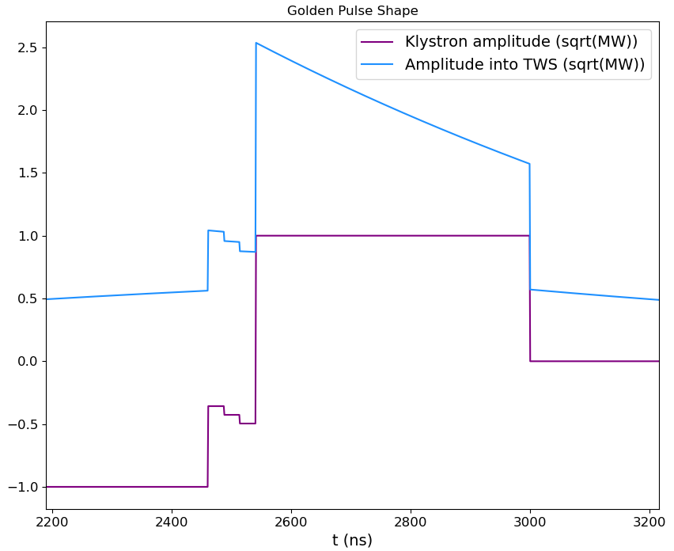
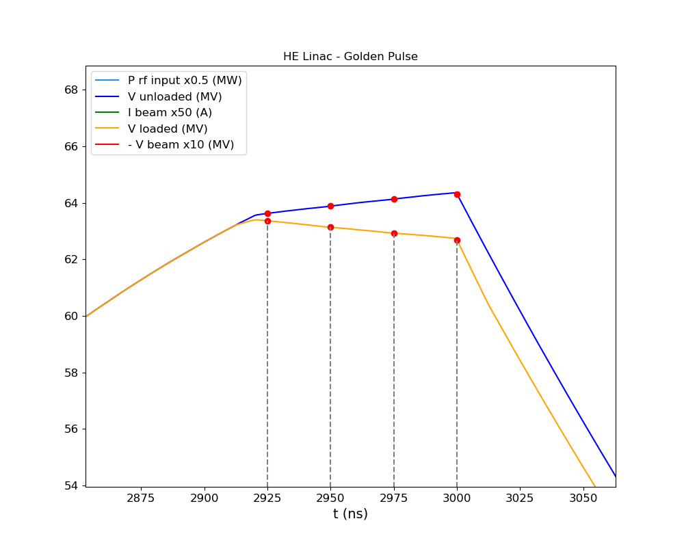
HE Linac: top-up operation using “golden” pulse
4 Bunches case:
 | 1st Bunch | 2nd Bunch | 3rd Bunch | 4th Bunch
Unloaded Voltages | 63.63 MV | 63.89 MV | 64.13 MV | 64.30 MV
P_klys = 14.2 MW
3m structure
G = V/L
+1.1% energy spread
For bunch charge: 5 nC
25 ns of bunch spacing
 | 1st Bunch | 2nd Bunch | 3rd Bunch | 4th Bunch
Loaded Voltages | 63.37 MV | 63.14 MV | 62.93 MV | 62.68 MV
-1.1 % energy spread
See poster:
A. Kurtulus, et. al
“RF Design and Optimization of the High-Energy Linac for the FCC-ee Injector Complex”

Slide 6
e- and HE linac beam dynamics: static effects
Sensitivity to static misalignments
  Assumed rms Gaussian distributed misalignments: 50 um for quadrupoles, 100 um per RF structures, and 30 um per BPM
  Applied one-to-one correction and DFS (including 10 um resolution) in cascade
  More than the 98% of the good seeds considered in the calculation of the emittance growth
e- linac:
  Emittance good enough for the positron production (e-linac)
  Emittance expected to be good enough for the injection to DR
HE linac:
  Emittance growth fulfilling the booster requirements
Emittance growth under control
ε_{x} (mm.mrad) |  | ε_{y} (mm.mrad)
Maximum | Design | Maximum | Design
20 | <12 | 2 | 1.6

Slide 7
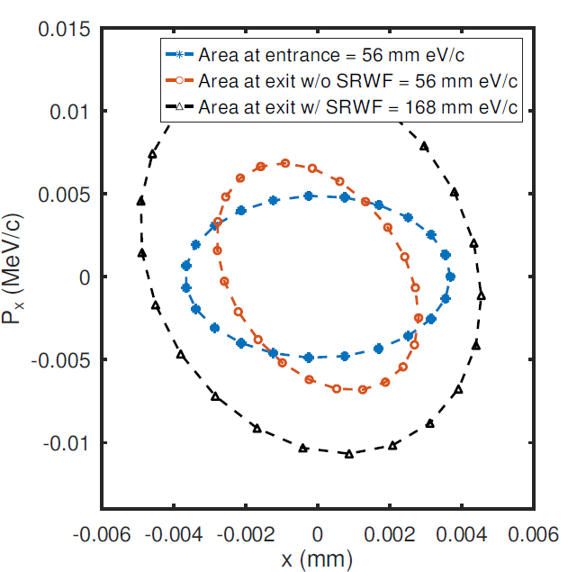

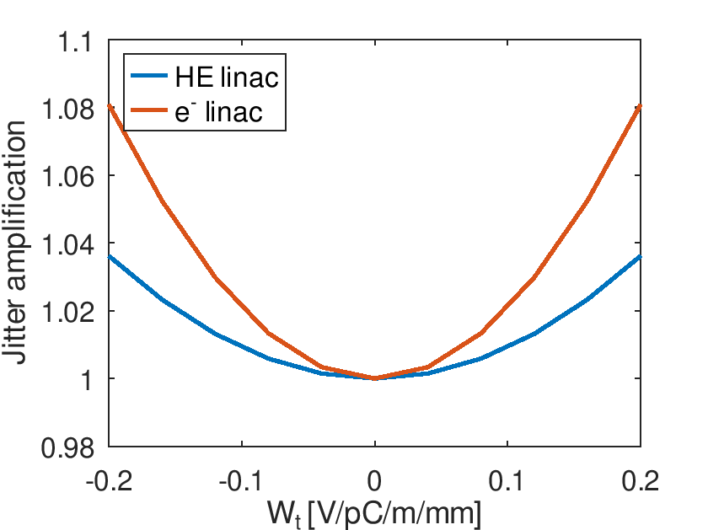
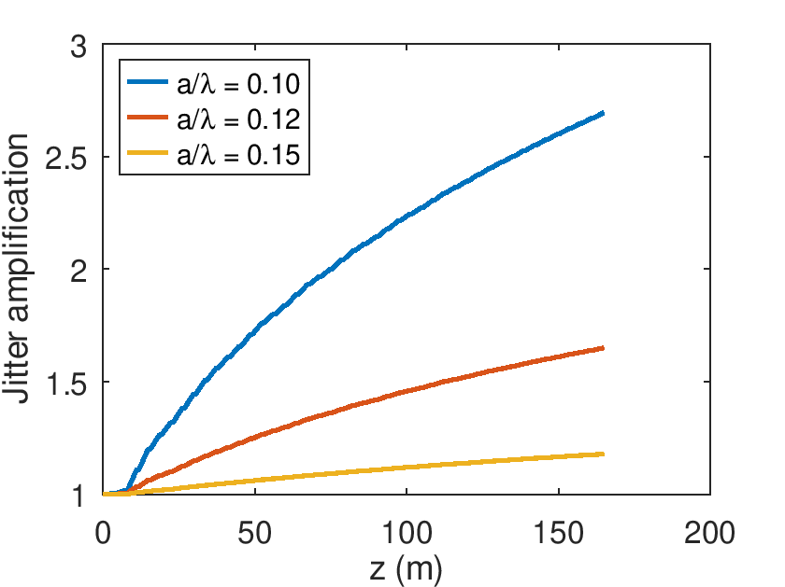
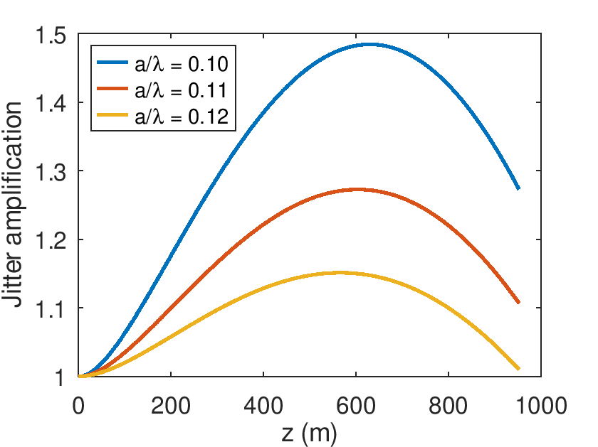
e- and HE linac: dynamic effects
e- linac |  | HE linac
Multi-bunch | Single bunch | Multi-bunch | Single bunch
1.03 | 1.18 | 1.02 | 1.01
Multi-bunch
Single bunch
HE linac
(a/λ = 0.12)
e- linac
(a/λ = 0.15)
From the previous design RF optimized for a maximum kick=0.11 V/pC/m/mm
Positron production→ok 0.15
Damping ring→ waiting for an answer
Booster→ok
No showstoppers identified
See talk: S. Bettoni, et. al
“FCC-ee injector: linacs design for single- and multi-bunch effects”

Slide 8
Single and Multi-bunch energy spread reduction:
“golden” pulse and high energy compressor (HEC)
R₅₆ ~ 0.55 m
f2 = 2.8 GHz
V = 620 MV
f1 = 2.8 GHz
HE linac
RF EC
σ_{z0} = 0.8 mm
σ_{z0} = 0.8 mm
DE/E = 0.6%
Max DE_{cen} /E = 2.1%
σ_{z0} = 4 mm
DE/E = 0.6%
Max DE_{cen} /E < 0.05%
σ_{z0} = 4 mm,
DE/E = 0.11%
DE_{cen} /E < 0.05%
  Total length <100 m including matching sections upstream and along HEC
  For the top-up operation with variable (0-100%) charges in each of the 4 bunches, LLRF used to generate a unique golden pulse
  HEC is used to match both the single- and multi- bunch target parameters, see below
Q = 5 nC: DE/E ~ 0.11%. Factor 3 smaller DE/E possible (single-bunch)
Q = 5 pC → machine settings unchanged vs the high Q mode
 | Bunch 1 | Bunch 2 | Bunch 3 | Bunch 4
Single bunch DE/E (%) | 0.11 | 0.11 | 0.10 | 0.09
Rms bunch length (mm) | 4.06 | 4.07 | 4.09 | 4.10
DE/E centroid from B1 (%) | 0 | -0.01 | -0.03 | -0.05
Dt from bunch 1 (ps) | 0 | 5.7 | 11.0 | 17.3
 | Bunch 1 | Bunch 2 | Bunch 3 | Bunch 4
Single bunch DE/E (%) | 0.13 | 0.13 | 0.12 | 0.12
Rms bunch length (mm) | 1.04 | 1.04 | 1.03 | 1.03
DE/E centroid from B1@5nC (%) | 0.14 | 0.21 | 0.29 | 0.36
Dt from B1@5nC (ps) | -29 | -35 | -41 | -45
See talk: S. Bettoni, et. al
“FCC-ee injector: linacs design for single- and multi-bunch effects”
These parameters seem to be acceptable by the booster

Slide 9
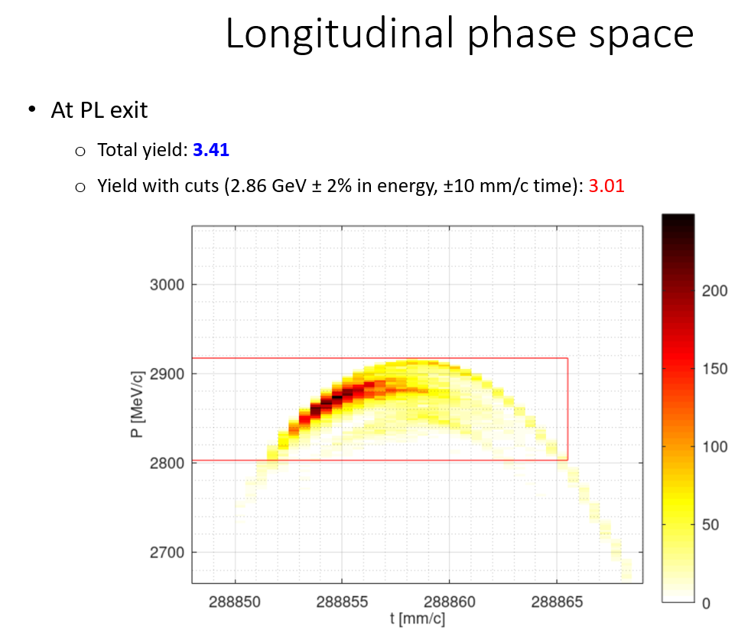
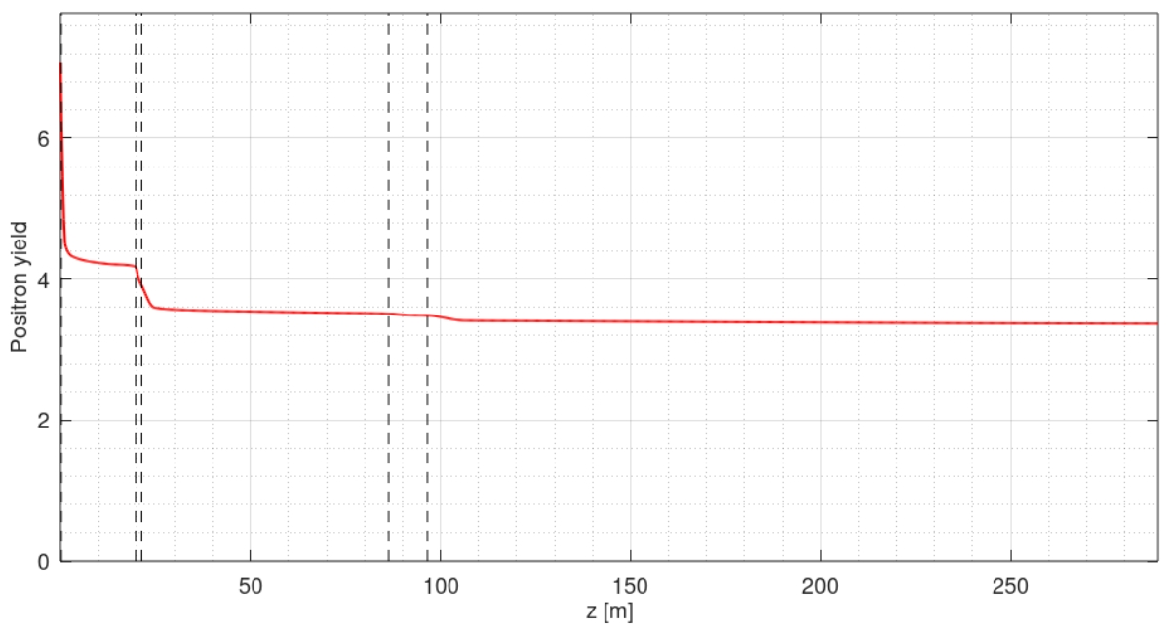
e+ linac: design, transmission and yield
Primary
e-bunch:
4.5 nC
solenoids
quadrupoles
Collimation chicane
200 MeV
Matching section
930 MeV
2860 MeV
3.41
3.01
13.5 nC
σ_{z} = 3 mm
σ_{E} = 0.95 %
ε_{Nx,y} = 13 mm*rad
See talk: I. Chaikovska, “Positron production for FCC-ee”

Slide 10
From FSR to TDR
The baseline schematic layout remains basically the same for the TDR.
However, the design of the linacs and associated sub-system must be adapted to accommodate the following changes:
  RF frequency from 2.8 GHz to 3 GHz in e- and HE linacs. (Straightforward)
  In e+ linacs, we will attempt to move from 2 GHz to 3 GHz given the acceptance of the new DR at 2.86 GeV. (Difficult)
  Site-related space constraints must be addressed given the final placement as well as DR and TL layout
Finally, engineering design will be done for the TDR

Slide 11
FCCee linacs: the exact RF frequency
(Case of the Z-mode, 4 bunches, 100 Hz)
Nominal bunch spacing: 25 ns
Minimum time step to modify the bunch spacing: 5 ns => 200MHz. So that every second bucket in CR can be used potentially.
RF frequency in CR: f_CR = 400.788 MHz (FCC FSR, Table 1.2)
RF frequency in linacs (S-band): f_LI = f_CR*15/2 = 3005.91 MHz
Standard EU S-band: f_EU = 2998.5 MHz
Difference: f_LI – f_EU = 7.41 MHz

Slide 12
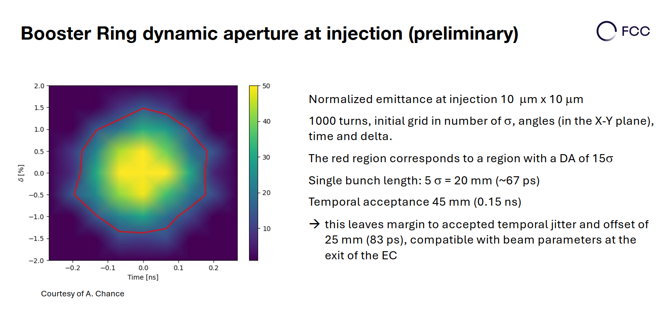
4 bunch train
BR bucket length:
2*400.788MHz => 374.0mm,
f_LI (3005.91MHz)
wavelength: 99.73 mm
EU S-band (2998.5MHz) wavelength: 99.98 mm
75*99.98mm
25ns
If EU S-band is used in linacs, the 2nd bunch will be shifted from the center of the bucket in the BR by : 75*(99.98-99.73) = 18.5mm, the 3rd by 2*18.5mm = 37mm, 4th by 55.5mm
OR all 4 bunches are shifted like this: 1. -27.75, 2. -9.25, 3. 9.25, 4. 27.75 > 25mm
This is not acceptable by the booster even without any longitudinal jitter and/or the bunch phase shift due to multi-bunch energy spread reduction in HEC
75*99.73mm

Slide 13
What if high energy compressor chicane is also used to correct the bunch spacing
R56 ~ 550 mm => dE ~ 27.75mm * 20 GeV / 550 mm ~ 1000 MeV
V_RF(@3GHz) = 1000MeV/sin(2π 27.75mm/100mm) = 1015 MV > 620MV
sin(2π 27.75mm/100mm) ~1 we are far from linear regime
This is not good for correction linear bunch phase shift due to different RF frequencies
AND the single bunch energy chirp is different between 4 bunches, => different final single bunch energy spread
The HEC cannot be used both for single bunch energy compression and bunch spacing correction, at least using 3 GHz
Significantly lower RF frequency for the HEC is needed to make both

Slide 14
Timing and synchronization of linacs and rings
In case, linacs run at Standard EU S-band: f_EU = 2998.5 MHz which is different from the Ring harmonic of 15*f_CR/2 = 3005.91 MHz
The synchronization system will have to take care of the frequency difference: 7.41 MHz.
This will set some constraints on the timing and synchronization between linacs and rings.
Bottom line: there are number of challenges if the S-band used in the linacs is not the harmonic of the CR RF frequency

Slide 15
What are the challenges of using different from Eu S-band RF frequency of 3005.9 MHz?
Typical klystron operating frequency specs are nominal f_RF ±1MHz
Some operational experience shows that ±2MHz is OK
Nevertheless +7 MHz will require different specs for FCCee klystrons: 3005.9±1MHz
This is no problem for mid and long term when new klystrons must be purchased (developed)
What about short term and potential use of existing klystrons?
Examples of different S-band RF frequencies used in Europe
 | S-Band frequencies
Lab |  | MHz
PSI | SWISS FEL | 2998.80 |  | Riccardo
DESY | FLASH=XFEL | 2997.20 |  | Rolf Jonas
DESY | SINBAD | 2997.92 |  | Rolf Jonas
DESY | LINAC 2 | 2997.98 | ±2MHz | Rolf Jonas
Daresbury | CLARA | 2998.50 |  | Graeme
Trieste | FERMI | 2998.01 |  | Nuaman
CERN | CLIC | 2998.55 |  | Steffen
 | Canon E37327A | 2998.80 | ±1MHz | Riccardo

Slide 16
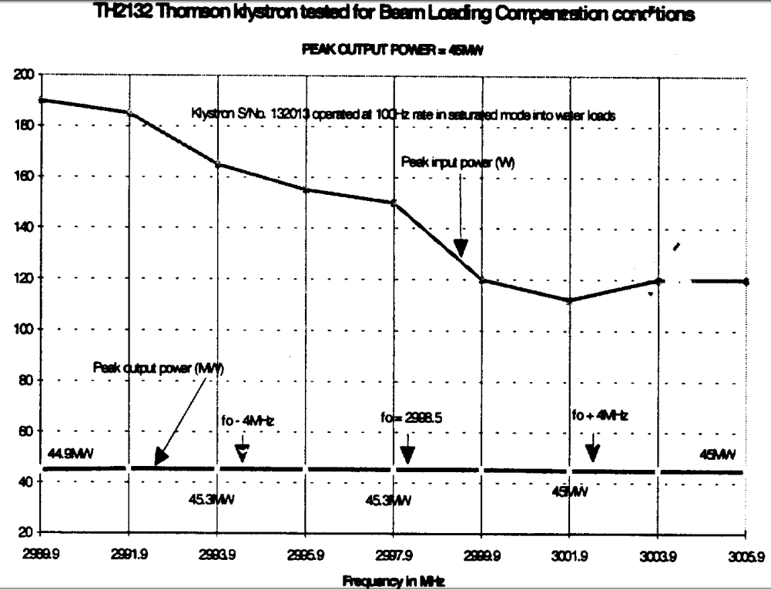
Use of EU S-band klystron at 3005.9 MHz
CTF2 TDR, CLIC note 304, 1996
S-Band frequencies
 | MHz
CLIC | 2998.55
CTF2 RF gun | 3000.50
CTF2 HCS1 | 3006.36
CTF2 HCS2 | 2990.74
Thomson TH2132 | 2998.5
Based on the measurement done for the CTF2
2998.5 klystron can be operated at nominal output RF power (45MW) at 3006 MHz.
Due to lower gain higher power might be required for the driver amplifier
This should not be a problem
More measurements are needed

Slide 17
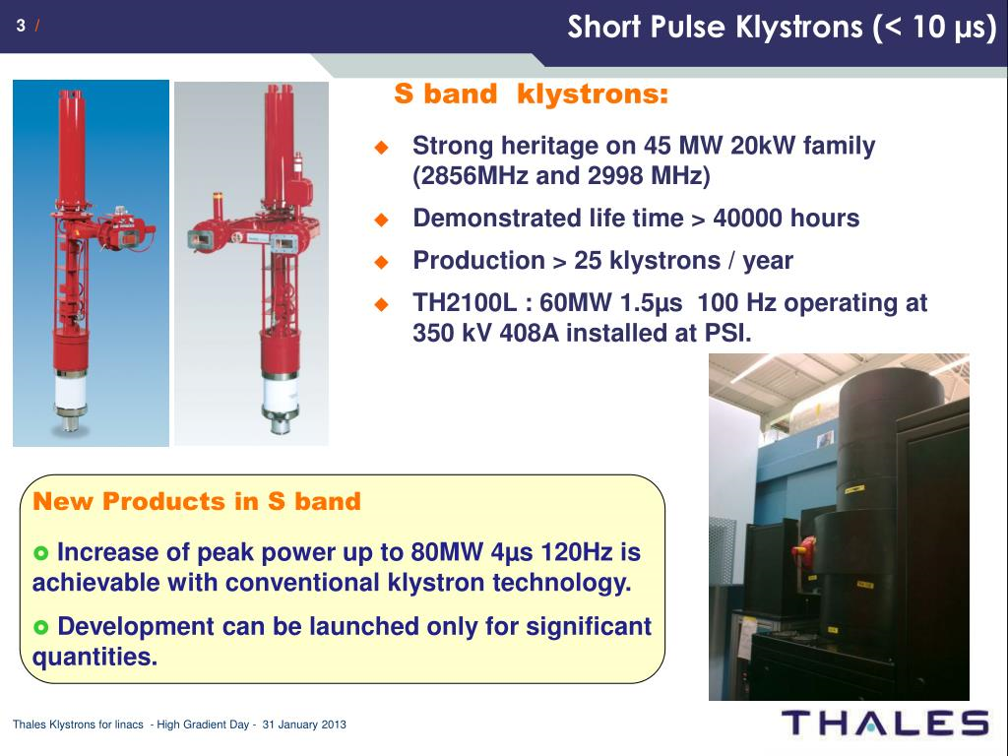
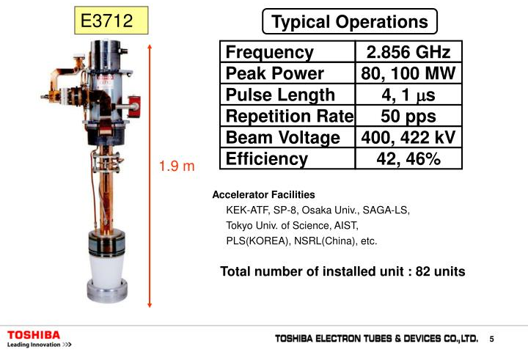
RF power for Linacs: existing S-band klystrons
THALES
CANON former TOSHIBA
2998.5 MHz version exists.
E37333 build for CLARA (UK)
Nominal parameters:
70 MW, 100 Hz, 3 us
FCC-ee injector linacs 3 GHz klystron parameters: 80 MW, 3 us, 100 Hz
Several suppliers have klystrons with very close parameters, but
A new dedicated tube will be developed for the FCC injector linacs

Slide 18
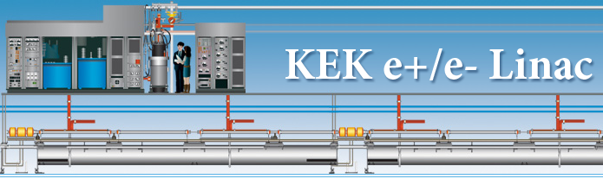
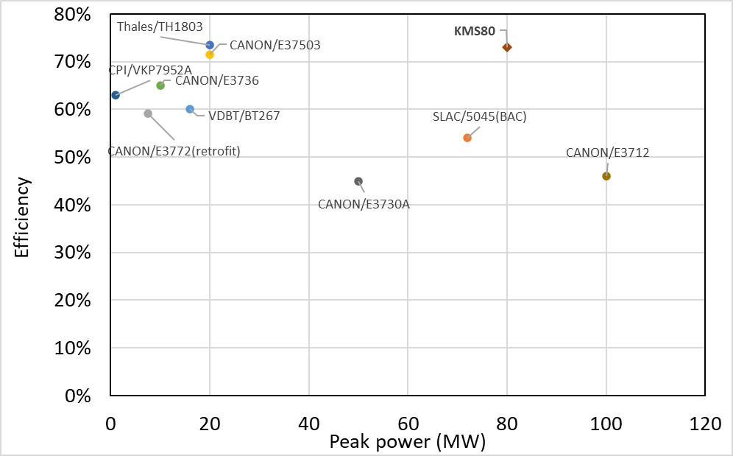
New design of high efficiency S-band Multi Beam Klystron (MBK) for KEK injector linac: KMS80
For dual records in both efficiency and output power in the field of S-band MBKs
The overall parameters of KMS80
Parameters(unit) | value
Frequency(MHz) | 2856
Gun voltage(kV) | 300
Total gun current(A) | 366.4
Beam No. | 8
Output power(MW) | 80
Expected efficiency | 73%
4us, 50Hz
(Courtesy of Takuya Natsui)
Shengchang Wang, at 2nd Workshop on efficient RF sources (23-25 September 2024): Overview · Indico

Slide 19
High efficiency RF power for FCC-ee linacs
R&D at KEK/CANON on the high efficiency MBK with 80 MW, 4 us, 50 Hz, 73% is very encouraging (1st prototype to be tested 2026)
It paves the way to high efficiency RF power source for FCC-ee injector linacs: 80 MW, 3 us, 100 Hz, >70%
Increasing klystron efficiency from 42% to 70 % is not only big reduction of the power consumption in the linacs from 19.5 MW to 13.7 MW
BUT it is also a significant reduction of the investment cost:
  modulator cost which dominates with 29% the linac hardware cost
  infrastructure cost: CV, EL

Slide 20
Conclusions
Robust design of the FCC-ee injector linacs has been done for the Feasibility Study Report
It must be adjusted and reoptimized for the TDR to address several changes including new RF frequency, new DR acceptance, site constraints
It seems that the choice between European S-band 2998.5 and the CR harmonic 3006.9 MHz favor the latter one due to simpler overall compatibility of the linacs and rings with minimum impact on the RF power systems
The design for the TDR is a chance to push the sustainability of the FCC even further by developing a high efficiency (>70%) multi-beam klystron as RF power source for the injector linacs

Slide 21

Credits
Thank you for your attention
PSI | B. Auchmann, I. M. Besana, S. Bettoni, P. Craievich, M. Duda, R. Fortunati, H. Garcia-Rodrigues, D. Hauenstein, R. Ischebeck, P. Juranic, J. Kosse, F. Marcellini, U. Michlmayr, G. L. Orlandi, M. Pedrozzi, J.-Y. Raguin, S. Reiche, R. Rotundo, S. Sanfilippo, M. Schär, N. Strohmaier, N. Vallis, M. Zykova, R. Zennaro, H.H. Braun, M. Seidel all the technical groups involved in the P3 experiment
IJCLab | F. Alharthi, R. Chehab, I. Chaikovska, V. Mytrochenko, Y. Wang
CERN | W. Bartmann, H. Bartosik, M. Calviani, S. Doebert, Y. Duthell, J. L. Grenard, A. Grudiev, B. Humann, A. Kurtulus, A. Latina, A. Lechner, R. Mena Andrade, A. Perillo Marcone, K. Oide, Y. Zhao, F. Zimmermann, Z. Vostrel, M. Benedikt
INFN-LNF | C. Milardi, A. De Santis, O. Etisken, S. Spampinati
SLAC | T. Raubenheimer
KEK | Y. Enomoto, K. Furukawa
and L. Bandiera, M. Soldani, A. Sytov (INFN/Ferrara), A. Bacci, M. Rossetti Conti (INFN/Milano)
This work was done under the auspices of CHART (Swiss Accelerator Research and Technology) Collaboration, https://chart.ch - CHART Scientific Report: https://chart.ch/reports/
FCCIS: 'This project has received funding from the European Union's Horizon 2020 research and innovation programme under the European Union's Horizon 2020 research and innovation programme under grant agreement No 951754.'

Slide 22
Spare slides

Slide 23
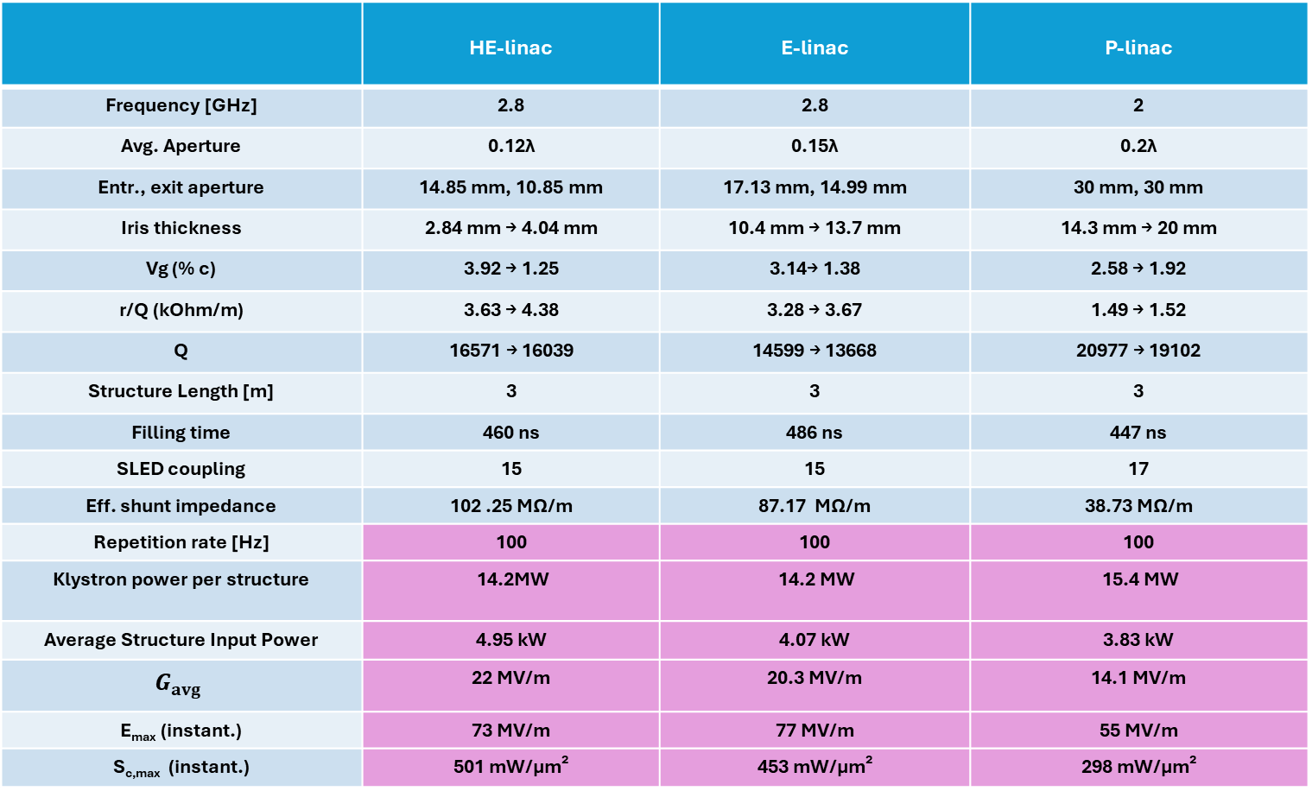
Acc. Structure parameters
Structure parameters are calculated for the single bunch case.
 | HE-linac | E-linac | P-linac
Frequency [GHz] | 2.8 | 2.8 | 2
Avg. Aperture | 0.12λ | 0.15λ | 0.2λ
Entr., exit aperture | 14.85 mm, 10.85 mm | 17.13 mm, 14.99 mm | 30 mm, 30 mm
Iris thickness | 2.84 mm → 4.04 mm | 10.4 mm → 13.7 mm | 14.3 mm → 20 mm
Vg (% c) | 3.92 → 1.25 | 3.14→ 1.38 | 2.58 → 1.92
r/Q (kOhm/m) | 3.63 → 4.38 | 3.28 → 3.67 | 1.49 → 1.52
Q | 16571 → 16039 | 14599 → 13668 | 20977 → 19102
Structure Length [m] | 3 | 3 | 3
Filling time | 460 ns | 486 ns | 447 ns
SLED coupling | 15 | 15 | 17
Eff. shunt impedance | 102 .25 MΩ/m | 87.17 MΩ/m | 38.73 MΩ/m
Repetition rate [Hz] | 100 | 100 | 100
Klystron power per structure | 14.2MW | 14.2 MW | 15.4 MW
Average Structure Input Power | 3.72 kW | 3.76 kW | 3.68 kW
 | 22 MV/m | 20.3 MV/m | 14.1 MV/m
E_{max} (instant.) | 73 MV/m | 77 MV/m | 55 MV/m
S_{c,max} (instant.) | 501 mW/μm² | 453 mW/μm² | 298 mW/μm²

Slide 24
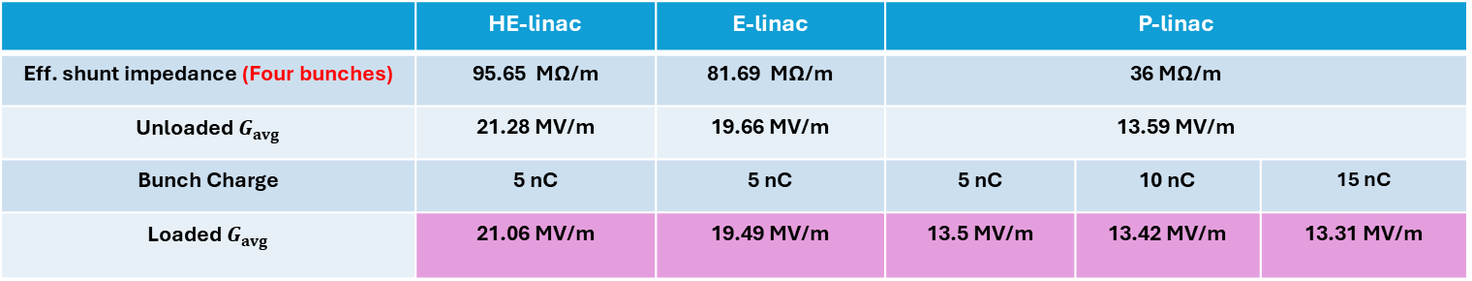
Acc. Structure parameters
Structure parameters are calculated for the four bunches case.
 | HE-linac | E-linac | P-linac
Eff. shunt impedance (Four bunches) | 95.65 MΩ/m | 81.69 MΩ/m | 36 MΩ/m
Klystron power per structure | 14.2MW | 14.2 MW | 15.4 MW
 | 21.28 MV/m | 19.66 MV/m | 13.59 MV/m
Bunch Charge | 5 nC | 5 nC | 5 nC | 10 nC | 15 nC
 | 21.06 MV/m | 19.49 MV/m | 13.5 MV/m | 13.42 MV/m | 13.31 MV/m

Slide 25
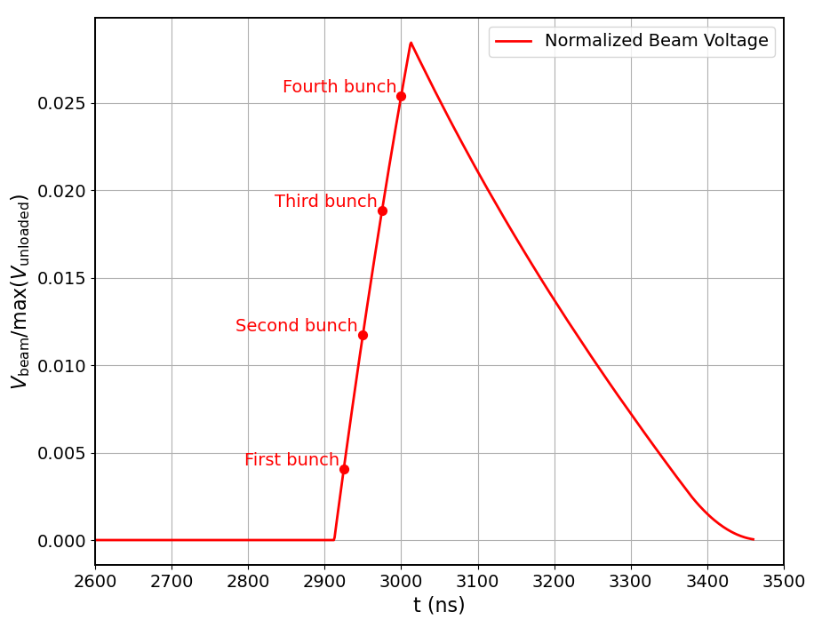
HE Linac:
4 Bunches case:
Beam loading effect
For bunch charge: 5 nC
25 ns of bunch spacing
Max Beam-Loading: 2.54 %

Slide 26
e+ linac design
Section 1 (S1)
  Structure a=30mm, L = 3m and solenoids
  N = 20, G = 13.3 MV/m, φ = -10° (optimized for max. yield)
  Average energy (around bunch core) at exit: 931.7 MeV
Section 2 (S2)
  Structure a = 30mm, L = 3m
  Periodic FODO cells. 2 structures per FODO cell. FODO phase advance: 76.345° (optimized for min. beta)
  Quadrupole length: 0.4 m. Quadrupole-Structure distance: 0.15 m. Quadrupole spacing: 3.3 m
  N = 52, G = 12.756 MV/m, φ = 5° (optimized for max. yield)
  Average energy (around bunch core) at exit: 2.866 GeV
Parameter | Value
Collective effects considered | Space charge; Short-range wakefield
Primary electron bunch charge assumed for collective effects [nC] | 5.0
Bunch length (around bunch core) at PL exit [mm] | 3.0
Energy spread (around bunch core) at PL exit [%] | 0.95
Total positron yield (all positrons) at PL exit | 3.41
Expected DR accepted yield with ±2% energy acceptance at PL exit | 3.01
Normalized X, Y emittances (accepted positrons) at PL exit [mm*rad] | 13.1, 13.0
Geometric X, Y emittances at (accepted positrons) PL exit [mm*mrad] | 2.34, 2.32

Slide 27
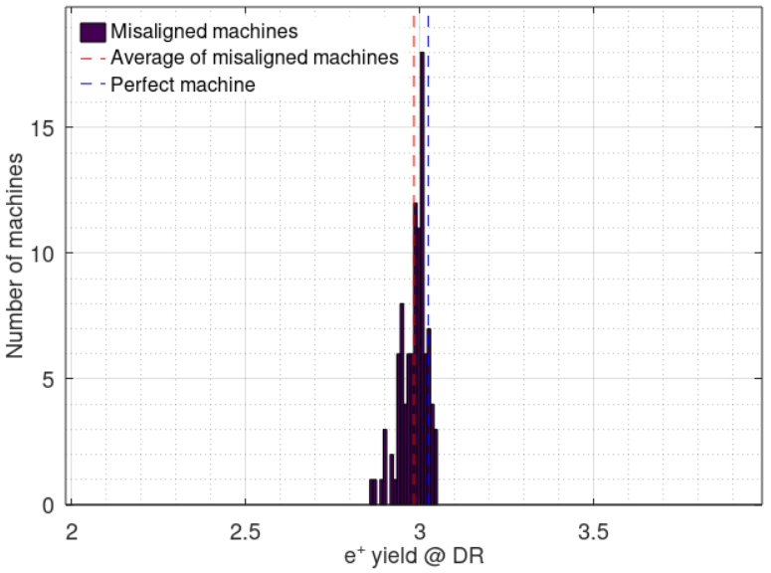
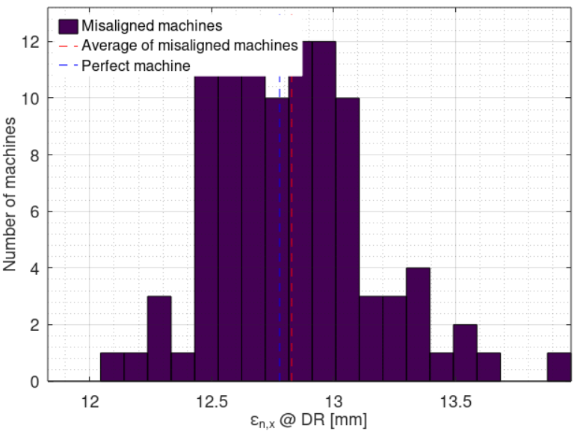
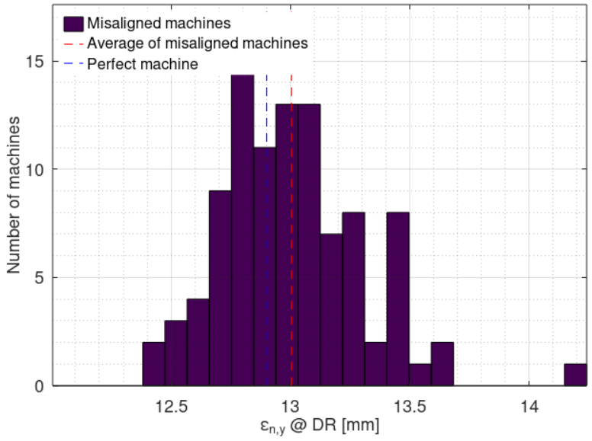
p-linac imperfections
Imperfections considered
  Position error (x, y): σ = 100 um for all elements
  Angular error (roll, pitch, yaw): σ = 100 urad for all elements, except that σ = 200 urad for all NC solenoids and dipoles
  Magnetic strength error: σ = 0.1% for all magnets
  RF gradient error: σ = 1% for all RF structures
  RF phase error: σ = 0.1° for all RF structures
  Beam position jitter (x, y): σ = 100 um for e⁺ beam from target
  Beam angular jitter (x’, y’): σ = 100 urad for e⁺ beam from target
100 random machines with imperfections
Compared with perfect machine:
  Average DR accepted e+ yield reduction: 1.3% (3.01 → 2.97)
  Average normalized X / Y emittance increase: 0.4% / 0.8% (13.1 / 13.0 mm → 13.2 / 13.1 mm)
Impact of considered imperfections is negligible

