Slide 1




High Energy Booster Emittance Tuning
Q. Bruant, B. Dalena, T. Da Silva, A. Chancé (CEA irfu and Paris-Saclay University)
A. Ghribi (GANIL, CNRS)
A. Mash’al (IPM)
Thanks to: J.Dilly, J.Keintzel, R. Tomas, K. Oide and all the FCC tuning team
 |  | FCCIS – The Future Circular Collider Innovation Study. This INFRADEV Research and Innovation Action project receives funding from the European Union’s H2020 Framework Programme under grant agreement no. 951754.

Slide 2
Outline
Errors assignments and correctors placement
Emittance Tuning Strategy
Results
Conclusion & further steps

Slide 3
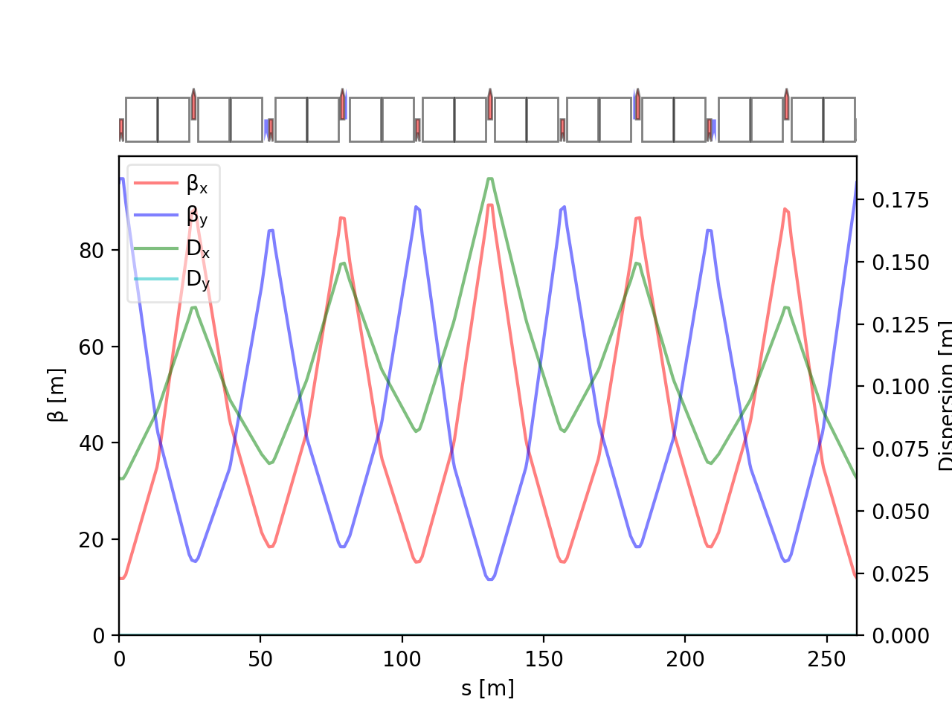
Errors and Correctors
D1
F1
D2
F2
D3
F3
D3
F1
Error type | σ value
Dipole relative field error | 10⁻³
Quadrupole relative field error | 2 x 10⁻⁴
Sextupole relative field error | 2 x 10⁻⁴
Main dipole roll error | 300 μrad
Offset quadrupoles | 200 µm (girder) + 50 µm
Main Quadrupoles roll | 300 μrad
Offset BPMs | 200 µm (girder) + 50 µm
Offset sextupoles | 200 µm (girder) + 50 µm
F2
D2
MQ
BPM
MS
MS
MQ
BPM
Errors are randomly distributed in arcs
(PDF=Truncated gaussian @3σ).
= skew quad corrector
(568)
= normal quad corrector
(560)
= orbit corrector
(~2800)

Slide 4
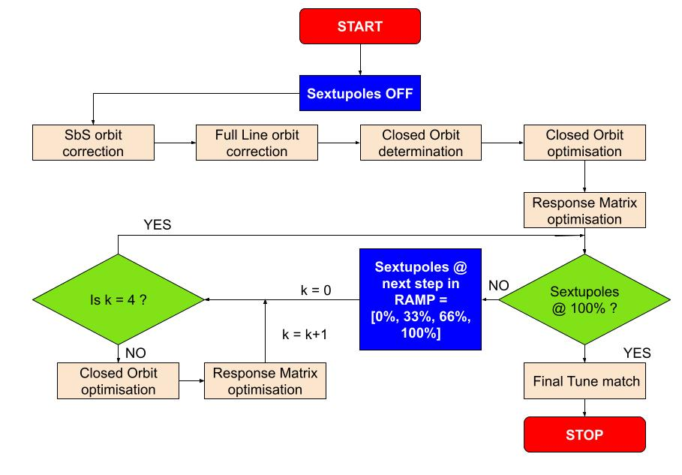
Correction Strategy
Response matrix divided in two matrices :
  normal quads
    μ_{x}, μ_{y}, Q_{x}, Q_{y}, D_{x}
  skew quads
    Re{f₁₀₀₁}, Re{f₁₀₁₀}, Im{f₁₀₀₁}, Im{f₁₀₁₀}, D_{y}
Sextupole RAMP ensure limited effect due to interplay between sextupole strength and imperfections
100 seeds simulated

Slide 5
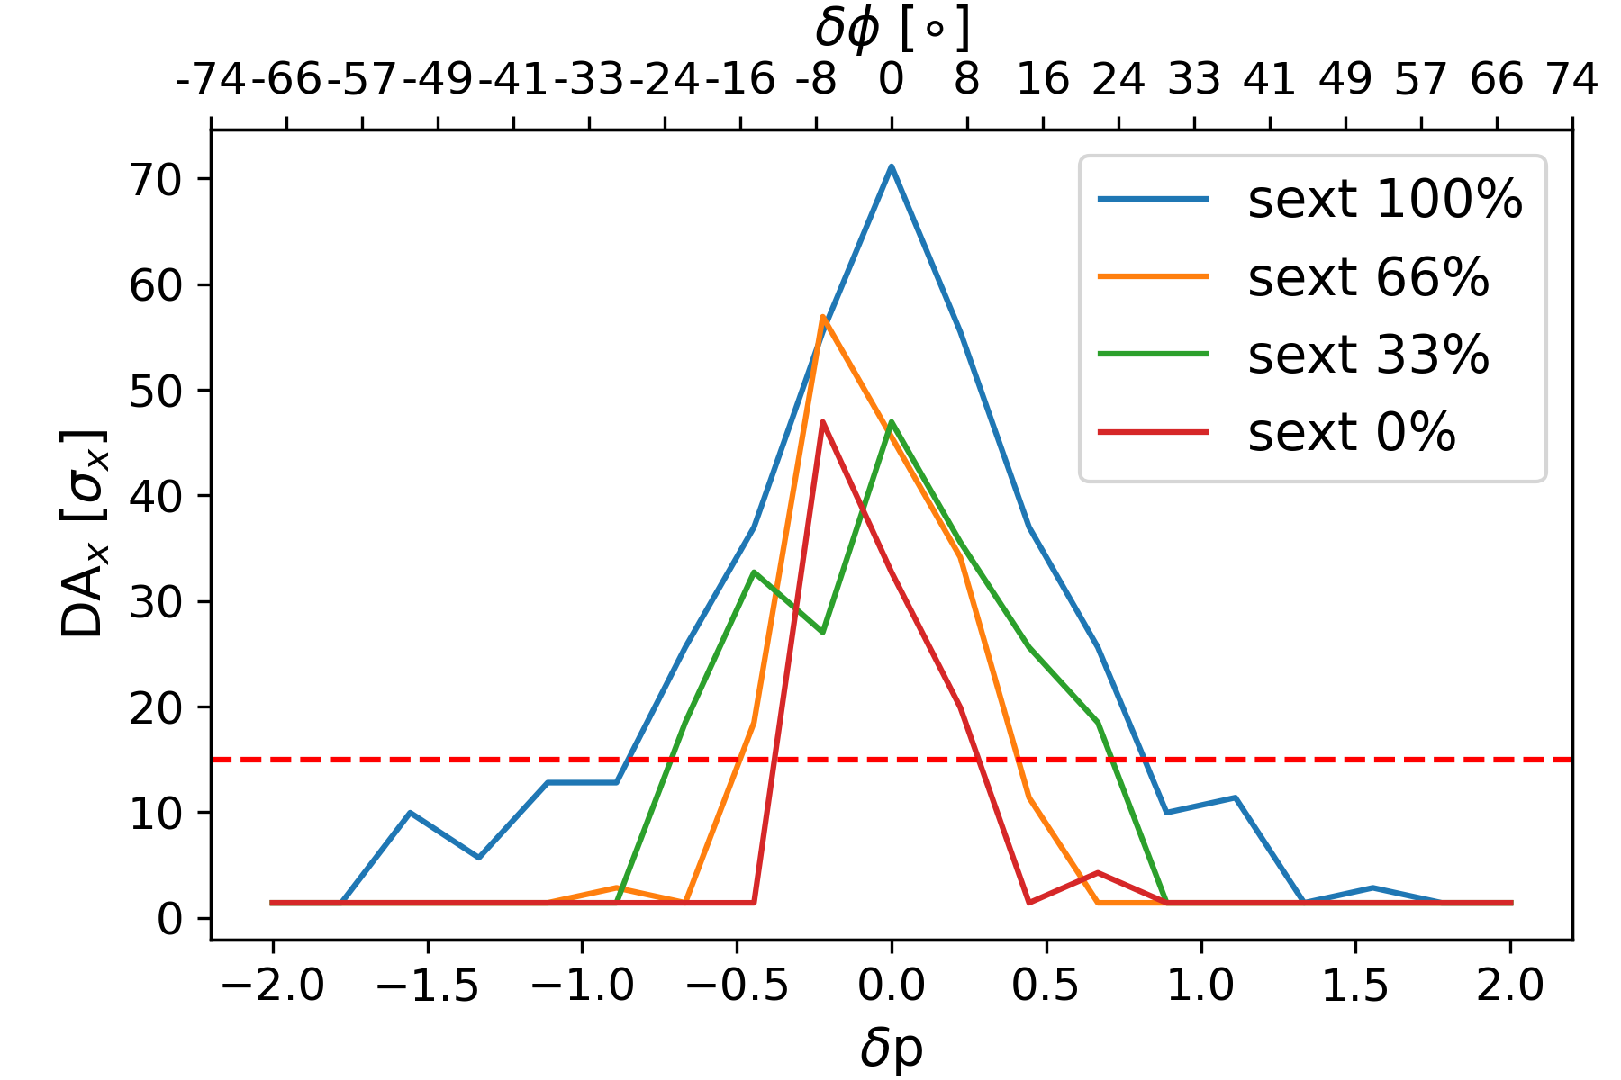
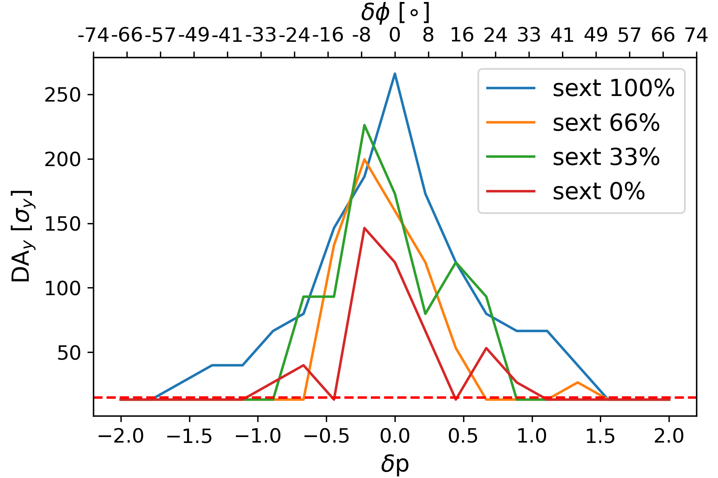
MA wrt sextupole ramp
MA seems to be large enough at each step of the ramp.
High Energy LINAC can provide dedicated single bunches with .05% energy spread.

Slide 6
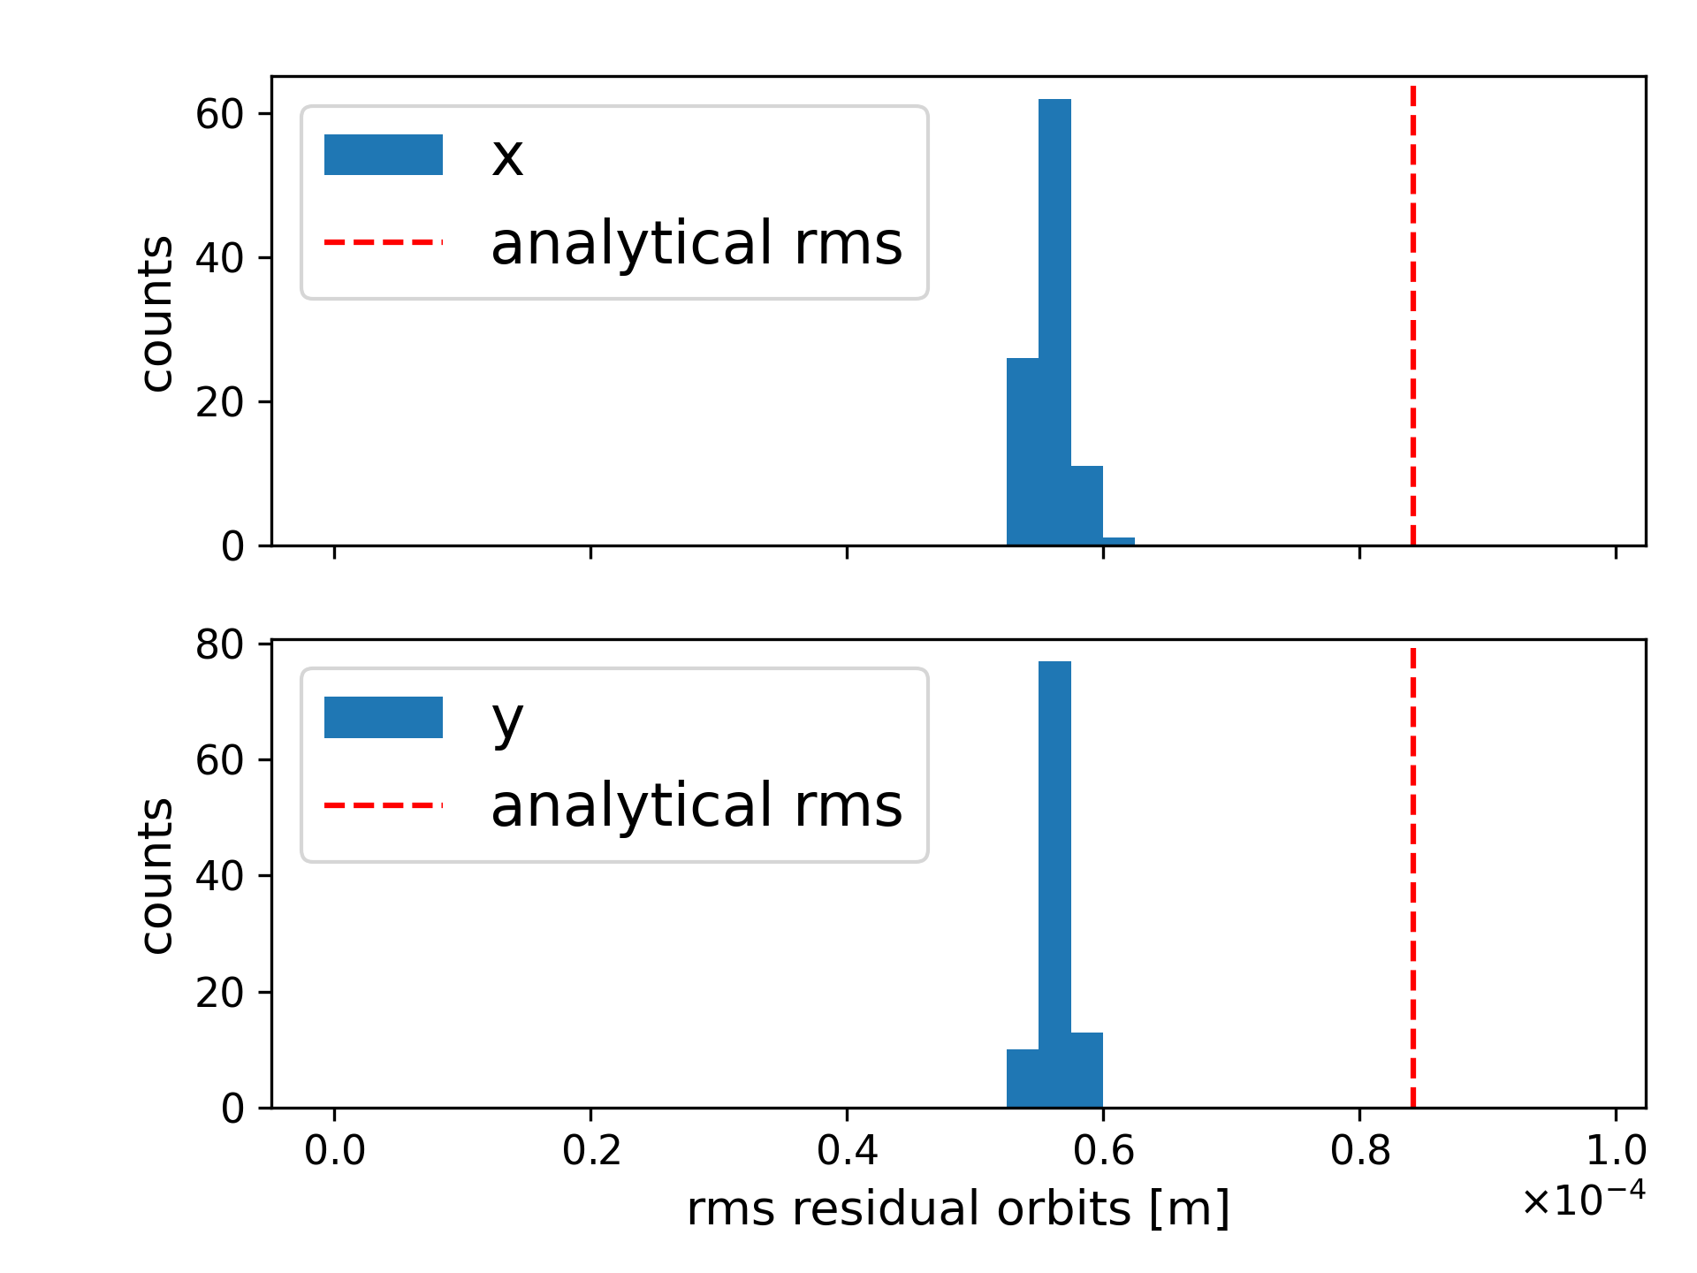
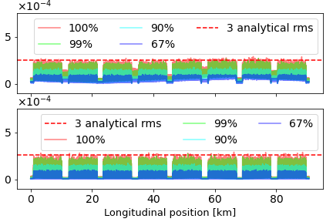
Residual Orbit
|x| [m]
|y| [m]
RMS residual orbits below analytical value
Absolute orbit excursion below .3mm
100 successful seeds

Slide 7
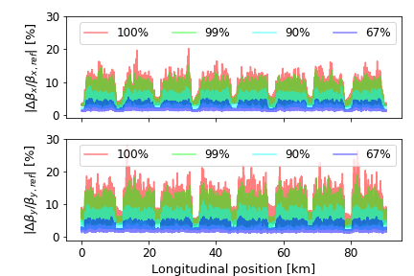
Beta-beating
Limitation of Beta-beating under 20% for 99% of seeds
⅔ of the seeds show Beta-beating below 5% in both planes
Vertical plane seems higher than horizontal
  add quad correctors?
100 successful seeds

Slide 8
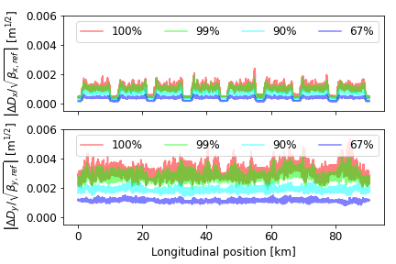
Normalized dispersion
Horizontal normalized dispersion kept under 2x10⁻³ m^{1/2}
Vertical normalized dispersion twice as high as horizontal
  add some skew correctors in straight sections ?
  Use full response matrix instead of two separated matrices ?
100 successful seeds

Slide 9
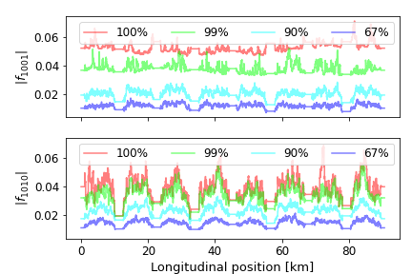
RDTs
90% of coupling RDTs below .04
100 successful seeds

Slide 10
Correctors integrated strength
Corrector type | E [GeV] | 3 x RMS
Orbit X | 20 (inj) | 2.5 mT.m
 | 182.5 (ttbar) | 23 mT.m
Orbit Y | 20 (inj) | 2.6 mT.m
 | 182.5 (ttbar) | 24 mT.m
Normal Quad | 20 (inj) | 0.11 T.m⁻¹.m
 | 182.5 (ttbar) | 0.96 T.m⁻¹.m
Skew Quad | 20 (inj) | 0.05 T.m⁻¹.m
 | 182.5 (ttbar) | 0.39 T.m⁻¹.m
100 successful seeds

Slide 11
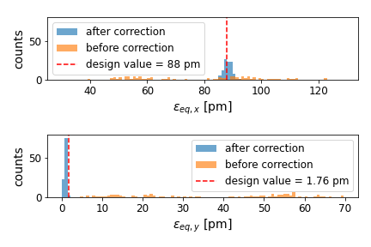
Equilibrium Emittance
Emittance in both planes are centered around the design values
100% stability, all seeds converging

Slide 12
Recap
Orbit excursion kept below 3×10⁻⁴ m in both plane
Beta-beating:
  below 20% in both planes for 99% of seeds
  below 5% in both planes for 67%
Normalized dispersion:
  horizontal: below 2×10⁻³ m^{1/2}
  vertical: twice as high
90% of coupling RDTs below .04
Correctors integrated strength:
  dipoles: 3×RMS below 25mT.m
  quadrupoles: 3×RMS below 1T.m⁻¹m
Final emittance close to target values

Slide 13
Perspectives
Introduce longitudinal misalignment
Introduce tapering at ttbar energy to correct distortion due to SR
Compute DA with errors and corrections
Further optimisation of correction scheme:
  Correctors position and number,
  Study of correctors correlation, non-linear approach

Slide 14
THANK YOU

Slide 15
Annex

Slide 16
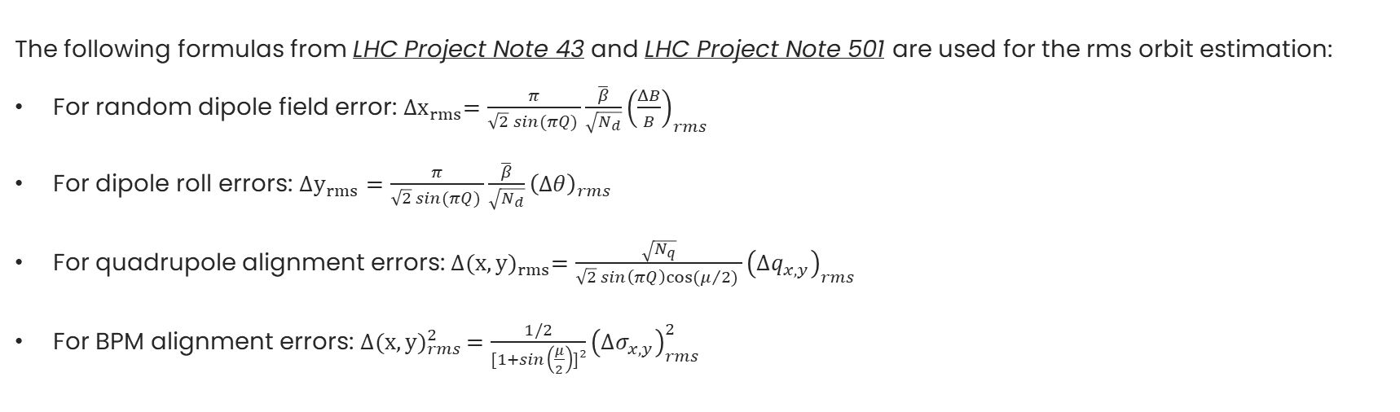
Analytical computation

