Slide 1





Collimation studies for the FCC-ee
G. Broggi^{1,2,3} A. Abramov², K. Andre², M. Boscolo^{2,3}, R. Bruce², X. Buffat², D. Gibellieri², M. Hofer², A. Lechner², S. Marin², G. Nigrelli^{1,2,3}, A. Perillo-Marcone², S. Redaelli², K. Skoufaris², F. Van der Veken², C. Zannini²
¹ Sapienza University of Rome, Italy ² CERN, Meyrin, Switzerland ³ INFN-LNF, Frascati, Italy
FCC week 2025, Vienna, Austria, 20/05/2025
Acknowledgements:
H. Burkhardt, Y. Dutheil, A. Frasca, G. Iadarola, R. Kersevan, P. Kicsiny, G. Lerner, D. Mirarchi, L. Nevay, A. Natochii, T. Ishibashi, M. Migliorati, K. Oide, T. Raubenheimer, J. Salvesen, S. Terui, F. Zimmermann

Slide 2
Outline
Introduction
  Collimation for the FCC-ee
  FCC-ee collimation system
FCC-ee beam losses and collimation simulations
  Simulation benchmark with SuperKEKB data
Updates on FCC-ee beam loss simulations
  Beam halo losses
  Beam-gas losses
  Beam-beam losses
  Top-up injection losses
  Losses from fast instabilities
FCC-ee collimation summary
20/05/2025
G. Broggi | Collimation studies for the FCC-ee

Slide 3
Outline
Introduction
  Collimation for the FCC-ee
  FCC-ee collimation system
FCC-ee beam losses and collimation simulations
  Simulation benchmark with SuperKEKB data
Updates on FCC-ee beam loss simulations
  Beam halo losses
  Beam-gas losses
  Touschek scattering losses (tbd)
  Beam-beam losses
  Top-up injection losses
  Losses from fast instabilities
FCC-ee collimation summary
20/05/2025
G. Broggi | Collimation studies for the FCC-ee

Slide 4
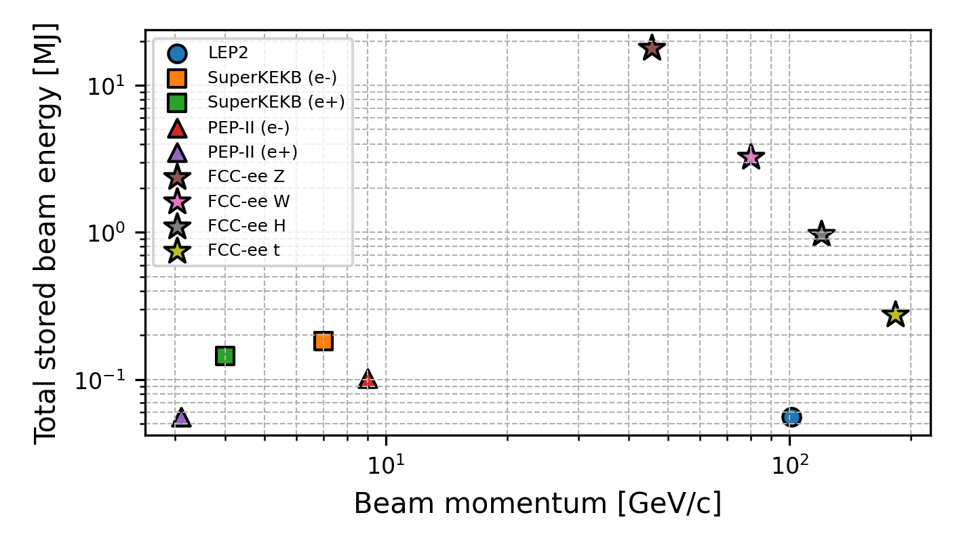
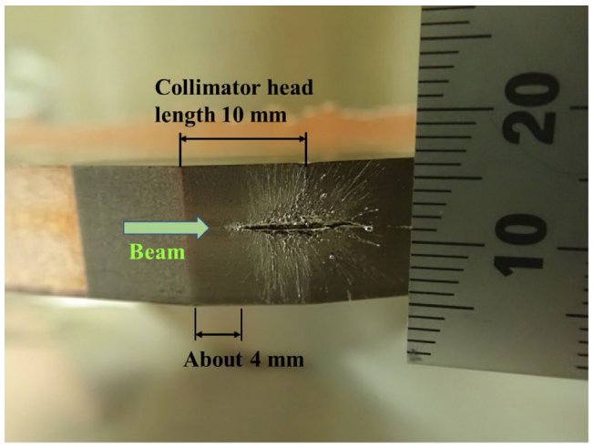
Collimation for the FCC-ee
FCC-ee is the FCC first stage e⁺e⁻ collider
  90.7 km circumference, tunnel compatible with FCC-hh
  4 beam operation modes: Z (45.6 GeV), W (80 GeV), H (120 GeV), ttbar (182.5 GeV)
FCC-ee presents unique collimation challenges
  Unprecedented stored beam energy for a lepton collider
    17.5 MJ in the Z operation mode
  Highly destructive beams: collimation system indispensable
    Reduce background in the experiments
    Protect the machine from unavoidable beam losses
Collimation strategy for the FCC-ee
  Beam-halo (global) collimation
    + local protection collimation
  Secondary particle shower absorbers
  Synchrotron radiation (SR) collimation – upstream of the IPs
~2 orders of magnitude
Damage to coated collimator jaw due to accidental beam loss in SuperKEKB – T. Ishibashi (talk)
20/05/2025
G. Broggi | Collimation studies for the FCC-ee

Slide 5
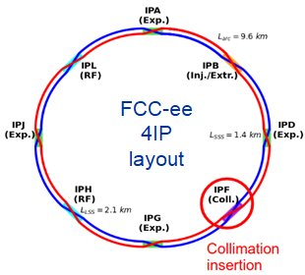
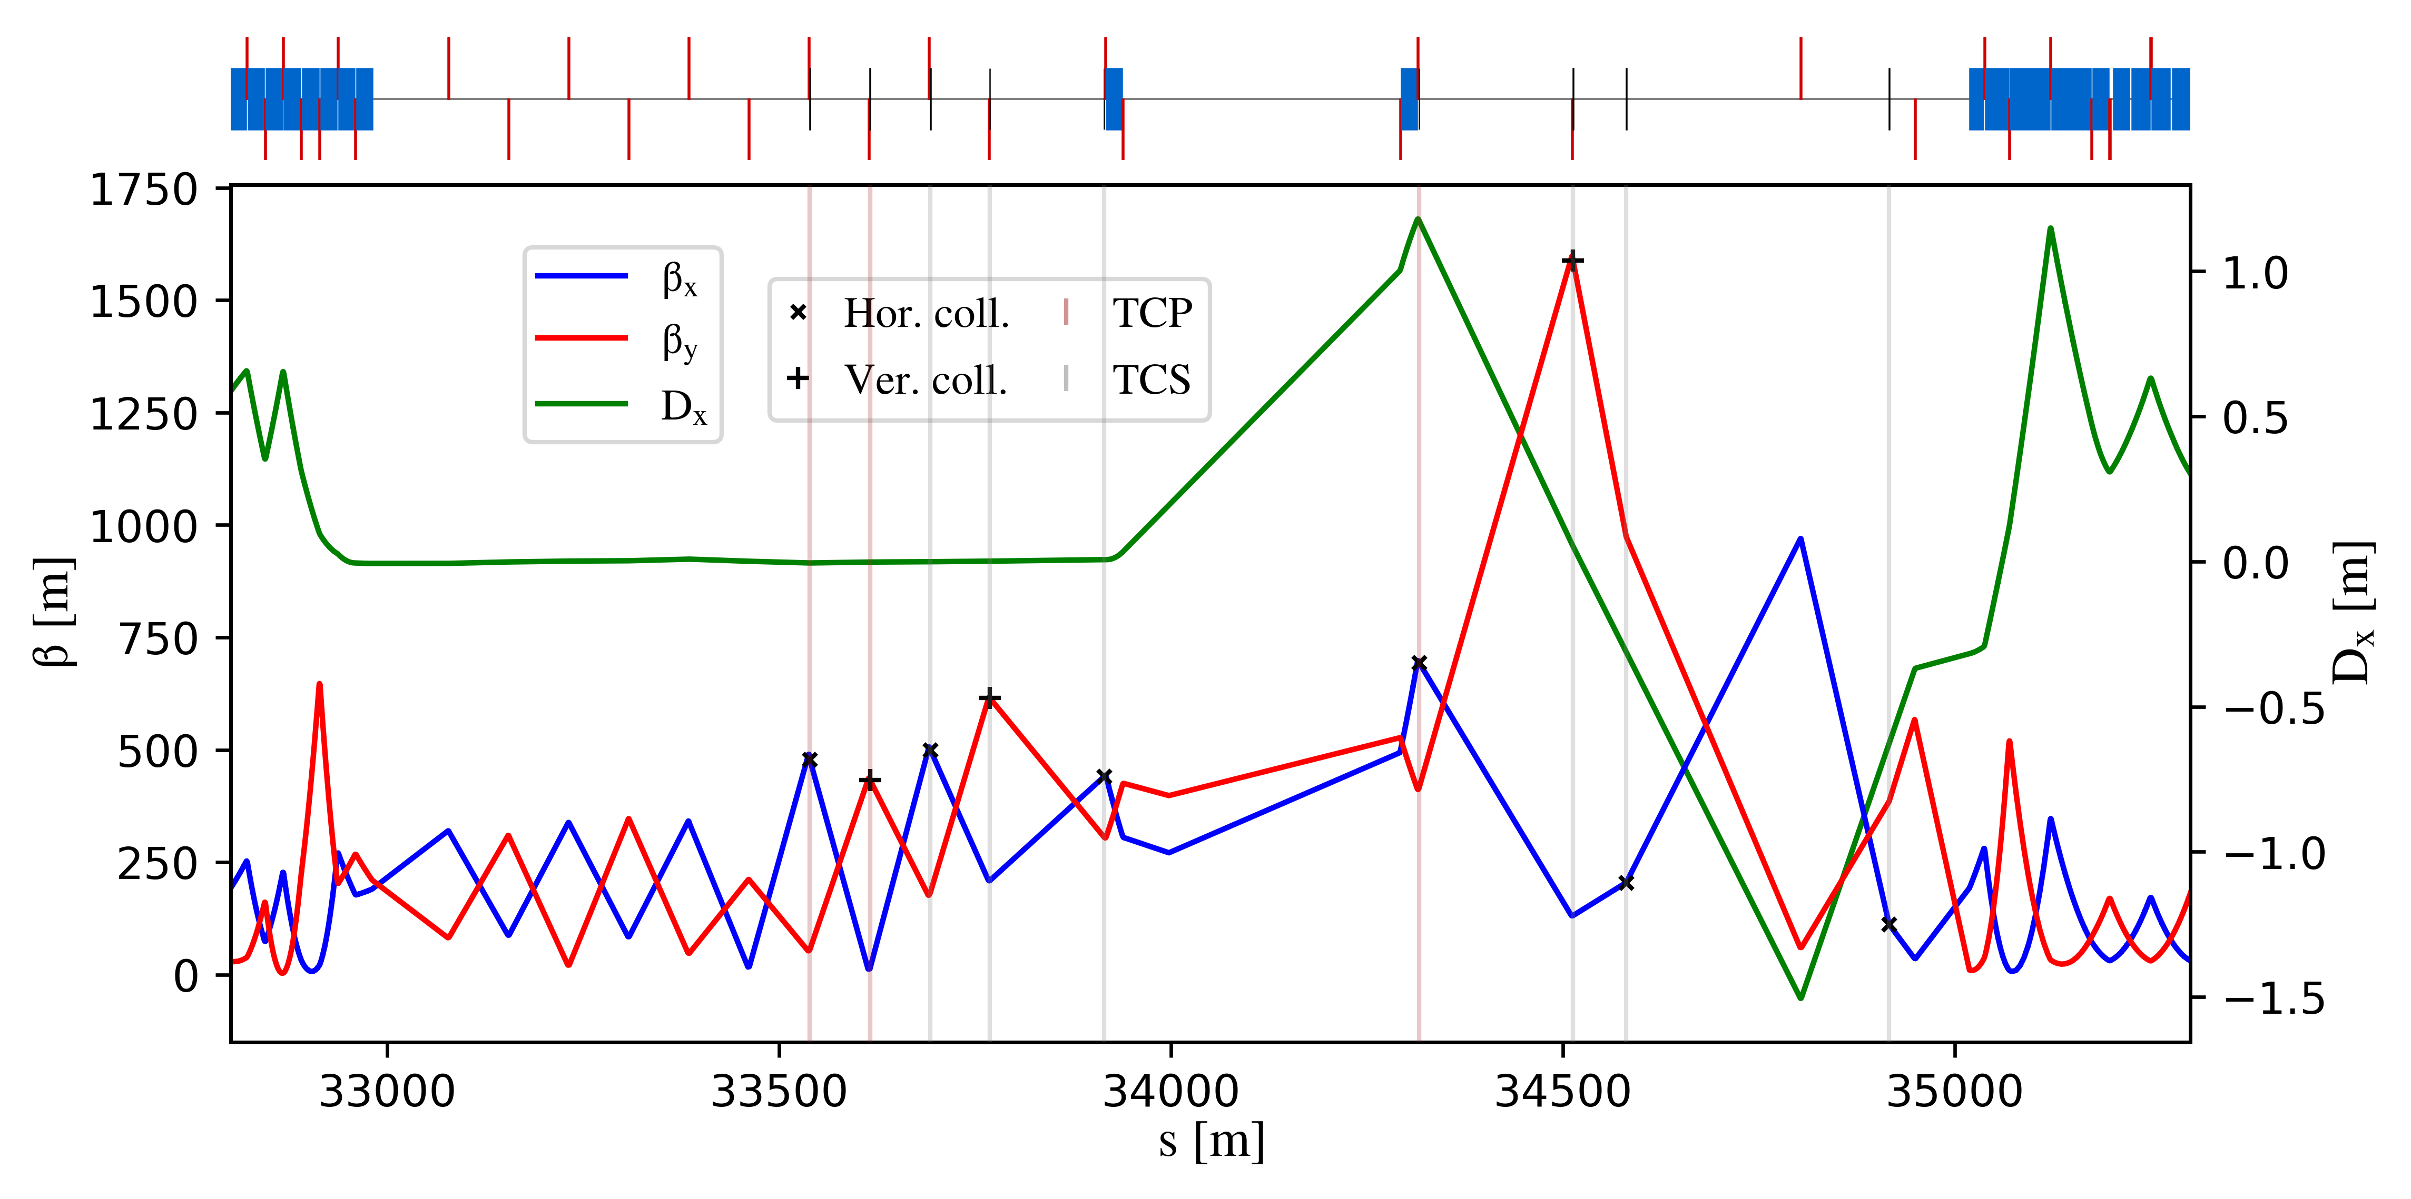
FCC-ee halo collimation system
Dedicated long straight section in PF
  Common technical insertion optics by K. Oide (V25.2 GHC - talk)
  Two-stage betatron and off-momentum collimation
  Ensure protection of the aperture bottlenecks in different conditions
    Aperture bottleneck at Z: 11.5σ (H plane), 81.5σ (V plane)
  First collimator design for cleaning performance
    Sizeable impedance increase driven by TCP.V collimator (D. Gibellieri, FCC week 2025 talk)
    Collaboration with optics, impedance, FLUKA, and engineering team to optimize the design
    First exploratory study on crystal collimation for FCC-ee (NIMA paper)
betatron
off-momentum
FCC-ee (Z) beam halo collimator parameters and settings
Name | Plane | Material | Length [cm] | Gap [σ] | Gap [mm] | δ_{cut} [%]
TCP.H.B1 | H | C-based | 25 | 9.5 | 5.6 | -
TCP.V.B1 | V | C-based | 25 | 50 | 1.4 | -
TCS.H1.B1 | H | Mo-based | 30 | 10.5 | 6.2 | -
TCS.V1.B1 | V | Mo-based | 30 | 65 | 2.2 | -
TCS.H2.B1 | H | Mo-based | 30 | 10.5 | 6.5 | -
TCS.V2.B1 | V | Mo-based | 30 | 65 | 3.6 | -
TCP.HP.B1 | H | C-based | 25 | 18 | 12.5 | 1.1
TCS.HP1.B1 | H | Mo-based | 30 | 28 | 11.0 | 3.5
TCS.HP2.B1 | H | Mo-based | 30 | 28 | 8.3 | 1.3
20/05/2025
G. Broggi | Collimation studies for the FCC-ee

Slide 6
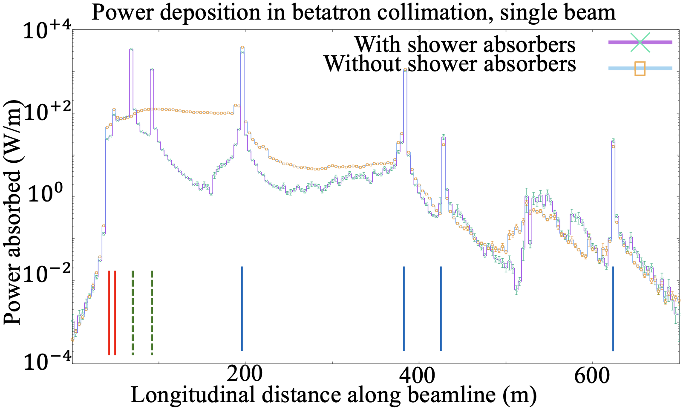
Shower absorbers
The use of a few (~2 per beam) strategically placed shower absorbers can reduce the fraction of the power absorbed by vacuum chamber, tunnel, and environment:
From ~50 %, close to the LHC values, to ~15 %
Quadrupole magnets receive a small fraction of power, even without absorbers.
SHOWER ABSORBERS
Courtesy S. Marin, A. Lechner
Vertical, gap: 3.268 mm
Horizontal, gap: 8.252 mm
17.4 %
6.6 %
0.5 %
All quadrupoles : 0.78 %
Tunnel/earth/vacuum chamber: 15.1 %
1.1 %
20 m
12.8 %
20 m
3.4 %
100 m
Total: 31.2 %
Total: 10.5 %
0.075 %
0.065 %
1.14 %
0.30 %
0.014 %
0.005 %
50% Vertical impact
50% Horizontal impact
0.10 %
0.18 %
10.5 %
3.17 %
0.08 %
0.06 %
0.012 %
0.09 %
19.1 %
7.13 %
0.20 %
0.08 %
Not to scale*
Primary V
Primary H
Secondary H
Secondary V
Secondary H
Secondary V
20/05/2025
G. Broggi | Collimation studies for the FCC-ee

Slide 7
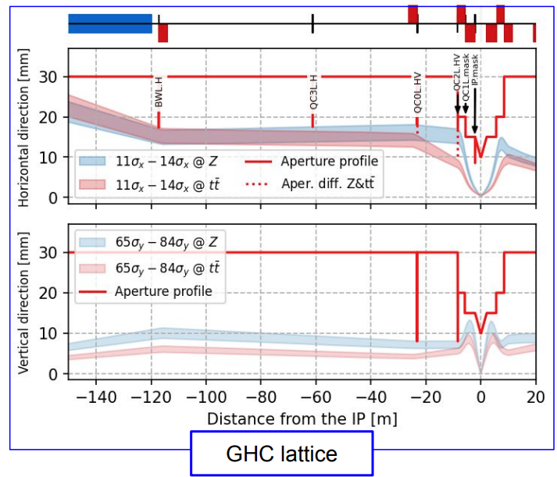
FCC-ee SR collimation system
Synchrotron radiation collimators around the IPs
  6 collimators and 2 masks upstream of the IPs
  Designed to reduce detector backgrounds and power loads in the inner beampipe due to photon losses
FCC-ee (Z) SR collimators parameters and settings (V25.2 GHC)
Name | Plane | Material | Length [cm] | Gap [σ] | Gap [mm]
TCR.H.WL.B1 | H | W-based | 10 | 11.5 | 20.4
TCR.V.C0.B1 | V | W-based | 10 | 81.5 | 7.1
TCR.H.C0.B1 | H | W-based | 10 | 11.5 | 25.0
TCR.H2.C0.B1 | V | W-based | 10 | 11.5 | 21.3
TCR.V.C2.B1 | V | W-based | 10 | 81.5 | 8.2
TCR.H.C2.B1 | H | W-based | 10 | 11.5 | 18.0
V24.3 GHC
SR collimator apertures = estimated aperture bottlenecks
Studies carried out by K. Andre up to V24.3 GHC
  FCC physics workshop 2025 talk
20/05/2025
G. Broggi | Collimation studies for the FCC-ee

Slide 8
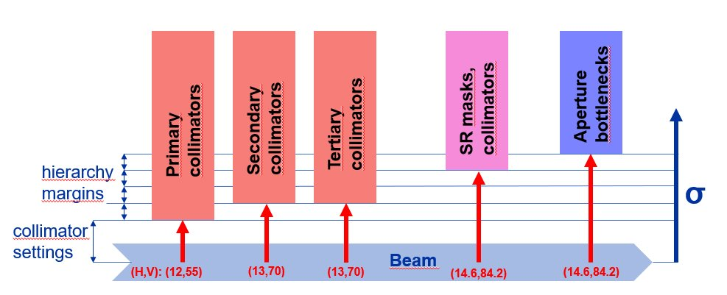
Tertiary collimators
Beam loss simulations have shown that SR collimators or even final focus magnets may be exposed to beam losses
  SR collimators not primarly designed to intercept large beam losses: risk of damages/backgrounds
Two (H+V) tertiary collimators (TCTs) for local protection added
  Placed upstream of each IP
  s-location optimized for optimal phase-advance (multiple of π) between TCTs and
  Need for shower absorber downstream of TCTs to be studied
Further local protection devices (e.g., injection protection) to be studied by energy deposition (FLUKA), beam transfer and engineering team
SR collimators
aperture bottlenecks
FCC-ee (Z) collimation hierarchy
Hierarchy margins set to 100-300um
  ~1 σ_{βx}, ~15 σ_{βy}
Name | Plane | Material | Length [cm] | Half-gap [σ] | Half-gap [mm]
TCT.H.B1 | H | C-based | 25 | 10.5 | 2.4
TCT.V.B1 | V | C-based | 25 | 65 | 7.3
G. Broggi | Collimation studies for the FCC-ee

Slide 9
Outline
Introduction
  Collimation for the FCC-ee
  FCC-ee collimation system
FCC-ee beam losses and collimation simulations
  Simulation benchmark with SuperKEKB data
Updates on FCC-ee beam loss simulations
  Beam halo losses
  Beam-gas losses
  Beam-beam losses
  Top-up injection losses
  Losses from fast instabilities
FCC-ee collimation summary
20/05/2025
G. Broggi | Collimation studies for the FCC-ee

Slide 10
FCC-ee beam loss scenarios
The FCC-ee Z mode is the current focus: has the highest stored beam energy 17.5 MJ
Important to identify different beam loss scenarios and define the ones to protect against
Current selection of beam loss scenarios to study and simulate:
  Generic beam halo losses
  Beam losses from interactions with residual gas
  Beam losses from beam-beam interactions
  Beam losses due to fast instabilities
  Beam losses from top-up injection
  Beam losses from Touschek scattering: simulation model available – being extended to FCC-ee case
  Beam losses from interactions with thermal photons: study planned for 2025-2026
Important effect at LEP - analytical estimates first to understand potential impact on FCC-ee
  Accidental scenarios
    Injection failure: work in progress
    asynchronous dump, others: waiting for inputs to set up models
    SuperKEKB-like sudden beam loss events presently not accounted for by design
In this talk
20/05/2025
G. Broggi | Collimation studies for the FCC-ee

Slide 11
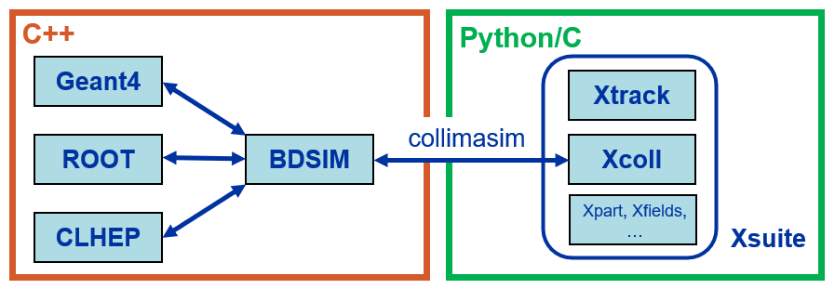
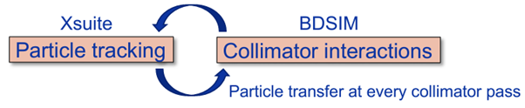
FCC-ee collimation simulations
FCC-ee presents unique challenges for collimation simulations
  Synchrotron radiation and magnet strength adjustment (tapering) to compensate it
  Complex beam dynamics – strong sextupoles in the lattice and strong beam-beam effects
  Detailed aperture and collimator geometry modelling
  Electron/positron beam particle-matter interactions
  Large accelerator system – 90+ km beamline
Xsuite + BDSIM (Geant4) coupling (A. Abramov, JINST paper)
  Developed for FCC collimation simulations
  Benchmarked against
  Other tools available (e.g., Xsuite-FLUKA coupling)
other simulation codes: MAD-X, pyAT, Sixtrack-FLUKA
measured data from: SPS, LHC, SuperKEKB, DAφNE is also being considered
20/05/2025
G. Broggi | Collimation studies for the FCC-ee

Slide 12

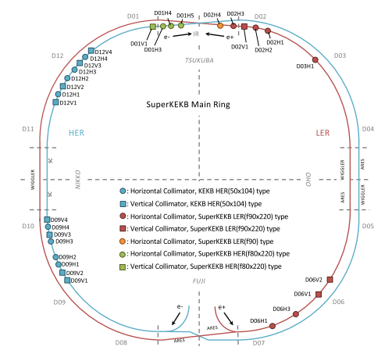
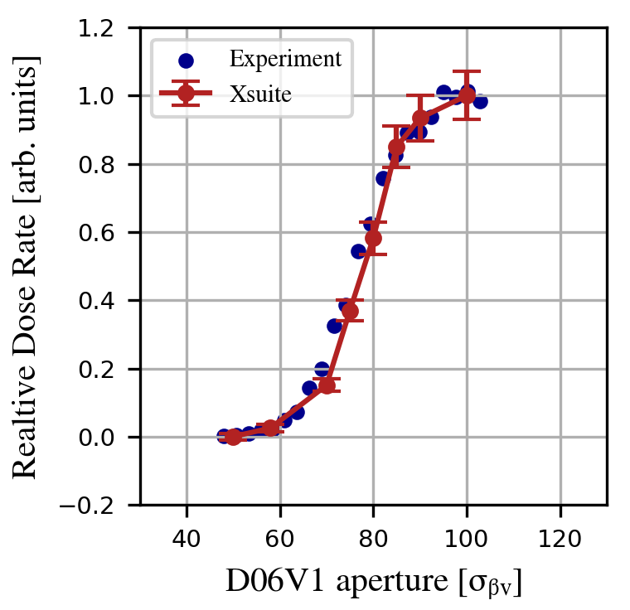
Xsuite-BDSIM benchmark at SuperKEKB
Comparison of Xsuite–BDSIM simulations with measured backgrounds at SuperKEKB (IPAC'25 paper)
Dedicated single-beam background study at SuperKEKB LER (June 2020, A. Natochii, PRAB)
  D06V1 collimator aperture scan
  Radiation dose rates measured by Belle II radiation monitors
SuperKEKB collimator layout as of June 2020
Relative total dose rate for QCS-FW diamond detector vs. D06V1 collimator aperture in units of σβV
Simulations accurately reproduce the measured background trend
Validates Xsuite–BDSIM for collimation and background studies in e+e− machines
Many thanks to G. Iadarola, A. Natochii, J. Salvesen, KEK colleagues and EAJADE programme for the support!
*background sources included in simulations: beam-gas (Brems, Coulomb) and Touschek scattering
20/05/2025
G. Broggi | Collimation studies for the FCC-ee

Slide 13
Outline
Introduction
  Collimation for the FCC-ee
  FCC-ee collimation system
FCC-ee beam losses and collimation simulations
  Simulation benchmark with SuperKEKB data
Updates on FCC-ee beam loss simulations
  Beam halo losses
  Beam-gas losses
  Beam-beam losses
  Top-up injection losses
  Losses from fast instabilities
FCC-ee collimation summary
20/05/2025
G. Broggi | Collimation studies for the FCC-ee

Slide 14
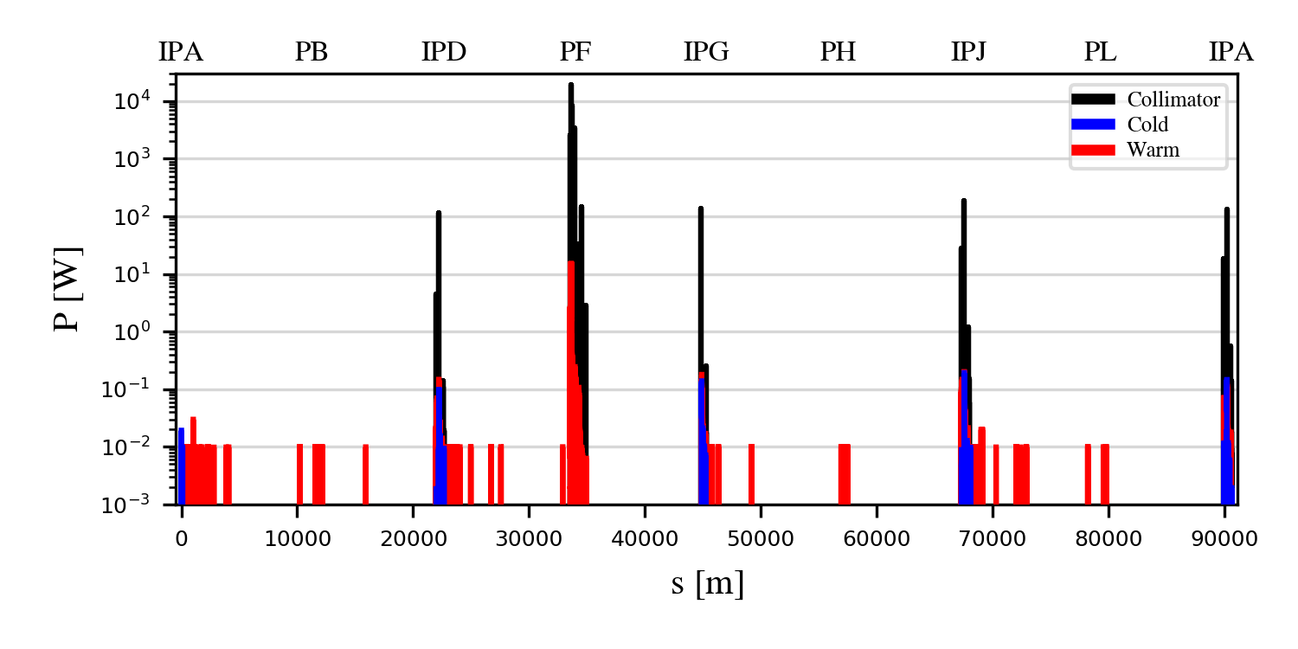
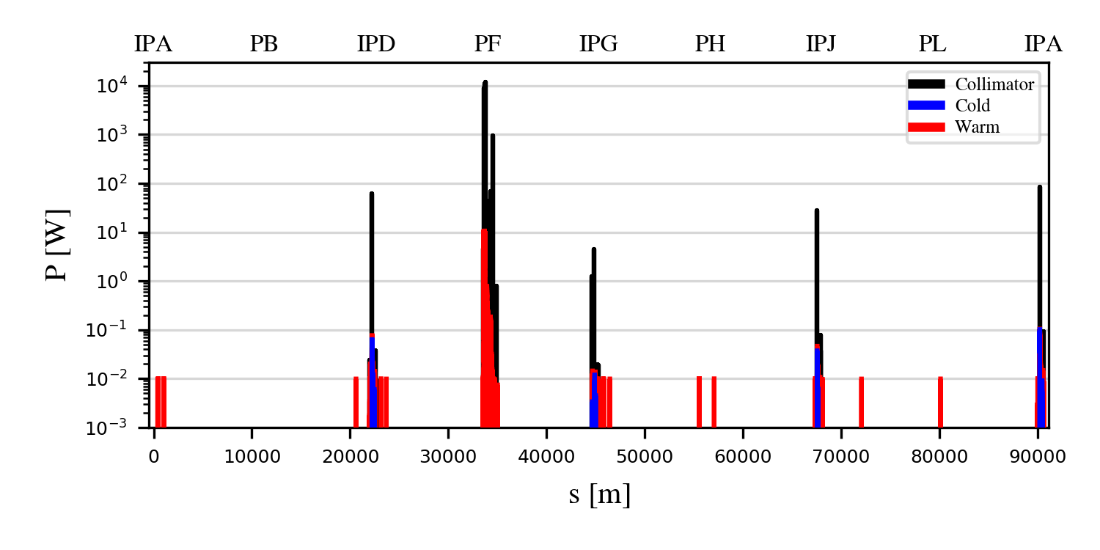
Generic halo losses for the Z mode
Generic halo losses:
  Slow loss process assumed*
  The loss process is not simulated
  Beam halo directly impacts one of the TCPs
  Beam lifetime drop to 5 min is assumed
Horizontal and vertical betatron collimation losses (B1H, B1V)
Good halo cleaning performance overall
  Losses well contained within the collimation insertion PF
  Loss suppressed by:
    ∼2 orders of magnitude on the TCTs
    ∼4-5 orders of magnitude on the SR collimators
    >5 orders of magnitude on all the other elements outside PF
B1H
B1V
*This is strictly valid only if DA is under control w.r.t. TCP gaps: currently, this is not the case for the V-plane
20/05/2025
G. Broggi | Collimation studies for the FCC-ee

Slide 15
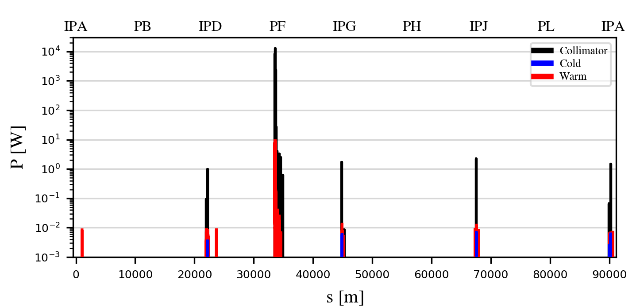

Collimator angular alignment
As found in previous studies, collimator angular alignment can significantly improve the collimation performance
Losses outside of PF are significantly suppressed
  Improvement factor ~100
Important input for hardware design (A. Perillo-Marcone, FCC week 2025 talk)
  Collaboration with the engineering team
  Need to collaborate with other groups (e.g., beam instrumentation) for integration of collimator BPMs
  Tolerances on the collimator angular alignment are being evaluated
B1H
B1H + tilt
Collimator jaw
θ
effective active length
b
s
halo particle
b: impact parameter
20/05/2025
G. Broggi | Collimation studies for the FCC-ee

Slide 16
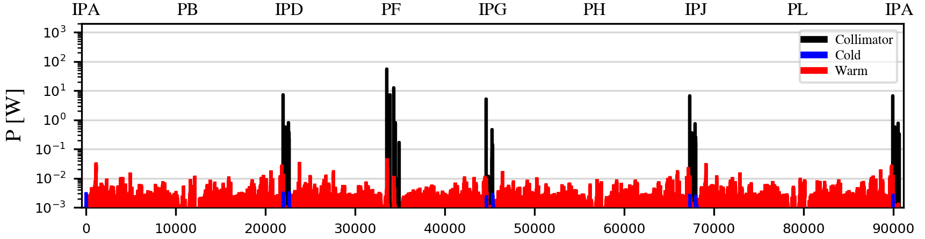
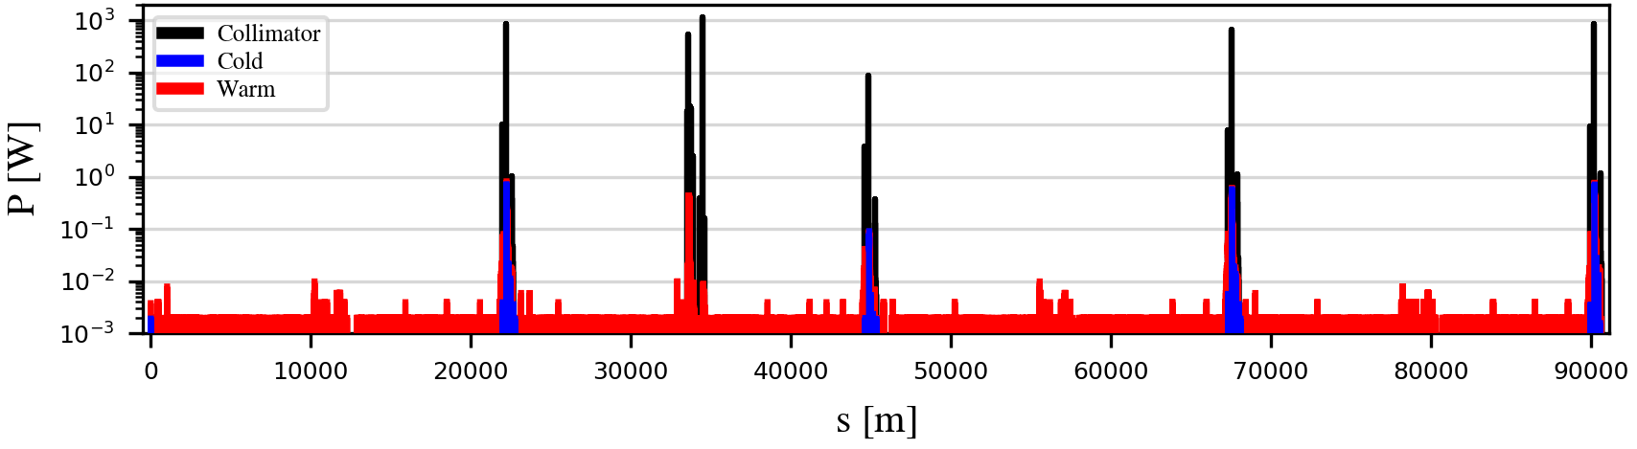
*1h beam conditioning at full nominal current (1.27 A): pressure is expected to condition down further (up to a factor ~100) over time
Beam-gas losses for the Z mode
A scattering routine to simulate beam-gas interactions while tracking in Xsuite has been developed​ (IPAC'25 paper)
  Based on realistic pressure and gas composition profile provided as input
Beam-gas bremsstrahlung
Estimated lifetime after only 1h of beam conditioning*: 274 min
Expected to increase to > 100 h in a fully conditioned machine
Beam-gas Coulomb scattering
Estimated lifetime after only 1h of beam conditioning*: 41 min
Expected to increase to > 10 h in a fully conditioned machine
At the FCC-ee beam energies, bremsstrahlung is expected to dominate beam-gas-induced lifetime degradation
BUT, under particular machine conditions, such as limited DA, even small angular deflections from a single Coulomb scattering event can be sufficient to drive particles beyond the DA limit
20/05/2025
G. Broggi | Collimation studies for the FCC-ee

Slide 17
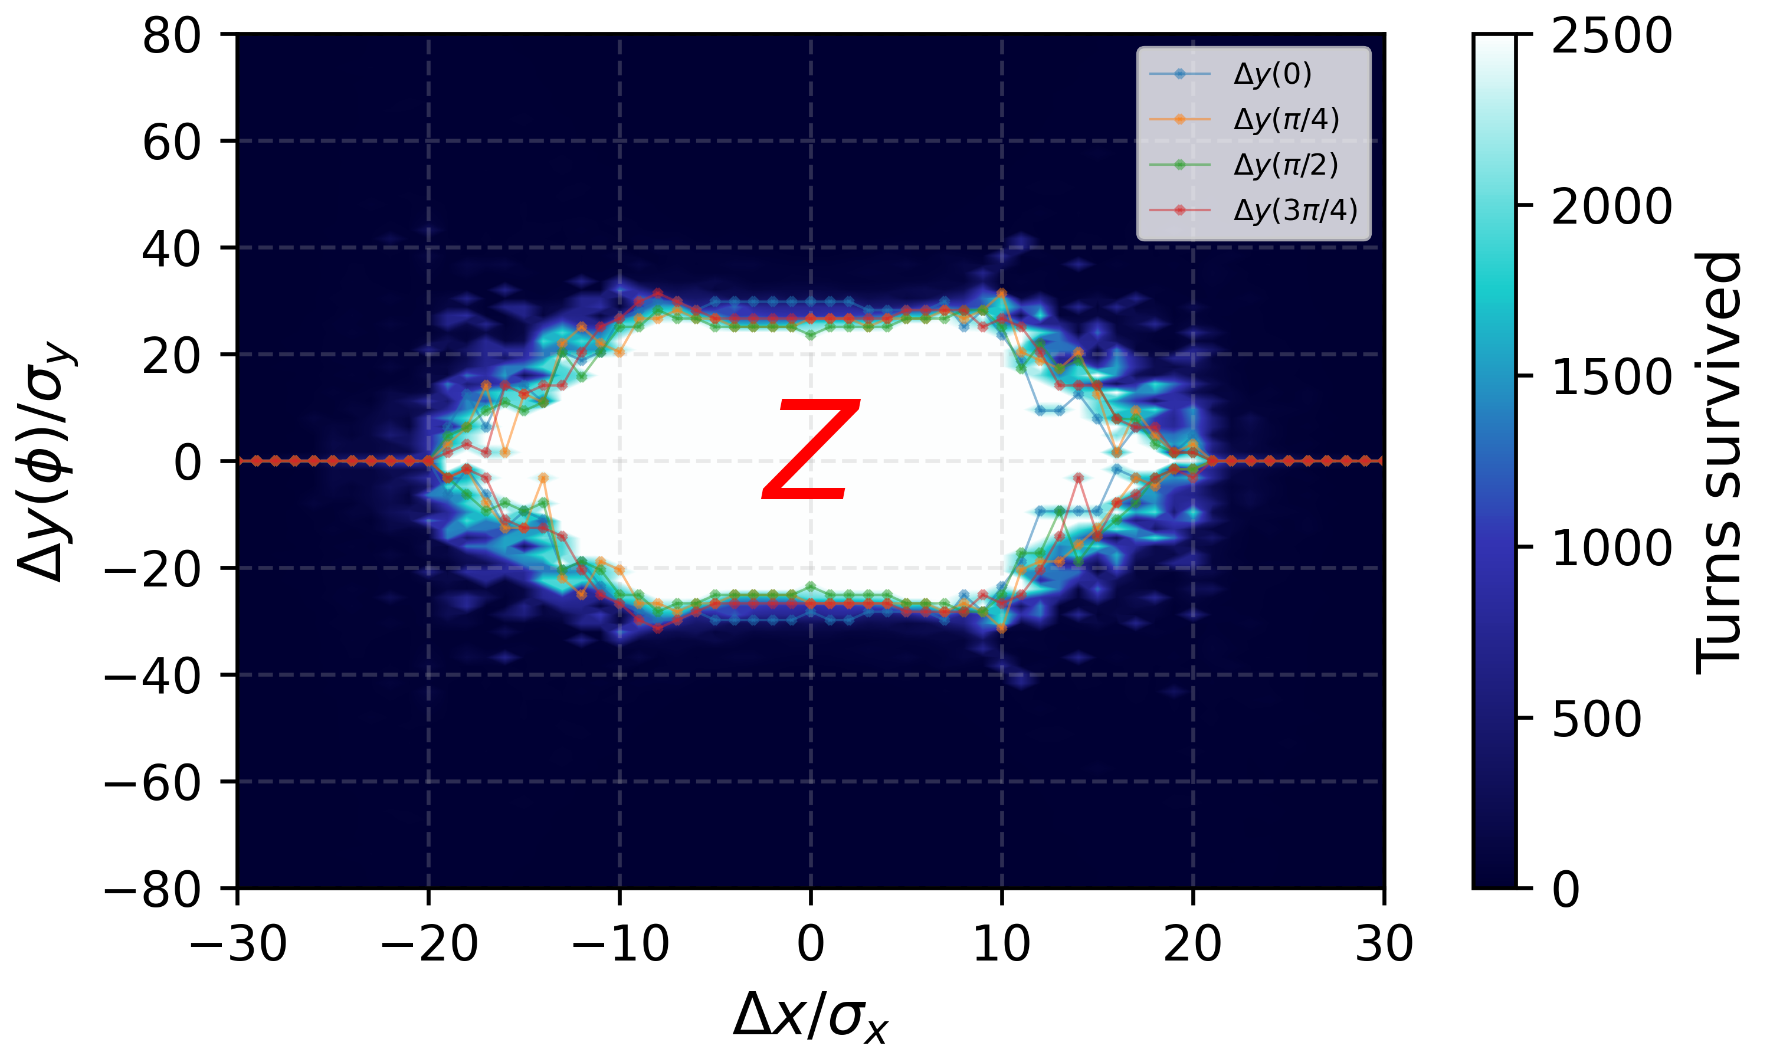
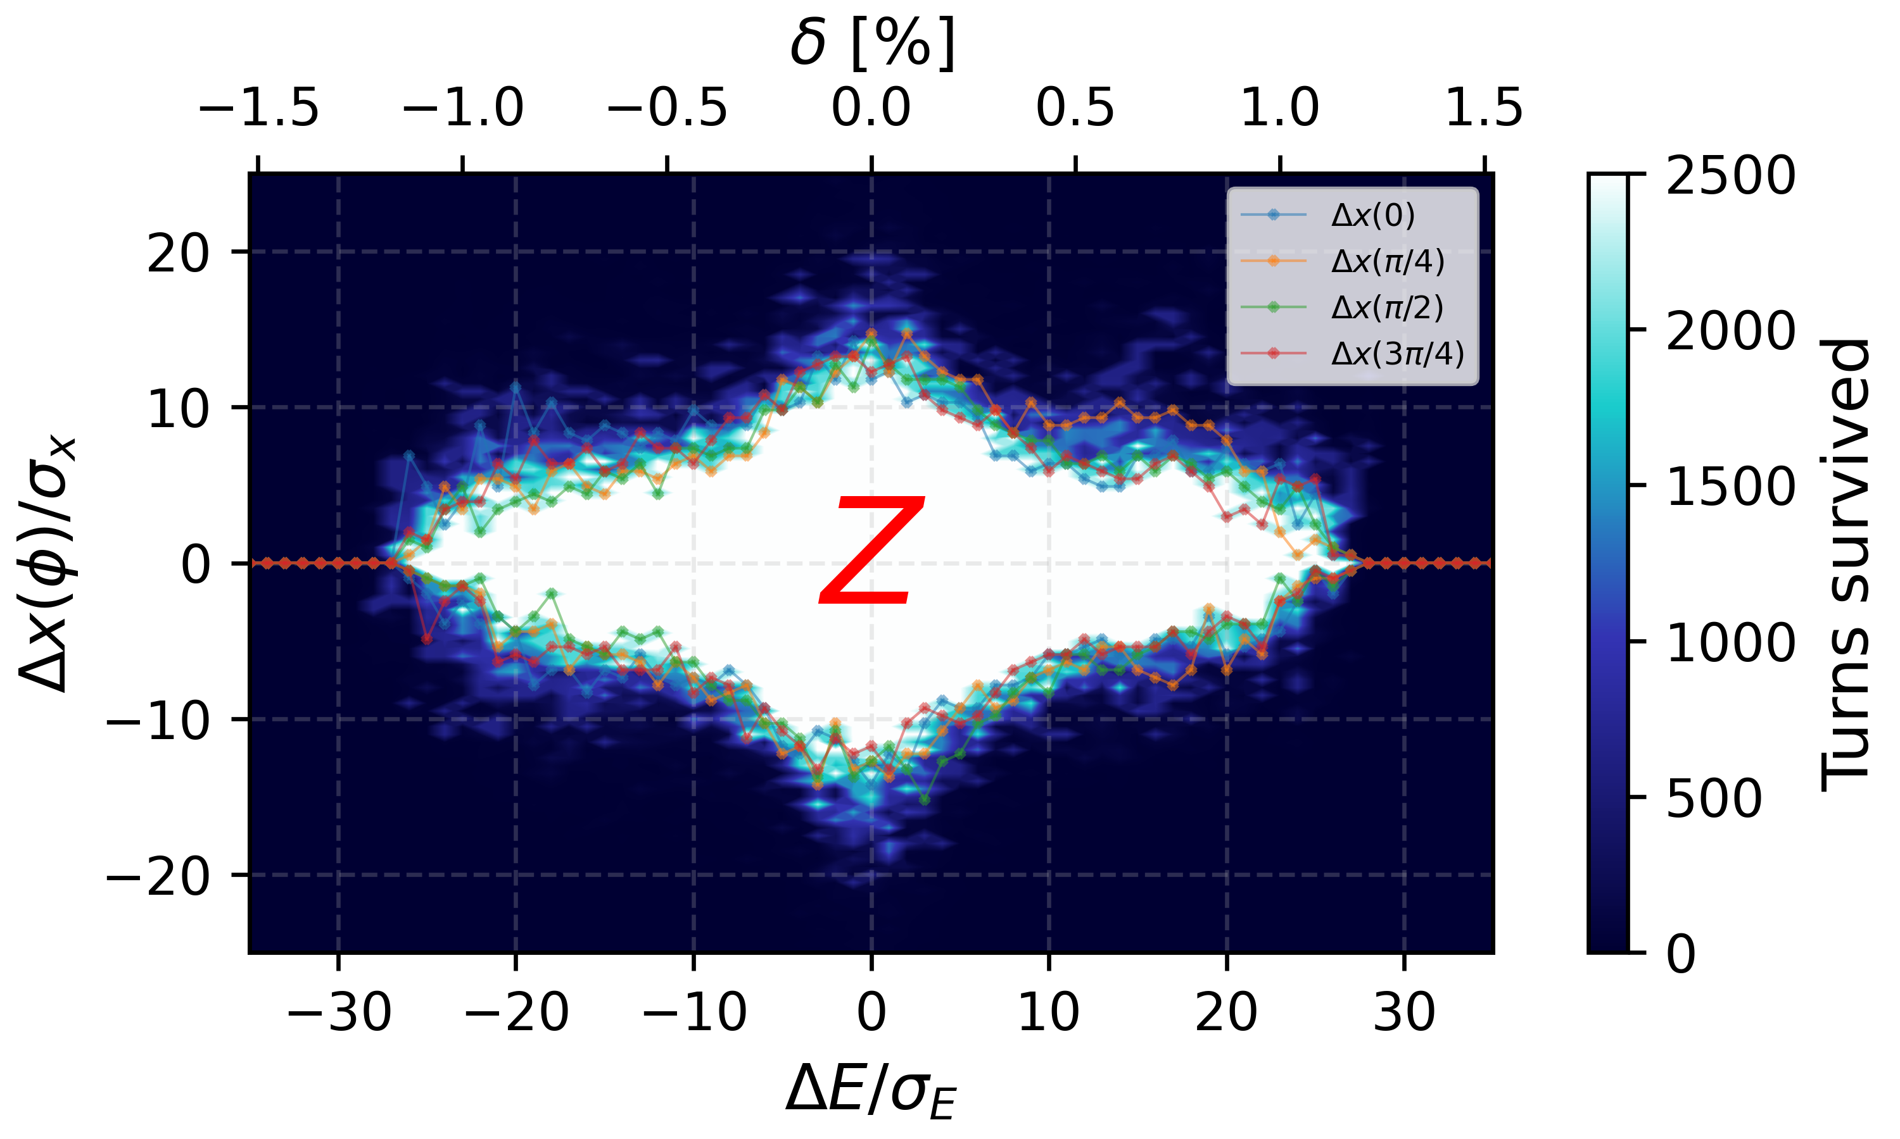
Beam-gas losses for the Z mode
FCC-ee Z V25.2 GHC DA and MA
Vertical DA in the FCC-ee Z-mode lattice is limited to ~30 σ
  Beam is highly sensitive to vertical angular kicks
  Typical vertical divergence (arcs): σₚᵧ ≈ 0.3 μrad
  A 10 μrad vertical kick → >30 σₚᵧ → particle loss
Sensitivity increases near IPs
  βᵧ reaches several km → σₚᵧ further reduced
  Even smaller kicks can cause losses
Horizontal sensitivity is lower
  σₚₓ ≫ σₚᵧ (due to much larger εₓ and lower IR-βₓ )
  Same kick → smaller normalized deflection
  Horizontal DA ≈ vertical DA
Bremsstrahlung losses more sensitive to longitudinal DA (~1%)
  Caused by photon emission → off-momentum particles
WIP to evaluate impact of beam-gas on detector background
  G. Broggi, A. Frasca, MDI session on Thursday
20/05/2025
G. Broggi | Collimation studies for the FCC-ee

Slide 18
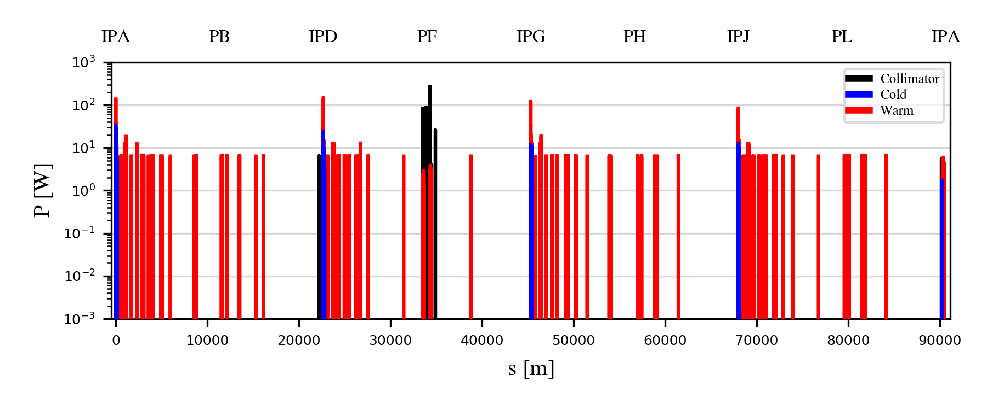
*quantum + lattice + BS + lum.
Beam-beam losses for the Z mode
Xsuite allows to set-up complex combined-effects simulations: beam-beam + collimation
  Beam-beam kicks, radiative Bhabha, beamstrahlung in 4 IPs + detailed aperture and collimator model
  Common technical insertion optics shows significant advantages
    Absence of strong-vertical emittance blow-up previously observed (BB'24 talk)
    Beam lifetime* in agreement with expectations: ~14 min vs. ~17 min without aperture and collimators
      Primary collimator openings: 9.5σ (H plane), 50σ (V plane)
Beam-beam losses intercepted by the collimation system in PF
Beam-beam losses outside PF mostly on elements downstream of the IPs
  Local losses that cannot be intercepted in PF on a second turn
  Physics-debris-like collimators downstream of the IPs ?
20/05/2025
G. Broggi | Collimation studies for the FCC-ee

Slide 19
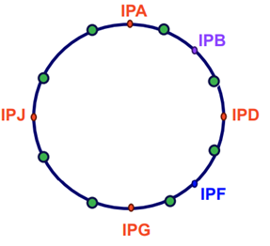
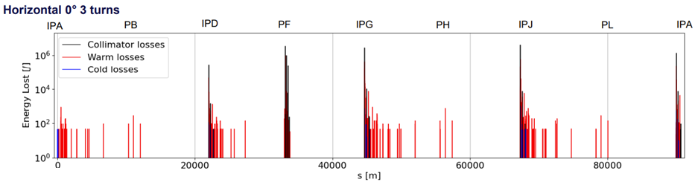
Fast instability losses for the Z mode
Studies on fast instability losses have been performed (G. Nigrelli – FCC physics workshop 2025 talk)
  Fast instability modeled by synchronized kicks placed along the ring with raising strength
    Mimic instabilities with different rise times
    Studied beam loss distributions around the ring and across multiple turns
The fast instability could be dangerous if the feedback system fails – feedback system redundancy ?
  Full beam potentially lost within few turns
  Almost 50% of beam energy lost in one turn, losses of order of MJ in the collimator can be expected
  Important input for feedback system design: such scenario must be avoided in operation
20/05/2025
G. Broggi | Collimation studies for the FCC-ee

Slide 20
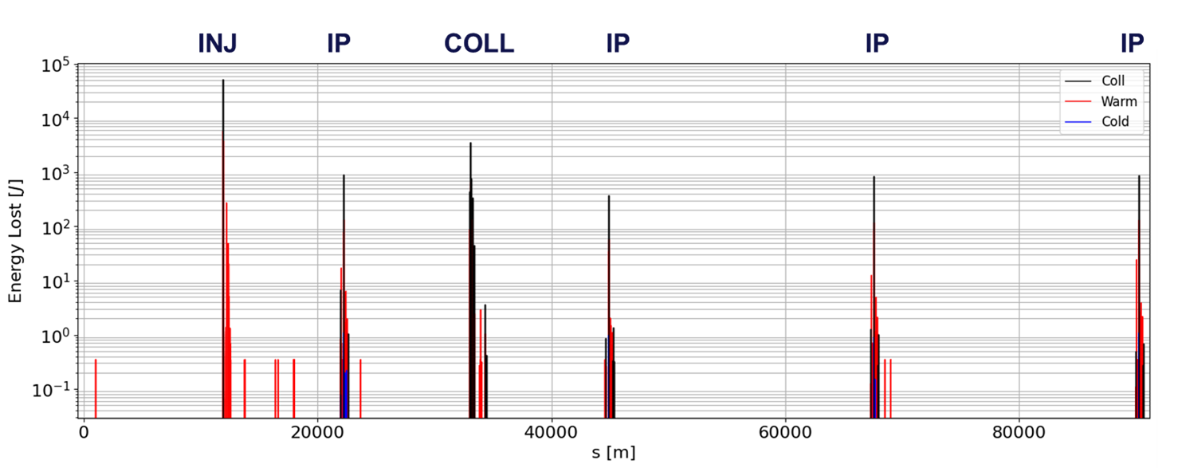
Top-up injection losses for the Z mode
First studies on top-up injection losses have started (G. Nigrelli)
  Baseline injection scheme as presented by Y. Dutheil, FCC week 2025 talk
Simulated injected beam, core beam, halo beam (lossmap above)
  Studies of impact of injection losses on detector background have started
  More details in G. Nigrelli – First look at injection backgrounds, FCC week 2025 talk (Thu 22/05)
Studies of injection failure scenarios are being set up
FCC-ee Z V25.2 GHC loss map showing the distribution of beam halo losses caused by the injection bump in PB
20/05/2025
G. Broggi | Collimation studies for the FCC-ee

Slide 21
Outline
Introduction
  Collimation for the FCC-ee
  FCC-ee collimation system
FCC-ee beam losses and collimation simulations
  Simulation benchmark with SuperKEKB data
Updates on FCC-ee beam loss simulations
  Beam halo losses
  Beam-gas losses
  Beam-beam losses
  Top-up injection losses
  Losses from fast instabilities
FCC-ee collimation summary
20/05/2025
G. Broggi | Collimation studies for the FCC-ee

Slide 22
FCC-ee collimation summary
Studies of beam losses and collimation for the FCC-ee
  First collimation system design available, including beam halo, SR collimators and shower absorbers
  Simulations of several beam loss scenarios ongoing:
    Beam halo losses, beam-gas losses, beam-beam losses, top-up injection losses, losses from fast instabilities for the most critical Z mode
    No show-stoppers identified
  Developed simulation routines for beam-gas and Touschek scattering
  Simulation benchmarked against measured data from an e+e- collider (SuperKEKB)
  Collaboration with the optics, MDI, impedance, FLUKA and engineering studies team
Next steps​
  Study other beam loss scenarios – e.g., failure scenarios
  Obtain input for the equipment tolerances – superconducting magnets, collimators, others…​
    Energy deposition studies required for magnets, collimators, and masks​
    Impact of beam losses on experimental background as well as detector tolerances to be studied​
      Work in progress with FLUKA and MDI team
  Extend the studies to the electron beam (B2)
  Extend the studies to all beam modes
20/05/2025
G. Broggi | Collimation studies for the FCC-ee

Slide 23
Thank you!
20/05/2025
G. Broggi | Collimation studies for the FCC-ee

Slide 24
Backup
20/05/2025
G. Broggi | Collimation studies for the FCC-ee

