Slide 2
FCCee top-up injection
Y. Dutheil, on behalf of SY-ABT and the top-up injection WG CERN, Geneva, Switzerland

Slide 3
Outline
Context
Baseline scheme choice
Concept
Implementation in PB
Hardware choice
Top-up injection working group
Activities and outcomes
Objectives for 2025
Conclusion

Slide 4
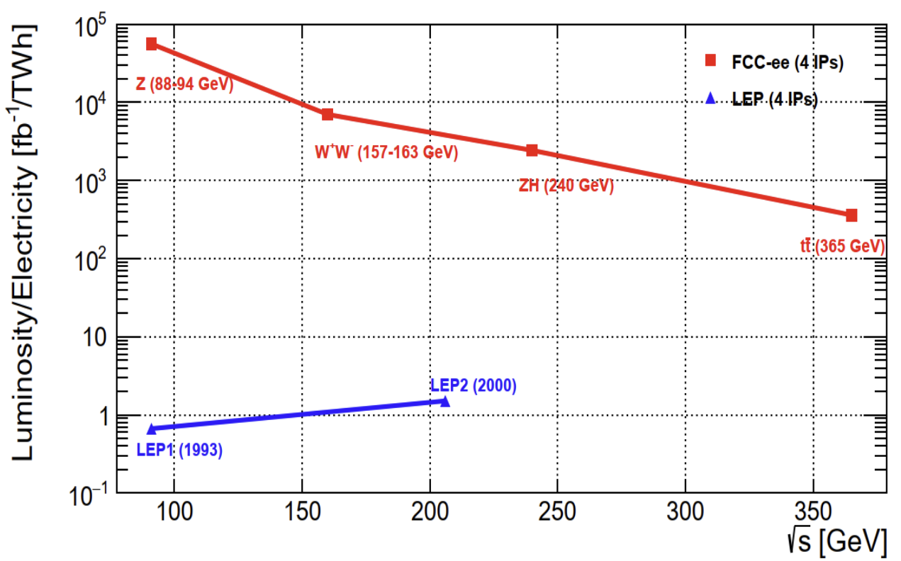
Context
The FCCee collider will deliver lepton collisions for sustainable physics [2]
Short beam lifetime and high luminosity require continuous refilling of the circulating bunches
Swap-out injection is not possible due to the high bunch charge HEPS-scheme [1] has not been explored
Top-up injection is required to maintain the collider bunch charge and luminosity
Top-up injection in numbers
For Z-mode
10 successive injections within 30 s, per beam
18 MJ per beam, 180 kJ per injection
Injector complex is sized with a minimum injection efficiency of 80%
[2]
[1] Z. Duan et. al., The Swap-Out Injection Scheme for the High Energy Photon Source, IPAC2018, Vancouver, BC, Canada [2] M. Benedikt, FCC Feasibility Study Results, FCCweek 2025, Vienna, Austria

Slide 5
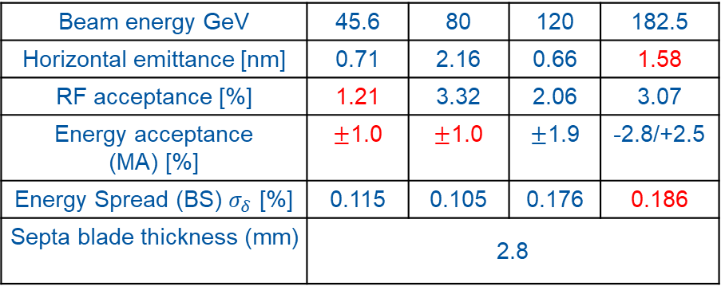
Top-up injection in numbers
H & T modes:
Enhance injection efficiency by increasing energy offset
W mode:
Large beam emittance
FCCee collider parameter [1]
Beam energy GeV | 45.6 | 80 | 120 | 182.5
Horizontal emittance [nm] | 0.71 | 2.16 | 0.66 | 1.58
RF acceptance [%] | 1.21 | 3.32 | 2.06 | 3.07
Energy acceptance (MA) [%] | $±$1.0 | $±$1.0 | $±$1.9 | -2.8/+2.5
Energy Spread (BS) $σ_{δ}$ [%] | 0.115 | 0.105 | 0.176 | 0.186
Septa blade thickness (mm) | 2.8
FCCee booster parameter
Beam energy GeV | 45.6 | 80 | 120 | 182.5
Horizontal emittance [nm] | 0.12 | 0.27 | 0.6 | 1.4
Energy spread [10⁻³] | 0.38 | 0.67 | 1.01 | 1.53
Extraction bunch length [mm] | 2.43 | 2.56 | 2.26 | 1.98
[1] K. Oide, Collider GHC lattice, [2]Booster lattice, GitLab

Slide 6
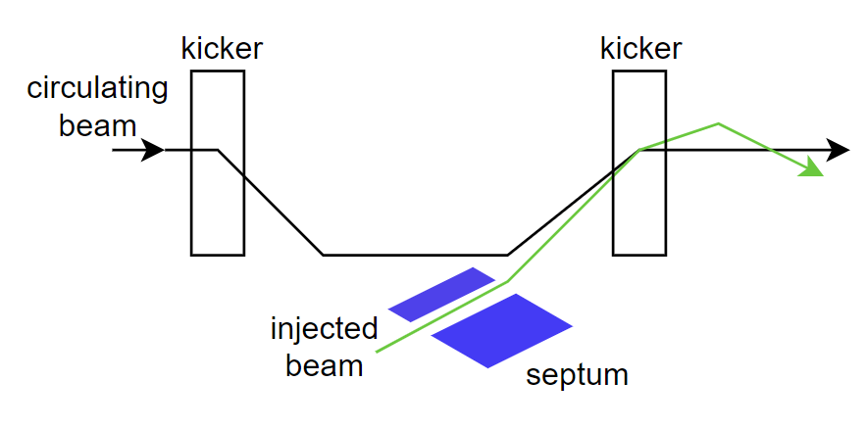
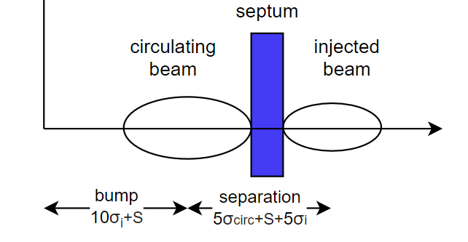
Baseline scheme : concept and objectives
Objective of the injection scheme
No perturbation to the circulating beam outside injection region
No perturbation to the IRs and experiment
Exploiting existing technologies
Highly reliable and resilient to accidental scenario
Selected concept
Conventional injection scheme
On-axis injection : separation between injected and circulating beams is provided by dispersion and an energy offset
Faster damping since the injected beam undergoes longitudinal oscitations
Flat trajectories in the achromatic experimental straight sections minimises radiation doses to experiments
Overall, less affected by injection errors and provided better injection efficiency at higher beam current [1]
Bumped orbit
Off energy orbit
[1] Collier, Paul. "Synchrotron phase space injection into LEP." Proceedings Particle Accelerator Conference. Vol. 1. IEEE, 1995.

Slide 7
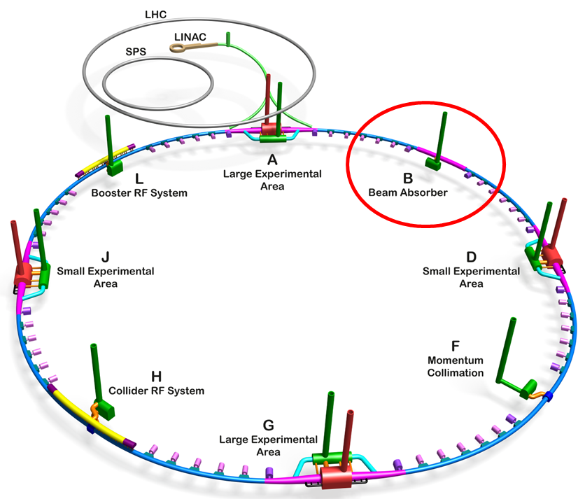
Baseline concept : implementation in PB
Layout in PB
F. Valchkova-Georgieva, FCCee Underground Structure point B, PLM reference, EDMS reference

Slide 8
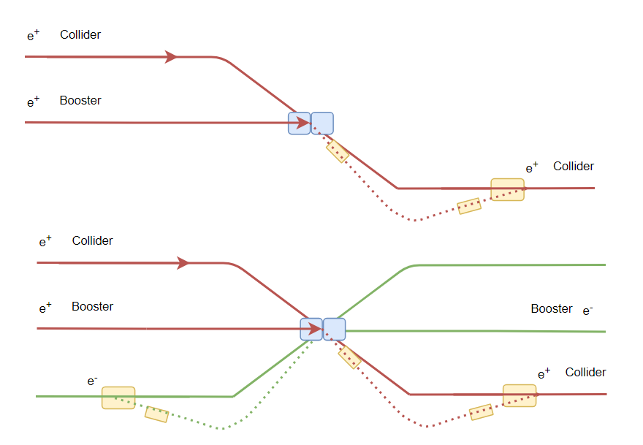
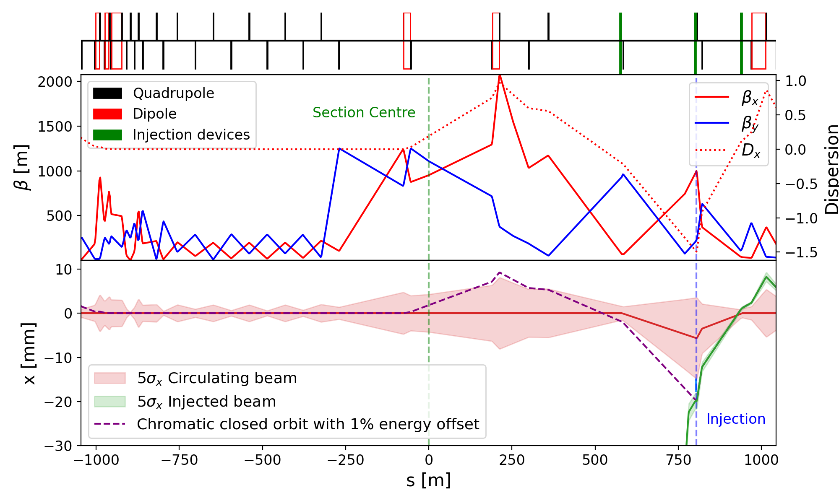
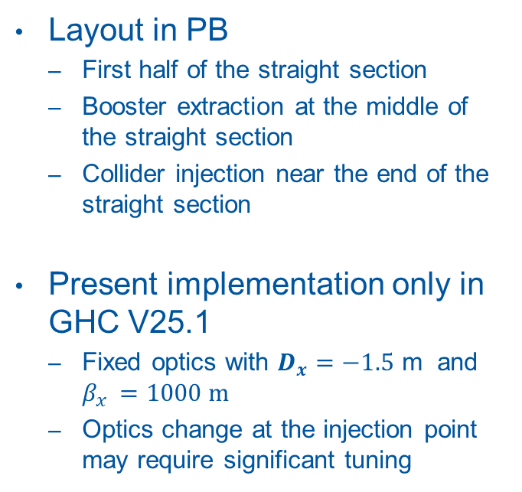
Baseline concept : implementation in PB
Layout in PB
First half of the straight section
Booster extraction at the middle of the straight section
Collider injection near the end of the straight section
Present implementation only in GHC V25.1
Fixed optics with $D_{x}=−1.5$ m and $β_{x }=1000 m$
Optics change at the injection point may require significant tuning
Positron beam direction

Slide 9
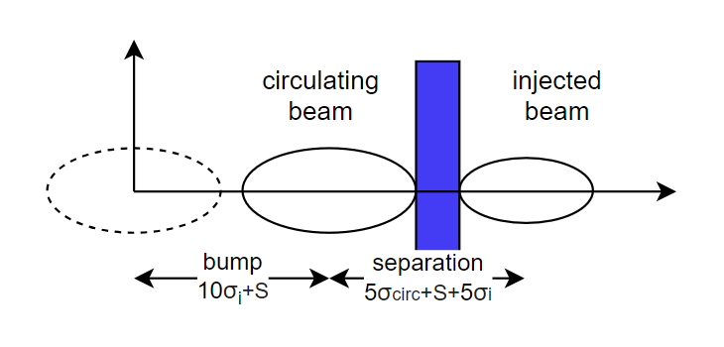
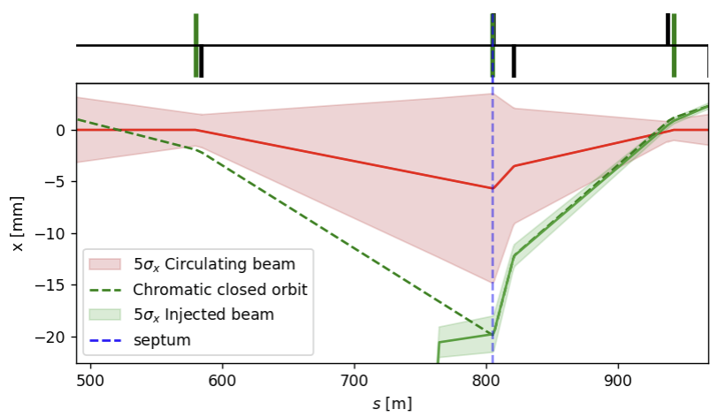
Baseline concept : orbit bump
The conventional scheme
Bump amplitude of 10σ + septum thickness
Fast bump lasting only 1 turn
Pi-bump
Kicker strength: 40 µrad and 60 µrad (due to different beta function at the two locations)
Rise and fall time of 600 ns flat-top time: 304 µs for full turn filling
Kicker hardware discussed on Wednesday (Overview of and Challenges for the FCCee Fast Pulsed Beam Transfer Systems by G. Favia)
kicker
septum
kicker

Slide 10
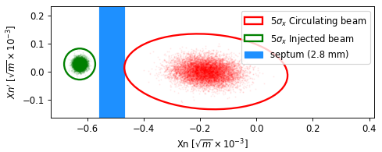
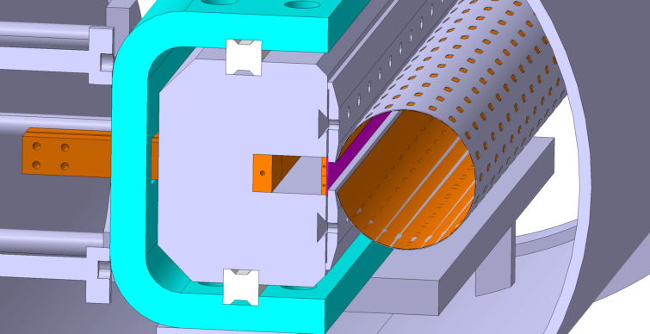
Baseline concept : septum hardware choice
Thin magnetic septum
Long flat-top requirement prevents the use of eddy current septum
Completely under vacuum to minimise the apparent thickness
Specifications
Blade thickness of 2.8 mm
Flat-top duration of 304 μs
See poster by L. Porta on Thursday
Phase space at the injection point for Z-mode
Mechanical design concept for the collider

Slide 11
Top-up injection WG
Context
Significant penalties on injection performance at higher circulating currents have been major challenges at other lepton colliders [1, 2]
Unique challenges of FCCee due to the beam energy and machine protection aspects
Top-up injection requires the combined expertise of multiple experts (optics, beam dynamics, injection systems, collective effects, …)
Regular meeting to converge towards comprehensive studies of the injection scheme
Meeting category here and open egroup fcc-ee-topup-injection
Possible reporting to the optics design meeting
Input to the layout & optics meeting
Precise mandate remains to be established
[1] M. Masuzawa, et al., in 7th International Beam Instrumentation Conference (JACoW, 2019), p.TUPC13. https://doi.org/10.18429/JACoW-IBIC2018-TUPC13
[2] P. Collier. Transfer and injection into LEP. Presented at the 7th LEP Performance Workshop, Chamonix, France (1997). URL https://cds.cern.ch/record/348081

Slide 12
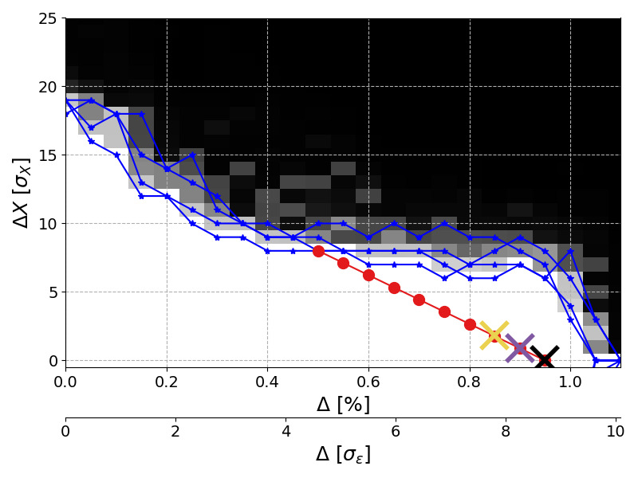
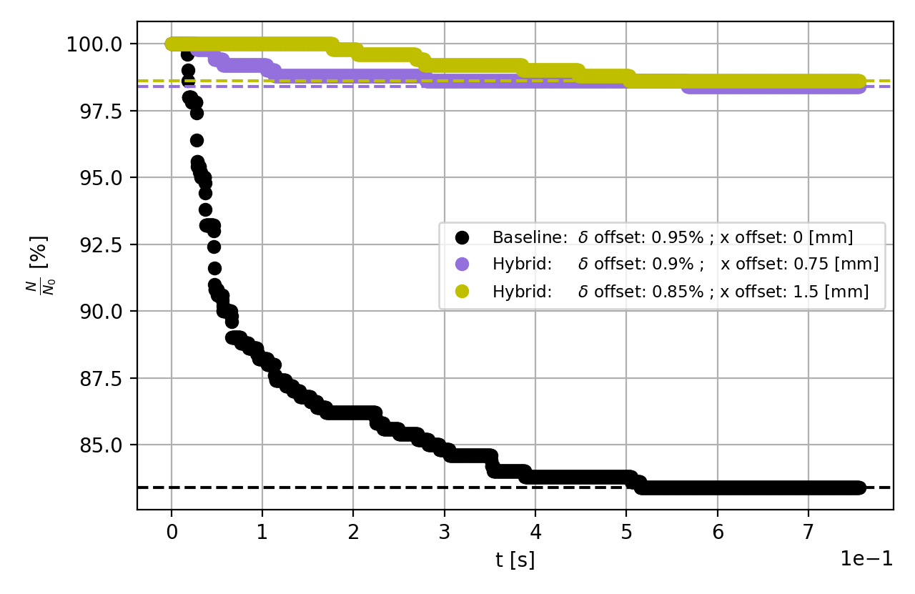
Top-up injection WG: baseline scheme optimisation for the FSR
First simulation of injection with beam-beam element
Conducted at the Z-mode and with GHC v25.1
Revealed important particle loss for the baseline injection scheme
Hybrid scheme
Momentum offset may be reduced at the expense of betatron oscillations
Red line in the DA/MA denotes the geometrical condition for injection
New hybrid working point with 1-2 σ betatron offset validated and providing high injection efficiency
Quarter quadrant representation of the dynamic aperture and momentum acceptance without beam-beam. Crosses denote the three injection settings simulated with beam-beam
Evolution of the captured fraction of injected beam for three different injection betatron offset, modelled with Xsuite using the beam-beam element under nominal conditions.

Slide 13
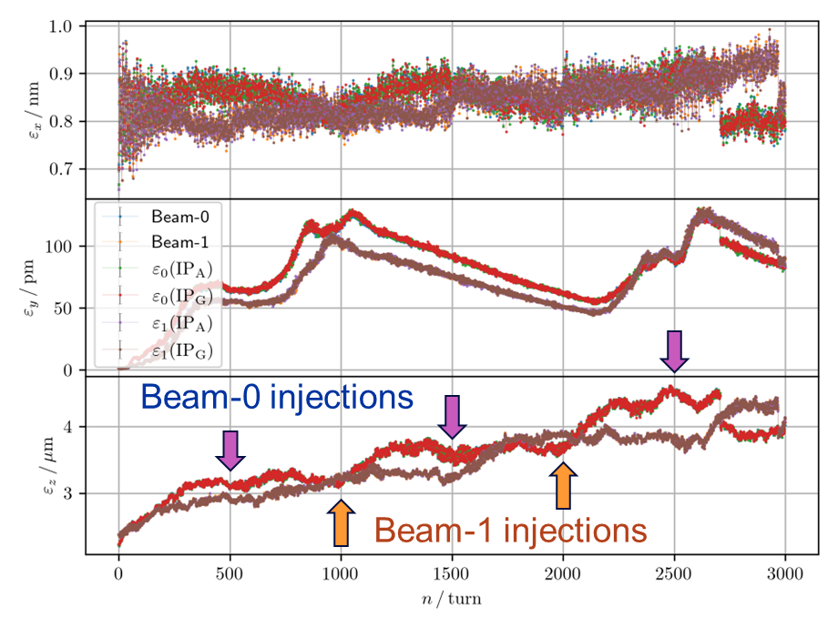
Top-up injection WG: Quasi-Strong-Strong Beam-Beam
Tracking with Quasi-Strong-Strong Beam-Beam
Uses the full lattice with SAD
Modelling of bootstrapping from low intensity
Preliminary observation
Vertical optics mismatch in the presence of beam-beam
Increase of longitudinal emittance with intensity
Tool to identify and optimise the beam parameters
Poster by T. Mori on Thursday
T. Mori, top-up injection modelling and quasi-strong-strong beam-beam effects, top-up injection meeting, 03/04/2025
T. Mori, Updates of Injected Beam Study, 205th FCC-ee Accelerator Design Meeting

Slide 14
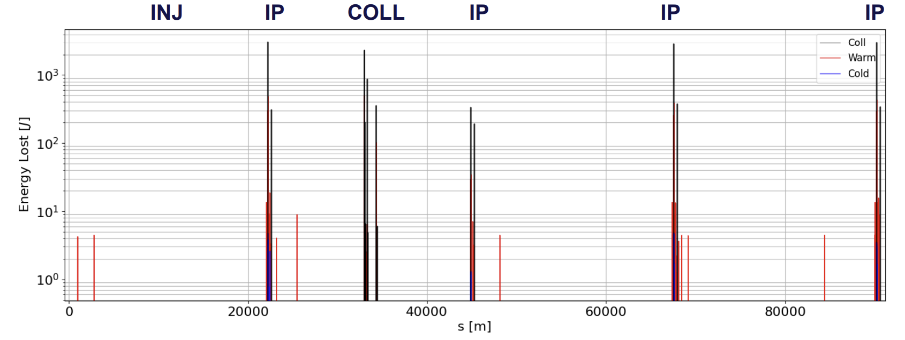
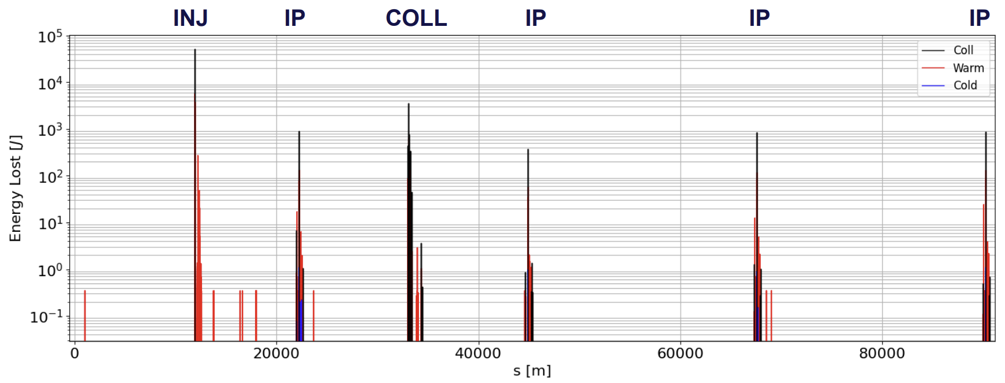
Top-up injection WG: Injection losses [1]
Injected beam
Example of Z-mode
18 MJ of circulating beam and 180 kJ injected every 3s
Injection losses modelling
Local losses at the injection septum from the circulating beam
Distributed losses around the ring from the injected beam
Injection protection requirement
Background to experiments -> Talk by G. Nigrelli : “First look at injection backgrounds” on Thursday
Circulating beam halo
[1] G. Nigrelli, preliminary results on injection losses, FCC-ee top-up injection

Slide 15
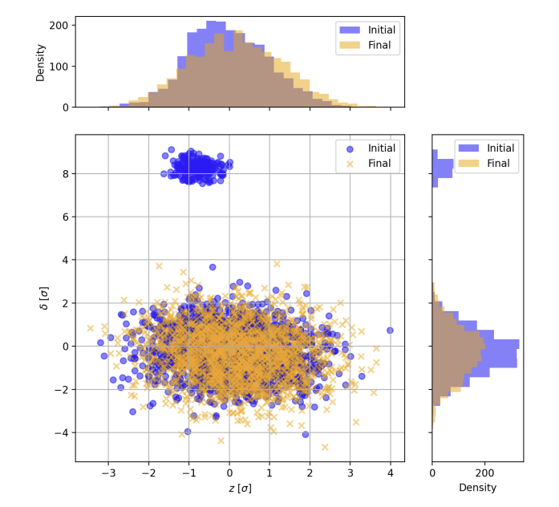
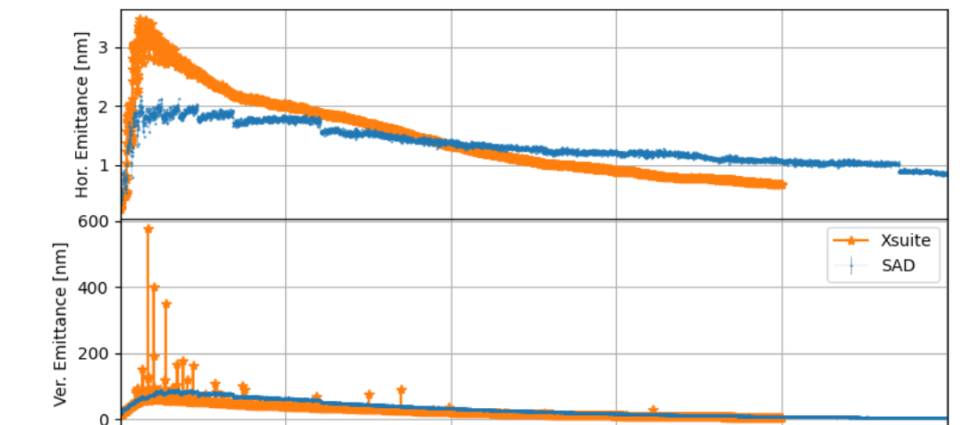
Top-up injection WG: beam dynamics and benchmark
Injected beam dynamics [1]
Vertical beam emittance increase during injection tracking seem understood
Highlights the importance of chromatic matching and the role of beam-beam
Code benchmark
Presently Xsuite and SAD used in parallel
Simulation in gitlab CI being implemented for continuous comparison
Collider injection git repo
[1] K. Skoufaris, Injection performances and emittance evolution for v25.1_GHC, 205th FCC-ee Accelerator Design Meeting

Slide 16
Top-up injection WG: objective in 2025
Optics and implementation
Possible update to the optics requirement for the GHC lattice and validation of lower energy offset (0.85 % to 0.90 %)
Implementation of the injection scheme into the LLC lattice
Reviewed injection scheme
Using a full 4-bump system for flexibility and independence from optics
Feasibility and advantages of a multipole injection kicker
Beam dynamics and benchmark
Maintain simulation for both SAD and Xsuite
Review and optimisation of the injected beam optics requirements
Input to the optics & layout for comparison of GHC and LCC lattices
Injection efficiency and hardware requirements
Injection losses and background to experiment
Machine protection and accidental scenario
Timeline and deliverables towards the pre-TDR

Slide 17
Conclusion
Baseline scheme established for the FSR
Exploits a robust concept with the aim of frequent and reliable injection with minimal perturbation to the experiments
Hardware solution identified for the FSR but development timeline to installation requires a commitment to the selected parameters
Presently only implemented in the GHC lattice, must be done for the LCC
Some aspects need reviewing (reduced momentum offset, 4-bump layout)
Is there an interest to enforce an on-axis baseline or hybrid is sufficient ?
Top-up injection WG
Resuming activities in 2025 and already swift progress (benchmark, beam dynamics, injection losses, beam-beam, …)
Clear mandate is being established
Input to the layout and optics meeting by the end of 2025
The format and precise list of criteria remain to be established
Complete comparison is not possible within the required timeline but the present level of study on GHC could certainly be applied to the LCC

Slide 18
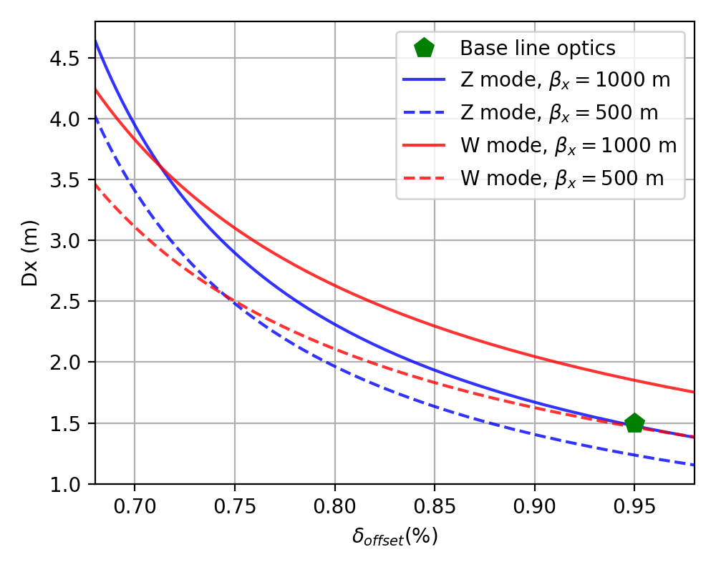
Required dispersion
Increased dispersion is needed to reduce the injected beam energy offset
Based on Collider GHC V25.1 and Booster V24_FODO

