Slide 1
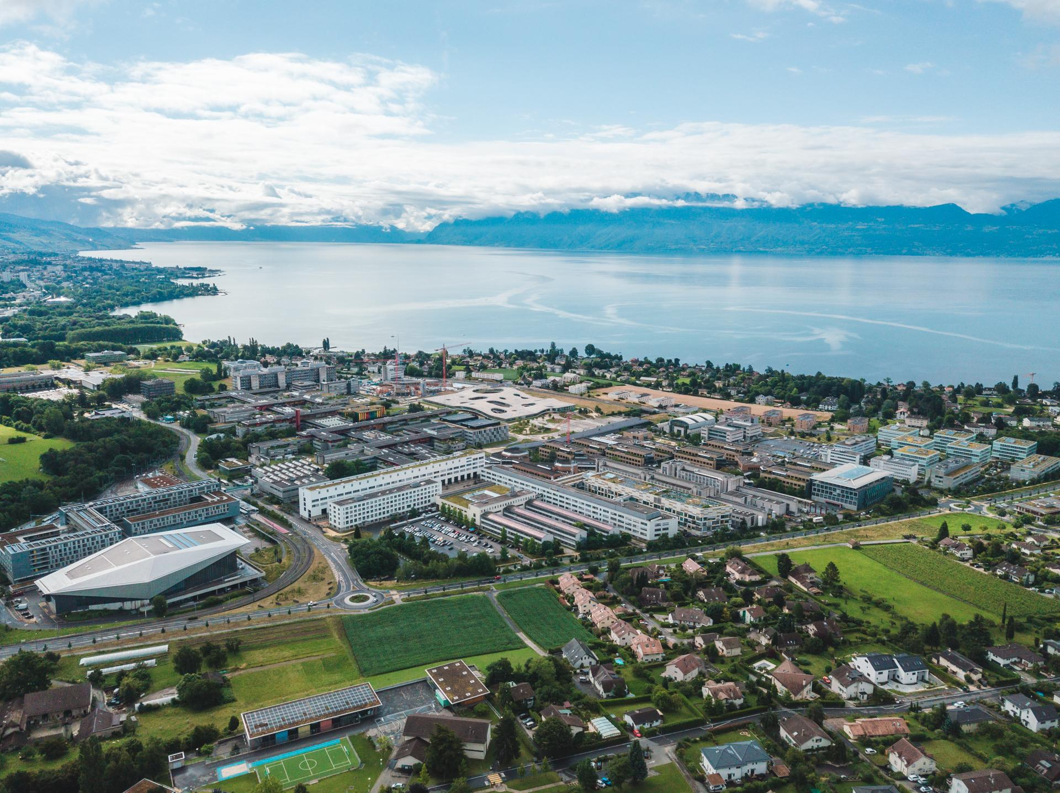
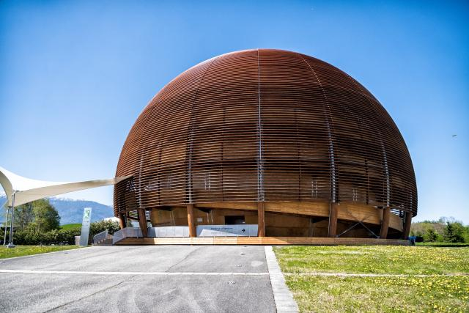




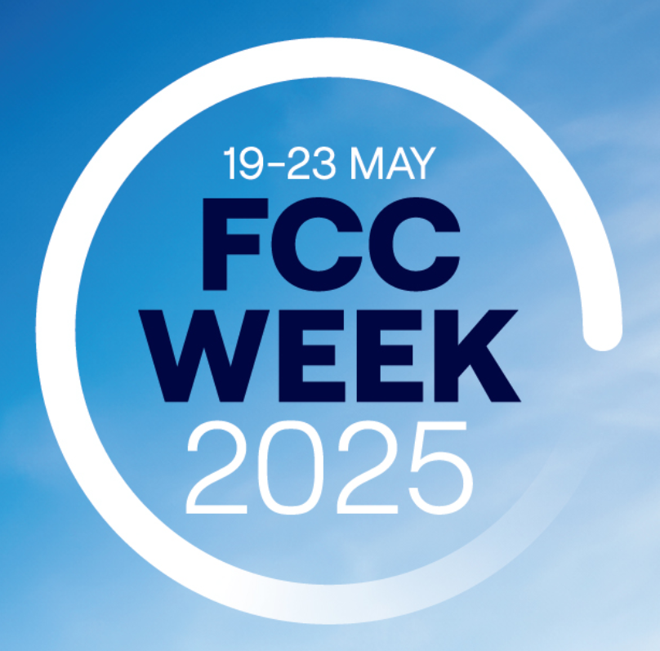
Nested Magnets and Ballistic Optics for the FCC-ee
Cristóbal García-Jaimes¹, Tatiana Pieloni¹, Leon van Riesen-Haupt¹, Mike Seidel¹, Kyriacos Skoufaris² and Rogelio Tomás²
1 EPFL-LPAP 2 CERN
This work was carried out under the auspices and with the support of the EPFL-Global Leaders, CHART and FCC-ee studies at CERN.
May 20th 2025
FCC WEEK 2025

Slide 2
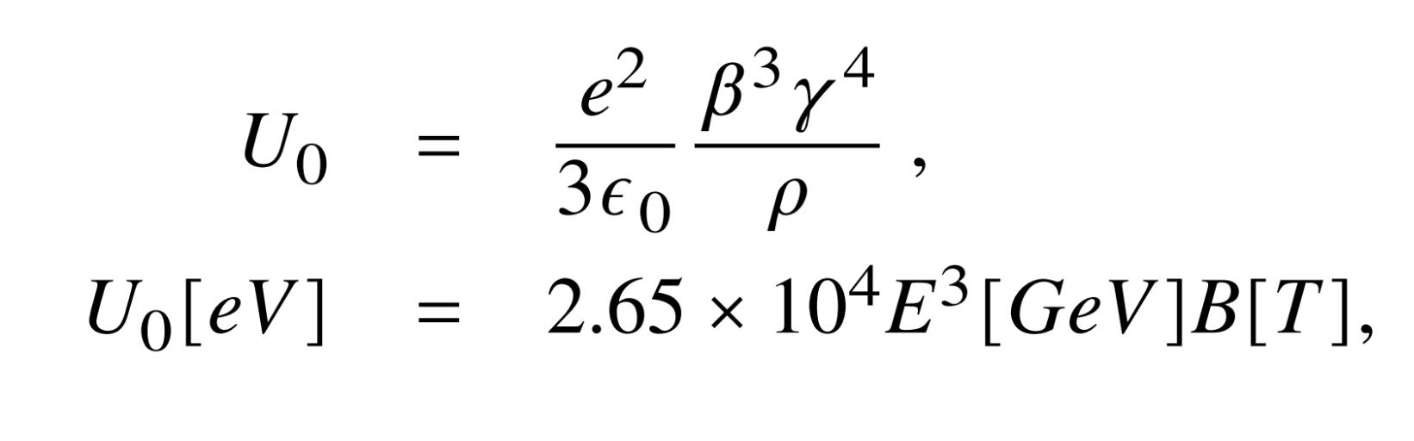
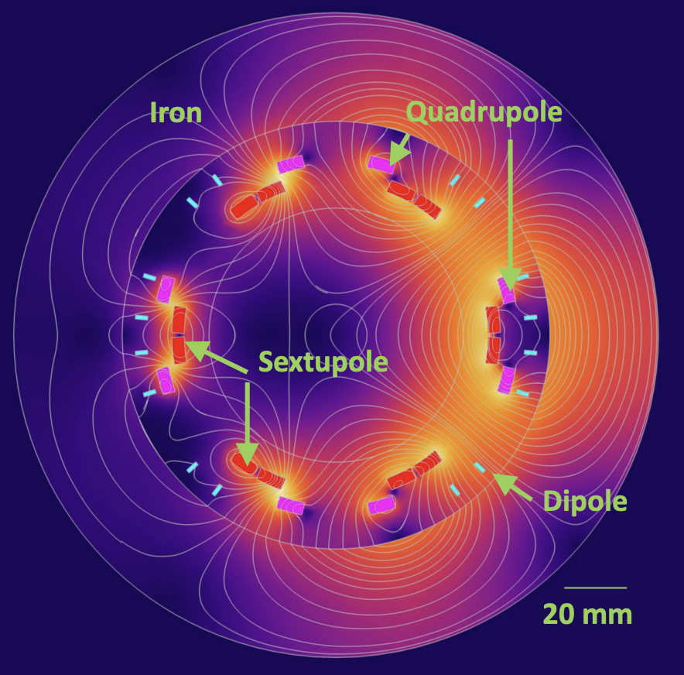
An Alternative Optics Design:
Integration of HTS-Nested Magnets in FCC-ee
Synchrotron Radiation (SR) plays a key role in determining the overall performance and feasibility in accelerators. For FCC-ee, the limit is 50 MW per beam in all operating modes.
SR is inversely proportional to the bending radius rho, and there is no additional space to add more dipoles in the FCC-ee baseline.
Extend dipole field to quadrupoles and sextupoles to increase the filling factor and study an alternative optics using nested magnets.
In collaboration with the CHART HTS4 project [1]— High Temperature Superconducting nested magnets which allows to have independently magnetic fields and gradients in the same element [2].
Energy
loss per
turn
Cristóbal García-Jaimes
HTS nested: dip+sext+quad
FCC WEEK 2025
J. Kosse

Slide 3
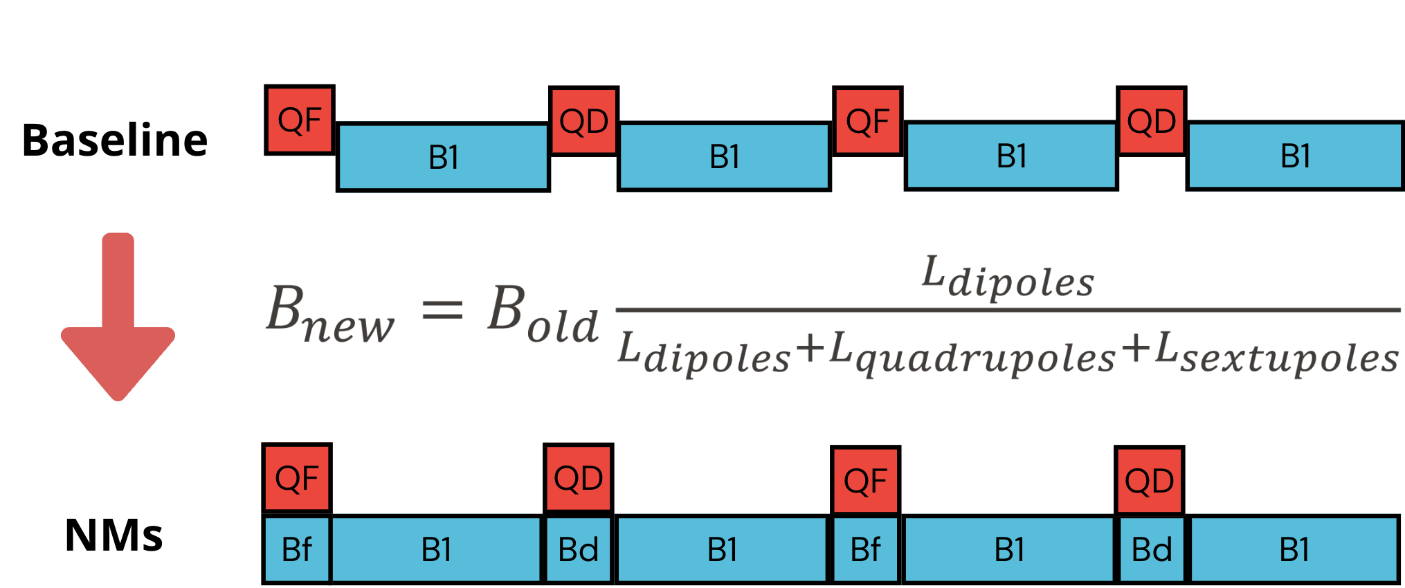
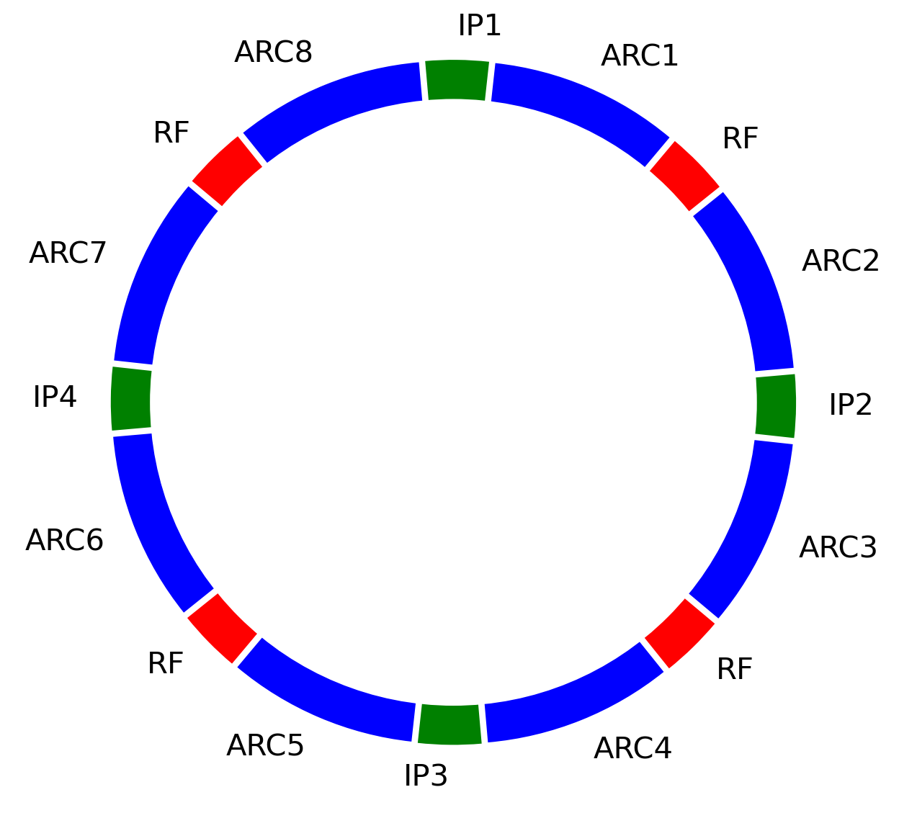
Starting Simple:
The FODO Cell as the Fundamental Unit
3
The FODO cell is made of alternating focusing (QF) and defocusing (QD) quadrupoles, with dipoles in between.
This structure is repeated throughout the FCC-ee arcs.
  Nested Magnets (NMs) are implemented in quadrupoles and sextupoles, which occupy 14% of the arc.
Cristóbal García-Jaimes
FCC WEEK 2025
ARC2
IP
ARC1
ARC1
ARC2
FCCee
IP
IP
ARC2
ARC1
ARC1
ARC2
IP

Slide 4
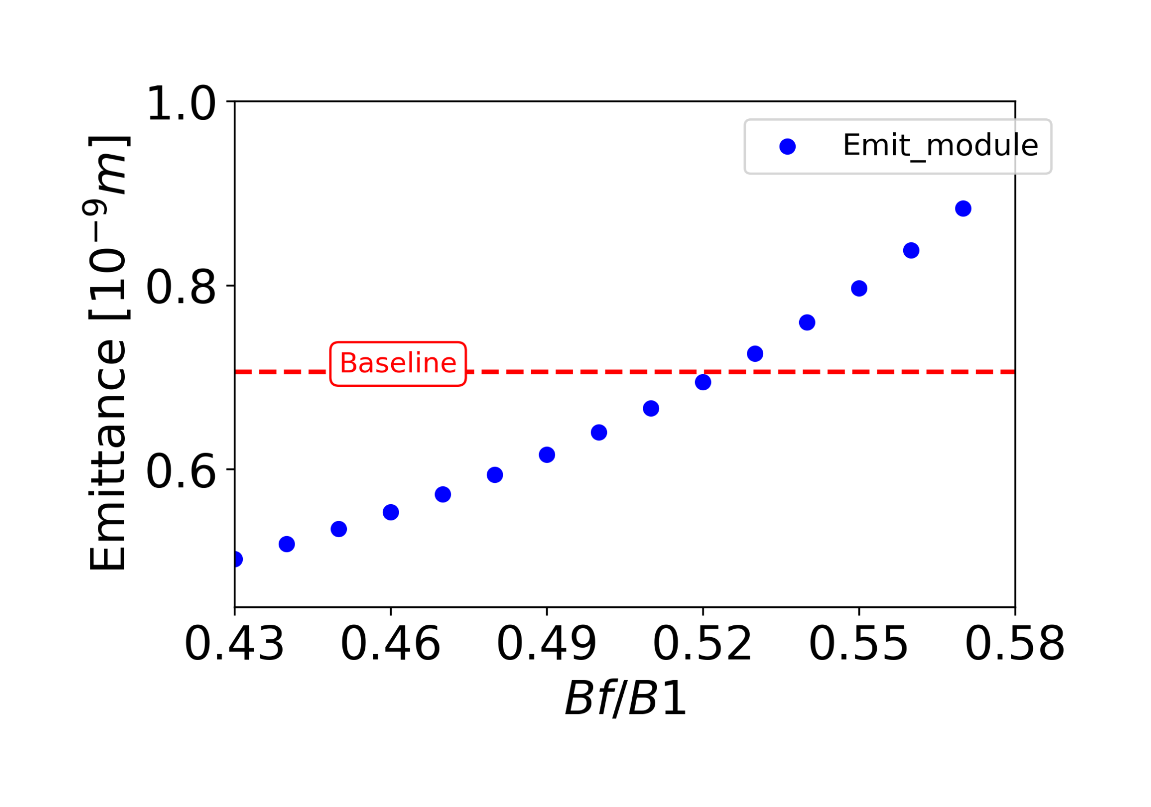
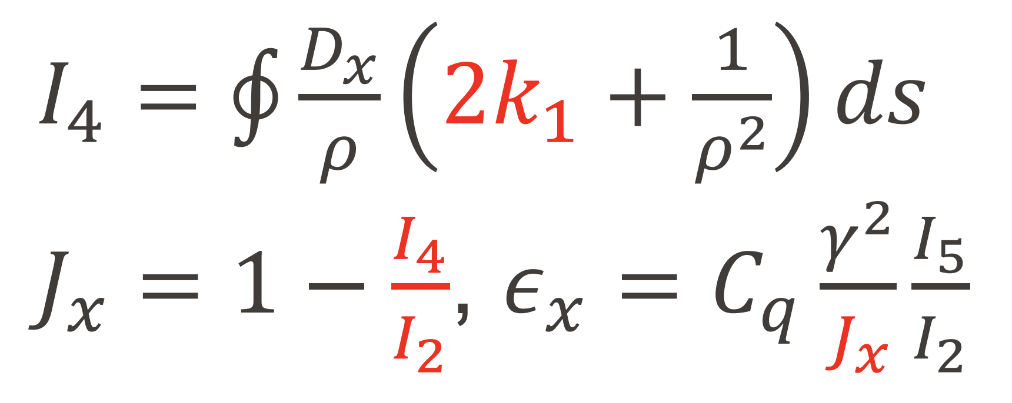
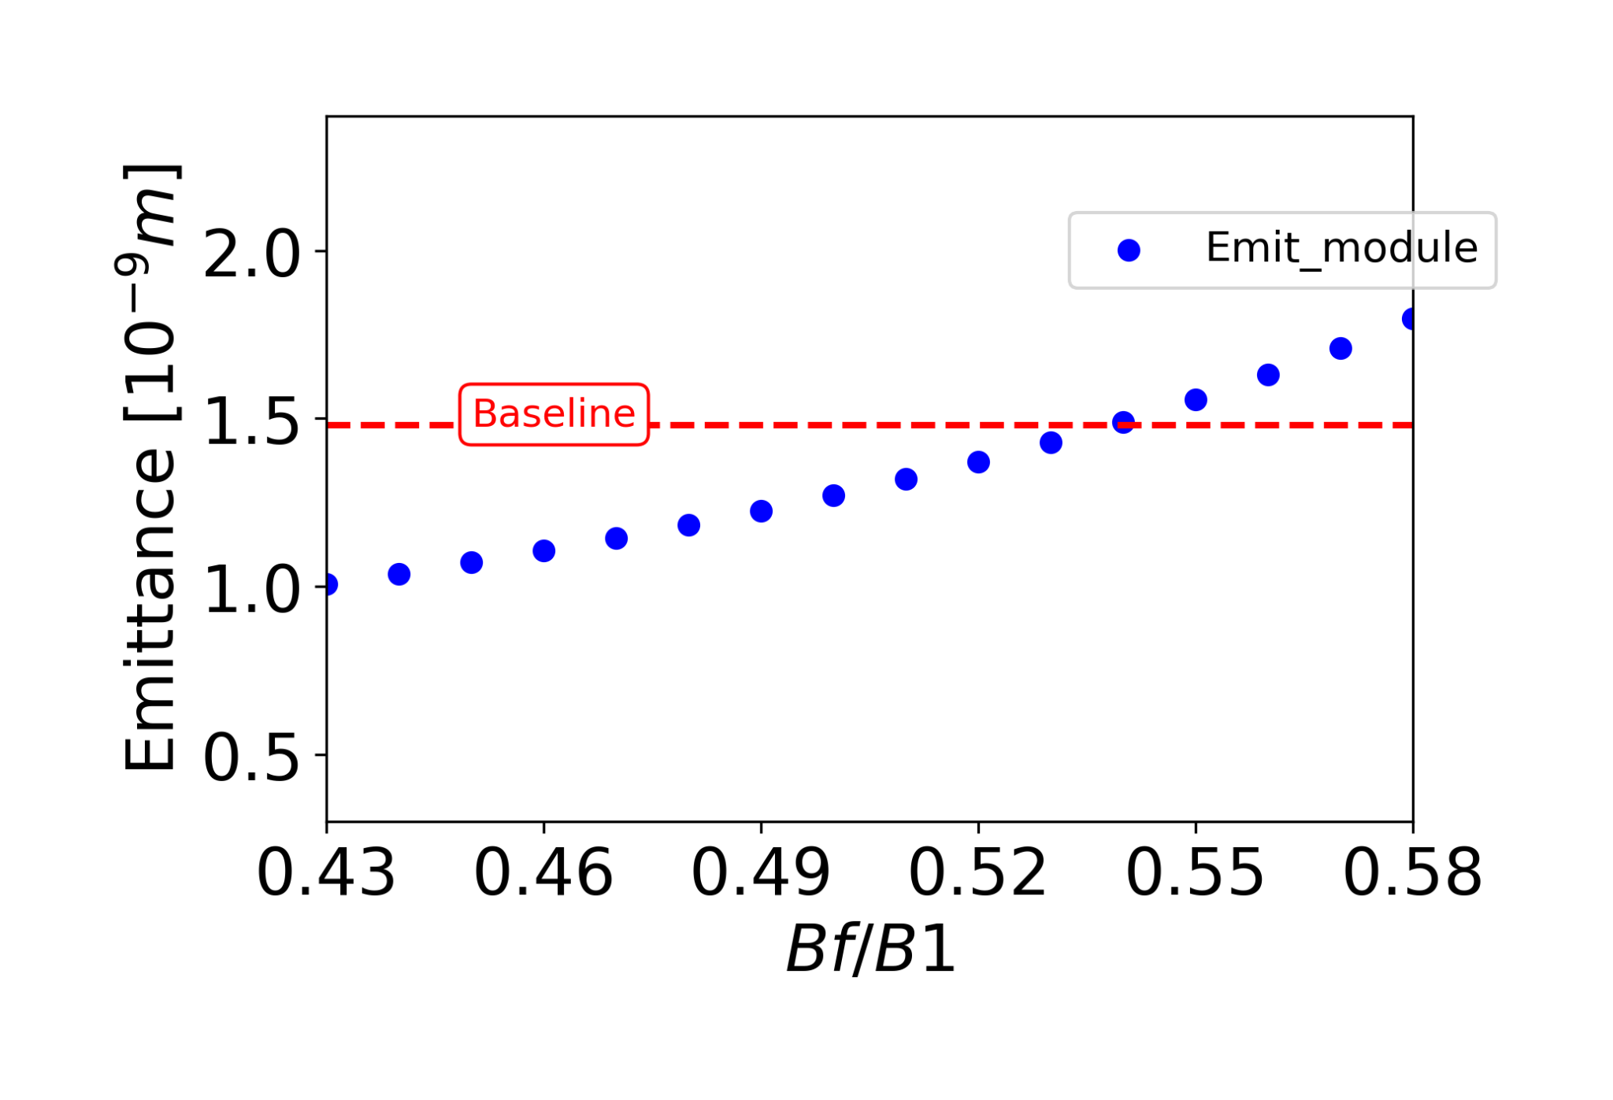
Equilibrium Emittance
Introducing NMs modifies the Damping Partition Numbers (DPNs) due to the addition of a dipolar field to the quadrupoles.
This affects the radiation integral I₄, which is dependent on the sign of k₁:
The field in QF contributes more to I₄ than QD, due to the larger horizontal dispersion at QF. Meanwhile, a strong field can be applied in QD.
To explore the options we define:
  Bf: dipole field assigned to QF,
  B1: field in main dipole and in QD.
We varied the ratio Bf/B1 to study its impact on emittance.
Z-mode
Cristóbal García-Jaimes
FCC WEEK 2025
tt-mode

Slide 5
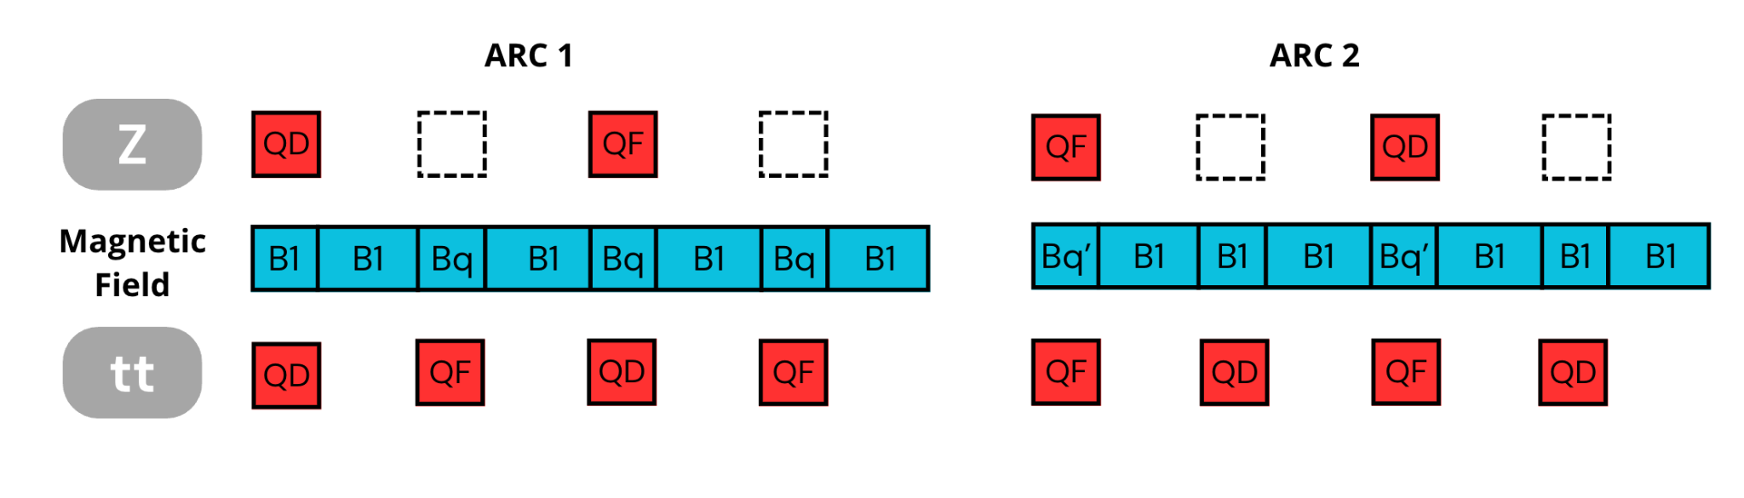
Shared Layout Between Z and tt modes
5
Cristóbal García-Jaimes
In previous solutions [2–6], different magnetic fields were assigned to the QF and QD quadrupoles in tt and Z, leading to layout challenges.
To avoid such complications, we explored a solution in which the dipole field distribution is identical in both lattices. The strategy is as follows:
  If a slot is never occupied by a QF magnet, it is assigned the same magnetic field as the main dipoles (B1). Otherwise, it receives a reduced field, denoted as Bq.
FCC WEEK 2025

Slide 6
Shared Layout Between Z and tt modes
6
Cristóbal García-Jaimes
Arc 1 and Arc 2 have different overlaps between the Z and tt configurations; as a result, Bq and Bq′ differ. The relationship is given by: Bq′ = (3Bq-B1)/2
Although this approach resolves the layout incompatibilities, the emittance evolves slightly differently in each lattice.
  This is because Bq′ appears in both the QF and QD magnets in the Z configuration, whereas in the tt configuration it is applied only to the QF quadrupoles.
FCC WEEK 2025

Slide 7
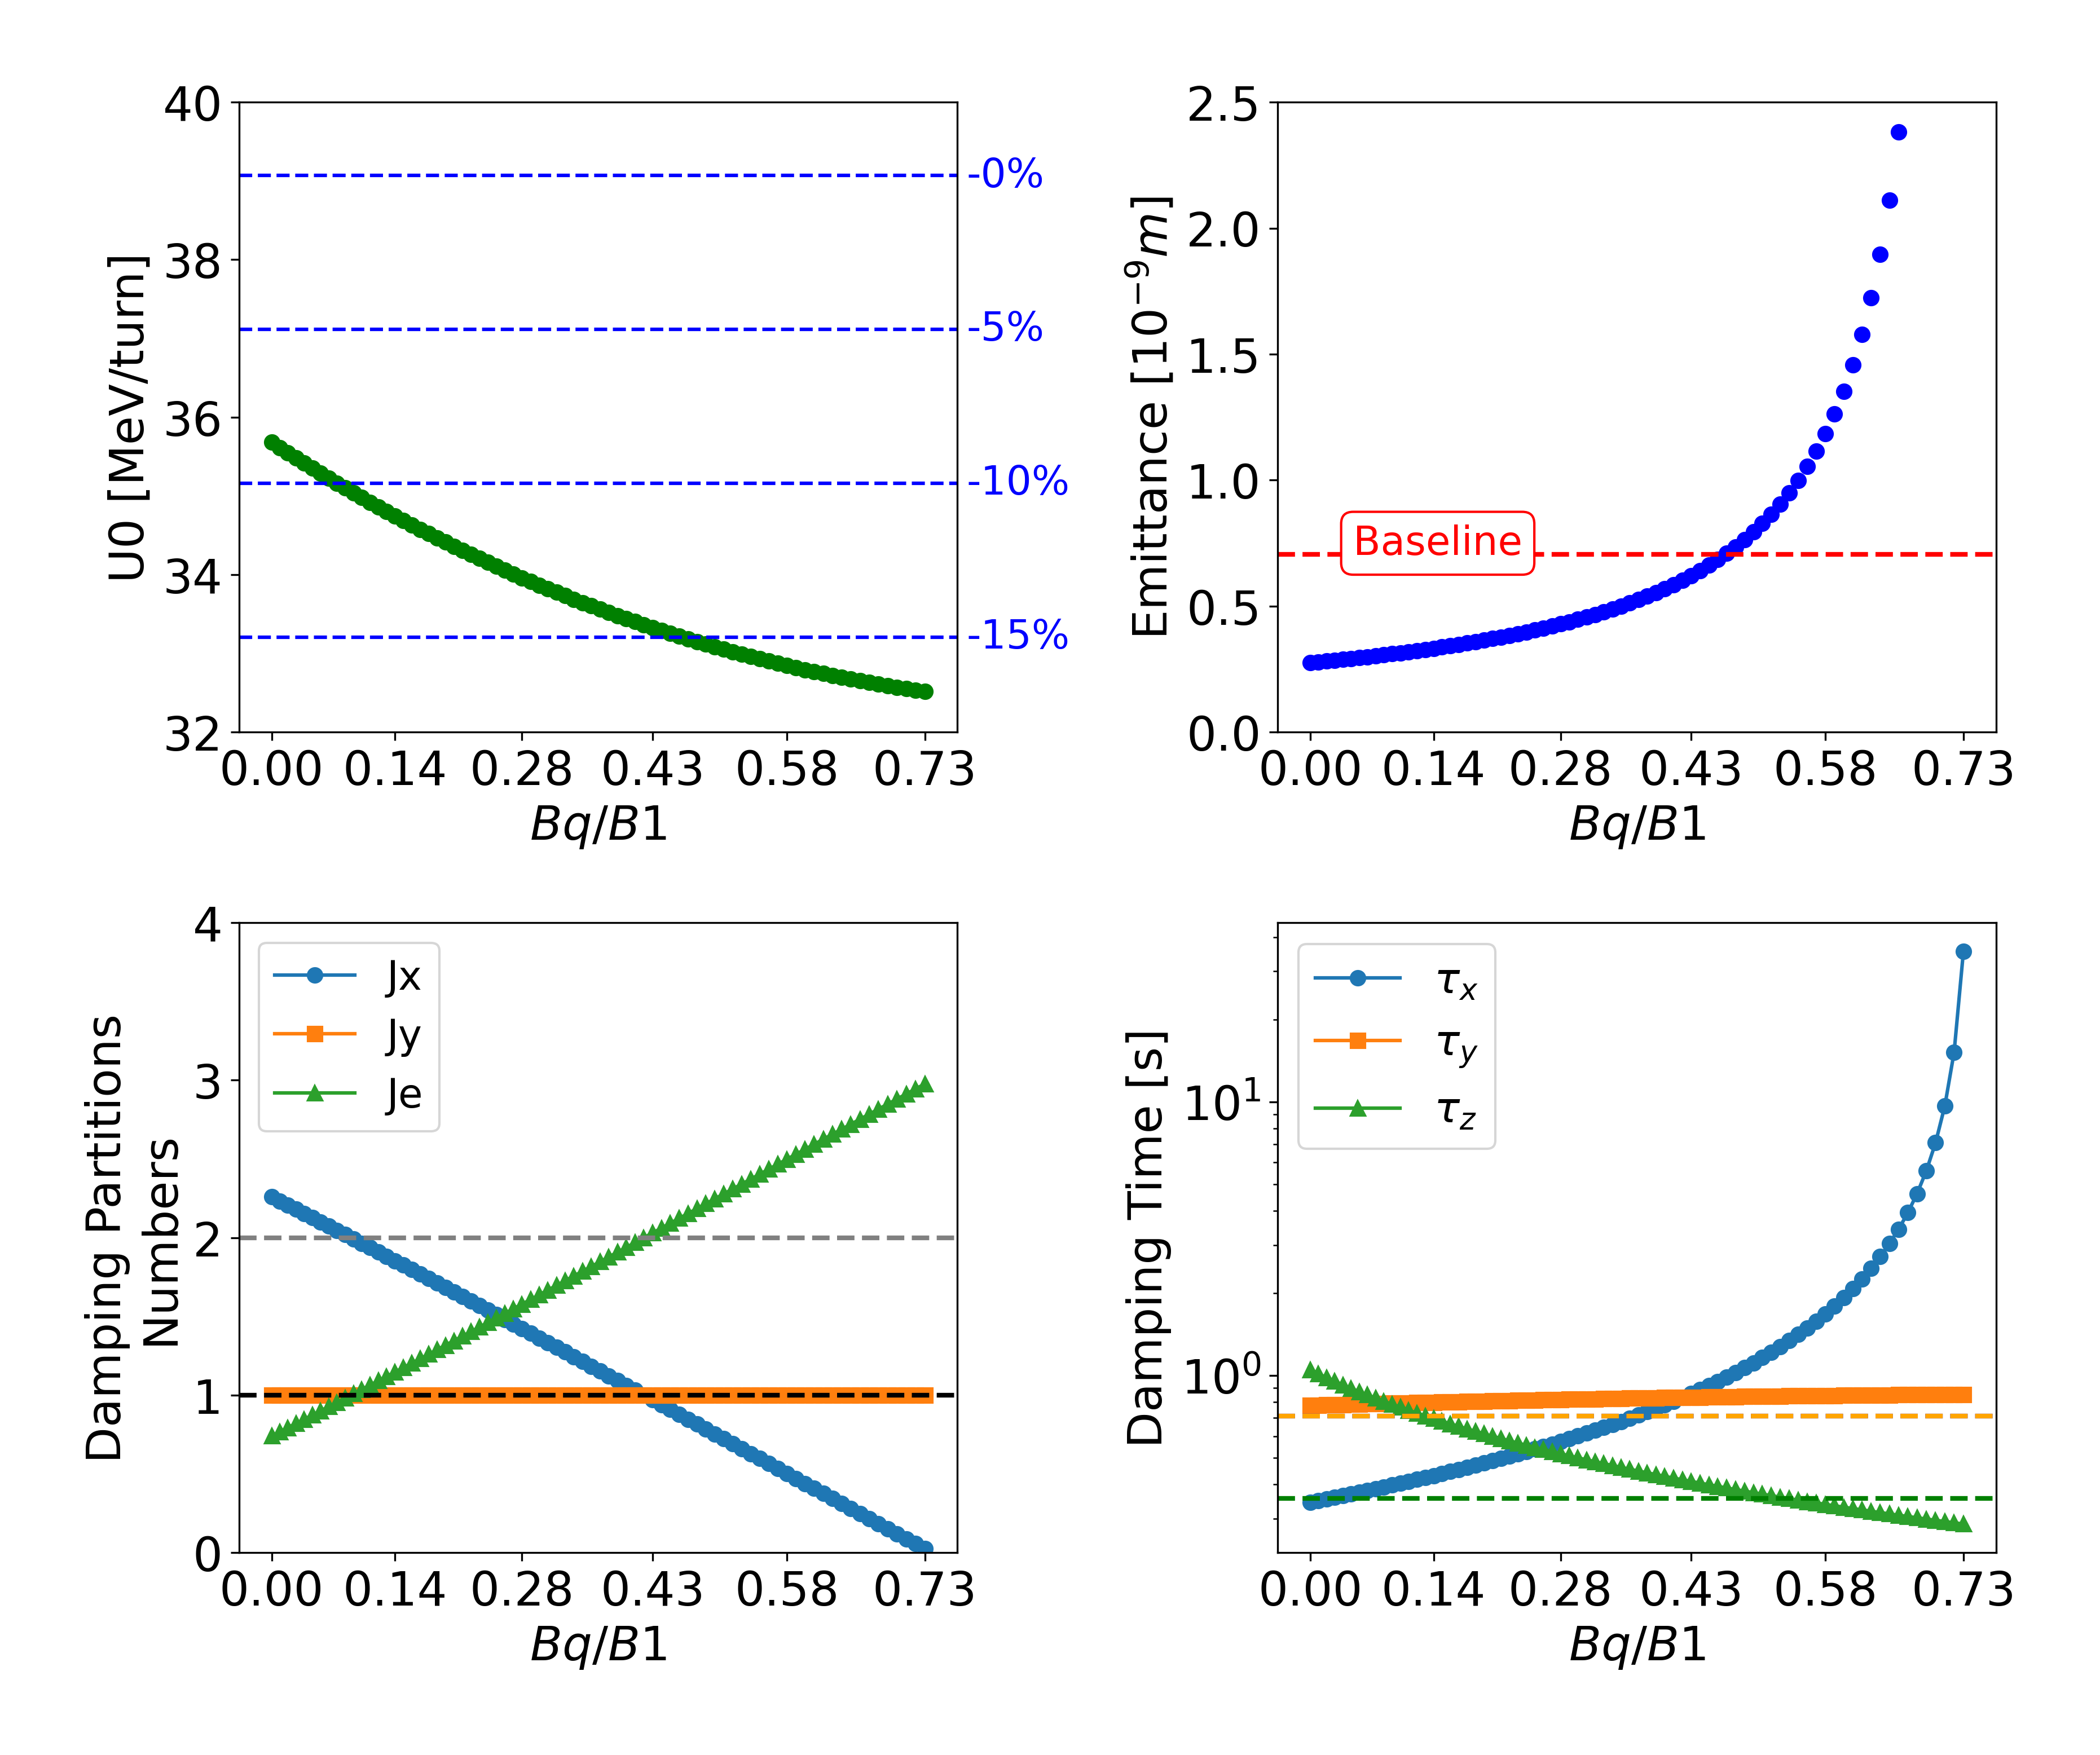
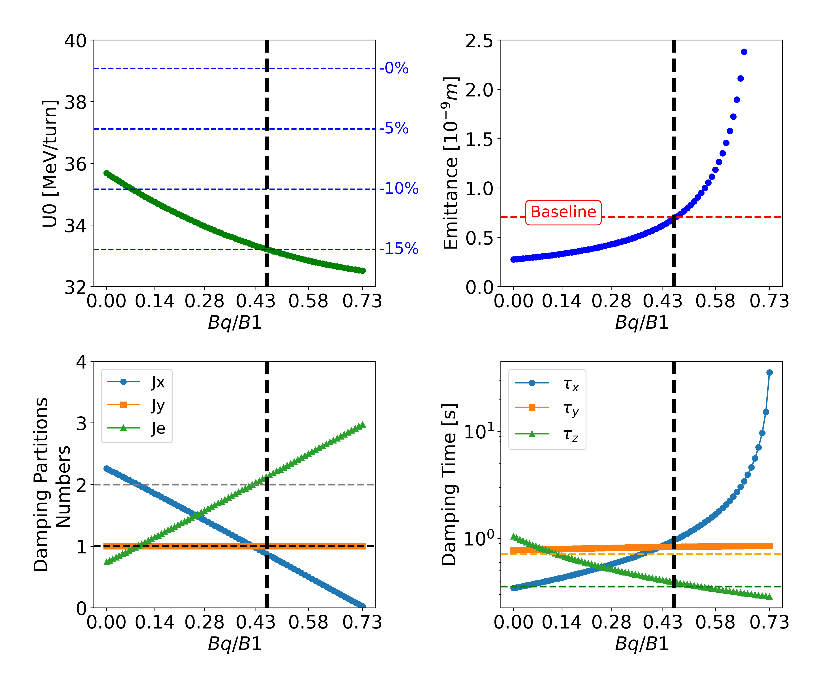
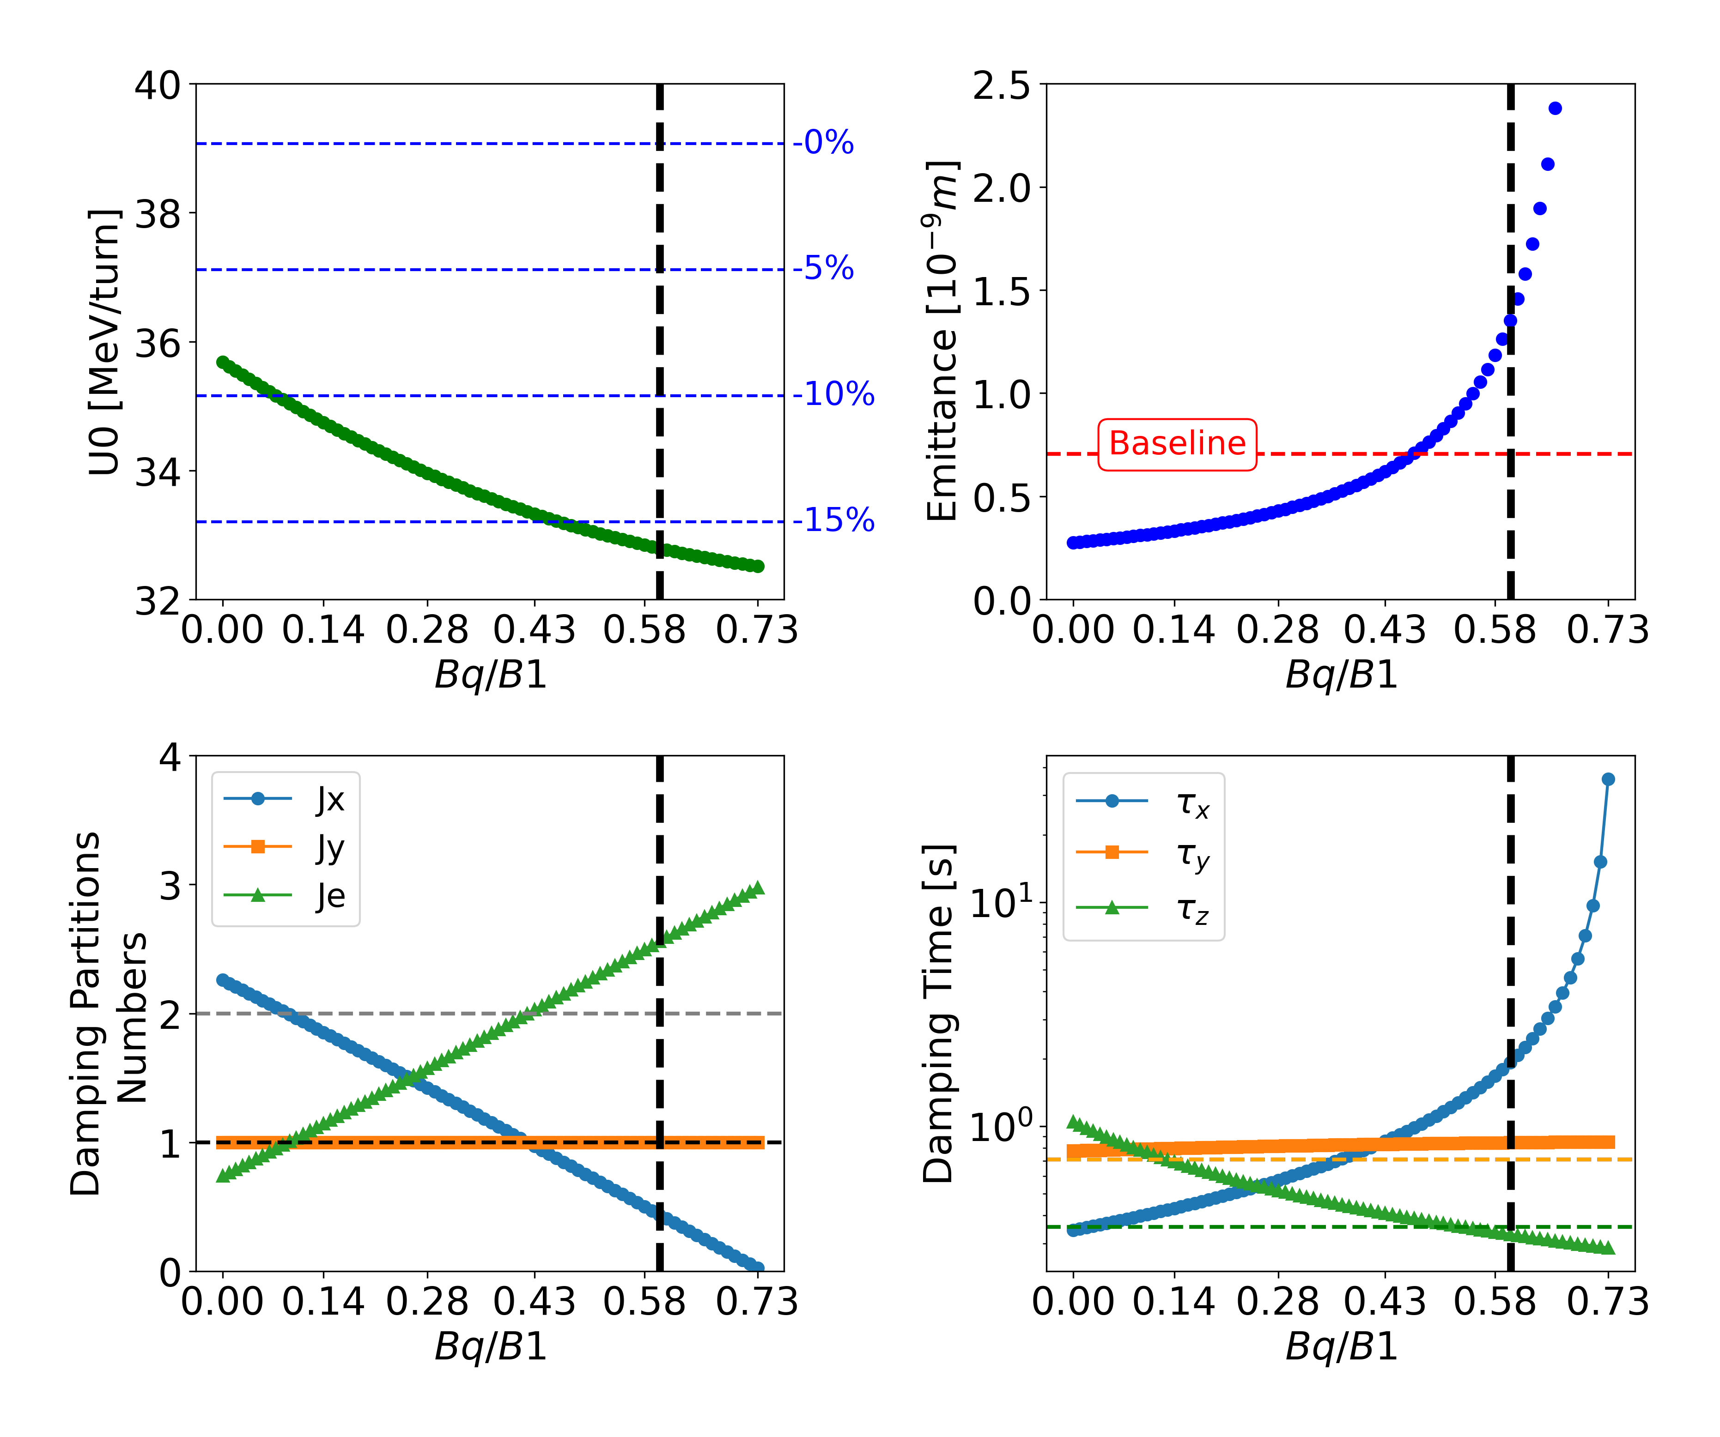
Z Lattice Optimization
7
The primary objective is to reduce U₀ by using different values of the Bq/B1 ratio.
As Bq/B1 increases, the emittance also grows, which can impact the beam quality and luminosity.
The DPNs evolve with the ratio. While their nominal values are (Jₓ, Jᵧ, Jₑ) = (1, 1, 2), the scan shows clear deviations.
Horizontal Damping time increase with the ratio.
𝝱 and dispersion beating less than 2%.
Cristóbal García-Jaimes
Selecting | Emittance [nm] | DPNs | U0 Reduction [%] | Ratio Bq/B1
Reproduce Emittance | 0.709 | 0.846 1 2.153 | 15.1 | 0.46
Reproduce DPNs | 0.602 | 1 1 2 | 14.6 | 0.41
Min U0 | 1.35 | 0.438 1 2.561 | 16.0 | 0.60
FCC WEEK 2025

Slide 8
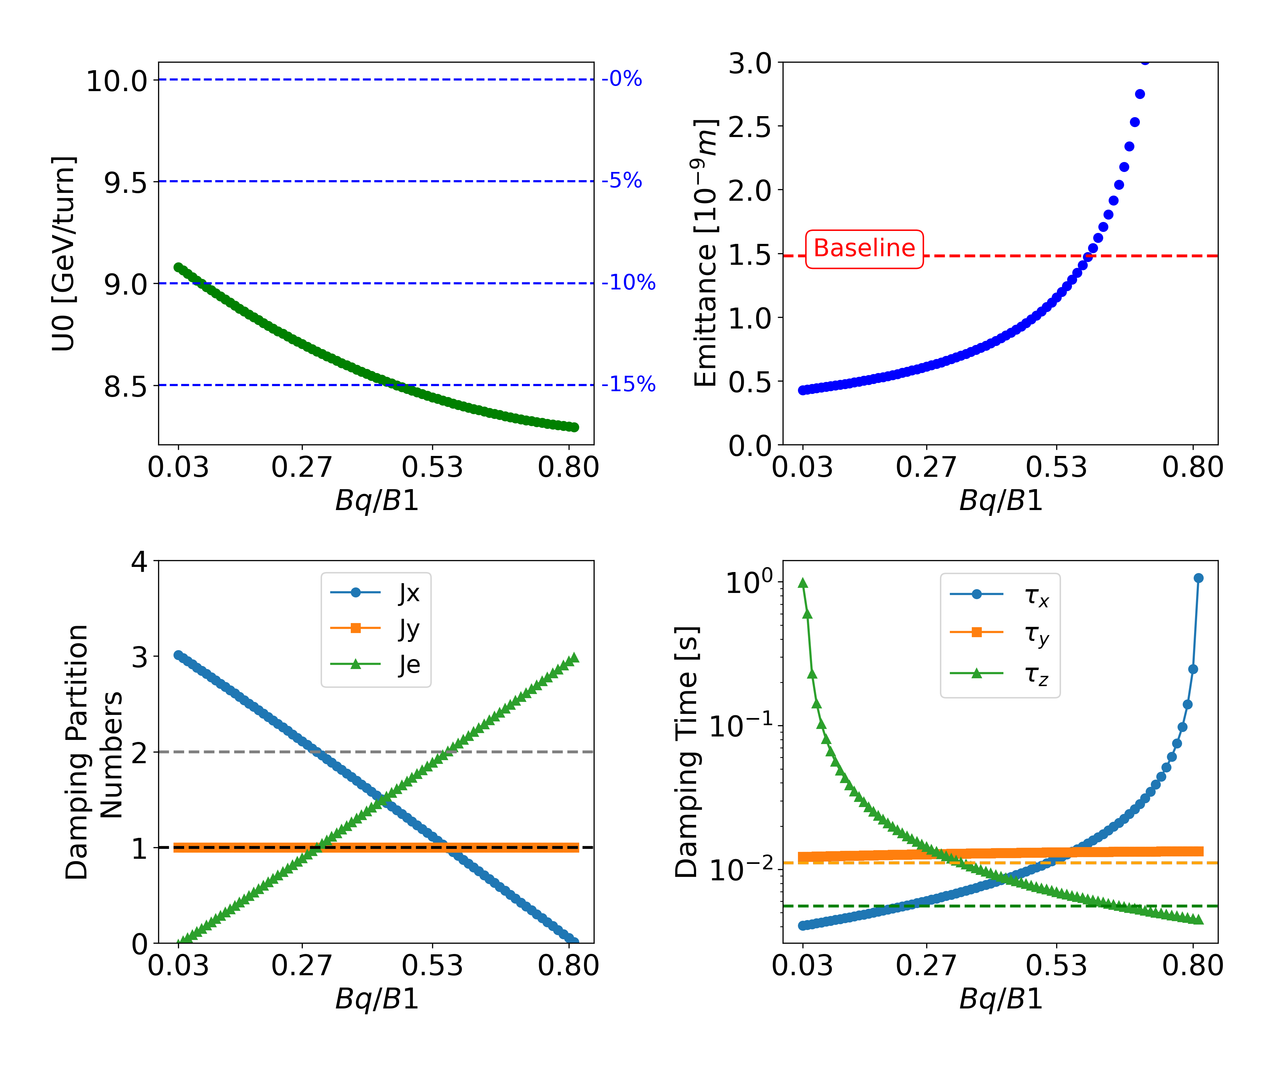
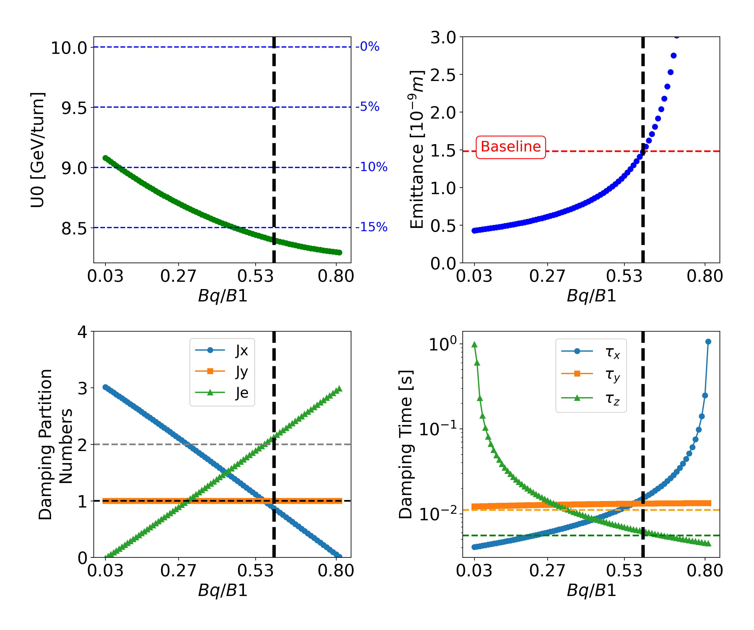
tt Lattice Optimization
8
As in the Z lattice, similar behaviors are observed in the tt lattice.
𝝱 and dispersion beating less than 1% compared to baseline.
Cristóbal García-Jaimes
Selecting | Emittance [nm] | DPNs | U0 Reduction [%] | Ratio Bq/B1
Reproduce Emittance | 1.47 | 0.872 1.000 2.127 | 16.0 | 0.58
Reproduce DPNs | 1.29 | 0.99 0.99 2.00 | 15.8 | 0.55
FCC WEEK 2025
These configurations resolve the compatibility issues.

Slide 9
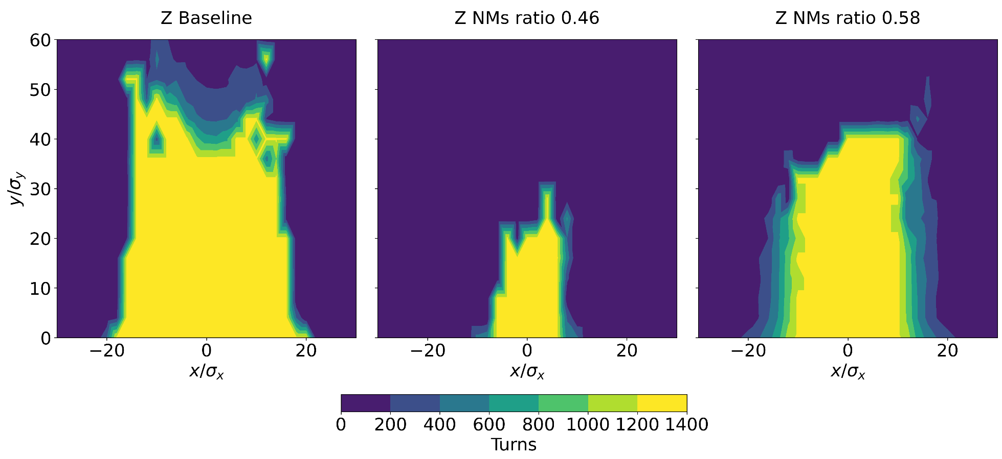
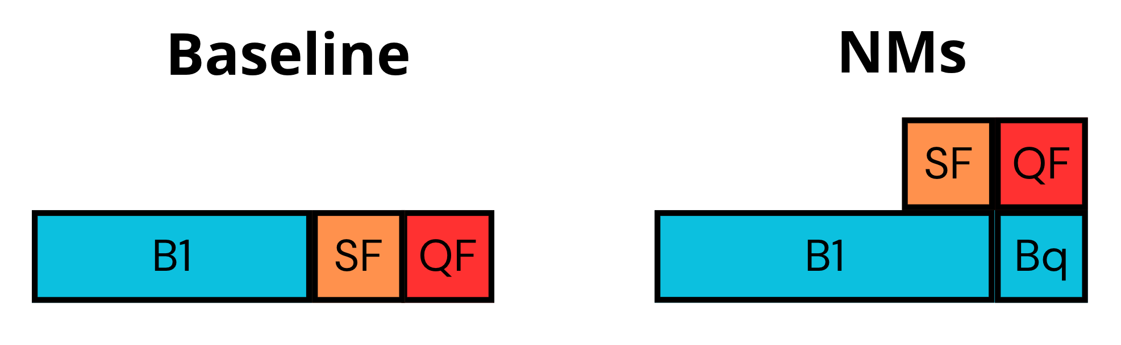
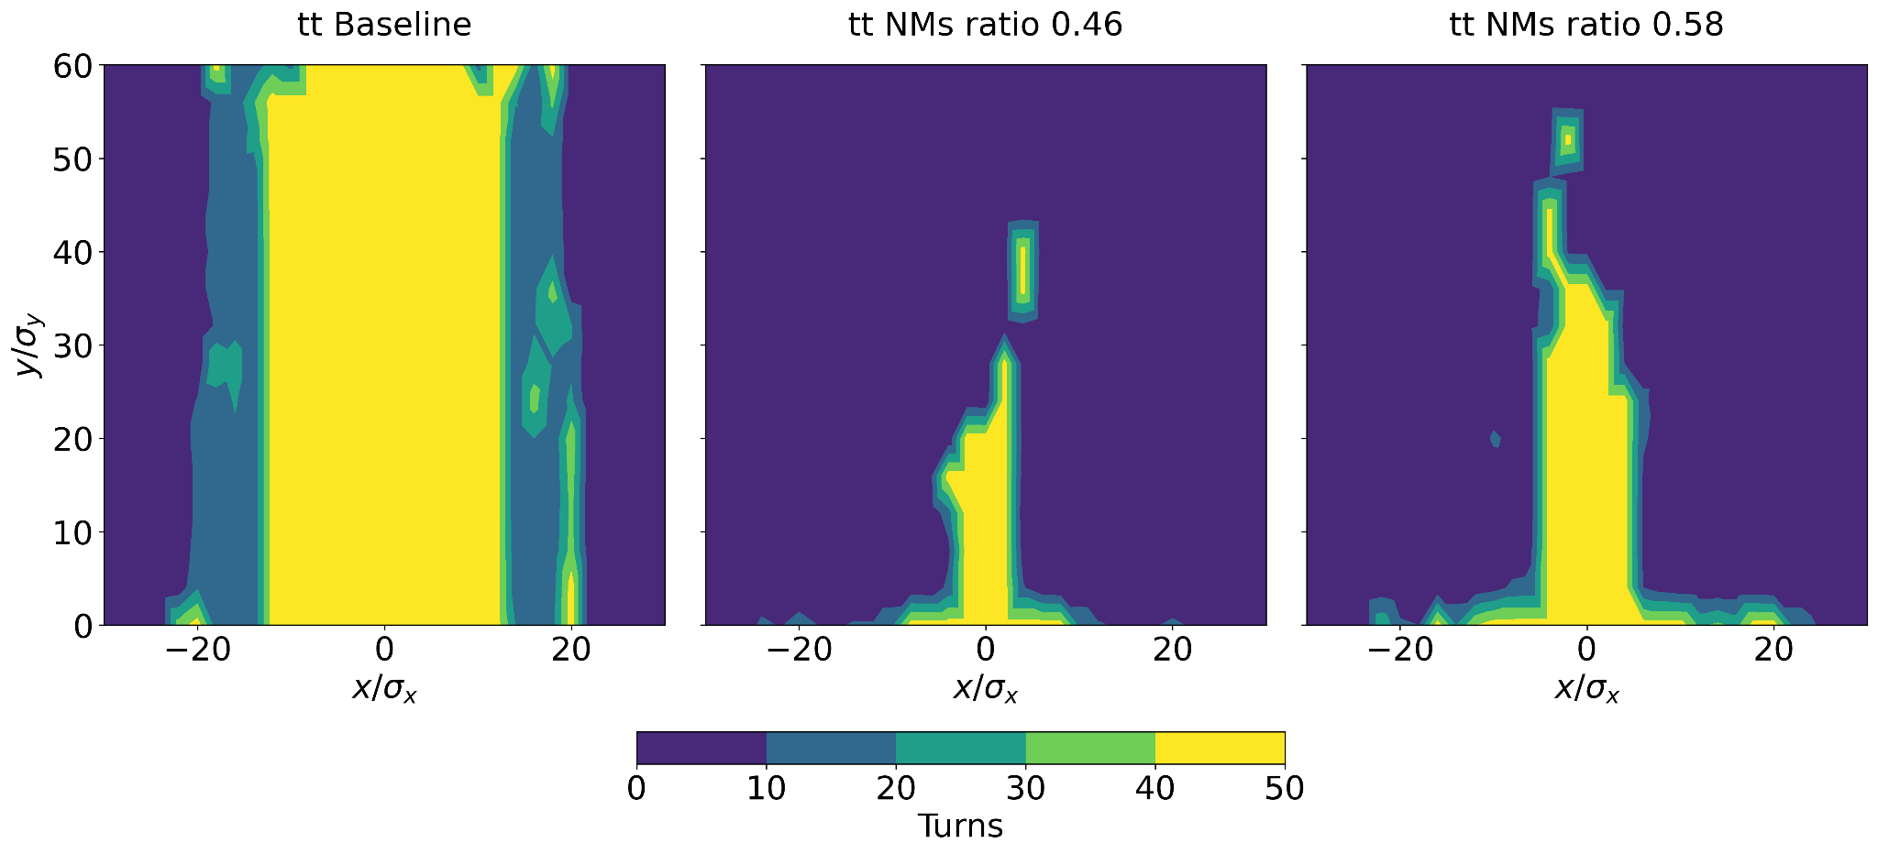
First Look at the Dynamic Aperture
9
Installing the sextupoles at the nominal positions, results in two types of NMs: Dipole+Sextupole & Dipole+Quadrupole.
The Dynamic Aperture (DA) presents significant challenges (better DA at larger Bq/B1 ratios) which should be addressed through sextupole optimization.
  Additionally, it will be necessary to explore alternative configurations for sextupoles that may offer better performance.
Cristóbal García-Jaimes
FCC WEEK 2025

Slide 10
Summary and Outlook
10
A new lattice design using nested magnets has been fully integrated in the GHC lattice.
Beam stability was achieved by adjusting the dipole fields inside focusing quadrupoles. In parallel, layout compatibility issues between lattice configurations have also been resolved with the following advantages:
  Only one arc dipole family is required, replacing the original three (B1, B1S, B1L).
  This optics could also be feasible with Combined Function Magnets, but requires further studies.
  NMs could achieve a range of around 15% reduction in Synchrotron Radiation power loss, contributing to a potential 20% decrease in the machine's total energy consumption [2].
Future work to optimize DA and evaluate the impact on beam alignment and tuning flexibility.
The LCC optics already feature a lower U0 compared to the baseline design, and preliminary tests indicate that an additional 6% reduction can be achieved with the implementation of NMs, confirming the broader applicability of the concept.
Cristóbal García-Jaimes
FCC WEEK 2025

Slide 11

Ballistic Optics for Commissioning
(Z lattice)

Slide 12
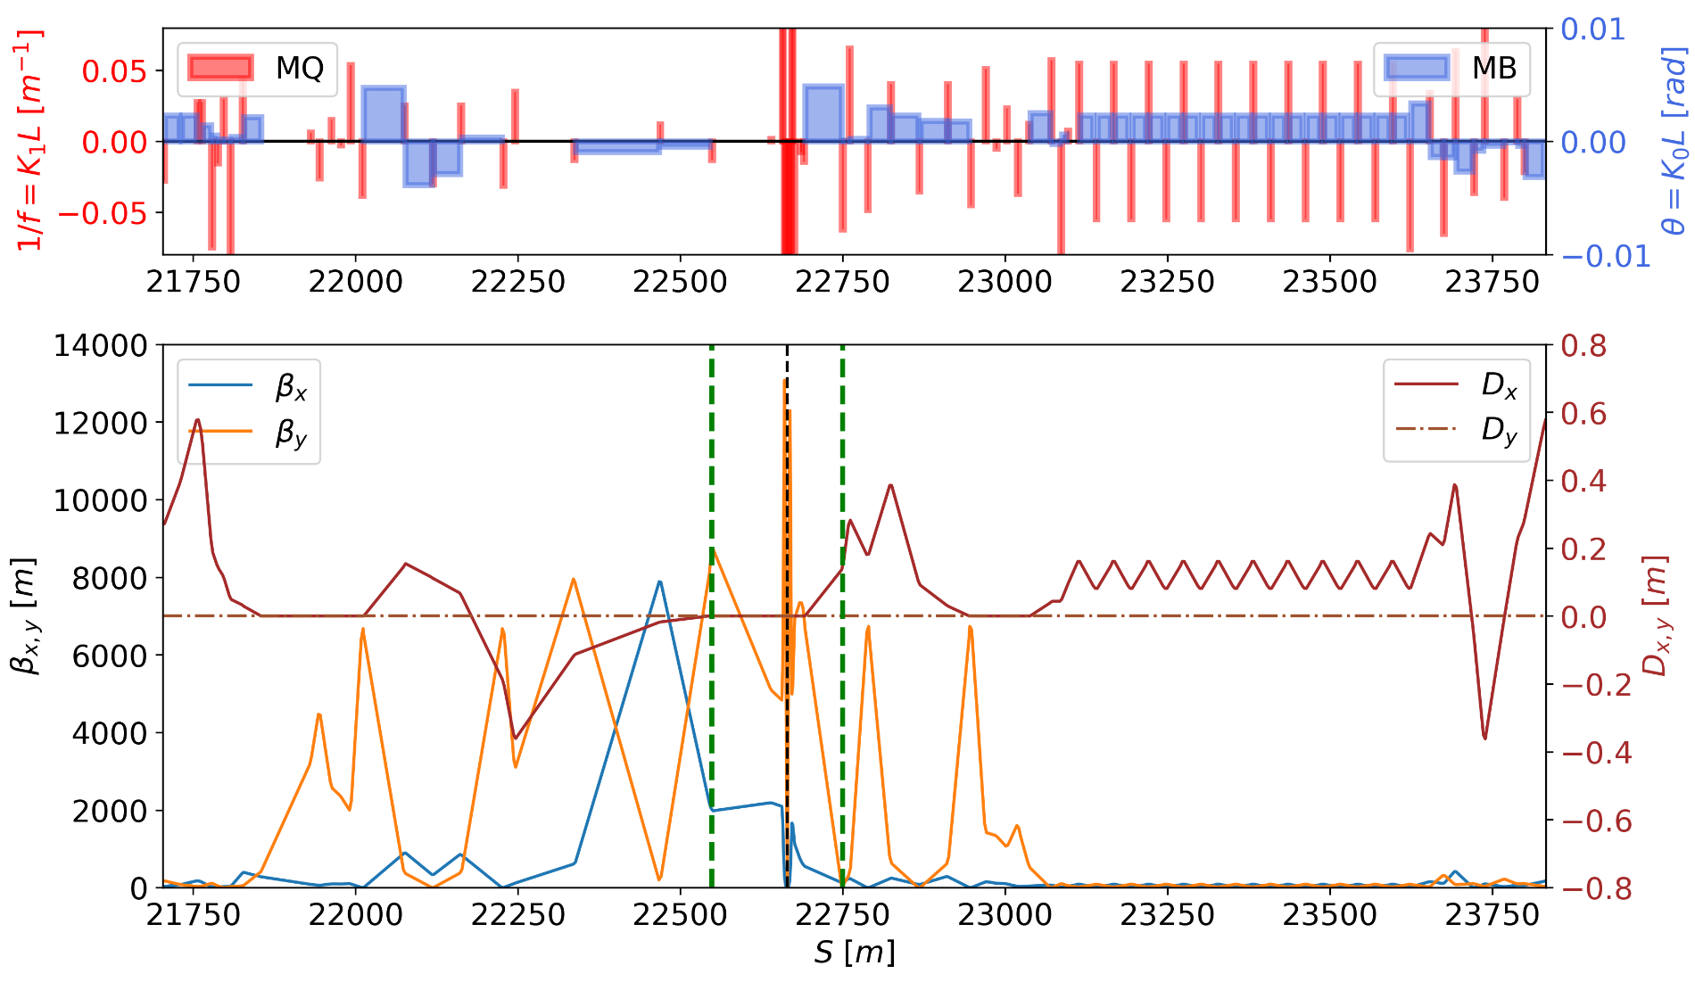
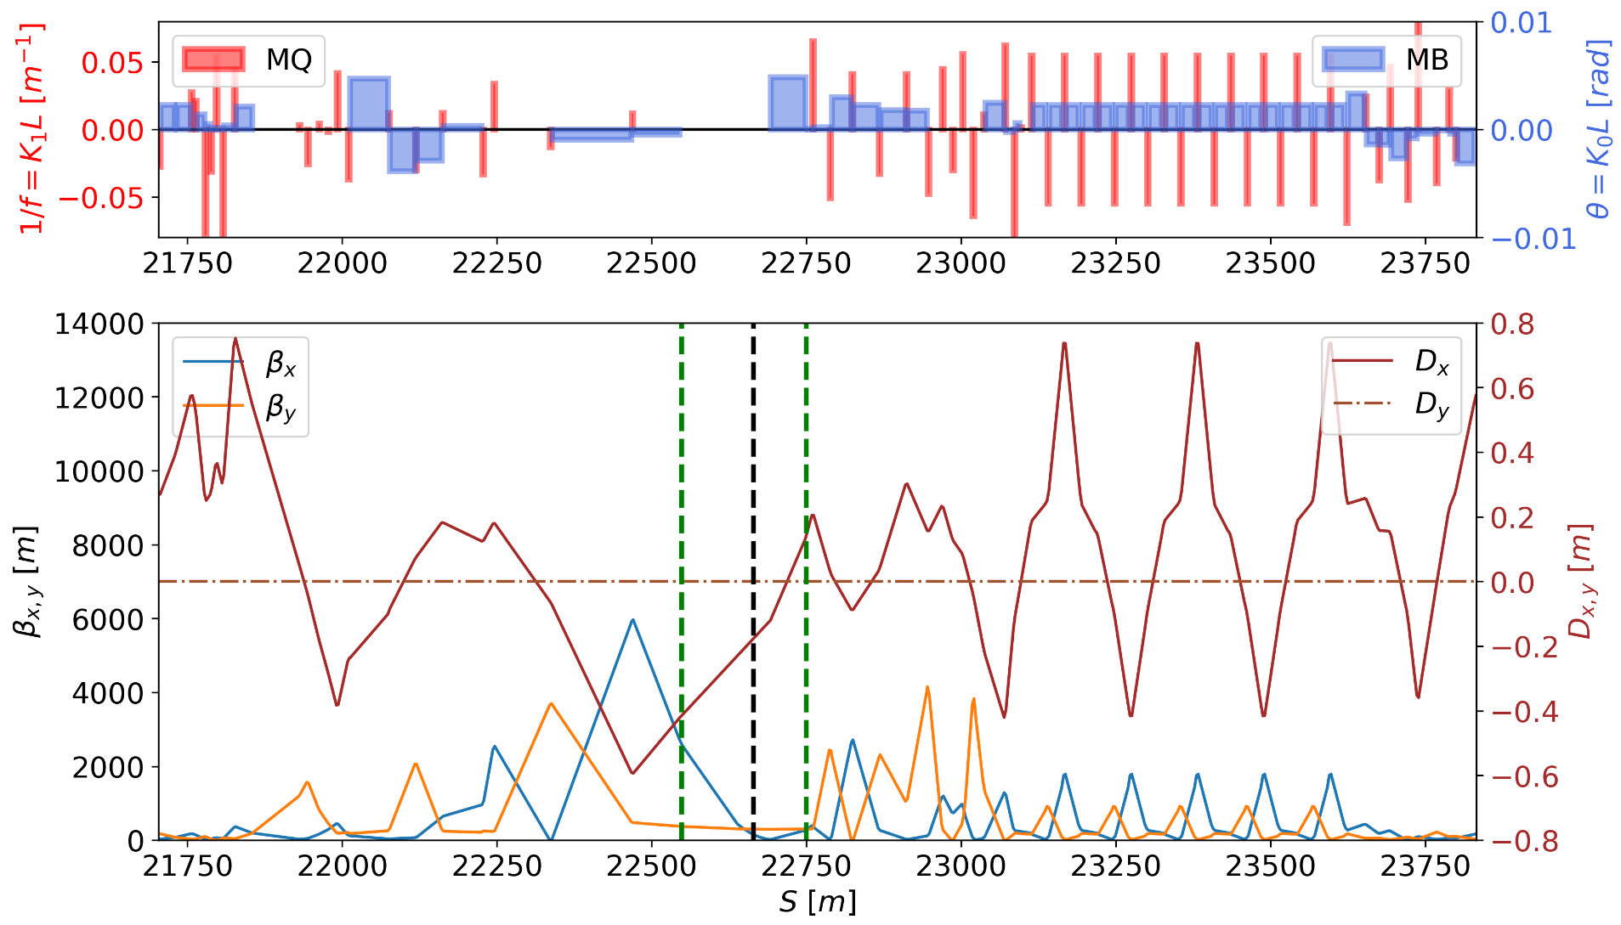
Ballistic Optics for Z lattice
Ballistic optics removes field gradients near the IP, allowing straight beam orbits for easier BPM alignment and calibration.
It also has low chromaticity and no synchrotron radiation in the Final Doublet, making it ideal for initial tuning [7-8].
Cristóbal García-Jaimes
Baseline lattice
VS
Ballistic lattice
FCC WEEK 2025
Notes:
To get the optical configuration you want → matching

Slide 13
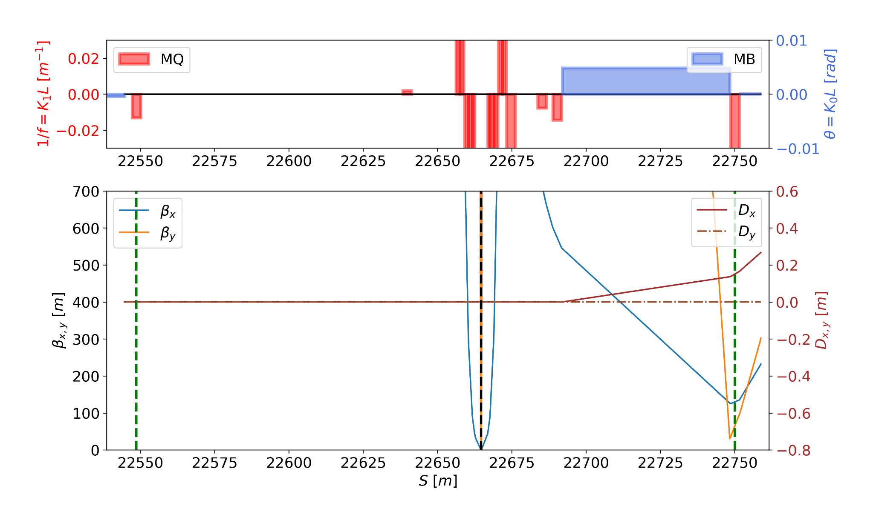
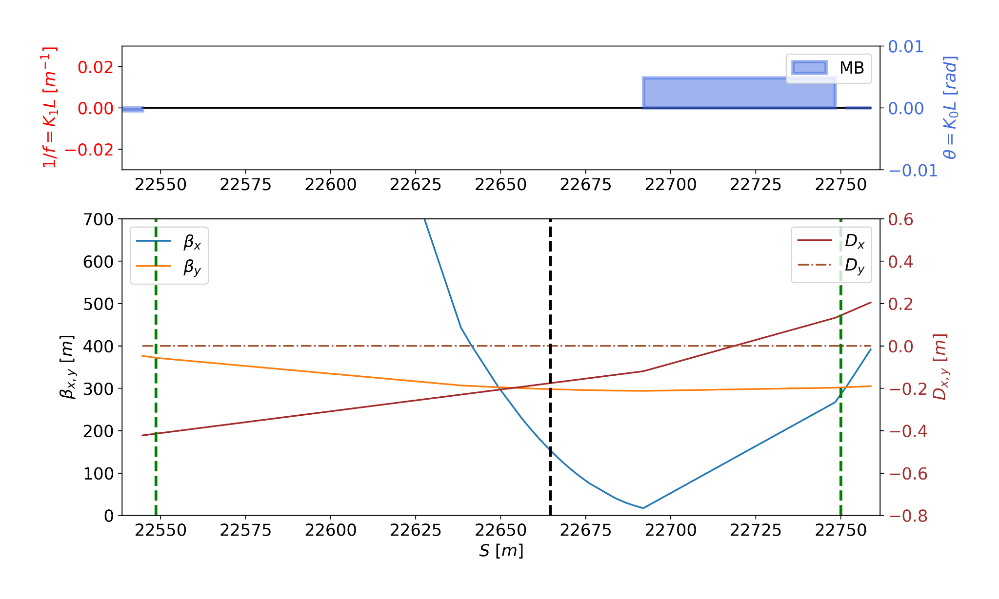
Ballistic Optics for Z lattice
Strategy:
Select a Ballistic Region (BR) in the Interaction Region (IR) and turn off the quadrupoles there.
Turn off all the sextupoles in the IR
Rematching the BR in terms of Betas.
Cristóbal García-Jaimes
Baseline lattice
VS
Ballistic lattice
FCC WEEK 2025
IP
IP
Ballistic Region
Ballistic Region
Notes:
To get the optical configuration you want → matching

Slide 14
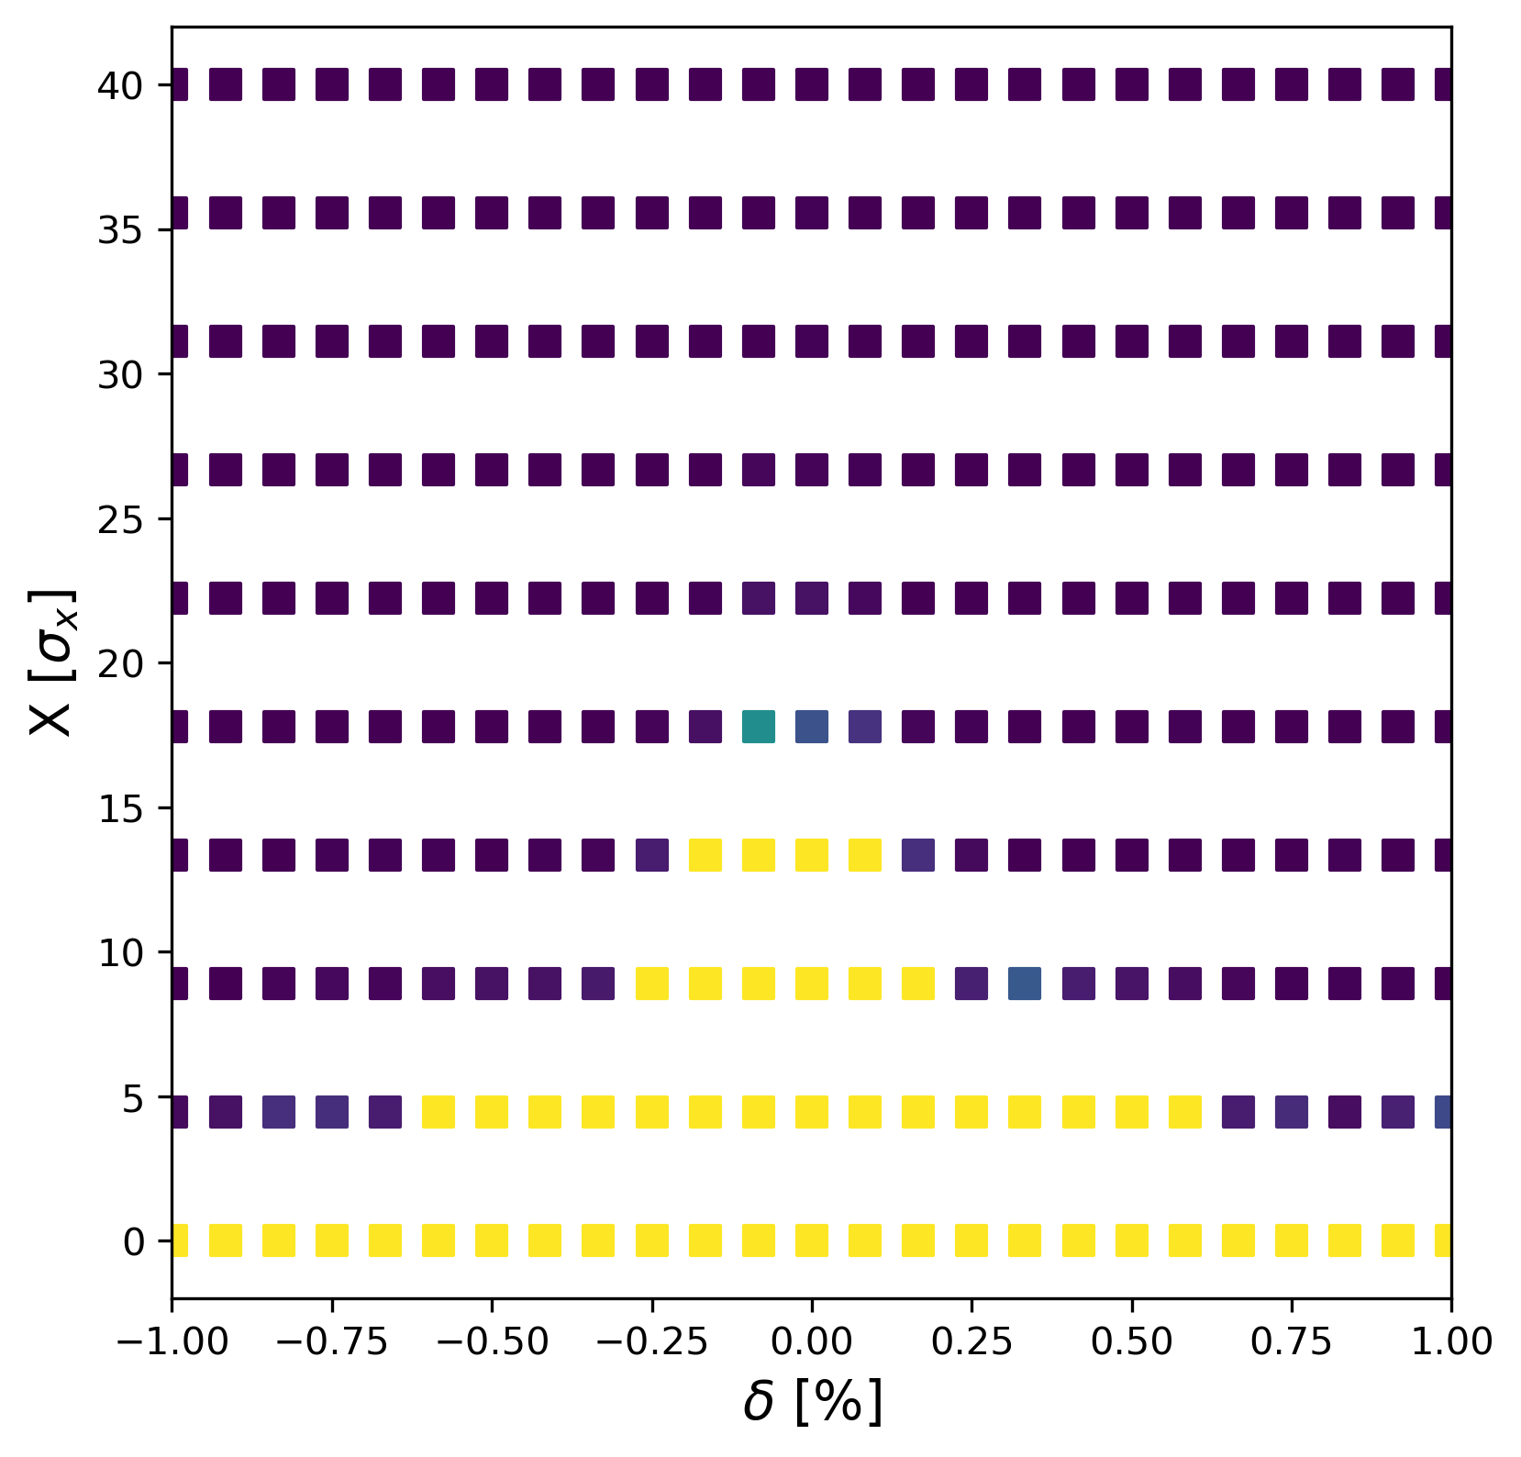
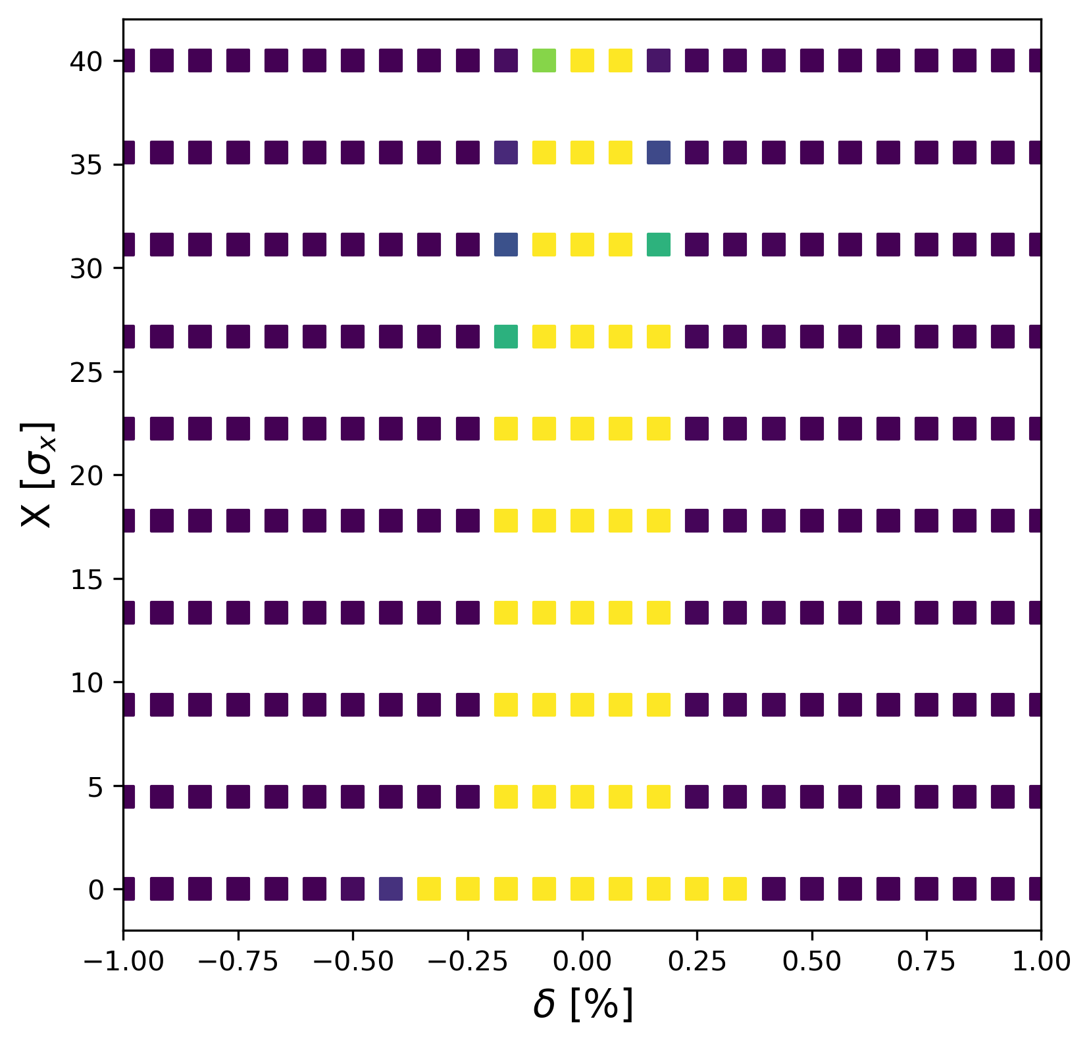
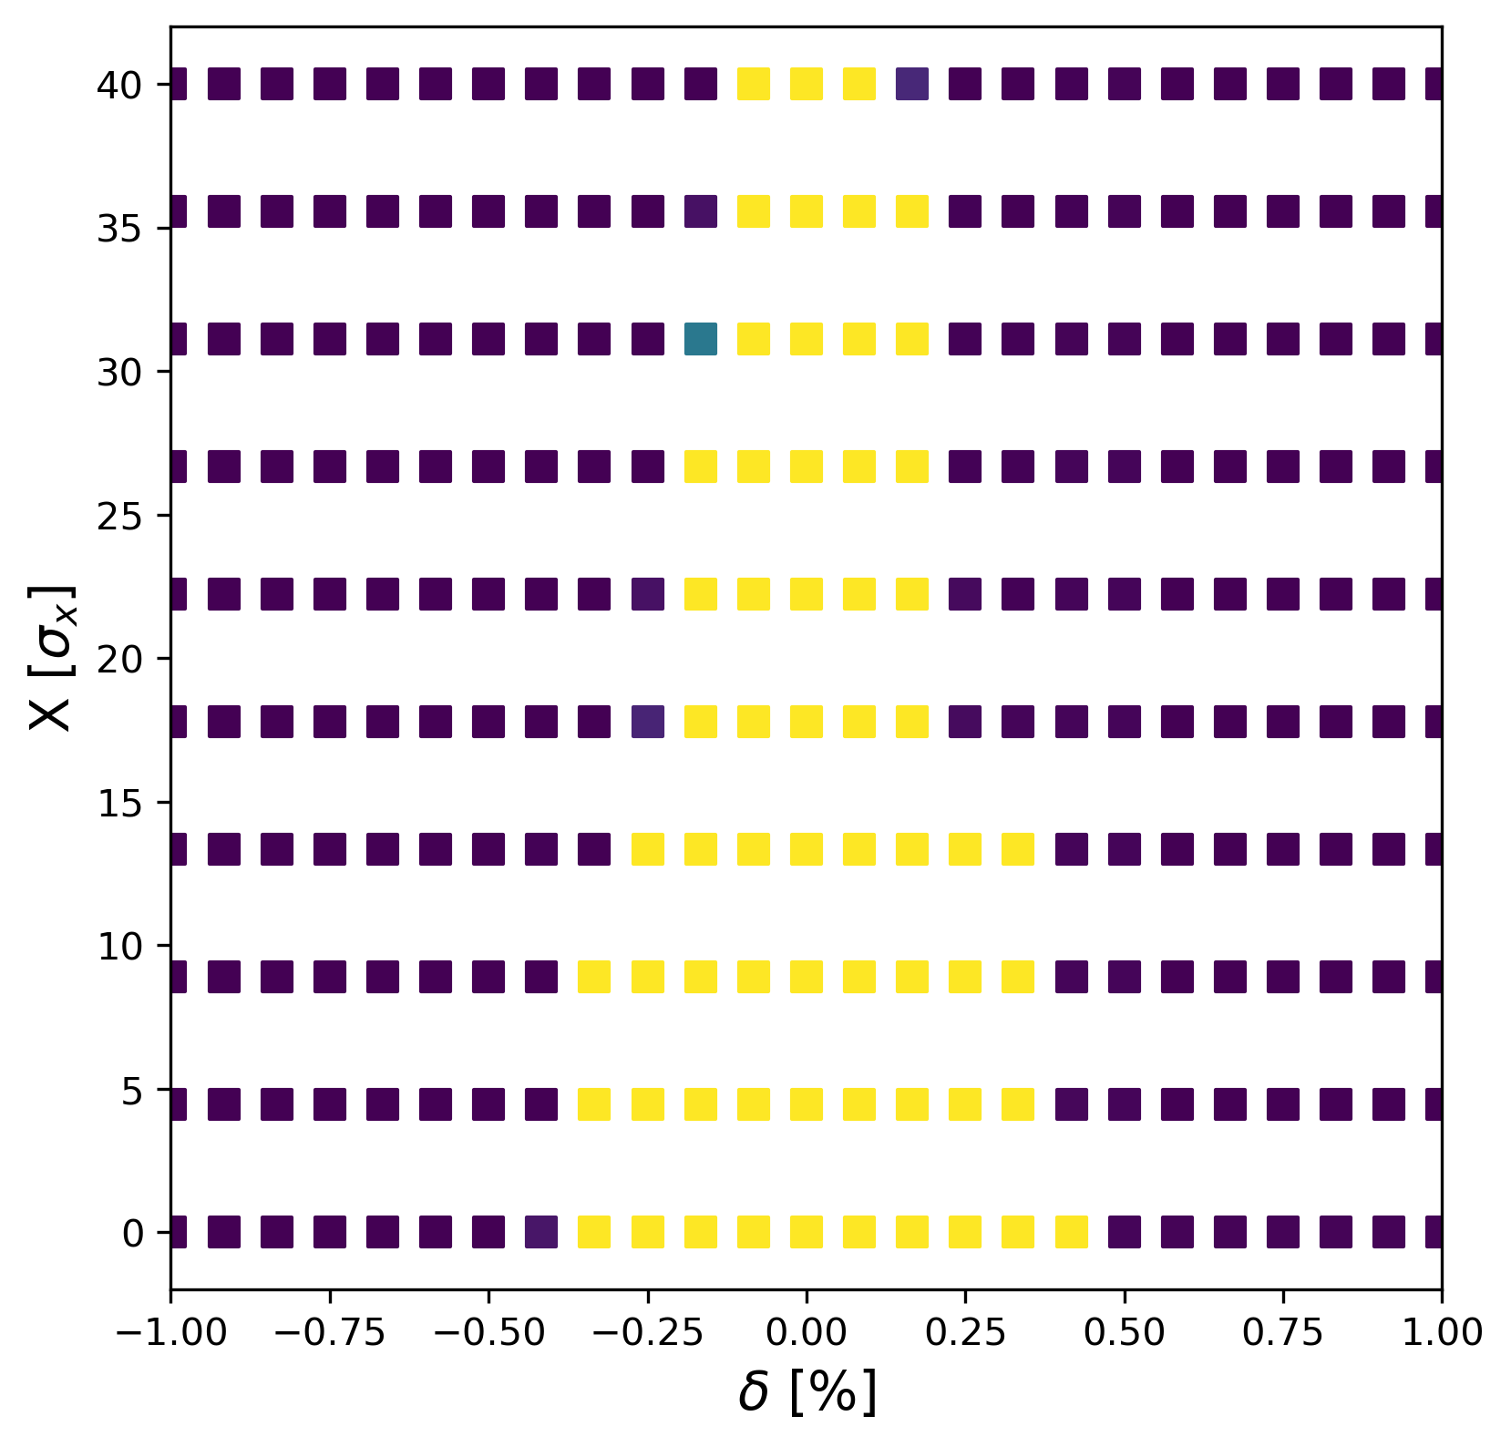
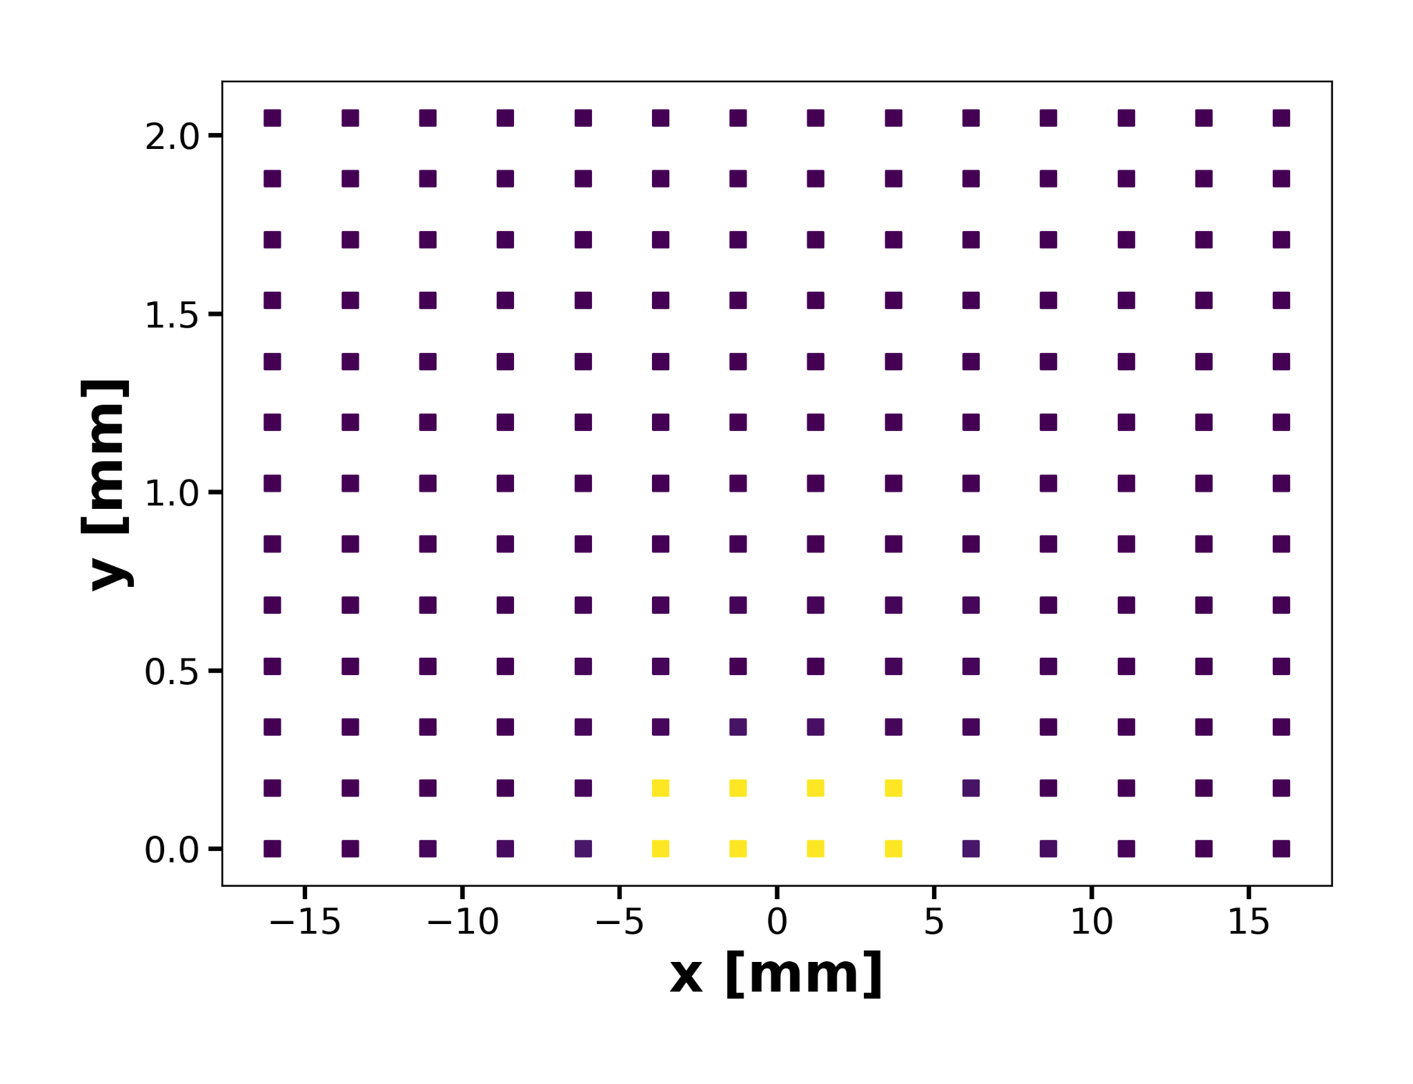
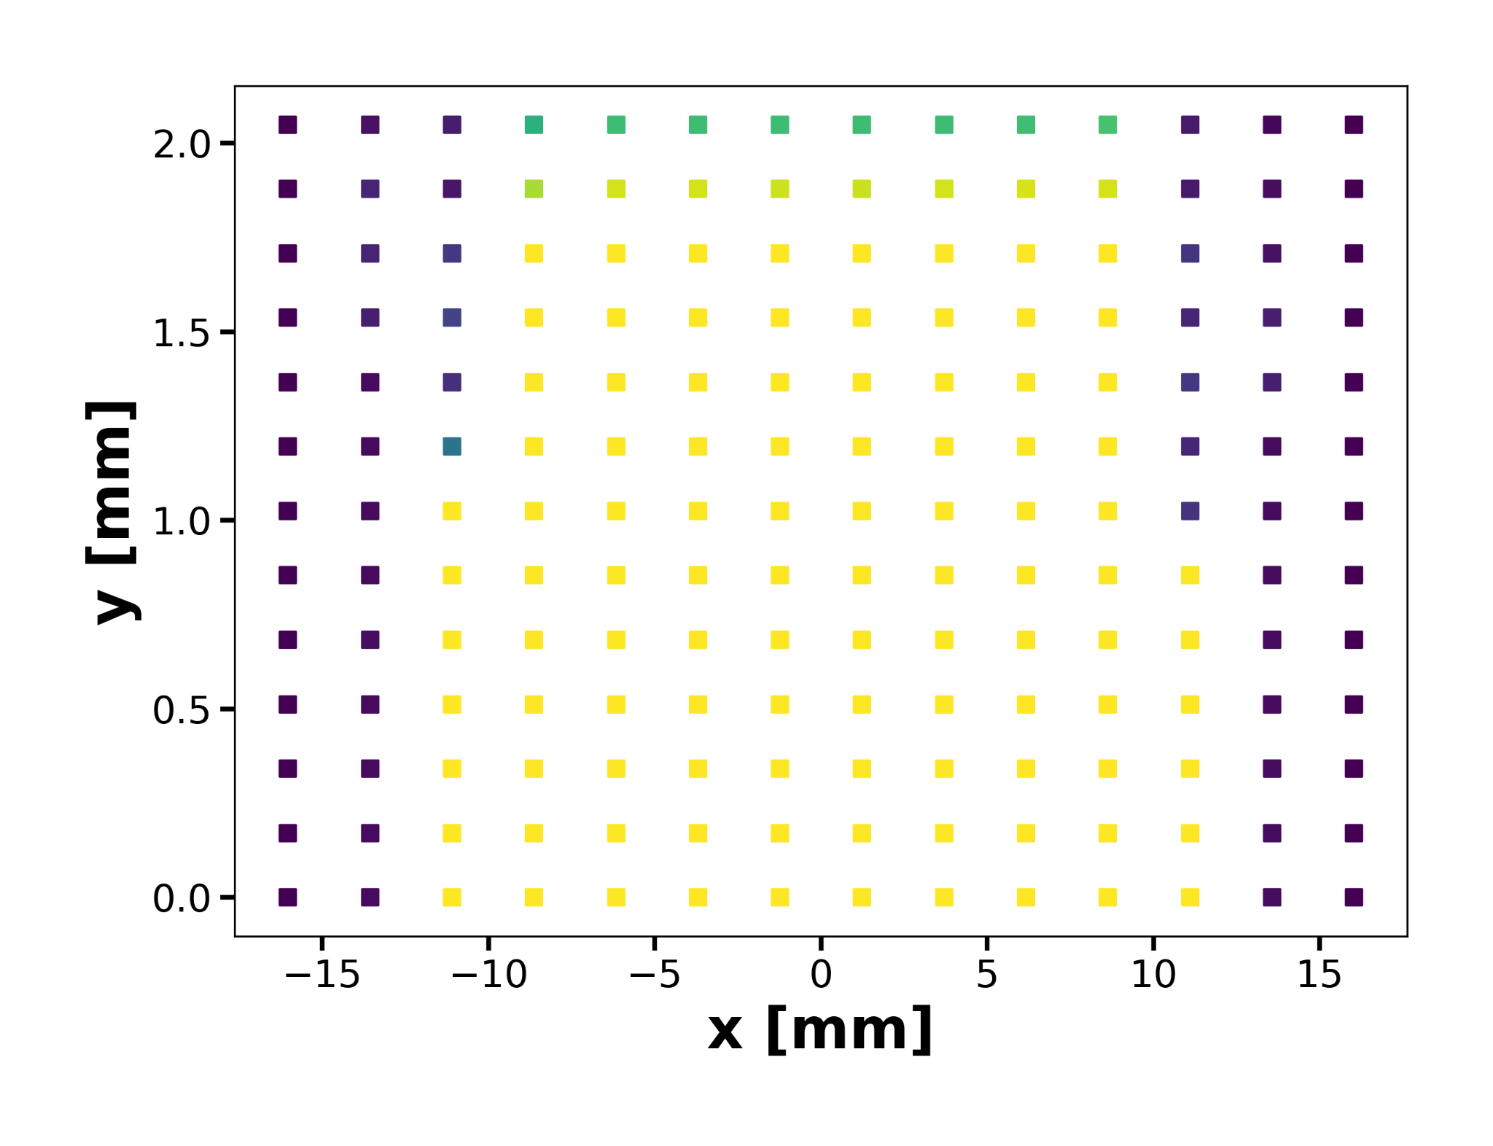
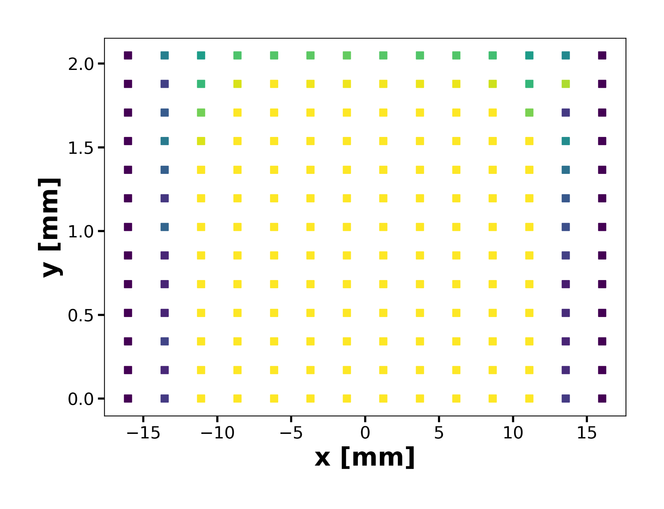
Momentum Acceptance & Dynamic Aperture
13
Baseline V23
Baseline Ballistic Optics
Optimized Ballistic Optics
MA
Cristóbal García-Jaimes
FCC WEEK 2025
DA

Slide 15
Conclusions and outlook
Ballistic Optics
  Ballistic optics feature a significantly larger DA, ideal for the early commissioning.
  It is possible to achieve improved ballistic optics by optimizing MA with the arc sextupole families, and the DA remains enhanced, more details [10].
  Future studies should focus on optimizing MA and Beam Lifetime.
Cristóbal García-Jaimes

Slide 16
References
[1] HTS4 development. M. Koratzinos. FCCWeek2025
[2] Kosse, J., Schmidt, J., Auchmann, B., Brem, A., Thabuis, A., & Koratzinos, M. (2024, septiembre 13). HTS4: Towards an energy-efficient FCC-ee. SPS2024, CERN. https://indico.cern.ch/event/1382917/contributions/6028543/attachments/2927303/5139183/2024_SPS_HTS4_4.pdf
[3] C. GARCIA JAIMES, L. van Riesen-Haupt, R. Tomas, and T. Pieloni, “Exploring FCCee optics designs with combined function magnets”, in Proc. 14th Int. Particle Accelerator Conf. (IPAC'23), Venice, Italy, May 2023, paper MOPL066, pp. 698-701.
[4] C. GARCIA JAIMES, L. van Riesen-Haupt, M. Seidel, R. Tomas, and T. Pieloni, “Impact of dipole quadrupolar errors in FCC-ee”, in Proc. 14th Int. Particle Accelerator Conf. (IPAC'23), Venice, Italy, May 2023, paper MOPL065, pp. 694-697.
[5] C. M. Garcia Jaimes, L. van Riesen-Haupt, M. Seidel, R. Tomas, and T. Pieloni, “First FCC-ee lattice designs with Nested Magnets”, presented at the 15th Int. Particle Accelerator Conf. (IPAC'24), Nashville, TN, USA, May 2024, paper WEPR10, this conference.
[6] C. M. Garcia Jaimes, T. Pieloni, L. van Riesen-Haupt, M. Seidel, and R. Tomas, “First comparison studies in Dynamic Aperture for Nested Magnets and baseline lattice in the FCC-ee”, presented at the 15th Int. Particle Accelerator Conf. (IPAC'24), Nashville, TN, USA, May 2024, paper WEPR12, this conference.
[7] C. M. Garcia Jaimes et al., “Parameter space for the magnetic design of Nested Magnets in the FCC-ee arc cell”, presented at the 15th Int. Particle Accelerator Conf. (IPAC'24), Nashville, TN, USA, May 2024, paper WEPR11, this conference.
[8] Garcia Jaimes, C., van Riesen-Haupt, L., Pieloni, T., & Tomás, R. (2024, septiembre). Ballistic Optics for FCC-ee.CERN. https://indico.cern.ch/event/1450442/contributions/6113015/attachments/2927766/5140223/Ballistic%20Optics%20tuning%20meeting.pdf
[9] Garcia Jaimes, C., Iadarola, G., Skoufaris, K., van Riesen-Haupt, L., Pieloni, T., & Tomás, R. (2024, noviembre). Update for Ballistic Optics. Presentación en la reunión de ajuste de óptica balística, CERN. Recuperado de https://indico.cern.ch/event/1477971/contributions/6231754/attachments/2968140/5222652/Update%20for%20Ballistic%20Optics.pdf
[10] Integrated simulations for calculation of tolerances. K. Skoufaris. FCCWeek2025.
Cristóbal García-Jaimes
FCC WEEK 2023

Slide 17
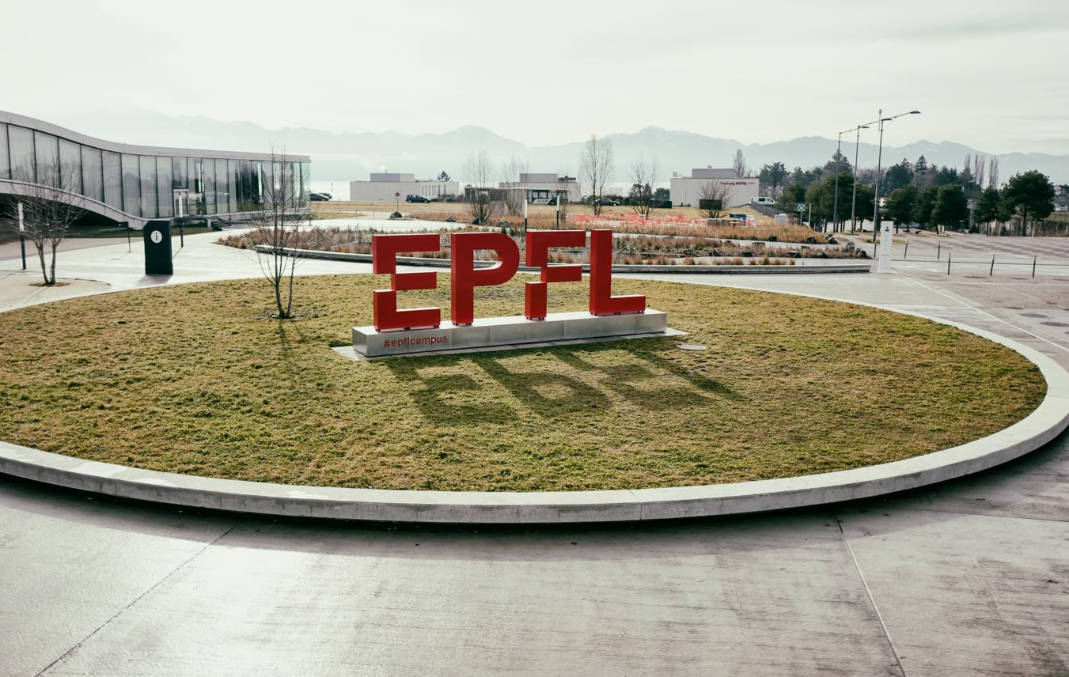
Merci
Cristóbal M.
García-Jaimes

Slide 18
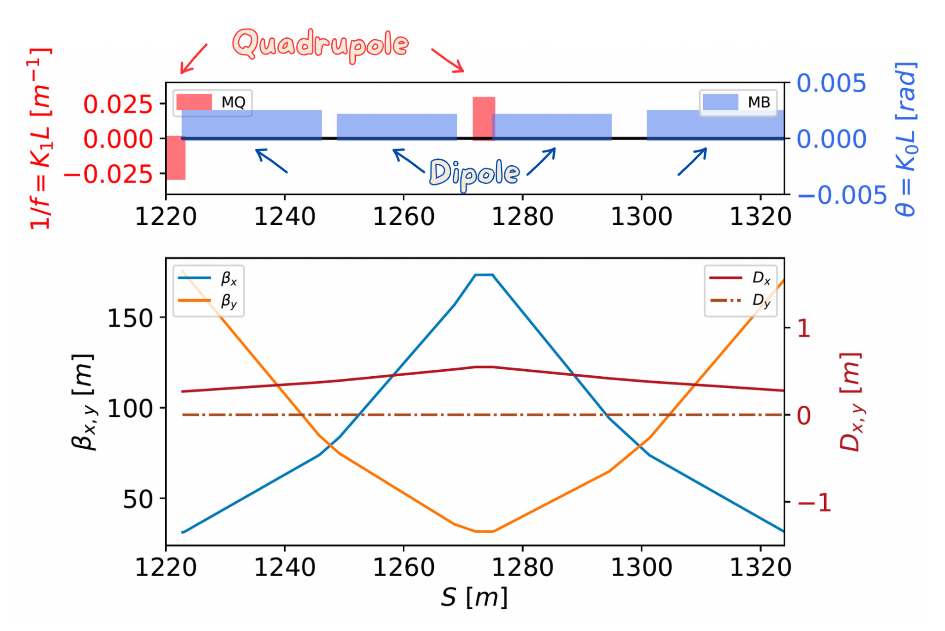
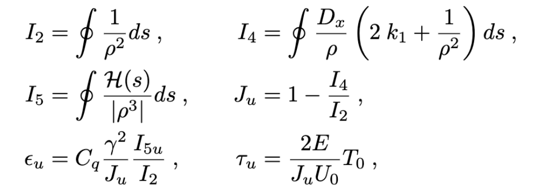
FODO cell and Radiation Integrals
17
Cristóbal García-Jaimes
FCC WEEK 2025

Slide 19
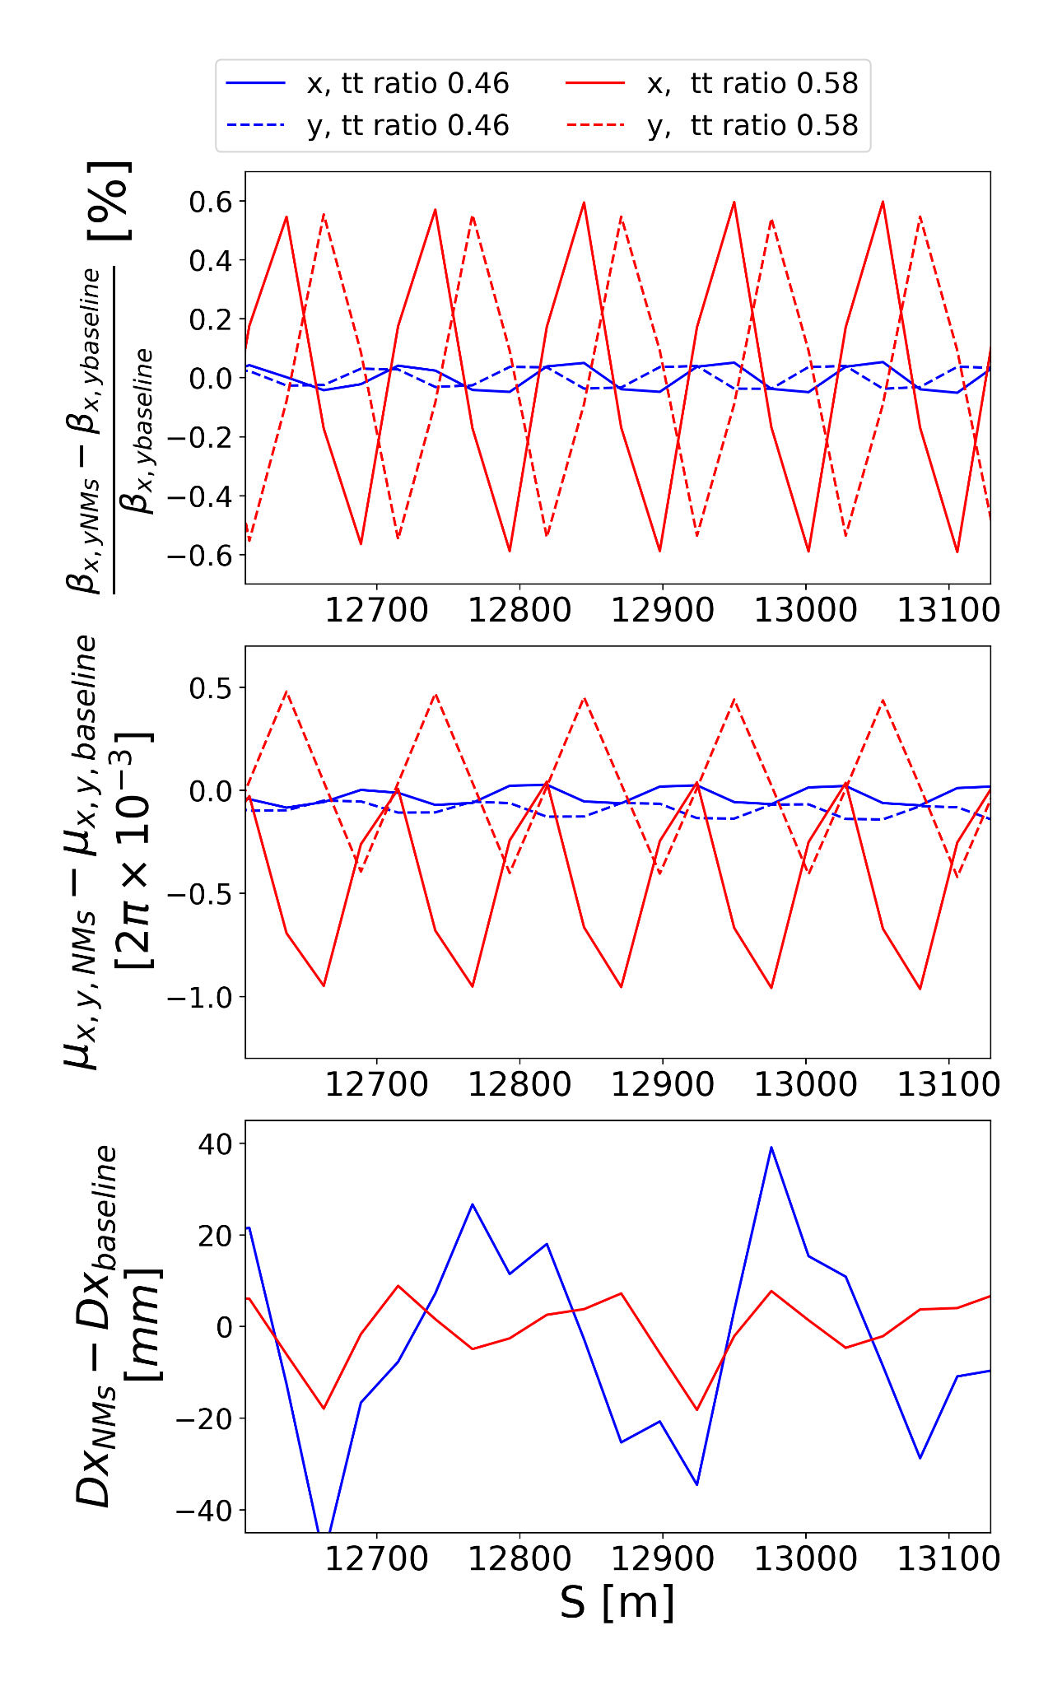
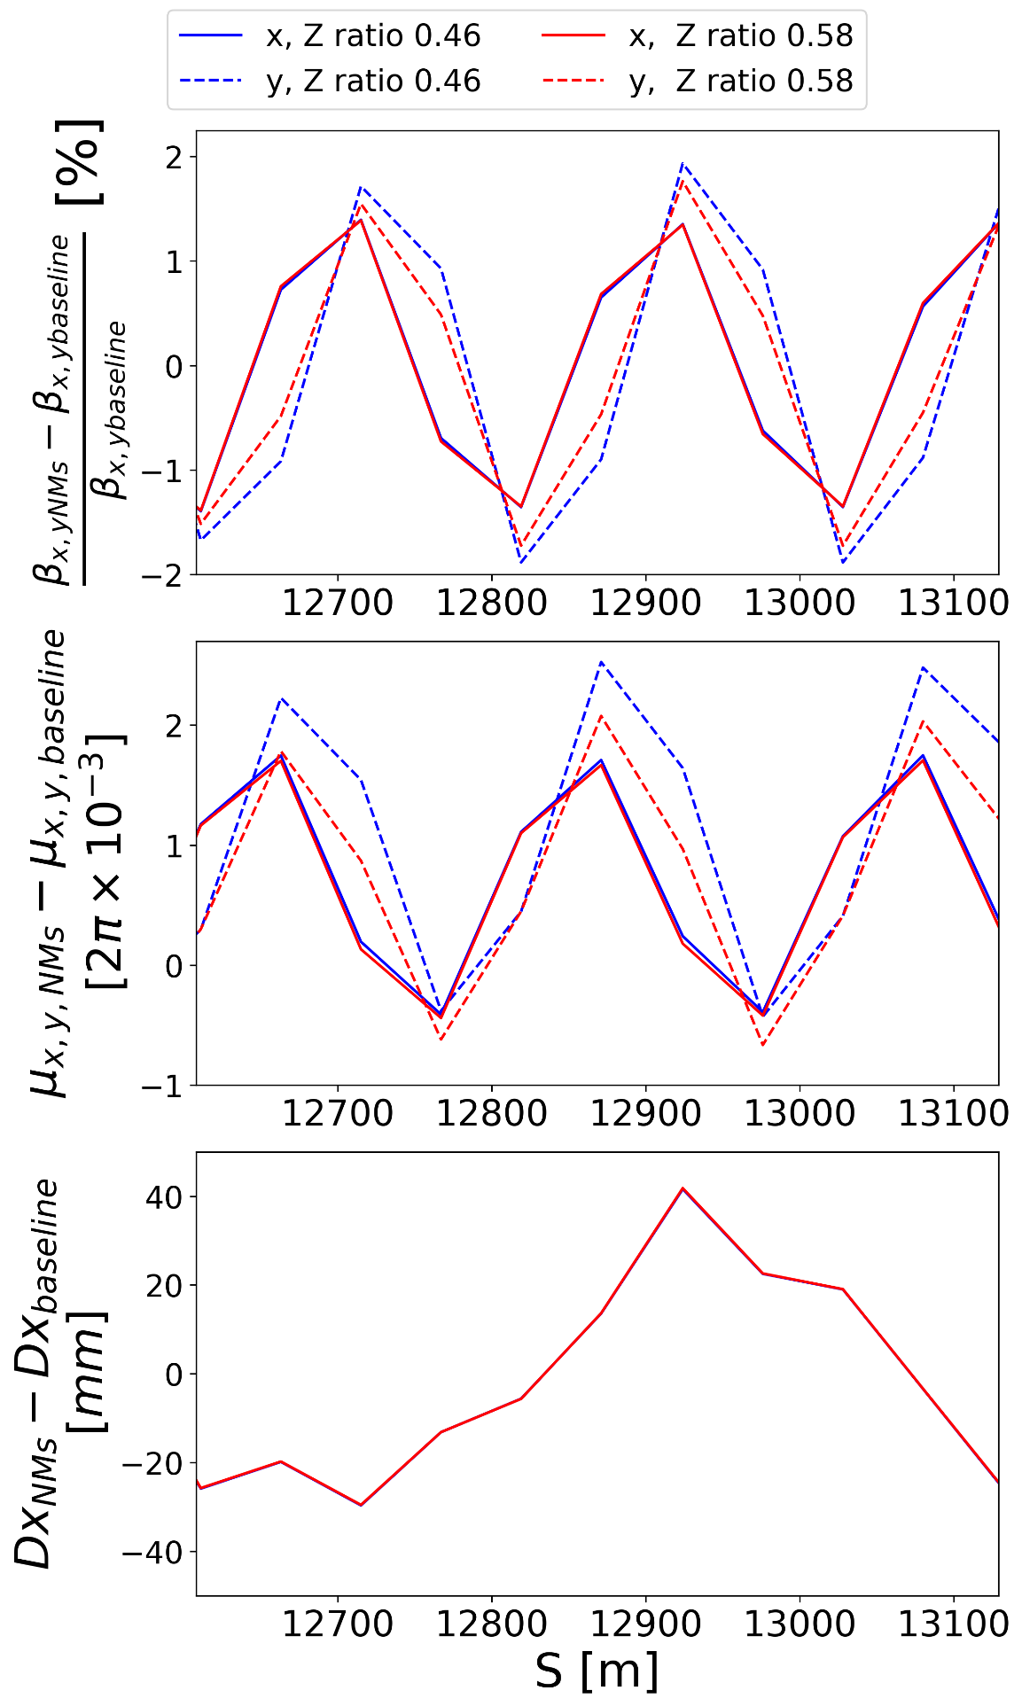
Optical Functions with Nested Magnets
18
Cristóbal García-Jaimes
FCC WEEK 2025

Slide 20
LCC lattice with NMs
19
Parameter | Z GHC | Z LCC | Z LCC NMs
Emittance [nm] | 0.705 | 0.687 | 0.685
U0 [Mev/turn] | 39.11 | 34.50 -11.78% | 32.12 -17.87%
I2 [E-4] | 6.4 | 5.6 | 5.2
I4 [E-10] | -2.5 | 204 | 216474
DPNs | 1 1 2 | 1 1 2 | 0.931 0.999 2.06
Cristóbal García-Jaimes
FCC WEEK 2025

