Slide 1
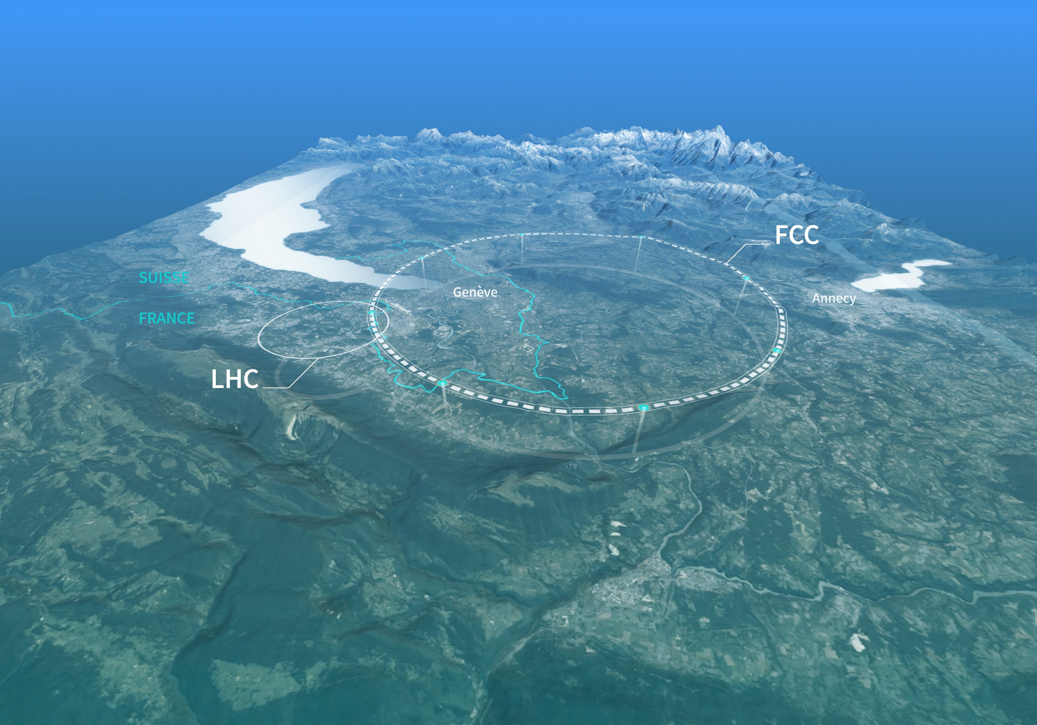




Impact of Collimators' Geometric Impedance on Beam Stability in the FCC-ee
Analysis and Optimization Techniques
FCC week 2025 - 11th edition of the Future Circular Collider Conference , Vienna, Austria, 20 May 2025
Dora Gibellieri^{1,2,3}, Carlo Zannini¹, Adnan Ghribi^{2,3}, Mauro Migliorati^{4,5} and Mikhail Zobov^{4,5}
¹CERN ²University of Caen Normandy ³GANIL ⁴Sapienza University of Rome ⁵INFN

Slide 2

02
Outline
Introduction
  FCC-ee main parameters for Z configuration
  FCC-ee main ring impedance model
FCC-ee beam coupling impedance of the collimation system
  Collimators geometrical impedance
    Optimization strategies
  Collimators RW impedance
    Comparison between different optics
Conclusion and next steps
20.05.2025 | FCC week 2025 | Dora Gibellieri

Slide 3
03
Introduction
Outline
Introduction
  FCC-ee main parameters for Z configuration
  FCC-ee main ring impedance model
FCC-ee beam coupling impedance of the collimation system
  Collimators geometrical impedance
    Optimization strategies
  Collimators RW impedance
    Comparison between different optics
Conclusion and next steps
20.05.2025 | FCC week 2025 | Dora Gibellieri

Slide 4
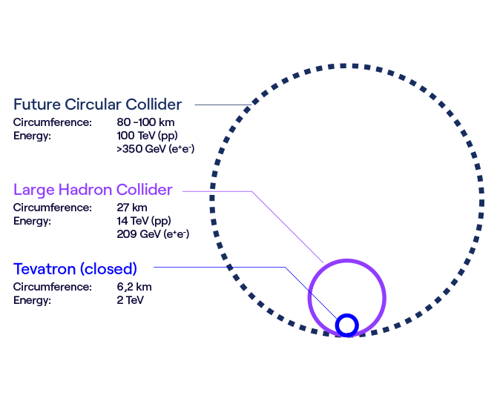
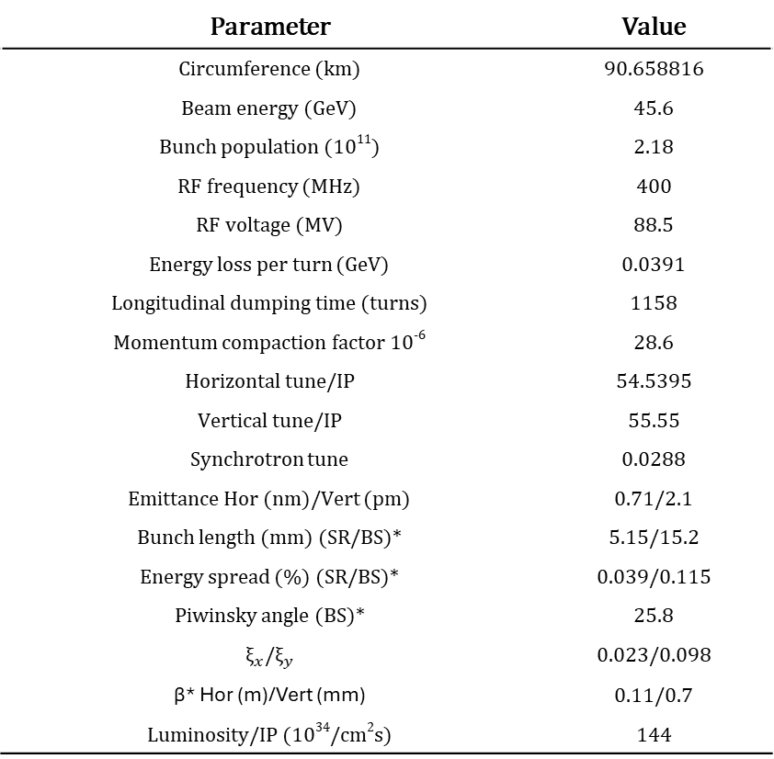
04
Introduction
FCC-ee main parameters for Z configuration
Parameter | Value
Circumference (km) | 90.658816
Beam energy (GeV) | 45.6
Bunch population (10¹¹) | 2.18
RF frequency (MHz) | 400
RF voltage (MV) | 88.5
Energy loss per turn (GeV) | 0.0391
Longitudinal dumping time (turns) | 1158
Momentum compaction factor 10⁻⁶ | 28.6
Horizontal tune/IP | 54.5395
Vertical tune/IP | 55.55
Synchrotron tune | 0.0288
Emittance Hor (nm)/Vert (pm) | 0.71/2.1
Bunch length (mm) (SR/BS)* | 5.15/15.2
Energy spread (%) (SR/BS)* | 0.039/0.115
Piwinsky angle (BS)* | 25.8
${\text{ξ}}_{x}$/${\text{ξ}}_{y}$ | 0.023/0.098
β* Hor (m)/Vert (mm) | 0.11/0.7
Luminosity/IP (10³⁴/cm²s) | 144
Necessity of having a highly flexible model to account for all changes during the feasibility study development phase
*SR: synchrotron radiation, BS: beamstrahlung
20.05.2025 | FCC week 2025 | Dora Gibellieri

Slide 5
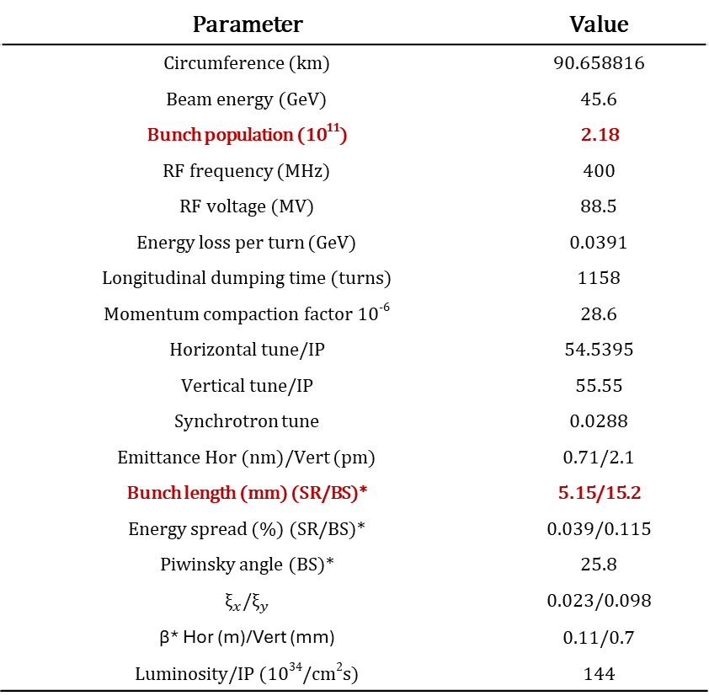
05
Introduction
FCC-ee main parameters for Z configuration
Parameter | Value
Circumference (km) | 90.658816
Beam energy (GeV) | 45.6
Bunch population (10¹¹) | 2.18
RF frequency (MHz) | 400
RF voltage (MV) | 88.5
Energy loss per turn (GeV) | 0.0391
Longitudinal dumping time (turns) | 1158
Momentum compaction factor 10⁻⁶ | 28.6
Horizontal tune/IP | 54.5395
Vertical tune/IP | 55.55
Synchrotron tune | 0.0288
Emittance Hor (nm)/Vert (pm) | 0.71/2.1
Bunch length (mm) (SR/BS)* | 5.15/15.2
Energy spread (%) (SR/BS)* | 0.039/0.115
Piwinsky angle (BS)* | 25.8
${\text{ξ}}_{x}$/${\text{ξ}}_{y}$ | 0.023/0.098
β* Hor (m)/Vert (mm) | 0.11/0.7
Luminosity/IP (10³⁴/cm²s) | 144
Necessity of having a highly flexible model to account for all changes during the feasibility study development phase
*SR: synchrotron radiation, BS: beamstrahlung
20.05.2025 | FCC week 2025 | Dora Gibellieri

Slide 6
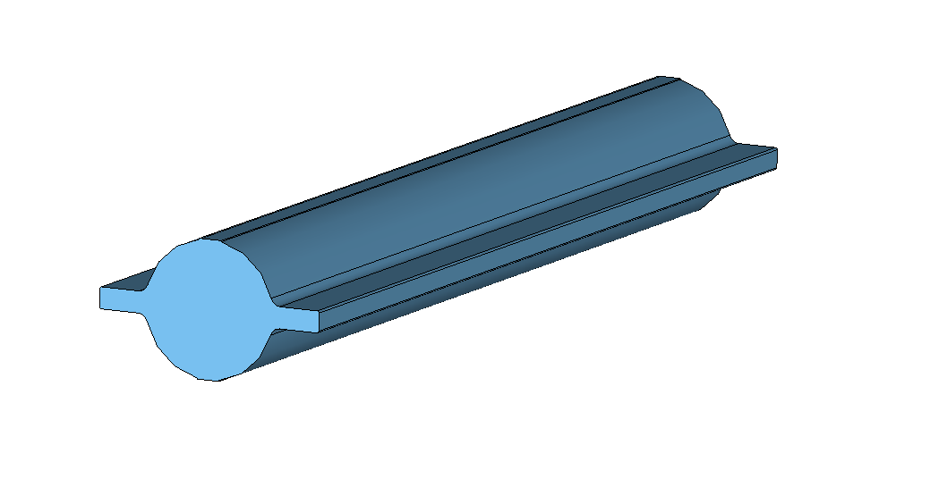

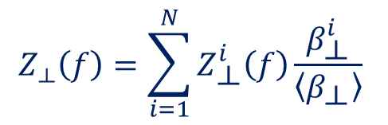

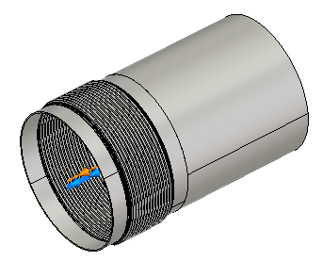
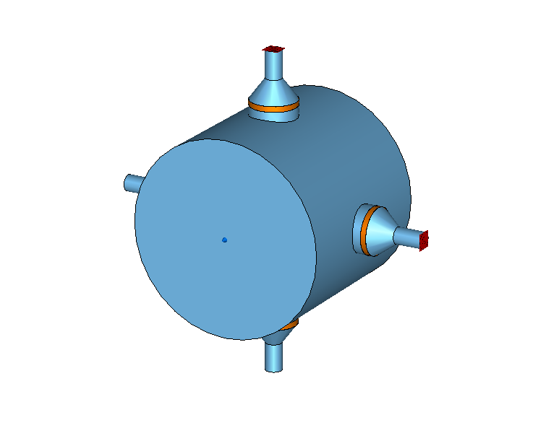
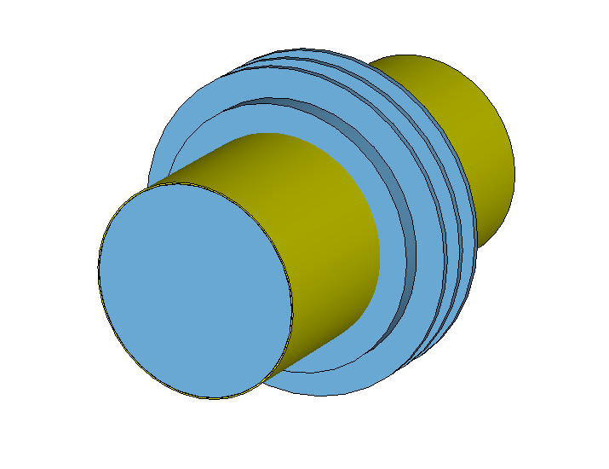

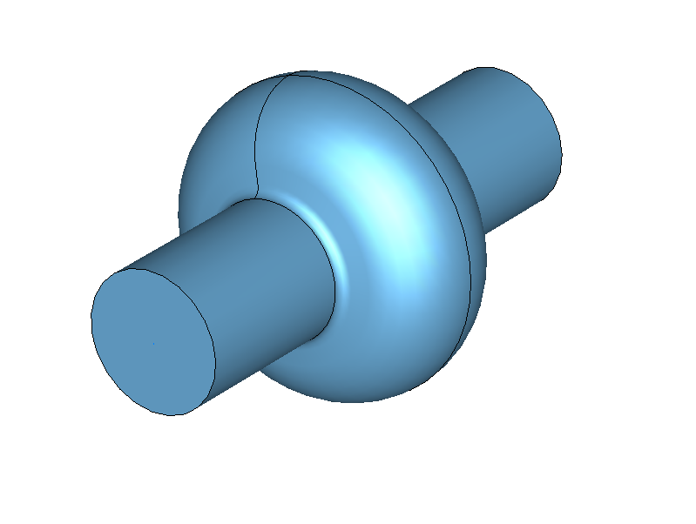
06
Introduction
FCC-ee main ring impedance model
Identify main impedance contributors
3D EM Simulations and Analytical Model
Accelerator I/W Model
IRIS / IW2D · GitLab
20.05.2025 | FCC week 2025 | Dora Gibellieri

Slide 7

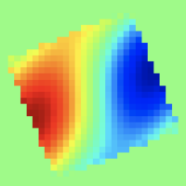
07
Introduction
FCC-ee main ring impedance model
Identify main impedance contributors
3D EM Simulations and Analytical Model
Accelerator I/W Model
FCC-ee I/W model
ImpedanCEI/fcc_ee_IW_model: Impedance/Wake model of the Future Circular Collider (FCC)
20.05.2025 | FCC week 2025 | Dora Gibellieri

Slide 8
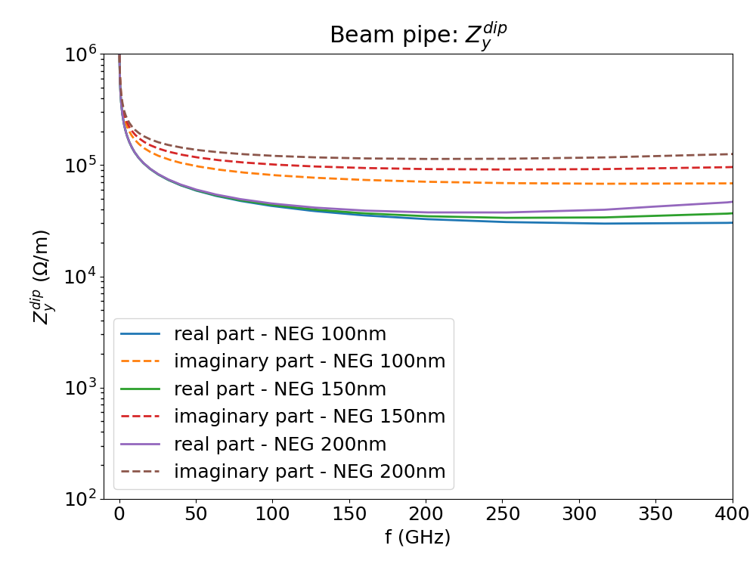
08
Introduction
Highly flexible I/W model
Identify main impedance contributors
3D EM Simulations and Analytical Model
Accelerator I/W Model
Flexible & modular model
Thanks to its flexibility, the developed model integrates seamlessly with IW2D. Variations in material properties or coating thickness—such as changes to the NEG coating of the beam pipe—can be readily incorporated, enabling rapid evaluation of their impact on the overall impedance.
20.05.2025 | FCC week 2025 | Dora Gibellieri

Slide 9

09
Introduction
FCC-ee main ring impedance model
Identify main impedance contributors
3D EM Simulations and Analytical Model
Accelerator I/W Model
Output:
Assessment of beam stability
Beam Dynamics Simulations
20.05.2025 | FCC week 2025 | Dora Gibellieri

Slide 10
10
Introduction
FCC-ee main ring impedance model
Identify main impedance contributors
3D EM Simulations and Analytical Model
Accelerator I/W Model
Output:
Assessment of beam stability
Beam Dynamics Simulations
Flexible & modular model
Constant Model Optimization
20.05.2025 | FCC week 2025 | Dora Gibellieri

Slide 11
11
FCC-ee beam coupling impedance of the collimation system
Outline
Introduction
  FCC-ee main parameters for Z configuration
  FCC-ee main ring impedance model
FCC-ee beam coupling impedance of the collimation system
  Collimators geometrical impedance
    Optimization strategies
  Collimators RW impedance
    Comparison between different optics
Conclusion and next steps
20.05.2025 | FCC week 2025 | Dora Gibellieri

Slide 12
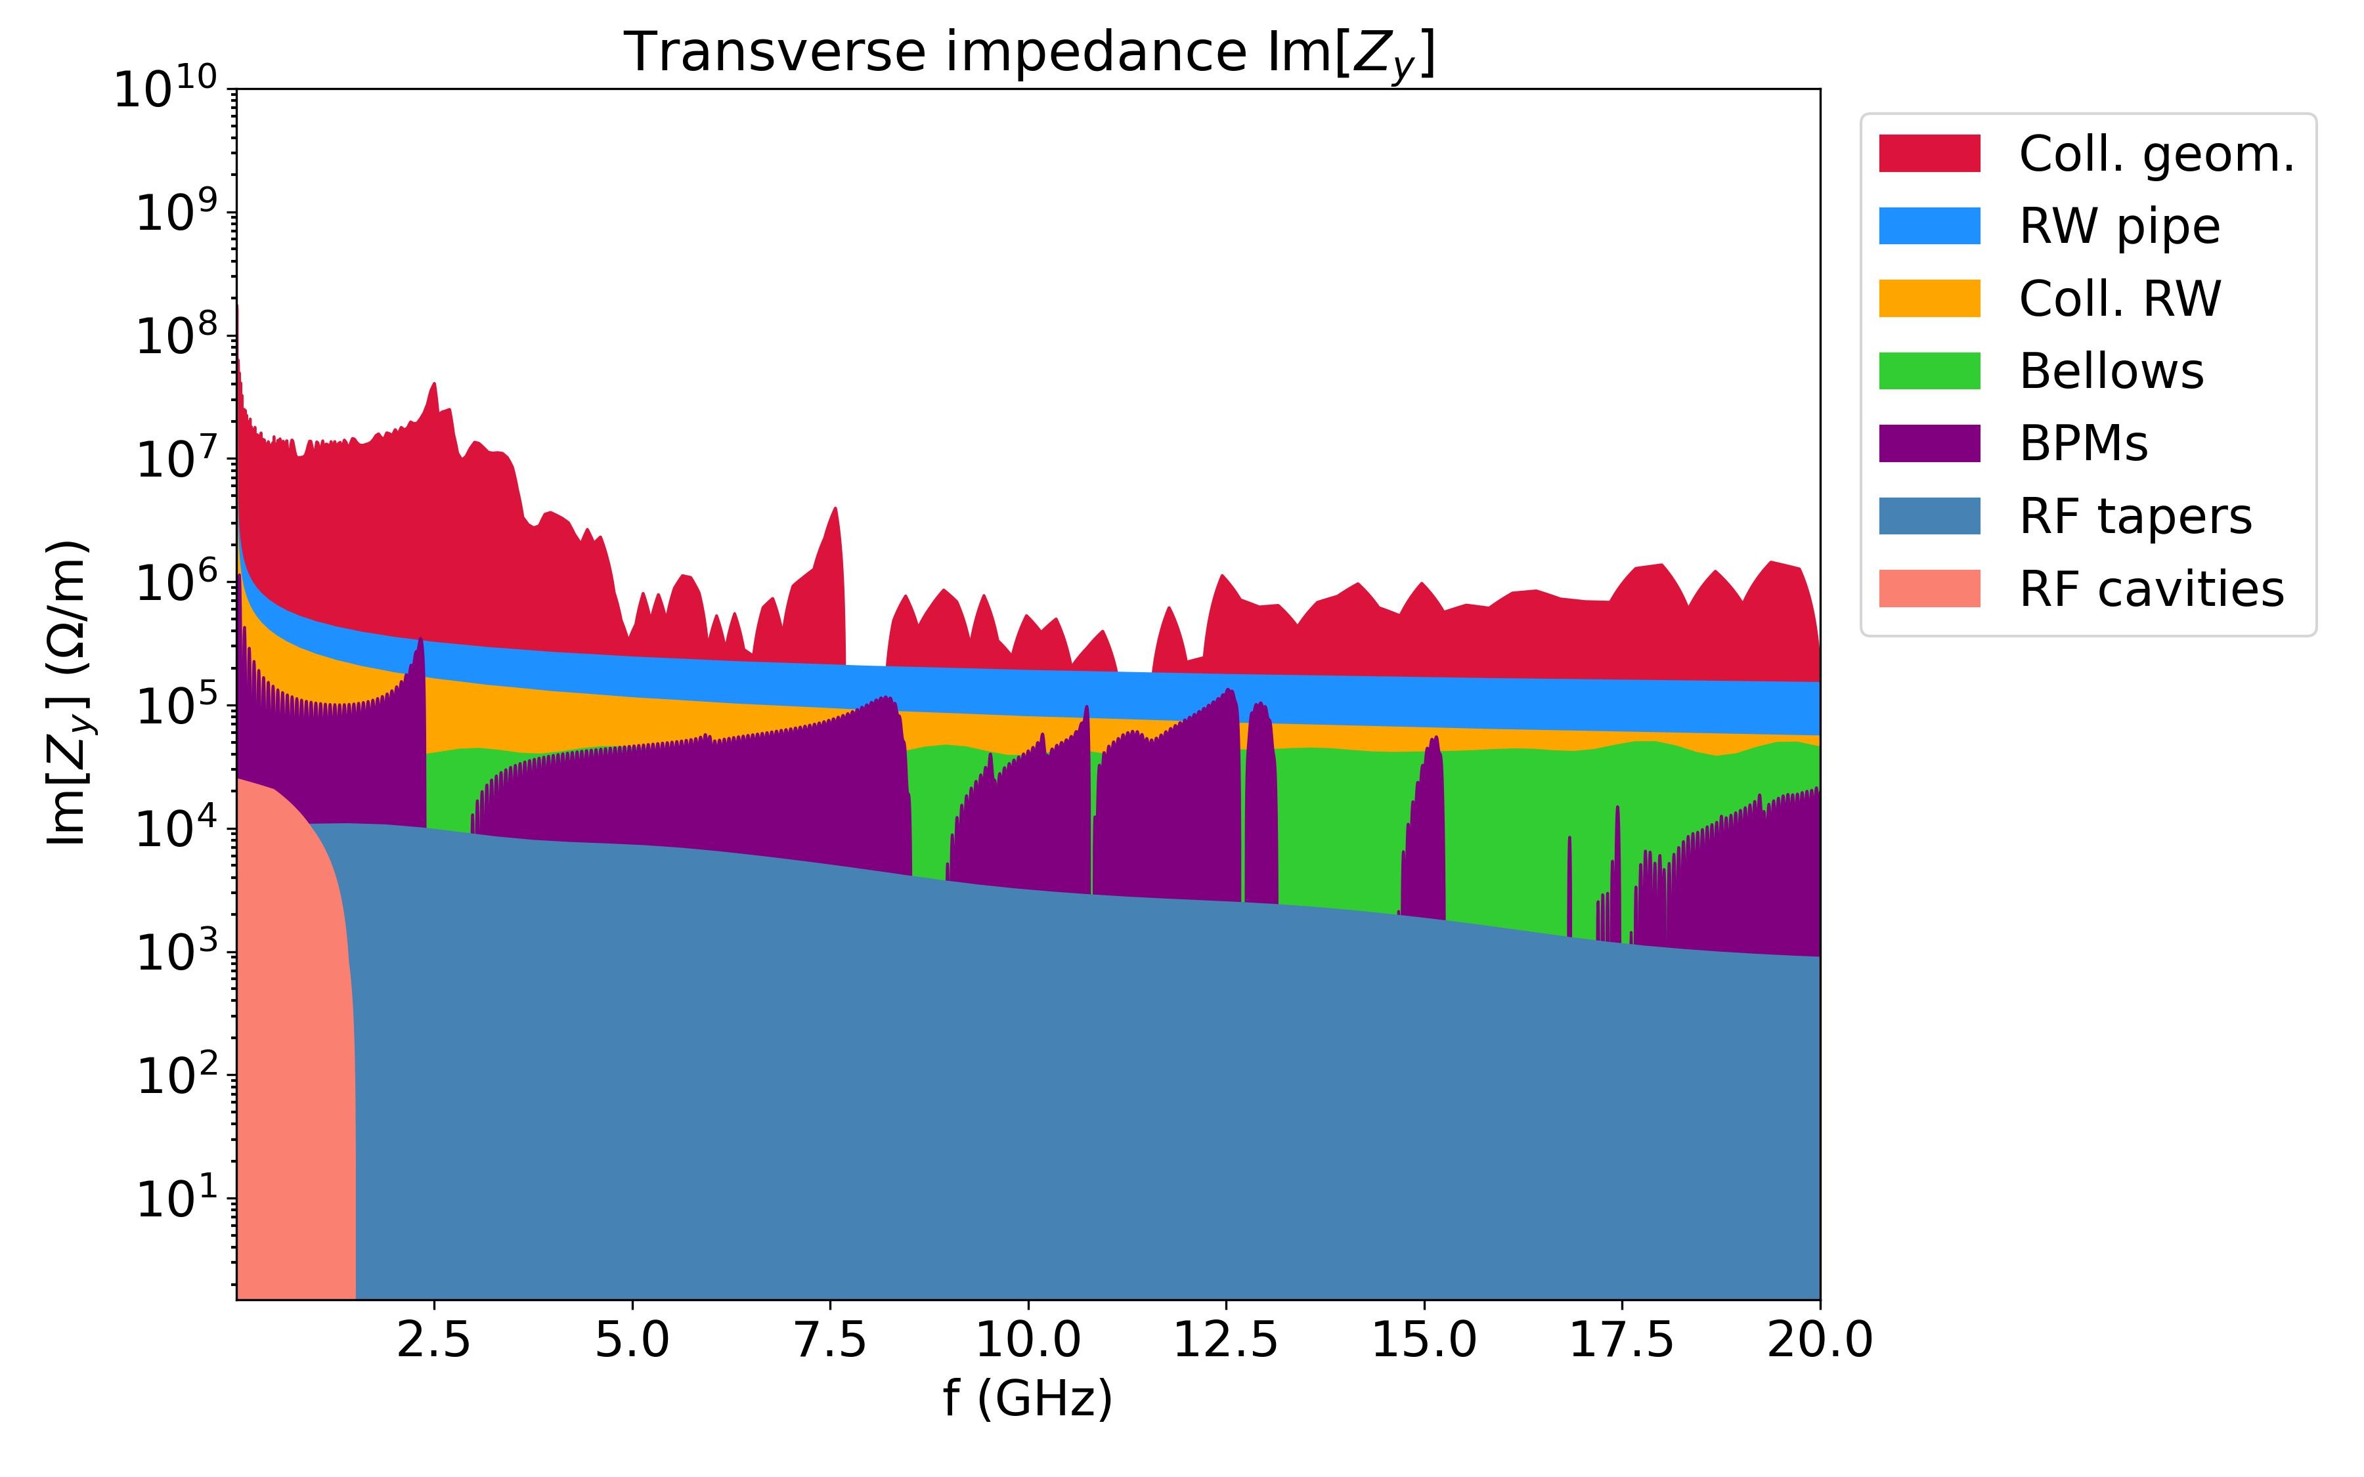
12
FCC-ee beam coupling impedance of the collimation system
Criticality of the collimation system
Identify main impedance contributors
3D EM Simulations and Analytical Model
Accelerator I/W Model
FCC-ee I/W model
The visualization of certain parameters, such as the imaginary part of the y-dipolar impedance of various contributors, enables the identification of the primary impedance sources.
Collimation optics:
FCCee_z_v23_coll_TCTs
20.05.2025 | FCC week 2025 | Dora Gibellieri

Slide 13
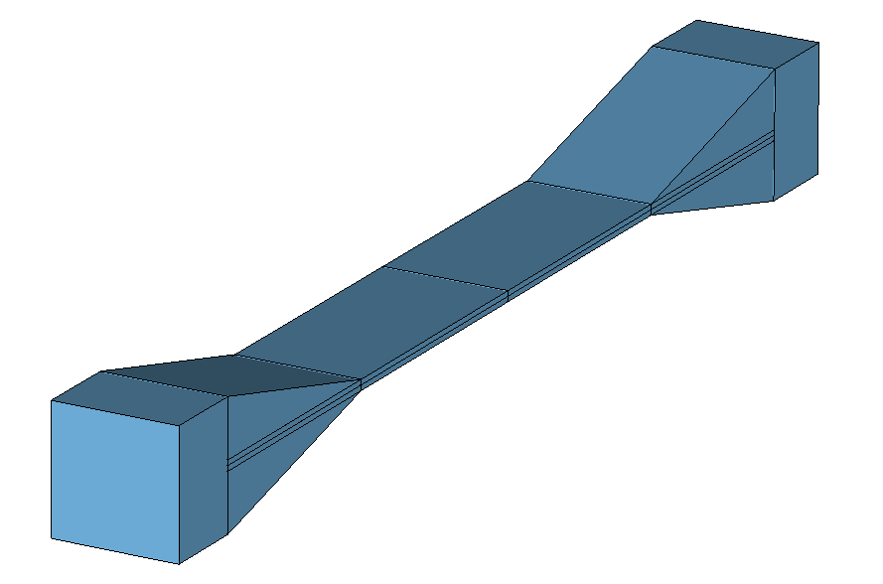
13
FCC-ee beam coupling impedance of the collimation system
Collimation system: study process
Collimators were simulated in CST Studio Suite, initially using a simplified model to isolate geometric and resistive wall dependencies.
Schematic design
While previous models accounted only for the resistive wall (RW) contribution, this study includes both resistive and geometric effects, enabling a more comprehensive understanding of the system’s impact on beam stability.
The model accurately reproduces the actual jaw lengths and apertures and effectively highlights critical parameters that can be optimized to mitigate impedance.
A linear taper with an angle of 15 degrees was initially proposed.
By enabling the isolation of geometric effects, this model served as a baseline for next refinements

Slide 14
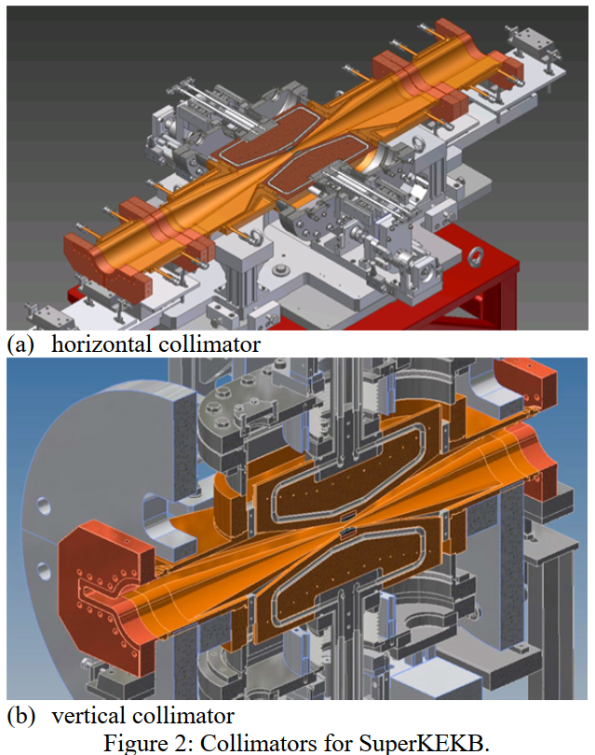
14
FCC-ee beam coupling impedance of the collimation system
Collimation system: study process
Design based on collimators for SuperKEKB.
Schematic design
SuperKEKB design
Courtesy of Regis Seidenbinder

Slide 15
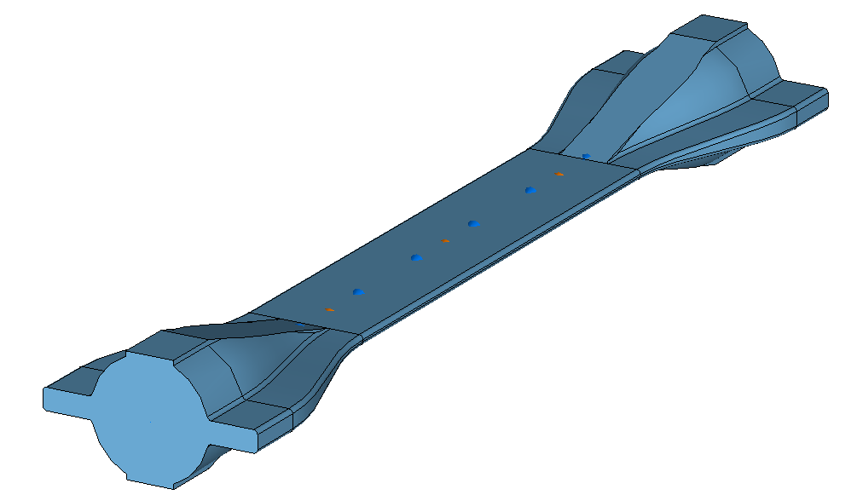
15
FCC-ee beam coupling impedance of the collimation system
Collimation system: study process
Design based on collimators for SuperKEKB, with circular pipe and winglets.
Schematic design
Winglets design

Slide 16
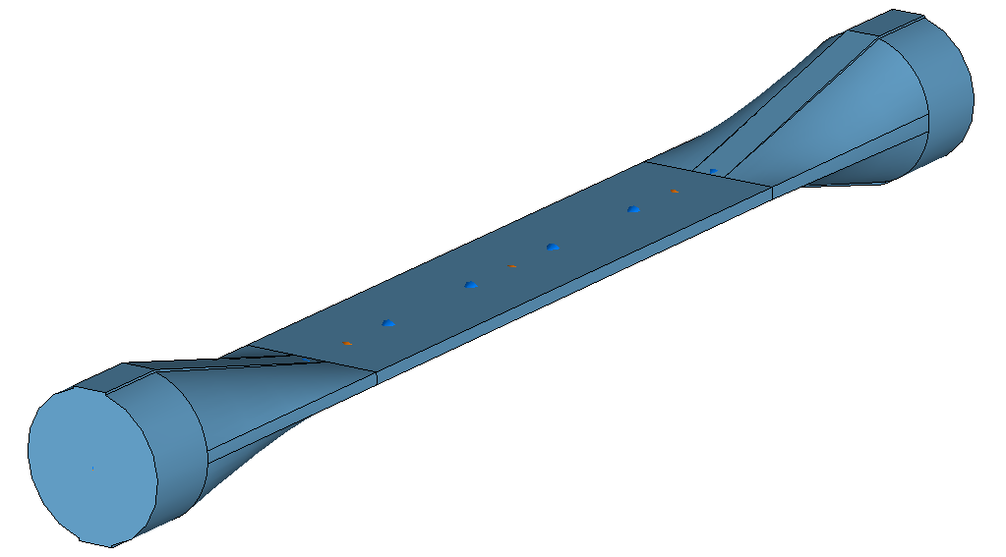
16
FCC-ee beam coupling impedance of the collimation system
Collimation system: study process
Final proposed design with circular pipe without winglets at the collimator injection.
Schematic design
Winglets design
Non-winglets design

Slide 17
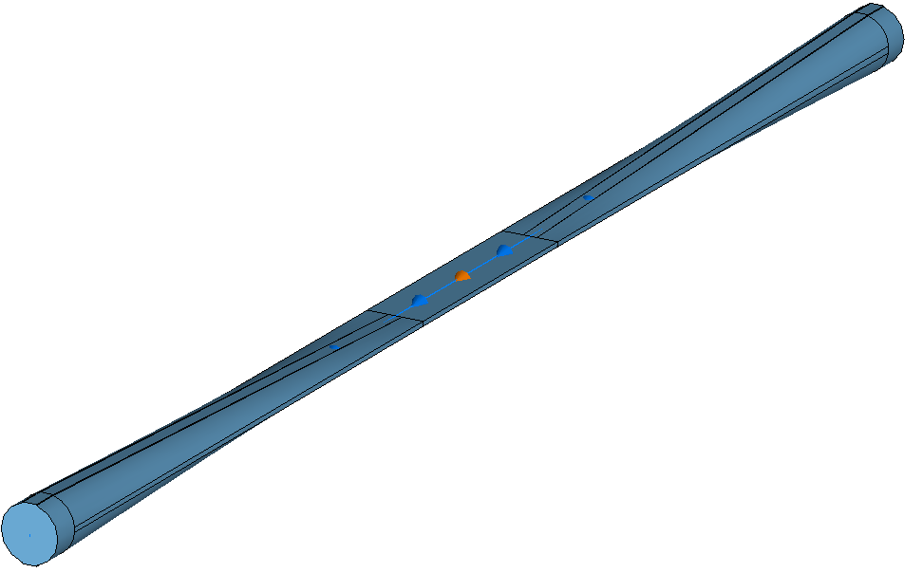
17
Collimators geometrical impedance
Optimization strategies
Since the geometrical contribution of the collimators has been identified as the primary source of impedance, an optimization of the taper angle for all vertical collimators has been proposed, reducing it from 15 degrees to 2.5 degrees. The most recent optimization refers to latest collimators design.
tcp.v.b1
Coll. length = 250 mm
Taper length = 110mm
Taper angle = 15 degrees
tcp.v.b1
Coll. length = 250 mm
Taper length = 630 mm
Taper angle = 2.5 degrees
It is worth noting that the achievable taper angle could be limited by spatial and mechanical constraints
20.05.2025 | FCC week 2025 | Dora Gibellieri

Slide 18
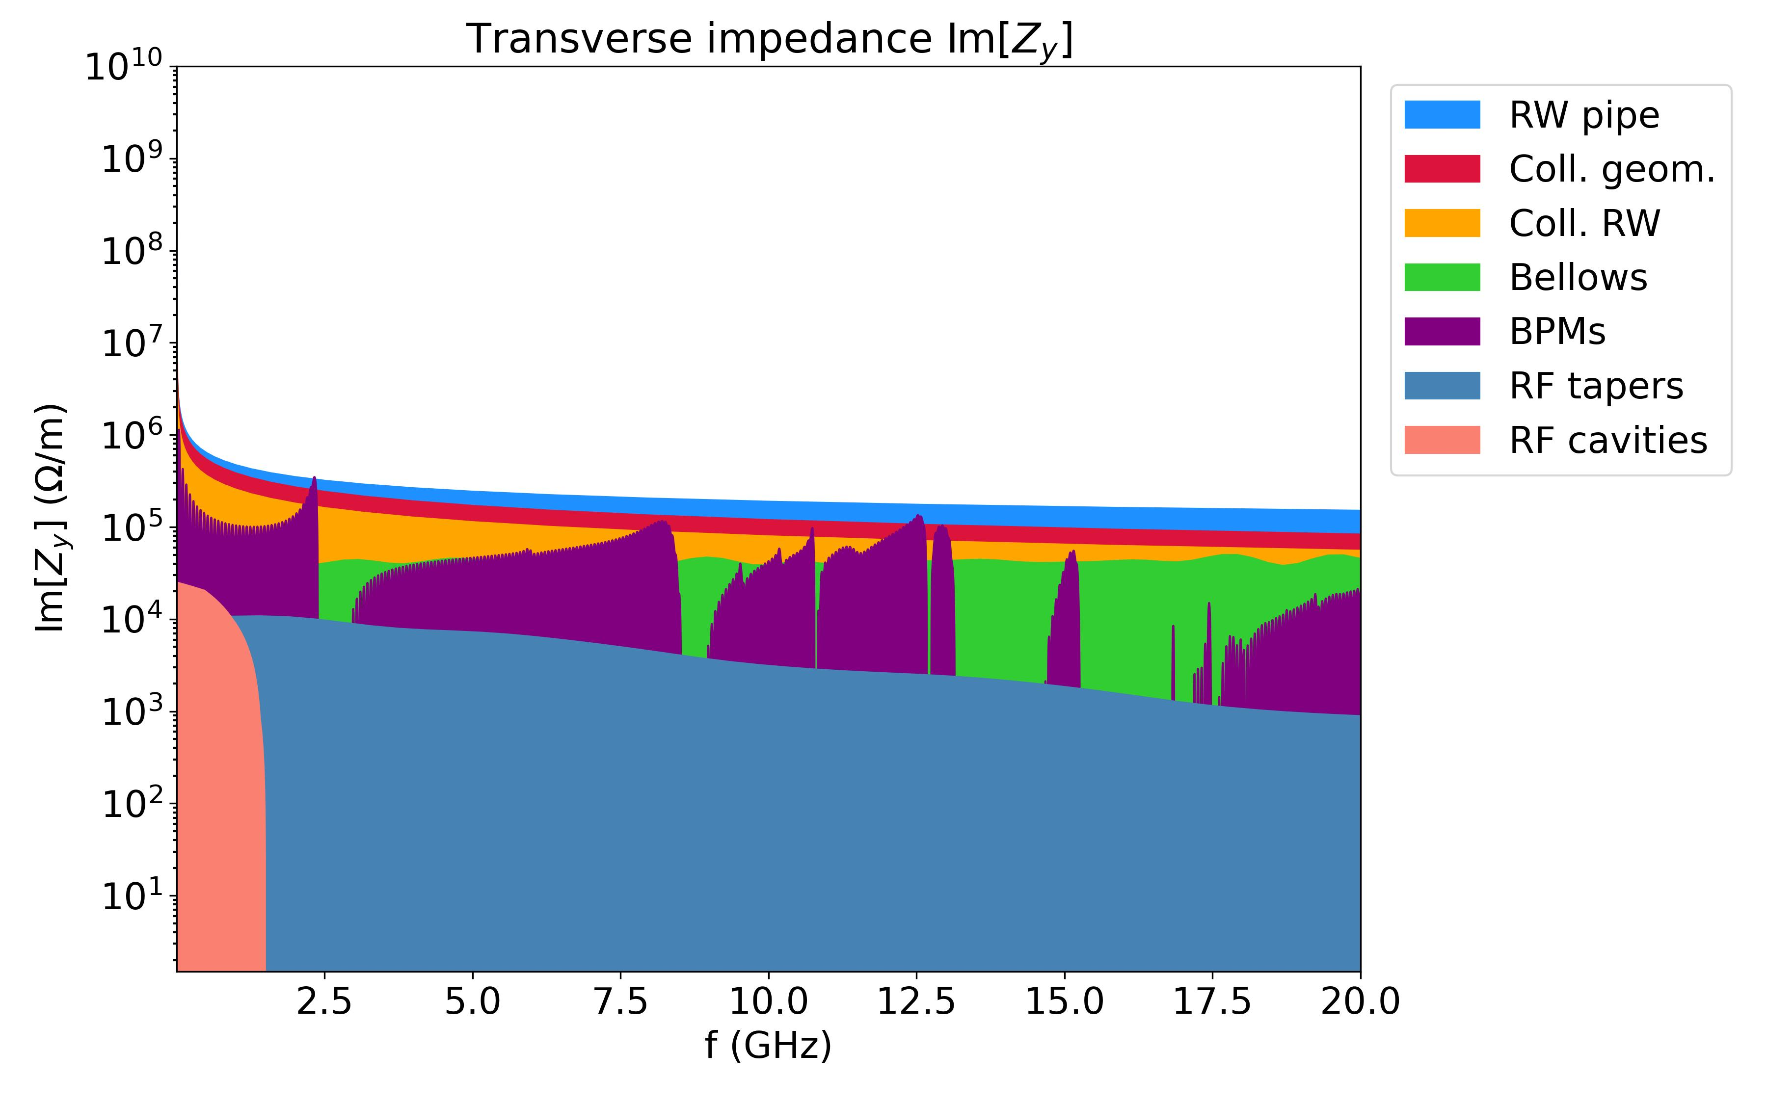
18
Collimators geometrical impedance
Geometrical impedance mitigation
Thanks to the optimization of the taper angle for all vertical collimators by reducing it from 15 degrees to 2.5 degrees, the y-transverse impedance drastically reduces.
Horizontal and vertical collimator taper angle of 15 degrees
Horizontal collimator taper angle of 15 degrees and vertical taper angle of 2.5 degrees
FCCee_z_v23_coll_TCTs
Optimization
20.05.2025 | FCC week 2025 | Dora Gibellieri

Slide 19
19
Collimators RW impedance
Outline
Introduction
  FCC-ee main parameters for Z configuration
  FCC-ee main ring impedance model
FCC-ee beam coupling impedance of the collimation system
  Collimators geometrical impedance
    Optimization strategies
  Collimators RW impedance
    Comparison between different optics
Conclusion and next steps
20.05.2025 | FCC week 2025 | Dora Gibellieri

Slide 20
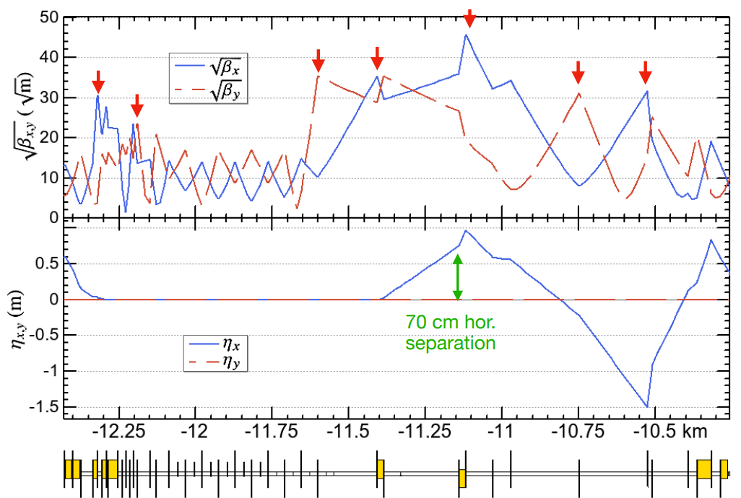
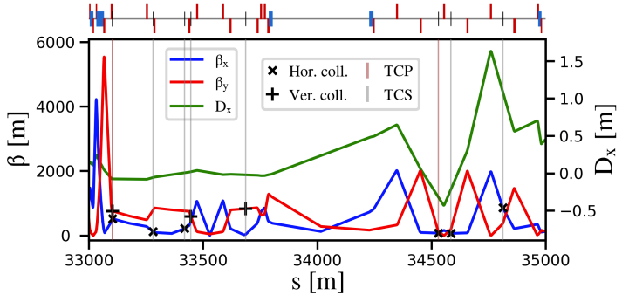
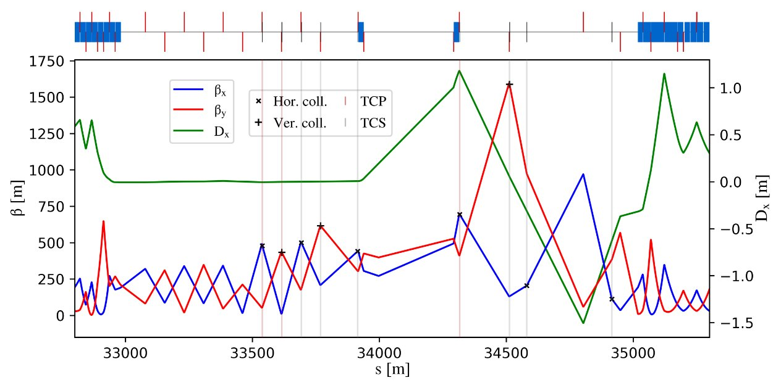
20
Collimators RW impedance
Comparison between different optics
Different optics have been analyzed:
v23
V24.4
V25.2
K. Oide: FCCWeek_Optics_Oide_230606
K. Oide: Optics_Oide_241106
K. Oide: Optics_Oide_bx*:techi_250424
20.05.2025 | FCC week 2025 | Dora Gibellieri

Slide 21
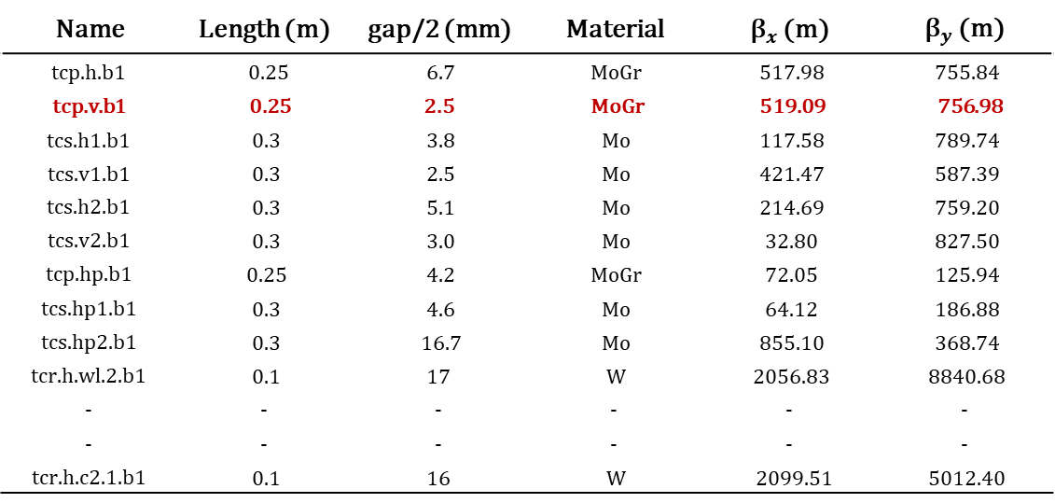
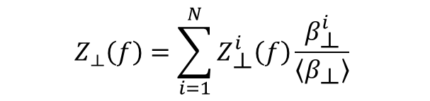
21
Collimators RW impedance
Collimation optics: v23
Collimator parameters from the version 23 of the collimation layout optics. The current layout consists of 17 beam halo collimators - 3 primary, 6 secondary, and 8 tertiary units- and 24 synchrotron radiation (SR) collimators. Among these, the main contributors to the overall impedance are listed below.
Name | Length (m) | gap/2 (mm) | Material | ${\text{β}}_{x}$ (m) | ${\text{β}}_{y}$ (m)
tcp.h.b1 | 0.25 | 6.7 | MoGr | 517.98 | 755.84
tcp.v.b1 | 0.25 | 2.5 | MoGr | 519.09 | 756.98
tcs.h1.b1 | 0.3 | 3.8 | Mo | 117.58 | 789.74
tcs.v1.b1 | 0.3 | 2.5 | Mo | 421.47 | 587.39
tcs.h2.b1 | 0.3 | 5.1 | Mo | 214.69 | 759.20
tcs.v2.b1 | 0.3 | 3.0 | Mo | 32.80 | 827.50
tcp.hp.b1 | 0.25 | 4.2 | MoGr | 72.05 | 125.94
tcs.hp1.b1 | 0.3 | 4.6 | Mo | 64.12 | 186.88
tcs.hp2.b1 | 0.3 | 16.7 | Mo | 855.10 | 368.74
tcr.h.wl.2.b1 | 0.1 | 17 | W | 2056.83 | 8840.68
- | - | - | - | - | -
- | - | - | - | - | -
tcr.h.c2.1.b1 | 0.1 | 16 | W | 2099.51 | 5012.40
Due to small half-gaps and large beta functions, primary collimators contribute significantly to transverse RW impedance, with collimator tcp.v.b1 identified to be the most critical.
$$Z_{⟂}\left(f\right)=\sum_{i=1}^{N}{Z_{\text{⟂}}^{i}\left(f\right)\frac{β_{\text{⟂}}^{i}}{\left\langle β_{\text{⟂}}\right\rangle }}$$
tcp: primary, tcs: secondary, tcr: synchrotron radiation, h: horizontal, v: vertical, $σ_{MoGr}={10}^{6} S/m$, $σ_{Mo}={1.8 10}^{7 } S/m$, $σ_{W}={1.8 10}^{7 } S/m$. . Table courtesy of Giacomo Broggi.
20.05.2025 | FCC week 2025 | Dora Gibellieri

Slide 22
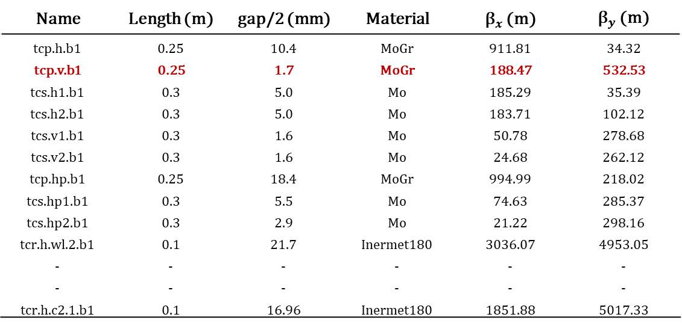


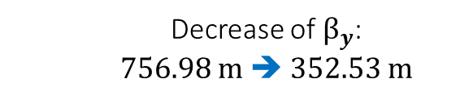
22
Collimators RW impedance
Collimation optics: v24.4
Collimator parameters from version 24.4 of the collimation layout optics, which includes 17 beam halo collimators and 24 synchrotron radiation (SR) collimators. Particular attention is given to changes in the vertical primary collimator tcp.v.b1, which plays a critical role in the overall impedance of the collimation system.
Name | Length (m) | gap/2 (mm) | Material | ${\text{β}}_{x}$ (m) | ${\text{β}}_{y}$ (m)
tcp.h.b1 | 0.25 | 10.4 | MoGr | 911.81 | 34.32
tcp.v.b1 | 0.25 | 1.7 | MoGr | 188.47 | 532.53
tcs.h1.b1 | 0.3 | 5.0 | Mo | 185.29 | 35.39
tcs.h2.b1 | 0.3 | 5.0 | Mo | 183.71 | 102.12
tcs.v1.b1 | 0.3 | 1.6 | Mo | 50.78 | 278.68
tcs.v2.b1 | 0.3 | 1.6 | Mo | 24.68 | 262.12
tcp.hp.b1 | 0.25 | 18.4 | MoGr | 994.99 | 218.02
tcs.hp1.b1 | 0.3 | 5.5 | Mo | 74.63 | 285.37
tcs.hp2.b1 | 0.3 | 2.9 | Mo | 21.22 | 298.16
tcr.h.wl.2.b1 | 0.1 | 21.7 | Inermet180 | 3036.07 | 4953.05
- | - | - | - | - | -
- | - | - | - | - | -
tcr.h.c2.1.b1 | 0.1 | 16.96 | Inermet180 | 1851.88 | 5017.33
  Compared to v23 for tcp.v.b1, there was a decrease in the half-gap:
  2.5 mm ➔ 1.7 mm
  Decrease of ${\text{β}}_{y}$:
  756.98 m ➔ 352.53 m
$$Z_{⟂}\left(f\right)∝{1/gap}^{3}$$
$$Z_{⟂}\left(f\right)∝\text{β}$$
tcp: primary, tcs: secondary, tcr: synchrotron radiation, h: horizontal, v: vertical, , $σ_{MoGr}={10}^{6} S/m$, $σ_{Mo}={1.8 10}^{7 } S/m$, $σ_{inermet180}={1.05 10}^{7 } S/m$. Table courtesy of Giacomo Broggi.
20.05.2025 | FCC week 2025 | Dora Gibellieri
Notes:
Inermet 180: Tungsten alloy

Slide 23
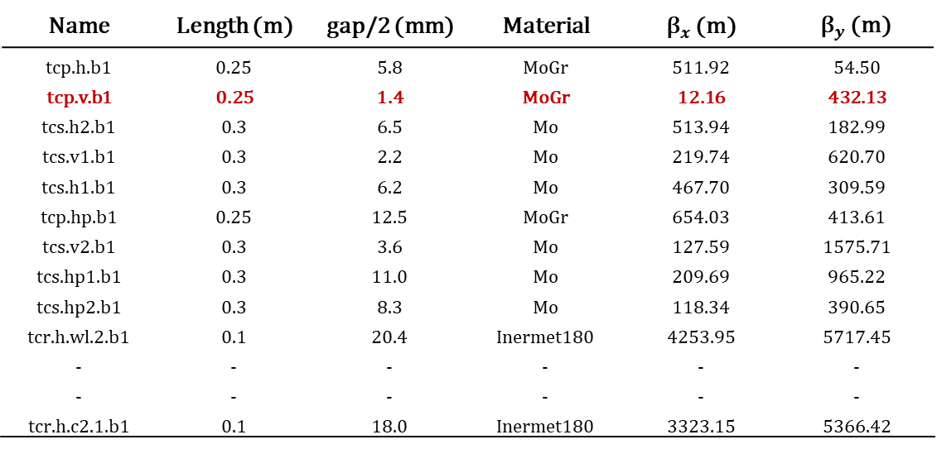

23
Collimators RW impedance
Collimation optics: v25.2
Collimator parameters from version 25.2 of the collimation layout optics, which includes 17 beam halo collimators and 24 synchrotron radiation (SR) collimators. Importance to highlight the changes on the vertical primary collimator tcp.v.b1, which plays a critical role in the overall impedance of the collimation system.
Name | Length (m) | gap/2 (mm) | Material | ${\text{β}}_{x}$ (m) | ${\text{β}}_{y}$ (m)
tcp.h.b1 | 0.25 | 5.8 | MoGr | 511.92 | 54.50
tcp.v.b1 | 0.25 | 1.4 | MoGr | 12.16 | 432.13
tcs.h2.b1 | 0.3 | 6.5 | Mo | 513.94 | 182.99
tcs.v1.b1 | 0.3 | 2.2 | Mo | 219.74 | 620.70
tcs.h1.b1 | 0.3 | 6.2 | Mo | 467.70 | 309.59
tcp.hp.b1 | 0.25 | 12.5 | MoGr | 654.03 | 413.61
tcs.v2.b1 | 0.3 | 3.6 | Mo | 127.59 | 1575.71
tcs.hp1.b1 | 0.3 | 11.0 | Mo | 209.69 | 965.22
tcs.hp2.b1 | 0.3 | 8.3 | Mo | 118.34 | 390.65
tcr.h.wl.2.b1 | 0.1 | 20.4 | Inermet180 | 4253.95 | 5717.45
- | - | - | - | - | -
- | - | - | - | - | -
tcr.h.c2.1.b1 | 0.1 | 18.0 | Inermet180 | 3323.15 | 5366.42
  Compared to v23 for tcp.v.b1, there was a decrease in the half-gap:
  2.5 mm ➔ 1.4 mm
  Decrease of ${\text{β}}_{y}$:
  756.98 m ➔ 325.49 m
$$Z_{⟂}\left(f\right)∝{1/gap}^{3}$$
$$Z_{⟂}\left(f\right)∝\text{β}$$
tcp: primary, tcs: secondary, tcr: synchrotron radiation, h: horizontal, v: vertical, , $σ_{MoGr}={10}^{6} S/m$, $σ_{Mo}={1.8 10}^{7 } S/m$, $σ_{inermet180}={1.05 10}^{7 } S/m$. Table courtesy of Giacomo Broggi.
20.05.2025 | FCC week 2025 | Dora Gibellieri
Notes:
Inermet 180: Tungsten alloy

Slide 24
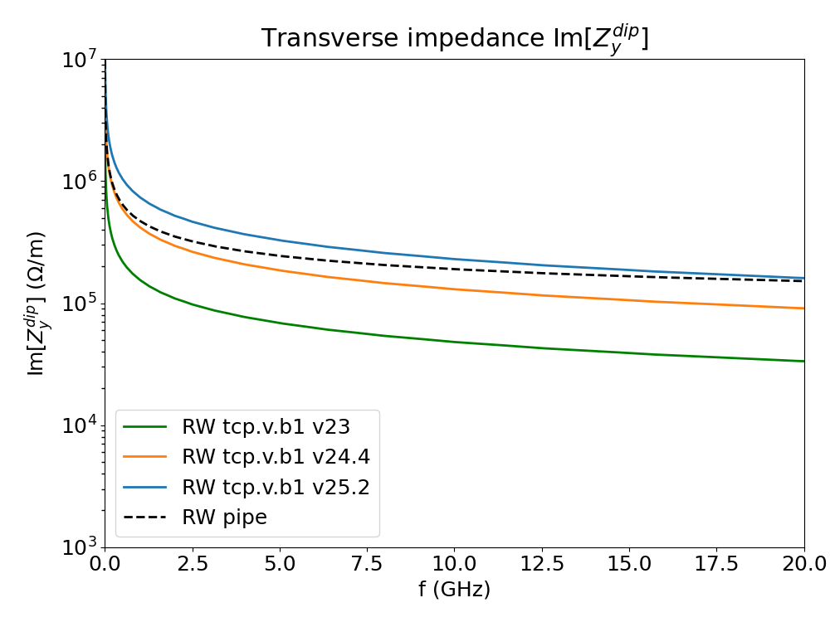


24
Collimators RW impedance
Comparison between different optics
To highlight the impact of the new collimation optics, the RW impedance of the vertical collimator tcp.v.b1 under different optics is compared with that of the circular copper pipe, with 30 mm radius and 150 nm NEG coating. The plot presents the imaginary part of the vertical dipolar impedance.
  Decrease in half-gap
  for tcp.v.b1:
  2.5 mm ➔ 1.7 mm ➔ 1.4 mm
$$Z_{⟂}\left(f\right)∝{1/gap}^{3}$$
$$Z_{⟂}\left(f\right)∝\text{β}$$
20.05.2025 | FCC week 2025 | Dora Gibellieri
Notes:
Inermet 180: Tungsten alloy

Slide 25
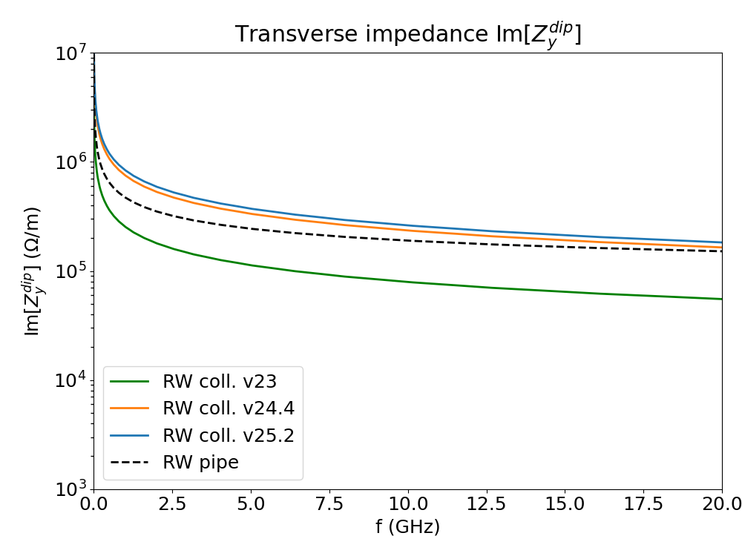
25
Collimators RW impedance
Comparison between different optics
Imaginary part of the vertical transverse dipolar impedance: total RW contribution from all collimators, comparing optics versions 23, 24.4, and 25.2, along with the RW impedance of the beam pipe (considering a circular copper pipe with 30 mm radius and 150 nm NEG coating).
  Collimator RW impedance exceeds beam pipe RW in v24.4 and v25.2
20.05.2025 | FCC week 2025 | Dora Gibellieri
Notes:
Inermet 180: Tungsten alloy

Slide 26
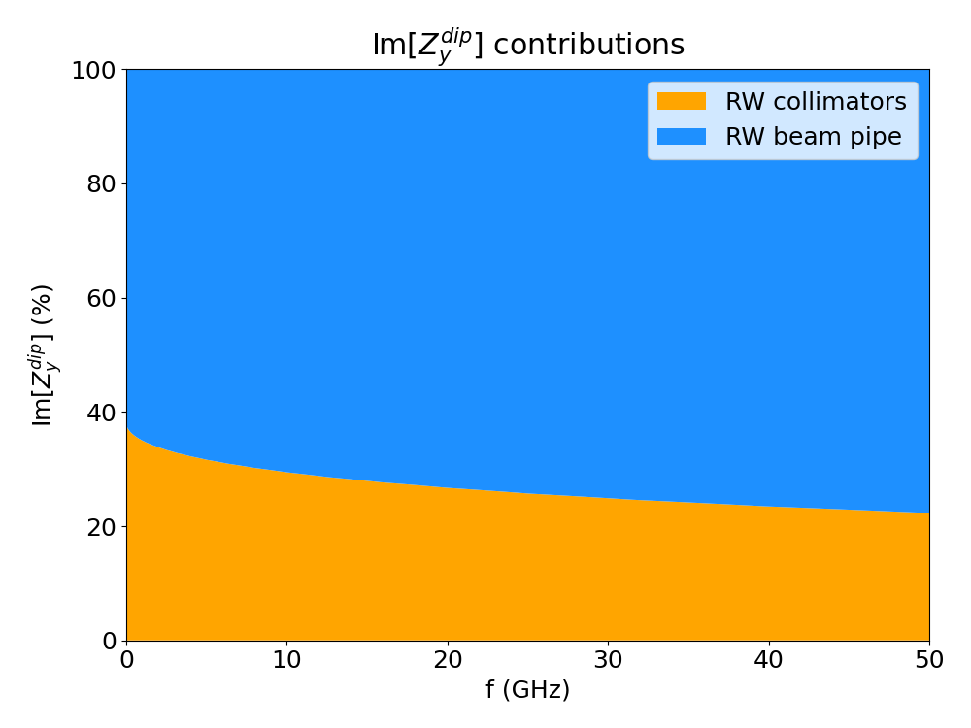
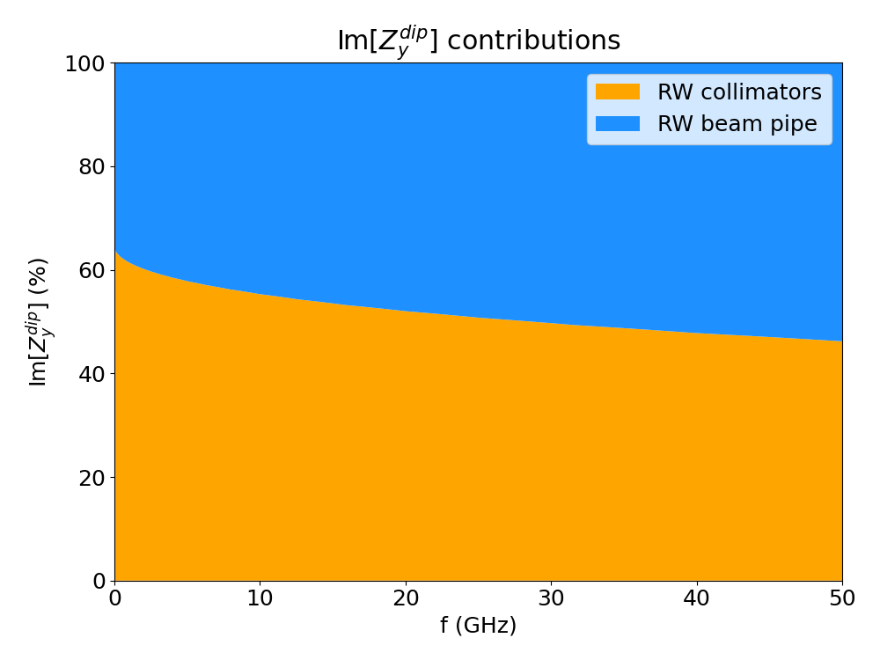
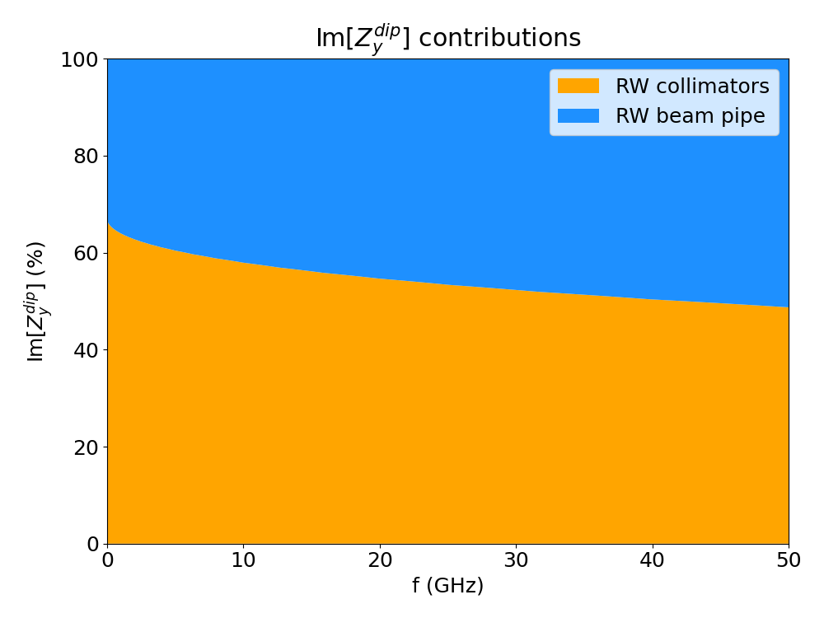
26
Collimators RW impedance
Comparison between different optics
Estimation of impedance considering the RW contributions from the beam pipe and collimators, with an analysis of collimators based on different optics layouts.
v23
V24.4
V25.2
Already with v23, the beam operates close to the stability limit, requiring the combined action of an ideal bunch-by-bunch feedback system over 4-turns and positive chromaticity (see M. Migliorati: 2025_05_20_FCC-IS_week.pdf).
20.05.2025 | FCC week 2025 | Dora Gibellieri

Slide 27
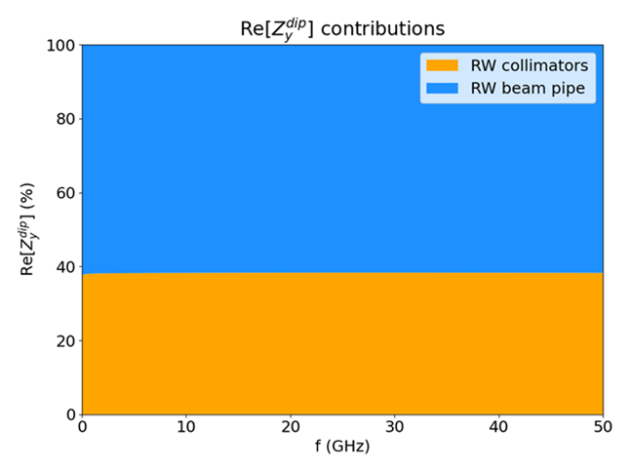
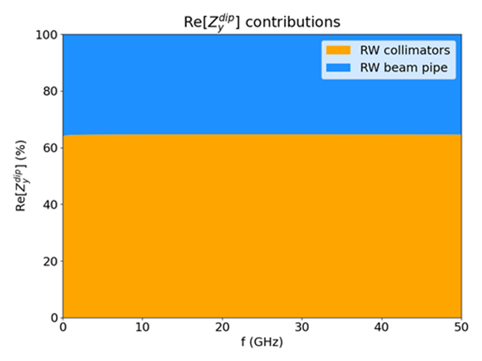

27
Collimators RW impedance
Comparison between different optics
Estimation of impedance considering the RW contributions from the beam pipe and collimators, with an analysis of collimators based on different optics layouts.
v23
V24.4
V25.2
Already with v23, the beam operates close to the stability limit, requiring the combined action of an ideal bunch-by-bunch feedback system over 4-turns and positive chromaticity (see M. Migliorati: 2025_05_20_FCC-IS_week.pdf).
20.05.2025 | FCC week 2025 | Dora Gibellieri

Slide 28
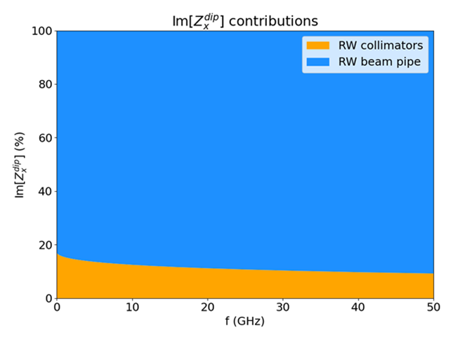
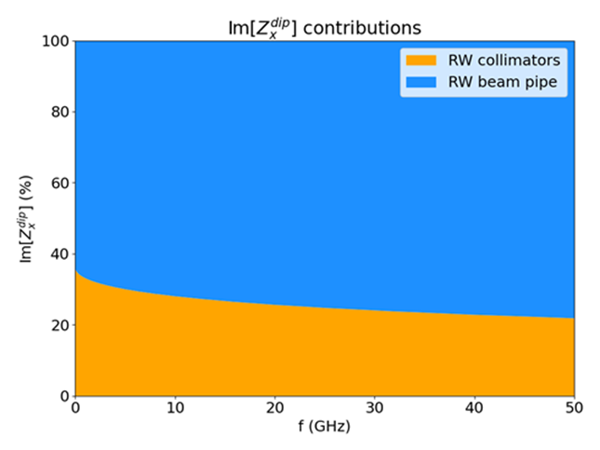
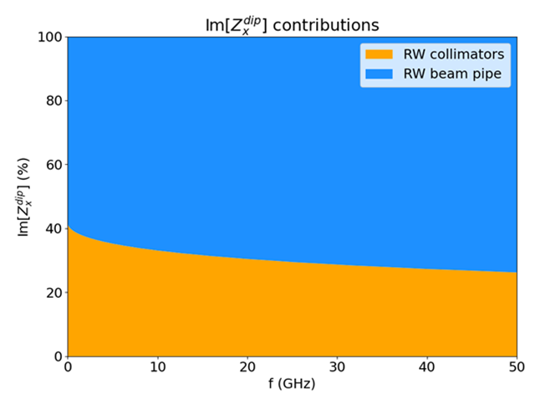
28
Collimators RW impedance
Comparison between different optics
Estimation of impedance considering the RW contributions from the beam pipe and collimators, with an analysis of collimators based on different optics layouts.
v23
V24.4
V25.2
Already with v23, the beam operates close to the stability limit, requiring the combined action of an ideal bunch-by-bunch feedback system over 4-turns and positive chromaticity (see M. Migliorati: 2025_05_20_FCC-IS_week.pdf).
20.05.2025 | FCC week 2025 | Dora Gibellieri

Slide 29
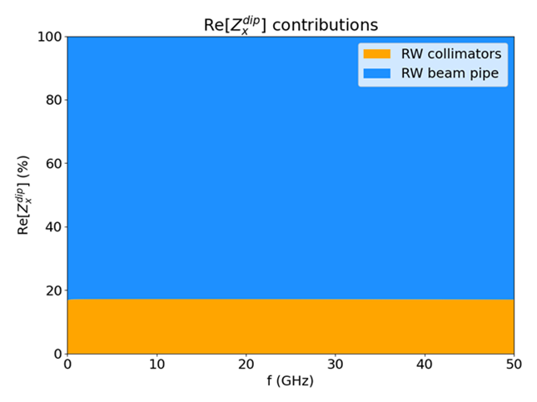
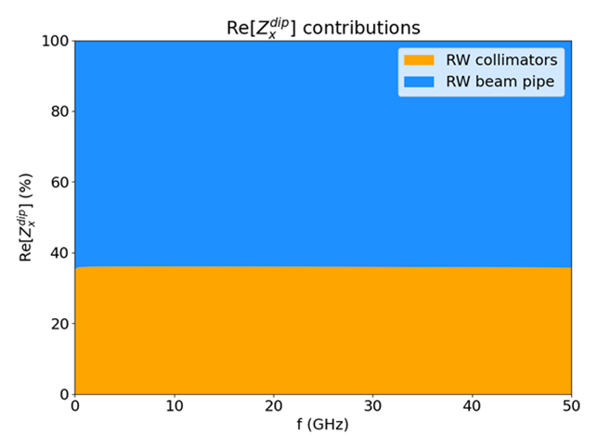

29
Collimators RW impedance
Comparison between different optics
Estimation of impedance considering the RW contributions from the beam pipe and collimators, with an analysis of collimators based on different optics layouts.
v23
V24.4
V25.2
Already with v23, the beam operates close to the stability limit, requiring the combined action of an ideal bunch-by-bunch feedback system over 4-turns and positive chromaticity (see M. Migliorati: 2025_05_20_FCC-IS_week.pdf).
20.05.2025 | FCC week 2025 | Dora Gibellieri

Slide 30
30
Conclusion and next steps
Outline
Introduction
  FCC-ee main parameters for Z configuration
  FCC-ee main ring impedance model
FCC-ee beam coupling impedance of the collimation system
  Collimators geometrical impedance
    Optimization strategies
  Collimators RW impedance
    Comparison between different optics
Conclusion and next steps
20.05.2025 | FCC week 2025 | Dora Gibellieri

Slide 31


31
Conclusion and next steps
Status updates: tools, models, and resources
Simulations made on Xsuite
FCC-ee Impedance Model available on GitHub
Impedance budget space (common to booster and collider) on CERN gitlab
Calculations made on several computing clusters : LXPLUS (CERN), FEYNMAN (CEA), and with dedicated computing resources on Jean-Zay (IDRIS) and CC IN2P3
Dedicated chat spaces for the high energy booster and the collective effects studies on mattermost
20.05.2025 | FCC week 2025 | Dora Gibellieri

Slide 32
32
Conclusion and next steps
Conclusion
🔹 Impedance/Wake model development for critical design decisions:
  The extremely short bunch length makes impedance and wakefield simulations highly challenging.
  Ensured model flexibility to facilitate impedance and wakefield updates in optics, material choices, coating thickness, geometries, and new machine elements.
  Enabled impedance assessments of different scenarios.
🔹 Criticality of the collimation system:
  A step-by-step approach is being adopted to explore computational limits and propose optimized impedance solutions.
  Collimators geometrical impedance:
    Optimization strategy ➔ taper optimization.
      Solutions developed in collaboration with the design and collimation groups to address spatial and mechanical constraints.
  Collimators RW impedance:
    Comparison between different optics layouts.
    Optimization strategy ➔ optics designed to maximize the collimator aperture and favor materials with high electrical conductivity.
20.05.2025 | FCC week 2025 | Dora Gibellieri

Slide 33
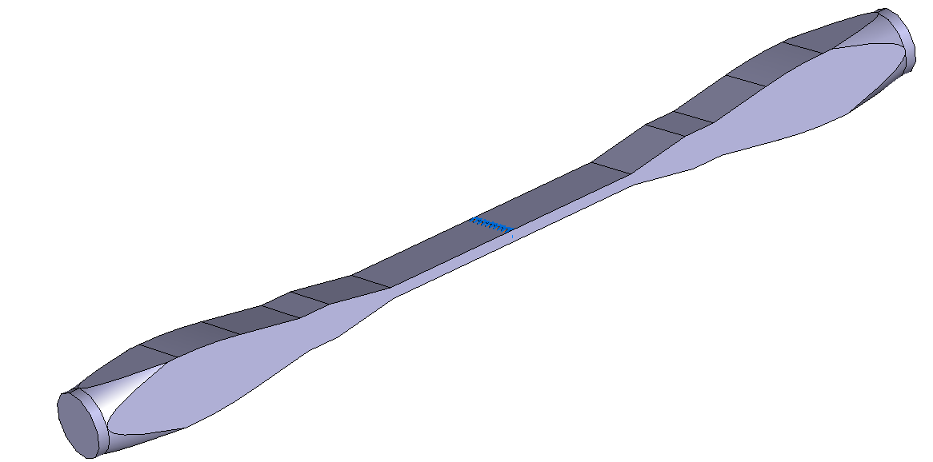
33
Conclusion and next steps
Ongoing activities: example
Proposed taper section design for collimators
Features:
  9.4° taper (1:6 ratio) with circle-to-square transition
  Small flats at ±10 mm from jaws for BPMs
  Configured for 5 mm half-gap (adjustable)
Advantages:
  Simplified mechanical design: flexibility needed in only one direction
  More robust RF fingers
  Enhanced mechanical reliability
Status:
  Impedance evaluation in progress
  Taper length: 180 mm each side (excluding BPM)
  Lengths adjustable; taper is not a limiting factor unless angle < 2.5°
Courtesy of Richard Jonathan Cowan
20.05.2025 | FCC week 2025 | Dora Gibellieri

Slide 34
34
Conclusion and next steps
Ongoing activities: example
Proposed taper section design for collimators
Flexible element – 300mm radius blend
Small flat for transition
Jaw end (30mm from jaw flat)
Circle to square transition
30mm from beam
Taper 2
BPM
10mm from jaw flat
Taper 1
Jaw flat
Beam
End of jaw
+ 60mm
+ 90mm
+ 210mm
The design allows the use of flexible elements in only 1 direction, offering improved conductance and more robust shielding around the edge of the jaw and simplifying mechanical design
Courtesy of Richard Jonathan Cowan
20.05.2025 | FCC week 2025 | Dora Gibellieri

Slide 35


35
Conclusion and next steps
Acknowledgements
Many thanks to M. Boscolo, G. Broggi, R. Bruce, X. Buffat, C. Carli, L. Giacomel, G. Iadarola, T. Ishibashi, A. Lechner, E. Macchia, A. Perillo-Marcone, S. Marin, K. Oide, S. Redaelli, G. Rumolo, R. Seidenbinder, R. Soos, F. Zimmermann, and all FCC-ee/FCCIS colleagues for their valuable contributions and support.
Project part of FCCIS – The Future Circular Collider Innovation Study. This INFRADEV Research and Innovation Action project receives funding from the European Union’s Horizon 2020 Framework Programme under grant agreement no. 951754.
20.05.2025 | FCC week 2025 | Dora Gibellieri

Slide 36
Thank you for your attention ☺
FCC week 2025 - 11th edition of the Future Circular Collider Conference , Vienna, Austria, 19 - 23 May 2025

