Slide 1



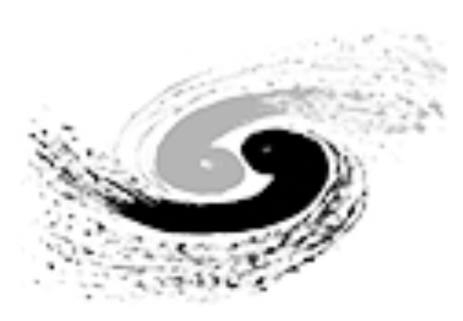


Overview of collective effects for the main rings
M. Migliorati
and the FCC-ee collective effects study group
Acknowledgements: collimation, vacuum and RF groups, Xsuite code developers, …
FCCIS: This project has received funding from the European Union's Horizon 2020 research and innovation programme under the European Union's Horizon 2020 research and innovation programme under grant agreement No 951754.
Work partially supported also by INFN National Committee I through the RD_FCC project.

Slide 2
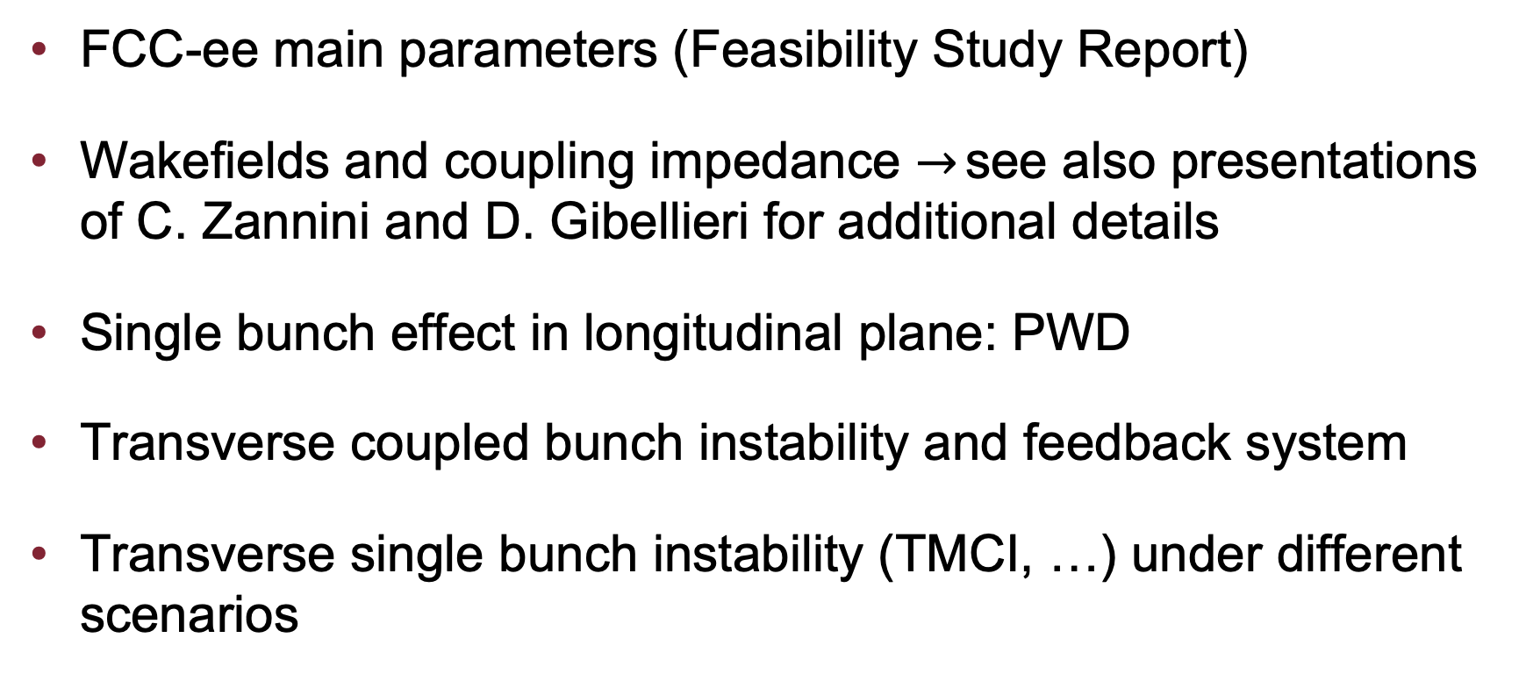
Outline
FCC-ee main parameters (Feasibility Study Report)
Wakefields and coupling impedance $→$ see also presentations of C. Zannini and D. Gibellieri for additional details
Single bunch effect in longitudinal plane: PWD
Transverse coupled bunch instability and feedback system
Transverse single bunch instability (TMCI, …) under different scenarios

Slide 3
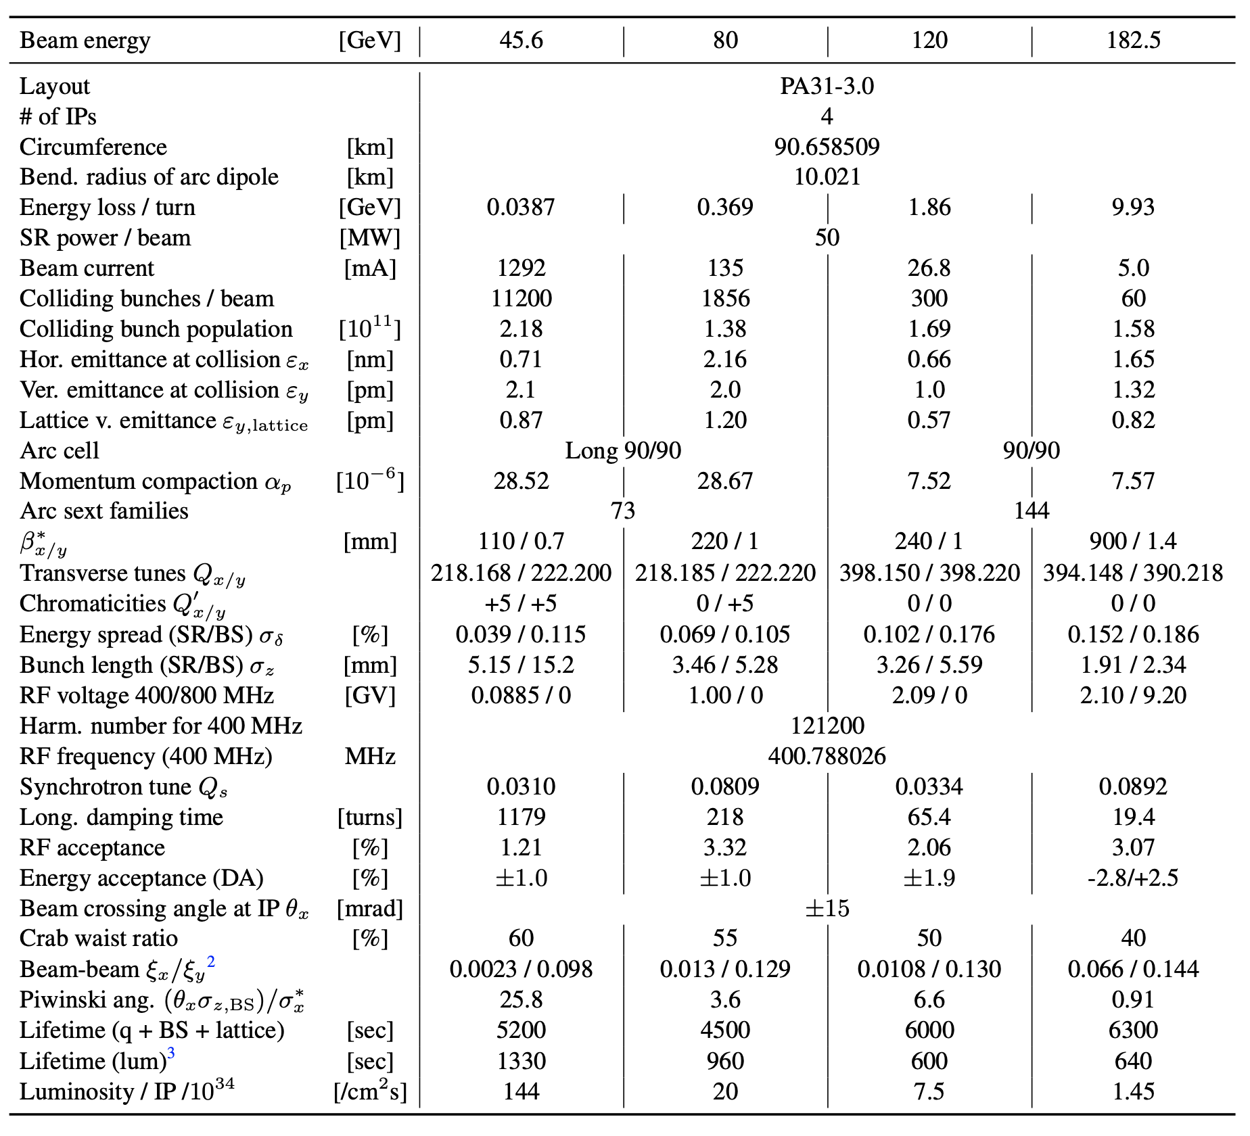
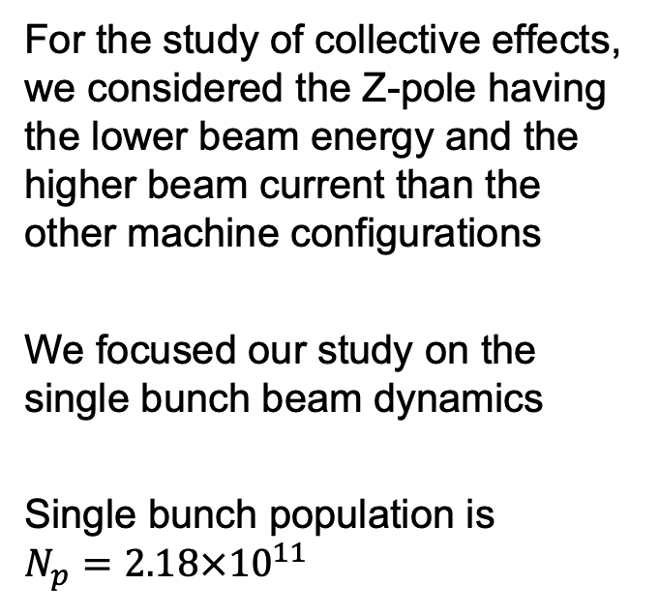
FCC-ee main parameters (from the Feasibility Study Report)
For the study of collective effects, we considered the Z-pole having the lower beam energy and the higher beam current than the other machine configurations
We focused our study on the single bunch beam dynamics
Single bunch population is
$$N_{p}=2.18×{10}^{11}$$

Slide 4
Wakefields and coupling impedance
For the impedance model, we have evaluated the contribution of:
RW (30 mm) plus NEG (150 nm)
A new cavity system: 132 two-cell cavities instead of 56 single-cell cavities. We have also increased the number of tapers from the beam pipe to the cryomodule from 14 to 33 double tapers.
New design (and number) of BPMs (10000 vs previous 7000).
Some comments:
RW of the beam pipe is the largest impedance source so far.
The collimation system represents, in the transverse plane, the second largest impedance source. This is another great challenge for the collective effects, and the work is still in progress.

Slide 5
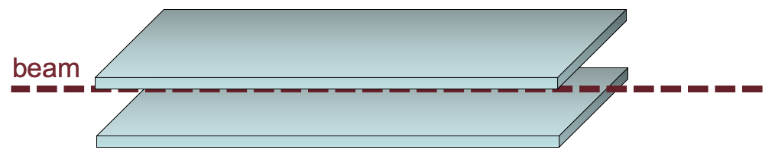
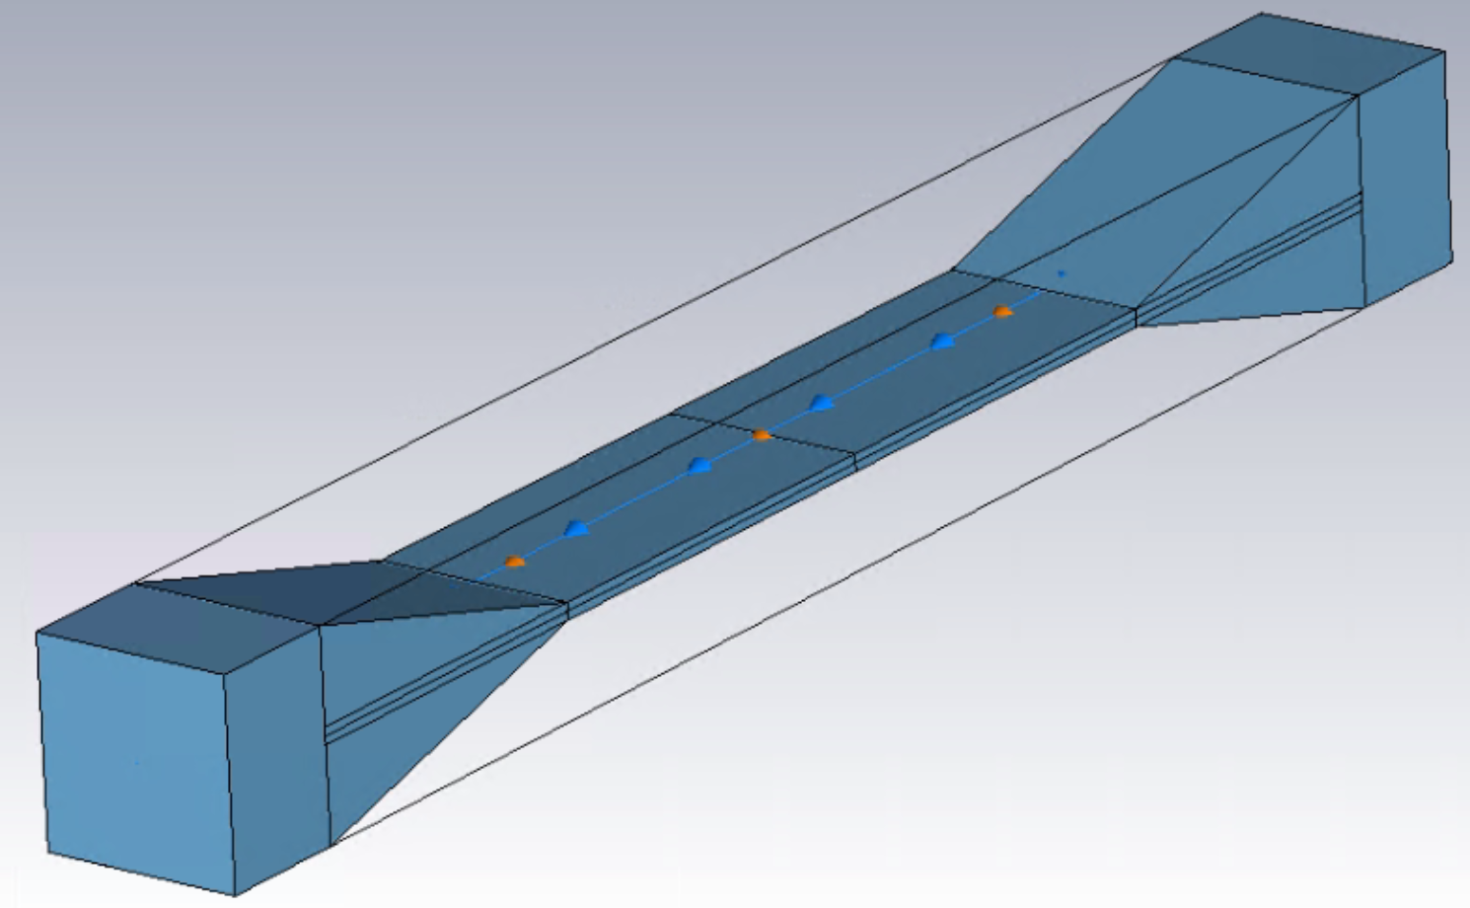
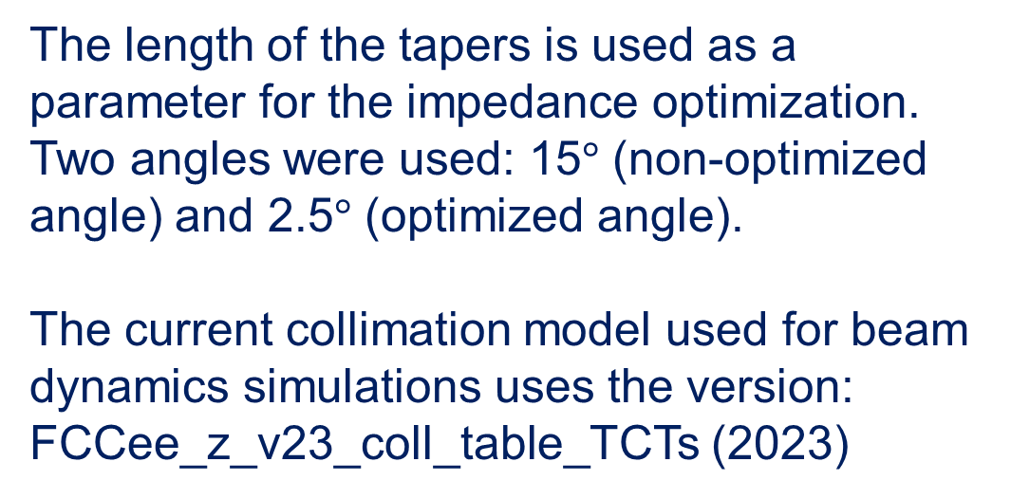
Wakefields and coupling impedance: collimation system
We have evaluated the RW contribution of the collimators, weighted by the local beta function, by considering parallel plates
For the geometrical contribution, a first estimation considered a simplified model.
The length of the tapers is used as a parameter for the impedance optimization. Two angles were used: 15$°$ (non-optimized angle) and 2.5$°$ (optimized angle).
The current collimation model used for beam dynamics simulations uses the version: FCCee_z_v23_coll_table_TCTs (2023)

Slide 6
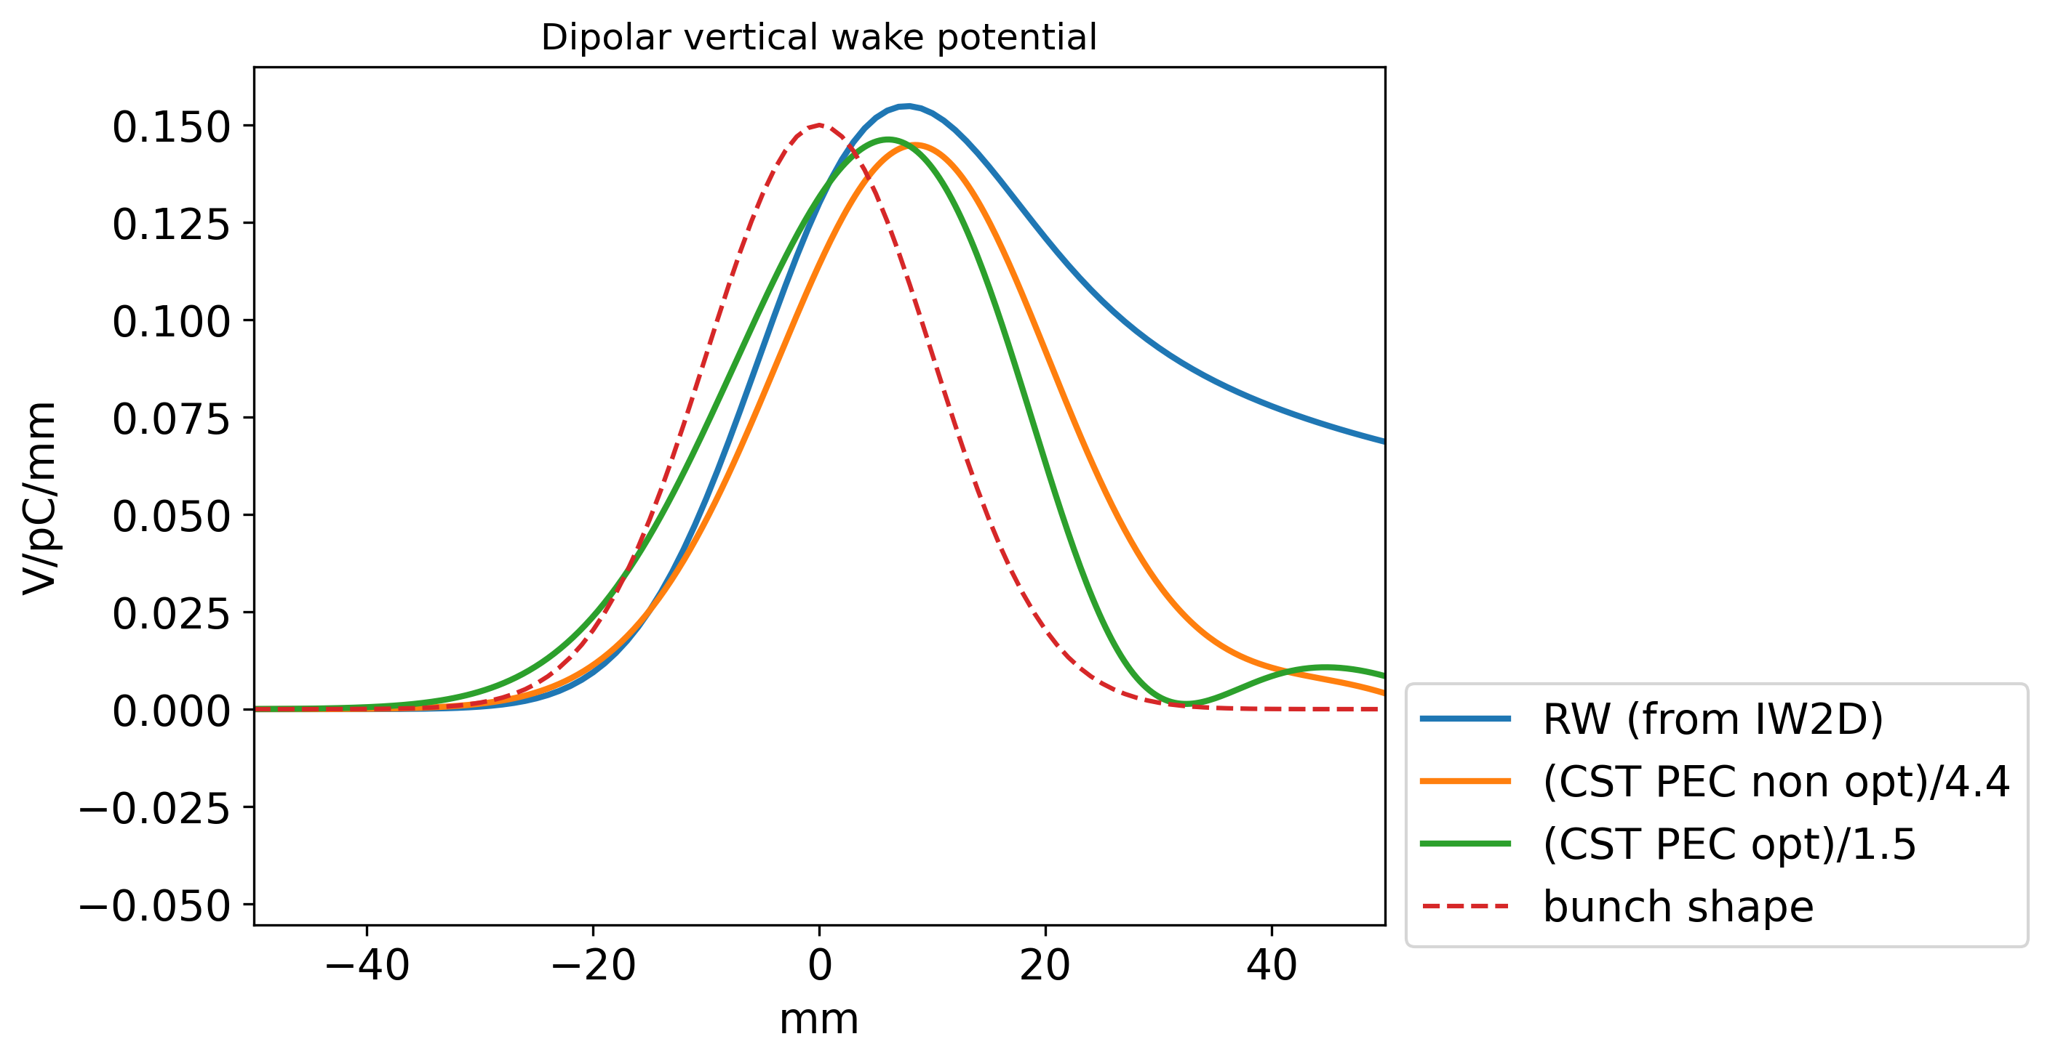
Wakefields and coupling impedance: collimation system
The most important source of impedance among collimators is the tcp.v.b1.
Dipolar vertical wake potential of the tcp.v.b1 collimator generated by a 10 mm Gaussian bunch.
(PEC = Perfect Electric Conductor)

Slide 7
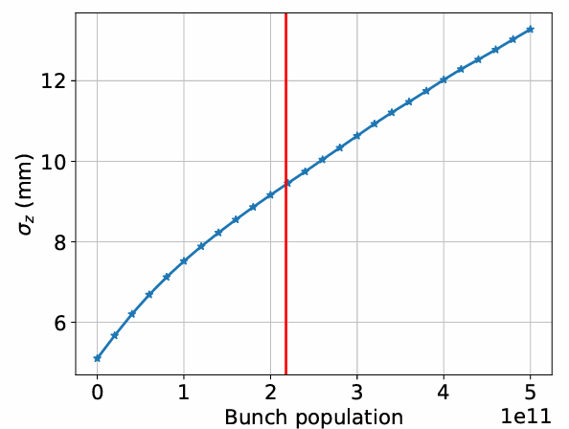
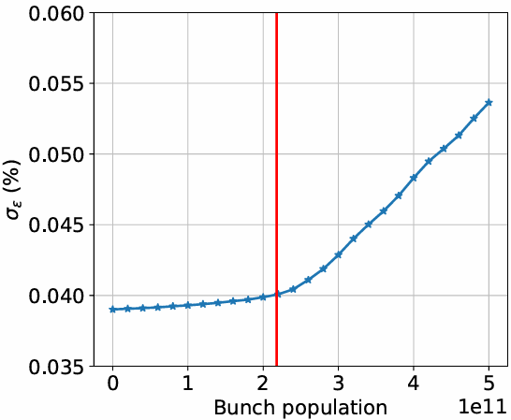
PWD in the longitudinal plane
For beam dynamics studies and collective effects evaluations, we have used the wake potential of a 0.4 mm Gaussian bunch as a pseudo-Green function.

Slide 8
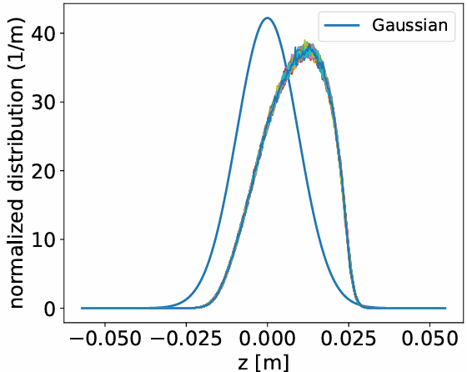
PWD in the longitudinal plane
Bunch shape due to the potential well distortion at the nominal intensity of 2.18e11 ppb

Slide 9
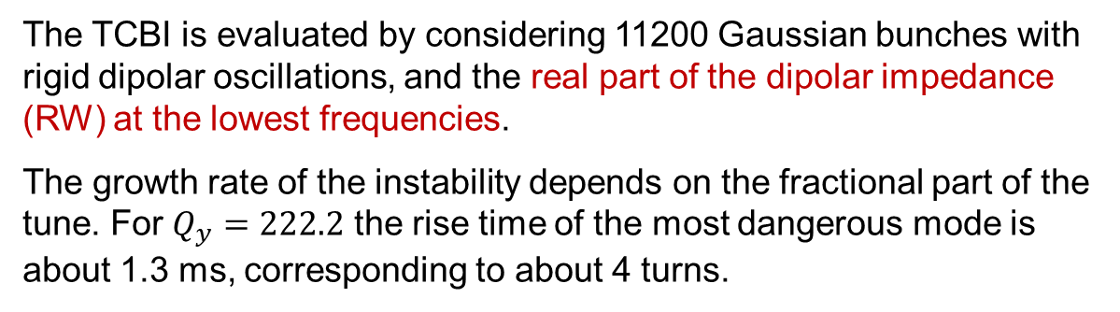
Transverse coupled bunch instability and feedback system
The TCBI is evaluated by considering 11200 Gaussian bunches with rigid dipolar oscillations, and the real part of the dipolar impedance (RW) at the lowest frequencies.
The growth rate of the instability depends on the fractional part of the tune. For $Q_{y}=222.2$ the rise time of the most dangerous mode is about 1.3 ms, corresponding to about 4 turns.
Observe that many coupled bunch modes are excited.
A feedback system is necessary to suppress the TCBI.
The damping time of the feedback system in the transverse plane should be about 1 ms.

Slide 10
Transverse single bunch instability under different scenarios
Wake without collimators
no chromaticity, no feedback system
chromaticity = 5 - feedback system on (4 turns)

Slide 11
Transverse single bunch instability under different scenarios
Wake without collimators’ geometric contribution (only RW)
chromaticity = 5 - feedback system on (4 turns)
x-plane
y-plane

Slide 12
Transverse single bunch instability under different scenarios
Wake with optimised collimators’ geometry
(geometric part = 1.5*RW part)
chromaticity = 5 - feedback system on (4 turns)
x-plane
y-plane

Slide 13
Transverse single bunch instability under different scenarios
Wake with reduced collimators’ geometric contribution (geometric part = RW part)
chromaticity = 5 - feedback system on (4 turns)
x-plane
y-plane

Slide 14
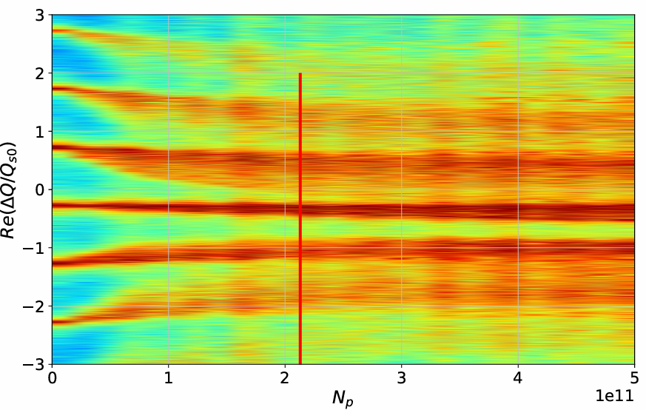
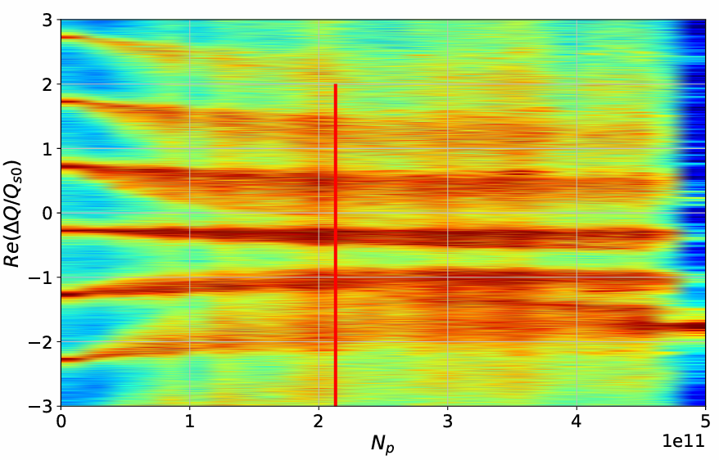
Transverse single bunch instability under different scenarios
Wake with reduced collimators’ geometric contribution (geometric part = RW part)
chromaticity = 20 - feedback system on (4 turns)
x-plane
y-plane

Slide 15
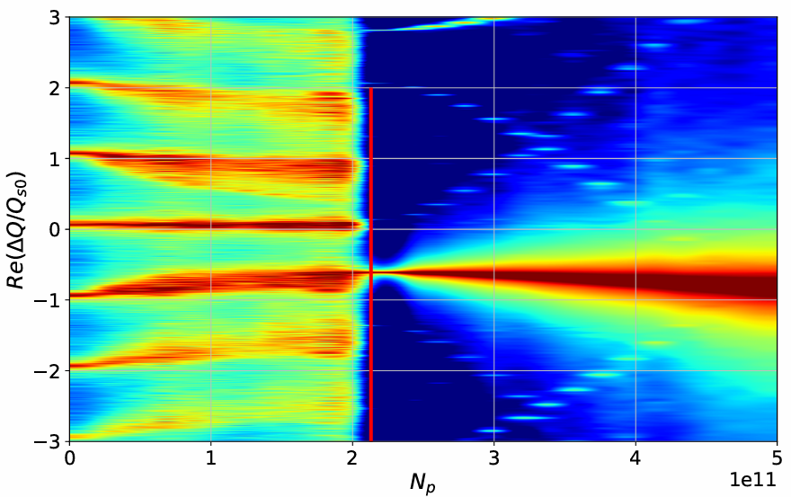
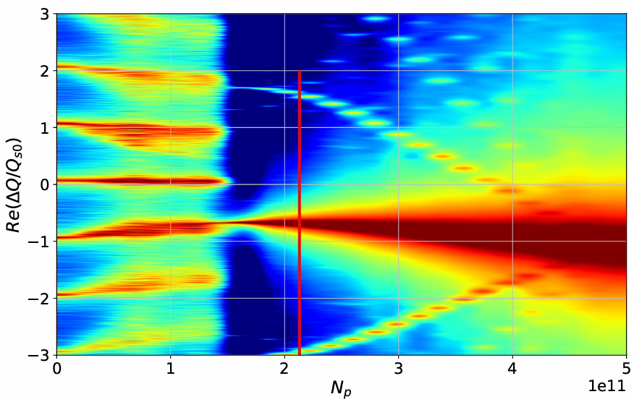
Transverse single bunch instability under different scenarios
Wake with reduced collimators’ geometric contribution (geometric part = RW part)
chromaticity = -5 - feedback system on (4 turns)
x-plane
y-plane

Slide 16
Transverse single bunch instability under different scenarios
Wake with non-optimised collimators’ geometry
(geometric part = 4.4*RW part)
chromaticity = 20 - feedback system on (4 turns)
x-plane
y-plane

Slide 17
Conclusions
Transverse single-bunch instability is the most challenging collective effect in the single-beam regime. The feedback system seems able to suppress TMCI, but the ‘-1 mode’ instability appears. An investigation with a more realistic feedback system is necessary.
Different scenarios have been presented. With the current impedance model, the vertical plane shows an instability threshold close to the nominal intensity.
Feedback system and chromaticity help, but vertical instability remains critical.
We are still missing several impedance sources (e.g. stripline kickers, vacuum flanges, 200 nm NEG thickness instead of 150, …). Additionally, other impedance devices need to be updated (such as bellows that, so far, were evaluated using a 35 mm beam pipe radius).
A common question from different groups is whether a device's design can be ‘accepted’ from the impedance point of view. We cannot answer such a question. An effective strategy to mitigate collective effects should include the optimized design of all devices contributing to the overall impedance.
Additionally, interplay with beam-beam and beamstrahlung must be taken into account.

Slide 18
Conclusions
Transverse single-bunch instability is the most challenging collective effect in the single-beam regime. The feedback system seems able to suppress TMCI, but the ‘-1 mode’ instability appears. An investigation with a more realistic feedback system is necessary.
Different scenarios have been presented. With the current impedance model, the vertical plane shows an instability threshold close to the nominal intensity.
Feedback system and chromaticity help, but vertical instability remains critical.
We are still missing several impedance sources (e.g. stripline kickers, vacuum flanges, 200 nm NEG thickness instead of 150, …). Additionally, other impedance devices need to be updated (such as bellows that, so far, were evaluated using a 35 mm beam pipe radius).
A common question from different groups is whether a device's design can be ‘accepted’ from the impedance point of view. We cannot answer such a question. An effective strategy to mitigate collective effects should include the optimized design of all devices contributing to the overall impedance.
Additionally, interplay with beam-beam and beamstrahlung must be taken into account.
Thank you for
your attention

