Slide 1


Main rings impedance budget
C. Zannini
X. Buffat, D. Gibellieri, A. Ghribi, J. Li, E. Macchia, I. Mases, M. Migliorati, L. Sito, M. Zobov
Acknowledgments: C. Antuono, H. Bartosik, E. Belli, M. Boscolo, G. Broggi, R. Bruce,
E. Carideo, E. De la Fuente, W. Hofle, I. Karpov, C. Pasquino, S. Redaelli, E. Rose Howling,
G. Rumolo, R. Soos, D. Sittard, H. Sullivan, F. Zimmermann

Slide 2
Overview
Introduction
Impedance beam induced power
FCC-ee impedance model
Multi-bunch tune shift considerations
Summary

Slide 3
Overview
Introduction
Impedance beam induced power
FCC-ee impedance model
Multi-bunch tune shift considerations
Summary

Slide 4
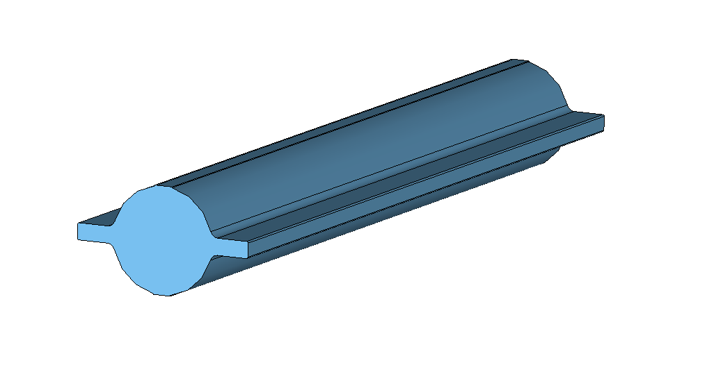
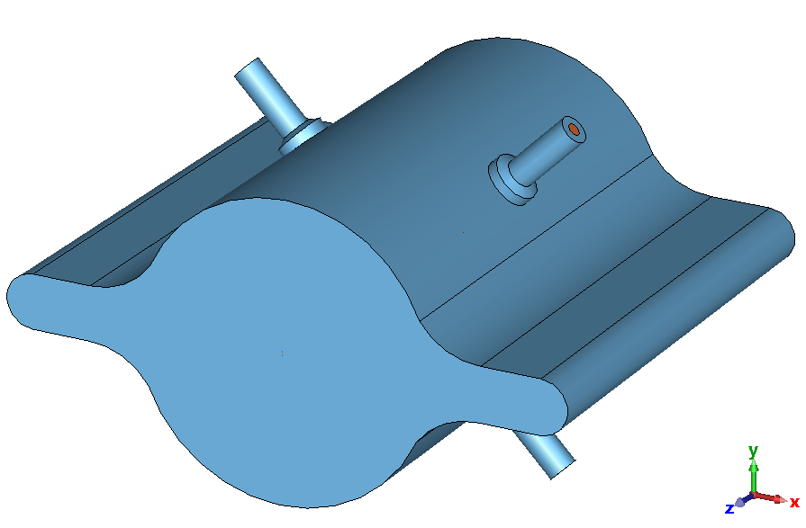
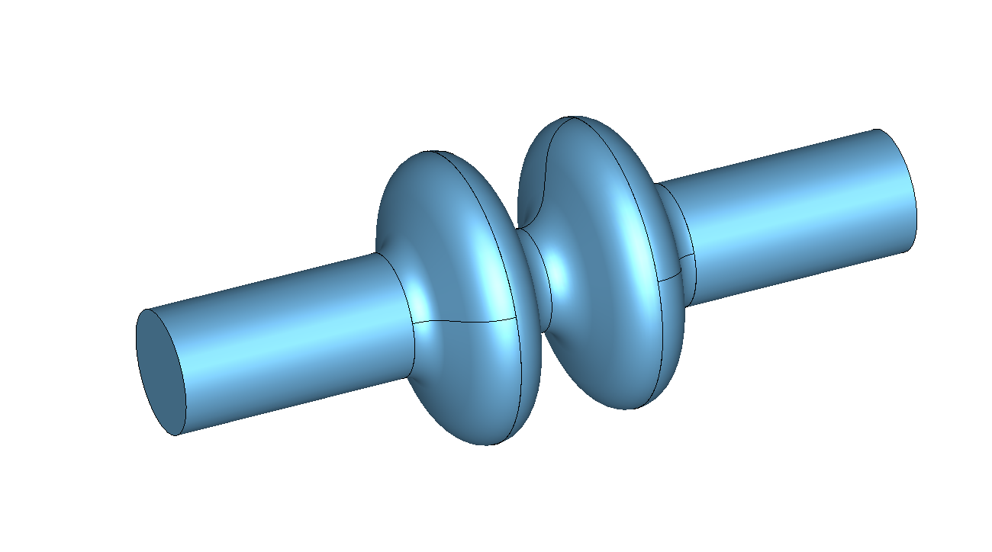
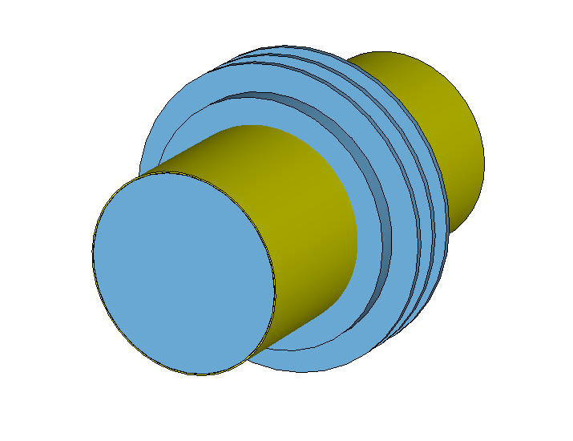
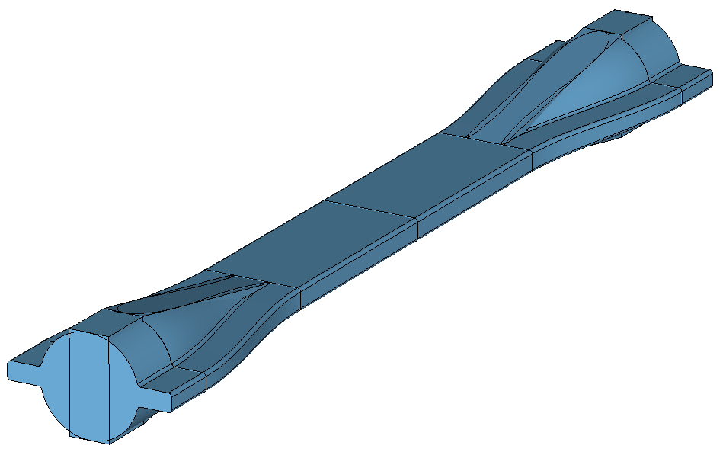
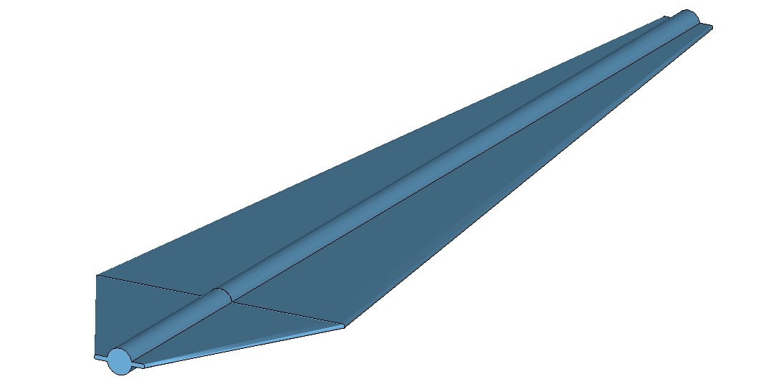
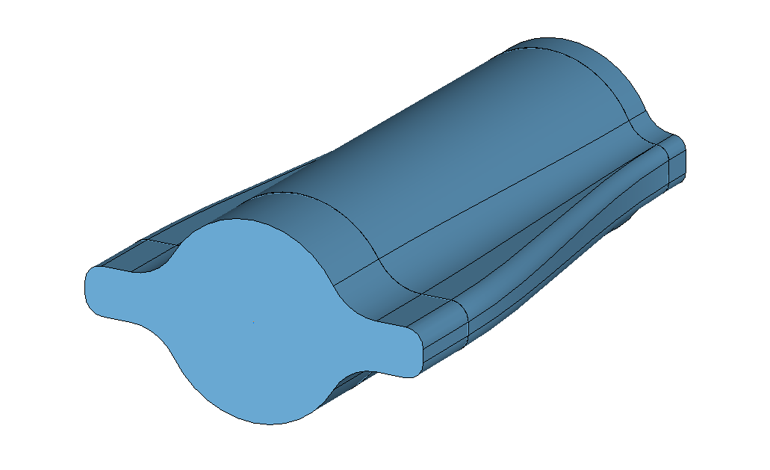
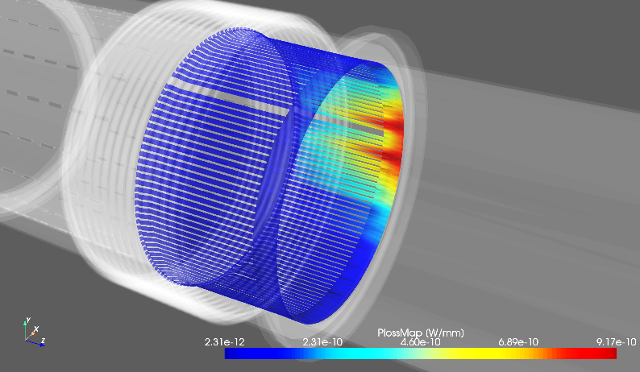
Introduction
Impedance optimization of accelerator elements is crucial to avoid
  Beam instabilities
    Machine impedance
  Equipment degradation and damage
    Beam induced heating
    Beam induced sparking

Slide 5
Impedance optimization
Impedance optimization requires the knowledge of the knobs to manipulate the impedance
Having simplified formulas to master the main dependencies
Step by step simulation to have a deep understanding of the impedance mechanism
Impedance evaluation
Beam induced power
Power loss map
Combining 3D simulations and BIHC results
Simulations, analytical models, measurements
Established calculation tool BIHC https://github.com/ImpedanCEI/BIHC
Impedances are included in the global impedance model
for beam dynamics assessments and energy loss budget considerations
Design optimization

Slide 6
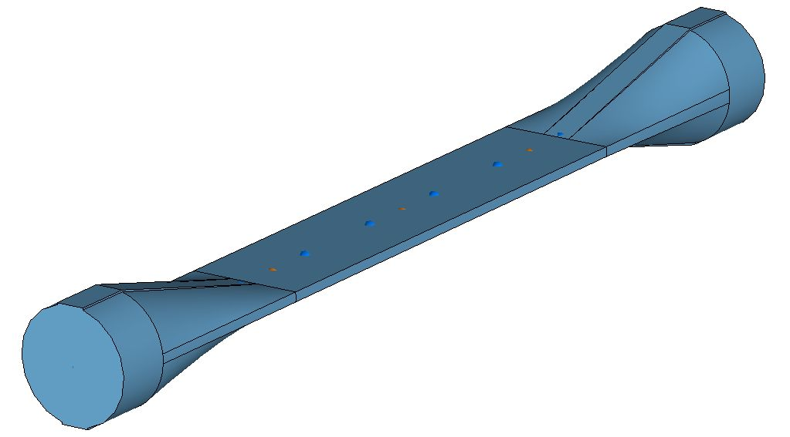

FCC-ee impedance challenges
Challenging simulation regime
  Combination of large beam pipe dimensions and short bunch lengths
    Very high number of mesh cells.
~3000 bilion mesh cells
~3 bilion mesh cells
~15 bilion mesh cells
Ad-hoc developments in the open source wakefield solver Wakis are ongoing to address this simulation challenge efficiently https://github.com/ImpedanCEI/wakis/

Slide 7
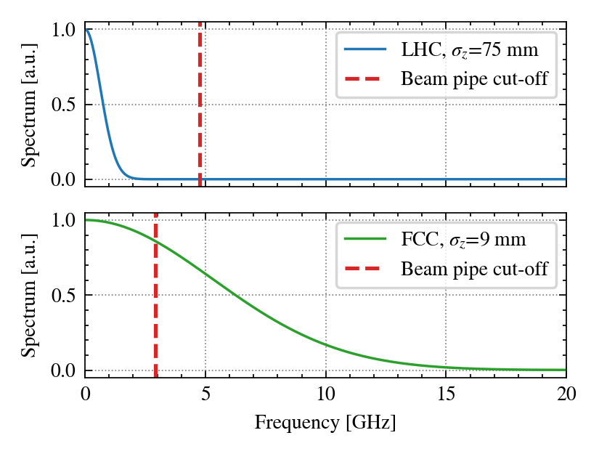
FCC-ee impedance challenges
Normalized spectrum envelope
Courtesy of L. Sito
The beam pipe cut-off lies well within the relevant frequency spectrum.
  Several modes above cut-off are strongly excited, leading to significant crosstalk between different accelerator elements.
    Particularly relevant for long range wakefield and beam induced power assessment
  Multiple modes can propagate along the accelerator. Should we consider implementing ad-hoc devices to absorb the propagating power?

Slide 8
Overview
Introduction
Impedance beam induced power
FCC-ee impedance model
Multi-bunch tune shift considerations
Summary

Slide 9

Beam induced power
Power loss map
Impedance evaluation
Beam induced power
Combining 3D simulations and BIHC results
Simulations, analytical models, measurements
Established calculation tool BIHC https://github.com/ImpedanCEI/BIHC
Total number of particles in the beam
Longitudinal impedance
Revolution frequency of particles
Normalized beam spectrum
Input for equipment owner to assess risks due to beam induced power level

Slide 10
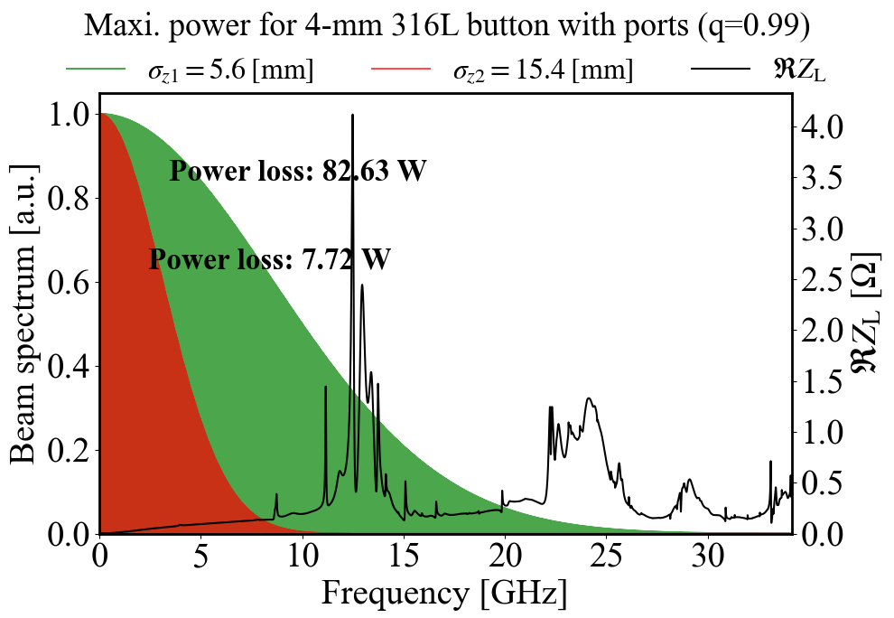
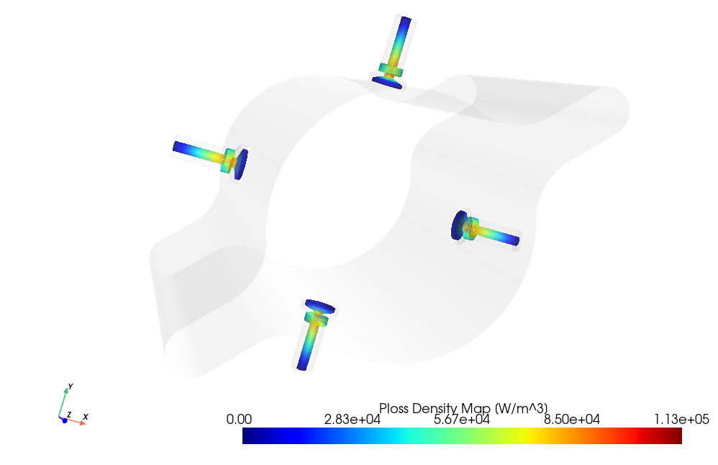
Beam induced power: the FCC-ee BPM example
Beam induced power loss map obtained combining the effect from all modes is provided to equipment owner for thermo-mechanical assessment
Courtesy of J. Li and E. De la Fuente

Slide 11
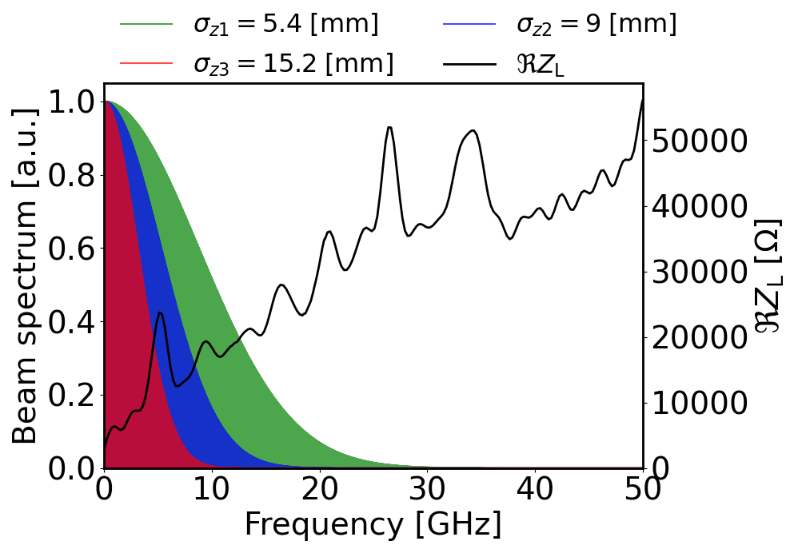
Total beam induced power from impedance
Z configuration
Beam induced power from impedance
with the latest impedance model
1.8 MW at 15.2 mm bunch length
4.2 MW at 9 mm bunch length
9 MW at 5.4 mm bunch length
Courtesy of J. Li
Energy loss per turn from SR 0.039 GeV
SR power for the full beam ~50 MW
Impedance beam induced power from ~4% to ~20% of SR power depending on bunch length

Slide 12
Overview
Introduction
Impedance beam induced power
FCC-ee impedance model
Multi-bunch tune shift considerations
Summary

Slide 13
FCC-ee impedance budget

Slide 14
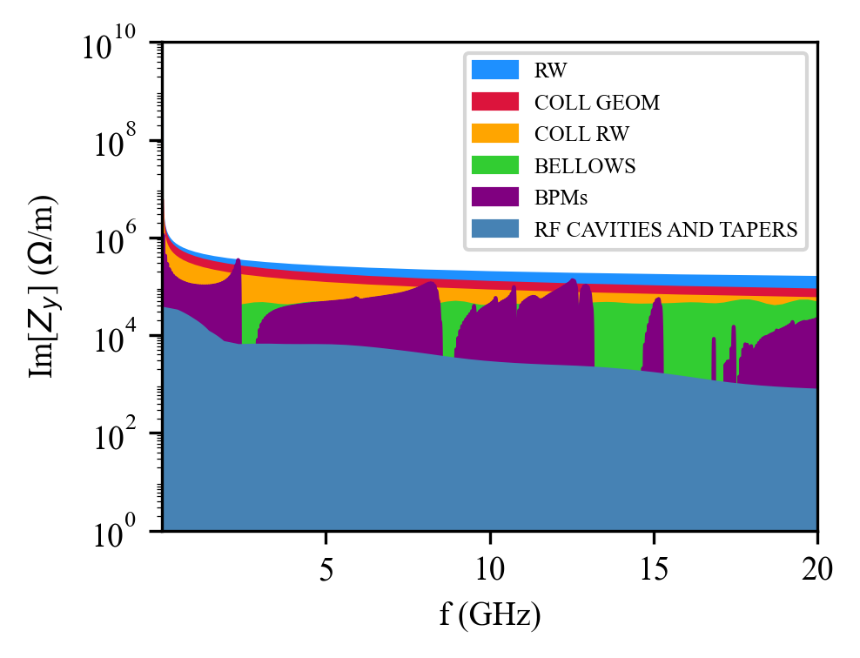
FCC-ee impedance budget
Status of the impedance/wake model
Accelerator element | Model status | Evaluation method
Beam pipe (RW) | Advanced | Analytical (IW2D)
Collimator RW | Initial | Analytical (IW2D)
Collimator geom. | Initial | 3D simulations
Bellows | Initial | 3D simulations
BPMs | Initial | 3D simulations
RF cavities+tapers | Initial | 3D simulations
Polarimeter | Initial | 3D simulations
Stripline kickers | Initial | 3D simulations
Chamber transitions | Initial | 3D simulations
Courtesy of D. Gibellieri
Follow-up design evolution ensuring impedance optimization and update models accordingly
Inclusion of additional elements (e.g. injection and extraction devices)

Slide 15
Overview
Introduction
Impedance beam induced power
FCC-ee impedance model
Multi-bunch tune shift considerations
Summary

Slide 16
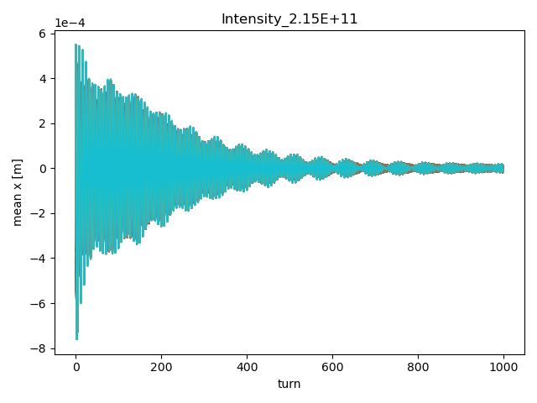
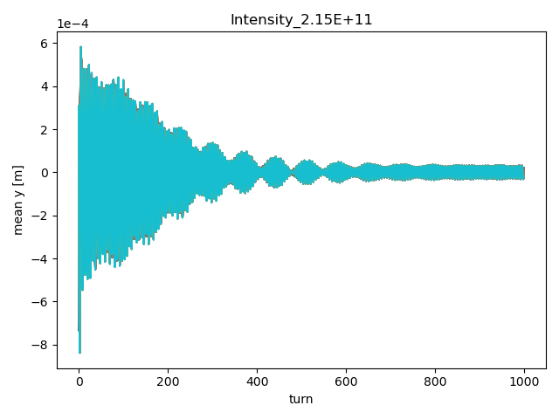
Bunch-by-bunch tune shift considerations
Multi-bunch simulations with resistive wall wake
Courtesy of I. Mases
Bunch-by-bunch tune shifts are obtained from the bunch monitoring of the centroid position

Slide 17
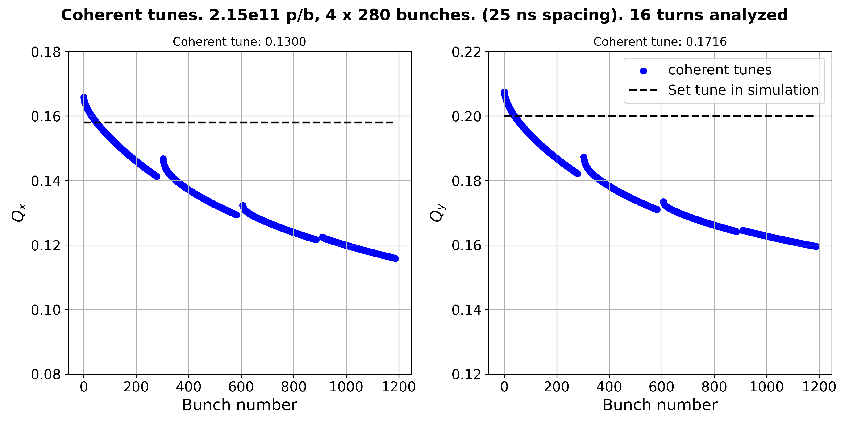
Bunch-by-bunch tune shift of a partially filled machine
Courtesy of I. Mases
Bunch-by bunch tune shift of the order of few ${10}^{−2}$ over one train of 280 bunches for partially filled machines

Slide 18
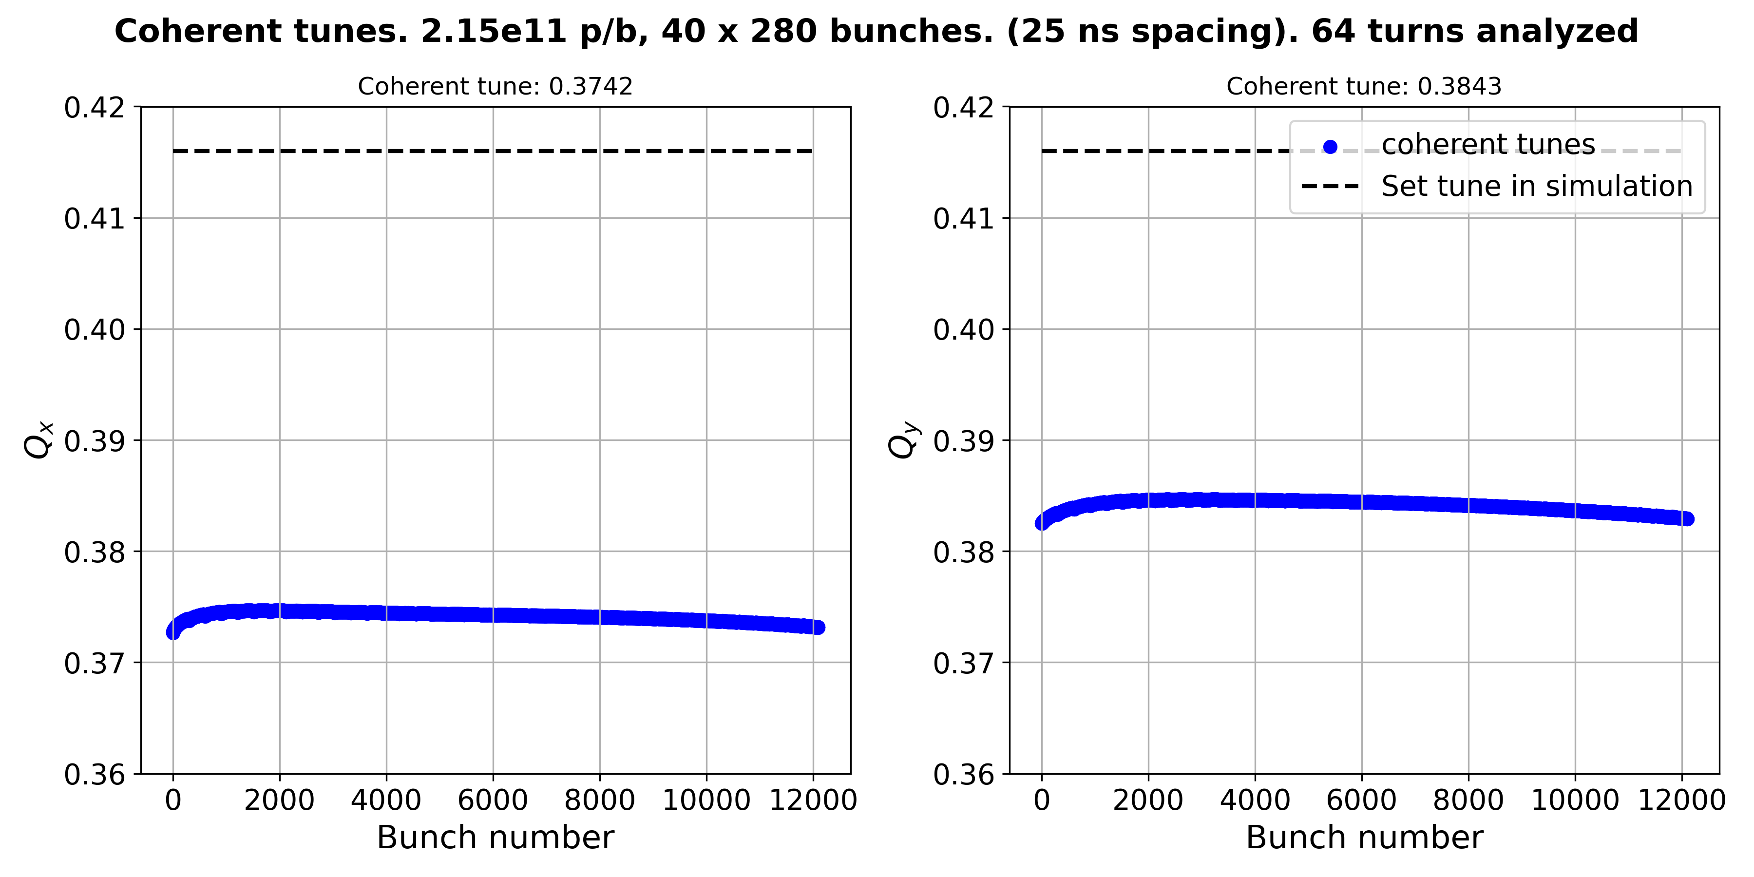
Bunch-by-bunch tune shift of the full machine Z configuration
Tune shift = -0.0418
Tune shift = -0.0317
Critical for X-Z instability (see R. Soos talk)
Overall bunch-by-bunch tune shift in the order of few ${10}^{−3}$ (in the same order of the horizontal beam beam parameter)

Slide 19
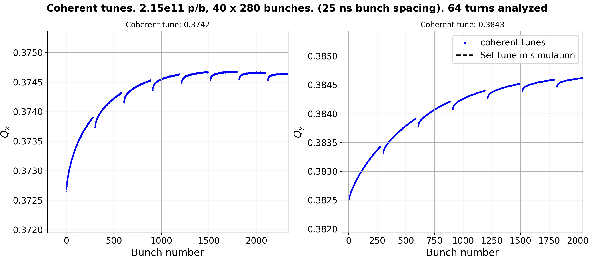
Bunch-by-bunch tune shift of the full machine Z configuration
Very preliminary studies
Courtesy of I. Mases
Overall bunch-by-bunch tune shift in the order of few ${10}^{−3}$ (in the same order of the horizontal beam beam parameter)
Bunch-by-bunch tune shift is a very critical subject for FCC-ee and must be taken into account to define the filling strategy and the overall impedance budget

Slide 20
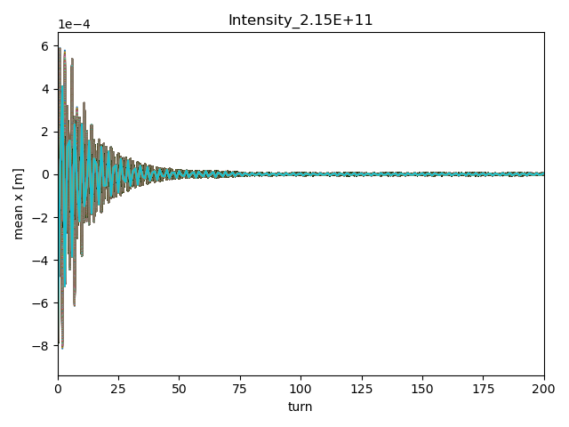
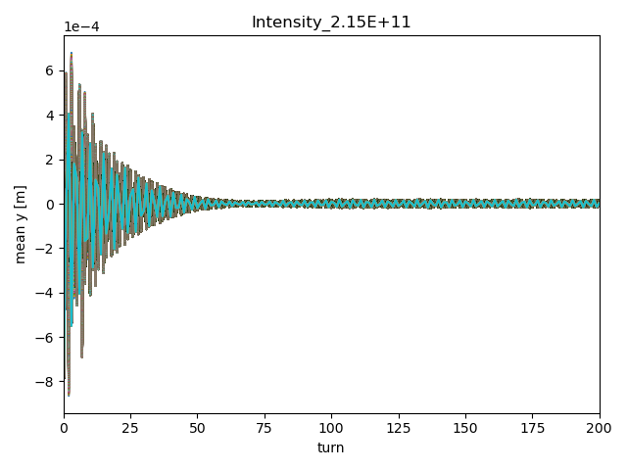

Beam stability with multi-bunch beam Z configuration
Set tunes:
Qx = 218.416
Qy = 222.416
Chromaticity = 5
Stable for damping time $≤5 turns$
Zoom in the first 200 turns
Zoom in the first 200 turns
Courtesy of I. Mases

Slide 21
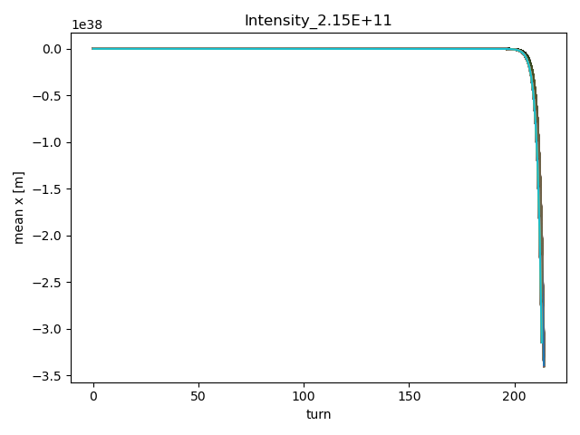
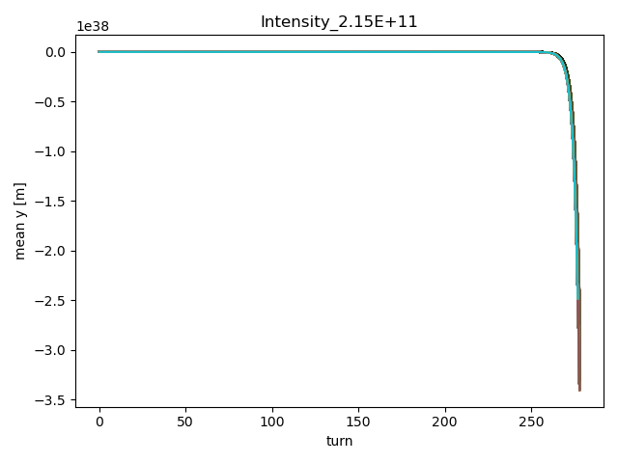
Beam stability with multi-bunch beam Z configuration
Set tunes:
Qx = 218.198
Qy = 222.232
Stability at nominal tune extremely challenging. Unstable with 4 turns damper
Very preliminary studies
Courtesy of I. Mases
Simulations including beam-beam and more realistic damper model to be performed.
Stability with multiple bunches at the nominal working point looks challenging

Slide 22
Overview
Introduction
Impedance beam induced power
FCC-ee impedance model
Multi-bunch tune shift considerations
Summary

Slide 23
Summary
FCC-ee challenging regime
  Combination of large beam pipe dimensions and short bunch lengths
  The beam pipe cut-off lies well within the relevant frequency spectrum
    Significant crosstalk between different accelerator elements
Follow-up design evolution ensuring impedance optimization
  Update FCC-ee model accordingly
Impedance beam induced power has a significant impact on the energy loss per turn from ~4% to ~20% depending on bunch length
Impedance induced multi-bunch effects
  Bunch-by-bunch tune shifts must be taken into account to define the filling strategy and the overall impedance budget
  Stability at nominal working point looks critical due to very fast coupled bunch instability (~2 turns growth rate).
    Studies including beam-beam and realistic feedback system are needed

Slide 24
Thank you for your attention

