Slide 1

Studies towards a depolariser design
11th FCC Week 22.05.2025
presented by W. Hofle
CERN SY-RF-BR
Acknowledgements:
I. Karpov, D. Sittard, L. Thiele,
Epol WG

Slide 2
Depolariser kickers and transverse feedback
11th FCC Week 22.05.2025
Wolfgang Hofle
Recapitulation
due to similar requirements for bandwidth synergy between the needed kickers for the transverse feedback and the depolariser have been explored
long, O(m), stripline kickers operating at a multiple of the bunch repetition frequency offer good RF power efficiency and sufficient bandwidth
differences in requirements between transverse feedback and depolarizer kickers are
  depolarizer kicker only needed for vertical kicks, transverse feedback also for horizontal plane kicks
  implementation of depolariser excitation as a modulated local orbit bump requires one or several sets of pairs of kickers with bending magnets in between
    no perturbation on experimental points permitted, recommended to have a tuning possibility with a third kicker per set of kickers
  kick strength required for depolarizer is high (10 μrad) and adequate protection is needed to prevent acting on Physics bunches (loss of synchronisation with gaps)

Slide 3
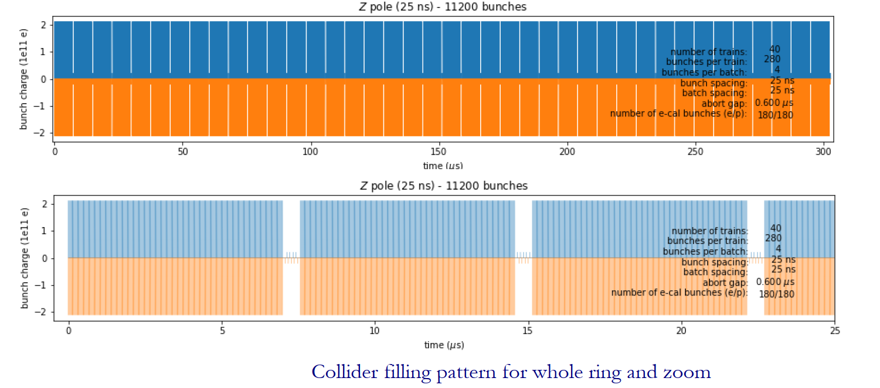
Filling pattern Z-pole – update of 2024
11th FCC Week 22.05.2025
Wolfgang Hofle
H. Bartosik, FCC week 2024
(new alternate filling schemes with short trains (e-cloud mitigation of 5 ns spaced bunches need study)
e-cal bunches of at least one gap are affected by injection bump risetime, so effectively 175 (one beam), 176 (the other beam) useful bunches at maximum

Slide 4
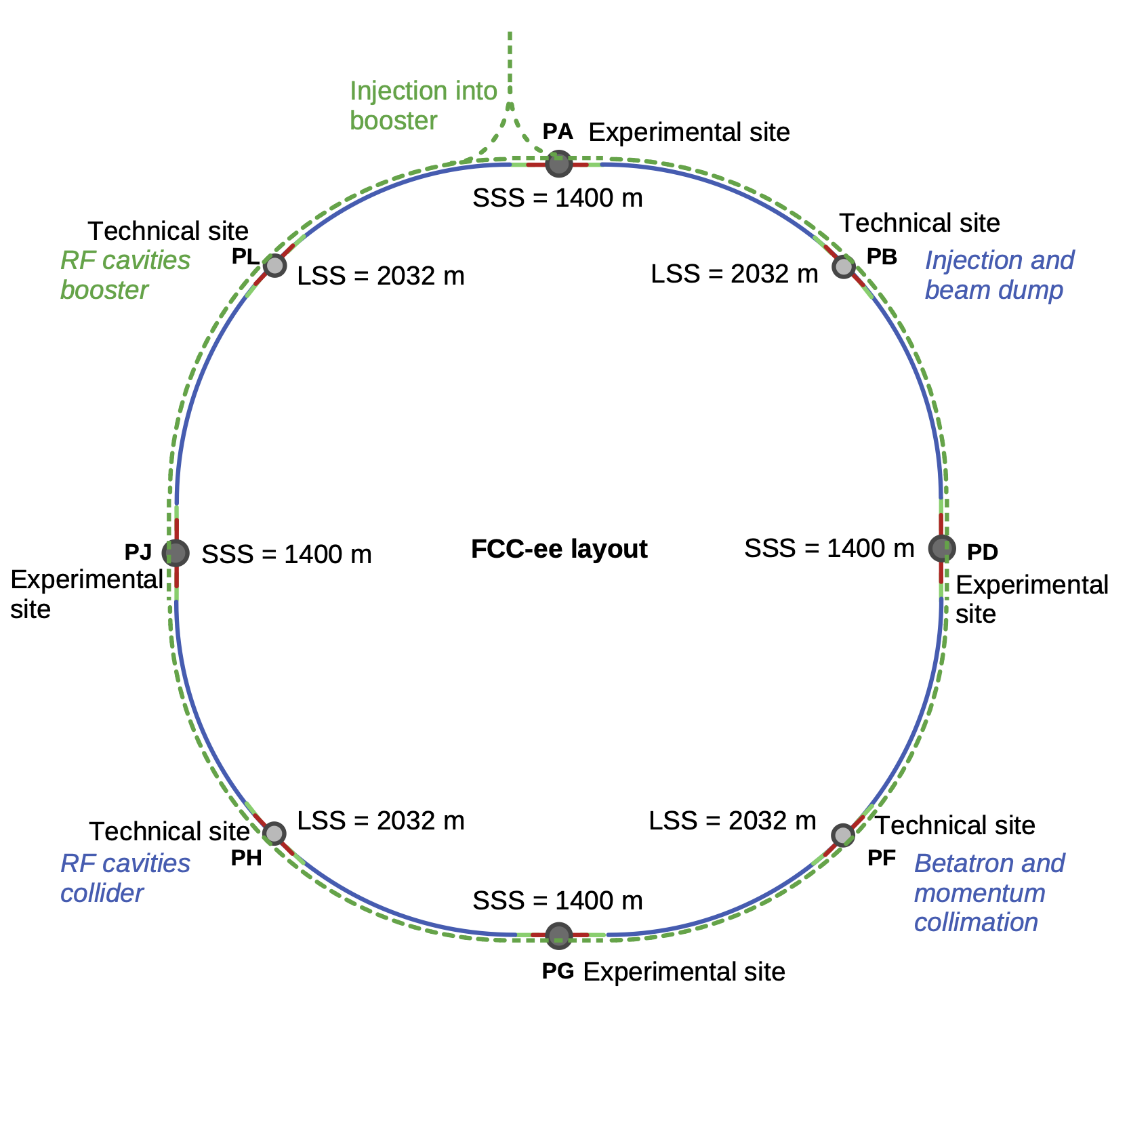
Considerations for placement in ring
11th FCC Week 22.05.2025
Wolfgang Hofle
PL: collider
transverse feedback kickers & depolarizer (4)
PB:collider
transverse feedback kickers & depolarizer (1)
Update 2025:
arcs adjacent to technical sites PL, PB, PF, PH now preferred
  see K. Oide FCC week 2025 for proposal for integration of kickers in GHC optics
  assume similar possibilities in LCC optics exist, but needs check, LCC optis has somewhat lower beta functions → impacts efficiency at least for transverse feedback part
experimental sites (PA, PG, PD, PJ)
  spaces that were considered:
    return arc (optics not really suited)
    regular arc, out-going beam, still a possibility
booster
transverse feedback kickers
PH: collider
transverse feedback kickers & depolarizer (3)
PF: collider
transverse feedback kickers & depolarizer (2)

Slide 5
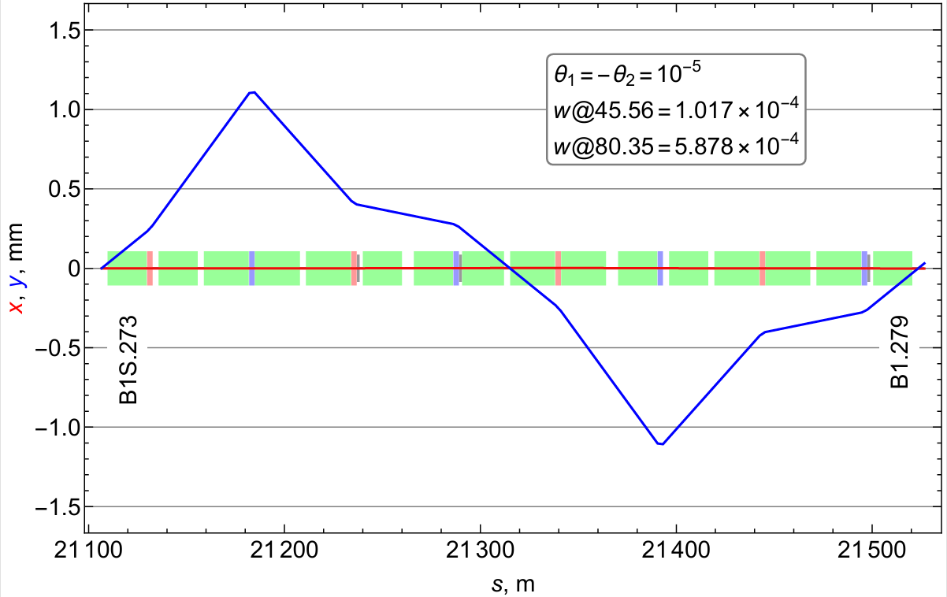
Placement in regular arc under study
11th FCC Week 22.05.2025
Wolfgang Hofle
positron beam outgoing (clockwise) / right of Ips, see also K. Oide FCC week 2025
split system over eight locations, left and right of four points, four per beam
chose kickers of lengths of 1 m
→ at least 8 kickers per beam for four full wave bumps per beam
+ a third kicker to ensure bump closure (another 4 kickers per beam)
24 kickers in total
If split as proposed over four locations, angle is 2.5e-6 and position peak also factor 4 smaller → more realistic
Kicker 3
Kicker 1
Kicker 2
optional kicker 3 to ensure full wave bump is closed
Following proposal by I. Koop, update see K. Oide, FCC week 2025
https://indico.cern.ch/event/1471324/contributions/6220925/attachments/2963259/5212471/Koop-depolarizer%20review.pdf

Slide 6
Depolariser and distributed transverse feedback
11th FCC Week 22.05.2025
distrubuted system with four-fold symmetry
kickers and pick-ups installed at on out-going beam at start of arc
points “Q,R,S,T” can be either experimental points or technical points
  arcs adjacent to technical sites now preferred !
three kickers per point and beam (12 per beam, 24 total)
  two strong kickers (also main depolarizer bump kickers)
  one shorter kicker (polarizer bump correction)
    can have a higher frequency reach (100 MHz)
four pick-ups per point and beam (16 per beam, 32 total)
  spacial sampling, i.e. betatron phase advance between pick-ups 60-120 degrees, covering one period of betatron oscillation
  pick-ups down stream of kickers (immediate monitoring of system malfunction, machine protection! )
low latency data links connecting the four processing nodes per beam
  simulations needed to determine what processing will provide additional damping to the low order coupled bunch modes using these links
processing
processing
kickers(2+1)
pick-ups (4x)
processing
processing

Slide 7
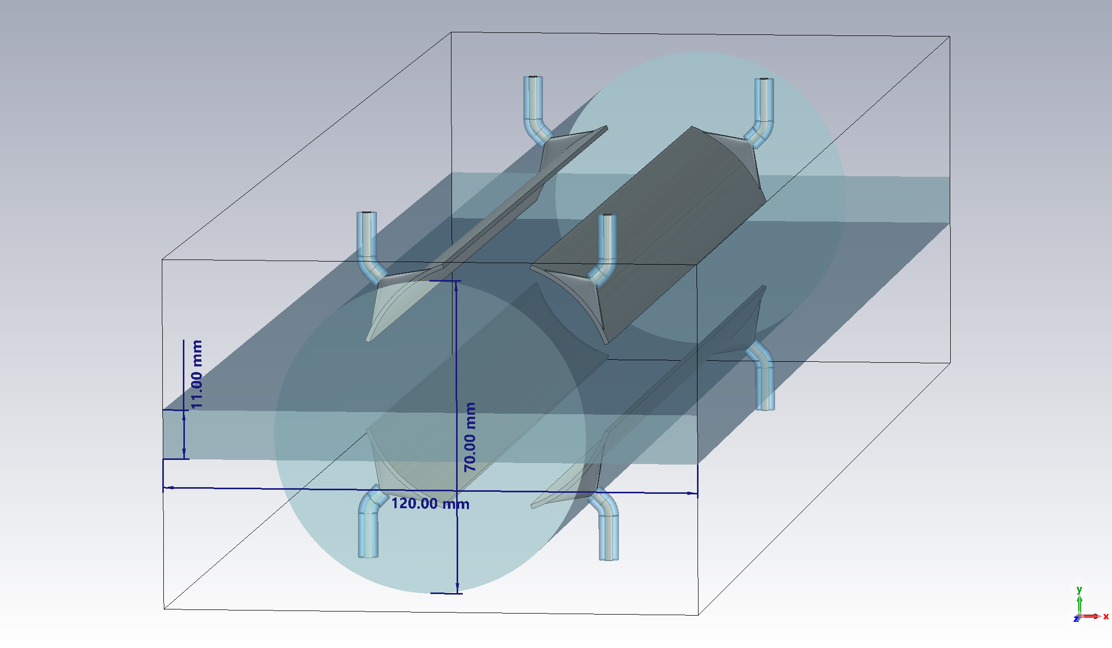
Stripline kicker: arc compatible version (1st version)
11th FCC Week 22.05.2025
Wolfgang Hofle
Characteristics (good for transverse feedback, but too low shunt impedance for depolariser with arc compatible diameter)
RF power
four electrodes arranged at 45 degrees
leaves horizontal plane free for synchrotron radiation absorbers similar as for BPM designs
compatible with vacuum chamber diameters of 60-70 mm foreseen for arcs (initial proposal)
small diameter also desirable for increased shunt impedance, but matching to 50 Ohm must be considered for both differential mode and common mode
universal design that can be powered to provide vertical or horizontal kicks, even simultaneously, power can be directed to plane that needs high level kicks
device is a backward coupler, powered at beam downstream ports and terminated at upstream ports
action on beam provided in equal parts from magnetic and electric fields
length can be adjusted to match actual needs for bandwidth
total kick strength provided by set of kickers, placed at the appropriate phase advance / optics as needed
up to 1m long
RF loads
RF power
RF loads
D. Sittard (CST)

Slide 8
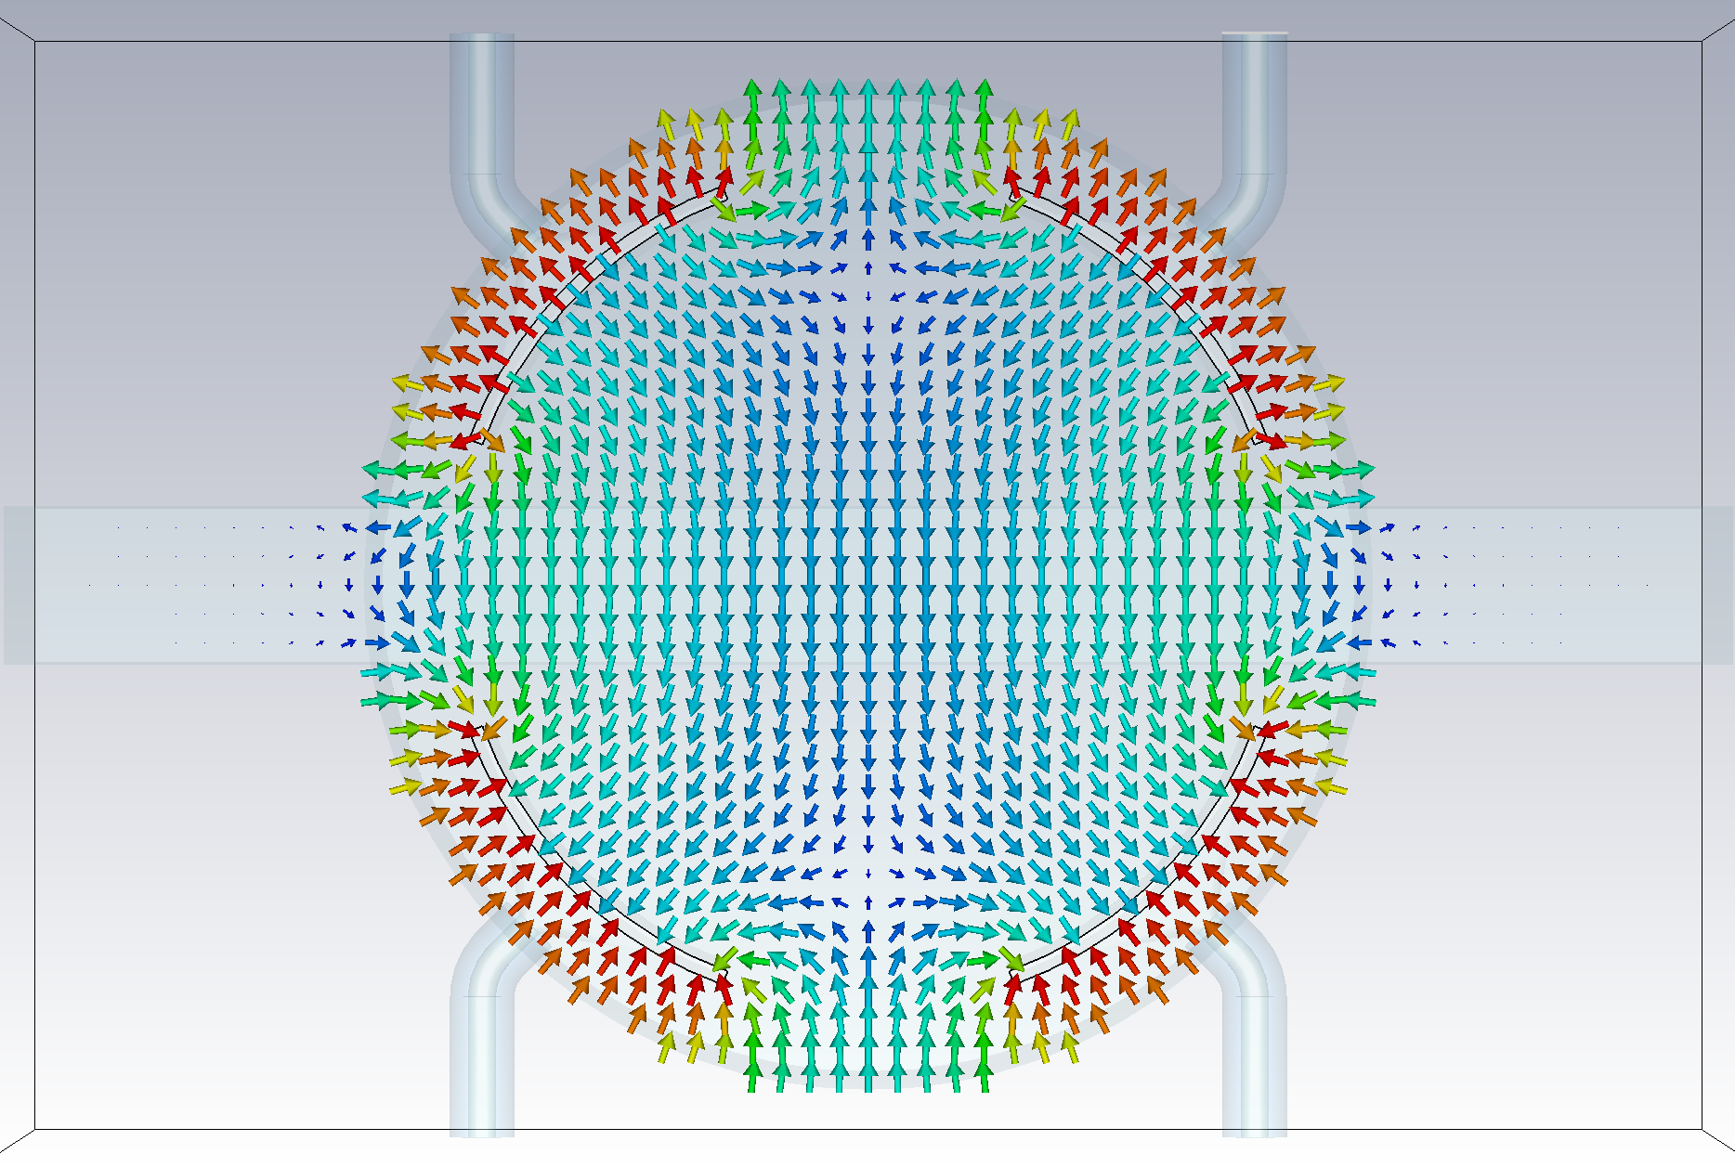
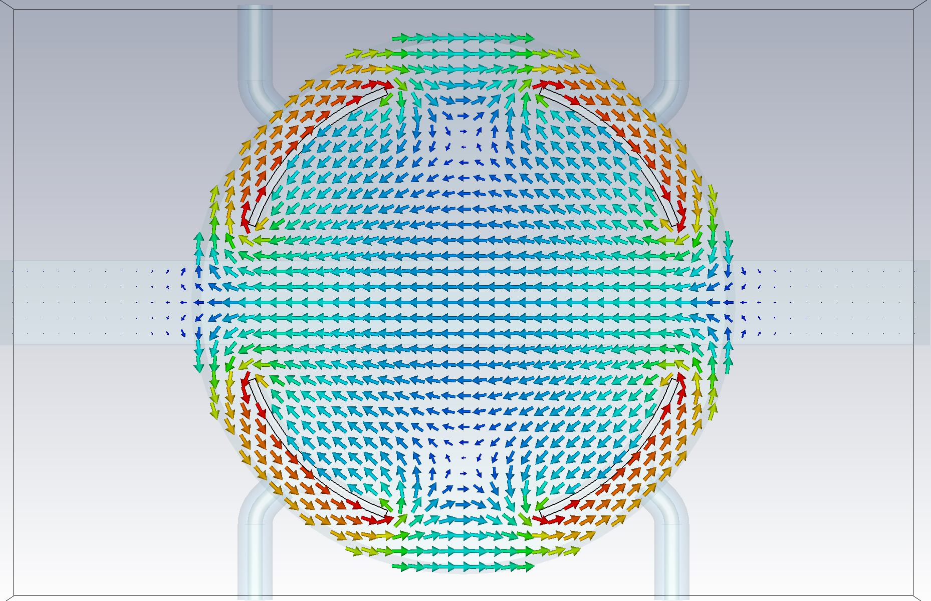
Stripline kicker: field plots (70 mm chamber)
11th FCC Week 22.05.2025
Wolfgang Hofle
Electric field (vertical)
Magnetic field field (horizontal)
D. Sittard
vertical kick evenly split between electric and magnetic fields
optimization is planned to start this year (beam impedance, details of the design compatible with short bunch length … )

Slide 9
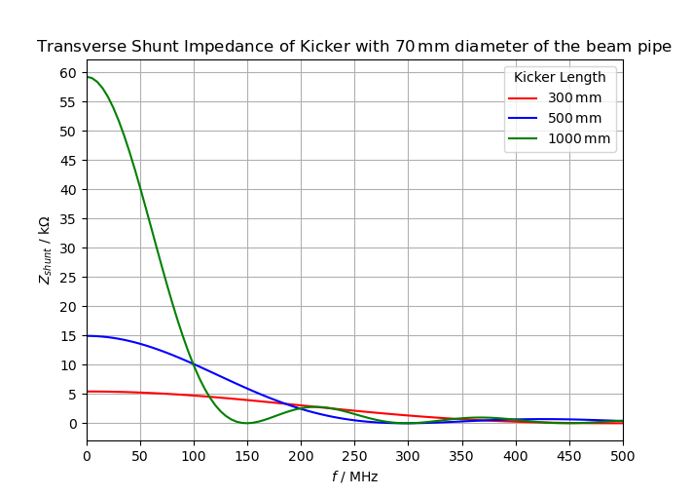
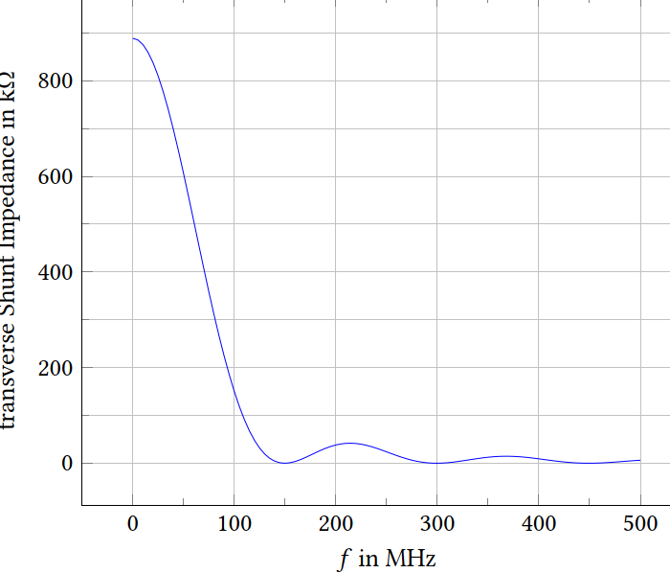

Shunt impedance kicker (four electrode version)
11th FCC Week 22.05.2025
Wolfgang Hofle
Adaptation of length to bandwidth also possible (using 1 m long kickers for 40 MHz +/- 20 MHz)
26 mm vacuum chamber (→ 18 mm between electrodes)
70 mm vacuum chamber diameter (directly arc compatible)
→ power need reduced by factor 15.6
40 MHz
for 10 μrad @ 45.6 GeV
@40 MHz, 700 kΩ
4 electrodes
looks feasible, 1 m length
beam impedance check with BE-ABP ongoing, tapers (minimize broadband impedance!)
minimum bunch length ?!
4 kickers
RF power
4x4x 35 kW
4x4x 2.26 kW
80 MHz
160 MHz
D. Sittard
integrated transverse kick 450 kV needed (split voltage over four kickers):
$$VT=\sqrt{2PZs}$$
total length per beam for kickers ~10 m (+ overhead tapers)
3 m per location per beam (if split over four points per beam)

Slide 10
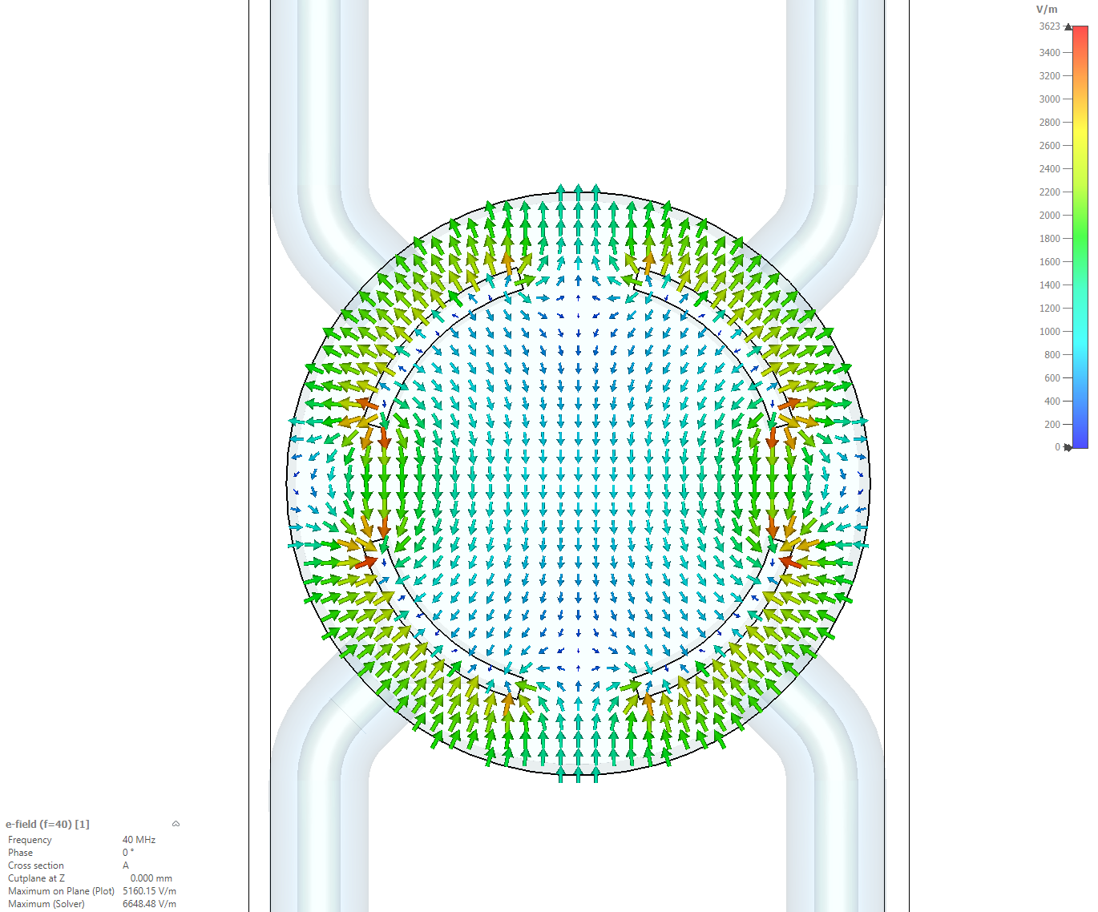
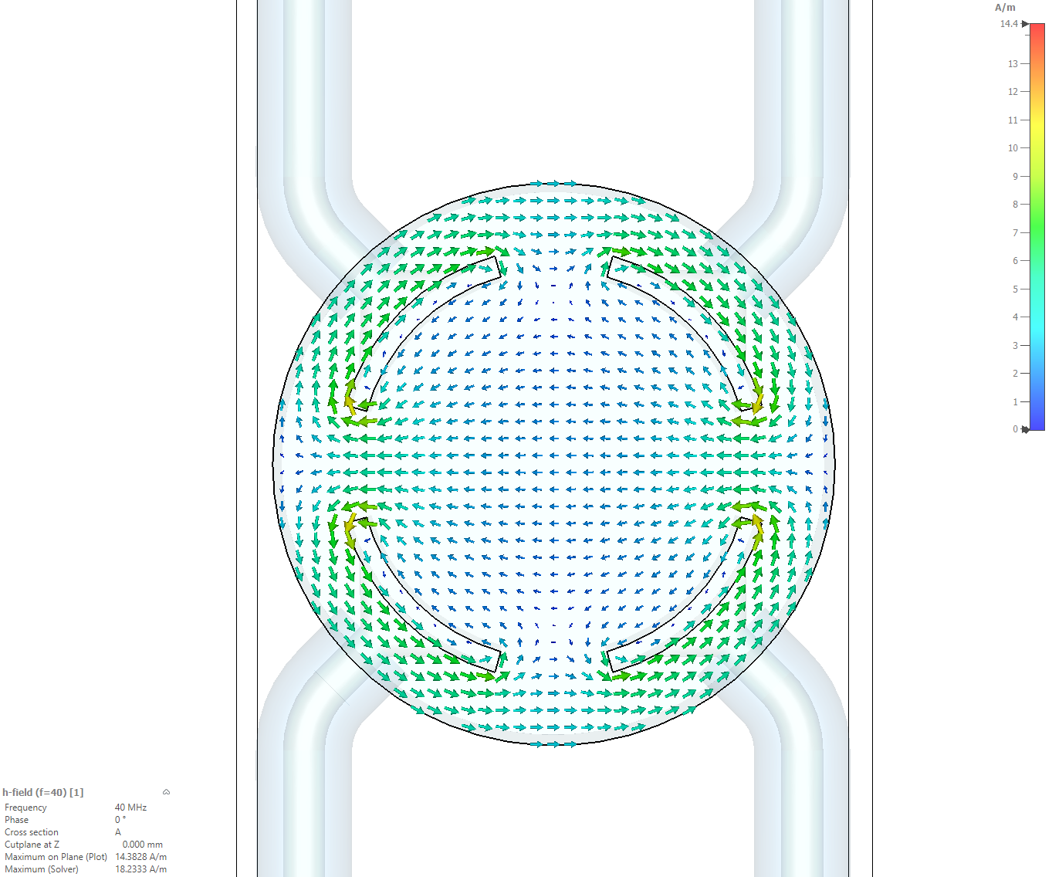
Stripline kicker: field plots (26 mm chamber)
11th FCC Week 22.05.2025
Wolfgang Hofle
18 mm
Electric field (vertical)
Magnetic field field (horizontal)
D. Sittard
vertical kick evenly split between electric and magnetic fields
18 mm diameter stay clear aperture, tight tapers needed for impedance → possibly adds to installation length !

Slide 11
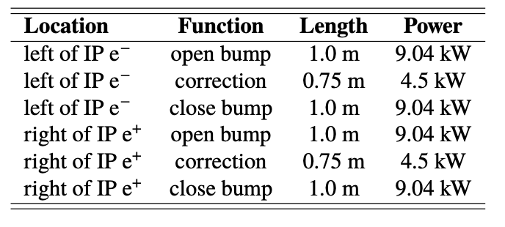
Kick voltage and kick angle summary
11th FCC Week 22.05.2025
Wolfgang Hofle
10 μrad at 45 GeV → 450 keV/c transverse momentum kick needed for the depolariser function, several kickers needed to implement this modulated closed bump
stripline kickers offer a viable solution
split over four locations per beam
  use sets of 1 m long kickers (RF matched to 50 Ω) with four electrodes for each location to create local modulated bump (2x4x2.26 kW = 18 kW RF power per bump)
  four such systems per beam
  24 kickers in total for both beams combined
    for 16 main kickers: 144 kW RF power
    for 8 adjustment kickers: 36 kW RF power
    bandwidth for adjustment kicker can be higher
Kicker lengths and powers (table is for one of four locations)

Slide 12
Next crucial steps – my view
11th FCC Week 22.05.2025
Wolfgang Hofle
optimization of kickers with respect to having high power efficiency (shunt impedance) in operating band and acceptable beam impedance overall
  optimization of electrode design, possible consideration of advantages of higher line impedance kicker
  decision on minimum bunch length for design specification
simulations with new tools available to confirm kick strength is sufficient for depolarisation as needed, see G. Iadaorola FCC week 2025 (Xsuite)
move to prototyping depolariser kicker once a solid electromagnetic design is established (prototyping not before 2026), clarify where a prototype could be tested
converging on exact installation location and optics including the space needed with tapers
follow-up on machine protection considerations

Slide 13
Thank you for your attention.
11th FCC Week 22.05.2025
Wolfgang Hofle
13

Slide 14
Spare
11th FCC Week 22.05.2025

Slide 15
FCCee collider and booster transverse feedback
11th FCC Week 22.05.2025
Wolfgang Hofle
Key requirements
need bunch-by-bunch operation at 25 ns bunch spacing → defines bandwidth
can operate at multiple of bunch repetition frequency (short bunches) → no need to work in “base-band” as in LHC → helps as it reduces relative bandwidth
sets of RF matched strip-lines with carefully chosen length as kickers seem obvious choice
Booster:
  request to also operate to damp a significant transverse injection error → defines maximum kick requirements
    needs estimate of injection errors, filamentation time, … to define system
  moderate damping times only for instabilities (not beyond experience from LHC)
  single location in ring sufficient, but also resonant depolarizer function if polarized beams are injected
Collider:
  need to damp very fast transverse instabilities → four turns risetime, high gain system
    favors distributed system with multiple pick-ups and kickers
    possibility of synergy with exciter for resonant depolarization (as in LEP)

Slide 16
Recapitulation TFB for FCC-ee
11th FCC Week 22.05.2025
FCC-ee requires a coupled bunch transverse feedback system
fast rise times of the instability of 4 turns caused by the resistive wall impedance are predicted for the lowest order coupled bunch modes, see M. Miglorati (FCC week 2025)
requires shortest possible latency (1-2 turns), short latency ensures transverse FB disentabled from orbit FB
  use several pick-ups for “spacial sampling”, see D. Teytelman (FCC week 2024)
  notch filter for closed orbit supression
  distributed kicker system for possibly feeding back low frequency mode with less than 1 turn delay, see A. Drago (FCC week 2018)
lowest betatron frequency can be as low as 500 Hz for a tune fractional tune of 0.15
  the feedback system should cover all unstable modes, i. e. frequencies up to half the bunch repetition frequency → 20 MHz bandwidth for baseline 25 ns bunch spacing
  when introducing shorter bunch spacings (5 ns) at least a few feedback kickers are needed to cover frequencies up to 100 MHz, the mixed scheme proposed for electron cloud mitigation needs further scrutiny on how the bunches oscillate, and simulations with realistic feedback

Slide 17
Machine Protection considerations (03.10.24)
11th FCC Week 22.05.2025
Wolfgang Hofle
What can go wrong?
Mitigation
excitations not correctly synchronized
excitation amplitudes not correct leading to not closed depolarizing bumps
any of the other excitations that will certainly be used (AC dipole mode etc.) need to be protected against failures
very strong kicks possible comparable or even larger than at LHC injection
protection with BLMs of limited or of no use due to small beam size, absence of significant halo
monitoring of positions at appropriate distance from kickers at specific phase advance
global monitoring of beam position required turn-by-turn, independent of pick-ups used for TFB
interlocks need to be derived from this monitoring
  use also down strip TFB pick-ups for monitoring
beam stoppers?
machine protection task force working group requested examination of failure scenarios and mitigations
from MP point of view not clear if entangling TFB and depolarizer system into one system is the optimum due to the different kick strength required for both systems and the possible failure scenario
  possibility to have common kickers, with combination of signals before kicker (pulsed system for de-polarizer, cw system for feedback function)

Slide 18
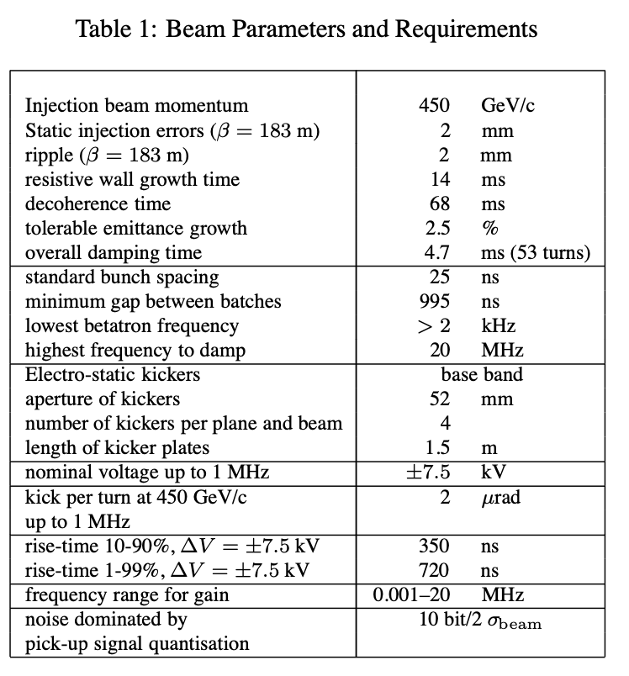
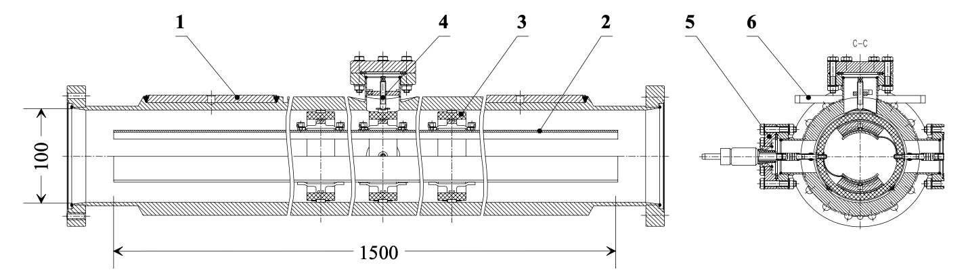
11th FCC Week 22.05.2025
Wolfgang Hofle
LHC ADT kicker (LHC transverse feedback)
  high impedance tetrode amplifiers
  kicks with electric field only
  6 m effective length split over 4 kickers twice as strong as depolarizer kicker system (2 μrad at 450 GeV/c)
  full amplitude not as bunch selective as needed for FCCee
  due to resonances not (readily?) suitable for short electron bunches
W. Hofle et al. PAC 2001

