Slide 1

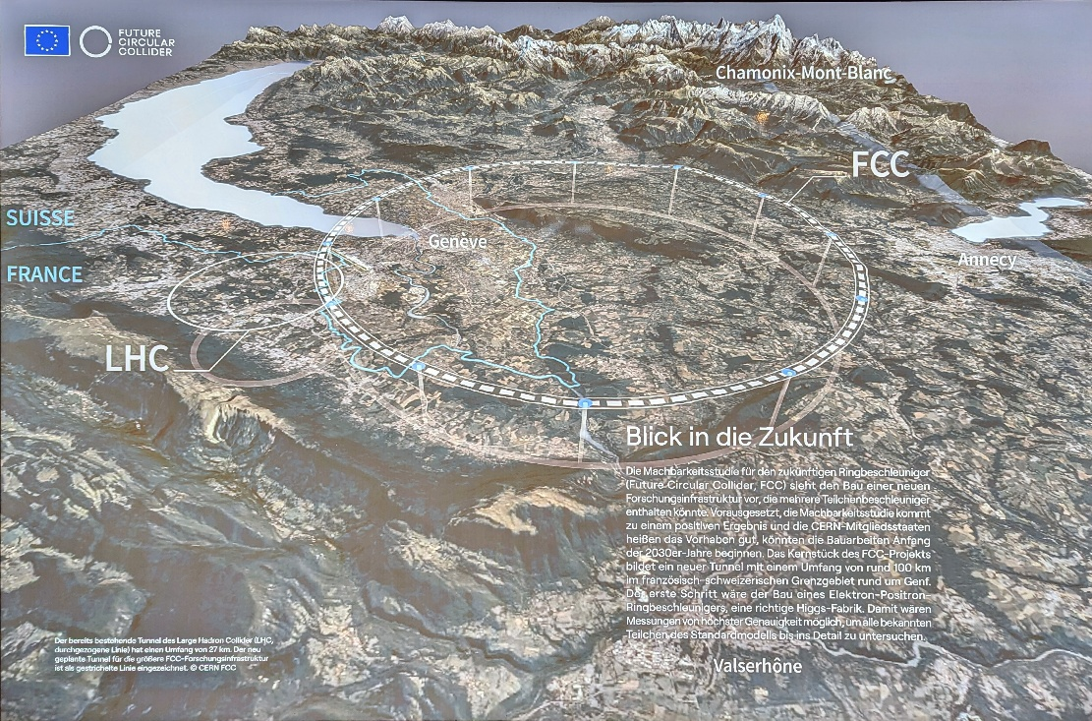

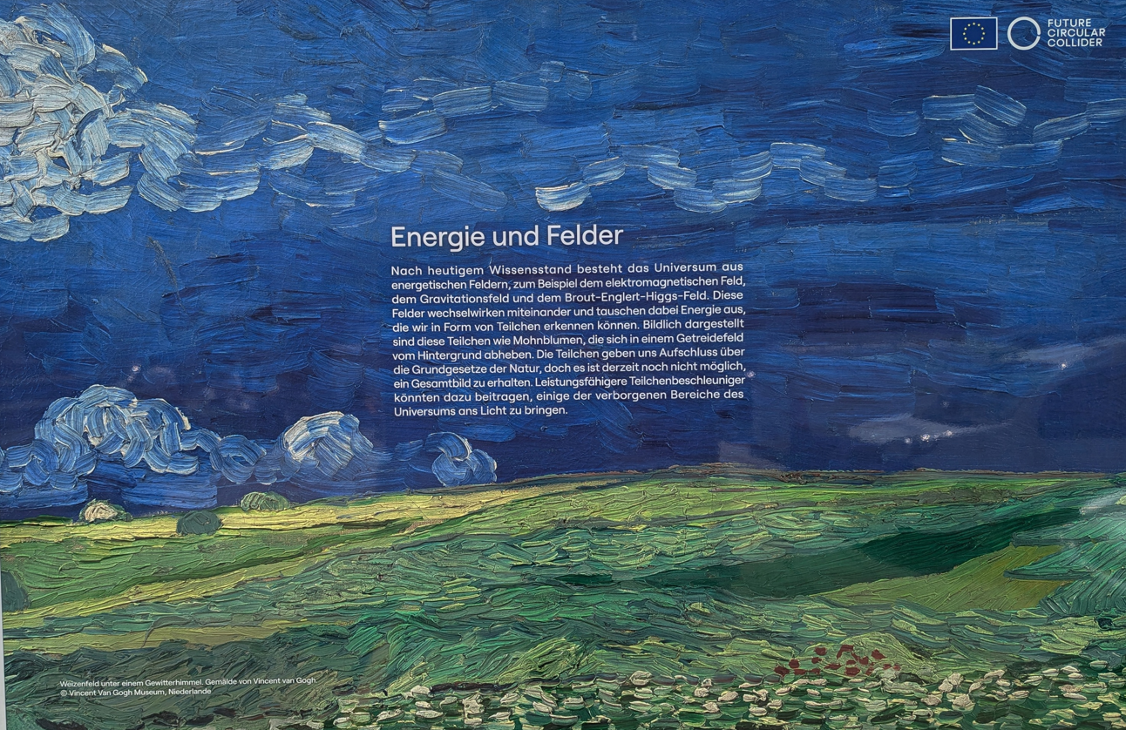
2025 FCC Week Summary:
FCC-hh and High Field Magnets
Mike LAMONT (CERN), Vladimir SHILTSEV (NIU), Pierre VEDRINE (CEA)
FCC Week 2025 · May 23 · Vienna, Austria

Slide 2



Slide 3
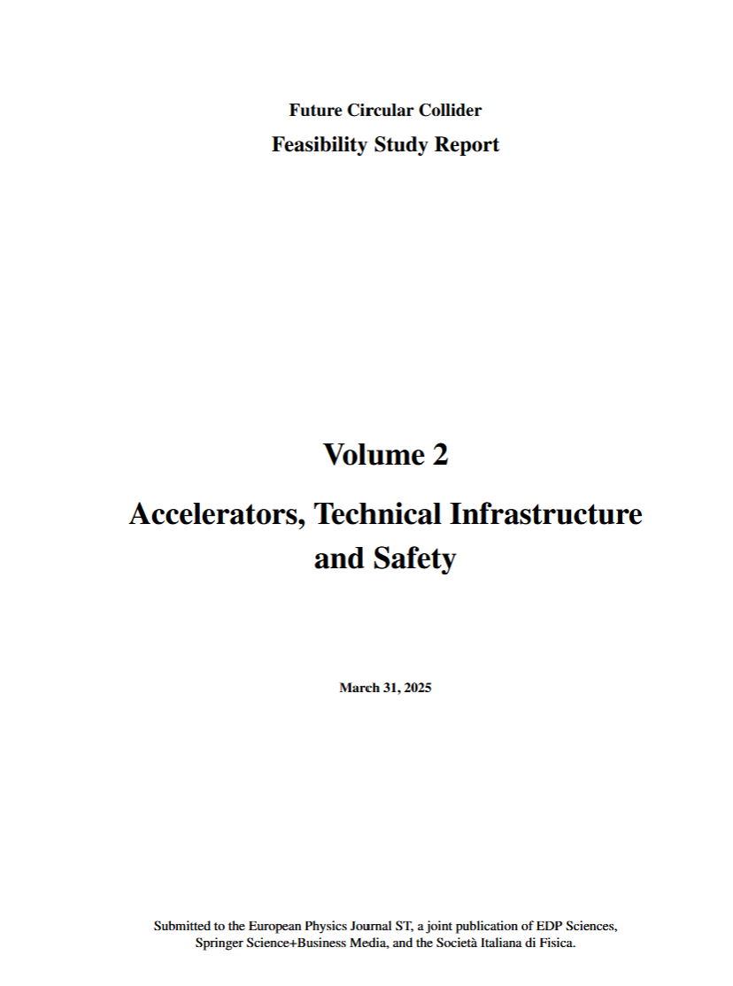
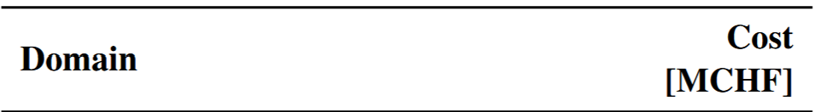



627 Pages
FCCee: 498 pages
Estimated investment costs in 2024 Swiss Francs.
The investments are distributed over a time frame of about 15 years.
The investments are distributed over a time frame of about 15 years.

Slide 4
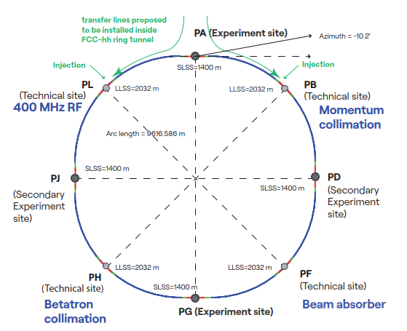
Stage 2: Hadron Collider FCC-hh
Parameter optimization to lower electricity consumption (~max. consumption of FCC-ee)
Magnetic field considered realistic with today’s technologies (Nb₃Sn, ~14T, 1.9 K)
Main parameters FSR 2025
FCC-hh functional layout
parameter | FCC-hh | FCC-hh CDR | HL-LHC
collision energy cms [TeV] | 85 | 100 | 14
dipole field [T] | 14 | 16 | 8.33
circumference [km] | 90.7 | 97.8 | 26.7
beam current [A] | 0.5 | 0.5 | 1.1
synchr. rad. per ring [kW] | 1200 | 2400 | 7.3
peak luminos. [10³⁴ cm⁻²s⁻¹] | 30 | 30 | 5 (lev.)
events/bunch crossing | 1000 | 1000 | 132
stored energy/beam [GJ] | 6.5 | 8.3 | 0.7
integr. luminosity / IP [ab⁻¹] | 20 | 20 | 3

Slide 5
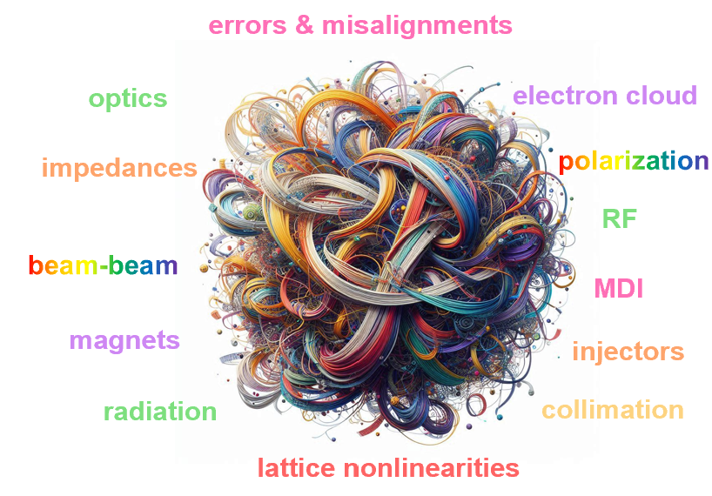
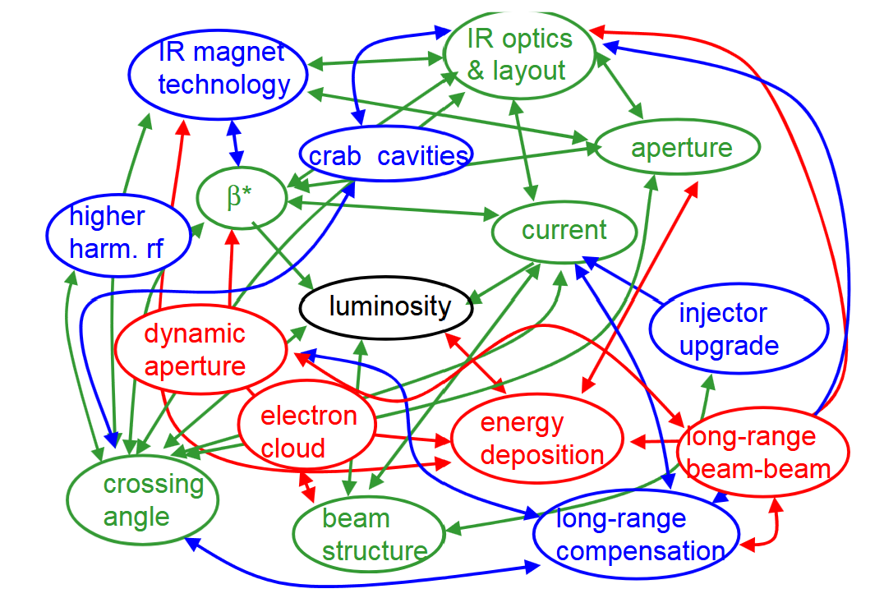
Accelerator Complexity Score (ASC)
Scale · Diversity · Complexity · Novelty of Subsystems & Effects
FCC e+e-
ASC≈11.0
FCC pp
ASC≈12.0
ASC_{LHC}=10
Peter Kicsiny
Frank Zimmermann

Slide 6
FCChh & HFM: 13 Talks @FCC Week 2025
FCC-hh accelerator: baseline & cryogenics chair: V.Shiltsev/NIU, 10h30-12h00
Feasibility Study Baseline Layout and Prospects for FCC-hh, Gustave Perez Segurano/U Malta
Hybrid REBCO-Cu coating for the FCC beam screen to achieve low surface impedance and high magnetic field homogeneity, Joffre Gutierrez Royo/ ICMAB-CSIC
Tl-1223 Superconducting Films for Beam Screen Coatings in FCC: Synthesis and Performance Validation, Emilio Bellingeri/CNR-SPIN
Cryogenic baseline and advancements on the 4.5 K option for FCC-hh using Nb3Sn magnets, Patricia Borges de Sousa/CERN
High-Field Magnets (1) chair: P.Vedrine/CEA 13h30-15h00
Overview of LTS HFM magnet and conductor activities, Ezio Todesco/CERN
Protection of LTS and HTS magnets and circuits for FCC-h, Arjan Verweij /CERN, Jan Uythoven/CERN
HTS magnet R&D for next-generation accelerators at IHEP, Qingjin Xu
Progress towards HTS HFM magnet and conductor strategy, Dr Amalia Ballarino/CERN
High-Field Magnets (2) chair: M.Lamont/CERN, 15h30-17h00
Status of US MDP, Paolo Ferracin /LBNL
Status of HFM development at CEA, Etienne Rochepault /Université Paris-Saclay
Status of HFM development at CIEMAT, Fernando Toral/CIEMAT - Centro de Investigaciones Energéticas Medioambientales y Tec.
Status of HFM development at INFN, Alessandra Pampaloni/INFN Genova
Status of HFM development at PSI, Bernhard Auchmann/PSI

Slide 7
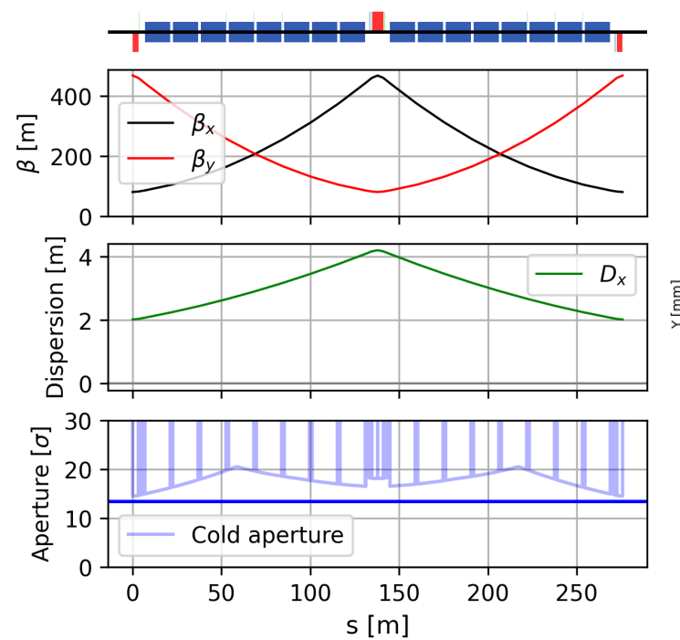
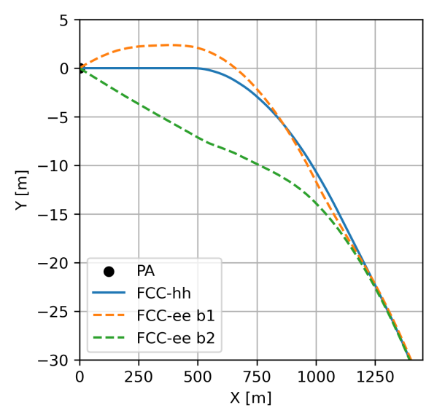
FCC-hh layout & optics
geometry of FCC-hh and FCC-ee at PA
3.3TeV injection; 14.87m dipoles, 14T, longer cells → 275 m
Filling factor: 80% → 83% → 85% (? future)… to explore:
Longer magnets? Combined function magnets?
Gustavo Perez Segurana
16-dipole periodic arc FODO cell

Slide 8

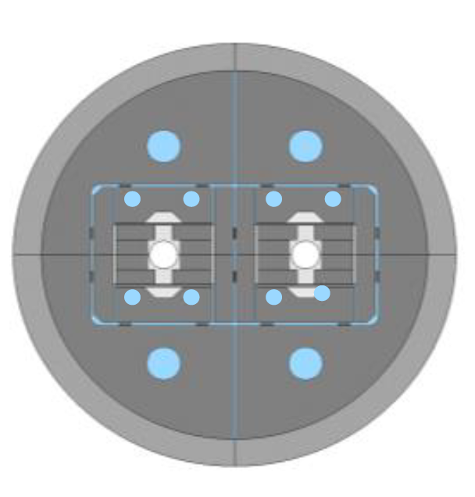
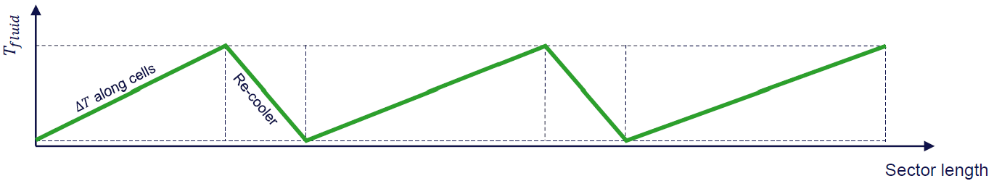
New FCC-hh baseline and power consumption
Technical system choices and areas for optimization:
Cold mass either at 1.9 K with superfluid He (studied in CDR, cf. LHC) or with 4.5 K with forced flow
Temperature of beam vacuum system (beam screen) + Cryogenics eco mode during shutdowns
4.5 K Allows LOWER Capital Cost + Lower Ops Cost + Less He inventory
But Lose effective heat conductivity of He II (1000x that of Cu at same T) → forced flow
FCC 91 km | Nb₃Sn 14T | Nb₃Sn 14T
Magnet temperature | 1.9 K | 4.5 K
Electric energy/yr | < 2.5 TWh | < 2.0 TWh
Temperature gradients: longitudinal and transverse
Patricia Borges de Sousa

Slide 9
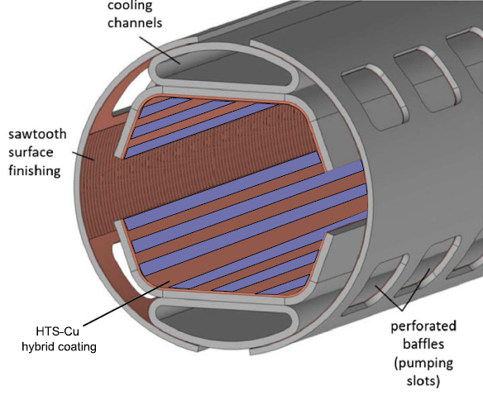
FCC-hh: Beam Screen – HTS Options
Screen : shields magnets from Synchrotron Radiation
to achieve low surface impedance + high magnetic field homogeneity + low SEY + mechanical robustness → just Copper might not be sufficient
Option 1: Hybrid REBCO – Cu coatings 40K – 60K and 14(16)T, allows to operate the system with the consequent decrease in running cost.
Option 2: Thallium-1223 has even higher
Tc ~120K, electro-chemical deposition, but toxic, volatile
Joffre Gutierres
Emilio Bollingeri

Slide 10




High Field Magnet R&D – International Landscape
Global programmes advancing Nb₃Sn and HTS technologies for future high-energy colliders (e.g. FCC-hh)
Diverse magnet concepts: cos-theta, block coil, common coil, hybrid LTS/HTS
Shared aims: 14 T operational field, 50 mm aperture, scalable designs, reduced training, enhanced diagnostics
Participating Institutes:
    US MDP (BNL, FNAL, LBNL, NHMFL)
    CEA Paris-Saclay
    CIEMAT (Spain)
    INFN (Italy)
    PSI (Switzerland)

Slide 11
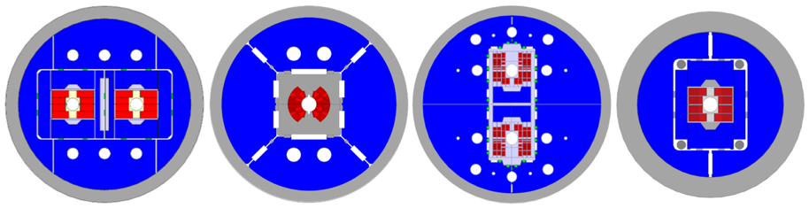


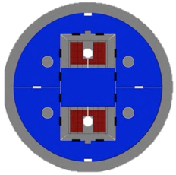



FCC-hh High-Field Magnet R&D ongoing
Nb₃Sn:
12-T and 14-T short demonstrators
Different coil geometries
Tests scheduled for 2026
4 options studied in parallel in the European HFM programme
  12 T magnet at 77 TeV ; at least 5-20 % cheaper for only 10 % less energy
  Operation at 4.5 K with 30% reduction in power consumption
  20 m long magnets 25% cheaper i.e. less magnet to produce and possible 4% gain in TeV, etc.
  Hybrid Nb3SN/NbTi magnet; for 14 T magnet, half of the coil can be in NbTi, i.e. reducing the cost of the conductor and the hysteresis loss.
16 T hybrid Nb3Sn/HTS magnets are being developed at IHEP in China, combining Nb3Sn outsert between 13 T and 10 T, and HTS insert between 3 T and 6 T. Several tests have been performed, showing problems and damage during the tests due to the lack of strong coupling between HTS and LTS coils during quenching ...

Slide 12
Nb₃Sn & Hybrid Magnet Progress
US MDP:
    Large-aperture Nb₃Sn dipoles (up to 14 T)
    Hybrid magnet (HM1) test mid-2025
    Advanced modelling and quench diagnostics
CEA:
    R2D2 (block coil) in assembly; F2D2 aims at 14 T with field quality
INFN:
    FalconD 12 T cos-theta dipole design completed; next: 14 T, 4-layer model
    New CERN-INFN agreement includes HTS concept development
CIEMAT:
    Common coil models: ISAAC (low-preload, existing coils), DAISY (Nb₃Sn/NbTi hybrid demonstrator in prep)

Slide 13
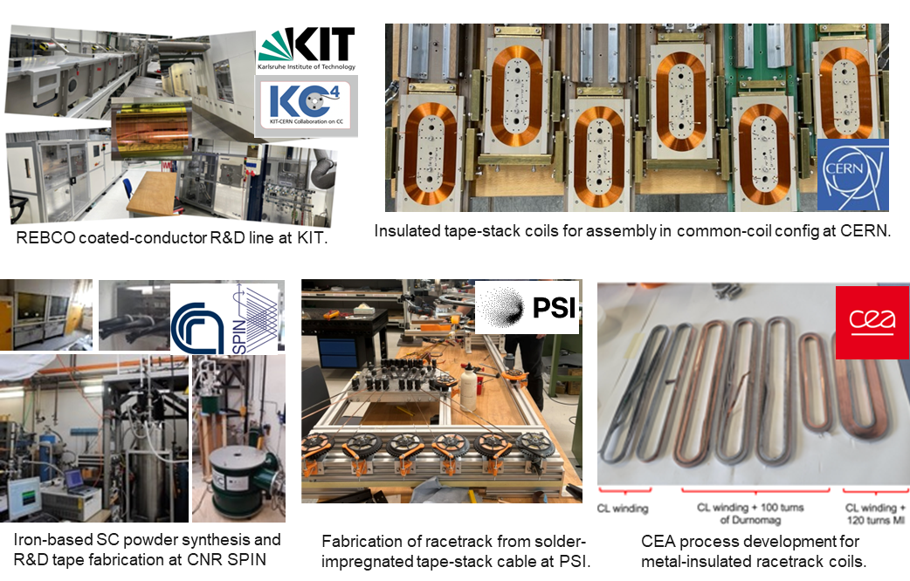
FCC-hh High-Field Magnet Nb₃Sn and HTS R&D ongoing
HTS R&D in various domains:
REBCO and IBS Conductor R&D
Racetrack coil developments
The HFM HTS strategy is to "demonstrate the suitability of high temperature superconductors (HTS) for accelerator magnet applications, providing proof-of-principle of HTS magnet technology beyond the Nb3Sn range, with a target of over 20 T".
Parallel development of HTS conductor and iron-based superconductor (Ba-122): The latter is superior to Nb3Sn in terms of critical field and temperature, and superior to HTS in terms of lower anisotropy, improved grain connectivity and lower cost. IBS is being developed in China and Italy (SPIN).
The current focus is on small 5 T - 10 T REBCO coils. This is a necessary intermediate step towards higher fields and accelerator quality magnets.
The HTS magnet effort is well established in Europe with 9 contributors today to study different aspects of the technology.

Slide 14
HTS Development and Outlook
PSI:
    LTS: Stress-managed magnet series (BigBOX, SMACC1)
    HTS: REBCO subscale coils progressing toward 4–5 T
    R&D on cryogenic efficiency, AC loss modelling, REBCO scaling
CEA:
    MI REBCO racetrack coils reach >12 T (peak), withstand quenches
    Scaling up to 600 mm NARSIL demonstrator
INFN:
    Designing a subscale REBCO dipole targeting 10 T at 20 K with a 50 mm aperture.
Common Threads:
    Stress management, diagnostics, and energy extraction are critical
    Hybrid approaches are gaining traction, but HTS maturity for accelerator quality still under scrutiny

Slide 15
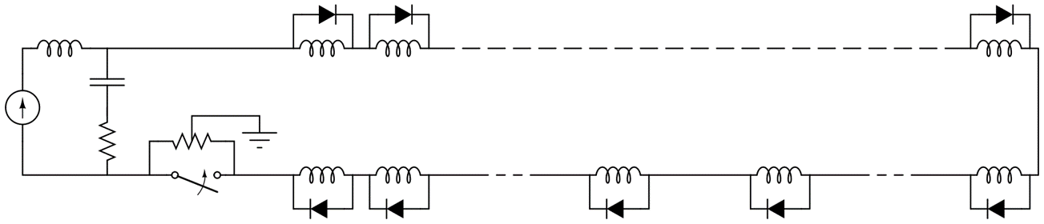
Protection of LTS and HTS magnets and circuits for FCC-hh
Changing the magnet parameters does not change the protection strategy for Nb3Sn magnets developed in the previous FCC studies.
New Nb3Sn magnet protection devices are proposed as the recently developed Energy Shift with Coupling (ESC) method, which is based on magnetic coupling. However, ESC units are quite large, so sufficient space should be provided to locate these systems close to each magnet, supported by calculations using different codes.
The power supply and protection circuits are similar to those of the LHC, and the number of power converters is being optimized.
For HTS magnet protection, differences in enthalpy margins, which are higher, have a strong effect, i.e. small mechanical movements do not trigger quenches, quench detection time is much shorter, etc.
The protection and power supply of HTS magnets is very different from that of Nb3Sn magnets. Three protection concepts could be envisaged: active protection (using ESC, QHs), self-protection using NI, MI insulation, quench-free concept. A rigorous R&D programme is needed to decide on the best concept.

Slide 16
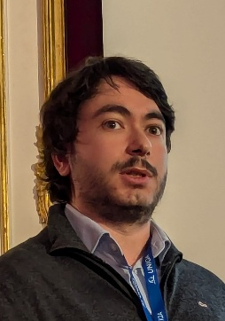
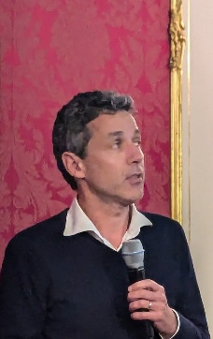

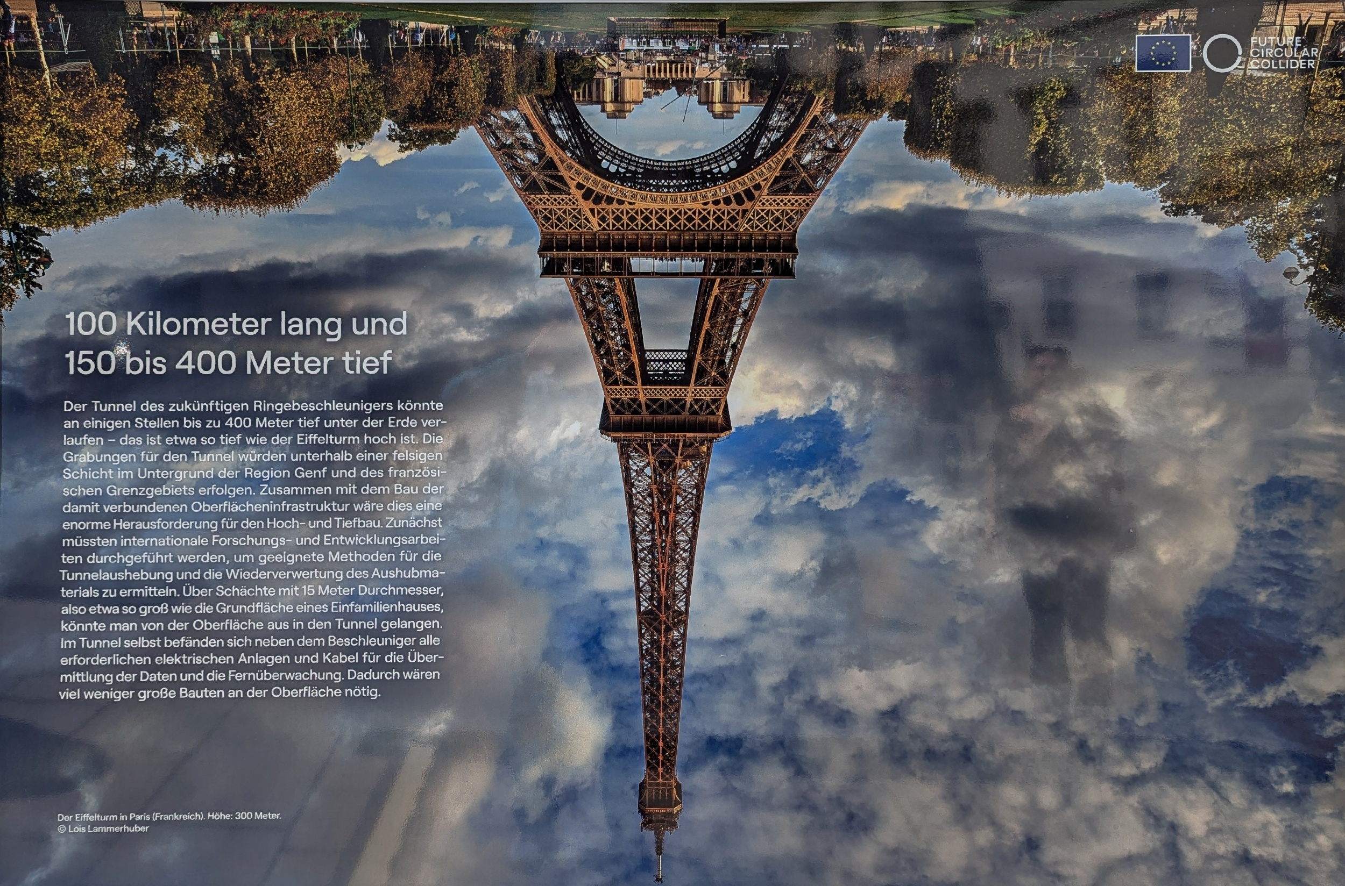
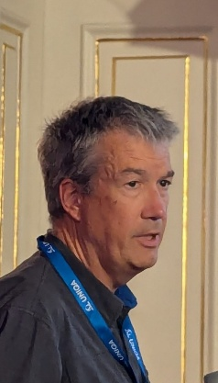
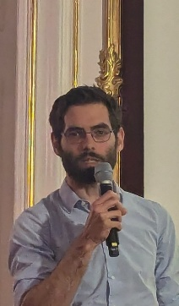

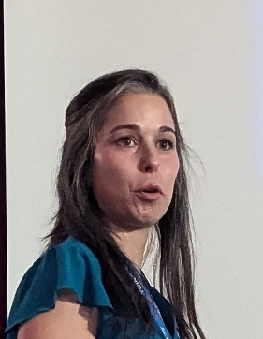
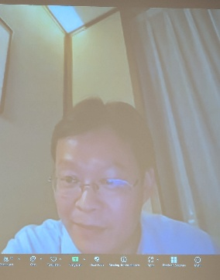
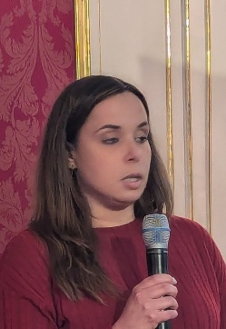
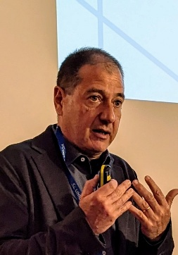
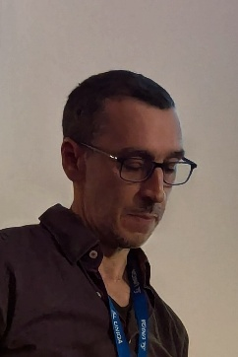
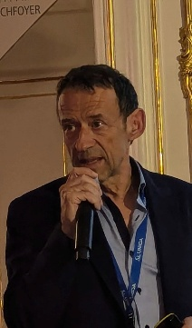
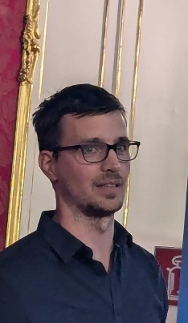
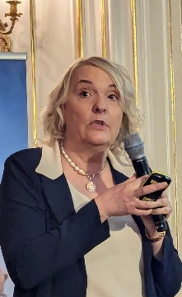
Thanks to the speakers!
Thank you for your attention!

